Slide 1
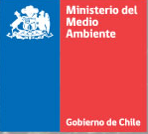



Latin America and the Caribbean for Environmental Democracy:
Towards a Regional Instrument http://www.cepal.org/rio20
Constance A. Nalegach
cnalegach@mma.gob.cl
Focal Point Ministry of Environment
Notes:
Good morning colleagues
First, I will like to thank all the organizers and sponsors of this relevant event. And not only for their kind invitation and for this meeting, but most of all for their strong commitment for sustainable development, citizens rights and governance.
In a complex global scenario, having a space where we, government representatives, have the chance to dialogue and exchange points of view and experiences with civil society is crucial when addressing democracy issues
Of course, democracy and environmental democracy are rich concepts that can be analyze from different perspectives. Today we are focusing in principle 10 and, in particular, in a regional process that just started and that we hope will increase in ambition and actors. So hopefully, we will be seen many of you in the near future.

Slide 2
OUTLINE
Background
United Nations Conference on Sustainable Development (Rio+20)Brazil, June 2012
III. Regional Process for Environmental Democracy
Notes:
I will briefly refer to the background of this regional initiative that was already well presented by ECLAC.
Then, I will share with you the process leading to the Rio + 20 summit, where 10 countries launched this initiative through a declaration.
Finally, this presentation will address what the process is about, its achievmentes, and how we are moving forward.

Slide 3
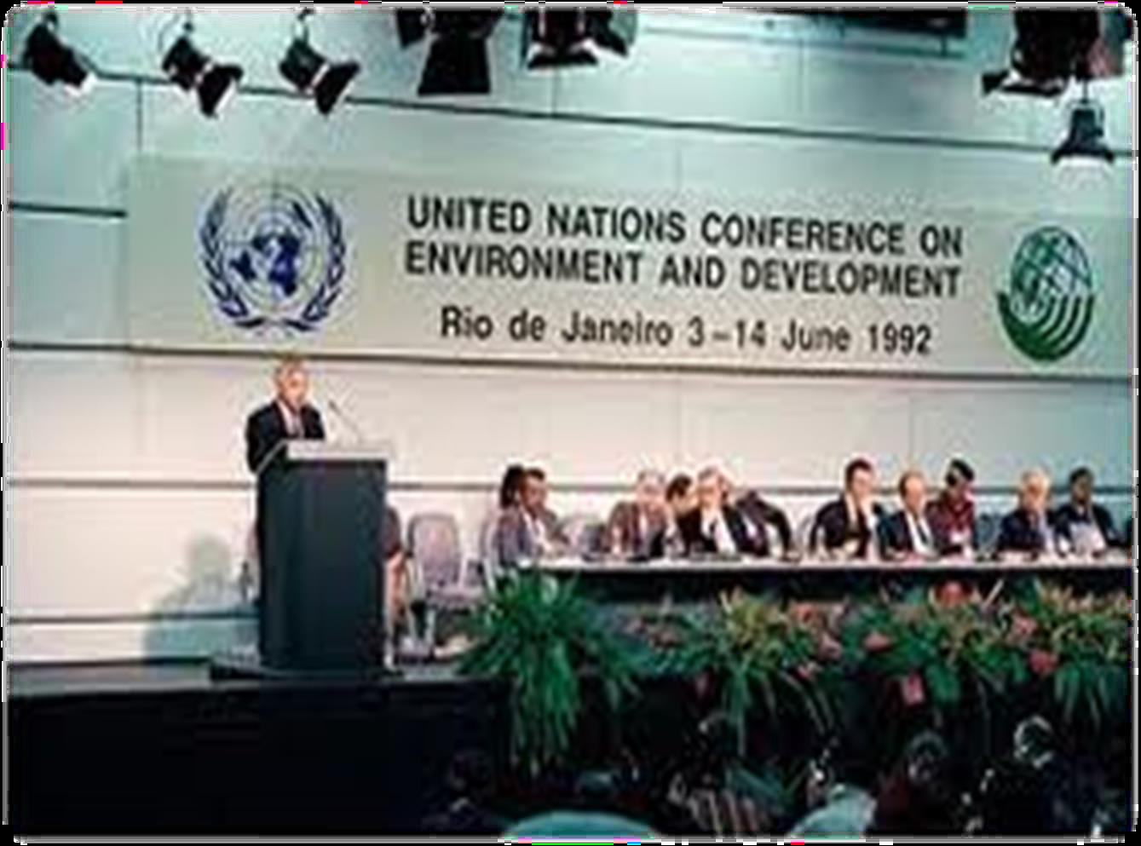

HOW TO DEAL WITH ENVIRONMENTAL ISSUES?
Recognition since 1992: Environmental issues are best handled with:
Participation of all concerned citizens.
Access to information concerning the environment that is held by public authorities, including information on hazardous materials and activities.
Effective access to judicial and administrative proceedings.
                Principle 10 Río Declaration
Notes:
ECLAC already talk about Principle 10 but I will just like to underscore that even though it is an instrument that is been classify as soft law, it is indeed source for national and international law:
First, the wording is strong. It doesn´t say “as long as government think is necessary” or “one way to deal with environmental issue is”.
No, 20 years ago more than 178 countries and more than a 100 heads of state, recognize that the best way to deal with environmental challenge is through democracy and we, governments, must honor that commitment.

Slide 4
P10 RECEPTION
BALI GUIDELINES
Europe-Asia: Aarhus Convention (2001)
National Examples
+ than 100 countries with information laws
+ than 120 countries with Participation provisions
+ than 44 countries with environmental courts
It is by far the most impressive elaboration of principle 10 of the Rio Declaration (…) As such it is the most ambitious venture in the area of environmental democracy so far undertaken under the auspices of the United Nations.
Kofi A. Annan, Secretary-General of the United Nations (1997-2006)
International examples:
MEAs
FTA
Notes:
So, how have we honor that commitment?
As you may know, the only legally binding instrument is the Aarhus Convention, signed by develop and developing countries.
Also, at a national level we can find laws about access rights but this issues are also present in instrument like Multilateral environmental agreements, but more dealing with obligations among states and in instruments that are not by nature environmental instruments like free trade agreements. In FTA we can find articles regarding, transparency rules, public participation or public submission.

Slide 5
ARGUMENTS FOR A LAC INSTRUMENT
Promotes joint action to confront shared environmental challenges Many important environmental challenges that our countries confront straddle beyond their national boundaries, so national advances- even when fully implemented- are insufficient. Instead there is a need for joint action at the regional level
Addressing new and complex issues: better prepare through cooperation.
Fosters dialogue, cooperation, capacity building and technical assistance
Allows to better face the lack of resources; way for synergies with ongoing funding
Contributes to prevent and/or mitigate social conflicts: a Regional Agreement can promote and ensure greater social inclusion; a peaceful way to channel interests, concerns and citizen demands that often go beyond national borders
Adding regional level, favors State policies, effective compliance and accountability
Notes:
Even though it was a hard negotiation, Chile decided to take this issue to Río + 20 mainly because:
It was an opportunity to take advantage of a high level political summit
It was an effort to achieve a concrete product of a not so ambitious summit
Also because this proposal gather different actors: petition from TAI and other countries like Jamaica were on board with environmental democracy. In the regional preparatory process, more than 100 NGOs where present and push for P10 to be in the conclusions of the meeting that was also favoured by the interagency document. Previously, ECLAC had offered its support during the second preparatory commitee (march 2011)
We saw synergies with developments of regional organizations and process : OAS_OGP
It was also fundamental the Mandate, Disposition ad key role of ECLAC.
So finally, we considered it was a balanced proposal between the level of ambition and realism:
Limit to national level
Join the Aarhus convention
Process towards a regional instrument
Process towards a global instrument

Slide 6
ARGUMENTS FOR A LAC INSTRUMENT
7) Countries commit to a minimum ground that can trigger local development
8) Fosters relationships of trust and supports objectives of States and of social actors. Promotes sustainable public-private partnerships. It also facilitates the achievement of the specific objectives of these groups by allowing access to relevant information and participation in decision-making
9)Promotes changes to unsustainable production and consumption patterns. Access rights are essential requirements for the empowerment of citizens committed to sustainable development. An active and engaged civil society is essential to bring about the necessary changes to unsustainable patterns of production and consumption.
10)Common ground with positive side effects for the region in other areas like trade.
11)Greater political stability in the region and greater visibility. In a complex global scenario, regional integration through an agenda of transparency, participation, access to information and accountability
PUBLIC AND GOVERNMENTS ACHIEVE MORE
WHEN HAVING INTERNATIONAL SUPPORT
Notes:
As you can see, there are many arguments that justify working in a regional level.

Slide 7
WHAT WAS ON THE TABLE?
FEASIBILITY
New burden; lack of human and financial resources to comply another international agreement Unnecessary as Aarhus Convention is open | Already a commitment; cooperation and dialogue to fully implement Notwithstanding differences, not starting from scratch Expertise from the public, support from organizations Recognizes specific features of the Region, respond to specific challenges and needs, and allows the Region to establish its own stages and goals they consider appropriate to their circumstances. Greater sense of ownership g
OPPORTUNITY
Full exercise of access right at a national level as a prior stage and condition | Cooperation window for compliance International dialogue that triggers and enhance domestic compliance
IMPACTS
Difficult to implement, sanctions and exposures of States for non compliance | Non confrontational but cooperation approach based on citizen´s rights Persuasive example for development and national compliance
Notes:
What were the main reactions from governments to our proposal of signing a declaration to analyze the feasibility of having a regional instrument.?
Feasibility: a baseline and a critical mass.
Experiences at a national and international level (Aarhus Convention): we have guidelines, guides, manual, conventions and laws

Slide 8

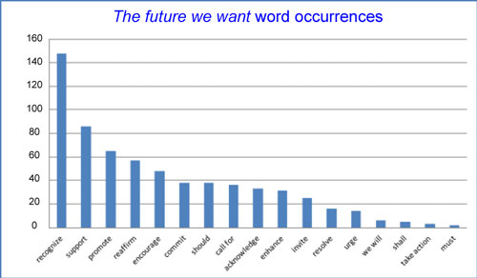
Notes:
So, what happened in Rio. Let me share with you some numbers
The total participants reach thirty thousands( 29.373). Representatives of NGO and other major groups: 10.047. Heads of States: 57
2. Number of events in RíoCentro : almost a hundred (498)
3. I will like to highlight a particular Side event that was called “Choosing Our Future: Open and Participatory Sustainable Development Governance” with presence from eclac, unep, wri, TAI, Aarhus Convention. In that meeting, Chile made a call to reaffirm the need of full implementation of access rights and to join the regional process .
In this graphic, at the left you can see verbs like recognize and encourage, and at the left side verbs like must and take actions. It is not strange that this document has been call just an spiritual document. We have to note that it is a one percent of the population adopting decisions for the rest of the 99 percent.
Negotiations were “painfully slow”
(Ban Ki-moon, ONU).
”Río+20 was a failure of epic proportions. World leaders delivered a "new definition of hypocrisy“ Greenpeace / Oxfam, WWF, and the International Trade Union Confederation (ITUC).

Slide 9
GLOBAL AGREEMENTS
Since 1992:
Democratic option for facing environmental issues
2012: Two milestones: “The Future We Want” (globally) and LAC Declaration (regionally)
Acknowledged that democracy, good governance and the rule of law, at the national and international levels, as well as an enabling environment, are essential for sustainable development.
Broad public participation and access to information and judicial and administrative proceedings are essential to the promotion of sustainable development.
Encourage action at the regional, national, subnational and local levels to promote access to information, public participation and access to justice in environmental matters, as appropriate.
VALIDATION
OF ACCESS RIGHTS
Notes:
The future we want final document of the conference
I. More than 70 contributions to the zero document where Jamaica and Chile pushed for regional conventions
II. Tensions: Placement- Levels-Principles
Enero zero draft: 17.We underscore that a fundamental prerequisite for the achievement of sustainable development is broad public participation in decision-making. (…) 18. We recognize that improved participation of civil society depends upon strengthening the right to access information and building civil society capacity to exercise this right (zero documento 128 art)
Marzo: We underscore that [, in line with the Rio Principle 10, - Montenegro], [a fundamental prerequisite for the achievement of sustainable development is – G77 delete; EU retain] broad public participation [and influence in policy and – EU; G77 delete] [in [all levels of – Liechtenstein, EU; G77 delete] decision-making – G77 delete; EU, Switzerland retain] [at local, national, regional and international levels – EU, Switzerland] [, access to information and judicial and administrative proceedings are essential to the promotion of sustainable development in line with Rio Principle 10 –G77, Switzerland; New Zealand, US delete] [, implementation and monitoring – Switzerland]. 58. We agree to take steps to give further effect to Rio Principle 10 at the global, regional and national level, as appropriate.
128 articulos- a 400- a 283
[58. We [recognize the need to ensure the rule of law, good governance and citizens’ right of access to official information, public participation in decision-making and equal access to justice and – Switzerland, EU] [agree to take steps to give further effect to Rio Principle 10 [and 20 – Iceland] at the global, regional and national level, [by further implementing and strengthening existing tools or by developing new ones, - Serbia] as appropriate] / encourage action at the national, regional and local levels to promote access to information, public participation, and access to environmental justice in environmental matters – US] . – G77, EU, Canada, New Zealand, Norway, Japan delete]
[58 alt. We resolve to promote enhanced access to information, public participation in decision-making and access to judicial and administrative procedures in environmental matters. – Norway, EU; US, Liechtenstein combine with para 58]
CST 58. We encourage action at the national, regional and local levels to promote access to information, public participation, and access to justice in environmental matters, as appropriate.
Declaración Política Regional de Intenciones
A río + 20: Perú, Costa Rica, Jamaica, Chile

Slide 10

DECLARATION ON THE APPLICATION ON PRINCIPLE 10 OF THE RIO DECLARATION
Commitments must be made to ensure the full exercise of rights of access to information, participation and justice regarding environmental issues as enshrined in Principle 10 of the Rio Declaration of 1992. To this end, we declare our willingness to launch a process to explore the feasibility of adopting a regional instrument, ranging from guidelines, workshops and best practices to a regional convention open to all countries in the region and with the meaningful participation of all concerned citizens. Latin America and the Caribbean can and must take a meaningful step forward on this front. The above-mentioned Governments therefore commit to drafting and implementing a Plan of Action 2012-2014, with the support of the Economic Commission for Latin America and the Caribbean (ECLAC) as the technical secretariat, to work towards such a regional convention or other instrument.

Slide 11
REGIONAL PROCESS AGREEMENTS
  Advance from a Principle to a Rights approach. Renewed political commitment
  Final goal: full implementation of access rights. Despite our efforts and progress thus far, however, we recognize the need for agreements to ensure proper fulfillment of these rights to access
  Access rights are essential for sustainable development, including sustained and inclusive economic growth, social development, environmental protection and the eradication of poverty and hunger,
  Synergies with relevant regional and international agencies and processes
  Process aimed at strengthening dialogue, capacity building and regional cooperation
  ECLAC as technical secretariat
  Process for a regional instrument that reflects a common vision on the importance and benefits of Principle 10 access rights and the values and principles underpinning them and their implementation
  Essential elements:
  Open to all countries of LAC
  Broad definition of public for a meaningful participation of all interested citizens
MOMENTUM AND UNIQUE OPPORTUNITY TO FULFILL A COMMITMENT

Slide 12
SIGNATORY COUNTRIES A/CONF.216/13. http://daccess-dds-ny.un.org/doc/UNDOC/GEN/N12/440/43/PDF/N1244043.pdf?OpenElement
POTENTIAL IMPACT :
500 MILLIONS
Notes:
Argentina, Brasil, Colombia, Costa Rica, Ecuador, Honduras, Jamaica, México, Panamá, Paraguay, Perú, República Dominicana, Trinidad y Tobago, Uruguay, Chile
Diversidad pero comunión en opción democrática no en un estadio de desarrollo
Anglo parlantes,
ALBA,
PIB per càpita bajo los 4 mil dolares (paraguay) hasta superar los 14 mil.

Slide 13
WHAT ARE WE TALKING ABOUT?
What this process is not | What is this process
Just another political declaration | A democratic process for a democratic instrument. Time (urgency) for all on board.
The negotiation of another Multilateral (regional) Environmental Agreement. “Too many MEAs” | A path towards an instrument that will benefit compliance of national and international commitments like MEAs. Sustainability through democracy
A mechanism for sanctioning States | Process of dialogue and regional cooperation that will benefits countries An initiative to ensure the full exercise of rights of access through mutual support. A learning process.
An exclusive process: for developed countries with full implementation of environmental democracy | An open process to all countries of the region without any condition. Parallel to national process. Recognition of the particular conditions in each signatory country.

Slide 14


ACHIEVMENTS SO FAR (1/2)
From 10 original signatories, to 15 members
Two focal points meetings and virtual meetings of working groups
Instruments that reaffirm commitment and channel process (Declaration, Road Map and Action Plan)
4) Agreement on main tasks:
Promoting the Declaration and incorporating new signatories
Strengthening and highlighting the progress made in the region
Actions to promote public participation at the national level
Establishment of working groups for advancing towards the formulation of a regional instrument:
  Identify strengths and weaknesses in the region, especially for capacity building.
  Discuss the nature and content of the regional instrument.

Slide 15

ACHIEVMENTS SO FAR (2/2)
5) International and public recognition
"Appreciate initiatives for regional implementation of the 10th Principle of the 1992 Rio Declaration, regarding the rights of access to information, participation and environmental justice, as a significant contribution to the participation of organized community committed to Sustainable Development“.
Declaration of the first CELAC Summit, Santiago; January 27-28, 2013.
“…The importance of implementing Principle 10 of the 1992 Rio Declaration at the Earth Summit, and reiterate the importance of advancing initiatives in this matter.” They reiterated the right of citizens to participate in the formulation,
implementation and monitoring of public policies.
Declaration of the CELAC-EU Summit, Santiago; January 26-27, 2013.
6) Baseline: ECLAC document: “Access to information, participation and justice in environmental maters in Latin America and the Caribbean: Situation, outlook and examples of good practice”
Notes:
(Community of Latin American and Caribbean States (CELAC) - EU Summit, Santiago- January 2013-CELAC Summit, Santiago- January 2013-Meeting of the Governing Council UNEP, Nairobi- February 2013-Independent expert human rights/environment, Nairobi- February 2013 Conference SD, post 2015 and Rio + 20, Bogotá-march 2013-Side event Choosing Our Future: Open and Participatory Sustainable Development Governance, June 2012, Major groups UNEP)

Slide 16
The Access Initiative Vision
Legally Binding Convention for LAC.
Key contribution for democracy, governance and sustainable development.
Set standards and procedures for access rights.
Prevent and reduce environmental conflicts .
Reduce poverty.
Protection of natural resources.
Governments will benefit from training and technical asssitance.
Strengthen regional integration through a transparency agenda.
Source:
Andrea Sanhueza´s presentation.
June 2013
Notes:
Biding instrumentbasing their position on four main reasons: environmental challenges require better legal instruments to address them; conflicts require channels for social dialogue to promote social peace; the challenge of legitimize the exercise of power and public institutions, and the limited capacities that make it necessary to have mechanisms that involve local communities and strengthen public institutions

Slide 17
















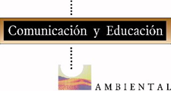


Active Participation of Civil Society Organizations
UNES,
El Salvador
FARN, Argentina
IDARD, Dominican
Republic
Prodena, Bolivia
CIPA, Nicaragua
CEDA, Ecuador
Article 19, Brazil
IDEA, Paraguay
Ambiente y Sociedad,
Columbia
Jamaica Environment
Trust, Jamaica
SPDA, Peru
Coopesolidar,
Costa Rica
CAINFO,
GAIA,
Uruguay
FIMA, Chile
Cultura Ecológica
Comunicación y
Educación Ambiental
IA/Mex, Mexico
CIAM, Panama

Slide 18
Next Steps
Implementation of Action plan to 2014
Working Groups and Focal Points Meetings
Public Participation
Substantive contribution to regional process and action plan
Follow up national and international commitments
Due ambition
Alliances and actions
Save the date
Perú 30th and 31st of October
PUBLIC:
Any natural or legal person or community organization
Notes:
Definition of Public acording to action plan:

Slide 19

How to Participate?
Governments official willingness: Just a letter (email) to Presiding Officers (Chile, Mexico, Dominican Republic) or the Secretariat (ECLAC)
Public Participation: Regional Public Mechanism
http://teamrooms.cepal.org/apps/Principio10.nsf/Inscripcion?OpenForm&Leng=I#
Notes:
Definition of Public acording to action plan:

Slide 20
NEW INTERACTIONS
IN A DEMOCRATIC CONTEXT
GOVERNMENTS
PUBLIC
LAC COUNTRIES
Rights based approach
State legitimacy
Environmental Efficiency
Political Agreements: Re think -Re create
New partnerships and strategic vision for SD
Solid ground for an appropriate regional instrument
Democratic and inclusive Process
Effectiveness
P10
Cooperation
Capacity Building
Compliance
Notes:
The base-the process-the means-the vission

Slide 21
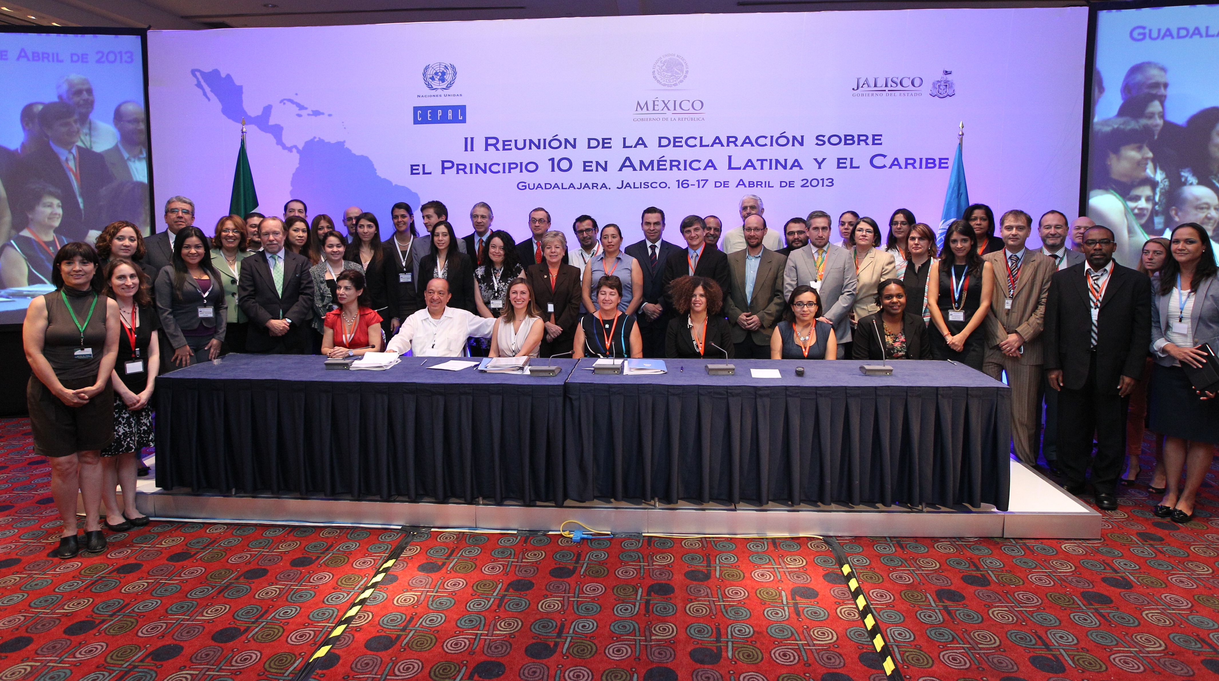
Thank You
“A country does not have to be deemed fit for democracy; rather, it has to become fit through democracy." Amartya Sen

