Slide 1


UNEP South-East Europe Platform to beat Pollution (SEEPP), Western Balkans Regional Soil Pollution Conference UNEP Chemicals and Pollution Action (CPA) Sub-programme
Tomas Marques, Regional Sub-programme Coordinator, Chemicals and Pollution Action UNEP Europe Office Vienna, 26.03.2026

Slide 2
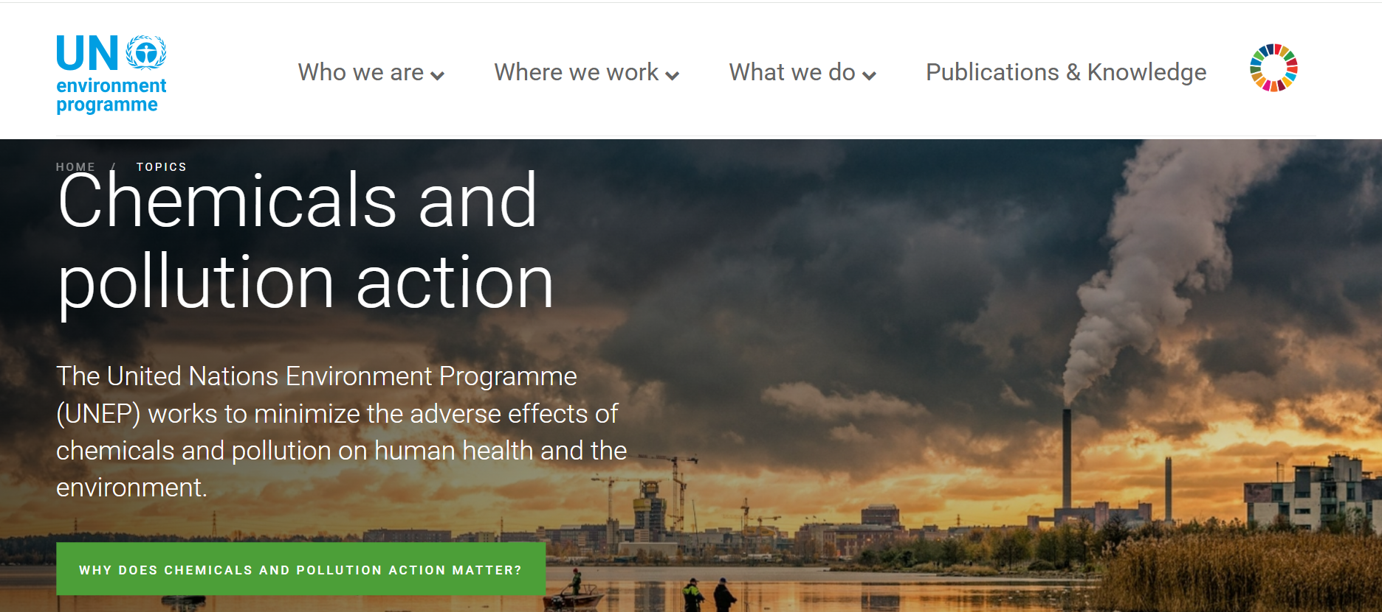
https://www.unep.org/topics/chemicals-and-pollution-action

Slide 3
Where are we coming from ?
  MTS 2022-2025: Strategic objective
  Programme Outcomes
  UNEA and UNGA Resolutions
Air Quality
3A
  Health and environment outcomes optimized through sound management of chemicals and waste
Towards a Pollution-free Planet
Chemicals and waste
Nitrogen Management
3B
  Waste management and circularity is improved
Land and soil pollution
3C
  Releases of pollutants into air, water, soil, and ocean are reduced
Freshwater
Marine and Coastal
The subprogramme is linked to 31 UNEA resolutions and 3 UNGA Resolutions.
Cross-cutting

Slide 4
UNEA Resolutions on Pollution
Chemicals and Waste
Air
Land and Soil
UNEA/EA.1/Res 5 - Chemicals and waste
UNEA/EA.2/Res 7 - Sound management of chemicals and waste
UNEA/EA.2/Res 9 - Prevention, reduction and reuse of food waste
UNEA/EA.3/Res 9 - Eliminating exposure to lead paint and promoting environmentally sound management of waste lead-acid batteries
UNEA/EA.4/Res 2 - Promoting sustainable practices and innovative solutions for curbing food loss and waste
UNEA/EA.4/Res 14 – Sustainable Nitrogen Management
UNEA/EA.4/Res 7 - Environmentally Sound Management of Waste
UNEA/EA.4/Res 8 - Sound Management of Chemicals and Wastes
UNEA/EA.4/Res 9 - Addressing single-use plastic products pollution
UNEA/EA.5/Res 7 - Sound Management of Chemicals and Waste
UNEA/EA.6/Res 11 - Highly hazardous pesticides
UNEA/EA.6/Res 9 - Sound Management of Chemicals and Waste
UNEA/EA.1/Res 7 - Strengthening the role of UNEP in promoting air quality
UNEA/EA.3/Res 8 - Preventing and reducing air pollution to improve air quality globally
UNEA/EA.4/Res 3 - Sustainable mobility
UNEA/EA.6/Res 10 - Promoting regional cooperation on air pollution to improve air quality globally
UNEA/EA.3/Res 6 - Managing soil pollution to achieve sustainable development
UNEA/EA.5/Res 2 - Sustainable Nitrogen Management
UNEA/EA.6/Res 14 - Strengthening international efforts to combat desertification and land degradation, restore degraded land, promote land conservation and sustainable land management, contribute to land degradation neutrality and enhance drought resilience
UNEA/EA.6/Res 7 - Combating sand and dust storms
Freshwater
Marine and Coastal
UNEA/EA.1/Res 9 - Global Environment Monitoring System/Water Programme (GEMS/Water)
UNEA/EA.3/Res 10 - Addressing water pollution to protect and restore water-related ecosystems
UNEA/EA.5/Res 4 - Sustainable Lake Management
UNEA/EA.6/Res 13 - Effective and inclusive solutions for strengthening water policies to achieve sustainable development in the context of climate change, biodiversity loss and pollution
UNEA/EA.1/Res 6 - Marine plastic debris and microplastics
UNEA/EA.2/Res 10 - Oceans and seas
UNEA/EA.2/Res 11 - Marine plastic litter and microplastics
UNEA/EA.3/Res 7 - Marine litter and microplastics
UNEA/EA.4/Res 6 - Marine plastic litter and microplastics
UNEA/EA.4/Res 11 – Protection of the marine environment from land-based activities
UNEA/EA.6/Res 15 - Strengthening ocean efforts to tackle climate change, marine biodiversity loss and pollution

Slide 5
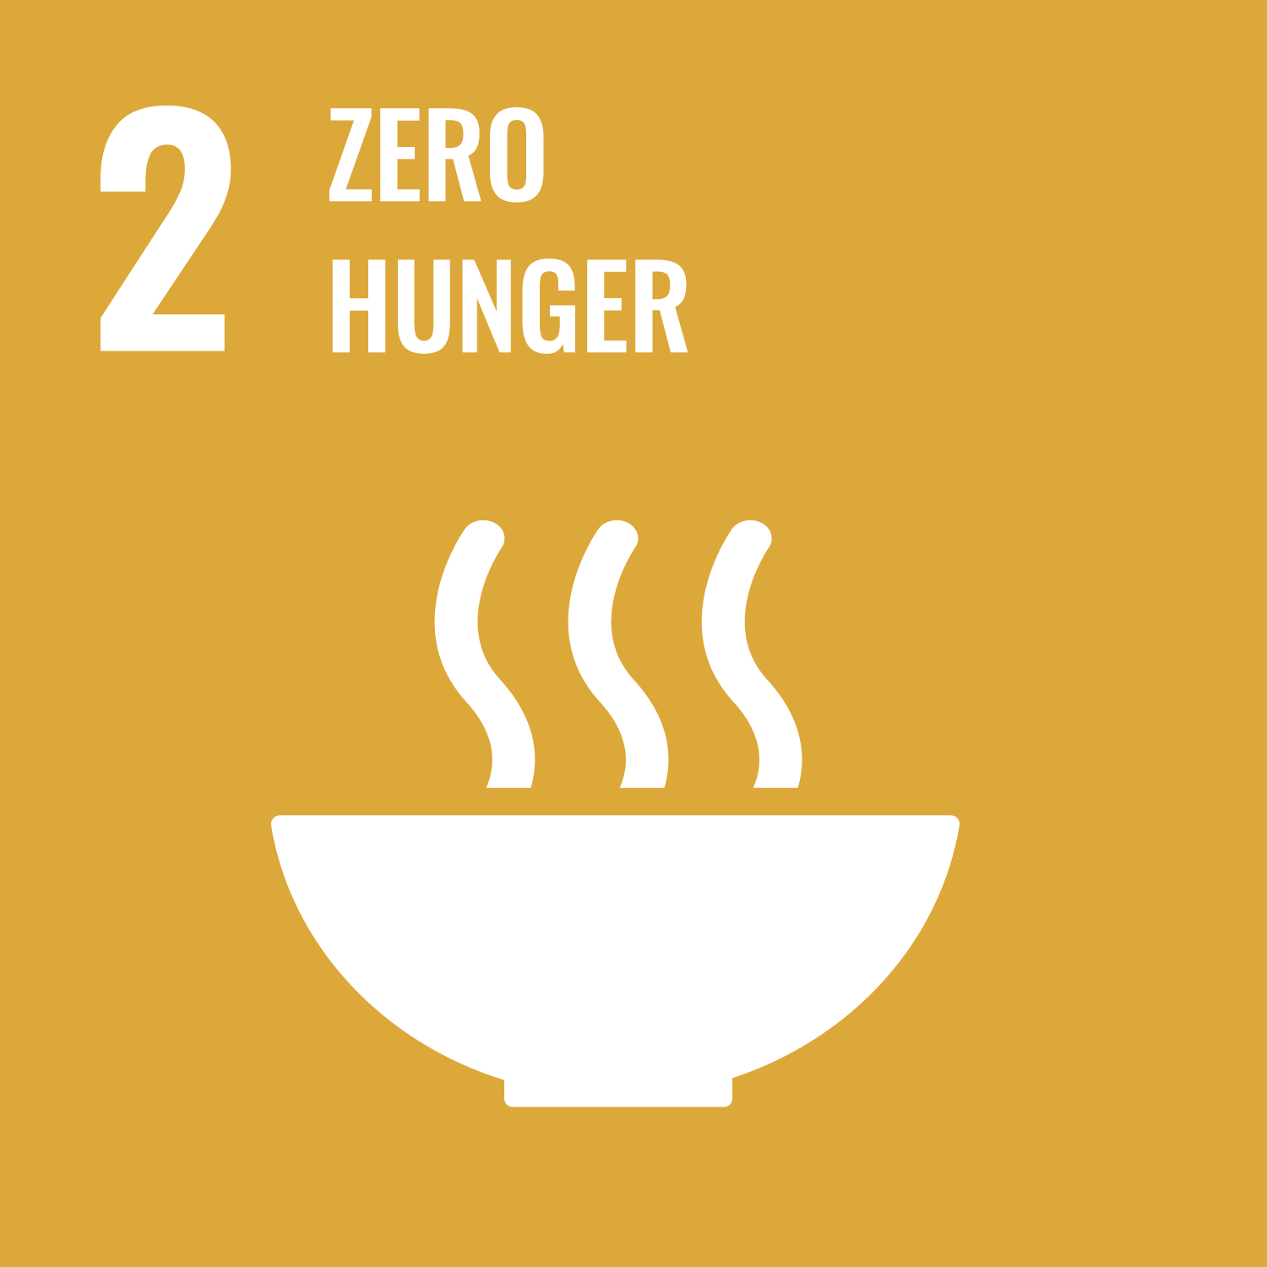




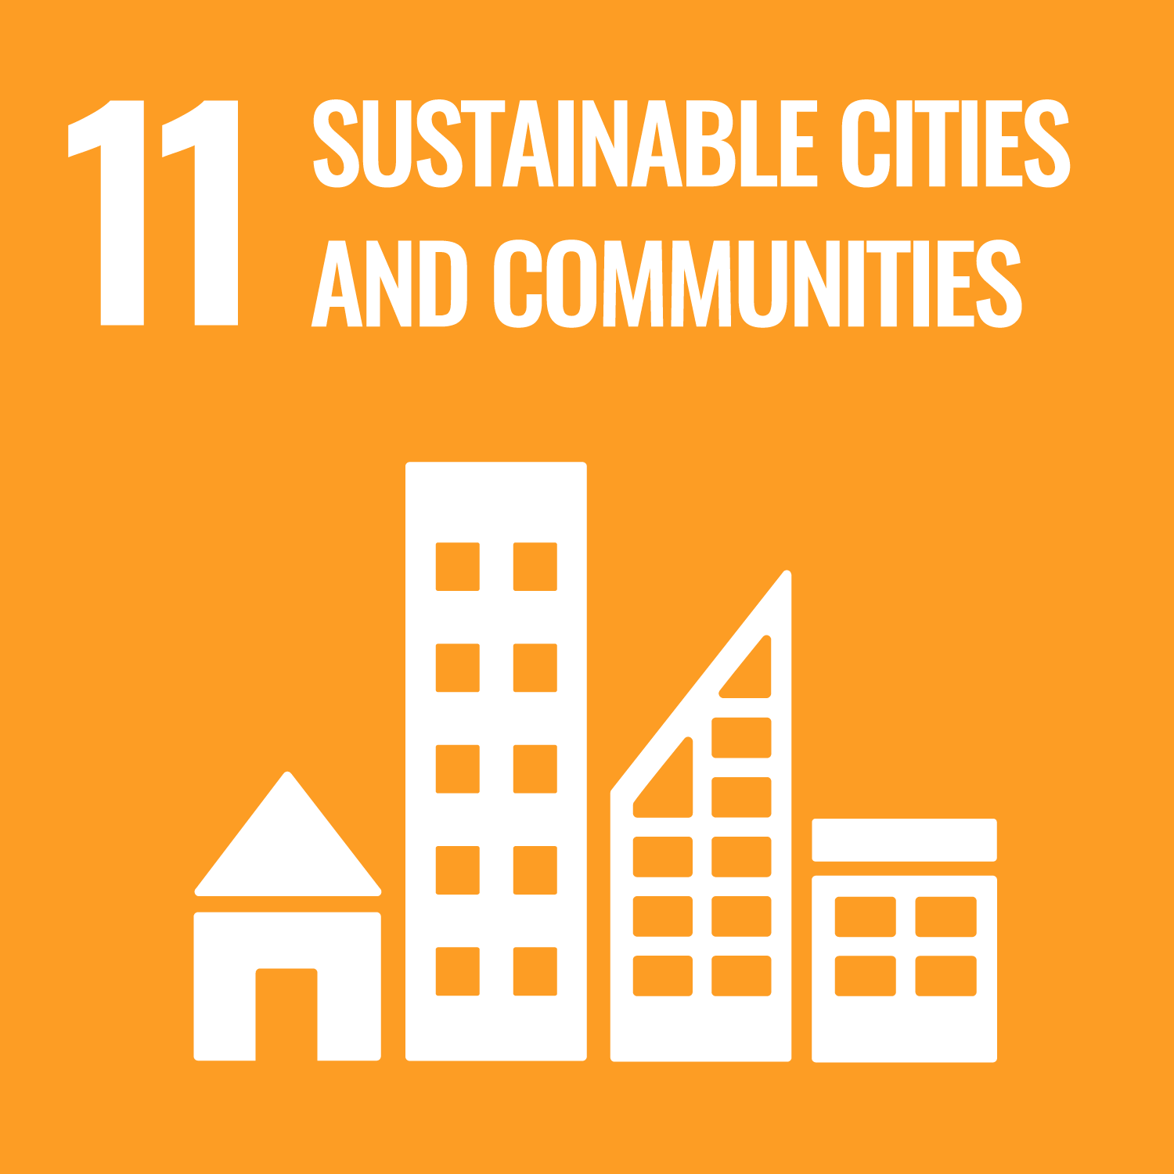
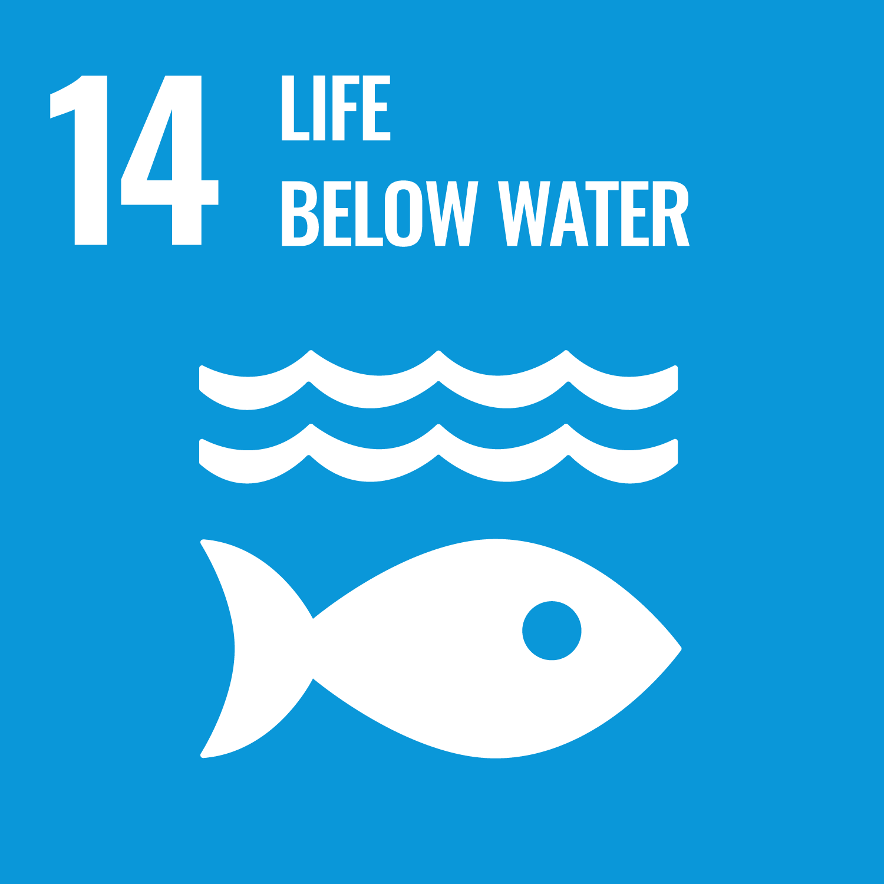
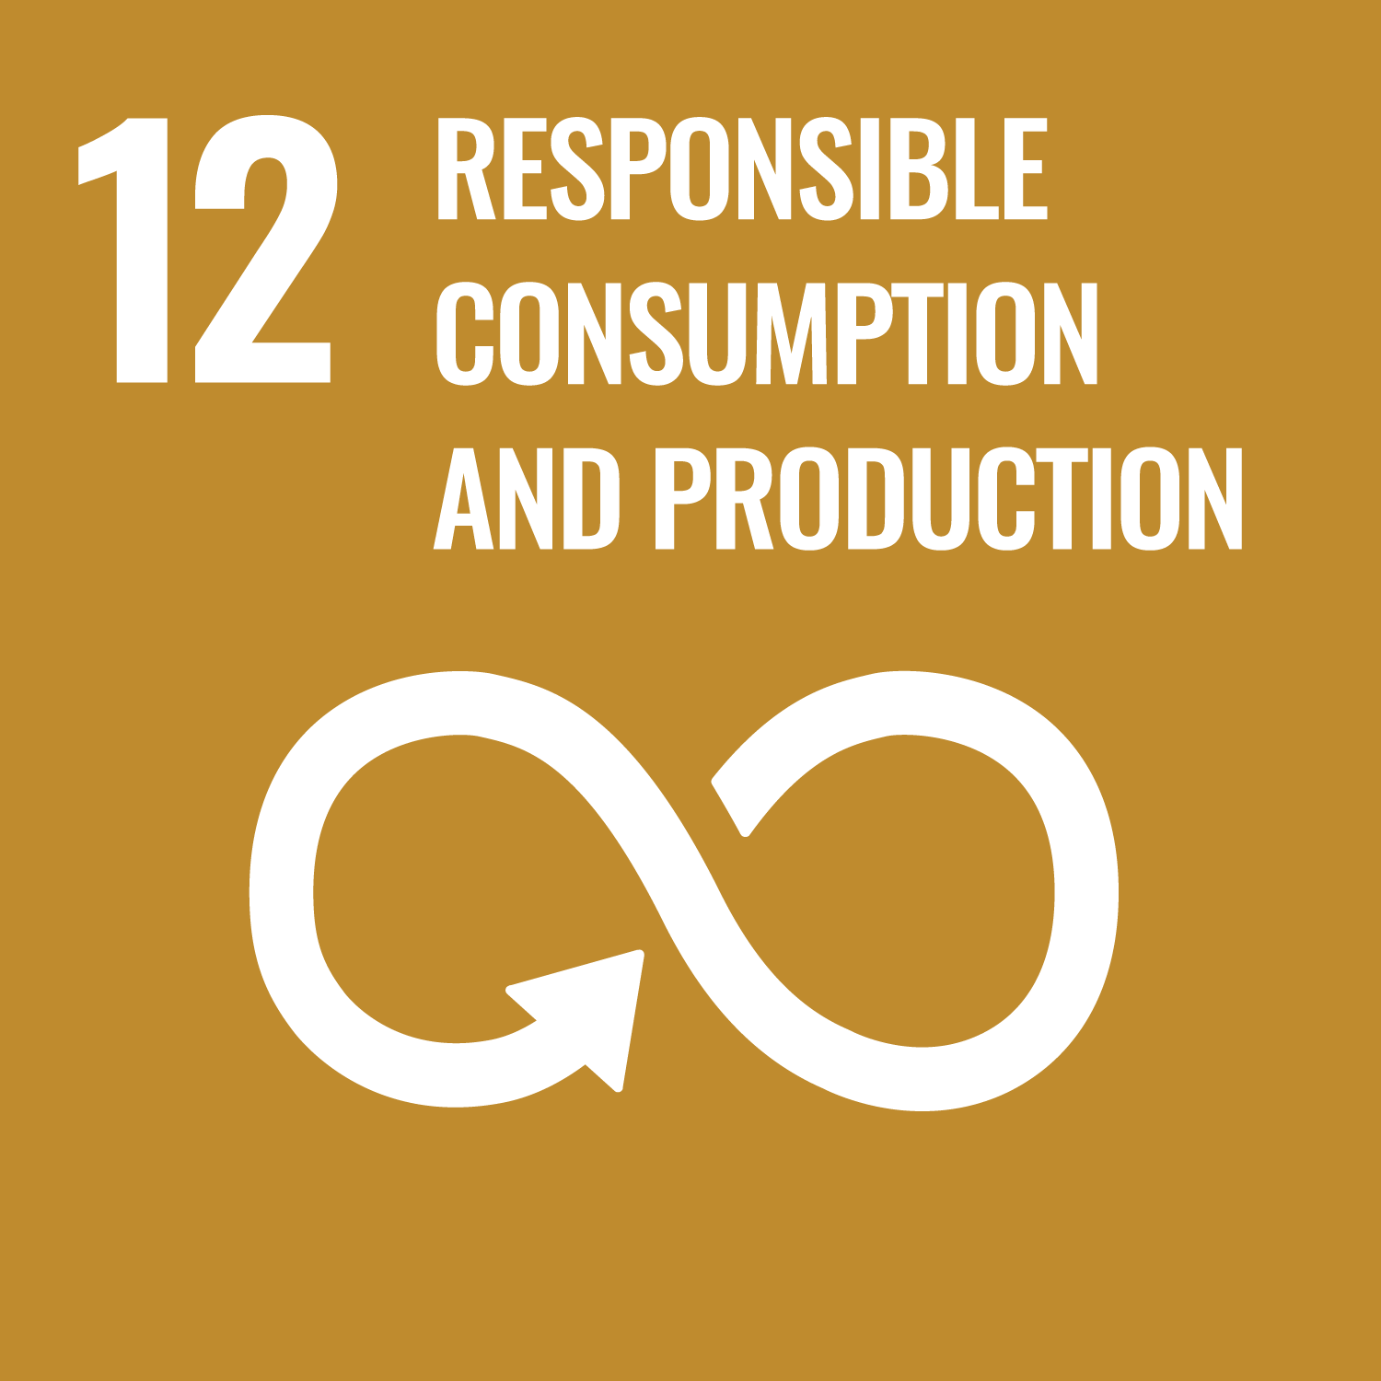

  Chemicals and Pollution Action Portfolio insights
Total portfolio:
402 USD million
62 M (15%)
Air quality and
source-to-sea pollution
220 M (55%)
204 M (51%)
Chemicals and waste
136 M (34%)
High-impact sectors
Number of projects:
Number of Countries
under implementation:
Overview of beneficiaries:
  Governments
  Private sector organizations
  Civil society organizations
  Scientific and technical institutions
69 projects
112 countries

Slide 6

  Next Steps and Opportunities
Operationalizing the Intergovernmental Science-Policy Panel on Chemicals, Waste and Pollution
Advancing Global Framework on Chemicals: Implementation Programmes & measurability
Advancing solutions to address plastic pollution
Furthering momentum in high impact sectors: textiles, electronics, minerals & metals, transport
Addressing Anti Microbial Resistance (AMR) with environment at the center
Continuing to strengthen national capacities
UN Photo/Rick Bajornas. A view of the Eduardo Kobra mural at UN Headquarters.
Making the case for investment in chemicals and pollution action to enhance environmental quality and health for people and planet

Slide 7
New MTS 2026-2029: where are we heading and what do we need to get there?
Scaling up circular, zero-waste and pollution-free sectors and value chains:
- SCP & zero waste in plastics, textiles, building materials and electronics value chains
- ESM across minerals and metals value chains
- Reducing pollution from agrifood, transport, waste, energy and B&C sectors
Strengthening access to science and data on pollution and its sources and effective management and control frameworks:
- Intergovernmental Science-Policy Panel on Chemicals, Waste and Pollution
Supporting the UNEP-hosted Global Framework on Chemicals, MEAs and other frameworks
Promoting the uptake of solutions to improve air quality and reduce source-to-sea pollution & integrated action
Promoting integrated action on AMR and other health issues
Notes:
New UNEP MTS 2026-2029: same strategic objective “Towards a Pollution-free Planet” but with an enhanced focus on pollution-free sectors and value chains and the new Science-Policy Panel

Slide 8
A healthy, prosperous, resilient people and planet
Vision
Climate Stability
Living in Harmony with Nature and Achieving Land Degradation Neutrality
A Pollution-Free Planet
Strategic
Objectives
(b) to reduce biodiversity loss and ecosystem degradation, to maintain ecosystem functions and services, and to reduce
desertification, land degradation and drought
(c) to reduce pollution and enhance environmental quality and health for
people and planet
(a) to reduce emissions and enhance adaptation and resilience
THE ONE IMPACT FRAMEWORK (POW 2026-27)
2029
I2: Enhanced resilience and adaptation to the impacts of climate change
Impact
I1: Reduced GHG emissions
I3: Enhanced stability of land and water ecosystems
I4: Reduced exposures to harmful chemicals and pollution
O1: Increased use of environmental science and digital solutions, including AI in decision making.
O2: Strengthened governance to meet international environmental commitments, promote environmental rule of law and support implementation of national obligations to MEAs.
O3: Sustainable management and restoration of natural and productive ecosystems and enhanced pollution prevention and control, including in areas affected by disasters and conflict.
O4: Increased adoption of sustainable consumption and production and circular economy approaches in sectors.
O5: Increased adoption and implementation of integrated solutions for sustainability.
O6: Finance leveraged and/or re-directed for long-term sustainability.
O7: UNEP strengthened to advocate for the global environment and fit for purpose to deliver and influence.
12-monthly PPR on Outcome indicators, reported by SP
Outcomes

Slide 9

A Pollution-free Planet: Impact indicator
PoW 2026-2027
2029 Impact | Indicator | Unit of measure | Baseline and Targets | Data Sources
I4. Reduced exposures to harmful chemicals and pollution. | Releases of pollutants and waste to the environment avoided. | Metric tonnes of pollutants and waste, including those covered under MEAs | Baseline and target: December 2024 baseline: 3,298 metric tons Progress by December 2029: Reduced by +4,000 metric tons | Global Funds’ monitoring systems and reports UNEP partner sources
Main Components of the indicator: Solid and liquid Persistent Organic Pollutants (POPs) and Mercury
Other Components to be explored: Highly-hazardous pesticides, POPs/Mercury containing materials and products, POPs in air, Plastic waste, debris from disasters and conflicts, and other pollutants of concern
The baseline uses 2022-2024 programme results and the target is set based on that baseline.
Contributing Portfolio/Projects: GEF Chemicals and Waste projects, International Waters, Source-to-sea, Textiles, Plastics, Minerals and Metals

Slide 10
A Pollution-free Planet: Subprogramme indicators
PoW 2026-2027
Indicator | Primary Outcome (s) | Unit of measure | Baseline and Targets
3.1. Number of countries developing, adopting, revising or implementing policies, laws or regulations that advance circular approaches, sound management for chemicals and waste, and pollution prevention and control in key sectors | O2, O3 | 3.1.1 Number of countries that have developed, adopted, revised or implemented policies, laws or regulations that promote circular approaches, sound chemicals and waste management, and pollution prevention and control (disaggregated by sector/value chain/issue) | Dec 2024 baseline: 50 Progress by Dec 2026: +15 Progress by Dec 2027: +20
3.2 Number of private sector entities taking action to improve chemicals and waste management and reduce pollution | O4 | 3.2.1 Number of private sector entities at global or national level reporting progress in taking up more circular approaches, including through product design, extended producer responsibility schemes, safer alternatives, sound chemicals and waste management and pollution reduction measures (disaggregated by sector/value chain) | December 2025 baseline: 10 Progress by Dec 2026: +15 Progress by Dec 2027: +25
3.3 Increase in the number of sectoral and intersectoral efforts advancing positive outcomes for environment and health | O5 | 3.3.1 Number of intersectoral strategies/action plans/measures that address the environmental dimensions of antimicrobial resistance or other health issues | Dec 2025 baseline: 6 Progress by Dec 2026: +4 Progress by Dec 2027: +3
Data sources: UNEP partner sources, monitoring records, Global Funds’ monitoring systems and reports, media sources and UNEP project websites/databases

Slide 11
A Pollution-free Planet: Indicator Continuity
MTS 2022-25: OUTCOME INDICATORS
MTS 2026-29: IMPACT INDICATOR
Indicator (i) Number of Governments that are developing/implementing policies on chemicals and waste management
Impact Indicator: Releases of pollutants and waste to the environment reduced/avoided
MTS 2026-29: OUTCOME INDICATORS
Indicator (ii) Number of Governments developing or implementing policies to prevent or reduce waste
Indicator 3.1 Number of countries developing, adopting, revising or implementing policies, laws or regulations that advance circular approaches, sound management for chemicals and waste, and pollution prevention and control in key sectors
(disaggregated by sector/value chain/issue)
Indicator (iii) Number of policy, and technical measures developed to reduce pollution
Indicator 3.2 Number of private sector entities taking action to improve chemicals and waste management and reduce pollution
(disaggregated by sector/value chain)
Indicator (iv) Reduction in releases of pollutant to the environment
Indicator 3.3 Increase in the number of sectoral and intersectoral efforts advancing positive outcomes for environment and health
(AMR and other health issues)

Slide 12
Thank you
 | www.unep.org
Tomas Marques, Regional Sub-programme Coordinator, Chemicals and Pollution Action
UNEP Europe Office, tomas.marques@un.org
https://www.unep.org/topics/chemicals-and-pollution-action

