Slide 1
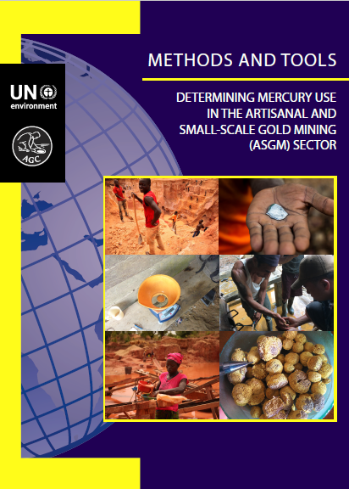


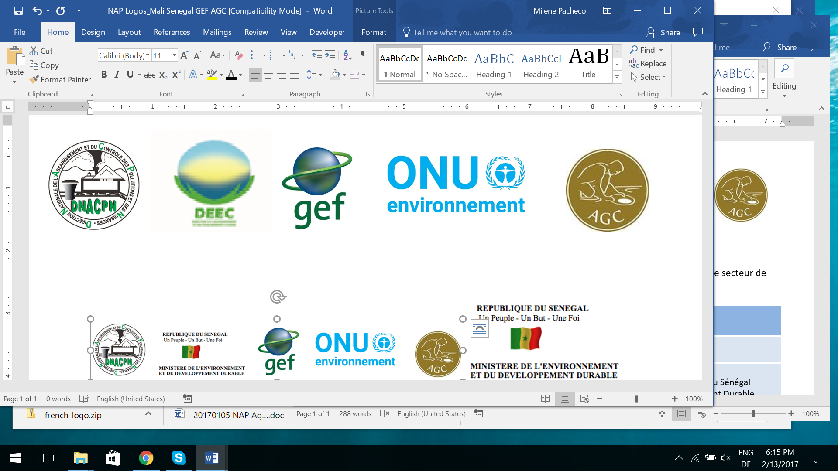
Introduction to
ASGM
Lecture 1
Introduction to
ASGM

Slide 2
Introduction to
ASGM

Slide 3
Overview
What is ASGM?
Geology and Gold
Mineral Extraction
Mineral Processing
Mercury Use in ASGM
Gold Supply Chains
Formality and Governance
Spatial Distribution & Seasonality
Health and Environment

Slide 4
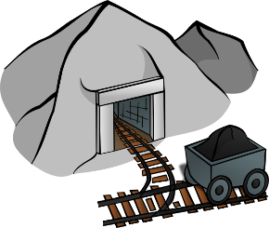
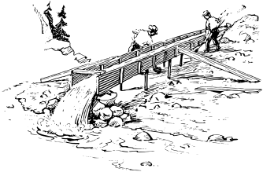


What is ASGM?
ASGM (Artisanal and Small Scale Gold Mining):
Gold mining done by individual miners, communities, or small enterprises with limited capital investment and production. ASGM uses largely manual and semi-mechanised techniques.

Slide 5
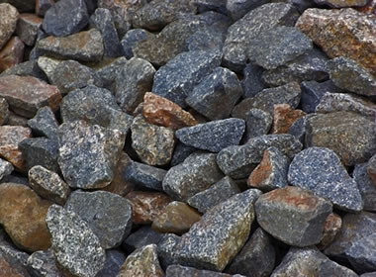
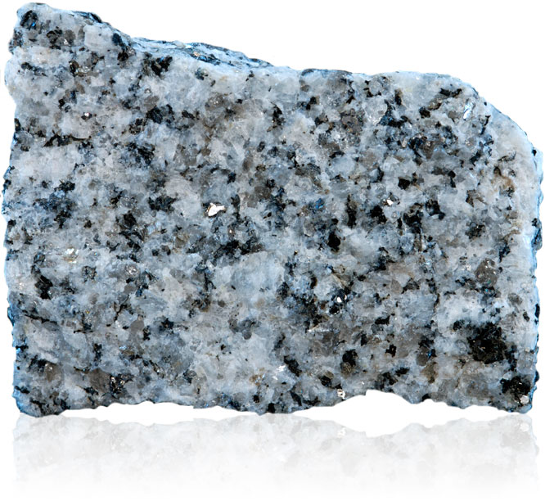
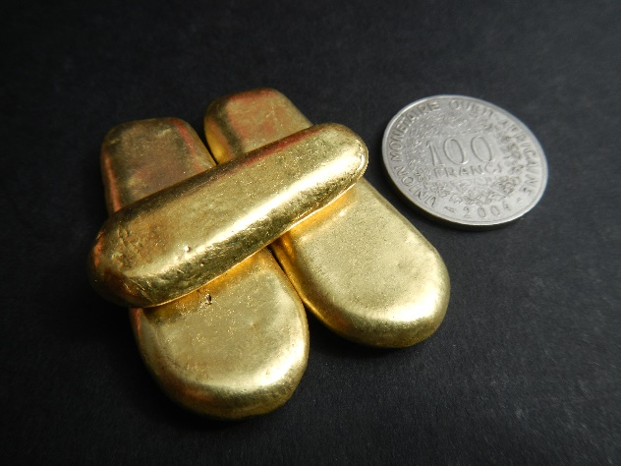

Where does gold come from?
Rocks
Minerals
Gold

Slide 6
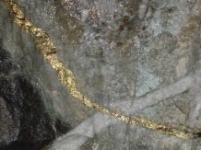
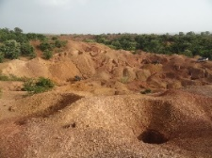
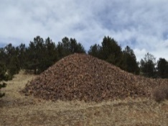
Where does gold come from?
gold vein
disseminated gold
gold in surface sediments
Rock containing gold that is targeted by miners = gold ore.
To produce gold, the ore must be processed to remove the other minerals.

Slide 7
Ore Grade
The amount of gold in the ore (expressed in g/T)
lower grade
higher grade
  Range from <1 to >100 g/T
  Can vary significantly between sites, and even within deposits

Slide 8
Gold Purity
Gold
80%
Recovered
“Gold”
Copper
10%
Silver
10%
  The “gold” recovered from ore is typically a mix of metals
  Purity is the proportion of this mix that is gold
  Expressed in % purity (0 to 100%) or in karats (0 to 24K)
  Can vary significantly between sites and less so within a site

Slide 9
Gold Purity
Correcting from impure to pure (24K) gold:
Weight of gold x (purity of gold/24K)
e.g., You have 100 g of 18K gold. How many g of pure gold?
100 g x 18K/24K = 75 g
100 g of 18K gold is 75 g of 24K gold

Slide 10
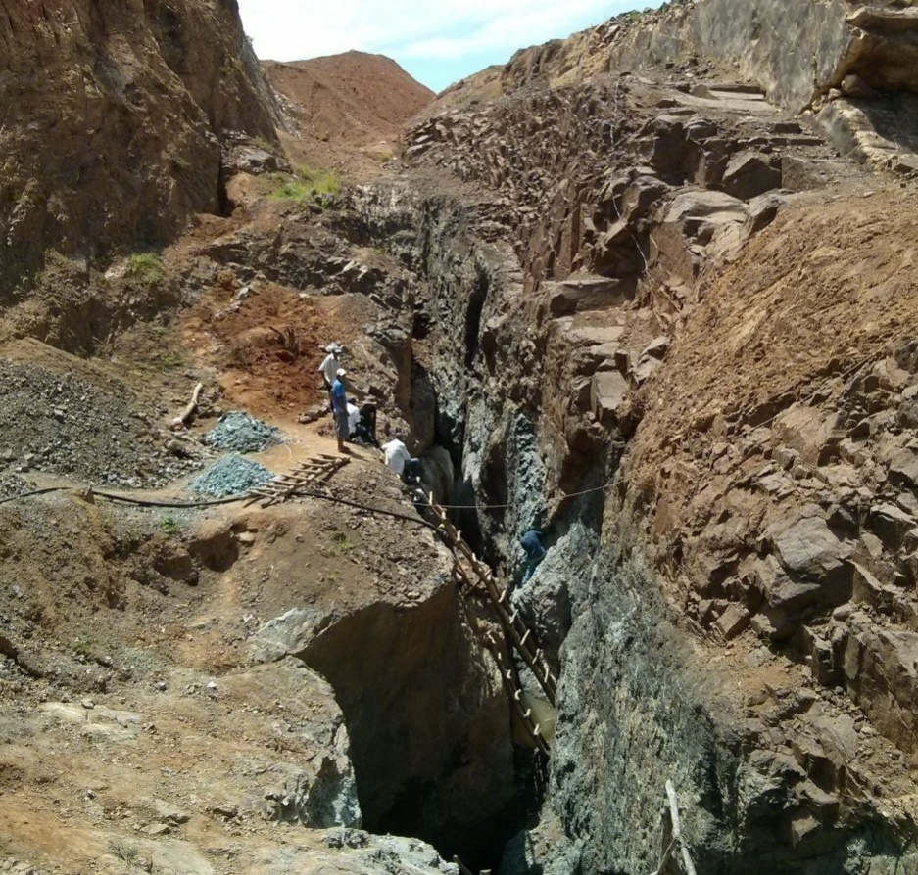
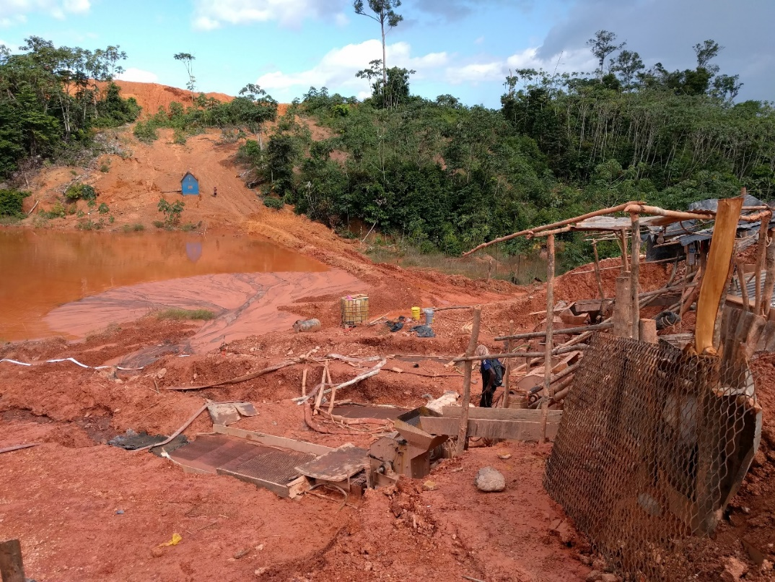
Mineral Deposits
Hard Rock Deposits
(Primary Deposits)
Soft Rock Deposits
(Alluvial Deposits)

Slide 11
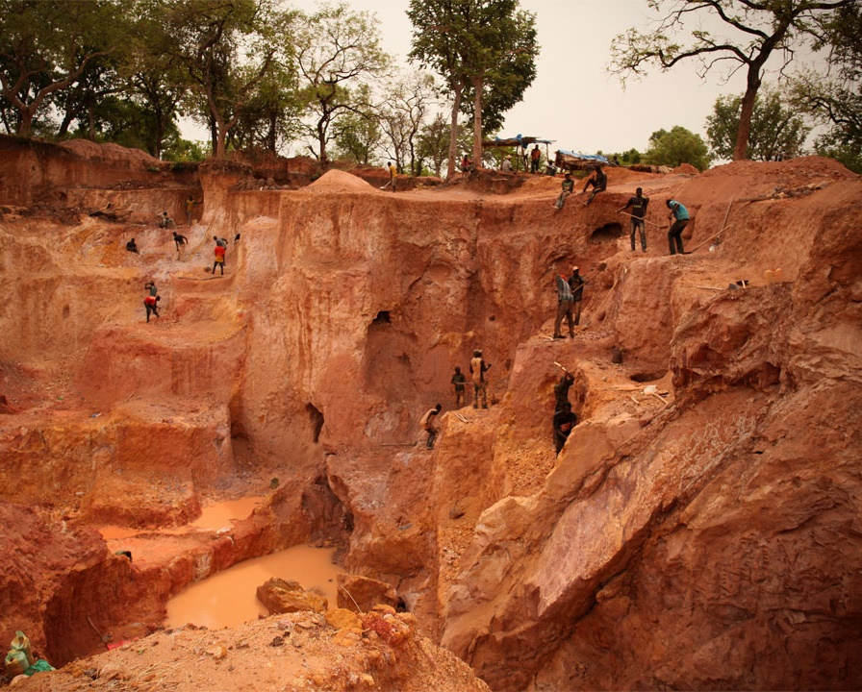
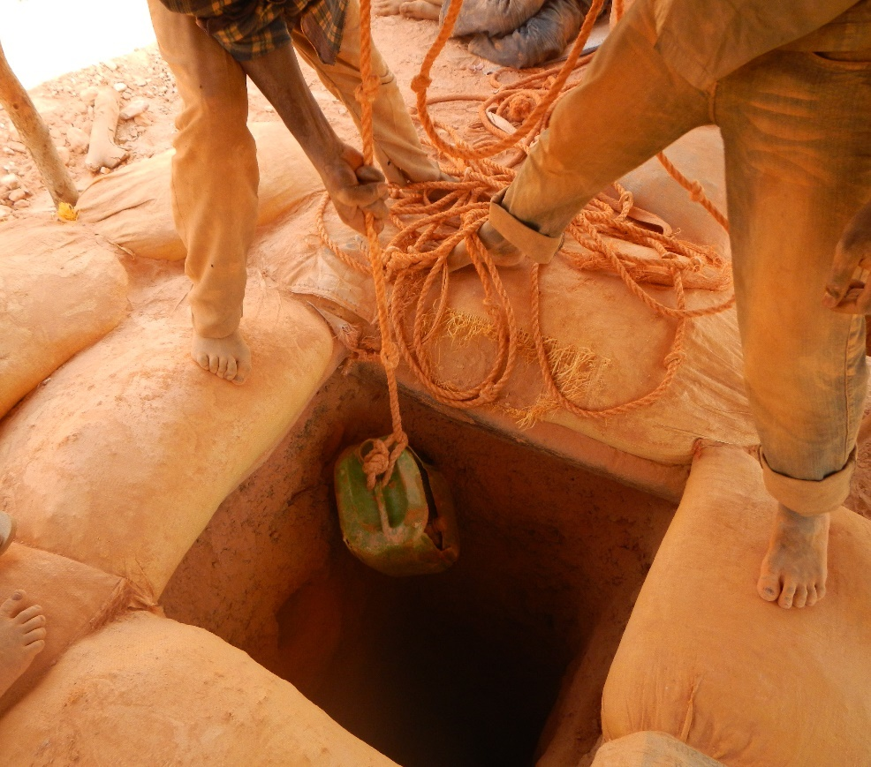
Extraction – Hard Rock
Open Pit
Mine Shaft

Slide 12
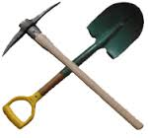
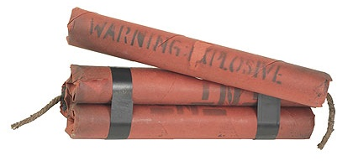
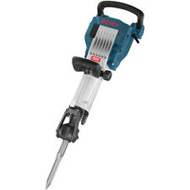
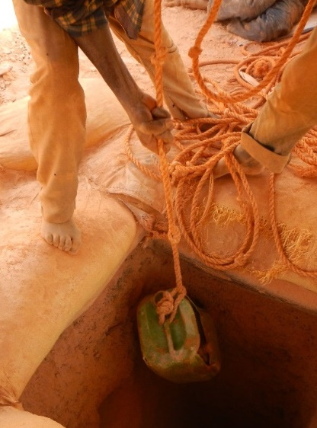
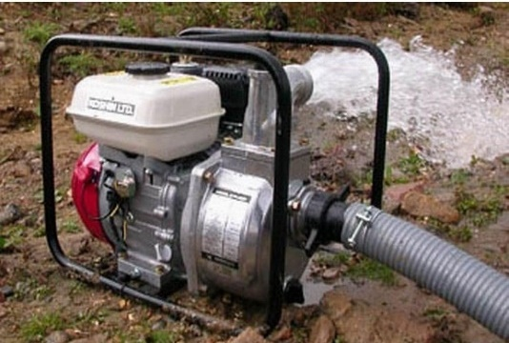
Extraction – Hard Rock

Slide 13
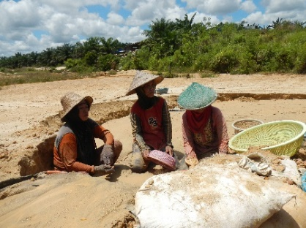
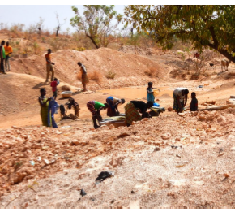
Extraction – Soft Rock

Slide 14
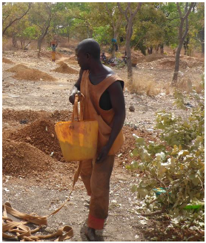
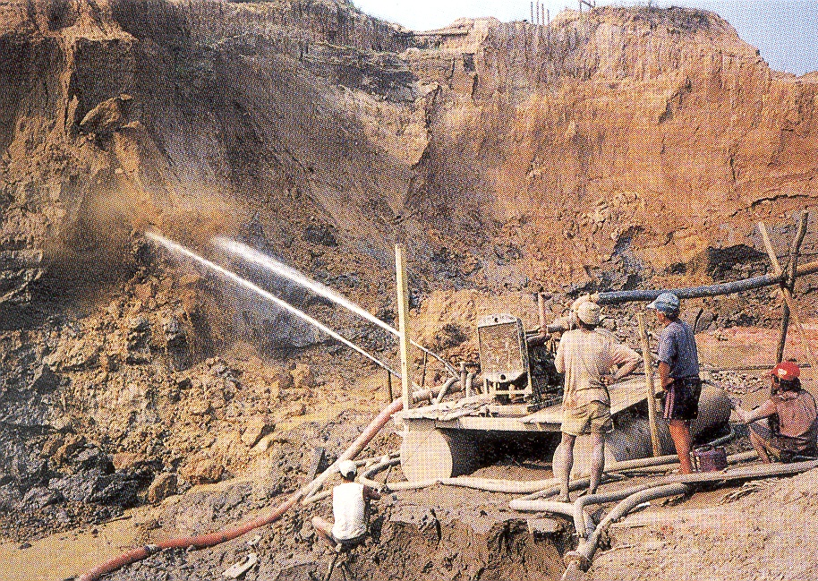
Extraction – Soft Rock

Slide 15

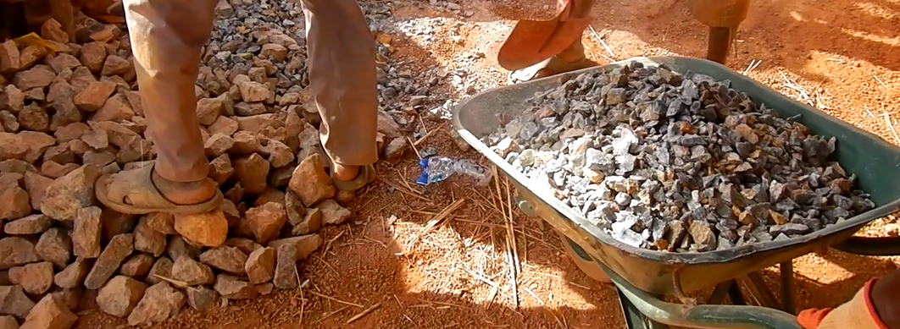
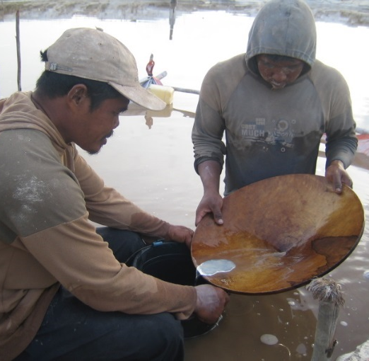
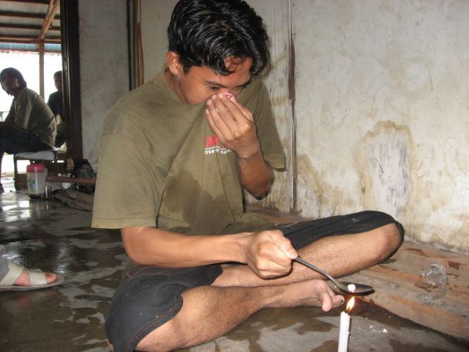
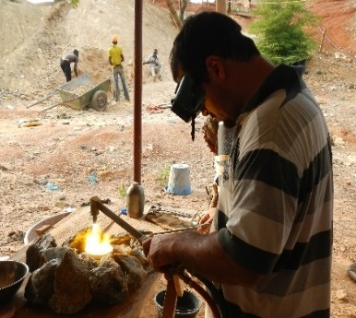
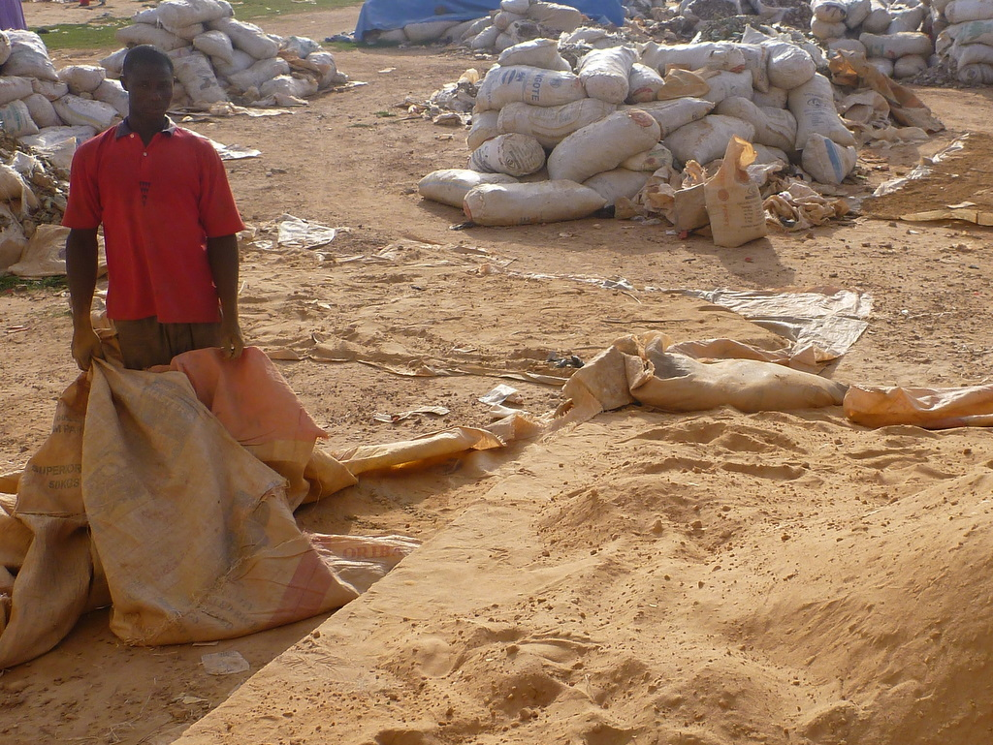
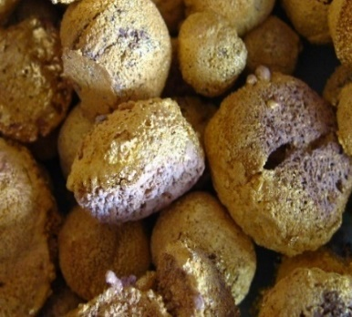
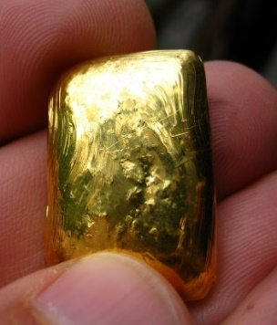
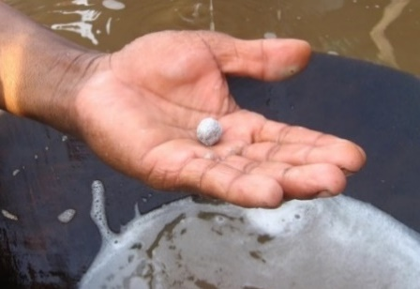
Processing
Crush
Mill
Concentrate
Amalgamate with Mercury
Burn Amalgam
Smelt/
Refine

Slide 16
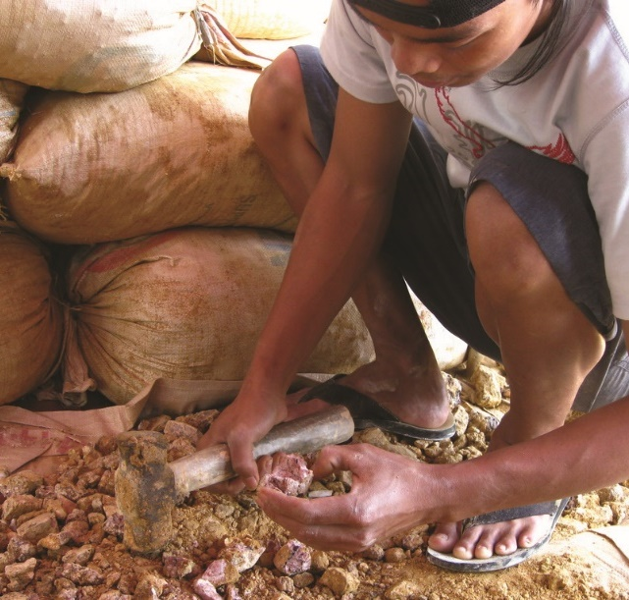
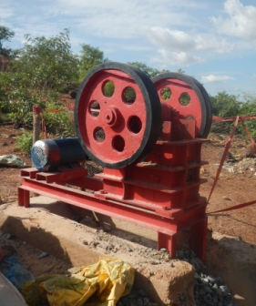
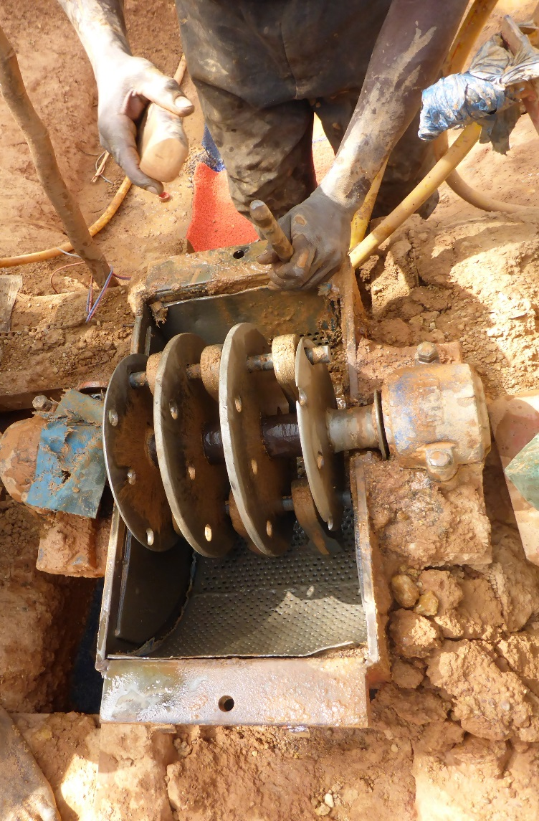
Crushing
Processing
Reduces size of ore rocks
Manual Hammering
Jaw Crusher
Hammer Crusher

Slide 17

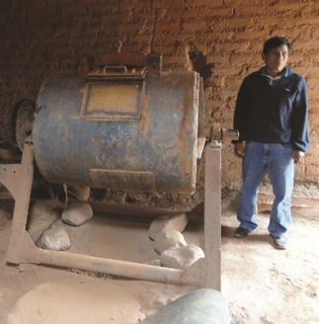
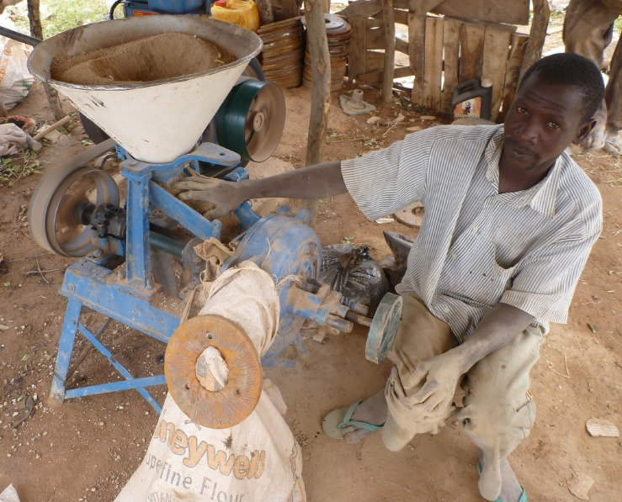
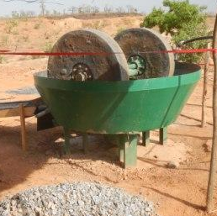
Milling
Processing
Reduces grain size further. Liberates gold from other minerals in the ore.
Good Liberation: grain size of the ore is fine enough to
separate gold particles from other
minerals.
* Proper grain size varies with ore.
Ball Mill
Disk Mill
Wet Pan Mill

Slide 18
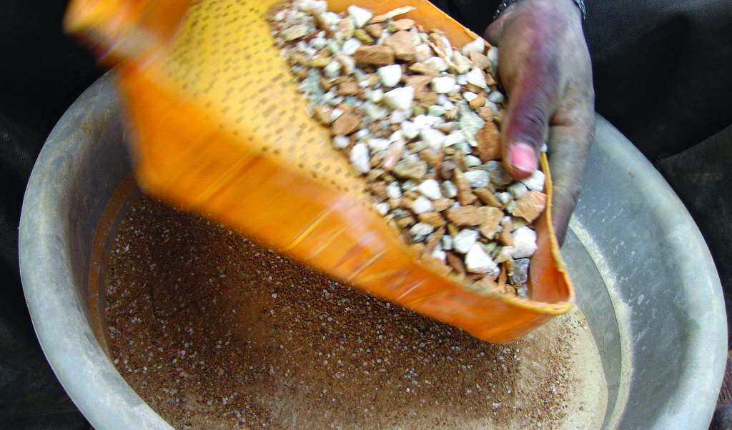
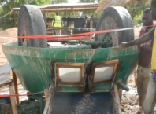
Processing
Grain size
Control
Improves recovery by ensuring the proper grain size for the best liberation of gold has been achieved.

Slide 19
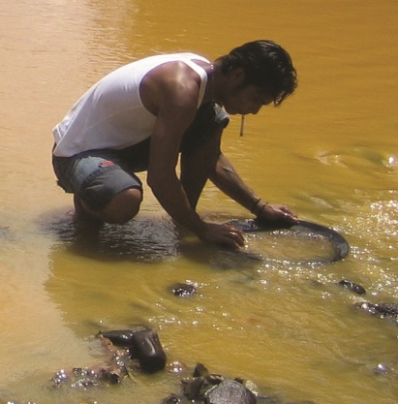
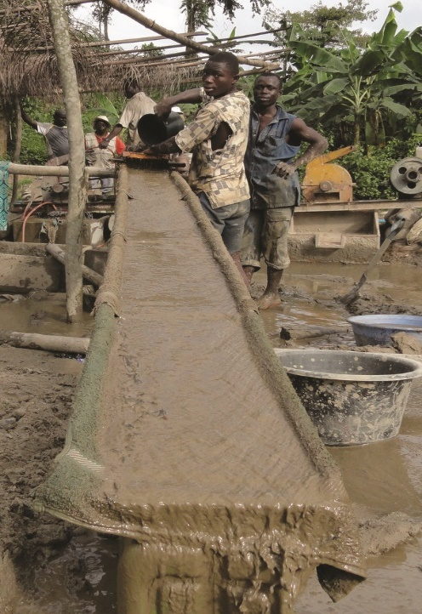
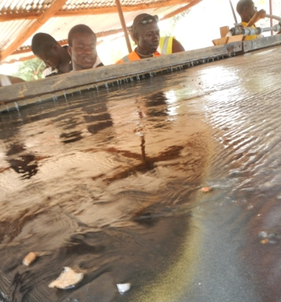
Gravimetric
Concentration
Processing
Removes non-gold minerals from the milled material, reducing the total volume of the milled ore and concentrating the gold particles within it.
Pan
Sluice
Shaking Table

Slide 20
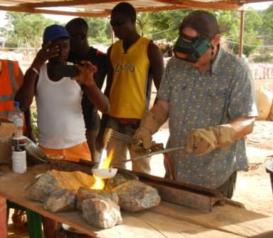
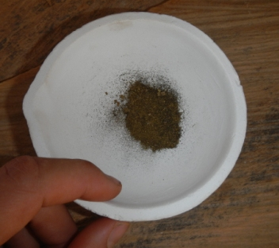

Smelting and Refining
Processing
Melts concentrated ore or gold into a solid gold piece. The gold can be further refined (usually by a gold shop or refinery) to pure 24K gold.

Slide 21
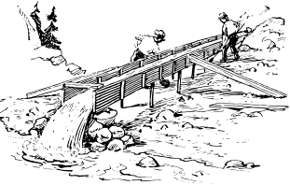
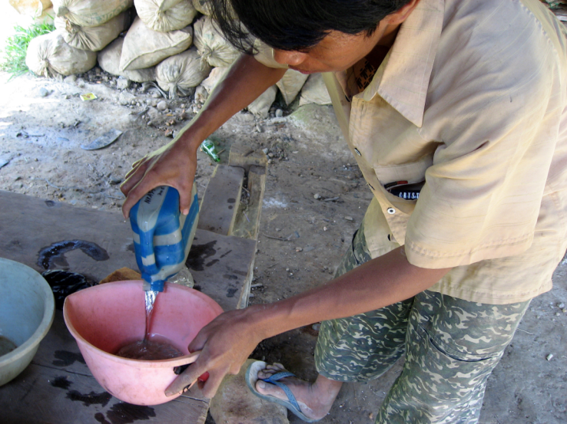
Where is mercury used in ASGM?
in processing
Hg
- Mercury is added to ore to extract gold
- Mercury binds easily with gold, making a heavy mercury-gold amalgam that is easier to separate from the rest of the ore
“AMALGAMATION”

Slide 22
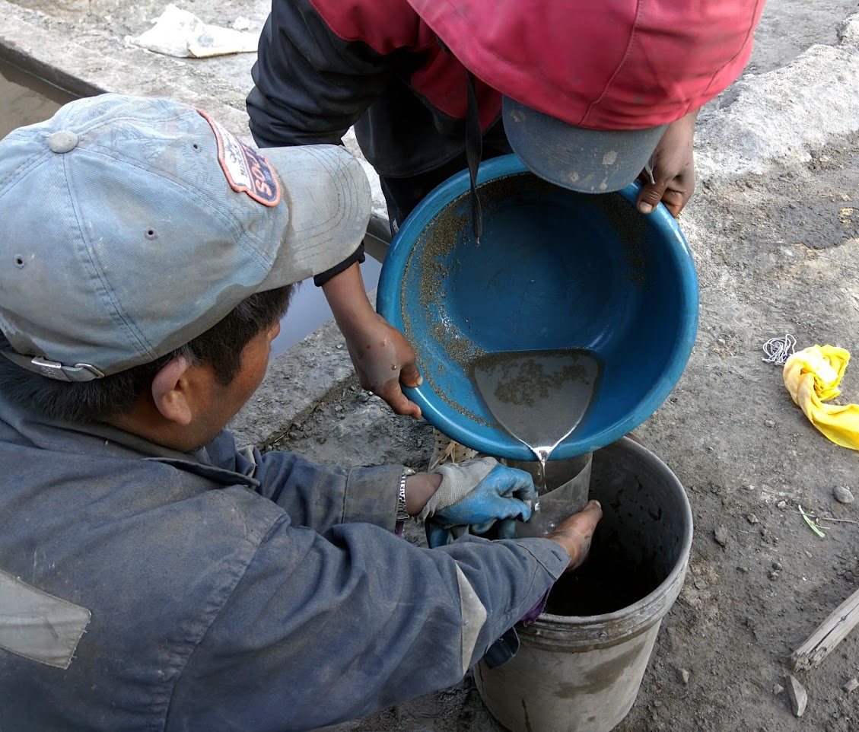
Mercury is added to ore to extract gold

Slide 23
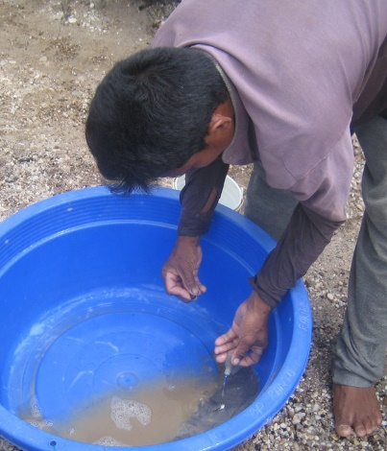
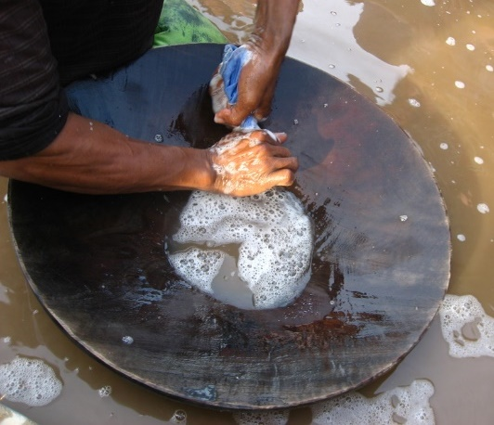
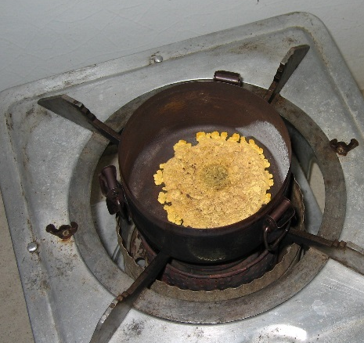



Mercury Amalgamation
Mix mercury with ore
Recover amalgam (squeeze)
Vaporize mercury
Sponge gold

Slide 24


Whole Ore Amalgamation

Slide 25



Concentrate Amalgamation

Slide 26
Mercury Use
“Mercury use” in ASGM in a Minamata context means:
The net loss of mercury during ore processing
or in other words, the amount of mercury that is lost to the environment during ore processing operations.
Where is mercury lost to the environment?

Slide 27
Mercury Use (loss to environment)
Mix Mercury With ore
Recover Amalgam
Vaporize Mercury
Sponge Gold
Hg
Hg
Hg

Slide 28




Mercury Use (loss to environment)
Crush
Mill
Concentrate
Whole Ore Amalgamation
Concentrate amalgamation
Burn Amalgam
Smelt/
Refine
OR

Slide 29
Mercury Use (loss to environment)
Crush
Mill
Concentrate
Whole Ore Amalgamation
OR
Concentrate amalgamation
Burn Amalgam
Smelt/
Refine

Slide 30

Mercury Use (loss to environment)
Crush
Mill
Concentrate
Burn Amalgam
Smelt/
Refine
Whole Ore Amalgamation
OR
Concentrate amalgamation
Atmosphere
Tailings
Rivers, lakes, ground water

Slide 31

If waste rock contains enough gold, it is sometimes reprocessed by leeching with cyanide. (worst practice banned by Minamata)
Processing
Processing
Tailings (waste)
Hg
Hg

Slide 32

A typical workflow

Slide 33

A typical workflow

Slide 34

A typical workflow

Slide 35

A typical workflow

Slide 36

A typical workflow

Slide 37

A typical workflow

Slide 38

A typical workflow

Slide 39
A typical workflow

Slide 40


A typical workflow

Slide 41

A typical workflow
mine
amalgam

Slide 42
A typical workflow
Atmosphere
mine
amalgam
Tailings piles
Rivers, lakes, ground water

Slide 43



Organization of ASGM
Organization of miners
Individuals
Small Businesses
Cooperatives

Slide 44
Workforce
Primary ASGM workforce - number of workers directly employed in the gold production system (receive direct payment from the gold proceeds).
- miners (extraction workers, processing workers, mining/processing foremen), business owners, mining coordinators, cooperative leaders
Secondary ASGM workforce - number of people indirectly financially dependent on the ASGM sector (provide goods and services to the sector).
- agricultural producers, merchants, traders, service providers

Slide 45

Organization of ASGM
Distribution
of Revenue

Slide 46

Organization of ASGM
Formality / Governance
Few ASGM operations adhere to national legal frameworks
Often local governance (Community, Municipality, Local police)
Understanding the governance structure can provide useful information for inventory work:
  Understand key stakeholders
  Determine who to interview
  Provide insight into local operations

Slide 47
Gold Supply Chain
10
Miners
Domestic ASM
International
70%
80%
90%
95%
98%
99%
LBMA
30
Miners
On Site Buyer
Region Buyer
Exporter
Intern. Trader
Refiner
5
Miners
10g
100g
10kg
50kg
100kg
1000kg
Domestic LSM
International
Mine
LBMA
Smelter
Refiner

Slide 48

Spatial Distribution

Slide 49
Seasonality
ASGM activity can vary greatly throughout the year, especially in regions with a heavy rainy season and seasonal flooding. During these times of the year, productivity and workforce, and thus mercury use in processing may be drastically reduced.
Relevance: Annual mercury use and gold production are often calculated by interviewing about daily productivity. It is important for a researcher to ask clear questions about the seasonality of ASGM in the region so that productivity is not over or underestimated. For example, on Site A, a baseline team finds that 1 kg of Hg is used per day on the site. Miner interviews indicate they work 5 days per week and have 10 holidays per year (250 days of work per year). This would lead the officer to believe: 1 kg Hg/d x 250 d/y = 250 kg Hg/y.
However, further questioning reveals that all extraction work stops for three months (~60 working days) of the year due to flooding. There are 190 active mining days and the annual mercury use estimate for the site is 1 kg Hg/d x 190 d/y = 190 kg Hg/y.

Slide 50



Environmental Impact
Tailings (waste) release
To water:
increased turbidity
increased erosion
circulation changes
coastline alteration
loss of habitat
To land:
Loss of habitat
Loss of mining
opportunity

Slide 51



Health Impact
Mercury is a neurotoxin – detrimental effects on the nervous system
  Skin contact / absorption
  inhalation

Slide 52






Health
  ingestion
Hg
Hg
Hg

Slide 53



Summary
3 key components of ASGM – each offering important
information that can be used for ASGM inventory
  Extraction
  Processing
  Markets
  Must understand each facet of ASGM - each is a source of valuable information
Significant variation in practices between sites, regions
and countries -- approaches will be different in every
country and will be tailored to each region within.
To understand ASGM must embrace its variability

Slide 54

Thank you very much!
Questions?

