Slide 1
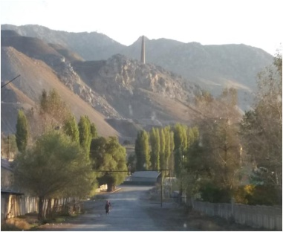




Lessons learned from the perspective of Study Design and Planning
Session on HBM
SRMC&RI (DU), CHENNAI, INDIA
Dr. Irina Ilchenko, Professor, Sechenov University, Russia
Dr. Krishnendu Mukhopadhyay, Professor, SRMC&RI, India
Dr. Ainash Sharshenova, Professor, Centre for Environmental medicine and human ecology, Kyrgyz Republic
Dr. Davaadorj Rendoo, National Center for Public Health, Mongolia
Dr. Edith E. Clarke, Health Service, Ghana

Slide 2
Main options of HBM survey Design
“Assessment of prenatal exposures to mercury”
WHO standard requirements
(Framework methodology for developing a national survey protocol)
National pilot
survey Protocol
1. Identification of mercury sources and hotspots
2. Identification of target population
3. Selection of hospitals and number of participating mothers
4. Inclusion (eligibility) criteria for participating mothers
1. Target population
2. Selection of hospital(s) and number of participating mothers
- Number of participants in the general population arm
- Number of participants in high exposure arm
- Identification of high exposure areas
3. Criteria for enrollment of mothers
4. The project follows up: medical surveillance of people with high mercury concentration

Slide 3
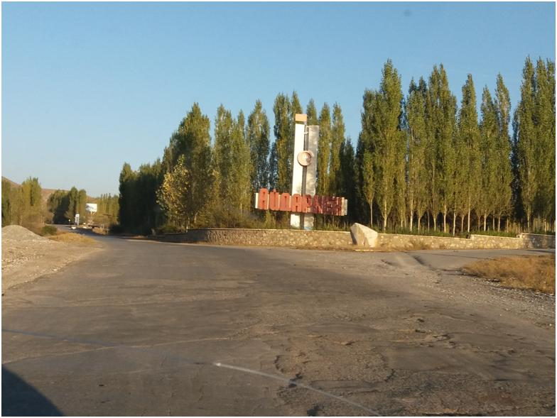
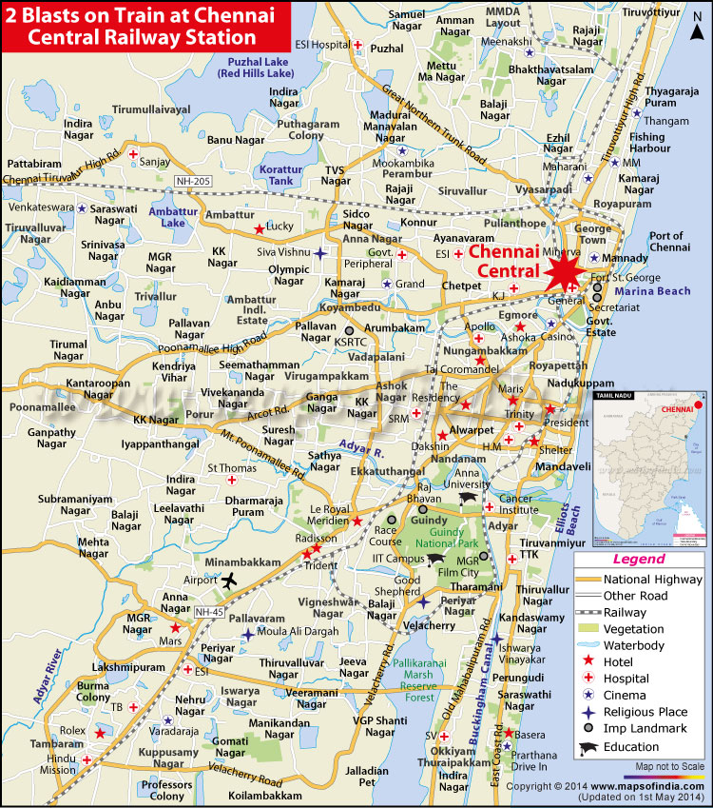
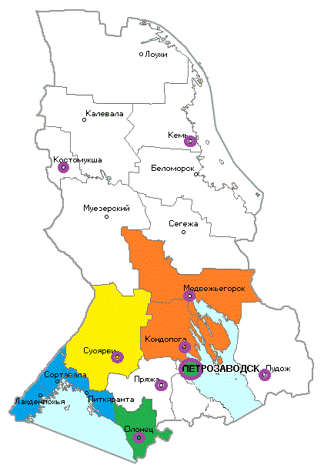
Kyrgyz Republic
( Aidarken area)
India
(Chennai area)
Enterprise with the production
of metallic
mercury
Residents from Chennai – religion and caste also play important role in dietary practice. Part of the country is primarily rice eaters.
Russia
(Southern part of Karelia)
industrialised part of Karelia,
dietary practice among residents associates with high consumption
of local fish.
Mongolia – artisanal small scale gold mining activity area
Ghana – fish eating population of Accra and Tema

Slide 4
Target population groups
National context from pilot countries
Hospitals and recruited women
Aidarken area -enterprise with the production of metallic mercury –Kyrgyz Republic
2 hospitals (107 women)
Artisanal small scale gold mining activity area - Mongolia
2 hospitals (250 women)
Fish eating population of Accra and Tema - Ghana
2 hospitals ( ? Women)
High exposure group in the area of Karelia with local fisheries , local fish eating - Russia
5 hospitals (250 women)
Random selection from fish eating community (costal area), having TPP (nearby costal area) - India
2 hospitals (250 women)

Slide 5

Sampling size of population groups
WHO requirements
Recruited numbers of women in pilot countries
Challenges
Hotspot areas:
Optimal 250 women
At least 120 women
Russia – 250
India - 250
Kyrgyz Republic - 107
Mongolia – 250
Ghana - ?
Difficulties with recruitment for the period of 6 months when the number of births is limited (KR)
Timelines were not kept (Ghana)
Difficulties with recruitment of women in rural areas: lack of maternity staff in small hospitals (Russia)

Slide 6
Sampling size of population groups - challenges
should be more
For big areas with big population groups ( Mongolia)
good
If annual number of births in the area is high, for instance 1200-1400 per year (Russia in urban areas, India)
should be less
If annual number of births in the area is small, for instance 640 per year (Kyrgyz Republic)
In rural areas for the same reason, for instance 300-400 per year(Russia)
250 for hotspot areas

Slide 7
Identification of hospitals in hotspot areas:
challenges (Russian experience)
INITIALLY - expected
ACTUALLY - recruited
Hotspot area | Hospitals | Number of women*
Petrozavodsk (urban) | 2 | 65 65
Kondopoga (urban/rural) | 1 | 40
Pitkaranta (ueban/rural) | 1 | 40
Suojarvi (rural) | 1 | 40
Hospitals | Number of women
1.Petrozavodsk (urban) | 78 70
2.Sortavala (urban/rural) | 50
3.Medveshegorsk (urban/rural) | 46
4.Suojarvi (rural) | 6
Main flow of rural women
Lack of personnel,
Closed for summer
5 hospitals is too much especially when the distance between them is big
4
137 km
3
* - based on average number of deliveries per year
57 km
206 km
1
2

Slide 8
Challenges for surveillance perspective
Options
Experience from pilot countries
Challenges
Only Local staff of the maternity is involved into the recruitment
Combination of Local staff and External research personnel involved into the recruitment
Russia
Kyrgyz Republic
Mongolia
India
Ghana
Recruitment of women depends on staff motivation, including financial compensation (India, Mongolia, Russia, Ghana, Kyrgyz Republic)
Inadequate numbers of midwives (Ghana)
Local staff has routine work, this may influence the quality of collected data ( Russia, Ghana)

Slide 9
Challenges for surveillance perspective
Real Costs for countries (financial issues) – India, Mongolia, Russia, Kyrgyz Republic, Ghana
Real national infrastructure to perform HBM surveys on the national scale – Kyrgyz Republic, Russia, Mongolia
National political will to get reliable HBM data on mercury exposure and monitor the trends - Russia

Slide 10
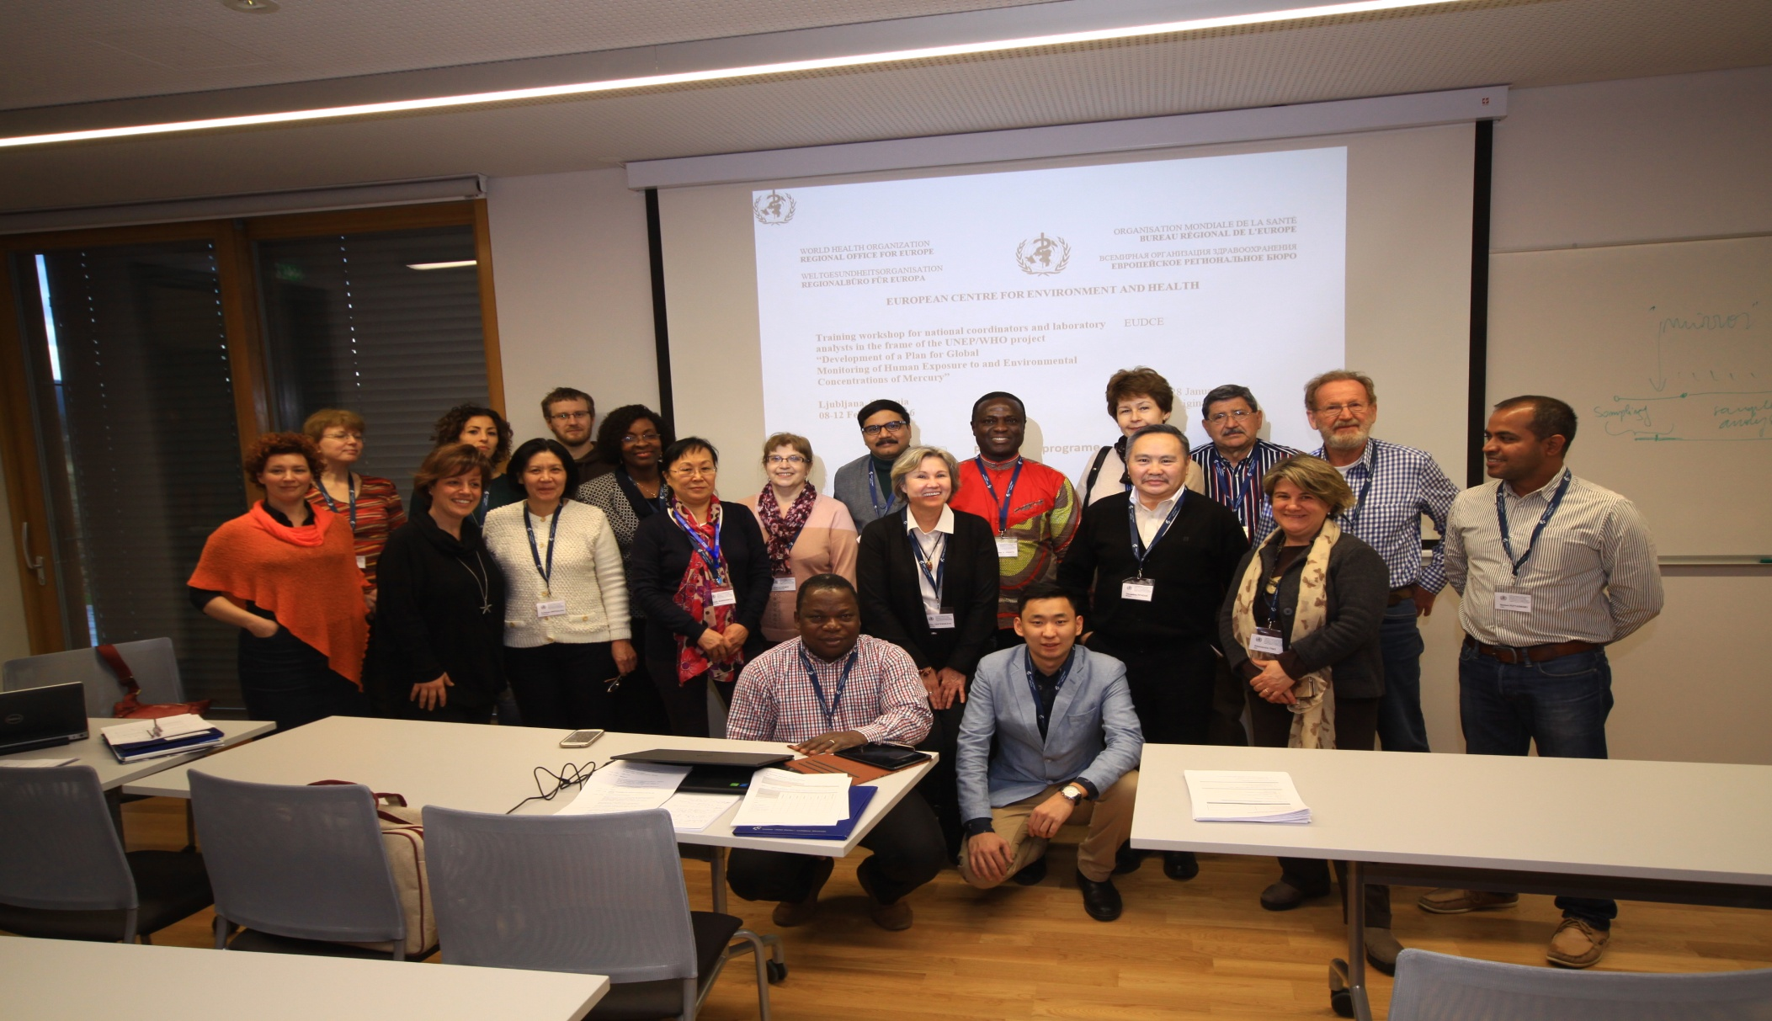
Thank you all!

