Slide 1
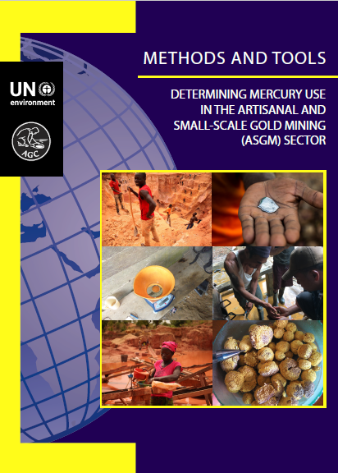


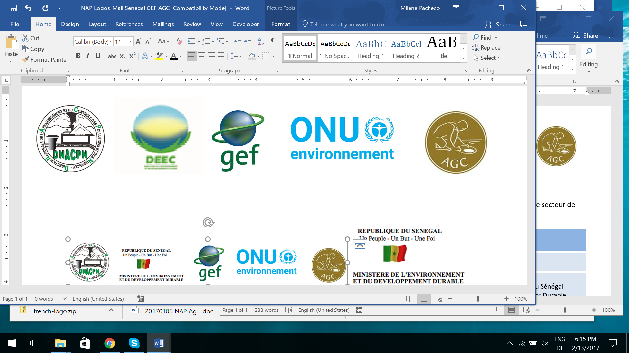
Lecture 4
ASGM Baseline
Case Study:
Nicaragua

Slide 2

Case Study:
Nicaragua

Slide 3
Introduction
Overview of ASGM in Nicaragua
National Level Scoping
Developing a country specific methodology
Methodology by mining region
Data collection by region
Data analysis by region
Producing national estimates
Conclusions

Slide 4

National Level Scoping
Literature review
Stakeholder Interviews
Field visits to select regions
Use existing information to develop a national approach

Slide 5
Literature Review
Limited academic literature
A few public sector reports (Government, NGOs)
3 major LSM companies (some useful information)
Mining noted in 6 departments
Basic understanding of extraction and processing

Slide 6
Stakeholder Meetings
Managua
National Governments (MEM and MARENA)
NGOs operating in the sector
LSM companies
Gold buyers
Regional
Regional and Municipal Governments
Miners and Processors
Gold Buyers

Slide 7
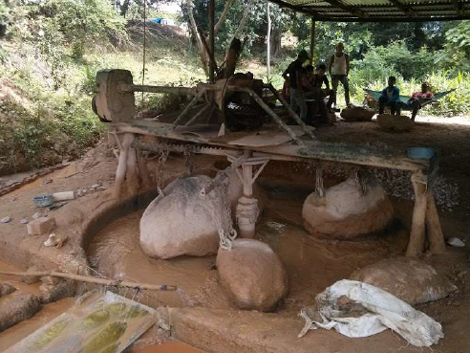
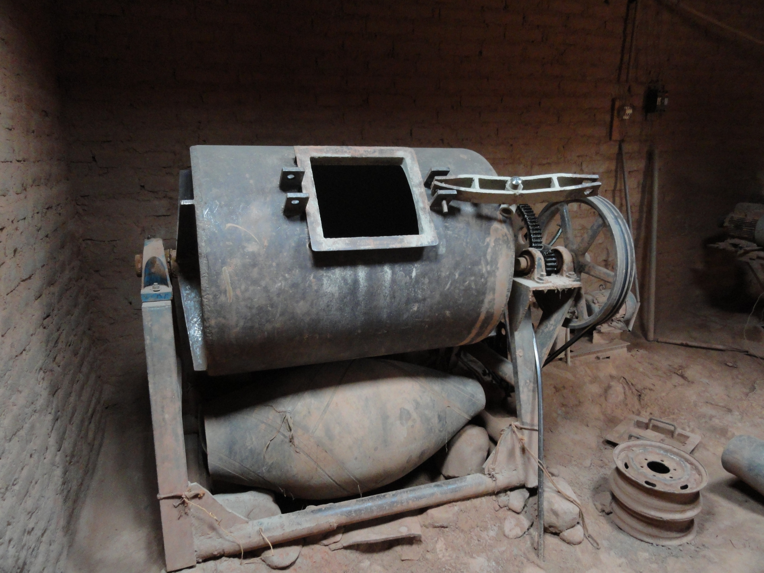
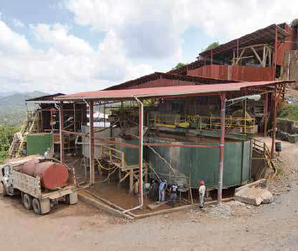
ASGM in Nicaragua
ASGM present in 6 departments
Few if any formal ASGM operations (local governance)
Manual extraction, mechanised processing
Extraction mixed open pit and tunnel
ALL processing conducted using toll milling services
  Rastras, Ball Mills, Central Cyanidation

Slide 8
Rastras

Slide 9
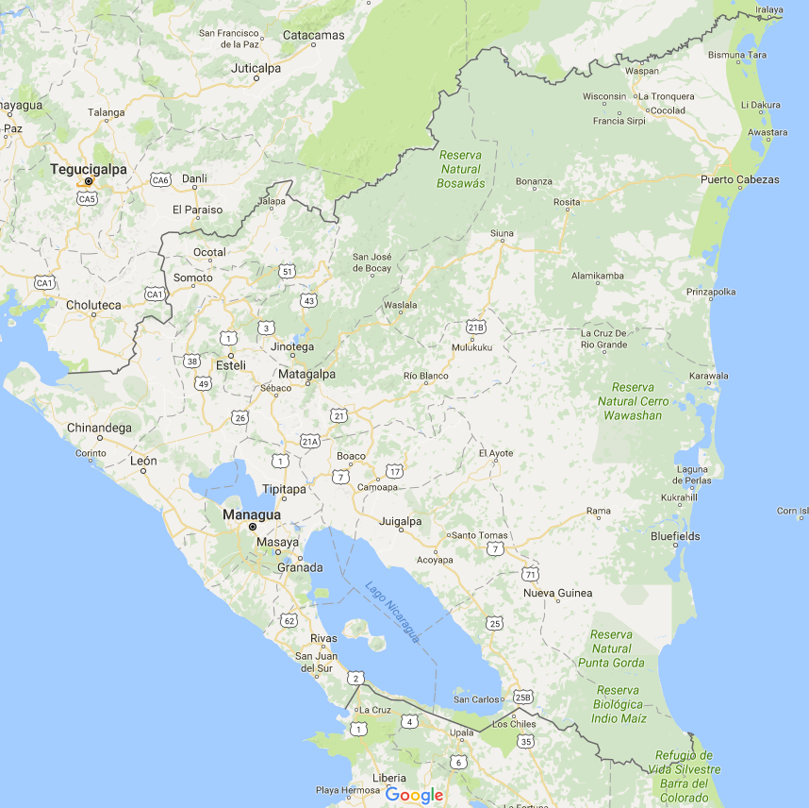
Mining Regions
Chinandega
Bonanza Triangle
Chontales
Matagalpa, Esteli, Leon
Nueva Segovia
Rio San Juan

Slide 10
Country Specific Approach
Use existing information for each region, and couple with field data as needed
Produce averages to allow extrapolation
Sum regional averages to produce national estimates
Processing systems are key!

Slide 11
Chinandega Approach
All processing done through rastras
Regional MEM representative has recent count of active rastras
Plan:
Determine regional averages, and apply to rastra count to produce regional estimates
  Grade
  Purity
  Throughput
  Days Active per year
  Hg:Au ratio
Go to field to collect regional data

Slide 12
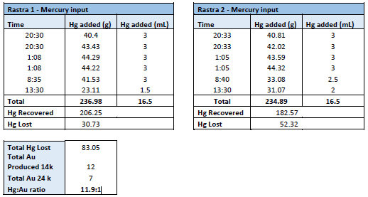
Hg:Au Ratio Measure

Slide 13
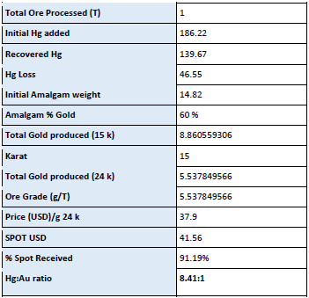
Hg:Au Ratio Measure

Slide 14
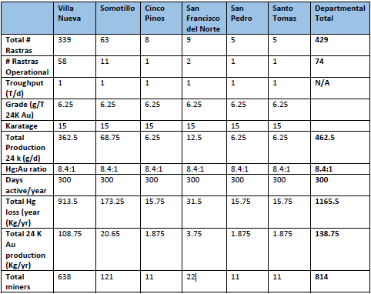
Chinandega
3 workers / rastra
8 miners to produce 1 T ore

Slide 15
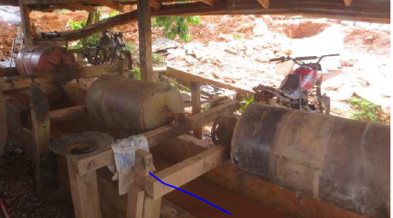
Bonanza Triangle
Processing mixed rastras and ball mills
3 mining communities (Bonanza, Rosita, Siuna)
Regional MEM representative had recent count of active rastras and ball mills for Bonanza
Local consultants have count for Siuna / Rosita
AGC did field visits to verify
Determine regional averages, and apply to rastra and ball mill count to produce regional estimates

Slide 16
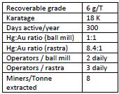
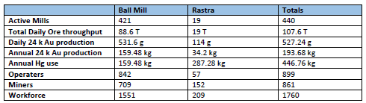
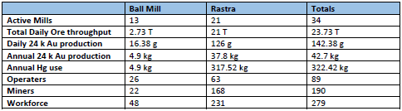
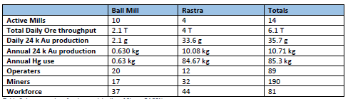
Bonanza Triangle
Bonanza
Ball mill = 0.21 T/d
Siuna
Rosita

Slide 17

Bonanza Triangle

Slide 18
Chontales
Reported rastra dominant processing workflow
At national level no existing known counts
Plan:
Visit site, conduct sit in (like Chinandega) to measure Hg:Au ratio
Conduct interviews to collect local grade, throughput, karat, etc.
Count all systems, produce estimates like before
Reported Cyanide system buying ASGM ore
  How does this impact inventory estimates?

Slide 19
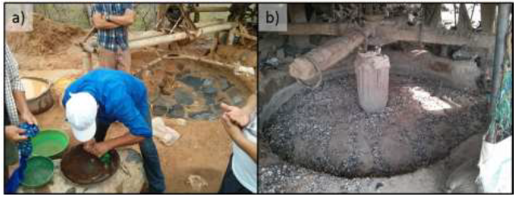
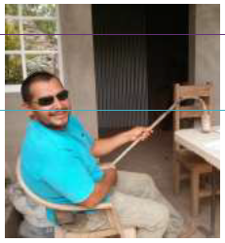
Chontales
Upon arrival conducted interviews with key stakeholders:
  LSM company
  Local municipality environment office
Both Municipality and LSM company had rastra counts
Rastras are different here!
Use retorts!

Slide 20
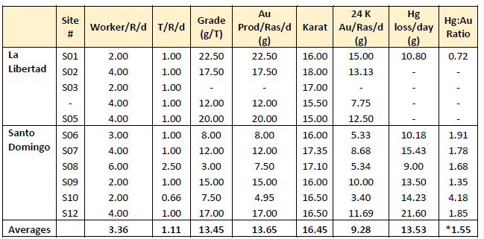
Chontales - Data

Slide 21
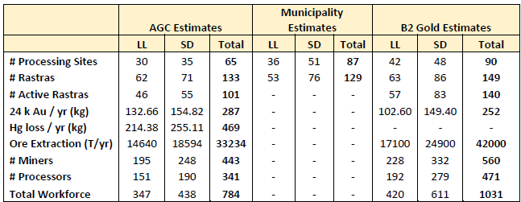

Chontales - Comparisons
Plantel Los Angeles

Slide 22
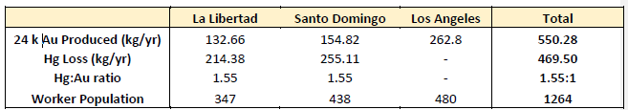
Chontales Totals

Slide 23
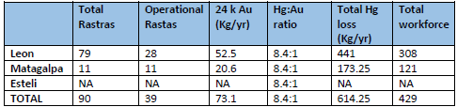


Other Regions

Slide 24
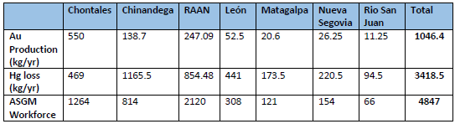
National Estimates

Slide 25
Conclusions
National level scoping is key to methodology development
On the ground realities may be different than expected (Must adapt!)
Produce regional estimates however possible
Sum regional estimates to produce national estimates

Slide 26
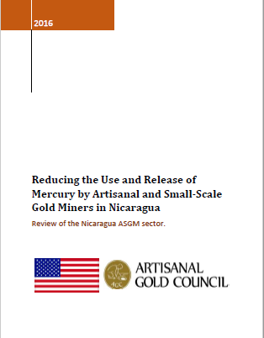
Additional Information
Introduction to the Nicaraguan ASGM sector and additional inventory information: http://www.artisanalgold.org/publications/reports/
Another more detailed report on conducting inventory work in Chontales will be available soon.

Slide 27
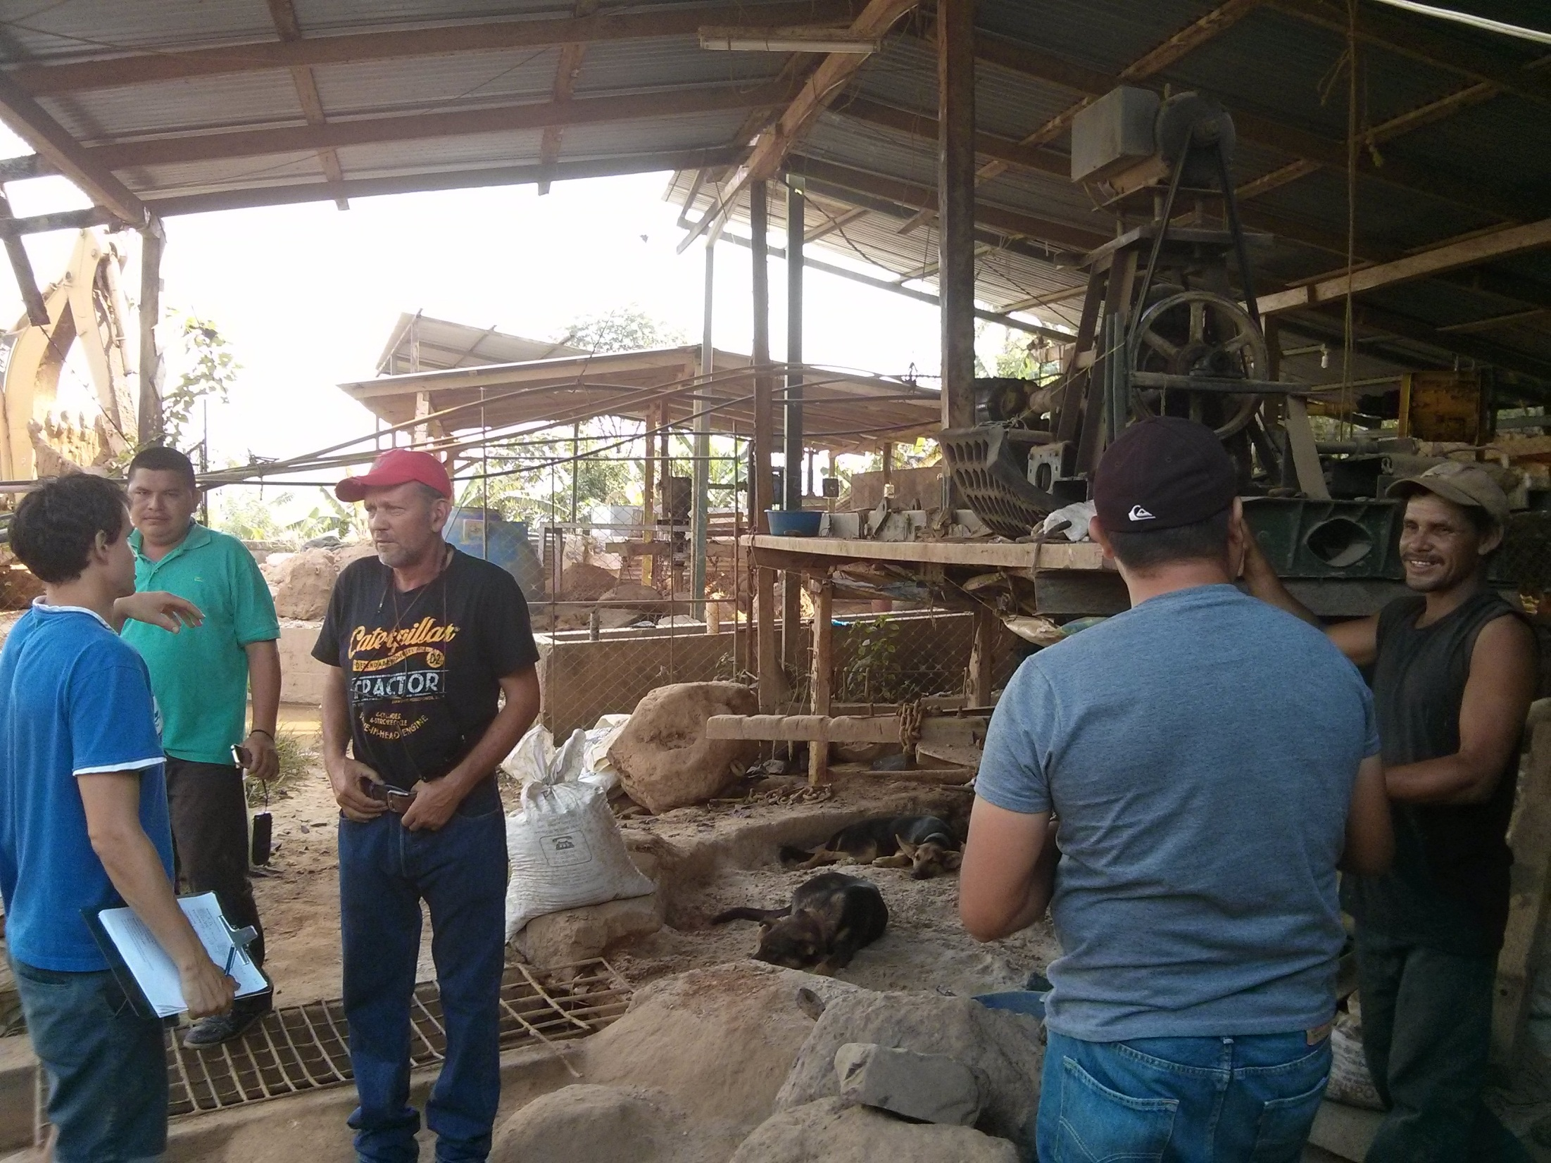
Thank you!

