Slide 1



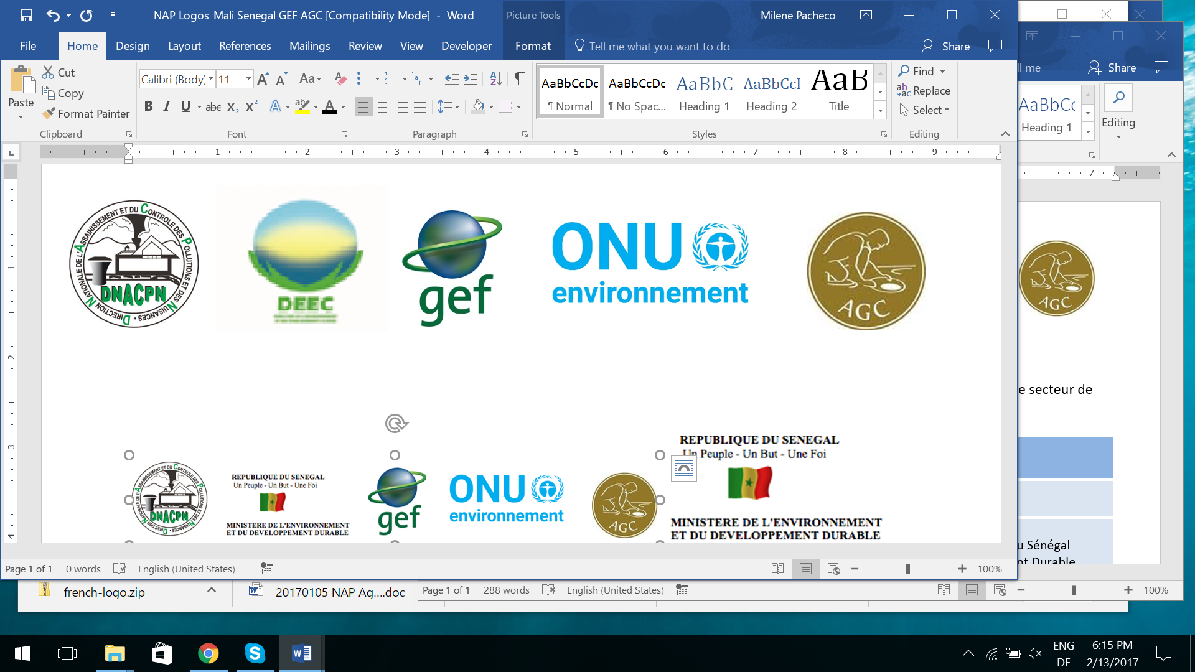
Lecture 3
Collecting
Baseline Information

Slide 2

Collecting Baseline Information:
Tools, Techniques and Approaches

Slide 3
Overview
Sources of Information
National Level Scoping
Field Data Collection Approaches
  Observations and General Descriptions
  Interviews
  Counts and Measures
  Physical Tools for Data Acquisition
Data Analysis
Step by Step Approach

Slide 4
Sources of information
Literature
Stakeholders
Official export data
Physical measurements
Universities
NGOs
Donor Agencies (GEF GOLD, World Bank, GMP)
Others?
National & Regional Government
(Mines & Environment)
LSM
Local Authorities
Municipalities
Mining Groups
Gold Buyers & Exporters
MINERS!

Slide 5

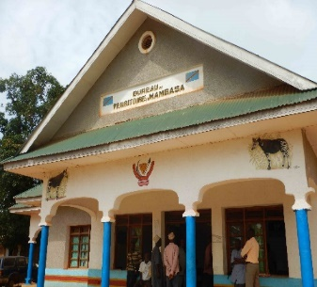
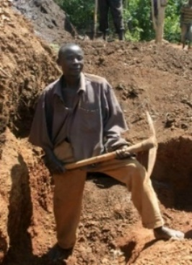
1. National Sector Scoping
Literature Review
Interviews with Stakeholders
Visits to the capital & major mining hubs
Visits to a few ASGM sites
  Official trade data, peer-reviewed journals, white papers from LSM, NGOs, GMP, World Bank, GEF GOLD
  Government (Mines, Environment, etc), NGOs, Universities, LSM companies, national gold buying houses, gold exporters
  Regional & municipal government offices, mayors office, regional gold traders, mining cooperatives
  On-the-ground realities, technology, access

Slide 6
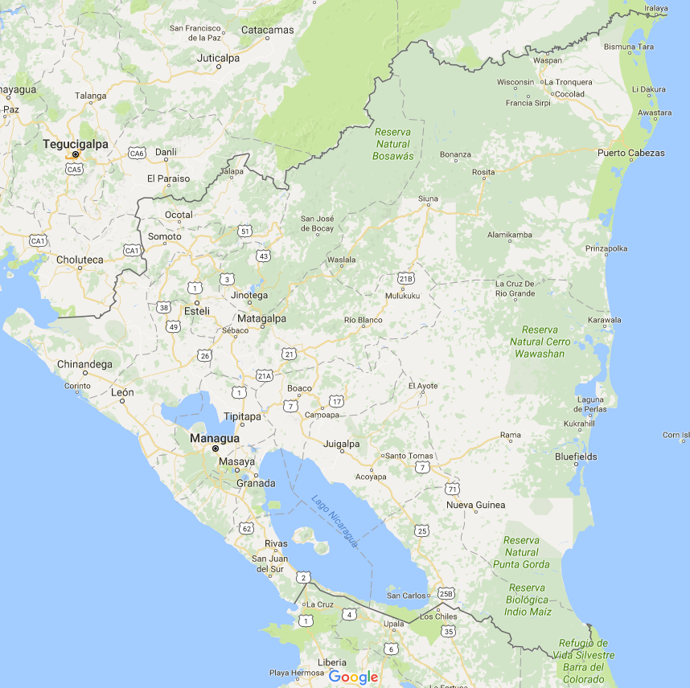
1. National Sector Scoping
Literature Review
Interviews with Stakeholders
Visits to the capital & major mining hubs
Visits to a few ASGM sites

Slide 7
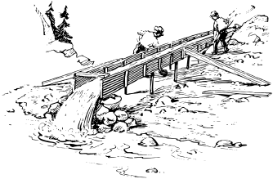
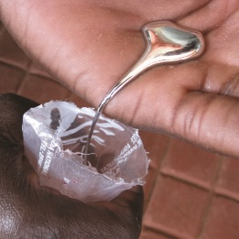

1. National Sector Scoping
Literature Review
Interviews with Stakeholders
Visits to the capital & major mining hubs
Visits to a few ASGM sites

Slide 8
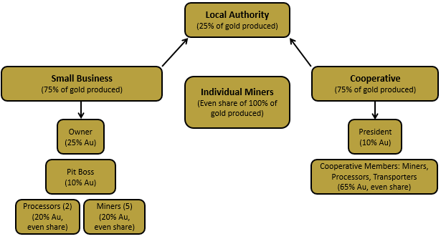
1. National Sector Scoping
Literature Review
Interviews with Stakeholders
Visits to the capital & major mining hubs
Visits to a few ASGM sites

Slide 9

1. National Sector Scoping
Literature Review
Interviews with Stakeholders
Visits to the capital & major mining hubs
Visits to a few ASGM sites

Slide 10
1. National Sector Scoping
Literature Review
Interviews with Stakeholders
Visits to the capital & major mining hubs
Visits to a few ASGM sites
#?

Slide 11

2. Design a Research Plan
Identify regions & region data
Identify missing data
Select approaches per region
Determine information needed
Outline Field Data Collection
?
?

Slide 12
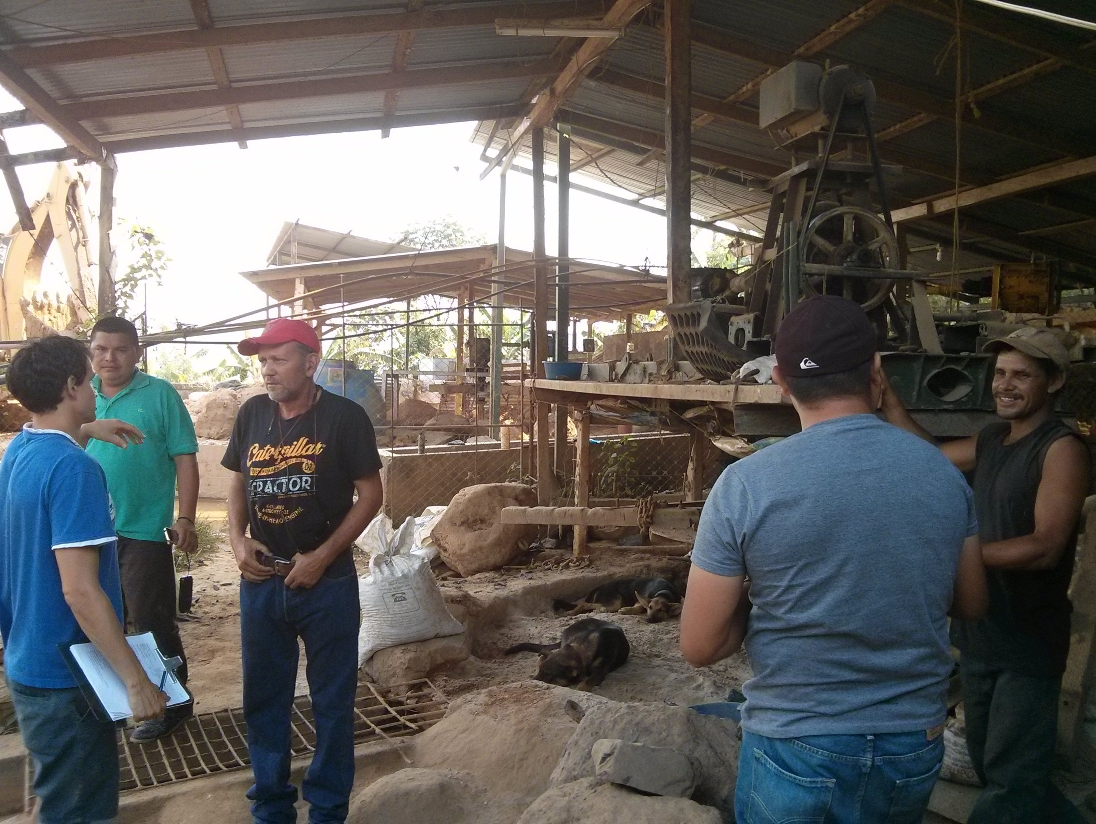
3. Collecting Field Data

Slide 13
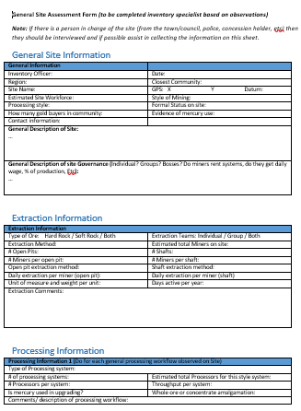
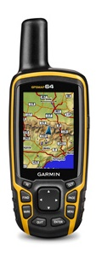
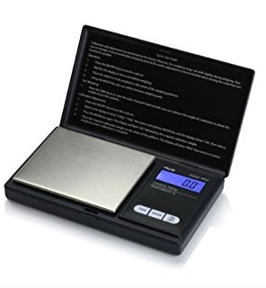



Tools

Slide 14
Step by Step Approach
Visit Regional Stakeholders
Visit Mining Communities
Meet Authorities
Visit extraction / processing sites
Casual introductions
Observations
Worker Interviews
Other local interviews?
Revise and compile data daily
Site and regional estimates
Adjust as necessary!

Slide 15
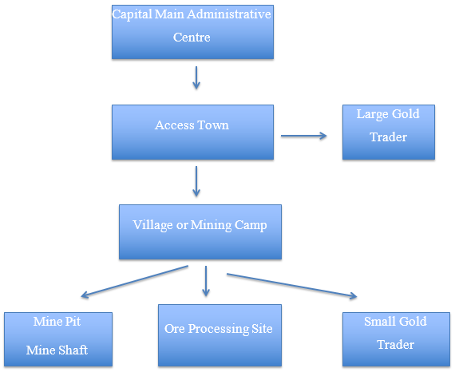
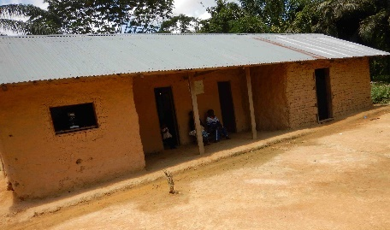

Step-by-Step Approach
Capital & Access Town
Meet with government and
administrative officials + local
authority. Explain project &
obtain permission

Slide 16
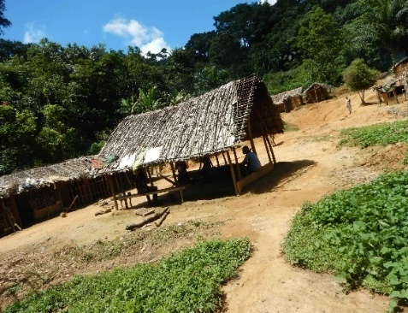
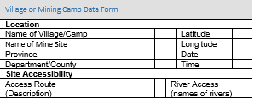
Step-by-Step Approach
Community
1. Meet with local authority
2. Explain project
3. Community Interview Form
collect info about mining here
(will be general)

Slide 17
A Note on Interviews
Informal is better
Build relationship and trust first
Best to isolate one person for the interview
It`s a conversation
Ask questions first, take notes later
Ask different questions to allow you to come to the same answers different ways
  Evaluate answers as you go!
Do NOT simply read questions off a sheet
  Use survey sheets as a guide
Analyse information during or immediately following interview
Step-by-Step Approach
Community
1. Meet with local authority
2. Explain project
3. Community Interview Form
collect info about mining here
(will be general)

Slide 18
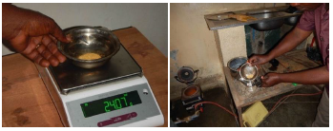
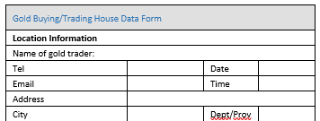
Step-by-Step Approach
Gold Traders
Meet with head of gold house
Interview, referring to the Gold Trader Form
Start with questions about gold (price, amount purchased, types, grades)
Ask to see some gold. Check for Hg use. Take a photo.

Slide 19
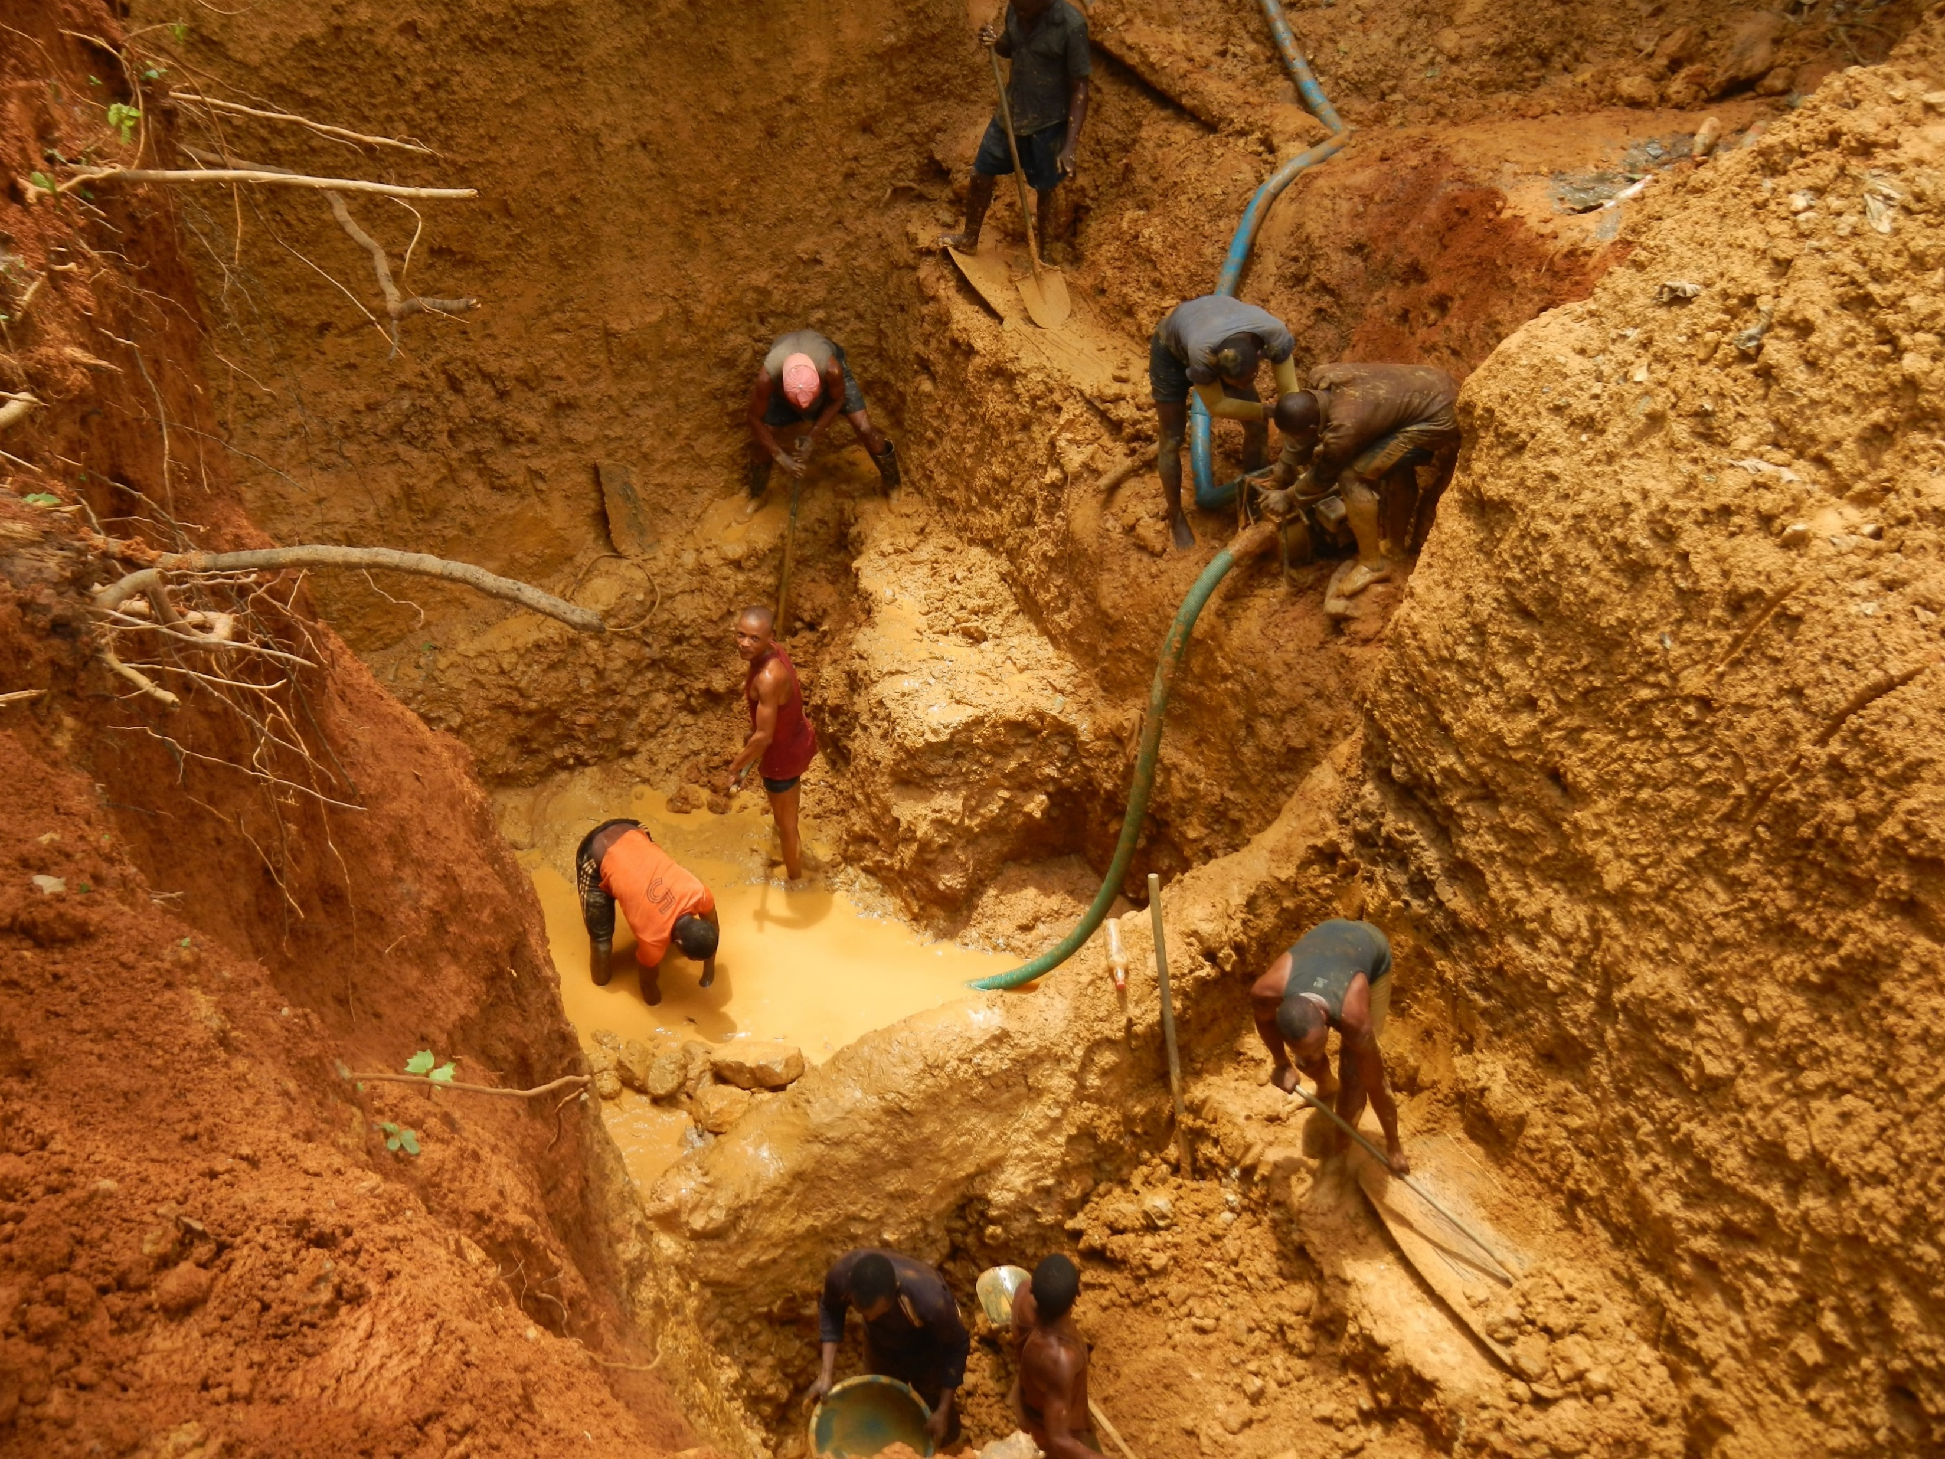
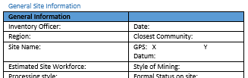
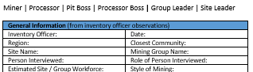
Step-by-Step Approach
Extraction Site
Scan site and determine practical approaches. Begin to fill out ASGM General Observations
Go to a pit/shaft, identify self
3. Interview the pit/shaft boss and
miners specific to the pit/shaft
4. Use ASGM Site Interview Form

Slide 20
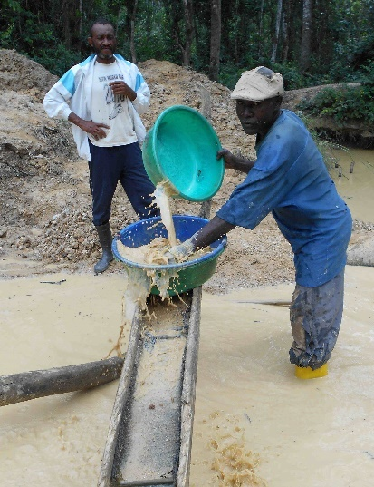
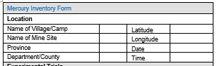
Step-by-Step Approach
Processing Site
Fill ASGM General Observations
Go to a processing team, identify self & explain project
Observe the processing workflow, noting steps, equipment & where Hg is used.
3. Go to each step & interview. Use
ASGM Site Interview Form
4. Do detailed mercury
measurement to find Hg:Au ratio
5. Use Hg:Au Form

Slide 21
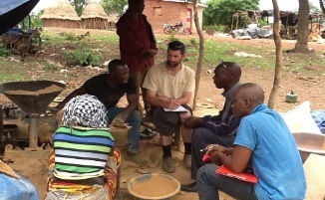
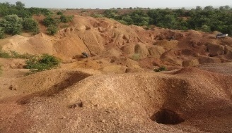
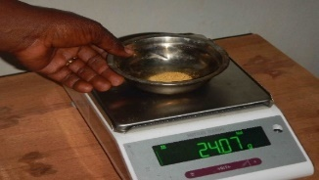
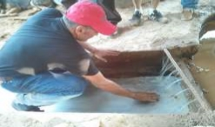
Ways of Collecting Information
Interviews
with miners, processors, bosses, land owners, gold traders
Direct Observation
Type of mineral, mining/processing workflows,
mercury use, site governance, socio-economic variables
Counts
Pits, shafts, processing systems, miners, bags of ore…
Weight
Bag of ore, mercury added/recovered, amalgam produced, gold produced…
Volume
Mercury added/recovered, water throughput…
GPS
Location, spatial distribution

Slide 22
Conducting Interviews
Informal is better
Build relationship and trust first
Best to isolate one person for the interview
It`s a conversation
Ask questions first, take notes later
Ask different questions to allow you to come to the same answers different ways
  Evaluate answers as you go!
Do NOT simply read questions off a sheet
  Use survey sheets as a guide
Analyse information during or immediately following interview

Slide 23
Analysing Data During Interview
Q. How much ore do you process in a day? A. 1 tonne
Q. How many bags of ore do you process in a day? A. 15
Q. How much does a bag of ore weigh? A. 100 kg

Slide 24
Analysing Data After Interview
Processor #1:
Throughput = 1 T/d
Recovery = 60 g/T
Days Active = 6 / wk
Month Prod = ~250 g
Processor #2:
Throughput = 10 bags/d
Measure: 100 kg/bag
Observe: 2.5 bag/6 hr
Recovery = 1 g/bag
Days Active = 25 / month
Month Prod = ~200 g
Processor #1:
Throughput = 1 T/d
Recovery = 10-15 g/T
(use 12.5 g/T)
Month Prod = ~250 g
Calculate Production:
Daily = 60 g/d
Month = 1440 g/month
Calculate Production:
Throughput = 1 T/d
Production = 10 g/d
Month = 250 g/month
Calculate Production:
Daily = 12.5 g/d
Month = 300 g/month
?
!

Slide 25
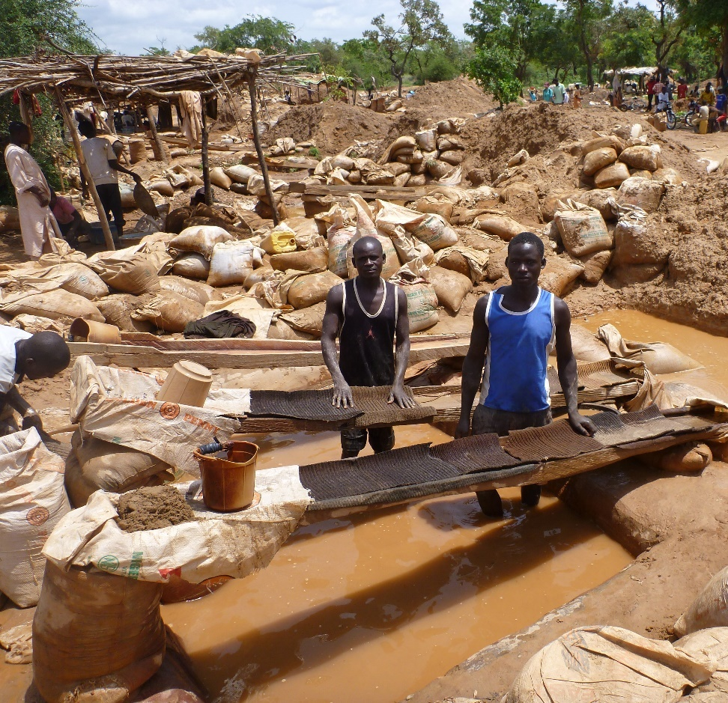
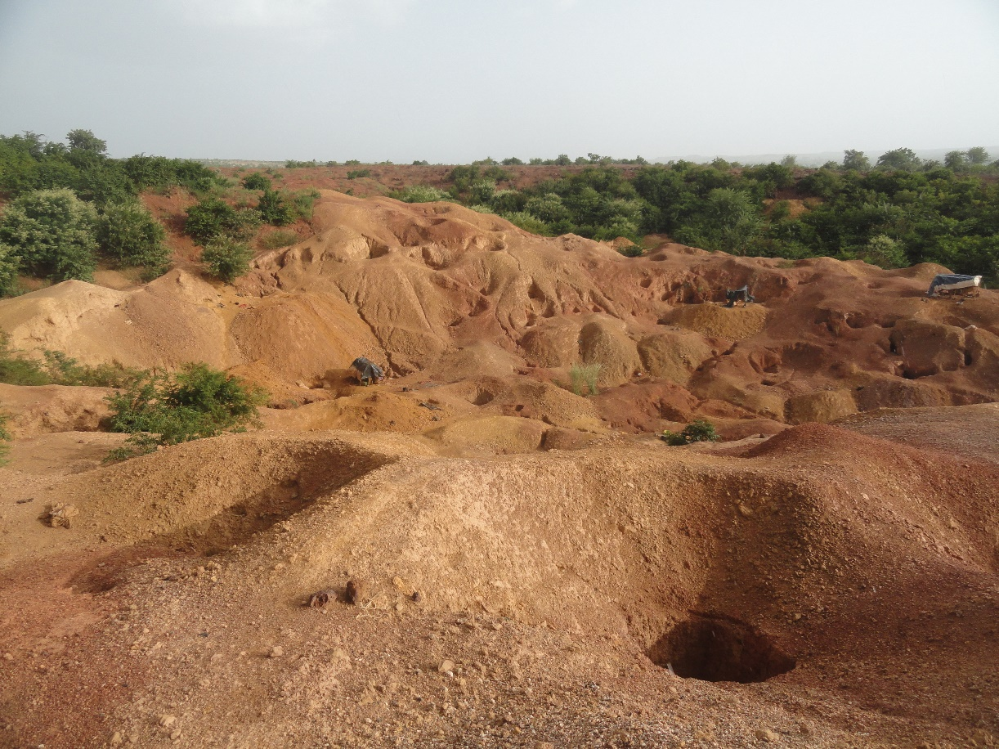
Site Counts
Visit sites and make counts of select characteristics
  Active Pits
  Active Processing systems
  Workers per pit or system
  Extraction per or throughput per system

Slide 26
Site Counts
For large sites or communities hire a local miner to show you around the site!
Counts at ALL sites in a region?
Couple with site authority interview?
Triangulate with other regional information?

Slide 27
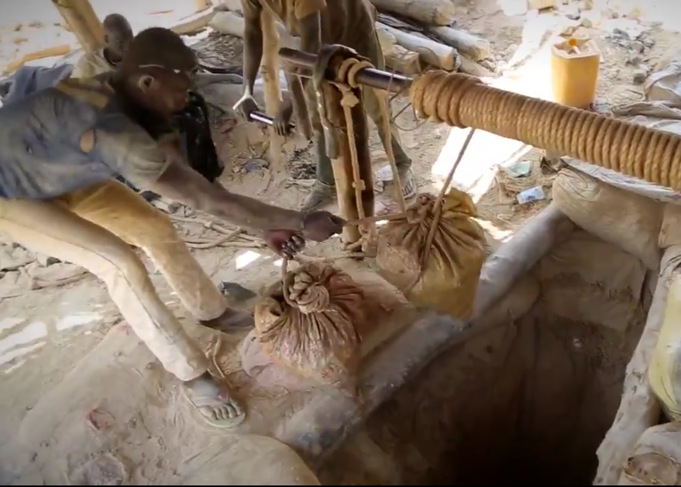
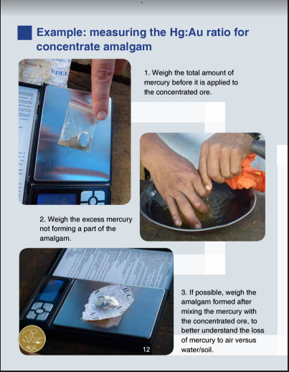
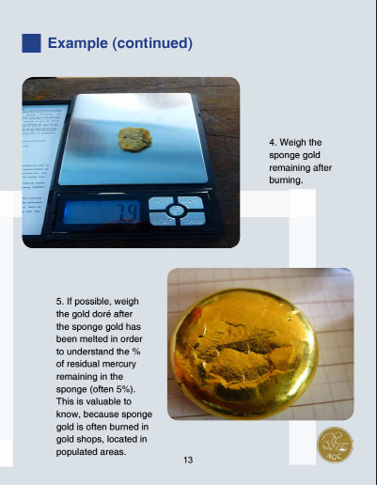
Physical Measurements
Mercury measurements
Gold Measurements
Ore bag measurements
Throughput

Slide 28
Hg:Au Ratio

Slide 29
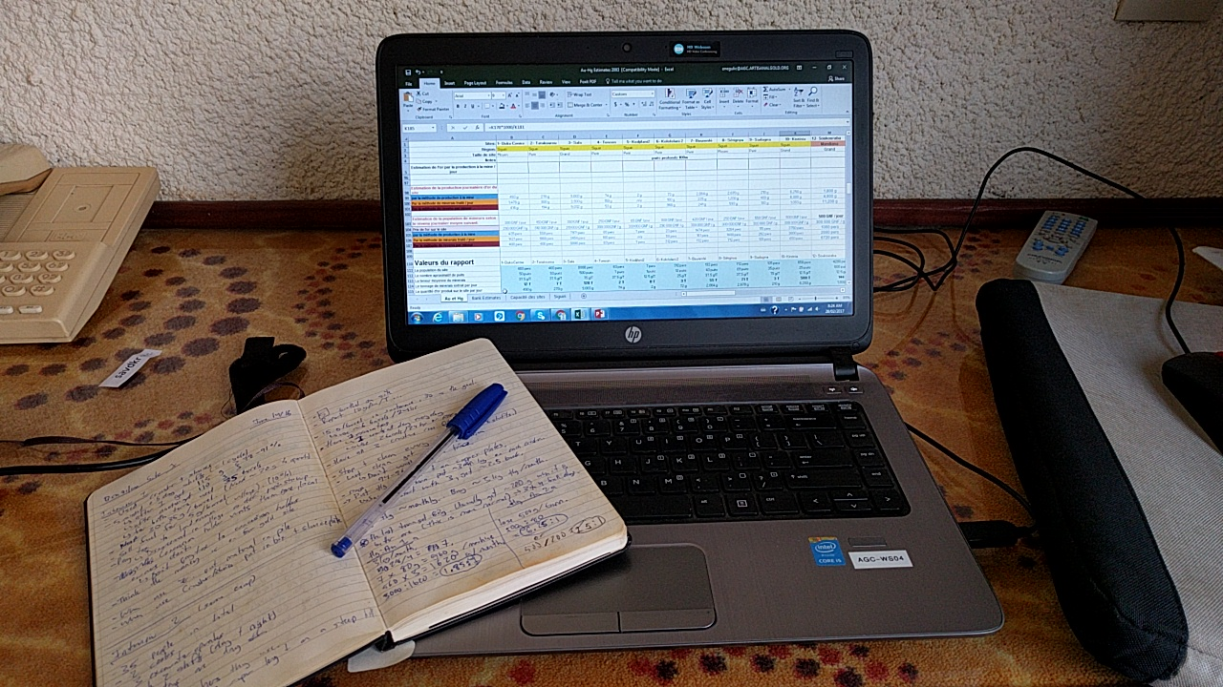
Data Analysis
Review and organize field data daily
Assess data collected to ensure you have information needed for regional extrapolations
Adjust field approaches as needed to ensure collection of useful data

Slide 30
Data Analysis
Review and organize field data daily
Assess data collected to ensure you have information needed for regional extrapolations
Adjust field approaches as needed to ensure collection of useful data

Slide 31
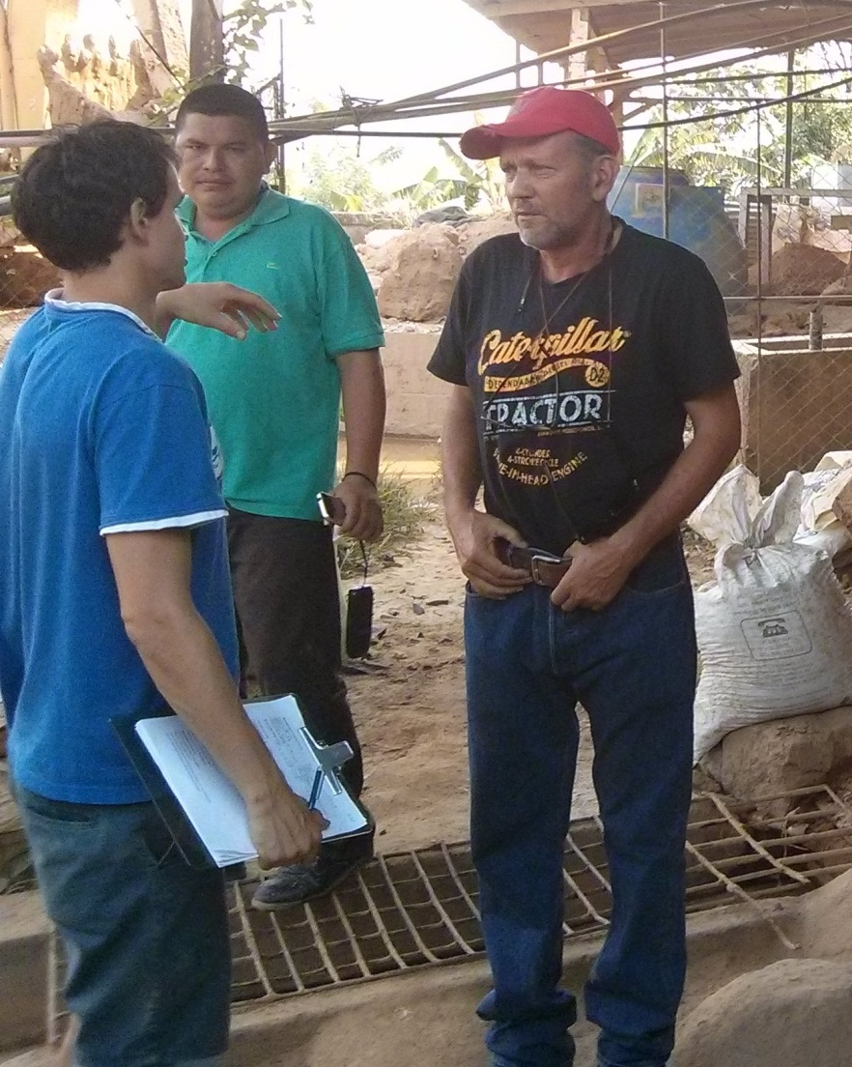
Data Analysis
Must compile and organize data
Determine which site data to use for regional estimates, and how to extrapolate
Couple site data with existing information to compare, and produce regional and national estimates
Compare estimates from different sources, and review to determine best estimates
Use logic, triangulation, and gather extra information where needed
Interview
Literature
Physical
Measure

Slide 32
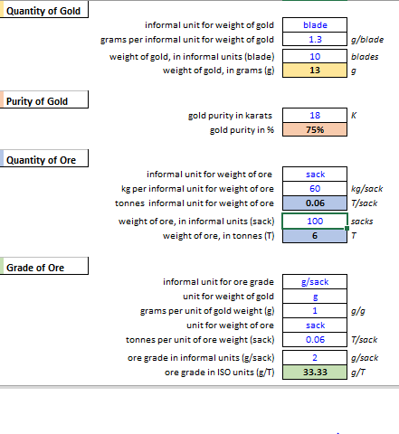
Excel Sheets: Unit Conversion

Slide 33
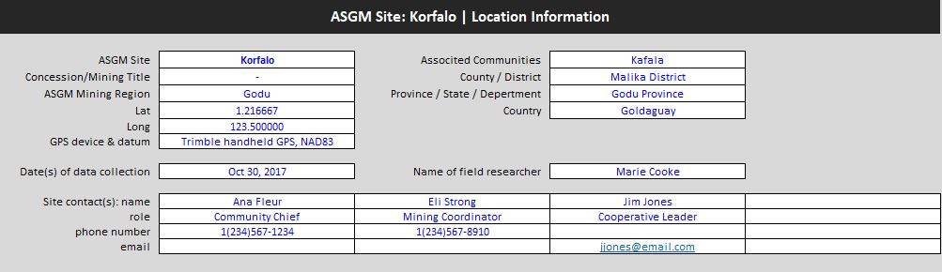
Excel Sheets: Site Estimates

Slide 34
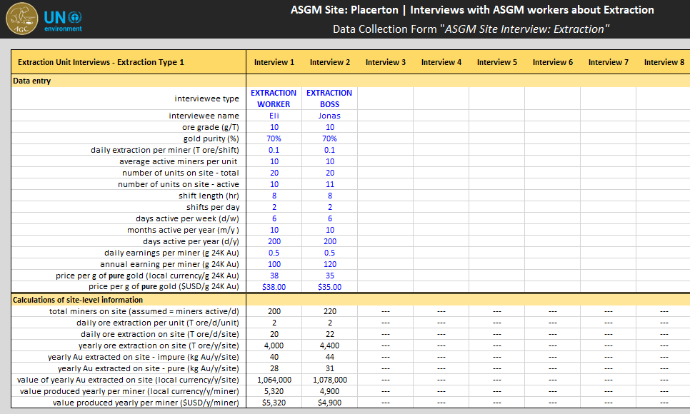
Excel Sheets: Site Estimates
Enter data (e.g., extraction-based data)

Slide 35
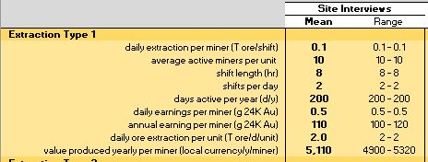
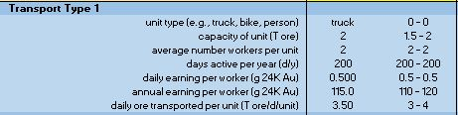
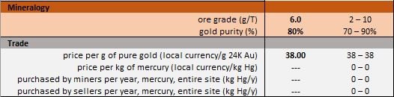
Excel Sheets: Site Estimates
Calculate - Useful variable averages:

Slide 36
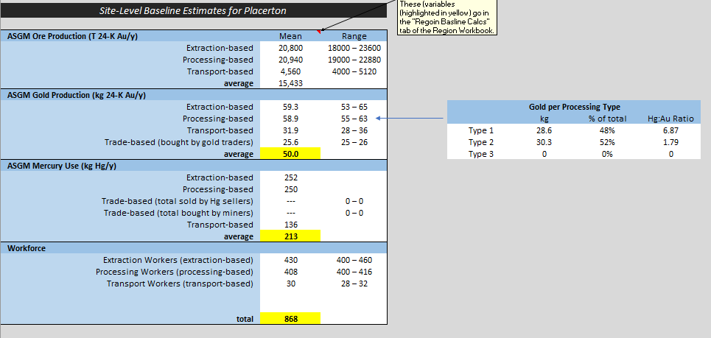
Excel Sheets: Site Estimates
Calculate - Baseline Estimates for the Site:

Slide 37
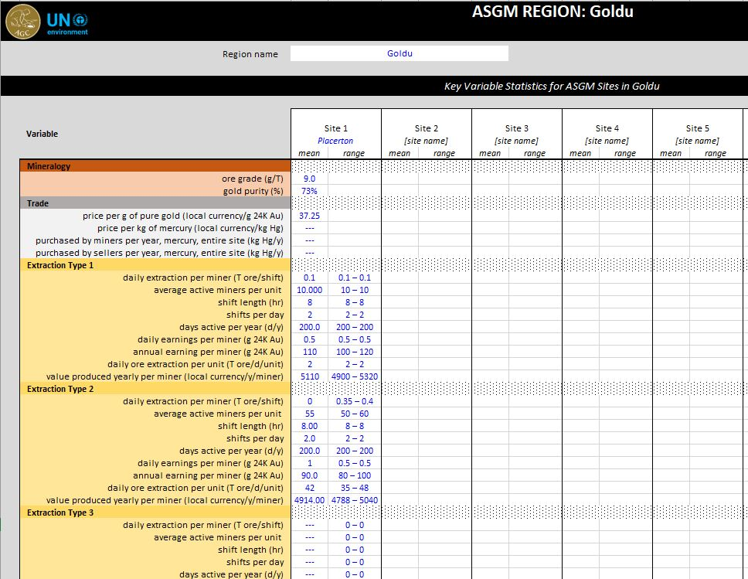
Excel Sheets: Region Summary
Summarize all useful variable averages in the region: (used later for extrapolation)

Slide 38
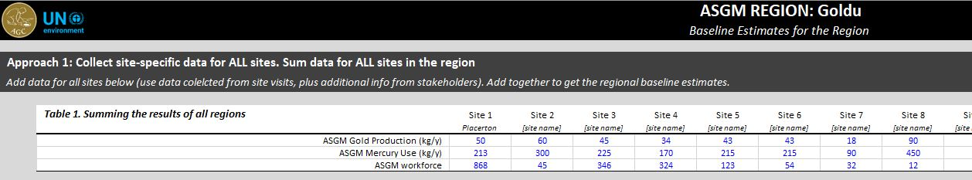
Excel Sheets: Region
Calculate - Baseline Estimates for the Region
Approach 1
Visited all sites? Add estimates from all sites!

Slide 39
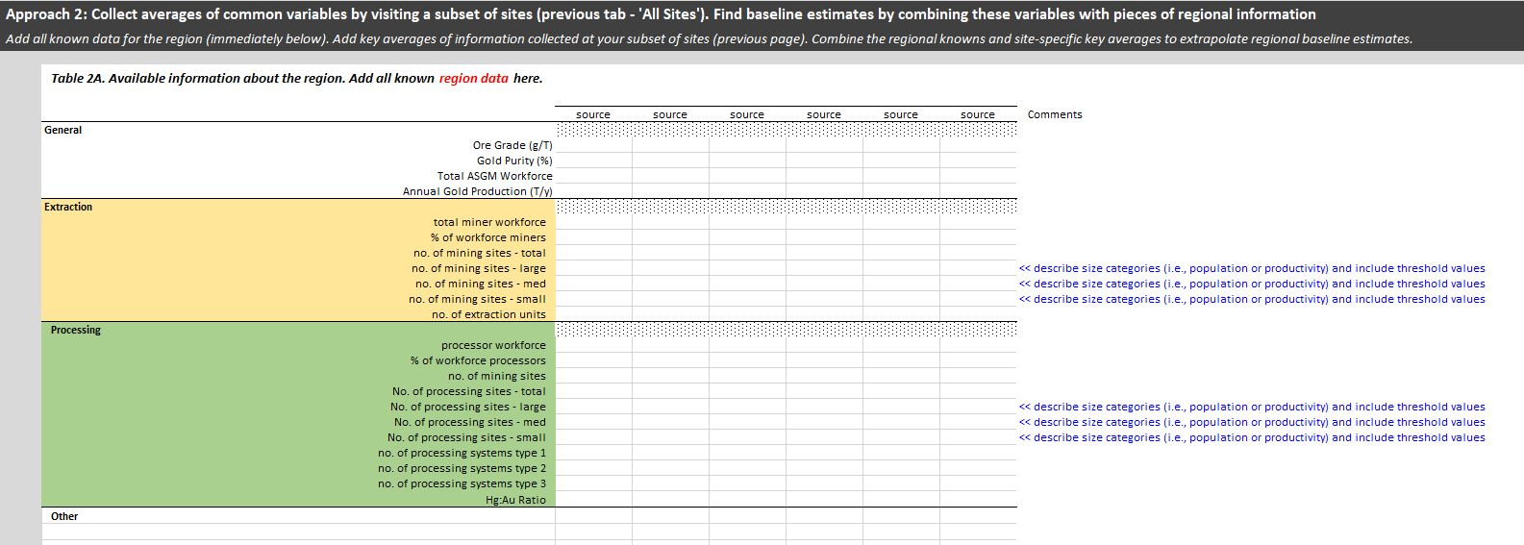
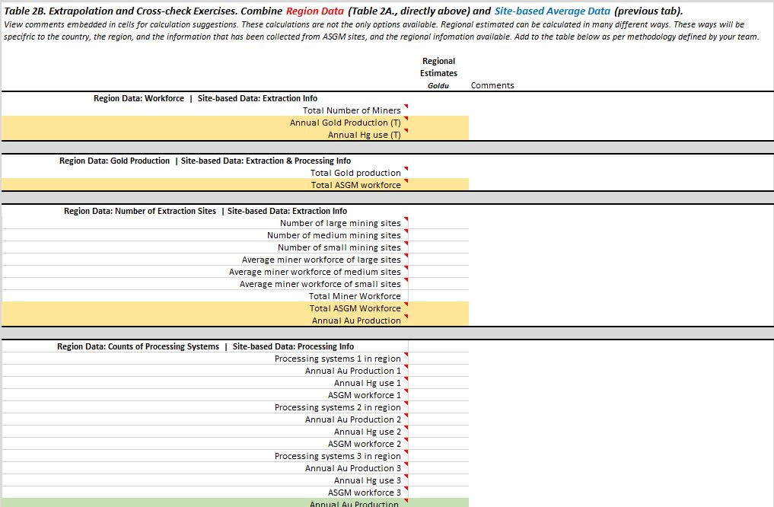
Excel Sheets: Region
Calculate - Baseline Estimates for the Region
Approach 2
Visited a subset of sites? Extrapolate regional estimates using the variable averages and pieces of information about the region

Slide 40
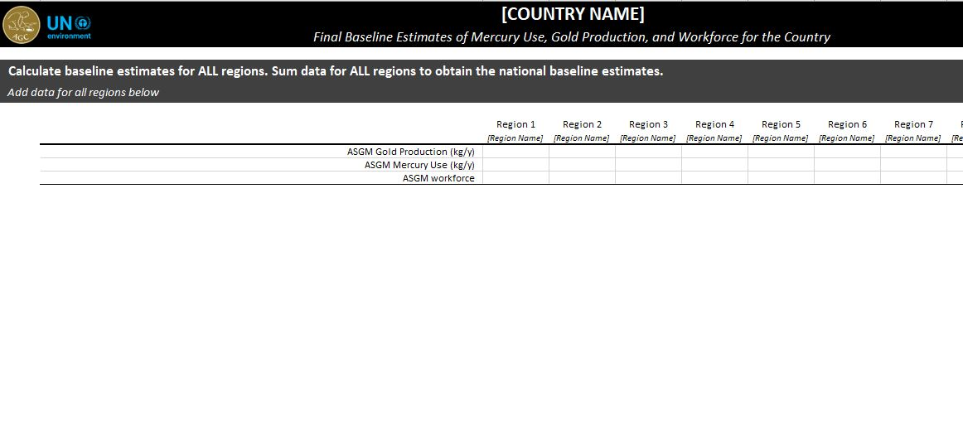
Excel Sheets: Country
Calculate - Baseline Estimates for the country:
Sum the final estimates from all regions

Slide 41
Step by Step Approach
Visit Regional Stakeholders
Visit Mining Communities
Meet Authorities
Visit extraction / processing sites
Casual introductions
Observations
Worker Interviews
Other local interviews?
Revise and compile data daily
Site and regional estimates
Adjust as necessary!

Slide 42
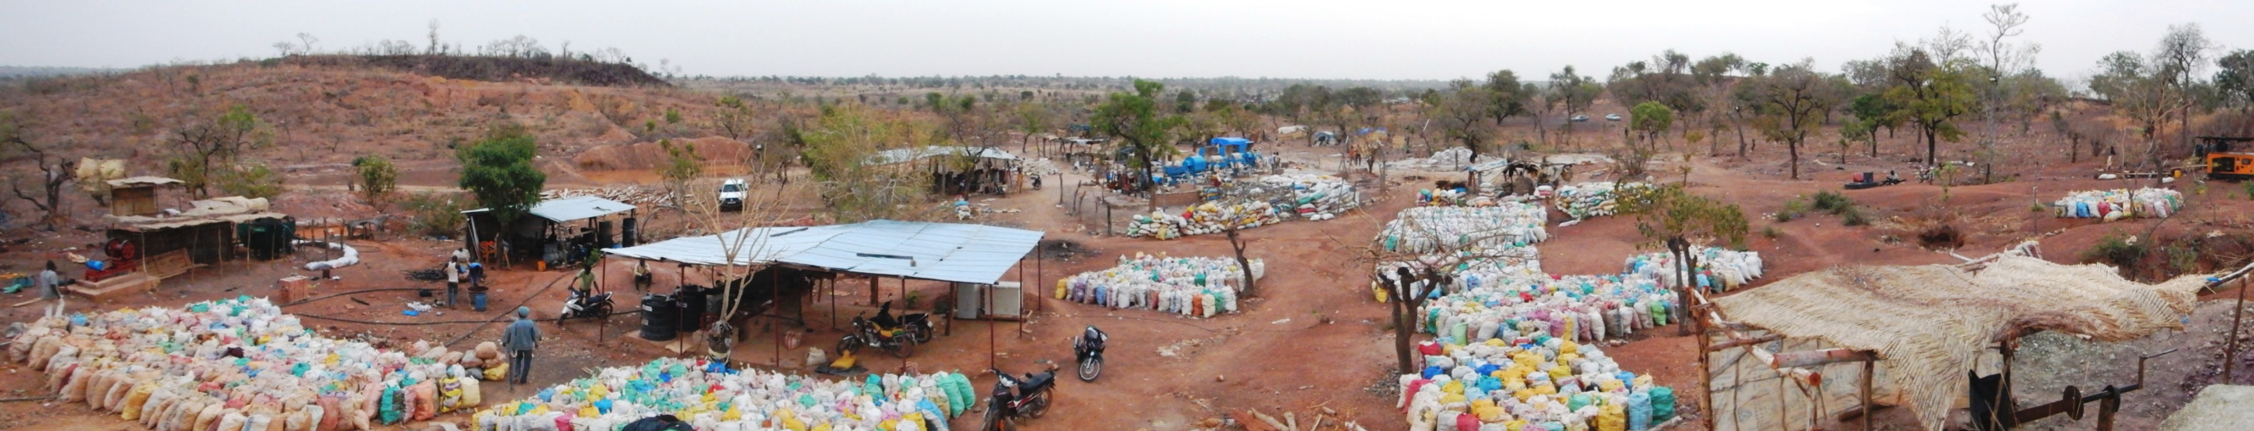
Conclusions
Various approaches and tools to collecting data
  Select those appropriate for your methodology
Constantly analyse information received
  Both in the field, and afterwards
Adapt methodology and questioning as you go
Triangulate as often as possible
Most important tool is knowledge of ASGM and experience

Slide 43

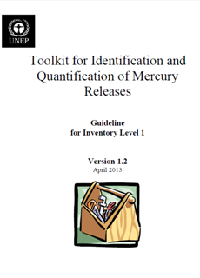
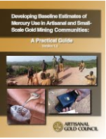
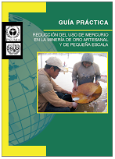
Other Reference Documents
Tools and Methods: Determining Mercury Use in the ASGM Sector
UNEP Nap Guidance Document
(http://www.unep.org/chemicalsandwaste/global-mercury-partnership/asgm/national-action-plans)
Minamata Convention on Mercury (UNEP)
Toolkit for Identification and Quantification of Mercury Releases (UNEP)
Developing Baseline Estimates of Mercury in ASGM Communities (AGC)
A Practical Guide: Reducing Mercury Use in ASGM (AGC/UNEP/UNIDO)

Slide 44
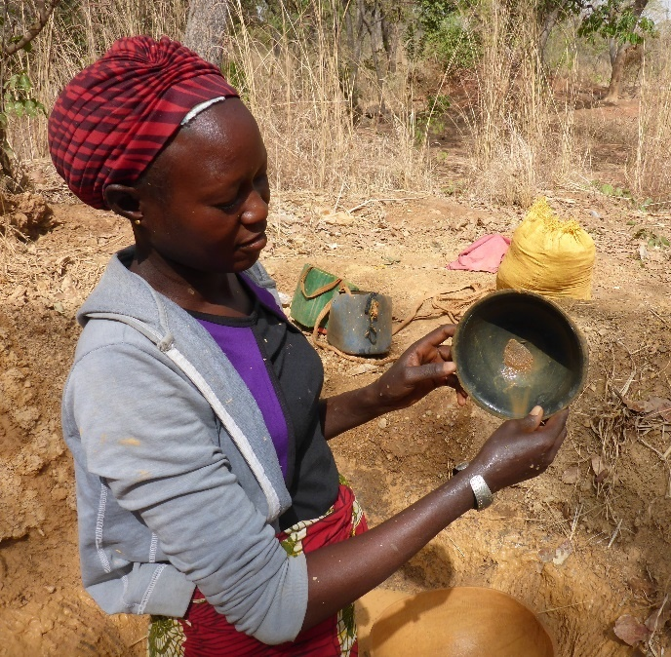
Thank you very much!
Questions?

Slide 45
Extra slides

Slide 46


Slide 47


Slide 48


Slide 49


