Slide 1


Emissions Gap Report 2018
Main findings and messages
Philip Drost
Nairobi, 4 December 2018

Slide 2

Emissions Gap Report series
The annual report describes
where we are likely to be: projected emissions after implemented climate plans
where we need to be: 1.5°C or ‘well below 2°C’
Difference = ‘emissions gap’
In addition: features opportunities to bridge the gap
2018: strengthening climate plans, non-state actors, innovation, fiscal policy;
2017: CO₂ removal, coal phase-out
2018 is 9th edition

Slide 3
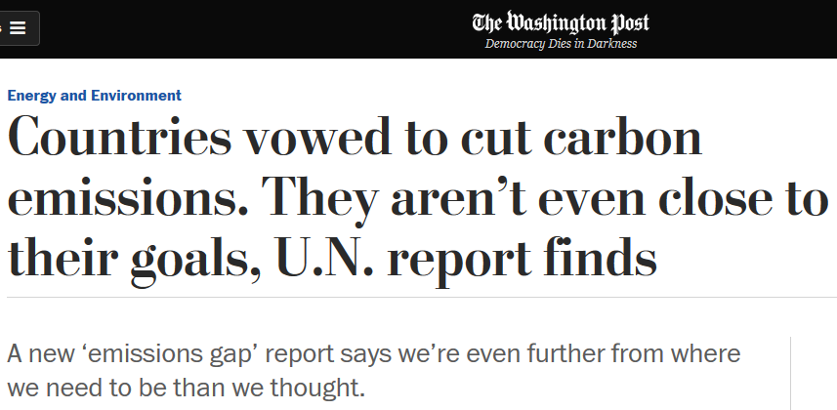
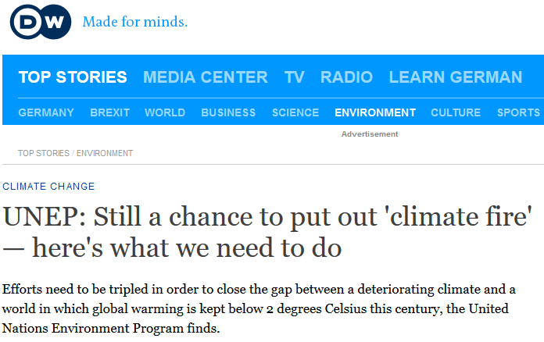
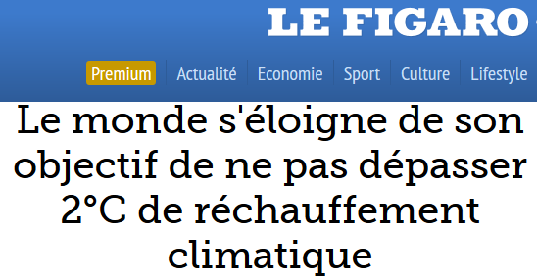
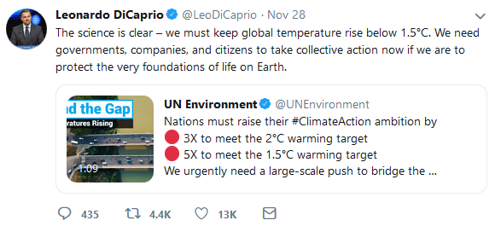
Impact of the 2018 Report
Probably the biggest impact
of all Emissions Gap Reports.
Downloads (up to 4 Dec 18)
13,328 (report) and 14,136 (executive summary)
Unique editorial mentions
4,200 (up 20% compared to 2017)
Unique broadcast and radio hits
562 (up 20% compared to 2017)
Agenda-setting at COP24
numerous references in opening statements

Slide 4
Political context of this edition
2018: Talanoa Dialogue
Sept 2018: Global Climate Action Summit
Oct 2018: IPCC Special Report on 1.5°C
Nov 2018: Emissions Gap Report
Dec 2018: UN Climate Conference Katowice
Sept 2019: SG’s Climate Summit New York
2020: Communication of updated climate plans

Slide 5
Main take-aways of this year’s report
1. The emissions gap is much bigger than before.
2. There is new evidence that countries are not doing enough.
3. There is new evidence of how to bridge the gap.

Slide 6
Global emissions up again after stabilization
2014 - 2016: emissions relatively stable
2017: clearly up, to a record 53.5 GtCO₂e
Reasons: higher GDP and slower decline in energy intensity
Global emissions show no signs of peaking
Already peaked: USA, EU, Russia (but going up again)
By 2030 57 countries have peaked (60% global emissions)
G20: Argentina, India, Indonesia, Saudi Arabia, South Africa and Turkey show no sign of peaking

Slide 7
National climate plans (NDCs)
Collectively, G20 will achieve Cancun pledges by 2020…
Except Canada, Indonesia, Mexico, Republic of Korea, South Africa, USA
…but will not realize their current NDCs for 2030
Argentina, Australia, Canada, EU28, Republic of Korea, Saudi Arabia, South Africa, USA are not on track
Brazil, China, Japan on track
India, Russia, Turkey: >10% below their targets → low ambition?
Indonesia, Mexico: unclear

Slide 8
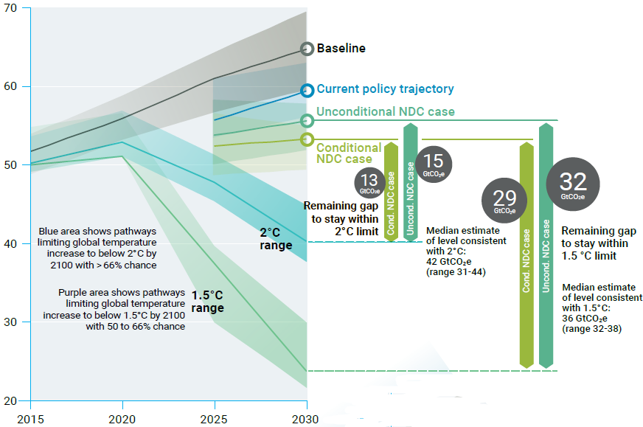
The 2018 emissions gap

Slide 9
Emissions gap is bigger than previous years
IPCC report:
more caution about CO₂ removal,
so more mitigation necessary

Slide 10
Effect of climate plans insufficient

Slide 11
Effect of climate plans insufficient
+3.2°C

Slide 12
3x more ambition needed to fill the 2ºC gap

Slide 13
…and 5x more to fill the 1.5ºC gap

Slide 14
How to bridge the gap?
Special topics this year:
Strengthening climate plans
Non-state and subnational action
Fiscal policy
The role of innovation

Slide 15
Strengthening climate plans: how?
Increase ambition by:
Strengthening/adding a greenhouse gas target or a sectoral non-GHG target
Strengthening/adding policies and actions
Aligning NDC implementation with long-term goals
Many technical options are economically feasible.
33GtCO₂e reduction possible → enough to close the 2ºC gap

Slide 16
Non-state and subnational action
Number of actors rising fast: 1000s cities and companies, but still huge potential for expansion.
Estimates on potential vary widely—but can be up to 19 GtCO₂e by 2030 (enough to close the 2ºC gap)
Proven impact so far very limited (0.45 GtCO₂e) due to lack of transparency.

Slide 17
Fiscal policy
15% of global emissions covered by 51 carbon pricing initiatives, 20% if China joins.
Most countries’ fiscal policy not geared to deliver the transition to low-carbon economy: carbon prices too low, not aligned with climate goals.
Carbon price of US$70/tCO₂ leads to 10-40% emission reduction.
Consider a broad range of issues when introducing fiscal policy: equity, social acceptance, job creation, and many others.

Slide 18
The role of innovation
Innovation has the potential to radically transform societies and reduce their emissions.
Five success factors:
Government must take high, early-stage risk
Mid-way, governments must nurture feedback effects and help de-risk private investment
Set direction for the whole economy
Approach as mission-oriented innovation with concrete targets
Policy: bottom-up, participatory, long-term design
Incredible development of solar panel deployment shows: public innovation policies crucial

Slide 19
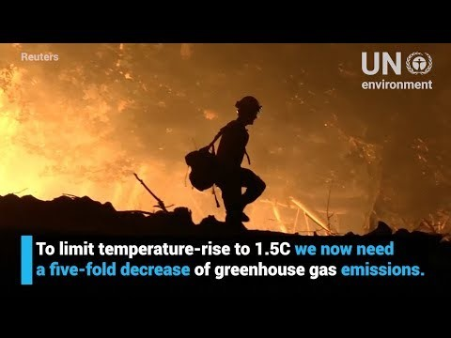
Outreach material
Available on unenvironment.org
Entire report, including annexes
Executive Summary – in all UN languages
E-book
Key messages
Press release
Video
Data visualization

Slide 20

Philip Drost
Science Division / Scientific Assessment Branch
philip.drost@un.org
unenvironment.org/emissionsgap

