Slide 1


UNEP South-East Europe Platform to beat Pollution (SEEPP), Western Balkans Regional Soil Pollution Conference – Connecting expertise to address complex challenges
Elena Stefanoni, Environmental Governance Expert Vienna, 26.03.2026

Slide 2
SEEPP and UNEP Programme of Work
SEEPP - Soil and water pollution pillar
Strengthening the capacities on contaminated sites in BiH and Serbia
Pilots training and guidelines on risk assessment, on-site trainings
Mapping illegal landfills; prioritization and remediation guidelines.
Enhancing enforcement capacities and public awareness on illegal landfill
Legal and institutional assessment and policy recommendations
Data collection and trainings
Strengthen enforcement and awareness, develop projects pipeline
UNEP-UNDP Agreement
Output 1: Creating enabling conditions. Fostering enabling conditions through policy support and partnership. (3.5)
Activity 1.1. Strengthening the legal frameworks, institutional mechanisms and capacities for environmentally sound chemicals management, including MEAs implementation (at national and regional levels).
Project Outcome: Stakeholders are equipped to reduce harmful chemicals in products and processes. (3.9)
POW Outcome: 3A Human health and environmental outcomes are optimized through enhanced capacity and leadership in the sound management of chemicals and waste.
Notes:
UPDATED

Slide 3
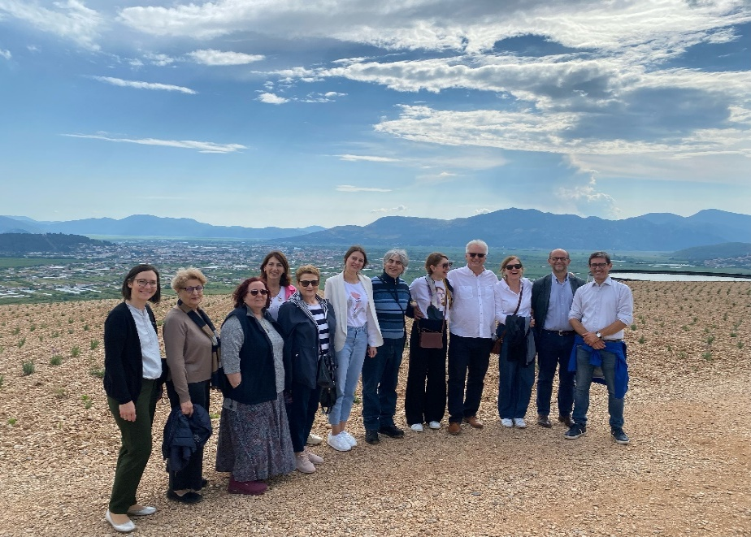
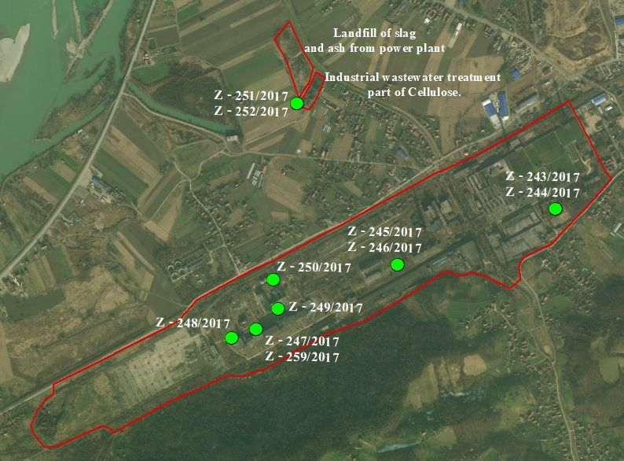



Strengthening the capacity in the management of Contaminated Sites in BiH and Serbia to reduce pollution into the environment (2023 - 2026)
Funded by Italy and UNDP
Budget: EUR 300,000 (IT) + USD 100,000 (UNDP)
Target Countries: BiH and Serbia
Objective: Reduce pollution, strengthening institutional capacities, improve human health and environment
1.
Coordination strengthe networks
2.
Strengthen capacities
3. Pilot sites preliminary characterization
:
Background: GEF on soil contamination in Serbia, Co-funded by Italy, SEEPP – Phase I
Notes:
UNDP complement the pilot sites
Identification and work on pilot sites essential for the capacity building
Capacity building is shaped around thepilots, which are addressing soil pollutants (old and new / emerging pollutants) interactions with other environmental media, policy gaps, EU accession exercise

Slide 4
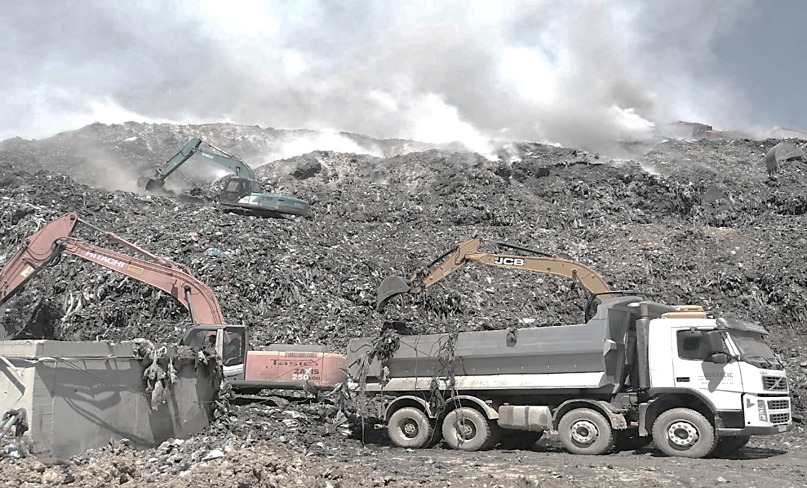
Enhancing enforcement capacities and public awareness to improve the management of Contaminated Sites from Non-Compliant and Illegal Landfills in the Western Balkans (2024 - 2026)
Source of funds: Italy
Budget: EUR 400,000
Target Countries: BiH and Serbia
Objective: Improve capacities, Strengthen enforcement mechanisms, Increase public awareness
1. Mapping non-compliant and illegal landfills
3.Strengthen enforcement capacity
4. Public awareness and stakeholder engagement
2. Capacity building
Picture: Branislava Matic
:
Background: SEEPP+GEF
Notes:
UPDATED

Slide 5

SEEPP AS A CONNECTING MECHANISM
Science
Policy
Practice
SEEPP Platform & Network
Connects experts, Institutions, countries across the Western Balkans
Facilitate knowledge exchange and collaboration
Links science → practice → policy
Notes:
Soil pollution is complex and multidisciplinary
Involves environment, health, agriculture, waste, industry
Fragmented responsibilities gaps in coordination
Limited data, uneven capacities across countries

Slide 6

MULTILEVEL NETWORKING
Connecting across levels is key
International: UNEP, global frameworks → guidance & expertise
Regional: IMPEL, JRC, WB Soil Partnership / RCC → coordination & harmonization
National: Authorities & institutions → implementation
SEEPP bridges all levels — from international frameworks to national action
Notes:
Impact
Better identification of priority risks
More coherent and coordinated responses
Strengthened institutional capacities
Faster uptake of good practices
Supports evidence-based decision making

Slide 7
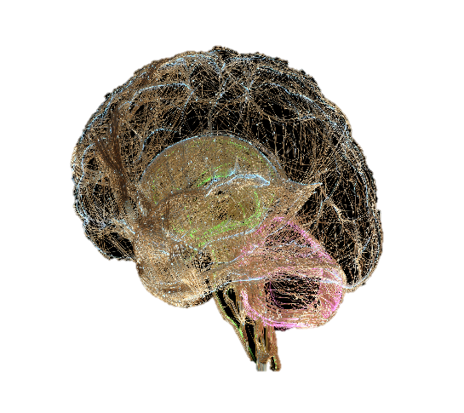






FROM DIALOGUE TO ACTION
Consultation
Surveys
Studies
Projects implementation
Project hub
SEEPP supports:
Identification of legal, technical, Institutional gaps
Prioritization of needs and actions
Generate concrete action ideas
Support development of targeted interventions/projects
Focus: moving from discussion to implementation

Slide 8

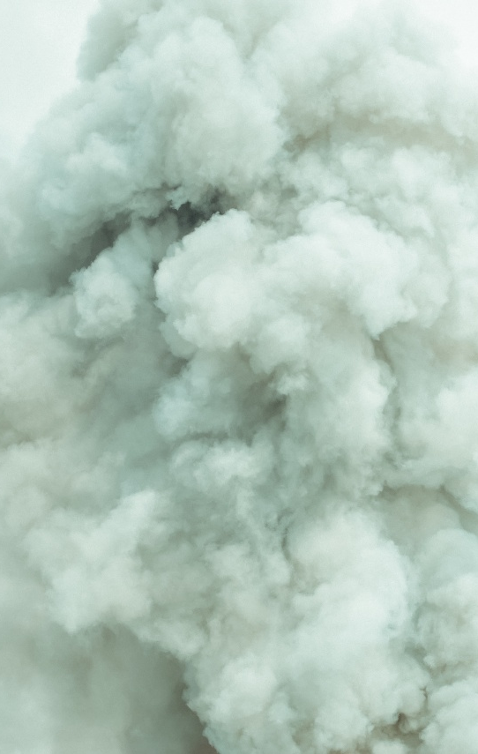
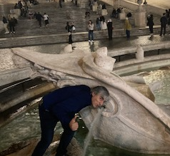
CONCLUSIONS AND WAY FORWARD
Conclusions
Soil pollution requires coordinated, multi-level action
Integrated approaches benefit environment, water, and health
Stronger collaboration improves effectiveness and impact
Way Forward
Continue strengthening regional cooperation
Implement targeted, evidenced-based interventions
Replicate and scale proven approaches across Western Balkans countries

Slide 9
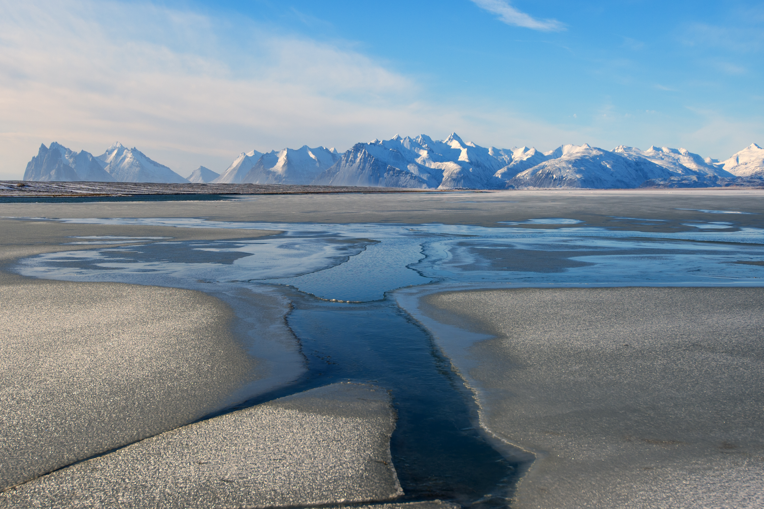
Thank you
Elena Stefanoni Email: elena.Stefanoni@un.org
www.unep.org

