Slide 1
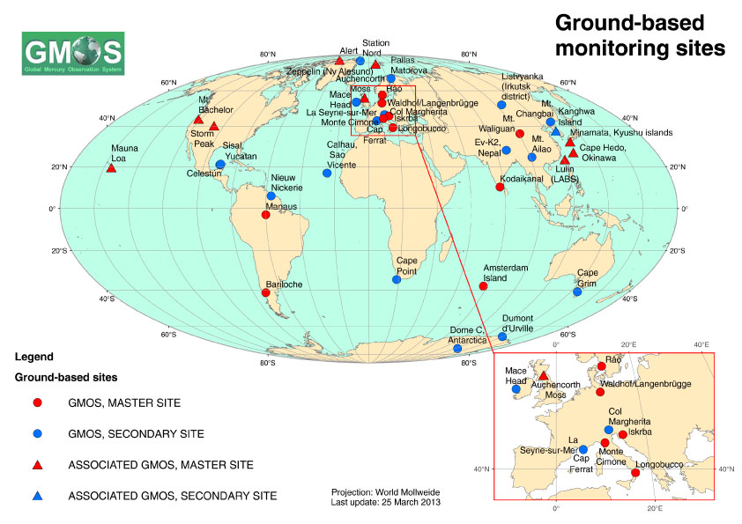
EMMA Master Station
(North Patagonia, Argentina)
Established by the Global Mercury Observation SYSTEM (FP7- EU)

Slide 2
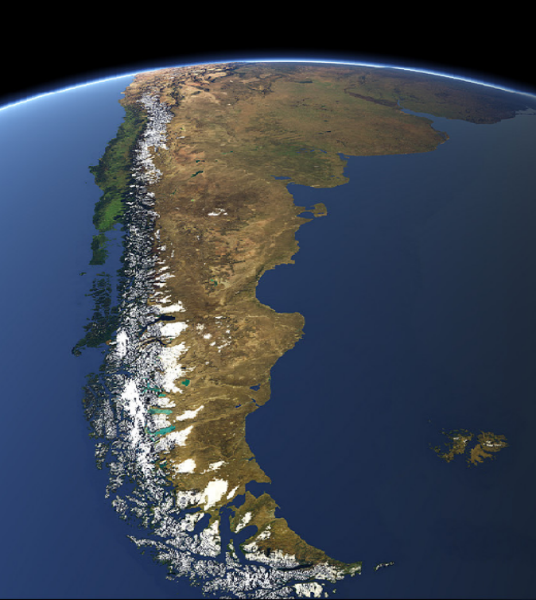
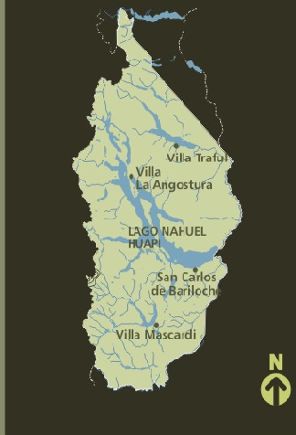
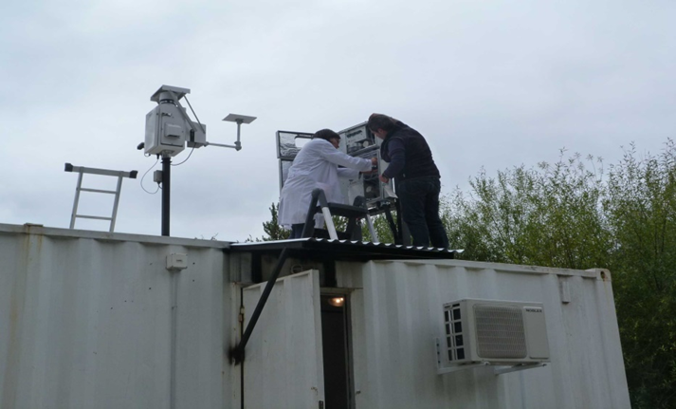
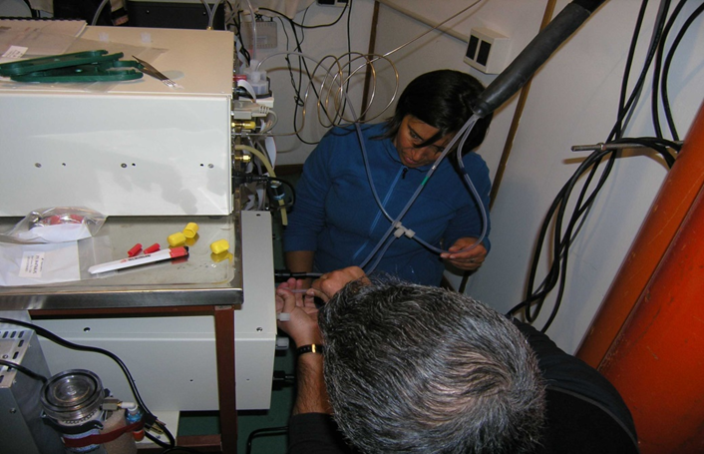
Nahuel Huapi National Park
EMMA Station (41.13°S - 71.42°W)
(Field laboratory Comahue University & CONICET)
EMMA Station

Slide 3
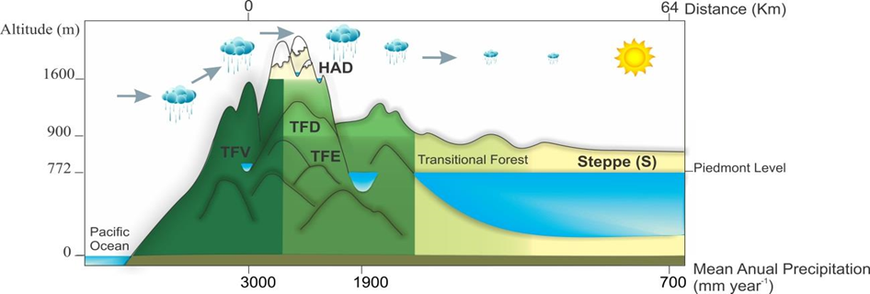
Climate & biomes surrounding EMMA
Cold temperate
Strong westerly winds year round
Orographic precipitation- rain shadow
Huge precipitation gradient (dropping from 3000 to 700 mm/y in 64 km)
Terrestrial biomes characterized by forest at the west grading to arid steppe
Large aquatic headwater network at the west draining towards arid Patagonia at the east

Slide 4
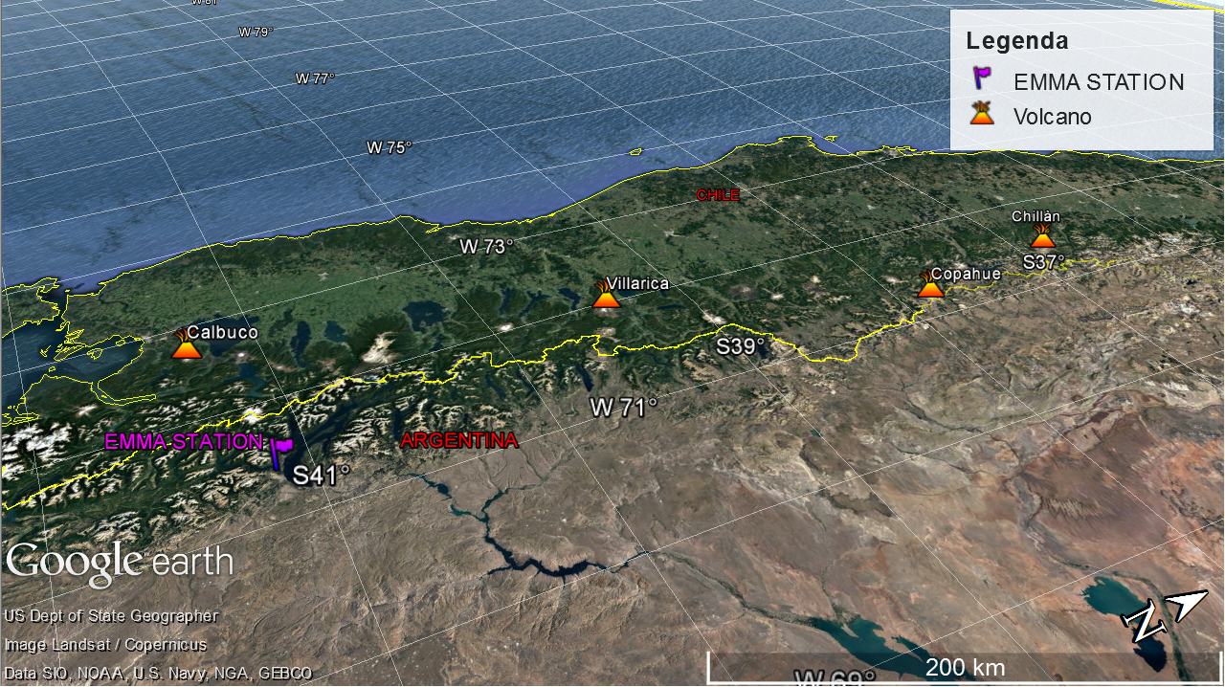
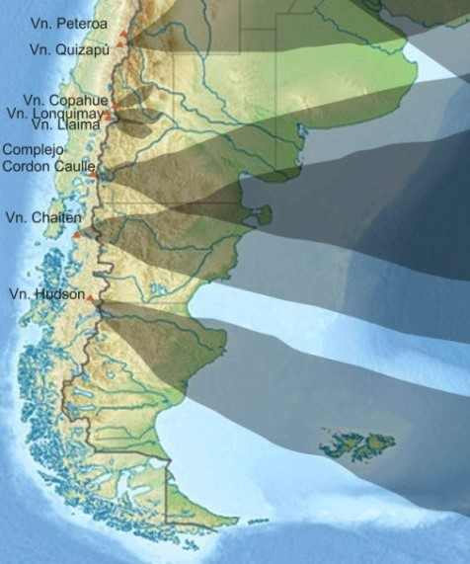
Potential Sources of Mercury in NW Patagonia
Long range atmospheric transport (W) and deposition
(favored by the westerlies and orographic precipitation)
Volcanoes
Andean Patagonia is in the Southern Volcanic Zone (SVZ)
Forest fires at the western and eastern flanks of the Andes

Slide 5
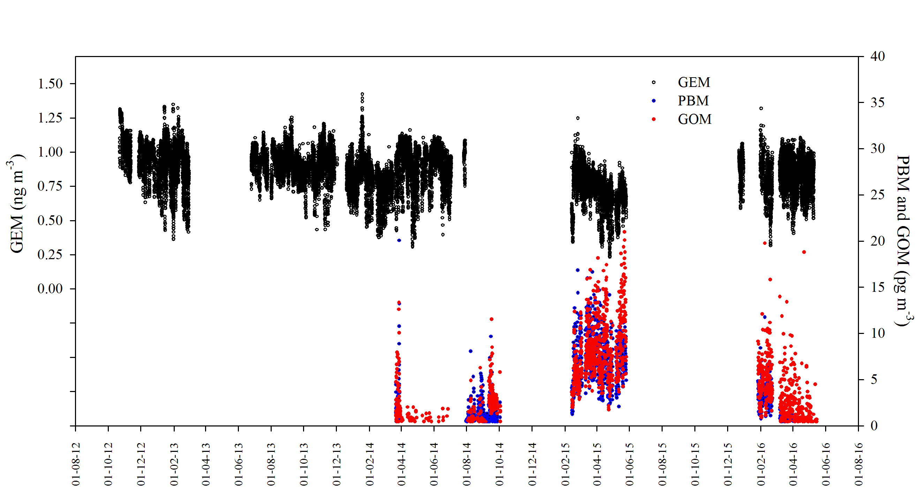
Atmospheric Hg measured at the EMMA Station

Slide 6
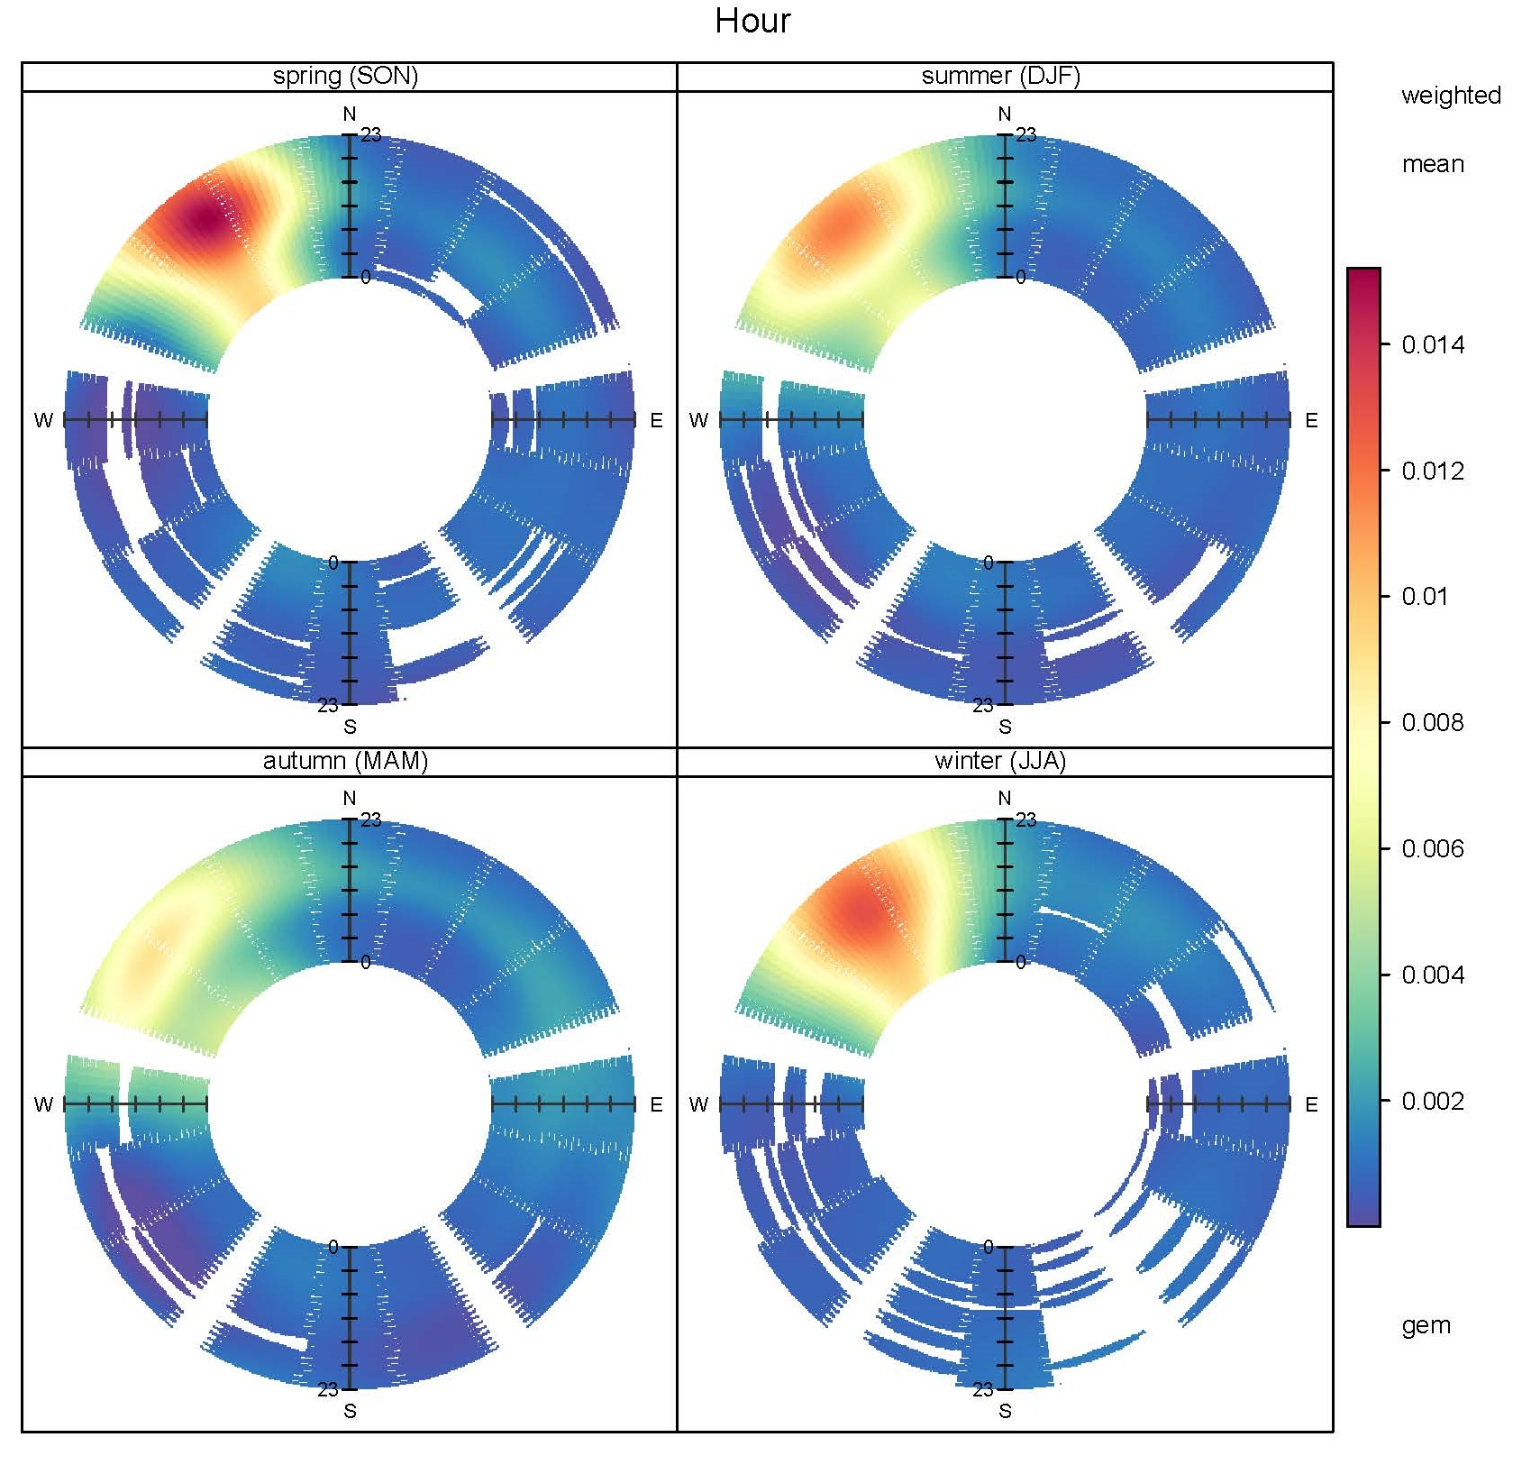
GEM seasonal pattern

Slide 7
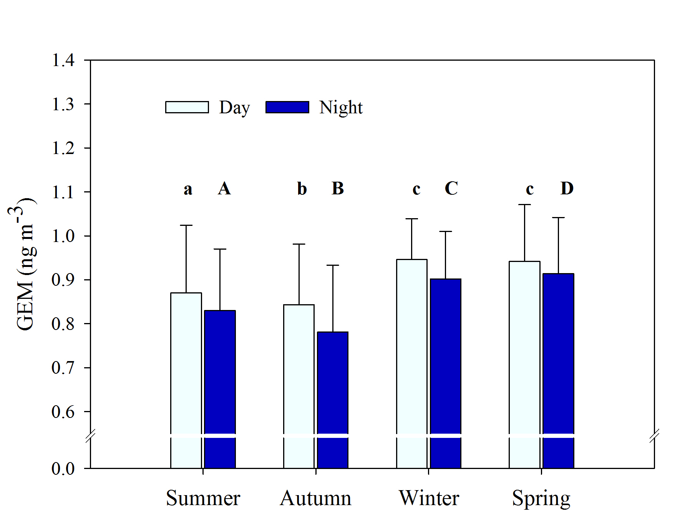
GEM daily pattern

Slide 8
 |  | Data frame | Summer DJF | Autumn (MAM) | Winter (JJA) | Spring (SON)
 | Min | 0.23 | 0.31 | 0.23 | 0.39 | 0.43
GEM (ng m⁻³) | Mean (SD) | 0.86 (0.15) | 0.85 (0.15) | 0.80 (0.14) | 0.92 (0.10) | 0.93 (0.13)
 | Max | 1.42 | 1.42 | 1.16 | 1.17 | 1.31
 | Min | 0.42 | 0.75 | 0.42 | 0.42 | 0.42
PBM (pg m⁻³) | Mean (SD) | 4.75 (3.49) | 4.45 (2.54) | 6.59 (3.33) | 1.48 (1.24) | 1.38 (1.42)
 | Max | 20.06 | 16.84 | 20.06 | 8.06 | 9.66
 | Min | 0.42 | 0.87 | 0.42 | 0.41 | 0.42
GOM (pg m⁻³) | Mean (SD) | 5.51 (3.95) | 5.07 (2.41) | 6.32 (4.35) | 1.29 (1.11) | 3.02 (1.67)
 | Max | 20.97 | 19.95 | 20.97 | 6.27 | 11.53

Slide 9
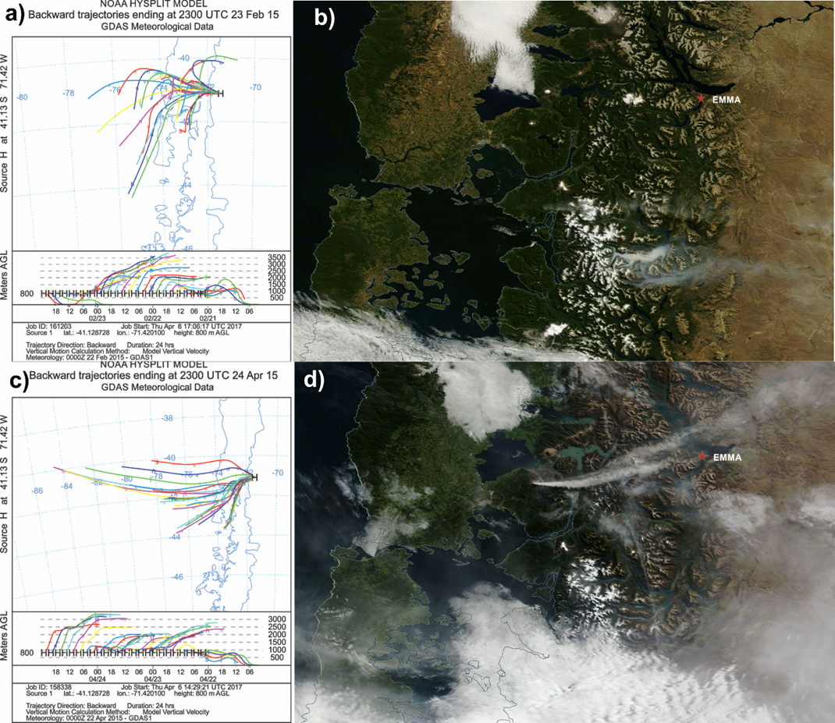
Hysplit backward trajectory corresponding to a high PBM-GOM event related to a large and persistent forest fire at a southern locality (Terra EOS Image)
Hysplit backward trajectory corresponding to a high PBM-GOM event related to a the eruption of the volcano Calbuco (Chile)

Slide 10
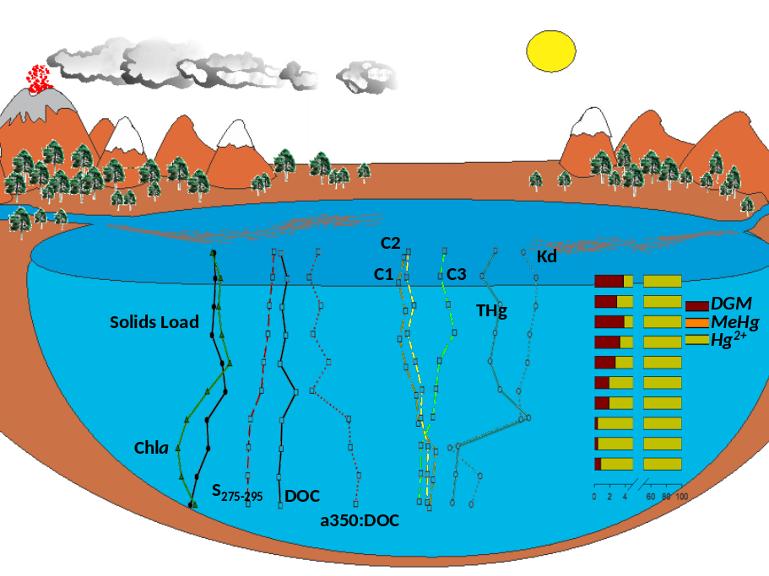
Mercury in freshwater systems and biota in Nahuel Huapi National Park
Water (low DOC, high THg:DOC)
THg: 41- 363 ng/l
Hg2+: 40 - 362 ng/l = 98.65 - 99.76%
Hg0: 0.13 – 1.33 ng/l = 0.18 – 3.81%
MeHg: 0.01 – 0.30 ng/l = 0.03 – 0.21%

Slide 11
EMMA Station in Patagonia and perhaps many other andean locations of the región may be interesting sites for assessing:
1-hG species levels in diffeErent matrices AS PRODUCT OF NATURAL SOURCES AND PROCESSES
2- Hg speciation patterns n different matrices and the effect of natural environmental factors and their fluctuation (I.e.(photochemicalreactions affecting Hg/Hg-complexes in the atmosphere, water and soil)
3- Hg dynamics in catchments in relation to climate fluctuation and forescasted changes due to global climate change affecting ecosystems connectivity and materials exchange between ecosystemic compartments
4-Mechanistic issues of Hg incorporation,transformation and transference in foodwebs (i.e. pelagic microbial food webs as pumps of Hg2+ into aquatic food webs)

Slide 12
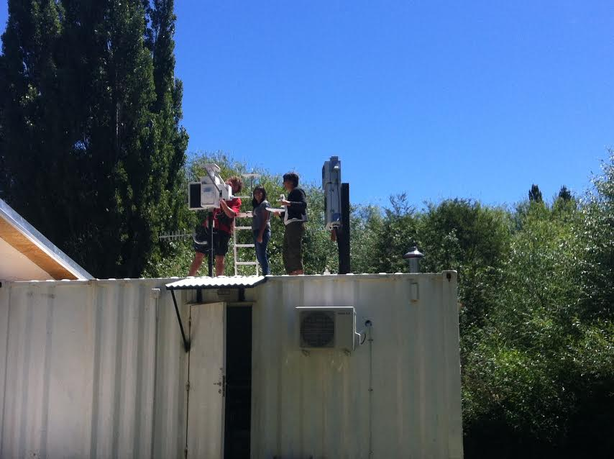
UNEP/GEF Project
Development of a Plan for Global Monitoring of Human Exposure to and Environmental Concentrations of Mercury

