Slide 1
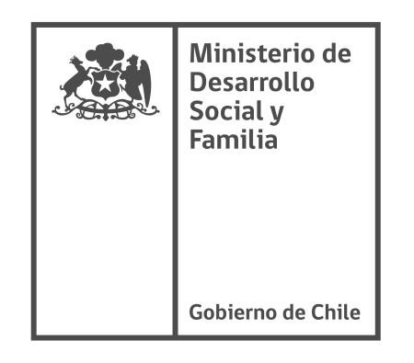
2030 Agenda in Chile:
Uncovering the climate and SDGs synergies

Slide 2
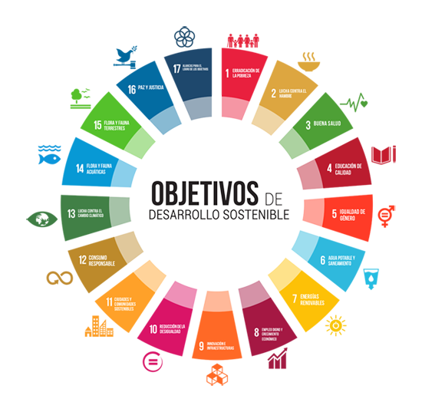

Table of Contents
1
Climate Change and COP25
2
2030 Agenda, Policy Coherence and Evaluation?
3
Wrap-up
2
Gobierno de Chile | Ministerio de Desarrollo Social y Familia

Slide 3
Global Temperature Rise
Warming Oceans
Shrinking Ice Sheets
Decreased Snow Cover
Glacial Retreat
Declining Arctic Sea Ice
Extreme Weather Events
Ocean Acidification

Slide 4
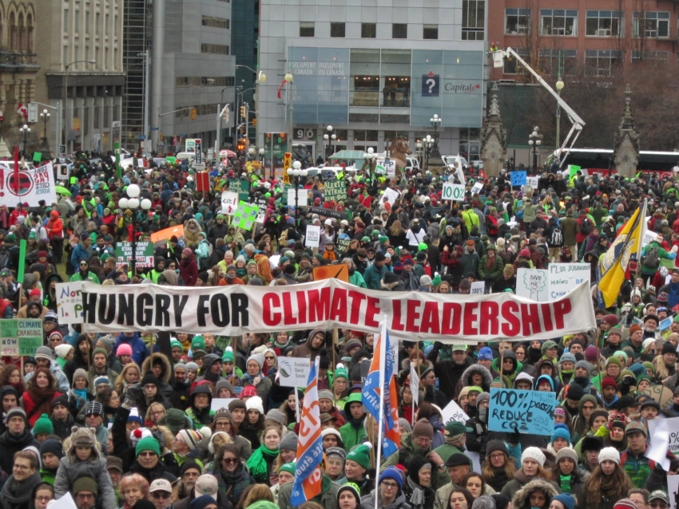

Slide 5
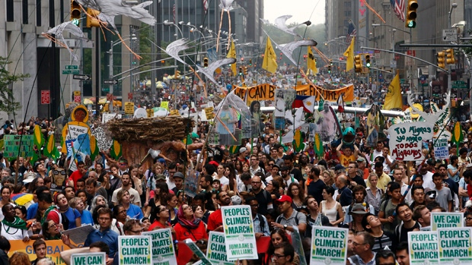

Slide 6
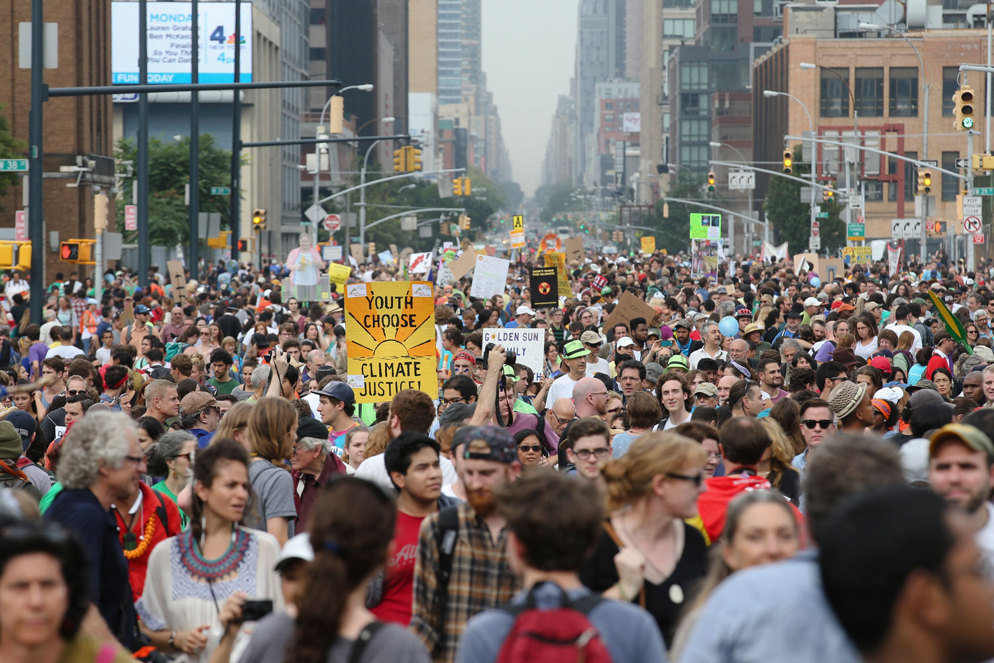

Slide 7
Are we the last generation that will be able to act and change the course of history?

Slide 8

From Negotation, to Implementation (Action)
2040: Coal Phase Out (Electricity Generation)
2050: Carbon Neutral

Slide 9
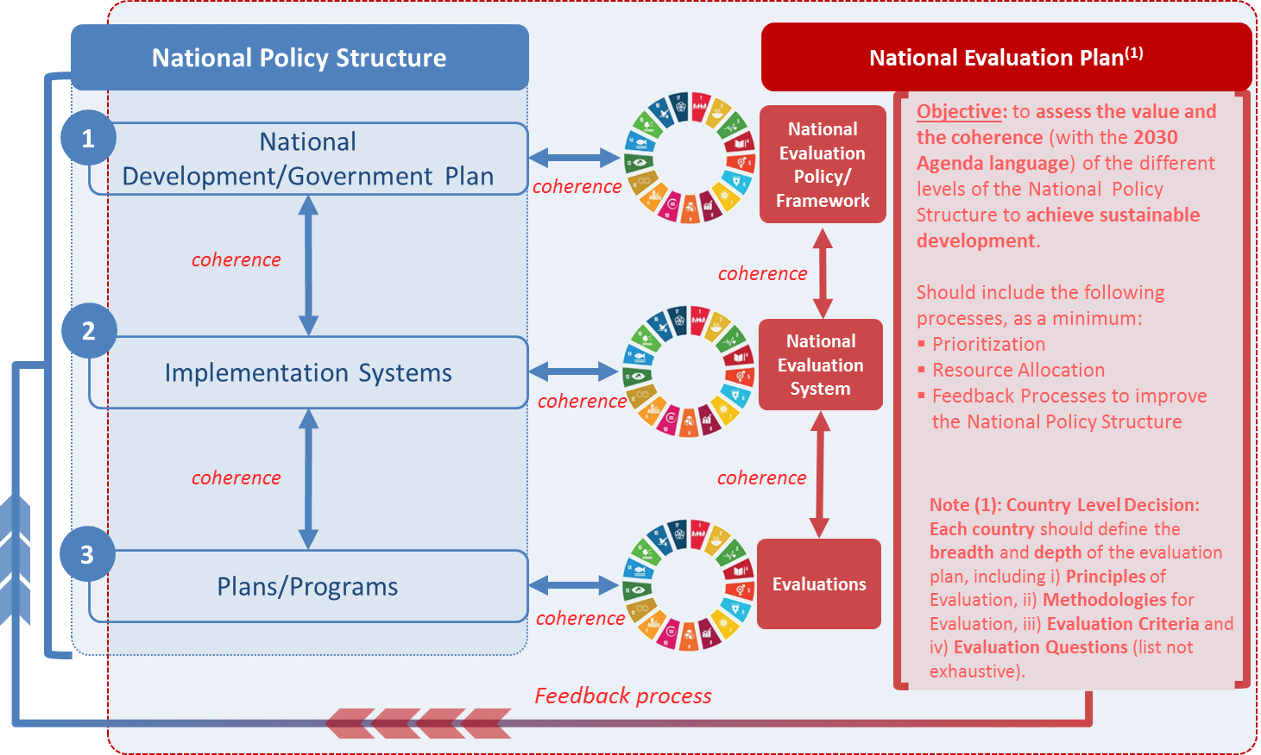
2. Agenda 2030, Policy Coherence and Evaluation?
Strategic Definition
What to do?
Strategic Planning
How to do it?
Source: Heksinki Retreat, March 2019
Gobierno de Chile | Ministerio de Desarrollo Social y Familia

Slide 10
3. Wrap up
Implementation
Monitoring & Evaluation
Measurement
Proposal of a National Implementation Strategy
for the 2030 Agenda
Priorities Definition
Measurement (indicators) acording to national priorities
Monitoring and Evaluation

Slide 11
But the question is:
Given the pressing challenges from today, do we need a Policy Coherence/Analysis of Interlinkages,
Before – During definition – After the strategic targets agreement
?
Ex-Ante
Ex-Ante
Ex-Post
e.g. 2050 Carbon Neutrality

Slide 12




From…
to…
and to…
Motivation
Alignment
Commitment

Slide 13
2030 Agenda in Chile:
Uncovering the climate and SDGs synergies

