Slide 1


Notes:
‘0’ This lecture explains mercury source categories and classification of mercury use and releases.

Slide 2
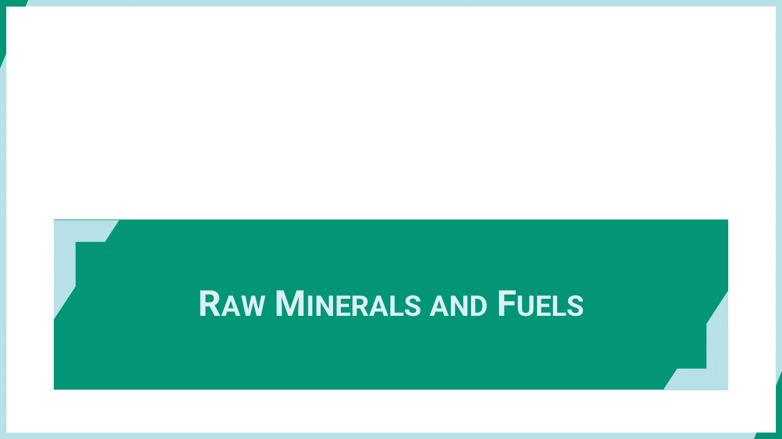
Notes:
‘1’ This section explains the source categories that mobilize mercury in raw minerals and fuels.

Slide 3
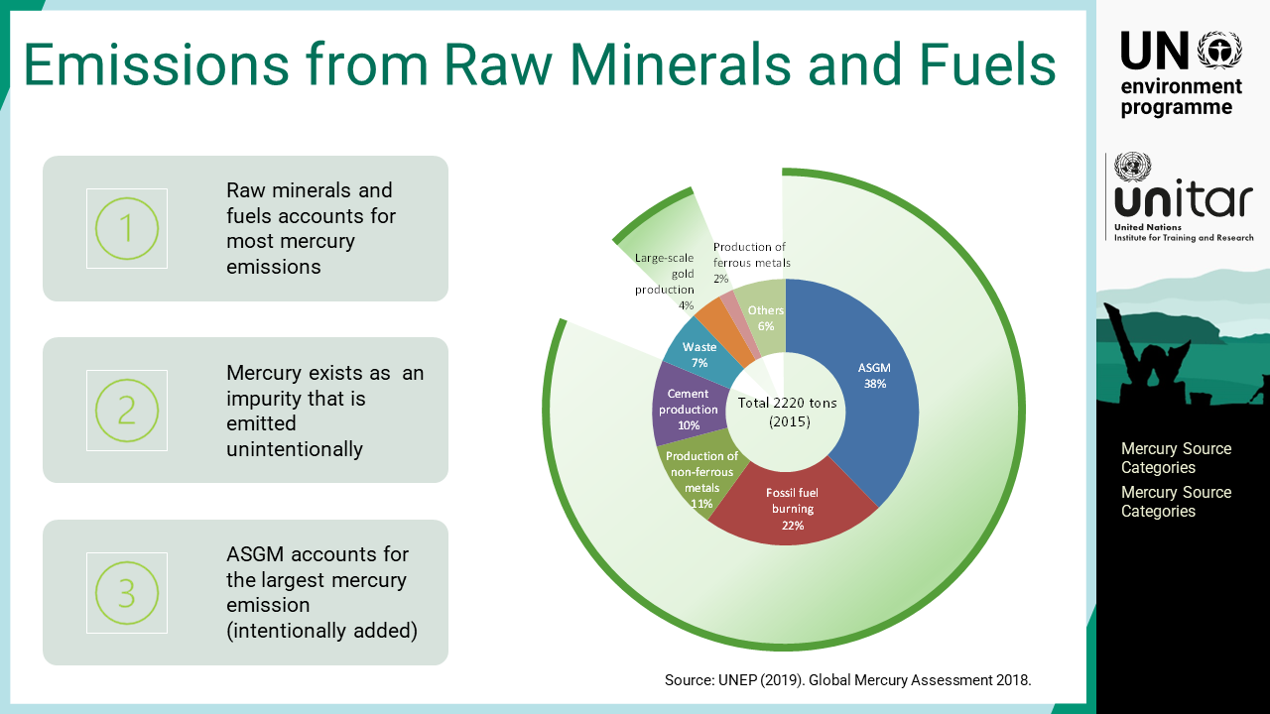
Notes:
‘2’ Raw minerals and fuels account for most mercury emissions. Mercury exists as impurity that is emitted unintentionally except in artisanal and small-scale gold mining, ASGM, where mercury is intentionally added to the ore to extract gold. ASGM accounts for the largest mercury emission source and disproportionally affects marginalised and less privileged groups, such as children and women of child-bearing age.

Slide 4
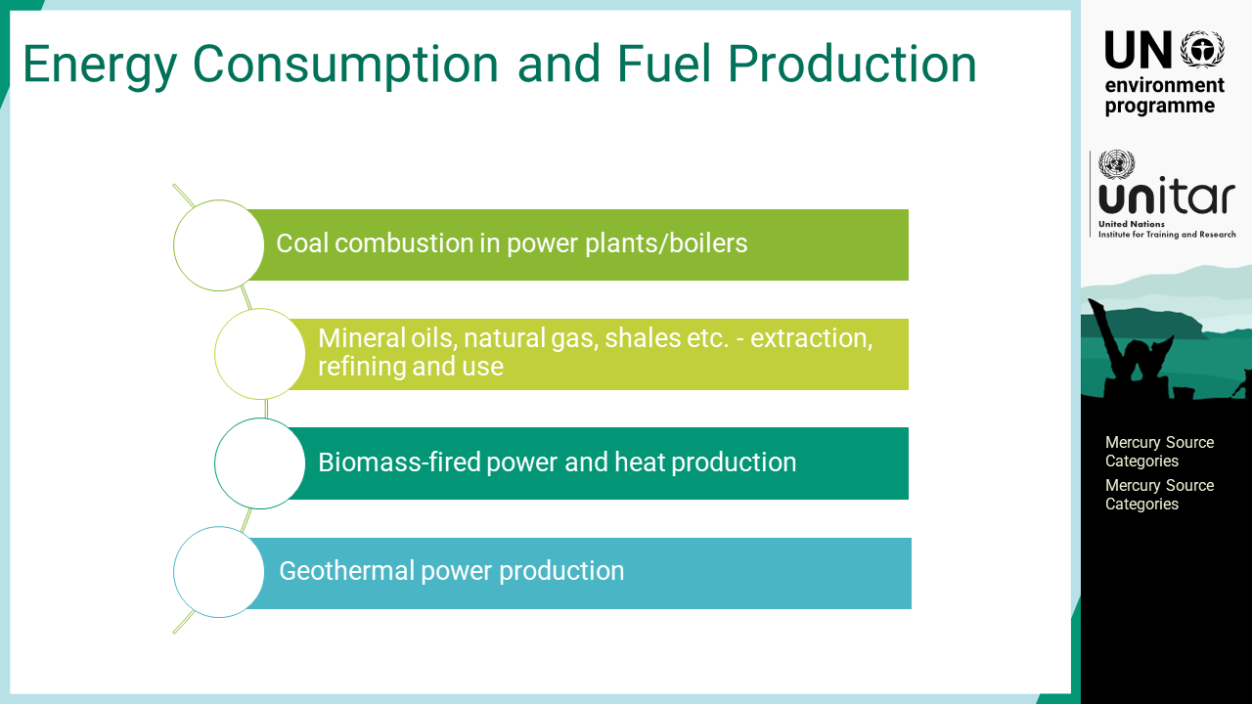
Notes:
‘3’ Fuel production and energy consumption are significant mercury emission sources. Coal, oil and natural gas contain trace amounts of mercury, which is either removed by the fuel production process or emitted during energy consumption. As mercury is troublesome in the oil and gas process, it is usually removed beforehand, and refined oil and gas products do not contain mercury at a significant level. Coal is provided either washed or unwashed. The coal washing process removes a certain amount of mercury and provides higher quality and price. Mercury is present in all biological and mineral fuels, including renewable fuels such as firewood, and straw. Biomass-fired power and heat production contribute to mercury emissions due to the high volumes used. Geothermal power production extracts only underground heat, not minerals, but the natural mercury concentration at a geothermal location is usually elevated. When a power plant release mercury-containing vent for power production, it can become a local mercury source.

Slide 5
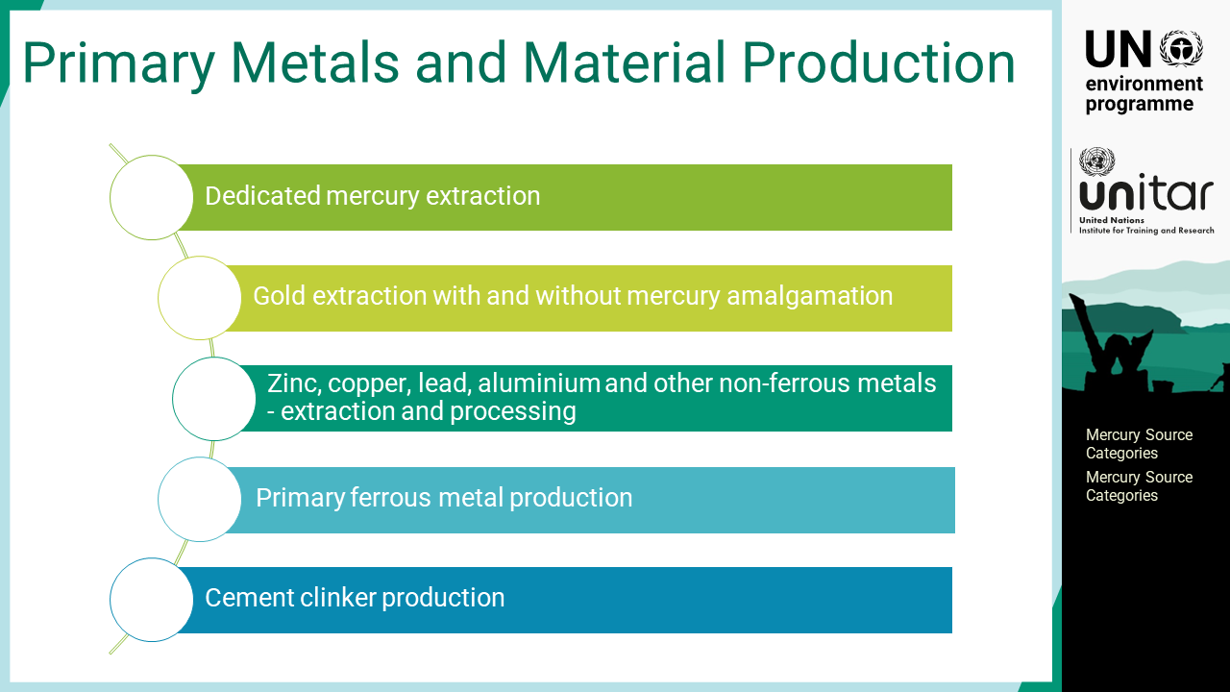
Notes:
‘4’ Primary metals and material production are also significant mercury sources. Mercury mines extracting and processing mercury as a primary mineral are always major mercury sources. Non-ferrous metals such as zinc, lead, gold, and copper often co-exist with mercury in their veins due to their chemical affinity; thus, mineral extraction results in a mercury source. When mercury is not used for gold extraction, the natural trace concentrations of mercury in the ore are released in the process, particularly in large-scale gold production. Even at lower concentrations, ferrous metal production is also a possible mercury source, as the scale of activity is large. Cement production is also a major source because the amount of raw material, such as limestone, used for the production is significantly large.

Slide 6
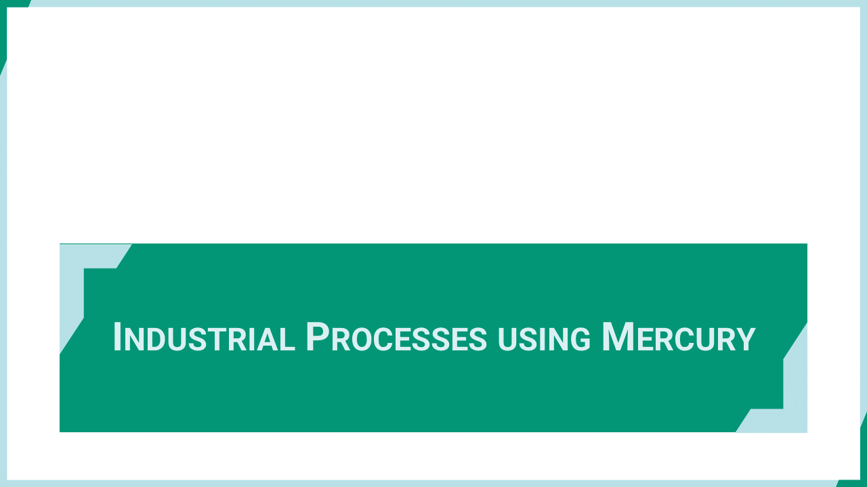
Notes:
‘5’ This section explains the industrial processes that use mercury as catalysts or other purposes for producing products other than mercury-added products.

Slide 7
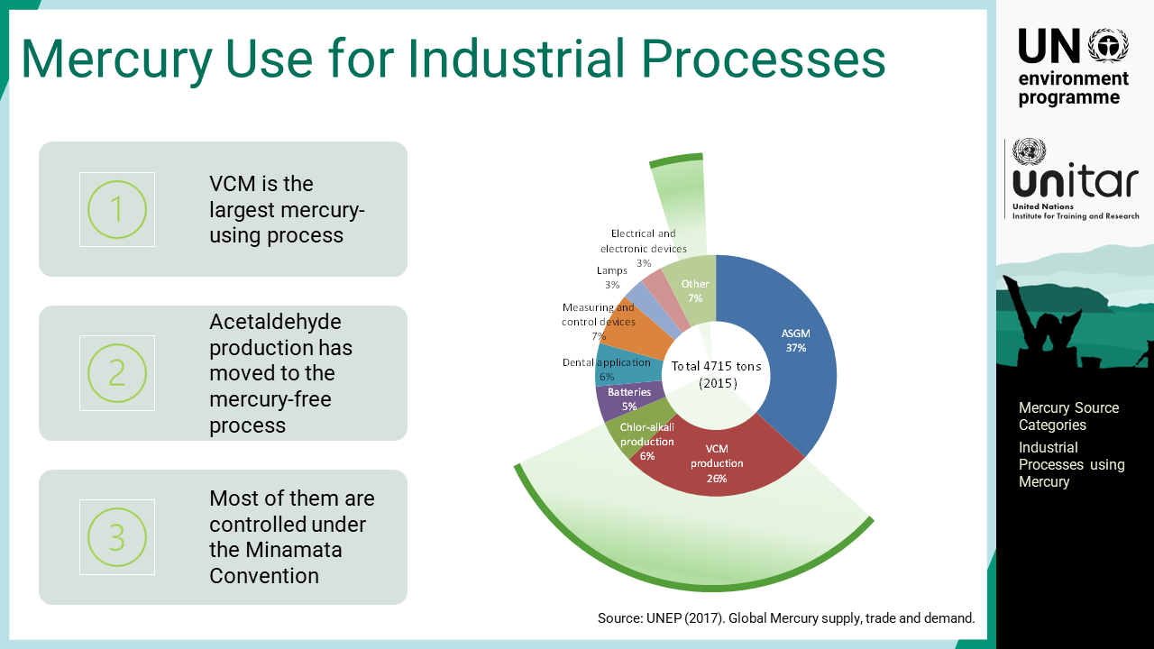
Notes:
‘6’ There are several known mercury-using processes that are controlled under the Minamata Convention. Vinyl-chloride monomer, VCM, production is the largest mercury-using process while acetaldehyde production has moved to the mercury-free process. Mercury-using processes account for approximately one-third of the global mercury use.

Slide 8
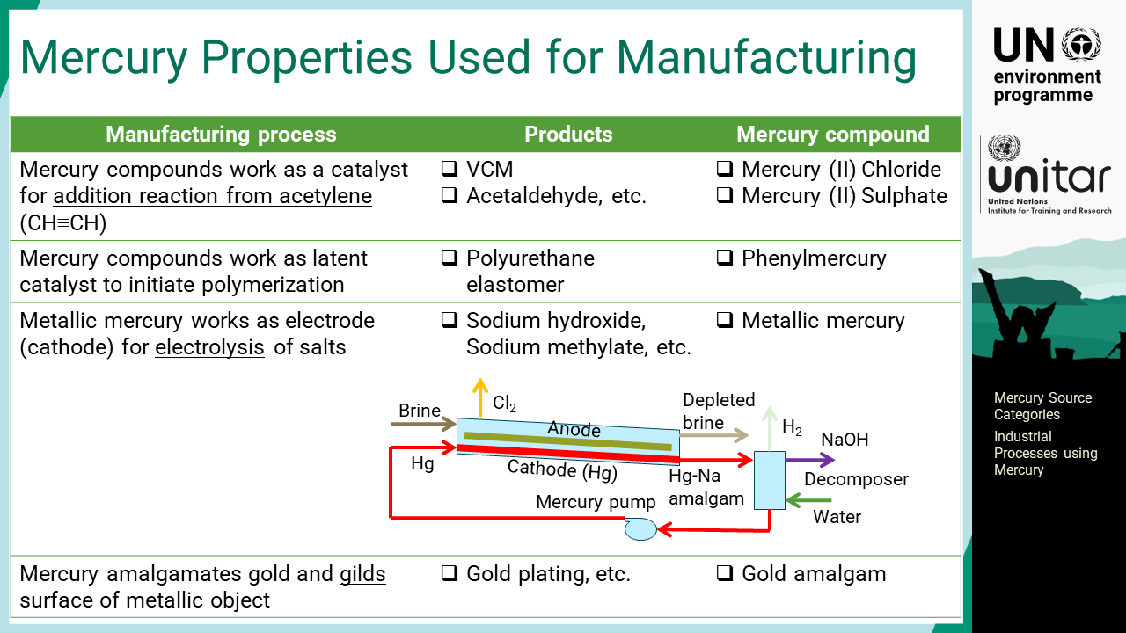
Notes:
‘7’ Important processes using mercury are acetylene-based chemical production, where mercury compounds serve as catalysts accelerating the addition reaction. To avoid the use of mercury, ethylene will be used for the feedstock instead of acetylene. Another type of catalyst is the initiator for polymerization of polyurethane elastomer that triggers the process in the moulded products or coating. Although mercury works as a catalyst, it actually remains in the product. Another mercury use is as the electrode for electrolysis or electrorefining. One of the major products is sodium hydroxide and chlorine gas using the mercury amalgamation method, where sodium amalgam plays a key role in extracting sodium ions from brine solution. Alcoholates such as sodium ethylate are used as catalysts for producing biofuel. Gold plating is also a possible mercury source under this category where gold amalgam is smeared on the metallic surface to gild the object.

Slide 9

Notes:
‘8’ This section explains the mercury-added products that contain mercury or a mercury compound that was intentionally added. This definition differentiates such products containing mercury from an impurity in raw materials.

Slide 10
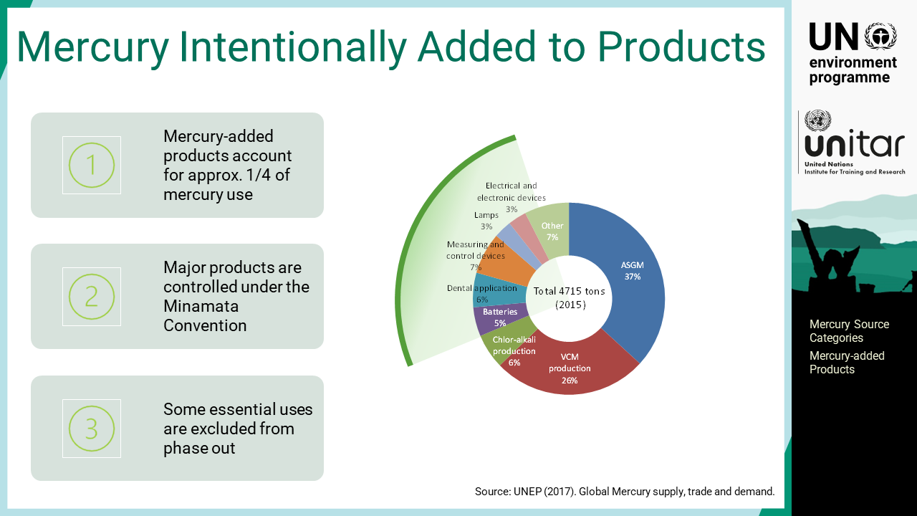
Notes:
‘9’ Mercury-added products account for approximately one-fourth of global mercury use. Mercury is used for many products in various sectors if historical uses are included. Although mercury-free alternatives have been developed to a great extent, mercury-added products are still widely used. Major products that consume substantial amounts of mercury are controlled under Minamata Convention, but some essential uses are excluded from phase-out.

Slide 11
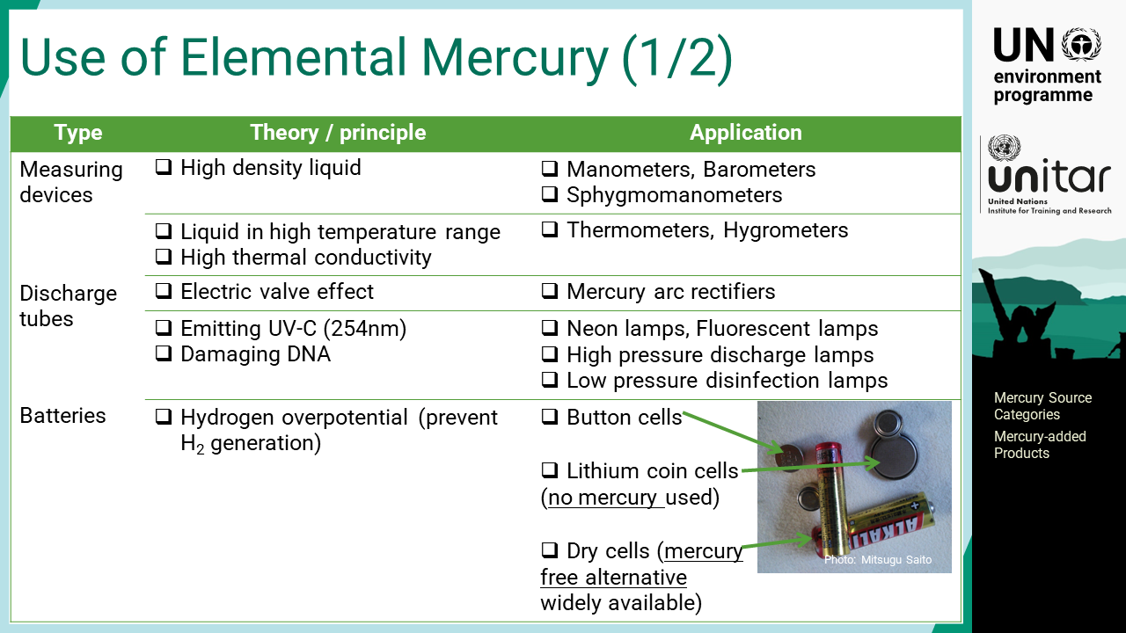
Notes:
‘10’ Elemental mercury has some unique properties that are utilized for developing various products. A non-electrical pressure gauge is one of the typical examples that uses the property of a high-density liquid that is suitable for the purpose. Mercury is in liquid form between -38.8 and 356 degrees C, so it is used for temperature measurement. Its high thermal conductivity also benefits the quick response to temperature change. Discharge tubes are another popular use of mercury. Mercury vapour emits ultraviolet rays when excited, which can be used for lighting and disinfection purposes. Elemental mercury is added to the battery to avoid the generation of hydrogen gas that causes rupture and leakage.

Slide 12
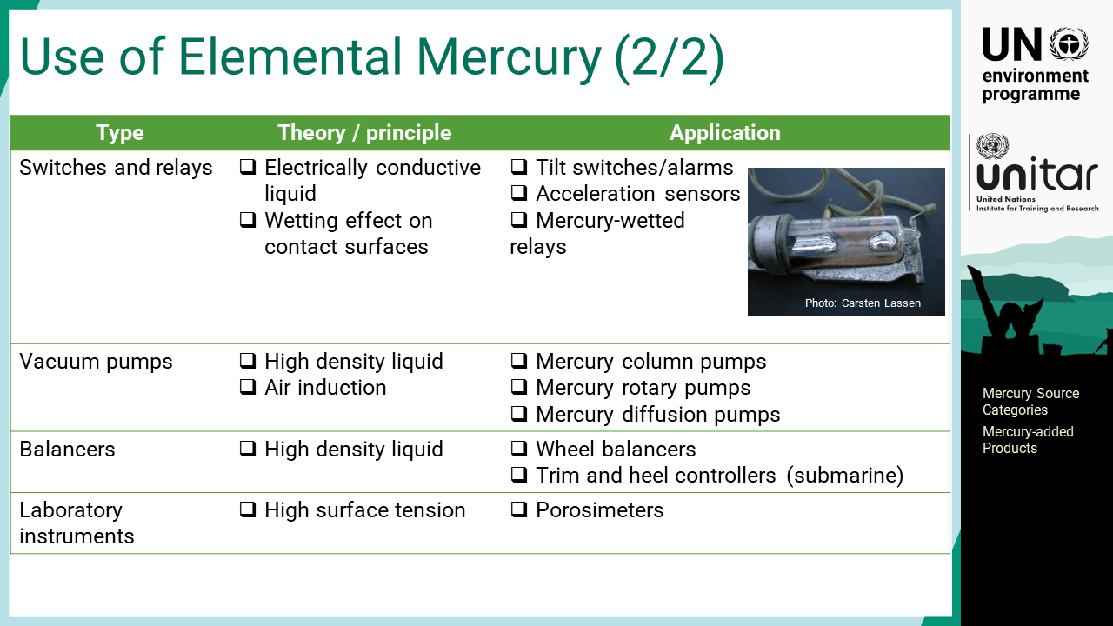
Notes:
‘11’ The mercury switch and relay also provide a unique function in electric circuits. As an electrically conductive liquid, mercury-added electric appliances can provide many functions, such as tilt switching and acceleration sensing. Liquid mercury has a wetting effect on other metals, so it provides ideal contact on the surface of the mercury relay that enables very high frequency switching without chattering. Elemental mercury has many other applications, such as vacuum pumps and balancers. However, many of them have been replaced by mercury-free alternatives. One exception is for laboratory instruments, which are excluded from the phase-out list of the Minamata Convention. The porosimeter measures the surface pore volume and distribution in the size of pores on the material surface.

Slide 13
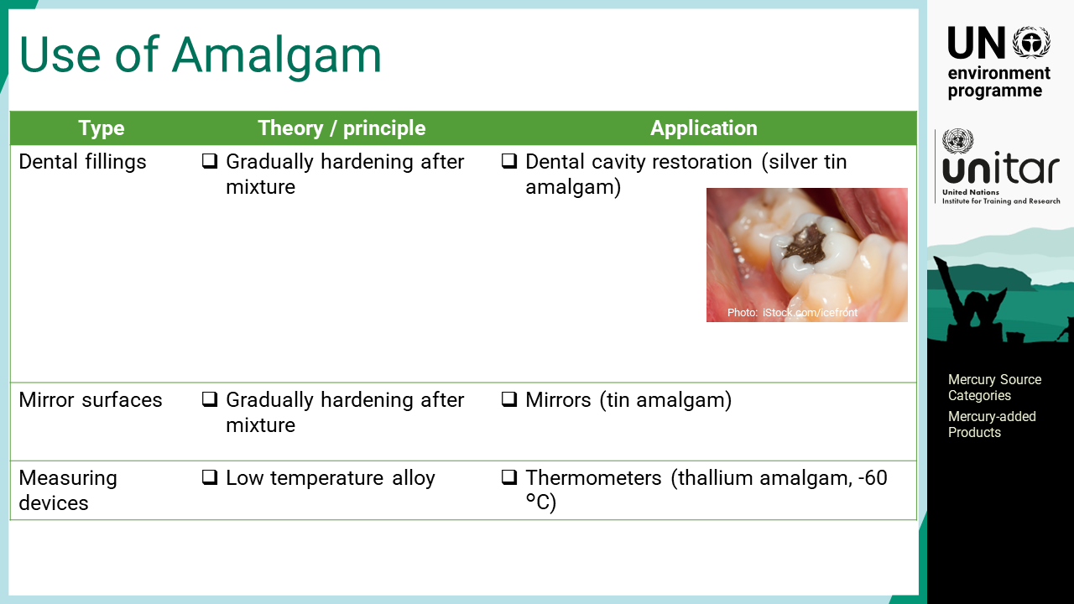
Notes:
‘12’ Amalgam is an alloy of mercury and other metals. Most metallic elements can form amalgam with a few exceptions such as iron, platinum, manganese, nickel, etc. Silver tin amalgam is the most widely used amalgam product for dental restoration. It gradually hardens after mixing such that it fills the dental cavities of the dental patients. This 3-metal amalgam can control the degree of expansion / contraction to avoid gaps between the filling and tooth. Thallium amalgam has the unique property of a low melting temperature and can be used for thermometers with a lower temperature range than mercury thermometers.

Slide 14
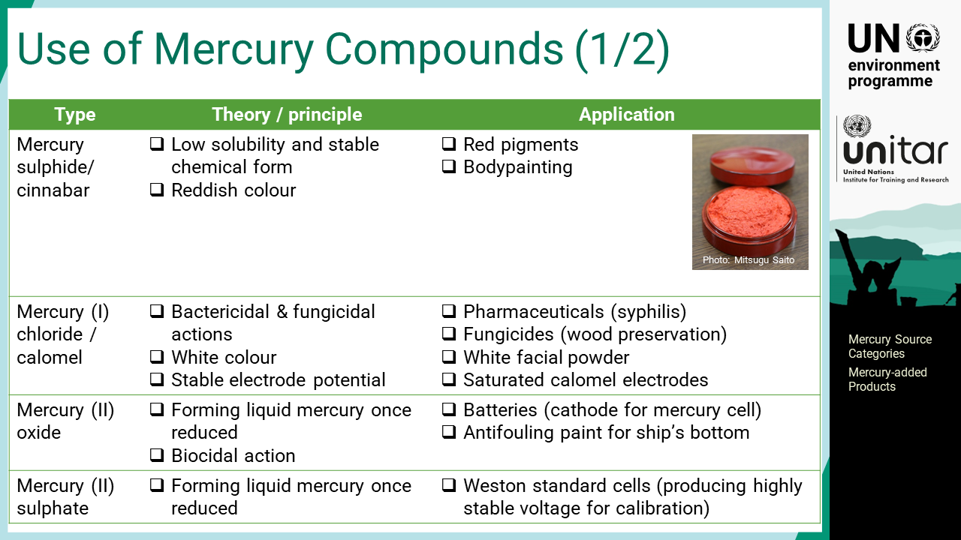
Notes:
‘13’ Mercury compounds have been used as red pigments since the Stone Age. Mercury sulphide, or cinnabar, is the chemical form found in mercury ore. Due to its low solubility and high chemical stability, the painted colour does not fade out for centuries. Mercury chloride one, or calomel, is another common mercury compound with wide applications. Its bactericidal and fungicidal properties are applied as a preservative. The lower solubility and white colour enabled calomel to also be used as a facial powder. In the science field, saturated calomel electrodes are commonly used as stable electrode potentials. Mercury oxide two was used for the cathode of the mercury cell to obtain a stable voltage. It was also used for antifouling paint for the ship’s bottom.

Slide 15
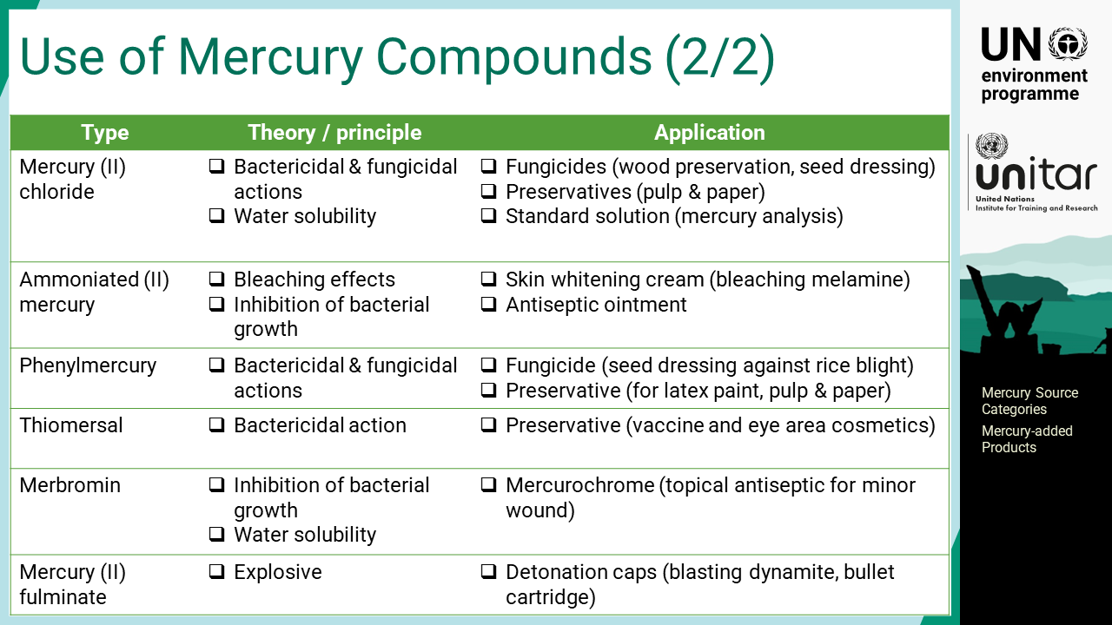
Notes:
‘14’ Many more mercury compounds have been used for various products. Agricultural chemicals such as fungicides, preservatives, and topical antiseptics are biocidal applications. Some mercury compounds have bleaching effects that are used for skin whitening cosmetics, which is still widely used by many women in the societies where lighter coloured skin is preferred. One of the unique compounds is mercury fulminate two, which is explosive and used for detonation caps for dynamite and firearms.

Slide 16
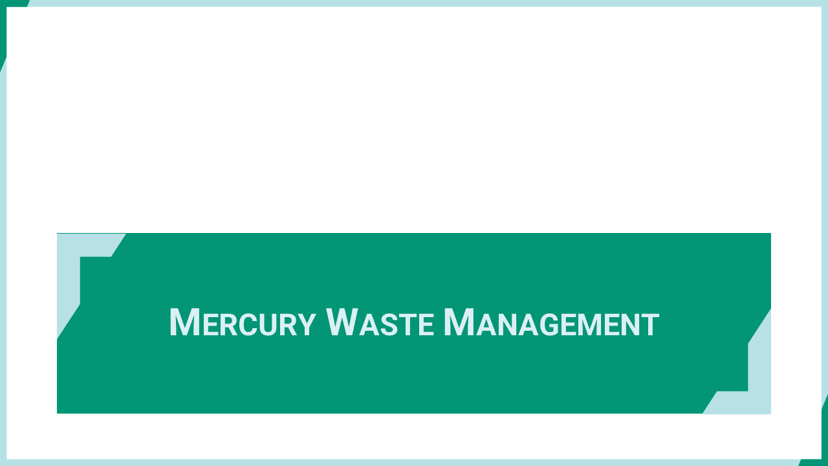
Notes:
‘15’ This section explains the mercury waste management and release from the facilities.

Slide 17
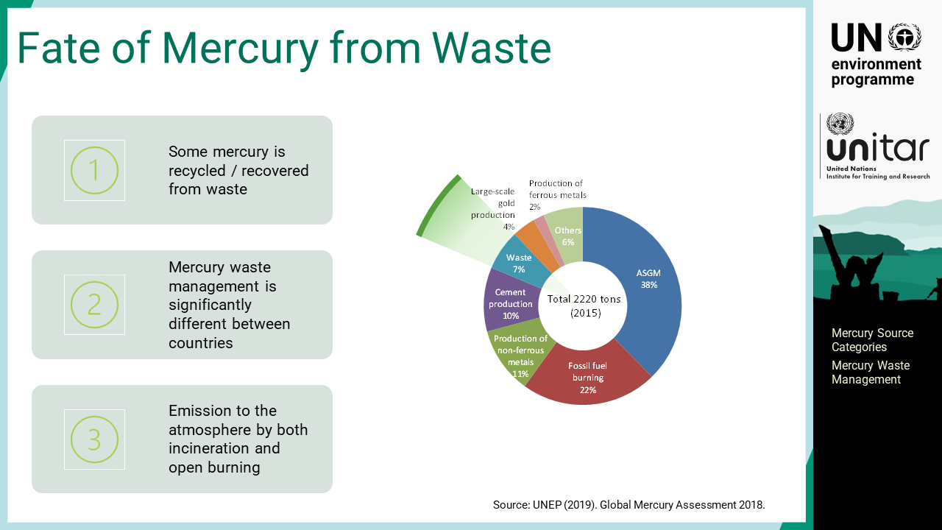
Notes:
‘16’ The amount of mercury emissions from the waste sector is substantial but less significant in comparison with the amount of mercury handled. Mercury waste management is significantly different between countries. The special collection and treatment of mercury waste is challenging, although it has become increasingly practised. Some mercury is recycled or recovered from waste streams, which reduces mercury release from waste. Both waste incineration and open burning are significant emission sources to the atmosphere while landfills can serve the final mercury sink if they are properly managed.

Slide 18
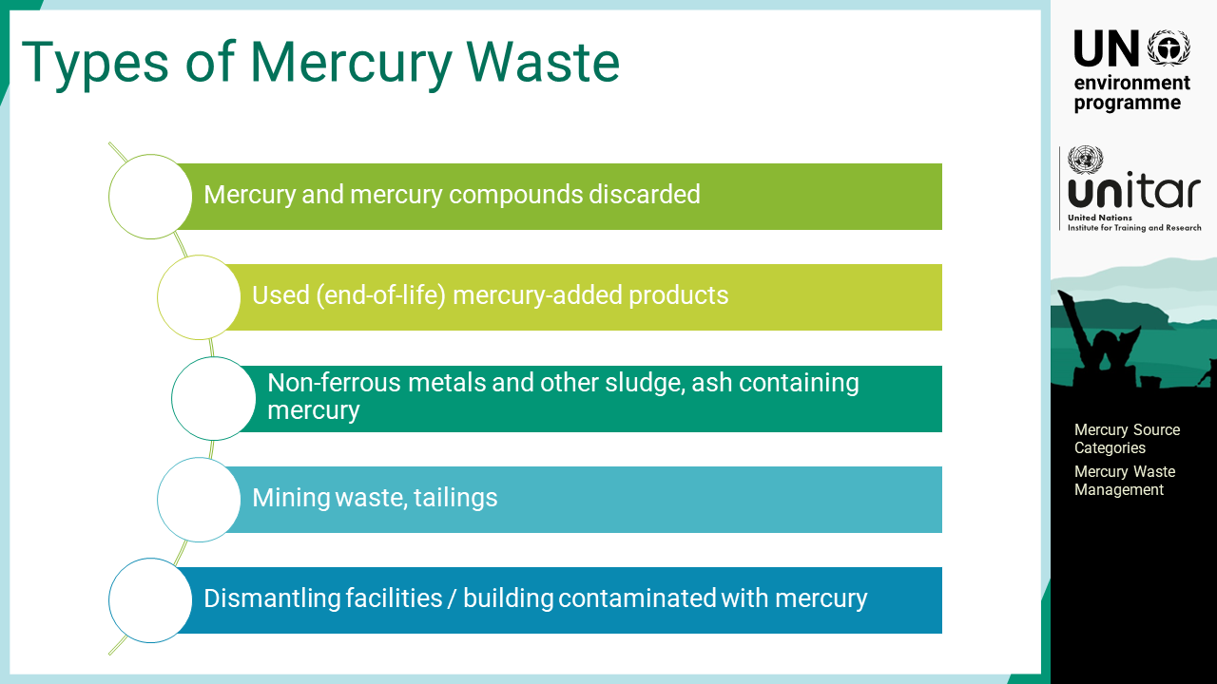
Notes:
‘17’ Mercury entering the waste stream has several types and properties that require different waste management schemes. Mercury and mercury compounds that are discarded need special care, such as stabilization as mercury in this form is an important source of mercury contamination. End-of-life mercury-added products are mixed with general waste or collected separately. If a hazardous waste collection scheme is in place, mercury can be removed before such waste is disposed of. Some non-ferrous metals and other sludge and incineration ash contain mercury. Depending on the concentration level, such waste should be treated as mercury waste. Fly ash from coal-fired power plants contains a certain concentration of mercury but is often mixed with cement for construction work. At mining sites, mining waste and tailings may contain trace amounts of mercury depending on the geological characteristics of the mines. Mine tailings of gold mines where amalgamation methods were used may be contaminated with substantial levels of mercury. Mining waste and tailings are very large in volume, so the amount of mercury could also be significant. Finally, in the event when some facilities or buildings are dismantled, mercury could be released if mercury-containing materials were handled in such buildings or facilities. Dismantling could generate a large quantity of waste contaminated with mercury and special care, including worker safety measures, should be put in place.

Slide 19
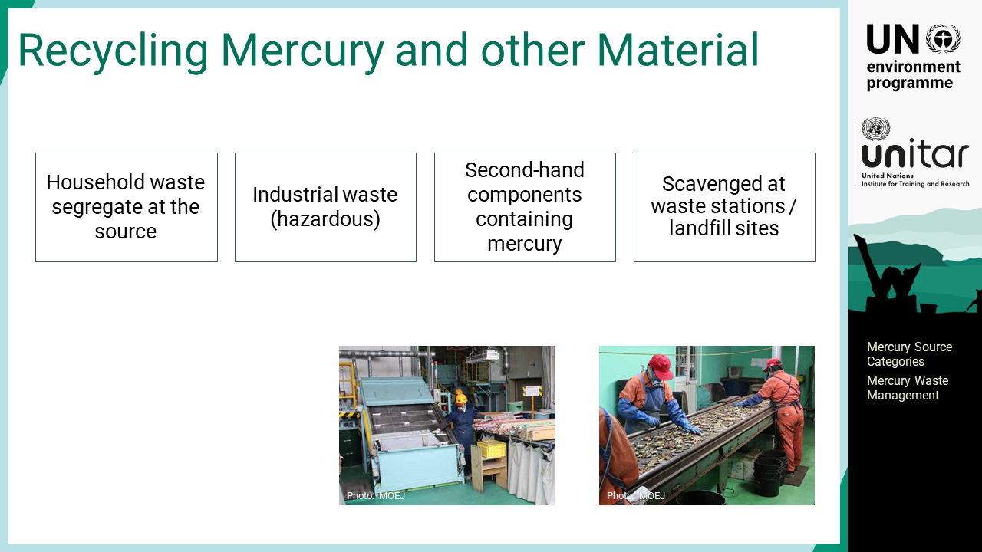
Notes:
‘18’ Recycling is an important process for mercury waste management. Mercury waste will include different waste streams such as household waste segregated at the source, hazardous industrial waste, second-hand components containing mercury, scavenged materials at waste stations or landfill sites, etc. Recycling can recover mercury as well as useful materials, which makes recycling economically profitable. Instead, recycling for other materials could also be a potential source of emissions if mercury-added products are contained in the waste. In the past, cars used mercury switches, displays, etc. Thus automotive shredding residue was contaminated with mercury.

Slide 20
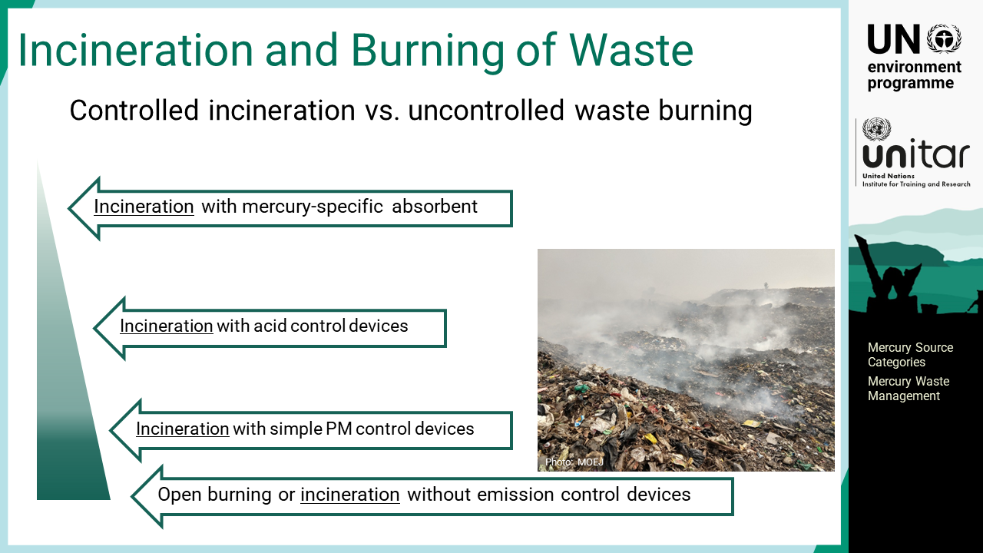
Notes:
‘19’ Incineration is a waste management scheme practised widely for many types of waste. Although incineration is a good waste management practice for certain types of waste, it is a potential mercury emission source. Incineration without emission control devices can release almost all mercury in the incinerated waste, which is equivalent to open burning of waste in terms of mercury management in the waste sector.

Slide 21
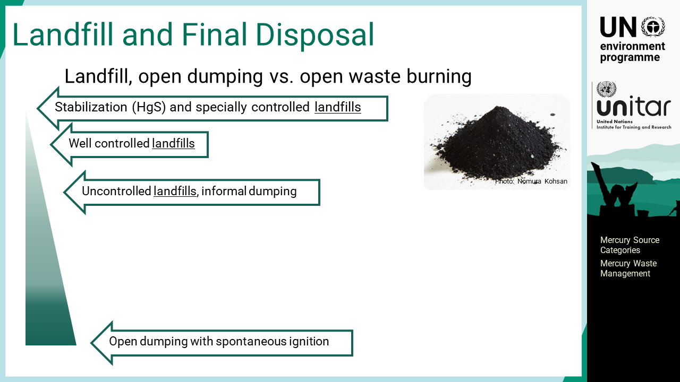
Notes:
‘20’ Waste landfill is the final process of the waste management scheme. The purpose of mercury waste management is to immobilize mercury at landfill sites. Stabilization and disposal of mercury waste can effectively prevent mercury release to the atmosphere and water environment. The amount of mercury released to the environment may vary between well controlled and uncontrolled landfills, but a certain level of mercury stays in the landfill site unless spontaneous waste burning occurs.

Slide 22
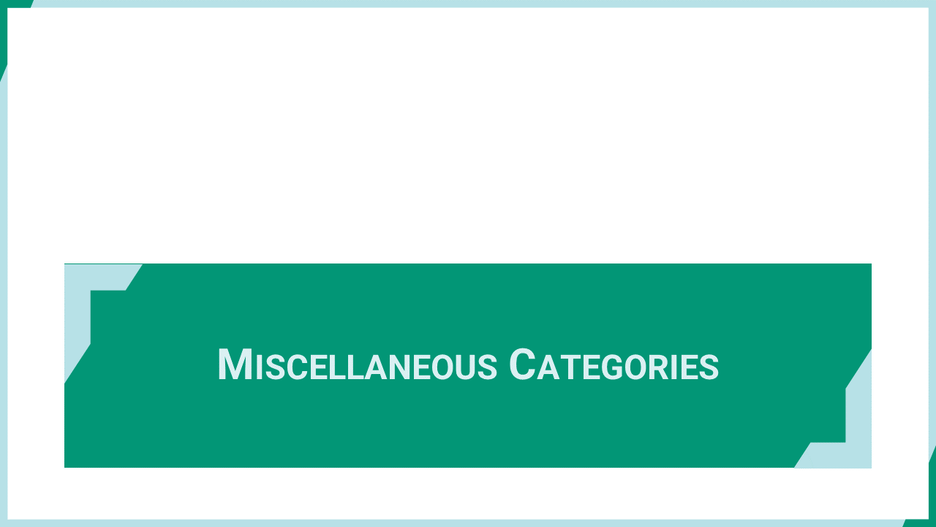
Notes:
‘21’ This section explains miscellaneous source categories that have some contribution to mercury releases.

Slide 23
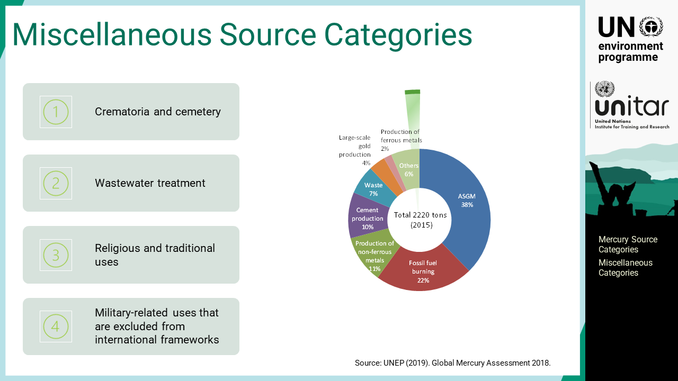
Notes:
‘22’ Mercury is a chemical element and presents every corner of the world. The types of mercury usage in products and processes are also diverse. There are some minor use or source categories of mercury that may have some contribution to mercury releases. Crematoria and cemetery are potential mercury sources from human remains. Crematoria burns bodies that emit mercury into the atmosphere, while cemetery buries bodies that may result in mercury release into water bodies. Particularly for the population with dental restoration using mercury amalgam, mercury releases from crematoria and cemetery may account for a certain level. There are wastewater treatment facilities that accumulate aquatic pollutants in the sludge. The reuse of such sludge should be carefully considered for its chemical safety. Finally, some potential categories that are less surveyed are explained. There are uses for mercury in some religious and traditional purposes in particular cultures. For example, some ayurvedic and homeopathic remedies contain mercury. It is not practised globally but could be a substantial source for particular countries and regions. There are known military-related uses that are excluded from international frameworks.

