Slide 1
The SDG Synergies Approach to Assess SDGs Interlinkages
Ivonne Lobos Alva
July 2019

Slide 2
Contents
The challenge
How we aimed to contribute to tackling the challenge
What we did
Outcomes
Reflexions on the methodology
Next steps for the Colombian stakeholders
Taking all this forward as SEI

Slide 3

Localizing the SDGs: the remaining challenge
High commitment
Difficult to integrate in national and local decision making
How to change institutional Modus Operandi?
Integrated thinking, cross-sectoral collaboration
Notes:
The SDGs turned three years old this past September, and while countries maintain their commitment to the 2030 Agenda, they are experiencing different challenges to localize and integrate this global framework in their national and local decision-making. One challenge is how to achieve transformational changes in the way national institutions make decisions, devise policies, legislate, and report on sustainable development issues. Integrated thinking, cross-sectoral collaboration and coordination, both within and across institutions — as well as more inclusive mechanisms — are a precondition for this change.

Slide 4
Partners
Technical partners:
United Nations Environment Programme (UN Environment), in the framework of its project "Towards a coherent implementation of the environmental dimension of SDS"
Stockholm Environment Institute (SEI)
National level:
The National Planning Department (DNP) through the Technical Secretariat of the SDG Commission
Ministry of Environment and Sustainable Development
The SDGs Center for Latin America and the Caribbean
Regional:
Regional Corporation of Antioquia (CorAntioquia)
Environment Secretariat of the Governorate of Antioquia
Antioquia Sostenible

Slide 5
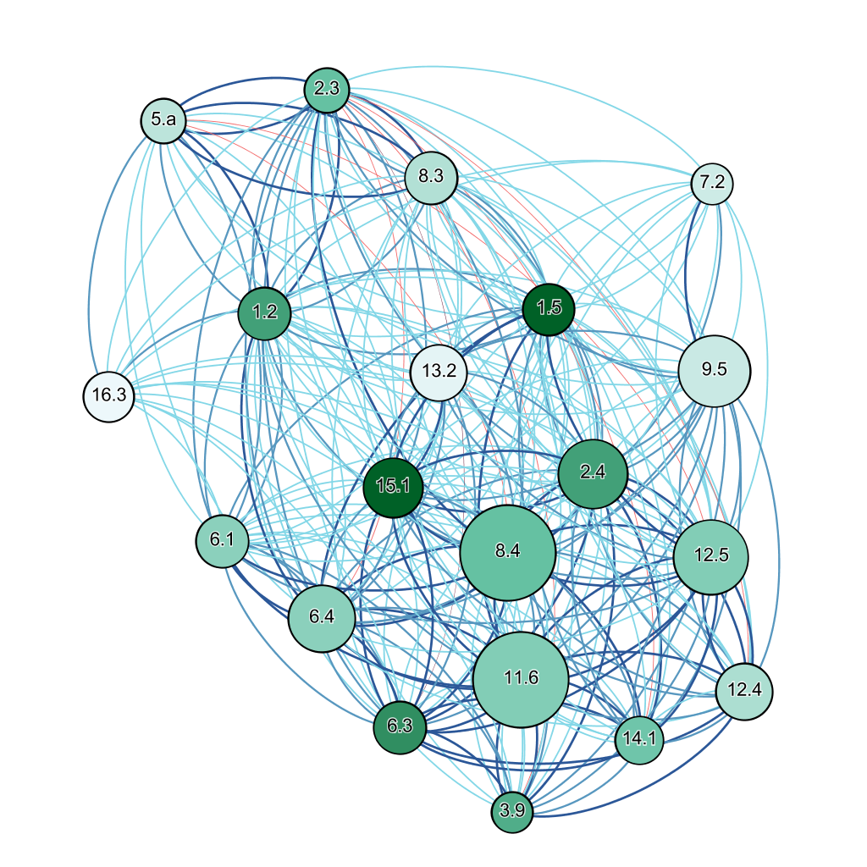
Our approach - We need to understand the system and its interconections (based on Weitz et al. 2018)
Hypotheses:
SDGs interactions are contextual
To fully understand the system, you need to zoom into the national or even local level
The current methodology uses the support of a web tool to facilitate the analysis
Source: SEI, Colombia network analisys
Notes:
This project will support this needed change by engaging in national and regional level exercises, jointly with key local stakeholders, to determine crucial interactions between SDGs. The aim will be to determine strategies and priorities that support a coherent implementation of the environmental dimension of the SDGs in Colombia, while taking socio-economic and governance aspects into consideration.

Slide 6
Core steps of the analysis
1. Customization: the first phase consists of the selection of a collection of targets, specifically for the context
2. Scoring of the interactions: a cross- impact matrix is constructed using the input from the participating experts
3. Network analysis: evaluation of the second order interactions of the selected targets

Slide 7
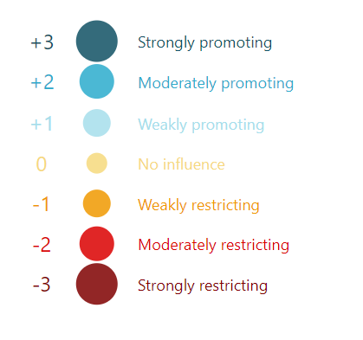
Scoring scale
Based on Weitz et al. 2018

Slide 8
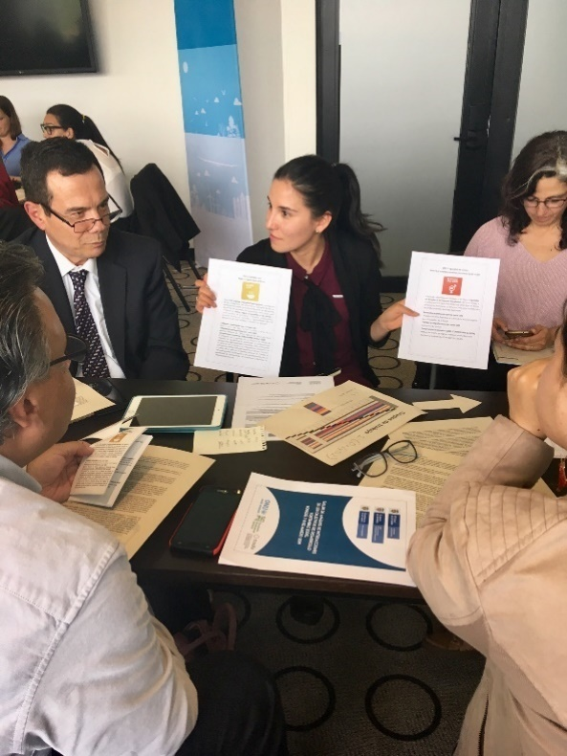
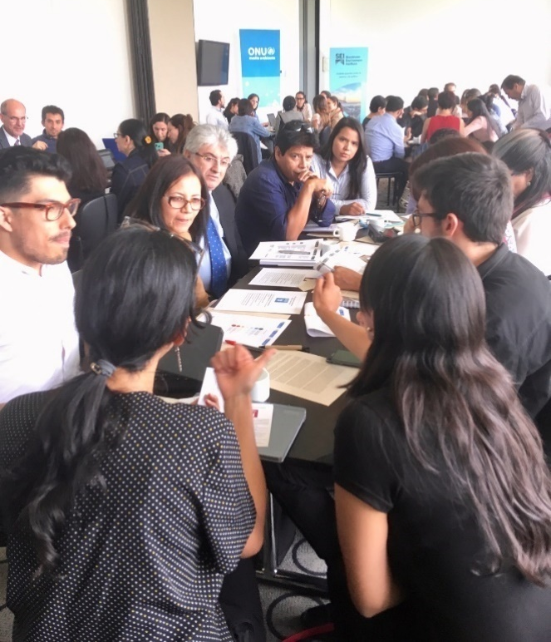


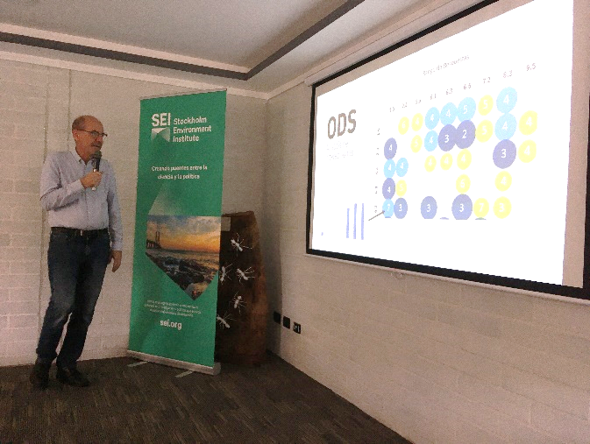
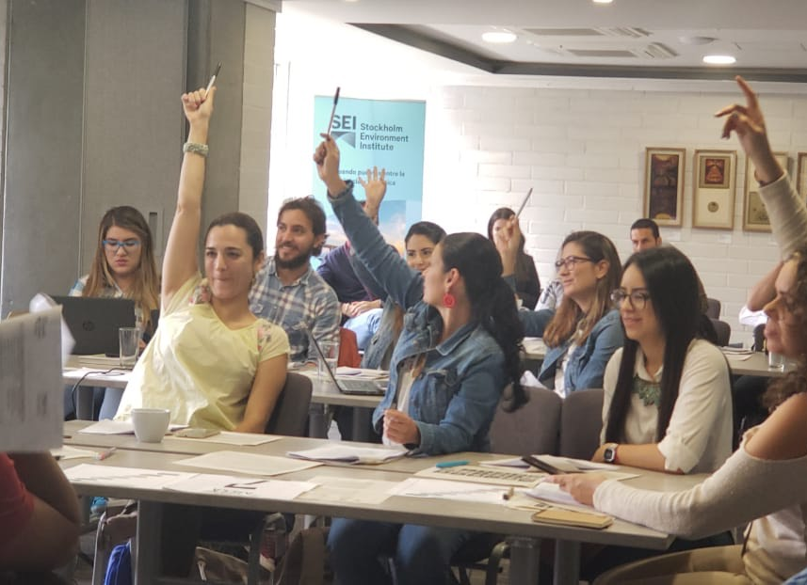
How do we conduct the analysis?
Bogotá, march 2019
Medellín, novermber 2018

Slide 9
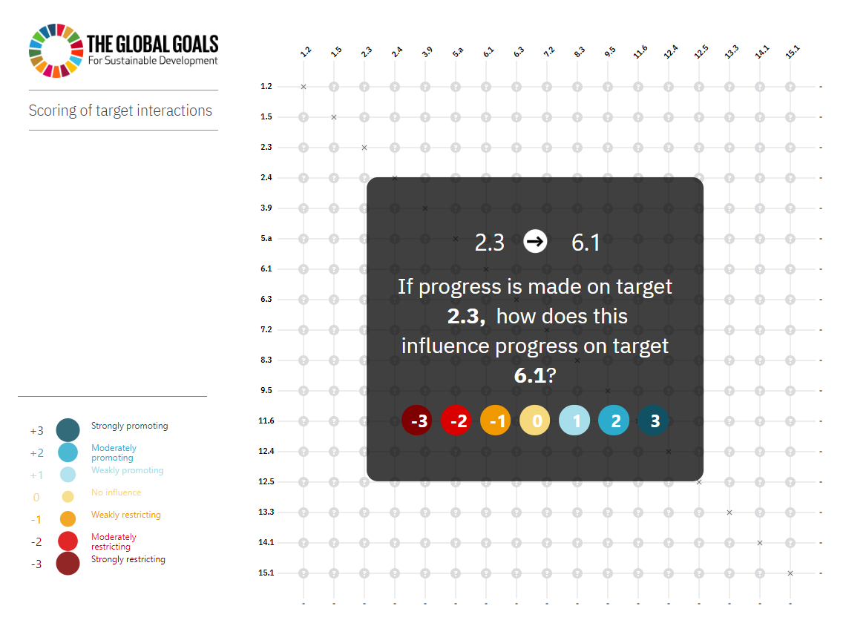
The matrix
Notes:
SEI Survey Tool
The SEI survey tool was, and is, being actively developed as a web-based tool with the objective to function on modern browsers (IE 11 and up) and, eventually, to be responsive for use on hand-held devices.
The tool is divided into two sections. The first is the section where users (identified by an anonymous token) can respond to the questions about interactions between Sustainable Development Goal (SDG) targets. The second is the administrator section where, administrators (identified by username and password) can create events, link specific targets to events, restrict and validate user responses, download data and visualize the final results for any event.
Although this tool is actively being developed and some of the technologies mentioned below may change in future versions, the current version uses the following technologies for its functioning.
1) A MySQL (MariaDB v. 10.2 or MySQL v. 5.7) database to store events, targets, responses and credentials
2) PHP (v. 7.2) to interact with the database, setup a basic database API and manage authentication.
3) Bootstrap (v. 4.1) to facilitate the front-end layout and responsiveness.
4) D3.js (v. 5.7) for creating the front-end visualizations of the responses (the matrix view).
5) Vue.js (v. 2.5) for handling front-end interactions of users/administrators.
6) Axios.js (v 0.18) for handling front-end calls to the database API.
7) On the development side, this tool is being developed with node (v. 10) and webpack (v. 4.25).

Slide 10
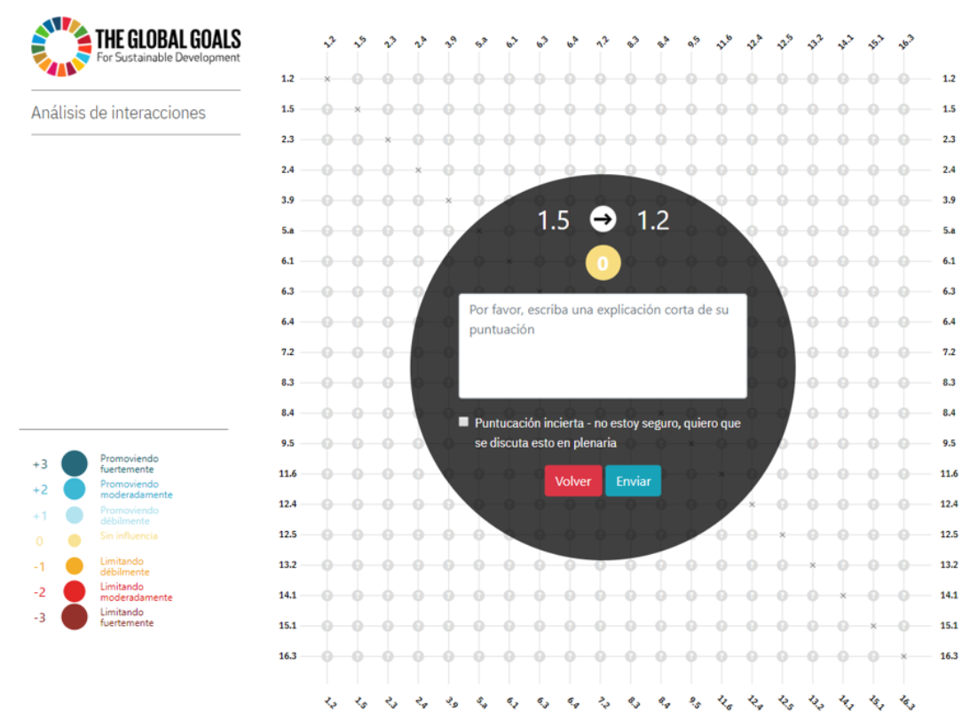
Explaining the score and uncertainty

Slide 11


Results
Foto:
Patrick Tomasso / Unsplash
Notes:
Photo: https://unsplash.com/photos/61MtRBl1qeE

Slide 12
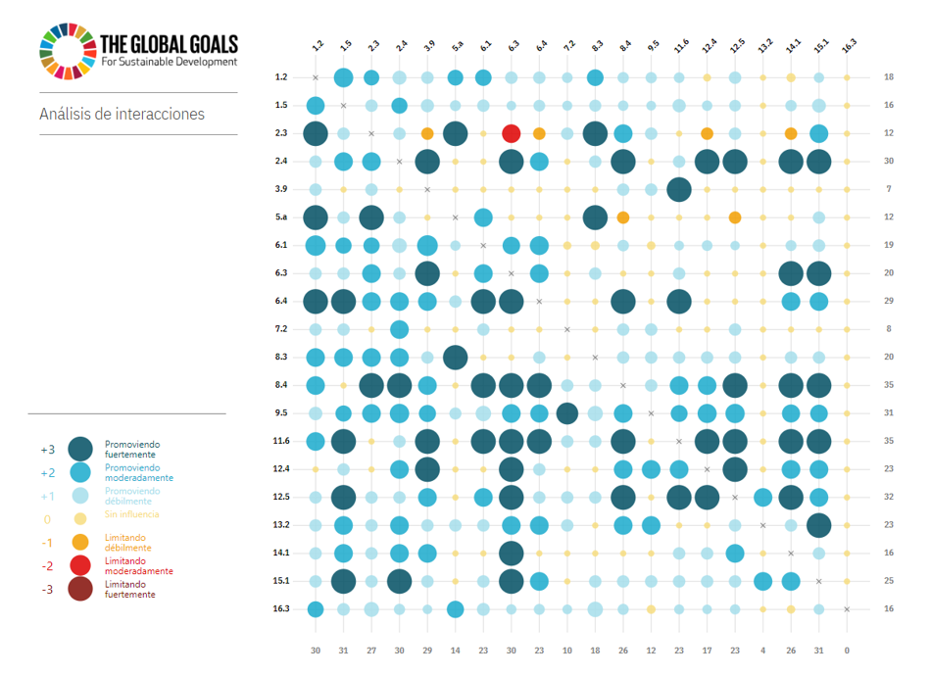
The final matrix
Notes:
Based on the matrix presented in Illustration 5, at the national level, the most influential goals are 8.4 on sustainable production and consumption and 11.6 on reducing the negative impacts of cities. Target 8.4 was considered very influential as the decoupling of economic development from the deterioration of natural resources implies involving the private sector, the government and the consumer and changing from consumption habits to production models. For this reason, target 8.4 generates a particular cascading effect in relation to other environmental and sustainable production issues. The goal that deals with the negative impact of cities (11.6) was also considered as a catalyst since it can help advance many other issues such as waste management, climate change mitigation, among others, in a highly urbanized context, as is the case of Colombia.Translated with www.DeepL.com/Translator

Slide 13
1st order and 2nd order interactions
Rank | 1st order | 2nd order
1 | 8.4 SCP 11.6 Impact from cities | 8.4 SCP
2 | 12.5 Waste reduction | 11.6 Impact from cities
3 | 9.5 Science and technology | 12.5 Waste reduction
4 | 2.4 Sustainable agriculture | 2.4 Sustainable agriculture
5 | 6.4 Water efficiency | 9.5 Science and technology
Example of results of an SDG interactions analyisis

Slide 14
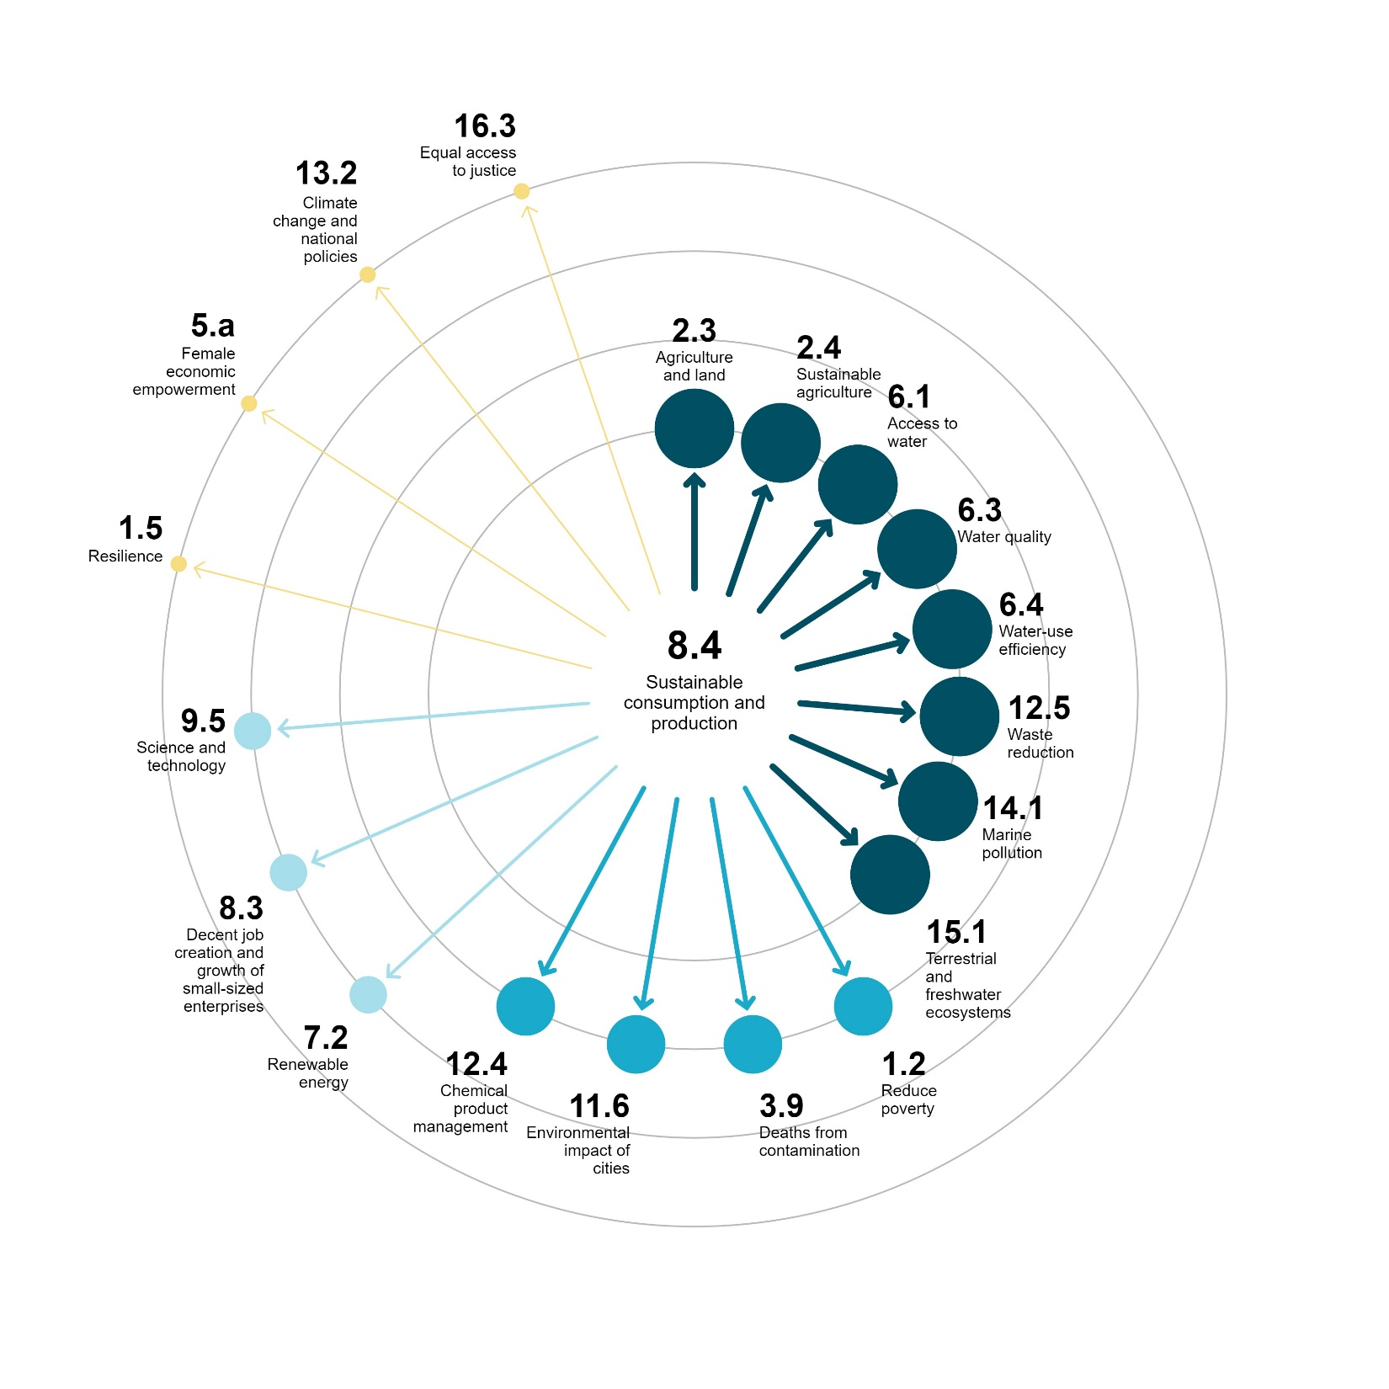
Visualizing 1st order interactions
Example of most influential target

Slide 15
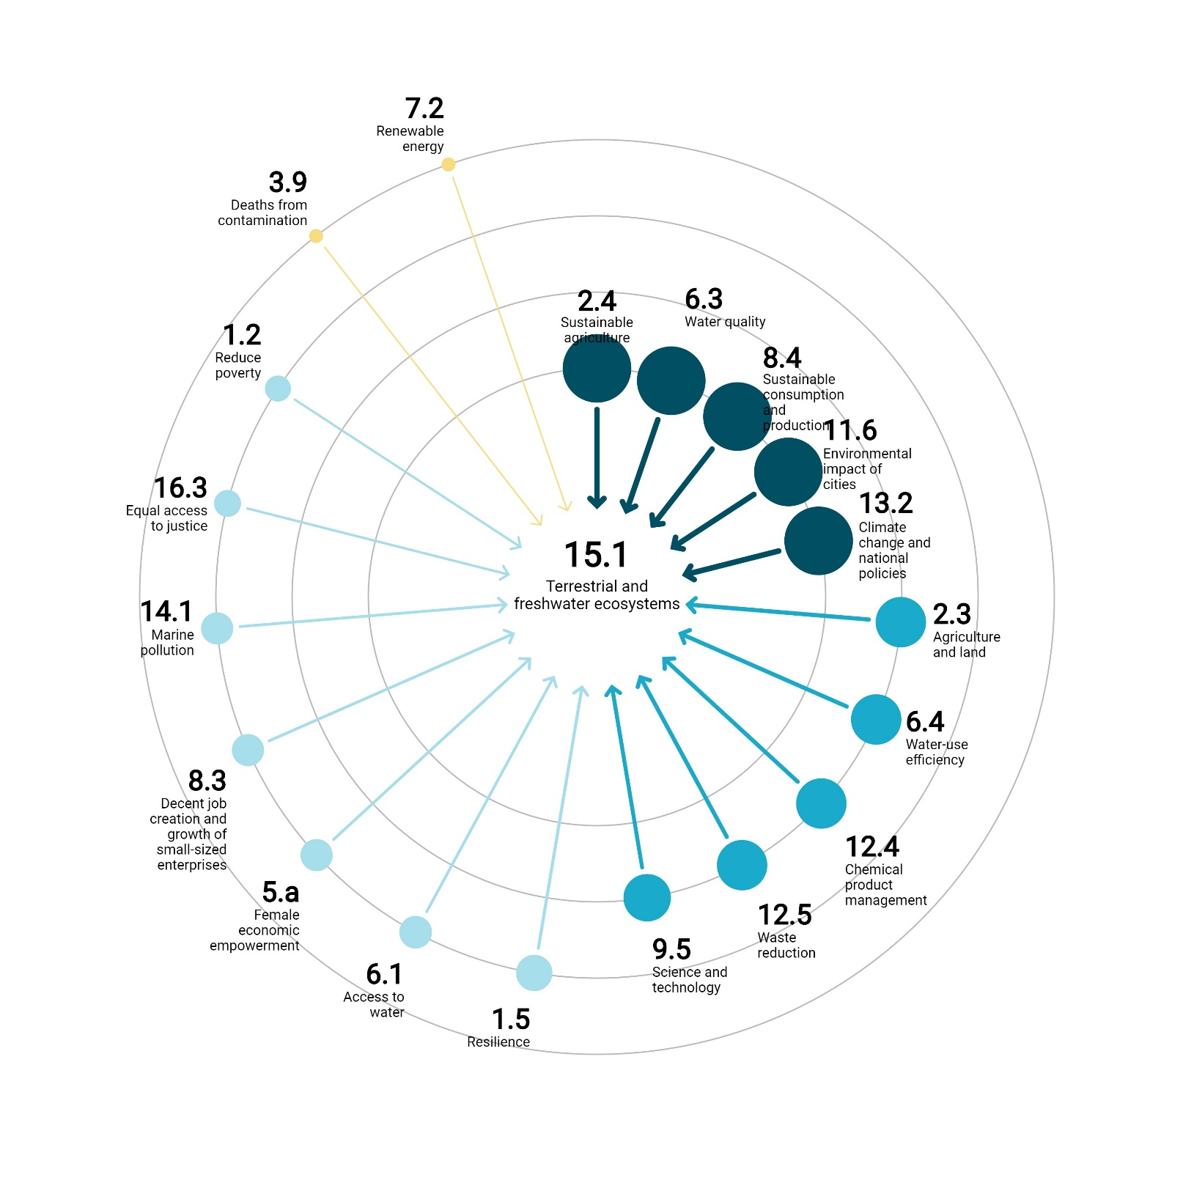
Visualizing 1st order interactions
Example of most influenced target

Slide 16
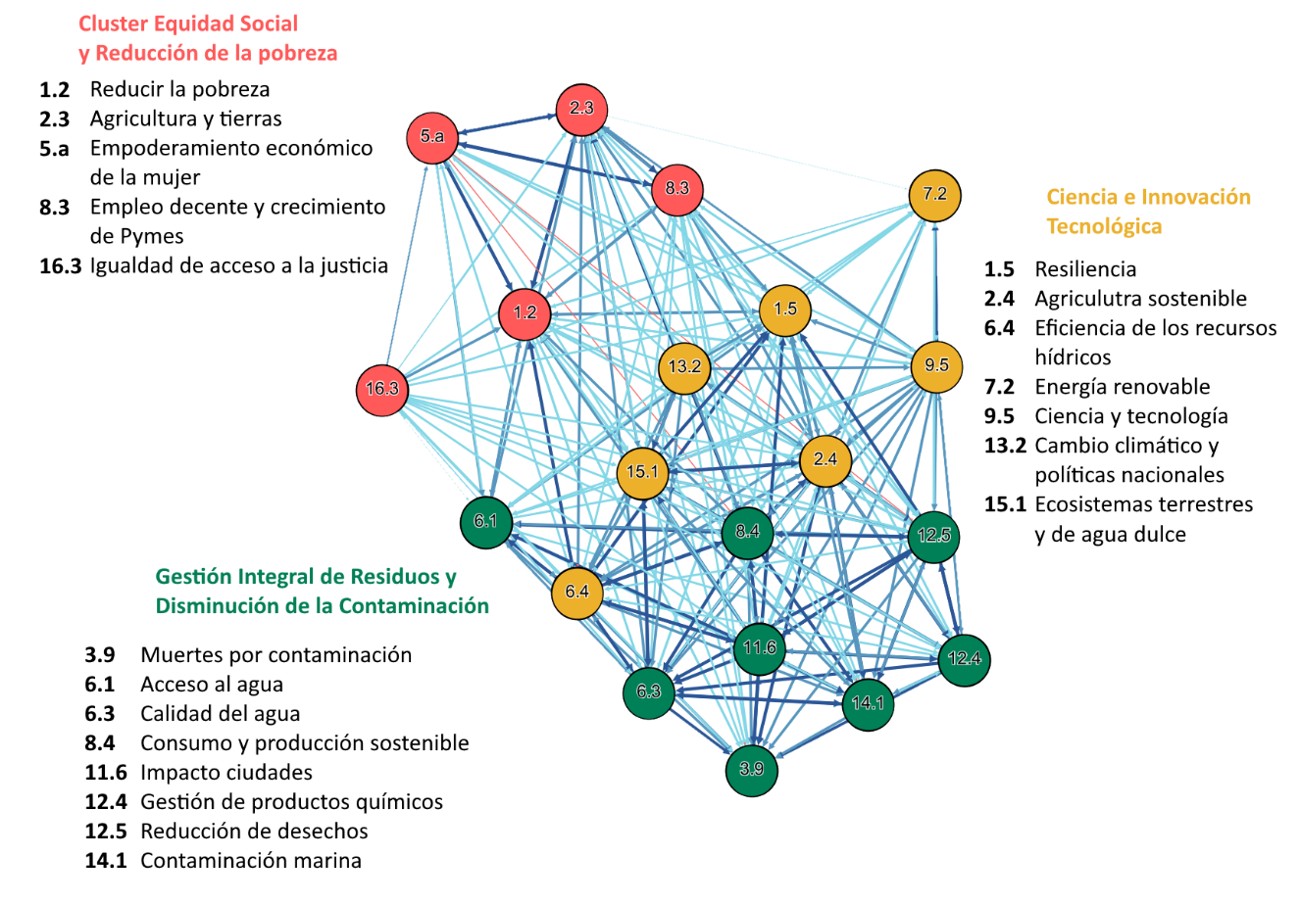
Clusters
Social equity and poverty reduction
Science, innovation and sustainability of ecnomic activities
Sustainable management of waste and pollution

Slide 17
Regional level 1st order and 2nd order interactions
Rank | 1st order | 2nd order
1 | 2.4 Sustainable agriculture | 2.4 Sustainable agriculture
2 | 12.5 Waste reduction | 12.5 Waste reduction
3 | 6.3 Water quality 12.4 Management of chemicals | 12.4 Management of chemicals
4 | 6.6 Water related ecosystems 11.6 Impacts from cities 13.3 CC policies and strategies | 11.6 Impacts from cities
5 | 9.5 Science and technology | 6.3 Water quality

Slide 18
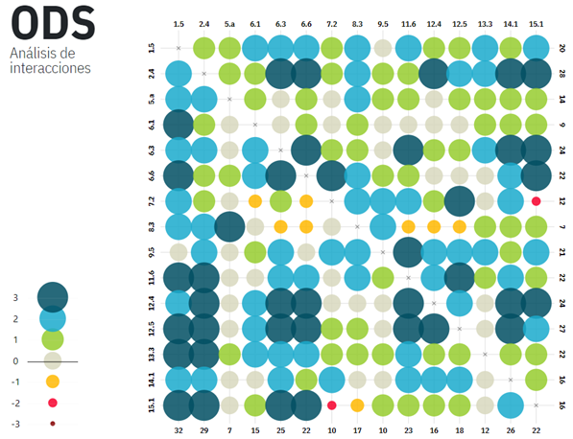

Slide 19
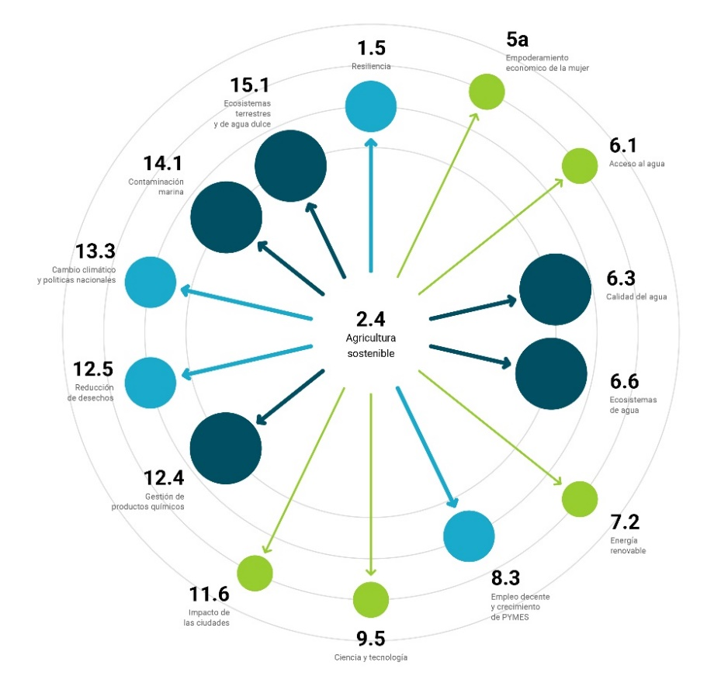
Regional: Visualizing 1st order interactions
Most influential target regional analysis

Slide 20
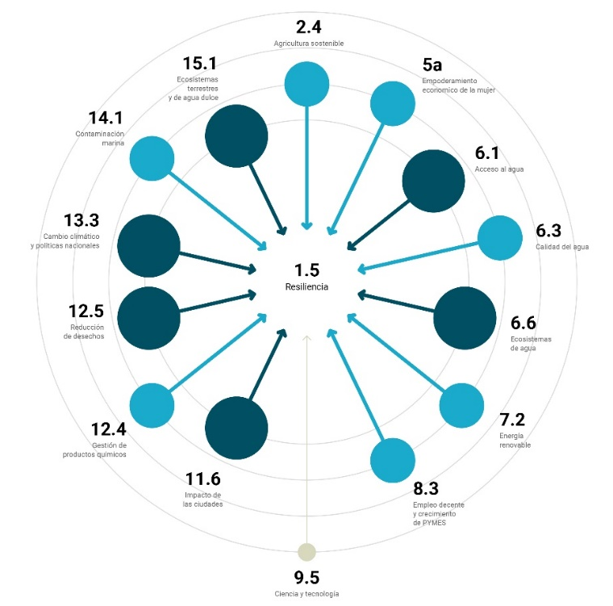
Visualizing 1st order interactions
Most influenced target regional analysis

Slide 21
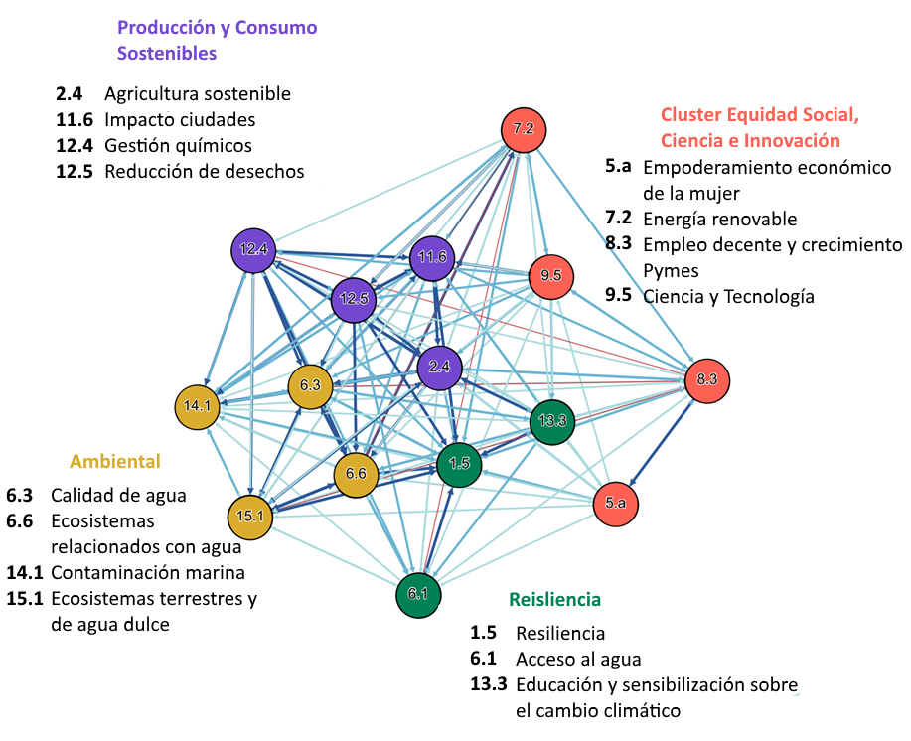
Clusters
Social equity , science and innovation
Capacity development and resilience
Integrated waste management and reduction impacts from agriculture and cities
Ecosystem conservation

Slide 22

Conclusions and next steps…
Foto: Photo by Duncan on Unsplash

Slide 23
The design of the process and the selection of targets/partners/experts are key to the success of these type of analysis
Regional and local analyses are needed to understand how interactions manifest themselves in the territories and to inform the formulation national plans and policies
More research is needed to perfect the process design and to develop different formats (a menu of applications)
Need to develop more studies of countries and to test the application to specific sectors

Slide 24
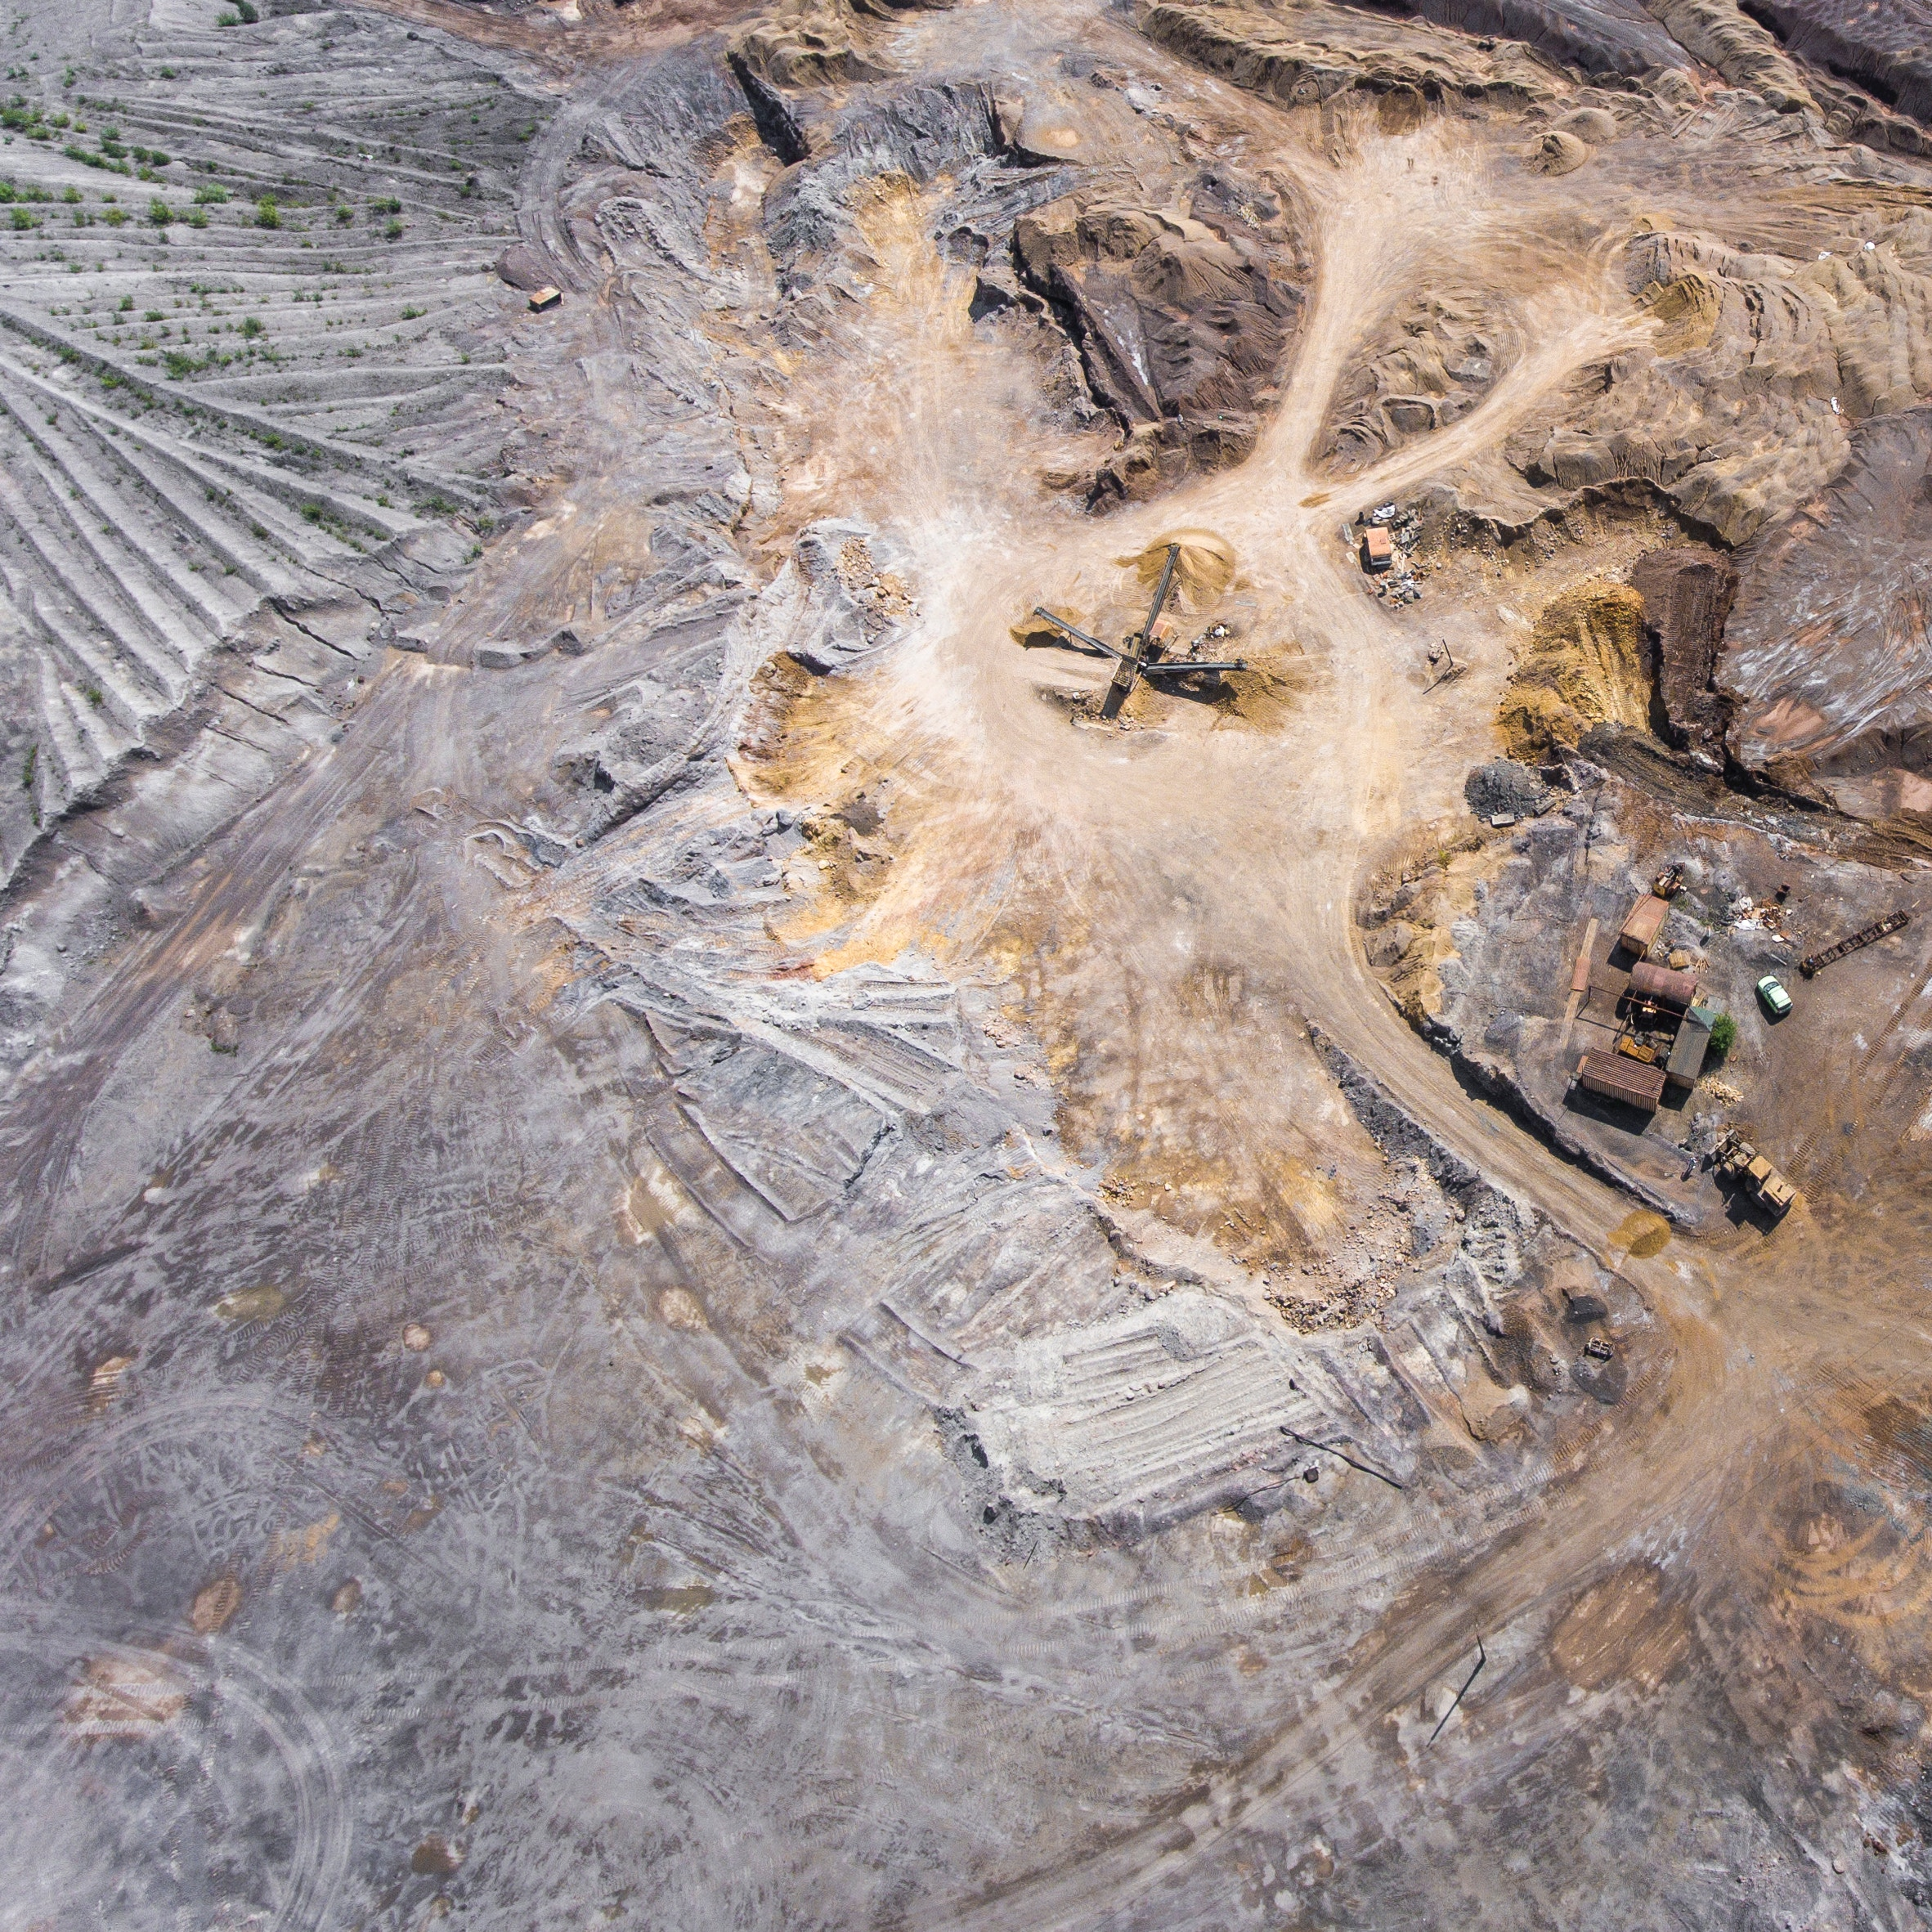
Aligning the mining and energy sector with the SDGs, NDC and OECD commitments

Slide 25
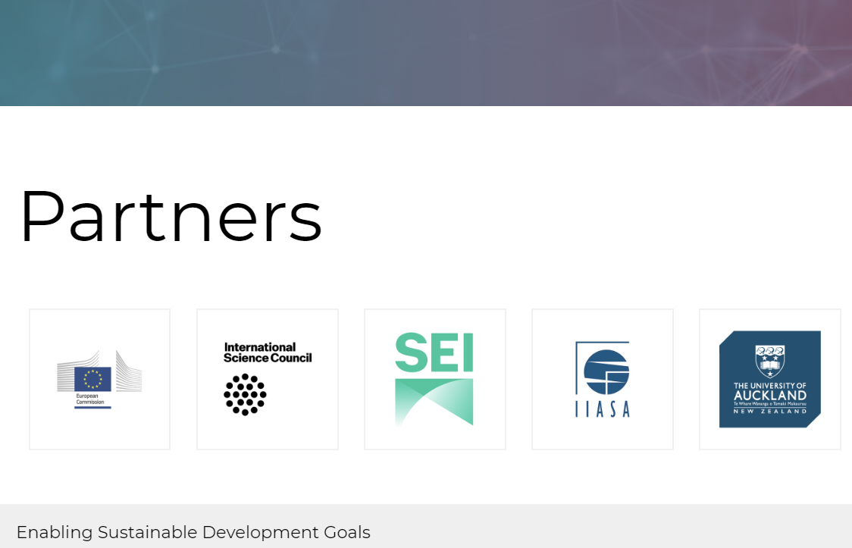


Alliance – SDG Interactions Toolkit

Slide 26
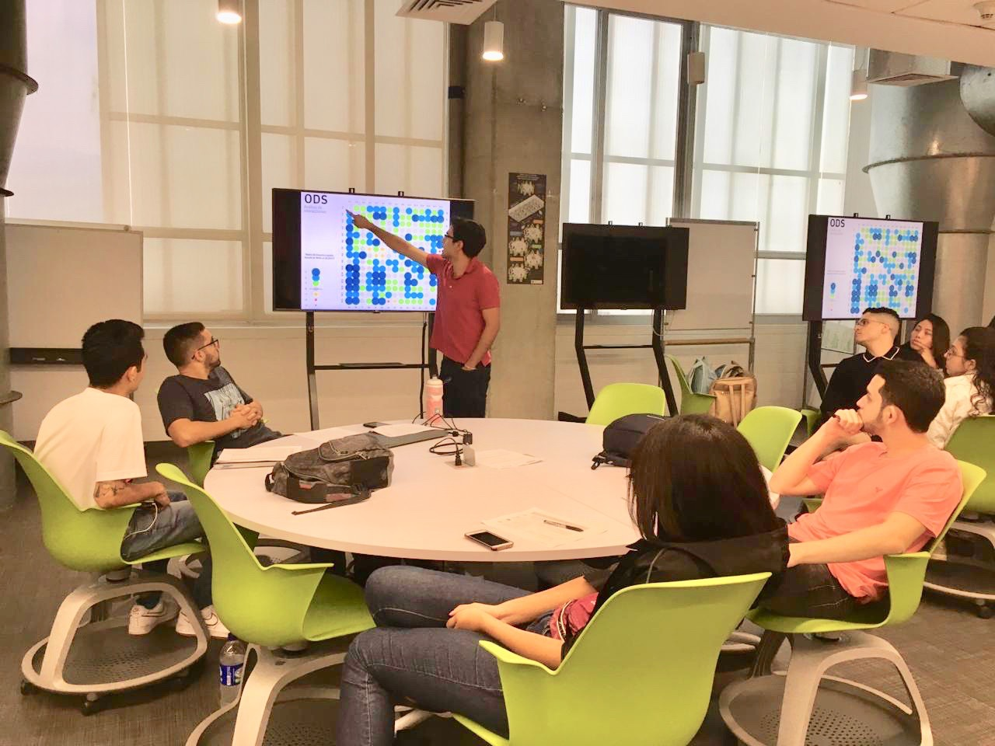
Experimenting with the tool and methods

Slide 27
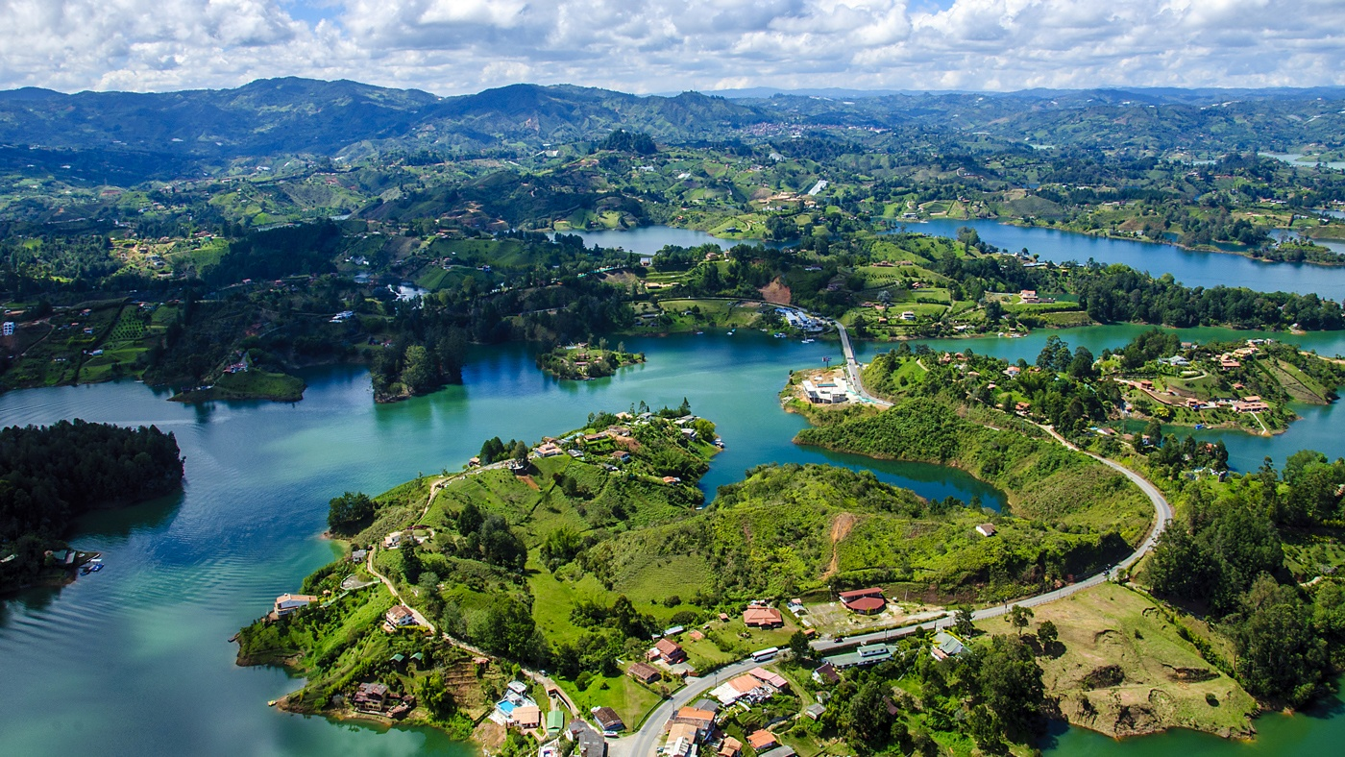
Thank you!

Slide 28


