Slide 1


Notes:
‘0’ This lecture explains the mass balance principle and examples on the process, sectoral and societal levels, relationship between mercury mass flows, the UNEP Mercury Inventory Toolkit, and other mercury inventory tools.

Slide 2

Notes:
‘1’ This section explains the mass balance principle and introduces several examples at different scales.

Slide 3
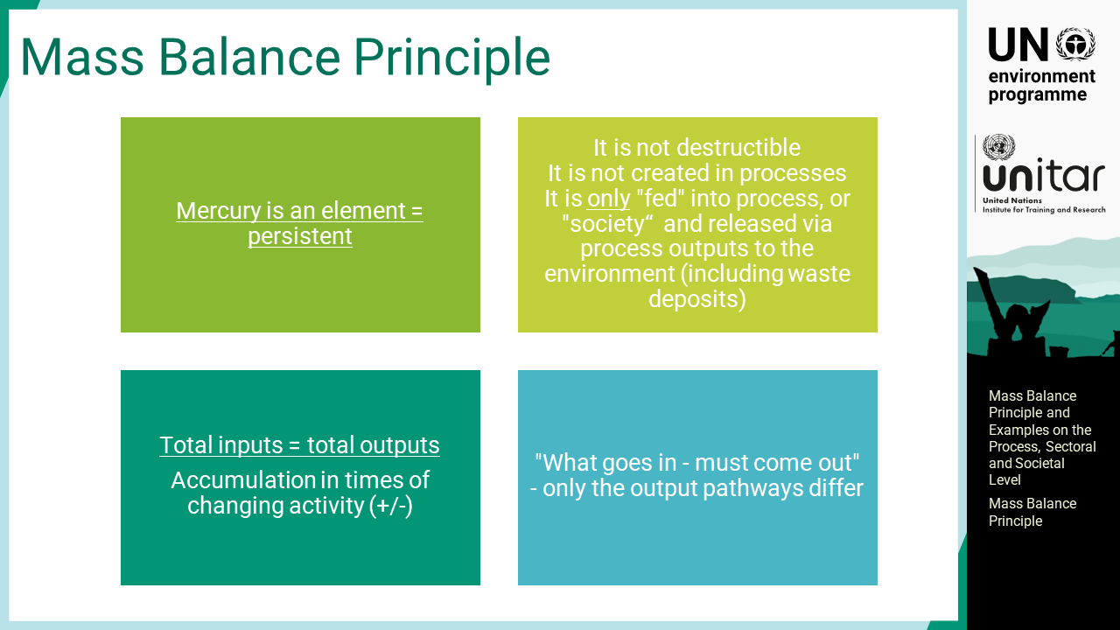
Notes:
‘2’ In general, the mass balance principle is described as follows: Mercury is a chemical element and persistent in the environment. This means that it is not destroyed, nor is it created in processes. It is only "fed" into process, or "society“ and released via process outputs to the environment, including waste deposits. When mercury is extracted from soil as a mineral or a trace element of other material, it enters society where it needs to be managed to reduce or avoid its adverse impacts. Thus, the first option would be avoidance for mercury from being brought into society as much as possible. Total inputs equal total outputs, meaning that what goes in must eventually come out. The only difference is the output pathways. In a timewise manner, however, mercury may accumulate if the activity rate changes over time. The accumulation may be positive or negative depending on the balance between inputs and outputs.

Slide 4
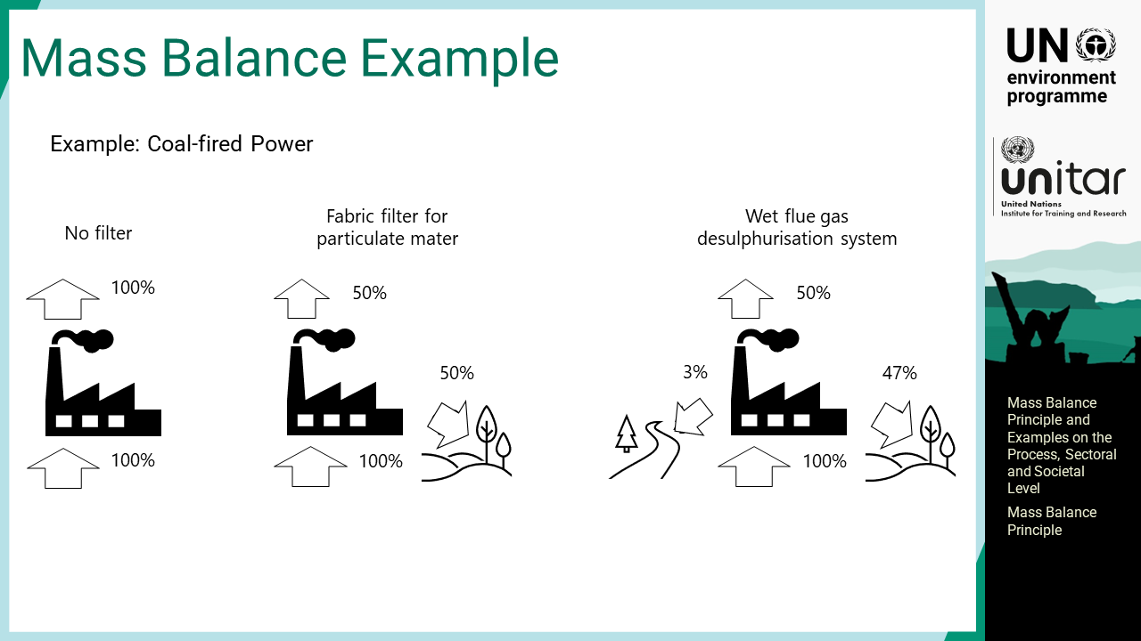
Notes:
‘3’ The figures give a simple example of the mass balance for a coal-fired power plant where all mercury inputs come with the coal in natural trace concentrations, which accounts for the hundred percent to the incoming arrows. The output pathways are influenced by the air emission control systems installed in the facilities. If there is no filter on the stack, then all mercury leaves through the stack because mercury is evaporated at such high temperatures. If a high-efficiency fabric filter for particulate matter is introduced, it may reduce mercury emissions up to 50 % but may actually vary significantly. Mercury trapped to the filter goes for disposal. If a wet process is introduced such as desulphurisation system, some part of mercury may be released to the aquatic environment. The same principle applies for other emission control technologies.

Slide 5
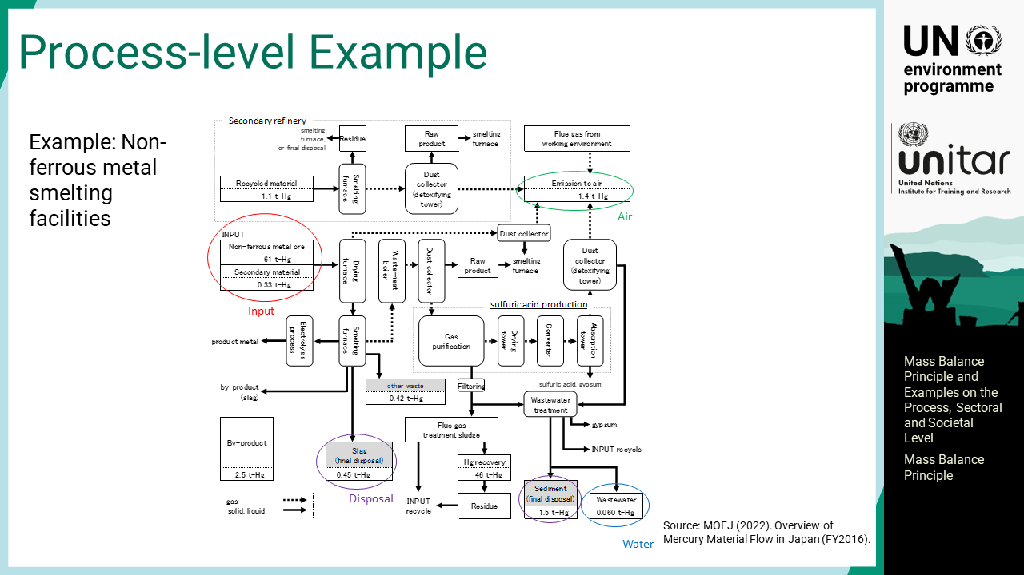
Notes:
‘4’ The mass balances for non-ferrous metal smelting facilities in Japan are presented as a process-level example. Non-ferrous smelting facilities are complex facilities with various types of chemical processes involved. Mercury is included in input feed, that is non-ferrous metal ore, in sludge, sediment and wastewater from flue gas treatment, by-product gypsum slag etc. The data are primarily obtained through interviews with the Japan Mining Industry Association in fiscal year 2016. In this example, a very small portion of the mercury input is released to the environment. Mercury is recovered from the system as calomel or metal mercury. It also flows out of the system with by-products, such as acid and gypsum, which may contain low concentrations of mercury.

Slide 6
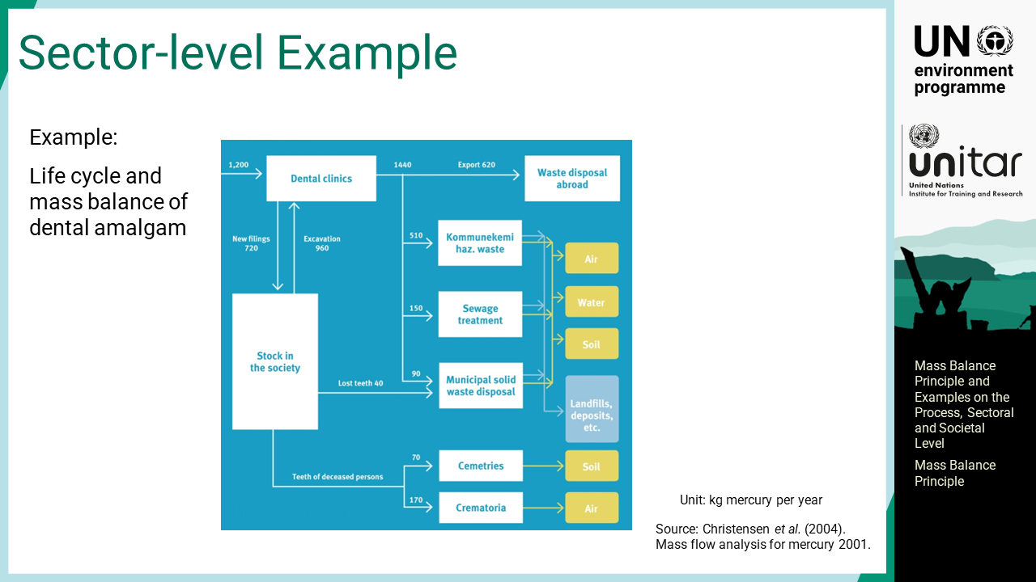
Notes:
‘5’ Life cycle and mass balance of dental amalgam of Denmark in 2001 is a mass flow example at the sector level. Amalgam is placed on people’s teeth in dental clinics, thereby increasing the mercury stock in society. From the stocks of amalgam in people’s teeth, mercury is lost to waste when teeth fall out, through excavations in the dental clinics, to cemeteries when the corpses are buried, or to the atmosphere if they are cremated. Dental treatment in clinics results in mercury release to air, water, and soil. It also produces mercury-bearing wastes, which may be released to wastewater or municipal solid waste if the amalgam is not segregated at the source. Dental amalgam waste should be separated into hazardous waste and specially treated. This mass balance is approximately 20 years old, and today, there is hardly any use of dental amalgam in Denmark because it has been regulated already. However, older people still have dental amalgam fillings, and they make their teeth drilled out or fall out, so mercury waste management must continue, which is the typical legacy mercury issue.

Slide 7
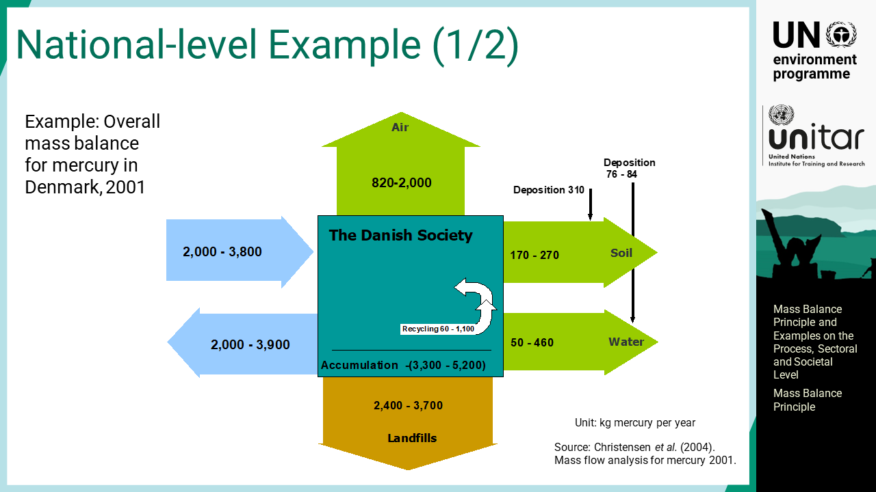
Notes:
‘6’ A national-level example of mercury mass balance is shown here. The diagram describes the overall summary of mercury flow in Denmark in 2001. The incoming arrow on the left is the overall import of mercury with products and materials. The outgoing arrow indicates exports, mainly as waste. There are also losses to air, soil and water, and to waste deposition at a significant level. As a whole, the accumulation at that time showed negative accumulation, which means a decrease in social stock.

Slide 8
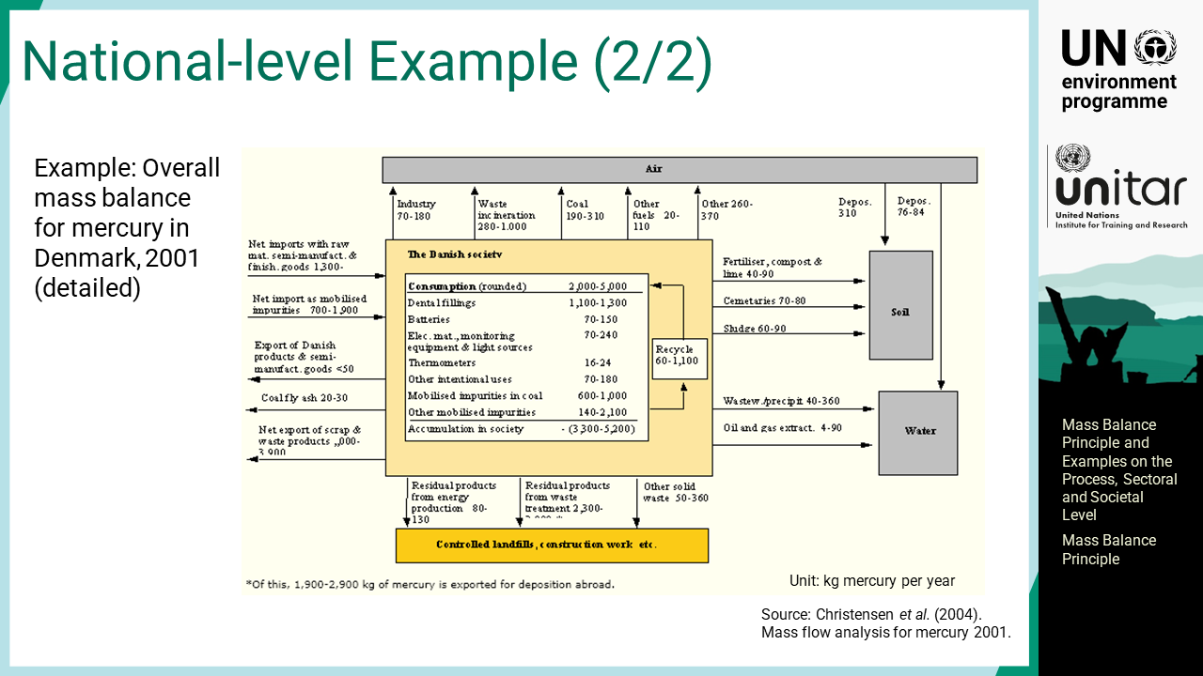
Notes:
‘7’ The previous diagram was simple, but background work to develop it was substantial. This diagram is the detailed version of the same diagram that indicates sector- or product-level figures. The negative accumulation is seen widely in the world today, thanks to the Minamata Convention, but the mercury waste issue will continue for decades. The use of mercury-added products was much higher in the past. It is now replaced by mercury-free alternatives or disposed of as waste. The legacy problems need to be addressed in the long term while implementing the Convention.

Slide 9

Notes:
‘8’ This section explains key mass balance equations that estimate the amount of mercury flow in the system.

Slide 10
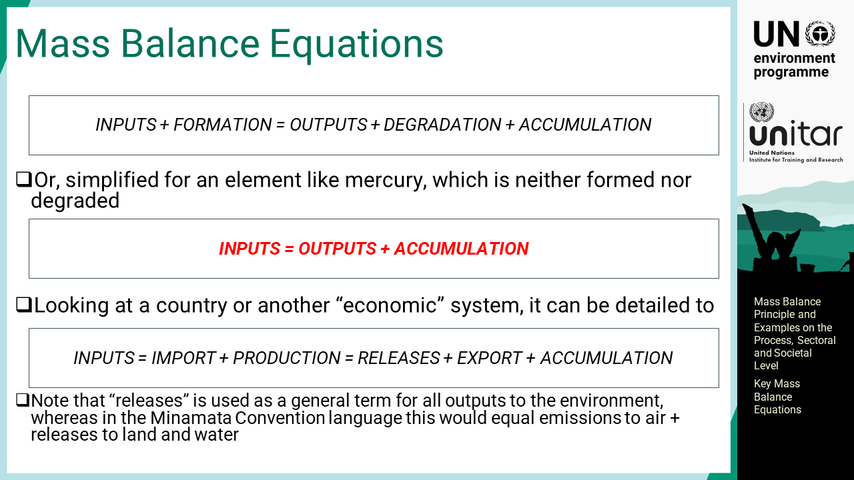
Notes:
‘9’ The mass balance equation is given in the first formula for the general case. For the specific case of an element such as mercury, which is neither formed nor degraded, it will be simplified to the second formula. Looking at a country or another “economic” system, it can be detailed in the third formula.

Slide 11
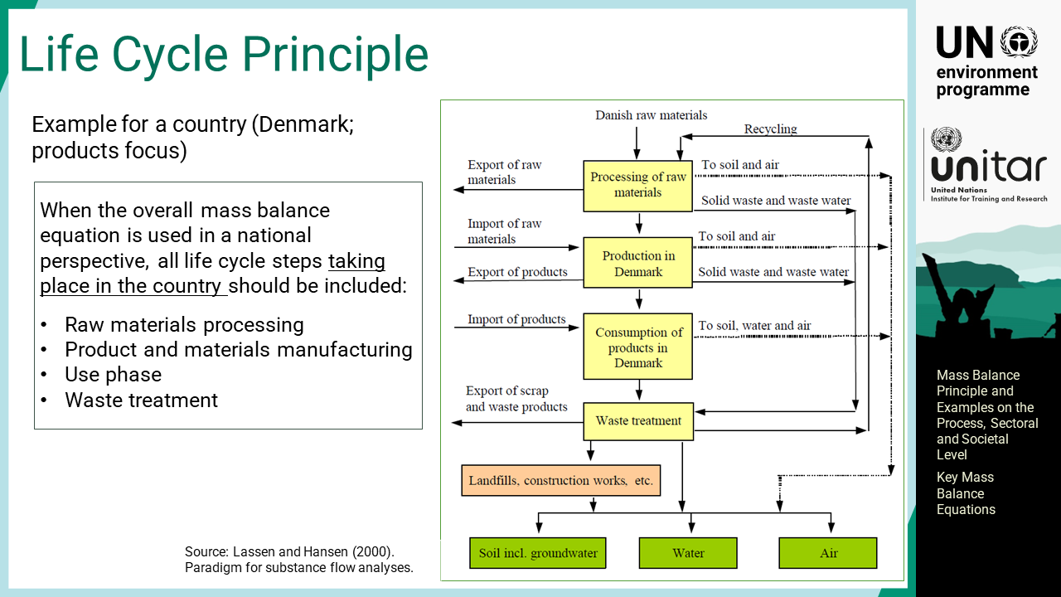
Notes:
‘10’ When the overall mass balance equation is used from a national perspective, all life cycle steps taking place in the country should be included. More specifically, all life cycle steps taking place inside the system boundaries, typically the country’s borders, should be considered. This may be raw materials processing, product or materials manufacturing, use phase, waste disposal and recycling. For example, in the case of dental amalgam fillings, the steps may include filling preparation in dental clinics, waste collection and treatment from dental clinics, recycling of filling material, wastewater discharge, evaporation loss of mercury from the fillings in the mouths, loss of teeth over the lifespan of a person and the fate of the teeth, and output to land in cemeteries or to air from cremation.

Slide 12
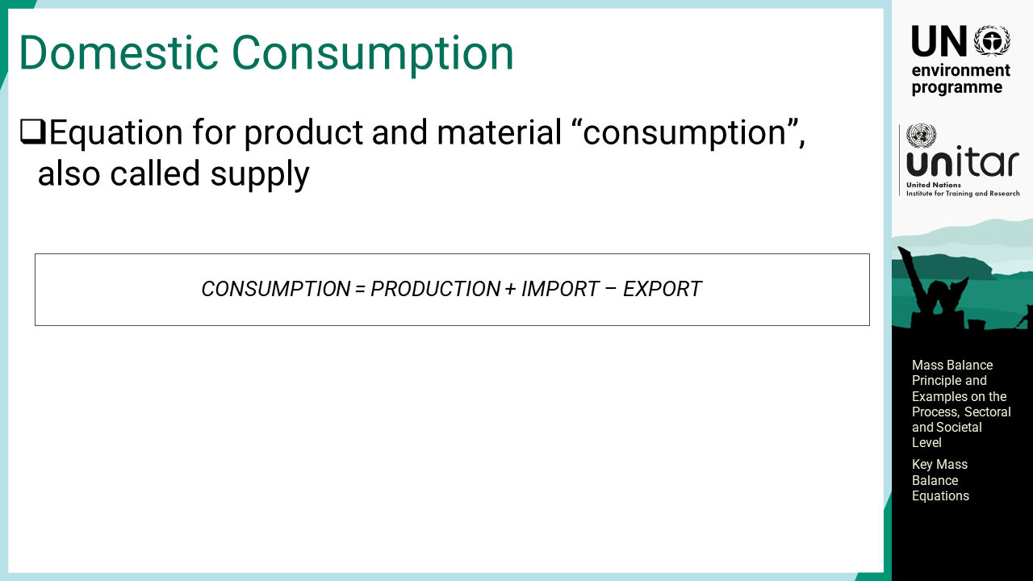
Notes:
‘11’ Domestic consumption equals production and imports minus exports. The terms domestic consumption and supply are often used interchangeably. In some studies, consumption refers to the true value while supply indicates statistical data because trade statistical data can include discrepancies due to less strict use of Harmonized Customs codes.

Slide 13
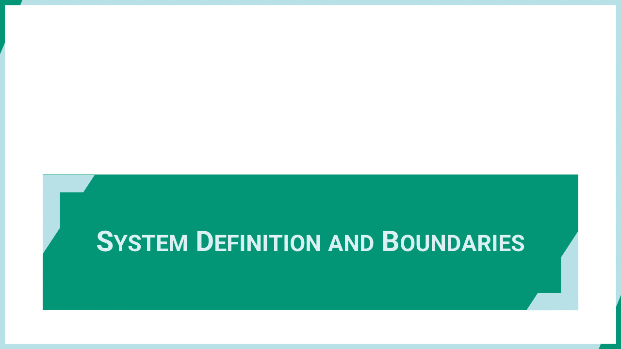
Notes:
‘12’ This section discusses the system definition and boundaries that enable a snapshot of the flow profile.

Slide 14
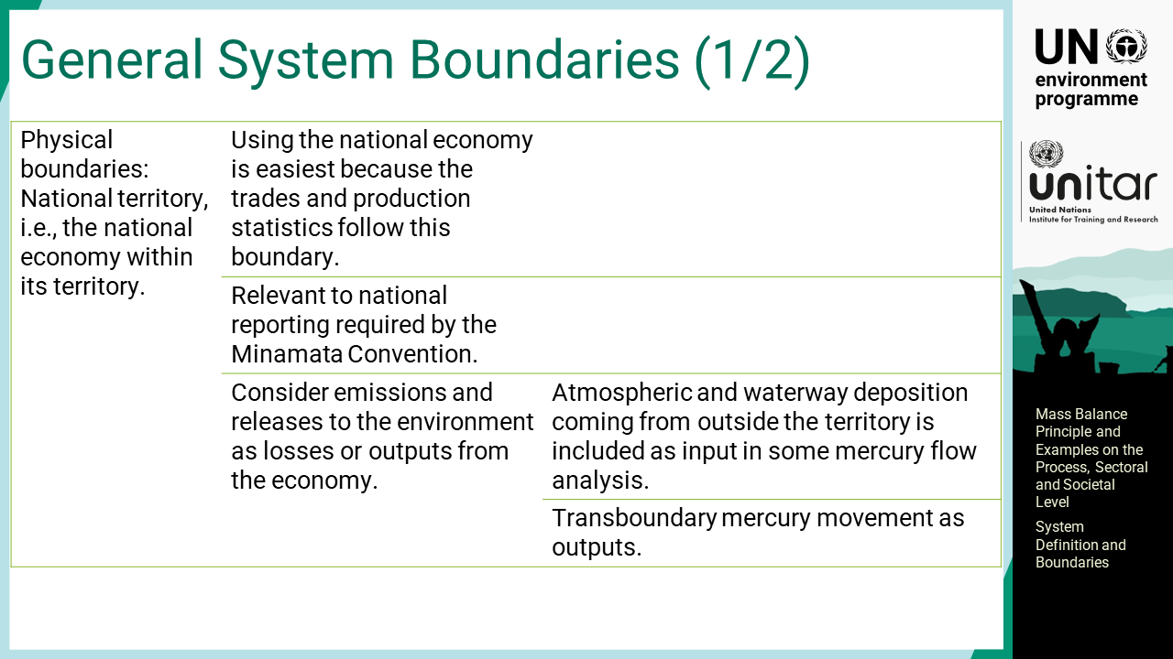
Notes:
‘13’ It is a basic concept to delineate the boundaries to monitor the flow crossing them so that incoming and outgoing amounts can be quantified. A typical physical boundary is a national territory, that is, the national economy within its territory. Using the national economy is easiest because the trades and production statistics follow this boundary. Flow analysis within national boundaries is also relevant to national reporting required by the Minamata Convention. Typically, in mass flow analysis, emissions and releases to the environment are considered losses or outputs from the economy. Atmospheric and waterway deposition coming from outside the territory is included as input in some mercury flow analyses.

Slide 15
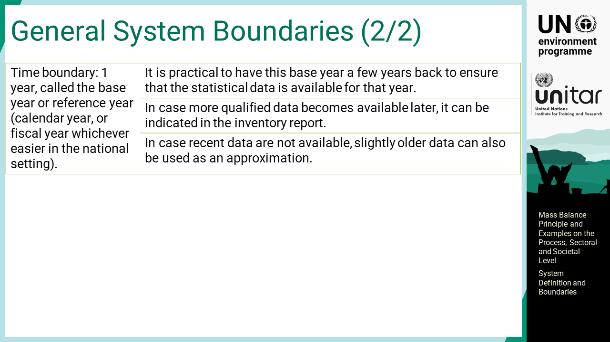
Notes:
‘14’ Additionally, a boundary in time has to be defined. This is typically one year, which is called the base year or reference year. It could be a calendar year or fiscal year, whichever is easier in the national setting. It is practical to have this base year a few years ago to ensure that the statistical data are available for that year. If more qualified data become available later, they can be indicated in the inventory report. In case recent data are not available, slightly older data can also be used as an approximation, but it must always be stated the year in question for each dataset.

Slide 16
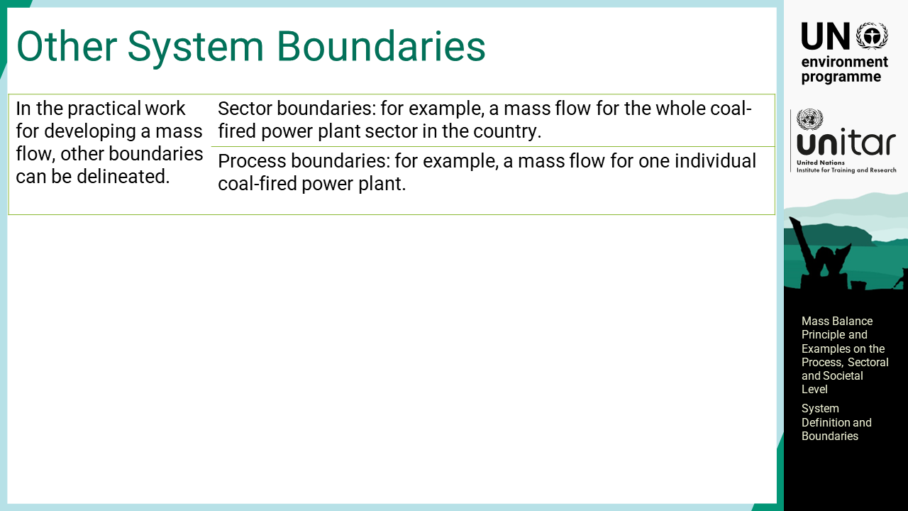
Notes:
‘15’ In the practical work for developing a mass flow, other boundaries can be delineated. For example, a mass flow for the whole coal-fired power plant sector in the country can be developed. Sometimes, a mass flow is developed at the process level. It could be just for one individual coal-fired power plant, which is for disclosure and data sharing. Such individual data can also inform the approximation of the entire sector through extrapolation if the presented data are accurate.

Slide 17
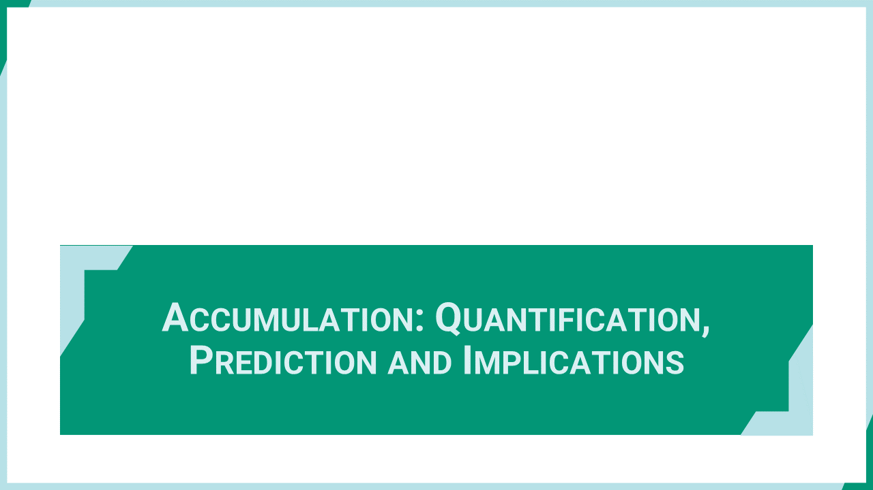
Notes:
‘16’ This section discusses the accumulation including its quantification, prediction, and implications.

Slide 18
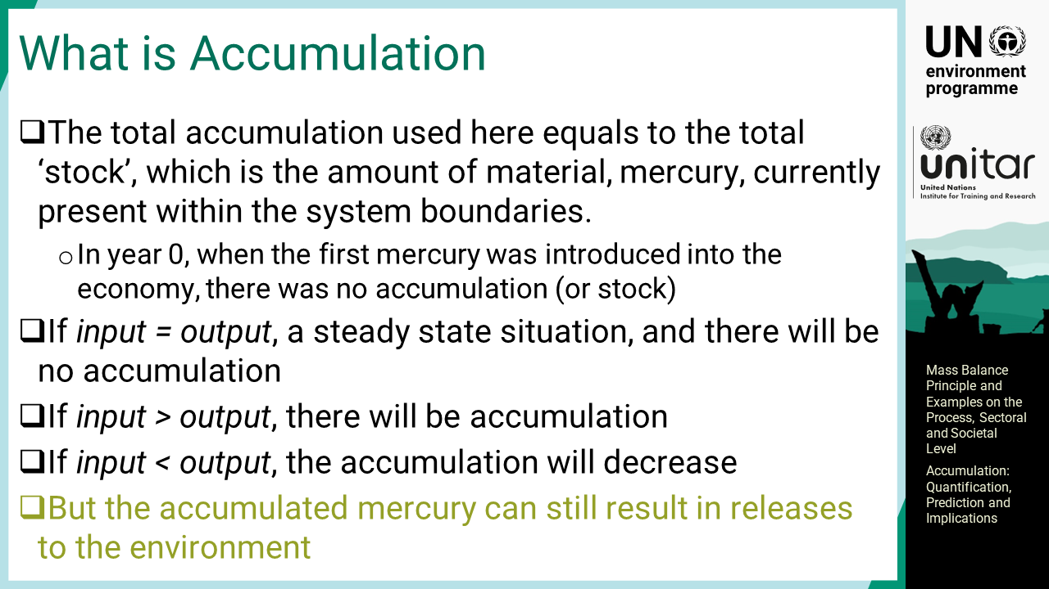
Notes:
‘17’ The total accumulation used here equals the total ‘stock’, which is the amount of material, mercury, currently present within the system boundaries. In year zero, when mercury was introduced into the economy, there was no accumulation or stock. In the following years, the input to society equals the output, which is called a steady state situation, and there will be no accumulation. However, if the input is larger than the output, accumulation will start forming in society. Assuming the early days when new mercury-added products were introduced, an increased amount of mercury built up in a society. Today, mercury has already accumulated in society that needs to be handled. If the input becomes smaller than the output by reducing mercury consumption or enhancing discarding mercury in use, the accumulation will decrease. Even though the mercury stock is decreasing in some countries, the accumulated mercury can still result in releases to the environment.

Slide 19
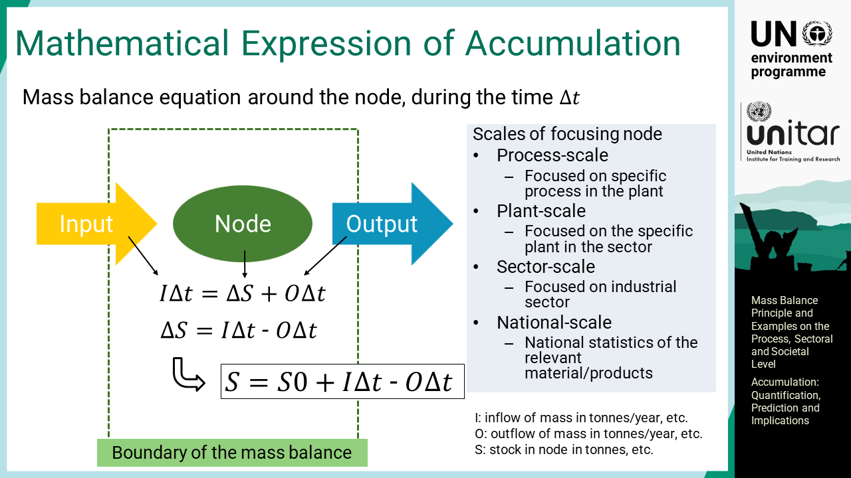
Notes:
‘18’ The mass balance concept and mathematical expression of accumulation are described in the differential equations. The node is the focus of the mass balance calculation, which can be at various scales. The stock in the node is a function of time, delta T, and initial stock, S zero. It is important to be aware of dynamics, which change over time among input, output, and stock in the node.

Slide 20
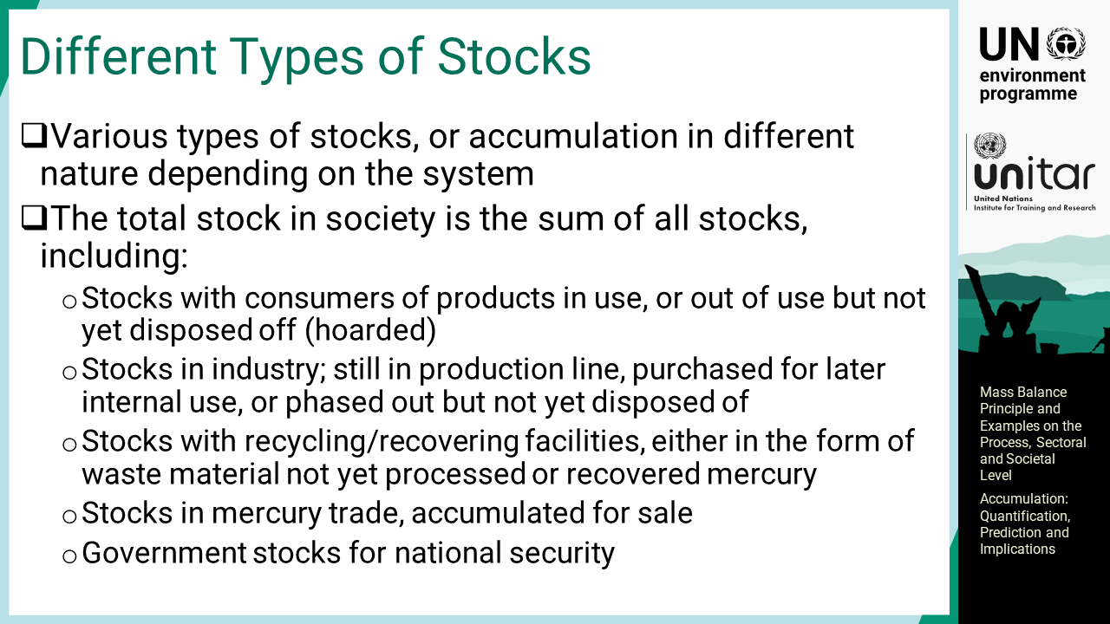
Notes:
‘19’ There are various types of stocks of different natures. The total stock in society is the sum of all stocks, including the following examples. Consumer products still in use or not in use but still kept by consumers are practically regarded as a stock. In industry, mercury-added products still in the production line, purchased for later internal use, or phased out but not yet disposed of, should also be stocks. The elemental mercury in chlor-alkali plants is stored for manufacturing use in the future or absorbed in plant facilities over the years. In recycling or recovering facilities, stocks will be found either in the form of waste material not yet processed or recovered mercury. There are also stocks in mercury trade companies accumulated for sale. There are also examples of government stocks of mercury as mercury is an important commodity for national security reasons. In the European Union and the USA, the sale of mercury in such stocks has now been prohibited because of the environmental impacts.

Slide 21
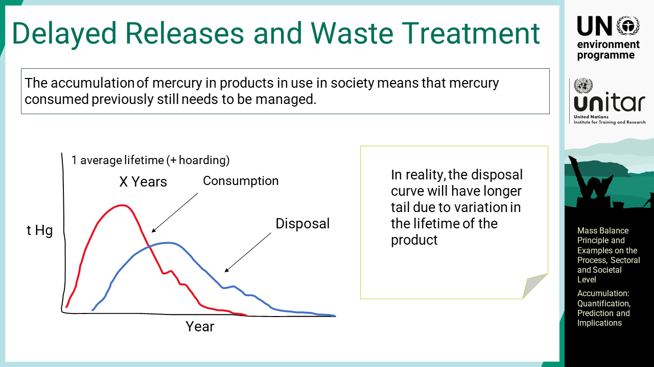
Notes:
‘20’ The accumulation of mercury in products in use in society means that mercury consumed previously still needs to be managed. Such delayed releases are due to the life of mercury-added products in use or hoarded. The red curve shows the consumption of a mercury-added product, or sales to consumers, industry, etc, over a range of years. It takes time before the product is no longer used, and people do not dispose of it immediately after use. In reality, the disposal curve would have a longer tail due to the variation in the lifetime of the product. This illustrates the need to handle legacy mercury waste for many years after sales have stopped.

Slide 22
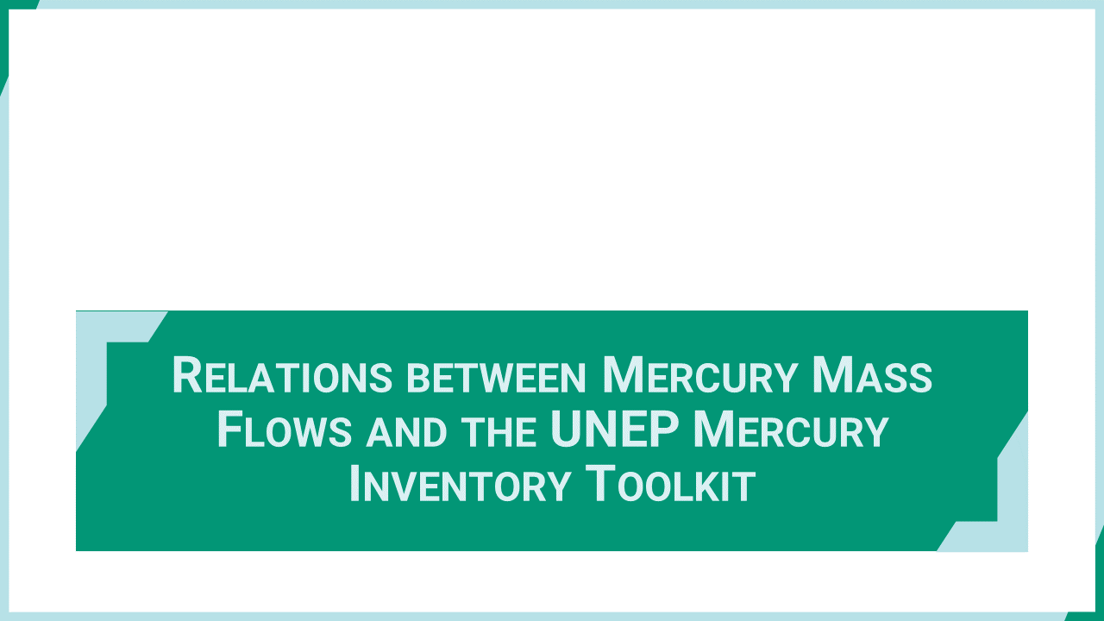
Notes:
‘21’ This section discusses the relations between mercury mass flows and the UNEP Mercury Inventory Toolkit.

Slide 23
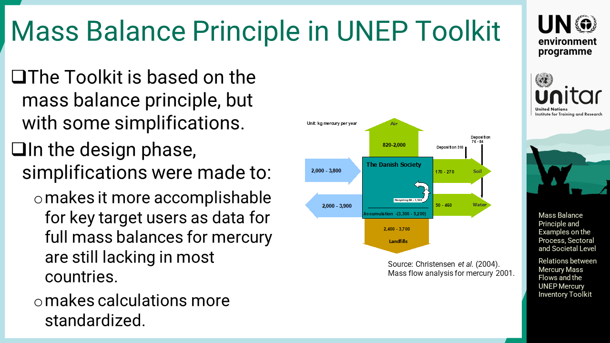
Notes:
‘22’ The Toolkit is based on the mass balance principle, but with some simplifications to make it easier to operate. This made Toolkit inventories much more accomplishable for the key targeted users, namely developers of the inventories. The Toolkit methodology also makes inventories more standardized, and thereby more comparable. The idea to simplify the methodology assumed that data for full mass balances for mercury are still lacking in most countries. Previously mass flows for mercury have been made in countries where there is relatively good access to data. Today, the database is increasing gradually through the works implementing the Minamata Convention. Simplified inventories have been developing over time for many countries, thus opening for more detailed inventories and mass flows.

Slide 24
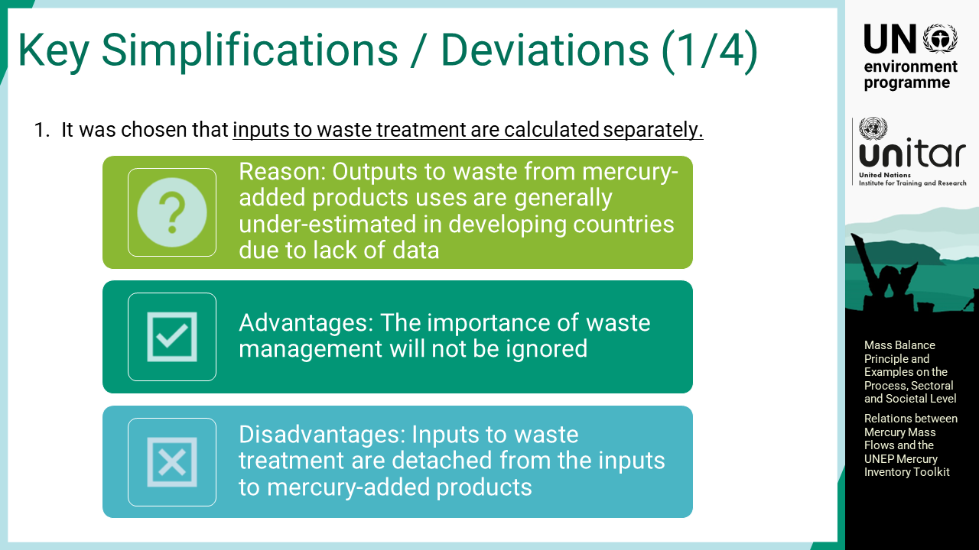
Notes:
‘23’ A few simplifications or deviations from the mass balance principle were introduced to the UNEP Toolkit. One of the major simplifications was the separate calculation of the inputs to waste treatments, which is a major deviation from a mass balance principle. This was because the flows to waste of mercury-added products were generally underestimated in developing countries due to a lack of data. The advantage of this simplification is, therefore, the emphasis of waste management, which should not be ignored. The disadvantage is that inputs to waste treatment are detached from the inputs to mercury-added products. This discrepancy can be accommodated if actual mass balances are developed.

Slide 25
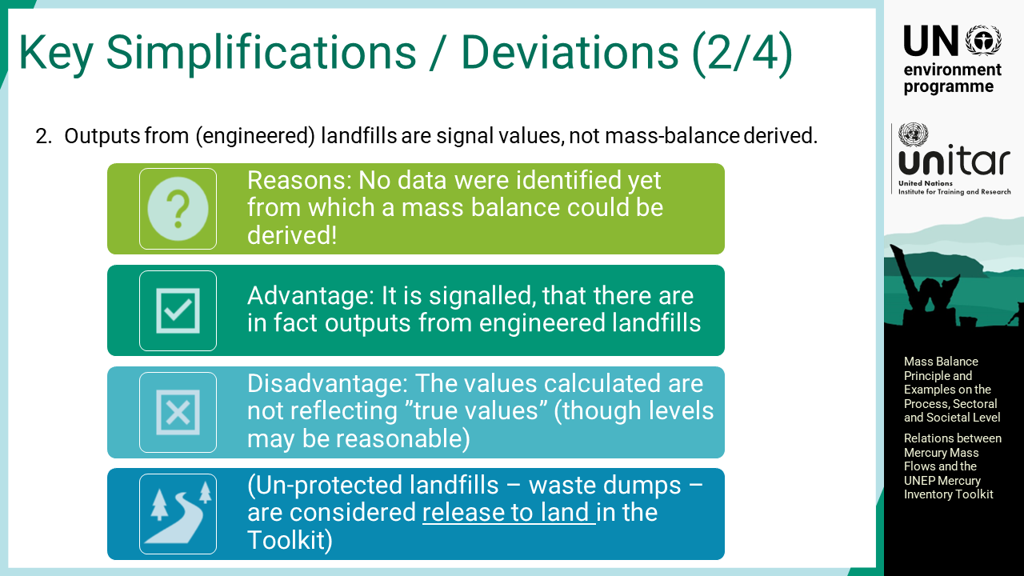
Notes:
‘24’ For the outputs from engineered landfills, the default factors for releases to air and water, meaning leachate, are not derived from mass balance. This is simply because no mass balance data are available for landfills. The advantage of it is to signal the possible outputs from engineered landfills. There is some evidence that mercury evaporates from landfills and that water leachates contain mercury. The disadvantages are that the calculated values do not reflect the true mass balance derived values but are the best assumption under current knowledge. In addition, unprotected landfills, or waste dumping sites, are considered direct releases to land in the Toolkit.

Slide 26
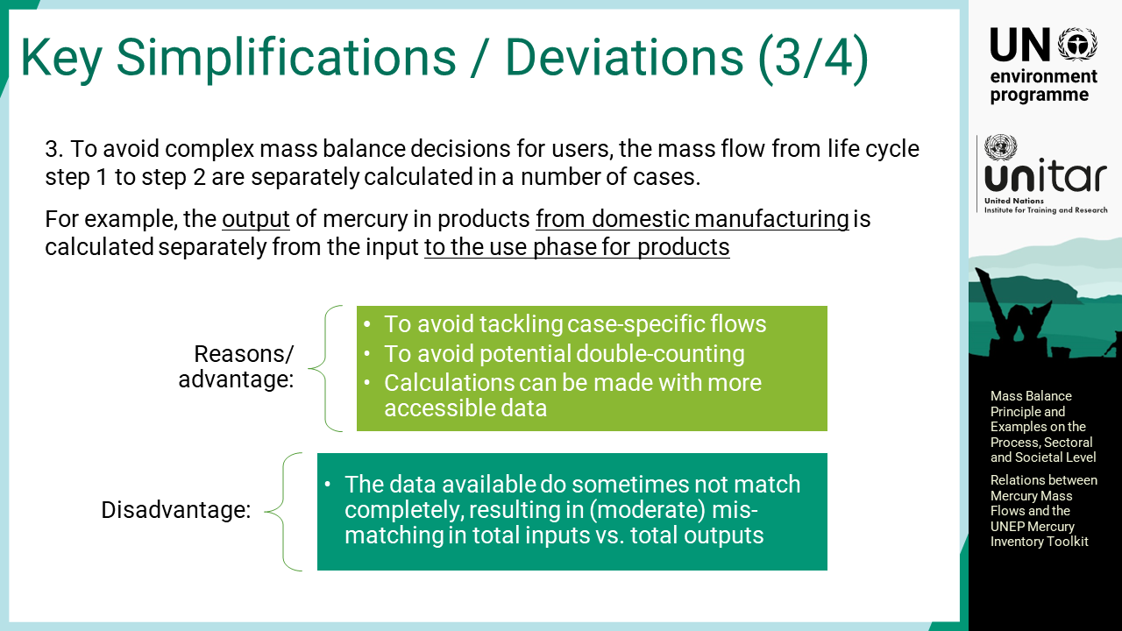
Notes:
‘25’ To avoid complex mass balance decisions for users, the mass flow from life cycle step one to step two is separately calculated in several cases to make data collection easier. It also saves users from handling potential double counting. For example, the output of mercury in products from domestic manufacturing is calculated separately from the input to the use phase for products. Additionally, the results are obtained with the production amount of mercury products without detailed mass balance studies. Instead, there is a disadvantage that moderate mismatch between total inputs and total outputs is seen in some Toolkit inventories due to the mismatching data. One hundred percent accuracy is usually not expected for mercury inventory within the available budgets. However, it will be improved if more data are available.

Slide 27
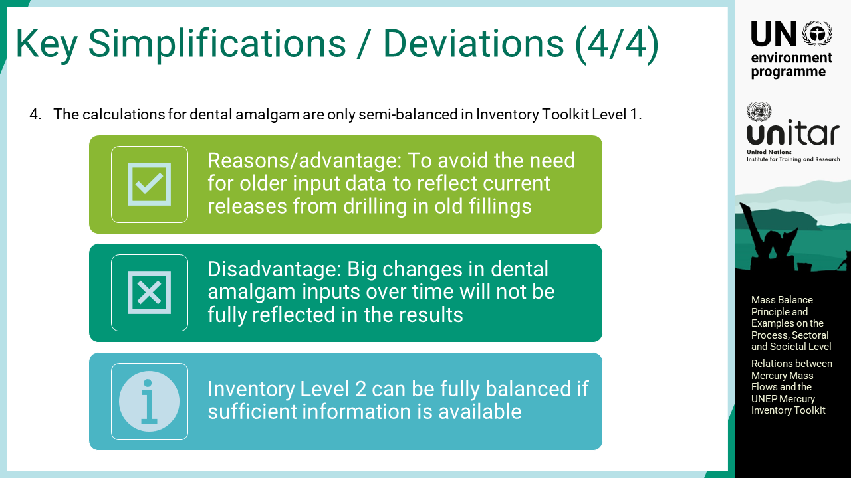
Notes:
‘26’ The calculations for dental amalgam are also semi-balanced in Inventory Toolkit Level one. The major reason is to avoid the need for older input data to reflect current releases from drilling in old fillings. Instead, it will obscure the effect of large changes in dental amalgam inputs over time. Inventory Level two can be fully balanced if sufficient information is available.

Slide 28
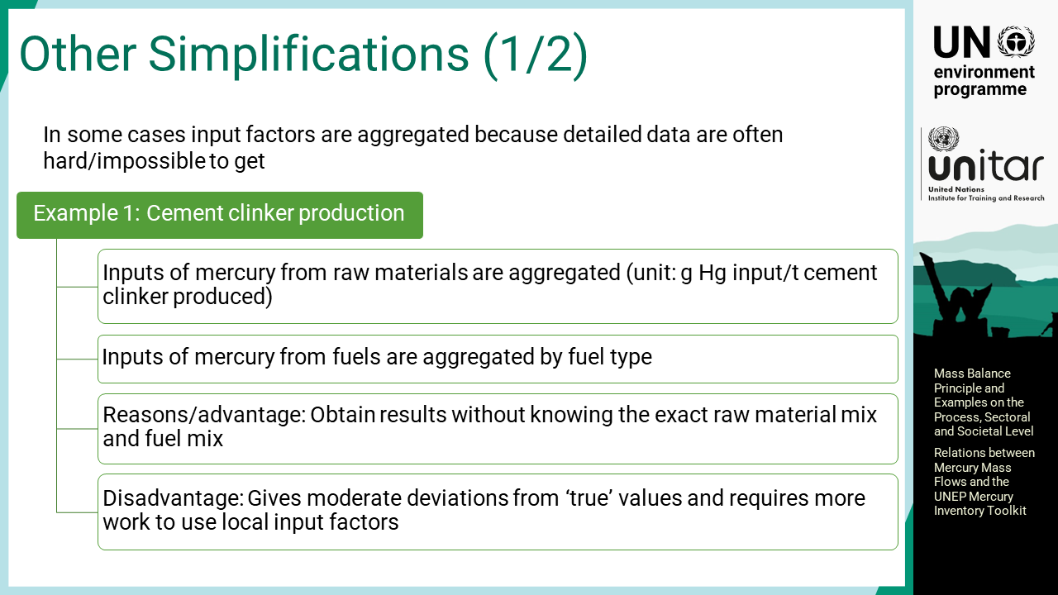
Notes:
‘27’ In some cases input factors are aggregated because detailed data are often hard or impossible to obtain. For cement clinker production in the Toolkit, inputs of mercury from raw materials are aggregated as tonnage of cement produced instead of getting mercury data for the clay, lime and other materials. Additionally, the inputs of mercury from fuels are aggregated by fuel type. This simplification can provide results without knowing the exact raw material mix and fuel mix. Instead, it gives moderate deviations from so-called true values and requires more work to use local input factors.

Slide 29
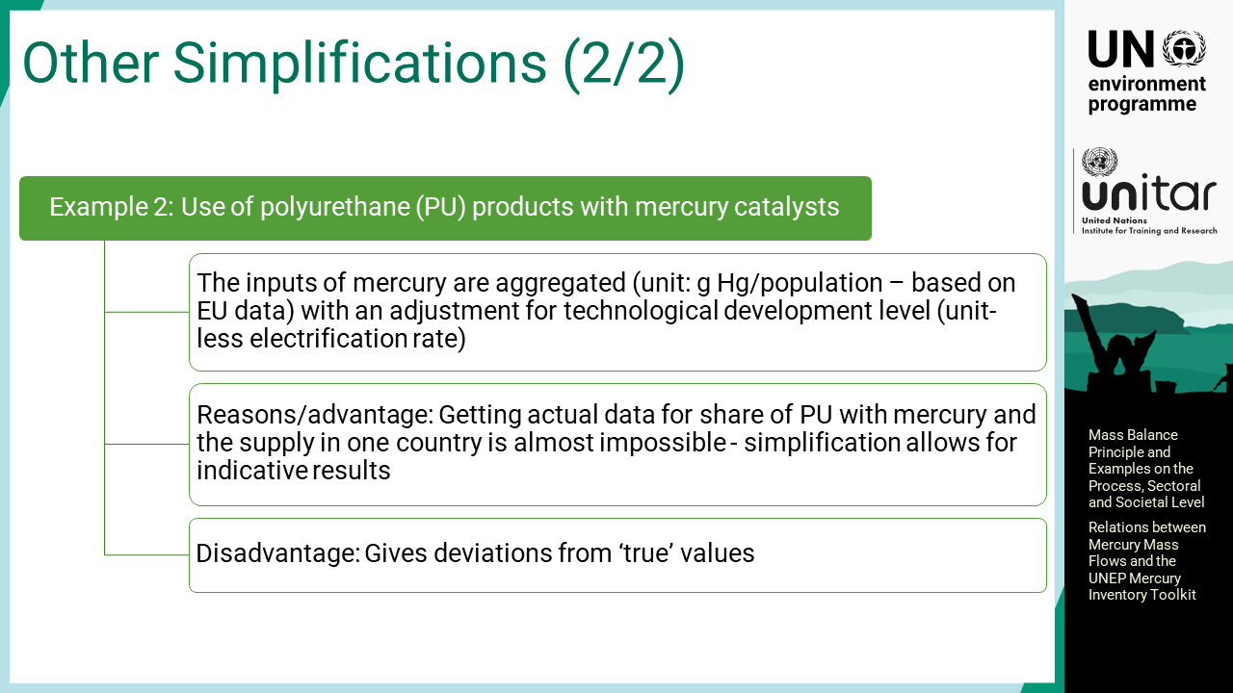
Notes:
‘28’ Another example is the use of mercury catalysts in polyurethane production where the inputs of mercury are aggregated with grams of mercury per population based on EU data with an adjustment for technological development level. This is because obtaining actual data for the share of polyurethane elastomers with mercury and the supply in one country is very difficult or almost impossible; thus, simplification can allow for indicative results.

Slide 30

Notes:
‘29’ This section provides information on other available mercury emission estimation tools.

Slide 31
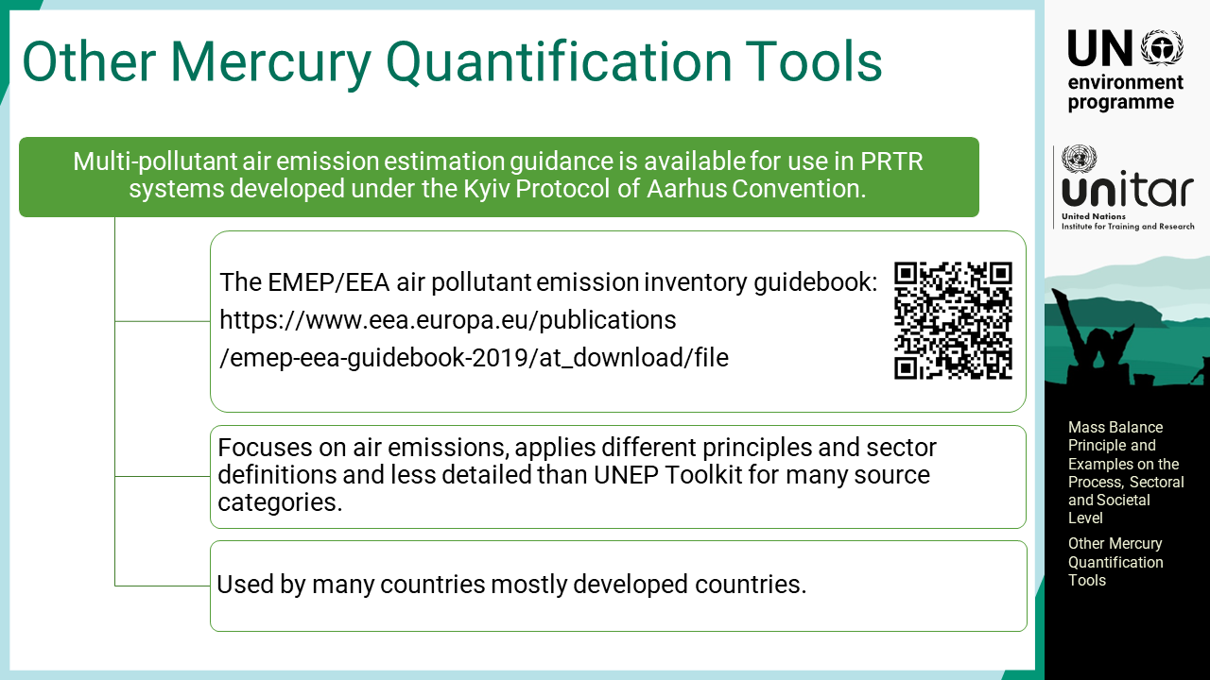
Notes:
‘30’ Multi-pollutant air emission estimation guidance is available for use in PRTR systems developed under the Kyiv Protocol of the Aarhus Convention. It focuses on air emissions, applies different principles and sector definitions and is less detailed than the UNEP Toolkit for many source categories. The method is, however, used in many countries covered by this Convention, and some other countries that have PRTR systems.

