Slide 1


july 2026
OzonAction Products and Tools catalogue

Slide 2


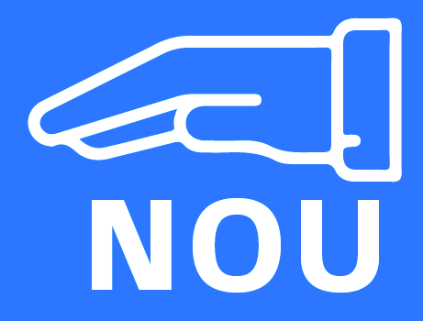
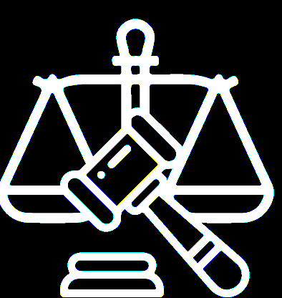
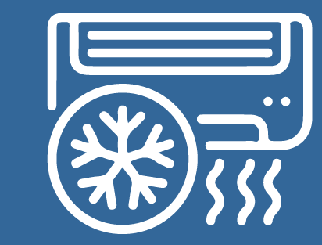

HOME
Enforcement, Customs & Illegal
trade
Gender
NOU Operations
Policy and Regulations
Public Awareness
Refrigeration and Air Conditioning

Slide 3







Enforcement, Customs & Illegal
trade
Publications, Training Manuals, & Guides
Special Initiatives & Campaigns
Factsheets, Briefs, & Quick Tools
Online Courses
Mobile & Desktop Apps

Slide 4




Enforcement, illegal TRADE AND CUSTOMS
Joining forces with Customs and Enforcement Officers for Safeguarding the Montreal Protocol (2024)
Vanuatu’s Case Study on integrating ODS/HFC into the National Single Window System (2023)
How to set up and manage logbooks for RACHP and other types of equipment (2023)
Checklist on Auctioning of Seized Refrigerants (2020)
Dealing with Seized ODS - Options for Article 5 Countries (2020)
Cheat Sheet – Proposed Additional HS Code Sub-Headings for HFCs in Advance of the 2022 HS Code Update (2020)
Refrigerant Cylinder Colours - What has changed? (2020)
Commonly Traded HCFCs and Mixtures Containing HCFCs - Post-Kigali Update (2016)
Commonly Used Non-ODS Substitute Refrigerants (2016)
Refrigerant Blends: Calculating Ozone Depleting Potentials (2016)
Refrigerant Blends: Calculating Global Warming Potentials (2016)
Customs Quick Tool for Screening ODS (2016)
Free Trade Zones and trade in ODS (2015)
Factsheets, Briefs, & Quick Tools
Enforcement, Customs, & Illegal
trade
Checklist for Environmental Inspectors - based on Serbia's Checklist (2019)
Common Products and Equipment containing or reliant on HCFCs (2016)
Europe and Central Asia Montreal Protocol Award for Customs and Enforcement Officers
Green Customs (2022)
Special Initiatives & Campaigns

Slide 5


Enforcement, illegal TRADE AND CUSTOMS
Guidance on Streamlining National ODS/HFC Licensing System in Asia and the Pacific (2024)
Watch out for Illegal Trade of HCFCs and HFCs: Lessons learnt from the Global Montreal Protocol Award for Customs and Enforcement Officers (2023)
Global Montreal Protocol Award for Customs and Enforcement Officers (2019)
Training Manual for Customs and Enforcement
Publications, Training Manuals, & Guides
Officers -3rd EDITION - Saving the Ozone Layer (2013)
Enforcement Strategies for Combatting the Illegal Trade in HCFCs and Methyl Bromide (2013)
Legislative and Policy Options to Control HFCs (2018)
Minimising Quarantine and Pre-shipment (QPS) Uses of Methyl Bromide: Tools for Controlling, Monitoring and Reporting (2016)
Phasing-out Methyl Bromide in Developing Countries (2014)
Gas Card Tool (2021)
New and Improved iPIC Platform (2020)
HCFC Quota and Licence Tracker (2020)
Refrigerant Identifier Video series: Guidance on how to identify refrigerants using a refrigerant identifier (2018)
WhatGas? (2018)
Enforcement, Customs & Illegal
trade
Mobile & Desktop Apps

Slide 6


GENDER
Guidebook on Mainstreaming Gender in the Implementation of the Montreal Protocol (2024)
Gender Mainstreaming in the Montreal Protocol: Experiences in Latin America and the Caribbean (2022)
Women in Cooling: A Worldwide Survey (2022)
Women in the Refrigeration and Air-conditioning Industry: Personal Experiences and Achievements (2019)
Publications, Training Manuals, & Guides
Gender Policy Implementation – Throughout the lifecycle of projects funded under the Multilateral Fund
Gender Assessment: Preparation guide for multi-year agreements supported under the Multilateral Fund
Understanding Gender : Using gender-related terms…(2024)
Breaking Molds: Inclusion in the Refrigeration and Air Conditioning Industry
Women in the Refrigeration and Air-conditioning (RAC) Sector: Why it matters
6 ways to create opportunities for women to join and professionally succeed in RAC sector
3 ways to create gender-responsive work conditions
Women's Participation in the Refrigeration and Air-conditioning (RAC) Sector
Gender Mainstreaming: Potential Linkages between the Montreal Protocol and gender equality outcomes in various Sustainable Development Goals (SDGs)
Women's Rights in Refrigeration and Air-conditioning (RAC)
Gender
Factsheets, Briefs, & Quick Tools

Slide 7

GENDER
Posters for different target audiences Montreal, including on gender mainstreaming (2022)
Special Initiatives & Campaigns
Gender

Slide 8





NOU Operations
Publications, Training Manuals, & Guides
Mobile & Desktop Apps
Newsletters and Bulletins
Factsheets, Briefs, & Quick Tools
Special Initiatives & Campaigns
Online Courses

Slide 9

NOU OPERATIONS 1/3
Update on New Refrigerants Designations and Safety Classifications (2026)
Considerations for Establishing National HFC Quota System (2023)
How to set up and manage logbooks for RACHP and other types of equipment (2023)
Recognition of Prior Learning Scheme for RAC Servicing Technicians in Mongolia (2023)
Labelling Refrigerant Cylinders (2021)
Cheat Sheet – Proposed Additional HS Code Sub-Headings for HFCs in Advance of the 2022 HS Code Update (2020)
Dealing with Seized ODS - Options for Article 5 Countries (2020)
Refrigerant Cylinder Colours - What has changed? (2020)
Servicing Tail for HCFCs (2020)
Article 7 Data Reporting on HFCs: When Countries Need to Start Reporting (2019)
Twinning of National Ozone Officers and Energy Policymakers (2018)
The Path from Kigali: HFC Phase-down Timeline (2018)
Demonstration of a Regional Strategy for ODS Waste Management and Disposal in the ECA Region (2017)
OzonAction Series of Fact Sheets on the Kigali Amendment (2017)
Common Products and Equipment containing or reliant on HCFCs (2016)
Commonly Traded HCFCs and Mixtures
Containing HCFCs - Post-Kigali Update (2016)
Commonly Used Non-ODS Substitute Refrigerants (2016)
Global Warming Potential of Refrigerants (2016)
Ozone Depleting Potential of Refrigerants (2016)
Refrigerant Blends: Calculating Ozone Depleting Potentials (2016)
Refrigerant Blends: Calculating Global Warming Potentials (2016)
The Kigali Amendment : HFC phase-down (2016)
QPS uses of Methyl Bromide and their alternatives (2015)
Tracking Methyl Bromide Consumption for QPS (2015)
Free Trade Zones and trade in ODS (2015)
Management of ODS in the Global Fishing Industry (2015)
Promoting low-GWP refrigerants for air-conditioning sectors in high-ambient temperature countries (PRAHA) (2015)
How the Montreal Protocol Protects Health (2014)
Adoption of a Sustainable Green Technology Approach in Shoe Sole Production in Guanajuato, Mexico (2014)
Factsheets, Briefs, & Quick Tools
NOU
Operations

Slide 10

NOU OPERATIONS 2/3
Guidance on Streamlining National ODS/HFC Licensing System in Asia and the Pacific (2024)
Cold Chain Technology Brief - Fishing Vessel Applications (2025)
Cold Chain Technology Brief - Commercial, Professional, and Domestic Refrigeration (2025)
Cold Chain Technology Brief - Walk-in Cold Rooms in Article 5 Countries (2025)
Cold Chain Technology Brief – Road Refrigerated Transport in Hot Climates (2025)
Cold Chain Technology Briefs – Vaccines (2021)
Cold Chain Technology Briefs – Refrigeration in Food Production and Processing (2020)
Cold Chain Technology Briefs – Cold Storage and Refrigerated Warehouse (2020)
Training Programme for National Ozone Officers (2020)
Promoting Low-GWP Refrigerants for Air-Conditioning Sectors in High Ambient temperature Countries Phase II (PRAHA-II) - Project Report (2019)
Promoting Low-GWP Refrigerants for Air-Conditioning Sectors in High-Ambient Temperature Countries (PRAHA) (2016)
Legislative and Policy Options to Control Hydrofluorocarbons (2018)
Promoting Ozone and Climate-Friendly Technologies in Public Procurement (2016)
Minimising Quarantine and Pre-shipment (QPS) Uses of Methyl Bromide: Tools for Controlling, Monitoring and Reporting (2016)
Financing the Climate Co-benefits of HCFC Phase-out: A Guide for LVCs (2015)
Good Servicing Practices: Phasing out HCFCs in the RAC Servicing Sector (2015)
International Standards in the RAC sector (2015)
National Certification Schemes for RAC service technicians (2015)
Phasing-out HCFC in Small and Medium-sized Foam Enterprises (2015)
The Montreal Protocol and Human Health: How Global Action Protects Us from the Ravages of Ultraviolet Radiation (2015)
Publications, Training Manuals, & Guides
NOU
Operations

Slide 11
NOU OPERATIONS 2/3
Lower-GWP Alternatives in Commercial and Transport Refrigeration: An Expanded Compilation of Propane, CO2, Ammonia and HFO Case Studies (2014)
Phasing-out Methyl Bromide in Developing Countries (2014)
Low-GWP Alternatives for Small Rigid PU Foam Enterprises (2014)
UNEP Guide for National Ozone Officers (2013)
The Montreal Protocol and the Green Economy: Assessing the contributions and co-benefits of a multilateral environmental agreement (2012)
Financing the Climate Co-benefits of HCFC Phase-out: A Guide for LVCs (2015)
Good Servicing Practices: Phasing out HCFCs in the RAC Servicing Sector (2015)
International Standards in the RAC sector (2015)
National Certification Schemes for RAC service technicians (2015)
Phasing-out HCFC in Small and Medium-sized Foam Enterprises (2015)
The Montreal Protocol and Human Health: How Global Action Protects Us from the Ravages of Ultraviolet Radiation (2015)
Publications, Training Manuals, & Guides
Lower-GWP Alternatives in Commercial and Transport Refrigeration: An Expanded Compilation of Propane, CO2, Ammonia and HFO Case Studies (2014)
Phasing-out Methyl Bromide in Developing Countries (2014)
Low-GWP Alternatives for Small Rigid PU Foam Enterprises (2014)
UNEP Guide for National Ozone Officers (2013)
The Montreal Protocol and the Green Economy: Assessing the contributions and co-benefits of a multilateral environmental agreement (2012)
NOU
Operations

Slide 12



NOU OPERATIONS 3/3
OzonAction Knowledge Map (2021)
HCFC Quota and Licence Tracker (2020)
New and Improved iPIC Platform (2020)
GWP-ODP Calculator (2018)
Refrigerant Identifier Video series: Guidance on how to identify refrigerants using a refrigerant identifier (2018)
WhatGas? (2018)
Mobile & Desktop Apps
OzonAction Scoop (annually since 2017)
Ozzy Ozone: Defender of our Planet - Comic Books No.1-4 (2005-2008)
OzoNews (since 2000)
Newsletters and Bulletins
NOU Operations
Lower-GWP Innovation Award
World Ozone Day
World Refrigeration Day (WRD) Campaigns
Special Initiatives & Campaigns
Refrigerant Literacy e-Learning (2017)
Online Courses

Slide 13



POLICY AND REGULATIONS
New Refrigerants Designations and Safety Classifications (2026)
Legal advice to support the implementation of the Montreal Protocol and its Kigali Amendment in Article 5…
Labelling Refrigerant Cylinders (2021)
Dealing with Seized ODS - Options for Article 5 Countries (2020)
Refrigerant Cylinder Colours - What has changed? (2020)
Servicing Tail for HCFCs (2020)
The Path from Kigali: HFC Phase-down Timeline (2018)
Demonstration of a Regional Strategy for ODS Waste Management and Disposal in the ECA Region (2017)
OzonAction Series of Fact Sheets relevant to the Kigali Amendment (2017)
Global Warming Potential of Refrigerants (2016)
Refrigerant Blends: Calculating Ozone Depleting Potentials (2016)
Refrigerant Blends: Calculating Global Warming Potentials (2016)
The Kigali Amendment to the Montreal Protocol: HFC phase-down (2016)
Free Trade Zones and trade in ODS (2015)
QPS uses of Methyl Bromide and their alternatives (2015)
GWP-ODP Calculator (2018)
HCFC Quota and Licence Tracker (2020)
New and Improved iPIC Platform (2020)
Refrigerant Identifier Video series: Guidance on how to identify refrigerants using a refrigerant identifier (2018)
WhatGas? (2018)
Factsheets, Briefs, & Quick Tools
Mobile & Desktop Apps
How ECA Network Countries Used Legislative & Policy Options - RAC Sector Action Tables to Support Kigali Amendment Implementation (2024)
Legislative and Policy Options to Control HFCs (2018)
Phasing-out HCFC in Small and Medium-sized Foam Enterprises (2015)
International Standards in the RAC Sector (2015)
National Certification Schemes for RAC technicians (2015)
Publications, Training Manuals, & Guides
Policy and Regulations
Refrigerant Literacy e-Learning (2017)
Online Courses

Slide 14

PUBLIC AWARNESS
Every Action Counts: Kigali Amendment (2022)
Women in the RAC Industry: Personal Experiences and Achievements (2019)
The Montreal Protocol and Human Health: How Global Action Protects Us from the Ravages of Ultraviolet Radiation (2015)
Putting a Face to the Ozone Layer Protection: Regional Highlights (2013)
The Montreal Protocol and the Green Economy: Assessing the contributions and co-benefits of a multilateral environmental agreement (2012)
OzonAction Education Packs (2006-2008)
OzonAction Scoop (annually since 2017)
OzoNews (since 2000)
Ozzy Ozone: Defender of our Planet: Comic Books No. 1-4 (2005-2008)
Publications, Training Manuals, & Guides
Newsletters and Bulletins
Asia Pacific Regional Ozone2Climate Art Contest (2023)
Lower-GWP Refrigeration and Air-Conditioning Innovation Award (annually since 2020)
World Refrigeration Day (WRD) Campaigns (annually since 2019)
World Ozone Day
Special Initiatives & Campaigns
Public Awareness
Joining forces with Customs and Enforcement Officers for Safeguarding the Montreal Protocol (2024)
How the Montreal Protocol Protects Health (2014)
Factsheets, Briefs, & Quick Tools

Slide 15

Refrigeration and Air Conditioning
Factsheets, Briefs, & Quick Tools
Special Initiatives & Campaigns
Publications, Training Manuals, & Guides
Mobile & Desktop Apps
Online Courses

Slide 16

REFRIGERATION AND AIR CONDITIONING 1/2
UNEP UNEP-AREA Training Manual: Refrigerants Servicing and Good Practices (2026)
Women in the RAC Industry: Personal Experiences and Achievements (2019)
Good Servicing Flammable Refrigerants Quick Guide (2018)
Good Servicing Practices: Phasing out HCFCs in the RAC Servicing Sector (2015)
International Standards in the RAC sector (2015)
National Certification Schemes for RAC service technicians (2015)
Phasing-out HCFC in Small and Medium-sized Foam Enterprises (2015)
Safe Use of HCFC Alternatives in RAC: An Overview for Developing Countries (2015)
Publications, Training Manuals, & Guides
Lower-GWP Alternatives in Commercial and Transport Refrigeration: An Expanded Compilation of Propane, CO2, Ammonia and HFO Case Studies (2014)
Cold Chain Technology Brief - Fishing Vessel Applications (2025)
Cold Chain Technology Brief - Commercial, Professional, and Domestic Refrigeration (2025)
Cold Chain Technology Brief - Walk-in Cold Rooms in Article 5 Countries (2025)
Cold Chain Technology Brief – Road Refrigerated Transport in Hot Climates (2025)
Cold Chain Technology Briefs – Vaccines (2021)
Cold Chain Technology Briefs – Refrigeration in Food Production and Processing (2020)
Cold Chain Technology Briefs – Cold Storage and Refrigerated Warehouse (2020)
Refrigeration and Air Conditioning

Slide 17
REFRIGERATION AND AIR CONDITIONING 2/2
Gas Card Tool (2021)
OzonAction Knowledge Maps (2021)
RAC Technicians Videos (2020)
Good Servicing Flammable Refrigerants Quick Guide (2018)
WhatGas? (2018)
GWP-ODP Calculator (2018)
Certification of RAC Service Technicians (2016)
Energy Efficiency in the RAC sector (2016)
Management of ODS in the Global Fishing Industry (2015)
Safe Use of HCFC Alternatives in RAC: Flammable Refrigerants (2015)
Safe Use of HCFC Alternatives in Refrigeration and Air-Conditioning: Higher Pressure Refrigerants (2015)
Safe Use of HCFC Alternatives in Refrigeration and Air-Conditioning: Higher Toxicity Refrigerants (2015)
How the Montreal Protocol Protects Health (2014)
Demonstrating the Feasibility of R-290 based AC Manufacturing: China’s Midea and Meizhi case (2014)
Maximizing Climate Benefits of HCFC Phase-out in the Refrigeration Servicing Sector (2012)
Mobile & Desktop Apps
New Refrigerants Designations and Safety Classifications (2026)
Recognition of Prior Learning Scheme for RAC Servicing Technicians in Mongolia (2023)
How to set up and manage logbooks for RACHP and other types of equipment (2023)
Demonstration of a Regional Strategy for ODS Waste Management and Disposal in the ECA Region (2017)
Refrigeration and Air Conditioning
Factsheets, Briefs, & Quick Tools

Slide 18
REFRIGERATION AND AIR CONDITIONING 2/2
Energy Efficiency Literacy: Online Learning Covering the Basics of Air Conditioning and Refrigeration and How to Mitigate their Climate Impact (2020)
Refrigerant Literacy e-Learning (2017)
Sound Management of Refrigerants e-Learning (2018)
University Course for Future Engineers (Refrigerant Management) (2015)
Online Courses
Lower-GWP Refrigeration and Air-Conditioning Innovation Award (annually since 2020)
World Refrigeration Day (WRD) Campaigns
Refrigeration and Air Conditioning
Special Initiatives & Campaigns

Slide 19

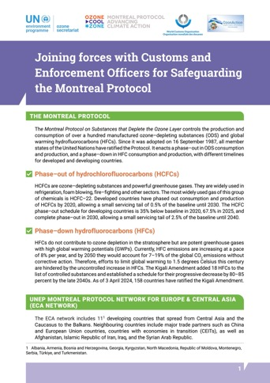
Factsheets, Briefs, & Quick Tools
Joining forces with Customs and Enforcement Officers for Safeguarding the Montreal Protocol (2024)
The ECA network has implemented enforcement–related activities since its inception in 2003 including regional enforcement meetings, border dialogues, and a series of awards for Customs and Enforcement Officers.
Read it in English here
Читать на русском здесь

Slide 20
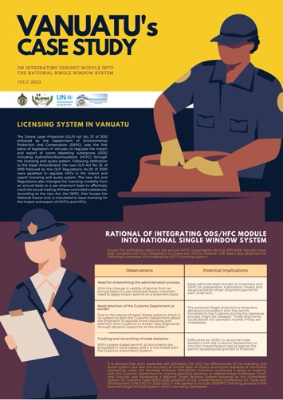
Factsheets, Briefs, & Quick Tools
Vanuatu's Case Study on Integrating ODS/HFC Module into the National Single Window System (2023)
The National Single Window is a centralized system that links all relevant government approving authorities and acts as a ‘one-stop-shop’ where importers and exporters may submit applications electronically including information and all required paperwork to support the application and approval process.
Read it in English here

Slide 21
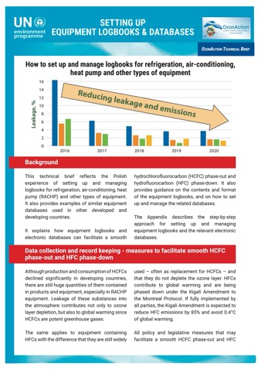
Factsheets, Briefs, & Quick Tools
How to set up and manage logbooks for refrigeration, air-conditioning, heat pump and other types of equipment (2023)
This technical brief reflects the Polish experience of setting up and managing logbooks for refrigeration, air-conditioning, heat pump (RACHP) and other types of equipment. It also provides examples of similar equipment databases used in other developed and developing countries.
Read it in English here
Читать на русском здесь
Léalo en español aquí

Slide 22
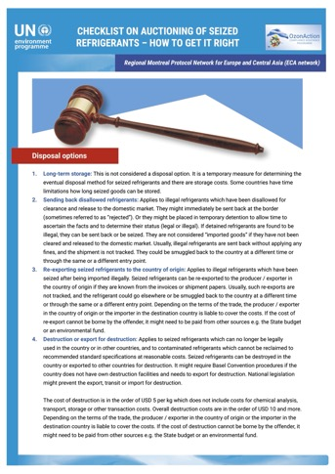
Factsheets, Briefs, & Quick Tools
Checklist on Auctioning of Seized Refrigerants - How to Get it Right (2020)
Checklist for successful auctioning of seized refrigerants.
Read it in English here
Читать на русском здесь

Slide 23
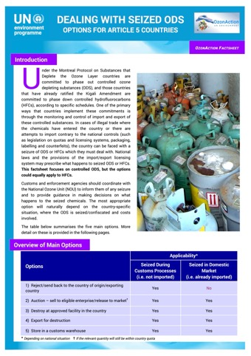
Factsheets, Briefs, & Quick Tools
Dealing with Seized ODS - Options for Article 5 Countries (2020)
One of the primary ways that countries implement their commitments under the Montreal Protocol and particularly the Kigali Amendment is through the monitoring and control of import and export of controlled substances. This fact sheet provides various options for Article 5 countries on how to deal with seized refrigerants in cases of illegal trade.
Read it in English here
Читать на русском здесь

Slide 24
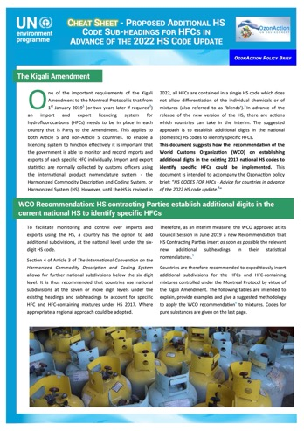
Factsheets, Briefs, & Quick Tools
Cheat Sheet- Proposed Additional HS Code Sub-Headings for HFCs in Advance of the 2022 HS Code Update (2020)
This document suggests how the recommendation of the World Customs Organization (WCO) on establishing additional digits in the existing 2017 national HS codes to identify specific HFCs could be implemented.
Read it in English here
Читать на русском здесь
Léalo en español aquí

Slide 25
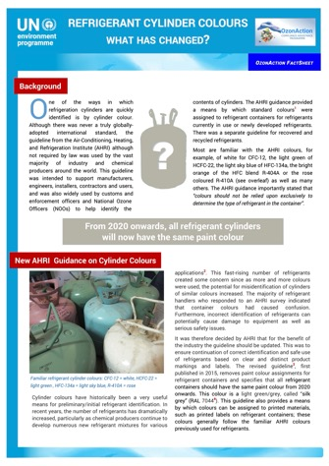
Factsheets, Briefs, & Quick Tools
Refrigerant Cylinder Colours - What has changed? (2020)
One of the ways in which refrigeration cylinders are quickly identified is by cylinder colour. Although there was never a truly globally adopted international standard, the guideline from the Air-Conditioning, Heating, and Refrigeration Institute (AHRI) although not required by law was used by the vast majority of industry and chemical producers around the world. This guideline was intended to support manufacturers, engineers, installers, contractors and users, and was also widely used by customs and enforcement officers and National Ozone Officers (NOOs) to help identify the contents of cylinders.
Read it in English here
Читать на русском здесь
Léalo en español aquí

Slide 26
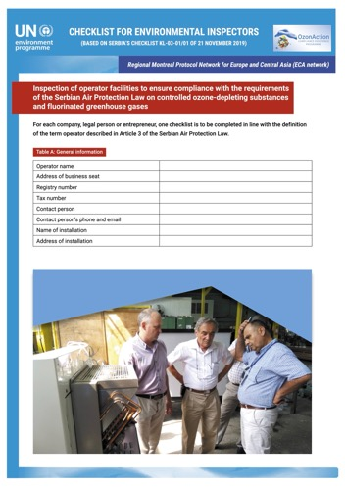
Factsheets, Briefs, & Quick Tools
Checklist for Environmental Inspectors (Based on Serbia's Checklist - November 2019)
Inspection of operator facilities to ensure compliance with the requirements of the Serbian Air Protection Law on controlled ozone-depleting substances and fluorinated greenhouse gases
Read it in English here
اقرأها بالعربية هنا
Читать на русском здесь

Slide 27
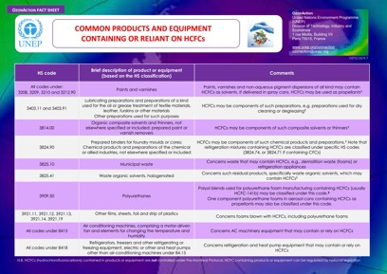
Factsheets, Briefs, & Quick Tools
Common Products and Equipment containing or reliant on HCFCs (2016)
Table of common products and equipment containing or reliant on HCFCs.
Read it in English here

Slide 28
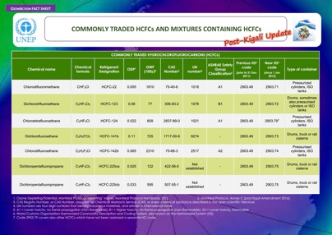
Factsheets, Briefs, & Quick Tools
Commonly Traded HCFCs and Mixtures Containing HCFCs - Post-Kigali Update (2016)
Ozone Depleting Potential, Montreal Protocol ‘reporting’ values, Montreal Protocol Handbook, 2012.
Global Warming Potential, WMO Scientific Assessment Report, 2014
A1 = Lower toxicity, no flame propagation (non-flammable); B1 = Higher toxicity, no flame propagation (non-flammable); A2 = Lower toxicity, flammable
Code 2903.79 covers also other HCFCs which have not been assigned a separate HC code
Read it in English here
Lisez-le en français ici

Slide 29
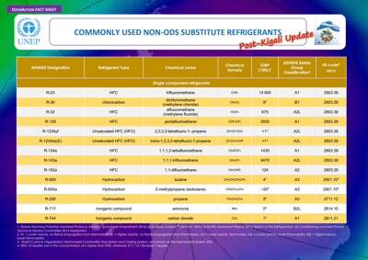
Factsheets, Briefs, & Quick Tools
Commonly Used Non-ODS Substitute Refrigerants (2016)
Global Warming Potential, WMO Scientific Assessment Report 2014; Report of the Refrigeration, Air Conditioning and Heat Pumps Technical Options Committee 2014 Assessment
A1 = Lower toxicity, no flame propagation (non-flammable); B1 = Higher toxicity, no flame propagation (non-flammable); A2 = Lower toxicity, flammable; A2L = Lower toxicity, lower flammability; B2L = Higher toxicity, lower flammability.
2901.10 applies only if the concentration of is higher than 95%, otherwise 2711.13 (“Butanes”) applies.
Read it in English here
Lisez-le en français ici
Léalo en español aquí

Slide 30
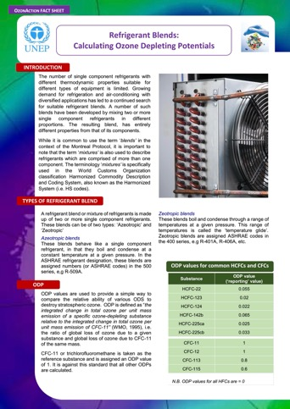
Factsheets, Briefs, & Quick Tools
Refrigerant Blends: Calculating Ozone Depleting Potentials (2016)
The number of single component refrigerants with different thermodynamic properties suitable for different types of equipment is limited. Growing demand for refrigeration and air-conditioning with diversified applications has led to a continued search for suitable refrigerant blends. A number of such blends have been developed by mixing two or more single component refrigerants in different proportions. The resulting blend, has entirely different properties from that of its components. While it is common to use the term ‘blends’ in the context of the Montreal Protocol, it is important to note that the term ‘mixtures’ is also used to describe refrigerants which are comprised of more than one component. The terminology ‘mixtures’ is specifically used in the World Customs Organization classification Harmonized Commodity Description and Coding System, also known as the Harmonized System (i.e. HS codes).
Read it in English here

Slide 31
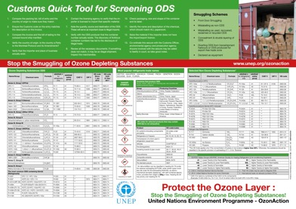
Factsheets, Briefs, & Quick Tools
Customs Quick Tool for Screening ODS (2016)
This poster provides a short checklist for customs officers of things to keep in mind when handling ozone depleting substance shipments.
Read it in English here
Lisez le en français ici
Léalo en español aquí

Slide 32
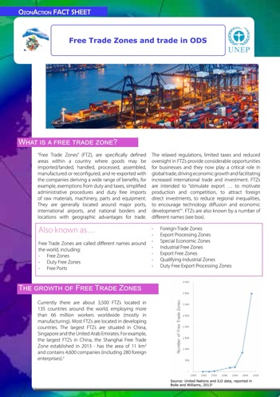
Factsheets, Briefs, & Quick Tools
Free Trade Zones and trade in ODS (2015)
Free Trade Zones” (FTZ), are specifically defined areas within a country where goods may be imported/landed, handled, processed, assembled, manufactured or reconfigured, and re-exported with the companies deriving a wide range of benefits, for example, exemptions from duty and taxes, simplified administrative procedures and duty free imports of raw materials, machinery, parts and equipment. They are generally located around major ports, international airports, and national borders and locations with geographic advantages for trade.
Read it in English here
اقرأها بالعربية هنا
Читать на русском здесь
Léalo en español aquí

Slide 33

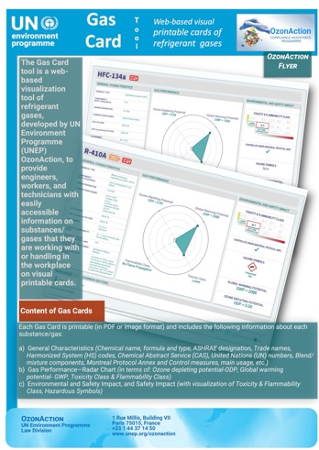
Mobile & Desktop Apps
Gas Card Tool (2021)
The Gas card tool is a web-based visualization tool of refrigerant gases, developed by UN Environment Programme (UNEP) OzonAction, to provide engineers, workers, and technicians with basic information on each substance/gas on visual printable cards that they are working with or handling in the workplace.
Access the tool here

Slide 34
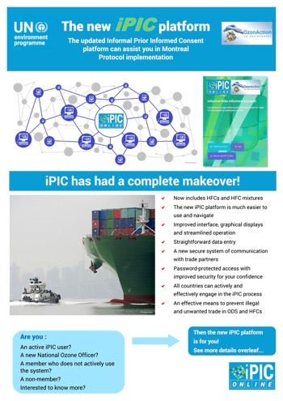
New and improved iPIC (Informal Prior Informed Consent) platform (2020)
Mobile & Desktop Apps
The new iPIC (Informal Prior Informed Consent) online system provides member countries with a standardised and personalised access to key licensing system data in each of the participating countries. As of June 2022, iPIC has at least 100 participating countries plus the European Union and lists more than 2000 companies authorised to trade ODS and hydrofluorocarbons (HFCs) in its database. Countries that have not yet registered to use iPIC Online are strongly encouraged to do so to help enhance their national monitoring and control of legal trade and unwanted trade in substances controlled under the Montreal Protocol.
Following consultations with active users of iPIC Online, the platform has been revised to further simplify its use and provide basic and straightforward information to trade and customs authorities to facilitate approval of ODS shipment and issuance of appropriate import/export licence.
Contact your UNEP Regional Coordinators or the iPIC Online Administrator for more information.
Access iPIC online
Download iPIC flyer in English here
Read the iPIC 2024 Annual Report in English here

Slide 35
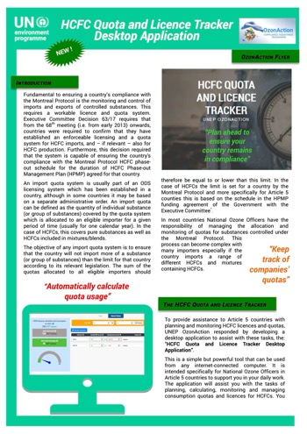
Mobile & Desktop Apps
HCFC Quota and Licence
Tracker (2020)
The HCFC Quota and Licence Tracker Desktop Application is a simple but powerful tool designed to assist National Ozone Officers in Article 5 countries in their daily work. The tracker enables the planning, calculating, monitoring and management of consumption quotas and licences for HCFCs. It can be simply used as a tracking tool, or for future planning by analysing and making adjustments with substances and quantities and directly assess the potential results on your national consumption.
The inbuilt gauge and summary information in the application will instantly display the HCFC quota used and that remaining according to what has been entered in terms of allocations assigned to specific companies. The ODP values used in this tool are the values incorporated into the text of the Montreal Protocol which provides standardisation and ensures accuracy of your allocations.
Read the flyer in English here
Lisez le dépliant en français ici
Lea aquí el folleto en español
Access the app here

Slide 36
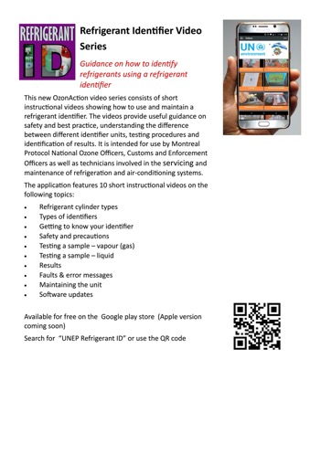
Mobile & Desktop Apps
Refrigerant Identifier Video series: Guidance on how to identify refrigerants using a refrigerant identifier (2018)
Video series on guidance on how to identify refrigerants using a refrigerant identifier. This new OzonAction video series consists of short instructional videos showing how to use and maintain a
refrigerant identifier. The videos provide useful guidance on safety and best practice, understanding the difference between different identifier units, testing procedures and identification of results. It is intended for use by Montreal Protocol National Ozone Officers, Customs and Enforcement Officers as well as technicians involved in the servicing and maintenance of refrigeration and air-conditioning systems.
Download the guide here

Slide 37
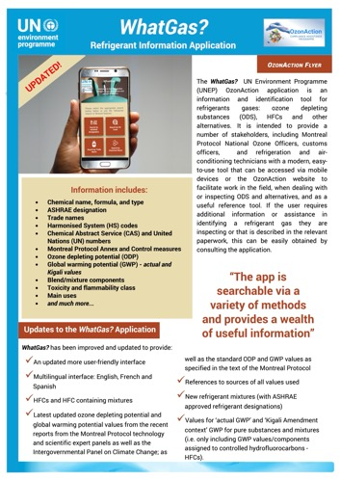
Mobile & Desktop Apps
WhatGas? (2018)
The OzonAction ‘WhatGas?’ application is an information and identification tool for refrigerants gases: ozone depleting substances (ODS), HFCs and other alternatives. It is intended to provide some stakeholders, including Montreal Protocol National Ozone Officers, customs officers, and refrigeration and air-conditioning technicians with a modern, easy-to-use tool that can be accessed via mobile devices or the OzonAction website to facilitate work in the field, when dealing with or inspecting ODS and alternatives, and as a useful reference tool.
This latest release includes the 2022 Harmonized System (HS) Codes for HFCs and blends, which facilitates the process of inspection and identification of controlled and alternative substances.
Access the flyer in English here
Доступ к буклету на русском языке здесь

Slide 38

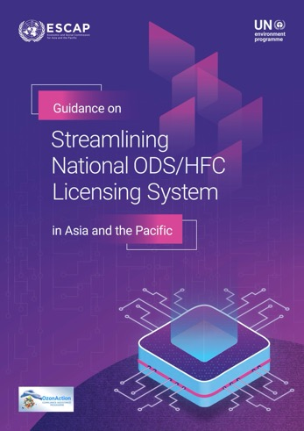
Publications, Training Manuals, & Guides
Guidance on Streamlining National ODS/HFC Licensing System in Asia and the Pacific (2024)
This booklet is designed to assist the governments of developing countries (“Article 5 countries” under the Montreal Protocol on Substances that Deplete the Ozone Layer) in devising strategies for digital solutions in electronic import/export licensing systems to enhance monitoring, reporting, verification, and enforcement (MRVE) of licensing system of controlled substances under the Montreal Protocol. The key functions of these systems include facilitating interactions and information sharing among licensing authorities, importers, exporters, and Customs.
The target audience is government officers responsible for operating licensing systems for substances controlled under the Montreal Protocol. The guidance offers an overview of available options and recommendations for Ozone-Depleting Substances (ODS) and hydrofluorocarbon (HFC) import/export control processes and how to integrate them with other online systems used for national-level international trade.
Read it in English here

Slide 39
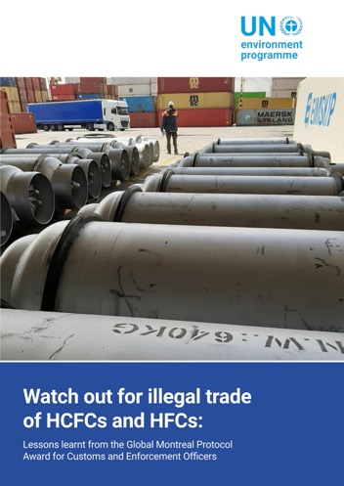
Publications, Training Manuals, & Guides
Watch out for Illegal Trade of HCFCs and HFCs: Lessons learnt from the Global Montreal Protocol Award for Customs and Enforcement Officers (2023)
This publication provides an analysis of the cases submitted in the context of the Global Montreal Protocol Award for Customs and Enforcement Officers. The Global Award was launched in 2018 by UNEP OzonAction. This Global Award is intended to raise awareness about the Montreal Protocol and to recognise customs and enforcement officials for their efforts in preventing and combating illicit traffic in Montreal Protocol and Kigali Amendment-regulated substances. Ozone-depleting substances (ODS) include hydrochlorofluorocarbons (HCFCs) and other compounds with a high Global Warming Potential (GWP), particularly hydrofluorocarbons (HFCs).
Read it in English here

Slide 40
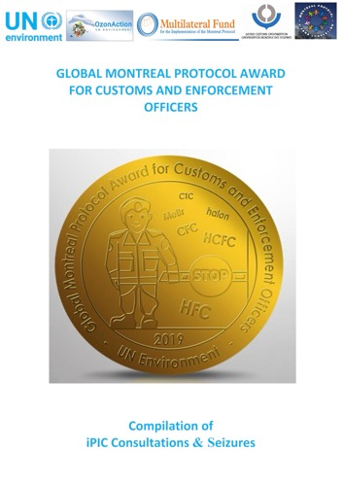
Publications, Training Manuals, & Guides
Global Montreal Protocol Award for Customs and Enforcement Officers (2019)
Global Award for Customs and Enforcement Officers: Compilation of iPIC Consultations & Seizures
Read it in English here

Slide 41
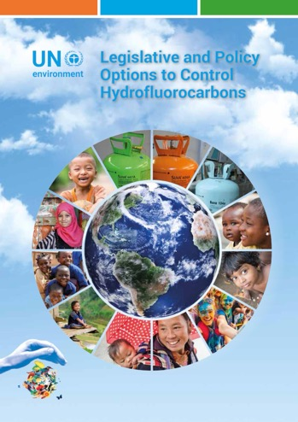
Publications, Training Manuals, & Guides
Legislative and Policy Options to Control Hydrofluorocarbons (2018)
In order to follow and facilitate the HFC phase-down schedules contained in the Kigali Amendment, the Parties, including both developed and developing countries, will have to implement certain measures. This booklet contains a recommended set of legislative and policy options which the developing (Article 5) countries may wish to consider for implementation. It is intended to be a guide/tool for countries. It complements the previous publication “HCFC Policy & Legislative Options: A Guide for Developing Countries“
Read it in English here
Lisez-le en français ici
Читать на русском здесь
Léalo en español aquí

Slide 42
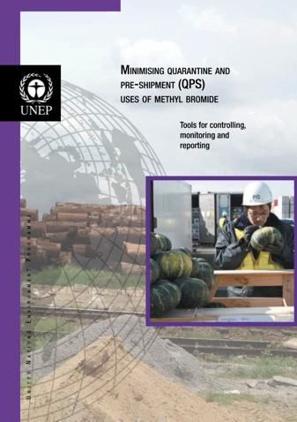
Publications, Training Manuals, & Guides
Minimising Quarantine and Pre-shipment (QPS) Uses of Methyl Bromide: Tools for Controlling, Monitoring and Reporting (2016)
This UNEP OzonAction publication is intended to help National Ozone Units understand why the close supervision of Methyl Bromide (MB) use in QPS applications is important for their countries continued compliance with the Montreal Protocol. It provides information about how to correctly identify MB QPS uses, data management, reporting, stakeholder engagements, and how to control and prevent potential illegal trade of this ODS.
Read it in English here

Slide 43
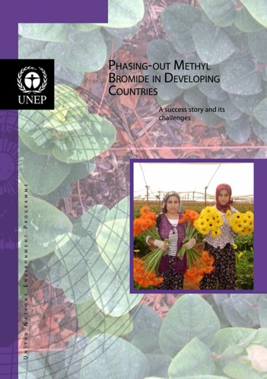
Publications, Training Manuals, & Guides
Phasing-out Methyl Bromide in Developing Countries: A success story and its challenges (2014)
This booklet addresses the efforts undertaken to phase-out Methyl Bromide in developing countries, the lessons learned and what is pending to reach final phase-out. It further analyses factors that may impact or put at risk the continuity of the phase-out and possible ways to mitigate them. It aims to promote the south-south and north-south-south cooperation, facilitate information exchange on advanced technologies for materials, varieties, rootstocks, etc. and raise awareness on risk of reversibility of MB uses and encourage policy to avoid it happening.
Read it in English here
Lisez-le en français ici
Léalo en español aquí

Slide 44
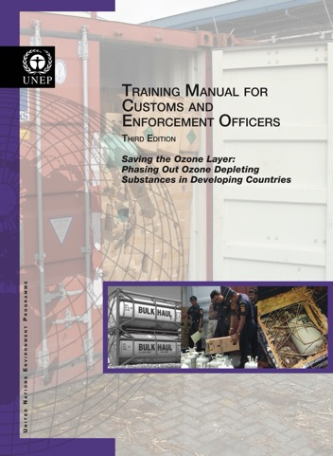
Publications, Training Manuals, & Guides
Training Manual for Customs and Enforcement Officers -3rd EDITION Saving the Ozone Layer (2013)
An essential tool in building the capacity of Customs Officers, The Training Manual for Customs Officers provides the necessary guidance and information to effectively monitor and facilitate the legal trade in ozone depleting substances and to combat their illegal trade. It presents information on the international policy context and an overview of the technical issues, including information on chemicals and products traded and how these may be smuggled. The manual is intended to be used in conducting training programmes for Customs Officers as well as serving as a stand-alone reference document. Now in its third edition, this version takes into account the developments in international trade and provides new material to reflect changes in the Montreal Protocol, Harmonised System codes, licensing systems and other relevant information since its original publication in 2001 and its second edition in 2008.
Read it in English here
Lisez-le en français ici
Читать на русском здесь
Léalo en español aquí

Slide 45
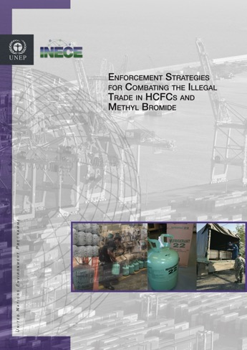
Publications, Training Manuals, & Guides
Enforcement Strategies for Combatting the Illegal Trade in HCFCs and Methyl Bromide (2013)
This booklet is intended to be an easy-to-use resource for ozone officers and others who will be involved in the detection, prevention, and prosecution of smuggling in HCFCs and methyl bromide. Ozone officers and enforcement professionals from both developed and developing countries were interviewed during the preparation of the booklet in order to gain their real-world advice. Through dozens of case studies and examples, the booklet provides enforcement strategies that can be implemented with ﬂexible approaches that maximize the efficient use of scarce human and financial resources.
Read it in English here

Slide 46

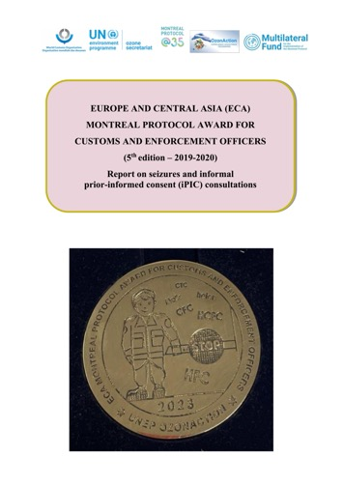
Special Initiatives & Campaigns
Europe and Central Asia (ECA) Montreal Protocol Award for Customs and Enforcement Officers (5th edition – 2019-2020)
This Europe and Central Asia (ECA) Montreal Protocol Award for Customs and Enforcement Officers (5th edition – 2019-2020) - Report seizures and informal prior-informed consent (iPIC) consultations has been prepared by UNEP Law Division OzonAction for the virtual ceremony of the Europe and Central Asia (ECA) Montreal Protocol Award for Customs and Enforcement Officers (5th edition) on Wednesday, 29 March 2023. It is based on the cases reported by the awardees and the supporting documents provided. The award scheme is part of the work programme of the UNEP Law Division’s Regional Montreal Protocol Network for Europe and Central Asia (ECA network).
Read it in English here

Slide 47
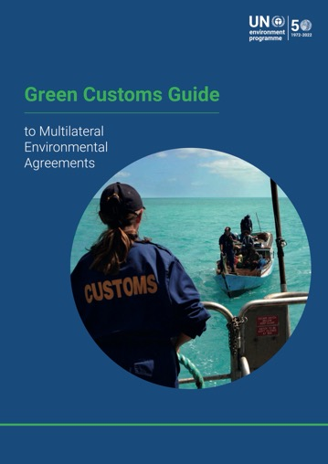
Special Initiatives & Campaigns
Green Customs Guide to Multilateral Environmental Agreements (2022)
The Green Customs Guide to Multilateral Environmental Agreements was designed to promote sustainable trade and encourage customs and border control officers to take on a proactive role in protecting the environment. The guide provides customs and border control officers, as well as anyone interested, with useful information and guidance about relevant trade-related multilateral environmental agreements (MEAs), thus facilitating legitimate trade in environmentally sensitive items while preventing illicit trade in such items and contributing to the achievement of the Sustainable Development Goals.
This updated version of the guide reflects several new developments that have taken place in recent years, such as the entry into force of the Minamata Convention on Mercury, the Kigali Amendment to the Montreal Protocol on Substances that Deplete the Ozone Layer, and the plastic wastes amendments to the Basel Convention. The guide also considers the gender perspective of the daily work of customs and border control officers.
The Green Customs Initiative, launched in 2004, is a partnership of international entities cooperating to prevent the illegal trade in environmentally sensitive commodities and substances and to facilitate their legal trade. Its objective is to enhance the capacity of customs and other relevant border control officers to monitor and facilitate the legal trade and to detect and prevent illegal trade in environmentally sensitive commodities covered by relevant trade-related MEAs and the Chemical Weapons Convention. In addition to UNEP, several MEAs secretariats and OPCW, Interpol and the World Customs Organization are also partners.
Download it in English here
Téléchargez-le en français ici
Descárgalo en español aquí

Slide 48
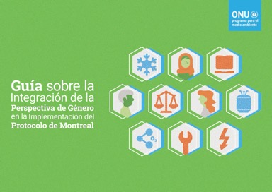
Guidebook on Mainstreaming Gender in the Implementation of the Montreal Protocol (2024)
Publications, Training Manuals, & Guides
This Guidebook on Mainstreaming Gender in the Implementation of the Montreal Protocol (hereinafter referred to as the guidebook) has been developed to help advance the agenda of gender equality and women’s empowerment under the implementation of the Montreal Protocol through the NOUs and national stakeholders mainstreaming gender issues into their daily works and operations. The Guidebook maps the existing issues and challenges in achieving gender equality through Montreal Protocol activities and identifies gender mainstreaming opportunities under the implementation of the Montreal Protocol along with examples and good practices from various countries.
The guidebook has been developed through an iterative process that involved reviewing MLF-related documents at both global and country levels. This review included selected MLF project proposals, work programmes, progress reports, evaluation reports, and other relevant documents. Additionally, consultations were held with selected NOUs and the four implementing agencies. A questionnaire survey covering 29 NOUs provided further insights into gender-related achievements and challenges.
Download it in English here
اقرأها بالعربية هنا
Téléchargez-le en français ici
Descárguelo en español aquí
Читать на русском здесь

Slide 49

Publications, Training Manuals, & Guides
Gender Mainstreaming in the Montreal Protocol: Experiences in Latin America and the Caribbean (2022)
Taking into account that women and girls constitute half of the world’s population and, therefore, represent half of the potential and innovation necessary to face the “triple planetary crisis” — climate change, nature and biodiversity loss, pollution and waste —, positioning people and the planet as central pillars of the transformation necessary to overcome it, and considering the guiding principles and the scopes of action of the Operational Policy on Gender Mainstreaming of the Multilateral Fund, the United Nations Environment Programme (Latin America and the Caribbean Office), as an implementing agency, has prepared this publication contextualizing the international legal framework and the instruments available regarding rights, gender and equality aspects, in order to give visibility to the actions, good practices and progress achieved in a non-exhaustive group of countries of the region. We are convinced that they will serve as an inspiring guide and model for other countries for the integration of gender perspective into their national programs and projects. At the end of this publication, is included a section with action principles and tools for the institutional, operational and communication areas, and a series of complementary resources and relevant references to support your efforts in the implementation of policies on gender mainstreaming in your countries.
Read it in English here
Léalo en español aquí

Slide 50
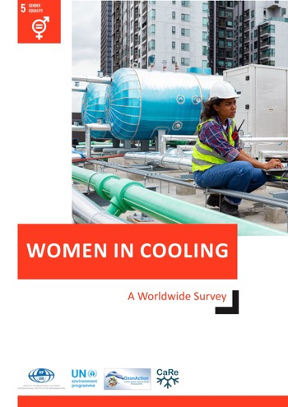
Publications, Training Manuals, & Guides
Women in Cooling: A Worldwide Survey (2022)
Refrigeration, Air-Conditioning, and Heat-pumps (RACHP) are crucial for our health, nutrition, comfort, and well-being. It is one of the sectors that crosscuts many of the UN sustainable development goals and can contribute significantly to safeguard the environment, advance welfare of humanity and support the growth of employment and economics worldwide. Over 15 million people are employed worldwide in the refrigeration industry, which means that almost 5 out of 1000 people have a job linked to the manufacturing, installation, maintenance, and servicing of refrigeration equipment. Women are highly under-represented in this sector as indicated by the fact that only 6% of the members of national refrigeration associations/organisations/institutions are women. As the need for RACHP professionals continues to grow, a high potential that can be unleashed by encouraging women to pursue education and job opportunities in this sector. In 2019, the UNEP OzonAction and UN Women published a booklet of stories of 107 women from 50 countries who work in the RACHP sector to raise awareness of the opportunities available to women and recognise their success. The booklet showcased inspirational career experiences from many women across the globe, but also highlighted some of the challenges. In order to better understand the background, motivation, challenges, and opportunities faced by women working in RACHP a worldwide survey was undertaken by the International Institute of Refrigeration (IIR) and OzonAction of UN Environment Programme (UNEP) in cooperation with several partners.
Read it in English here

Slide 51
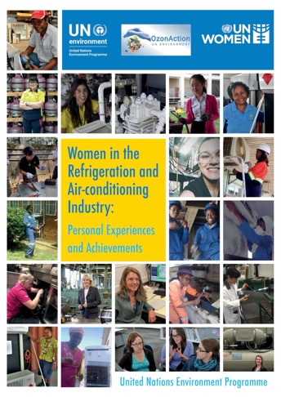
Publications, Training Manuals, & Guides
Women in the Refrigeration and Air-conditioning Industry: Personal Experiences and Achievements (2019)
Refrigeration and air-conditioning is crucial for our health, nutrition, comfort and well-being. From prevention of food wastage to preservation of vaccines, from air conditioning in hospitals to our homes, we increasingly rely on the advances that refrigeration has brought us. However, all around the world the sector has always been a largely male-dominated work environment. The fast-growing sector can offer a wide variety of interesting and fulfilling careers for women as well as men. UN Environment Programme (UNEP), OzonAction, in cooperation with UN Women, has compiled this booklet to raise awareness of the opportunities available to women and to highlight the particular experiences and examples of women working in the sector and to recognise their successes. Being aware of these experiences and the opportunities available can encourage and inspire other women to consider similar careers and support girls to seek to follow a career path in this fast growing and important sector.
Read it here

Slide 52
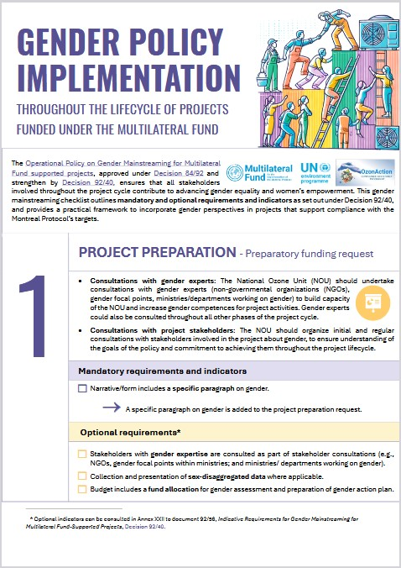
Factsheets, Briefs, & Quick Tools
Gender Policy Implementation: Throughout the lifecycle of projects funded under the Multilateral Fund
This gender mainstreaming checklist outlines mandatory and optional requirements and indicators, providing a practical framework for incorporating gender perspectives into projects that support compliance with the Montreal Protocol’s targets.
Available in English, French and Spanish

Slide 53
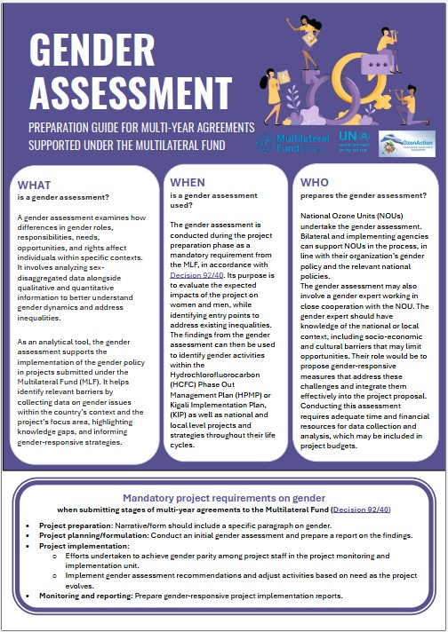
Factsheets, Briefs, & Quick Tools
Gender Assessment: Preparation guide for multi-year agreements supported under the Multilateral Fund
The Gender Assessment Factsheet is a practical guide designed to support gender-responsive activities during the preparation and implementation of multi-year agreements—such as HPMPs and KIPs—under the Multilateral Fund. This tool explains what a gender assessment is, why it matters, and how it can be effectively integrated into project planning and implementation.
The factsheet provides practical guidance on:
• Conducting gender assessments during project preparation.
• Identifying barriers and opportunities for gender equality.
• Implementing gender-responsive strategies throughout the project lifecycle
Available in English, French and Spanish

Slide 54
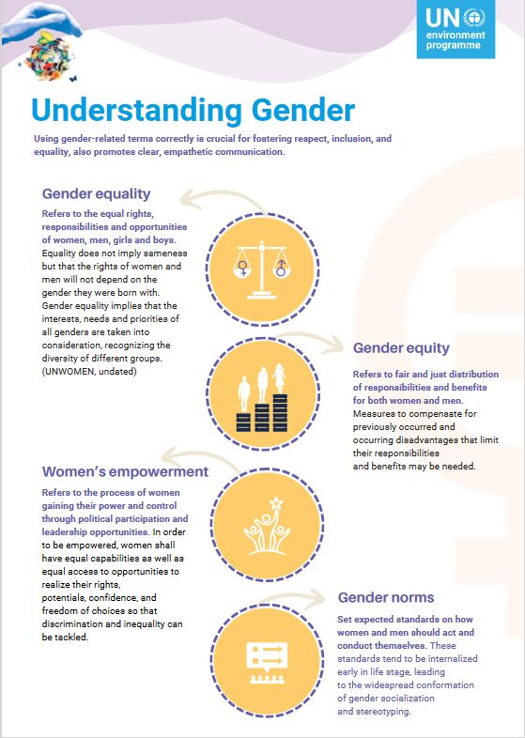

Factsheets, Briefs, & Quick Tools
Understanding Gender : Using gender-related terms correctly is crucial for fostering respect, inclusion, and equality, also promotes clear, empathetic communication
This factsheet highlights Women representation in engineering globally, and the top five challenges women face in their workday. UNEP OzonAction has developed a suite of resources aimed at integrating a gender perspective into the implementation of the Montreal Protocol, with a focus on empowering women in the Refrigeration and Air-Conditioning (RAC) sector. These materials highlight the value of inclusive practices, such as equitable workplace policies, mentoring programmes, and access to training, that enable women to participate fully and thrive across all levels of the RAC industry. By promoting gender equality and women’s economic independence, these resources support not only the fundamental rights of women, but also the development of a more innovative, efficient, and competitive sector.
Read it here

Slide 55
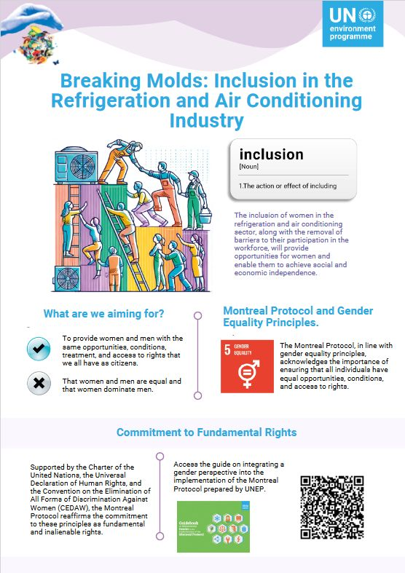

Factsheets, Briefs, & Quick Tools
Breaking Molds: Inclusion in the Refrigeration and Air Conditioning Industry
This factsheet highlights women’s representation in engineering globally and the top five challenges women face in their workday. UNEP OzonAction has developed a suite of resources aimed at integrating a gender perspective into the implementation of the Montreal Protocol, with a focus on empowering women in the Refrigeration and Air-Conditioning (RAC) sector. These materials highlight the value of inclusive practices, such as equitable workplace policies, mentoring programmes, and access to training, that enable women to participate fully and thrive across all levels of the RAC industry. By promoting gender equality and women’s economic independence, these resources support not only the fundamental rights of women but also the development of a more innovative, efficient, and competitive sector.
Read it here

Slide 56
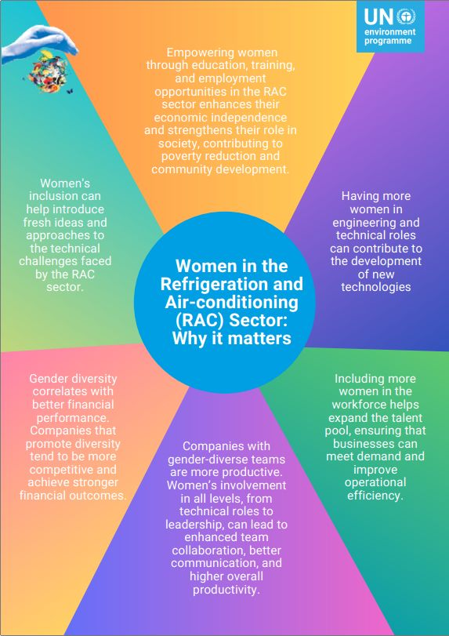
Factsheets, Briefs, & Quick Tools
Women in the Refrigeration and Air-conditioning (RAC) Sector: Why it matters
This factsheet highlights women’s representation in engineering globally and the top five challenges women face in their workday. UNEP OzonAction has developed a suite of resources aimed at integrating a gender perspective into the implementation of the Montreal Protocol, with a focus on empowering women in the Refrigeration and Air-Conditioning (RAC) sector. These materials highlight the value of inclusive practices, such as equitable workplace policies, mentoring programmes, and access to training, that enable women to participate fully and thrive across all levels of the RAC industry. By promoting gender equality and women’s economic independence, these resources support not only the fundamental rights of women but also the development of a more innovative, efficient, and competitive sector.
Read it here

Slide 57
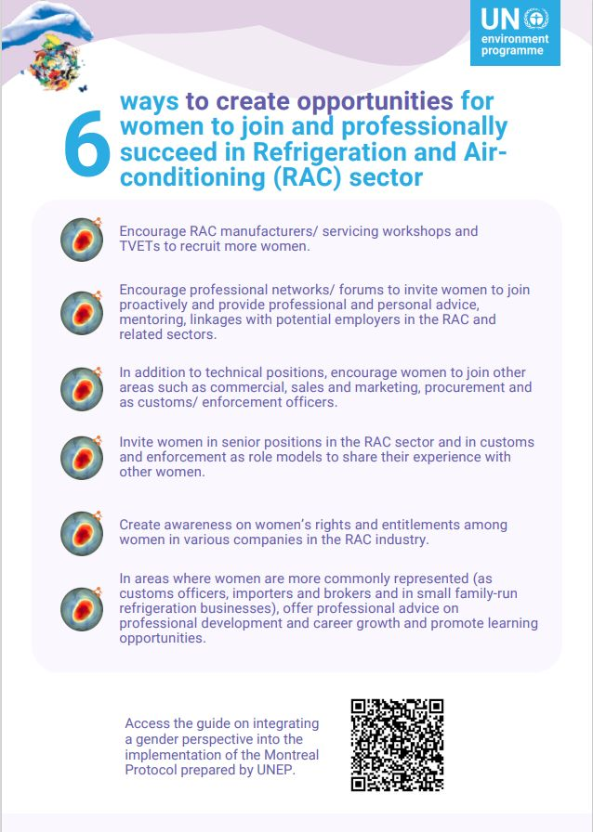
Factsheets, Briefs, & Quick Tools
6 ways to create opportunities for women to join and professionally succeed in Refrigeration and Air-conditioning sector
This factsheet highlights women’s representation in engineering globally and the top five challenges women face in their workday. UNEP OzonAction has developed a suite of resources aimed at integrating a gender perspective into the implementation of the Montreal Protocol, with a focus on empowering women in the Refrigeration and Air-Conditioning (RAC) sector. These materials highlight the value of inclusive practices, such as equitable workplace policies, mentoring programmes, and access to training, that enable women to participate fully and thrive across all levels of the RAC industry. By promoting gender equality and women’s economic independence, these resources support not only the fundamental rights of women but also the development of a more innovative, efficient, and competitive sector.
Read it here

Slide 58
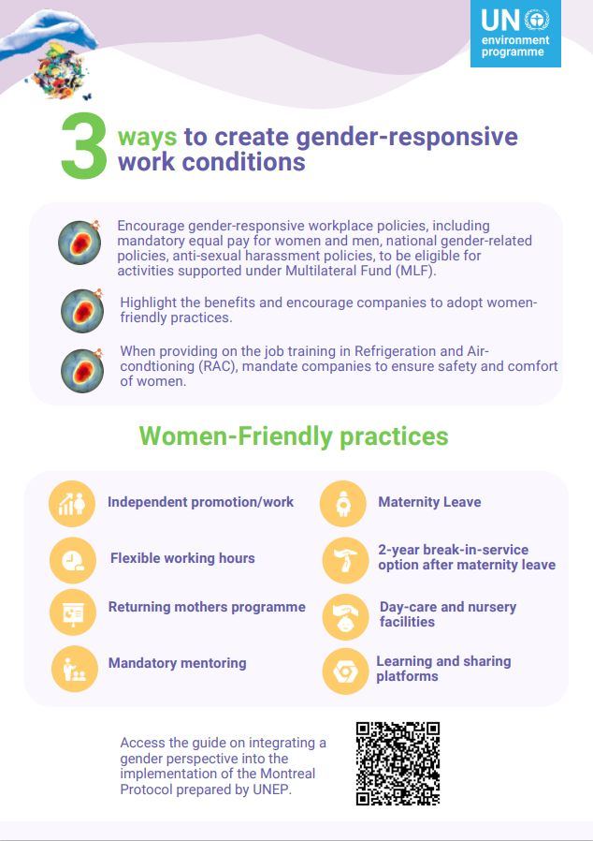

Factsheets, Briefs, & Quick Tools
3 ways to create gender-responsive work conditions
This factsheet highlights women’s representation in engineering globally and the top five challenges women face in their workday. UNEP OzonAction has developed a suite of resources aimed at integrating a gender perspective into the implementation of the Montreal Protocol, with a focus on empowering women in the Refrigeration and Air-Conditioning (RAC) sector. These materials highlight the value of inclusive practices, such as equitable workplace policies, mentoring programmes, and access to training, that enable women to participate fully and thrive across all levels of the RAC industry. By promoting gender equality and women’s economic independence, these resources support not only the fundamental rights of women but also the development of a more innovative, efficient, and competitive sector.
Read it here

Slide 59
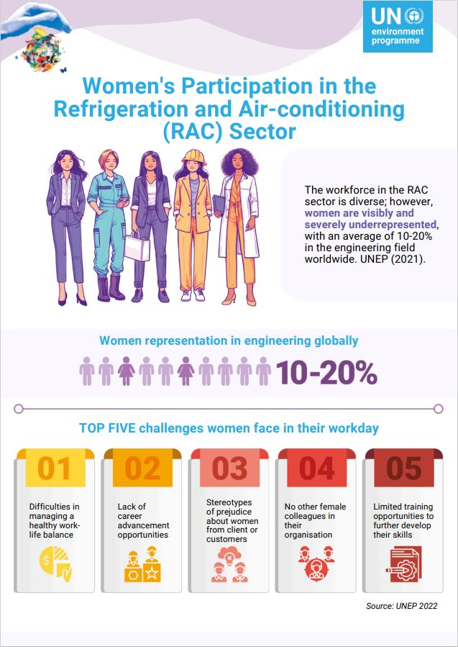

Factsheets, Briefs, & Quick Tools
Women's Participation in the Refrigeration and Air-conditioning (RAC) Sector
This factsheet highlights women’s representation in engineering globally and the top five challenges women face in their workday. UNEP OzonAction has developed a suite of resources aimed at integrating a gender perspective into the implementation of the Montreal Protocol, with a focus on empowering women in the Refrigeration and Air-Conditioning (RAC) sector. These materials highlight the value of inclusive practices, such as equitable workplace policies, mentoring programmes, and access to training, that enable women to participate fully and thrive across all levels of the RAC industry. By promoting gender equality and women’s economic independence, these resources support not only the fundamental rights of women but also the development of a more innovative, efficient, and competitive sector.
Read it here

Slide 60
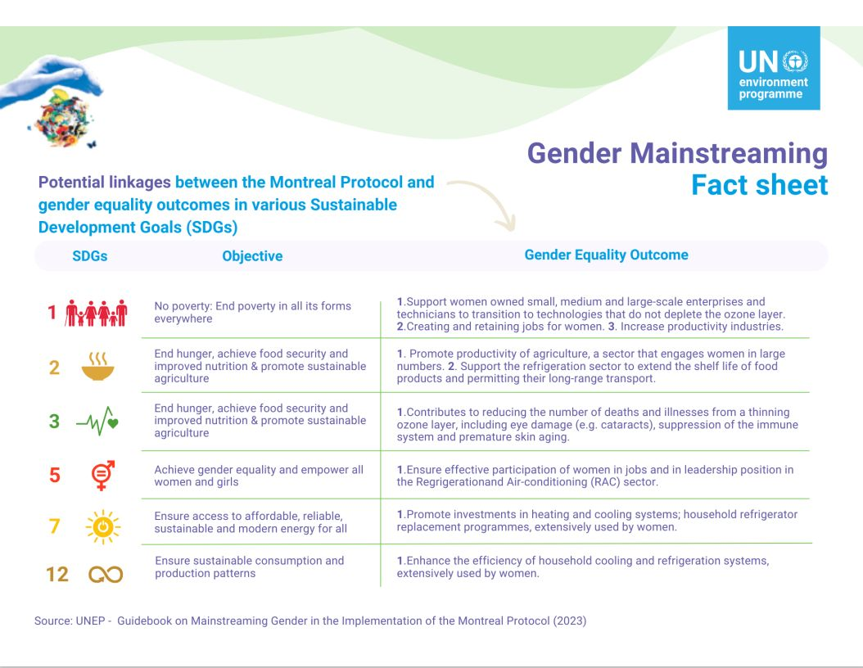

Factsheets, Briefs, & Quick Tools
Gender Mainstreaming: Potential Linkages between the Montreal Protocol and gender equality outcomes in various Sustainable Development Goals (SDGs)
This factsheet highlights women’s representation in engineering globally and the top five challenges women face in their workday. UNEP OzonAction has developed a suite of resources aimed at integrating a gender perspective into the implementation of the Montreal Protocol, with a focus on empowering women in the Refrigeration and Air-Conditioning (RAC) sector. These materials highlight the value of inclusive practices, such as equitable workplace policies, mentoring programmes, and access to training, that enable women to participate fully and thrive across all levels of the RAC industry. By promoting gender equality and women’s economic independence, these resources support not only the fundamental rights of women but also the development of a more innovative, efficient, and competitive sector.
Read it here

Slide 61
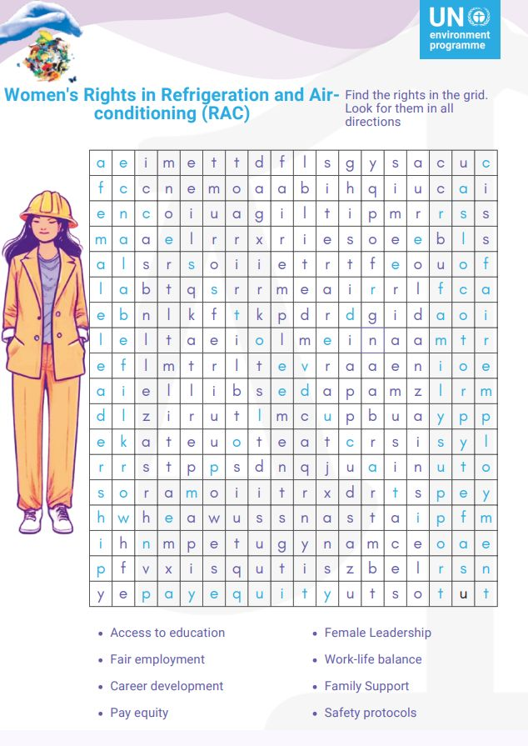

Factsheets, Briefs, & Quick Tools
Women's Rights in Refrigeration and Air-conditioning (RAC)
This factsheet highlights women’s representation in engineering globally and the top five challenges women face in their workday. UNEP OzonAction has developed a suite of resources aimed at integrating a gender perspective into the implementation of the Montreal Protocol, with a focus on empowering women in the Refrigeration and Air-Conditioning (RAC) sector. These materials highlight the value of inclusive practices, such as equitable workplace policies, mentoring programmes, and access to training, that enable women to participate fully and thrive across all levels of the RAC industry. By promoting gender equality and women’s economic independence, these resources support not only the fundamental rights of women but also the development of a more innovative, efficient, and competitive sector.
Read it here

Slide 62
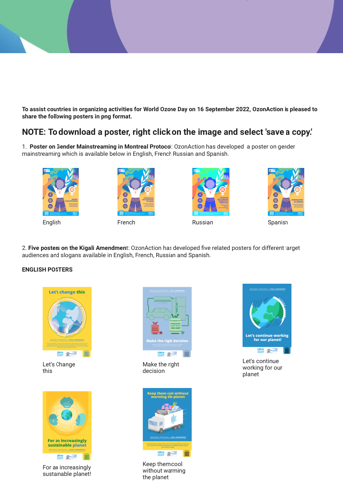
Special Initiatives & Campaigns
Posters (2022)
OzonAction made available posters in png format, that can be used for different target audiences in English, French, Russian and Spanish:
Posters on Gender Mainstreaming in Montreal Protocol
Posters on the Kigali Amendment
Access the posters here

Slide 63
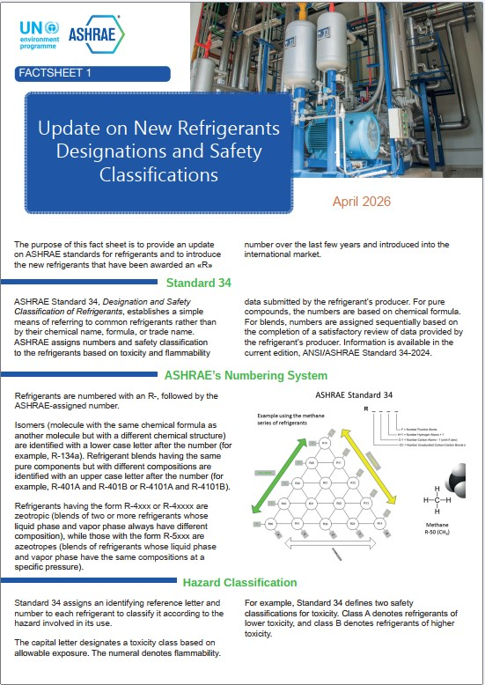
Factsheets, Briefs, & Quick Tools
Update on New Refrigerants Designations and Safety Classifications (2026)
The purpose of this fact sheet is to provide an update on ASHRAE standards for refrigerants and to introduce the new refrigerants that have been awarded an «R» number over the last few years and introduced into the international market.
Read it in English here
Lisez-le en français ici
Léalo en Español aquí

Slide 64
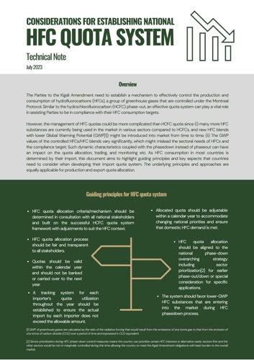
Factsheets, Briefs, & Quick Tools
Considerations for Establishing National HFC Quota System (2023)
The Parties to the Kigali Amendment need to establish a mechanism to effectively control the production and consumption of hydrofluorocarbons (HFCs), a group of greenhouse gases that are controlled under the Montreal Protocol. Similar to the hydrochlorofluorocarbon (HCFC) phase-out, an effective quota system can play a vital role in assisting Parties to be in compliance with their HFC consumption targets.
Read it in English here
Читать на русском здесь
Léalo en español aquí

Slide 65
Factsheets, Briefs, & Quick Tools
How to set up and manage logbooks for refrigeration, air-conditioning, heat pump and other types of equipment (2023)
This technical brief reflects the Polish experience of setting up and managing logbooks for refrigeration, air-conditioning, heat pump (RACHP) and other types of equipment. It also provides examples of similar equipment databases used in other developed and developing countries.
Read it in English here
Читать на русском здесь
Léalo en español aquí

Slide 66
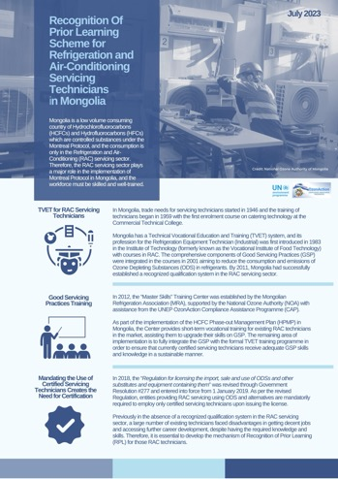
Factsheets, Briefs, & Quick Tools
Recognition of Prior Learning Scheme for Refrigeration and Air-Conditioning Servicing Technicians in Mongolia (2023)
The Recognition of Prior Learning (RPL) process can help those in the industry acquire a formal qualification that matches their knowledge and skills and thereby contributes to improving their employability, mobility, and lifelong learning. RPL can make a significant contribution to providing the relevant learning framework necessary for the present and ongoing maintenance of a quality workforce, especially in the RAC servicing sector. In Mongolia, the RPL process has been rolled out in over 30 TVET trades in the construction, mining, and other sectors, including apparel and culinary, etc. Mongolia initiated the RPL scheme for RAC servicing technicians as part of their implementation of the HPMP in cooperation with various national stakeholders.
Read it in English here

Slide 67
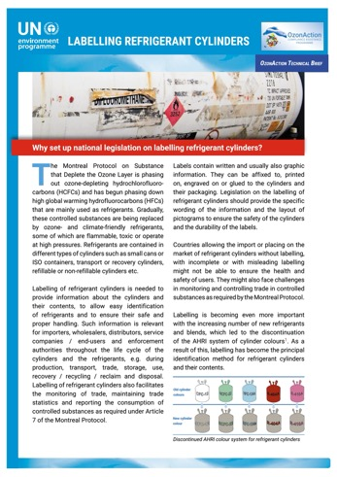
Factsheets, Briefs, & Quick Tools
Labelling Refrigerant Cylinders: Why
Set Up National Legislation on Labelling Refrigerant Cylinders? (2021)
Why set up national legislation on labelling refrigerant cylinders? One of the ways in which refrigeration cylinders are quickly identified is by cylinder colour. Although there was never a truly globally adopted international standard, the guideline from the Air-Conditioning, Heating, and Refrigeration Institute (AHRI) although not required by law was used by the vast majority of industry and chemical producers around the world. This guideline was intended to support manufacturers, engineers, installers, contractors and users, and was also widely used by customs and enforcement officers and National Ozone Officers (NOOs) to help identify the contents of cylinders.
Read it in English here
Читать на русском здесь

Slide 68
Factsheets, Briefs, & Quick Tools
Cheat Sheet- Proposed Additional HS Code Sub-Headings for HFCs in Advance of the 2022 HS Code Update (2020)
This document suggests how the recommendation of the World Customs Organization (WCO) on establishing additional digits in the existing 2017 national HS codes to identify specific HFCs could be implemented.
Read it in English here
Читать на русском здесь
Léalo en español aquí

Slide 69
Factsheets, Briefs, & Quick Tools
Dealing with Seized ODS - Options for Article 5 Countries (2020)
One of the primary ways that countries implement their commitments under the Montreal Protocol and particularly the Kigali Amendment is through the monitoring and control of import and export of controlled substances. This fact sheet provides various options for Article 5 countries on how to deal with seized refrigerants in cases of illegal trade.
Read it in English here
Прочитайте это на русском здесь

Slide 70
Factsheets, Briefs, & Quick Tools
Refrigerant Cylinder Colours - What has changed? (2020)
One of the ways in which refrigeration cylinders are quickly identified is by cylinder colour. Although there was never a truly globally adopted international standard, the guideline from the Air-Conditioning, Heating, and Refrigeration Institute (AHRI) although not required by law was used by the vast majority of industry and chemical producers around the world. This guideline was intended to support manufacturers, engineers, installers, contractors and users, and was also widely used by customs and enforcement officers and National Ozone Officers (NOOs) to help identify the contents of cylinders.
Read it in English here
Читать на русском здесь
Léalo en español aquí

Slide 71

Factsheets, Briefs, & Quick Tools
Servicing Tail for HCFCs - What is it & Why Does it Matter (2020)
An important Montreal Protocol issue that is currently being discussed and will need to be carefully considered in light of the HCFC phase-out Management Plans (HPMP) second or third stages, which are now being prepared and submitted to the Executive Committee, is that of the HCFC ‘Servicing tail’
To avoid any unforeseen challenges in the future, it is crucial that all countries have a good understanding of their likely requirements and plans regarding the HCFC ‘servicing tail’ when preparing for and drafting their Stages II and III.
The brief aims to provide clarity about the main points and issues related to the issue.
Read it in English here
Читать на русском здесь
Léalo en español aquí

Slide 72

Factsheets, Briefs, & Quick Tools
Article 7 Data Reporting on HFCs: When Countries Need to Start Reporting (2019)
One of the important commitments of the Protocol is that of reporting the consumption and production of substances controlled under the Montreal Protocol. Following the ratification of the Kigali Amendment, this commitment is now extended to HFCs. This short factsheet provides some useful information on relevant Article 7 reporting dates and deadlines for HFCs.
Read it in English here
Lisez-le en français ici
Читать на русском здесь
Léalo en español aquí

Slide 73

Factsheets, Briefs, & Quick Tools
Twinning of National Ozone Officers and Energy Policymakers (2018)
Under the Kigali Cooling Efficiency Program (K-CEP), UN Environment is implementing a two-year "twinning" project to build the capacity of National Ozone Officers and national energy policymakers for linking energy efficiency and Montreal Protocol objectives in support of the Kigali Amendment.
Read it in English here

Slide 74

Factsheets, Briefs, & Quick Tools
The Path from Kigali: HFC Phase-down Timeline (2018)
HFC Phase-down timeline.
Download the poster here

Slide 75

Factsheets, Briefs, & Quick Tools
Demonstration of a Regional Strategy for ODS Waste Management and Disposal in the ECA Region (2017)
The project "Demonstration of a Regional Strategy for ODS Waste Management and Disposal in the ECA Region" was prepared jointly by UN Environment and UNIDO, on behalf of Goverments of Bosnia and Herzegovina, Croatia and Montenegro.
Read it in English here

Slide 76

Factsheets, Briefs, & Quick Tools
OzonAction Series of Fact Sheets Relevant to the Kigali Amendment (2017)
Following the adoption of the Kigali Amendment to the Montreal Protocol on Substances that Deplete the Ozone Layer, UN Environment's OzonAction prepared a series of fact sheets describing the immediate and future challenges to be addressed by the different Parties between now and until the amendment comes into force.
Read it in English here

Slide 77
Factsheets, Briefs, & Quick Tools
Common Products and Equipment containing or reliant on HCFCs (2016)
Table of common products and equipment containing or reliant on HCFCs.
Read it in English here

Slide 78
Factsheets, Briefs, & Quick Tools
Commonly Traded HCFCs and Mixtures Containing HCFCs - Post-Kigali Update (2016)
Ozone Depleting Potential, Montreal Protocol ‘reporting’ values, Montreal Protocol Handbook, 2012.
Global Warming Potential, WMO Scientific Assessment Report, 2014
A1 = Lower toxicity, no flame propagation (non-flammable); B1 = Higher toxicity, no flame propagation (non-flammable); A2 = Lower toxicity, flammable
Code 2903.79 covers also other HCFCs which have not been assigned a separate HC code
Read it in English here
Lisez-le en français ici

Slide 79
Factsheets, Briefs, & Quick Tools
Commonly Used Non-ODS Substitute Refrigerants (2016)
Global Warming Potential, WMO Scientific Assessment Report 2014; Report of the Refrigeration, Air Conditioning and Heat Pumps Technical Options Committee 2014 Assessment
A1 = Lower toxicity, no flame propagation (non-flammable); B1 = Higher toxicity, no flame propagation (non-flammable); A2 = Lower toxicity, flammable; A2L = Lower toxicity, lower flammability; B2L = Higher toxicity, lower flammability.
2901.10 applies only if the concentration of is higher than 95%, otherwise 2711.13 (“Butanes”) applies.
Read it in English here
Lisez-le en français ici
Léalo en español aquí

Slide 80

Factsheets, Briefs, & Quick Tools
Global Warming Potential (GWP) of Refrigerants: Why are Particular Values Used? (2016)
In 2016, the Montreal Protocol was amended to phase-down the production and consumption of hydrofluorocarbons (HFCs) which are commonly used alternatives to ozone depleting substances.
Read it in English here
Léalo en español aquí

Slide 81

Factsheets, Briefs, & Quick Tools
Ozone Depleting Potential (ODP) of Refrigerants: Which Particular Values are Used? (2016)
Under the Montreal Protocol on Substances that Deplete the Ozone Layer, Article 7 of the Protocol requires all Parties, both developing countries (also called Article 5 countries) and developed countries, to provide statistical data on an annual basis, on various issues related to trade and production of ozone-depleting substances (ODS), covering CFCs, halons, carbon tetrachloride, methyl chloroform, HCFCs, HBFCs, bromochloromethane and methyl bromide to the Ozone Secretariat. This data is then used to calculate each Party’s official ODS consumption and production levels. The data reported includes information on: production; imports from and exports to Parties and non-Parties; imports and exports of ODS that have been recycled; amounts used for feedstock; amounts destroyed by technologies approved by the Parties; the amount of methyl bromide used for quarantine and pre-shipment (QPS) applications.
Read it in English here

Slide 82
Factsheets, Briefs, & Quick Tools
Refrigerant Blends: Calculating Ozone Calculating Ozone Depleting Potentials (2016)
The number of single component refrigerants with different thermodynamic properties suitable for different types of equipment is limited. Growing demand for refrigeration and air-conditioning with diversified applications has led to a continued search for suitable refrigerant blends. A number of such blends have been developed by mixing two or more single component refrigerants in different proportions. The resulting blend, has entirely different properties from that of its components. While it is common to use the term ‘blends’ in the context of the Montreal Protocol, it is important to note that the term ‘mixtures’ is also used to describe refrigerants which are comprised of more than one component. The terminology ‘mixtures’ is specifically used in the World Customs Organization classification Harmonized Commodity Description and Coding System, also known as the Harmonized System (i.e. HS codes).
Read it in English here

Slide 83

Factsheets, Briefs, & Quick Tools
Refrigerant Blends: Calculating Global Warming Potentials (2016)
The number of single component refrigerants with different thermodynamic properties suitable for different types of equipment is limited. Growing demand for refrigeration and air-conditioning with diversified applications has led to a continued search for suitable refrigerant blends. A number of such blends have been developed by mixing two or more single component refrigerants in different proportions. The resulting blend, has entirely different properties from that of its components. While it is common to use the term ‘blends’ in the context of the Montreal Protocol, it is important to note that the term ‘mixtures’ is also used to describe refrigerants which are comprised of more than one component. The terminology ‘mixtures’ is specifically used in the World Customs Organization classification Harmonized Commodity Description and Coding System, also known as the Harmonized System (i.e. HS codes).
Read it in English here

Slide 84

Factsheets, Briefs, & Quick Tools
The Kigali Amendment to the Montreal Protocol: HFC phase-down (2016)
This fact sheet summarises and highlights the main elements of the Amendment of particular interest to countries operating under Article 5 of the Protocol (Article 5 Parties).
Read it in English here
Lisez-le en français ici
Читать на русском здесь
Léalo en español aquí

Slide 85

Factsheets, Briefs, & Quick Tools
QPS uses of Methyl Bromide and their alternatives (2015)
At the 1992 Meeting of the Parties in Copenhagen, methyl bromide (MB) was included as a controlled substance Ozone Depleting Substance, (ODS). Article 2H of the Protocol specifically excluded Quarantine and Pre-shipment (QPS) uses from control measures as it was considered that there were no alternatives to MB for the diverse range of treatments carried out for QPS. Although QPS was about 10% of global MB consumption at the time, this use was nevertheless considered especially significant in allowing inter- and intra-country trade in commodities treated with MB in the absence of site-specific alternatives. Since that time Parties have nevertheless been urged to adopt alternatives to MB for QPS and reduce emissions and use of this fumigant whenever possible.
Read it in English here
Читать на русском здесь
Léalo en español aquí

Slide 86

Factsheets, Briefs, & Quick Tools
Tracking Methyl Bromide Consumption for QPS (2015)
Efficient tracking of methyl bromide (MB) use requires close monitoring and a full understanding of both controlled and exempted uses. The IPPC has developed a list of articles typically fumigated with MB for quarantine and pre-shipment (QPS) purposes, which facilitates collection and reporting of MB usage data. Modifications may be made in accordance to each Party’s circumstances and may vary when the intended use of for quarantine or for pre-shipment. There are many examples of successful tracking and control systems around the world.
Read it in English here
Читать на русском здесь
Léalo en español aquí

Slide 87
Factsheets, Briefs, & Quick Tools
Free Trade Zones and trade in ODS (2015)
Free Trade Zones” (FTZ), are specifically defined areas within a country where goods may be imported/landed, handled, processed, assembled, manufactured or reconfigured, and re-exported with the companies deriving a wide range of benefits, for example, exemptions from duty and taxes, simplified administrative procedures and duty free imports of raw materials, machinery, parts and equipment. They are generally located around major ports, international airports, and national borders and locations with geographic advantages for trade.
Read it in English here
اقرأها باللغة العربية هنا
Читать на русском здесь
Léalo en español aquí

Slide 88

Factsheets, Briefs, & Quick Tools
Management of Ozone Depleting Substances in the Global Fishing Industry (2015)
Fisheries make a major contribution to the economies of many developing countries through foreign exchange earnings and employment creation.
Read it in English here
Lisez-le en français ici

Slide 89

Factsheets, Briefs, & Quick Tools
Promoting low-GWP refrigerants for air-conditioning sectors in high-ambient temperature countries (PRAHA) (2015)
The current commercially available technologies, used as replacements for HCFCs, not only perform less efficiently in high-ambient conditions but may also possess high-GWP characteristics which do not provide optimum alternatives in the context of the HCFC phase-out programmes in this sector. This exceptional project is designed to respond to some of the challenges related to the availability of low-GWP alternative refrigerants that are sustainable in the long term and their associated technologies including final products, components, and accessories in high-ambient temperature countries.
Read it in English here
Lisez-le en français ici

Slide 90

Factsheets, Briefs, & Quick Tools
How the Montreal Protocol Protects Health (2014)
This booklet aims to assist foam enterprises, especially SMEs, to better understand policies on HCFC phase-out, access to assistance from the Multilateral Fund for the Implementation of the Montreal Protocol and access alternative technologies in different foam applications taking into account challenges in converting to alternative technology. It also discusses some tips on how to identify enterprises that may use HCFCs and verify the HCFCs consumption of enterprises.
Read it in English here
Читать на русском здесь
Léalo en español aquí
Lisez-le en français ici

Slide 91

Factsheets, Briefs, & Quick Tools
Adoption of a Sustainable Green Technology Approach in Shoe Sole Production in Guanajuato, Mexico (2014)
The manufacture of shoes is an important industry in Mexico—particularly in the Guanajuato region which produces each year around 244 million pairs of shoes in over 7,000 enterprises that employ 135,000 people directly (and some 270,000 indirectly). Most of these shoes are fit with microcellular polyurethane shoesoles many of which, in turn, are blown with HCFC-141b. Other than rigid insulation foams, the blowing agent requires blowing capability only—while providing good structural properties—no thermal insulation.
Read it in English here

Slide 92
Publications, Training Manuals, & Guides
Guidance on Streamlining National ODS/HFC Licensing System in Asia and the Pacific (2024)
This booklet is designed to assist the governments of developing countries (“Article 5 countries” under the Montreal Protocol on Substances that Deplete the Ozone Layer) in devising strategies for digital solutions in electronic import/export licensing systems to enhance monitoring, reporting, verification, and enforcement (MRVE) of licensing system of controlled substances under the Montreal Protocol. The key functions of these systems include facilitating interactions and information sharing among licensing authorities, importers, exporters, and Customs.
The target audience is government officers responsible for operating licensing systems for substances controlled under the Montreal Protocol. The guidance offers an overview of available options and recommendations for Ozone-Depleting Substances (ODS) and hydrofluorocarbon (HFC) import/export control processes and how to integrate them with other online systems used for national-level international trade.
Read it in English here

Slide 93

Publications, Training Manuals, & Guides
Cold Chain Technology Brief - Fishing Vessel Applications (2025)
The global fishing sector faces a dual challenge: the lack of adequate onboard chilling systems leads to significant food loss, while the continued use of high-GWP refrigerants threatens environmental integrity and public health.
This brief presents an overview of the different existing refrigeration technologies in fishing vessels along with the environmental impacts of refrigerants used, and introduces environmentally friendly and energy-efficient technologies. Sustainability and safety in fishing vessels refrigeration encompass proper management of existing systems to prevent refrigerant leaks, as well as ongoing research and development into further improvement of the overall energy efficiency of systems.
Read it in English here
Lisez-le en français ici
Léalo en español aquí

Slide 94

Publications, Training Manuals, & Guides
Cold Chain Technology Brief - Commercial, Professional, and Domestic Refrigeration (2025)
This brief provides a comprehensive overview of the role and challenges of commercial, professional, and domestic refrigeration within the global cold chain. These systems are essential for preserving food, medicines, and vaccines, yet they face persistent issues related to temperature control, energy consumption, and refrigerant emissions. The cold chain remains vulnerable to inefficiencies, especially in its final stages, where inconsistent temperatures and poor maintenance practices can compromise product safety and increase environmental impact. Despite technological progress, a significant share of products still exceeds recommended temperature thresholds, and energy use remains high across all sectors.
Read it in English here
Lisez-le en français ici
Léalo en español aquí

Slide 95

Publications, Training Manuals, & Guides
Cold Chain Technology Brief - Walk-in Cold Rooms in Article 5 Countries (2025)
This brief presents an overview of existing Walk-in Cold Rooms (WICRs) technologies, refrigerants and foam blowing agents used, along with their environmental impact. The key challenges for WICRs relate to affordability and ensuring sound and sustainable business models. Issues related to access to equipment and skills in Article 5 countries are also addressed in this brief. Recommendations are included to support the development of sustainable cold chains through coordinated policies, capacity building and financial support.
Read it in English here
Lisez-le en français ici
Léalo en español aquí

Slide 96

Publications, Training Manuals, & Guides
Cold Chain Technology Brief – Road Refrigerated Transport in Hot Climates (2025)
This brief highlights key elements of transport refrigeration with a specific focus on hot climates! High ambient temperatures are prevalent in many areas of the world that lack proper cold chain infrastructures: it is crucial that local boundaries are considered to adopt proper technologies
Read it in English here
Lisez-le en français ici
Léalo en español aquí

Slide 97

Publications, Training Manuals, & Guides
Cold Chain Technology Briefs – Vaccines (2021)
This note provides an overview of the vaccine cold chain in general and COVID-19 in particular, its requirements and challenges. First, the eﬀects of temperature on these vaccines, old and new, and their storage and transport requirements should be known. Second, the temperature-controlled logistics of vaccines in general and COVID-19 vaccines in particular, and the equipment and solutions used for their cold chain, must be analysed. Finally, if refrigeration is essential for our health as well as for our food, it must be sustainable, and it is therefore, necessary to analyse the challenges to be met so that the cold chain for vaccines disrupted by COVID-19, is sustainable in the short, medium, and long term.
Read it in English here
Lisez-le en français ici
Читать на русском здесь
Léalo en español aquí

Slide 98

Publications, Training Manuals, & Guides
Cold Chain Technology Briefs – Refrigeration in Food Production and Processing (2020)
For consumers, the cold chain is often associated with transport, retail and household refrigerators. But refrigeration is also and widely used in the agri-food industry for the storage of raw materials and final products, as well as for food processing. This brief gives a short overview of refrigeration applications in the industry. The refrigeration technologies in use are briefly presented, according to facility size and temperature requirements, and the problems relating to the use of refrigerants are also discussed. In conclusions, opportunities for sustainable refrigeration are briefly explored.
Read it in English here
Lisez-le en français ici
Léalo en español aquí

Slide 99

Publications, Training Manuals, & Guides
Cold Chain Technology Briefs – Cold Storage and Refrigerated Warehouse (2020)
Cold storage warehouses store food after production and before foods are transported and distributed to supermarkets or catering establishments. Food is stored either chilled or frozen and may remain in the store for periods of a few hours, days or even a year (for some fruits and vegetables) in chillers and up to several months in freezers. This sector has been shown to be one of the sectors of the cold chain where the temperature of products is well temperature-controlled. Energy usage is important to cold store operators as it is a high proportion of the overall operating costs. Cold storage warehouses traditionally have high usage of low global warming potential refrigerants.
Read it in English here
Lisez-le en français ici
Léalo en español aquí

Slide 100

Publications, Training Manuals, & Guides
Training Programme for National Ozone Officers (2020)
Comprehensive modular training programme for new National Ozone Officers (NOOs), assistants and other staff of National Ozone Units (NOUs).
A key factor contributing to the significant success of the Montreal Protocol on Substances that Deplete the Ozone Layer is the ‘country-driven approach’. This approach places National Ozone Units at the centre of the action to protect the ozone layer. The NOU led by the NOOs, is the single most important element in national strategies to comply with the Montreal Protocol. The knowledge and capacity of the NOO in effectively developing projects, managing strategies, reporting data, and working with national and international institutions - directly or indirectly - affects each developing (Article 5) country’s ability to meet its obligations under the Montreal Protocol treaty.
For this reason, OzonAction has completely transformed and updated its NOO training programme to assist NOUs in successfully understanding all the roles and requirements and in carrying out their daily tasks in Montreal Protocol implementation. The main objective of this training programme is to provide new NOU staff with essential information about the Montreal Protocol, a country’s obligations under the Montreal Protocol, and the main activities carried out by NOUs. It aims to provide new NOU staff with fundamental knowledge and information tools that will enable them to support their national government in meeting the commitments agreed by all countries under the Montreal Protocol.
Read it in English here

Slide 101

Publications, Training Manuals, & Guides
Promoting Low-GWP Refrigerants for Air-Conditioning Sectors in High Ambient temperature Countries Phase II (PRAHA-II) - Project Report (2019)
PRAHA-II is a continuation of the process with specific goals that are aligned with the findings of PRAHAI. The two main findings of PRAHA-I are that, 1) there are viable alternatives at High Ambient Temperature (HAT) conditions which need optimized equipment design to perform and deliver the energy efficiency minimum requirements, and 2) that there is a concern about safety of the most flammable alternative refrigerants that calls for a special risk assessment model for the HAT countries.
Read it in English here

Slide 102

Publications, Training Manuals, & Guides
Promoting Low-GWP Refrigerants for Air-Conditioning Sectors in High-Ambient Temperature Countries (PRAHA) (2016)
The project was implemented at the regional level in consultation with National Ozone Units of the Gulf Coordination Council (GCC) countries, namely Bahrain, Kuwait, Qatar, Oman, Saudi Arabia, and the UAE plus Iraq, to ensure incorporating the project outputs within the HPMPs particularly for the preparation of post 2015 policies and action-plans. The project outcome will not only benefit the participating countries, but all regions of the world where high ambient temperatures are prevalent.
Read it in English here

Slide 103
Publications, Training Manuals, & Guides
Legislative and Policy Options to Control Hydrofluorocarbons (2018)
In order to follow and facilitate the HFC phase-down schedules contained in the Kigali Amendment, the Parties, including both developed and developing countries, will have to implement certain measures. This booklet contains a recommended set of legislative and policy options which the developing (Article 5) countries may wish to consider for implementation. It is intended to be a guide/tool for countries. It complements the previous publication “HCFC Policy & Legislative Options: A Guide for Developing Countries“
Read it in English here
Lisez-le en français ici
Читать на русском здесь
Léalo en español aquí

Slide 104

Publications, Training Manuals, & Guides
Promoting Ozone and Climate-Friendly Technologies in Public Procurement: A Scoping Study of Asia Pacific (2016)
This document was produced by the UNEP Division of Technology, Industry and Economics (UNEP DTIE) OzonAction Programme under the framework of the UNEP-U.S. Environmental Protection Agency (USEPA) grant partnership project: “Regional Programme for Enhancing Institutional Capacity for HCFC Phase-out linked to Energy Efficiency and Climate benefits in Asia Pacific”.
Read it in English here
Lisez-le en français ici
Léalo en español aquí

Slide 105
Publications, Training Manuals, & Guides
Minimising Quarantine and Pre-shipment (QPS) Uses of Methyl Bromide: Tools for Controlling, Monitoring and Reporting (2016)
This UNEP OzonAction publication is intended to help National Ozone Units understand why the close supervision of Methyl Bromide (MB) use in QPS applications is important for their countries continued compliance with the Montreal Protocol. It provides information about how to correctly identify MB QPS uses, data management, reporting, stakeholder engagements, and how to control and prevent potential illegal trade of this ODS.
Read it in English here

Slide 106

Publications, Training Manuals, & Guides
Financing the Climate Co-Benefits of the HCFC Phase-out: A Guide for Low Volume Consuming Countries (2015)
This document provides guidance for Ozone Officers in low volume HCFC consuming countries (LVCs) to help them understand how to seek financing outside of the Montreal Protocol’s Multilateral Fund to achieve the climate co-benefits indicated in their national HCFC Phase-out Management Plans
Read it in English here
Léalo en español aquí
Lisez-le en français ici

Slide 107

Publications, Training Manuals, & Guides
Good Servicing Practices: Phasing out HCFCs in the Refrigeration and Air-Conditioning Servicing Sector (2015)
This guide for trainers is designed for organisations and institutes that conduct training workshops for servicing technicians involved in the maintenance of refrigeration and air-conditioning (RAC) equipment. It offers trainers up-to-date information on new technologies and refrigerants, as well as other issues related to their use and application.
Download it in English here
Скачайте это на русском здесь

Slide 108

Publications, Training Manuals, & Guides
International Standards in Refrigeration and Air-Conditioning (2015)
This guide is intended to provide an introduction to standards and how they can be useful in supporting the adoption of alternatives in the context of the HCFC phase-out in developing countries. It also includes an overview of existing standards related to HCFCs and their alternatives, barriers to alternatives, the process of the adoption of international and regional standards at the national level, barriers to the adoption and how to overcome them.
Read it in English here
Lisez-le en français ici
Читать на русском здесь
Léalo en español aquí

Slide 109

Publications, Training Manuals, & Guides
National Certification Schemes for Refrigeration and Air-conditioning service technicians (2015)
It is expected that in the near future there will be a considerably higher uptake around the world, and particularly in developing countries of ‘alternative refrigerants’, such as hydrocarbons, ammonia, carbon dioxide, unsaturated hydrofluorocarbons (HFCs) –or hydrofluoroolefins (HFOs) and HFOs mixtures.
Read it in English here
Lisez-le en français ici
Скачайте это на русском здесь

Slide 110

Publications, Training Manuals, & Guides
Phasing-out HCFC in Small and Medium-sized Foam Enterprises (2015)
This booklet aims to assist foam enterprises, especially SMEs, to better understand policies on HCFC phase-out, access to assistance from the Multilateral Fund for the Implementation of the Montreal Protocol and access alternative technologies in different foam applications taking into account challenges in converting to alternative technology. It also discusses some tips on how to identify enterprises that may use HCFCs and verify the HCFCs consumption of enterprises.
Read it in English here

Slide 111

Publications, Training Manuals, & Guides
The Montreal Protocol and Human Health: How Global Action Protects Us from the Ravages of Ultraviolet Radiation (2015)
The booklet summarises current understanding of how changes in the ozone layer affect human health, not only in the world we live in but also in the ‘World Avoided’. That is the world we would have lived in had we failed to control ozone depleting substances. By examining the ‘World Avoided’ we clearly see, to echo the words of the Vienna Convention, the magnitude of the “harmful impact on human health and the environment” that we have prevented through the effective implementation of the Montreal Protocol.
Read it in English here
Lisez-le en français ici
Léalo en español aquí

Slide 112

Publications, Training Manuals, & Guides
Lower-GWP Alternatives in Commercial and Transport Refrigeration: An Expanded Compilation of Propane, CO2, Ammonia and HFO Case Studies (2014)
The present publication comprises an expanded and updated compilation of case studies on lower-GWP energy efficient alternatives and technologies in the commercial refrigeration as well as the transport refrigeration sectors. It provides a number of new commercial refrigeration case studies as well as case studies from the transport refrigeration sector, including alternatives not previously considered in the first volume, to provide better geographical spread and present a more comprehensive overview of lower-GWP alternatives adopted.
Read it in English here

Slide 113
Publications, Training Manuals, & Guides
Phasing-out Methyl Bromide in Developing Countries: A success story and its challenges (2014)
This booklet addresses the efforts undertaken to phase-out Methyl Bromide in developing countries, the lessons learned and what is pending to reach final phase-out. It further analyses factors that may impact or put at risk the continuity of the phase-out and possible ways to mitigate them. It aims to promote the south-south and north-south-south cooperation, facilitate information exchange on advanced technologies for materials, varieties, rootstocks, etc. and raise awareness on risk of reversibility of MB uses and encourage policy to avoid it happening.
Read it in English here
Lisez-le en français ici
Léalo en español aquí

Slide 114

Publications, Training Manuals, & Guides
Low-GWP Alternatives for Small Rigid PU Foam Enterprises (2014)
To improve technical capacity in relation to adoption of cyclopentane technology of a large number of small foam producers, the project was, therefore, designed to assist a system house for which small foam enterprises rely on for their supply of raw materials and technical advice, to develop polyol, one of the major raw materials for foam production, pre-blended with cyclopentane, instead of HCFC-141b. This approach also enhances market penetration of this new product by using the existing market network.
Read it in English here

Slide 115

Publications, Training Manuals, & Guides
UNEP Guide for National Ozone Officers (2013)
This Guide aims to support National Ozone Units and the MLF's country-driven approach. It was originally developed by OzonAction through the Regional Office for Asia and the Pacific Compliance Assistance Programme (ROAP CAP), and has been updated to reflect important developments in the Protocol since 2005. The Guide is based on the experiences of numerous NOOs around the world, international agencies and individual experts. It represents the collective wisdom of the wider community of NOOs who lead National Ozone Units.
Read it here
Lisez-le en français ici
Lealo aquí en español

Slide 116

Publications, Training Manuals, & Guides
The Montreal Protocol and the Green Economy: Assessing the contributions and co-benefits of a multilateral environmental agreement (2012)
This global study addresses how and to what degree national, regional and international actions taken under the Montreal Protocol have also contributed to the restructuring of national economies and the global one towards a “Green Economy”, defined as “one which achieves increasing wealth, provides decent employment, successfully tackles inequities and persistent poverty, and reduces ecological scarcities and climate risks”. More specifically, this study explores how the Montreal Protocol has contributed to the stimulation of more efficient production processes, driving innovation, industrial restructuring, job creation, trade, health and ecosystem benefits, and climate change mitigation.
Read it here

Slide 117

OzonAction Knowledge Maps (2021)
Mobile & Desktop Apps
The UNEP OzonAction Knowledge Maps were created to provide National Ozone Units (NOUs) and UNEP’s partners, access to data and information about relevant stakeholders involved in the implementation of the Montreal Protocol (MP) programmes/projects supported by the MP’s Multilateral Fund (MLF).
The three knowledge maps are listed below:
Refrigeration, Air-Conditioning and Heat Pumps (RACHP) Associations & Organizations: This Knowledge Map provides a global directory of RACHP associations, societies, and organizations around the world. These are the key stakeholders for ensuring safe and efficient refrigerant transitions, for the training of technicians and supporting the national policies related to the Montreal Protocol.
Local Technical & Vocational Education and Training (TVET): This Knowledge Map provides a global directory of TVET entities and centres around the world. These are the strategic partners for conducting and promoting training and certification programs related to the refrigeration servicing sector.
UNEP’s Multilateral Fund Projects:This Knowledge Map provides a global overview of projects in developing countries implemented by UNEP under the Montreal Protocol’s Multilateral Fund. (This knowledge map will be updated following each ExCom and when the MLF Inventory database will be updated ).
Access the maps here
Read the flyer in English here
Lea aquí el folleto en español

Slide 118
Mobile & Desktop Apps
HCFC Quota and Licence
Tracker (2020)
The HCFC Quota and Licence Tracker Desktop Application is a simple but powerful tool designed to assist National Ozone Officers in Article 5 countries in their daily work. The tracker enables the planning, calculating, monitoring and management of consumption quotas and licences for HCFCs. It can be simply used as a tracking tool, or for future planning by analysing and making adjustments with substances and quantities and directly assess the potential results on your national consumption.
The inbuilt gauge and summary information in the application will instantly display the HCFC quota used and that remaining according to what has been entered in terms of allocations assigned to specific companies. The ODP values used in this tool are the values incorporated into the text of the Montreal Protocol which provides standardisation and ensures accuracy of your allocations.
Read the flyer in English here
Lisez le dépliant en français ici
Lea aquí el folleto en español
Access the app here

Slide 119
New and improved iPIC (Informal Prior Informed Consent) platform (2020)
Mobile & Desktop Apps
The new iPIC (Informal Prior Informed Consent) online system provides member countries with a standardised and personalised access to key licensing system data in each of the participating countries. As of June 2022, iPIC has at least 100 participating countries plus the European Union and lists more than 2000 companies authorised to trade ODS and hydrofluorocarbons (HFCs) in its database. Countries that have not yet registered to use iPIC Online are strongly encouraged to do so to help enhance their national monitoring and control of legal trade and unwanted trade in substances controlled under the Montreal Protocol.
Following consultations with active users of iPIC Online, the platform has been revised to further simplify its use and provide basic and straightforward information to trade and customs authorities to facilitate approval of ODS shipment and issuance of appropriate import/export licence.
Contact your UNEP Regional Coordinators or the iPIC Online Administrator for more information.
Access iPIC online
Download iPIC flyer in English here
Read the iPIC 2024 Annual Report in English here

Slide 120

Mobile & Desktop Apps
GWP-ODP Calculator (2018)
The UNEP OzonAction GWP-ODP Calculator app will help you to convert between values in metric tonnes, ODP tonnes and CO2-equivalent tonnes (or kg) of substances controlled by the Montreal Protocol and their alternatives. The updated application now includes a new “Kigali Amendment” mode.
It is very important to note that in the Kigali Amendment mode the GWP values provided are those specified in the Kigali Amendment to the Montreal Protocol, i.e. GWP values are only assigned to controlled HFCs.
Read it in English here
Читать на русском здесь

Slide 121
Mobile & Desktop Apps
Refrigerant Identifier Video series: Guidance on how to identify refrigerants using a refrigerant identifier (2018)
Video series on guidance on how to identify refrigerants using a refrigerant identifier. This new OzonAction video series consists of short instructional videos showing how to use and maintain a
refrigerant identifier. The videos provide useful guidance on safety and best practice, understanding the difference between different identifier units, testing procedures and identification of results. It is intended for use by Montreal Protocol National Ozone Officers, Customs and Enforcement Officers as well as technicians involved in the servicing and maintenance of refrigeration and air-conditioning systems.
Download the guide here

Slide 122
Mobile & Desktop Apps
WhatGas? (2018)
The OzonAction ‘WhatGas?’ application is an information and identification tool for refrigerants gases: ozone depleting substances (ODS), HFCs and other alternatives. It is intended to provide some stakeholders, including Montreal Protocol National Ozone Officers, customs officers, and refrigeration and air-conditioning technicians with a modern, easy-to-use tool that can be accessed via mobile devices or the OzonAction website to facilitate work in the field, when dealing with or inspecting ODS and alternatives, and as a useful reference tool.
This latest release includes the 2022 Harmonized System (HS) Codes for HFCs and blends, which facilitates the process of inspection and identification of controlled and alternative substances.
Access the flyer in English here
Доступ к буклету на русском языке здесь

Slide 123

Special Initiatives & Campaigns
Lower-GWP Refrigeration and Air-Conditioning Innovation Award (annually since 2020)
A joint ASHRAE and UN Environment award promotes innovative design, research and practice by recognizing people who have developed or implemented innovative technological concepts applied in developing countries to minimize global warming potential (GWP) through refrigeration and air-conditioning management.
Read more and register here

Slide 124

Special Initiatives & Campaigns
World Ozone Day
In 1994, the United Nations General Assembly proclaimed 16 September as the International Day for the Preservation of the Ozone Layer, commemorating the signing of the Montreal Protocol on Substances that Deplete the Ozone Layer in 1987.
More information about the 2026 campaign can be accessed here

Slide 125

Special Initiatives & Campaigns
World Refrigeration Day (WRD) Campaigns (annually since 2019)
World Refrigeration Day is an international awareness campaign established by the World Refrigeration Day Secretariat to raise the profile of the refrigeration, air-conditioning and heat-pump sector and focuses attention on the significant role that the industry and its technology play in modern life and society. It draws attention to wonderful engineering and science that is all around us every day. Refrigeration is at the very heart of modern life. It enables people to live, travel and work comfortably. It saves lives. It enables people to achieve.
Access the website here

Slide 126


Newsletters and Bulletins
OzonAction Scoop (annually since 2017)
The OzonAction Newsletter produced by OzonAction is a tri-annual publication dedicated to the protection of the ozone layer and implementation of the Montreal Protocol.
Find every issue here

Slide 127




Newsletters and Bulletins
Ozzy Ozone: Defender of our Planet (2005-2008)
This richly-illustrated comic booklet uses the Ozzy Ozone character and his new friends to educate children about the causes and effects of ozone layer depletion, the need to follow “safe sun” practices, and actions that they can take to be “ozone-friendly”. Developed as part of UNEP’s work programme under the Multilateral Fund for the Implementation of the Montreal Protocol, these booklets are suitable for dissemination in schools as part of national ozone protection awareness campaigns. The Ozzy Ozone character is a registered trademark of the Government of Barbados. UNEP would like to thank the Government of Barbados for its permission to use this character.
Ozzy Flies High! (Comic Book No.1, 2005)
Ozzy Goes Farming! (Comic Book No.2, 2006)
Ozzy Goes Polar! (Comic Book No.3, 2007)
Ozzy Goes Island Hopping (Comic Book No. 4, 2008)
Read it in English here
Read it in English here
Read it in English here
Read it in English here
Lisez-le en français ici
Читать на русском здесь
Lisez-le en français ici
Lisez-le en français ici
Leia em português aqui
Léalo en español aquí
Léalo en español aquí
Читать на русском здесь
Léalo en español aquí

Slide 128

Newsletters and Bulletins
OzoNews (since 2000)
Since its inception in January 2000, the goal of OzoNews is to provide current news relating to ozone depletion and the implementation of the Montreal Protocol, to stimulate discussion and promote cooperation in support of compliance with the Montreal Protocol.
Find every issue here

Slide 129


Refrigerant Literacy e-Learning (2017)
Online Courses
UN Environment and ASHRAE have partnered on a web-based course entitled “Refrigerants Literacy.” This course is 4.5 hours of instruction covering the basics of refrigerants used in air conditioning and refrigeration applications.
The course is mainly designed for non-specialist in HVAC&R operation and servicing i.e., Non-Ozone Units (NOUs), policy makers, procurement officers, buildings owners, facility managers, etc. It is also recommended for HVAC&R engineers, consultants and technical people who wish to get an holistic overview about refrigerants and its progress.
The course consists of 4 lessons. Lesson 1 covers refrigerants types and addresses environmental considerations. Lesson 2 deals with refrigerant classifications, including ASHRAE Standards 15 and 34. Lesson 3 addresses refrigeration selection, including residential and small commercial applications. Lesson 4 covers refrigerant management, including the development of a management plan, containers, storage, and recovery, recycling, and reclamation. In addition, the course includes interactivities in the form of knowledge checks to test the learner’s mastery of the content as well as narration to keep the learner engaged. At the end of the course, there is a compulsory examination which, if passed, earns the learner a course completion certificate. The exam consists of 35 questions with unlimited attempts.
Enrol here here

Slide 130
Factsheets, Briefs, & Quick Tools
Update on New Refrigerants Designations and Safety Classifications (2026)
The purpose of this fact sheet is to provide an update on ASHRAE standards for refrigerants and to introduce the new refrigerants that have been awarded an «R» number over the last few years and introduced into the international market.
Read it in English here
Lisez-le en français ici
Léalo en Español aquí

Slide 131
Factsheets, Briefs, & Quick Tools
Legal advice to support the implementation of the Montreal Protocol and its Kigali Amendment in Article 5 countries on the pilot basis (2025)
The Montevideo Programme V delivers technical legal assistance in support of its key objectives.
The Law Branch, in collaboration with OzonAction’s Compliance Assistance Programme, offers this technical legal assistance to Article 5 Parties to support the development, updating and/or revision of their national compliance frameworks under the Montreal Protocol on Substances that Deplete the Ozone Layer and its Kigali Amendment.
Read it in English here
Lisez-le en français ici

Slide 132
Factsheets, Briefs, & Quick Tools
Labelling Refrigerant Cylinders: Why
Set Up National Legislation on Labelling Refrigerant Cylinders? (2021)
Why set up national legislation on labelling refrigerant cylinders? One of the ways in which refrigeration cylinders are quickly identified is by cylinder colour. Although there was never a truly globally adopted international standard, the guideline from the Air-Conditioning, Heating, and Refrigeration Institute (AHRI) although not required by law was used by the vast majority of industry and chemical producers around the world. This guideline was intended to support manufacturers, engineers, installers, contractors and users, and was also widely used by customs and enforcement officers and National Ozone Officers (NOOs) to help identify the contents of cylinders.
Read it in English here
Читать на русском здесь

Slide 133
Factsheets, Briefs, & Quick Tools
Dealing with Seized ODS - Options for Article 5 Countries (2020)
One of the primary ways that countries implement their commitments under the Montreal Protocol and particularly the Kigali Amendment is through the monitoring and control of import and export of controlled substances. This fact sheet provides various options for Article 5 countries on how to deal with seized refrigerants in cases of illegal trade.
Read it in English here
Прочитайте это на русском здесь

Slide 134
Factsheets, Briefs, & Quick Tools
Refrigerant Cylinder Colours - What has changed? (2020)
One of the ways in which refrigeration cylinders are quickly identified is by cylinder colour. Although there was never a truly globally adopted international standard, the guideline from the Air-Conditioning, Heating, and Refrigeration Institute (AHRI) although not required by law was used by the vast majority of industry and chemical producers around the world. This guideline was intended to support manufacturers, engineers, installers, contractors and users, and was also widely used by customs and enforcement officers and National Ozone Officers (NOOs) to help identify the contents of cylinders.
Read it in English here
Читать на русском здесь
Léalo en español aquí

Slide 135
Factsheets, Briefs, & Quick Tools
Servicing Tail for HCFCs - What is it & Why Does it Matter (2020)
An important Montreal Protocol issue that is currently being discussed and will need to be carefully considered in light of the HCFC phase-out Management Plans (HPMP) second or third stages, which are now being prepared and submitted to the Executive Committee, is that of the HCFC ‘Servicing tail’
To avoid any unforeseen challenges in the future, it is crucial that all countries have a good understanding of their likely requirements and plans regarding the HCFC ‘servicing tail’ when preparing for and drafting their Stages II and III.
The brief aims to provide clarity about the main points and issues related to the issue.
Read it in English here
Читать на русском здесь
Léalo en español aquí

Slide 136
Factsheets, Briefs, & Quick Tools
The Path from Kigali: HFC Phase-down Timeline (2018)
HFC Phase-down timeline.
Download the poster here

Slide 137
Factsheets, Briefs, & Quick Tools
Demonstration of a Regional Strategy for ODS Waste Management and Disposal in the ECA Region (2017)
The project "Demonstration of a Regional Strategy for ODS Waste Management and Disposal in the ECA Region" was prepared jointly by UN Environment and UNIDO, on behalf of Goverments of Bosnia and Herzegovina, Croatia and Montenegro.
Read it in English here

Slide 138
Factsheets, Briefs, & Quick Tools
OzonAction Series of Fact Sheets Relevant to the Kigali Amendment (2017)
Following the adoption of the Kigali Amendment to the Montreal Protocol on Substances that Deplete the Ozone Layer, UN Environment's OzonAction prepared a series of fact sheets describing the immediate and future challenges to be addressed by the different Parties between now and until the amendment comes into force.
Read it in English here

Slide 139
Factsheets, Briefs, & Quick Tools
Global Warming Potential (GWP) of Refrigerants: Why are Particular Values Used? (2016)
In 2016, the Montreal Protocol was amended to phase-down the production and consumption of hydrofluorocarbons (HFCs) which are commonly used alternatives to ozone depleting substances.
Read it in English here
Léalo en español aquí

Slide 140
Factsheets, Briefs, & Quick Tools
Refrigerant Blends: Calculating Ozone Depleting Potentials (2016)
The number of single component refrigerants with different thermodynamic properties suitable for different types of equipment is limited. Growing demand for refrigeration and air-conditioning with diversified applications has led to a continued search for suitable refrigerant blends. A number of such blends have been developed by mixing two or more single component refrigerants in different proportions. The resulting blend, has entirely different properties from that of its components. While it is common to use the term ‘blends’ in the context of the Montreal Protocol, it is important to note that the term ‘mixtures’ is also used to describe refrigerants which are comprised of more than one component. The terminology ‘mixtures’ is specifically used in the World Customs Organization classification Harmonized Commodity Description and Coding System, also known as the Harmonized System (i.e. HS codes).
Read it in English here

Slide 141
Factsheets, Briefs, & Quick Tools
Refrigerant Blends: Calculating Global Warming Potentials (2016)
The number of single component refrigerants with different thermodynamic properties suitable for different types of equipment is limited. Growing demand for refrigeration and air-conditioning with diversified applications has led to a continued search for suitable refrigerant blends. A number of such blends have been developed by mixing two or more single component refrigerants in different proportions. The resulting blend, has entirely different properties from that of its components. While it is common to use the term ‘blends’ in the context of the Montreal Protocol, it is important to note that the term ‘mixtures’ is also used to describe refrigerants which are comprised of more than one component. The terminology ‘mixtures’ is specifically used in the World Customs Organization classification Harmonized Commodity Description and Coding System, also known as the Harmonized System (i.e. HS codes).
Read it in English here

Slide 142
Factsheets, Briefs, & Quick Tools
The Kigali Amendment to the Montreal Protocol: HFC phase-down (2016)
This fact sheet summarises and highlights the main elements of the Amendment of particular interest to countries operating under Article 5 of the Protocol (Article 5 Parties).
Read it in English here
Lisez-le en français ici
Читать на русском здесь
Léalo en español aquí

Slide 143
Factsheets, Briefs, & Quick Tools
Free Trade Zones and trade in ODS (2015)
Free Trade Zones” (FTZ), are specifically defined areas within a country where goods may be imported/landed, handled, processed, assembled, manufactured or reconfigured, and re-exported with the companies deriving a wide range of benefits, for example, exemptions from duty and taxes, simplified administrative procedures and duty-free imports of raw materials, machinery, parts and equipment. They are generally located around major ports, international airports, and national borders and locations with geographic advantages for trade.
Read it in English here
اقرأها بالعربية هنا
Читать на русском здесь
Léalo en español aquí

Slide 144
Factsheets, Briefs, & Quick Tools
QPS uses of Methyl Bromide and their alternatives (2015)
At the 1992 Meeting of the Parties in Copenhagen, methyl bromide (MB) was included as a controlled substance Ozone Depleting Substance, (ODS). Article 2H of the Protocol specifically excluded Quarantine and Pre-shipment (QPS) uses from control measures as it was considered that there were no alternatives to MB for the diverse range of treatments carried out for QPS. Although QPS was about 10% of global MB consumption at the time, this use was nevertheless considered especially significant in allowing inter- and intra-country trade in commodities treated with MB in the absence of site-specific alternatives. Since that time Parties have nevertheless been urged to adopt alternatives to MB for QPS and reduce emissions and use of this fumigant whenever possible.
Read it in English here
Читать на русском здесь
Léalo en español aquí

Slide 145
Mobile & Desktop Apps
GWP-ODP Calculator (2018)
The UNEP OzonAction GWP-ODP Calculator app will help you to convert between values in metric tonnes, ODP tonnes and CO2-equivalent tonnes (or kg) of substances controlled by the Montreal Protocol and their alternatives. The updated application now includes a new “Kigali Amendment” mode.
It is very important to note that in the Kigali Amendment mode the GWP values provided are those specified in the Kigali Amendment to the Montreal Protocol, i.e. GWP values are only assigned to controlled HFCs.
Read it in English here
Читать на русском здесь

Slide 146
Mobile & Desktop Apps
HCFC Quota and Licence
Tracker (2020)
The HCFC Quota and Licence Tracker Desktop Application is a simple but powerful tool designed to assist National Ozone Officers in Article 5 countries in their daily work. The tracker enables the planning, calculating, monitoring and management of consumption quotas and licences for HCFCs. It can be simply used as a tracking tool, or for future planning by analysing and making adjustments with substances and quantities and directly assess the potential results on your national consumption.
The inbuilt gauge and summary information in the application will instantly display the HCFC quota used and that remaining according to what has been entered in terms of allocations assigned to specific companies. The ODP values used in this tool are the values incorporated into the text of the Montreal Protocol which provides standardisation and ensures accuracy of your allocations.
Read the flyer in English here
Lisez le dépliant en français ici
Lea aquí el folleto en español
Access the app here

Slide 147
New and improved iPIC (Informal Prior Informed Consent) platform (2020)
Mobile & Desktop Apps
The new iPIC (Informal Prior Informed Consent) online system provides member countries with a standardised and personalised access to key licensing system data in each of the participating countries. As of June 2022, iPIC has at least 100 participating countries plus the European Union and lists more than 2000 companies authorised to trade ODS and hydrofluorocarbons (HFCs) in its database. Countries that have not yet registered to use iPIC Online are strongly encouraged to do so to help enhance their national monitoring and control of legal trade and unwanted trade in substances controlled under the Montreal Protocol.
Following consultations with active users of iPIC Online, the platform has been revised to further simplify its use and provide basic and straightforward information to trade and customs authorities to facilitate approval of ODS shipment and issuance of appropriate import/export licence.
Contact your UNEP Regional Coordinators or the iPIC Online Administrator for more information.
Access iPIC online
Download iPIC flyer in English here
Read the iPIC 2021 Annual Report in English here

Slide 148
Mobile & Desktop Apps
Refrigerant Identifier Video series: Guidance on how to identify refrigerants using a refrigerant identifier (2018)
Video series on guidance on how to identify refrigerants using a refrigerant identifier. This new OzonAction video series consists of short instructional videos showing how to use and maintain a
refrigerant identifier. The videos provide useful guidance on safety and best practice, understanding the difference between different identifier units, testing procedures and identification of results. It is intended for use by Montreal Protocol National Ozone Officers, Customs and Enforcement Officers as well as technicians involved in the servicing and maintenance of refrigeration and air-conditioning systems.
Download the guide here

Slide 149
Mobile & Desktop Apps
WhatGas? (2018)
The OzonAction ‘WhatGas?’ application is an information and identification tool for refrigerants gases: ozone depleting substances (ODS), HFCs and other alternatives. It is intended to provide some stakeholders, including Montreal Protocol National Ozone Officers, customs officers, and refrigeration and air-conditioning technicians with a modern, easy-to-use tool that can be accessed via mobile devices or the OzonAction website to facilitate work in the field, when dealing with or inspecting ODS and alternatives, and as a useful reference tool.
This latest release includes the 2022 Harmonized System (HS) Codes for HFCs and blends, which facilitates the process of inspection and identification of controlled and alternative substances.
Access the flyer in English here
Доступ к буклету на русском языке здесь

Slide 150

Publications, Training Manuals, & Guides
How ECA Network Countries Used Legislative & Policy Options / RAC Sector Action Tables to Support Kigali Amendment Implementation
The Kigali Amendment to the Montreal Protocol requires parties to reduce hydrofluorocarbon (HFC) consumption. To support the countries’ efforts, UNEP OzonAction has developed tools to assist countries in implementing effective legislative and policy measures.
A Proven Framework: Lessons from HCFC Phase-out Initiatives:
In 2010, UNEP OzonAction released a publication focusing on hydrochlorofluorocarbons (HCFCs) - ‘HCFC Policy and Legislative Options: A Guide for Developing Countries’ (available in English, Russian and other languages). It recommended the adoption of various measures to phasing out the consumption of ozone-depleting substances including HCFCs.
Read it in English here
Читать на русском здесь

Slide 151
Publications, Training Manuals, & Guides
Legislative and Policy Options to Control Hydrofluorocarbons (2018)
In order to follow and facilitate the HFC phase-down schedules contained in the Kigali Amendment, the Parties, including both developed and developing countries, will have to implement certain measures. This booklet contains a recommended set of legislative and policy options which the developing (Article 5) countries may wish to consider for implementation. It is intended to be a guide/tool for countries. It complements the previous publication “HCFC Policy & Legislative Options: A Guide for Developing Countries“
Read it in English here
Lisez-le en français ici
Читать на русском здесь
Léalo en español aquí

Slide 152
Publications, Training Manuals, & Guides
Phasing-out HCFC in Small and Medium-sized Foam Enterprises (2015)
This booklet aims to assist foam enterprises, especially SMEs, to better understand policies on HCFC phase-out, access to assistance from the Multilateral Fund for the Implementation of the Montreal Protocol and access alternative technologies in different foam applications taking into account challenges in converting to alternative technology. It also discusses some tips on how to identify enterprises that may use HCFCs and verify the HCFCs consumption of enterprises.
Read it in English here

Slide 153
Publications, Training Manuals, & Guides
International Standards in Refrigeration and Air-Conditioning (2015)
This guide is intended to provide an introduction to standards and how they can be useful in supporting the adoption of alternatives in the context of the HCFC phase-out in developing countries. It also includes an overview of existing standards related to HCFCs and their alternatives, barriers to alternatives, the process of the adoption of international and regional standards at the national level, barriers to the adoption and how to overcome them.
Read it in English here
Lisez-le en français ici
Читать на русском здесь
Léalo en español aquí

Slide 154
Publications, Training Manuals, & Guides
National Certification Schemes for Refrigeration and Air-conditioning service technicians (2015)
It is expected that in the near future there will be a considerably higher uptake around the world, and particularly in developing countries of ‘alternative refrigerants’, such as hydrocarbons, ammonia, carbon dioxide, unsaturated hydrofluorocarbons (HFCs) –or hydrofluoroolefins (HFOs) and HFOs mixtures.
Read it in English here
Lisez-le en français ici
Скачайте это на русском здесь

Slide 155
Refrigerant Literacy e-Learning (2017)
Online Courses
UN Environment and ASHRAE have partnered on a web-based course entitled “Refrigerants Literacy.” This course is 4.5 hours of instruction covering the basics of refrigerants used in air conditioning and refrigeration applications.
The course is mainly designed for non-specialist in HVAC&R operation and servicing i.e., Non-Ozone Units (NOUs), policy makers, procurement officers, buildings owners, facility managers, etc. It is also recommended for HVAC&R engineers, consultants and technical people who wish to get an holistic overview about refrigerants and its progress.
The course consists of 4 lessons. Lesson 1 covers refrigerants types and addresses environmental considerations. Lesson 2 deals with refrigerant classifications, including ASHRAE Standards 15 and 34. Lesson 3 addresses refrigeration selection, including residential and small commercial applications. Lesson 4 covers refrigerant management, including the development of a management plan, containers, storage, and recovery, recycling, and reclamation. In addition, the course includes interactivities in the form of knowledge checks to test the learner’s mastery of the content as well as narration to keep the learner engaged. At the end of the course, there is a compulsory examination which, if passed, earns the learner a course completion certificate. The exam consists of 35 questions with unlimited attempts.
Enrol here in here

Slide 156

Publications, Training Manuals, & Guides
Every Action Counts: Kigali Amendment (2022)
This brochure targets the general public and explains in a simplified manner what the Montreal Protocol and its Kigali Amendment signify. It includes some actions that everybody can do to support the Kigali Amendment. It also covers the relationship between the Kigali Amendment and Sustainable Development Goals. It introduces some examples of successful communication campaigns on the Kigali Amendment.
اقرأها باللغة العربية هنا
Read it in English here
Получить на русском здесь
Léalo en español aquí

Slide 157
Publications, Training Manuals, & Guides
Women in the Refrigeration and Air-conditioning Industry: Personal Experiences and Achievements (2019)
Refrigeration and air-conditioning is crucial for our health, nutrition, comfort and well-being. From prevention of food wastage to preservation of vaccines, from air conditioning in hospitals to our homes, we increasingly rely on the advances that refrigeration has brought us. However, all around the world the sector has always been a largely male-dominated work environment. The fast-growing sector can offer a wide variety of interesting and fulfilling careers for women as well as men. UN Environment Programme (UNEP), OzonAction, in cooperation with UN Women, has compiled this booklet to raise awareness of the opportunities available to women and to highlight the particular experiences and examples of women working in the sector and to recognise their successes. Being aware of these experiences and the opportunities available can encourage and inspire other women to consider similar careers and support girls to seek to follow a career path in this fast growing and important sector.
Read it here

Slide 158
Publications, Training Manuals, & Guides
The Montreal Protocol and Human Health: How Global Action Protects Us from the Ravages of Ultraviolet Radiation (2015)
The booklet summarises current understanding of how changes in the ozone layer affect human health, not only in the world we live in but also in the ‘World Avoided’. That is the world we would have lived in had we failed to control ozone depleting substances. By examining the ‘World Avoided’ we clearly see, to echo the words of the Vienna Convention, the magnitude of the “harmful impact on human health and the environment” that we have prevented through the effective implementation of the Montreal Protocol.
Read it in English here
Lisez-le en français ici
Léalo en español aquí

Slide 159

Publications, Training Manuals, & Guides
Putting a Face to the Ozone Layer Protection: Regional Highlights (2013)
Just as important, we need to relate all our work to people whose health, livelihoods and prosperity we are trying to safeguard.
Download it in English here

Slide 160
Publications, Training Manuals, & Guides
The Montreal Protocol and the Green Economy: Assessing the contributions and co-benefits of a multilateral environmental agreement (2012)
This global study addresses how and to what degree national, regional and international actions taken under the Montreal Protocol have also contributed to the restructuring of national economies and the global one towards a “Green Economy”, defined as “one which achieves increasing wealth, provides decent employment, successfully tackles inequities and persistent poverty, and reduces ecological scarcities and climate risks”. More specifically, this study explores how the Montreal Protocol has contributed to the stimulation of more efficient production processes, driving innovation, industrial restructuring, job creation, trade, health and ecosystem benefits, and climate change mitigation.
Read it here

Slide 161


Publications, Training Manuals, & Guides
OzonAction Education Packs (2006-2008)
These education packs contain entire teaching and learning programmes, based on basic knowledge, practical skills and participation, for students to learn about concrete and simple solutions to protect the ozone layer and safely enjoy the sun.
Primary school – teacher’s book
Secondary school – teacher’s book
Secondary school - student’s book
Get it in English here
Get it in English here
Get it in English here
Lisez-le en français ici
Lisez-le en ici
Lisez-le en français ici
Pegue em português aqui
Pegue em português aqui
Pegue em português aqui
Скачайте это на русском здесь
Получить на русском здесь
Получить на русском здесь
Léalo en español aquí
Léalo en español aquí
Léalo en español aquí

Slide 162
Factsheets, Briefs, & Quick Tools
Joining forces with Customs and Enforcement Officers for Safeguarding the Montreal Protocol (2024)
The ECA network has implemented enforcement–related activities since its inception in 2003 including regional enforcement meetings, border dialogues, and a series of awards for Customs and Enforcement Officers.
Read it in English here
Читать на русском здесь

Slide 163
Factsheets, Briefs, & Quick Tools
How the Montreal Protocol Protects Health (2014)
This booklet aims to assist foam enterprises, especially SMEs, to better understand policies on HCFC phase-out, access to assistance from the Multilateral Fund for the Implementation of the Montreal Protocol and access alternative technologies in different foam applications taking into account challenges in converting to alternative technology. It also discusses some tips on how to identify enterprises that may use HCFCs and verify the HCFCs consumption of enterprises.
Read it in English here
Читать на русском здесь
Léalo en español aquí
Lisez-le en français ici

Slide 164
Newsletters and Bulletins
OzonAction Scoop (annually since 2017)
The OzonAction Newsletter produced by OzonAction is a tri-annual publication dedicated to the protection of the ozone layer and implementation of the Montreal Protocol.
Find every issue here

Slide 165
Newsletters and Bulletins
OzoNews (since 2000)
Since its inception in January 2000, the goal of OzoNews is to provide current news relating to ozone depletion and the implementation of the Montreal Protocol, to stimulate discussion and promote cooperation in support of compliance with the Montreal Protocol.
Find every issue here

Slide 166
Newsletters and Bulletins
Ozzy Ozone: Defender of our Planet (2005-2008)
This richly-illustrated comic booklet uses the Ozzy Ozone character and his new friends to educate children about the causes and effects of ozone layer depletion, the need to follow “safe sun” practices, and actions that they can take to be “ozone-friendly”. Developed as part of UNEP’s work programme under the Multilateral Fund for the Implementation of the Montreal Protocol, these booklets are suitable for dissemination in schools as part of national ozone protection awareness campaigns. The Ozzy Ozone character is a registered trademark of the Government of Barbados. UNEP would like to thank the Government of Barbados for its permission to use this character.
Ozzy Flies High! (Comic Book No.1, 2005)
Ozzy Goes Farming! (Comic Book No.2, 2006)
Ozzy Goes Polar! (Comic Book No.3, 2007)
Ozzy Goes Island Hopping (Comic Book No. 4, 2008)
Read it in English here
Read it in English here
Read it in English here
Read it in English here
Lisez-le en français ici
Читать на русском здесь
Lisez-le en français ici
Lisez-le en français ici
Leia em português aqui
Léalo en español aquí
Léalo en español aquí
Читать на русском здесь
Léalo en español aquí

Slide 167

Special Initiatives & Campaigns
Asia Pacific Regional Ozone2Climate Art Contest (2023)
On the occasion of World Ozone Day (16 September), commemorating the Montreal Protocol on Substances that Deplete the Ozone Layer, UNEP and its partners were pleased to announce the 36 artists who won the “Asia Pacific Regional Ozone2Climate Art Contest.” This competition, which took place over a one-year period, was designed to increase public awareness about the importance of the treaty for protecting human health and nature and to generate further support for the Protocol’s compliance objectives. The contest was organized as part of UNEP’s mandate as an Implementing Agency of the Protocol’s Multilateral Fund. This document is a compilation of the 62 honourable mentions in the Adult and Youth drawing, graphic and photography categories.
Download Asia Pacific Regional Ozone2Climate Art Contest (Winners) here
Download Asia Pacific Regional Ozone2Climate Art Contest (Honourable Mentions) here

Slide 168
Special Initiatives & Campaigns
Lower-GWP Refrigeration and Air-Conditioning Innovation Award (annually since 2020)
A joint ASHRAE and UN Environment award promotes innovative design, research and practice by recognizing people who have developed or implemented innovative technological concepts applied in developing countries to minimize global warming potential (GWP) through refrigeration and air-conditioning management.
Read more and register here

Slide 169
Special Initiatives & Campaigns
World Refrigeration Day (WRD) Campaigns (annually since 2019)
World Refrigeration Day is an international awareness campaign established by the World Refrigeration Day Secretariat to raise the profile of the refrigeration, air-conditioning and heat-pump sector and focuses attention on the significant role that the industry and its technology play in modern life and society. It draws attention to wonderful engineering and science that is all around us every day. Refrigeration is at the very heart of modern life. It enables people to live, travel and work comfortably. It saves lives. It enables people to achieve.
Access the website here

Slide 170
Special Initiatives & Campaigns
World Ozone Day
In 1994, the United Nations General Assembly proclaimed 16 September the International Day for the Preservation of the Ozone Layer, commemorating the date of the signing, in 1987, of the Montreal Protocol on Substances that Deplete the Ozone Layer.
More information about the 2026 campaign can be accessed here

Slide 171

Publications, Training Manuals, & Guides
UNEP-AREA Training Manual: Refrigerants Servicing and Good Practices (2026)
The UNEP‑AREA Refrigerants Servicing and Best Practices Manual is a comprehensive training resource designed to support refrigeration and air‑conditioning (RAC) technicians in the safe, efficient, and environmentally responsible use of refrigerants. Developed by UNEP OzonAction in collaboration with the European Association of Refrigeration, Air Conditioning and Heat Pump Contractors (AREA), the manual responds to the growing need for updated skills in handling low Global Warming Potential (GWP) refrigerants, including those with higher flammability such as A2L and A3.
Read it in English here

Slide 172
Publications, Training Manuals, & Guides
Women in the Refrigeration and Air-conditioning Industry: Personal Experiences and Achievements (2019)
Refrigeration and air-conditioning is crucial for our health, nutrition, comfort and well-being. From prevention of food wastage to preservation of vaccines, from air conditioning in hospitals to our homes, we increasingly rely on the advances that refrigeration has brought us. However, all around the world the sector has always been a largely male-dominated work environment. The fast-growing sector can offer a wide variety of interesting and fulfilling careers for women as well as men. UN Environment Programme (UNEP), OzonAction, in cooperation with UN Women, has compiled this booklet to raise awareness of the opportunities available to women and to highlight the particular experiences and examples of women working in the sector and to recognise their successes. Being aware of these experiences and the opportunities available can encourage and inspire other women to consider similar careers and support girls to seek to follow a career path in this fast growing and important sector.
Read it here

Slide 173

Mobile & Desktop Apps
Good Servicing Flammable Refrigerants Quick Guide (2018)
This is the electronic and interactive version of the UN Environment OzonAction Quick Guide on Good Servicing Practices for Flammable Refrigerants.It offers easy reference to the key safety classification and technical properties of flammable refrigerants that are available in the market. It also provides important safety guidance for the installation and servicing of room air-conditioners designed to use flammable refrigerants.
Download the flyer here

Slide 174
Publications, Training Manuals, & Guides
Good Servicing Practices: Phasing out HCFCs in the Refrigeration and Air-Conditioning Servicing Sector (2015)
This guide for trainers is designed for organisations and institutes that conduct training workshops for servicing technicians involved in the maintenance of refrigeration and air-conditioning (RAC) equipment. It offers trainers up-to-date information on new technologies and refrigerants, as well as other issues related to their use and application.
Read it in English here
Читать на русском здесь

Slide 175
Publications, Training Manuals, & Guides
International Standards in Refrigeration and Air-Conditioning (2015)
This guide is intended to provide an introduction to standards and how they can be useful in supporting the adoption of alternatives in the context of the HCFC phase-out in developing countries. It also includes an overview of existing standards related to HCFCs and their alternatives, barriers to alternatives, the process of the adoption of international and regional standards at the national level, barriers to the adoption and how to overcome them.
Read it in English here
Lisez-le en français ici
Léalo en español aquí
Читать на русском здесь

Slide 176
Publications, Training Manuals, & Guides
National Certification Schemes for Refrigeration and Air-conditioning service technicians (2015)
It is expected that in the near future there will be a considerably higher uptake around the world, and particularly in developing countries of ‘alternative refrigerants’, such as hydrocarbons, ammonia, carbon dioxide, unsaturated hydrofluorocarbons (HFCs) –or hydrofluoroolefins (HFOs) and HFOs mixtures.
Read it in English here
Lisez-le en français ici
Скачайте это на русском здесь

Slide 177
Publications, Training Manuals, & Guides
Phasing-out HCFC in Small and Medium-sized Foam Enterprises (2015)
This booklet aims to assist foam enterprises, especially SMEs, to better understand policies on HCFC phase-out, access to assistance from the Multilateral Fund for the Implementation of the Montreal Protocol and access alternative technologies in different foam applications taking into account challenges in converting to alternative technology. It also discusses some tips on how to identify enterprises that may use HCFCs and verify the HCFCs consumption of enterprises.
Read it in English here

Slide 178

Publications, Training Manuals, & Guides
Safe Use of HCFC Alternatives in Refrigeration and Air-conditioning: An Overview for Developing Countries (2015)
Many of the alternative refrigerants to hydrochlorofluorocarbons (HCFCs) have particular characteristics in terms of toxicity, flammability and high pressure which are different from those used previously. It is therefore important that the refrigeration and air-conditioning industry adapts to both the technical and safety issues concerning these refrigerants. This publication provides an overview of the alternatives, their general characteristics and their application in the context of the safety issues. It provides guidance for National Ozone Units (NOUs) and other interested parties in developing countries on how they can advise and assist their national stakeholders in the selection and implementation of alternative refrigerants.
Read it in English here
Lisez-le en français ici

Slide 179
Publications, Training Manuals, & Guides
Lower-GWP Alternatives in Commercial and Transport Refrigeration: An Expanded Compilation of Propane, CO2, Ammonia and HFO Case Studies (2014)
The present publication comprises an expanded and updated compilation of case studies on lower-GWP energy efficient alternatives and technologies in the commercial refrigeration as well as the transport refrigeration sectors. It provides a number of new commercial refrigeration case studies as well as case studies from the transport refrigeration sector, including alternatives not previously considered in the first volume, to provide better geographical spread and present a more comprehensive overview of lower-GWP alternatives adopted.
Read it in English here

Slide 180

Online Courses
Energy Efficiency Literacy: Online Learning Covering the Basics of Air Conditioning and Refrigeration and How to Mitigate their Climate Impact (2020)
UNEP OzonAction, in cooperation with United for Efficiency (U4E), Kigali Cooling Efficiency Programme (KCEP) and ASHRAE have jointly developed a new introductory e-learning course to increase the awareness and understanding of government policymakers, community stakeholders and business leaders about energy-efficiency related to air conditioning and refrigeration. It is a 4-hour, self-paced virtual course that concludes with a final exam leading to Certificate of Successful Completion issued by ASHRAE.
Read the flyer here

Slide 181
Refrigerant Literacy e-Learning (2017)
Online Courses
UN Environment and ASHRAE have partnered on a web-based course entitled “Refrigerants Literacy.” This course is 4.5 hours of instruction covering the basics of refrigerants used in air conditioning and refrigeration applications.
The course is mainly designed for non-specialist in HVAC&R operation and servicing i.e., Non-Ozone Units (NOUs), policy makers, procurement officers, buildings owners, facility managers, etc. It is also recommended for HVAC&R engineers, consultants and technical people who wish to get an holistic overview about refrigerants and its progress.
The course consists of 4 lessons. Lesson 1 covers refrigerants types and addresses environmental considerations. Lesson 2 deals with refrigerant classifications, including ASHRAE Standards 15 and 34. Lesson 3 addresses refrigeration selection, including residential and small commercial applications. Lesson 4 covers refrigerant management, including the development of a management plan, containers, storage, and recovery, recycling, and reclamation. In addition, the course includes interactivities in the form of knowledge checks to test the learner’s mastery of the content as well as narration to keep the learner engaged. At the end of the course, there is a compulsory examination which, if passed, earns the learner a course completion certificate. The exam consists of 35 questions with unlimited attempts.
Enrol here

Slide 182

Online Courses
Sound Management of Refrigerants e-Learning (2018)
This course offers basic understanding about refrigerants types, policies, classifications and management practices. It is aimed at non-specialists in the field, such as facility managers, policy makers, and other individuals who are involved in refrigerant issues from a non-technical perspective. It also can serve as an introduction to refrigerant basics for those new to the industry. The course is available in English, Spanish, and French languages.
Enrol here

Slide 183

Online Courses
University Course for Future Engineers (Refrigerant Management) (2015)
United Nations Environment Programme (UNEP) OzonAction Branch, as well as other United Nations (UN) agencies operating under the Montreal Protocol on Substances that Deplete the Ozone Layer, offered over the last two decades exhaustive training programmes for the servicing technicians on the refrigeration good practices including emissions reduction and sound management of refrigerants. These training programmes always offered also opportunity to field engineers to get involved but majority of the training recipients were field technicians. Therefore, the level of training programmes is always simplified to the minimum scientific level with more focus on hands-on practices and service techniques.
Instructors can access material here

Slide 184
Mobile & Desktop Apps
Gas Card Tool (2021)
The Gas card tool is a web-based visualization tool of refrigerant gases, developed by UN Environment Programme (UNEP) OzonAction, to provide engineers, workers, and technicians with basic information on each substance/gas on visual printable cards that they are working with or handling in the workplace.
Access the tool here

Slide 185
OzonAction Knowledge Maps (2021)
Mobile & Desktop Apps
The UNEP OzonAction Knowledge Maps were created to provide National Ozone Units (NOUs) and UNEP’s partners, access to data and information about relevant stakeholders involved in the implementation of the Montreal Protocol (MP) programmes/projects supported by the MP’s Multilateral Fund (MLF).
The three knowledge maps are listed below:
Refrigeration, Air-Conditioning and Heat Pumps (RACHP) Associations & Organizations: This Knowledge Map provides a global directory of RACHP associations, societies, and organizations around the world. These are the key stakeholders for ensuring safe and efficient refrigerant transitions, for the training of technicians and supporting the national policies related to the Montreal Protocol.
Local Technical & Vocational Education and Training (TVET): This Knowledge Map provides a global directory of TVET entities and centres around the world. These are the strategic partners for conducting and promoting training and certification programs related to the refrigeration servicing sector.
UNEP’s Multilateral Fund Projects:This Knowledge Map provides a global overview of projects in developing countries implemented by UNEP under the Montreal Protocol’s Multilateral Fund. (This knowledge map will be updated following each ExCom and when the MLF Inventory database will be updated ).
Access the maps here
Read the flyer in English here
Lea aquí el folleto en español

Slide 186

Mobile & Desktop Apps
RAC Technicians Videos – Full Length Films (2020)
OzonAction Refrigeration and Air-Conditioning Technician Video Series consists of instructional videos on techniques, security and best practice and flammable refrigerant safety. They are intended to serve as a complementary training tool for refrigeration and air-conditioning (RAC) sector servicing technicians to help them revise and retain the skills they have acquired during hands-on training.
Access the videos in English here
Доступ к видео на русском языке здесь
Read the flyer in English here
Lisez le flyer en français ici
Lea el volante en español aquí

Slide 187
Mobile & Desktop Apps
Good Servicing Flammable Refrigerants Quick Guide (2018)
This is the electronic and interactive version of the UN Environment OzonAction Quick Guide on Good Servicing Practices for Flammable Refrigerants.It offers easy reference to the key safety classification and technical properties of flammable refrigerants that are available in the market. It also provides important safety guidance for the installation and servicing of room air-conditioners designed to use flammable refrigerants.
Download the flyer here

Slide 188
Mobile & Desktop Apps
WhatGas? (2018)
The OzonAction ‘WhatGas?’ application is an information and identification tool for refrigerants gases: ozone depleting substances (ODS), HFCs and other alternatives. It is intended to provide some stakeholders, including Montreal Protocol National Ozone Officers, customs officers, and refrigeration and air-conditioning technicians with a modern, easy-to-use tool that can be accessed via mobile devices or the OzonAction website to facilitate work in the field, when dealing with or inspecting ODS and alternatives, and as a useful reference tool.
This latest release includes the 2022 Harmonized System (HS) Codes for HFCs and blends, which facilitates the process of inspection and identification of controlled and alternative substances.
Access the flyer in English here
Доступ к буклету на русском языке здесь

Slide 189
Mobile & Desktop Apps
GWP-ODP Calculator (2018)
The UNEP OzonAction GWP-ODP Calculator app will help you to convert between values in metric tonnes, ODP tonnes and CO2-equivalent tonnes (or kg) of substances controlled by the Montreal Protocol and their alternatives. The updated application now includes a new “Kigali Amendment” mode.
It is very important to note that in the Kigali Amendment mode the GWP values provided are those specified in the Kigali Amendment to the Montreal Protocol, i.e. GWP values are only assigned to controlled HFCs.
Read it in English here
Читать на русском здесь

Slide 190
Factsheets, Briefs, & Quick Tools
Update on New Refrigerants Designations and Safety Classifications (2026)
The purpose of this fact sheet is to provide an update on ASHRAE standards for refrigerants and to introduce the new refrigerants that have been awarded an «R» number over the last few years and introduced into the international market.
Read it in English here
Lisez-le en français ici
Léalo en Español aquí

Slide 191
Factsheets, Briefs, & Quick Tools
Recognition of Prior Learning Scheme for Refrigeration and Air-Conditioning Servicing Technicians in Mongolia (2023)
The Recognition of Prior Learning (RPL) process can help those in the industry acquire a formal qualification that matches their knowledge and skills and thereby contributes to improving their employability, mobility, and lifelong learning. RPL can make a significant contribution to providing the relevant learning framework necessary for the present and ongoing maintenance of a quality workforce, especially in the RAC servicing sector. In Mongolia, the RPL process has been rolled out in over 30 TVET trades in the construction, mining, and other sectors, including apparel and culinary, etc. Mongolia initiated the RPL scheme for RAC servicing technicians as part of their implementation of the HPMP in cooperation with various national stakeholders.
Read it in English here

Slide 192
Factsheets, Briefs, & Quick Tools
How to set up and manage logbooks for refrigeration, air-conditioning, heat pump and other types of equipment (2023)
This technical brief reflects the Polish experience of setting up and managing logbooks for refrigeration, air-conditioning, heat pump (RACHP) and other types of equipment. It also provides examples of similar equipment databases used in other developed and developing countries.
Read it in English here
Читать на русском здесь
Léalo en español aquí

Slide 193
Publications, Training Manuals, & Guides
Cold Chain Technology Brief - Fishing Vessel Applications (2025)
The global fishing sector faces a dual challenge: the lack of adequate onboard chilling systems leads to significant food loss, while the continued use of high-GWP refrigerants threatens environmental integrity and public health.
This brief presents an overview of the different existing refrigeration technologies in fishing vessels along with the environmental impacts of refrigerants used, and introduces environmentally friendly and energy-efficient technologies. Sustainability and safety in fishing vessels refrigeration encompass proper management of existing systems to prevent refrigerant leaks, as well as ongoing research and development into further improvement of the overall energy efficiency of systems.
Read it in English here
Lisez-le en français ici
Léalo en español aquí

Slide 194
Publications, Training Manuals, & Guides
Cold Chain Technology Brief - Walk-in Cold Rooms in Article 5 Countries (2025)
This brief presents an overview of existing Walk-in Cold Rooms (WICRs) technologies, refrigerants and foam blowing agents used, along with their environmental impact. The key challenges for WICRs relate to affordability and ensuring sound and sustainable business models. Issues related to access to equipment and skills in Article 5 countries are also addressed in this brief. Recommendations are included to support the development of sustainable cold chains through coordinated policies, capacity building and financial support.
Read it in English here
Lisez-le en français ici
Léalo en español aquí

Slide 195
Publications, Training Manuals, & Guides
Cold Chain Technology Brief - Commercial, Professional, and Domestic Refrigeration (2025)
This brief provides a comprehensive overview of the role and challenges of commercial, professional, and domestic refrigeration within the global cold chain. These systems are essential for preserving food, medicines, and vaccines, yet they face persistent issues related to temperature control, energy consumption, and refrigerant emissions. The cold chain remains vulnerable to inefficiencies, especially in its final stages, where inconsistent temperatures and poor maintenance practices can compromise product safety and increase environmental impact. Despite technological progress, a significant share of products still exceeds recommended temperature thresholds, and energy use remains high across all sectors.
Read it in English here
Lisez-le en français ici
Léalo en español aquí

Slide 196
Publications, Training Manuals, & Guides
Cold Chain Technology Brief – Road Refrigerated Transport in Hot Climates (2025)
This brief highlights key elements of transport refrigeration with a specific focus on hot climates! High ambient temperatures are prevalent in many areas of the world that lack proper cold chain infrastructures: it is crucial that local boundaries are considered to adopt proper technologies
Read it in English here
Lisez-le en français ici
Léalo en español aquí

Slide 197
Publications, Training Manuals, & Guides
Cold Chain Technology Briefs – Vaccines (2021)
This note provides an overview of the vaccine cold chain in general and COVID-19 in particular, its requirements and challenges. First, the eﬀects of temperature on these vaccines, old and new, and their storage and transport requirements should be known. Second, the temperature-controlled logistics of vaccines in general and COVID-19 vaccines in particular, and the equipment and solutions used for their cold chain, must be analysed. Finally, if refrigeration is essential for our health as well as for our food, it must be sustainable, and it is therefore, necessary to analyse the challenges to be met so that the cold chain for vaccines disrupted by COVID-19, is sustainable in the short, medium, and long term.
Read it in English here
Lisez-le en français ici
Читать на русском здесь
Léalo en español aquí

Slide 198
Publications, Training Manuals, & Guides
Cold Chain Technology Briefs – Refrigeration in Food Production and Processing (2020)
For consumers, the cold chain is often associated with transport, retail and household refrigerators. But refrigeration is also and widely used in the agri-food industry for the storage of raw materials and final products, as well as for food processing. This brief gives a short overview of refrigeration applications in the industry. The refrigeration technologies in use are briefly presented, according to facility size and temperature requirements, and the problems relating to the use of refrigerants are also discussed. In conclusions, opportunities for sustainable refrigeration are briefly explored.
Read it in English here
Lisez-le en français ici
Léalo en español aquí

Slide 199
Publications, Training Manuals, & Guides
Cold Chain Technology Briefs – Cold Storage and Refrigerated Warehouse (2020)
Cold storage warehouses store food after production and before foods are transported and distributed to supermarkets or catering establishments. Food is stored either chilled or frozen and may remain in the store for periods of a few hours, days or even a year (for some fruits and vegetables) in chillers and up to several months in freezers. This sector has been shown to be one of the sectors of the cold chain where the temperature of products is well temperature-controlled. Energy usage is important to cold store operators as it is a high proportion of the overall operating costs. Cold storage warehouses traditionally have high usage of low global warming potential refrigerants.
Read it in English here
Lisez-le en français ici
Léalo en español aquí

Slide 200
Factsheets, Briefs, & Quick Tools
Demonstration of a Regional Strategy for ODS Waste Management and Disposal in the ECA Region (2017)
The project "Demonstration of a Regional Strategy for ODS Waste Management and Disposal in the ECA Region" was prepared jointly by UN Environment and UNIDO, on behalf of Goverments of Bosnia and Herzegovina, Croatia and Montenegro.
Read it in English here

Slide 201

Factsheets, Briefs, & Quick Tools
Certification of Refrigeration and Air Conditioning Service Technicians (2016)
Certification is the means by which a person (or enterprise), as a result of training, education, external review and assessment, receives official approval of being able to competently complete a job or task. Certification can be a legal requirement or a measure undertaken voluntarily for professional advantage. Certification schemes which are mandatory by legislation have the advantage of providing a strong incentive for technicians and enterprises to comply. Certification does not refer to the state of legally being able to practice or work in a profession. That is normally achieved by a licensing. Usually, licences are administered by a governmental entity primarily for public protection purposes and professional associations administer certification schemes. Licencing and certification are similar in that they both require the demonstration of a certain level of knowledge or ability.
Download it in English here
Téléchargez-le en français ici
Descarguelo en español aquí

Slide 202

Factsheets, Briefs, & Quick Tools
Energy Efficiency in the Refrigeration and Air-Conditioning (RAC) Sector (2016)
Energy Efficiency in the RAC Sector is important as it represents a major share of energy use in most developing countries as RAC applications consume large amounts of electricity for cooling requirements, resulting in a rapid increase in energy consumption in the commercial and residential sectors of many countries.
Read it in English here
Lisez-le en français ici

Slide 203
Factsheets, Briefs, & Quick Tools
Management of Ozone Depleting Substances in the Global Fishing Industry (2015)
Fisheries make a major contribution to the economies of many developing countries through foreign exchange earnings and employment creation.
Read it in English here
Lisez-le en français ici

Slide 204

Factsheets, Briefs, & Quick Tools
Safe Use of HCFC Alternatives in Refrigeration and Air-Conditioning: Flammable Refrigerants (2015)
As the phase out of hydrochlorofluorocarbons (HCFCs) progresses, it is expected that there will be a considerably higher uptake, in particular in developing countries of ‘alternative refrigerants’, such as hydrocarbons, ammonia, carbon dioxide, unsaturated hydrofluorocarbons (HFCs) –or HFOs. Many of these alternative refrigerants have particular characteristics in terms of toxicity, flammability and high pressure which are different from those used previously such as chlorofluorocarbons (CFCs) and HCFCs. When refrigeration and air-conditioning equipment is installed, serviced, repaired and dismantled, safety issues need to be carefully evaluated and considered particularly when servicing technicians have to deal with refrigerants with properties that they were previously not familiar with. It is therefore important that the refrigeration and airconditioning industry adapts to both the technical and safety issues concerning these refrigerants.
Read it in English here
Читать на русском здесь
Léalo en español aquí

Slide 205

Factsheets, Briefs, & Quick Tools
Safe Use of HCFC Alternatives in Refrigeration and Air-Conditioning: Higher Pressure Refrigerants (2015)
As the phase out of hydrochlorofluorocarbons (HCFCs) progresses, it is expected that there will be a considerably higher uptake, in particular in developing countries, of ‘alternative refrigerants’, such as hydrocarbons, ammonia, carbon dioxide, unsaturated hydrofluorocarbons (HFCs) –or HFOs. Many of these alternative refrigerants have particular characteristics in terms of toxicity, flammability and high pressure which are different from those used previously such as chlorofluorocarbons (CFCs) and HCFCs. When refrigeration and air-conditioning equipment is installed, serviced, repaired and dismantled, safety issues need to be carefully evaluated and considered particularly when servicing technicians have to deal with refrigerants with properties that they were previously not familiar with. It is therefore important that the refrigeration and airconditioning industry adapts to both the technical and safety issues concerning these refrigerants.
Read it in English here
Lisez-le en français ici
Читать на русском здесь
Léalo en español aquí

Slide 206

Factsheets, Briefs, & Quick Tools
Safe Use of HCFC Alternatives in Refrigeration and Air-Conditioning: Higher Toxicity Refrigerants (2015)
As the phase out of hydrochlorofluorocarbons (HCFCs) progresses, it is expected that there will be a considerably higher uptake, in particular in developing countries, of ‘alternative refrigerants’, such as hydrocarbons, ammonia, carbon dioxide, unsaturated hydrofluorocarbons (HFCs) –or HFOs. Many of these alternative refrigerants have particular characteristics in terms of toxicity, flammability and high pressure which are different from those used previously such as chlorofluorocarbons (CFCs) and HCFCs. When refrigeration and air-conditioning equipment is installed, serviced, repaired and dismantled, safety issues need to be carefully evaluated and considered particularly when servicing technicians have to deal with refrigerants with properties that they were previously not familiar with. It is therefore important that the refrigeration and airconditioning industry adapts to both the technical and safety issues concerning these refrigerants.
اقرأها بالعربية هنا
Read it in English here
Lisez-le en français ici
Читать на русском здесь
Léalo en español aquí

Slide 207
Factsheets, Briefs, & Quick Tools
How the Montreal Protocol Protects Health (2014)
This booklet aims to assist foam enterprises, especially SMEs, to better understand policies on HCFC phase-out, access to assistance from the Multilateral Fund for the Implementation of the Montreal Protocol and access alternative technologies in different foam applications taking into account challenges in converting to alternative technology. It also discusses some tips on how to identify enterprises that may use HCFCs and verify the HCFCs consumption of enterprises.
Read it in English here
Lisez-le en français ici
Читать на русском здесь
Léalo en español aquí

Slide 208

Factsheets, Briefs, & Quick Tools
Demonstrating the Feasibility of R-290 based AC Manufacturing: China’s Midea and Meizhi case (2014)
The project was designed so that the development of the new air-conditioning units and the new compressors could be done in parallel and in close cooperation between Midea and Meizhi, to ensure that an optimized system, based on R-290, is produced. In the case of Meizhi, the selected production line has an annual production capacity of 1,830,000 rotary compressors that are applied in split air-conditioners of 1 hp and 1.5 hp. Regarding Midea, the converted production line is an advanced mechanized line with complete manufacturing functions, in which 200,000 split units are produced annually.
Read it in English here

Slide 209

Factsheets, Briefs, & Quick Tools
Maximizing Climate Benefits of HCFC Phase-out in the Refrigeration Servicing Sector (2012)
This fact sheet aims to further highlight the benefits to climate and energy efficiency of good practices in the refrigeration servicing sector through some examples of good practices during installation, servicing and maintenance.
Read it in English here

Slide 210
Special Initiatives & Campaigns
Lower-GWP Refrigeration and Air-Conditioning Innovation Award (annually since 2020)
A joint ASHRAE and UN Environment award promotes innovative design, research and practice by recognizing people who have developed or implemented innovative technological concepts applied in developing countries to minimize global warming potential (GWP) through refrigeration and air-conditioning management.
Read more and register here

Slide 211
Special Initiatives & Campaigns
World Refrigeration Day (WRD) Campaigns (annually since 2019)
World Refrigeration Day is an international awareness campaign established by the World Refrigeration Day Secretariat to raise the profile of the refrigeration, air-conditioning and heat-pump sector and focuses attention on the significant role that the industry and its technology play in modern life and society. It draws attention to wonderful engineering and science that is all around us every day. Refrigeration is at the very heart of modern life. It enables people to live, travel and work comfortably. It saves lives. It enables people to achieve.
Access the website here

