Slide 1

TRADE
INVESTMENT
INNOVATION
DRIVING ECONOMIC
TRANSFORMATION
UNITED NATIONS INDUSTRIAL DEVELOPMENT ORGANIZATION

Slide 2
Outline
SUSTAINABLE DEVELOPMENT AGENDA
TII STRUCTURE & THEMATIC SERVICES
BUSINESS PARTNERSHIPS AND MOBILIZING INVESTMENT
PROGRAM FOR COUNTRY PARTNERSHIP (PCP)

Slide 3

SUSTAINABLE
DEVELOPMENT
AGENDA

Slide 4




Inclusive and Sustainable Industrial Development
PROSPERITY
Advancing economic and industrial growth, building trade capacities, ensuring that all countries can benefit from international trade, innovation and technological progress, applying modern industrial policies and complying with global standards
PEOPLE
PLANET
Advancing poverty eradication and inclusiveness, building productive capacities, providing more opportunities for women and men across all social groups
Advancing environmentally sustainable growth, greening industries through cleaner production technologies and resource efficiency methodologies

Slide 5











TII contributes to the SDGs, and especially to Goal 9
INCLUSIVENESS PEOPLE
TRADE
INNOVATION
COMPETITIVENESS
QUALITY
STANDARDS
PLANET
INVESTMENT
PROSPERITY
INDUSTRIAL DEVELOPMENT
SUSTAINABILITY

Slide 6

Goal 9: Build resilient infrastructure, promote inclusive and sustainable industrialization and foster innovation
Develop quality, reliable, sustainable and resilient infrastructure, including regional and transborder infrastructure, to support economic development and human well-being, with a focus on affordable and equitable access for all
Promote inclusive and sustainable industrialization and, by 2030, significantly raise industry’s share of employment and gross domestic product, in line with national circumstances, and double its share in least developed countries
Increase the access of small-scale industrial and other enterprises, in particular in developing countries, to financial services, including affordable credit, and their integration into value chains and markets
By 2030, upgrade infrastructure and retrofit industries to make them sustainable, with increased resource-use efficiency and greater adoption of clean and environmentally sound technologies and industrial processes, with all countries taking action in accordance with their respective capabilities
Enhance scientific research, upgrade the technological capabilities of industrial sectors in all countries, in particular developing countries, including, by 2030, encouraging innovation and substantially increasing the number of research and development workers per 1 million people and public and private research and development spending

Slide 7
UNIDO Organizational Structure
Director General
Human Resources
Strategic Planning
Legal Affairs
Evaluation & Monitoring
Ethics
Programme Development
& Technical Cooperation
External Relations
& Field Representation
Policy &
Programme
Support
Partnerships and
Results Monitoring
Agri-Business Development
External Relations
Finance
Trade, Investment & Innovation
UNIDO Offices New York, Geneva & Brussels
Research & Statistics
Energy
Regional Programmes and
Field Representatives
IT
Environment
Field Offices
Support Services

Slide 8

TII STRUCTURE &
THEMATIC SERVICES

Slide 9



TII Structure
INNOVATION
Business Environment, Cluster and Innovation Division (BCI)
1 Department
3 Divisions
Department of
Trade, Investment and Innovation
TRADE
INVESTMENT
Standards and Trade Facilitation Division (STF)
Investment Promotion Division (INV)

Slide 10




TII Services
Improving business environment
DRIVING ECONOMIC TRANSFORMATION
TII services to present solutions by COMBINING SERVICES
Strengthening
innovation
capacities &
capabilities
Promoting
standards
and quality
Enhancing
Competitiveness
of SMEs
Facilitating Trade
Building business partnerships & mobilizing investment
Supporting PCPs

Slide 11

Improving Business Environment
A conducive Business Environment is among the key prerequisites for economic growth and poverty reduction; it encourages competition and enhances the effectiveness and sustainability of other development interventions
Policy support and regulatory and institutional framework: policy, legal, institutional, and regulatory conditions that govern business activities
Competitiveness analysis and positioning studies
Financial and non-financial incentives
Improvements at national, sub-national and regional levels – as standalone interventions and as a cross-cutting theme accounted for in an array of other TII interventions

Slide 12

Strengthening Innovation Capacities & Capabilities
INNOVATION AND PROSPERITY
Sustained long-term economic growth brings prosperity to people
The pace of long-term growth depends on the rate of technological change
Technology can be acquired or created
UNIDO assists countries with technology acquisition (transfer) programmes
For self-sufficiency and enhanced absorptive capacity development of “own” innovation is crucial
Firms’ rate of innovation depends on own efforts and capabilities and the support infrastructure, the so-called National/Sectorial System of Innovation
Science, Technology & Innovation Programme (STI) Services
STI Observatory
Mapping and measuring of the National/Sectorial Systems of Innovation
Firm-level innovation and productivity survey
Global fora and conference on innovation
Capacity building related to the above STI tools and approaches
Evidence-based action plans for TC

Slide 13

Enhancing Competitiveness of SMEs
UPGRADING
CLUSTERS
SME CONSORTIA
What is it?
It is a continuous process designed to prepare and adapt enterprises and their environment to the requirements of free trade.
How does UNIDO support?
By improving the competitiveness and development of industrial enterprises, strengthening the capacities of support intuitions, and modernizing the industrial environment.
What are they?
They are agglomerations of interconnected enterprises and associated institutions. Firms in a cluster produce similar or related goods or services and are supported by a range of dedicated institutions located in spatial proximity.
How does UNIDO support?
By fostering and structuring linkages between cluster stakeholders (enterprises, institutions, service providers, etc.) and developing collective efficiency through joint actions.
What are they?
Formal voluntary alliances of SMEs:
In one ore more sectors, aiming at promoting the export of their members through joint actions (export consortia);
In one single value chain, aiming at adding value, increasing and protecting the reputation of a typical local product.
How does UNIDO support?
By coaching SMEs in the establishment of consortia, building the capacities of public and private support institutions, supporting the improvement of the regulatory incentive/framework.
Through clusters and consortia industrial upgrading can be more accessible to SMEs for increased impact

Slide 14



Building Business Partnerships & Mobilizing Investment
UNIDO assists governments and institutions in improving investment climate, enhancing the impact of foreign and domestic investments and technology transfer
INV’S PROGRAMMES FOCUS ON:
Institutional capacity-building on investment and technology promotion and appraisal of investment
projects
Development of Inclusive and Sustainable Industries and SMEs
Partnership promotion activities through investment and technology forums, including business-to-business interactions
INV’S NETWORKS AND TOOLS:
ITPO
Investment and technology Promotion Office Network (8)
COMFAR
Computer Model for Feasibility Analysis and Reporting (in 19 languages) and on-line
Delegates Programme
SPX
Subcontracting and partnership exchange
EDIP
Enterprise Development and Investment Promotion programme
IPA Nets
Regional networks of national investment promotion agencies
Focal Point for UN Global Compact, DCED, UN PS Group
Notes:
Include Technology??

Slide 15



Promoting Standards and Quality
Consumers
Enterprises
SYSTEMIC APPROACH
Demand-driven QI development
In line with private sector needs
Quality
Infrastructure
Services
Quality
Infrastructure
Institutions
Quality
Promotion
Governance
Conformity
Assessment
Testing
Certification
Inspection
Enterprise
Upgrading
Awareness
Rising
Regulatory Framework
Quality Policy
Metrology
Standardization
Accreditation
Value Chain
Development
Capacity
Building
Calibration &
Verification
UNIDO 2016

Slide 16
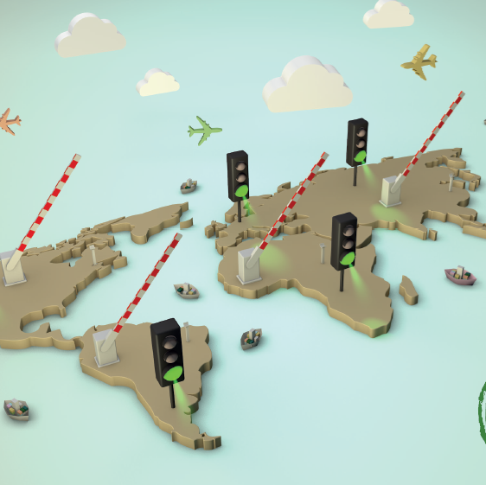
Facilitating Trade
1
Conduct analytical work
to identify the shortcomings in traded products
The overall objective is to contribute to reduce transaction costs and time needed of flow of goods as in the context of the WTO TF agreement.
2
5
Support institutions/
National standards
bodies (NSB) to align with international standards
Harmonization of compliance requirements and mutual recognition of conformity assessment procedures
3
4
Increase transparency by supporting testing/inspection service providers
Strengthening WTO TBT/SPS/TF Enquiry Points to contribute to the simplification of trade flows

Slide 17
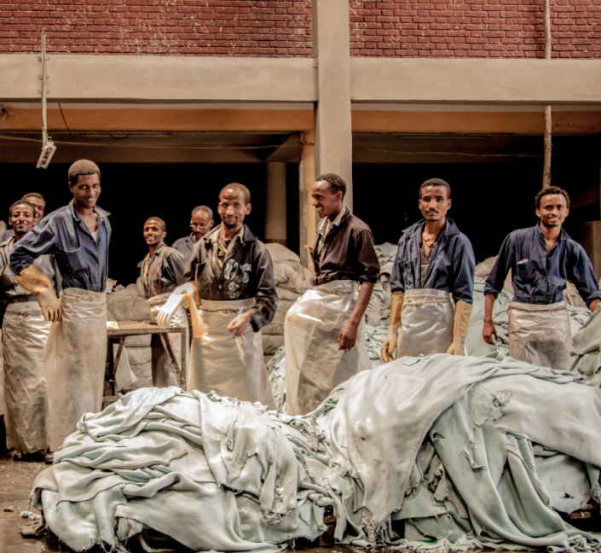
Supporting PCPs
ETHIOPIA
Achieving Inclusive and Sustainable Industrial Development (ISID) goals requires long-term commitments. Strategic partnerships expand the impact of UNIDO’s work well beyond the short-term grant-funded capacity-building assistance.
SENEGAL
In order to operationalize the partnership approach, UNIDO has developed a new type of assistance package for its Member States: the Programme for Country Partnership (PCP). The PCP is a custom-built partnership formula with each beneficiary country maintaining ownership of the complete process by defining its needs and required support, and finally ensuring the success of its delivery.
PERU

Slide 18

BUILDING BUSINESS PARTNERSHIPS &
MOBILIZING INVESTMENT

Slide 19




Investment Promotion
NETWORKS
RESEARCH
GLOBAL FORUM
UNIDO ITPO Network
Investment and Technology Promotion Offices (ITPOs) contribute to the reduction of development imbalances - by brokering investment and technology agreements.
UNIDO SPX Network
Subcontracting and Partnership Exchanges (SPXs) help local enterprises to successfully meet the challenges of globalization.
Investor Survey
Firm-level survey of the investment activities, performance and perceptions, development of technical research papers and creation of research platform with leading academic institution.
Quality FDI Conference
UNIDO, in partnership with the Kiel Institute for the World
Economy is organizing a 2-day conference on “Quality FDI, Growth and Development: Discussing the Impact and Policy
Options” in Vienna from 14 to 15 September 2016.
TOOLS
COMFAR
UNIDO’s Computer Model for Feasibility Analysis and Reporting (COMFAR): methodology and tools for pre-investment: project preparation and appraisal necessary to design analyze and optimize investment project scenarios.

Slide 20

Networks: Investment and Technology
Promotion Offices (ITPOs)
Creation of ITPOs through agreements between the hosting countries and UNIDO
Collaboration with public and private institutions on industrial development issues acting as international honest broker
Dissemination of the latest information on the legal and economic framework, on the investment and industrial cooperation opportunities
Identification and promotion of specific investment opportunities
Promotion of investments and technology transfer through investors and technology suppliers
Organization of business delegations to visit trade fairs and investment forums
BAHRAIN
CHINA (2)
GERMANY
ITALY
JAPAN
NIGERIA
REP. OF KOREA
RUSSIA
VIENNA

Slide 21

Networks: UNIDO SPX Centres
UNIDO establishes Subcontracting and Partnership Exchanges (SPXs) with the objective of helping local enterprises to successfully meet the challenges of globalization and to take advantage of the emerging opportunities that evolve from industrial subcontracting, outsourcing and supply chain opportunities.
  The Programme is a response to the need of large investors to find qualified local suppliers and develop local suppliers
More than 20 SPX Centres world wide are currently operational
SPX toolkit comprises a profiling methodology, a benchmarking methodology and an SPX Management Information System (MIS)
The SPX database currently comprises around 7,000 firm profiles and around 500 firm benchmarks and connects to other programmes in the area of investment and technology promotion

Slide 22
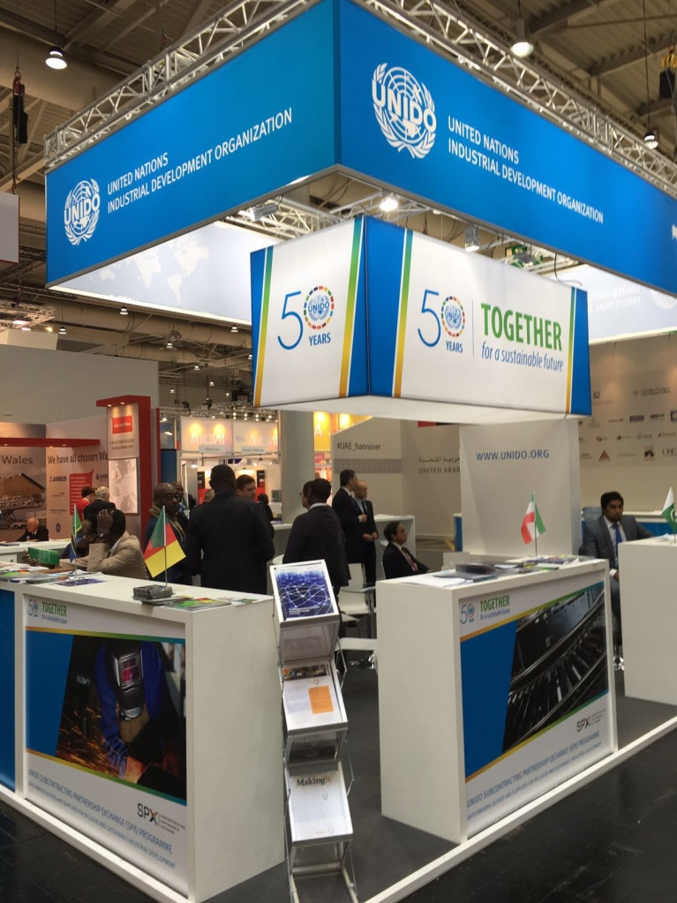
Hannover Messe 2016 & SPX
The Hannover Messe 2016, held 25-29 April 2016 in Germany, is the world's leading trade fair for industrial technology. It features topics such as global business and markets, industrial supply, renewable energy, industrial automation, mobility etc. Typically, there are about 6,500 exhibitors and 250,000 visitors.
UNIDO actively participated in the Messe, especially with its exhibition booth which saw co-exhibitors from 6 UNIDO’s Subcontracting and Partnership Exchange Centres (SPXs).
During the five days of the Fair, more than 350 meetings took place which are now actively being followed up.

Slide 23

Research: Investor Survey
AIS is a firm-level survey of the investment activities, performance and perceptions of companies active in Sub-Saharan Africa (SSA)
  Sampling strata: economic sub-sector (ISIC 2-digit level), size (# of employees), and ownership status (foreign- or domestic-owned)
So far, UNIDO has supported five rounds of investor surveys: 2001, 2003, 2005, 2010 and 2013
Close to 7,000 face-to-face interviews conducted with top-level managers from foreign/domestic-owned firms.
Covering a range of economic activities (agriculture, manufacturing services) across 19 SSA countries.
Notes:
Representative sample of registered public and private sector, for-profit enterprises
Information collected from business directories – harmonized & verified!

Slide 24

Tools: COMFAR
UNIDO’S COMPUTER MODEL FOR FEASIBILITY ANALYSIS AND REPORTING (COMFAR)
facilitates short and long term analysis of financial and economic consequences for industrial and non-industrial projects.
accompanied by manuals, teaching materials and interlinked software for project identification and preparation.
offers specialized modules, for example on Clean Development Mechanism (CDM) and on Environmental Management Accounting.
30 years
19 languages
over 10,000 users
160 countries

Slide 25
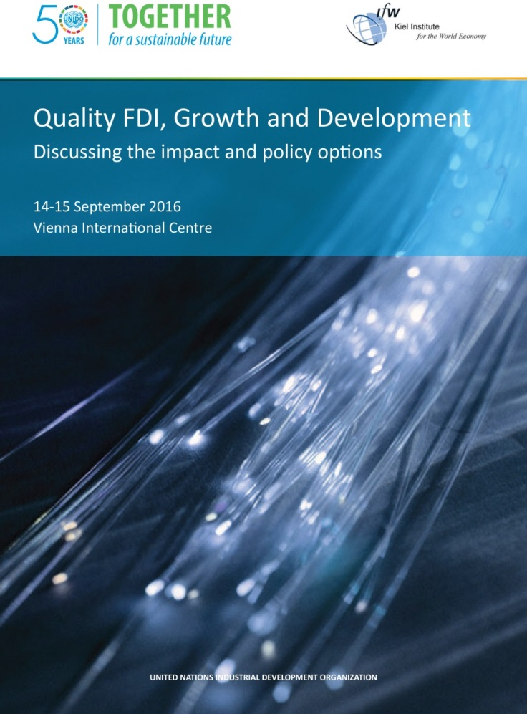
Quality FDI Conference
14-15 September 2016, Vienna
CONFERENCE CONTENT
Policy factors affecting entry mode, location and operation of FDI in developing countries
Inward FDI and upgrading within global value chain: assessing the evidence
Inter-firm linkages and spillovers from FDI: describing the transmission channels
Growing dynamism in South-South cooperation: role of emerging market MNEs
Maximizing development impact of migration-related FDI: patterns and prospects
New paths towards (re-)investment promotion: moving beyond improvement in business environment indicators

Slide 26

UNIDO PROGRAM
FOR COUNTRY
PARTNERSHIP (PCP)

Slide 27
UNIDO PCPs
Achieving Inclusive and Sustainable Industrial Development (ISID) goals requires long-term commitments. Strategic partnerships expand the impact of UNIDO’s work well beyond the short-term grant-funded capacity-building assistance.
ETHIOPIA
SENEGAL
In order to operationalize the partnership approach, UNIDO has developed a new type of assistance package for its Member States: the Programme for Country Partnership (PCP). The PCP is a custom-built partnership formula with each beneficiary country maintaining ownership of the complete process by defining its needs and required support, and finally ensuring the success of its delivery.
PERU

Slide 28

Programme for Country Partnership (PCP)
ETHIOPIA
AREAS OF INTERVENTION
The PCP is rooted in the industrial development strategy of Ethiopia. It aims to support the Government in the implementation of the GTP II and in addressing challenges associated with structural transformation.
The key features of the PCP are:
government ownership;
alignment with national development plans;
a strong partnership approach;
leveraging for investment;
focus on selected priority sectors;
rigorous monitoring and evaluation system.
partnership mobilization
agro-food sector
leather and leather products sector
textiles and apparel sector
institutional capacity-building
investment promotion
trade facilitation
environment
south-south and triangular industrial cooperation

Slide 29
Maximizing impact through partnership approach
Project
formulation
Program
implementation
Larger projects
Investments
PROJECT DEVELOPMENT
IMPLEMENTATION
PARTNERSHIP + INVESTMENT
UNIDO resources 30-50 K
UNIDO’s and donors’ resources: 1-5 million
> 100 million USD
Extensive consultation with stakeholder and inventory of programs of partners
Focus on fewer sectors and critical constraints
Integrated service provision by UNIDO TC branches (teams)
Synergy with other programs
Private and public finance (DFIs, CB, DP loans +grants)
Synergy with other programs
Larger infrastructure/ beneficiaries
Notes:
In the ongoing TC projects , we identify projects, program with the government, formulate and execute projects and evaluation!!!
PCP we continue the same process as TC however, during the identification of the program we take into consideration sectors which can be scaled-up, for job creation, export potential, comparative advantage of the country sectors which also likely to attract investment ..
Deploy multidisciplinary team of experts for from different branches in the focused priority sectors
Establish one project implementation unit for coordination ; strong ownership of the project for scaling-up and sustainability of the project achievements strong monitoring and evaluation of projects
Mobilize partners (DP, DFIs, PS and Public sector) for large investments
UNIDO receives grant for supporting the implementation of larger scale programs

Slide 30
THANK YOU
UNITED NATIONS INDUSTRIAL DEVELOPMENT ORGANIZATION

