Slide 1

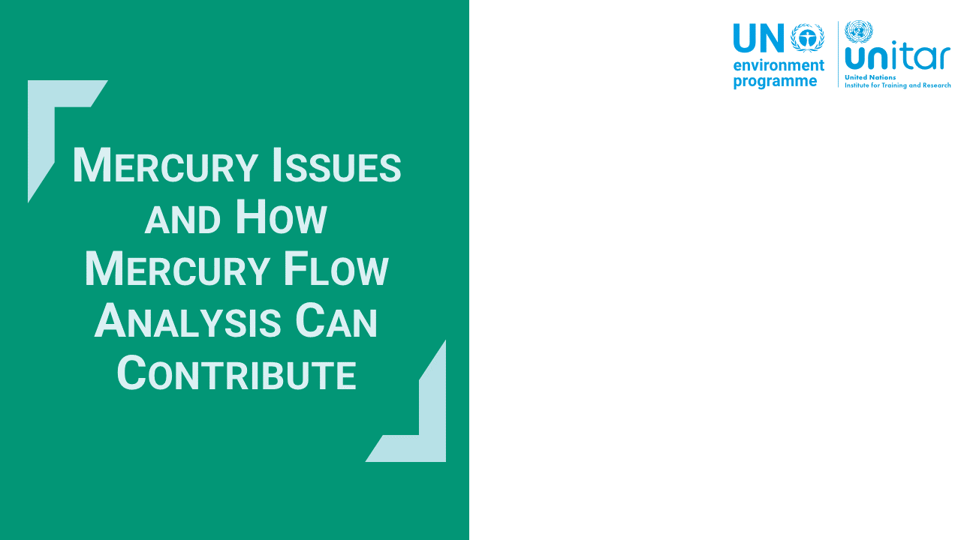
Notes:
‘0’ This lecture explains current mercury issues and values of mercury mass flow that can contribute to sound mercury management.

Slide 2
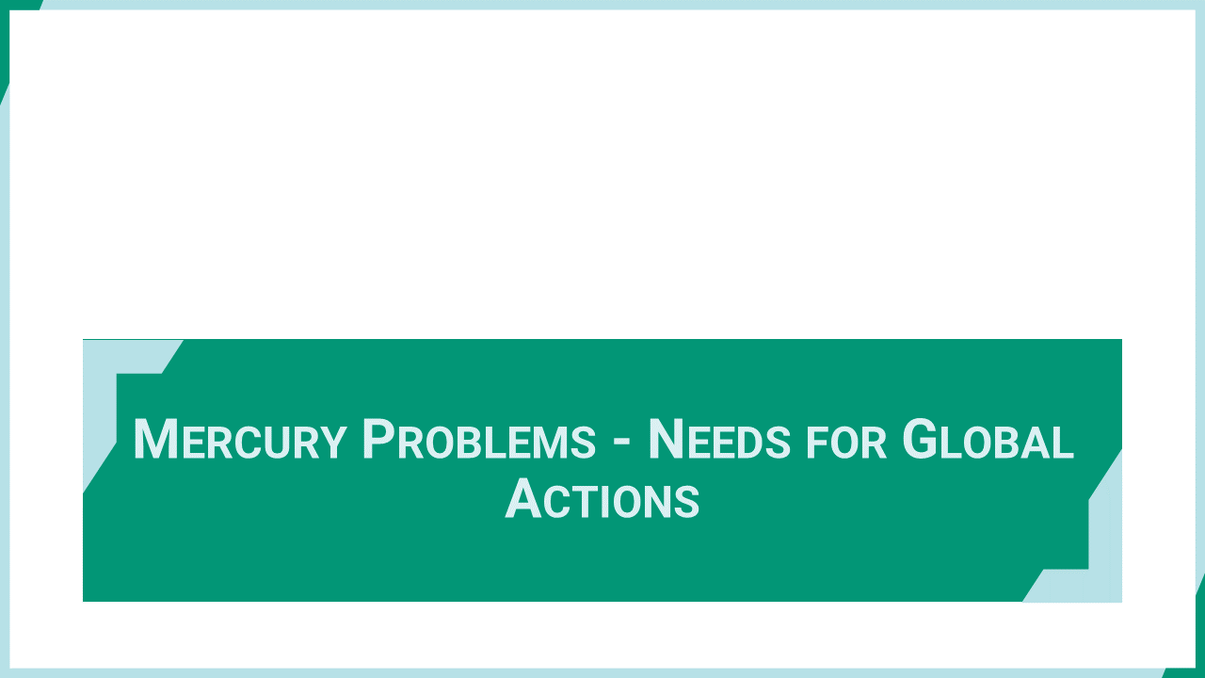
Notes:
‘1’ This section explains the backgrounds of mercury issues and challenges for the needs for global actions.

Slide 3
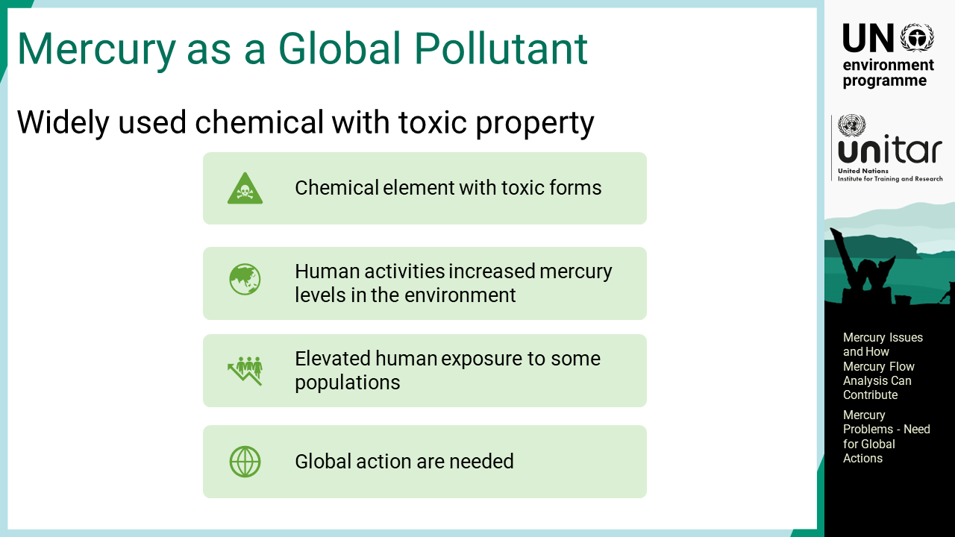
Notes:
‘2’ Mercury is a chemical element with unique physical properties. Methylmercury is a form of mercury compound of great concern due to its high toxicity, but many other mercury compounds also have certain level of toxicity. Mercury has been used widely because of its practical and technical characteristics. Although mercury has existed on Earth since its formation, recent anthropogenic activities have increased mercury levels in the environment, resulting in elevated exposure to some populations. This is why mercury is regarded as a global pollutant that requires global action.

Slide 4
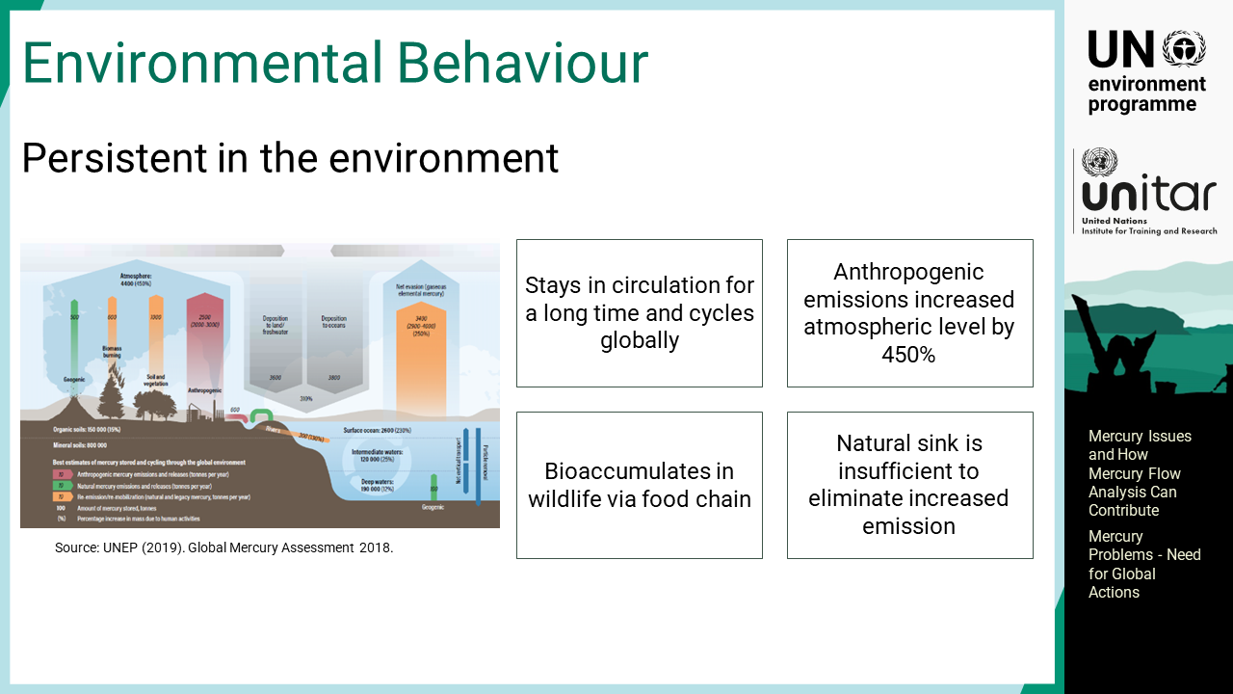
Notes:
‘3’ One of the important properties of mercury is its persistence and long-range transport. It is released from various sources in various chemical forms and stays in circulation for a long time and cycles globally. It is estimated that due to anthropogenic activities, mercury emissions to the atmosphere have increased by 4.5 times compared to the purely natural level. Mercury, particularly methylmercury, is toxic to the central nervous system at the development stage and bioaccumulates in wildlife via the food chain. Mercury changes its chemical forms and moves across multiple media, for example, air, water, soil, biota, etc. The main mercury sink is the bottom sediment of the ocean. Such a natural mercury elimination process is slow and not sufficient to resolve recent mercury problems.

Slide 5
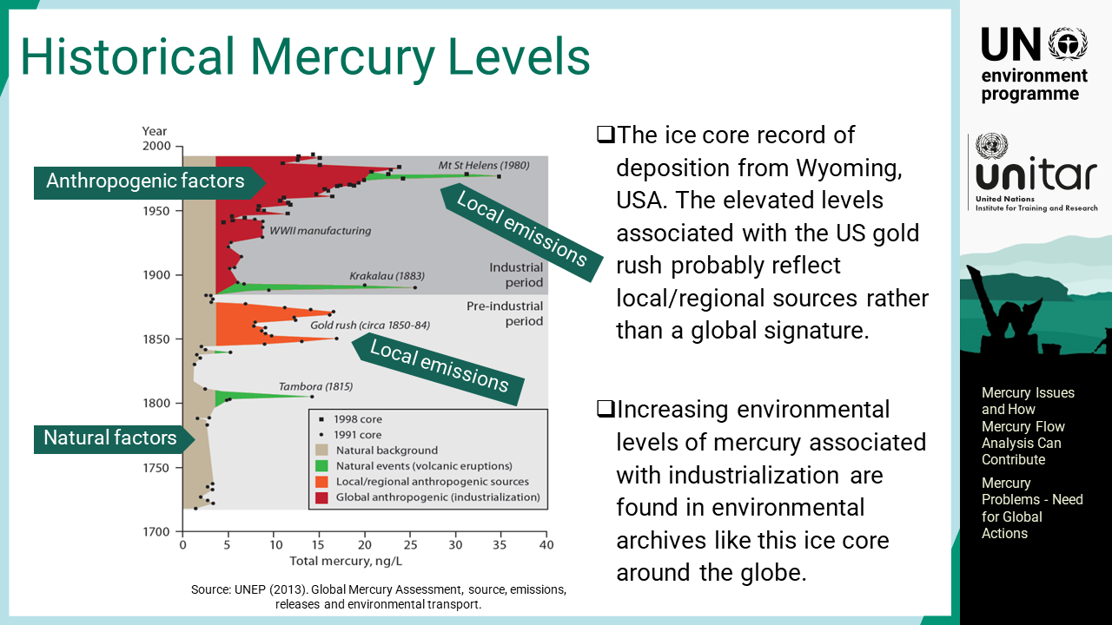
Notes:
‘4’ In recent years, more mercury has been released through human activities, such as combustion of fuels, mining activities, and consumption of mercury-added products. Some evidence shows that human activities have raised mercury levels in the environment. The ice core record of deposition from Wyoming, United States of America, indicates an increase in the global environmental mercury level since the onset of global industrialization in the 19th century. The figure also indicates a few spike peaks that might be associated with local and/or regional sources, and large volcanic activities.

Slide 6
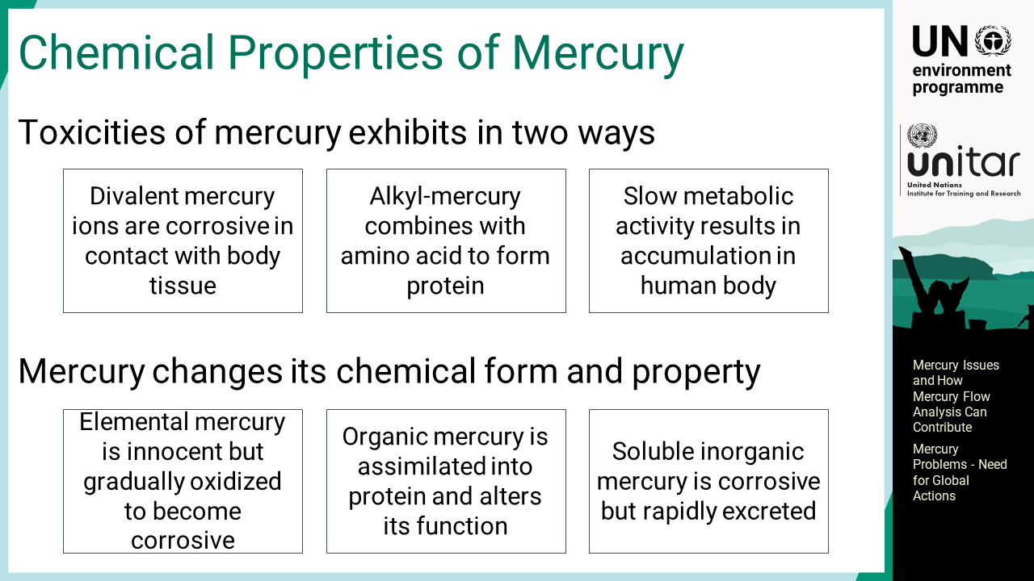
Notes:
‘5’ Most of the mercury and mercury compounds have certain toxicities, but their biological behaviours and toxicity levels are distinct. Elemental mercury is easily evaporated and absorbed by inhalation. Mercury is not corrosive in its elemental form, but once oxidized by metabolic activity, it becomes corrosive. Alkylmercury, particularly methylmercury, forms a complex with one of the amino acids and is assimilated into body tissues as a protein that alters its normal function. Mercury compounds are eventually metabolized to divalent mercury ions and excreted into urine, but the metabolic rates are different in different chemical forms.

Slide 7
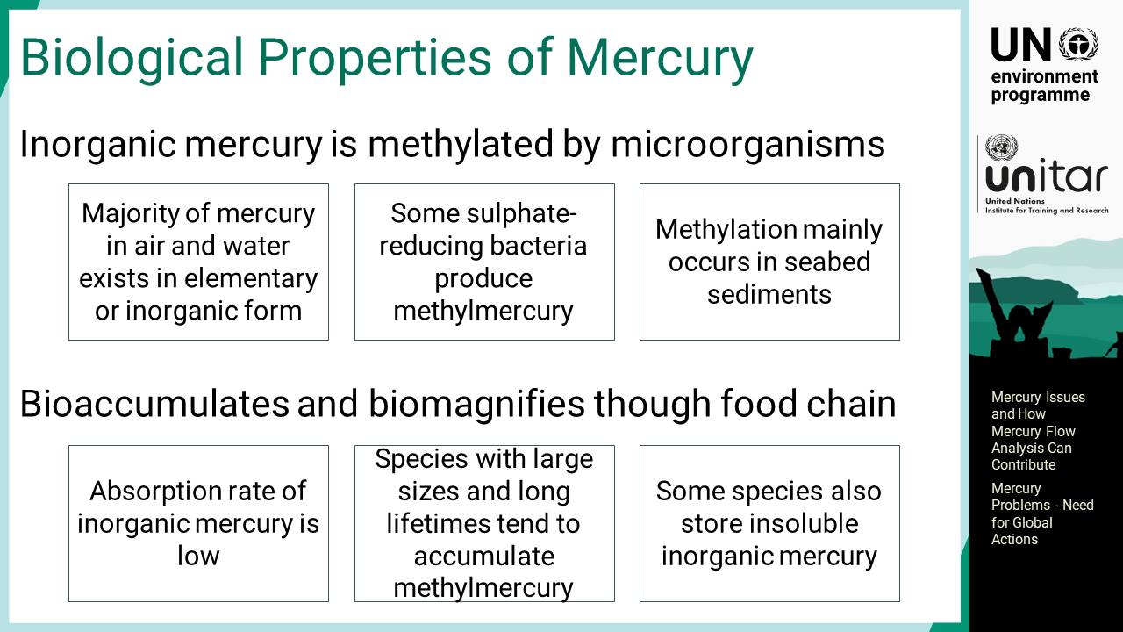
Notes:
‘6’ Mercury circulates in air and water in elementary or oxidized inorganic form, but most of the mercury that exists in humans and biota is methylmercury. Methylation occurs mainly in the bottom sediment of the seabed, where anaerobic conditions are dominant. Some sulphate-reducing bacteria produce methylmercury by reducing oxidized inorganic mercury. The absorption rate of inorganic mercury is lower than that of methylmercury, thus methylmercury is selectively assimilated. Species with large sizes and long lifetimes tend to accumulate methylmercury. Some animal species have obtained the metabolism to safely store insoluble inorganic mercury particles in their bodies.

Slide 8
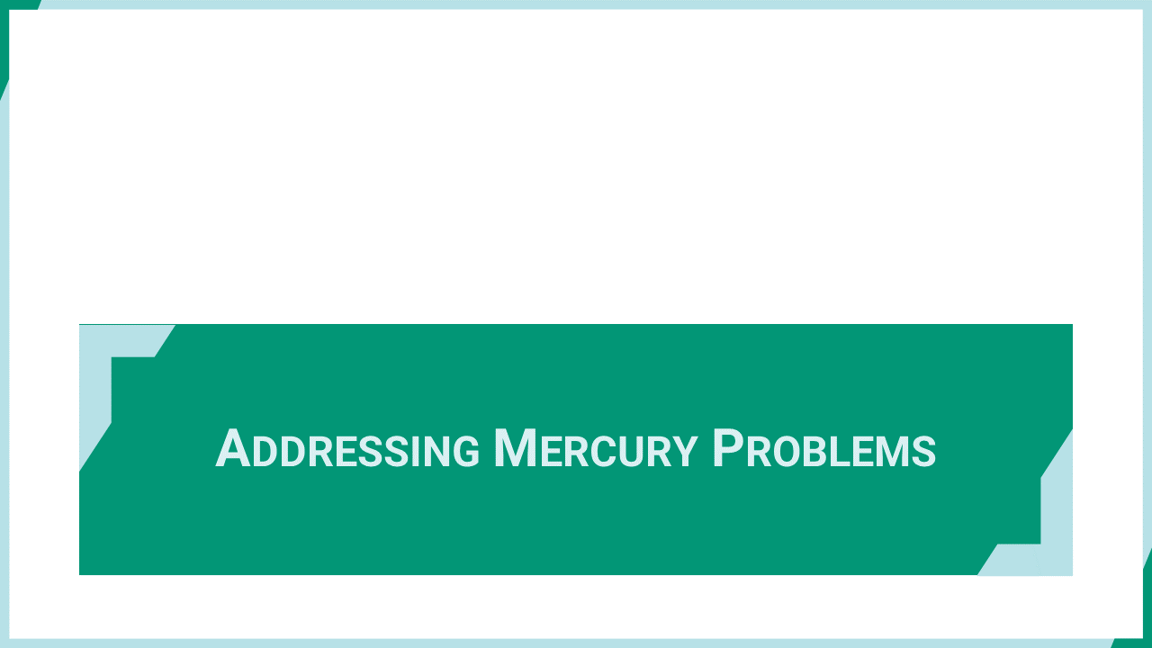
Notes:
‘7’ This section explains the relevance of the Minamata Convention to address global mercury problems.

Slide 9
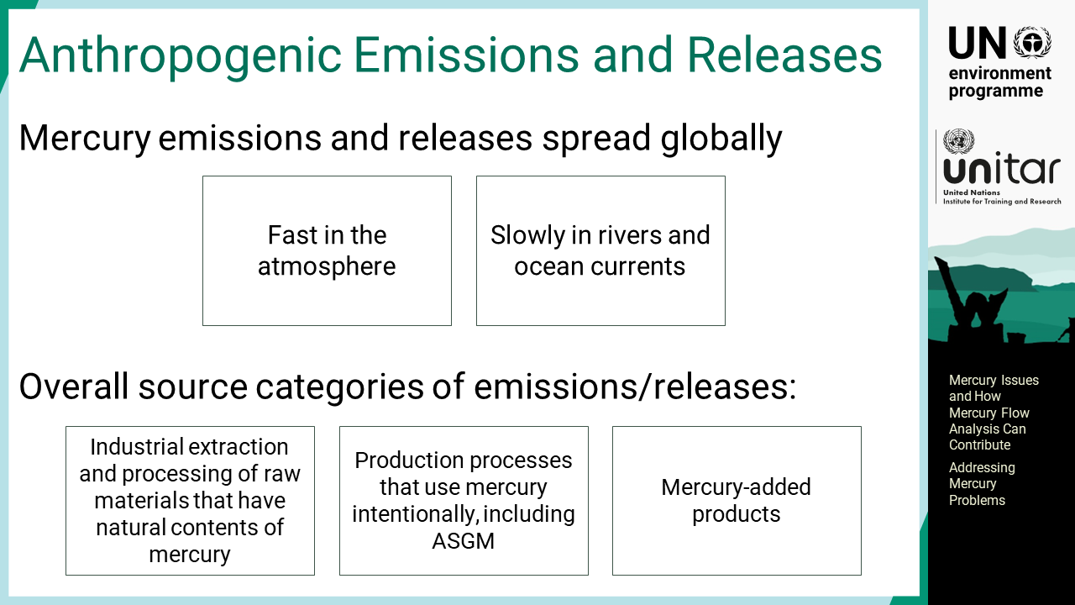
Notes:
‘8’ Mercury emissions and releases spread globally. It moves quickly in the atmosphere and more slowly in rivers and ocean currents. The main anthropogenic source categories of mercury emissions and releases are the following: extraction and processing of raw materials that have natural trace concentrations contents of mercury such as coal and non-ferrous metal ores, production process that use mercury intentionally including ASGM, and mercury-added products where mercury is added intentionally for a purpose.

Slide 10
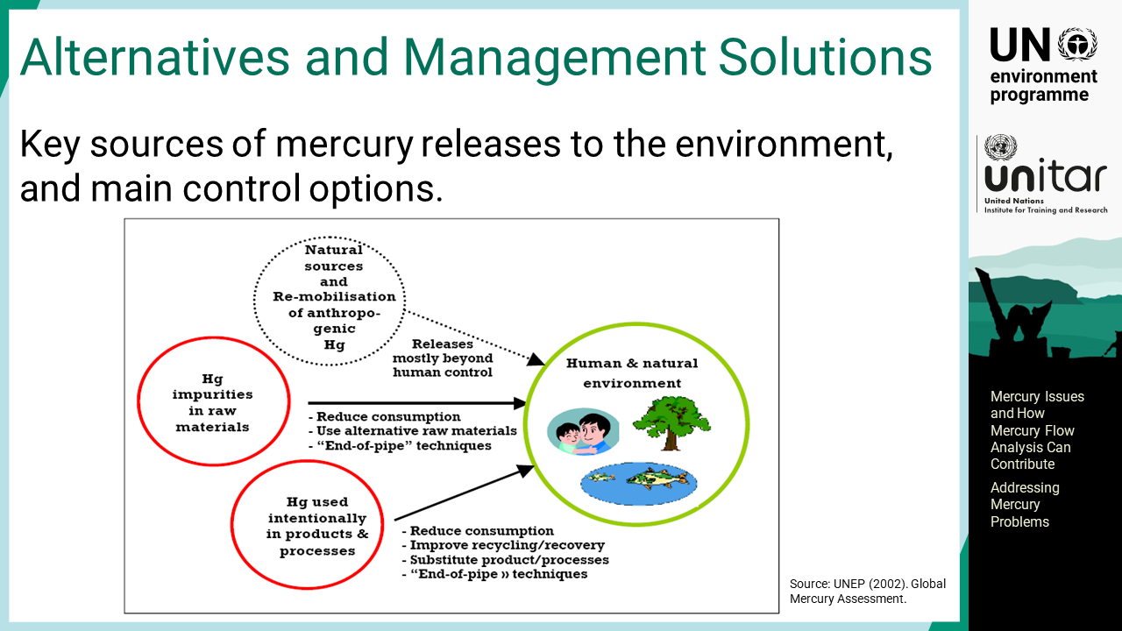
Notes:
‘9’ Regarding natural sources and remobilization, there is very little that can be done to reduce them. Mercury impurities in raw materials can be lowered by reducing consumption or, in some cases, substituting with other materials or processes. For example, reducing the use of coal to reduce climate impacts will have a large effect on mercury releases as well. Otherwise, the reduction is done by so-called “end of pipe” techniques, or mercury control techniques.

Slide 11
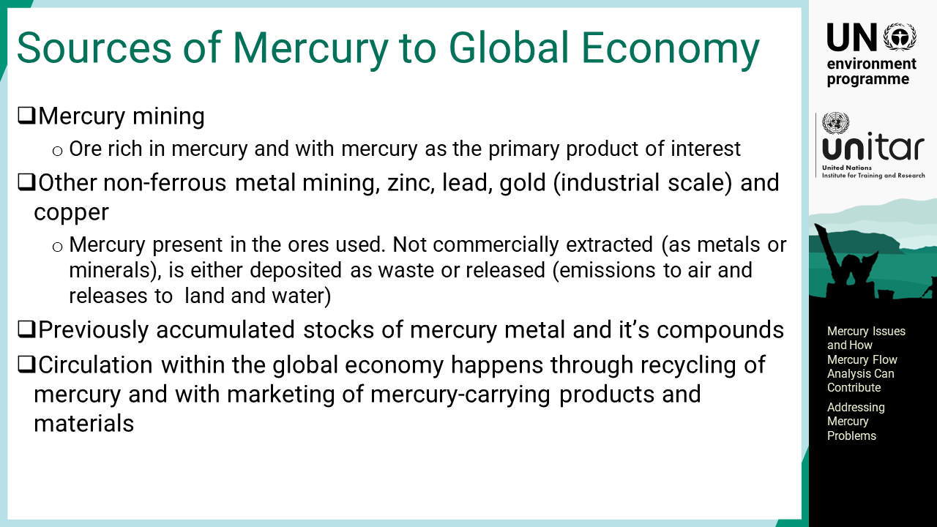
Notes:
‘10’ There are several other sources of mercury input to the global economy. Dedicated mercury mining is a primary source. In addition, other non-ferrous metal mining such as zinc, lead, copper, and industrial scale gold mining contribute to the mercury market as mercury is naturally occurring in the ore of these metals. Mercury in the ore may be sold for use, emitted to the atmosphere, or disposed of locally. As mercury has been extracted for many years, it is accumulated in the global market and traded. The sale of mercury from such stocks is, however, restricted in some countries as a part of mercury management. Finally, mercury circulates with products globally and some of them are collected for recovery of mercury, which is another mercury source to the economy. However, mercury is now gradually being permanently retired during final disposals in many countries to avoid future environmental impacts.

Slide 12
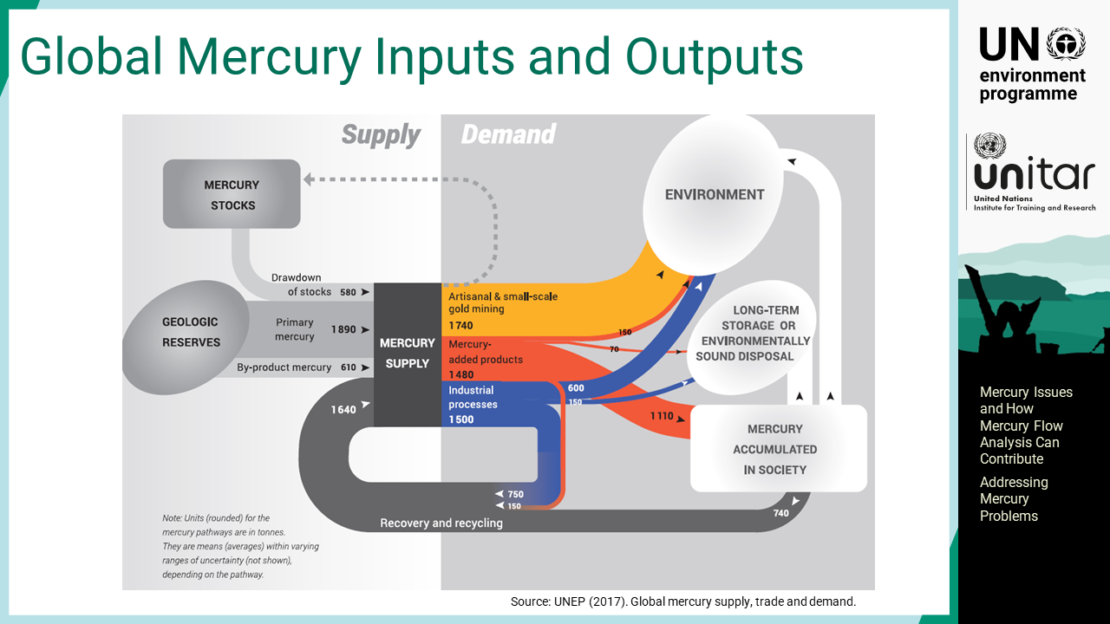
Notes:
‘11’ This slide gives an overview of the known intentional mercury inputs and their outputs globally. The geological reserves of primary mercury and mercury by-product account for the major mercury input. The recovery and recycling are also large and come from industrial processes such as vinyl chloride monomer production or mercury recovered from mercury-added products. Much of the mercury ends up in the environment. Additionally, there is some long-term storage of mercury and environmentally sound disposal. Finally, the accumulation of mercury in society in products and in processes is shown, and this contributes to recovery and recycling, as well as to environmental emissions and releases.

Slide 13
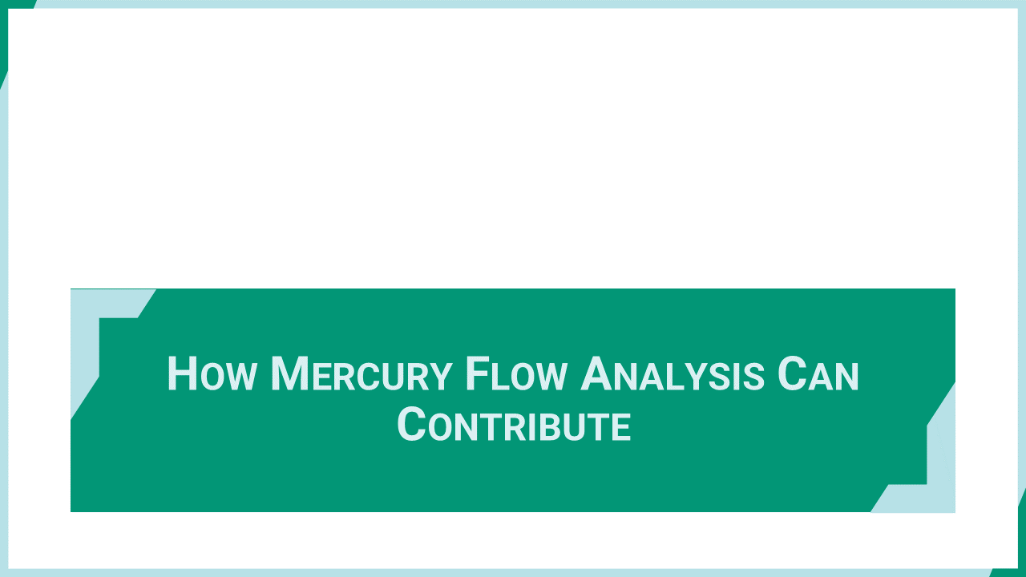
Notes:
‘12’ This section explains how mercury flow analysis can contribute to global mercury problems.

Slide 14
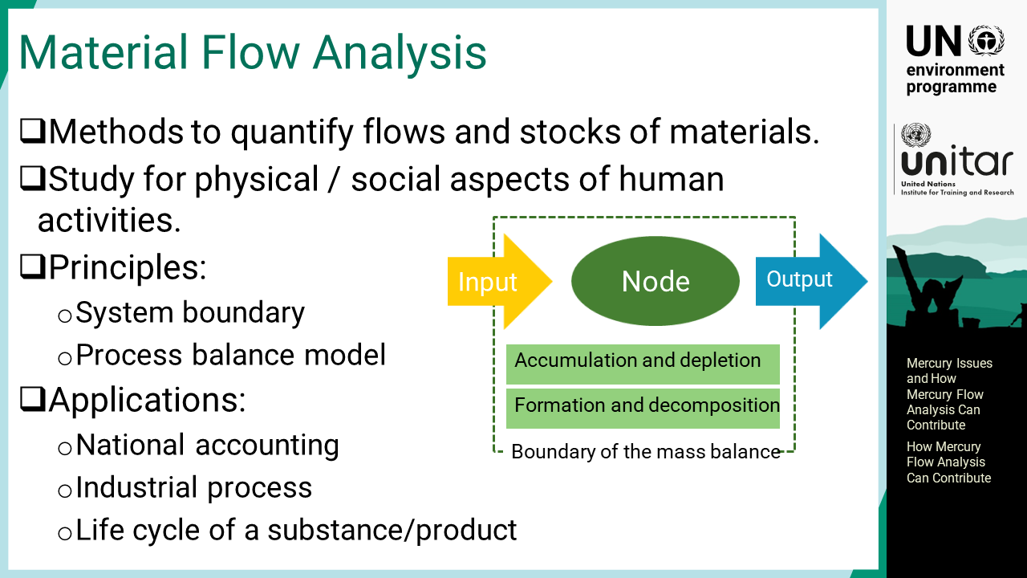
Notes:
‘13’ Material flow analysis is a systematic method to quantify flows and stocks of the target material. It can include substance or product and assesses human activities that change the physical and social properties of the material. The analysis involves two main principles, setting boundaries and modelling process balances. The inflow to and outflow from a boundary will affect the accumulation or depletion of the stock within the boundary if the mass balance is maintained. Material flow is applicable at many levels and purposes depending on the purpose and use.

Slide 15
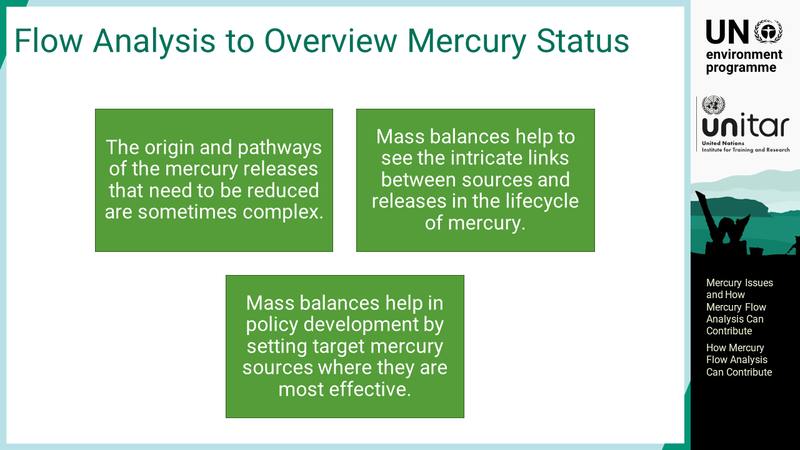
Notes:
‘14’ The origin and pathways of the mercury releases that need to be reduced are sometimes complex. Mass balances help to see the intricate links between sources and releases in the life cycle of mercury. Therefore, mass balances help in developing policy by setting target mercury sources where they are most effective. For example, a key source of mercury to agricultural land may be sewage sludge used as fertilizer, where mercury from dental amalgam use, thermometers spills, etc. end up via wastewater treatment facilities.

Slide 16
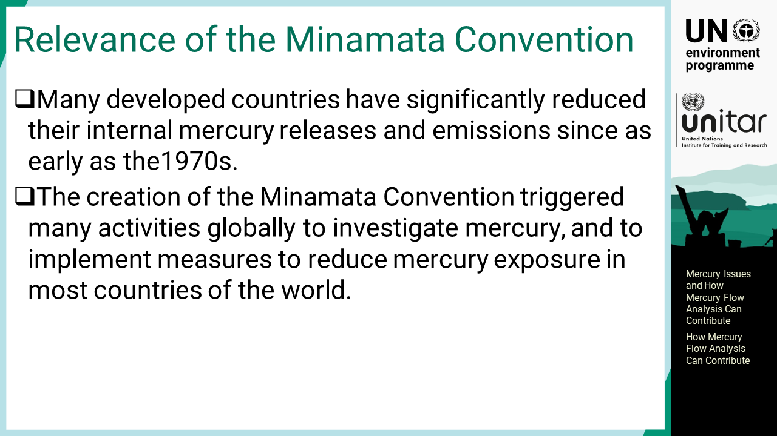
Notes:
‘15’ Minamata Convention is vital in efforts to reduce mercury’s adverse impacts. Many developed countries have significantly reduced their mercury releases and emissions since as early as the 1970s in response to the serious health effects caused in Minamata and a few other locations. The creation of the Minamata Convention triggered many activities globally to investigate mercury, and to implement measures to reduce mercury exposure in most countries of the world.

Slide 17
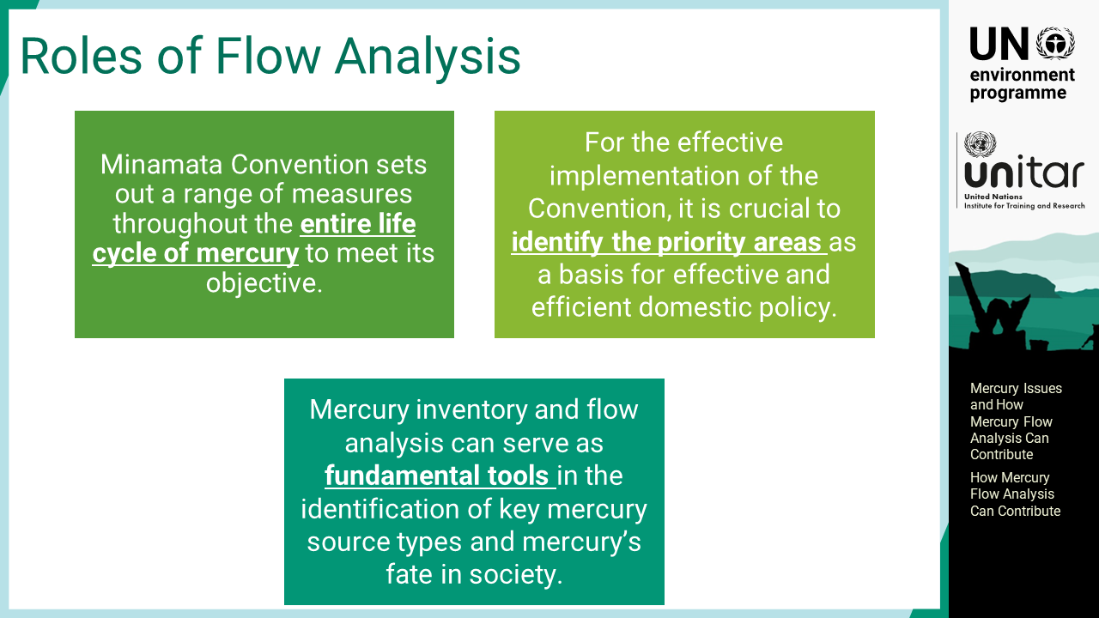
Notes:
‘16’ The Minamata Convention sets out a range of measures throughout the entire life cycle of mercury to meet its objective. For the effective implementation of the Convention, it is crucial to identify the priority areas as a basis for effective and efficient domestic policy. Mercury inventory and flow analysis can serve as fundamental tools in the identification of key mercury source types and mercury’s fate in society. Understanding the intricate linkages between mercury, socio-economic status and gender is important towards effective policies and interventions. Poverty is one of the main drivers for pushing women into mining and is further compounded by deterioration in subsistence farming. Thus, utilising a gender-responsive approach where relevant is recommended. Currently, National Action Plans under the Minamata Convention, are required to address women and children’s exposure to mercury in ASGM.

Slide 18
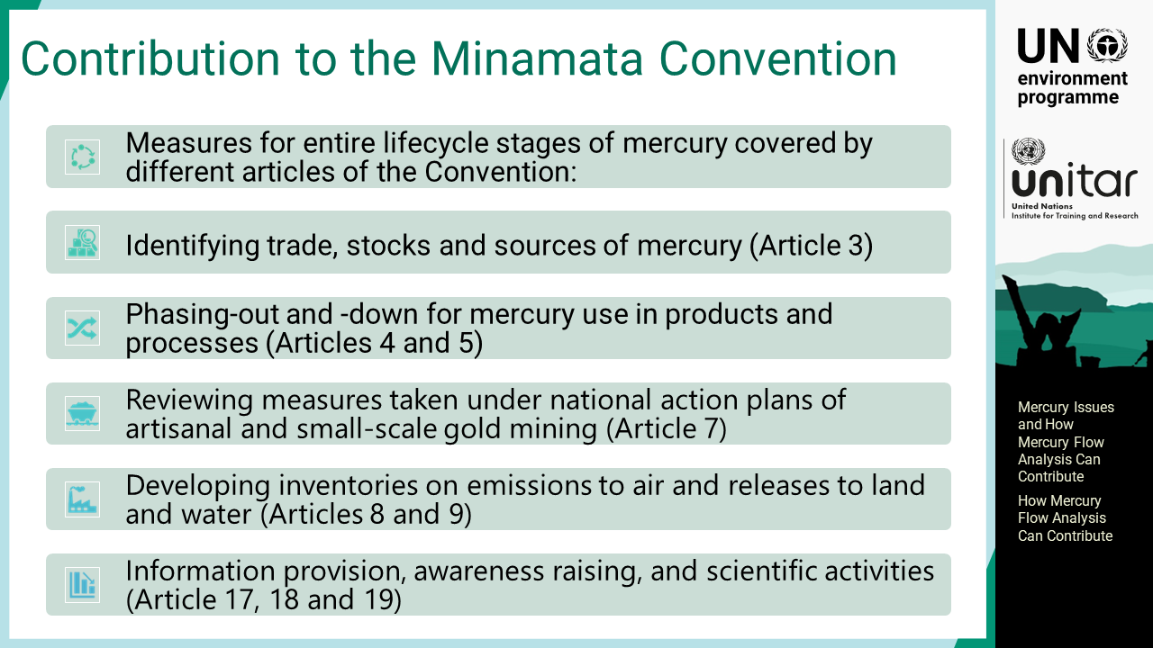
Notes:
‘17’ The Minamata Convention targets many aspects of the mercury problem. Mercury flow analysis can contribute to identifying mercury trade, stock and sources. It will be used to monitor several measures taken by the Parties such as the phase-out or phase-down of mercury-added products and processes and the implementation of ASGM national action plans. Mercury emission and release inventories will be direct products of mercury flow analysis. Overall, the information can be widely used for communications, education, research, and so on.

Slide 19
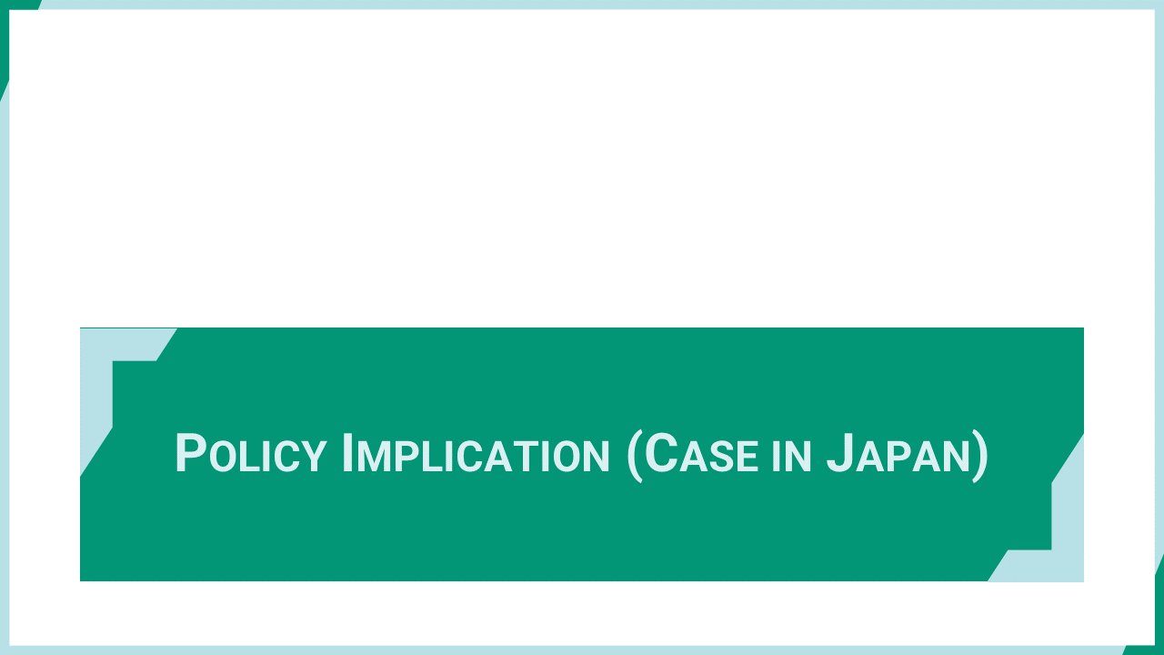
Notes:
‘18’ This section introduces an actual case study in Japan where mercury flow is used for national policymaking and implementation.

Slide 20
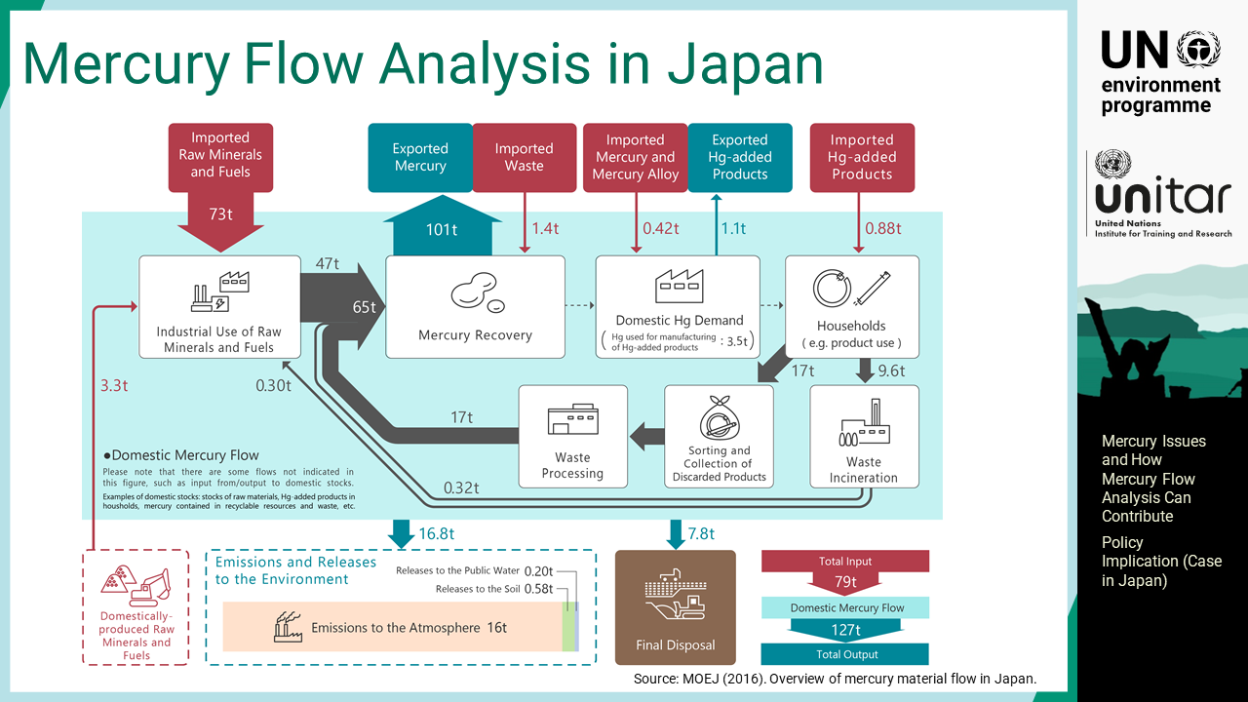
Notes:
‘19’ Ministry of the Environment, Japan has developed and is maintaining mercury flow analysis to capture mercury use for manufacturing processes and emissions and releases to the environment. Currently, the analysis versions in fiscal years 2010, 2014, and 2016 are available. It includes import and export of mercury and mercury compounds as well as mercury waste and recovery processes to capture the entire life cycle at the national level.

Slide 21
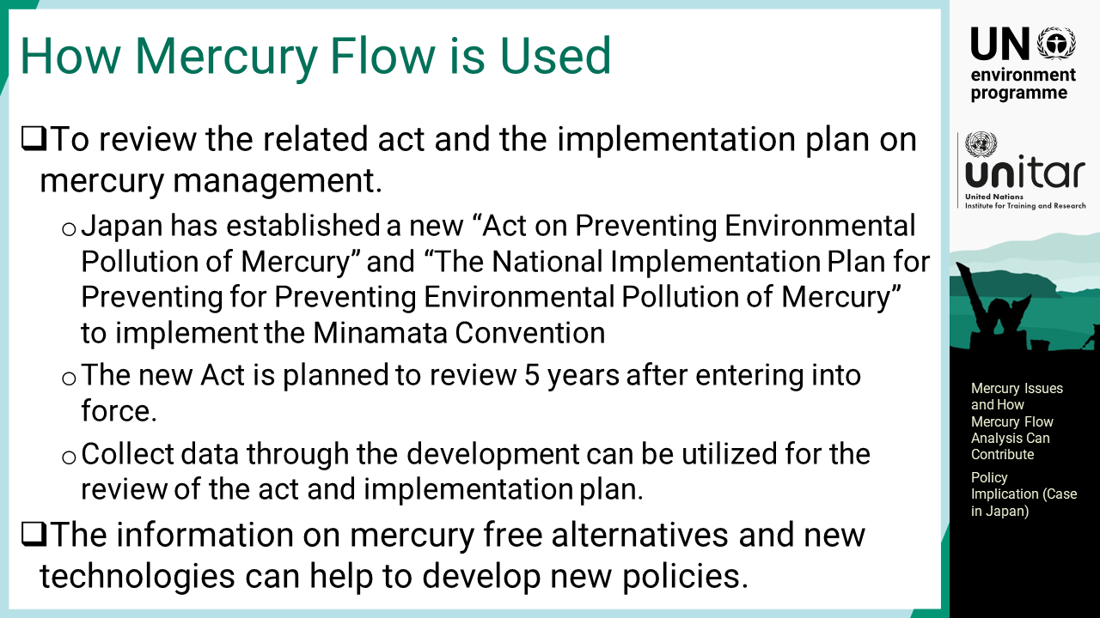
Notes:
‘20’ This analysis is used as base information among stakeholders for discussing domestic mercury management policies and plans. Japan has established a new “Act on Preventing Environmental Pollution of Mercury” and “The National Implementation Plan for Preventing Environmental Pollution of Mercury” to implement the Minamata Convention. The new Act is planned to be reviewed at 5 years after entering into force, and the data collected through the development of the mercury flow can be utilized for their reviews. Additionally, Japan is using the knowledge and experiences obtained through the development process for international cooperation for other countries.

Slide 22
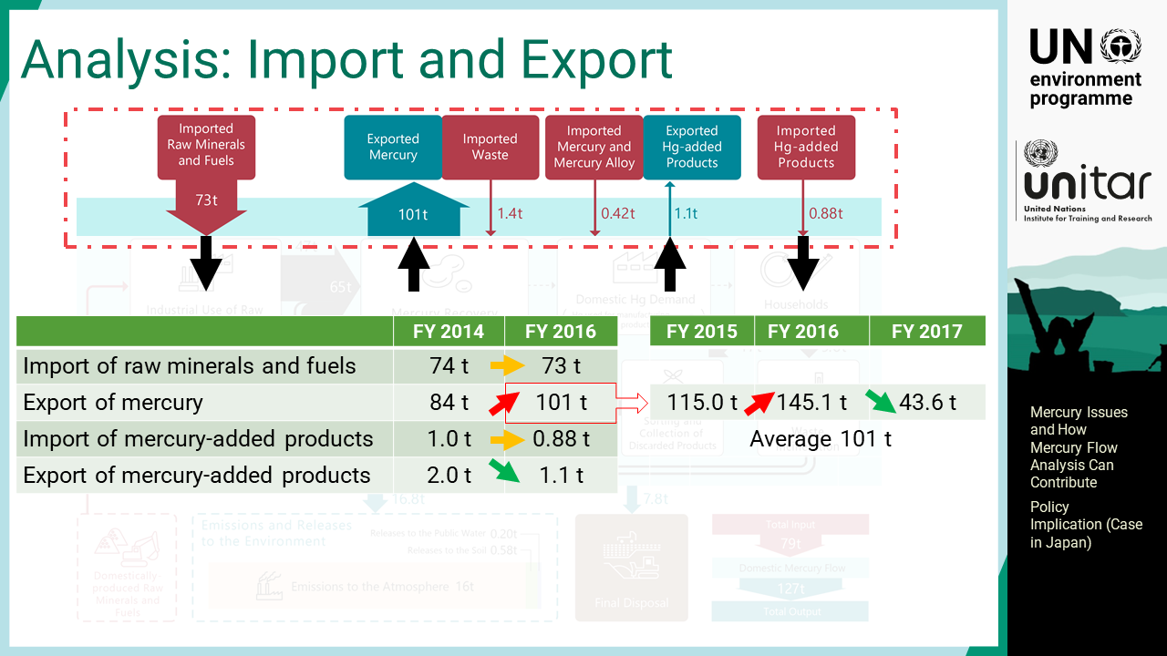
Notes:
‘21’ Import and export of mercury and mercury containing raw materials and products are compiled and converted to mercury amounts. The table below shows the trend between 2014 and 2016. The three-year average value is used for those with large yearly fluctuation.

Slide 23
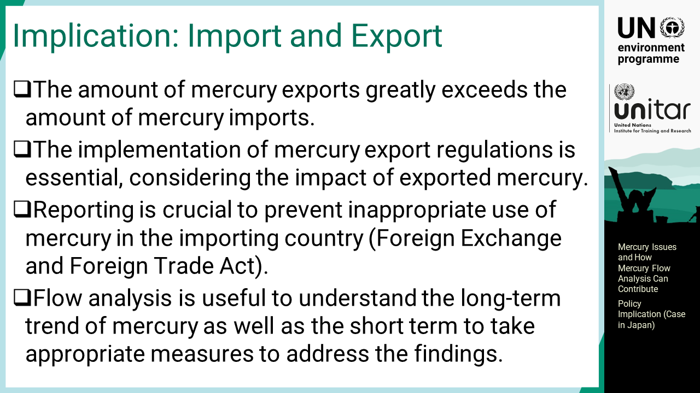
Notes:
‘22’ The amount of mercury exports from Japan greatly exceeds the amount of mercury imports as most mercury comes into the country as impurities in raw minerals and fuels. Considering the impact of exported mercury, the implementation of mercury export regulations is essential. In addition, the fate of mercury in importing countries is of concern to prevent inappropriate use; thus, exporters of mercury are responsible for reporting on final use from importing countries under the Foreign Exchange and Foreign Trade Act. Mercury flow analysis is useful to understand the long-term trend of mercury as well as the short term to take appropriate measures to address the findings.

Slide 24
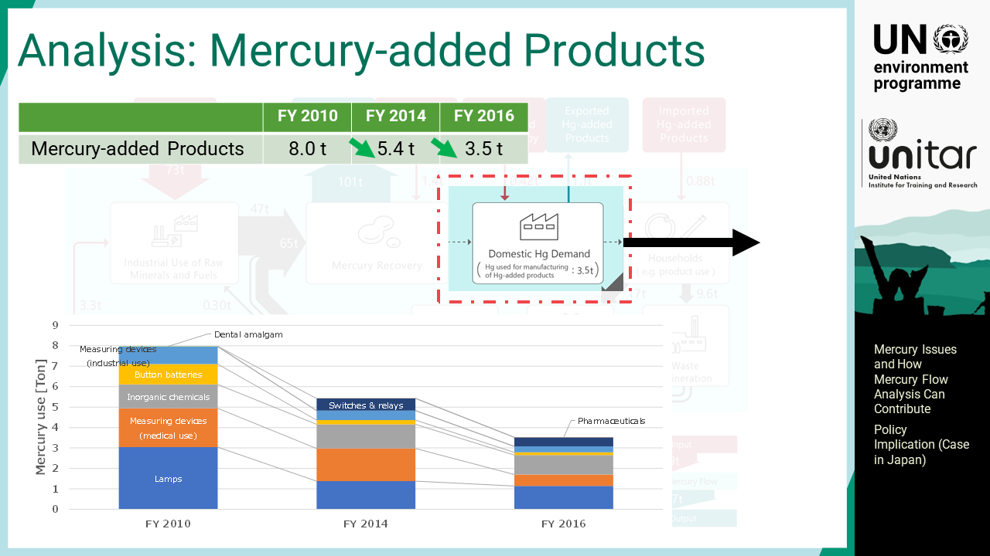
Notes:
‘23’ Domestic manufacturing of mercury-added products is still ongoing in Japan, although the total mercury amount used for the production is steadily declining.

Slide 25
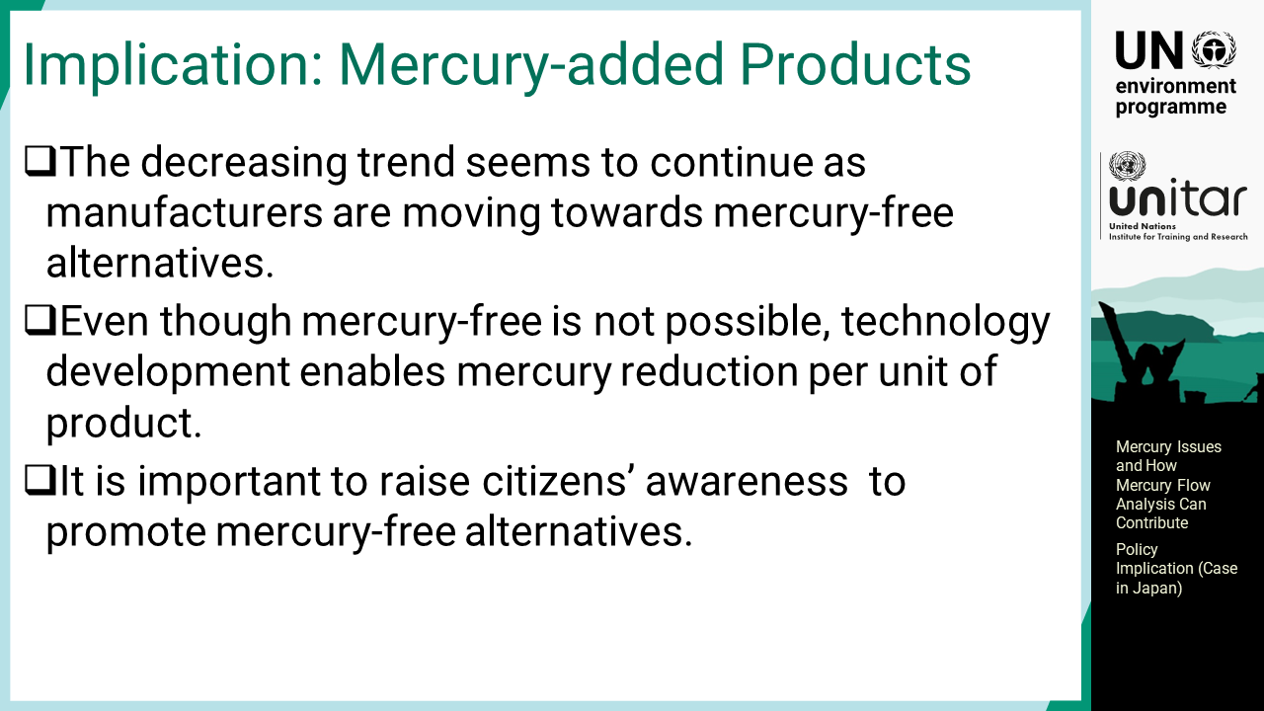
Notes:
‘24’ The decreasing trend seems to continue as manufacturers are moving towards mercury-free alternatives. Even though mercury-free is not possible, technology development enables mercury reduction per unit of product. It is important to raise citizens’ awareness to select mercury-free alternatives to their consumable products.

Slide 26
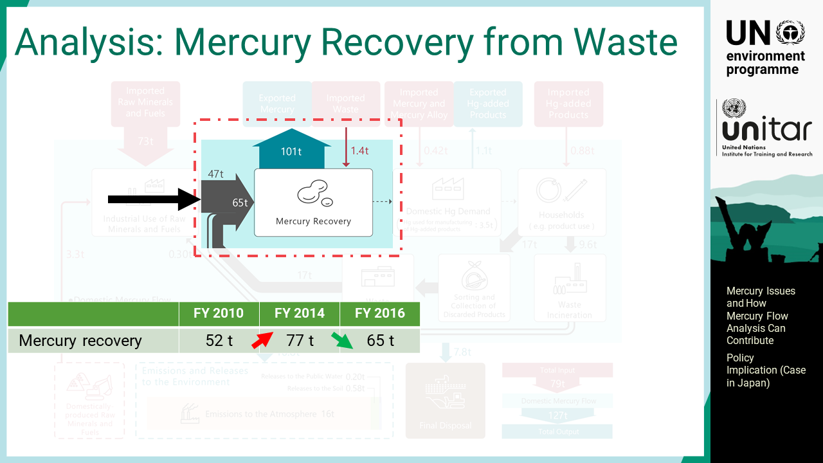
Notes:
‘25’ The mercury recovery industry exists in Japan and produces a significant amount of recycled mercury every year. The annual production level fluctuates but remains at a certain amount.

Slide 27
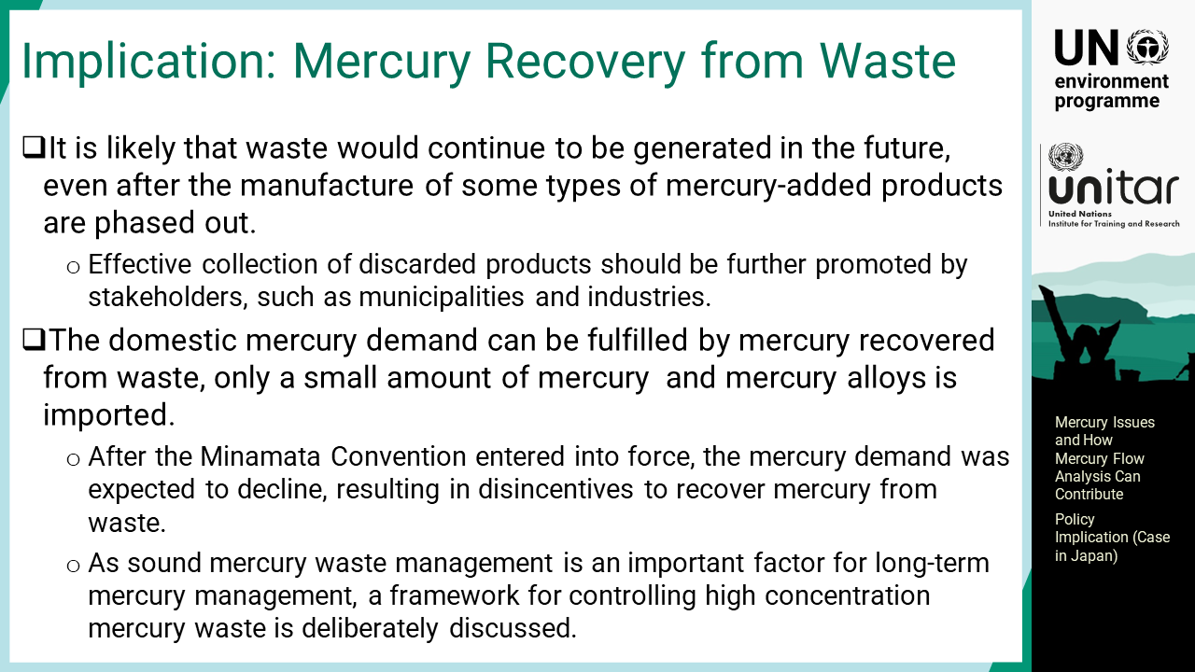
Notes:
‘26’ It is likely that waste of mercury-added products would continue to be generated in the future, even after the manufacture of some types of mercury-added products are phased out. Thus, the effective collection of discarded products should be further promoted by stakeholders, such as municipalities and industries. As the domestic mercury demand can be fulfilled by mercury recovered from waste, only a small amount of mercury and mercury alloys is imported. After the Minamata Convention entered into force, the mercury demand was expected to decline, resulting in disincentives to recover mercury from waste. As sound mercury waste management is an important factor for long-term mercury management, a framework for controlling high concentration mercury waste is deliberately discussed.

Slide 28
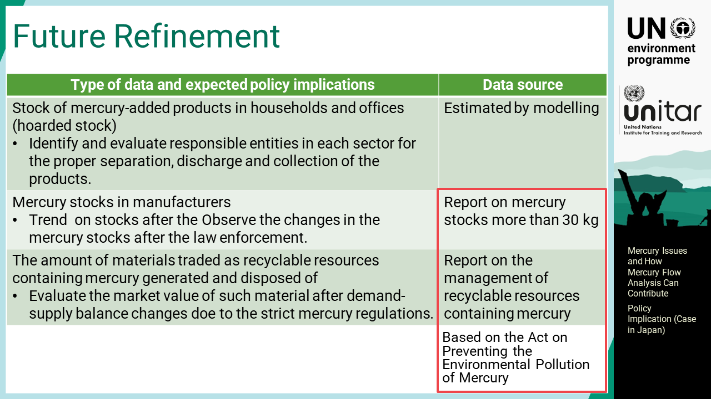
Notes:
‘27’ The 2016 version of Japan’s mercury flow still needs further refinement. Stock of mercury-added products in households and offices, which are also called hoarded stocks, should be identified and evaluated. The results will guide the responsible entities in each sector for the proper separation, discharge and collection of the products. Manufacturers storing a certain amount of mercury are subject to reporting on the management of their mercury under the new mercury act in Japan. Such reports provide the trend on stocks after the law enforcement. Those who manage materials traded as recyclable resource containing mercury are also required to report on the management of their resources under the new act. Such information is used for identifying flows of such resources.

Slide 29
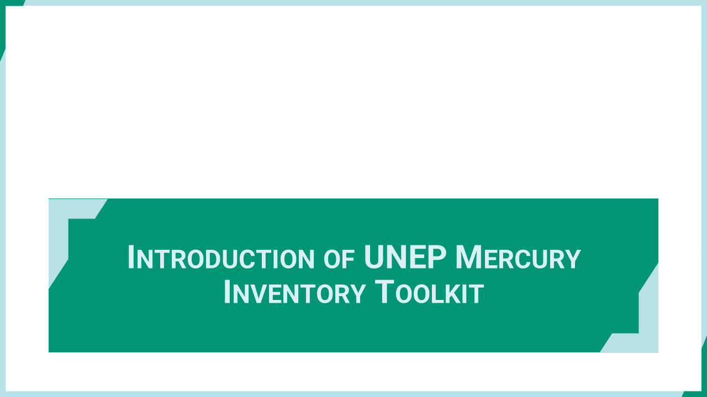
Notes:
‘28’ This section introduces UNEP Mercury Inventory Toolkit, which provides information directly relevant for mercury mass flows. It is used by many countries as the de facto standard for mercury inventory development.

Slide 30
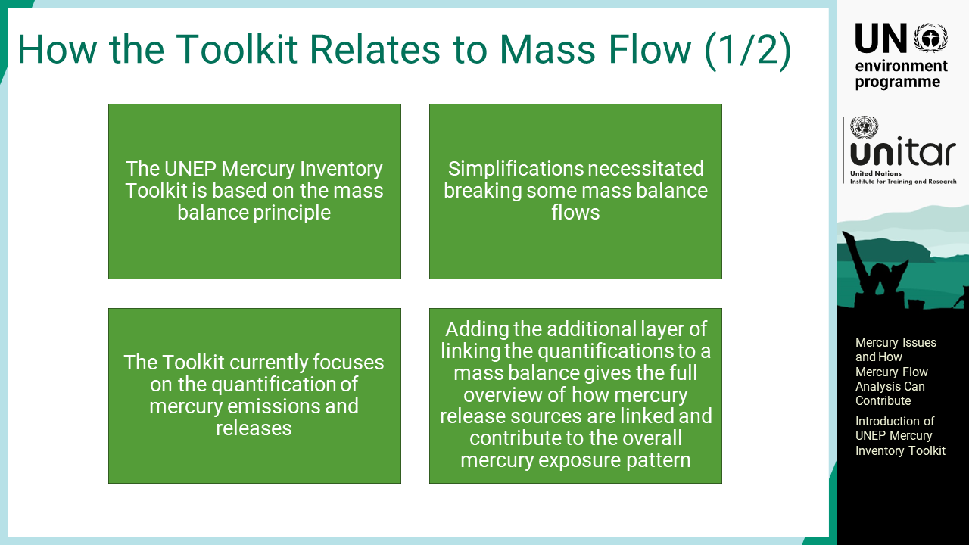
Notes:
‘29’ The UNEP mercury inventory toolkit is based on the mass balance principle with some simplifications to make inventory development easier for users. The toolkit currently focuses on the quantification of mercury emissions and releases. Mass flows add another layer of revealing how mercury sources are inter-linked and contribute to the overall mercury exposure pattern.

Slide 31
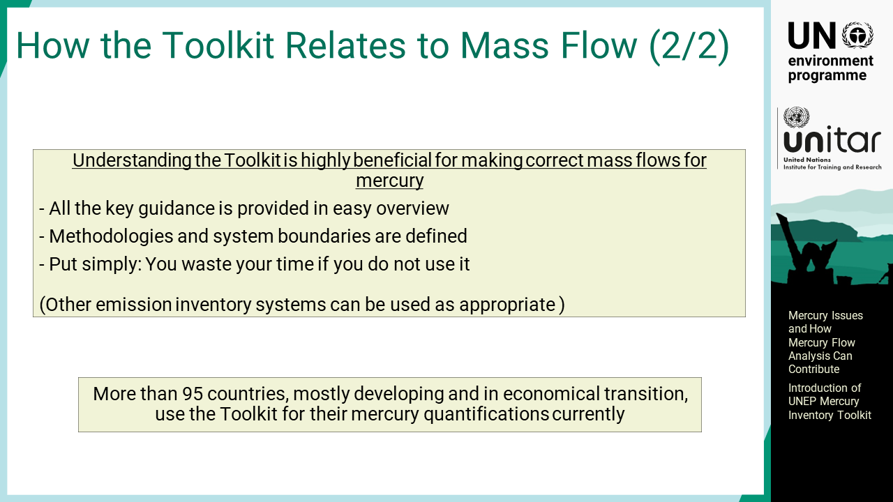
Notes:
‘30’ Therefore, understanding the Toolkit is very beneficial for work with mass flows because most of the key guidance is already given, such as methodologies, system boundaries, and sectors defined. There is always value in using the Toolkit for work. Other emission inventory systems can also be used if available. More than 95 countries, mostly developing and with economies in transition, have used the Toolkit for their mercury quantifications as part of their Minamata Initial Assessments.

Slide 32
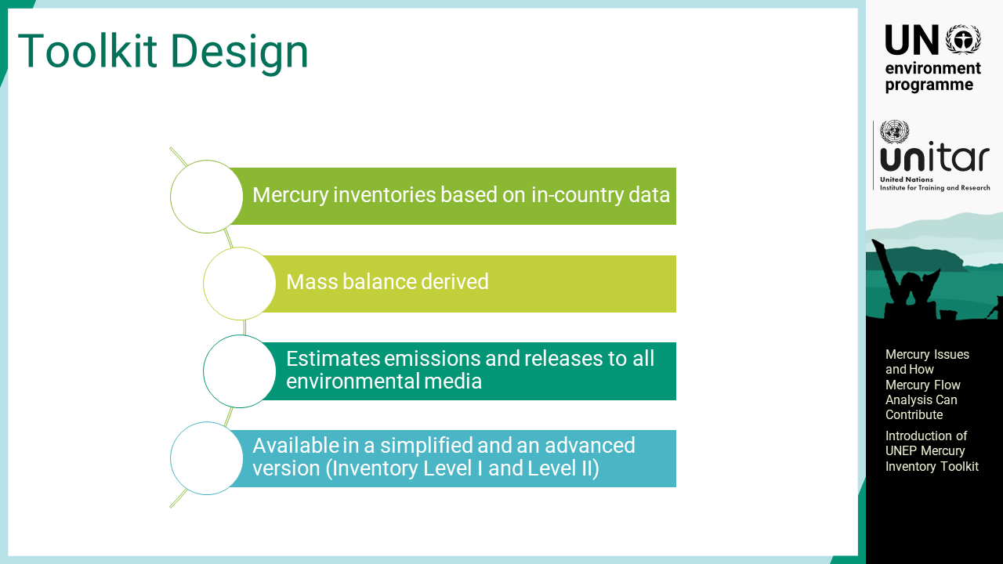
Notes:
‘31’ The Toolkit uses national data on different levels. In the simple Level 1, activity rates are used to show how much has happened in the relevant sectors. In the more detailed Level 2, it is recommended to use more national data to increase the accuracy of the estimates formed. Furthermore, the Toolkit estimates emissions and releases to all environmental media, and this is also needed for mass flow work.

Slide 33
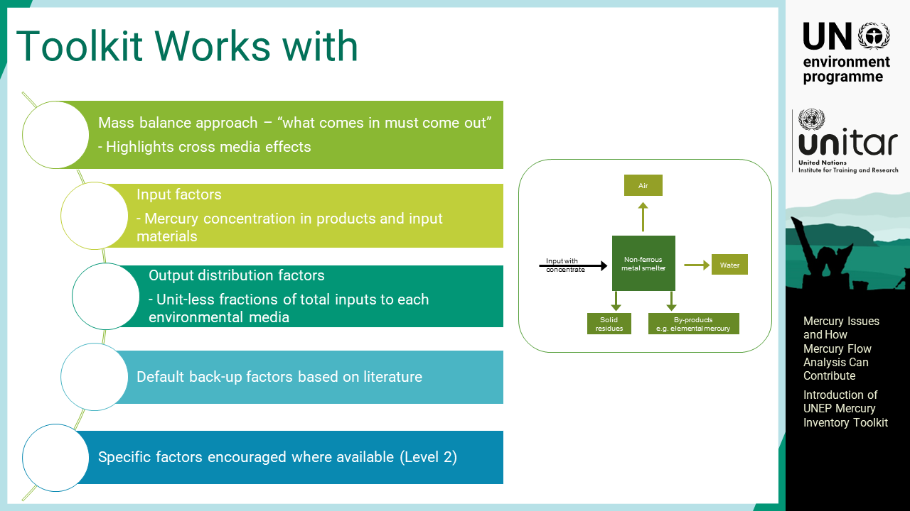
Notes:
‘32’ The Toolkit applies the mass balance principle, which refers to ‘what comes in must come out’. The Toolkit works with input factors and output distribution factors. Default factors are available for backup, based on the literature, but using local or national factors are encouraged wherever available. Using specific factors, however, requires more data, and this has been a challenge in many developing countries. Data availability is the main limitation in doing so. In the Toolkit inventories of the current Level 2 methodology, the precision of the estimation will increase if specific data are available.

Slide 34
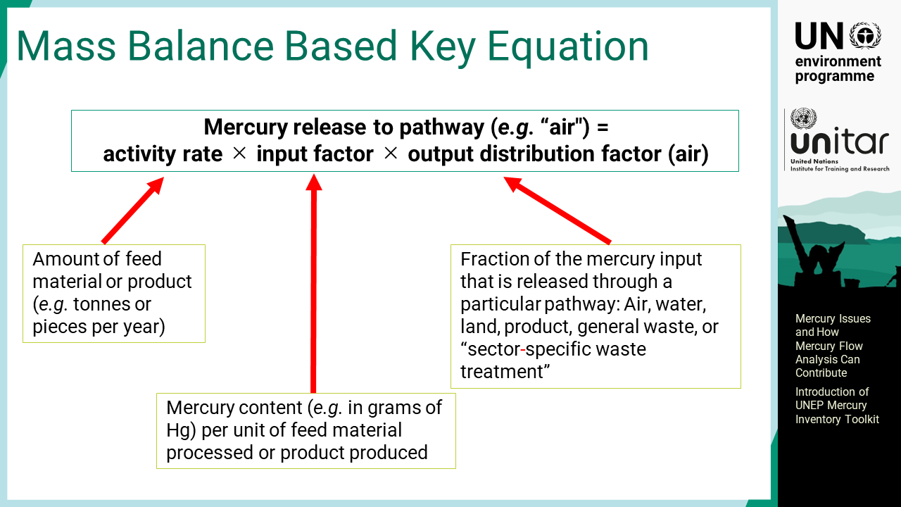
Notes:
‘33’ This slide shows the key equation used in the Toolkit. It works with the activity rates, which are typically the amount of materials fed into the process or the amount of products produced. The activity rate is multiplied by the input factor to obtain the overall mercury amount into this sector or process to society. The input factor is the mercury concentration or content per unit, so it could be the mercury concentration in coal or the mercury content of a thermometer. The output distribution factor estimates the release pathways to air in this formula. This is the unit-less fraction of the mercury input that is released through a particular pathway, such as air, water, land, product, general waste, or sector-specific waste treatment. By this definition, all the output distribution factors should add up to 100%. There are a few exceptions, although, to this principle to make inventory development easier for users.

Slide 35
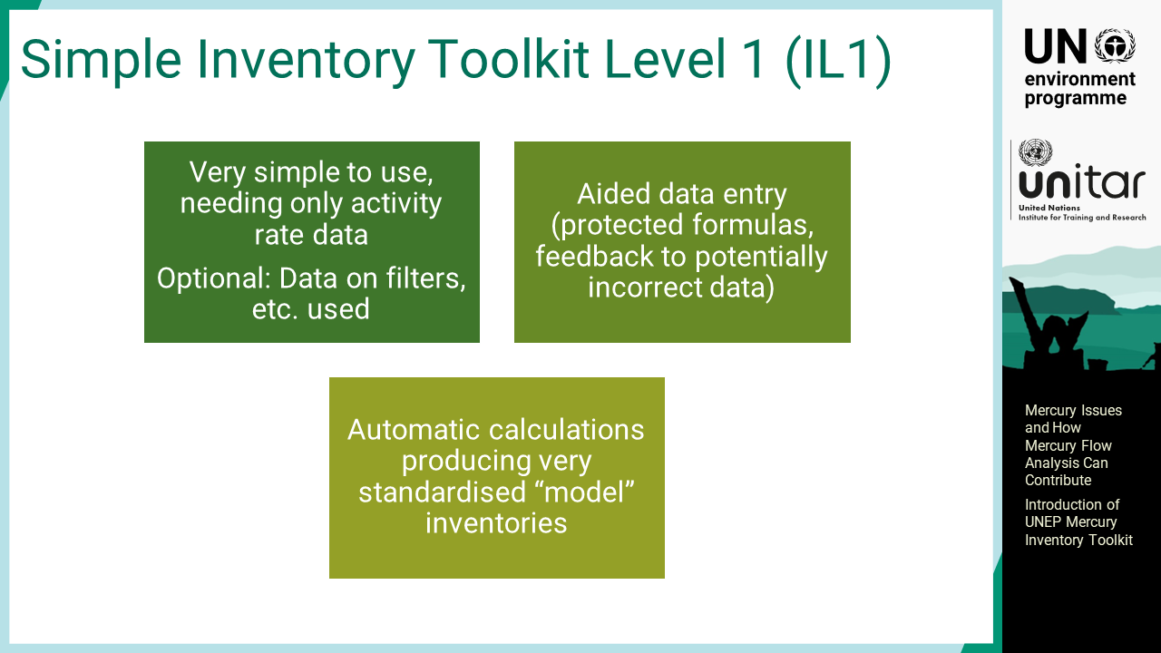
Notes:
‘34’ Toolkit Level 1 is very simple to use. Only activity rate data are needed to develop an inventory. It also has an optional function to add data on control measures such as filters. The calculation spreadsheet for Level 1 offers much help in entering data. It provides protected formulas, and feedback suggestions for potentially incorrect data. The results are automatically calculated and used to create a standardized inventory. As it applies a simplified model, these results are less accurate due to the use of default calculation factors.

Slide 36
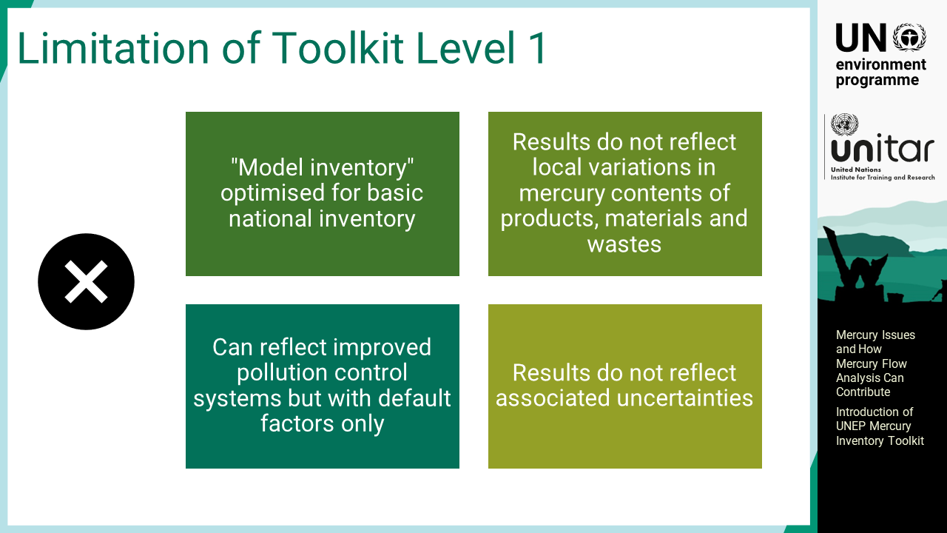
Notes:
‘35’ Because it uses a model with some limitations, and there are some local variations that are not incorporated, the results in Level 1 should be used with caution. For example, the mercury concentration in coal may vary by a factor of ten or more. Level 1 can reflect improved pollution control systems but with default factors only. Additionally, associated uncertainties are not reflected automatically, but they need to be addressed when developing reports. Such models applied in Level 2 are generally complex, which requires some extra work.

Slide 37
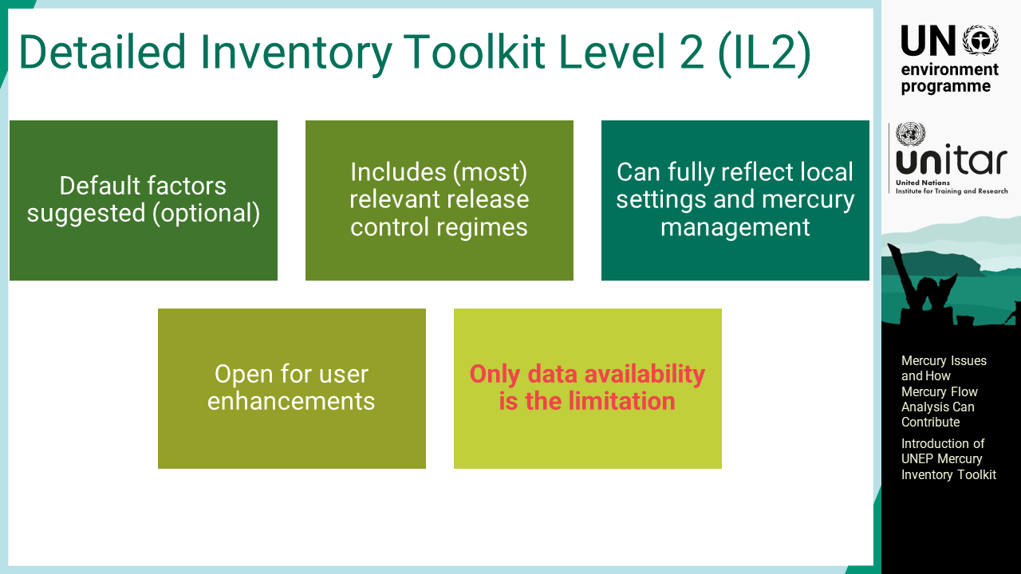
Notes:
‘36’ In Level 2, the default factors are still pre-populated for back-up, but they can be modified to improve the accuracy. Almost all mercury control regimes are reflected in Level 2. The output distribution factors can also be modified if well documented local data are available. Level 2 can fully reflect local settings and mercury management solutions. It is a strong monitoring tool to see the improvements over time when implementing the Minamata Convention. It is customizable to a great extent for enhancing the precision of the results, but some caution must be considered when preparing the inventory report. Such modification should be clearly documented to avoid misinterpretation by readers and peer reviewers.

Slide 38
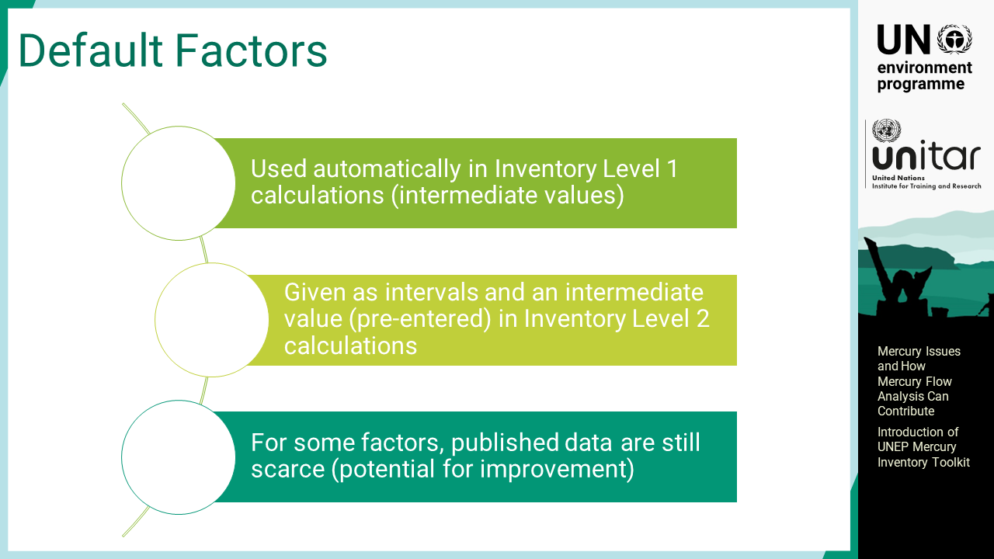
Notes:
‘37’ The Toolkit includes default calculation factors, which are based on the available literature. It should be noted that published data are still scarce for some factors, thus, there is still room for improvement. Measurement or detailed study for local inventory development may also inform the Toolkit for its improvement.

Slide 39
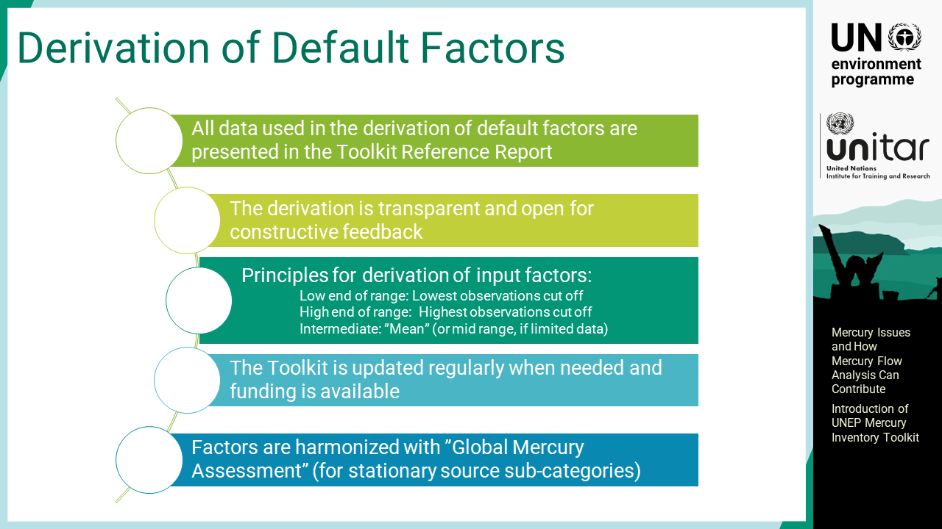
Notes:
‘38’ The full background of all default factors is presented in the Toolkit Reference Report, which is open to any new data being made available with good documentation. The default factors for stationary mercury sources have been harmonized with the Global Mercury Assessment methodology, whereas for products, the methodologies differ, focusing more on national data.

Slide 40

Notes:
‘39’ This section introduces useful tools and materials to guide the development and improvement of mercury mass flows.

Slide 41
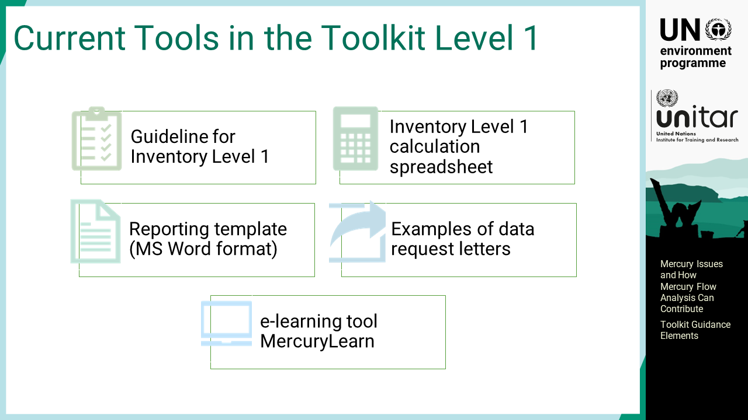
Notes:
‘40’ The Toolkit Level 1 includes a guideline, including advice and sources for data collection, which are useful for Level 2 work as well. It also includes a calculation spreadsheet, the reporting template, and examples of data collection letters for inspiration. The reporting templates are ready-to-use materials when making an original inventory. An online e-learning tool called MercuryLearn hosted and developed by UNITAR is also available online.

Slide 42
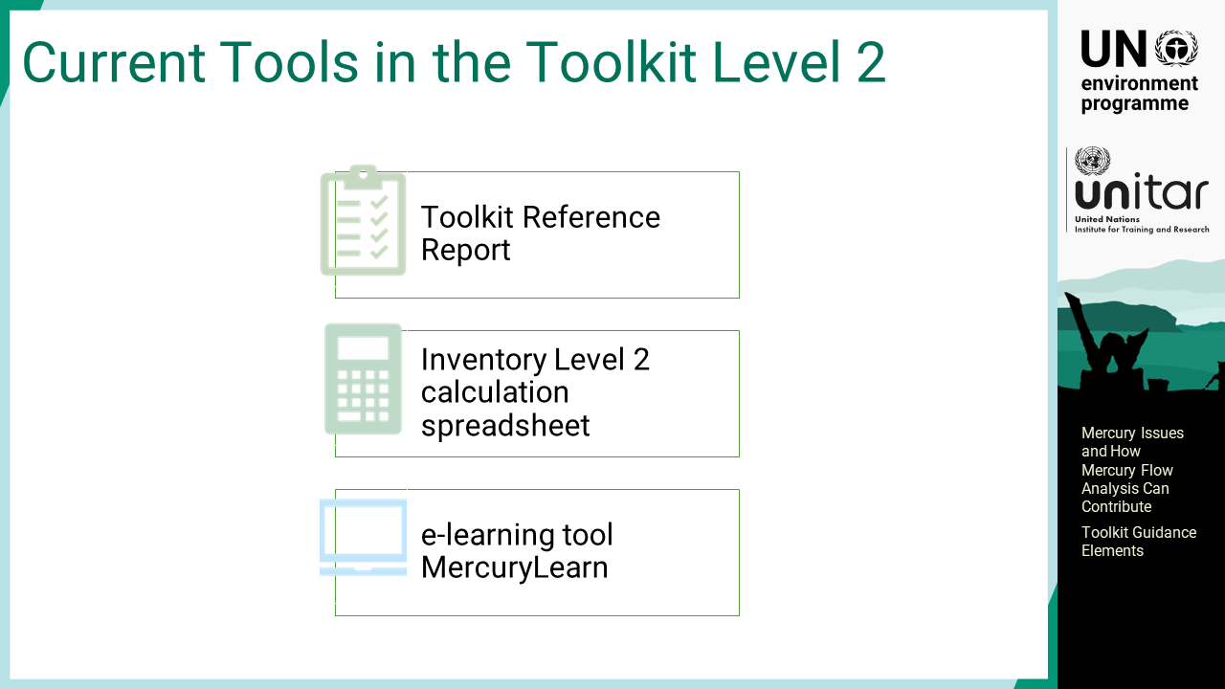
Notes:
‘41’ A cornerstone in the Toolkit Level 2 is the Toolkit Reference Report. It is a guideline for Level 2, but more importantly, it is a compendium on mercury source categories that describes the key features of all mercury source types. It provides valuable insight into the original source of mercury, examples of mercury inputs and release patterns from the literature, documentation for default factors used, and guidance for the source-specific inventory work involved on the Toolkit Level2. The Toolkit Level 2 also includes a spreadsheet and designated reporting template.

Slide 43
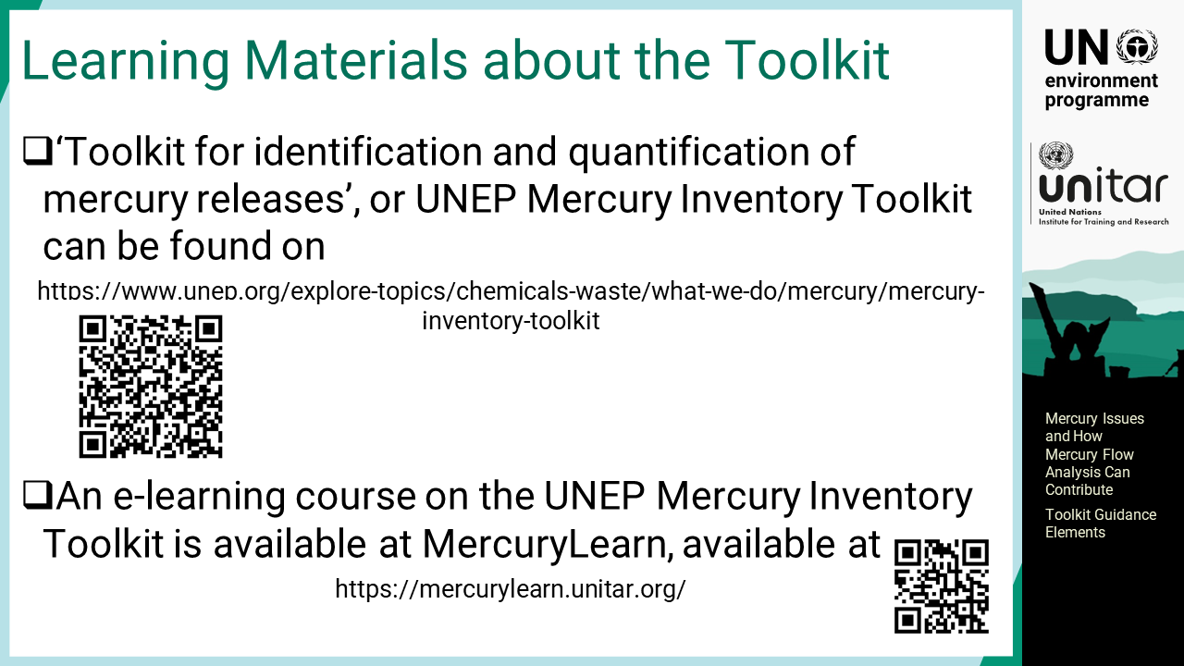
Notes:
‘42’ Leaning materials about the Toolkit give instructions and advice on inventory development using the Toolkit at both levels.

