Slide 1
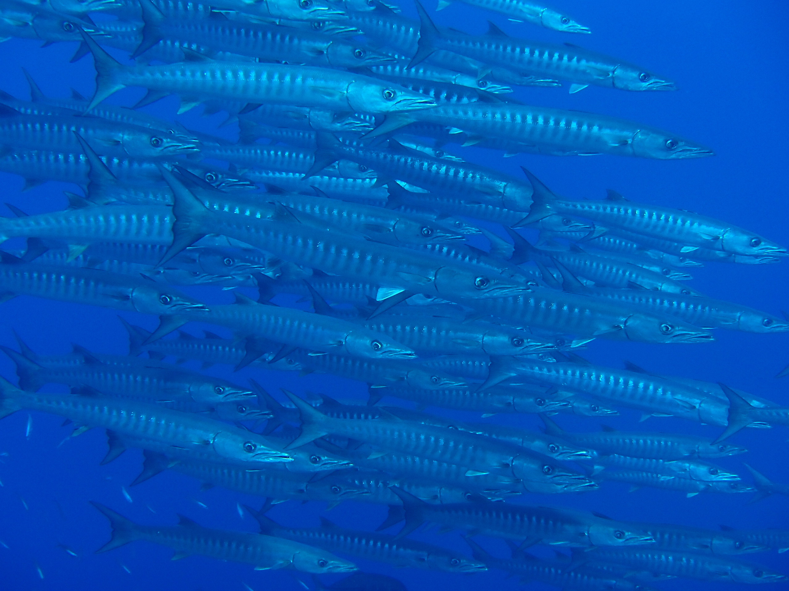


Marine Protected Areas (MPAs) in the Philippine Context
Hazel O. Arceo
University of the Philippines Cebu /
MSN Secretariat

Slide 2










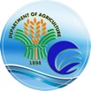








Objectives (as per MOA 2014):
To facilitate the sharing of lessons and good practices in MPA management;
To sustain adaptive management through progressive reviews and updates of the MPA database and information systems
To provide support to local MPA initiatives to improve MPA management.

Slide 3

Introduction
Over 1,800 existing MPAs in the country (Cabral et al. 2014)
Called by fish sanctuaries, marine reserves → mainly no-take zones
Varying modes of governance, but mostly LGU-managed
  Community-based
  LGU-initiated
  Nationally-legislated
MPA SUPPORT NETWORK I OCTOBER 2024

Slide 4
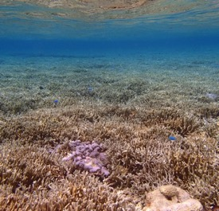

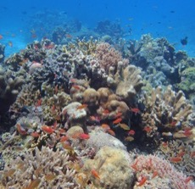

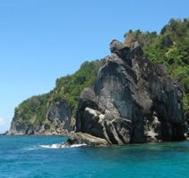
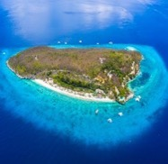
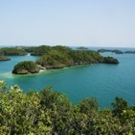
Milestones
2000’s: LGU-managed MPAs
Late 2000’s-2010’s: MPA networks
2018: Enactment of E-NIPAS Act (RA 11038)
1980’s-90’s: Community-based MPA initiatives
1988: Tubbataha Reefs National Marine Park
1991: Local Government Code (RA 7160)
1992: Enactment of NIPAS Act (RA 7586)
1978: Establishment of Tourist Zones and Marine Reserves (PP 1801)
1981: Establishment of Wilderness Areas (PP 2151)
Mangrove Swamp Forest Reserves (PP 2152)
1974: Sumilon Island Marine Reserve
1940: Hundred Islands National Park
Image credits: Hundred Islands National Park by Elmer nev valenzuela, CC BY-SA 4.0; Apo Island by Mike (TheCoffee), CC BY-SA 3.0; Sumilon IIsland by Mr.siwabud Veerapaisarn via https://www.dreamstime.com/
Notes:
PP 667 (16.76 km2); signed by Pres. Manuel L. Quezon on January Jan 18, 1940 for HINP
TZMR - as tourist zones and marine reserves under the administration and control of the Philippine Tourism Authority (PTA); at least 58 islands and coves such as Boracay Island, Olango Island and Gilutongan in Cebu; Balicasag, Panglao and Cabilao Is. In Bohol; Apo Island in Negros; Siqujor Island, Puerto Princesa and several islands in Palawan and whole Batangas coastline → No development projects or construction for any purposes shall be introduced within the zones without prior approval of the President upon recommendation of the PTA.
Wilderness areas – more islands; over 50 including Bantayan Is. In Cebu and Siargao Islands; with an aggregate area of 4,326 hectares, more or less → subject to future delineation and survey for foreshore protection, maintenance of estuarine and marine life, including special forests for the exclusive habitats of rare and endangered Philippine flora and fauna
MSFR - aggregate area of about 74,267 hectares

Slide 5
Trends
FC
LGC
NIPAS
E-NIPAS
Source: Philippine MPA Database
n = 1,501
Notes:
N = 1501 (with known year and area)

Slide 6

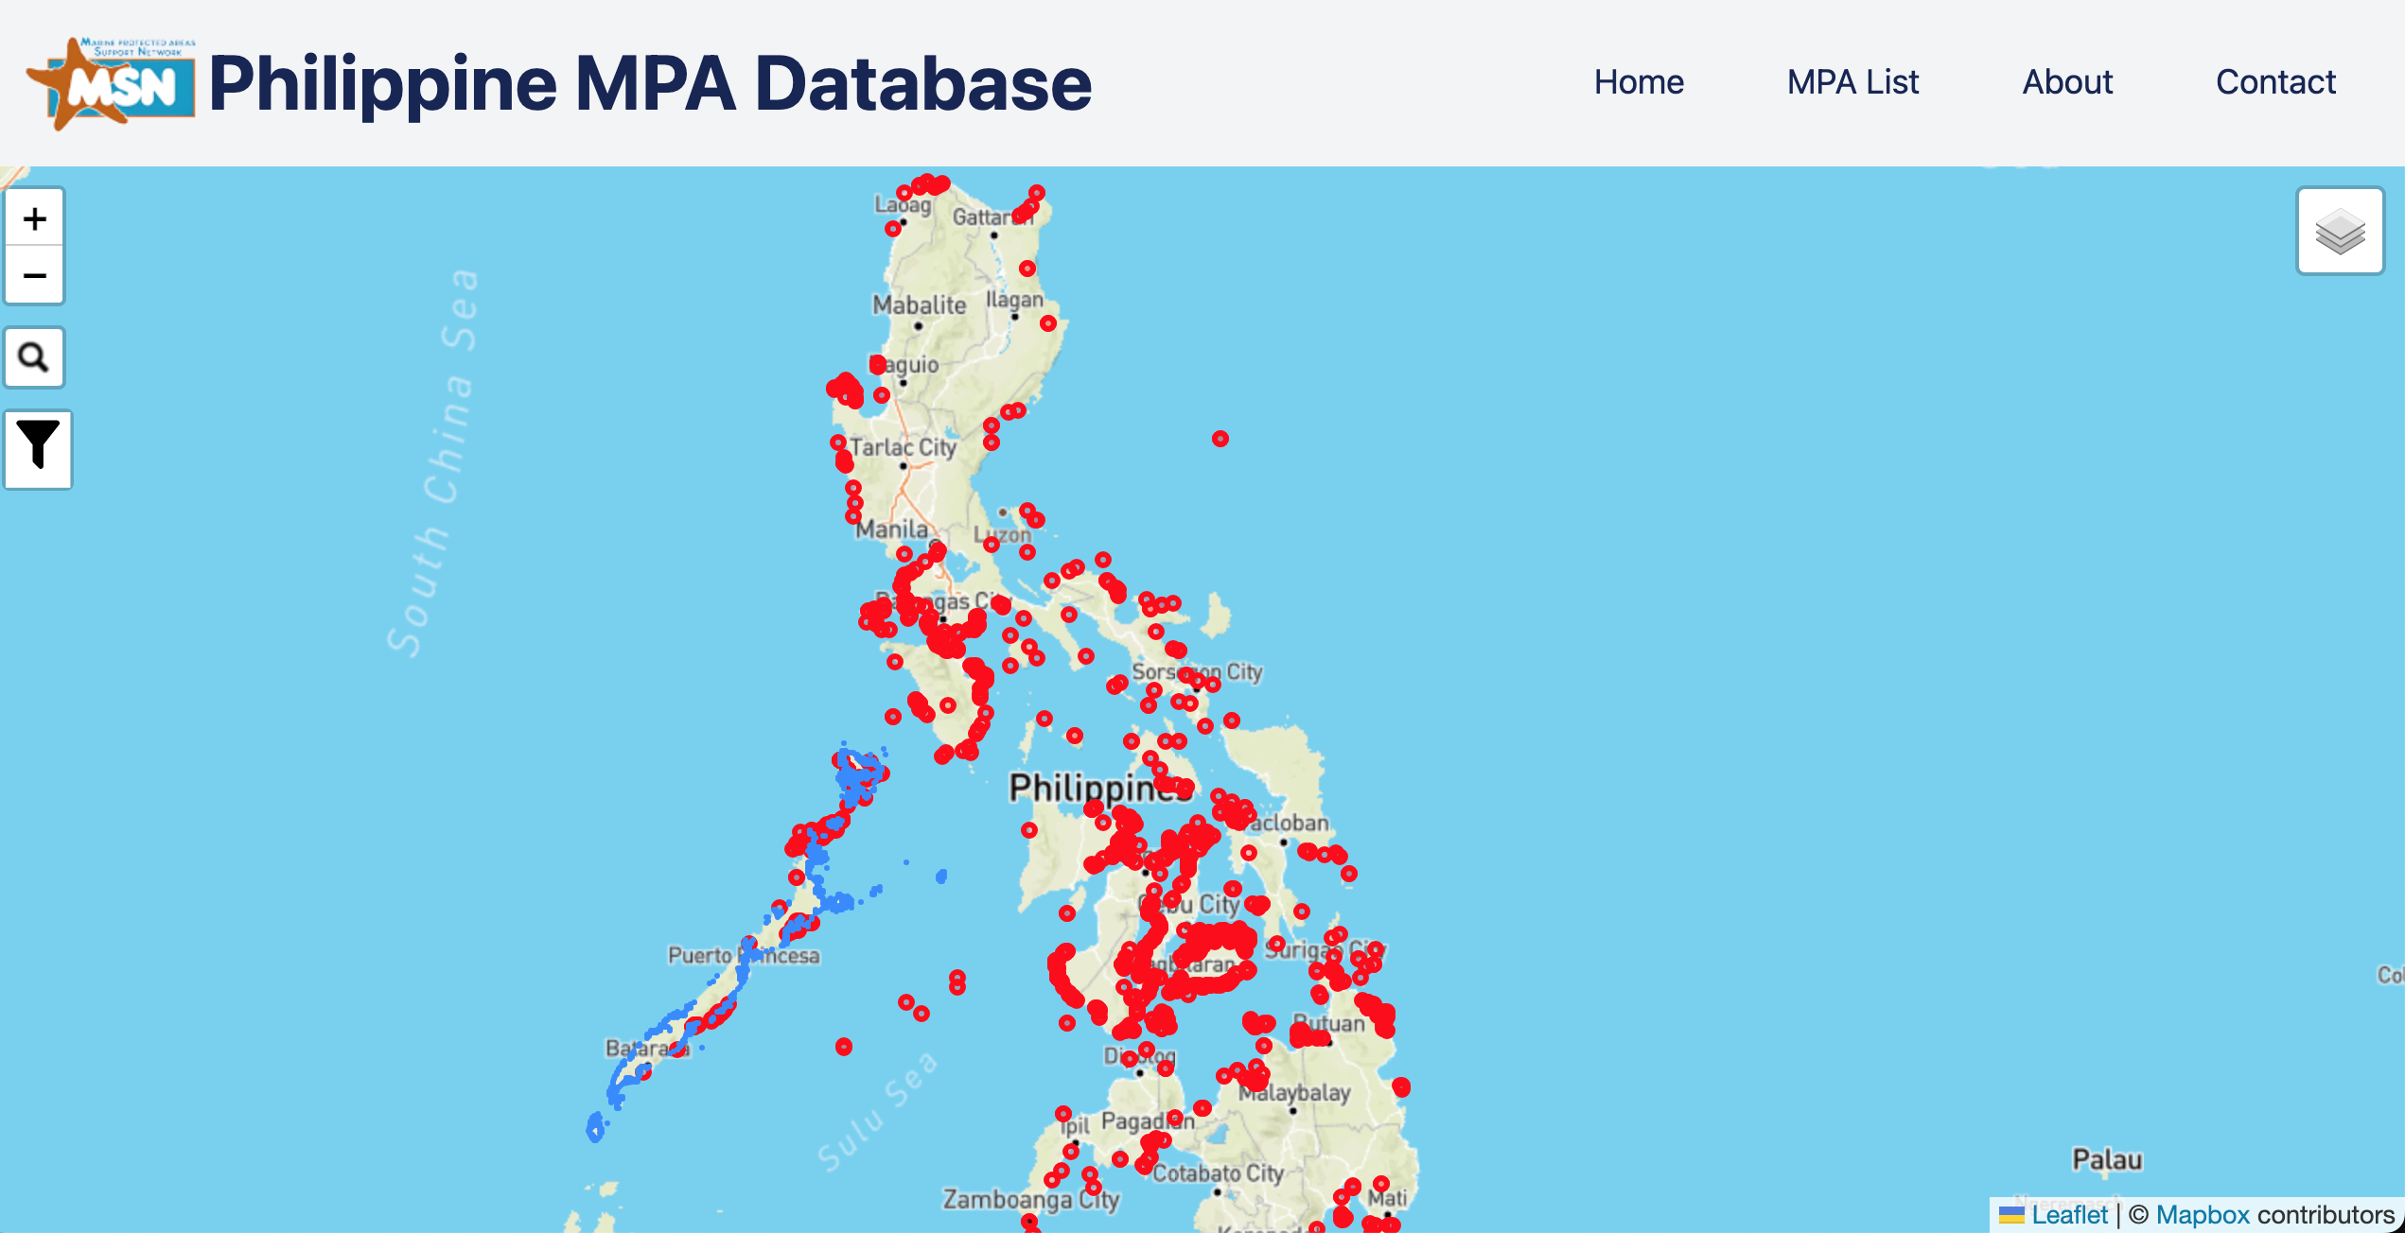

  Types of MPAs included
    Nationally-managed MPAs (under NIPAS Act; RA 7586)
    Locally-managed MPAs
  Currently hosted by the Marine Science Institute of the University of the Philippines Diliman
  Access website through this link: http://www.db.mpasupportnetwork.org/
Scan to access the MSN MPA Database
Notes:
A way of tracking and monitoring progress

Slide 7
Legal Basis for MPA Establishment
Establishment and management at the national level
Establishment and management at the local level
Presidential Proclamations
  Tourism Zones & Marine Reserves – Pres. Proc. No. 1801 of 1978
  Wilderness Areas – Pres. Proc. No. 2151 of 1981
  Mangrove Swamp Forest Reserves – Pres. Proc. No. 2152 of 1981
Republic Act No. 7586 (NIPAS Act of 1992)
  As amended by R.A. 11038 (Expanded NIPAS)
Republic Act No. 7160 (Local Government Code of 1991)
  devolution of the provision of basic services and facilities from the national government to the LGUs
Republic Act No. 8550 (Fisheries Code of 1998)
  As amended by R.A. 10654

Slide 8
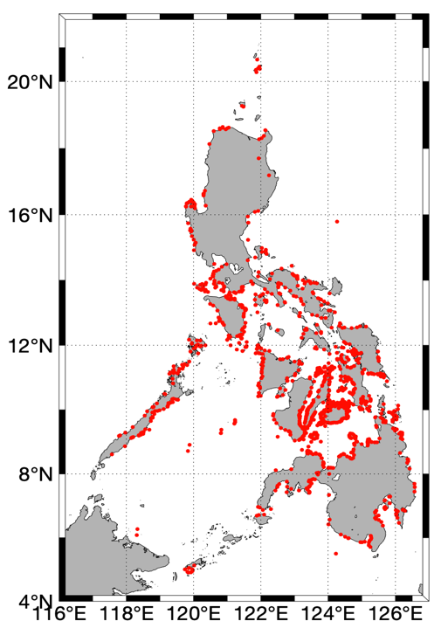
Advocating for at least one MPA per coastal municipality/city integrated into coastal, land and water use development plans
604 coastal municipalities/cities in 63 provinces
  from 276 in 2000 and 415 in 2007
CRM as a basic service by the LGU (EO 533)
Integrating MPAs into higher development plans (e.g., ICM, CCA, CLWUP)
Increased recognition of good performance
Notes:
604 out of 930 (65%)
Missing parts (NE and NW Luzon, southern Palawan, Western Mindanao
Executive Order 533 “Adopting ICM as a National Strategy to Ensure the Sustainable. Development of the Country's Coastal and Marine Environment and Resources

Slide 9
MPAs vs. OECMs
Protected area – a geographically defined area which is designated or regulated and managed to achieve specific conservation objectives [i.e., sites are being managed for conservation]
Other effective area-based conservation measure (OECM) – a geographically defined area other than a protected area, which is governed and managed in ways that achieve positive and sustained long-term outcomes for the in situ conservation of biodiversity, with associated ecosystem functions and services and where applicable, cultural, spiritual, socio–economic, and other locally relevant values.
Source: CBD, KMGBF

Slide 10
MPAs as defined in Philippine laws
"Protected Area" refers to identified portions of land and water set aside by reason of their unique physical and biological diversity and protected against destructive human exploitation [R.A. 7586, as amended]
“Marine Protected Area” – a defined area of the sea established and set aside by law, administrative regulation, or any other effective means in order to conserve and protect a part of or the entire enclosed environment through the establishment of management guidelines. It is considered a generic term that includes all declared areas governed by specific rules or guidelines in order to protect and manage activities within the enclosed area. [R.A. 10654]
  “Fishery Refuge and Sanctuaries” - a designated area where fishing or other forms of activities which may damage the ecosystem of the area is prohibited and human access may be restricted. [R.A. 8550]
Notes:
Consistent with CBD’s definition

Slide 11
MPAs under NIPAS
Scope: All areas or islands in the Philippines proclaimed, designated or set aside, pursuant to a law, presidential decree, presidential proclamation or executive order as national park, game refuge, bird and wildlife sanctuary, wilderness area, strict nature reserve, watershed, mangrove reserve, fish sanctuary, natural and historical landmark, protected and managed landscape/seascape, as well as identified virgin forests before the effectivity of this Act are hereby designated as initial components of the System.
Categories: (1) Strict nature reserve; (2) Natural park; (3) Natural monument; (4) Wildlife sanctuary; (5) Protected landscapes and seascapes; (6) Resource reserve; (7) Natural biotic areas; and, (8) Other categories established by law, conventions or international agreements which the Philippine Government is a signatory.
Management: National (Department of Environment and Natural Resources)
Notes:
Follows IUCN categories, interestingly, fish

Slide 12
MPAs under LGUs
Section 16 (R.A. 8550). Jurisdiction of Municipal/City Government. - The municipal/city government shall have jurisdiction over municipal waters as defined in this Code. The municipal/city government, in consultation with the FARMC, shall be responsible for the management, conservation, development, protection, utilization, and disposition of all fish and fishery/aquatic resources within their respective municipal waters.
  The municipal/city government may, in consultation with the FARMC, enact appropriate ordinances for this purpose and in accordance with the National Fisheries Policy.
Notes:
This is something different from the terrestrial setting, where forestlands are primarily managed by the DENR although LGUs can also establish tree parks and greenbelts as part of their devolved functions. In the marine envt, LGUs are primarily tasked to manage and protect their aquatic resources.

Slide 13
Fisheries Code of the Philippines (R.A. No. 8550; as amended by R.A. 10654)
Section 81 (R.A. 8550). Fish Refuge and Sanctuaries - … Provided, however, that in municipal waters, the concerned LGU in consultation with the FARMCs may establish fishery refuge and sanctuaries. The FARMCs may also recommend fishery refuge and sanctuaries: Provided, further, that at least fifteen percent (15%) where applicable of the total coastal areas in each municipality shall be identified, based on the best available scientific data and in consultation with the Department, and automatically designated as fish sanctuaries by the LGUs in consultation with the concerned FARMCs.

Slide 14
MPA Objectives
Protecting rare/endangered species
  e.g., species-targeted protection for dugongs or sea turtles
Protecting habitats and their ecosystem services
  e.g., seagrass sanctuaries; mangroves as nursery grounds
  expansion to cover multiple habitats
Protecting aquatic resources to sustain fisheries in adjacent areas
Notes:
Protected areas have conservation objectives as the primary objective of the site. The defining aspect of an OECM is the biodiversity conservation outcome, regardless of the objectives of the site.
- In the Philippines,

Slide 15
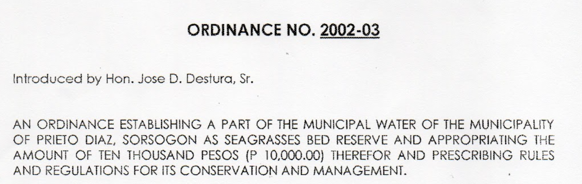
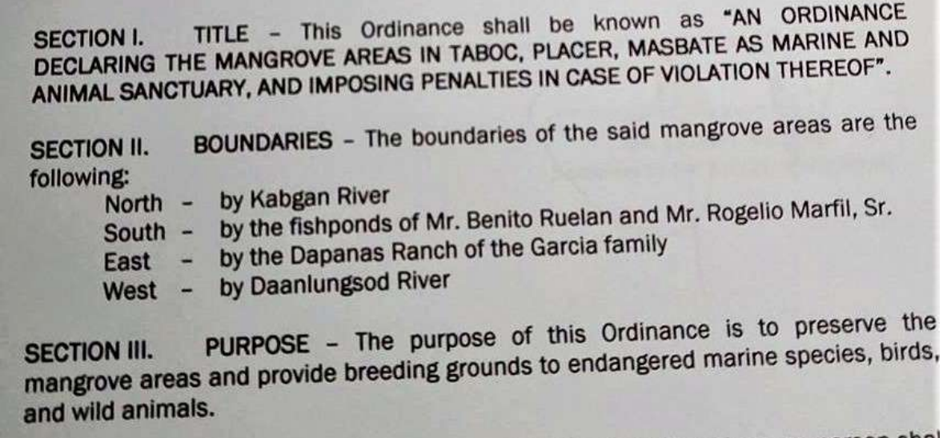
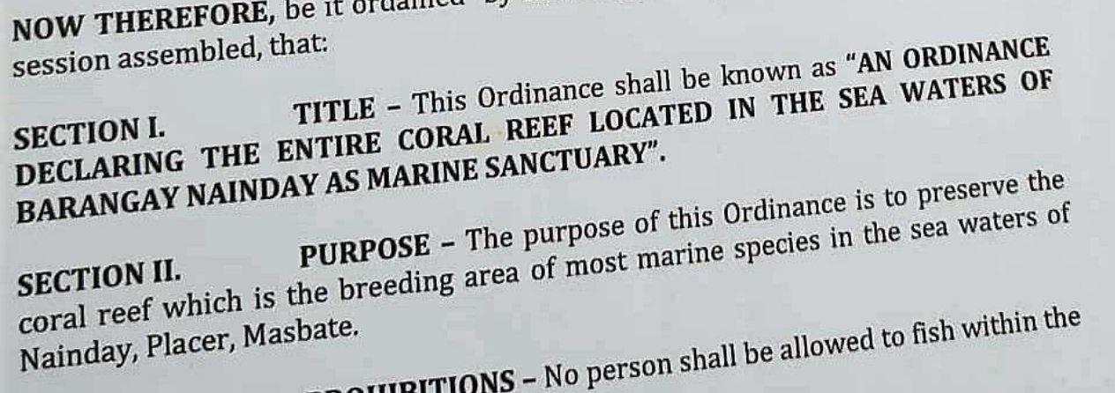
Notes:
Protected areas have conservation objectives as the primary objective of the site. The defining aspect of an OECM is the biodiversity conservation outcome, regardless of the objectives of the site.

Slide 16
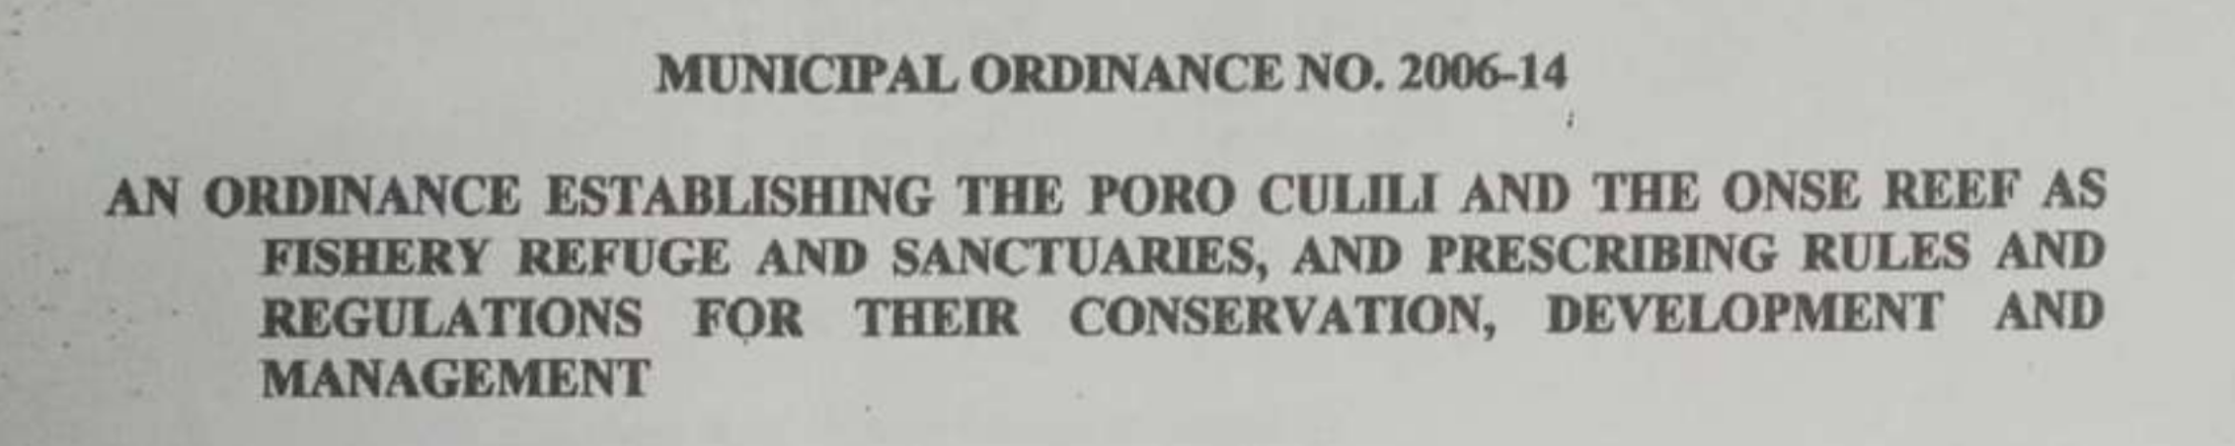


Slide 17



Recognizing and Disseminating
MPA Best Practices
Para el MAR: MPA Awards & Recognition
  a biennial national incentive system that recognizes best practices and exemplary management of MPAs and networks
Notes:
areas that meet the definition of a protected area, and are recognised as such by the governing authority, should be considered a protected area

Slide 18

THANK YOU !
Insert Image

