Slide 1


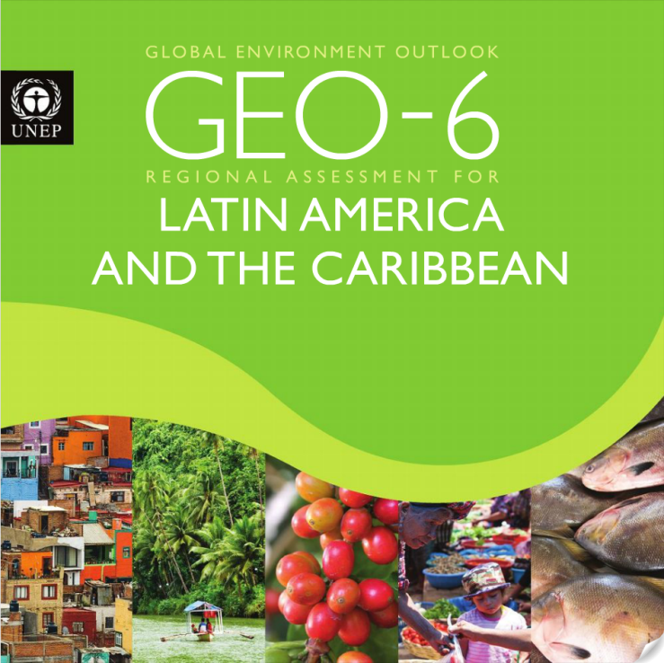



The GEO-6 Matrix Drafting Approach
Theory and implementation

Slide 2
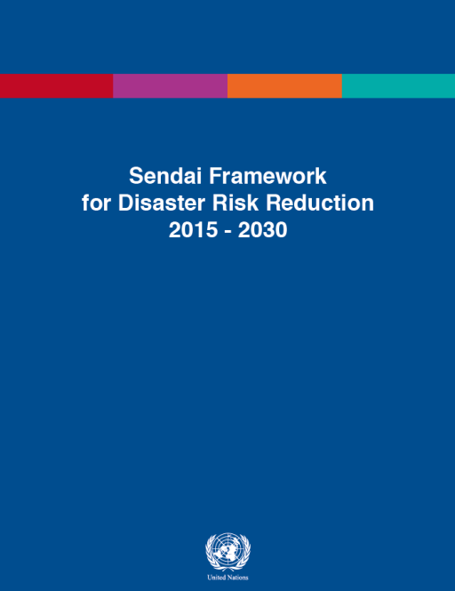












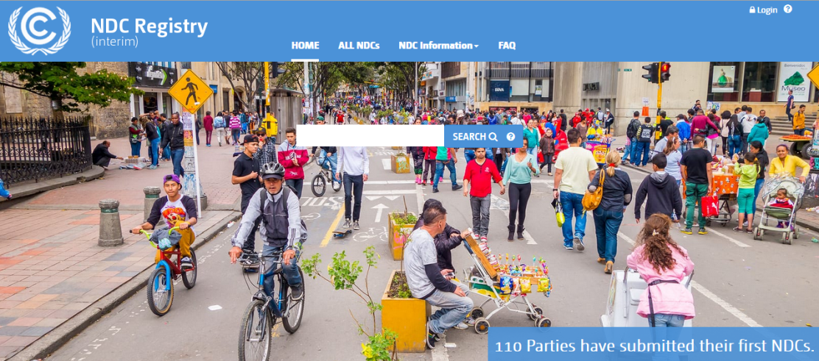






Context in which GEO-6 is being produced
Complex systemic environmental problems (e.g. climate change)
Important agreements on integrated environmental goals
Tracking progress becomes more challenging.

Slide 3
GEO-6 Work programme
Author Draft of SPM
Review Draft of full GEO
Draft State and Trends with Policy Response
Progress Report to UNEA-3
Final GEO-6
HLG Draft SPM
Final GEO-6 and SPM
1st Order Draft
Review Draft
2017
2018
2019
4-6 December
October
May
Review Period
Review Period
February
May
October
March
November
February
UNEA-3
UNEA-4
First global authors’ meeting
Second global authors’ meeting
Third global authors’ meeting + RE
Fourth global authors’ meeting
Review editors meeting
MS SPM negotiation
HLG SPM drafting meeting
Acronyms: High Level Intergovernmental and Stakeholder Advisory Group (HLG),
Global Environment Outlooks (GEO), Summary for Policy Makers (SPM), Review Editors (RE)
Notes:
The GEO-6 work programme has been designed to deliver two separate review drafts, one for the first two parts of the document (State and Trends, Policy Response) and the second to deliver the full GEO-6 including outlooks. The meeting schedule will encourage authors to prepare the drafts at the appropriate times to ensure the process moves forward. Here are some details:
First author’s meeting in Feb. 2017 with all three main groups (State and Trends, Policy Response, Innovative Outllooks group) and the GEO-6 advisory bodies meeting. There will be parallel sessions and combined sessions to allow an appropriate level of interaction among the groups as well as allow them time to plan their individual activities. The Innovative Outlooks Group will outline the work they will do to develop new Outlooks methods and tools that will be used in GEO-6.
Second author’s meeting in May, 2017 with only the State and Trends and Policy Response groups meeting. Here the goal is to prepare a review draft of the first two chapters and to provide input to the progress report being prepared for UNEA-3.
Third author’s meeting, all groups come back together. Here the goal is to ensure the review drafts of the first two chapters are completed (State and Trends, Policy Response) and that the drafting begins for the Outlooks chapter. Review editors will be present here to ensure authors have dealt with review comments appropriately and to prepare their summary report of the review process. The HLG and SAP will meet to ensure adequate planning and also to finalize the progress report for UNEA-3.
Fourth author’s meeting, March, 2018. Here the goal is to prepare the review draft of the full GEO, including Outlooks. Authors will also prepare the first draft of the Summary for Policy Makers. HLG and SAP will meet for planning purposes but also to observe the author drafting process and ensure it’s credibility and relevance for the needs of Member States.
2nd Review Editor’s meeting will address review comments from the second review period and prepare a summary report of how these were dealt with.
HLG SPM drafing meeting will review the draft SPM prepared by the authors and prepare a review draft that Member States will receive.
Member State SPM negotiation meeting. The draft SPM will be finalized by Member States in preparation for endorsement by UNEA-4.
The full GEO-6 as well as the translated SPM will be made available to UNEA-4 for endorsement.

Slide 4
Working Structure of GEO-6
High-level Intergovernmental and Stakeholder Advisory Group (HLG)
Scientific Advisory Panel (SAP)
UN Environment Secretariat
State & Trends + Policy Response
Co-chairs & vice-chairs
Innovative Outlooks Group
Coordinating Lead Authors
Coordinating Lead Authors
Lead Authors
Lead Authors
AMDG
Contributing Authors
GEO Fellows
Review Editors
Contributing Authors
UN Env. Experts
(Thematic and cross-cutting)
UN Env. Experts
(Outlooks and scenarios)
Assessment Methodologies, Data and Information Group (AMDG)
Notes:
The working structure of GEO-6 is different from GEO-5 in that it includes Co-chairs and vice-chairs. This structure was recommended by the Scientific Advisory Panel to help ensure the scientific credibility of the GEO-6 process. Other details of the structure include:
Policy advice will be received from the HLG
Scientific integrity of the process will be overseen by the SAP
Both advisory bodies will provide advice on the overall management of the GEO-6 process
The Co-Chairs (Dr. Ekin, Dr. Gupta) will act as the bridge between the advisory bodies and the author teams and will be supported by the Secretariat.
The Secretariat will continue to support the advisory bodies in their planning activities.
The author teams will be separated somewhat by the timing of the process, with the two first chapters being prepared in the first half of 2017 and the last chapter on Outlooks begin prepared in the last months of 2017 and the first months of 2018.
However, the main authors meetings will allow for interactions among all of the author teams in order to ensure coherence of the assessment.
GEO Fellows will support the process by assisting the authors with research questions and performing quality assurance tasks for citations and references.
Review editors will conduct evaluations at the end of each review period to ensure that review comments were dealt with appropriately. They will prepare a summary report from each review period.

Slide 5

Annotated outline of GEO-6
Drivers
Economic development
Population / demographics
Climate change
Technological change??
Introduction
Mandate
Changes since GEO-5
Systemic nature of environmental challenges
Classic GEO approach to setting the stage
Issues may have changed, severity also

Slide 6
Annotated outline of GEO-6 (cont.)
State and Trends of the Environment
Air
Fresh water
Oceans
Land
Biota
State of our knowledge and data
Evolution since GEO-5
Indicators-based assessments
Citizen science, ILK, big data
On knowledge and data: how much more do we know?
On state and trends: how to ensure link to environmental dimension of SDGs?

Slide 7
Annotated outline of GEO-6 (cont.)
Outlooks and innovations for systemic transformation and governance
Methodology
Agenda 2030
Sustainable in 2050
Knowledge gaps
Policies, goals, objectives and environmental governance
Air
Fresh water
Oceans
Land
Biota
On policies and governance: what has been effective?
On outlooks: how can we improve effectiveness? What are the pathways to success?

Slide 8

But how to ensure coherence?
Cross-cutting issues:
Climate (impacts)
Food
Energy
Human health
Resource use
Environmental disasters
Chemicals and waste
Culture, education, society
Gender
Polar regions
Advantages:
Ensures same issues are considered across environmental themes (priorities for governments)
Disadvantages:
Less flexibility in drafting approach. Potentially less innovation.

Slide 9

Matrix Approach for GEO-6
Resource Use
Chemicals, Waste
Climate
Energy
Gender
Air
Food
Human Health
Environmental Disasters
Culture, Education, Society
Polar
Fresh Water
Environmental Themes
Oceans
Land
Biota

Slide 10

Innovation will happen with Outlooks
6 – 9 months of methodological work
New methods/tools for conducting integrated outlooks
Analysis and pathways to achieve Agenda 2030
Analysis and pathways to achieve truly sustainable world in 2050
Largest chapter of GEO-6

Slide 11
Questions?
GEO.Head@unep.org

