Slide 1


Notes:
‘0’ This lecture explains safety and environmental management in the laboratory, which is not directly related to survey analysis. These items are basic but important for workers’ safety and reducing environmental impacts., so they should be well understood.

Slide 2
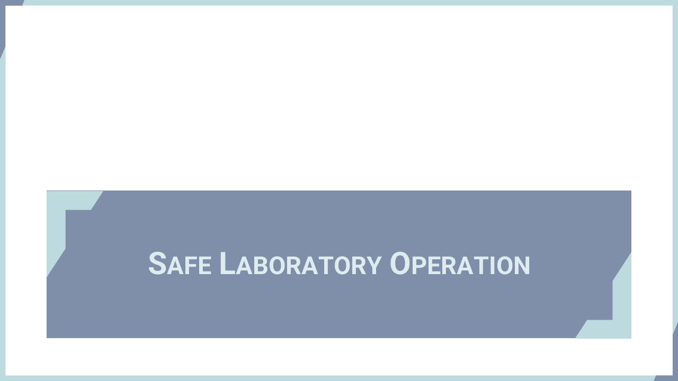
Notes:
‘1’ This section describes basic precautions when handling hazardous reagents such as acids.

Slide 3
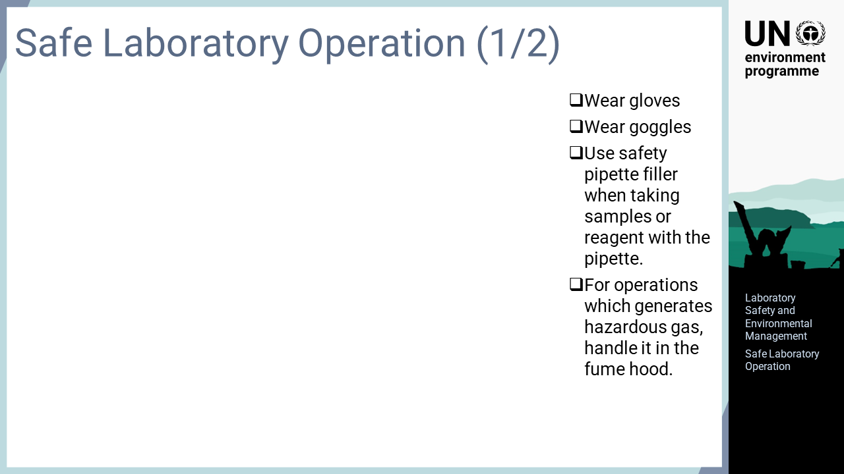
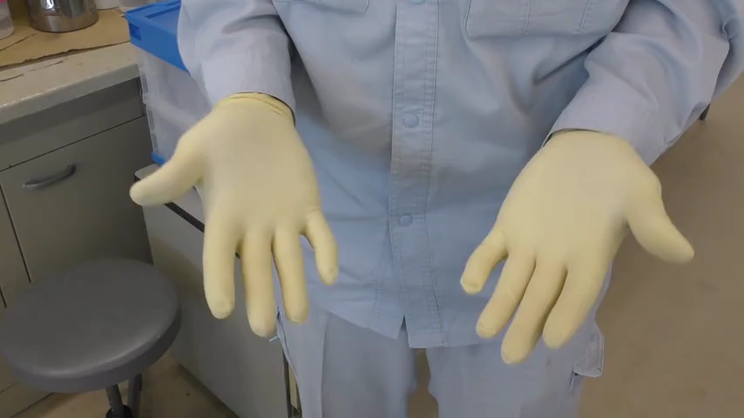
Notes:
‘2’ Protective goggles should be worn if reagents may be scattered by heat digestion or other operations. When transferring samples or reagents, a safety pipette filler should always be used instead of sucking with the mouth. Operations generating hazardous fumes, such as acid digestion, should be performed in a fume hood.

Slide 4
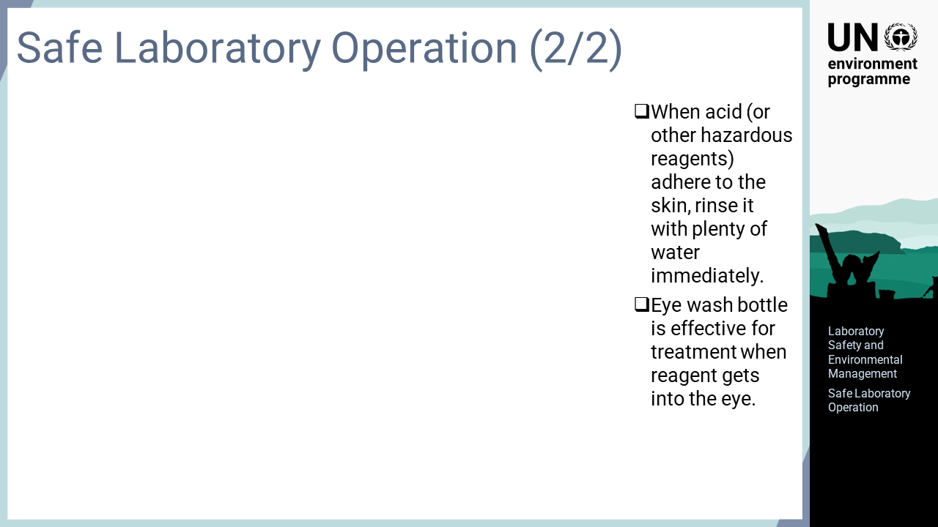
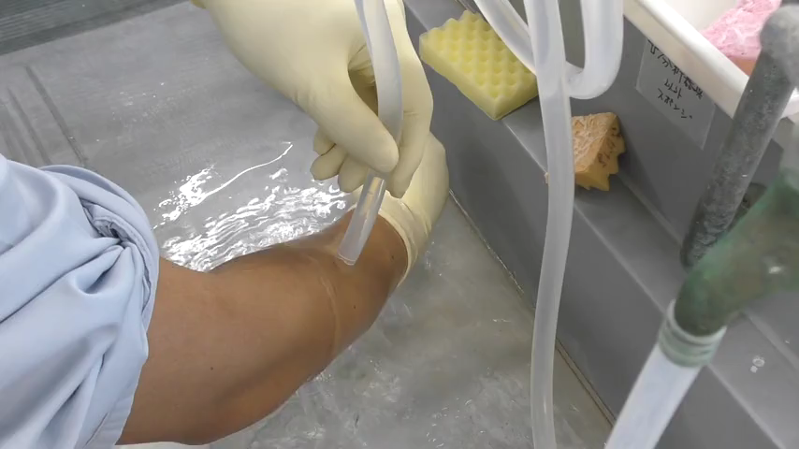
Notes:
‘3’ Despite having safety measures put in place, accidents sometimes happen. If an acid or other hazardous reagent adheres to the skin, it should be washed off immediately with plenty of water. Even when wearing protective goggles, droplets of a reagent could possibly get into the eyes through the gaps. An eye washing bottle is effective for washing reagents out of the eyes.

Slide 5
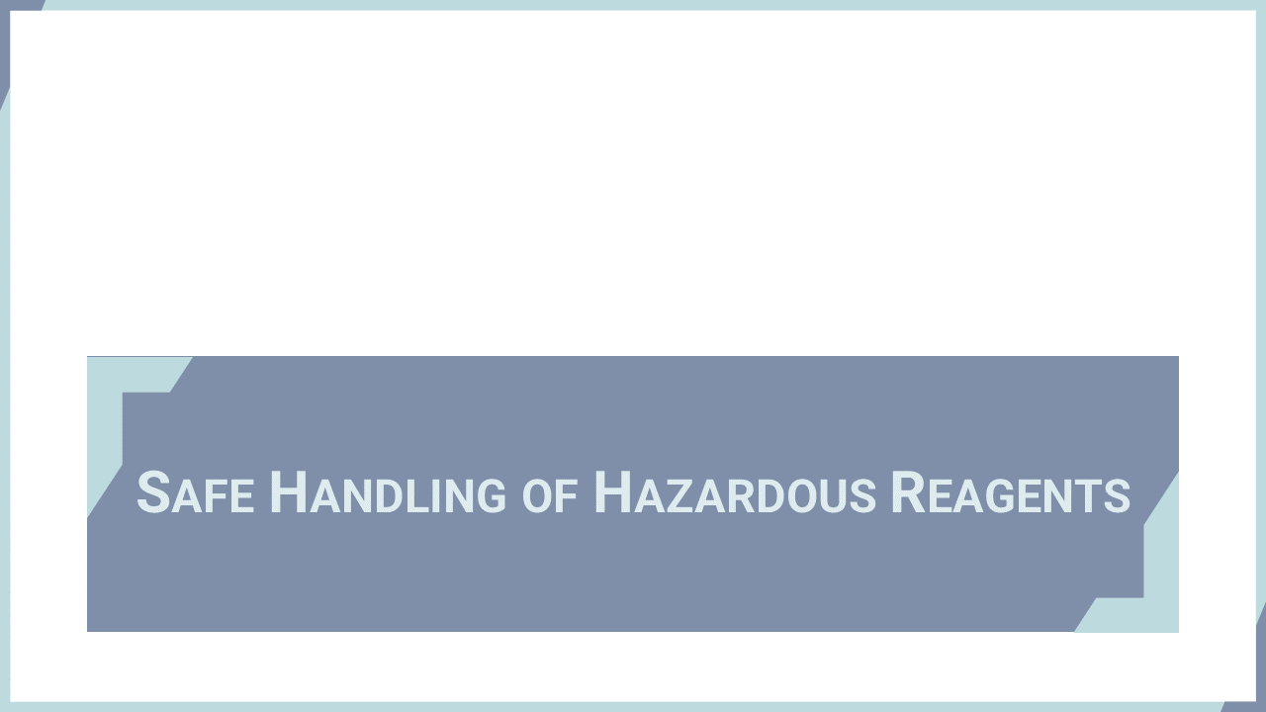
Notes:
‘4’ This section identifies reagents that are highly hazardous and require safe handling, especially those that are often used in mercury analysis. These reagents have their own unique properties. Understanding their properties is very important in laboratory safety management.

Slide 6
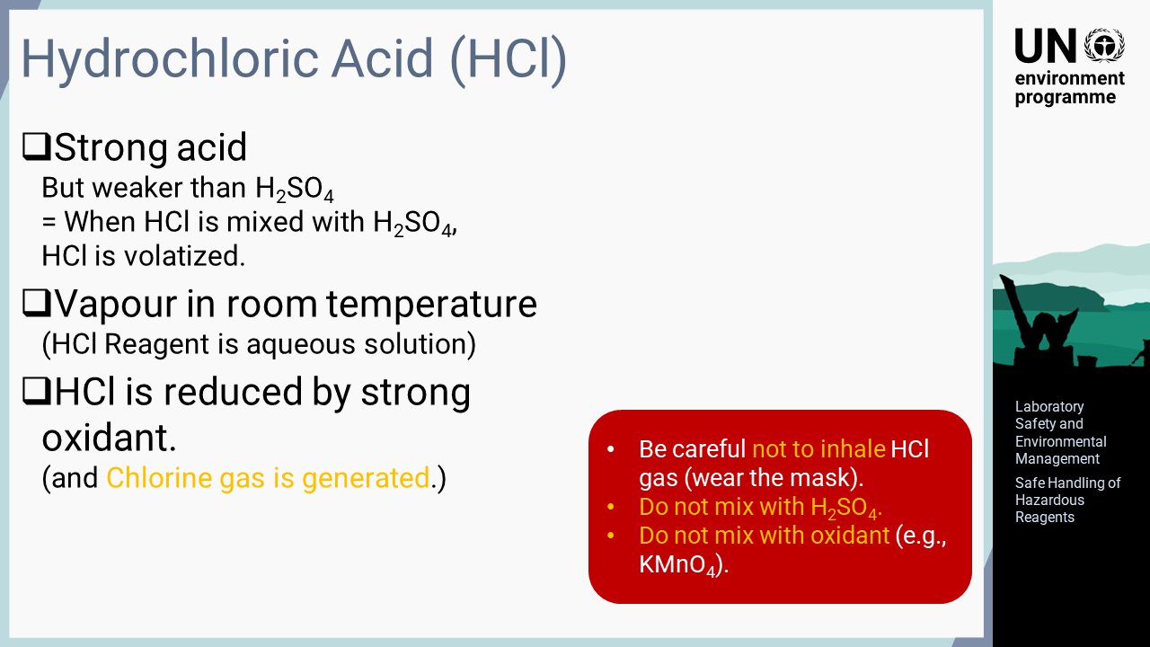
Notes:
‘5’ Hydrochloric acid is a strong acid and vapour at room temperature. An aqueous solution of hydrochloric acid is used as a reagent, which is prepared by dissolving hydrogen chloride in water. Hydrochloric acid itself is a vapour, and due to this property, it gradually evaporates from its concentrated solution. Therefore, a safety mask should be worn to avoid inhaling the vapour when handling this acid. Hydrochloric acid is classified as a strong acid, but it is weaker than sulphuric acid. The mixing of hydrochloric acid with sulphuric acid results in the release of hydrochloric acid vapour into the atmosphere. Therefore, hydrochloric acid should never be mixed with a sulphuric acid solution. Hydrochloric acid is reduced in the presence of strong oxidants, and reduced chlorine ions form chlorine gas; thus, mixing hydrochloric acid with an oxidant is extremely dangerous. For example, potassium permanganate, a strong oxidant used for mercury analysis, should never be mixed with a solution containing hydrochloric acid

Slide 7
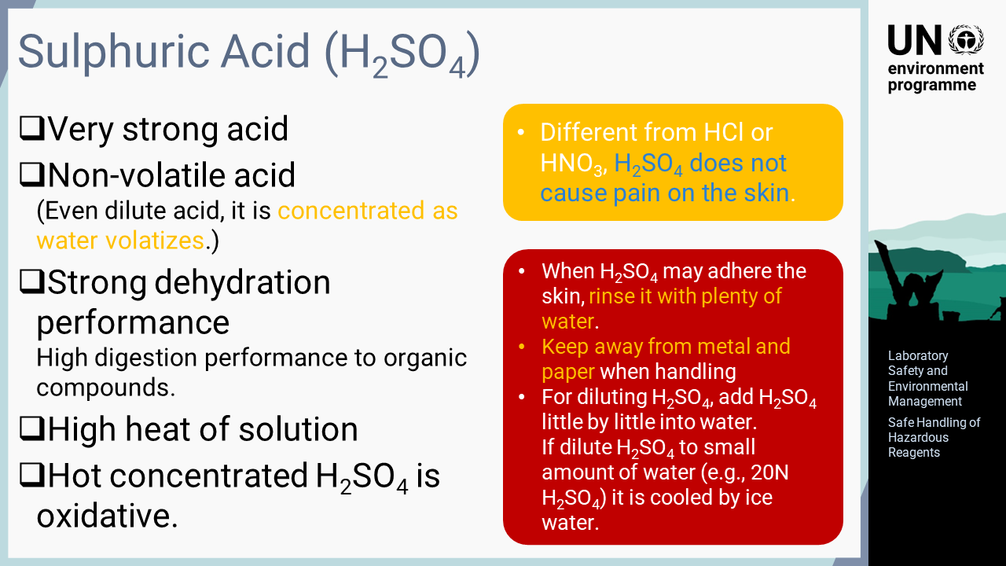
Notes:
‘6’ Sulphuric acid is explained in this slide. Many people believe that sulphuric acid is very dangerous; however, this fear often arises from a poor understanding of its properties, which leads to it not being handled correctly. Understanding the properties of sulphuric acid and handling it as shown on this slide will lead to safe laboratory operation. Sulphuric acid is, of course, a very strong acid and corrodes many metals. It is a non-volatile acid, meaning that it is not volatilized into the atmosphere, unlike hydrochloric acid. Therefore, if dilute sulphuric acid solution adheres to skin or clothes, it becomes more concentrated as water evaporates, which causes skin burns. Sulphuric acid also has a very strong dehydration capacity. Concentrated sulphuric acid shows a strong digestive ability for many organic substances, as it affects hydrogen and oxygen in organic substances. A few other important properties include a high heat of solution in water and the strong oxidizing capacity of hot concentrated sulphuric acid. Another important note for handling sulphuric acid is that it often causes almost no pain to the skin in contract to hydrochloric acid or nitric acid. Thus, laboratory workers can experience skin burns without having noticed that sulphuric acid was adhered to their skin or clothes. If there is any possibility of contact with sulphuric acid, the affected part should be washed with plenty of water. One should also be mindful to keep paper, cloth, metal, etc. away when handling sulphuric acid. As sulphuric acid has a high heat of solution, explosive boiling may occur when adding water for dilution. When diluting sulphuric acid, it should be added into water little by little. If it is necessary to dissolve sulphuric acid in a small amount of water, for example, to prepare 20 normality solution, the process should be conducted under cooling conditions with ice water to limit the increase in temperature.

Slide 8
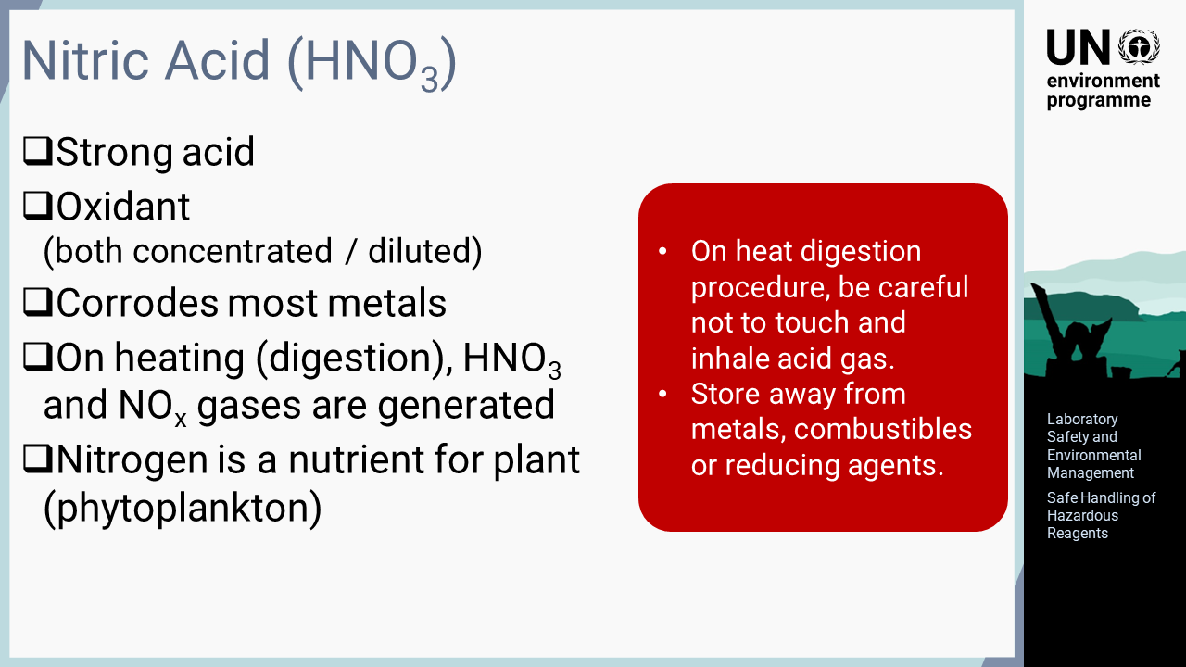
Notes:
‘7’ Nitric acid is explained in this slide. Different from hydrochloric acid and sulphuric acid, nitric acid is both a strong acid and an oxidant, with the oxidizing potential being maintained regardless of its concentration. Due to this property, nitric acid corrodes many metals. When heated, it produces nitric acid vapour and nitrogen oxide gas as a decomposition product, both of which are toxic to humans. Additionally, it may be noted that nitrogen is a nutrient for plants and may lead the blooming of phytoplankton, although this is not relevant to the laboratory safety. Nitric acid should be handled cautiously to avoid inhalation of and dermal contact with the toxic vapour generated during heating operations. In addition, as nitric acid has an oxidizing capacity, it is dangerous, particularly in the event of fire. Thus, nitric acid should be stored away from strongly reactive substances, particularly metals, combustibles, and reducing agents.

Slide 9
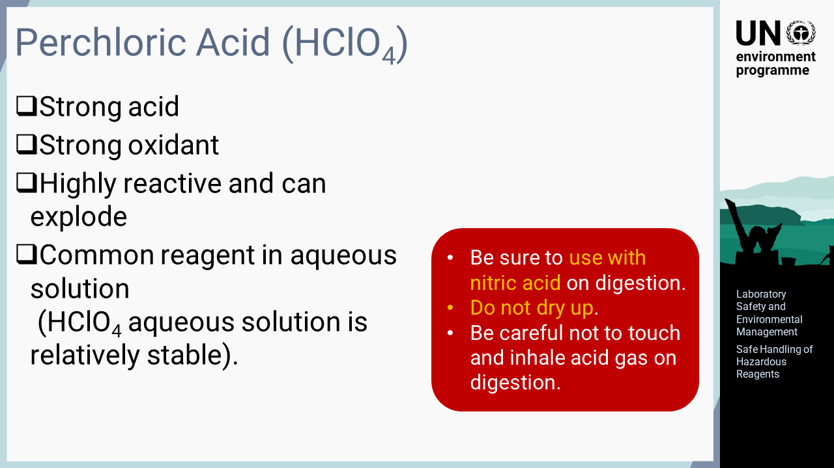
Notes:
‘8’ Perchloric acid is explained in this slide. Perchloric acid is a strong acid and has a very strong oxidizing potential, which makes it highly reactive and explosive on some occasions. However, perchloric acid in aqueous solution is relatively stable and often used in acid decomposition. This is very useful for sample digestion due to the high reactivity of perchloric acid. Nevertheless, there is a risk of explosion if handled incorrectly; thus, correct handling procedures should be put in place. When conducting heat digestion with perchloric acid, nitric acid should always be used together with perchloric acid. Additionally, the treated samples should never be dried, as perchloric acid becomes unstable without water and can easily explode. Perchloric acid also generates a hazardous gas containing hydrochloric acid during digestion operations. It should be handled cautiously to avoid inhalation of and dermal contact with its toxic vapour.

Slide 10
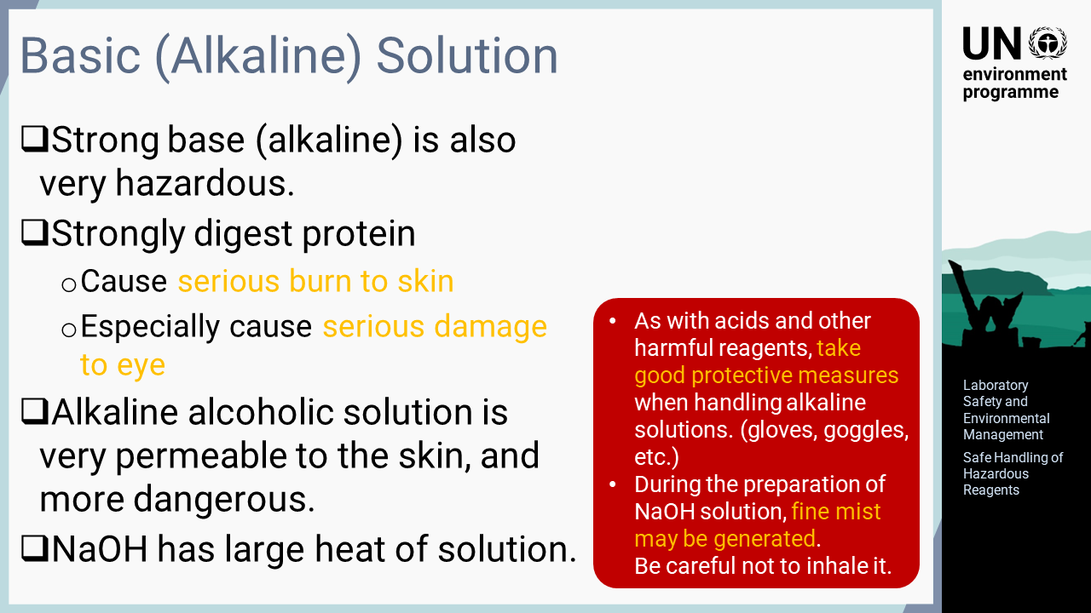
Notes:
‘9’ This slide explains the special precautions required for basic or alkaline solutions such as sodium hydroxide. The hazardous properties of basic solutions seem to be less recognized than those of acids. In fact, strong alkalis are very hazardous to humans. They have a strong ability to digest proteins, which results in severe burns and can especially cause serious damage to the eyes. Alcohol solutions of alkalis are more permeable to the skin, which risks more serious burns. Basic reagents such as sodium hydroxide have high heats of solution in water, which may cause a fine alkaline mist to be emitted into the air when preparing an aqueous solution. As explained, strong alkaline solutions are very harmful, similar to acids and other harmful reagents. Thus, the same level of protective measures should be taken, such as wearing gloves and protective goggles when handling alkaline solutions. Mists of strong alkalis generated during operations should not be inhaled.

Slide 11
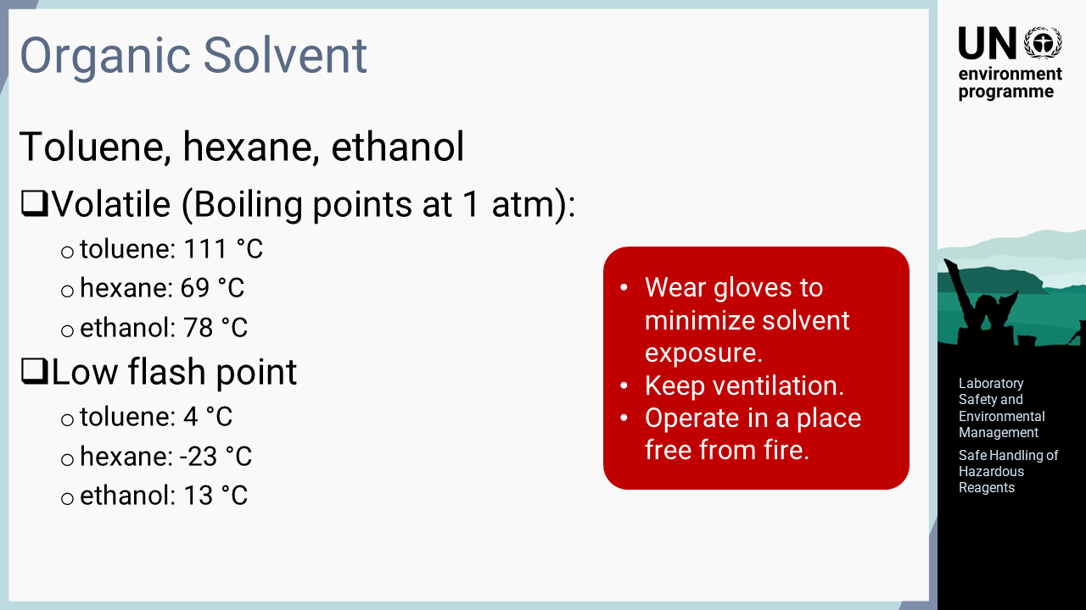
Notes:
‘10’ The handling of organic solvents is explained in this slide. The analysis of mercury does not very often require the use of organic solvents but small amounts of organic solvent, such as toluene, hexane, and ethanol, may be used for some analyses. These three solvents are volatile with relatively low boiling points, which may cause an inhalation risk during handling. The flash points are also low, and these solvents may ignite at room temperature. Needless to say, when handling organic solvents, gloves and other protective gear should be used to minimize exposure. In addition, sufficient ventilation should be provided in the handling area and operations should be performed in a location free from fire.

Slide 12

Notes:
‘11’ In this section, safety management for handling glassware and equipment is explained.

Slide 13
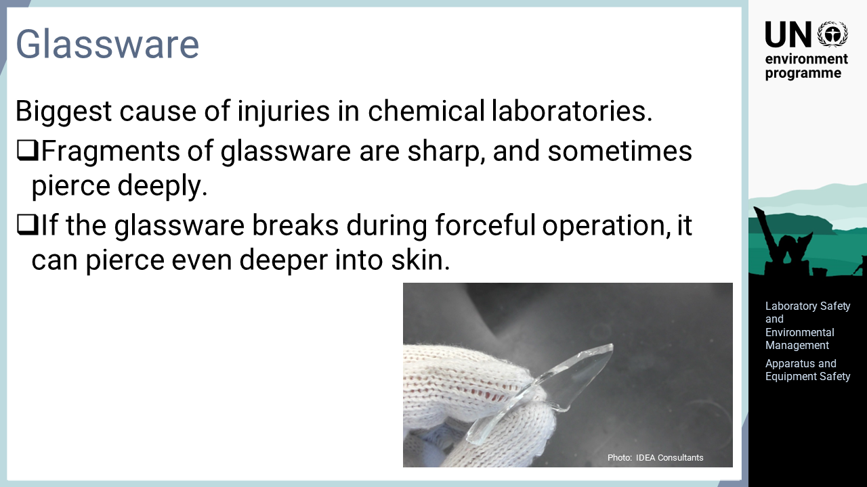
Notes:
‘12’ Glassware is the most common cause of injury in chemical laboratories. Glassware in its proper shape will not cause injures very often. Injuries are caused by fragments of broken or chipped glassware. Broken glass is sharp and can sometimes pierce deeply. If the glassware breaks during a forced operation, it can pierce even deeper into the skin.

Slide 14
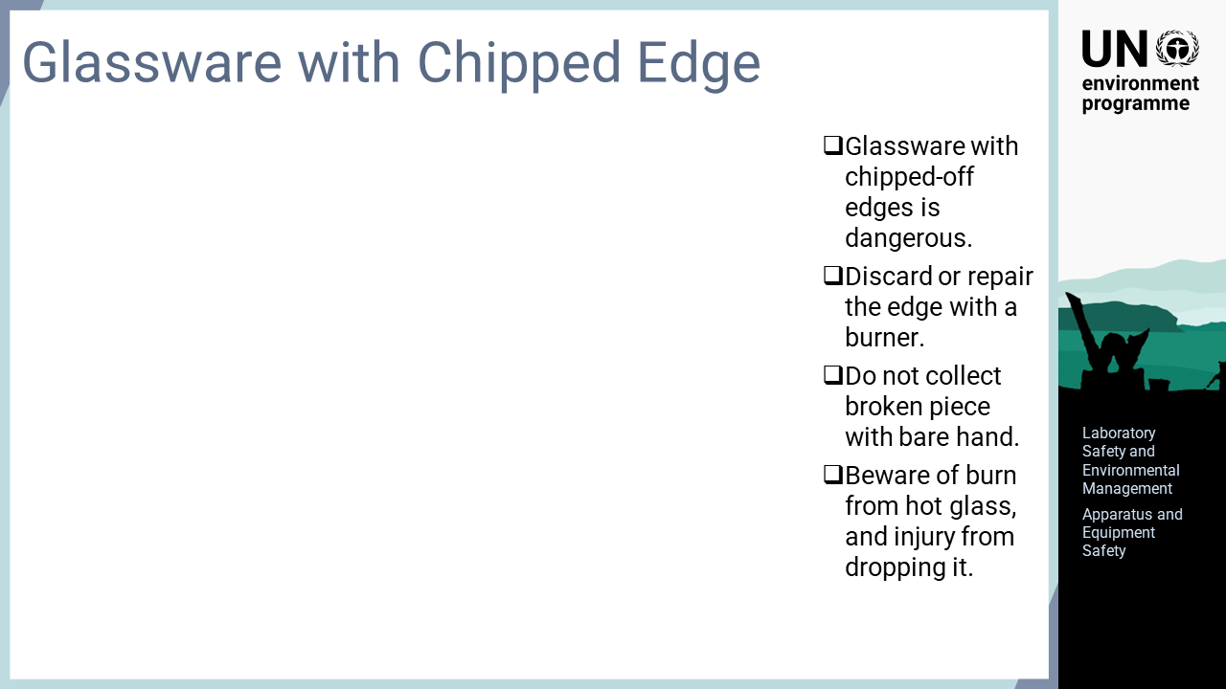
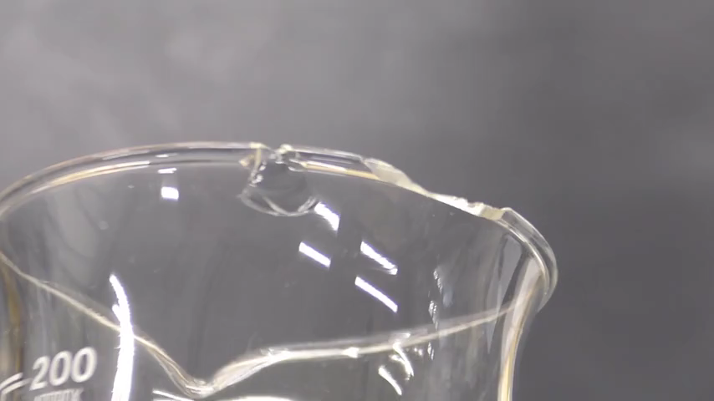
Notes:
‘13’ As glassware is used in laboratory, the edge is occasionally chipped. There are many injuries caused by the edge of glassware. Such glassware should not be used or the chipped edge should be repaired using a burner. Many injuries are also caused by picking up pieces of glassware that was accidentally broken. A broom or other tools should be used for collection, or if picking by hand, thick gloves should be used. As the appearance of glassware does not when heated, burns caused by hot glassware or injuries caused by dropping hot glassware are also common. Deliberate care should be taken when handling apparatus that may still be hot after heat digestion.

Slide 15
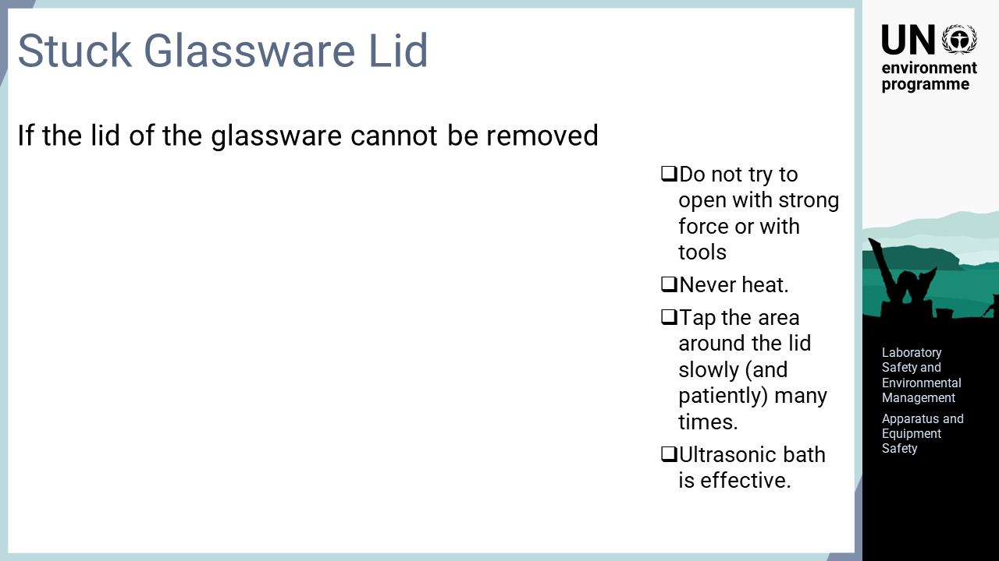
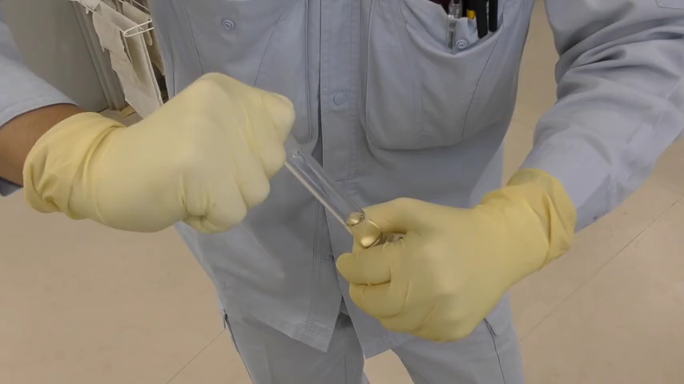
Notes:
‘14’ Sometimes, the lid sticks to glassware and cannot be removed. In such a case, forcibly removing the lid may result in breakage and injury; therefore, the lid should not be twisted by force or with tools. It is also not recommended that glassware is heated to remove the lid, as this may damage the glassware and cause serious injury. Boiling water or fire should never be used to remove the lid of glassware. If the lid cannot be removed, the area around the lid should be repeatedly tapped to unscrew it gradually and patiently. It is also effective to use an ultrasonic bath.

Slide 16
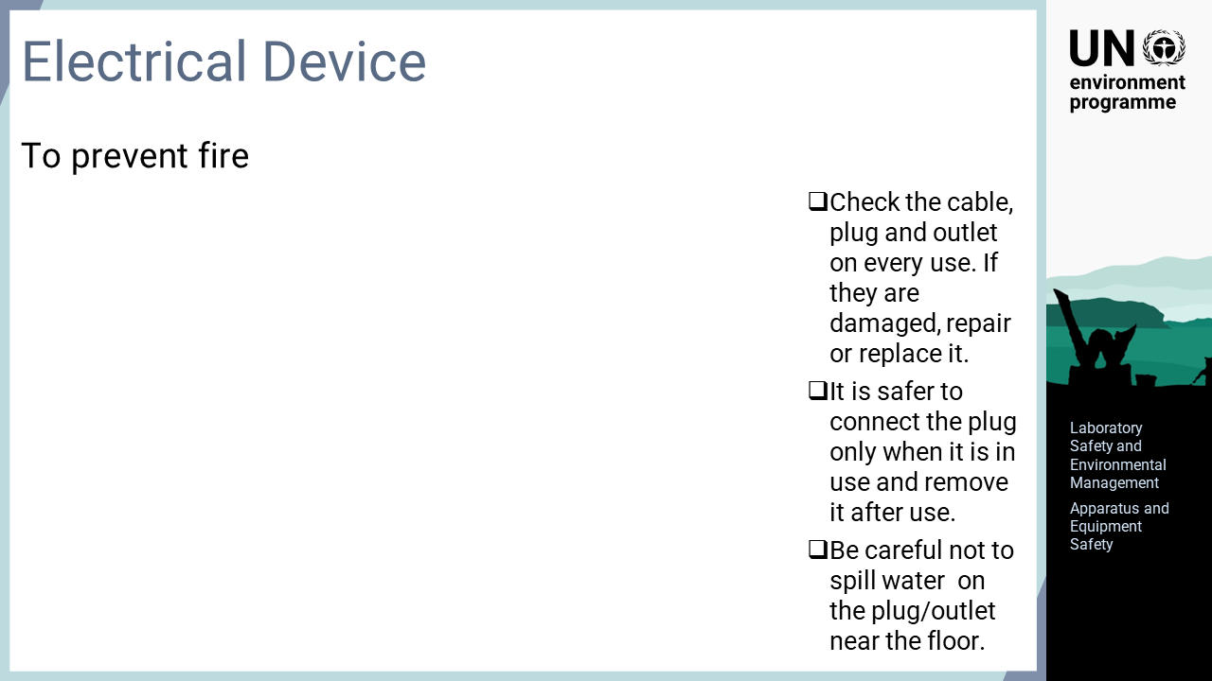
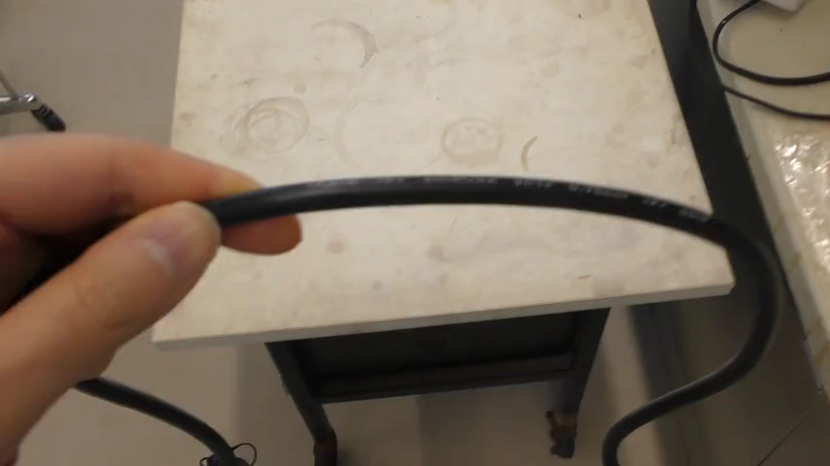
Notes:
‘15’ Fire is the most important concern when using electric appliances. Reagents such as acids used in the laboratory can damage the electric wires, plugs, and outlets of electrical appliances, which may cause a fire due to high temperatures or electric sparks. When using electric appliances, the condition of the wires, plugs, and outlets should be examined, and damaged parts should be repaired or replaced. It is safer to connect the plug of an electric appliance only when the apparatus is in use and to disconnect it after use. If power outlets are located near the floor, the plugs or outlets of electrical appliances may get wet. When using outlets located near the floor, water use in the laboratory should be carefully controlled.

Slide 17
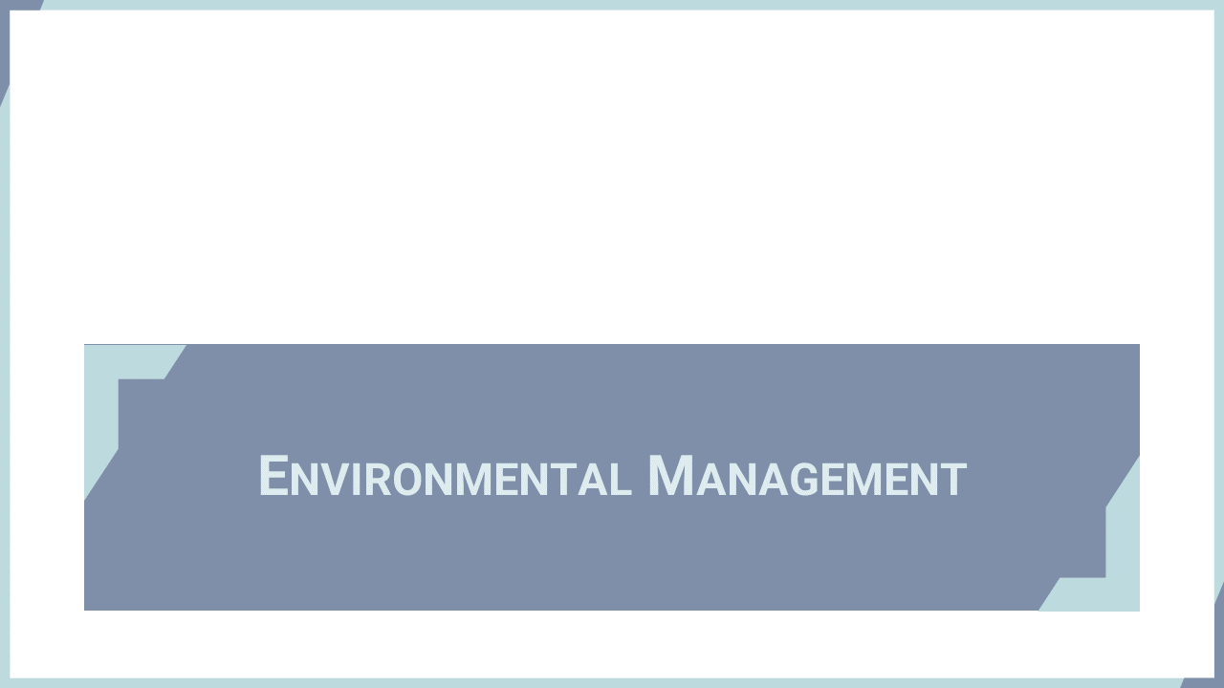
Notes:
‘16’ In this section, environmental management in the laboratory including wastewater and exhaust gas management are explained.

Slide 18
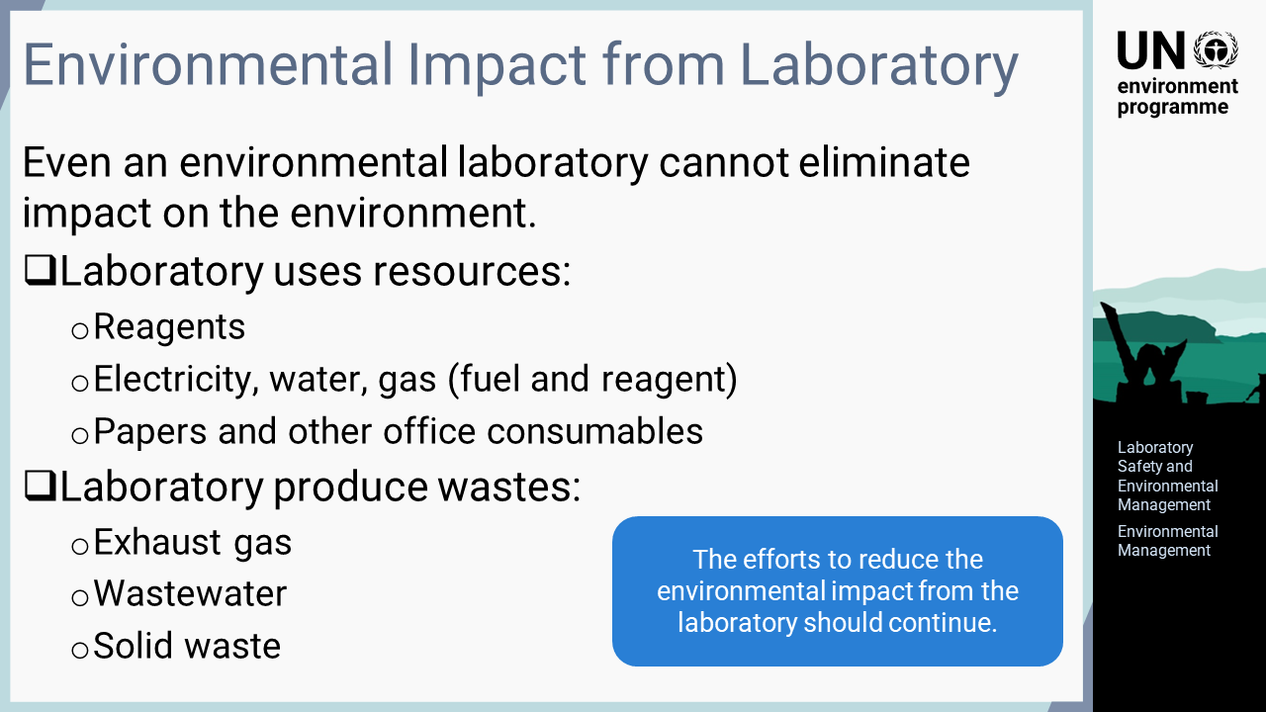
Notes:
‘17’ Even when a laboratory is working on environmental issues, it also impacts the environment during operation. For example, laboratory activities constantly consume resources such as reagents, electricity, water, and paper. Laboratory activities also result in the generation of wastewater, exhaust gases, and solid waste. Although it may not be possible to eliminate these issues completely, efforts to reduce the environmental impact must continue.

Slide 19
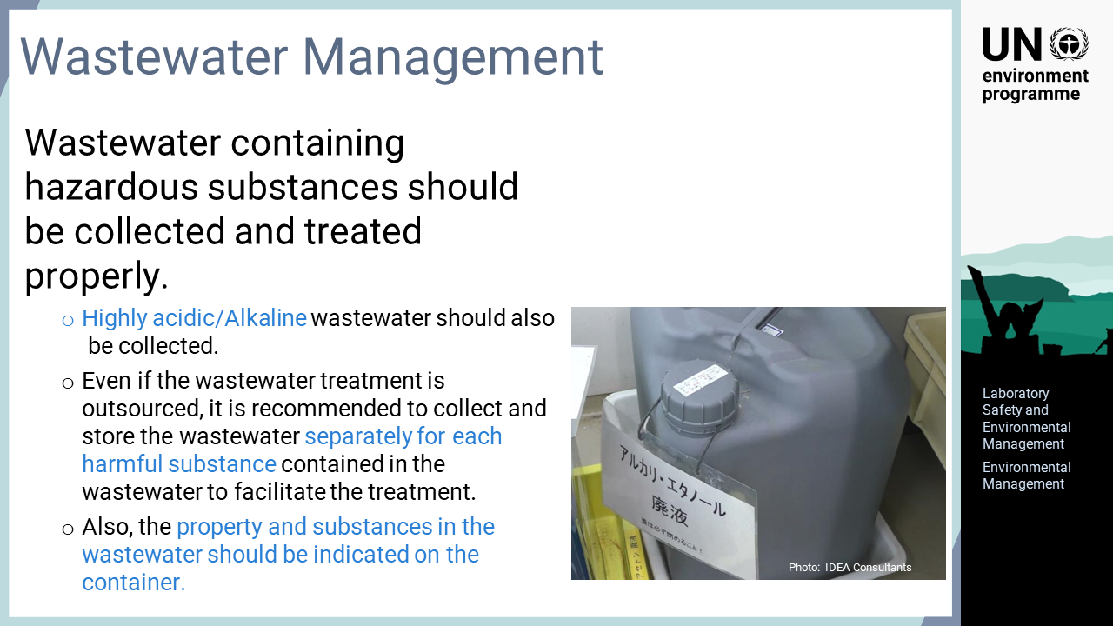
Notes:
‘18’ Wastewater that is hazardous to the environment must be collected and treated properly and must not be released directly into the environment. Besides wastewater containing hazardous substances such as heavy metals, strongly acidic or alkaline wastewater must also be collected, regardless of whether it contains hazardous substances. In some cases, acidic or alkaline wastewater may be neutralized to remove its harm and then released if no other hazardous substances remain in the wastewater. Usually, most laboratories outsource the treatment of collected wastewater. When outsourcing treatment, wastewater should be collected and kept separately based on the type of substances it contains. To facilitate subsequent treatment, the different types should not be mixed altogether. The type of wastewater and the contained substances should be indicated on the container for safety and proper management during storage.

Slide 20
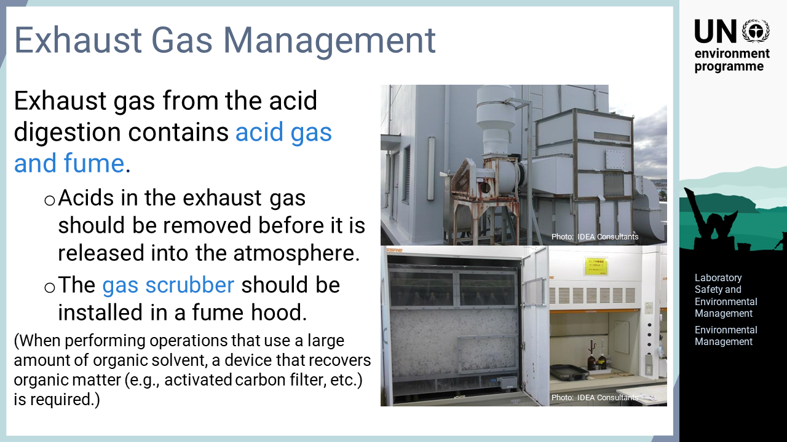
Notes:
‘19’ Analytical operations that generate harmful gases, such as acid digestion, should be performed in a fume hood. The air discharged from the hood contains acid gas or vapour, which must be removed before release into the atmosphere to avoid environmental impact. Since the exhaust cannot be collected and stored, the acid in the exhaust from the fume hood should be removed by a gas scrubber. There are several types of gas scrubbers that can be installed indoors or outdoors. The choice of a suitable scrubber depends on the laboratory situation. If a large amount of organic solvents is used in a fume hood, which is not often the case with mercury analysis, the generated organic gas is not removed by standard gas scrubbers. When a fume hood is used for this purpose, an activated carbon filter or other device that removes organic gas is required.

Slide 21
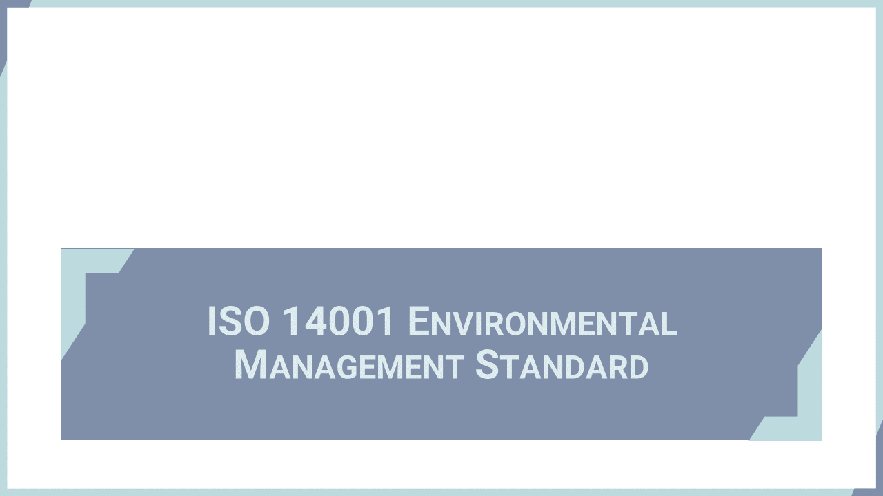
Notes:
‘20’ A standard for environmental management systems, ISO14000, is briefly introduced in this section.

Slide 22
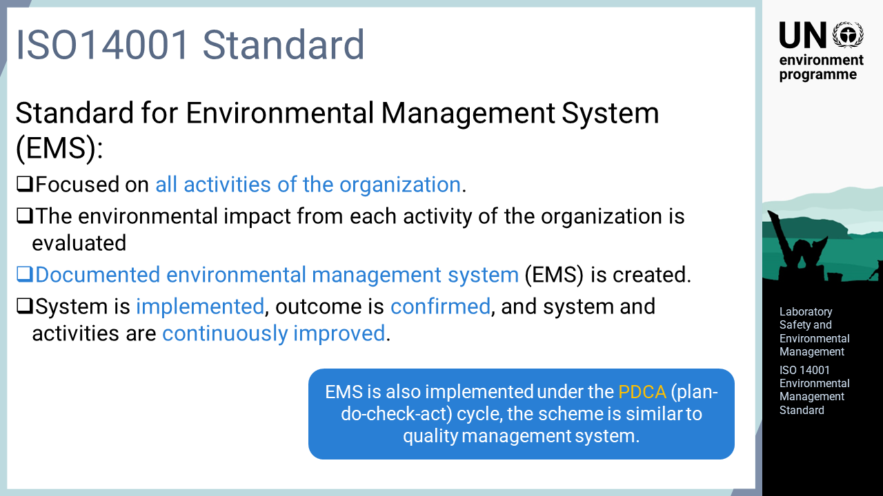
Notes:
‘21’ The ISO 14000 series, including ISO 14001, is a standard for developing environmental management systems. The difference from other quality standards such as ISO 9001 or ISO/IEC 17025 is that the ISO 14000 series covers all the activities of an organization to manage the environmental impact of the organization instead of focusing on specific activities. The environmental impact of each activity of the organization are extracted and evaluated. A documented environment management system based on the evaluated information is created. The system is implemented, the outcome is confirmed, and the system and activities are continuously improved. This flow is the same as the PDCA cycle in quality management systems. This means that the environmental management system is similar to the quality management system.

Slide 23
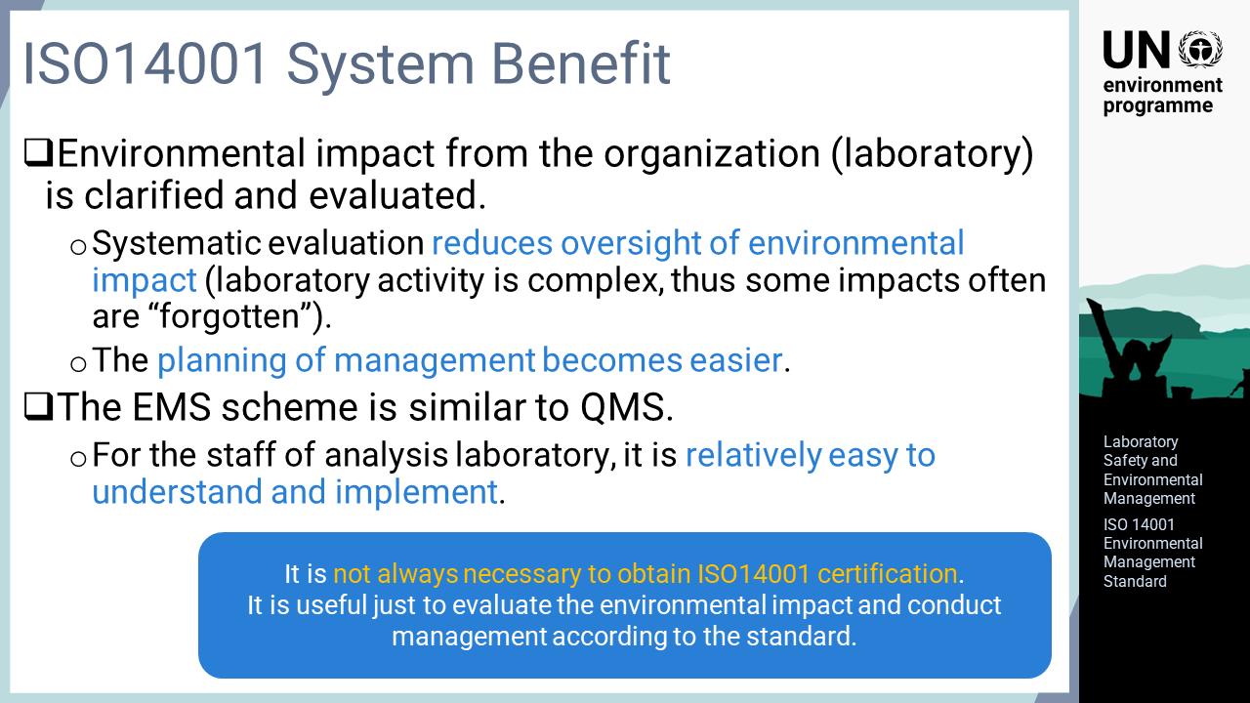
Notes:
‘22’ The benefits of introducing the ISO 14001 system have been explained in many places, including by ISO itself. The benefits particular to the analytical laboratory are discussed and explained here. Firstly, the environmental impact of the laboratory is systematically clarified and evaluated. Laboratory activities are complex and use many chemicals, so some environmental impact might be forgotten or neglected. Systematic environmental impact assessments help reduce such oversights. Thus, the planning of environmental impact assessments facilitates easier management. The operational advantage of the environmental management system in ISO 14000 is its similarity to the quality management system. As it belongs to the same family of ISO standards, it is understandable to the analytical staff of the laboratory and relatively easy to introduce and implement. Although it is not always necessary to obtain ISO 14001 certification, this series is nevertheless a very useful system regardless of having certification. Assessing the environmental impact in alignment with ISO 14000 and managing the laboratory accordingly will reduce the environmental impact. Therefore, it is recommended that analytical laboratories incorporate this system into their management.

