Slide 1





ELIMINATION OF THE USE OF MERCURY
IN CHLOR-ALKALI CHEMICAL PROCESSES
IDENTIFYING ENVIRONMENTAL CHALLENGES
DURING CONVERSION
VIENA, JUNE 2016
Javier CARRASCO
Minas de Almadén y Arrayanes S.A.
Industrial Activities Manager
jcarrasco@ctndm

Slide 2
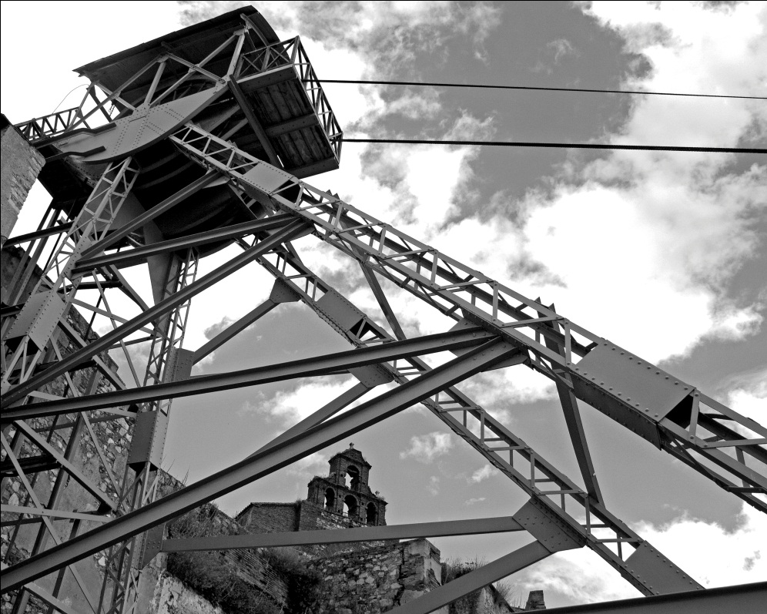
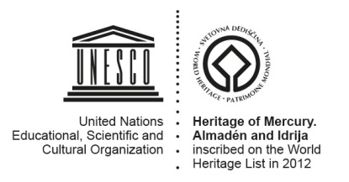
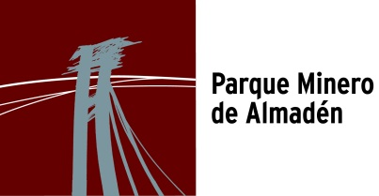
BACKGROUND
Year 2001
Almadén mine clousure
Year 2003
End of mercury production
Year 2011
End of reuse and commercialization of European surpluses
Saint Aquilino headframe . XX century
Notes:
The Almadén mine was closed in 2001
The mercury production went on till 2003, in that date the mining-metallurgic activity ended in Almadén .
The mercury exportation finished in March, 2011 for legal European regulations

Slide 3
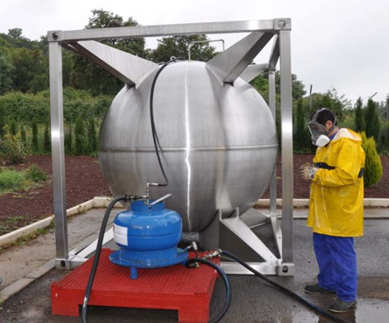
BACKGROUND
Design and construction of a prototype container for temporary storage of mercury:
Confinement of double barrier
security mechanisms and ongoing monitoring such as temperature, mercury level, pressure and stability.
MERCURY TEMPORARY STORAGE

Slide 4
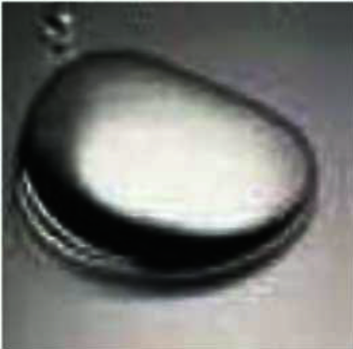
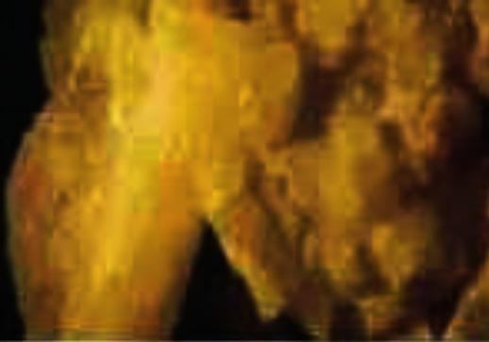
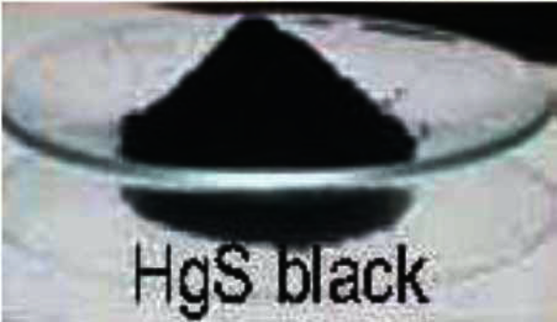
DESCRIPTION OF THE TECHNIQUE
Stabilization
Metallic Hg
Elemental sulfur
particles (< 60 μm)
react to obtain
HgS (Cinnabar)
MERCURY STABILIZATION PLANT

Slide 5
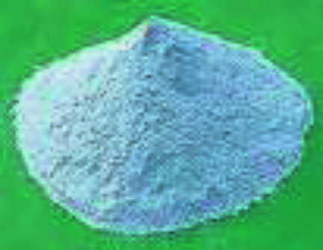
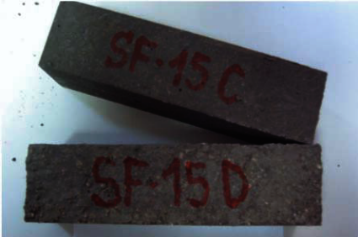
DESCRIPTION OF THE TECHNIQUE
Microencapsulation in a sulphur matrix
HgS S S polymer
HEATER-MIXER (<140ºC)
POLIMERIC CEMENT OF SULPHUR (Artificial rock)
MERCURY STABILIZATION PLANT

Slide 6
ADVANTAGES AND GUARANTEES
Inert solid with low porosity and impermeable.
1 ton of mercury produces 1.37 tons of residue (73% in Hg) and 1 liter of mercury produces 4.10 liters of residue
Emits 100-150 times less mercury than cinnabar
The MICROENCAPSULATION provides a second and additional barrier for avoiding mercury releases to the environment.
Safer product and easier to be managed: final disposal could be possible in inert landfill according its leaching conditions.
During the process, 100% of Hg is transformed.
Low energy consumption. No water consumption, and neither effluents nor wastes are generated.
MERCURY STABILIZATION PLANT

Slide 7
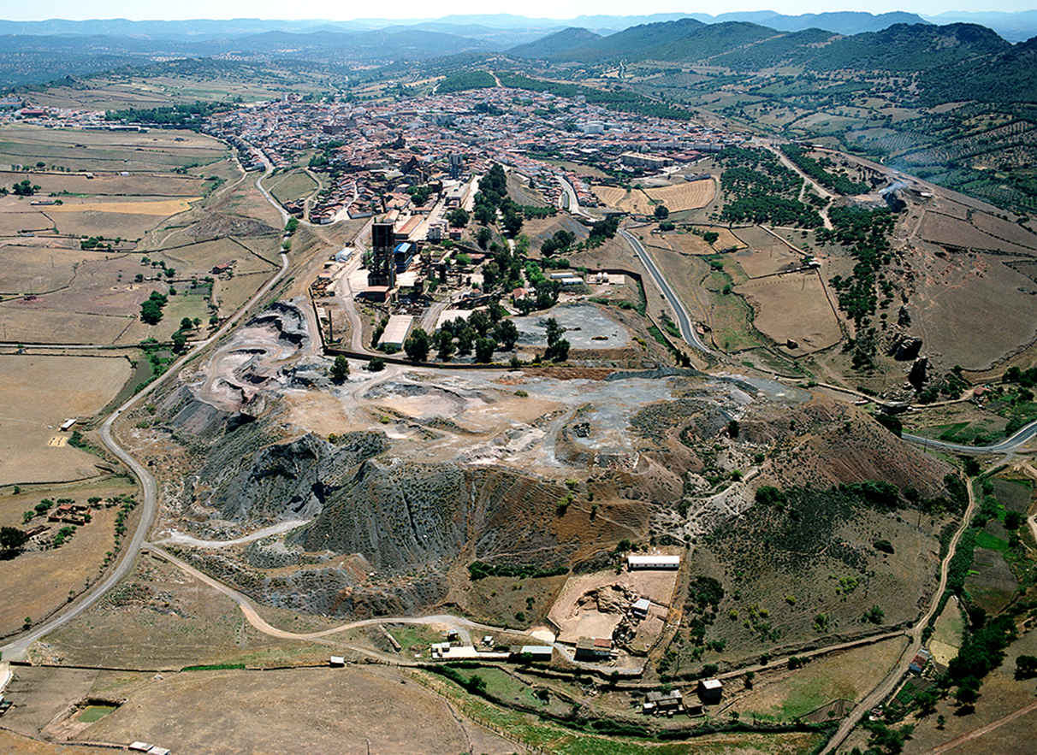
REMEDIATION SITE
This waste heap contains deposits of waste from the mining operations as well as slag from the metallurgical processes accumulated through the centuries.
The volume of the waste heap is at present close to 3,5 million tons, covering 10 hectares
ALMADEN MINE DUMP

Slide 8
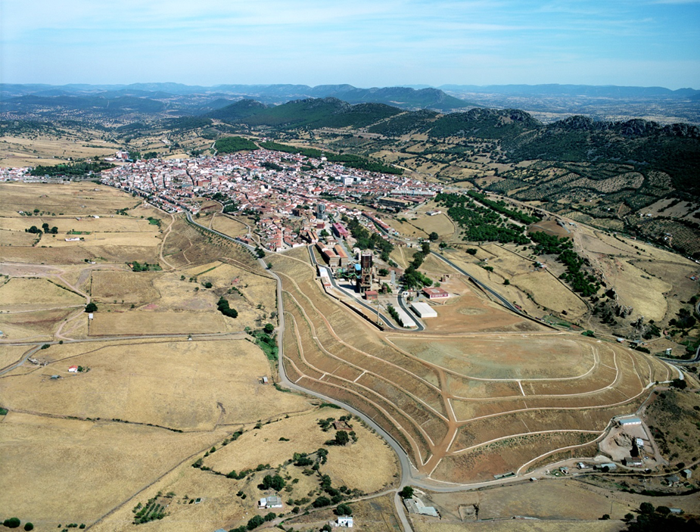
PROJECT DEVELOPMENT
MAIN WORKS: encapsulation of the dump
aimS:
Stability and landscape integration with the dump and the surroundings
Securing waterproofing, and isolation from its surface.
ALMADEN MINE DUMP
Notes:
The main works were encapsulation of the dump. Its aims were:
• The stability and landscape (lanskeip) integration, with the dump and the surroundings (saroundins).
• The securing (sekiurin) waterproofing, and isolation (aisoleosion) from its surface (sarfis).
The works started (id) in two thousand and five and ended (id) in may (mei) two thousand and eigth.
Works cost eight point two million euros (iuros)

Slide 9
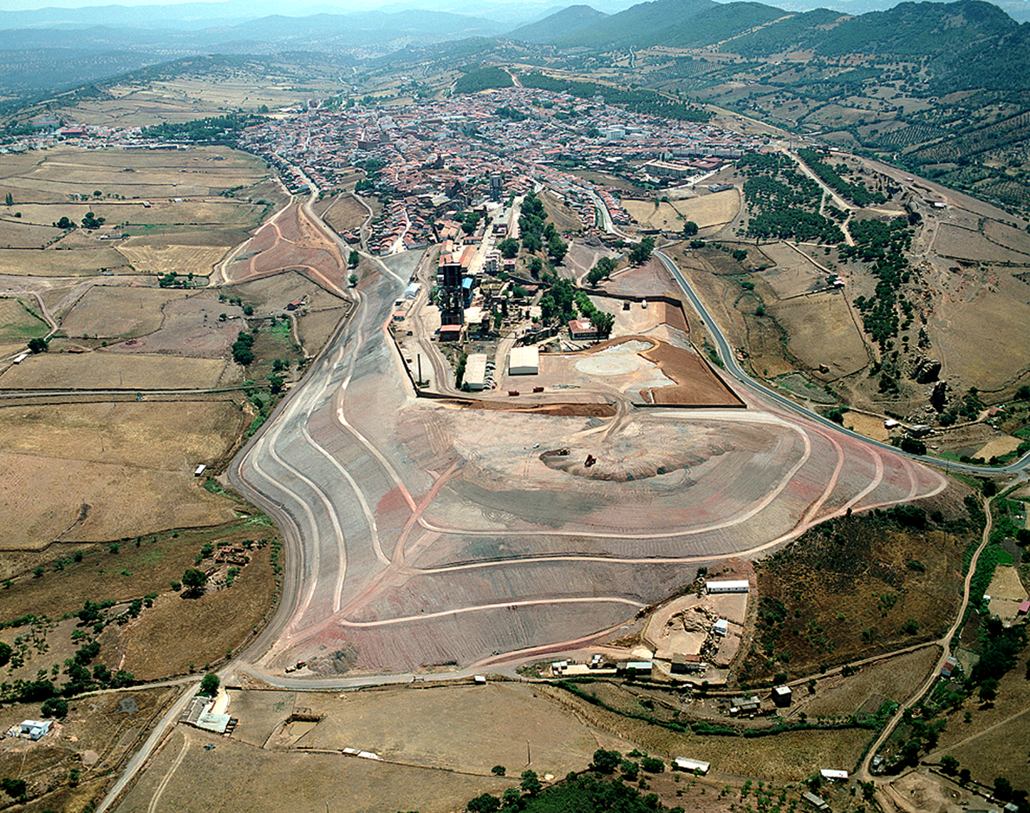
PROJECT DEVELOPMENT
1. DUMP FORMING
Aims:
Remodel the slopes and the capping plate of the dump
Stabilizing their conditions
Earth filling of 493,582 m3 of material
ALMADEN MINE DUMP
Notes:
The first works were the remodeling (rimodelin) of the slopes (sloups), and the top of the dump, to stabilize it.
We moved (muft) about five hundred thousand cubic (ciubic) metres (miters) of waste.

Slide 10
PROJECT DEVELOPMENT
JUNE 2007
ALMADEN MINE DUMP

Slide 11
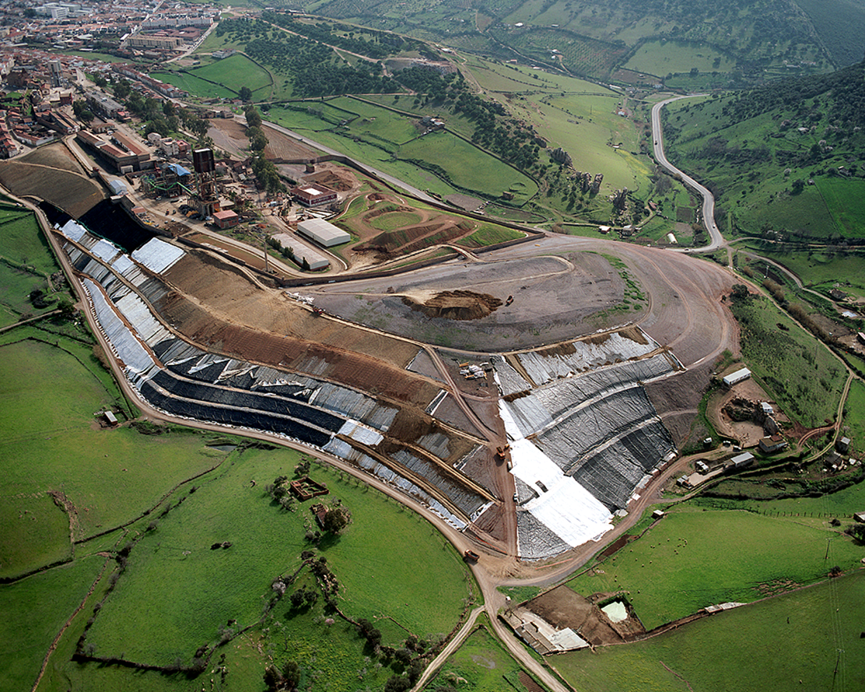
PROJECT DEVELOPMENT
2. DUMP SEALING:
Functions:
To prevent the entrance of water in the dump, avoiding the generation of leachate and the material dispersion.
Insulation, avoiding mercury evaporation on the dump surface
ALMADEN MINE DUMP
Notes:
The most important works, were the waterproofing, in order to prevent (privent):
- The entrance (entrench) of water and leachate (licheit) generation.
- The material dispersion and,
- the evaporation of mercury in the dump area (eiria)

Slide 12
PROJECT DEVELOPMENT
ALMADEN MINE DUMP

Slide 13
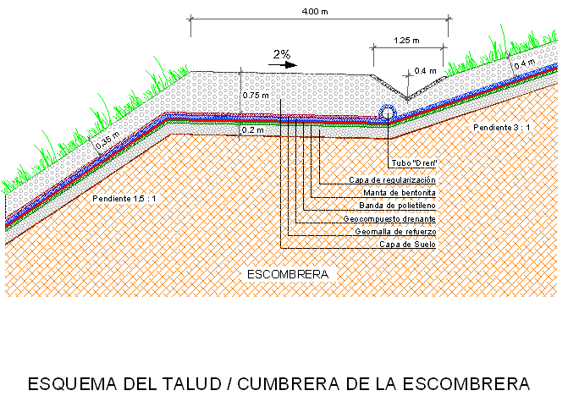
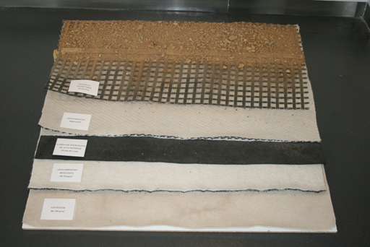
PROJECT DEVELOPMENT
GROUND
REINFORCEMENT GRID
DRAINING GEOCOMPOSED
HIGH DENSITY POLYETHYLENE
BENTONITE GEOCOMPOSED
GEOTEXTILE
DUMP
SEALING SURFACE SCHEME
LOW INCLINATION SLOPE
ALMADEN MINE DUMP
Notes:
This is a scheme (skim) of the sealed (silit) package (pakeks) in low-gradient slopes (sloups):
- Ground,
- Reinforcement grid,
- Draining geocomposed (yiocompoust)
- High density polyethylene,
- Bentonite geocomposed,
Geotextile(yiotextail)

Slide 14
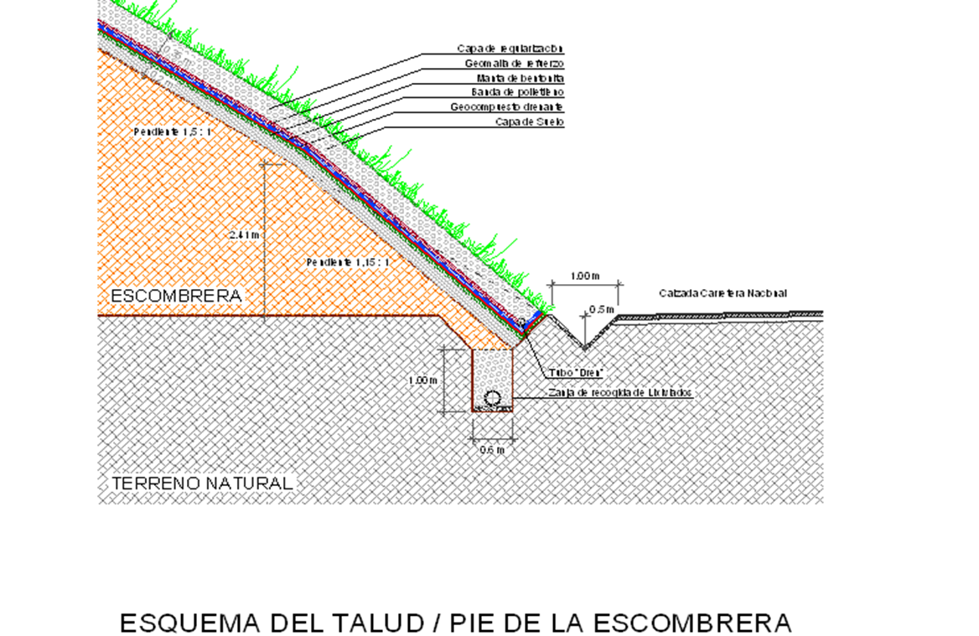
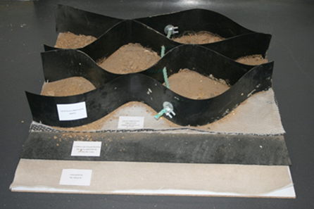
PROJECT DEVELOPMENT
GROUND
GEOCELLS
DRAINING GEOCOMPOSED
HIGH DENSITY POLYETHYLENE
GEOTEXTILE
DUMP
SEALING SURFACE SCHEME
LOW INCLINATION SLOPE
SEALING SURFACE SCHEME
HIGH INCLINATION SLOPE
ALMADEN MINE DUMP
Notes:
This is a scheme (skim) of the sealed (silid) package (pakeks), in high inclination slopes (sloups), we replaced (ripleist) the Reinforcement grid and Bentonite geocomposed (yiocompoust) by geocells

Slide 15
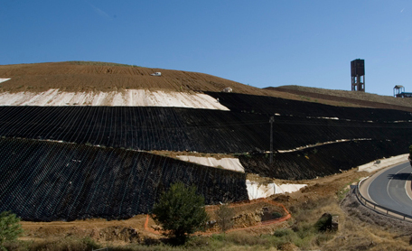
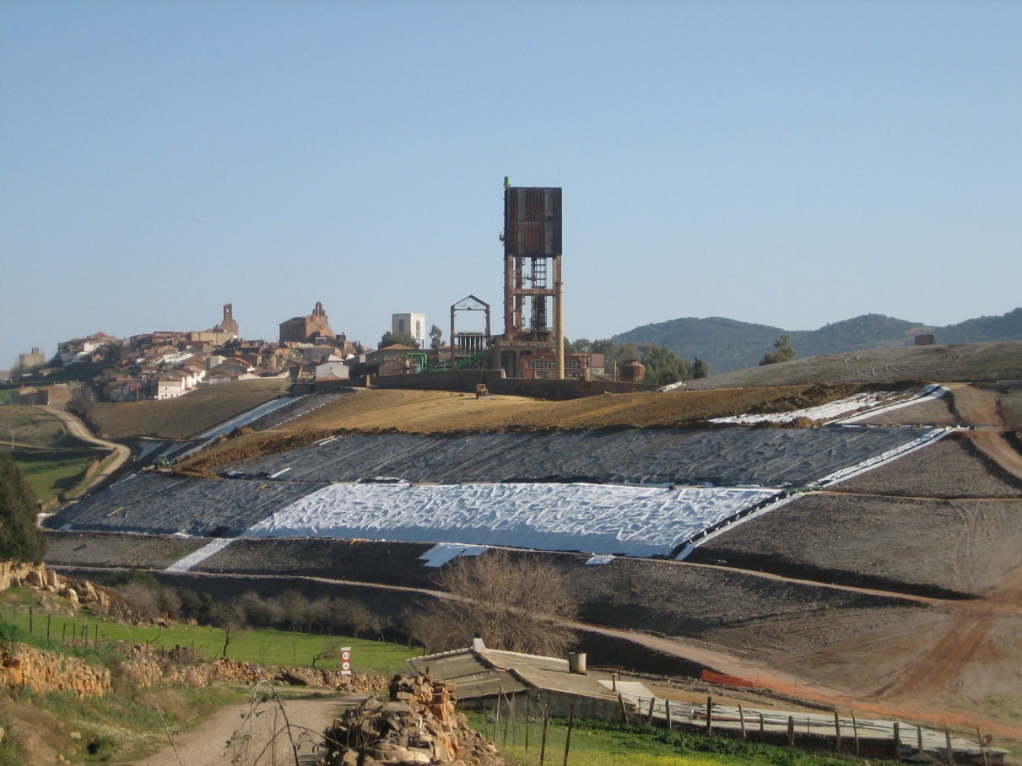
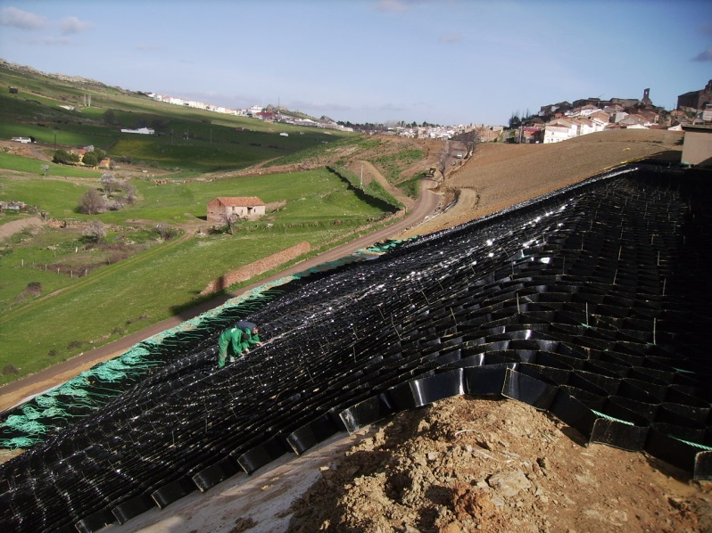
PROJECT DEVELOPMENT
ALMADEN MINE DUMP

Slide 16
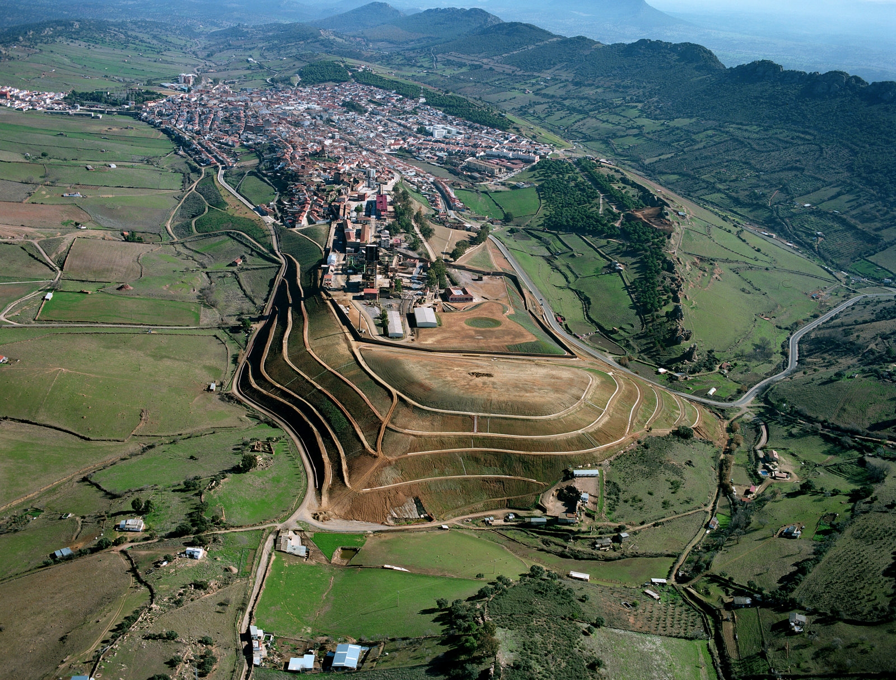
PROJECT DEVELOPMENT
3.INSTALLATION OF A COLLECTION, CIRCULATION AND EVACUATION WATER SYSTEM
4. RESTORATION OF THE VEGETAL LAYER.
50 cm of topsoil all over the surface (about 170.000 m3)
Hydroharvest in 16 ha
ALMADEN MINE DUMP
Notes:
The next step was the installation of the collection, circulation and water drainage (dreinich) system
And the last step was, the restoration of the vegetal (viyital) layer (leyar), for recovering the vegetation (veyiteision) and landscape (lanskeip) integration of the dump.
Providing (provaidin), at least (list), fifty centimeters of soil over the whole (joul) surface (sarfis), over (ouver) one hundred seventy thousands cubic (ciubic) metres (miters)

Slide 17

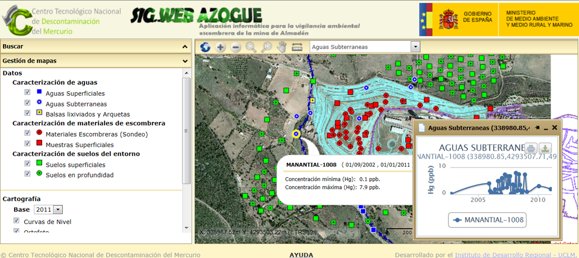
ENVIRONMENTAL MONITORING: RESULTS
GIS Azogue
(geographic information system ABOUT ALMADEN DUMP)
System designed to store, manipulate, analyze, manage, and present the environmental data about the monitoring of Almaden dump.
Incorporate topography and orthophotos, and analytical controls of the environmental characterization
On a GIS web platform (so that information can be consulted on a private platform over the Internet ).
It is a public information for everybody
Enter:
http://www.ctndm.es/proyectos/1-in.php
Press:
Enter SIG
ALMADEN MINE DUMP
Notes:
About Environmental monitoring:
The GIS (yiaies) Azogue (geographic information system about Almaden dump) is a system designed to store, manipulate, analyze, manage, and present (prisent) the environmental data about the monitoring of Almaden dump.
The system also incorporate topography and orthophotos from before and after the works, as well as all the analytical controls of the environmental characterization
The system is on a GIS web platform (so that information can be consulted on a private platform over the Internet ). GIS web technology makes possible (posibol) to transfer the maps and environmental information included in a GIS to the Internet and there, it is a public information to which everybody in the world can access.
To enter, please type: and them Enter SIG

Slide 18
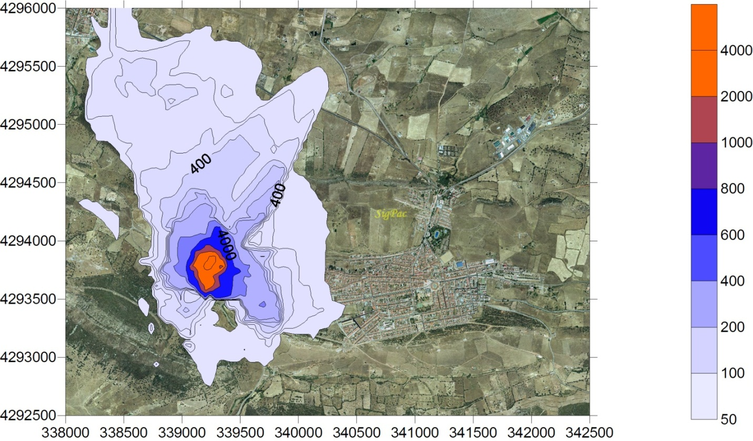
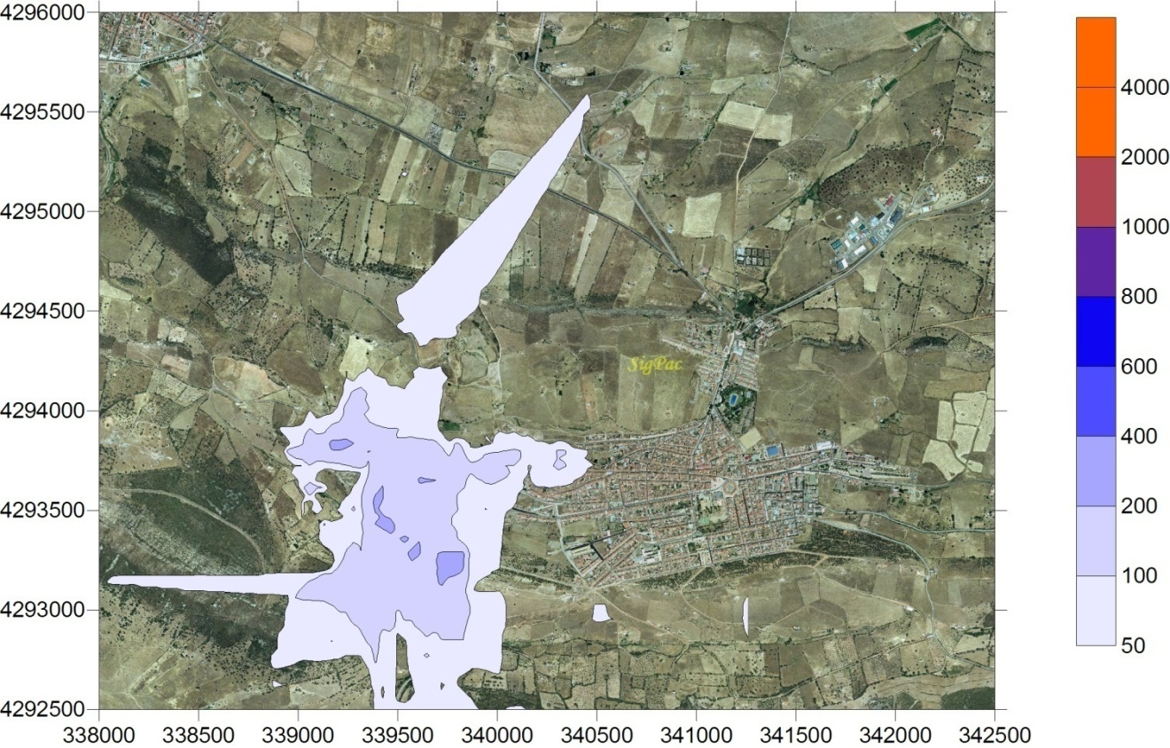
ENVIRONMENTAL MONITORING: RESULTS
RESTORATION OF THE WASTE HEAP IN THE SAN TEODORO ENCLOSURE
The first results:
Emission to the atmosphere
Test in the air during the works (ng/m3)ng·m⁻³
Test in the air after the works (ng/m3)
ALMADEN MINE DUMP
Source: Dr Pablo Higueras (UCLM)
Notes:
Regarding the total mercury levels in the air. Now you can see in left picture the levels during the works and in the right picture the levels after them.
The maximun levels are now about three hundred. The level of mercury was divided (divaidid) by ten

Slide 19
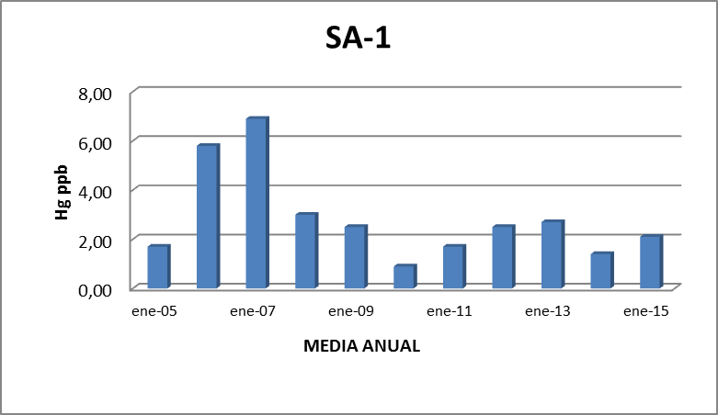
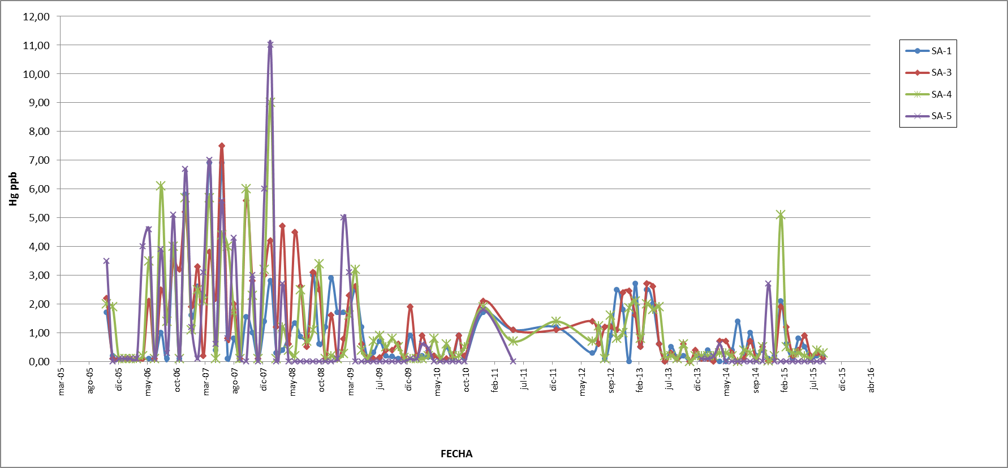
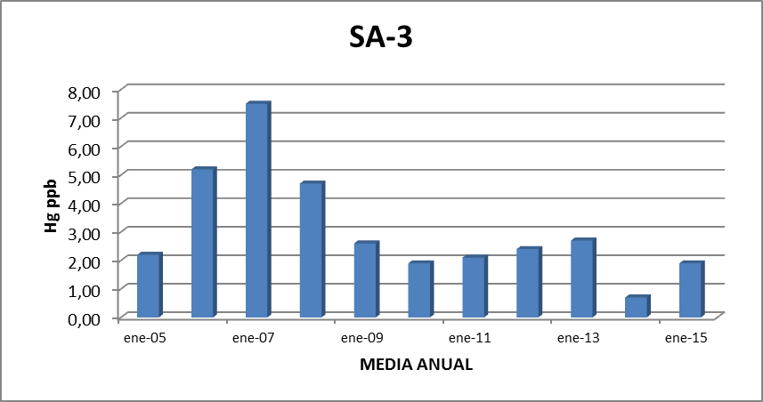
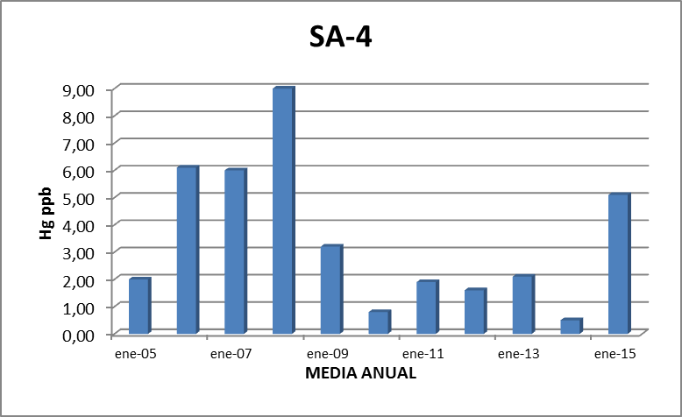
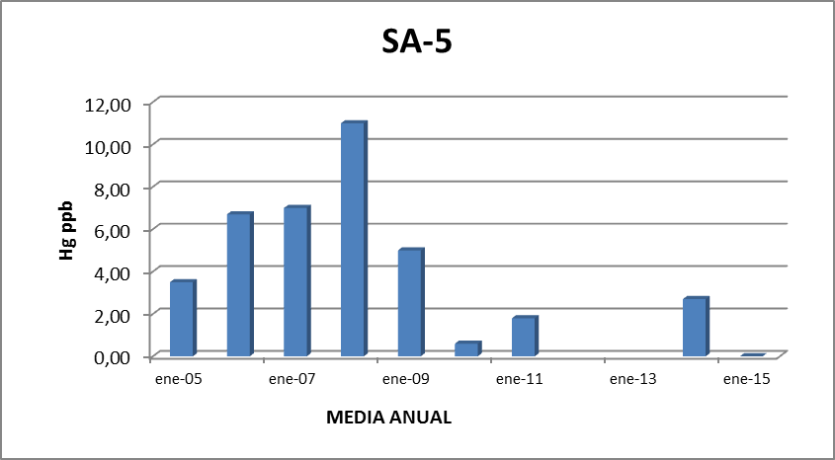
GROUNDWATER: DRILLHOLES
ENVIRONMENTAL MONITORING: RESULTS
ALMADEN MINE DUMP
Notes:
These are the data (deta) of groundwater monitoring. There are four drillholes (driljouls) in the surroundings (sarroundins) of the dump.
You can see how the values of mercury went up during the works but, after, they went down to lower levels.
Now, the levels are in the range of one or two ppb in the most cases.

Slide 20
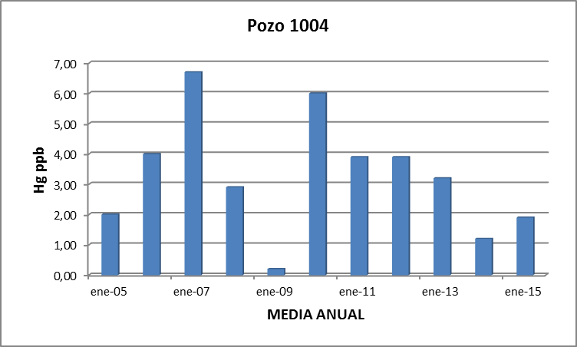
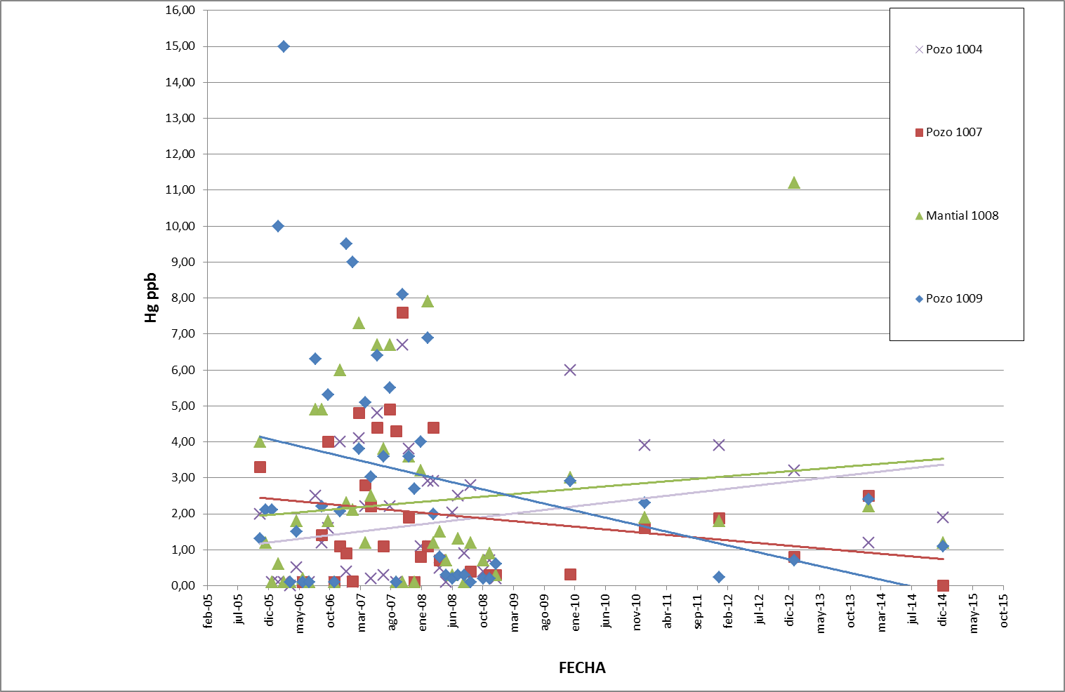
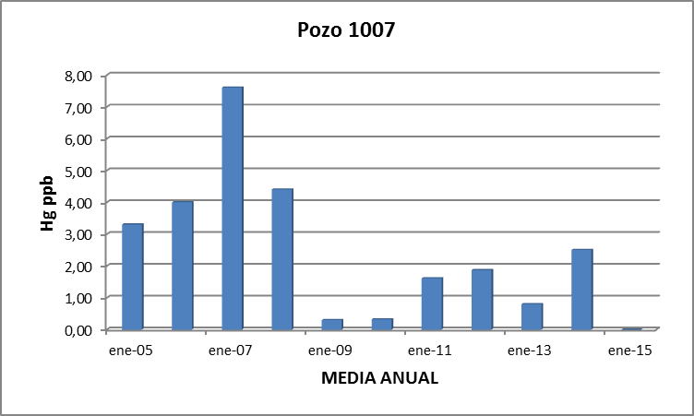
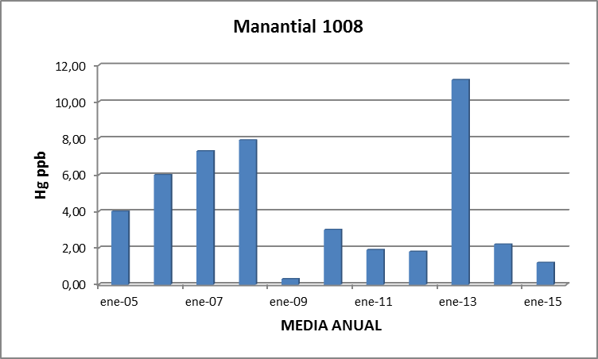
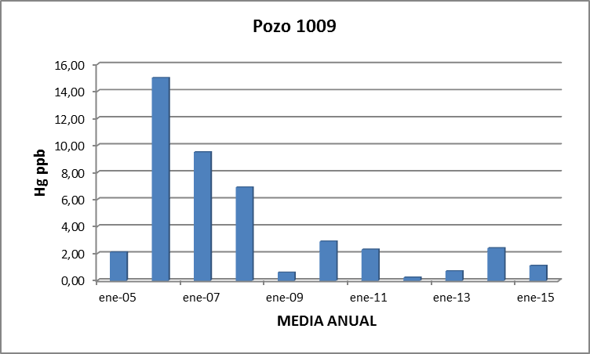
ENVIRONMENTAL MONITORING: RESULTS
GROUNDWATER: WELLS AND SPRINGS
ALMADEN MINE DUMP
Notes:
This is other data (deta) for groundwater monitoring. These are wells and natural (nachul) springs of the surroundings (sarroundins)

Slide 21
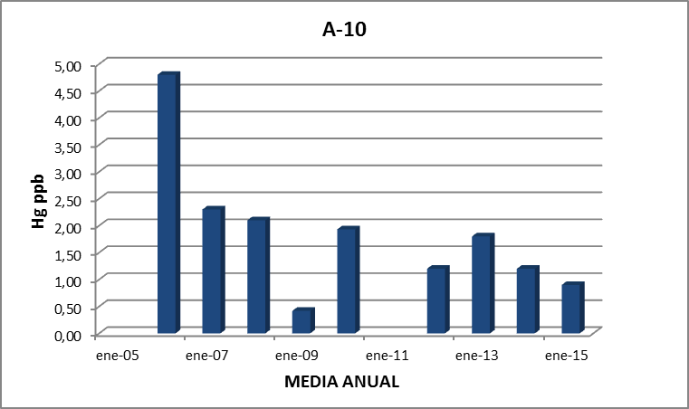
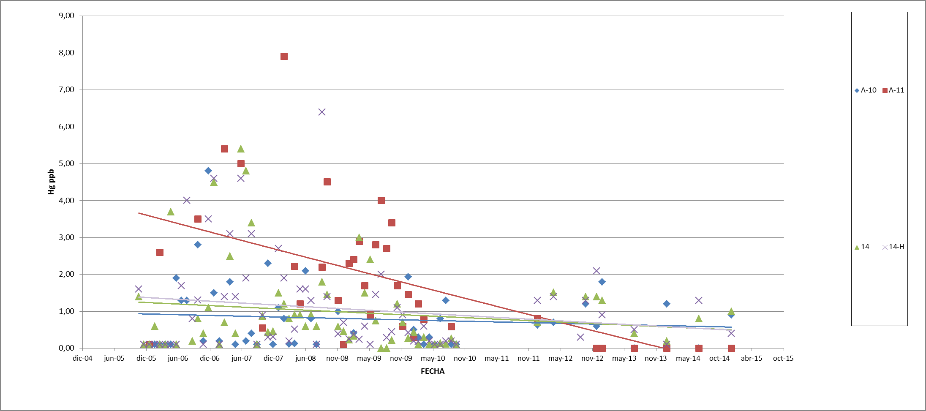
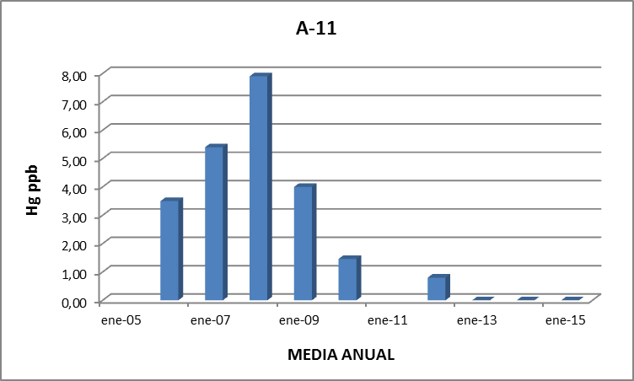
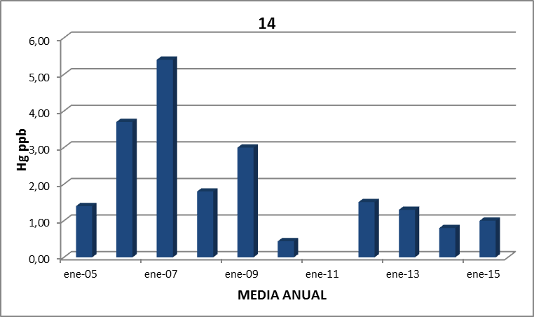
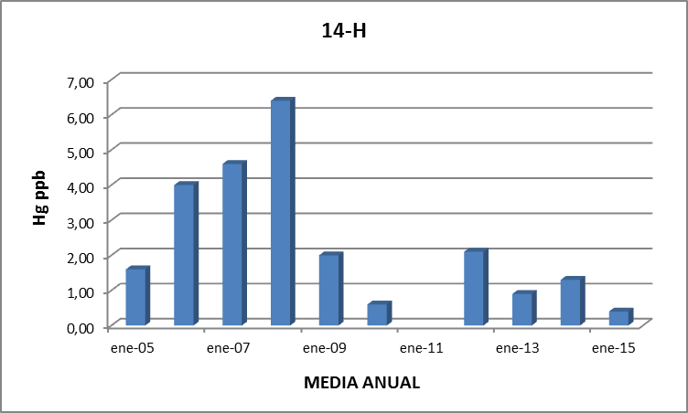
SURFACE WATER: STREAMS
ENVIRONMENTAL MONITORING: RESULTS
ALMADEN MINE DUMP
Notes:
As in surface water, you can see how the values in mercury went up during the works but after, they went down.
Now, the levels are also in the range of one ppb

Slide 22
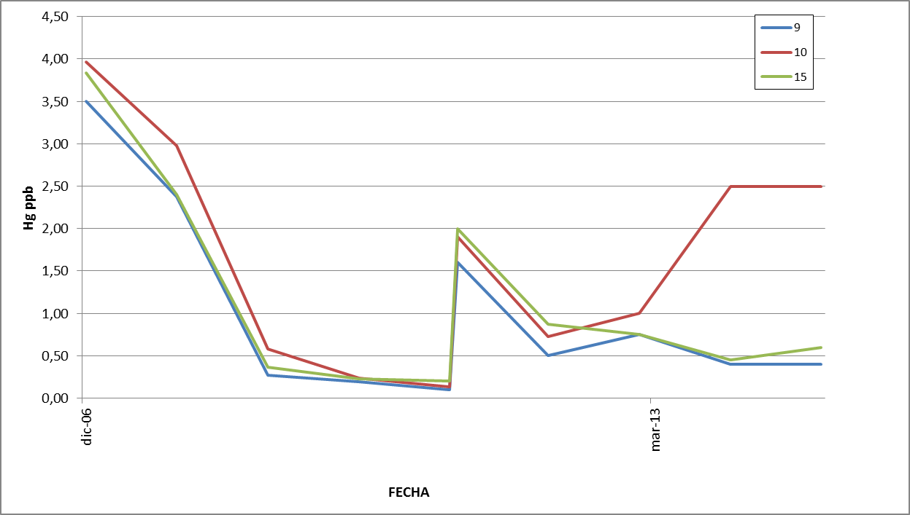
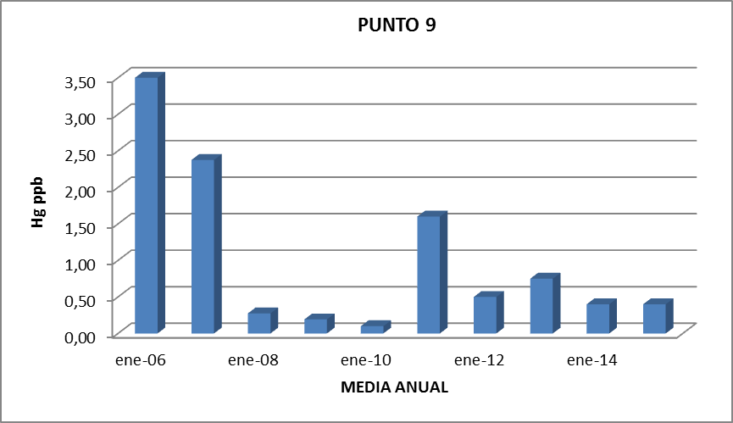
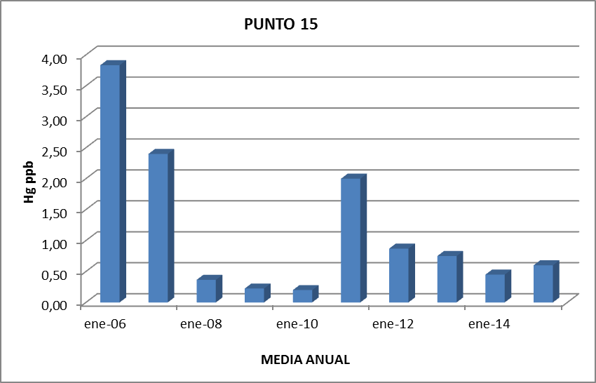
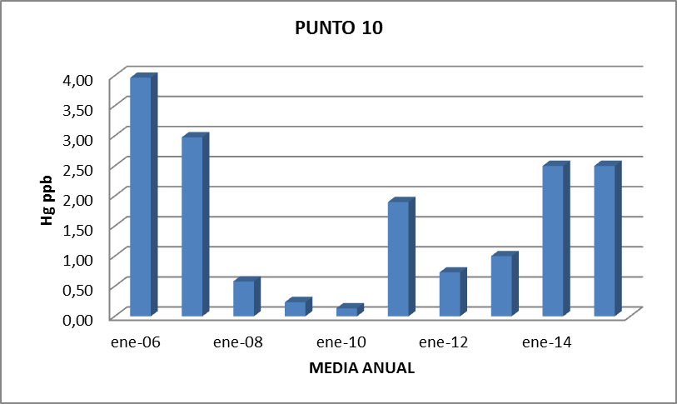
ENVIRONMENTAL MONITORING: RESULTS
SURFACE WATER: RIVER
POINT 9
VALDEAZOGUES RIVER BEFORE ITS
CONFLUENCE WITH AZOGADO STREAM
(POINT 9), AND AFTER THIS (POINT 10)
POINT 15
POINT 10
ALMADEN MINE DUMP
Notes:
These graphs shown (soun) the point nine (Valdeazogues river before its confluence with Azogado Stream) and the point ten (after its confluence)
The levels are now below (bilou) of one ppb except in the case of point ten that it is two point five ppbs.

Slide 23
ENVIRONMENTAL MONITORING: RESULTS
The restoration works are reducing:
The material dispersion and mercury evaporation
The lixiviate production which had as final destination the surrounding streams
The underground flow below the dump
ALMADEN MINE DUMP

Slide 24


THANK YOU!
Javier CARRASCO
Minas de Almadén y Arrayanes S.A.
Industrial Activities Manager
jcarrasco@ctndm

