Slide 1


SUSTAINABLE LAND MANAGEMENT AND POLLUTION
IN THE WESTERN BALKANS – UNEP ACTIVITIES

Slide 2

REGIONAL COOPERATION
Fostering sustainable land management and depollution activities through regional cooperation and knowledge sharing among stakeholders:
Stakeholder Engagement
Knowledge Sharing
Collaboration with institutions, local communities and organizations for effective land use practices.
Dissemination of best practices and successful case studies to promote effective resource management.
Regional Partnerships
Capacity Building
Fostering alliances among countries and international organisations to enhance sustainable land management initiatives.
Empowering local entities through training and resources to implement sustainable practices.

Slide 3



KEY WB INITIATIVES
Pollution Reduction Programs
Land Resource Management and Biodiversity
Implementing strategies to tackle air, water, and soil pollution in affected region.
Encouraging sustainable practices that enhance land productivity and ecosystem health.
Climate Change Adaptation
Health Impact Mitigation
Addressing public health concerns arising from pollution through targeted initiatives.
Helping countries assess risks, strengthen resilience, and integrate adaptation measures into policies, planning, and on-the-ground actions.

Slide 4
REGIONAL UNEP INTIATIVES
ON SLM AND DEPOLLUTION

Slide 5
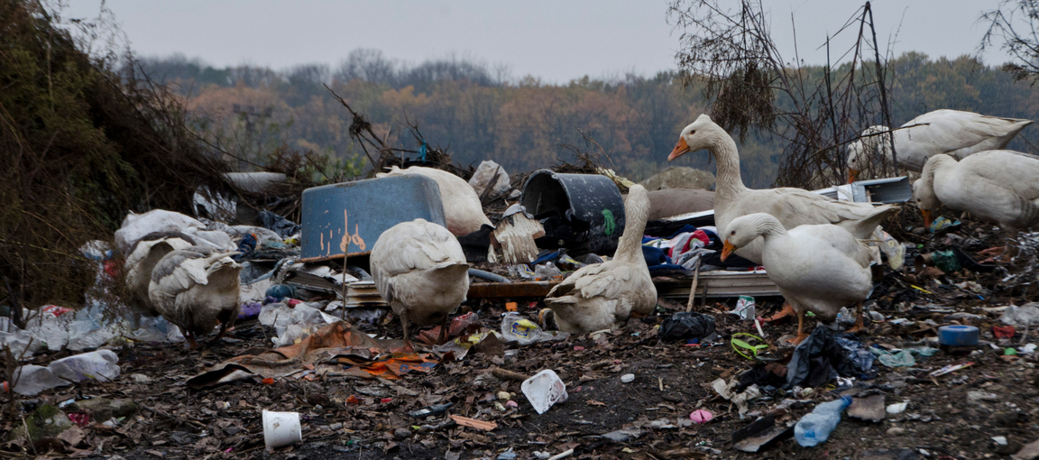
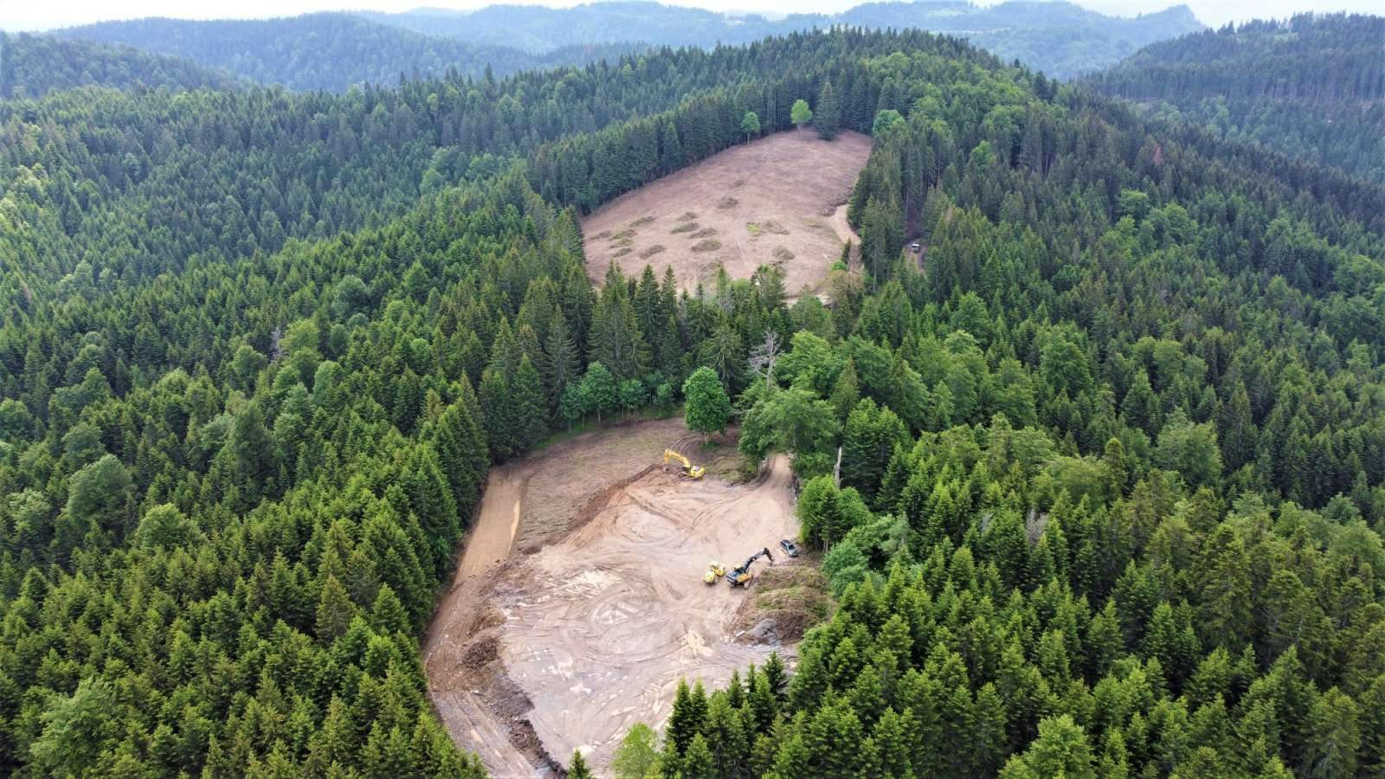
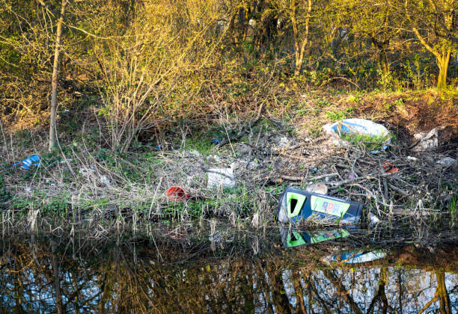
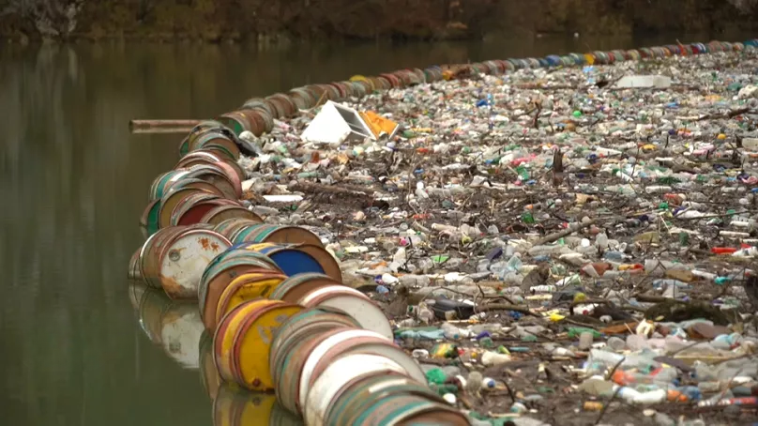
FIELD EXAMPLES

Slide 6



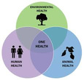
REGIONAL ACTIVITIES 2024 - 2026
Regional E-waste Monitor for the Western Balkans
Innovative circular economy approaches to agricultural and municipal waste management for better air quality in Asia Pacific and the Western Balkans
    Contaminated Sites in BiH-SRB
    Policy action for mitigating health impacts of air pollution from high-impact sectors
Towards Zero Waste
Circularity in Sectors
Pollution and Health
Agenda 2030 Multilateral Environmental Agreements (MEAs)

Slide 7



REGIONAL E-WASTE MONITOR
FOR THE WB - (2023)
PROJECT OBJECTIVE
to assist the beneficiary countries in making digitalization policies and strategies green and sustainable as well as based on evidence, with particular focus on e-waste management
RESULTS ACHIEVED:
  Baseline Assessment, including country profiles and regional statistics trainings with NSOs
  Regional E-waste Monitor and Media Campaign

Slide 8
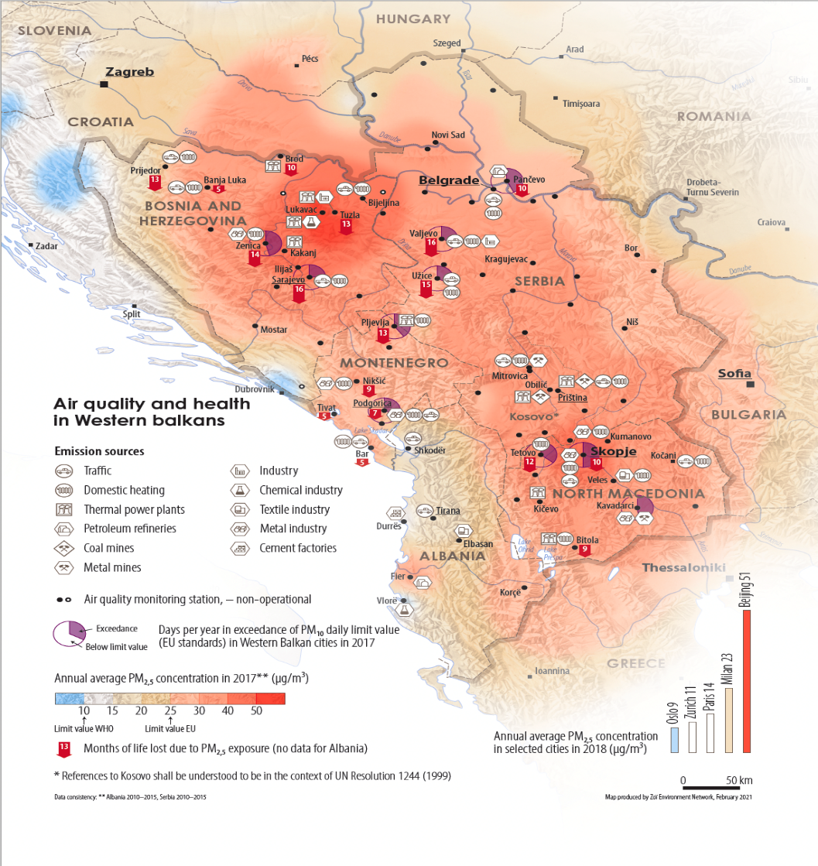
POLICY ACTION: HEALTH IMPACTS
OF AIR POLLUTION
Objective: To improve evidence-based policymaking and action to reduce air pollution from high-impact sectors and their effects on human health
1: Set of recommendations to enhance existing policy options in the identified high impact sector
2: Prioritisation of air quality in the development of policies taking into account the cost of inaction on air pollution
3: Advocacy on the socio-economic costs of air pollution-induced health impacts
Background - First regional study that quantifies the impact of air pollution on human health, considering 19 representative towns and cities across the region

Slide 9

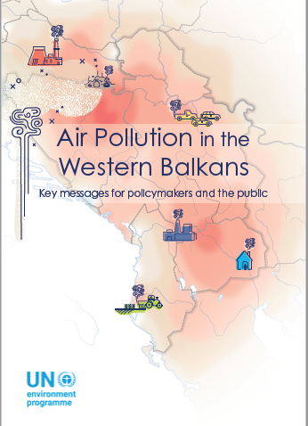
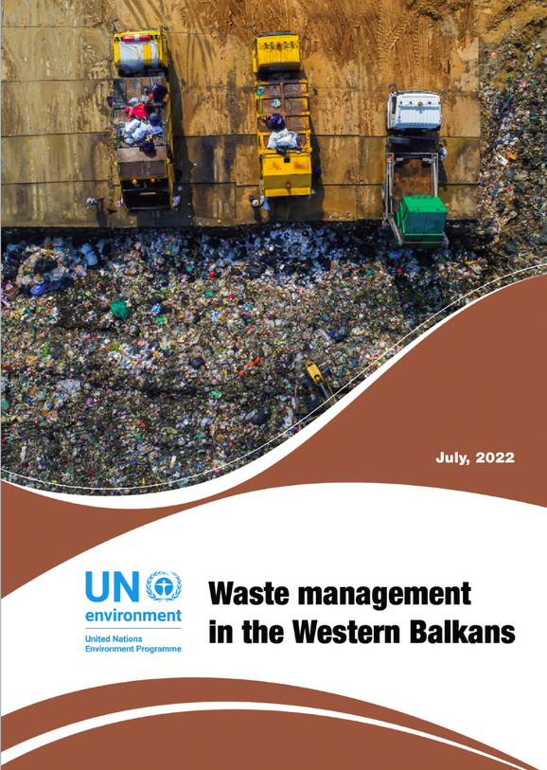
POLICY ACTION: HEALTH IMPACTS
OF AIR POLLUTION

Slide 10
INNOVATIVE CIRCULAR ECONOMY
Innovative circular economy approaches to agricultural and municipal waste management for better air quality in Asia-Pacific and the Western Balkans (UNDA16T)
  Implementation timeframe: January 2024 – December 2027
OBJECTIVE
To promote policy solutions for circularity and sound agricultural and municipal waste management for improved urban air quality and resilience to health, economic and social shocks in selected beneficiary countries in Asia-Pacific and the Western Balkans
Outcome 1 (OC1): Strengthened capacities of the target countries to detect and reduce the air pollution from agriculture and waste management high emitting impact sectors | Outcome 2 (OC2): Enhanced capacity of the target countries for evidence-based policy making to reduce air pollution from agriculture and waste management high emitting impact sectors

Slide 11
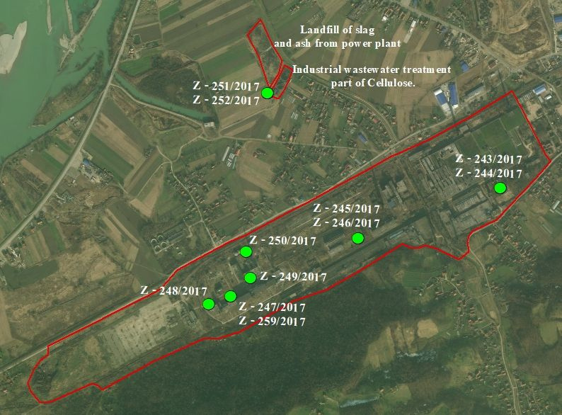

STRENGTHENING THE CAPACITY
Strengthening the capacity in the management of Contaminated Sites in BiH and Serbia to reduce pollution into the environment (2023 - 2026)
2. Strengthening capacities
1. Coordination, strengthening networks
3. Pilot sites preliminary characterization
Objective: To reduce pollution, increase environmental protection practices and improve human health, through strengthening institutions and capacities in identifying and prioritize pollution-prevention and related environmental priorities

Slide 12
THE SEEPP PLATFORM
The SEEPP Platform facilitates transboundary action and policy dialogue for environmental sustainability.
TRANSBOUNDARY COOPERATION
POLICY DIALOGUE
SUSTAINABLE PRACTICES PROMOTION
MONITORING AND REPORTING
Fostering cross-border collaboration to address shared environmental challenges.
Engaging stakeholders in discussions to shape effective environmental policies.
Encouraging the adoption of practices that enhance environmental sustainability.
Establishing frameworks to assess progress and impact of sustainability initiatives.

Slide 13
UNEP INTIATIVES ON SLM AND DEPOLLUTION IN WESTERN BALKAN ECONOMIES

Slide 14
WB COUNTRIES AND PROJECTS
ALBANIA
BOSNIA AND
HERZEGOVINA
MONTENEGRO
NORTH
MACEDONIA
SERBIA
    GEF5 Project: Expanding the PAs’ network and enhancing BD conservation
    GEF 6 Creating an enabling environment for LDN
    Special programme project
    Early Action Support
    GEF6 C/MPAs project
    Early action support
    GEF STAR5 PAs project
    GEF6 SLM project
    GEF7 PAs/Landscape project
    GEF8 transboundary project with Albania
    Early Action Support
    Enhanced Cross-Sectoral Land Management through Land Use Pressure Reduction and Planning
    Ambient and indoor air pollution and health – review
    EU Green Agenda for Nature
    Early Action Support
    GEF6 Project: Ecosystem restoration and sustainable land management
    GEF7 PAs project
    GEF8 transboundary project with North Macedonia

Slide 15
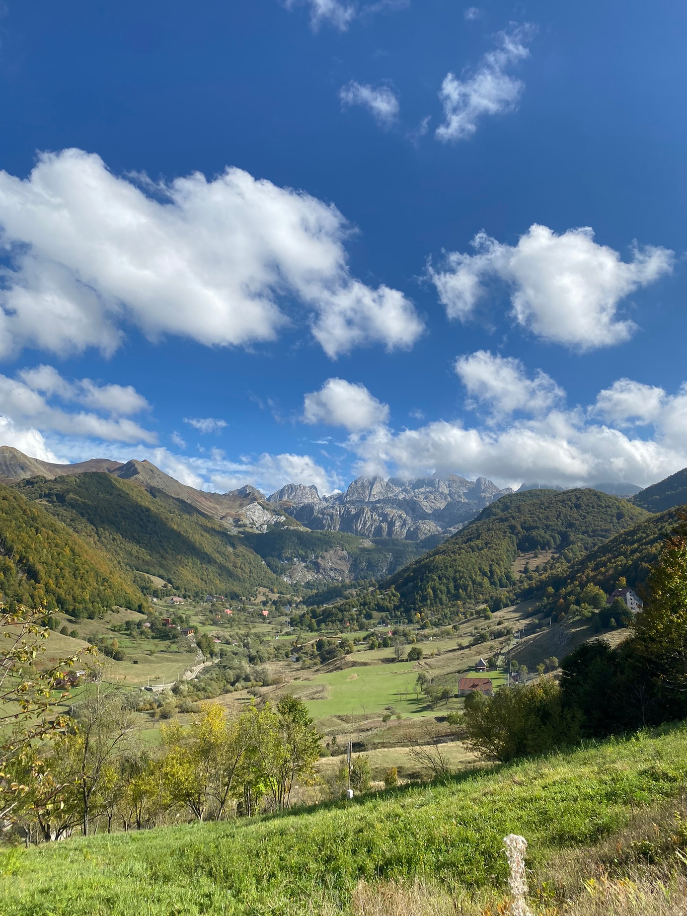
ALBANIA
Achieving biodiversity conservation through effective management and enhanced resilience to climate change in the existing protected area of the North Albanian Mountainous Region (2023-2026)
Component 1: Enabling environment for effective management of the Albanian Alps National Park
Component 2: Strengthening the practical experience and “know-how” of the Albanian Alps NP stakeholders to address threats
Component 3: Support to national level adoption and upscaling of sustainable PAs management best practices

Slide 16
ALBANIA
Promoting Sustainable Land Management (SLM) through Integrated Restoration of Ecosystems
Project Objective: Strengthening capacity and skills of national and local government institutions and promoting sustainable land management (SLM) practices in Albania through integrated ecosystem restoration
The project aimed to address this objective through two components and three outcomes:
  Component 1: Strengthened legal and institutional framework and capacity building for SLM
    Outcome 1.1: Shift from unsustainable to sustainable land use in agriculture and forestry sectors
    Outcome 1.2: Capacities and support for SLM strengthened
  Component 2: Demonstrating and Scaling-up of SLM Best Practices
    Outcome 2.1: Pressures on natural resources in at least 20,000 ha reduced through application of SLM activities

Slide 17

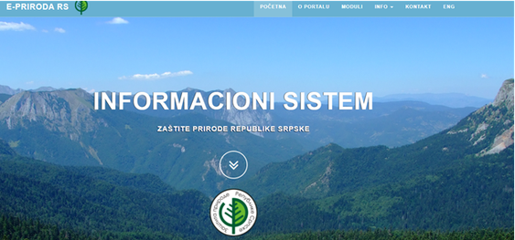
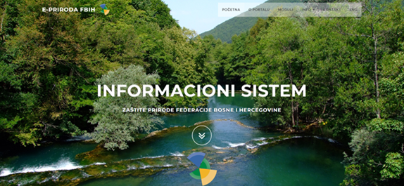


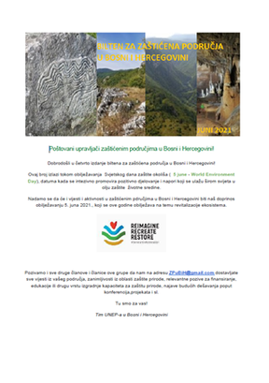

BOSNIA AND HERZEGOVINA
Achieving Biodiversity Conservation through Creation, Effective Management and Spatial Designation of Protected Areas and Capacity Building in Bosnia and Herzegovina (2016-2021)
Component 1: Establishment and effective management of protected areas and biological diversity
Component 2: Management effectiveness of the national protected areas system (capacity building and awareness raising)
Component 3: Biodiversity monitoring system in BiH addressing the important obstacles in nature conservation

Slide 18

BOSNIA AND HERZEGOVINA
SPECIAL PROGRAMME BIH
The focus of this Project is the establishment and capacity enhancement of the institutions implementing/enforcing BRS conventions and SAICM/ GFC in BiH, ultimately leading to the creation of BRS/GFC Coordination Team (BRS/GFC CT) for enhanced implementation of the BRS conventions and SAICM/GFC and the Minamata Convention upon its ratification.

Slide 19
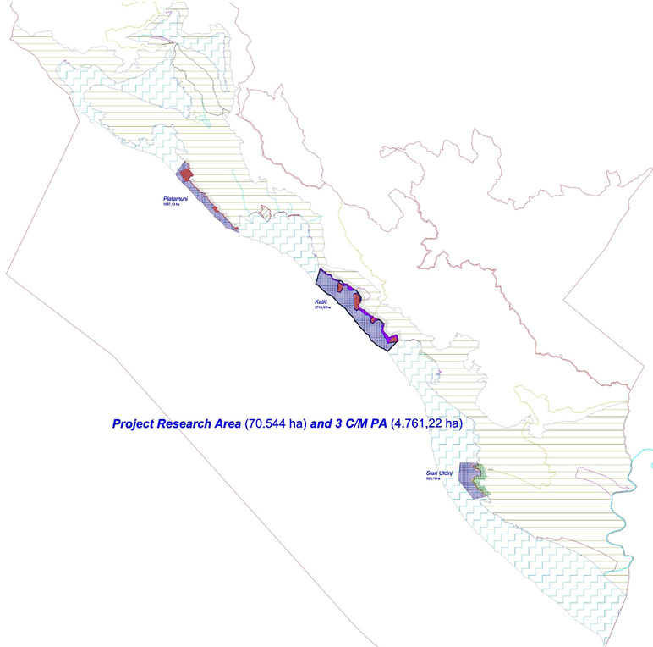


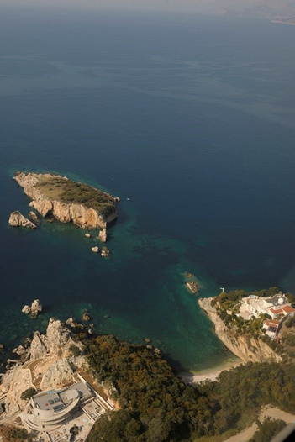
MONTENEGRO
Promoting Protected Areas Management through Integrated Marine and Coastal Ecosystems Protection in Coastal Area of Montenegro (2017–2022)
1
2
3
PLATAMUNI MARINE PROTECTED AREA
KATIČ MARINE PROTECTED AREA
STARI ULCINJ MARINE PROTECTED AREA
22 April 2021
16 Sept. 2021
30 Dec.2021
Results:
Completed inventories of key habitats and species using standardized surveys and tools
Produced verified GIS data and maps for marine and terrestrial ecosystems
Strengthened protected area planning and management through frameworks and plans

Slide 20




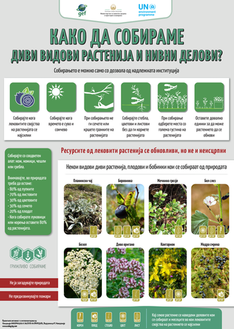
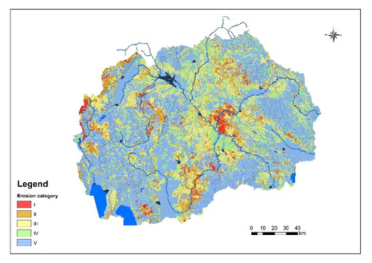
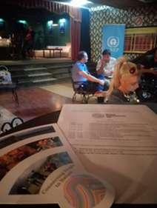

NORTH MACEDONIA
Red Lists and Red Books
High Nature Value Forests
Quotas for Non-timber forest products
Soil Erosion Map
Soil sealing rate database Forest vegetation maps
Capacity building
Awareness
Achieving Biodiversity Conservation through Creation and Effective Management of Protected Areas and Mainstreaming Biodiversity into Land Use Planning (2016-2022)
Reptiles
Amphibians
Priority list – plant species
RB update – 2023/24
Identification
Suggested management guidelines for Bukovikj and Belasica pilot areas
Analysis of status
Collection and use
Testing methodologies
Bearberry legal protection
Soil erosion map; SOM database: Ohrid, Prilep, Strumica; Maleshevo FVMs
Trainings
Study visits
Public campaigns
Gender equality
Bearberry video:
https://youtu.be/S-IfXqZM16o
SLM/LD materials: https://bit.ly/3E84SfM
https://bit.ly/3A4njAA
Shar proclamation promo story
700,000,000 potential readers

Slide 21
NORTH MACEDONIA
Shar Mts. National Park
Shar Mts. Management plan
Ohrid Lake valorization
Ohrid Lake Management Plan
MAK-NEN
Bio-corridors
Valorization study/SES
Public consultation
Supporting Proclamation
Development
Public consultation
SEA procedure
Adoption
Re/valorization study
Public consultation
MoU between 3 municipalities
Development
Public consultation
Feasibility study
Land use planning
Large carnivores
Two sites piloting
Recommendations

Slide 22
NORTH MACEDONIA
Promoting Sustainable Land Management (SLM) through Strengthening Legal and Institutional Framework, Capacity Building and Restoration of the Most Vulnerable Mountain Landscapes (2019-2023/4)
  Component 1: Strengthened legal and institutional framework and capacity building for SLM and SFM
  Outcome 1.1. Addressing gaps and weaknesses in the land use and land degradation policy, legal and regulatory framework to accelerate the achievement of LDN
  Outcome 1.2. Trained national and municipal resource managers to integrate SLM/SFM in LDN, in coordination with the NCSD
  Component 2: Sustainable land and forest management practices for reducing the effects of LD in 3 pilot sites in the most vulnerable mountainous region
  Outcome 2.1. Local governments in North Macedonia apply practical methods, approaches and practices for halting or reversing land degradation and deforestation beyond the pilots
  Component 3: Knowledge management and public awareness
  Outcome 3.1. Private sector land developers and users apply SLM/SFM best practices for mitigating erosion and degradation applicable for North Macedonia

Slide 23
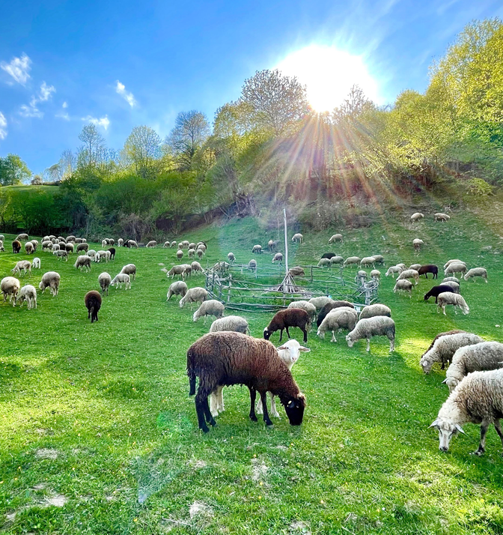
NORTH MACEDONIA
Biodiversity conservation, sustainable land management and sustainable tourism development in North Macedonia (2023-2027)
  Component 1: Practical application of integrated landscape approach to achieving LDN (Land Degradation Neutrality) and BD targets in the pilot area of the Shar Mountains and dependent ecosystems service area (peripheral productive landscape)
  Component 2: Support to national level adoption and upscaling of SLM and related LD and BD best practices

Slide 24
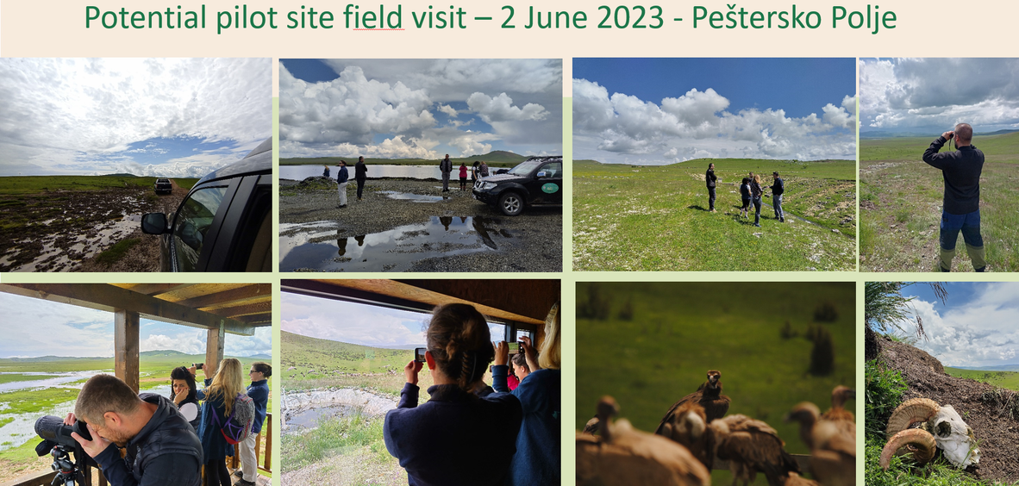
SERBIA
Enhanced Cross-Sectoral Land Management through Land Use Pressure Reduction and Planning
  Preparing the groundwork for cleaner soil
  More than 700 polluted sites
  Established Cadastre of Contaminated Sites
  Capacity building and awareness raising
  Analysis and testing of trade-off measures in Kraljevo and Sombor unauthorized landfills
Peštersko polje

Slide 25
ADDRESSING CHALLENGES -
THE WAY FORWARD

Slide 26
WB CHALLENGES
Western Balkans face severe pollution and environmental monitoring challenges, necessitating urgent action.
Environmental Health Concerns
Pollution Sources
The impact of pollution on public health is a pressing issue for local communities.
Identifying various sources of pollution is crucial for effective mitigation strategies.
Community Engagement
Monitoring Gaps
Further engagement with institutions and communities.
Enhanceing awareness of environmental issues.
Existing gaps in environmental monitoring hinder effective pollution management.

Slide 27
EFFECTIVE POLLUTION MANAGEMENT
Capacity building and data digitalization are essential for effective pollution management in the region.
DIGITAL TOOLS FOR DATA
BEST PRACTICES SHARING
Leveraging technology can enhance data accuracy and availability.
Sharing knowledge between regions can foster effective pollution management.
TRAINING INITIATIVES
SECTOR COLLABORATION
Capacity building programs for local stakeholders are necessary for sustainability.
Collaboration among sectors can lead to innovative solutions for environmental challenges.

Slide 28
REGIONAL COLLBORATION
The need for improved policies highlights the importance of regional collaboration against environmental degradation.
POLICY FRAMEWORKS
REGIONAL PARTNERSHIPS
INCLUSIVE POLICYMAKING
SUSTAINABLE PRACTICES PROMOTION
Updating and crafting policies is essential for environmental sustainability.
Strengthening partnerships among countries can enhance collective action.
Involving diverse stakeholders in policy creation is crucial for effectiveness.
Promoting sustainable practices can mitigate environmental degradation in the region.

Slide 29
THANK YOU!
Matea Grabovac
matea.grabovac@un.org
UNITED NATIONS ENVIRONMENT PROGRAMME

