Slide 1




Lecture 2
Introduction to
ASGM Baseline

Slide 2
Introduction to
ASGM Baseline
Producing a baseline to inform the National Action Plan (NAP)

Slide 3
Overview
What is an ASGM Baseline? Why carry one out?
What information are we looking for?
General baseline process
Methods for:
  collecting data in the field
  producing baseline estimates from data
  cross-checking data for quality and confidence

Slide 4

What is an ASGM Baseline?
Requirement of Minamata Convention Article 7,
Annex C:
National ASGM Baseline Estimates
Overview of ASGM Practices

Slide 5

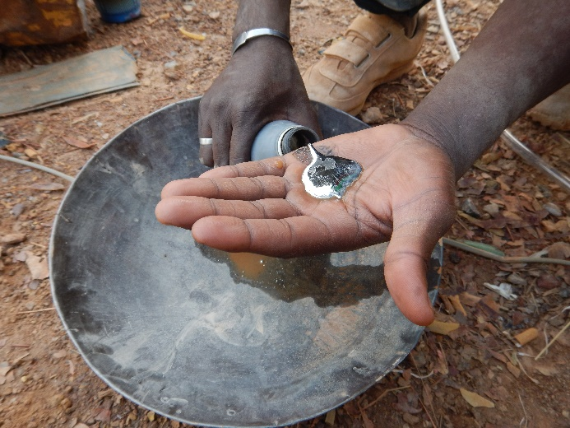
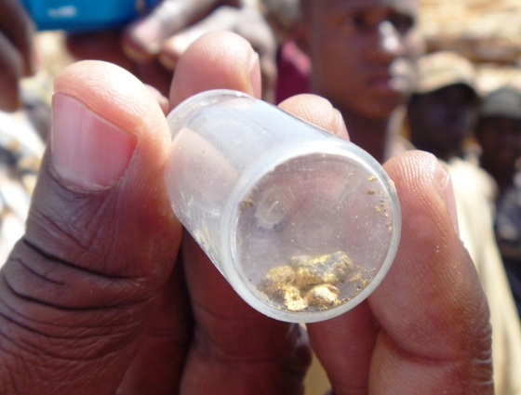
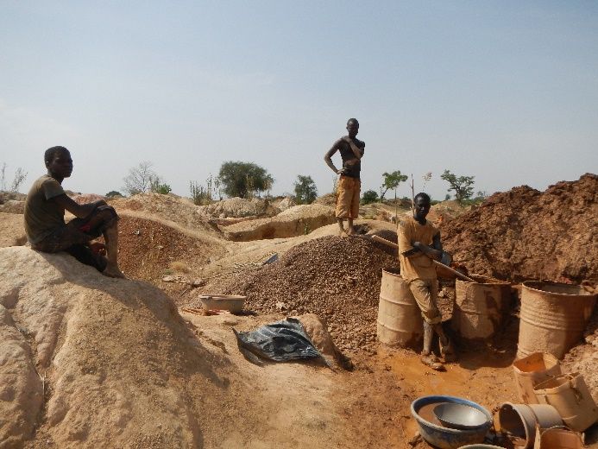

What information are we looking for?
1. National ASGM Baseline Estimates
Mercury Use *
Gold Production
Workforce
and the geographic distribution of these (site-specific, regional, national)

Slide 6

What information are we looking for?
2. Overview of ASGM Practices
Spatial Distribution
Governance
Mineralogy
Gold & Mercury Trade
Technology (Extraction & Processing)
Socioeconomics, Health & Environment
Knowledge Gaps

Slide 7

What information are we looking for?
2. Overview of ASGM Practices
  In general,
  Where does ASGM occur?
  What are the mining and processing practices in different regions?
  Which areas require the most attention?

Slide 8
Why mercury baseline?
To inform the development of the National Action Plan (NAP) in order to improve ASGM sectors and reduce mercury use
  - Limited information exists on the sector
To produce baseline estimates against which progress can be measured

Slide 9
The Baseline Process
Initial information gathering and national scoping
Country specific methodology development
Data acquisition (field work)
Data analysis
Production of local, regional and national estimates
Cross check information using various sources!
Investigate anomalies

Slide 10
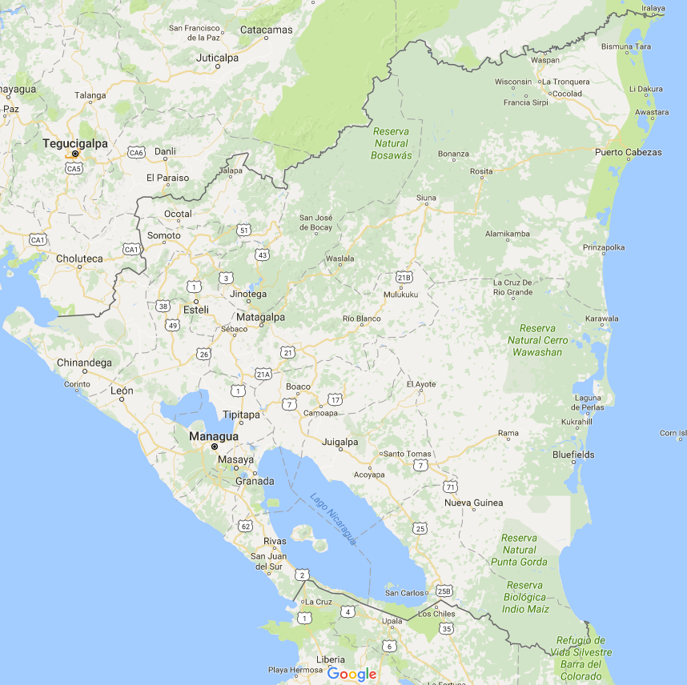
Producing national baseline estimates:
Site Information
Regional Estimates
National Estimate

Slide 11
Four ways of estimating national mercury use:
1. Consult official mercury trade documents
2. Interview sellers of mercury sellers
3. Interview users of mercury (processing workers and owners)
4. Estimate gold production and apply a mercury-to-gold ratio
» highest accuracy
» many techniques to estimate gold production
Baseline Approaches

Slide 12

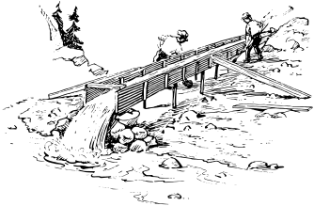


Three general approaches, based on:
1. Extraction information
2. Processing information
3. Earnings information
Estimating Gold Production
Many techniques used under these approaches

Slide 13


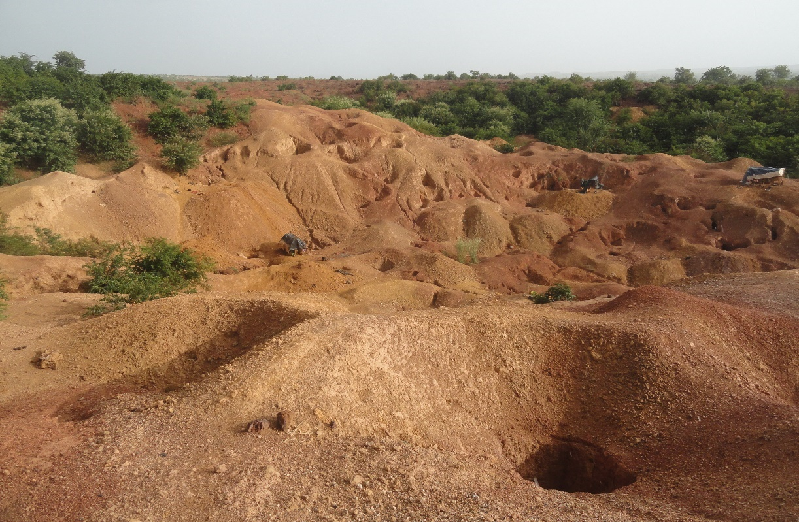
Extraction-based Estimates
Use amount of material mined on site to determine inventory estimates
Information Needed
Number of pits
Extraction per pit
Ore grade
Gold purity
Days worked per year
Workers per pit
What does this give you?
Site Specific Estimates
  Gold production
  Miner workforce
  USEFUL AVERAGES! – e.g., average gold production per miner, per pit, grade, purity

Slide 14
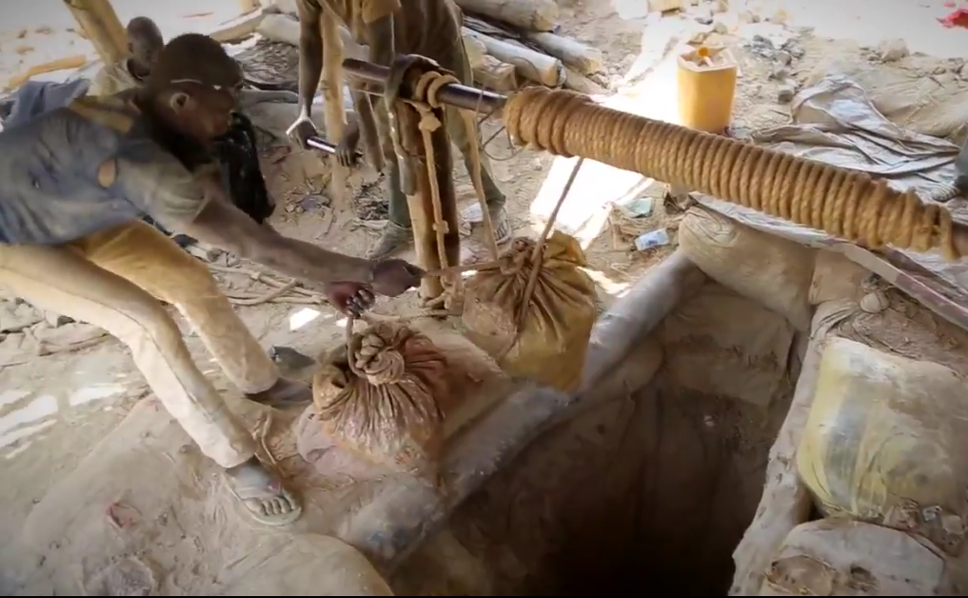


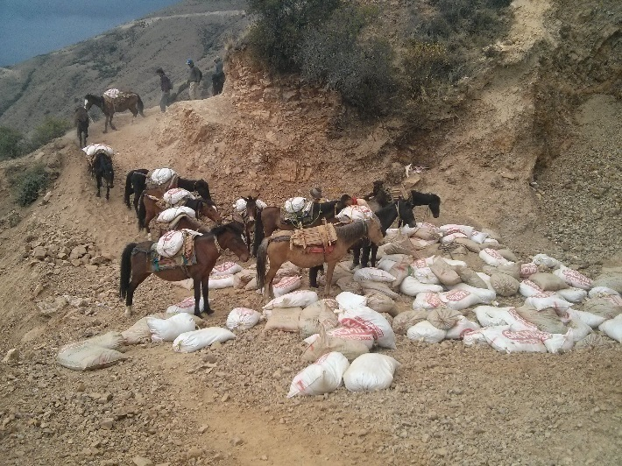


Extraction-based Estimates
Use amount of material mined on site to determine inventory estimates
Observations:

Slide 15
Extraction-based Estimates
Use amount of material mined on site to determine inventory estimates
10
x
10
30
for site

Slide 16
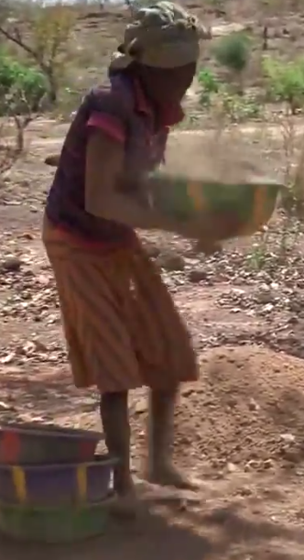
Extraction-based Estimates
Use amount of material mined on site to determine inventory estimates

Slide 17
Extraction-based Estimates
Use amount of material mined on site to determine inventory estimates
Miner Workforce
2 miners/pit 10 x 10 pits = 20 miners on site

Slide 18
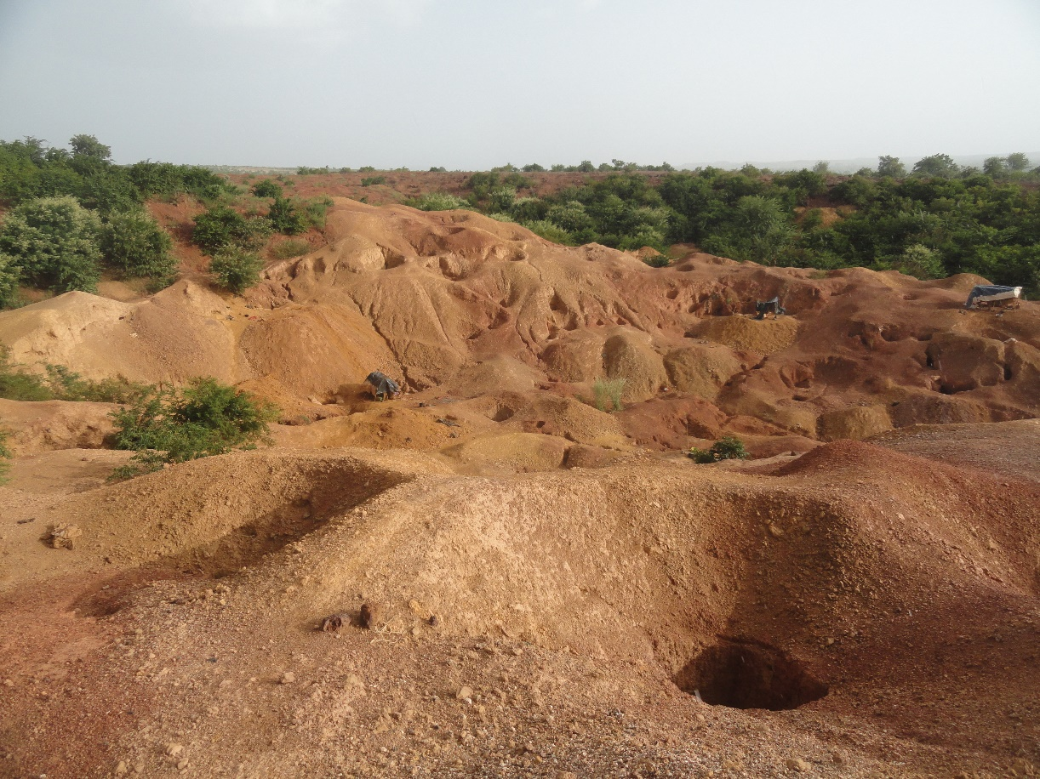
Extraction-based Estimates
Use amount of material mined on site to determine inventory estimates
Observations:
2 miners / pit
10 pits
3 bags / pit / day
1 bag = 100 kg
Interviews:
Grade = 1 g / bag
Purity = 18 K
Days worked = 200 / yr
A miner earns = 225 g/y
1 g Au = $40

Slide 19
Extraction-based Estimates
Use amount of material mined on site to determine inventory estimates
Knowns:
2 miners / pit
10 pits
3 bags / pit / day
1 bag = 100 kg
Grade = 1 g / bag
Purity = 18 K
Days worked = 200 / yr
A miner earns = 225 g/y
1 g Au = $40
Calculate:
Total miners
bags / site / day
kg ore / day
Grade (g/T)
bags / site / yr
Yearly Au
Yearly Au 24 k
Miner Earnings
Answers:
= 20 miners
= 30 bags / d
= 3000 kg / d
= 10 g/T
= 6000 bags / yr
= 6000 g / yr
= 4500 g (24 k) / yr
= 225 g / miner
= $9,000/miner/yr
Note: Miners make up only a portion of the ASGM workforce!

Slide 20
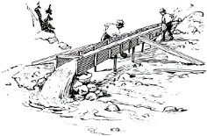
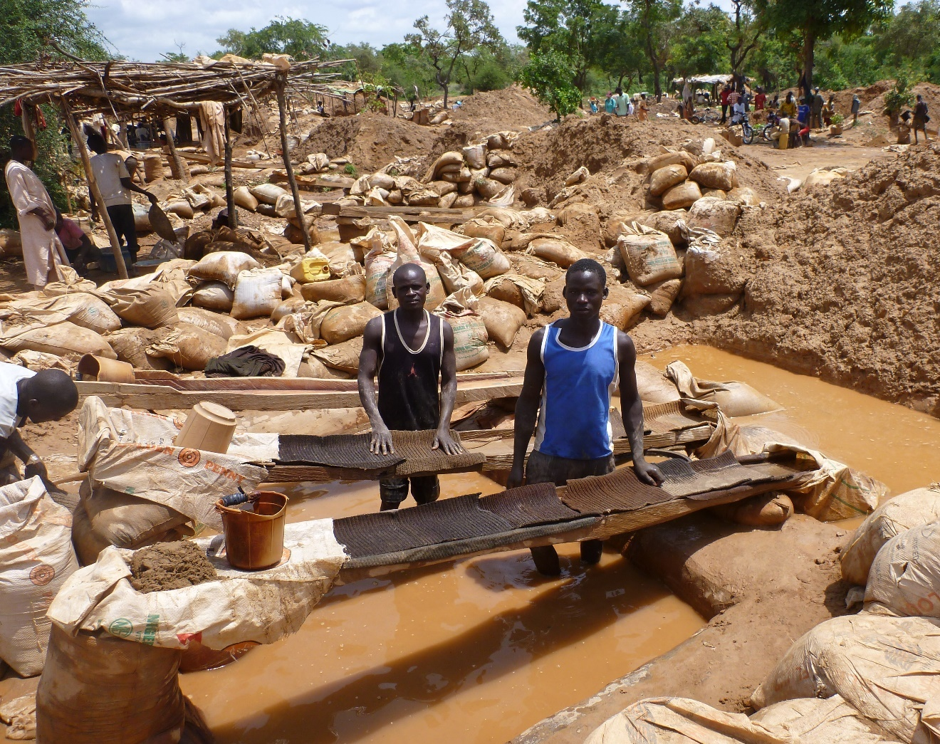
Processing-based Estimates
Use amount of material processed on site to determine inventory estimates
Observe:
1 operator per sluice
4 bags/sluice/d
8 sluices

Slide 21




Processing-based Estimates
Use amount of material processed on site to determine inventory estimates
1. Amount of ore processed (throughput)
Sluice observations:
1
1 4 /day
x 8
x 8
x 8
Site:
8
8 32 /day

Slide 22
Processing-based Estimates
Use amount of material processed on site to determine inventory estimates
Interviews:
1 bag = 100 kg
Grade = 1 g / bag
Purity = 18 k
Days Active= 200 d/y

Slide 23




Processing-based Estimates
Use amount of material processed on site to determine inventory estimates
2. Amount of gold produced
32 /day
100
kg
throughput = 32 sacks/d x 100 kg/sack
= 3.2 T/day
grade: 20 g/T
gold production = throughput x grade
= 3.2T x 20g gold/T
= 64 g gold/day
64 g/d

Slide 24
Processing-based Estimates
Use amount of material processed on site to determine inventory estimates
2. Amount of gold produced
64 g/d
gold production
daily
300 days worked per year
gold production
annual
19.2 kg /y
19.2 kg/y
correct to
100% purity

Slide 25
Processing-based Estimates
Use amount of material processed on site to determine inventory estimates
Knowns:
1 operator each
8 sluices
4 bags / sluice / d
1 bag = 100 kg
Grade = 1 g / bag
Purity = 18 k
Work = 200 / yr
Earnings = 1 $ / bag
Calculate:
Total Processors
bags / site / day
Kg ore / day
Grade (g/T)
bags / site / yr
Yearly Au
Yearly Au 24 k
Answers:
= 8 processors
= 32 bags / d
= 3200 kg / d
= 10 g/t
= 6400 bags / yr
= 6400 g / yr
= 4800 g (24 k) / yr
Compare: Production Estimate vs. Processing Estimate
24 k Au production: 4500 g vs. 4800 g
Very close!

Slide 26
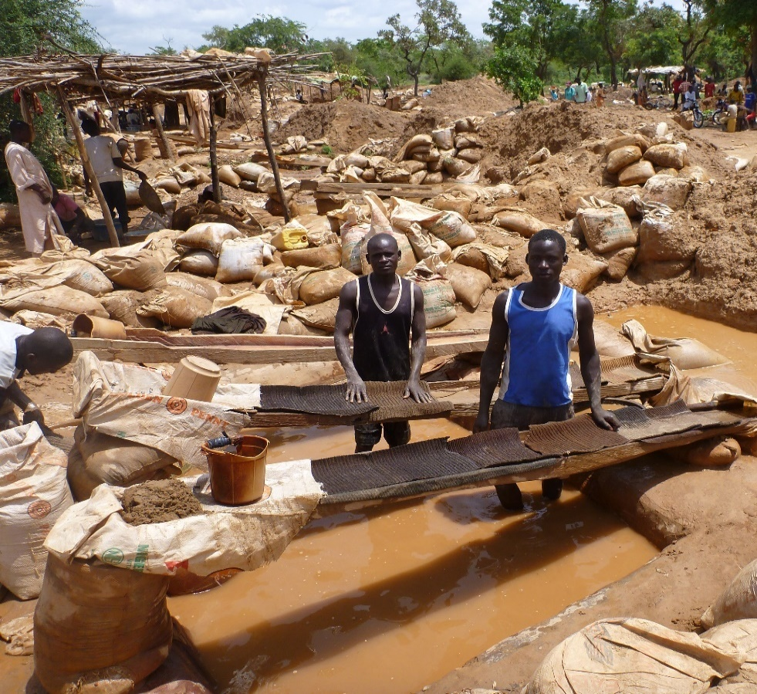
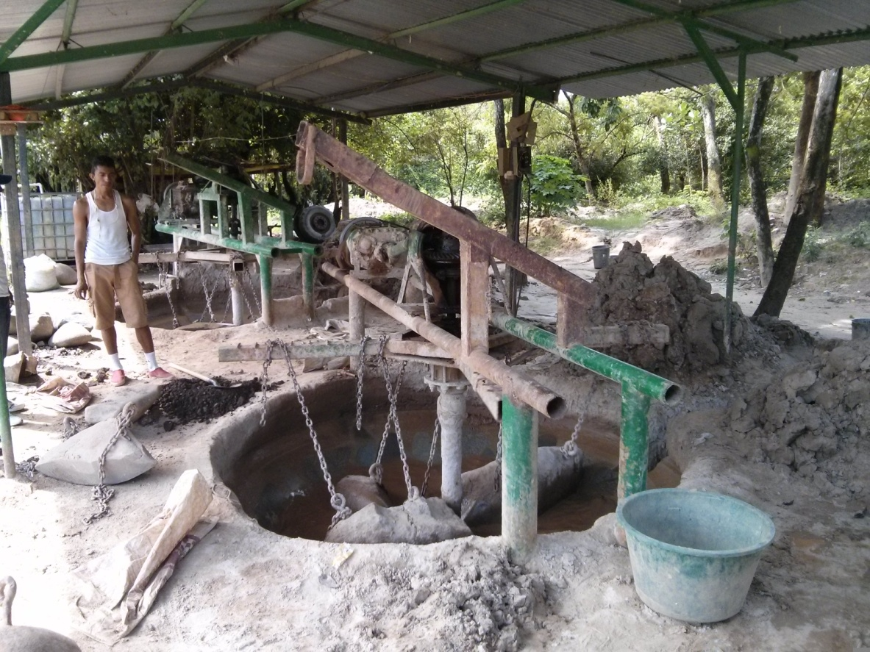
Multiple Processing Styles on a site?
Processing-based Estimates
Use amount of material processed on site to determine inventory estimates
How many of each system?
Produce estimates for each type

Slide 27

Multiple Processing Styles on a site?
Processing-based Estimates
Use amount of material processed on site to determine inventory estimates
Calculations:
Total Processors = 8
Total 24 k production = 4800 g

Slide 28
Processing-based Estimates
Use amount of material processed on site to determine inventory estimates
Multiple Processing Styles on a site?
Knowns:
3 operators each
2 rastras
20 bags / rastra / d
1 bag = 100 kg
Grade = 1 g / bag
Purity = 18 k
Work = 200 / yr
Calculations
Production = 6000 g / yr
Rastra processors = 6

Slide 29

Processing-based Estimates
Use amount of material processed on site to determine inventory estimates
Multiple Processing Styles on a site?
Processors = 8
24 k Au = 4800 g
Processors = 6
24 k Au = 6000 g
14
10800 g

Slide 30


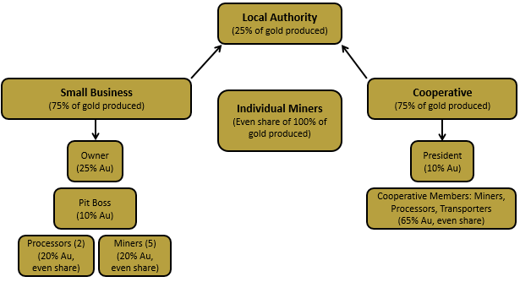
Earnings-based Estimates
Use earnings and revenue distribution to determine inventory estimates
Understand:
earnings per worker
distribution of revenues
Then:
If miner population is known, can estimate gold production
If gold production is known, can estimate miner population
Earnings based estimates provide very useful cross-checks
for extraction- and processing-based estimates

Slide 31
Earnings-based Estimates
Use earnings and revenue distribution to determine inventory estimates
Information Needed
Earnings per miner
Share of earnings amongst workers
Number of miners OR gold production

Slide 32
Earnings-based Estimates
Use earnings and revenue distribution to determine inventory estimates
Calculate:
$/miner/yr
24 k Au/miner/d
24 k Au/Miners/d
24 k Au/site/d
24 k Au/site/yr
Answers:
= $6000/yr
= 0.5 g / d
= 50 g / d
= 100 g/ d
= 30000 g / yr
Known Information
Miners earn $20/day
Operate 300 days/year
1 g Au (24 k) = $40
Au on site = 12 k
Miners get 50% gold
Owner gets 25% gold
Pit boss gets 25% gold (pays processors out of this!)
100 miners on site
10 miners / pit
Can we determine the workforce on this site?
10 pits = 10 pit bosses
1 owner
Total 111 workers
This does not include processing workforce!

Slide 33
How do we get from site-level information to an estimate for the region?

Slide 34
Producing regional estimates
from site-level averages:
Site Information
Regional Estimates

Slide 35
Producing regional estimates
from site-level averages:
Site Information
All Sites
Add
Regional Estimate

Slide 36
Producing regional estimates
from site-level averages:
Site Information
All Sites
Select Sites
Add
Extrapolate
Regional Estimate

Slide 37
Producing regional estimates from site-level averages:
Extrapolation:
Combine your key site averages, with a known for the region to allow extrapolation to the region.
What are these regional knowns?
Regional gold production
Regional miner population
Number and size of sites (production or population)
Number of pits
Number of processing systems

Slide 38
Producing regional estimates from site-level estimates:
Extrapolation:
Combine your key site averages, with a known for the region to allow extrapolation to the region.
Example:
From processing-based estimate, each sluice produces 1.2 kg of 24K gold per year.
Regional known:
Regional hub has a registry of all sluices in the region. The total is 230 sluices.
1.2 kg/sluice/y x 230 sluices
= 276 kg Au /y for the region
What are these regional knowns?
Regional gold production
Regional miner population
Number and size of sites (production or population)
Number of pits
Number of processing systems

Slide 39
Extrapolating using averages
Example: Average Regional Ore Grade
Site 1
Survey 5 miners
  Miner 1: 10 g/T
  Miner 2: 12 g/T
  Miner 3: 8 g/T
  Miner 4: 5 g/T
  Miner 5: 15 g/T
Site 1 Average: 10 g/T
5 Sites Visited (averages)
  Site 1: 10 g/T
  Site 2: 20 g/T
  Site 3: 30 g/T
  Site 4: 20 g/T
  Site 5: 20 g/T
Regional Average: 20 g/T

Slide 40
Extrapolating using averages
Processing capacity known
10 processing systems
1 T/d treated by each system
Active 100 d/yr
Regional Grade = 20 g/T
3 processors per system
1 Miner extracts 0.5 T/d
  Au production: 20000 g/yr
  Processor workforce: 30
  Miner workforce: 20
  Total Workforce: 50

Slide 41
Many different options!

Slide 42
Cross-check extrapolations where possible!
Buying house reports
Gold buying house suggests 18000 g/yr from this region
Worker earnings estimate
Workers report $15,000 / yr
  1 g Au = $40
  50 workers
  Worker earning/yr = $600,000
  Regional Au = 18,750 g/yr
Processing estimate
Processing extrapolation = 20000 g/yr

Slide 43


If different, why? Investigate.
Gold
Trader
This region produces 10 kg Au/year
Field Officer
But we saw 9.5 kg Au/year produced at a single site!

Slide 44
If different, why? Investigate.
Gold
Trader
This region produces 10 kg Au/year
calculate workforce from gold production to see if the number
makes sense
Field Officer
But we saw 9.5 kg Au/year produced at a single site!
Production = 10,000 g gold/y
Miner Earnings: 225 g/miner/y
Would need ~44 miners to produce this
Far > 44 miners in the region!

Slide 45
If different, why? Investigate.
Gold
Trader
This region produces 10 kg Au/year
calculate workforce from gold production to see if the number
makes sense
Field Officer
But we saw 9.5 kg Au/year produced at a single site!
Production = 10,000 g gold
Miner Earnings: 225 g/miner
Would need ~44 miners to produce this
Far > 44 miners in the region!
Search for more information
162 kg Au/yr
Extraction-based estimate

Slide 46

If different, why? Investigate.
Gold
Trader
This region produces 10 kg Au/year
calculate workforce from gold production to see if the number
makes sense
Field Officer
But we saw 9.5 kg Au/year produced at a single site!
Production = 10,000 g gold
Miner Earnings: 225 g/miner
Would need ~44 miners to produce this
Far > 44 miners in the region!
Search for more information
162 kg Au/yr
Country produces 20 T Au/y
1% comes from ASGM
= 200 kg Au/y
Extraction-based estimate
Ministry of Mines

Slide 47

If different, why? Investigate.
Gold
Trader
This region produces 10 kg Au/year
calculate workforce from gold production to see if the number
makes sense
Field Officer
But we saw 9.5 kg Au/year produced at a single site!
Production = 10,000 g gold
Miner Earnings: 225 g/miner
Would need ~44 miners to produce this
Far > 44 miners in the region!
Search for more information
162 kg Au/yr
Country produces 20 T Au/y
1% comes from ASGM
= 200 kg Au/y
Most miners save their gold and bring it to the capital to get a better price
Miner
Extraction-based estimate
Ministry of Mines

Slide 48
Triangulation
Back-
Calculation
>10 kg Au/y
Gold trader interview
10 kg Au/y
Miner
Interview
>10 kg Au/y
Ministry
Document
200 kg Au/y
Extraction-based
Estimate
162 kg Au/yr

Slide 49
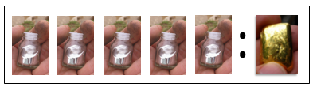
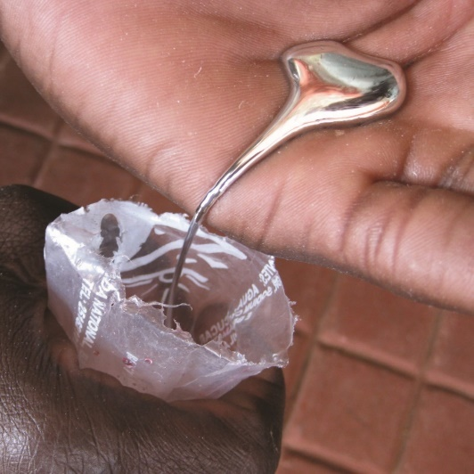
We now have regional estimates of gold production and work force
?
What about mercury?

Slide 50
The Mercury to Gold Ratio (Hg:Au)
grams of mercury consumed per gram of gold produced
Apply to the gold production estimate to get Hg use
x
=
Au production Hg:Au ratio Hg use
estimate estimate

Slide 51
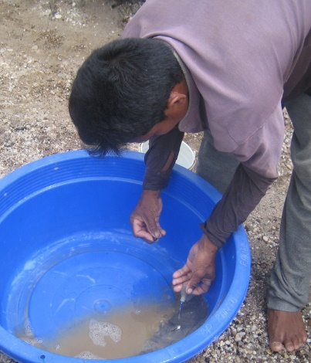
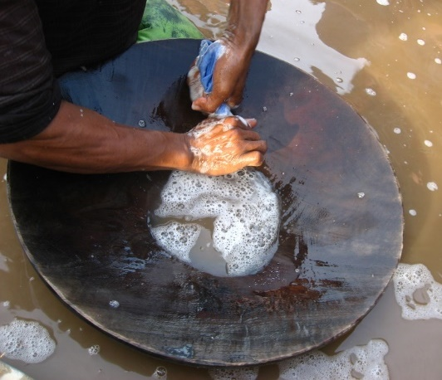
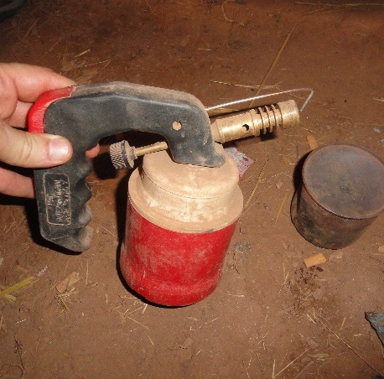
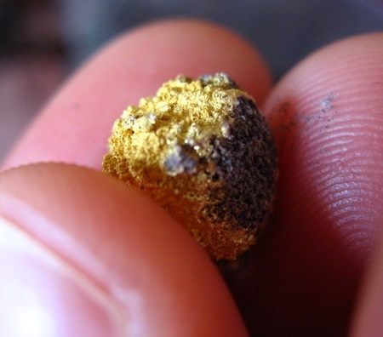
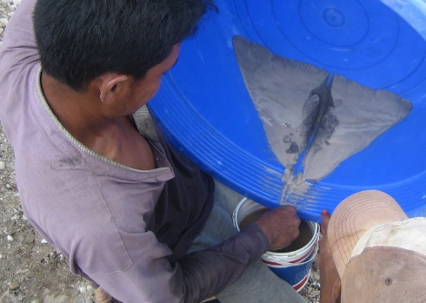
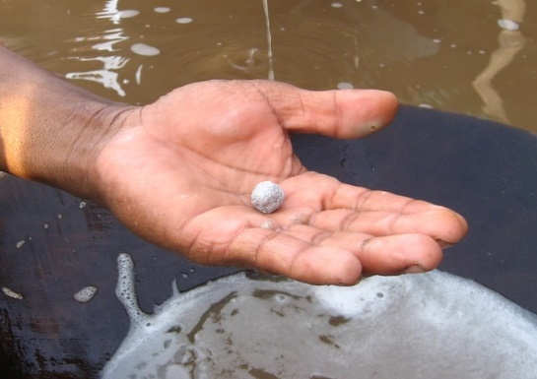
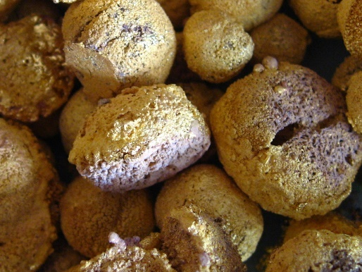
Mercury Amalgamation
Mix Mercury With Sands
Recover Amalgam
Vaporize Mercury
Sponge Gold

Slide 52
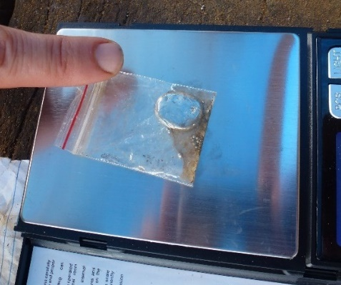
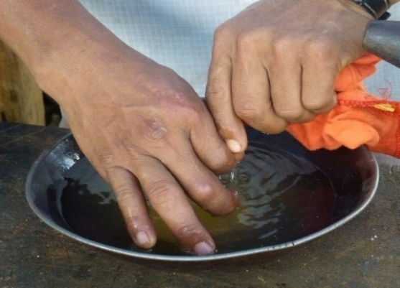
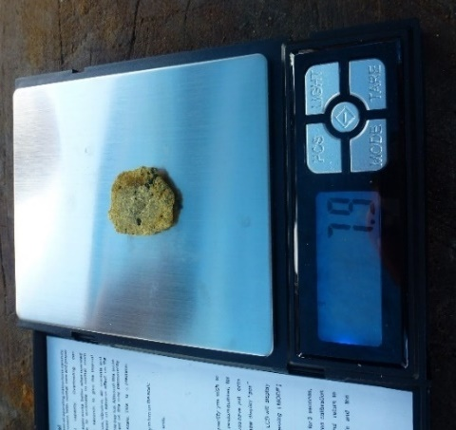
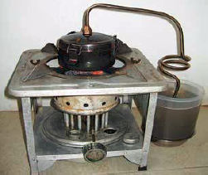
Take Measurements: Mercury in & Gold out
3) Weigh the amalgam before burning
4) Weigh sponge gold after burning
Weigh the Hg added to the ore
2) Weigh the Hg recovered
(squeeze)
5) Weigh the Hg recovered
(retort)
(initial Hg added – Hg recovered)
gold produced
Hg:Au
Ratio
1 = mercury added, 2+5 = mercury recovered

Slide 53

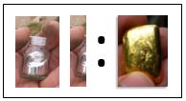
Different processing type = Different ratio
Rastra mill
Whole ore amalgamation
Sluice
Concentrate amalgamation
Measure for every processing type!!!

Slide 54
Apply the ratio to the estimate of regional gold production (from that processing type)
x
=
Au production Hg:Au ratio Hg use
estimate estimate
for sluice
for sluice
for sluice
Apply correct ratios to gold production!!!

Slide 55
Time to produce national estimates from our regional estimates:
Site Information
All Sites
Select sites
Sum
Extrapolate
Regional Estimates
Sum
National Estimate

Slide 56

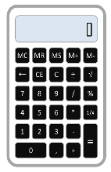
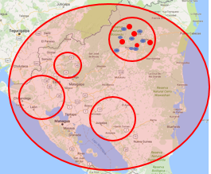

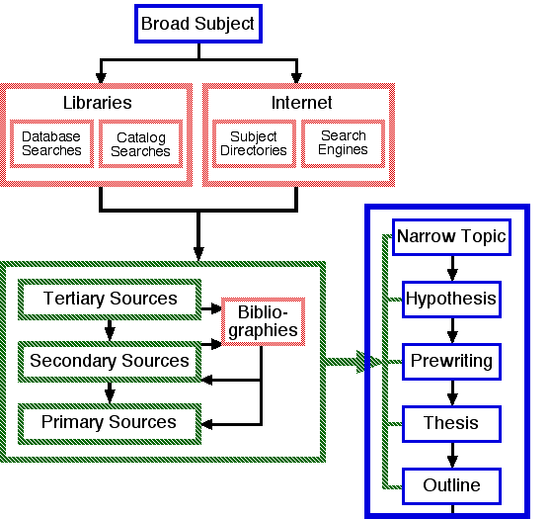
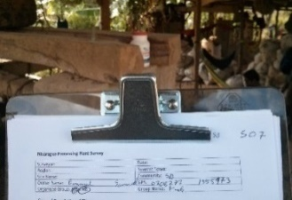
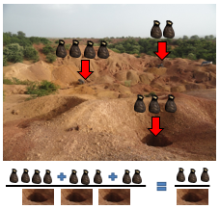
Baseline Steps
1. Research for existing information
5. Scale up to regional estimates from local information
2. Make a research plan
6. Cross check regional estimates using several approaches!
Interview
3. Collect data (field work)
Literature
Physical
Measure
7. Add final regional estimates to get national estimate
4. Produce local
information

Slide 57
How do we collect all this information?
Literature Review
Key stakeholder interviews
  Government (Mines, Environment, etc), NGOs, National gold buying houses, Universities, LSM companies, etc.
Mines site counts and observations
Processing site counts and observations
Miner and processor interviews
Gold buyer interviews
Local authority/site owner interviews
Physical measurements (weight of an ore bag, Hg:Au ratio calculations, ore assays for grade, etc)
Any other methods you can think of

Slide 58

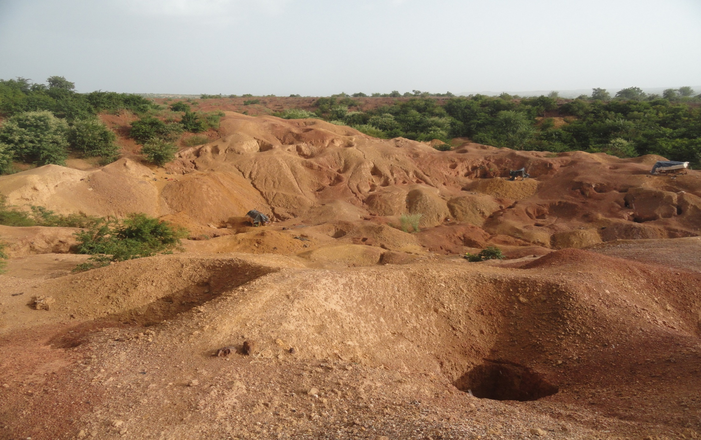
What does it really take?
Quick thinking, problem solving, open minded field officers
Must understand ASGM sector
  Mining
  Processing
  Economics
Experience in the field
Basic math skills
Data acquisition, management, and analysis skills
Training and experience
  Practice
  Supporting tools
Every case is different: ADAPT AS YOU GO

Slide 59

NAPs: Suggested Workflow
Baseline team lead (expert) does scoping
Team lead develops methodology
Team lead works with local workers
  BIG PICTURE IDEA of ASGM
  Interviews: It’s a conversation
  Physical measurements
  Important: Cross check all numbers
  Do analysis everyday after the field to ensure have all info
  Adjust your methods and ensure you collect the info needed
Expert analyzes data and produces estimates in collaboration with field team

Slide 60

Summary
Difficult, not impossible
Provides important information to the NAP
Case specific methodology
Need to define scope
  Timeline, capacity and budget
Every case is unique
There is no one solution for all regions and all sites. You must adapt as you go – be creative!
It’s fun!

Slide 61
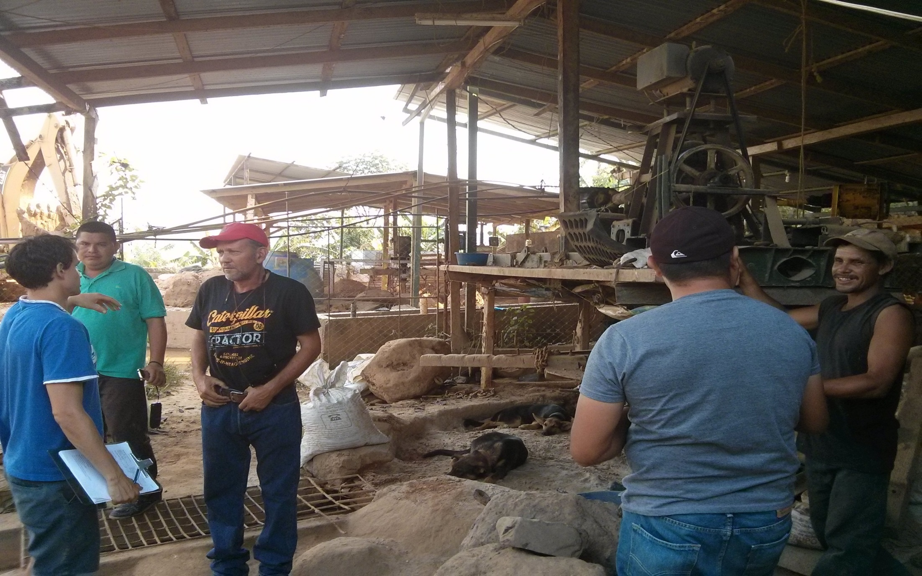
Thank you!
Questions?

