Slide 1


Notes:
‘0’ This lecture explains the collection and analysis of water samples.

Slide 2

Notes:
‘1’ The significance of mercury pollution in aquatic environments and the characteristics of water samples for survey and analysis are explained.

Slide 3
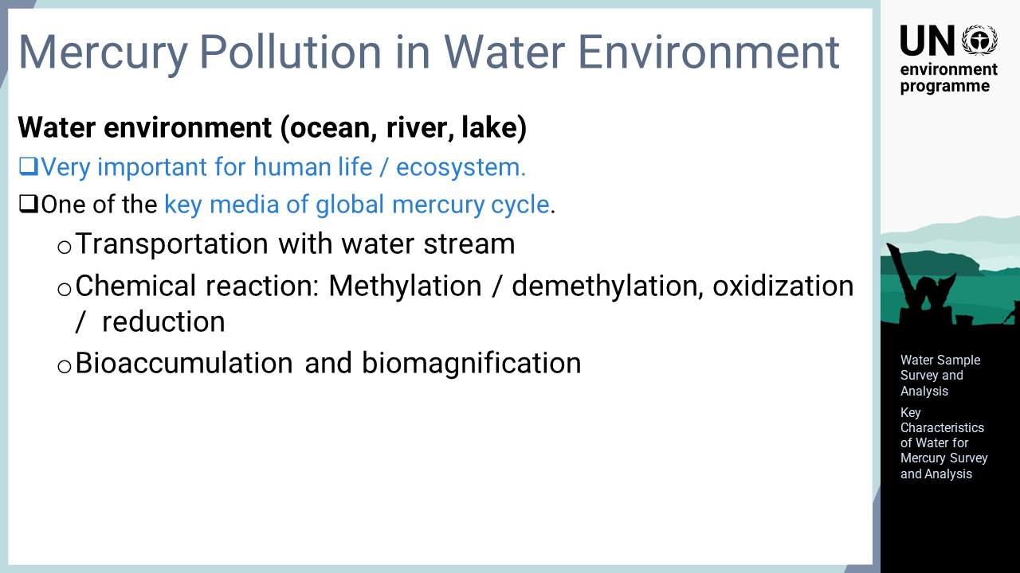
Notes:
‘2’ This slide explains the importance of aquatic environment surveys for understanding mercury pollution. Water is an essential element for all living creatures, and aquatic environments such as oceans, rivers and lakes are very important for human life and ecosystems. Water is also an important medium for understanding the dynamics of global mercury pollution. Mercury in an aquatic environment is transported with the water stream. Ongoing chemical reactions in bodies of water, such as mercury methylation, demethylation, oxidation, and reduction are especially complex. Furthermore, mercury is often taken up from aquatic environments into the ecosystem, where bioaccumulation and biomagnification through the food chain begins. For this reason, aquatic environments are important research media from both regional and global environmental viewpoints.

Slide 4
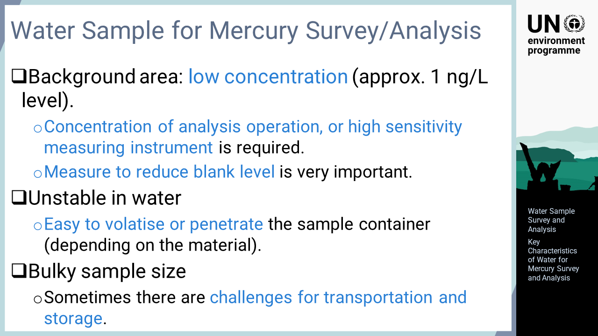
Notes:
‘3’ This slide describes the characteristics of water samples for mercury research and analysis. Firstly, for water samples, it should be noted that the mercury concentrations in background areas without local contamination are very low in comparison with those of other environmental media. The concentration varies due to regional and environmental factors, but a background aquatic environment survey should allow the system to be accurately analysed at a level of approximately one ng/L. For this purpose, the collected samples need to be concentrated during the analytical procedure or very sensitive analytical instruments should be used. Furthermore, the blank values from the laboratory environment, reagents, etc. become significant when analysing low concentration samples. Thus, the reduction of the operation blank level is more important than in other media. Another concern for mercury is its instability in water, which is a major difference from other metallic elements. As a result, mercury loss occurs relatively easily. Other metallic elements are not usually lost from collected water samples, but mercury may be reduced and vaporised under certain environmental conditions or penetrated through the surfaces of containers made of certain materials. Therefore, special attention must be paid to selecting the container type and to stabilizing mercury after sampling. Water samples are often larger in volume and heavier than samples in other media, partly because of the low mercury concentration. In addition, due to the instability of mercury and the risk of damage and leakage, the transportation and storage of water samples is often challenging.

Slide 5

Notes:
‘4’ In this section, the procedure for collecting water samples using a water sampler is explained.

Slide 6
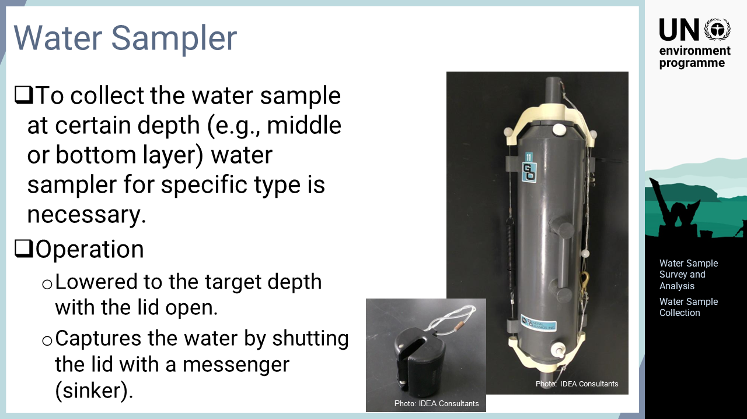
Notes:
‘5’ When sampling water, a clean pail can be used, for example, for collecting drainage of water tanks in the facility or surface water in rivers, sea, etc. However, collecting water at a specific depth requires a specific water sampler. The photo shows a water sampler called a Niskin bottle, which is often used for this purpose. There are several other types of water samplers for different purposes. These water samplers are usually lowered into water with open lids, and once the target depth is reached, the lids are shut by a sinker, called a messenger, released by the operator.

Slide 7
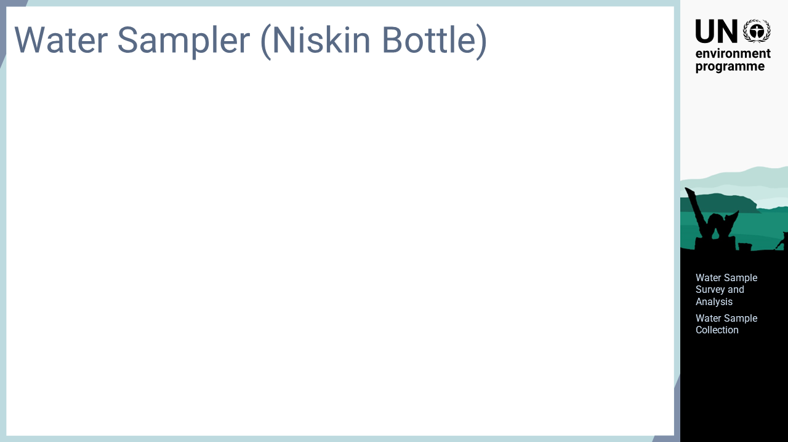
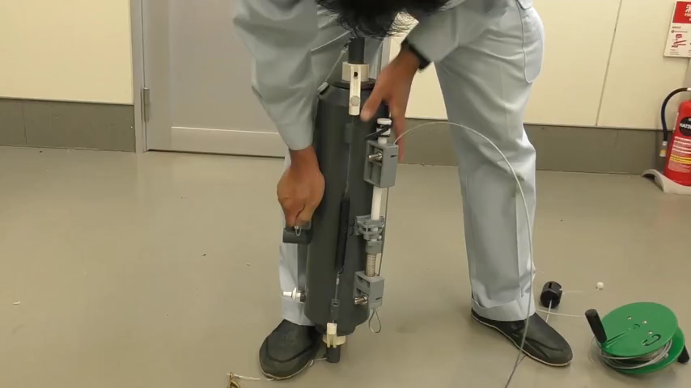
Notes:
‘6’ This slide explains how the Niskin bottle works. This device is actually submerged in water during operation, but the video is taken in air as the movement under water is not clearly visible. In the Niskin bottle, any part in contact with the sample water is made of resin, which is suitable for collecting water samples for surveys of metals such as mercury. As is common for many water samplers, the Niskin bottle is slowly lowered into a body of water with both the upper and lower lids open. Once the device reaches the depth for sample collection, a sinker, called a messenger, is plummeted along the wire. With the messenger hits the sampler, the lids shut and the water inside is trapped. Finally, the sampler is pulled out of the body of water to retrieve the collected water.

Slide 8
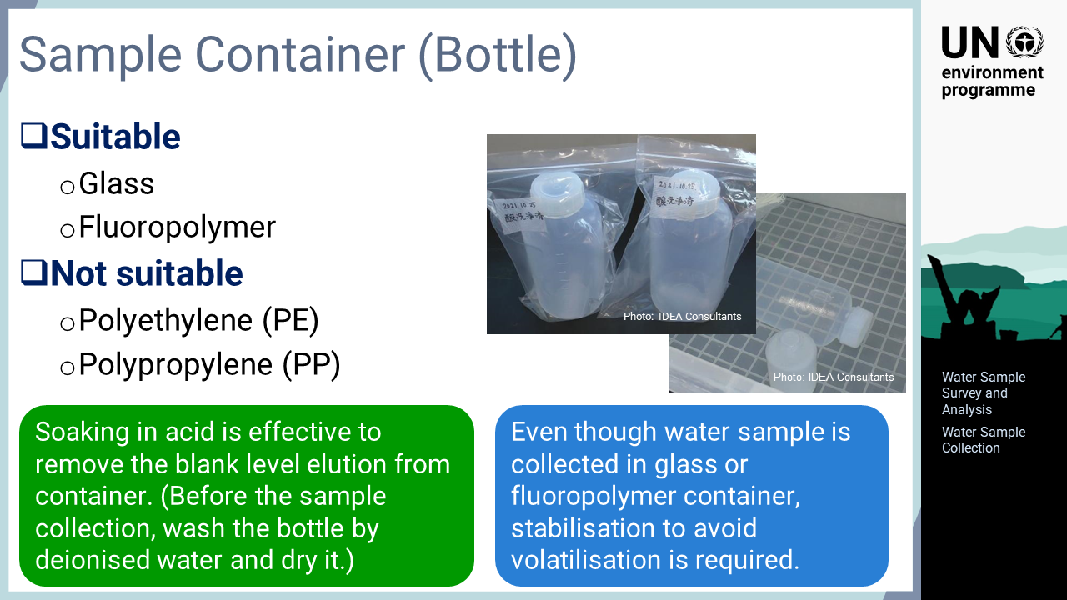
Notes:
‘7’ This slide describes the container materials that can be used for mercury surveys. Unlike many other metals, mercury can permeate the surfaces of containers made of certain materials. Glass and fluoropolymers are suitable materials to avoid mercury permeation. Although glass is not usually a suitable material for metal surveys as it may elute the metals of interest, it can be used for mercury surveys because mercury is not contained in glass. On the contrary, containers made of polyethylene or polypropylene are not suitable as mercury permeation is relatively easy. To reduce the blank level elution from the container, it is recommended that the containers are soaked in acid solution during storage, and then cleaned with deionized water and dried on the day before sampling. It is important to mention that regardless of the container material, mercury in the water sample will be reduced and volatilised. Thus, stabilisation to prevent mercury volatilisation is always needed.

Slide 9
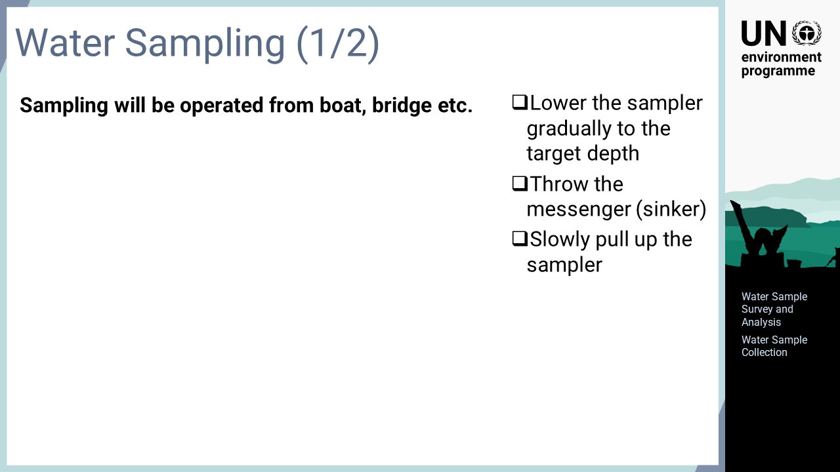

Notes:
‘8’ The actual operation of water sample collection is explained here. Water samples are usually collected from a bridge or boat. The sampler is gradually lowered into the water with the top and bottom lids open. After submerging the sampler to the target depth for sampling, the messenger is plummeted along the wire. It takes some time for the messenger to hit the sampler. After waiting for the messenger to hit the sampler, the sampler is pulled up with the wire.

Slide 10
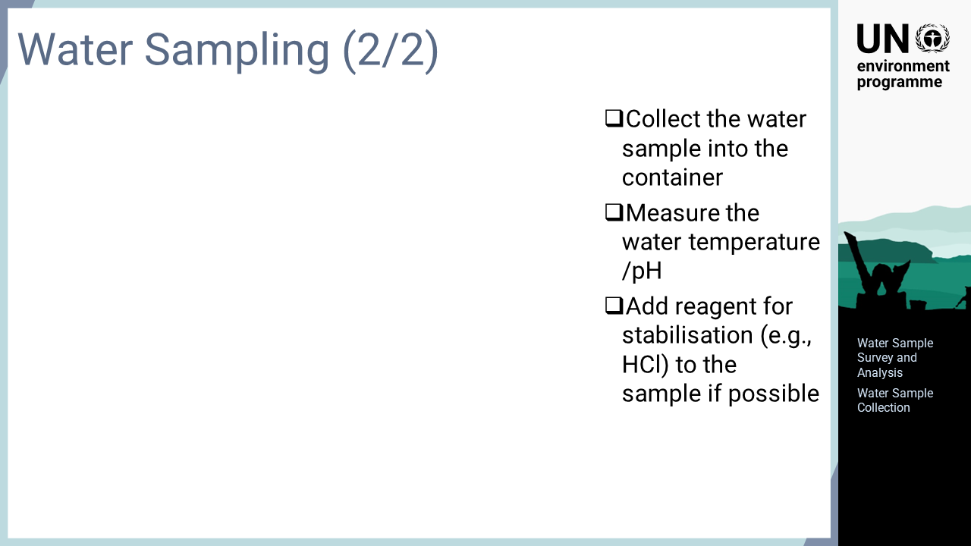
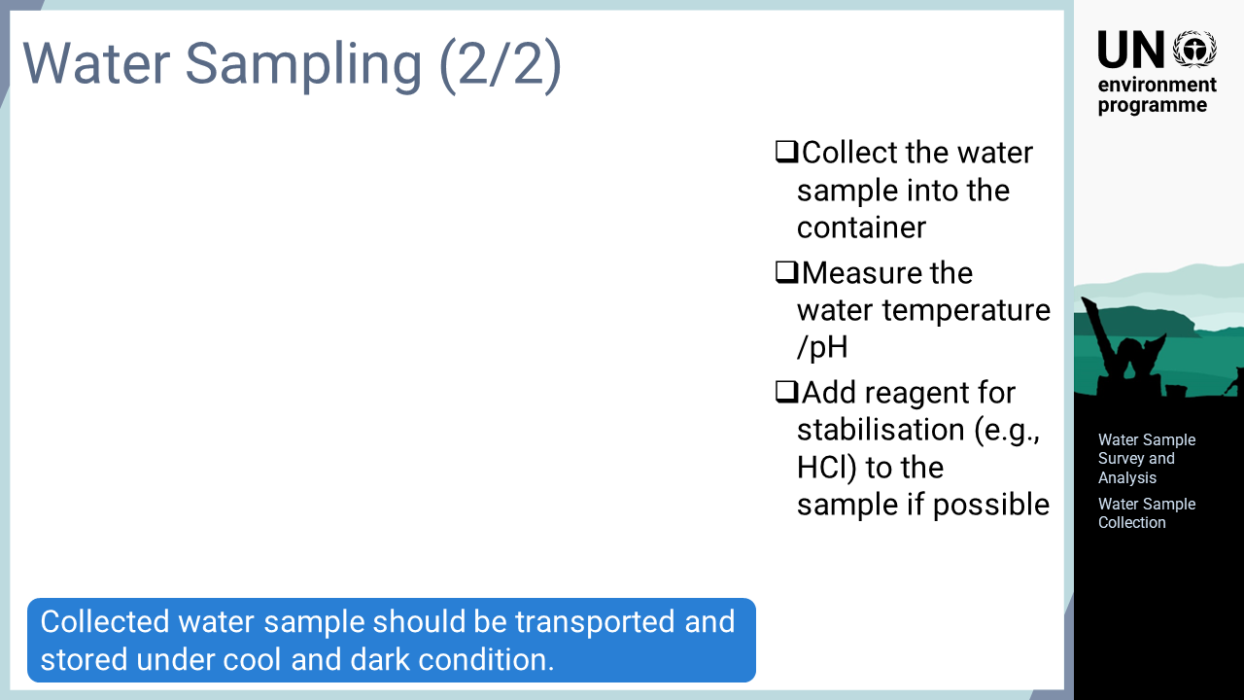
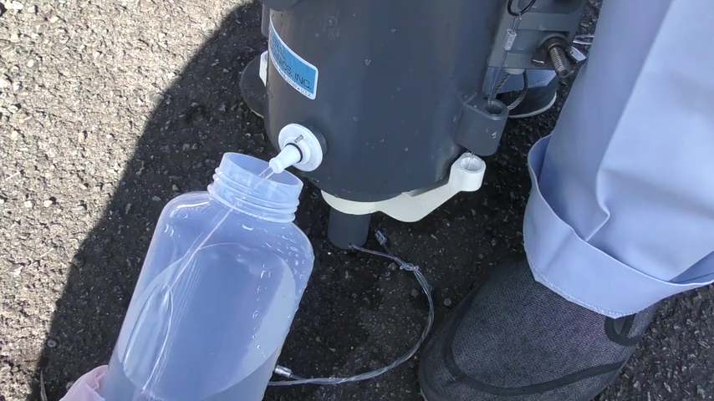
Notes:
‘9’ Once the sampler is retrieved, the sampling cock on the sampler is opened to transfer the water into the water container. The remaining water is placed in a beaker or another receptacle to measure the water temperature and pH. Although the water temperature and pH are not necessary to analyse mercury concentration, these parameters should be measured as much as possible because they provide very important information for understanding the condition of the survey site at the time of sampling. As mercury in water samples is unstable, mercury is effectively stabilised by adding a stabilisation reagent, such as hydrochloric acid, immediately after collection. If it is not possible to do this on site, the samples should be brought back to the laboratory as soon as possible for stabilisation. Finally, the collected samples are put in plastic bags and then transported and stored under cool and dark condition.

Slide 11
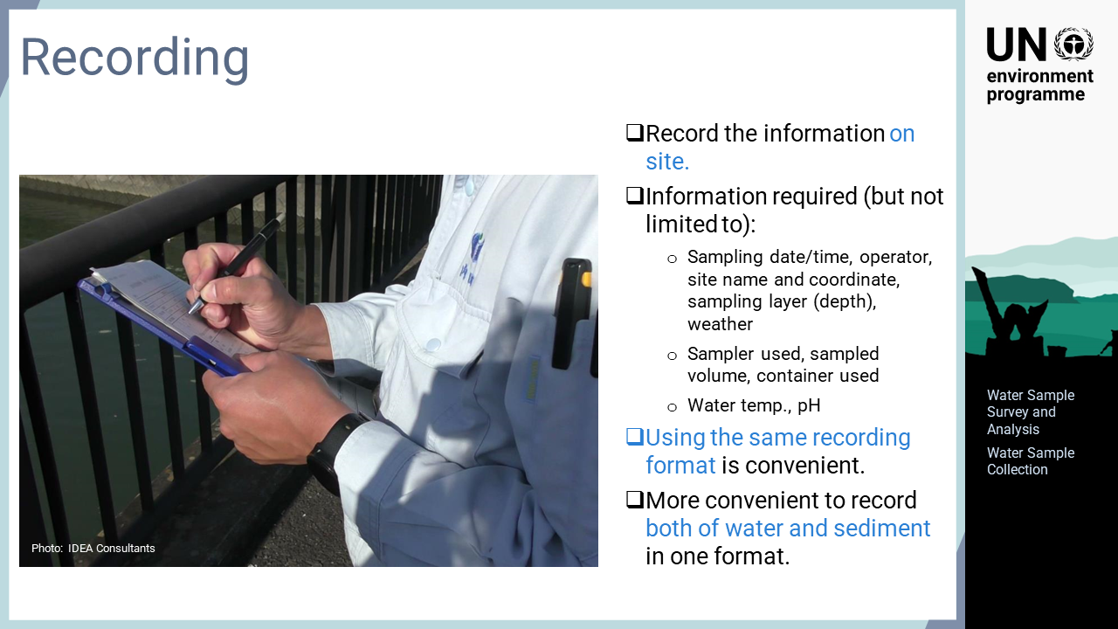
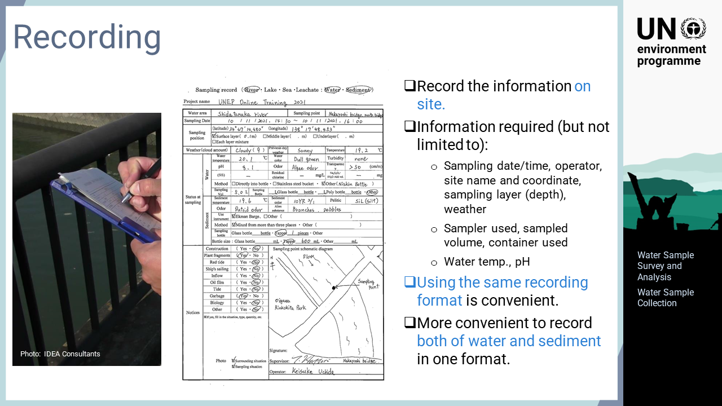
Notes:
‘10’ After sampling, the status of survey is recorded. The recording should be done at the sampling site, unless prevented by the weather or other conditions. The more time that passes after sampling, the more difficult accurate recording becomes. The information to be recorded includes the sampling date and time, operator, name and coordinates of the sampling point, sampling depth, sampler used, sampled volume, container used, water temperature, and pH. It is convenient to always use the same format for the on-site recording of the collection status for later reference. As water and sediment samplings are often carried out at the same location at the same time, developing a format that accommodates information about both water and sediment samples provide additional convenience.

Slide 12
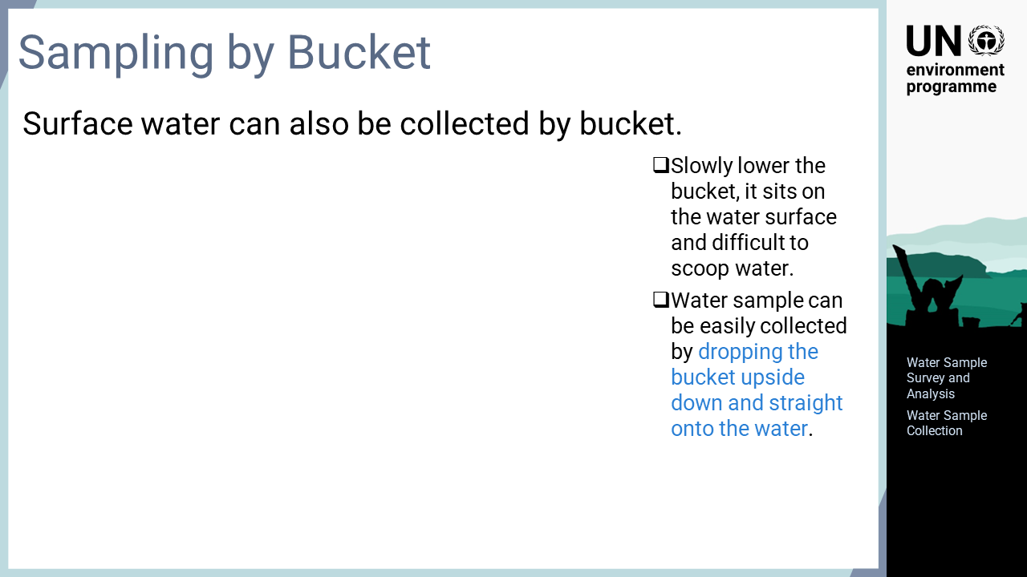
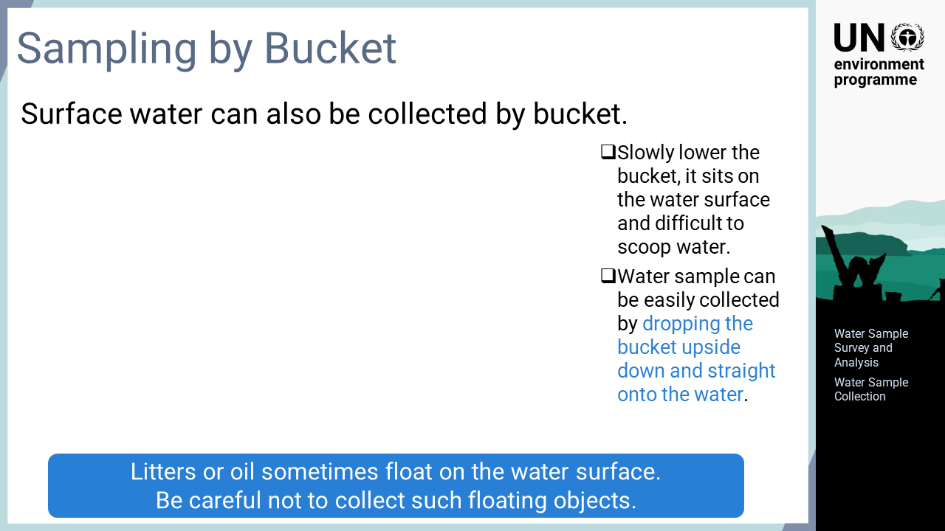
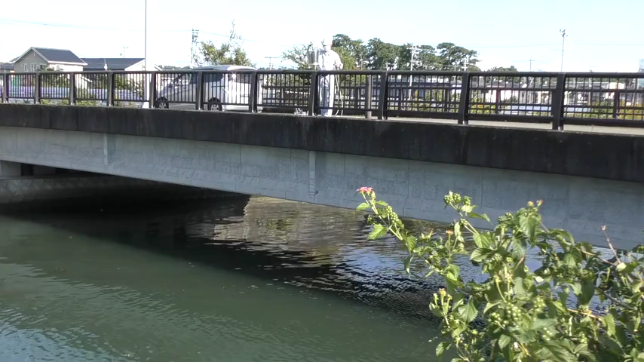
Notes:
‘11’ Another water sampling method using a bucket is explained here. A bucket can be used to collect near-surface water but not water in the middle or bottom layers. There are some tricks to collecting water using a rope and bucket. If the bucket is slowly lowered from a bridge or boat to the water, the bucket sits on the water surface and cannot easily scoop water. Instead, water sample can be easily collected by dropping the bucket upside down, straight onto the water. Care must be taken not to collect floating objects such as litter or oil when collecting surface water. Such objects exist only on the very surface of the water; therefore, at sample mixed with these objects may not represent the actual condition of the surface water at the sampling site. If litter or oil is identified on the surface of the water, it should be prevented from entering the bucket during water collection. As with water samplers, processes such as stabilisation and measuring the temperature and pH should also be performed.

Slide 13
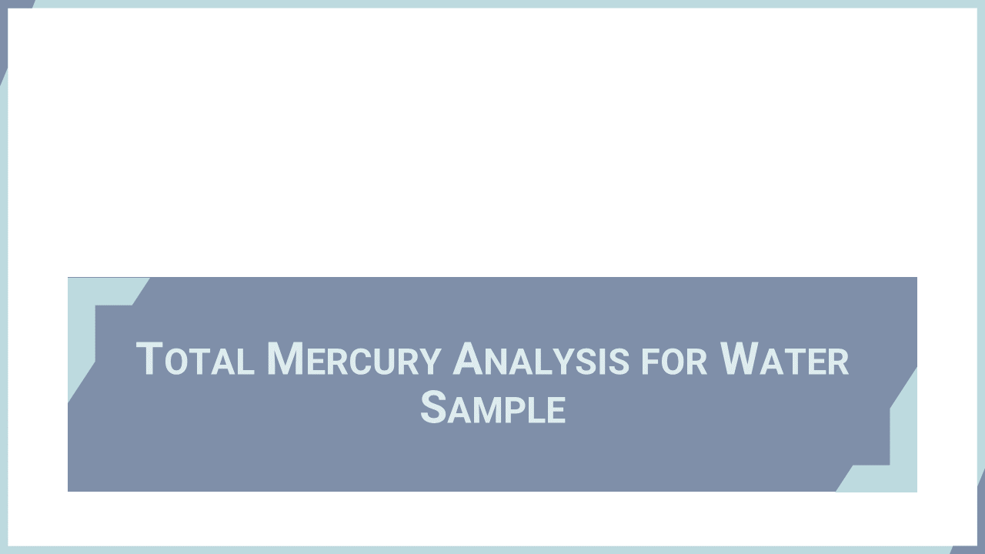
Notes:
‘12’ This section describes total mercury analysis for water samples applicable for both freshwater and sea water. The method of extracting and concentrating mercury as a dithizone complex is introduced here.

Slide 14
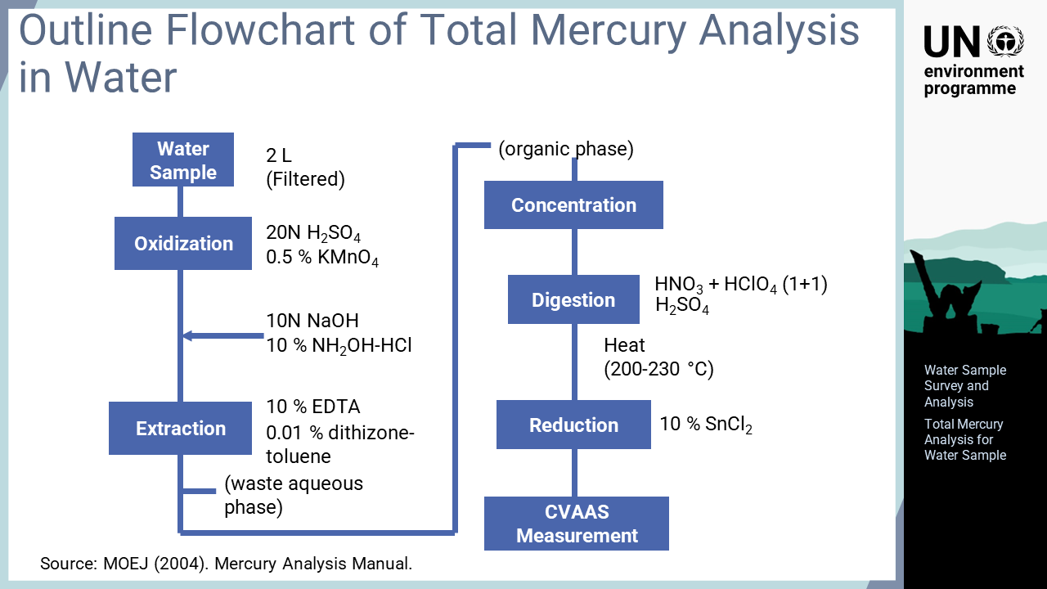
Notes:
‘13’ This diagram outlines the analysis of total mercury in water samples. High-sensitivity measuring devices such as an atomic fluorescence spectrometer, AFS, are sensitive enough to measure background-level environmental water samples. When cold vapour atomic absorption spectrometer, CVAAS, is used for water samples in the general environment, mercury cannot be detected unless the sample is concentrated before analysis. Firstly, mercury in soluble and suspended forms is separated by filtration as the method only applies to dissolved mercury. Suspended matter is analysed separately as a solid. All mercury in the filtrated water sample is oxidized with potassium permanganate. Then, potassium permanganate remaining in the solution, which interferes with the process, is reduced with hydroxylamine. Mercury in the sample is extracted as a dithizone complex into a small amount of toluene. After evaporation, the complex is digested with nitric acid, perchloric acid and sulphuric acid, as is done for solid samples, and then mercury is analysed with reduction aeration CVAAS.

Slide 15
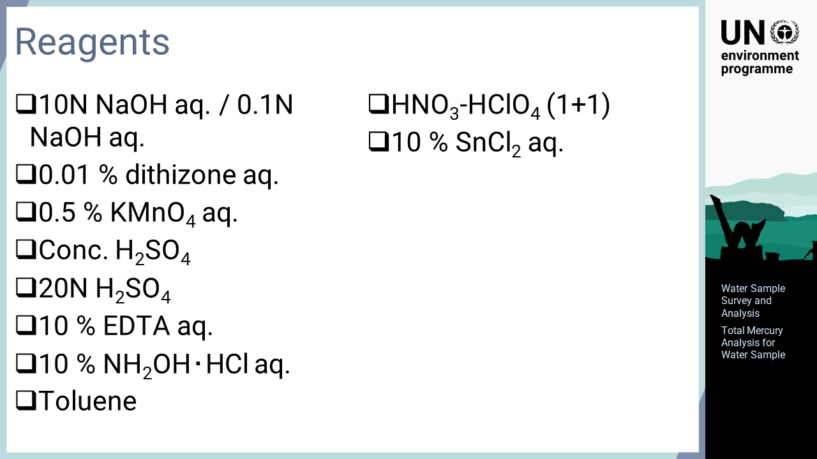
Notes:
‘14’ The reagents used in the analysis are shown on this slide.

Slide 16
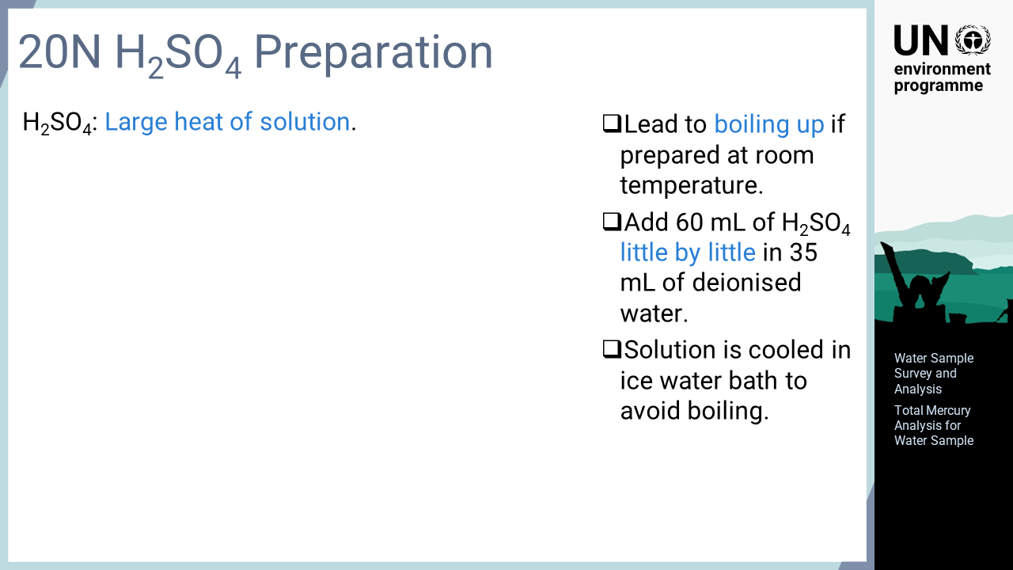
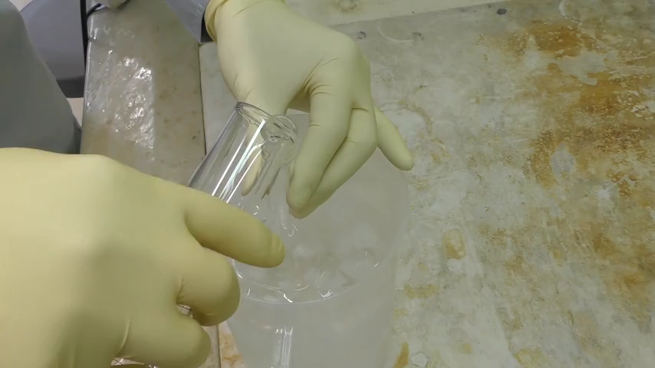
Notes:
‘15’ As explained here, 20 normality sulphuric acid is prepared by gradually adding 60 mL of concentrated sulphuric acid into 35 mL of deionized water. Since concentrated sulphuric acid is added to a small amount of water, a significant heat of solution is generated, which may lead to boiling if prepared at room temperature. The solution is cooled in an ice water bath to avoid boiling, and sulphuric acid is added gradually to minimise the generated heat of solution.

Slide 17
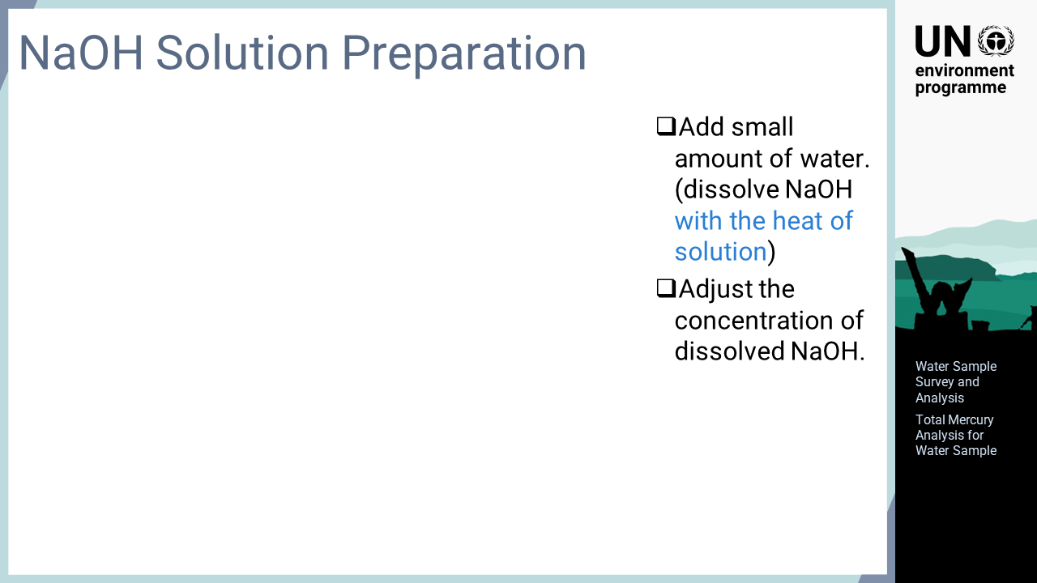
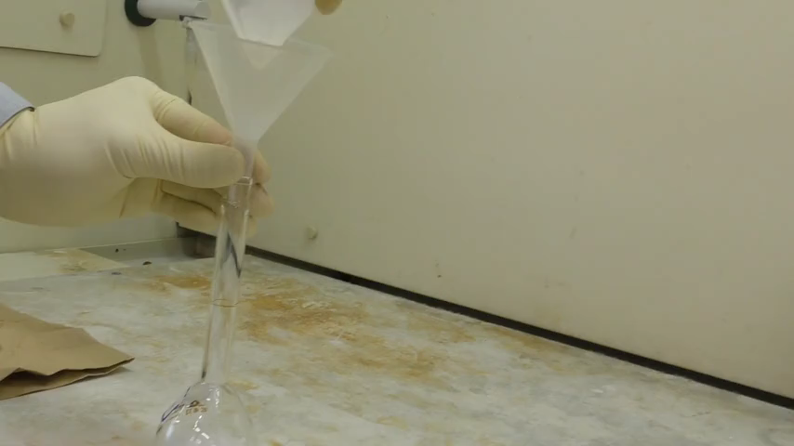
Notes:
‘16’ Sodium hydroxide does not dissolve easily when water is added all at once. It is firstly dissolved in a small amount of water to generate a heat of solution. Then, the concentration of dissolved sodium hydroxide is adjusted by adding the remaining water.

Slide 18
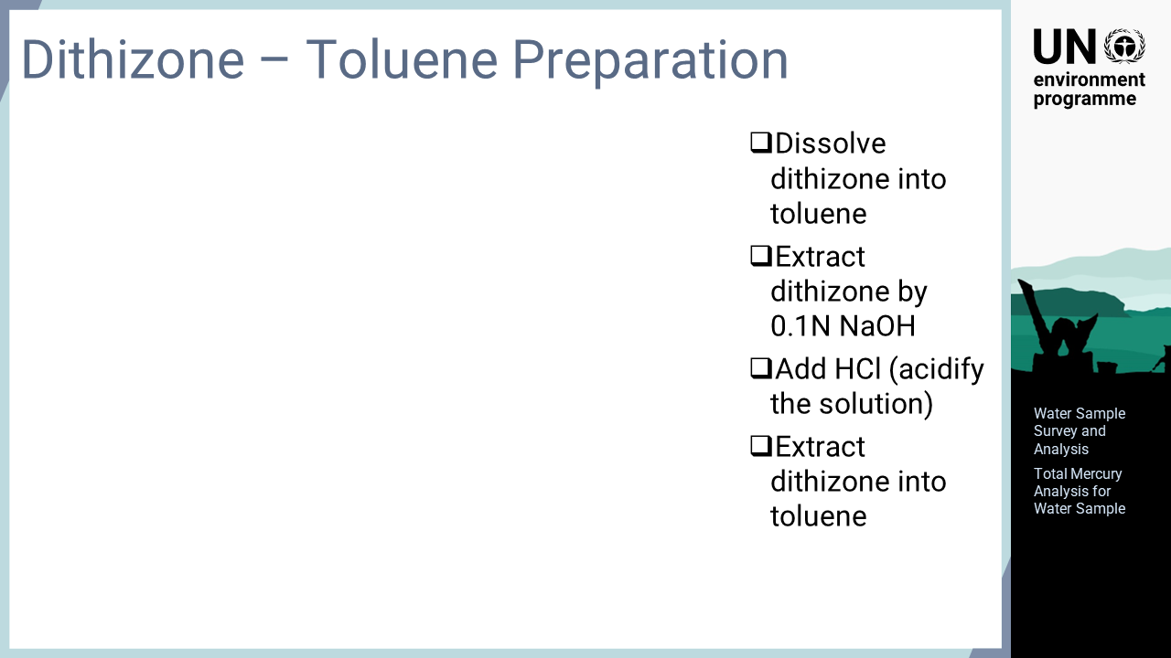
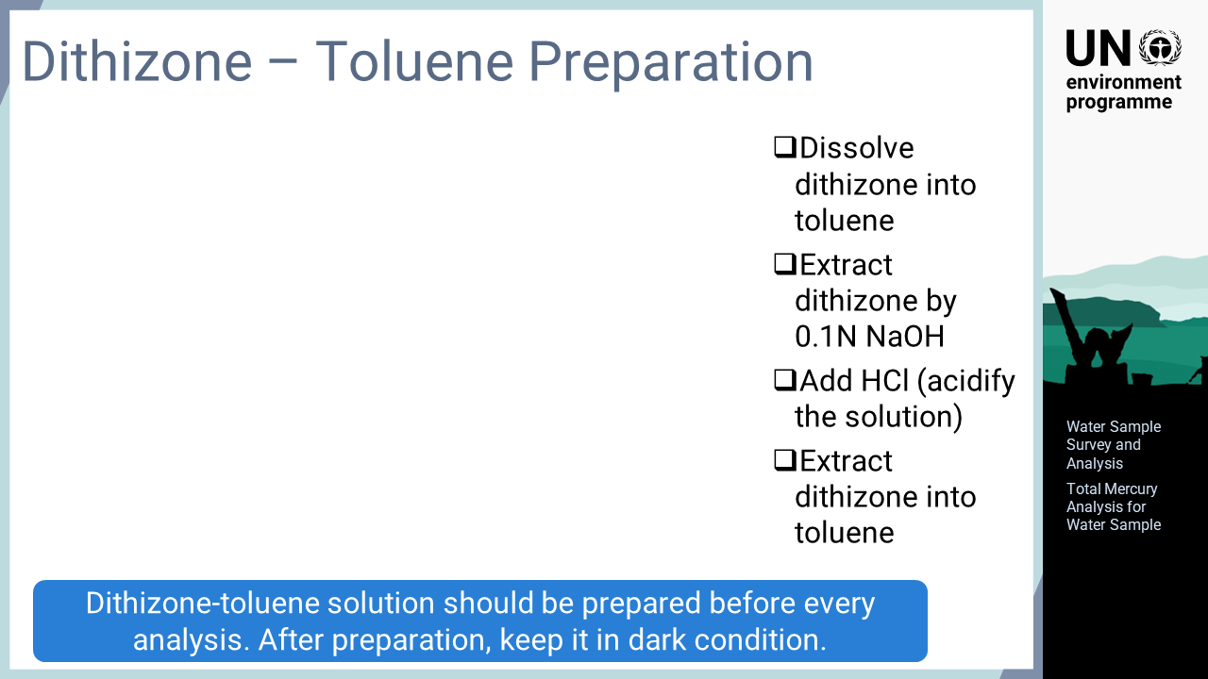
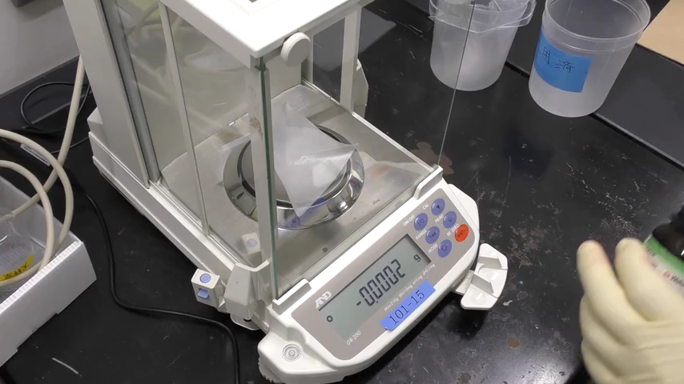
Notes:
‘17’ This slide describes the preparation of a dithizone-toluene solution. Dithizone is weighed and dissolved in toluene. Then, this solution is extracted once with a 0.1 normality sodium hydroxide solution. As dithizone is a weak organic acid, it moves into the aqueous phase under alkaline conditions. After that, the solution in which dithizone is dissolved is acidified with hydrochloric acid. Under acidic conditions, dithizone becomes soluble into toluene, which enables its extraction into toluene again. Dithizone can be purified by applying this process repeatedly. As dithizone is easily decomposed, it is prepared before each analysis and kept in dark conditions when not in use.

Slide 19
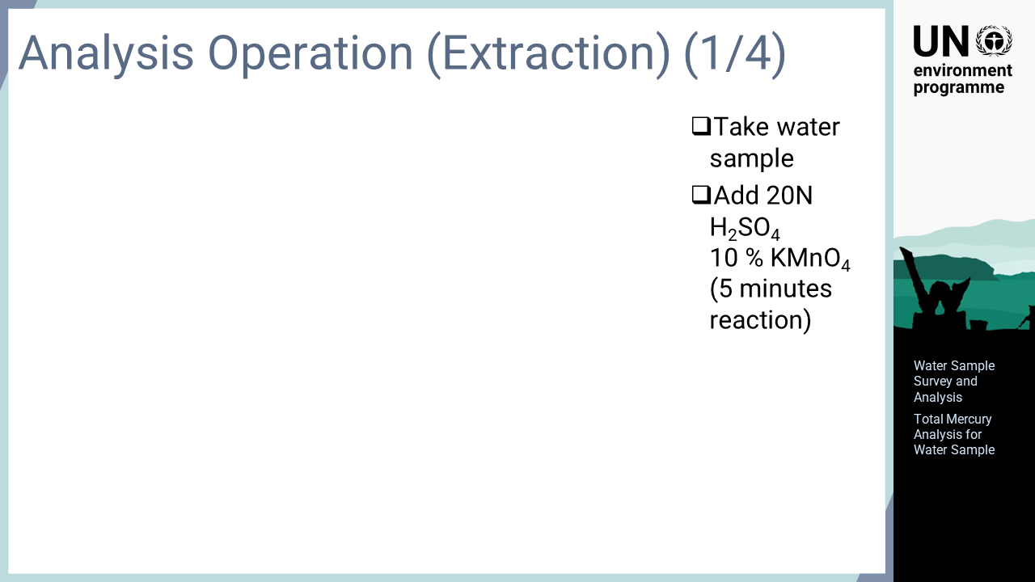
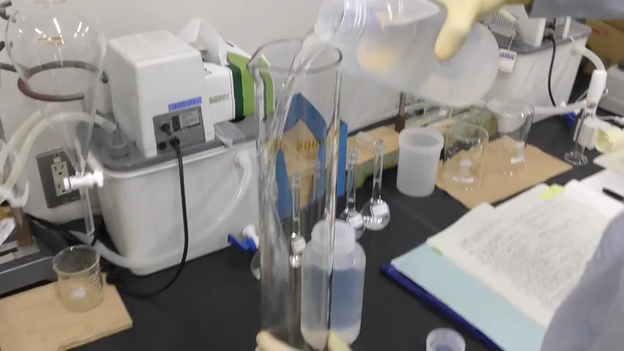
Notes:
‘18’ The analysis operation is explained here. Firstly, the water sample is placed in a separatory funnel. Then, 20 normality sulphuric acid and potassium permanganate solution are added to oxidize the mercury in the sample. The sample is left for five minutes to allow mercury to react completely.

Slide 20
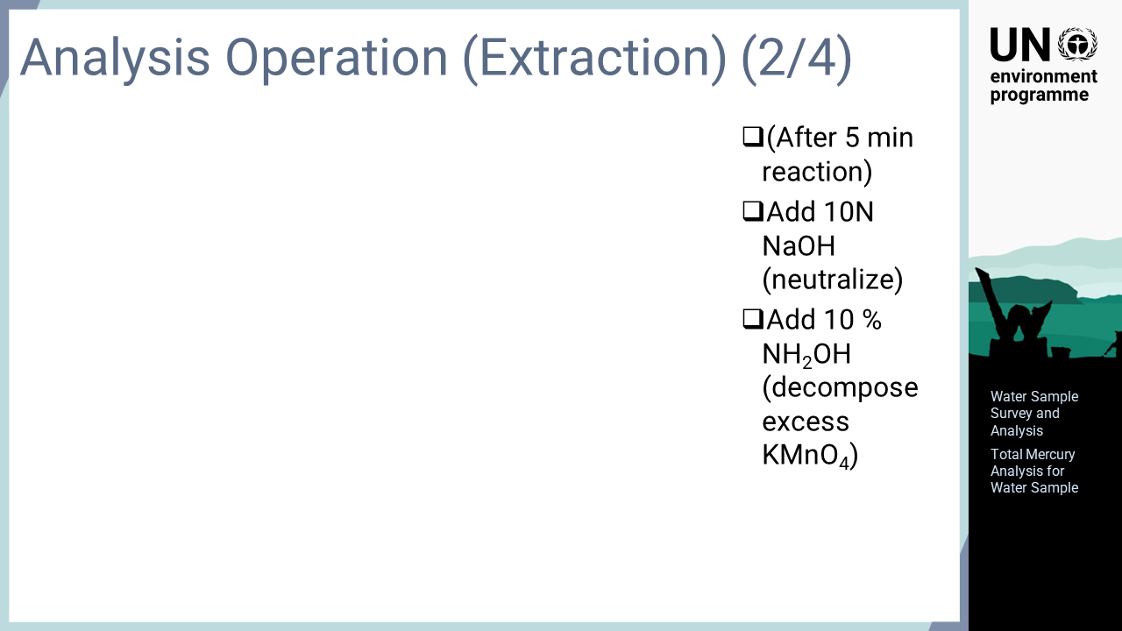
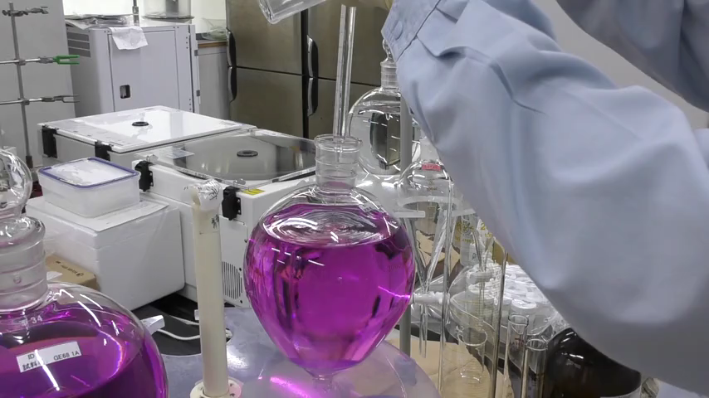
Notes:
‘19’ After five minutes, the sample is neutralised with the sodium hydroxide solution. Then, hydroxylamine is added to reduce and decompose permanganate. If the purple colour of permanganate does not disappear, more hydroxylamine should be added, as this indicates that the amount of hydroxylamine is insufficient.

Slide 21
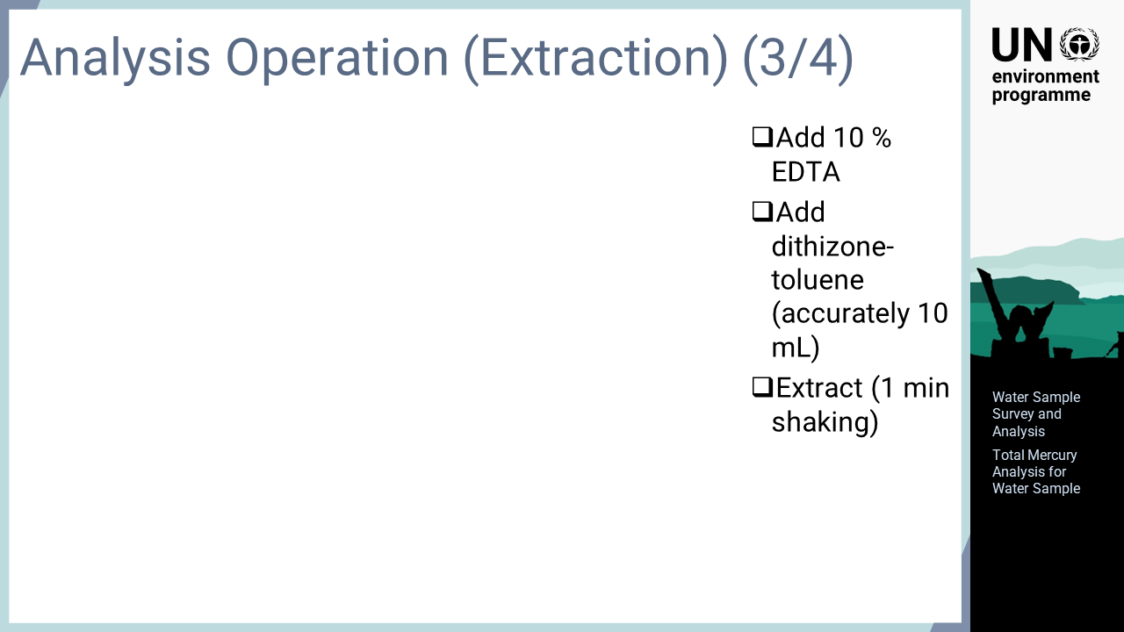
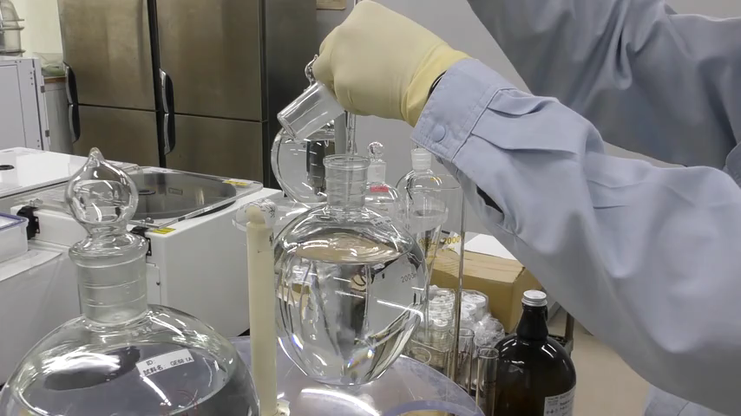
Notes:
‘20’ After the purple colour of permanganate disappears completely, an EDTA solution is added. Then, 10 mL of dithizone-toluene solution is precisely measured and added with a whole pipette. The sample is shaken well for one minute and then, left until toluene and water are separated.

Slide 22
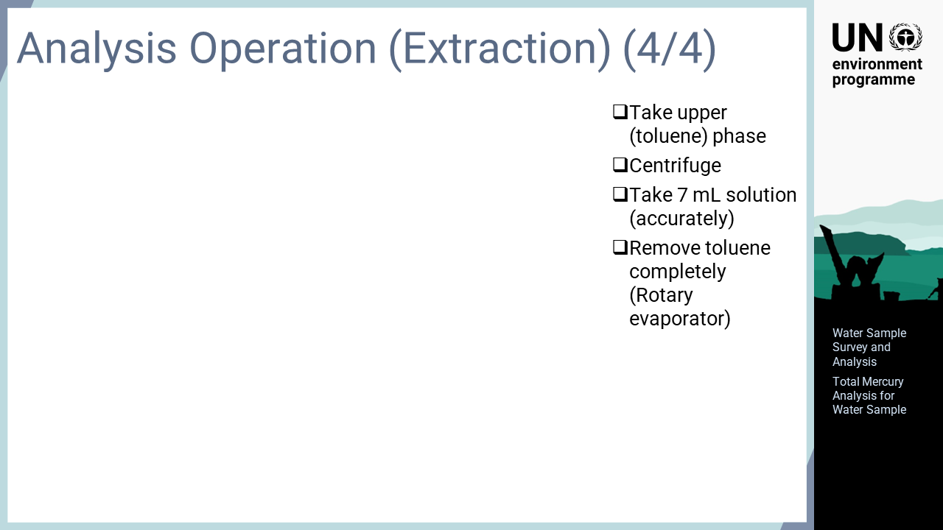
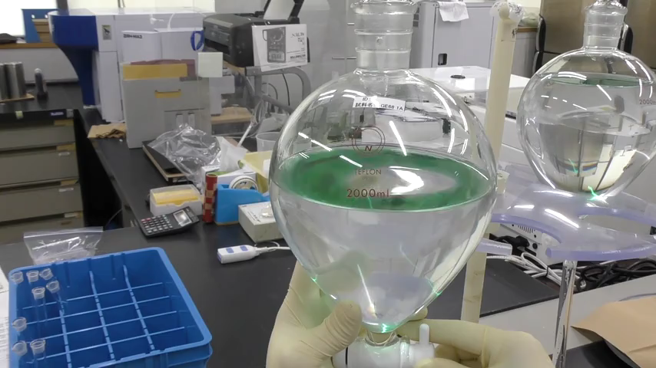
Notes:
‘21’ Once extraction with dithizone-toluene is complete, and the toluene and water phases are separated, the toluene phase is transferred from the separatory funnel into a test tube. Water still exists in the toluene phase despite the extraction process; thus, the sample is centrifuged to separate water completely. Then, exactly seven mL of the toluene solution is collected using a pipet. The solution is concentrated with a rotary evaporator to completely remove toluene, as any toluene remaining in the sample interferes with the subsequent acid digestion treatment. The concentration process should be continued until the liquid is completely gone.

Slide 23
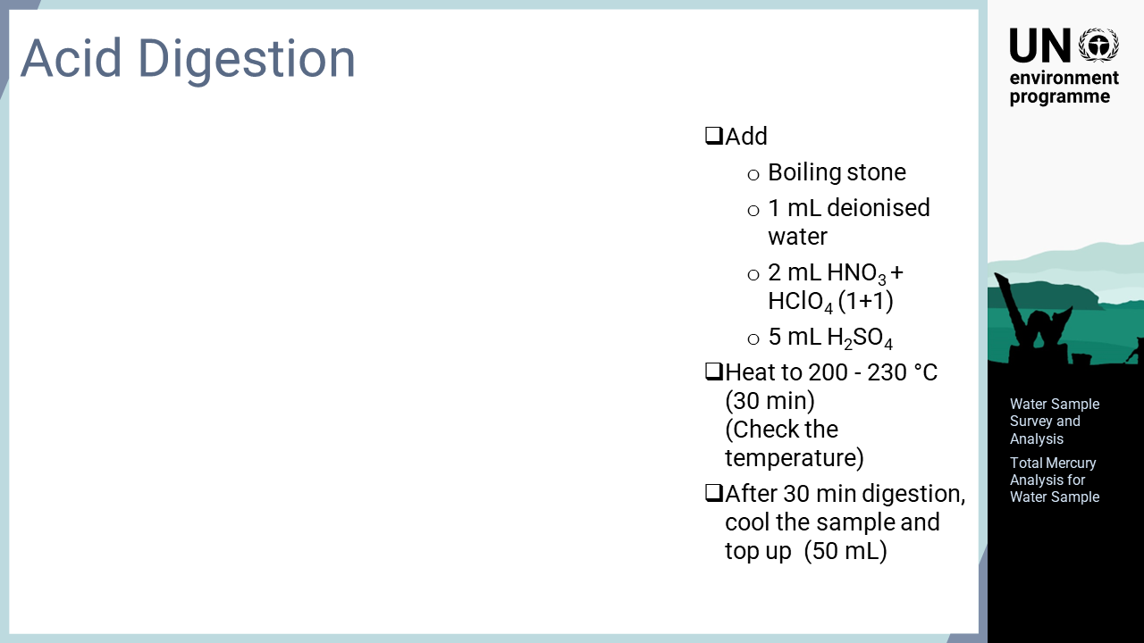
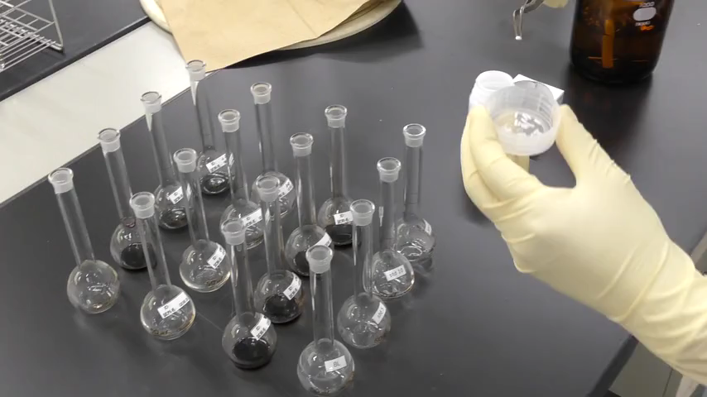
Notes:
‘22’ After extracting mercury with dithizone-toluene and removing the toluene completely, the sample is digested with acid by adding one mL of deionized water, two mL of a one-to-one mixture of nitric acid and perchloric acid, and five mL of sulphuric acid. The acid-added sample is digested by heating at 200 to 230 °C. If a hot plate is used, the temperature may not be sufficiently high for digestion. It is recommended that the actual temperature of the hot plate surface is measured to confirm that it is sufficient for the digestion. After digesting for 30 minutes, heating is stopped and the samples are left to cool to room temperature. Once the samples have cooled sufficiently, the volume of each sample is adjusted to 50 mL for analysis.

Slide 24
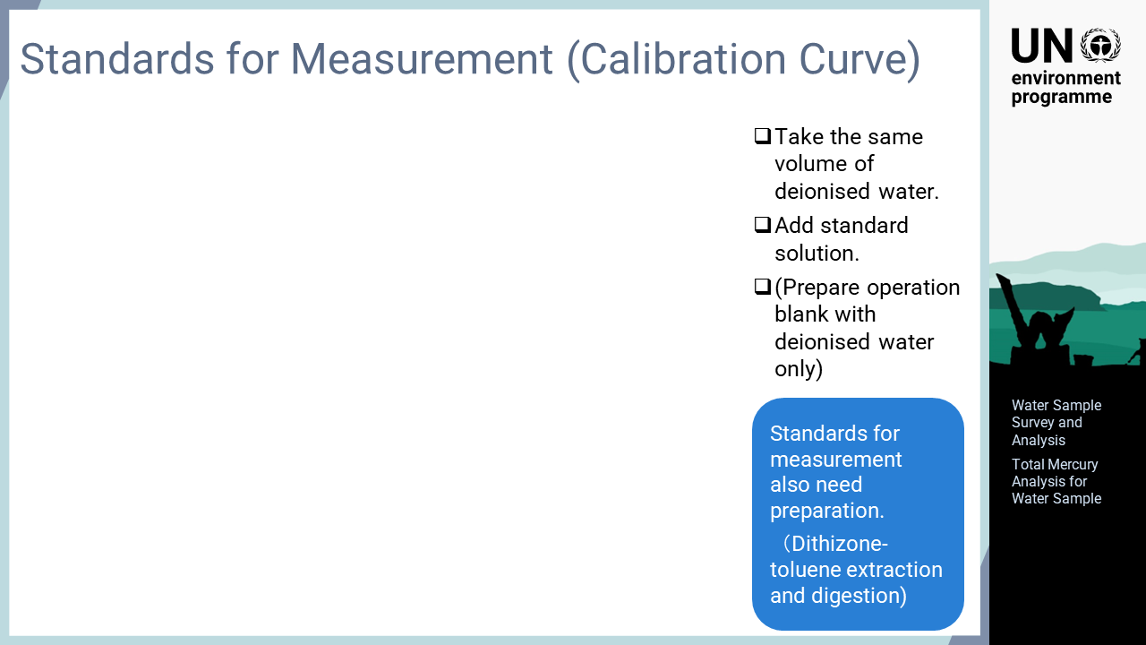
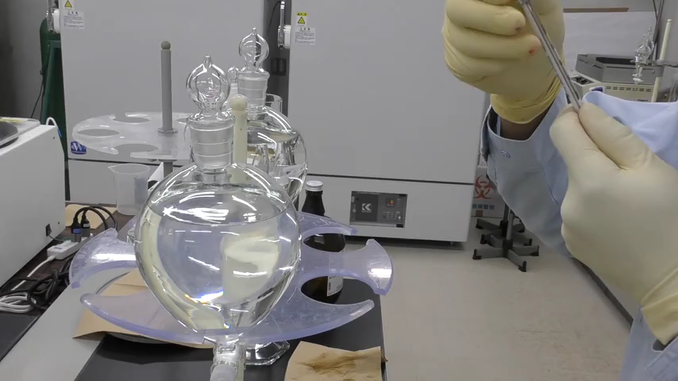
Notes:
‘23’ In this analysis method, the standard solutions for preparing the calibration curve are extracted and digested in the same manner. When placing a sample in the separatory funnel, the same amount of deionized water is added. The numbers of the water samples prepared corresponds to the points needed for the calibration curve. Then, the standard solution is added to each separatory funnel at an the amount corresponding to the concentration level of the calibration curve. An operation blank, containing only deionized water without added standard solution, is also prepared. After that, the same treatment as done for the collected samples is performed to prepare standard solutions for the calibration curve.

Slide 25
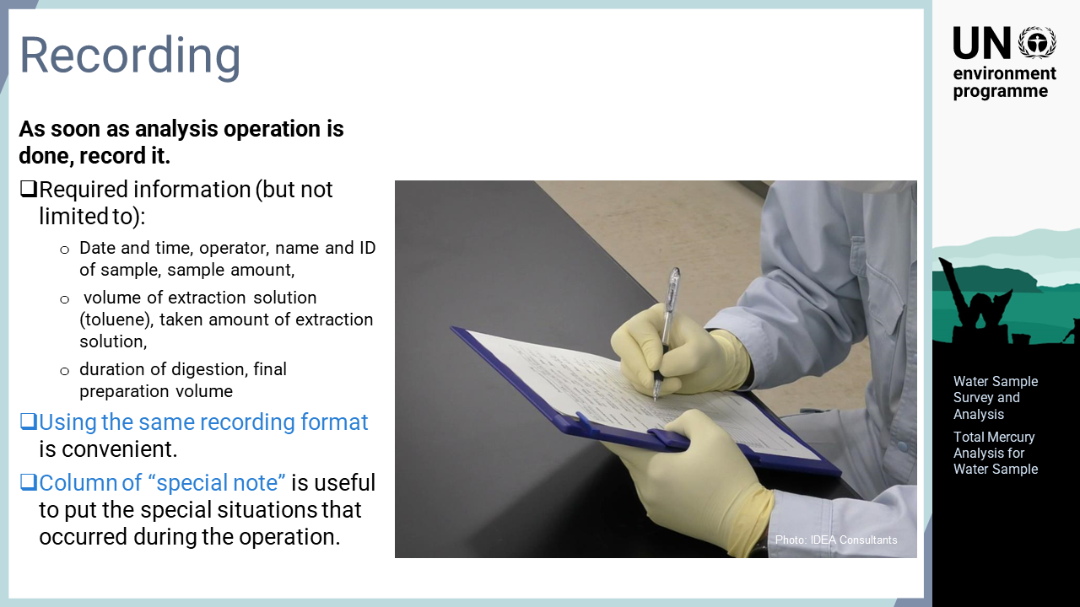
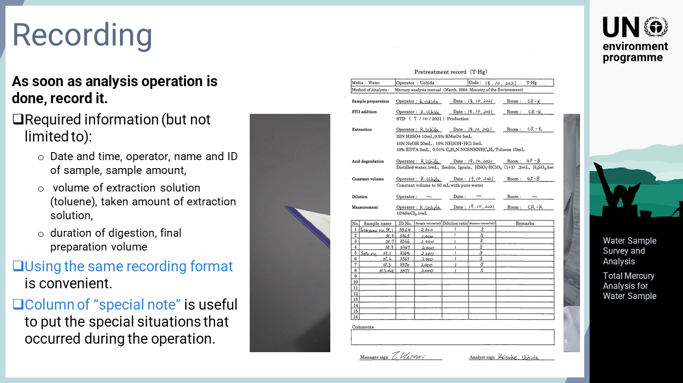
Notes:
‘24’ Once the analytical operation has been performed, the details of the operation should be recorded immediately. The necessary information includes the pre-treatment status of the samples, that is, the date and time of treatment, the operator who performed the treatment, the amount of sample used, the amount of standard solution used, the amount of toluene used for extraction, the duration of digestion, and the final preparation volume. For later reference, it is beneficial if the record form is prepared in advance. In addition, an entry field for special notes is useful to record special situations that occur during the operation.

Slide 26
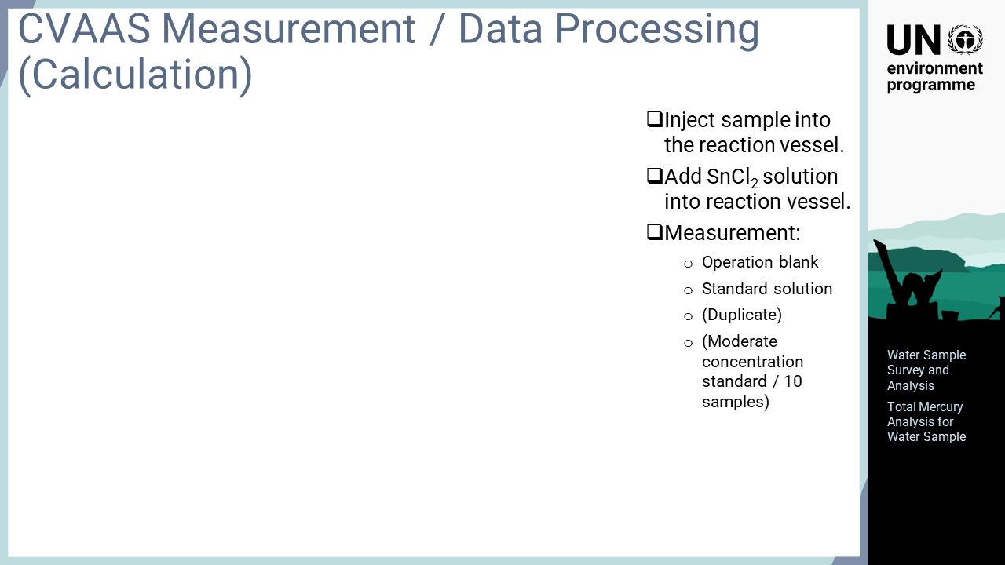
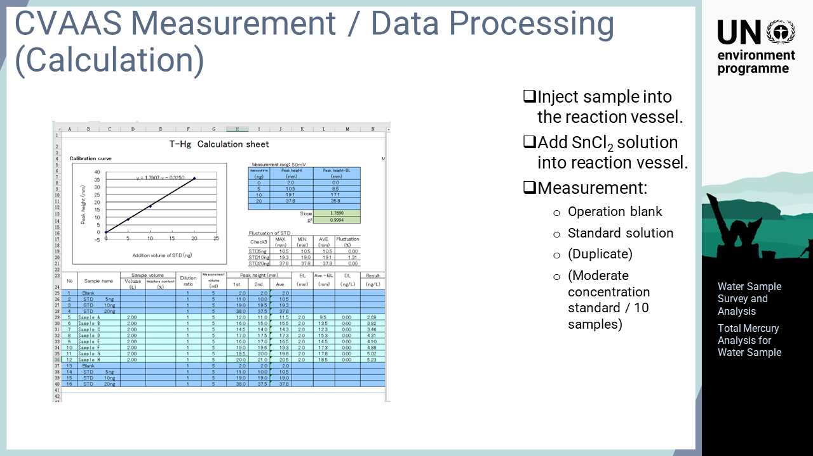
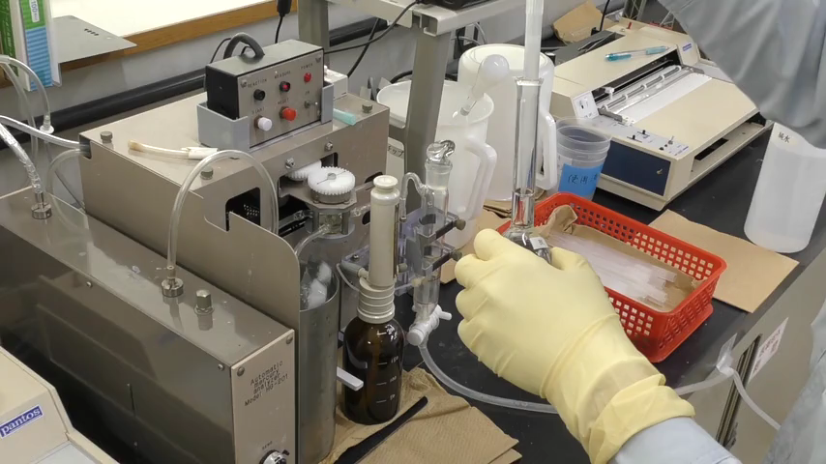
Notes:
‘25’ Once the extraction and digestion operations are complete, both the samples and standard solutions are analysed with a reduction aeration atomic absorption spectrophotometer. A sample is placed in the reaction vessel, whose lid is closed soon after injecting the sample, and then tin chloride is added. Mercury in the sample solution in the instrument is reduced by tin chloride, vapourised and introduced into the detector. These operations differ in different types of instruments, many of which perform this process automatically. Therefore, the details should be confirmed using the instruction manual of the instrument being used. The analysis is performed in the following order: operation blank, standard solutions for the calibration curve, and collected samples. If the number of samples exceeds 10, a standard solution with a moderate concentration in the calibration curve should be analysed every 10 samples. This step is to confirm that the sensitivity of the instrument is not fluctuating. After analysing the samples, a calibration curve is created based on the data obtained for the standard solutions and the concentrations of the samples are calculated.

Slide 27
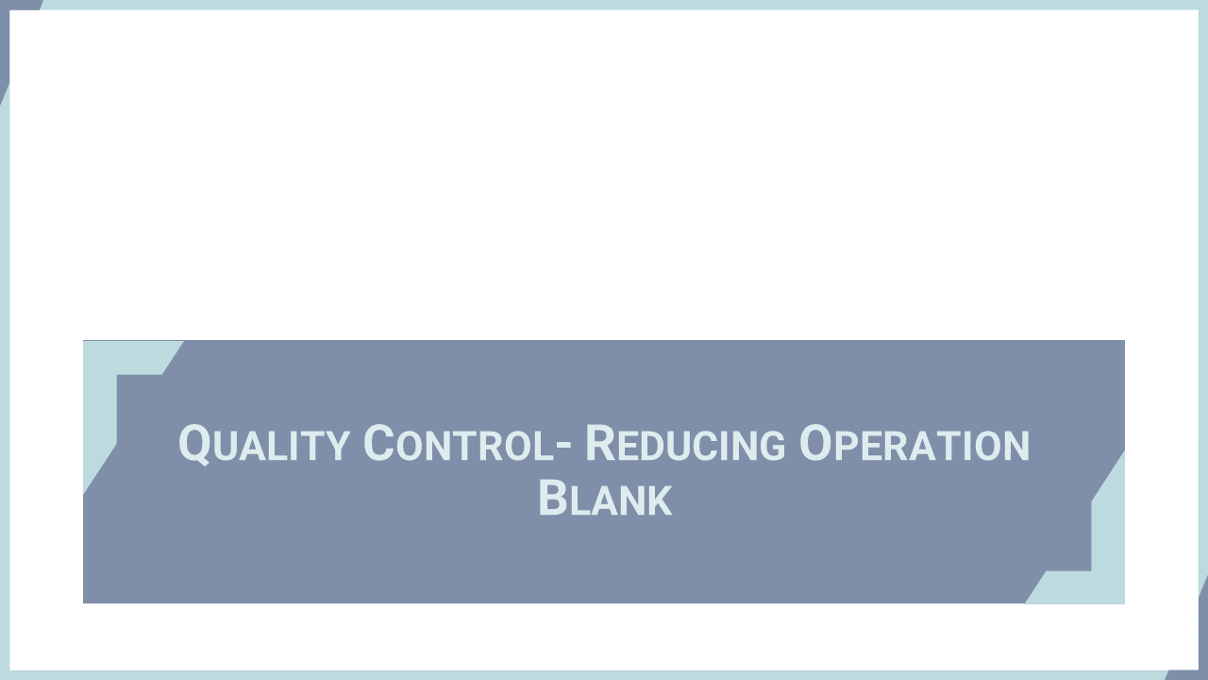
Notes:
‘26’ In this section, some means for reducing the operation blank values, which is a very important factor for quality control of the analysis of low-concentration water samples, are explained.

Slide 28
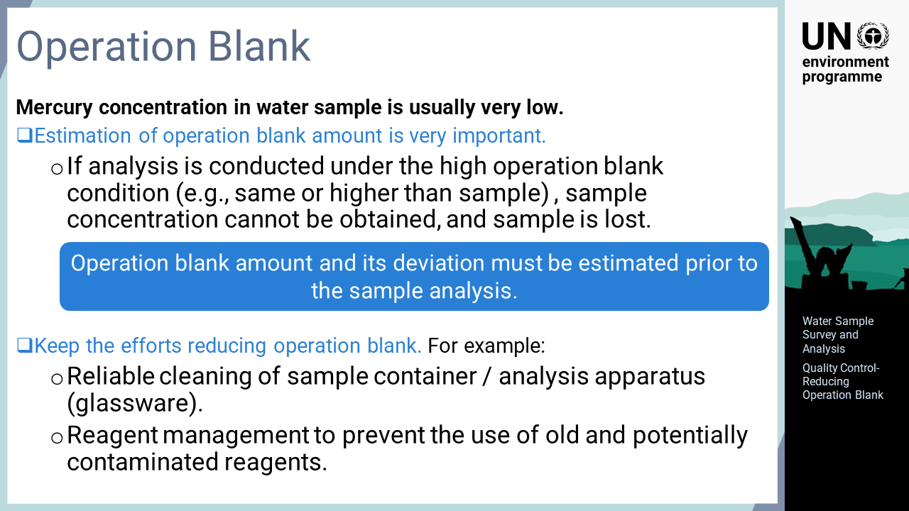
Notes:
‘27’ Efforts should always be made so that the operation blank has the lowest value in all analyses, but this is especially important for analysing total mercury in environmental water as the mercury concentration is usually very low. If a low concentration sample such as environmental water is analysed under an analytical condition with a high operation blank, a valid value will not be obtained, and the collected sample will be lost. To avoid wasting the efforts made for sample collection and analysis, the operation blanks for the laboratory analysis must be confirmed before analysing the samples. Even if the operation blank is sufficiently low, efforts to further reduce the operation blank value should always be performed to prevent accidental increases and to improve the quality of the data. Such efforts include: reliably cleaning the sample containers and glassware used for the analysis and reagent management to prevent the use of old or potentially contaminated reagents.

Slide 29
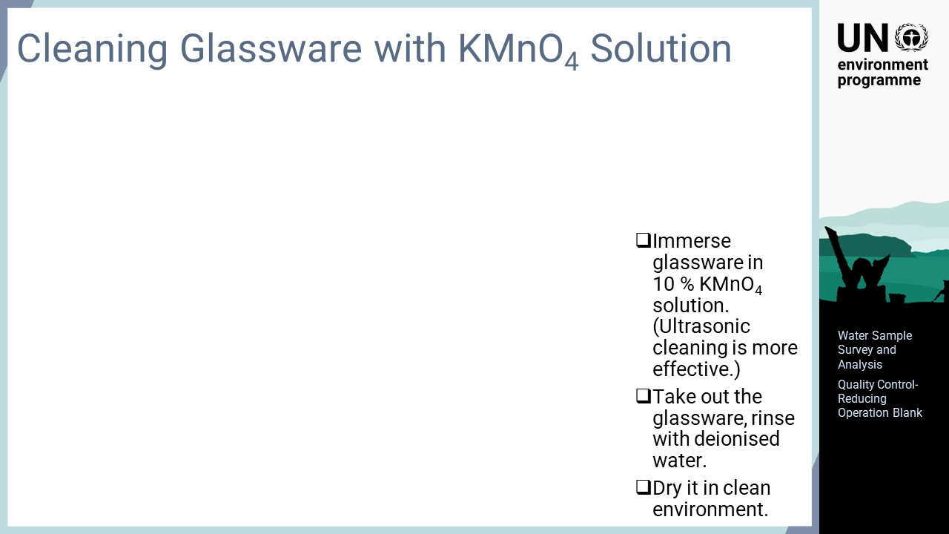
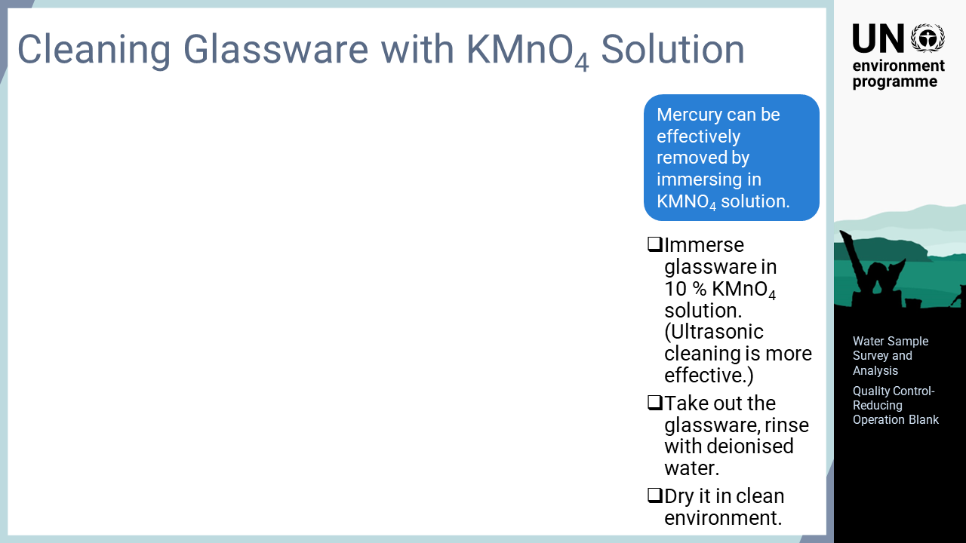
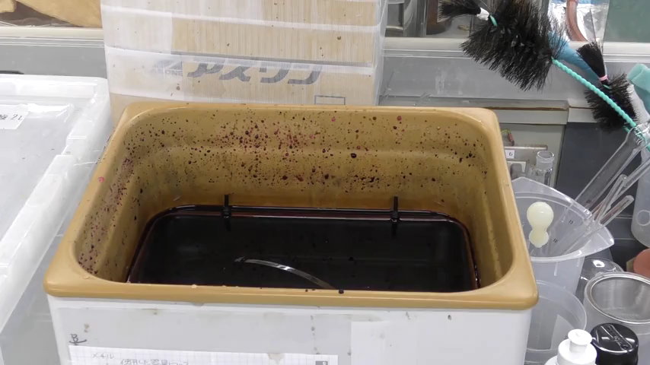
Notes:
‘28’ This slide explains the method for cleaning glassware. Cleaning with a potassium permanganate solution is effective for reliably removing mercury from glassware used for total mercury analysis. The glassware used or to be used for analysis is immersed in a potassium permanganate solution. If possible, it is more effective to perform ultrasonic cleaning while the glassware is immersed in the potassium permanganate solution. After cleaning with the potassium permanganate solution, the glassware is rinsed with deionized water and dried in a clean environment.

Slide 30
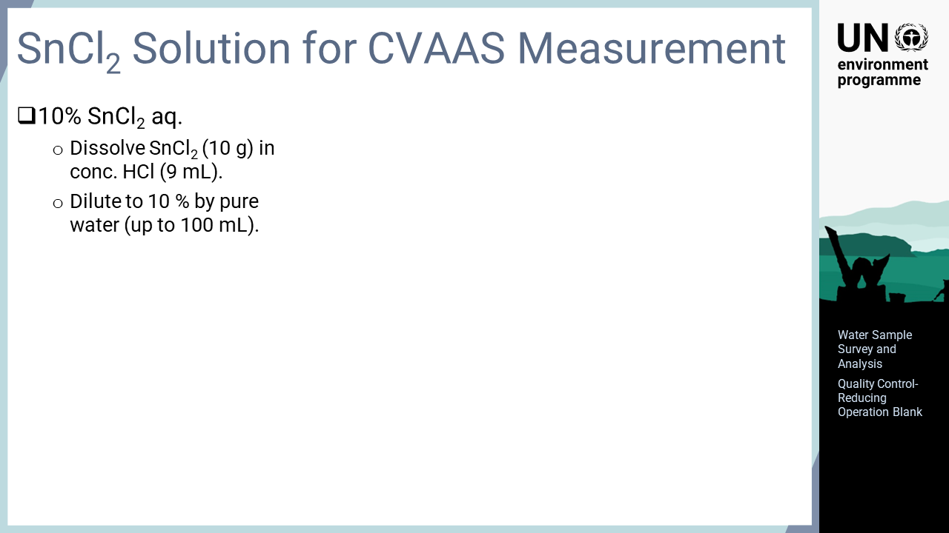
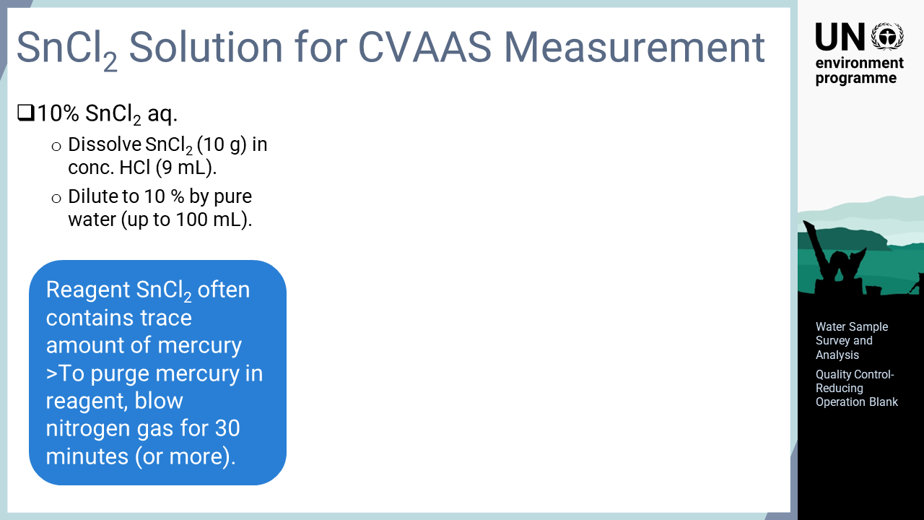
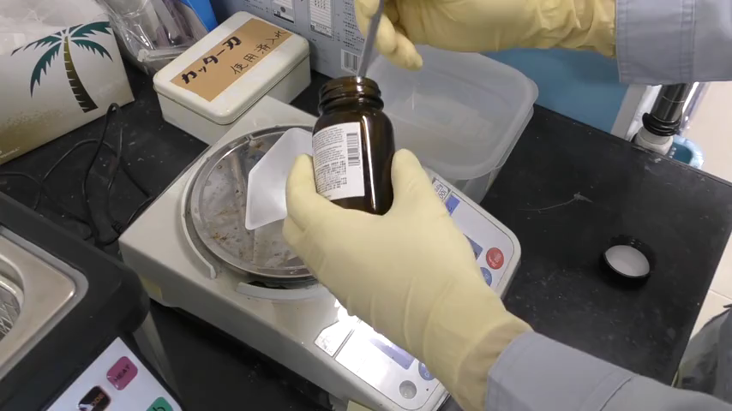
Notes:
‘29’ Another method for lowering the operation blank is to treat the tin chloride used in the reducing aeration atomic absorption spectrophotometer. Commercially available tin chloride contains a trace amount of mercury, which affects the analytical results. This mercury can be removed relatively easily by blowing with nitrogen after preparing the solution. The 10 percent tin chloride solution used for the analysis is prepared by dissolving tin chloride in hydrochloric acid and then diluting with deionized water to an appropriate concentration. After that, nitrogen gas is blown into the solution to expel mercury. Blowing for approximately 30 minutes can significantly decrease blank value, but this process is more effective if done for a longer time.

