Slide 1
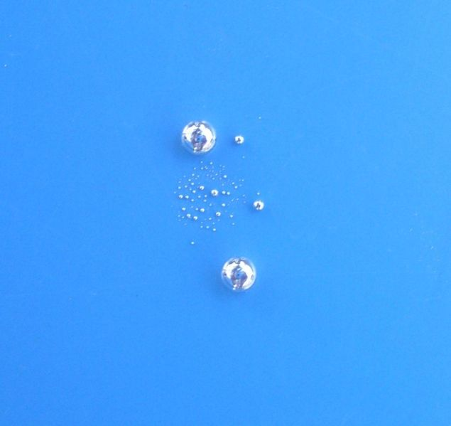
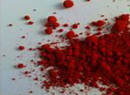
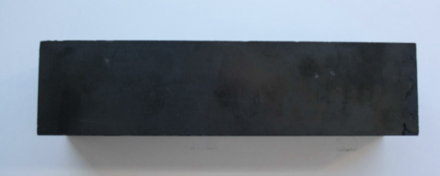
Mercury:
global policy, immediate action
Mercury Two country
-Mexico and Panama-
Storage and Disposal Project
Results Workshop
3-4 July 2013
Mexico City, Mexico
Desiree Montecillo-Narvaez
Programme Officer
Chemicals Branch
UNEP DTIE

Slide 2
Outline of presentation
Why mercury?
Towards the Minamata Convention on Mercury
The UNEP Global Mercury Partnership
Lessons learned from the Argentina and Uruguay mercury storage and disposal project
Mexico and Panama expected outcomes of the project

Slide 3
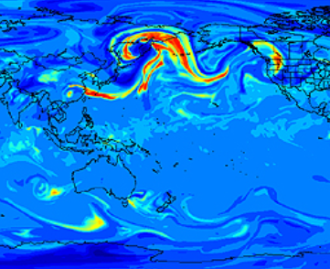
Why mercury?
  Of global concern…
  evidence of significant:
  atmospheric transport
  atmospheric residence
  health impacts through environmental exposure routes
  Other heavy metals considered of common concern
Image from: Dastoor, A. and D. Davignon. 2008. Eds: N. Pirrone and R. Mason. Interim Report of the UNEP Global Partnership
Notes:
3
explore how to share and exchange information most effectively

Slide 4
UNEP Global Mercury Programme:
A twin track approach
Diplomatic Conference, Japan, 2013
INC2 Japan
INC1 Sweden
INC3
Kenya
INC4 Uruguay
Intergovernmental
Negotiating
Committee
INC5
Geneva
2009
2010
2011
2012
2013
OEWGs
2018 onwards
GC = Governing Council
OEWG = Open-ended working group
2009-2013
2014~2017
2001-2008
UNEP GC
decisions
Entry into force?
…
Global Mercury Partnership
Global Hg assessments

Slide 5
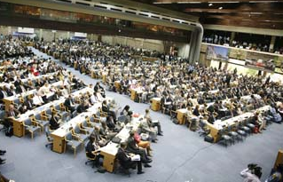
Negotiating the global treaty
UNEP Governing Council decision 25/5 III (Feb 2009):
Requested UNEP to convene and support an intergovernmental negotiating committee beginning work in 2010 … (and) … to complete negotiations prior to February 2013
Each INC:
  >125 Governments
  >500 participants
Observers:
  UN Agencies,
  Civil Society
  Academia
  Industry
Notes:
5

Slide 6
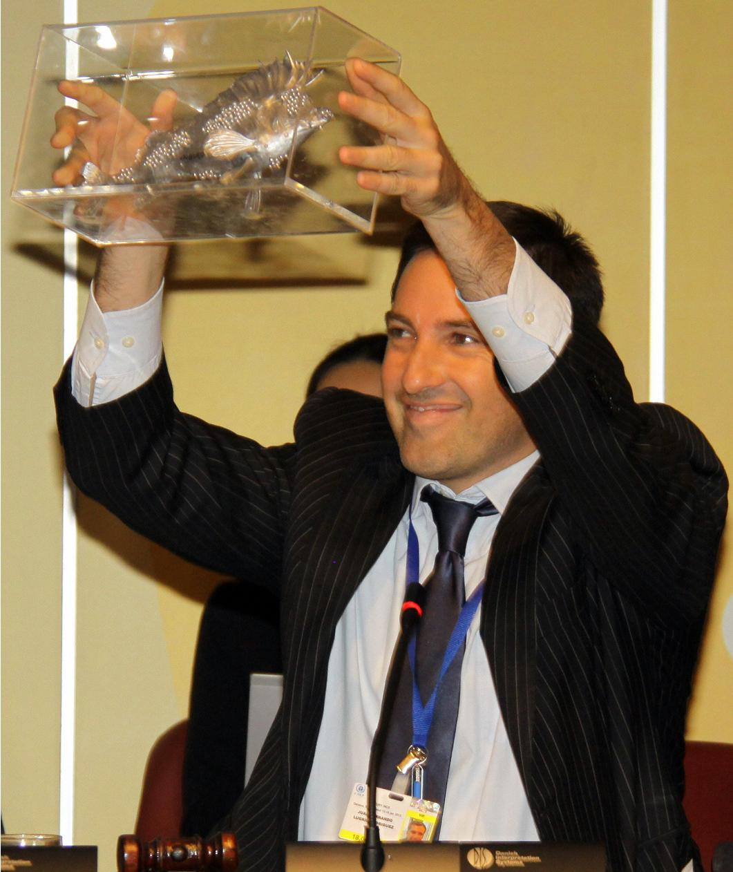
Outcome of INC5
19 January 2013:
Governments agreed to the text of the “Minamata Convention on Mercury” and successfully fulfilled the GC 25/5 mandate
Secretariat requested to prepare draft elements of the Final Act to be adopted at the DipCon
Notes:
6

Slide 7
Outcome of UNEP GC 27
Requests the Executive Director to convene a conference of plenipotentiaries- Minamata, Kumamoto perfecture 7-11 October 2013
Calls on governments and regional integration groups to adopt and thereafter sign the Minamata Convention on Mercury
…Take domestic measures to enable them to meet their obligations upon ratification,
Notes:
7

Slide 8
Outcome of UNEP GC 27
Requests UNEP secretariat and its partners to continue taking immediate action on mercury through the Global Mercury Partnership
Requests the ED to continue to provide support to the Global Mercury Partnership
Notes:
8

Slide 9

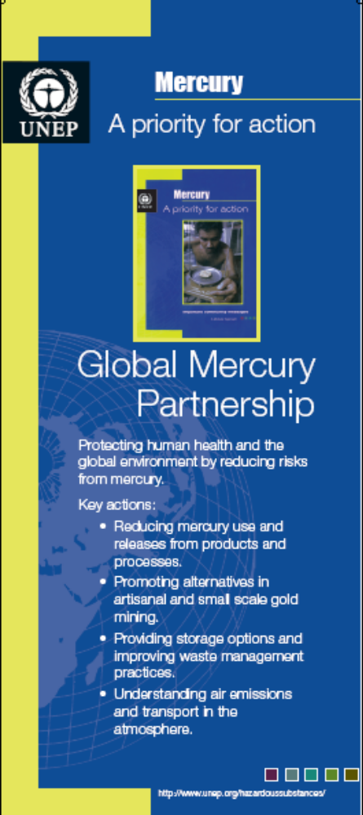

The Global Mercury Partnership
  Initiated in 2005
  8 partnership areas + business plans
  Partnership Advisory Group
  UNEP coordinates as secretariat
  >200 official partners
  Air transport and fate → improving knowledge
  Chlor-alkali → transforming ~ 100 facilities in 44 nations
  Products → identifying, promoting alternatives to Hg
  Supply & storage → reducing supply to dwindling demand
  Waste management → promoting sound disposal
  ASGM → linking mercury-free mining to development drivers
  Coal combustion → seeking pollution control co-benefits
  Cement → retaining not emitting
Notes:
9
Abstract:
In February 2009, the Governing Council of UNEP agreed on the need to develop a global legally binding instrument on mercury. The work is being undertaken by an intergovernmental negotiating committee and is to be finalized by February 2013. UNEP Chemicals acts as a Secretariat to the negotiating committee and also operates a voluntary partnership programme (the Global Mercury Partnership) that works on interim priority activities related to mercury.
This session will provide an introductory overview of UNEP’s mercury programme — outlining the negotiation, the Global Mercury Partnership and the interface of this work. Overall scientific information is critical for informed policy. This session will highlight how knowledge is playing into the UNEP program and explore how to share and exchange information most effectively, identify knowledge gaps, and outline some of the Partnership needs from the science community as well as some considerations for the scientific community in light of the future mercury treaty.

Slide 10
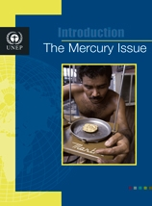
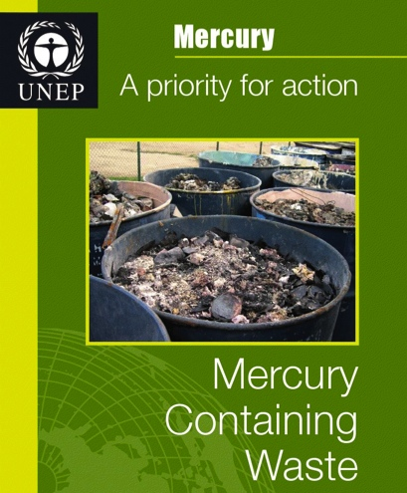
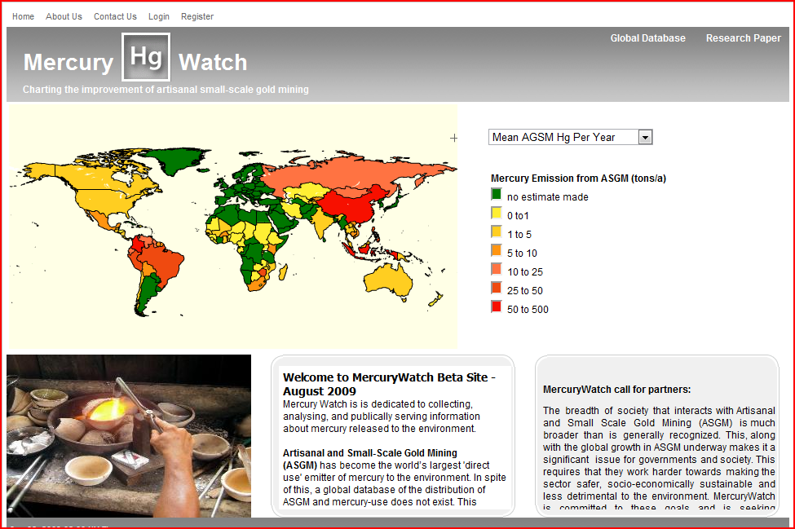
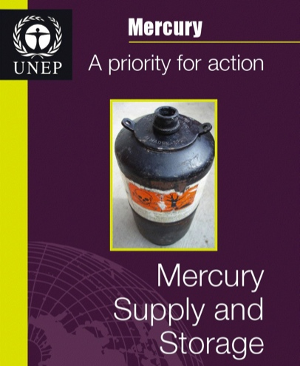
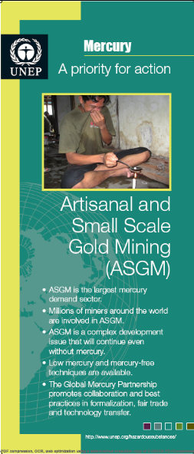
Main delivery tools and mechanisms
_______ _________ _______
Advocacy, awareness raising
Information gathering + exchange
Development of guidance materials
National and regional strategic planning
Demonstration projects
Notes:
- we are faced with treaty development… but it is a complementary process.

Slide 11
Global mercury budgets, based on models, illustrate the main environmental compartments and pathways, and the ways in which anthropogenic releases to air land and water move between these compartments.
Notes:
Mercury is released to the environment from natural sources and processes and as a result of human activities. Once it has entered the environment, mercury cycles between air, land, and water until it is eventually removed from the system through burial in deep ocean sediments or lake sediments and through entrapment in stable mineral compounds.
Methyl-mercury, which presents the greatest health risk to humans and wildlife, is mainly formed in aquatic environments through natural microbial processes.
Present anthropogenic emissions represent 30% of total emissions to air
Re-emissions comprising about 60%,
Natural emissions comprise about 10%
Re-emission is when mercury previously deposited from air onto soils, surface waters, and vegetation from past emissions are emitted back to the air. Re-emission is a result of natural processes that convert inorganic and organic forms of mercury to elemental mercury, which is volatile and therefore readily returns to the air. Mercury deposited to plant surfaces can be re-emitted during forest fires or biomass burning.
Mercury may be deposited and re-emitted many times as it cycles through the environment.
It is important that re-emitted mercury should not be considered a natural source. It may originally have come from natural or anthropogenic sources, but by the time it is re-emitted, it is difficult or impossible to identify its specific origin.
Natural sources: Mercury in the earth’s crust can be emitted and released in several ways to air, water, and land. Natural weathering of mercury-containing rocks is continuous and ubiquitous, allowing mercury to escape to air and to be washed into lakes and rivers. Volcanoes emit and release mercury when they erupt. Geothermal activity can also take mercury from underground and emit it to the atmosphere and release it to the deep oceans.

Slide 12
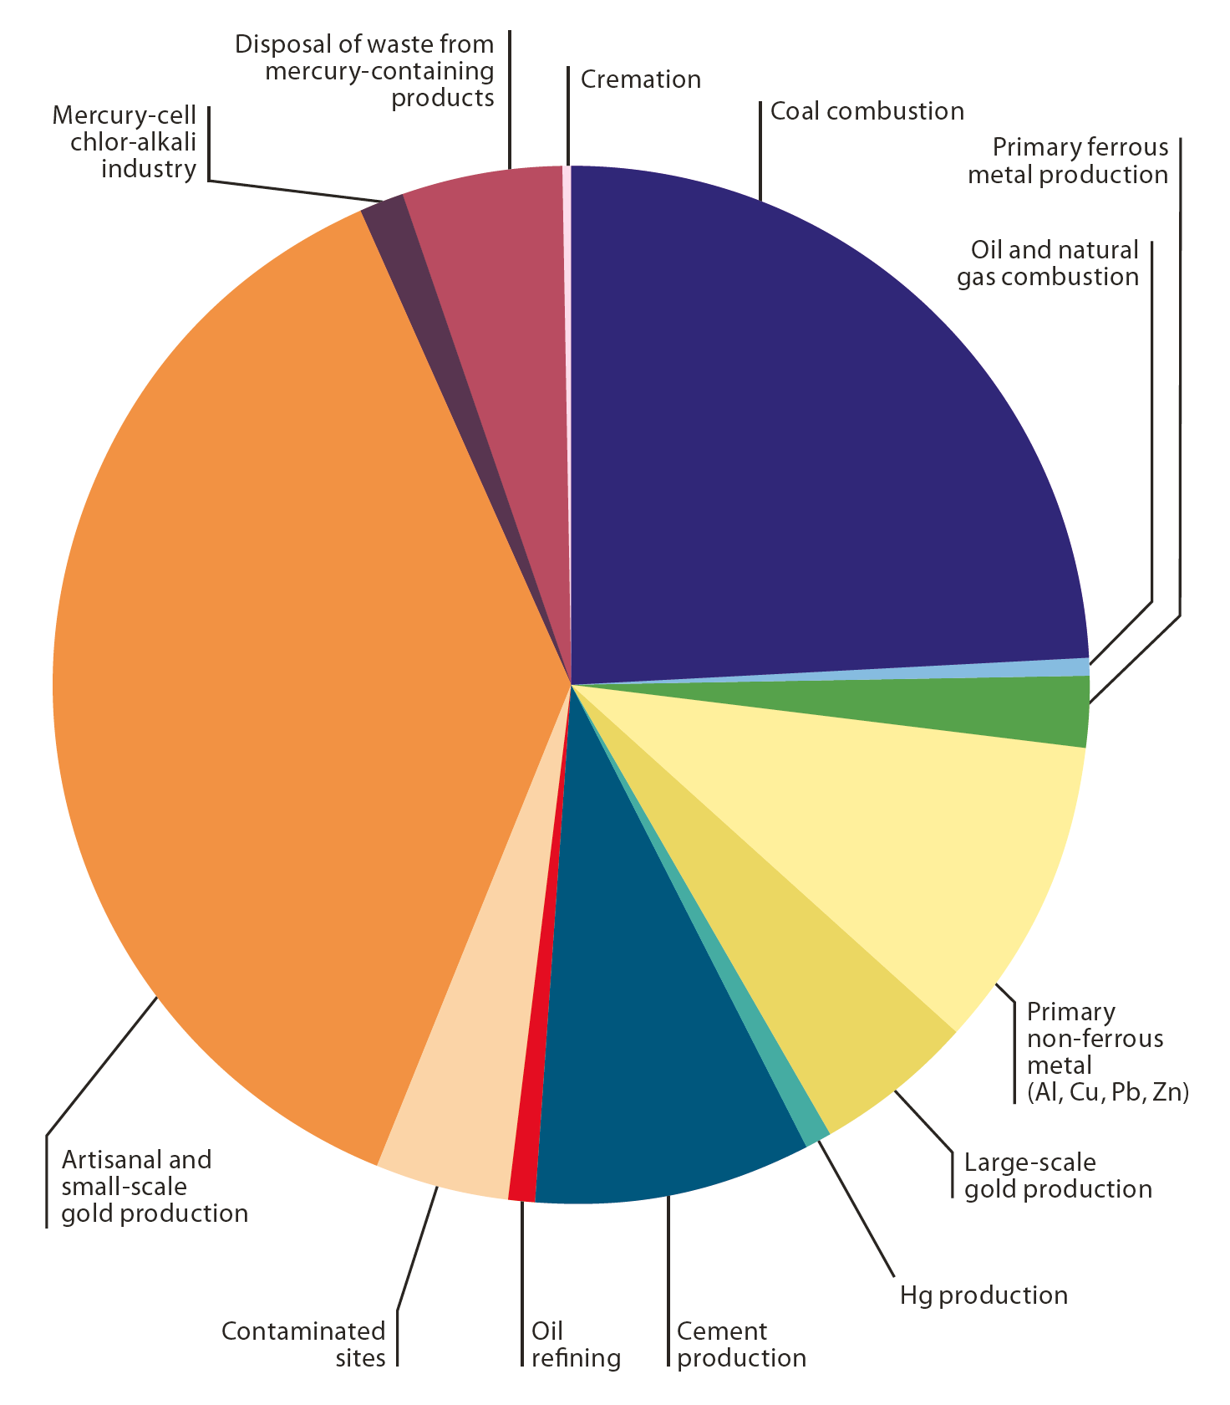
Emission estimates - by sectors
12
Notes:
12
The right side of the pie chart represents the un-intentional emissions, constituting a bit more than 50% of the total emissions, and emissions from intentional use slightly less on the left side of the pie.
The updated inventory of emissions to air confirms coal burning as a continuing major source of emissions, responsible for some 475 tonnes of mercury emissions to air annually (24% of total), compared with around 10 tonnes from combustion of other fossil fuels.
More than 85% of these emissions are from coal burning in power generation and industrial uses.
In the previous assessment, emissions from domestic and residential coal burning were highlighted as a possible larger contribution. Better information on coal consumption for domestic and residential uses indicates that these activities are a smaller contribution to total emissions from coal burning than previously thought.
Other large emitting sectors are: Primary non-ferrous metal production (10%), Cement production (9%). Worth mentioning is emissions from contaminated sites (4 %).
Artisanal and small-scale gold mining emissions are in the 2010 inventory, the major source of emissions to air, at 727 tonnes per year.
----------------------------------------------------------------------------
Emissions from the cement production industry are largely dependent on the fuels used. The new inventory avoids double counting of emissions from conventional fuels (such as coal and oil) which are included under the industrial fossil fuel burning emissions. However, it does attempt to account for emissions from other fuels, including alternative fuels (such as old tyres and other wastes) and from raw materials. Increasing amounts of waste are being co-incinerated in the cement industry both as fuel but also, in some plants, as a means of disposing of hazardous wastes, some of which may contain mercury. In some regions, additional measures are being introduced to make sure that mercury emissions associated with waste co-incineration do
not increase overall emissions from cement plants. Increased application of air pollution control devices, including some mercury-specific technologies, together with more stringent regulations in several countries have the effect of reducing mercury emissions from coal burning sectors and thus offset some part of the emissions arising from increased activity.
Mercury-cell technology is becoming less common in the chlor-alkali industry as other, more cost-effective processes are adopted. No new plants are being constructed, though many older plants remain to be converted. Old chlor-alkali plants and other decommissioned industrial sites may constitute contaminated sites that continue to release mercury to the environment for many years and emissions from contaminated sites are now part of the inventory.
Global emissions from use of mercury in dental amalgam resulting from cremation of human remains are estimated at 3.6 (0.9 – 11.9) tonnes in 2010.
In the production of vinyl chloride monomer, information is still lacking on the lifecycle and eventual fate of the mercury catalyst. Most of this production occurs in China, and about 800 tonnes of mercury is thought to have been used by this industry in China in 2012. Used mercury catalyst is recycled and reused by enterprises that hold permits for hazardous waste management. The amounts that may be emitted or released are unknown.
12

Slide 13
Global Mercury Supply
Sources of Mercury Supply (2007) | Mercury supply (metric tonnes)
Primary mercury mining | 1100-1400
By-product mercury | 600-800
Mercury from chlor-alkali cells (decommissioning) | 700-800
Recycled mercury catalyst, waste, products | 700-900
Total | 3100-3900
Source: Maxson, Peter
Notes:
13

Slide 14
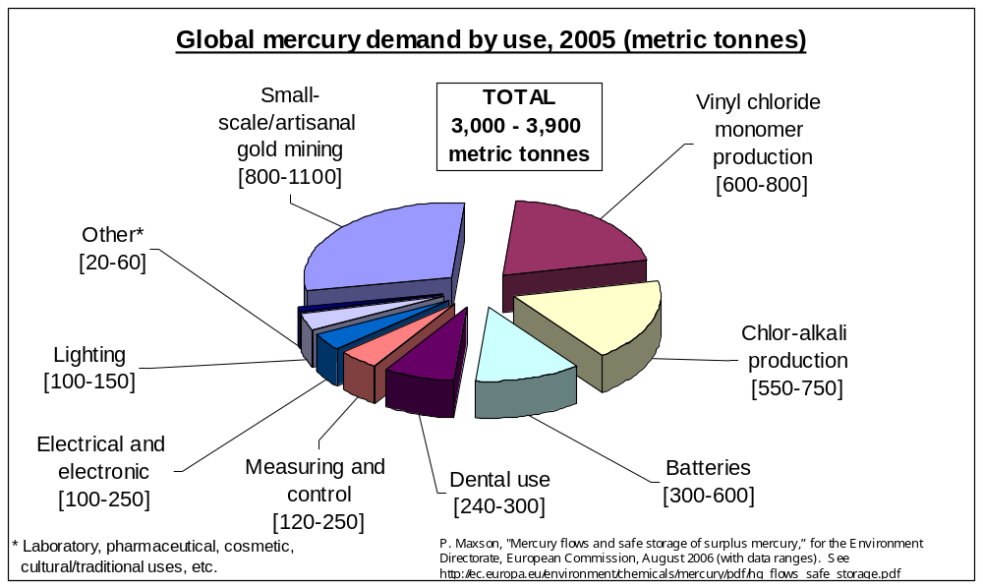
Global Mercury Use/Consumption

Slide 15
Mercury Life Cycle
Artisanal and Small-scale Gold Mining
Trade supply
Intentional use:
Process & products
Storage and Waste
Unintentional Releases

Slide 16
Waste/Disposal and Storage
Hg
Waste
Hg Commodity
Mercury Compounds (End of life products)
Industry mercury containing waste/elemental Hg
Elemental mercury (excess from decommissioned chlor alkali plants, byproduct from non-ferrous mining, oil and gas operations)
Basel Convention technical guidelines on the ESM of Mercury waste and waste containing mercury
Interim Storage options

Slide 17
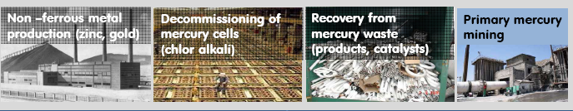
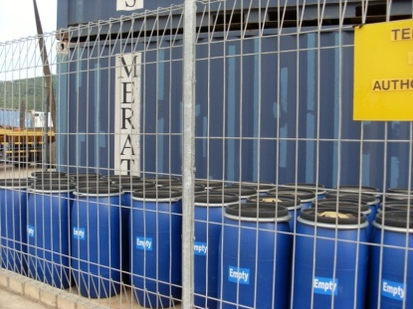
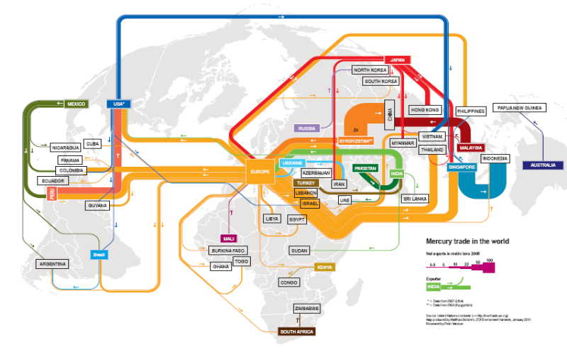
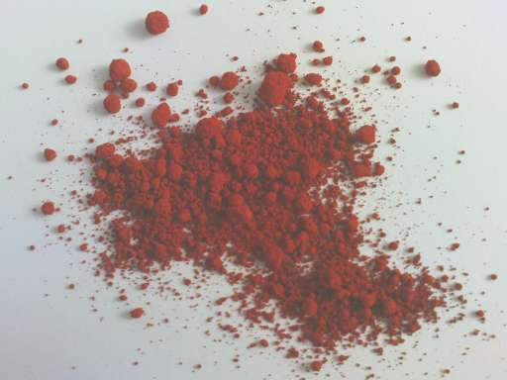
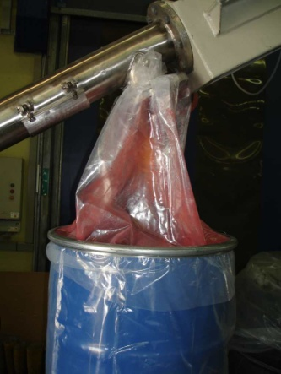
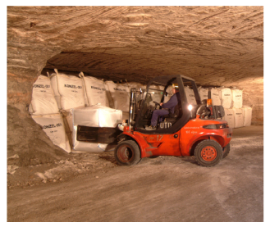
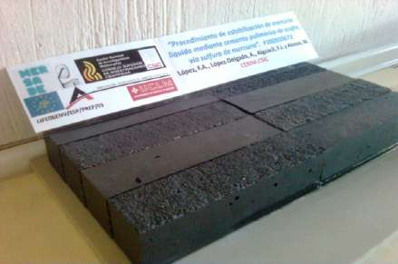
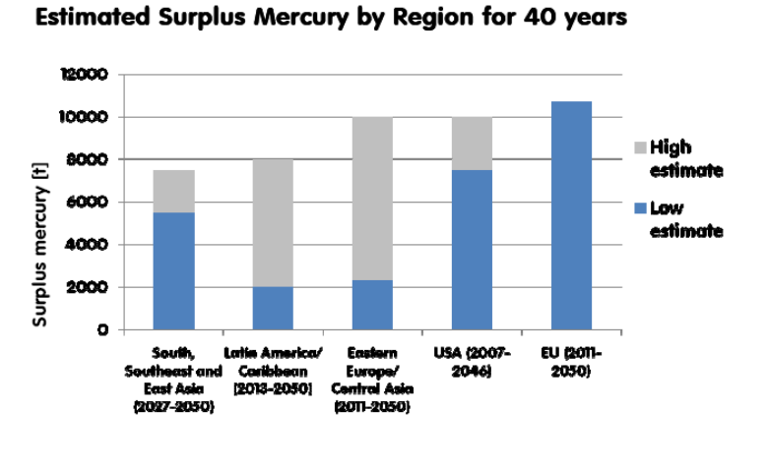
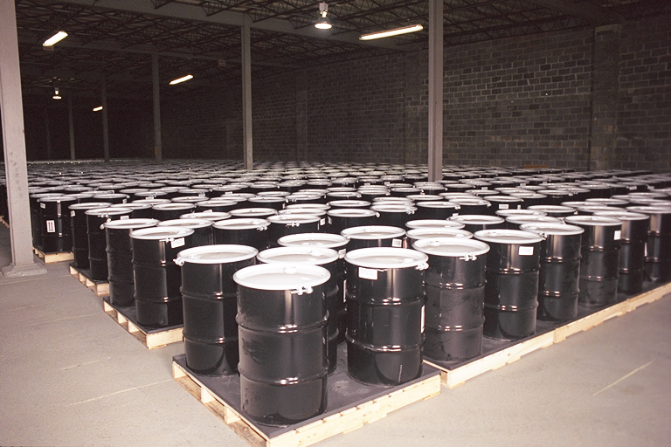
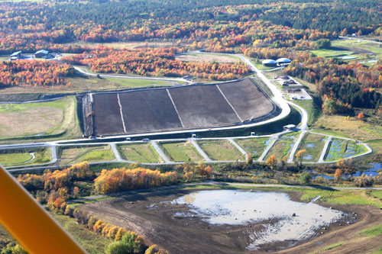
Supply, trade, storage, disposal
Examining options for storage, stabilization and encapsulation for mercury storage and disposal
Schematic mercury trade flows, prior to EU export ban.
Source: Zoi Environmental Network
Supply > demand in all regions < 2020
Surplus to 2050 estimated
  ∑_{xs min} 28,000 t, ∑_{xs max} 46,000 t

Slide 18
Article 10 of the Minamata Convention on Mercury: Environmentally sound interim storage of mercury
Article shall apply to the interim storage of mercury and mercury compounds that do not fall under the meaning of mercury waste in Article 11
Each Party shall take measures to ensure that the interim storage of such mercury and mercury compounds intended for a use is undertaken in an environmentally sound manner;
COP to adopt guidelines by the Conference of the Parties;
To enhance capacity-building by cooperation among each Party and relevant IOs and other entities.
Notes:
18

Slide 19
Article 11 of the Minamata Convention on Mercury: Mercury wastes
Mercury waste means substances or objects:
Consisting of mercury or mercury compounds;
Containing mercury or mercury compounds; or
Contaminated with mercury or mercury compounds
in a quantity above the relevant thresholds defined by the Conference of Parties.
Each Party shall take appropriate measures so that mercury waste is managed in an environmentally sound manner, taking into account the guidelines of Basel Convention;
In developing countries, the COP shall take into account Parties’ waste mangement regulations and programmes;
Close cooperation between the Conference of the Parties and the relevant bodies of the Basel Convention in the review and update of the guidelines;
Encouraging cooperation among each Party, relevant IOs and other entities to develop and maintain global, regional and national capacity.

Slide 20
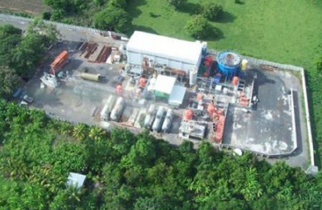
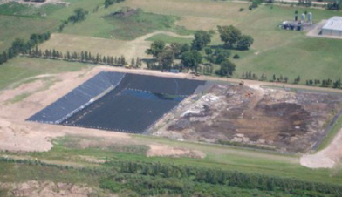
Mercury Storage and Disposal Project and its Output in Argentina and Uruguay
Objective: To promote the environmentally sound management of storage and disposal of surplus mercury in Argentina and Uruguay
Argentina and Uruguay…
wrote a draft National Action Plan for environmentally sound management of elemental and waste mercury
gained a better understanding of missing regulatory instruments
identified basic management options and potential sites for temporary storage
Source: Recovering S.A.
Source: Quimoalcali S.A.

Slide 21
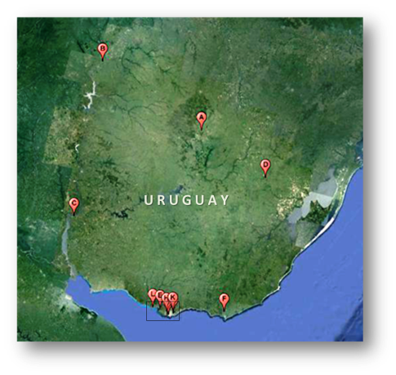
Country-Specifics: Uruguay
Findings:
2010 total releases = 2.2t - 3.6t → main sources:
  1) Chlor-Alkali, 2) Dental amalgam, 3) Electrical switches
16 potential sites for temporary storage
  Chlor-Alkali plant and industrial waste landfill best suited
  No security landfills for HW currently in operation
Regulations on hazardous substances + waste incomplete:
  no specific legal instrument specifically for HW , but new Waste Act due
Only 1 facility in operation to treat mercury containing waste (lamp crusher)
  Evaluating and supporting a distillation process for mercury waste in products
Recommendations:
Further investigate feasibility of the 2 potential sites becoming storage facilities
Proceed with preparation and adoption of the Waste Act; examine the draft and determine if the provisions take all necessary elements into account
Investment to create the necessary infrastructure to treat mercury waste
Location of potential sites.
(Source: adapted from Proyecto de Almacenamiento y Disposición de Mercurio Binacional Argentina – Uruguay. 2012)

Slide 22
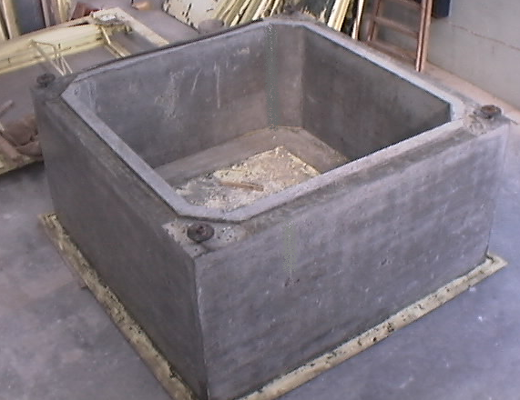
Country-Specific Findings (2): Argentina
Findings:
Inventory incomplete, limited knowledge of releases and hotspots
  Largest sources : 1) Health sector, 2) Chlor-Alkali, 3) Light bulbs
4 HW security landfills potential facilities for temporary storage
  2 landfills authorized for treatment (stabilization)
Technical proposal for permanent storage
  Good structural behavior, durability, penetrability
Solid regulatory framework covering HW, but:
  No specific instruments for mercury wastes,
  Only 5 Argentine provinces allow import of HW
Recommendations:
Enhance analysis of possible storage sites
Make detailed assessment of waste sources and their location
Advance on regulations specifically addressing mercury waste management
Adapt regulations enabling transfer of wastes to domestic facilities
INTI’s Prototype container (Source: Proyecto “Almacenamiento y disposición ambientalmente adecuados de mercurio elemental y sus residuos en la República Argentina”)

Slide 23
Mexico and Panama
Mercury Storage and Disposal Project
Expected Outcomes
Inventory of mercury and mercury waste
Potential sites for storage and disposal identified
Strengthened interagency collaborating mechanism
Management options identified
National action plans on mercury developed

Slide 24
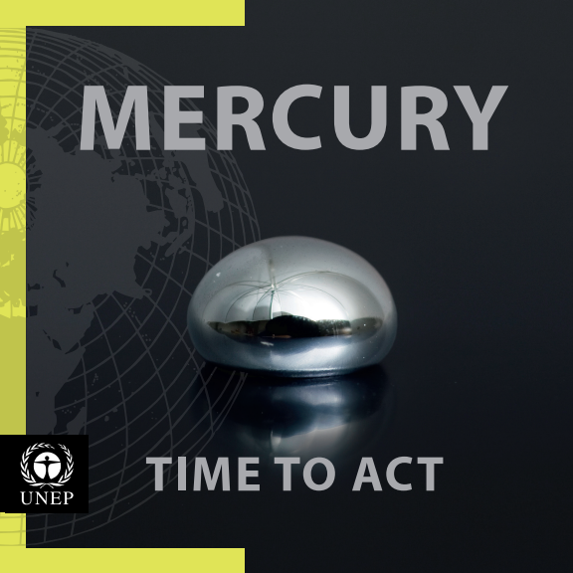

“It is imperative that we act now!”

Slide 25
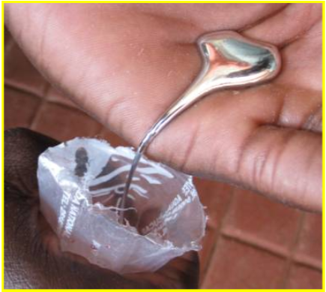
Mercury:
global policy, immediate action
Thank you
desiree.narvaez@unep.org
Notes:
25

