Slide 1

Strengthening the capacity in the management of Contaminated Sites in BiH and Serbia to reduce pollution into the environment
Vienna 27.03.2026

Slide 2



South-Eastern Europe (de)Pollution Platform (SEEPP) Activities 2024 - 2026
Towards Zero Waste
Western Balkans Regional Waste Conference (26-27 March 2024)
Circularity in Sectors
Innovative circular economy approaches to agricultural and municipal waste management for better air quality in Asia Pacific and the Western Balkans
Pollution and Health
Regional E-waste Monitor for the Western Balkans
Policy action for mitigating health impacts of air pollution
Soil Pollution: Contaminated Sites in BiH-SRB
Special programme BiH
One Health in the Western Balkans 4-5 December 2024
UNEP - UNCT WB technical dialogue on pollution
Agenda 2030 Multilateral Environmental Agreements (MEAs)
Notes:
UPDATED

Slide 3
SEEPP and UNEP Programme of Work
SEEPP - Soil and water pollution pillar
Strengthening the capacities on contaminated sites in BiH and Serbia
Pilots training and guidelines on risk assessment, on-site trainings
GIS maps of illegal landfills; prioritization and remediation guidelines.
Enhancing enforcement capacities and public awareness on illegal landfill management
Legal and institutional assessment and policy recommendations
Data collection and trainings
Strengthen enforcement and awareness, develop projects pipeline
UNEP-UNDP Agreement !NEW!
Output 1: Creating enabling conditions. Fostering enabling conditions through policy support and partnership. (3.5)
Activity 1.1. Strengthening the legal frameworks, institutional mechanisms and capacities for environmentally sound chemicals management, including MEAs implementation (at national and regional levels).
Project Outcome: Stakeholders are equipped to reduce harmful chemicals in products and processes. (3.9)
POW Outcome: 3A Human health and environmental outcomes are optimized through enhanced capacity and leadership in the sound management of chemicals and waste.
Notes:
UPDATED

Slide 4
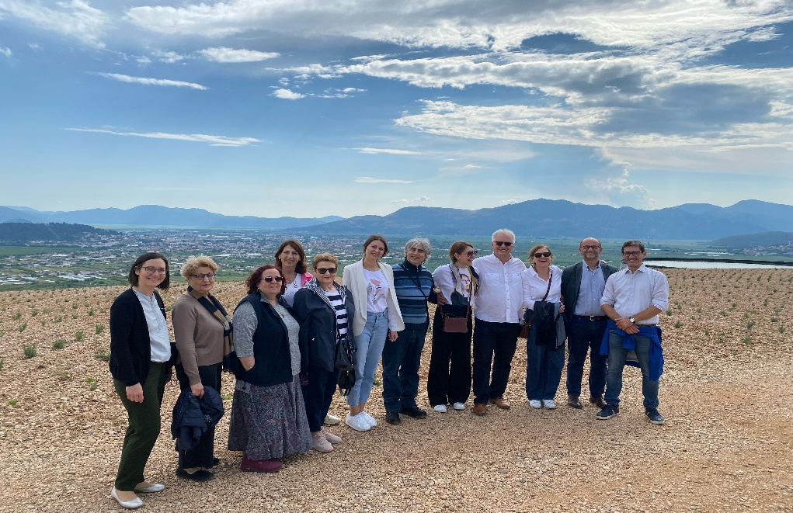
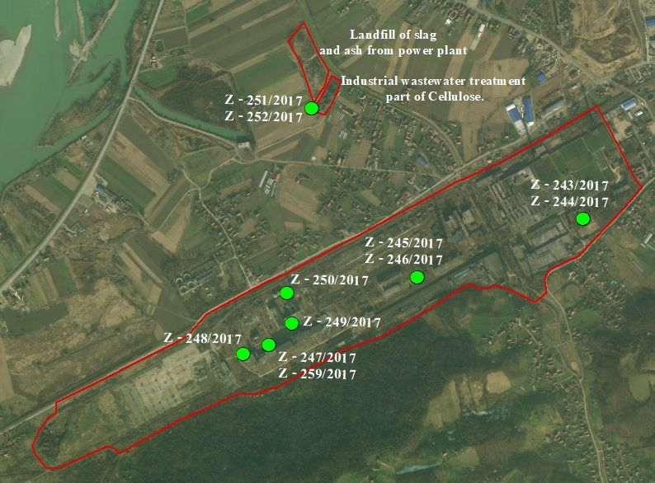

Strengthening the capacity in the management of Contaminated Sites in BiH and Serbia to reduce pollution into the environment (2023 - 2026)
Source of funds: Italy
Budget: EUR 300,000
Implementation timeframe: 2023 – 2026
Target Countries: BiH and Serbia
Objective: To reduce pollution, increase environmental protection practices and improve human health, through strengthening institutions and capacities in identifying and prioritize pollution-prevention and related environmental priorities
1.Coordination strengthening networks
2.Strengthening capacities
3. Pilot sites preliminary characterization
:
Background: GEF project Enhanced Cross-sectoral Land Management through Land Use Pressure Reduction and Planning in Serbia, Co-funded by Italy, SEEPP – Phase I
Notes:
UPDATED

Slide 5
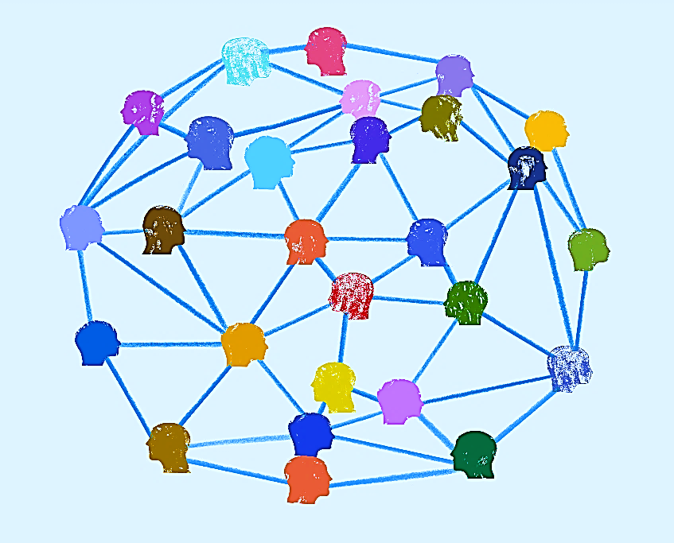


      COMPONENT 1 - Coordination activities, data exchange, strengthening networks
Activity | Outputs
1.1 Launching and closing event | 🎯 Launching event in March 2024 and inception meeting in May 2024 Final conference
1.2 Establishment of the Thematic Groups on pollution | 🎯 Thematic working group established in October 2024: 2 joint meetings (04.12.2024 and 22.02.2025), plus meetings at national level carried out Methodology for selection of pilot sites finalised
1.3 Visibility | 🎯 Pollution Platform UNEP webpage / LinkedIn / brochure Visibility materials (On-going)
Notes:
UPDATED

Slide 6

      COMPONENT 2 - Strengthening capacities
Activity | Outputs
2.1 Policy assessment | 🎯Report on the relevant environmental and health policies prepared Identification of policy actions needed: Identification of legal gaps and support in Law drafting*
2.2 Data survey and collection of data on contaminated sites | 🎯Collection of data related to contaminated and potentially contaminated sites and potential polluting activities. Support in development / updating of a register and list of main soil contaminants
2.3 Capacity building activities | 🎯Training government officials, clean-up professionals, inspectors and operators Training materials and technical guidelines
Notes:
UPDATED

Slide 7
      COMPONENT 3 Identification of pilot site(s) and design of preliminary characterization plan
Activity | Outputs
3.1 Identification and selection of pilot site(s) | 🎯Methodology for identification for contaminated sites developed Pilot site(s) identified (and approved by the PSC
3.2 Field investigation activities to determine the sampling points at selected sites for soil and groundwater | 🎯Field visit(s) report(s)
3.3 On-the job training on the development of characterization plans | Training materials and report (On-going)
3.4. Drafting characterization plan for the selected site(s) | 🎯 Draft Characterization plan(s) delivered
Notes:
Updated by AST
3.3. On-the job training on the development of characterization plans – considered as (partially) completed during the field visits?

Slide 8
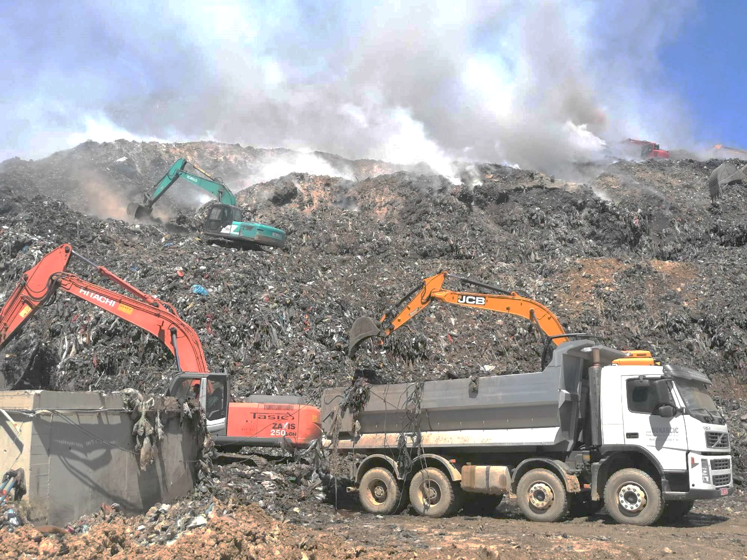
Enhancing enforcement capacities and public awareness to improve the management of Contaminated Sites from Non-Compliant and Illegal Landfills in the Western Balkans (2024 - 2026)
Source of funds: Italy
Budget: EUR 400,000
Implementation timeframe: 2024 – 2026
Target Countries: BiH and Serbia
Objective: To support the governments of Serbia and Bosnia and Herzegovina in identifying and addressing contaminated sites, specifically targeting illegal and non-compliant landfills.
1. Mapping of non-compliant and illegal landfills
3. Strengthened enforcement and preventive capacity
4. Public awareness and stakeholder engagement at regional level
2. Improved remediation planning and implementation
Picture: Branislava Matic
:
Background: Strengthening the capacity on Contaminated Sites management (2023 - 2026); GEF project Enhanced Cross-sectoral Land Management through Land Use Pressure Reduction and Planning in Serbia, Co-funded by Italy, SEEPP – Phase I
Notes:
UPDATED

Slide 9

      Outcome 1: Mapping of non-compliant and illegal landfills
Activity | Outputs
1.1 Identify illegal landfills and non-compliant waste disposal areas at regional level. | GIS-based map of illegal and non-compliant landfills at regional level, with data on waste composition, contamination, and affected areas, potential impact on environmental matrixes. - List of illegal landfills in BiH and Serbia
1.2 Gather data on types and quantities of waste, hazardous chemicals, and pollutants at each site. | Contamination database and analysis report, which will serve as a foundation for targeted remediation strategies. - List of illegal landfills in BiH and Serbia
1.3 a) Analyse available risk prioritization methodologies and select the most suitable approach. b) Apply the chosen methodology to assess illegal landfills and non-compliant waste disposal areas. | Selection of the most suitable risk methodology, application to available data, and creation of a prioritized list based on risk level
Notes:
Added by AST

Slide 10

      Outcome 2: Improved remediation planning and implementation
Activity | Outputs
2.1 Develop guidelines for the safety and remediation of non-compliant and illegal landfills, incorporating best practices for soil decontamination, waste removal, and landfill closure. | Guidelines for the safety and remediation of non-compliant and illegal landfills
2.2 a) Organize training sessions on waste management best practices, site remediation, and landfill closure methods for local authorities and environmental agencies. b) A module addressed to the local stakeholders in identifying and reporting on contaminated sites will be also included in the training programme. c) Study visits in Italy will be also organised to share best practices and lessons learnt | Training modules on contaminated site management, including legal frameworks, technical remediation techniques, and stakeholder engagement, improving reporting capacities of local authorities. 2 Study visits in Italy for the representatives of the PSC and the TWG. - Trainings modules on contaminated site management, including legal frameworks, technical remediation techniques, and stakeholder engagement. - Improving reporting capacities of local authorities in Serbia. - Study visit 1 to Rome
Notes:
Added by AST
Improving reporting capacities of local authorities in Serbia

Slide 11

      Outcome 3: Strengthened enforcement and preventive capacity
Activity | Outputs
3.1 Conduct a review of current enforcement mechanisms for managing contaminated sites, focusing on gaps and opportunities for strengthening regulations on illegal landfills. | 🎯 Legal framework report with recommendations for improving enforcement capacity, including proposals for policy adjustments and increased penalties.
3.2 Conduct workshops for law enforcement and regulatory personnel on monitoring, inspection, and penalization of illegal dumping activities at regional level. | Training sessions focused on enforcement strategies, evidence collection, and procedures for environmental law violations at regional level.
Notes:
Added by AST

Slide 12

      Outcome 4: Public awareness and stakeholder engagement at regional level
Activity | Outputs
4.1 a) Organize stakeholder consultations and community outreach events to raise awareness about the environmental and health impacts of illegal landfills. b) Emphasize the role of the public and private sectors in supporting sustainable waste practices. c) Develop a list of “quick start” project concepts and ideas, considering the identified countries’ needs and priorities in the fields addressed by the project | Public awareness campaigns, community workshops, and stakeholder forums aimed at fostering a culture of environmental responsibility and engaging communities in pollution prevention efforts. List of “quick start” project concepts and ideas (as a part of the SEEPP project hub)
Notes:
Added by AST

Slide 13

Key milestones and upcoming activities
  -----
  Finalising Sampling and the characterisation plans for selected sites in BiH and Serbia
  2nd Study Visit to Italy – October 2026
  Completed capacity building programme
  ------
  Visibility updating the UNEP SEEPP webpage and improve its visibility
Notes:
To be completed

Slide 14

Thank you
www.unep.org

