Slide 1

Use of Visuals in Assessments
Graphs, Charts, Maps and Infographics
Pierre Boileau, UN-Environment
Feb. 20, 2017

Slide 2
Importance of Visuals in the Global GEO 6 Assessment report
Improve readability of the Assessment report
  Interactiveness of the report
Improve the presentation of the document
  Style and consistency of the document
Enhance usability and outreach of the final product
  Easily accessible and reusable information in the document

Slide 3
Types of visuals
There is a wide variety of visuals that can be used and which are effective for different purposes. They can be divided in two major categories, functional and motivational.
Functional - Used to support or enhance an understanding of a topic. They can be subdivided into four categories.
  Graphs - used to show relationships and patterns over time
  Charts - used to represent parts of a whole or relationships with the whole
  Tables - used to display and organize large amounts of data, usually numerically
  Illustrations - (e.g. maps and infographics)- used to show how something looks or works
Motivational - used only to get the reader's attention and motivate him/her to read the document by making it more visually attractive. They can be anything from text formatting to stunning images/photos.
Usage
The incorporation of the visual is as important for its effectiveness as it is for using the correct type. When preparing a document you must plan in advance where to place and reference the visuals. Visuals must be incorporated and properly referenced within the text.

Slide 4
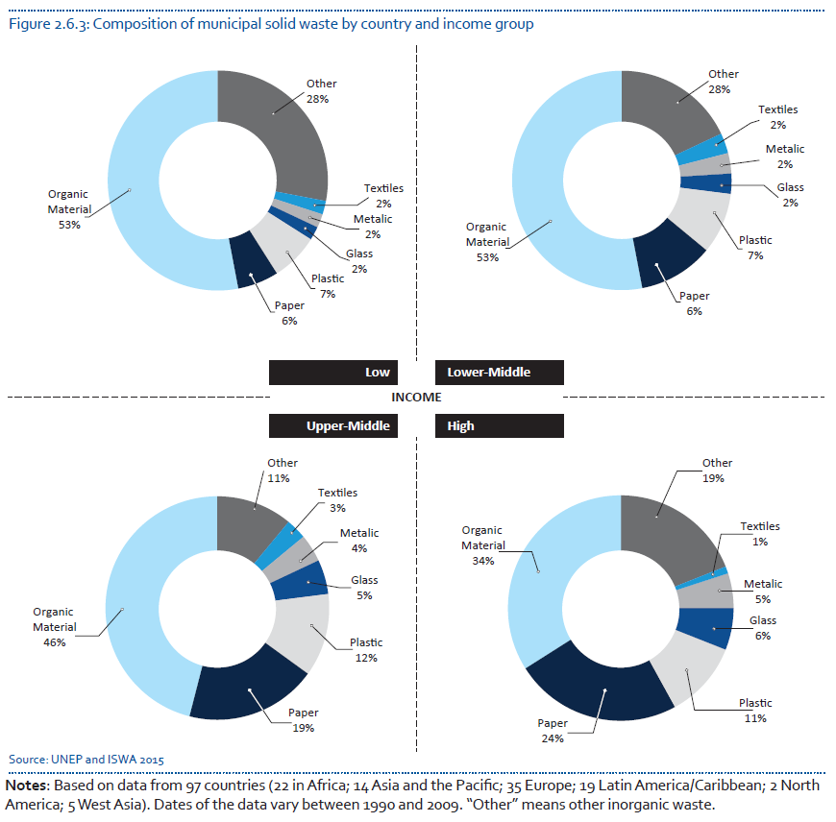
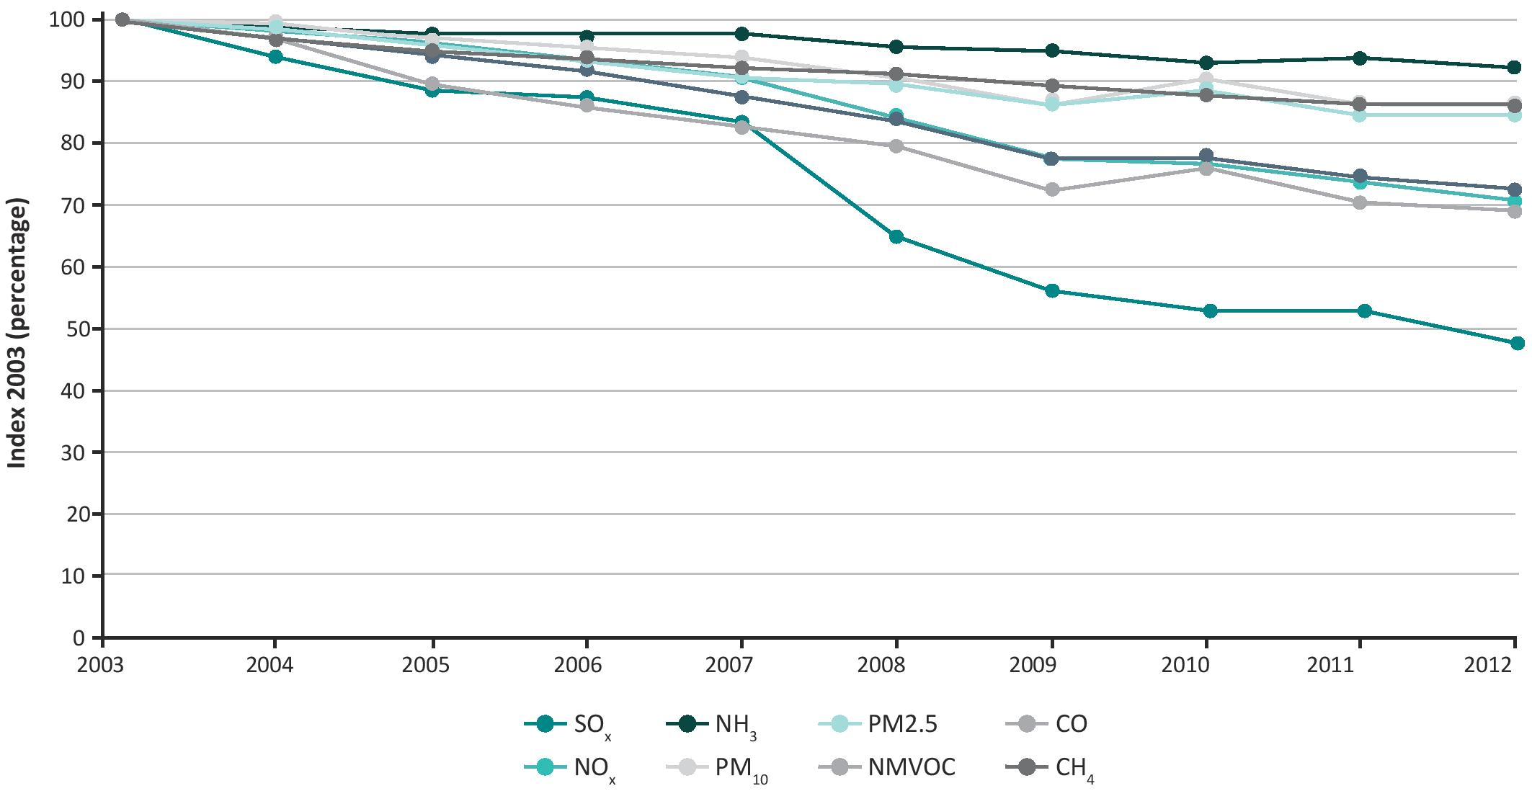
Use of visuals
GRAPHS
Readers often have trouble grasping a complex series of numbers. You can ease their difficulty by using graphs to show statistical trends and patterns.
CHARTS
Charts are particularly useful for summarizing large blocks of information

Slide 5






The Secretariat can support you in the preparation of your charts, maps, graphs and infographics throughout the GEO-6 process

Slide 6
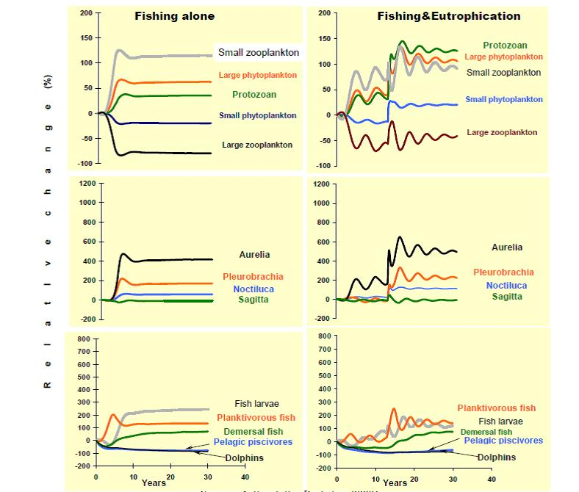
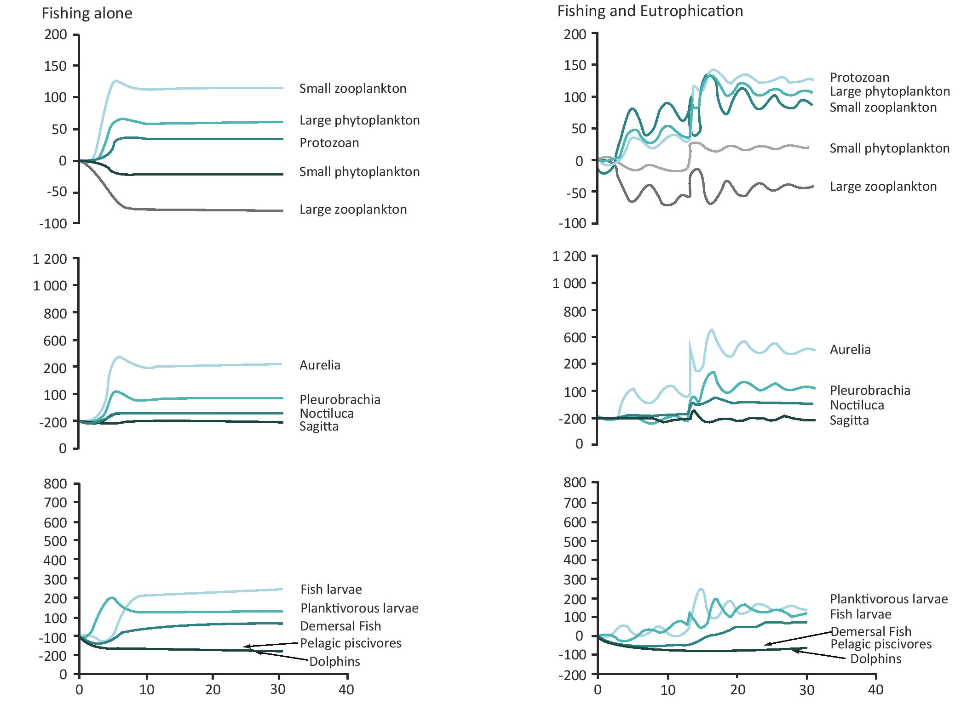
Clarity
Before
After

Slide 7
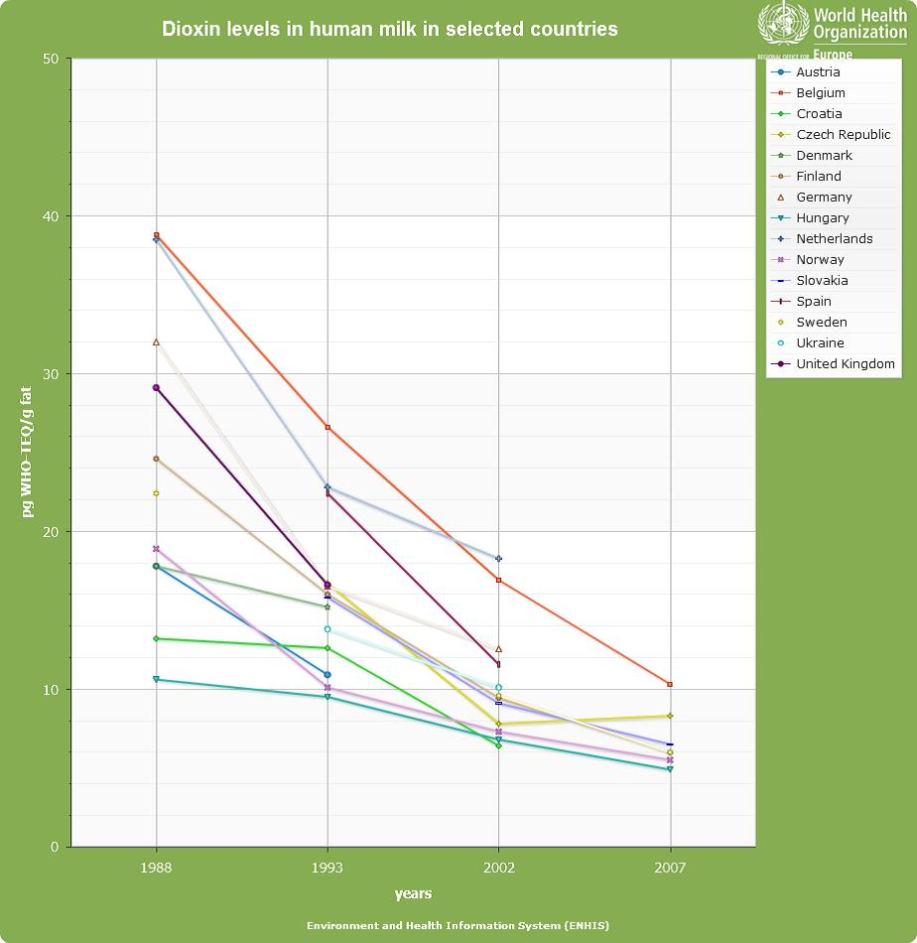
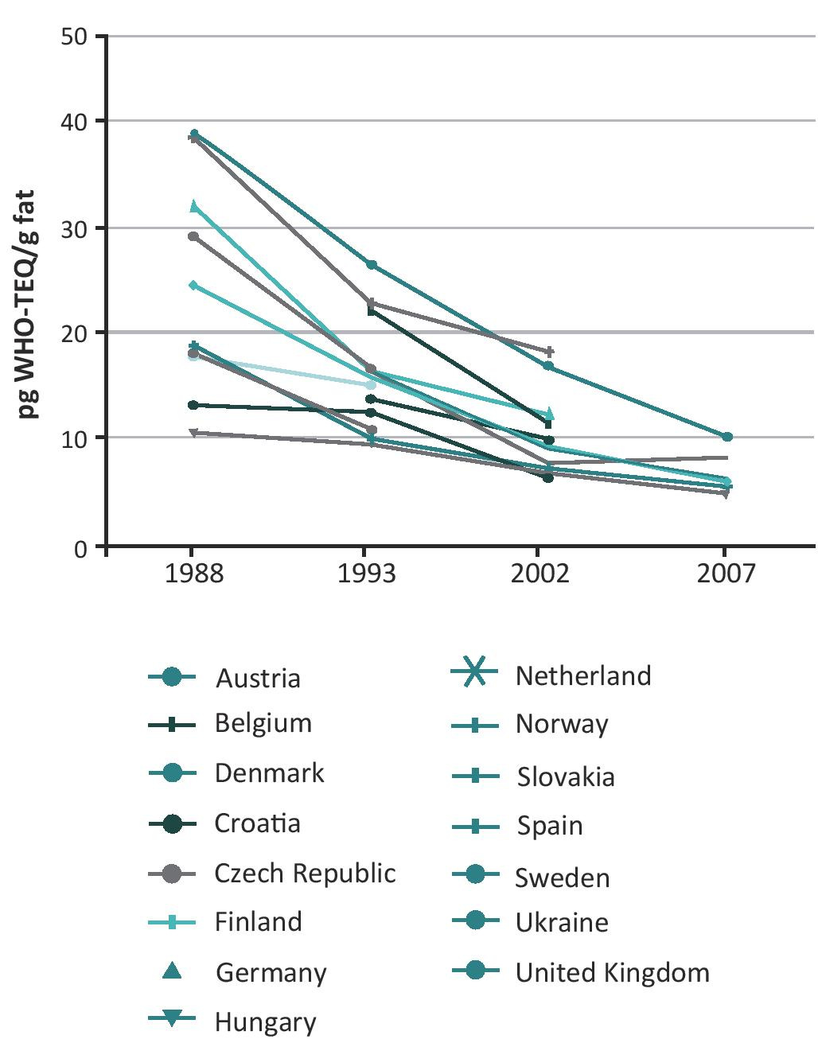
Adapt to the colour scheme of the assessment
Before
After

Slide 8
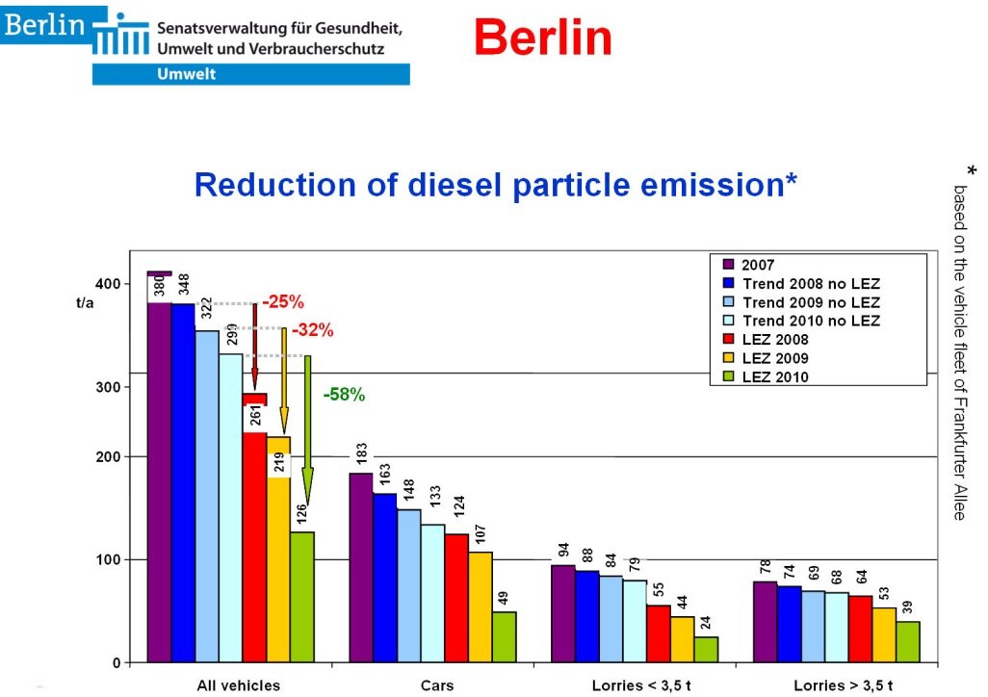
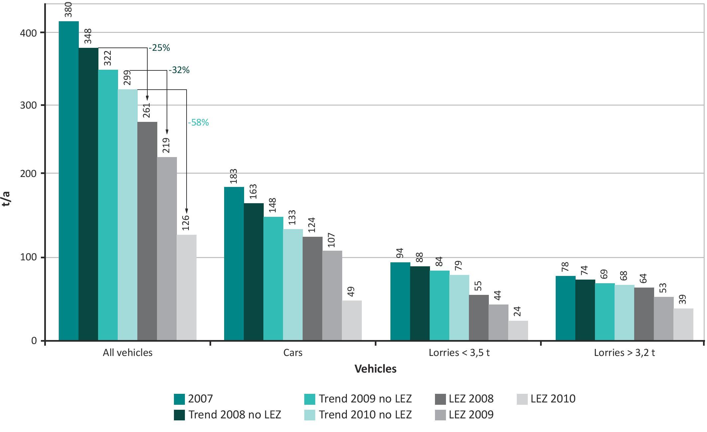
Improve quality
Before
After

Slide 9
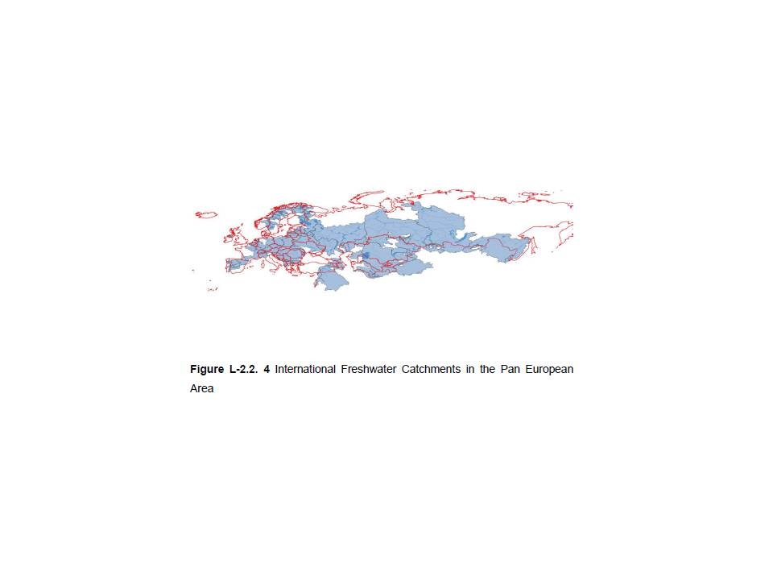
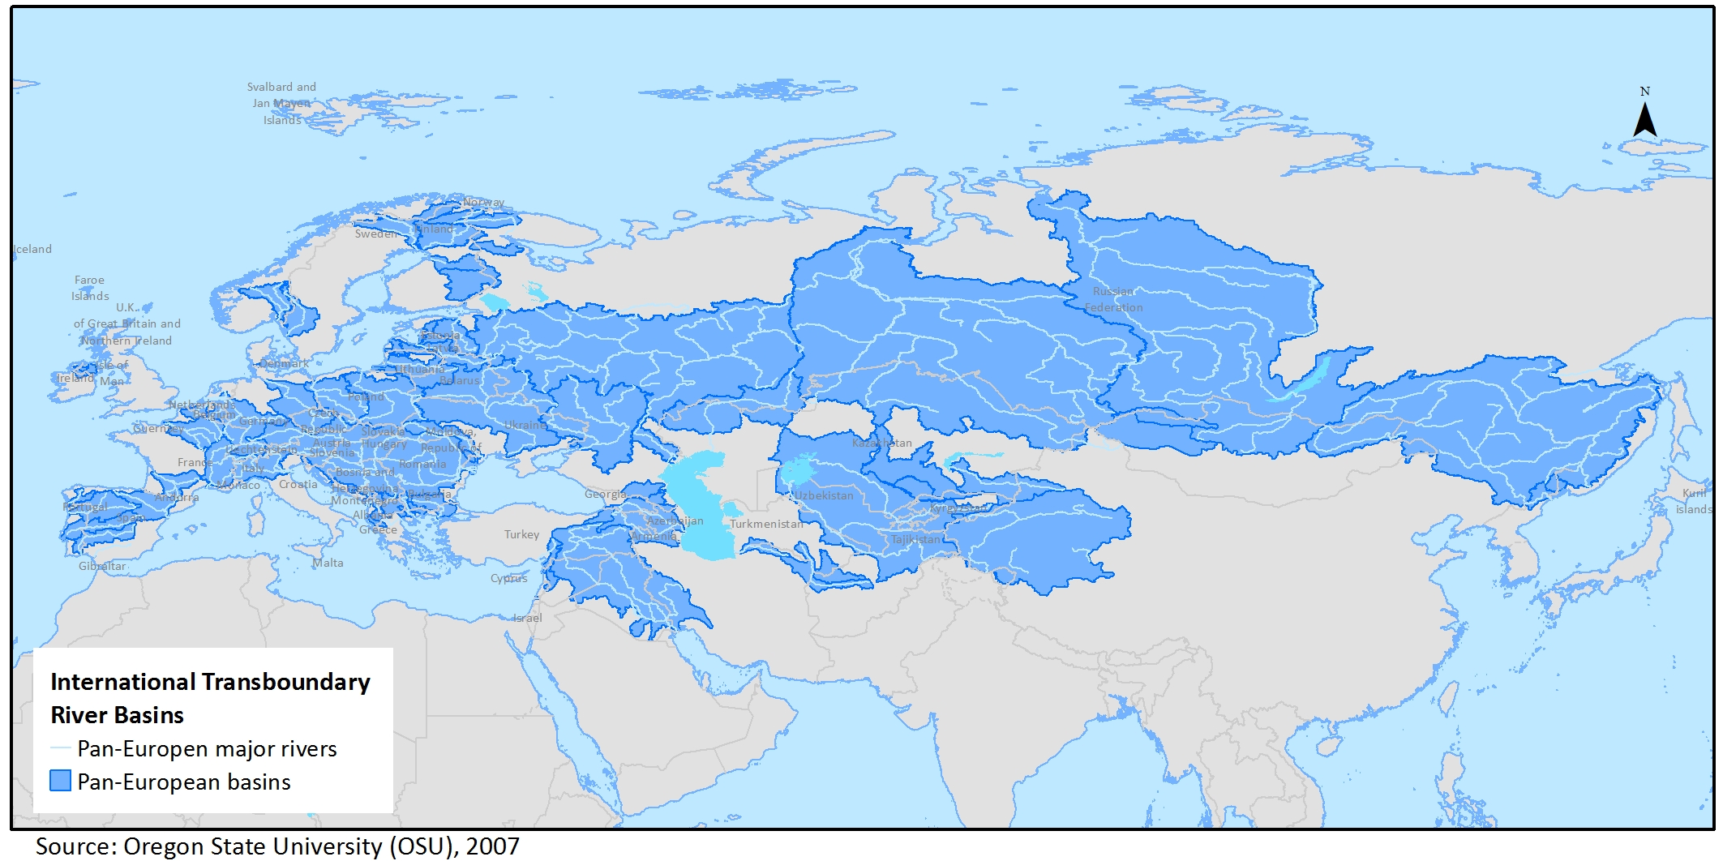
Adaptability and clarity
Before
After

Slide 10
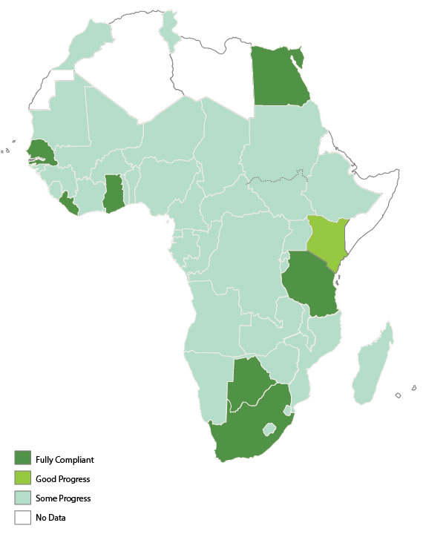
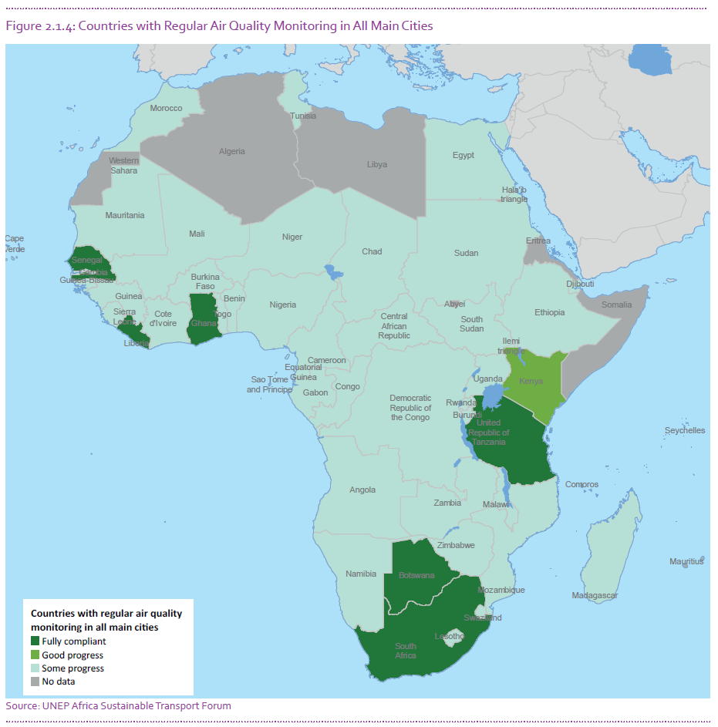
Clarity
Before
After

Slide 11
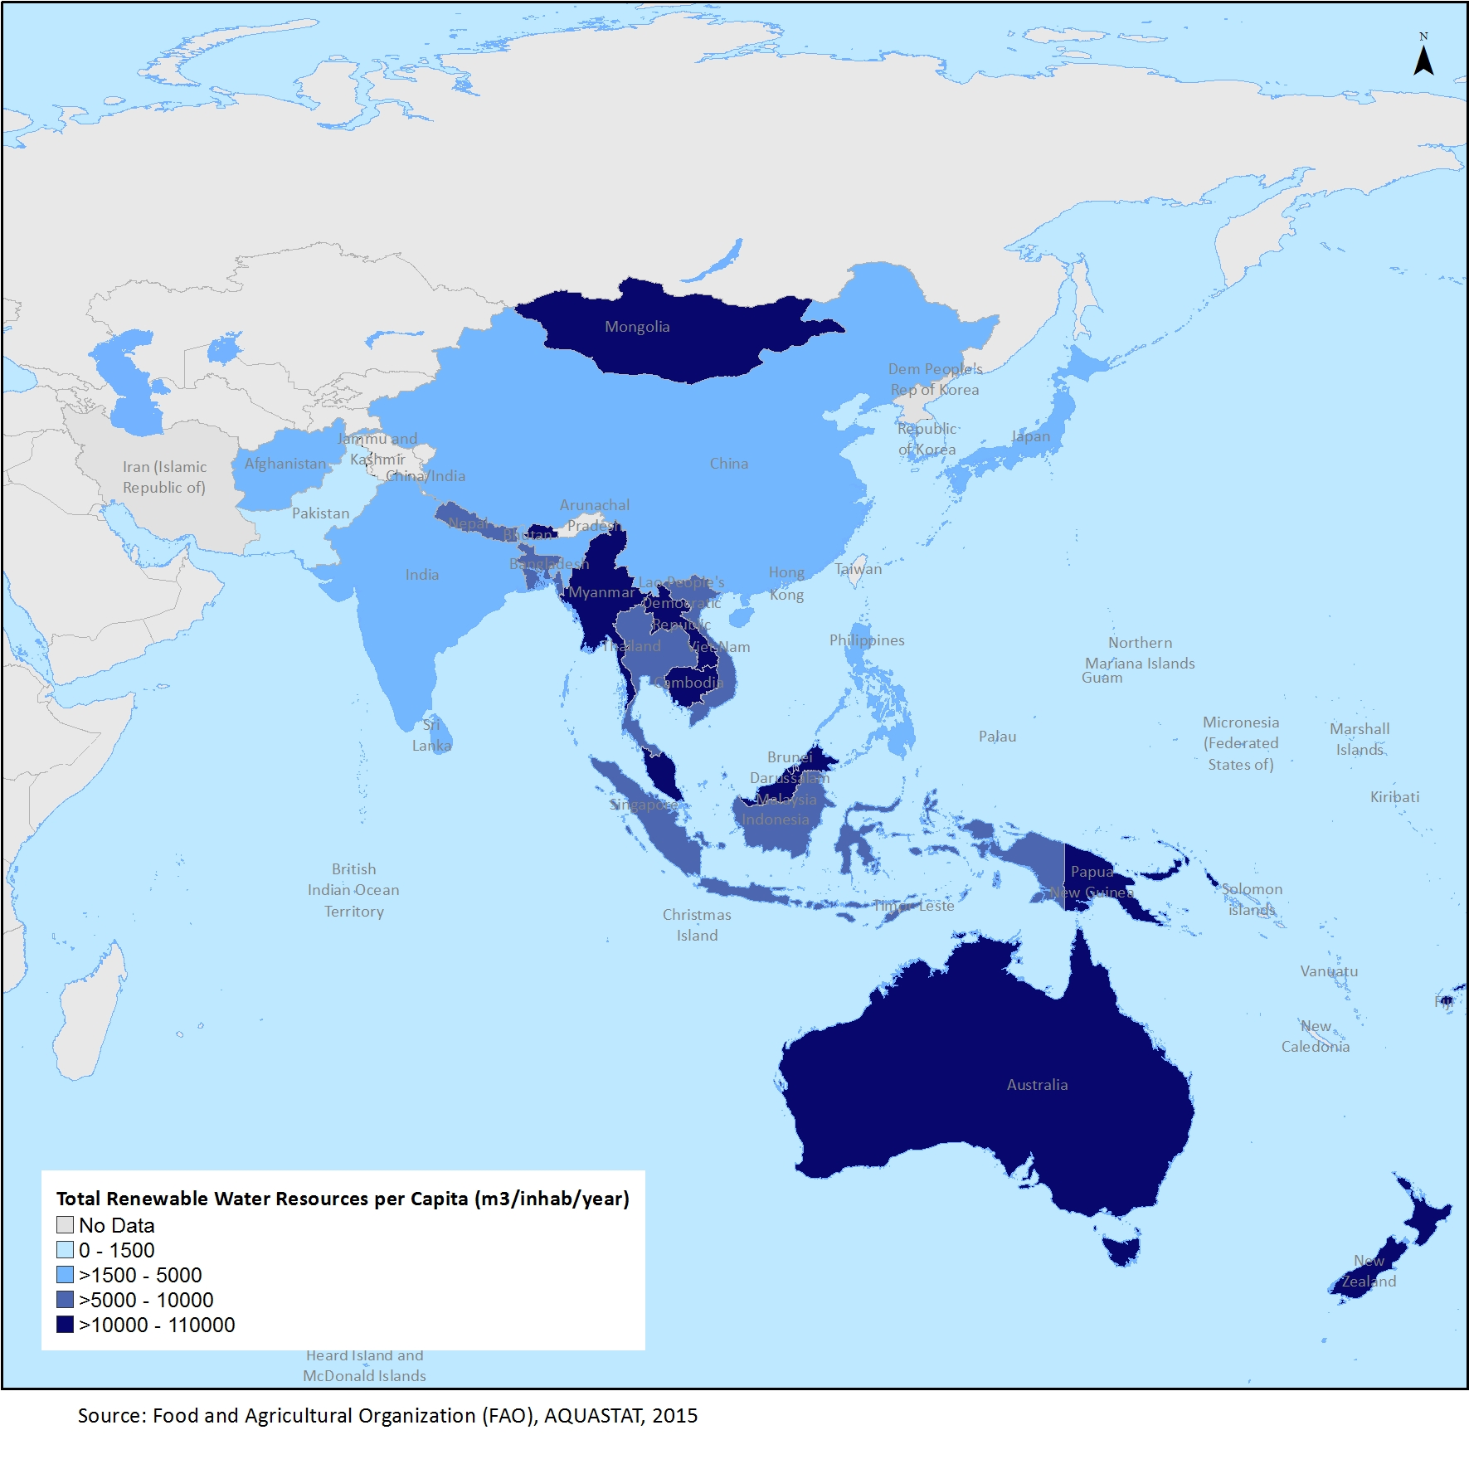
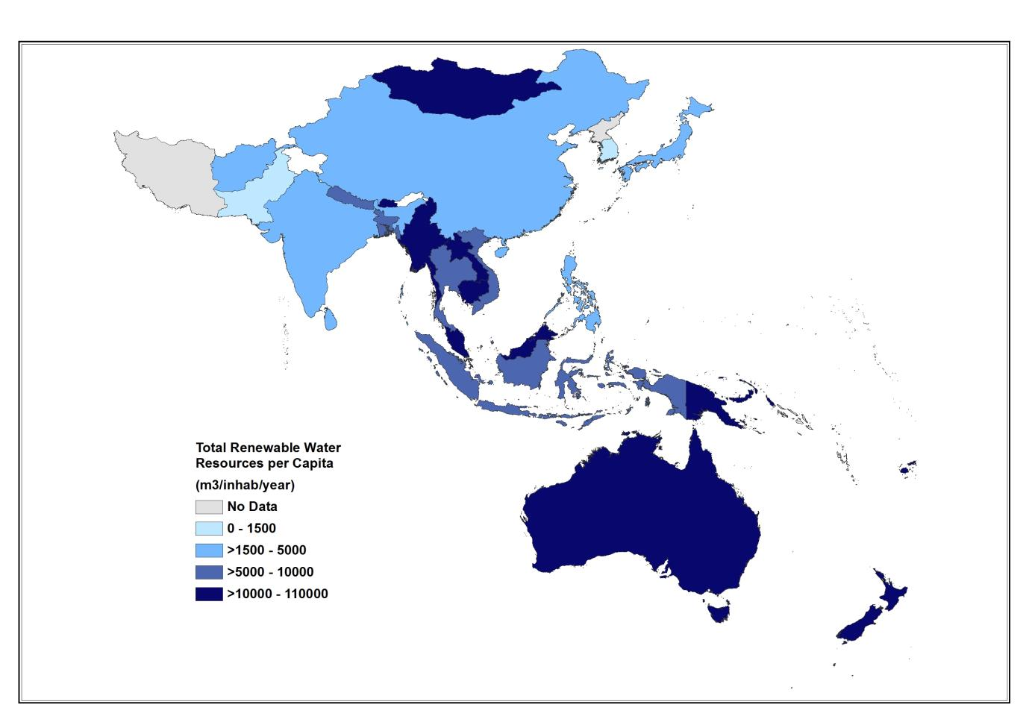
Accuracy and details
After
Before

Slide 12
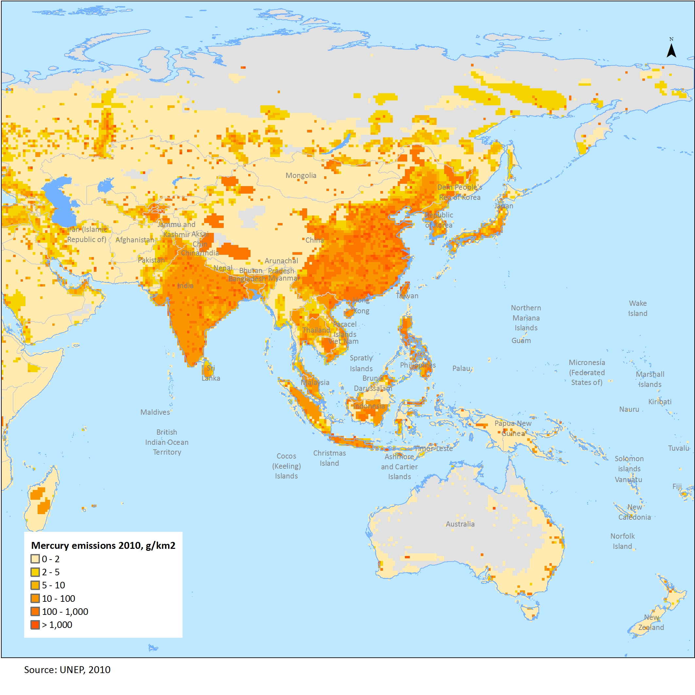
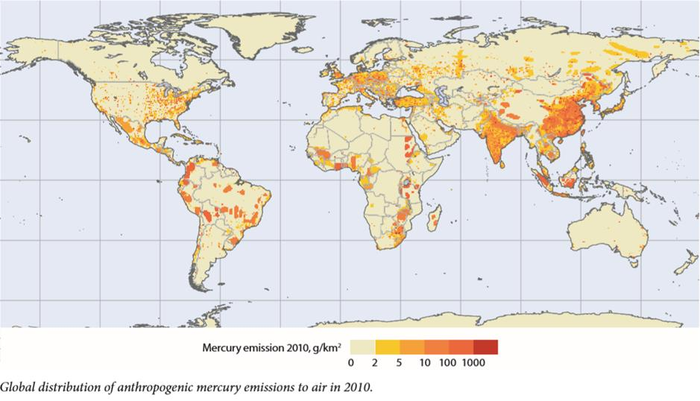
Focus to the region (or scope)
Before
After

Slide 13
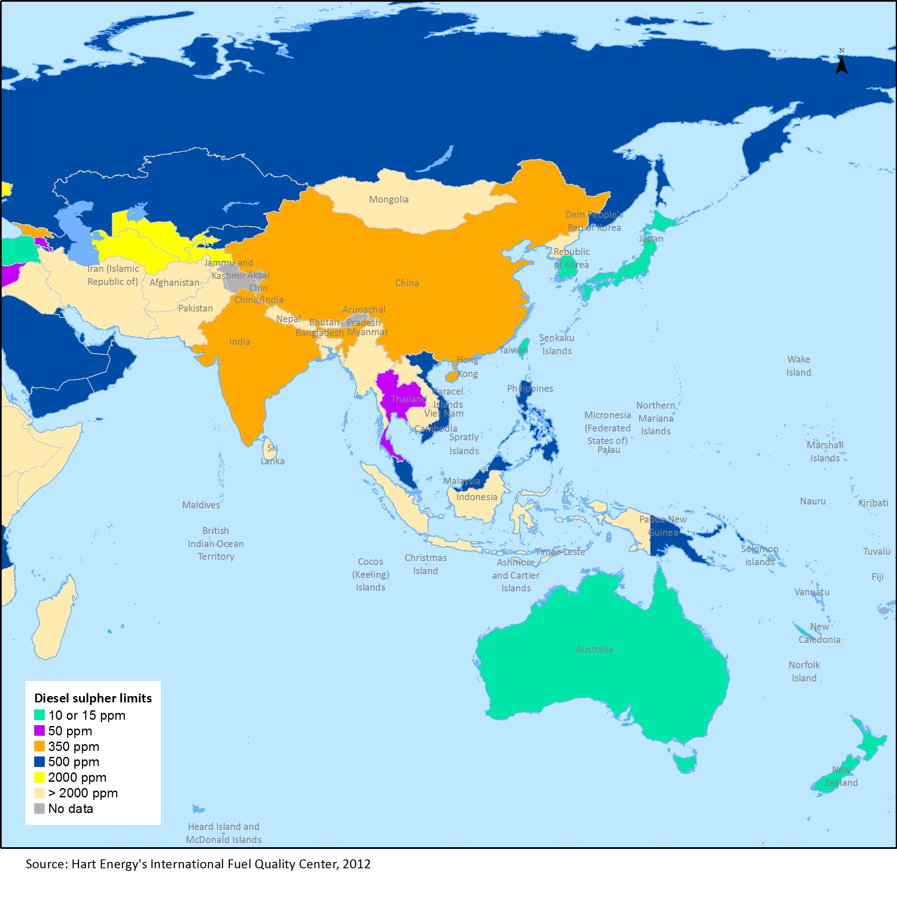
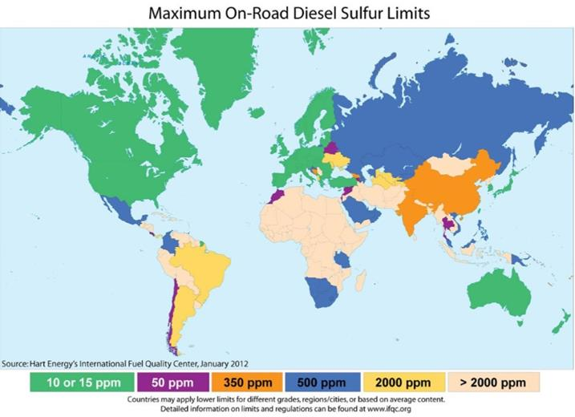
Scope focus
Before
After

Slide 14
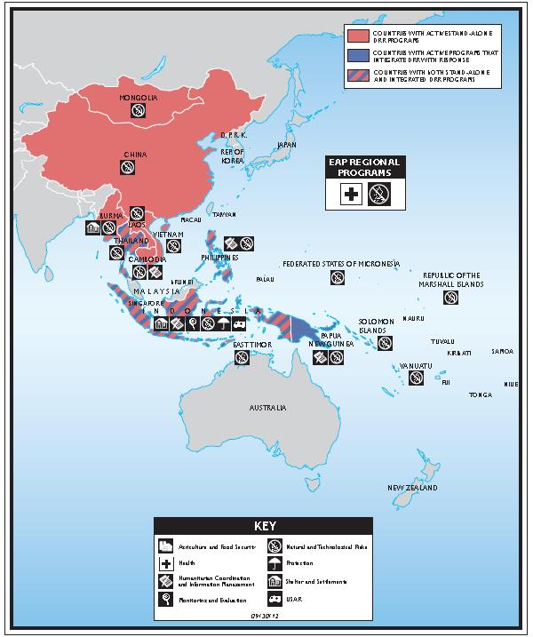
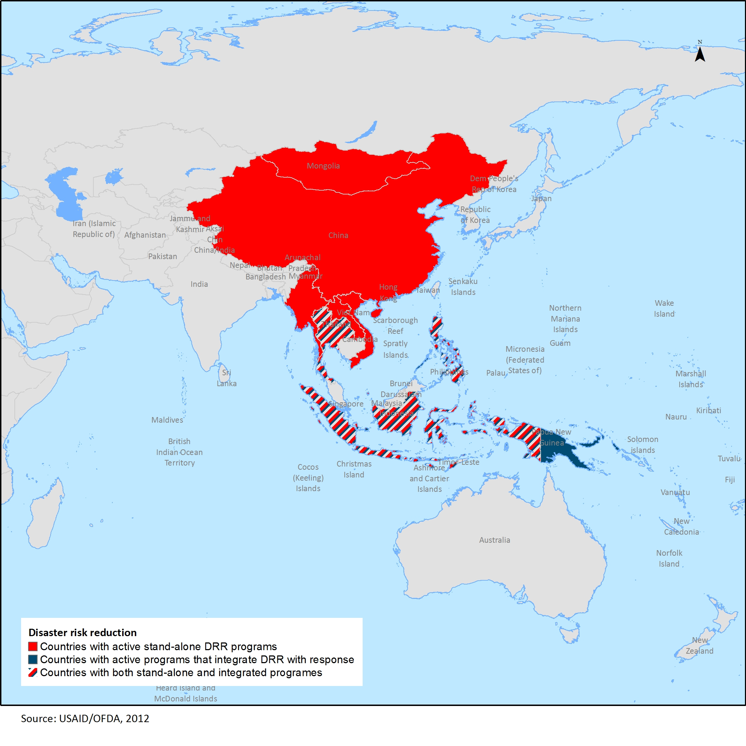
Presentation
Before
After

Slide 15
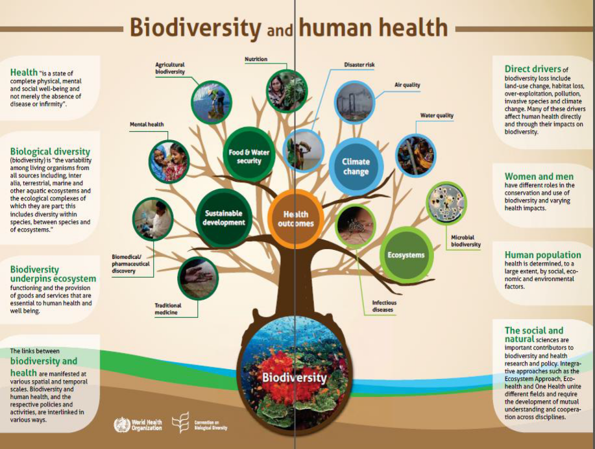
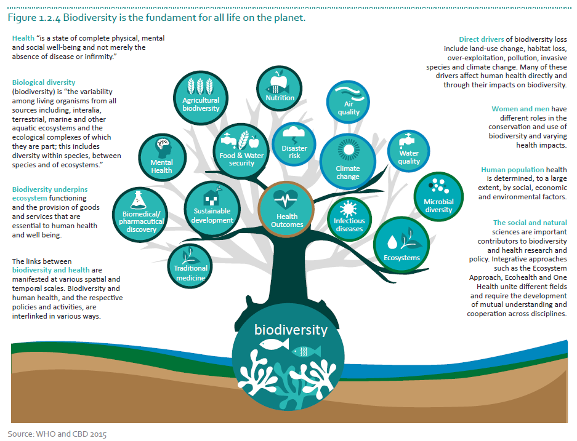
Enhance reusability
Before
After

Slide 16
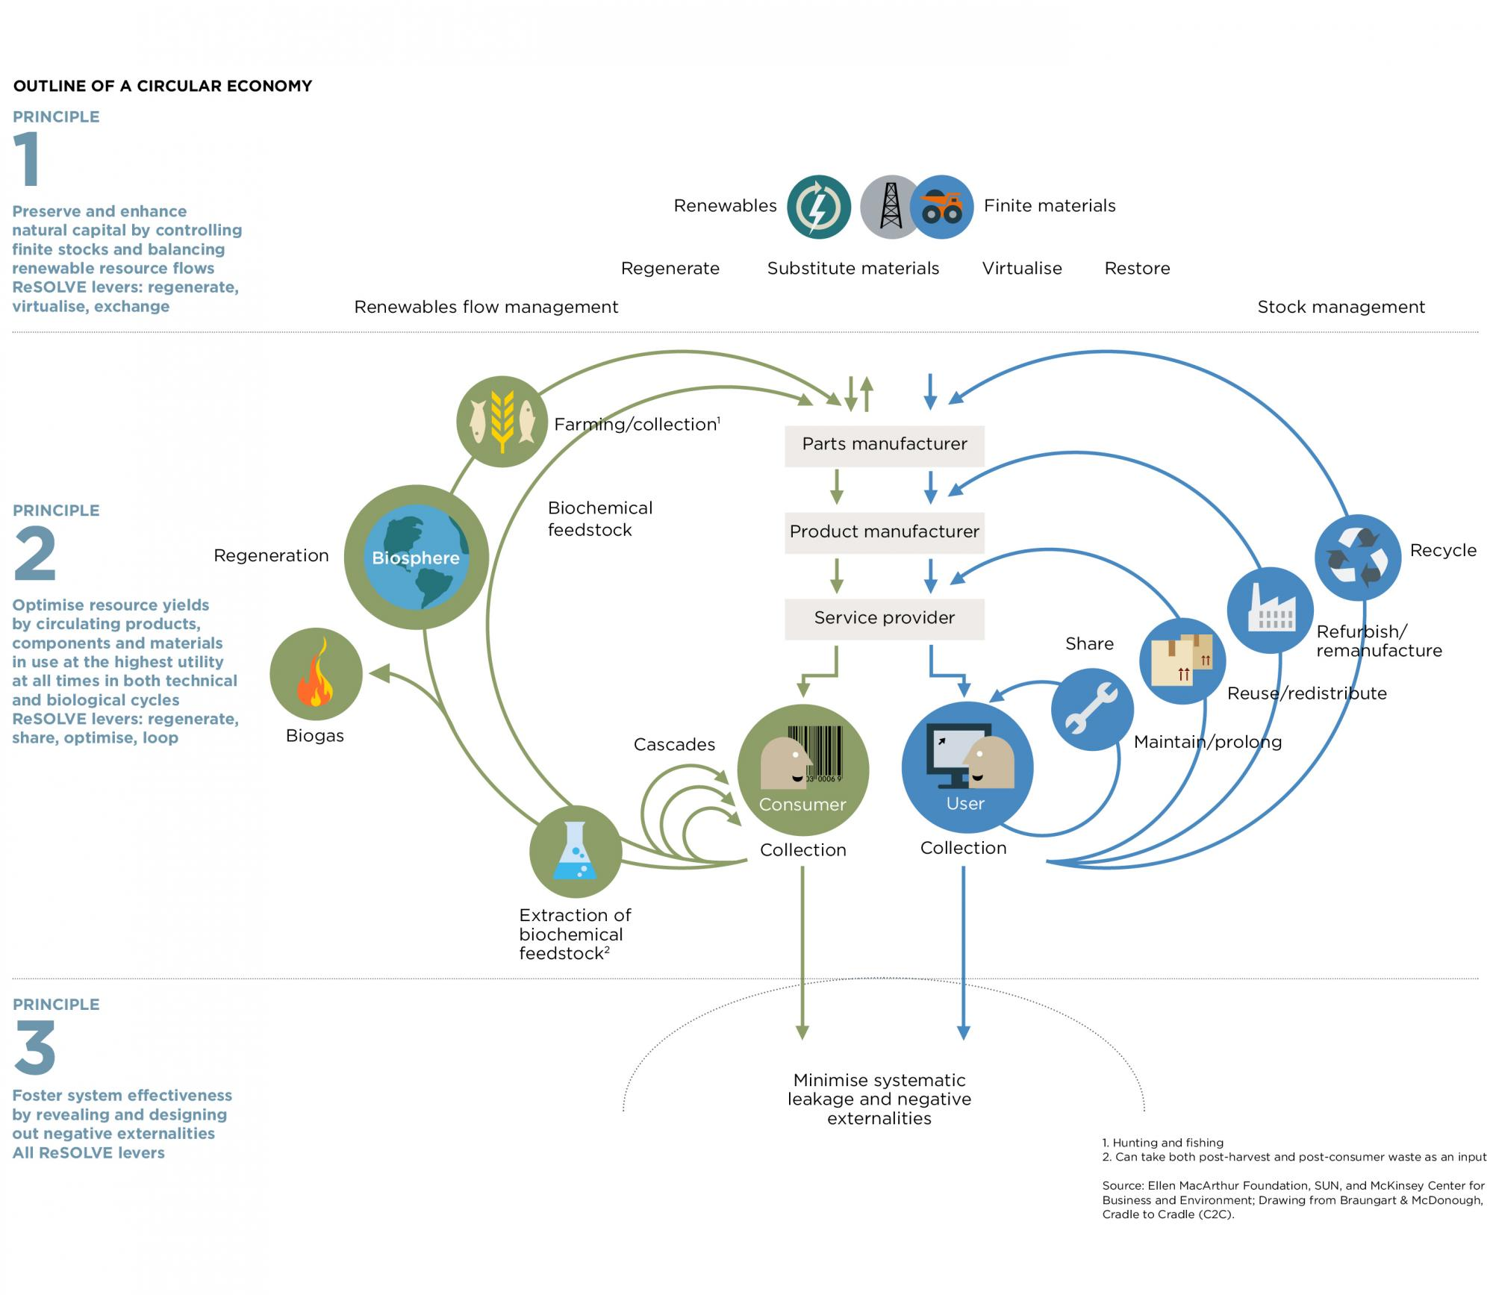
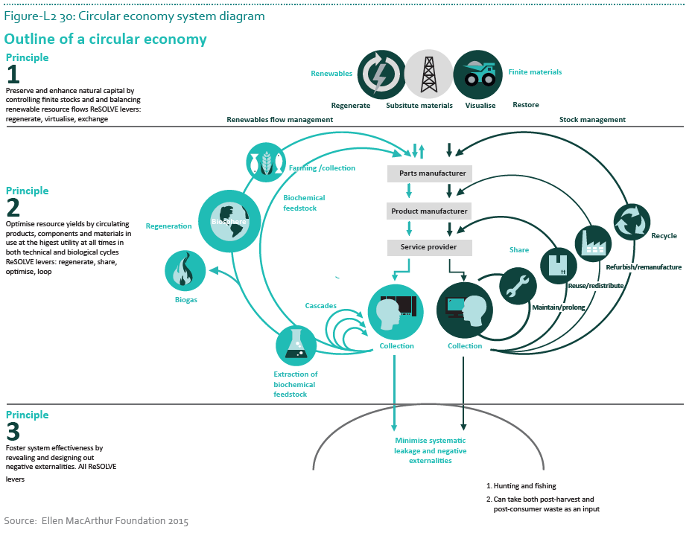
Enhancing the infographics
Before
After

Slide 17
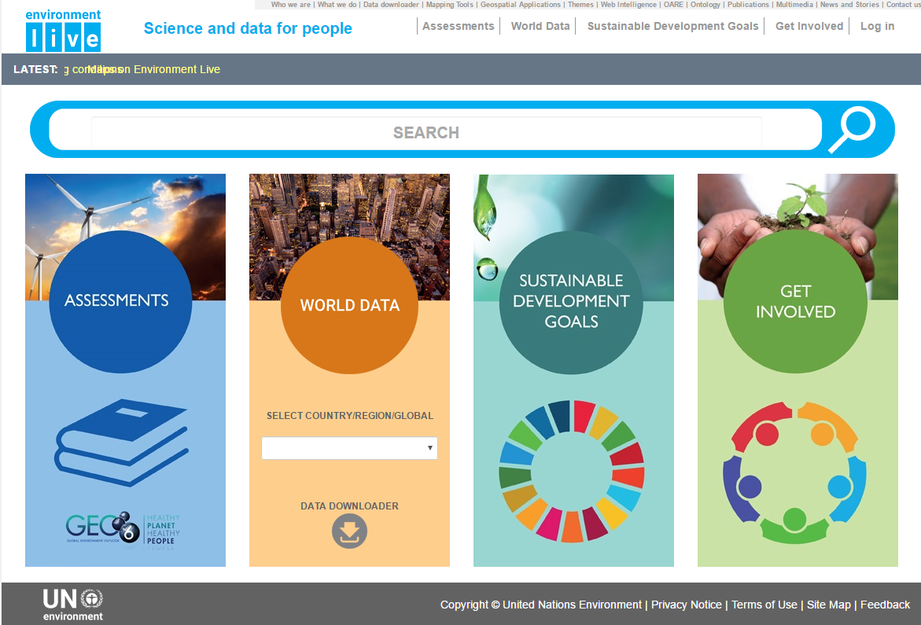

Slide 18
Visuals Checklist
Determine if a visual is needed to clarify an idea
Select the visual that best represents the information
Clearly label the visual (title, figure number, units, labels, source of data )
Introduce the visual before it appears in the document
Give a complete and relevant explanation of the visual
Place the visual close to were is referenced
Adjust your visual to the specific audience (UN Environment can help in this)

Slide 19



Thank you

