Slide 1
POPs monitoring: Challenges and Opportunities
Stakeholder Consultation on Securing Sustainable Conditions for the Monitoring of Persistent Organic Pollutants (POPs) under the Stockholm Convention
Brisbane, Australia, 10-11 December 2019
Ana Patricia Martínez Bolívar

Slide 2
Driving elements of the GMP
DATA PRODUCTION
MONITORING ACTIVITIES
COOPERATION ARRANGEMENTS
TRANSFER OF KNOWLEDGE

Slide 3
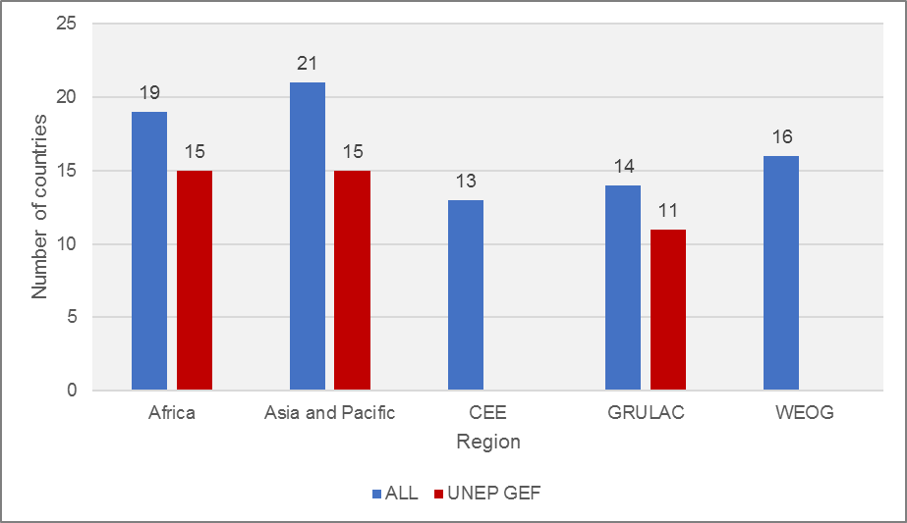
Monitoring Activities.
Summary of general GMP information
Number of passive monitoring sites of the UNEP/GEF 1 and 2 projects that delivered samples per región and year (up to October 2019).
Information of the global sampling network | PHASES
 | Phase 1 | Phase 2 | Phase 3 | Phase 4
 | Baseline on Air, Milk, Blood | Comparisons of Air and Milk. Baseline on Water | In process. Comparisons | In planning
Years | 2000-2008 | 2009-2015 | 2016-2020
Regions | 5 | 5 | 5
Matrices | Air, Milk, Blood | Air, Milk and Water | Air, Milk and Water
Number of POPs monitored | 12 | 21 | 23
Samplers Bank | WHO | WHO, GAPS, RECETOX | WHO, GAPS, RECETOX
Projects |  | UNEP/GEF GMP1 projects + SAICM | UNEP/GEF GMP2 projects
Number of funded countries |  | 32 | 42
Reports | First Global Monitoring Report (2009) | Second Global Monitoring Report (2017) | Third Global Monitoring Report (2021)
Milk Surveys’ Participating Countries
UNEP/GEF Projects’ Air Monitoring Sites

Slide 4
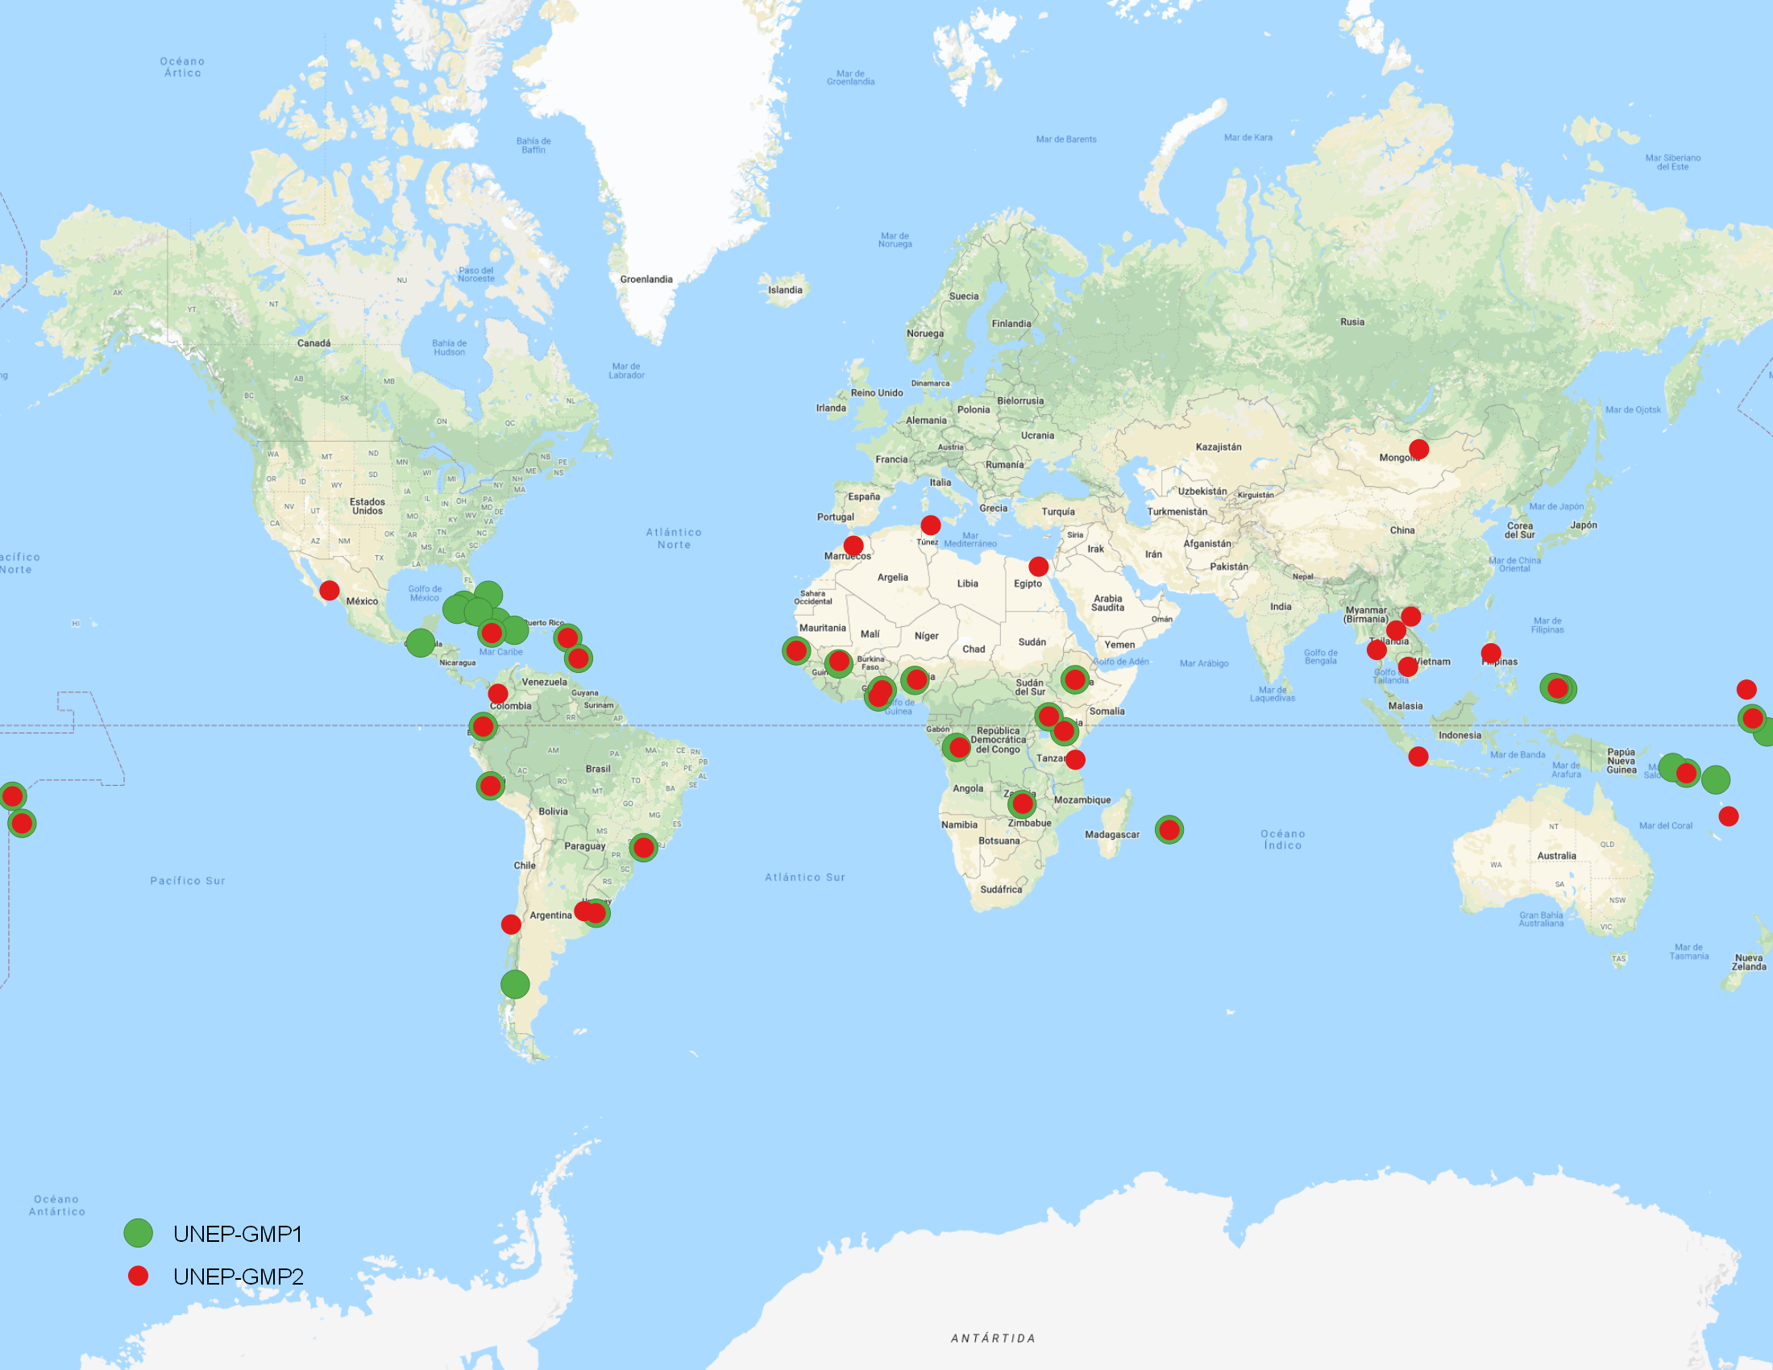
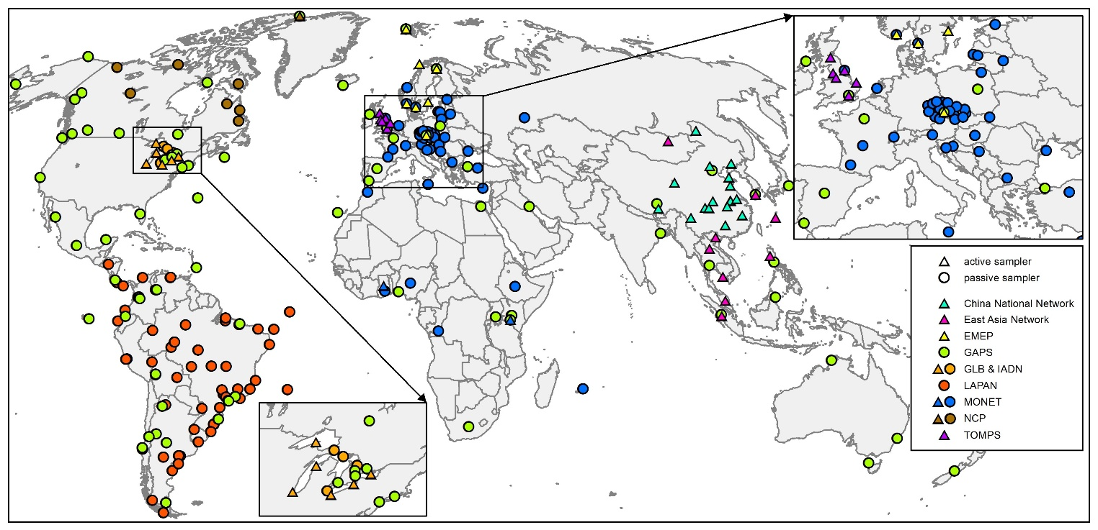
Cooperation arrangements.
AIR SAMPLING SITES
UNEP/GEF projects participating countries
Current map of the air monitoring sites color-coded according to the existing
monitoring programs. **
Strategic partnerships have been created with well-established monitoring programs before the implementation of UNEP/GEF projects which remain until today.
Cooperation arrangements with global, regional and some national programs with institutions and partners are well established.
There are currently 255 global POPs air monitoring sites across 10 monitoring networks
AIR SAMPLING SITES
** Review of facts, experience, achievements, and challenges in relation to POPs monitoring activities. Kateřina Šebková, Jana Klánová, Kevin White, Jiří Kalina. 2019.
Notes:
Do we have the opportunity to expand the cooperation arrangement?

Slide 5
Cooperation arrangements. Challenges
Air Monitoring Sites. Years in operation of existing programs’ monitoring sites (Warehouse Information: Passive 2003-2014 and Active 1989-2014)*
EXAMPLE
PASSIVE SITES
*Some existing monitoring programs used for the regional reports didn’t upload their information. That is the case of the Australian National Dioxins Program, the New Zealand: Ambient Concentrations of Selected Organochlorines in Air, International Monitoring Network in the Alpine Region for Persistent and other Organic Pollutants MONARPOP, Atmospheric Measurements of Persistent Organic Pollutants in Spain, the U.S. EPA’s National Dioxin Air Monitoring Network (NDAMN), and APOPSBAL, among others.
Notes:
205 Passive (41 %). 83 active (39%)
The long term prevalence of the existing monitoring programs’ sites in not secure. It is noted that most existing programs only operated for a year and some of them are not longer providing data for the GMP.
Would there be support for more sites needed if there are no existing monitoring sites?
What is the sustainability of all the existing monitoring networks?
What could happen if GAPS, LAPAN and MONET disappear?
Possible support in the future for this situation?
Is there a need for other cooperative arrangements?

Slide 6
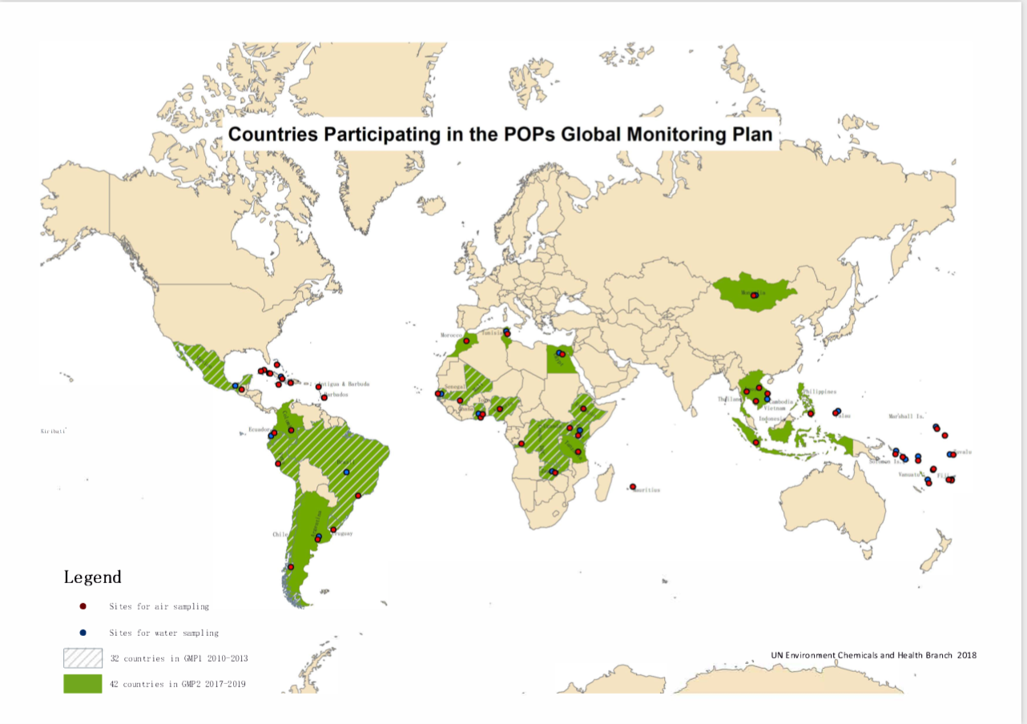
Monitoring Activities. Challenge
How to support this effort?
Notes:
Is there a need for these sites/matrices/POPs monitoring to continue?
Are more sites needed?
Is it necessary to monitor all POPs, in all regions?
What about the frequency?
Are more participating countries needed?

Slide 7
Highlights of the GCG Consultations for future UNEP/GMP projects:
Human milk survey would generate valuable human exposure data
Air monitoring could continue to cover critical gaps in current geographical coverage
Water sampling is important for monitoring PFOS, PFOA, and eventually PFHxS in the near future.
Focus would be on capacity building and QA/QC data generation on critical core matrices and in critical locations that complement other GMP activities.
The project design should also consider long-term strategies to generate information over time that is needed for effectiveness evaluation.
The involvement of the research community and academia is a showcase success story that enabled continuation of activities and effective use of the capacity that was built through the projects.
The formulation of a global project to enhance capacity on the critical gaps that are still identified within the GMP, in particular a global human milk survey, air monitoring that complements the GMP, and water monitoring at sites where baseline data is available, could offer a cost effective way to continue enhancing GMP capacity in a sustainable way.
Notes:
PFOS, PFOA, and eventually PFHxS: perfluorooctane sulfonate (PFOS), perfluorooctanoic acid (PFOA) and perfluorohexane sulfonate (PFHxS)
CONCLUSION:
The implementation of the human milk survey as part of the GEF projects worked very well and generated extremely valuable human exposure data for GMP-3. Air monitoring could continue as a project component in the future to cover critical gaps in current geographical coverage. Water sampling activities are also an important project component as monitoring of PFOS in this core matrix is at its incipient stage, and its scope would be enlarged to accommodate the recent listing of PFOA, and eventually PFHxS in the near future. Focus would be on capacity building and QA/QC data generation on critical core matrices and in critical locations that complement other GMP activities.
The project design should also consider long term strategies to generate information over time that is needed for the effectiveness evaluation. An example of success story that enabled continuation of activities and effective use of the capacity that was built through the projects was the involvement of the research community and academia.
The formulation of a global project to enhance capacity on the critical gaps that are still identified within the GMP, in particular a global human milk survey covering all developing regions, air monitoring in a limited number of sites that complement activities conducted by the monitoring programmes within the GMP, and water monitoring at sites where past activities have already generated baseline data, could offer a cost effective way to continue GMP capacity enhancement in a sustainable way.

Slide 8
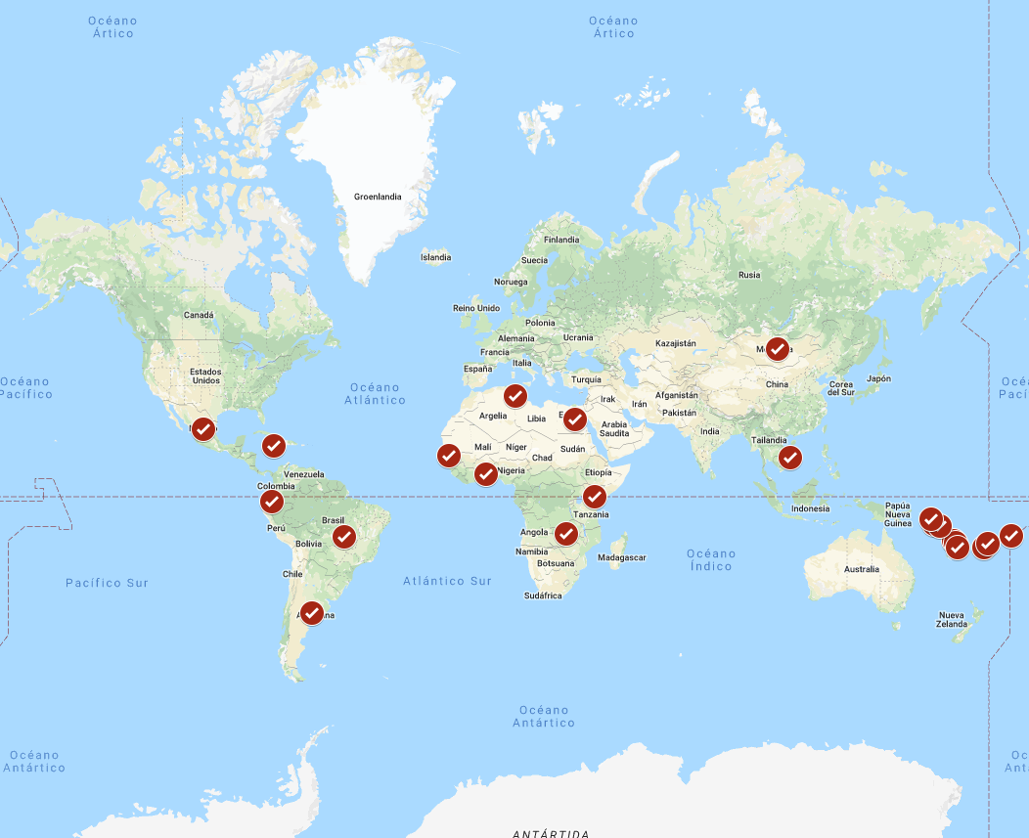
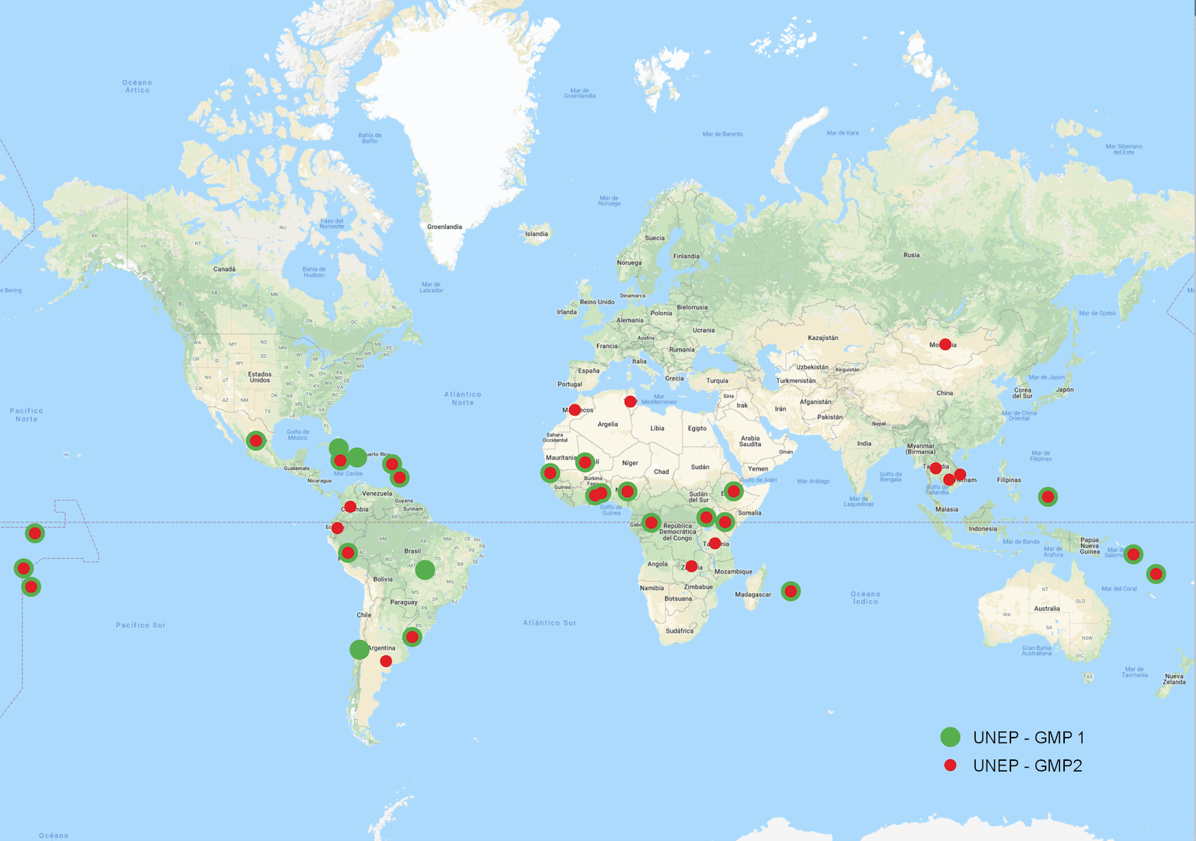
Monitoring Activities. Opportunities
Opportunities to have:
UNEP/GEF projects participating countries
UNEP/GEF projects participating countries
Human milk survey. Frequency of participation/deliver up to Oct. 2019* (2000-2019)
UNEP/GEF projects participating countries
Global coverage with consistent data
Gaps coverage
Comparable air and human exposure data.
Trends of forty six countries which participated in two or more milk survey rounds.
AIR SAMPLING SITES
WATER SAMPLING PARTICIPATING COUNTRIES
MILK SURVEYS PARTICIPATING COUNTRIES
*„Human Milk“ – State of play as of 16 Oct 2019. Rainer Malisch, Karin Malisch. Oct. 2019.
Notes:
Future proyects will add

Slide 9
Cooperation arrangements. Opportunities
Priority areas listed in NIPs submitted between 2014 and May 2016 by region*
Opportunity to have cooperation arrangements with national monitoring programs of developing country parties and parties with economies in transition.
*Report on the technical assistance needs of developing country Parties and Parties with economies in transition for the implementation of the Stockholm Convention and the technical assistance available from developed country Parties and others. February 2017. (UNEP/POPS/COP.8/INF/23)
Notes:
Some developing country parties and parties with economies in transition included in their National Implementation Plans (NIPs) environmental monitoring capacity and data management system for POPs as priority areas.
There is an opportunity for developing countries to have resources/funding for sound scientific monitoring programs through the NIPs. “This may require, for some countries, the linking of global monitoring plan efforts with national implementation plans as an option to help secure funding”(UNEP/POPS/COP.6/INF/31/Add.1)
Up to date there is evidence of the establishment of at least one regional monitoring program in developing countries from GRULAC LAPAN network from South America, that contributes to the Global Monitoring Plan (GMP).

Slide 10
How could the POPs monitoring help the countries?
To know the POPs baseline levels,
To know the concentrations of POPs in environments/matrices of countries’ concerns, specific studies like source oriented measurements
To calibrate emission inventories
To inform and advise the population
To develop policies
To evaluate the impact of the actions taken
To sensitize policy makers

Slide 11
Transfer of knowledge.
Guidance and SOPs developed in support of national sampling and analytical activities*
Subject | Available languages**
Passive Sampling of Ambient Air: Methodology and Procedure | En. Fr. Sp.
Protocol for the Sampling of Water as a Core Matrix in the UNEP/GEF GMP2 Projects for the Analysis of PFOS | En.
Guidelines for Organization, Sampling and Analysis of Human Milk on Persistent Organic Pollutants | En. Fr. Sp.
Protocol for the Sampling and Pre-treatment of National Samples | En. Fr. Sp.
Active sampling of Ambient Air: Operation procedure and Methodology | En. Fr. Sp.
Video tutorial for the sampling of human milk | En. Fr. Sp.
Video tutorial for passive air sampling | En. Fr. Sp. Ru.
Video tutorial for active air sampling | En. Sp.
General procedure for analysis of PFOS | En. Fr. Sp
General procedure for analysis of PCB and OCP | En. Fr. Sp
General procedure for analysis of PBDE | En. Fr. Sp
General procedure for analysis of PFAS in water | En. Fr. Sp
General procedure for analysis of dl-POPs | En. Fr. Sp
  Tools developed:
    Standard Operation Procedures
    Tutorial videos
    Guidance
  Training Courses:
    UNEP/GEF 1 projects: 18 countries trained
    UNEP/GEF 2 projects: 30 courses planned and 26 countries trained
  Inter-laboratory assessments:
    Four rounds nearly every two years
    293 labs registered in any round
*Review of facts, experience, achievements, and challenges in relation to POPs monitoring activities. Kateřina Šebková, Jana Klánová, Kevin White, Jiří Kalina. 2019.
**Note: En.-English; Fr.-French; Sp.-Spanish; Ru.-Russian

Slide 12
Transfer of knowledge in 42 UNEP/GEF projects’ participating countries.
Opportunities:
Challenges:
The countries could improve access to analytical capacities
The countries could develop national monitoring programs
Only Brazil and Barbados reported core matrices’ national monitoring programs.
6 countries expressed the commitment to implement national monitoring programs.
34 countries didn’t consider or mention the possibility of having national monitoring programs.
Notes:
Could countries need more accessibility to data?
I s there a need to develop more tools?
What kind of tools?
Is there a need to continue with the training courses open to all participating countries or criteria should be established?
Is there a need to continue with the inter laboratory assessments?

Slide 13
Strategic Elements. Opportunities
Effectiveness evaluation
Information Usage
Potential uses
Sensitization of the countries/ stakeholders
Sensitization of the partners, donors
Specific concerns of the countries
Outcome Indicators
Process Indicators
Health impacts/issues
GMP’s impact indicators
COPs by GMP reports
Communication of results
Countries with health issues
Countries with high ambient concentrations
Donors
Stakeholders
Potential communications
Notes:
What else can be done to help the countries?

Slide 14
Example of the usage of the monitoring information. Risk assessment. Safe levels⁺
 | Units | Safety standards as "Equivalent milk level" | Ranges in human milk (pooled samples)
 |  |  | Min | 25th perc. | Median | 75th perc. | 90th perc. | 95th perc. | Max
WHO-PCDD/F-PCB-TEQ (2005 / UB) | pg/g lipid | 0.2 – 0.9 | 1,5 | 5,6 | 9,4 | 14,3 | 20,3 | 23,7 | 49,0
Total PCBs * | ng/g lipid | 7 | 2 | 18 | 38 | 121 | 223 | 347 | 1009
Sum DDT ** | ng/g lipid | 2300 | 23 | 171 | 396 | 1015 | 1849 | 2616 | 23472
*In human milk as sum of 6 indicator PCBs.
**In human milk calculated after correction of metabolites for molecular weight.
+Presentation “Key outcomes from the human milk surveys, Heidelore Fiedler. HF Pacific Islands NIP updating WS, April 2016. Van den Berg (2013); UNEP, WHO

Slide 15
¡¡¡Thank you,
Gracias,
Merci,
Danke,
شكرا
謝謝你
спасибо тебе
!!!

Slide 16
END

