Slide 1




Expansion of the National Business Registration System to new business entities
(130217)
Vienna, May 2016
UNITED NATIONS INDUSTRIAL DEVELOPMENT ORGANIZATION

Slide 2


OUTLINE
Summary on previous Project & BRR Achievements
Milestones of NBRS Expansion Project
Proposal of new
Output 8

Slide 3


ECONOMIC REFORM BACKGROUND
Comprehensive economic reform (“Doi Moi” or “Renovation”) launched in 1986 and implemented systematically from 1989: closed & centrally planned economy (Stated-owned enterprises) → socialist-oriented market economy: Private sector development and business environment reform (BER)
Business registration reform (BRR) as a key pillar of BER: start-up willingness increased; entry barriers reduced

Slide 4
BUSINESS REGISTRATION REFORM
Legal framework
Multi Co-operation
1
5
- Consolidated reg. procedures & processes
- Single-point registration
Business Registration Reform
Programme
Provincial BROs
GDT (MOF)
Others: Ministry of Public Security, GSO (MPI)…
2
Computerisation
Institutional reform
4
- National Business Registration System
- National Business Registration Portal
- NBRS Online Registration System
- Information Services
- Central level:
BRD, ASMED, ABR (under MPI)
- Local level: 65 provincial BROs (under DPI)
3
Streamlining &
Standardisation
- Same service quality nationwide
- Customer-orientated
- Capacity building

Slide 5
BUSINESS REGISTRATION REFORM
5
Project BRR
Project “Expansion of NBRS to new business entities”
Overall Objective:
Provide policy and technical assistance towards the achievement of nationwide business registration reform
Overall Objective:
To contribute to an enabling business environment for the private sector by strengthening the capacities of the ABR, the BROs, ministries, agencies, including for inter-institutional coordination and collaboration
Phase A
(Dec 08- Apr 13)
Phase B
(Jan 11- Jun14)
Sep 14 – (tent.) Sep 18
Establishment of the NBRS containing registration information in 63 provinces
The NBRS is complemented with a computerized financial statements filing and information dissemination system operational nationwide
Immediate Objective:
The ABR and BROs are able to provide accurate, legally binding information on commercial entities to the business community, government agencies and the public in general, independently from further similar international donor support and with operational and financial sustainability

Slide 6

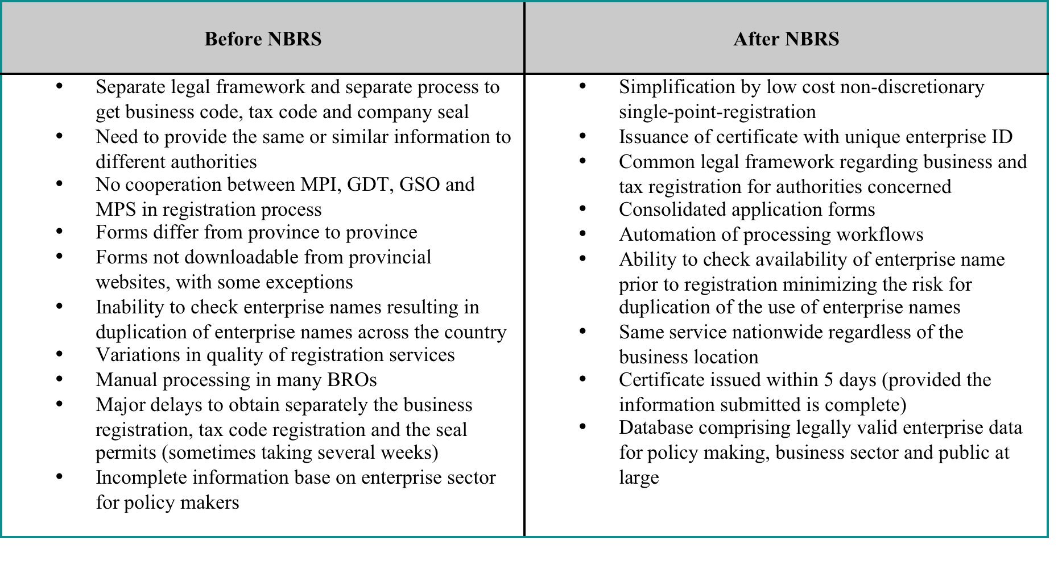


Slide 7



Project Expansion of the NBRS
Major milestones
Legal Framework
Passage of the revised Enterprise Law 2014 (Nov 2014)
Training& Capacity Building
8 in-depth training courses for BRO staff on revised legal framework & upgraded NBRS (Jun & Aug 2015)
Surveys
Completion of base-line survey on NBRS data quality & base-line survey on customer satisfaction
NBRS 2.0
Conversion & transference of FIE data to the NBRS
Promulgation of Decree 78 & Circular 20 (Sep & Dec 2015)
Promulgation of inter-ministerial 01/2016 on data exchange with the GDT (Feb 2016)
Launch of upgraded NBRS nationwide to accommodate regulatory changes of Enterprise Law 2014 (Jul 2015)
NBRS 2.1
NBRS version 2.1 meets the requirements for supplementation and modifications to some procedures to accommodate all changes in Enterprise Law and Investment Law 2014 as well as satisfy the business rules of BROs.

Slide 8

Production of outputs
4
Training/capacity building
1
Legal review & recommendations
8 sessions of in-depth training for BRO staff in in Jun, Aug and Dec 2015
1 training and team building session for ABR in Jul 2015
On-the-job training for ABR staff
1 study tour to Norway from 29 Nov – 8 Dec 2014
1 study tour to Abu Dhabi in Mar 2015
Enterprise Law & Investment Law : Nov 2014)
Legal Map for NBRS upgrade: completed Jan 2015
Decree 78 (14 Sep 15) and Decree 96 (19 Oct 2015)
Circular 20 on BR (1 Dec 2015)
Inter-ministerial Circular 01 btw. MPI & MOF on exchange BR information (23 Feb 2016)
7 WS introducing revised EL & IL + consultation on the Decree guiding revised EL and guiding Circular
5
Awareness raising
1 workshop introducing revised EL + IL to representatives of foreign business community in Jan 2015c
2
Upgraded NBRS
Technical Specification for upgrading the NBRS v2.0: completed end of Jan 2015
Contracting for upgrading the system: Mar 15
Development of NBRS v2.0: software released on 28 Jun 2015, OAT started on 1 Jul 2015
Technical Specification NBRS v2.1: ongoing
Development of FIE data computerization/uploading software: released in Jun 2015
Collection & computerization of FIE data: ongoing; total number of FIE and branch/rep office records in NBRS as of 1 July 2015; 17,368
Computerized FIE data review and correction: ongoing
Base- & end-line surveys
6
Base-line survey on NBRS data quality: completed in Dec 2015, detailed analysis and in-house discussions on the way forward continue
Base-line survey on customer satisfaction: completed in Jan 2016
Tech., Mgmt.,
operation activities
7
Project team and operations in place since Sep-Oct 2014
3 mission of Project Manager: Jan & Sep 2015; Mar 2016
4 missions of CTA in Oct-Nov 2014, Mar-Apr, Sep 2015, Mar 2016
2 missions of senior int’l legal expert in Jan and Mar 2015
2 missions of int’l IT expert in Apr and Jun 2015
Strategic plan ABR
3
Linking with new partners (Norway: labor, insurance, intellectual property under consideration)

Slide 9

New Proposal: Output 8
Single-point-registration cooperating mechanism established for issuing investment registration certificates and business registration certificates to foreign invested enterprises
  Objectives
To create favourable market-entry conditions for FIEs in order to reduce barriers to market-entry, further improve business and investment environment and increase national capacity of Vietnam.
To contribute to Vietnam’s successful realisation of its commitments to international and regional agreements and treaties such as TPP, EVFTA, ASEAN Economic Community (AEC) and through creating a better climate for investment and a more level playing field for foreign investors.
To further promote economic integration and sustainable economic growth of Vietnam, which is in line with bilateral economic development cooperation between Vietnam and Switzerland and Vietnam’s country development objectives.
To improve transparency of interactions between FIEs and State agencies.

Slide 10

OUTPUT 8: Logframe
New Output (Output 8): Single-point-registration cooperating mechanism established for issuing Investment Registration Certificates and Business Registration Certificates to foreign invested enterprises | Indicators | Means of verification
Activity 8.1: Establish legal basis for the single-point-registration cooperating mechanism in issuing Business Registration Certificate and Investment Registration Certificate to FIEs. Activity 8.2: Conduct consultative field trips to large provinces to assess the practical situation and a study tour abroad to learn about model of cooperation of similar nature. Activity 8.3: Organise training courses and capacity building courses for staff of BROs, IRDs and MBIEs on the guiding circular, the upgraded NBRS and service-oriented skills Activity 8.4: Organise seminars to introduce the guiding circular to the foreign business community. Activity 8.5: Support an awareness raising campaign to introduce the guiding circular and benefits of the single-point-registration cooperating mechanism to the foreign and domestic business communities. Activity 8.6: Upgrade the NBRS to accommodate the requirements on the single-point-registration cooperating mechanism between Business Registration Agency and Investment Registration Agency. | Circular guiding single-point-registration mechanism promulgated Field trips and study tour conducted Proportion of trainees evaluating training as satisfactory and useful in their work Representatives of FIEs, Foreign Business Associations and Chambers participate in the seminars Awareness raising campaigns conducted Upgraded NBRS is operational | Project files; implementation report, assessment of survey quality by final evaluation

Slide 11
THANK YOU
UNITED NATIONS INDUSTRIAL DEVELOPMENT ORGANIZATION

