Slide 1
Mercury supply, demand and trade in
South East and East Asia
Sven Hagemann
GRS
Asia Pacific (AP) Regional Mercury Storage Project
Executive Committee (Execom) Meeting
29-30 July 2011, Surabaya, Indonesia

Slide 2
Overview
What is surplus merrcury?
Asian Mercury supply
Asian Mercury demand
Surplus Mercury in Asia
Uncertainties
Trade patterns
Based on: Peter Maxson (Concorde) 2009
ASSESSMENT OF
EXCESS MERCURY IN ASIA,
2010-2050

Slide 3
Supply, excess supply and surplus mercury

Slide 4
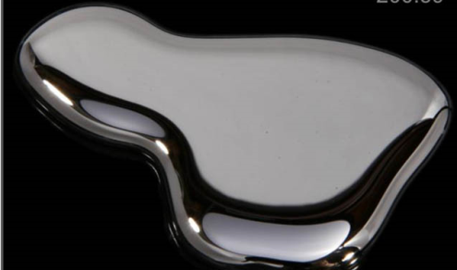
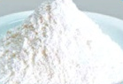
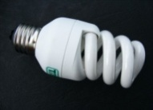
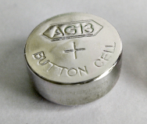
What is Surplus Mercury?
National/ regional mercury supply
National/ regional surplus
Elemental Hg &
Hg compounds like calomel
Need to manage
surplus mercury
→ storage
→ disposal
National / regional demand for products & proceses

Slide 5
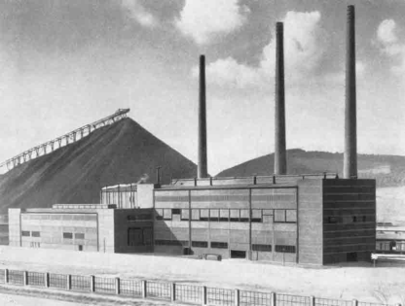
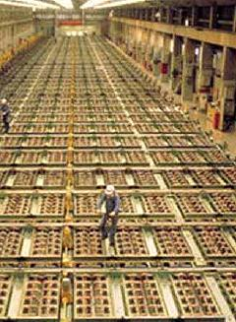
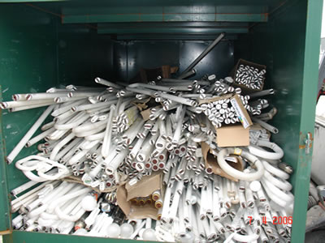
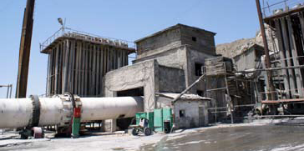

Important Sources of Supply and Commodity/ Waste
Non –ferrous metal production (zinc, gold)
Decommissioning of mercury cells
(chlor alkali)
Recovery from mercury waste (products, catalysts)
Primary mercury mining
Elemental mercury
Mercury compounds like calomel (mercurous chloride)
Commodity mercury
and mercury products
intended for later use or sale (OR not required for disposal)
Mercury waste:
Intended or required for disposal by national law
(covered by Basel Convention)
Export

Slide 6
Important Sources of Mercury Supply in Asia – Status Quo
Non –ferrous metal production (zinc, gold)
Decommissioning of mercury cells
(chlor alkali)
Recovery from mercury waste (products, catalysts)
Primary mercury mining
Zinc smelters (Japan, China?)
India, Pakistan, other?
Recycling of catalysts from VCM production (China)
Recycling of waste from SE Asian oil+gas industry (exported to EU/ USA)
Recycling of waste products: Japan
Kyrgysztan
China
Export

Slide 7
Important Sources of Mercury Supply in E + SE Asia – 2005
China | - | ? | 350 (VCM) 18-24 (waste) | 1094 (formal) 0-200 (inform.)
East + South East Asia | 67 | ? | 10-15 (waste)
Maximum (2010-2030) | 518 | 1252 (Inventory in MCCA plants) 1000-2000 (Governmental + trader Stocks) | 467 (VCM, 47% recovery) 58 (waste, 25% recovery) | 1000-1100 until 2015, decreasing to 300 in 2030
Non –ferrous metal production (zinc, gold)
Decommissioning of mercury cells
(chlor alkali)
+ Stockpiles
Recovery from mercury waste (products, catalysts)
Primary mercury mining

Slide 8
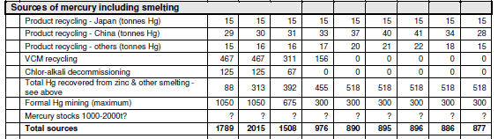
Prediction of Asian mercury supply 2010-2050
Assumed developments:
Mining: Partly depletion of mineable Hg deposits in China by 2015. Decrease of production from 1050 (2010) to 300 (2025)
VCM: Substitution of Hg catalysed process between 2015 and 2025
By-product: Installation of effective flue gas control technologies in NF metal smelters until 2030
8

Slide 9
Trade with Asian countries

Slide 10
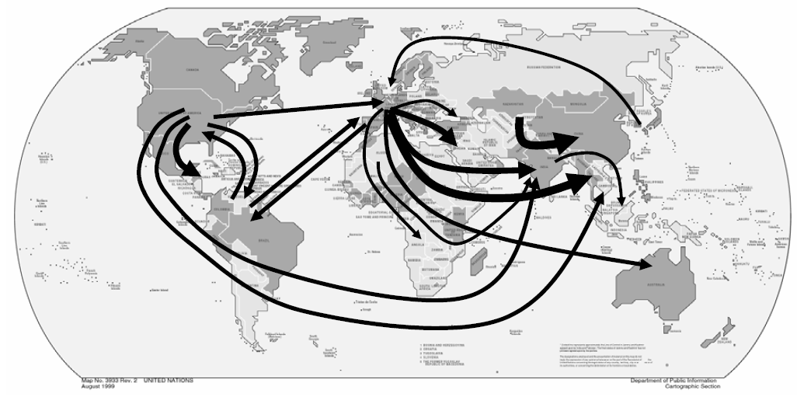
External supply: import of mercury to Asian countries (2004)

Slide 11
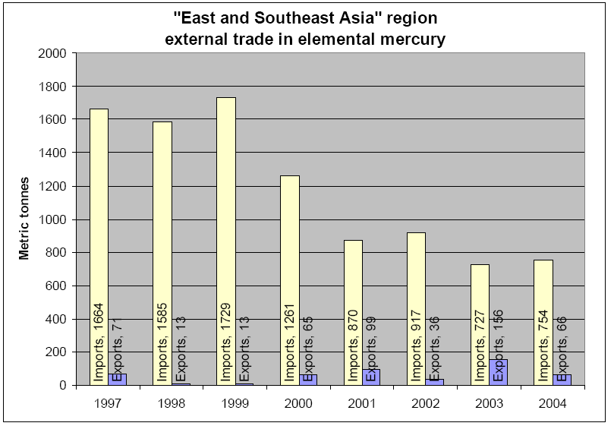
2009 Similar exports from EU-27 and USA to Asia in 2009

Slide 12
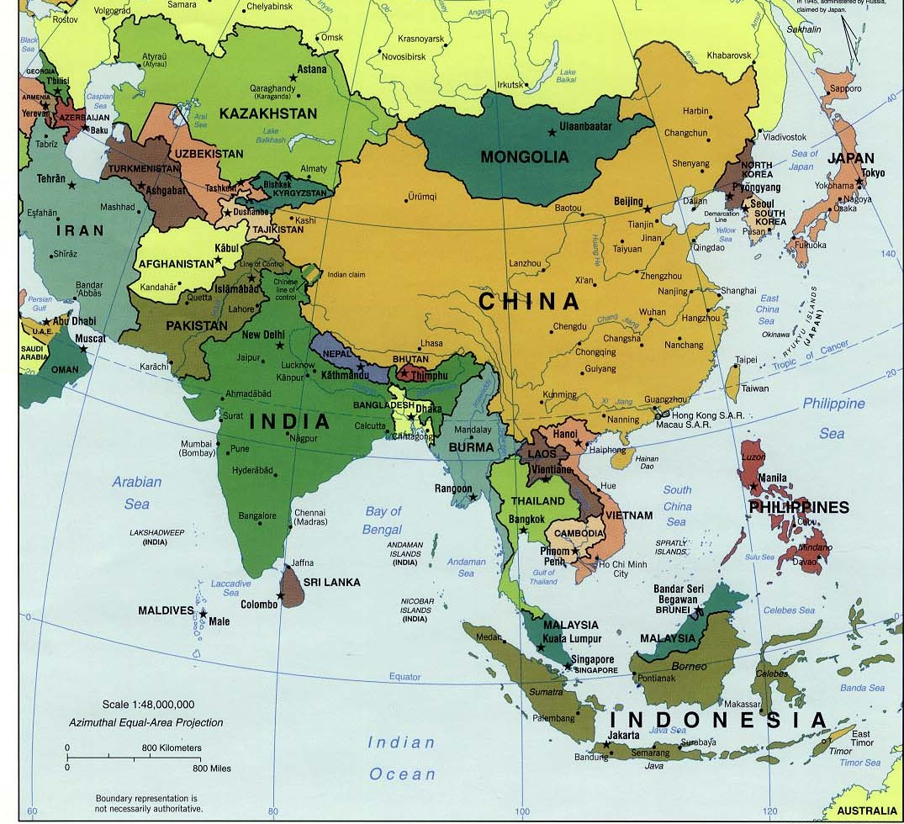
Some recent data on mercury trade in Asia (2009)
Exports
Imports
2009 (-)
2008:169
141
13
34
40
31
255
96
13
91
36
10
9
290
285

Slide 13
Trade flows EU/USA/Japan – remaining Asia
Exports to Asian countries
Destination | Exported by EU-27 | Exported by USA | Exported by Japan | Total imports notified in 2009 | Other sources
Singapore | 112/ 165 | 72 | 54 | 291
China | 38 | - | - | -
Hong Kong S.A.R, China | 14 | - | 27 | 42
Philippines | 44/20 | - | - | 96
India | 120 | 106 | 19 | 255
Malaysia | 1 | - | - | 91 | India, China
Rep. Of Korea | 9 | 7 | 1 | 13
Indonesia | 19 | - | 1 | 10 | Singapore (278 t)
Pakistan | 35 | - | - | 35
Thailand | 5 | - | 2 | 5
Notes:
Singapore data: 165 based on country data, 112 based on EU-27 data

Slide 14
Origin of imported mercury
Exporter | Exports in 2009 to Asian countries | Future development
EU-27 | ~ 426 | Export ban since 15 March 2011
USA | ~ 185 | Export ban from 1 January 2013
Kyrgysztan | ? | Stop of primary mercury mining in 2010
→ No significant imports from other regions from 2013

Slide 15
Asian mercury consumption, 2005
 | China |  | East and Southeast Asia, excl. China |  | South Asia
 | min. | max. | min. | max. | min. | max
VCM/PVC production | 700 | 800 | 0 | 0 | 0 | 0
Small-scale gold mining | 120 | 240 | 288 | 384 | 3 | 12
Measuring and control devices | 280 | 310 | 20 | 30 | 40 | 50
Batteries | 150 | 250 | 50 | 70 | 30 | 50
Lamps | 60 | 70 | 20 | 25 | 20 | 25
Dental applications | 45 | 55 | 25 | 31 | 22 | 32
Electrical & electronic equipment | 30 | 40 | 15 | 20 | 25 | 30
Chlor-alkali production | -- | -- | 4 | 8 | 35 | 40
Other* | 40 | 80 | 30 | 40 | 20 | 30
Totals | 1425 | 1845 | 452 | 608 | 195 | 269

Slide 16
Basic assumptions about future mercury consumption*
ASM | Reduce 50% over 10 years, then 5% per year.
VCM | Increase to 2010, stable to 2015, phase-out by 2030
Chlor-alkali | Indian mercury use phase-out by 2012, others by 2020
Batteries | Reduce 75% by 2015, and phase-out by 2025.
Dental uses | Reduce 15% by 2015, and phase-out by 2050.
Measuring and control | Reduce 60% by 2015, phase-out fever thermometers and sphygs by 2017, and remaining demand by 2025.
Lamps | Reduce 20% by 2015, and 80% by 2050.
Electrical & electronic | Reduce 55% by 2015, and phase-out by 2050.
Other applications | Reduce 25% by 2020, and another 50% by 2050.
* For future projections of mercury in products, see the UNEP “Mercury-Containing Products Partnership Area Business Plan”

Slide 17
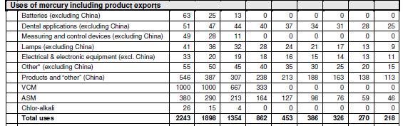
Prediction of future mercury demand
Reduction of Hg use for VCM production: -1000 t/a until 2030 (-100%)
Reduction of Hg in products (not lamps): -300 t/a until 2030 (-37%)
Use of Hg in ASM: -250 t/a until 2030 (-67%)
17

Slide 18
Supply and Demand 2010-2050
Scenario “reduced mining”
Reduced Hg mining due to reduced domestic demand
Reduced demand for ASM, VCM, products
“Base” supply:
by-product Hg + recycling
Surplus Hg
ASM, Products

Slide 19
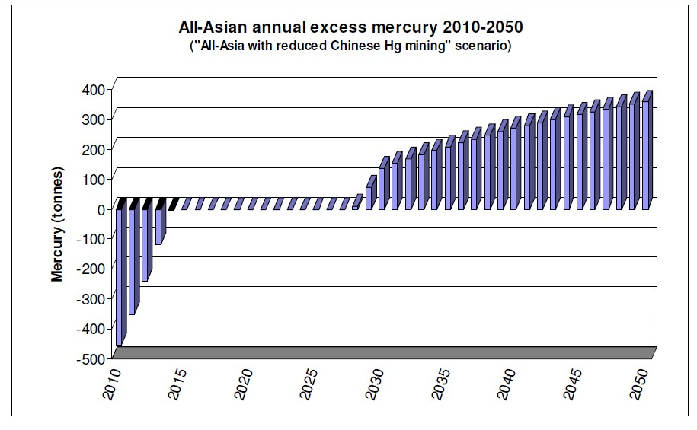
How Much Surplus Mercury Will Have to be Managed in South/ South East and East Asia? (Concorde 2009)
Main assumptions:
VCM production: decrease of consumption after 2015
Zinc smelting: strong increase of Hg recovery between now an 2030
Regional surplus
5,500 t (2029-50)
Possibly national surpluses
?
?
Alternative scenario:
7,500 t 2027-50
(reduced supply for ASM)
Management options for
surplus mercury?
AIT/RRCAP study (2010)

Slide 20
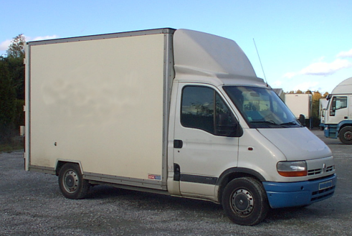
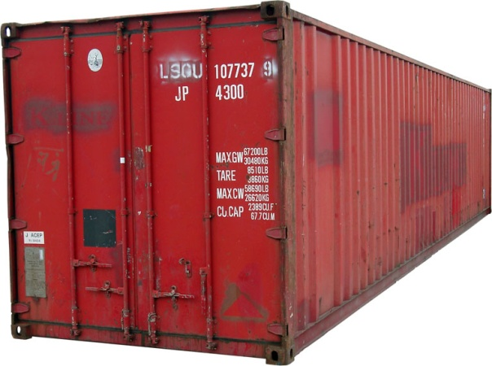
Illustration of Estimated Volume of Surplus mercury
Annual regional Hg surplus of 200 t
(as elemental Hg)
~ 15 m³
≈ space in small delivery truck
Annual global surplus of 500-900 t
(as elemental Hg)
~ 40 - 60 m³
≈ space in 40 feet container
→ Practical storage space always higher
(depending on storage concept)
Notes:
Hg has a very high density (13.5 t/ m³). That´s why 200 t of elemental mercury have a volume of only 14.8 m³.
Mercury compounds and stabilized mercury have a lower density and thus a higher volume. For example, stabilization as pure red mercury sulphide leads to a six-fold increase of volume. Additional room is needed for the containers itself and space between individual containers

Slide 21
National Hg surplus
National surplus
National surplus
when VCM Hg free
& Hg recovery in smelters
~Equilibrium or surplus from smelters
National legal surplus
from products &
smelters, oil/gas
National excess demand for ASM

Slide 22
National net surplus and legal surplus
Net surplus: National supply > National demand (e.g. Japan)
Legal surplus: (Potential) sources of Supply that are subject to national storage/ disposal obligation,
e.g. Hg in end of life products, Hg from decommissioned chlor-alkali plants
(e.g. Cambodia, Philippines)
Storable surplus: amount of surplus mercury that remains in the country and has to be stored/ disposed
(e.g. after export of mercury containing waste, e.g. oil/ gas waste from Indonesia)
Notes:
Hg has a very high density (13.5 t/ m³). That´s why 200 t of elemental mercury have a volume of only 14.8 m³.
Mercury compounds and stabilized mercury have a lower density and thus a higher volume. For example, stabilization as pure red mercury sulphide leads to a six-fold increase of volume. Additional room is needed for the containers itself and space between individual containers

Slide 23
Estimated Surplus Mercury by Region for 40 years
Surplus mercury [t]
Notes:
Estimates for Asia, LAC, EEC: Concorde 2008-2009
Estimates for USA: US EPA 2007 for 2007-2046, not including governmental stocks: 4436 t DOD/DNSC, 1200 t DOE. Figure of 10,000 t includes 2,500 t from foreign sources (LAC). These amounts are also included in the LAC estimates
Estimate for Europe: 7,400 t from decommissioned chlor-alkali cells (source: Eurochlor 2010) plus 83 t mercury per annum by-product mercury from non-ferrous metal production and gas cleaning (Source: Concorde 2006)

Slide 24
Illustration of Estimated Volume of Surplus mercury
Annual regional Hg surplus of 200 t
(as elemental Hg)
~ 15 m³
≈ space in small delivery truck
Annual global surplus of 500-900 t
(as elemental Hg)
~ 40 - 60 m³
≈ space in 40 feet container
→ Practical storage space always higher
(depending on storage concept)
Notes:
Hg has a very high density (13.5 t/ m³). That´s why 200 t of elemental mercury have a volume of only 14.8 m³.
Mercury compounds and stabilized mercury have a lower density and thus a higher volume. For example, stabilization as pure red mercury sulphide leads to a six-fold increase of volume. Additional room is needed for the containers itself and space between individual containers

Slide 25
Inventory of mercury waste
No inventory so far → estimates
Processes
Products
Demand: > 1400 t
-VCM: 1000 t, 15% waste?
-Chlor-alkali 20-30 t waste
- ASM: 380 t: 2/3 sediments/tailings
Demand: 837 t
-Part exported
-Part: release to air
-Part re-imported as waste
Part exportes as waste
3% recycling
By-product
Hg in Zink > 500t: only air?
Hg in Gold → Tailings?
Natural gas → partly exported
25

Slide 26
Conclusions
Regional mercury surplus probably only after 2020
National net surpluses may occur sooner
National legal surpluses already exist in many countries

Slide 27
Additional slides

Slide 28
Mercury surplus: Base scenario
Main assumptions:
- Hg based VCM production decreases after 2015
- strongly increased Hg recovery from zinc smelting
until 2015

Slide 29
Mercury surplus: Base scenario and
‘reduced supply to ASM’ scenario
2029
5,500 t
7,500 t
29

