Slide 1
Development of a global plan for monitoring of human exposure to mercury
2015-2017
Irina Zastenskaya, Dorota Jarosinska
WHO European Centre for Environment and Health

Slide 2
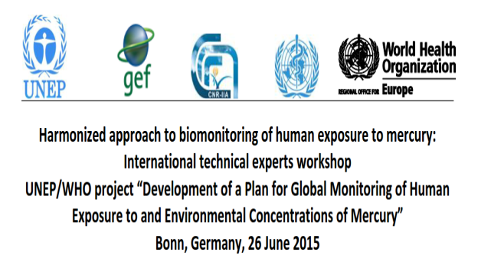
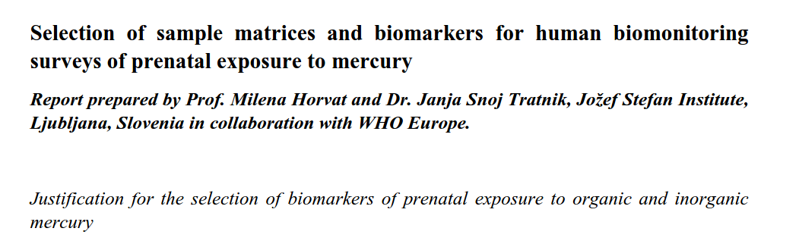
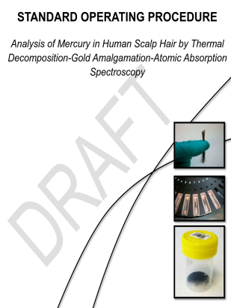
The main steps
2015
March-June
Scientific report on selection of biological matrices
SOPs for sampling and analysis
2015
June
International experts workshop (matrices, criteria for countries selection, scientific report on feasibility of development of SOP for fish monitoring
2015
July-november
Selection of countries (two from each UNEP region as candidates, initial information collection, selection of pilot countries)
SOP for monitoring of fish contamination

Slide 3
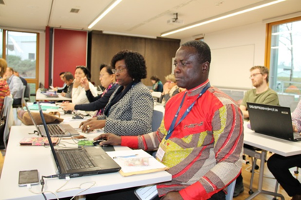
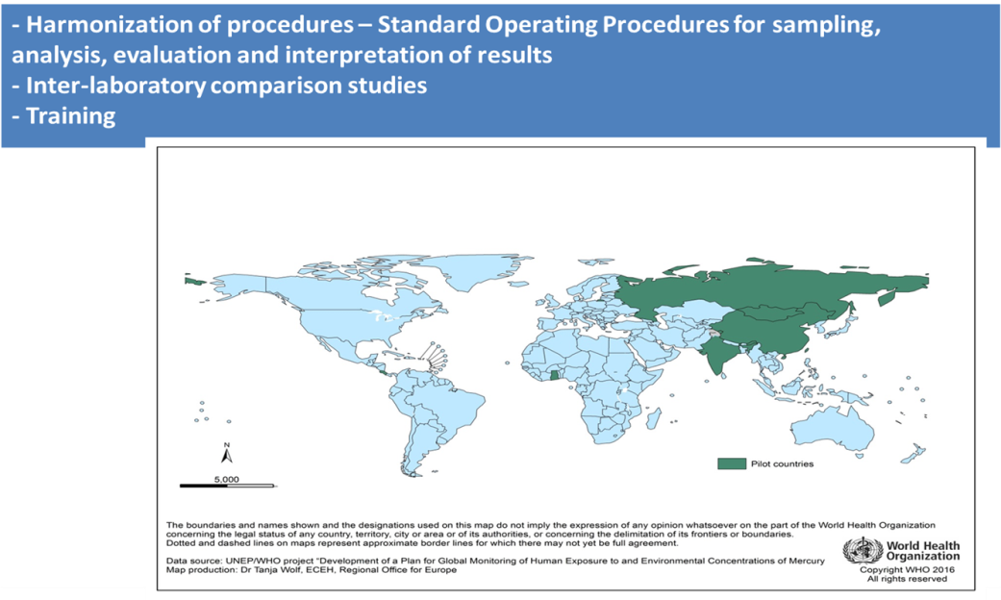
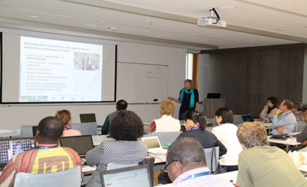

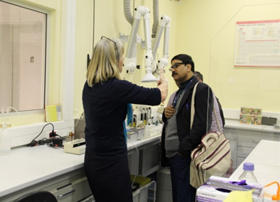
The main steps: training of the national survey laboratory analysist (Slovenia, JSI, Feb 2016)
Russian Karelia
Mongolia
Kyrgyzstan
China
Costa Rica
Ghana
India

Slide 4
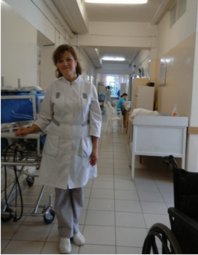
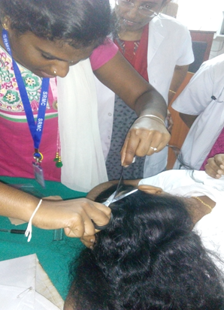
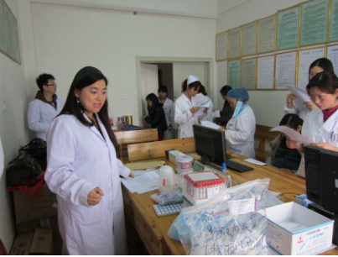
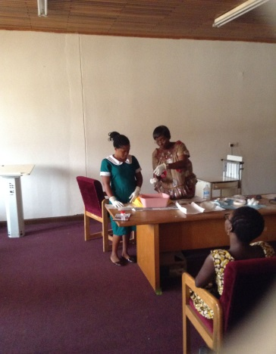
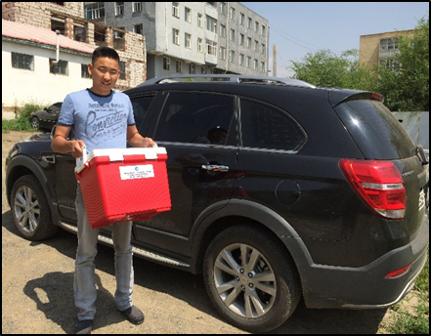
The main steps: pilot surveys
Preparation
Proficiency test (freeze-drying samples of cord blood)
Procurement of consumables
Revision of SOPs, survey protocol
Subcontracting countries
Pilot surveys:
ethical approval (local/national),
Training (for field staff),
adaptation of WHO documents,
Sampling (250 samples;
three matrices; Qs;
Mercury analysis
Data analysis
Databases creation
Communication of results
WHO
Development of Master
Survey Protocol, Reviewing SOPs

Slide 5
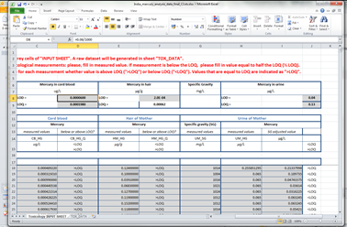
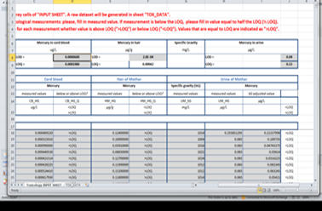

Main steps
Reporting
Finalizing documents
Statistical analysis
Creating databases

Slide 6
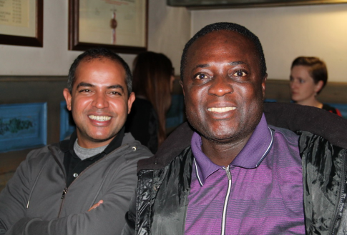
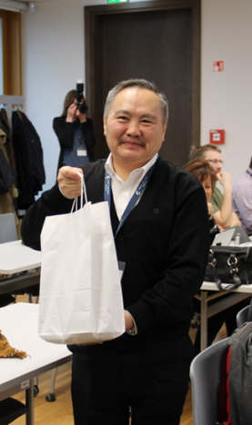
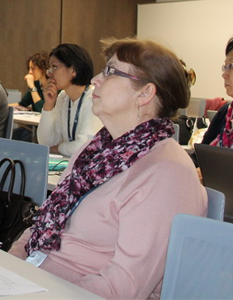
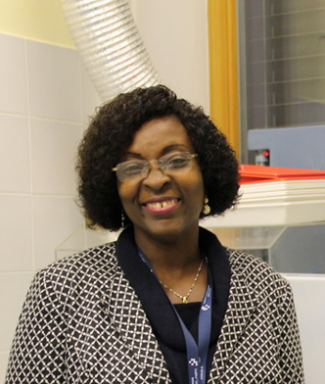
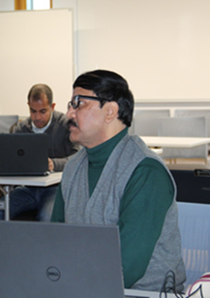
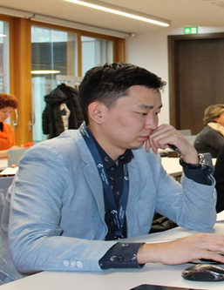
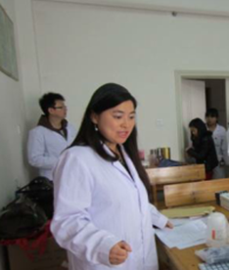
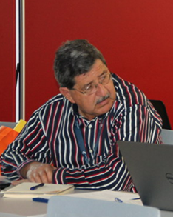
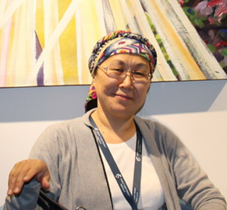
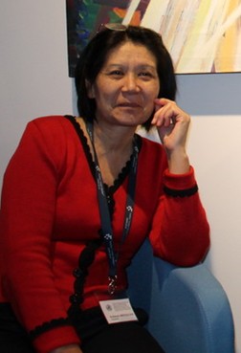
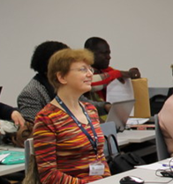
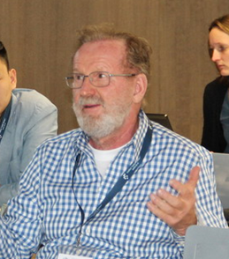
Those who made the dream a reality

Slide 7
Those who made the dream a reality
- The Jozef Stefan Institute, Slovenia (Milena Horvat and the team)
- The National Centre for Minamata Disease, Japan (Mineshi Sakamoto and the team)
- The National Centre for Environmental Health, Carlos III Institute of Health, Spain (Argelia Castaño and the team)
Research Centre for Toxic Compounds, Czech Republic (Katerina Sebkova and the team)
WHO SEARO (Lesley Onyon)

Slide 8
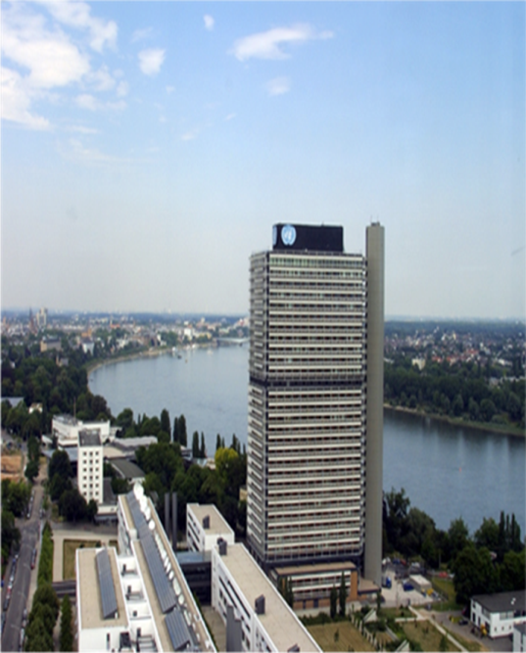
Thank you all very much
WHO European Centre for
Environment and Health
Platz der Vereinten Nationen 1
53113 Bonn, Germany

