Slide 1


Notes:
‘0’ This lecture explains the quality management of analytical data by referring to the definitions provided by the International Organization for Standardization, ISO.

Slide 2

Notes:
‘1’ This section outlines total quality management, TQM, quality assurance, QA, and quality control, QC. QA and QC are often confused. These explanations also include some terminology.

Slide 3
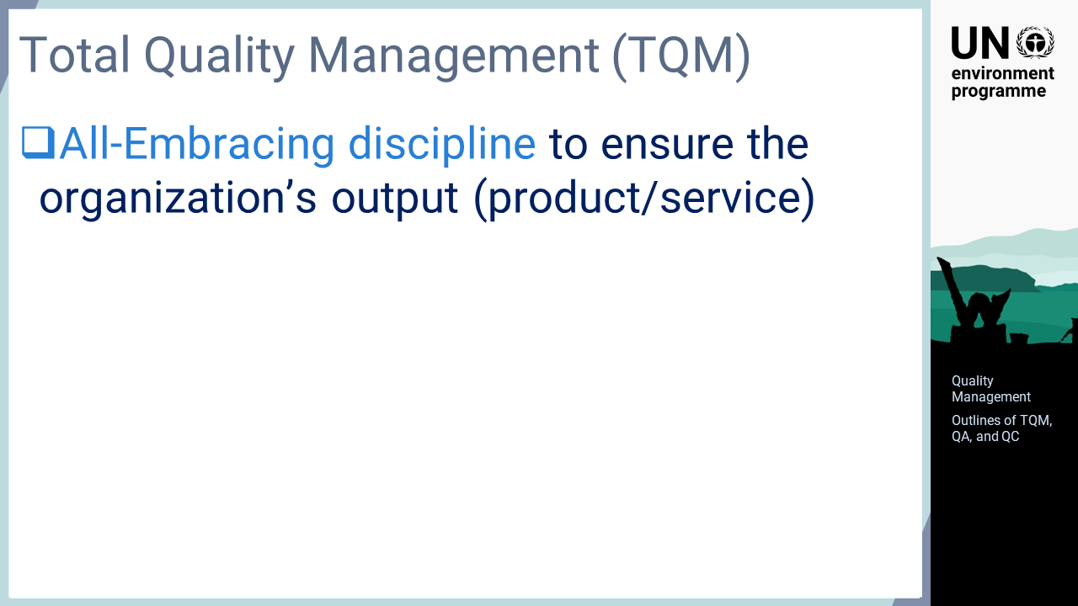
Notes:
‘2’ This slide shows the general principle of TQM. In fact, there is no clear definition of TQM provided by ISO, or others. The general principle can typically be understood as an "all embracing discipline to ensure the organization’s output".

Slide 4
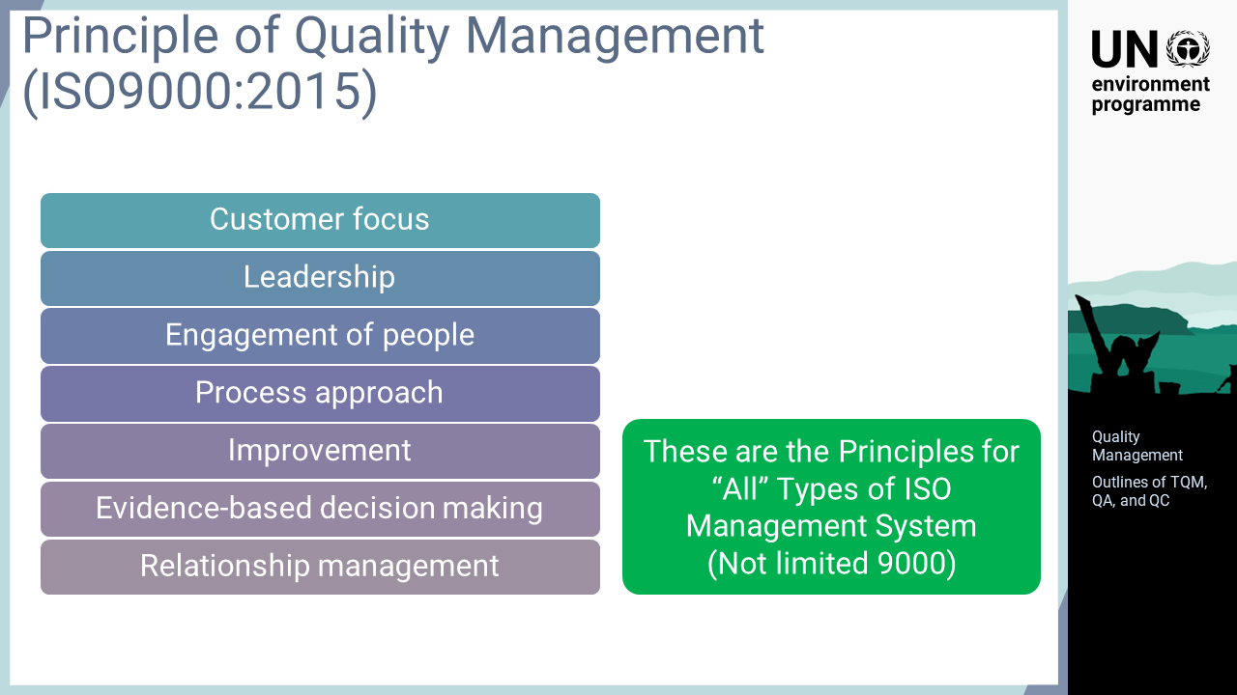
Notes:
‘3’ This slide shows the seven principles of quality management defined in ISO 9000. They are customer focus, leadership, engagement of people, process approach, improvement, evidence-based decision making, and relationship management. These principles are described in ISO 9000, but this idea applies universally across the management systems issued by ISO, including ISO/IEC 17025, where the system requirements are defined using the same philosophy.

Slide 5
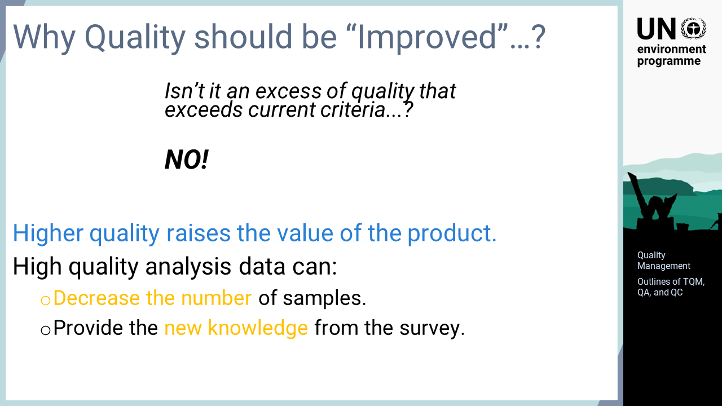
Notes:
‘4’ ‘Quality improvement’ is included in the configuration of TQM. It has often been questioned why quality must be continuously improved, as quality beyond the current criteria would be excessive. This criticism is refuted by the following explanation. Among industrial products with the same performance specifications, products of good quality are sold at a high price. Analytical data is not a commercial commodity per se, but high-quality data could create great value. For example, highly accurate data can provide qualified information to the subject with fewer samples. Thus, improving quality may offer new knowledge that was not previously understood.

Slide 6
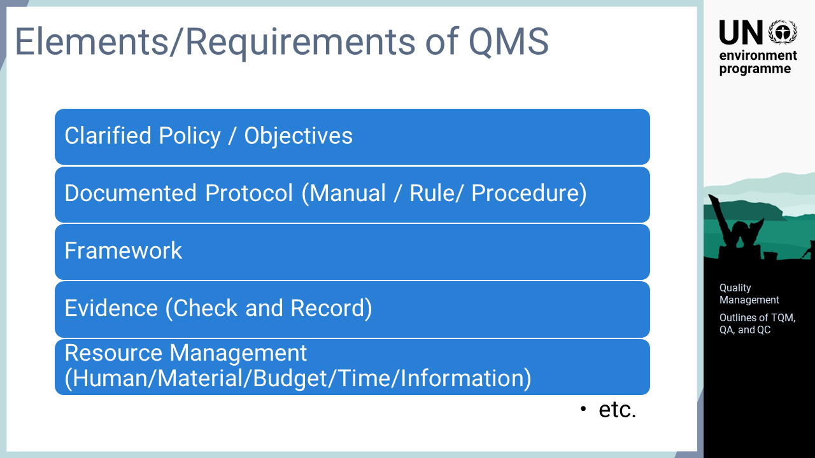
Notes:
‘5’ This slide explains the important points of a quality management system for an organization. These are not the exact terms defined by ISO or others, but could be summarised by the seven principles in the requirements of the ISO 9000 series and ISO/IEC 17025. They are clarified policy and objectives of the system, documented protocol for the purpose, clear framework of the system, properly obtained evidence, and appropriate resource management of human, material, budget, time, and information necessary for system operation. In a quality management system, it is important that these elements are clearly documented, properly implemented, and securely recorded.

Slide 7
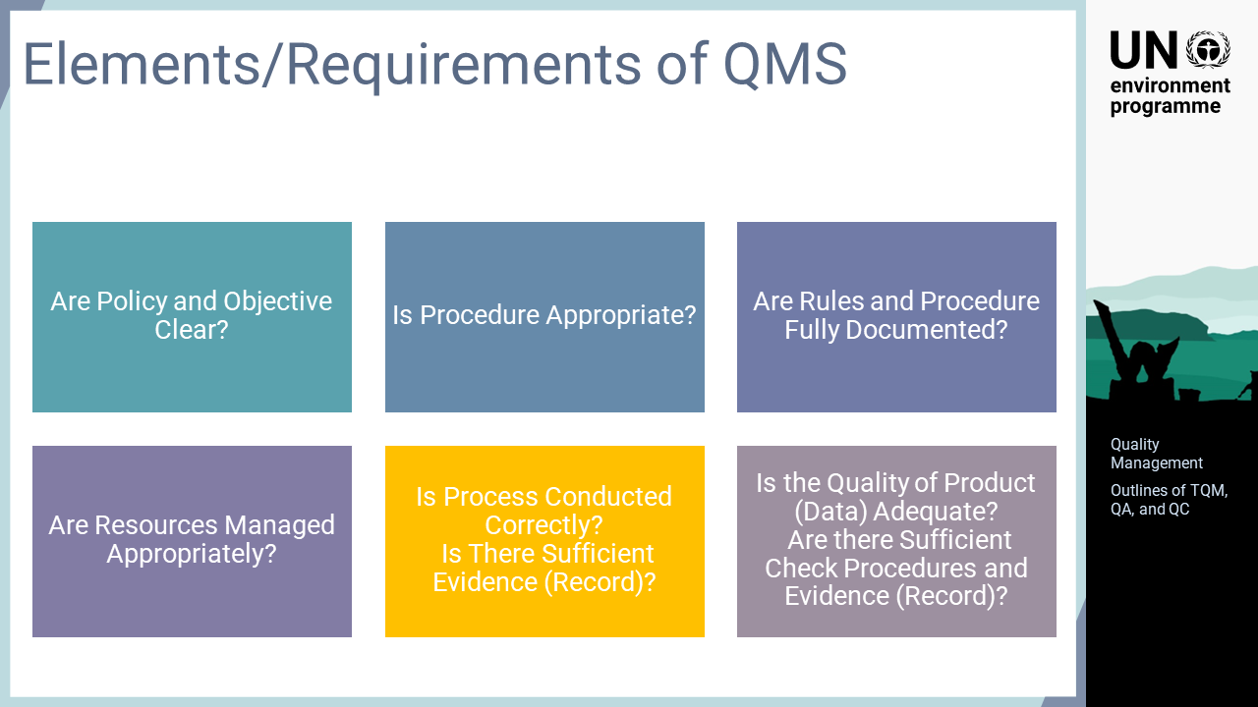
Notes:
‘6’ This slide indicates the necessary check items for quality management. Are the policy and objective clear? Is the procedure appropriate? Are the rules and procedures fully documented? Are the resources managed appropriately? Is the process conducted correctly? Is there sufficient evidence? Is the quality of the products adequate? Are there sufficient check procedures and evidence? It is necessary to check these items and correct them, if they are insufficient, throughout the system design and implementation. The first four are particularly important in system design, and the last two are important in system operation.

Slide 8
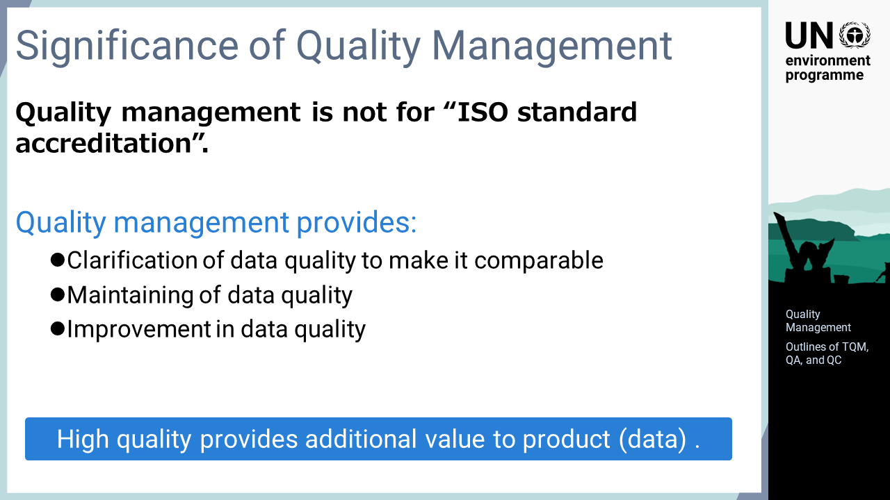
Notes:
‘7’ It is important to keep in mind that quality management has its own purpose, which is not for the sake of obtaining ISO accreditation. The quality management process can be cumbersome as it requires more steps. However, the quality management process clarifies the quality of laboratory data, that is, accuracy, and makes it comparable with other data. Maintaining and continuously improving the quality of data is the real value of quality management. It is emphasized that high-quality data creates new value, such as discovering new knowledge; thus, the improvement in data quality can be considered an improvement in the capacity of the laboratory.

Slide 9

Notes:
‘8’ This section explains the items relevant to QC. There are two important components for process clarity: a standard operating procedure, SOP, and a record.

Slide 10
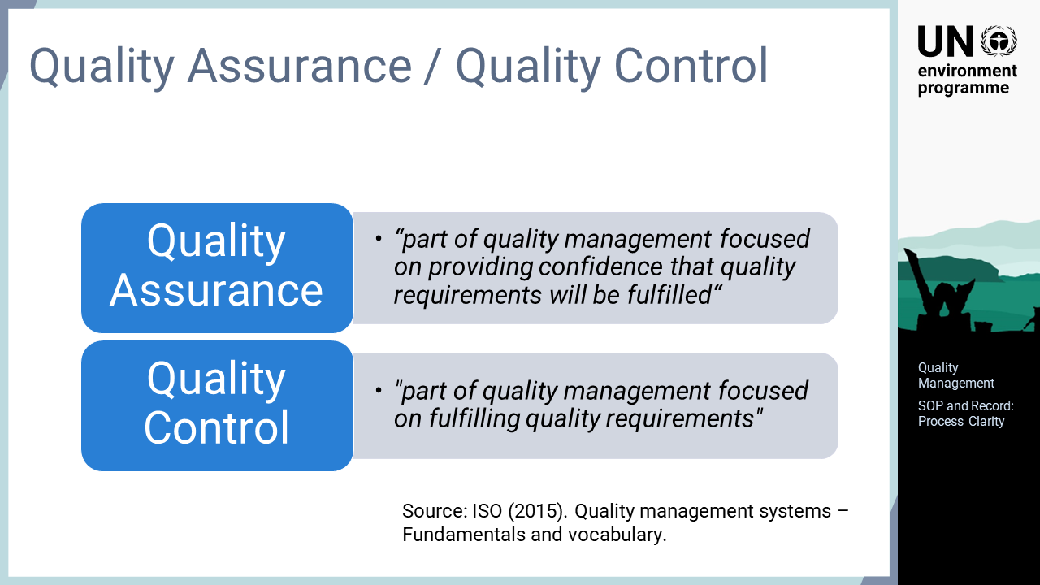
Notes:
‘9’ ISO defines the term QA as the "part of quality management focused on providing confidence that quality requirements will be fulfilled". QC is defined as the "part of quality management focused on fulfilling quality requirements". Both QA and QC are considered part of overall quality management.

Slide 11
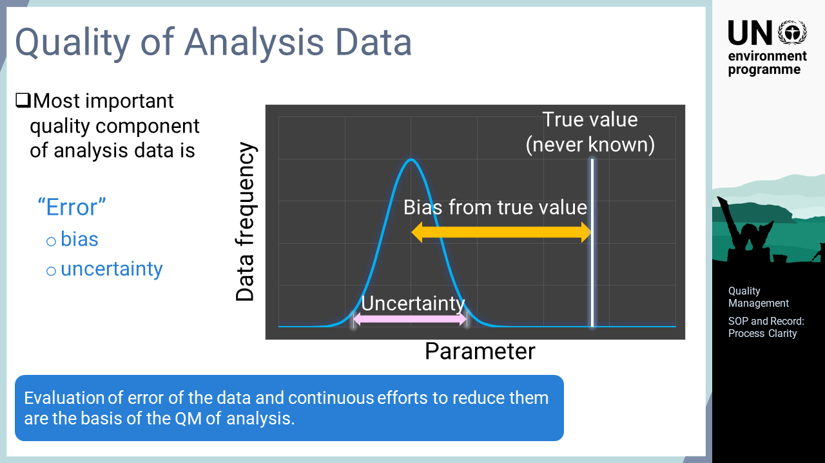
Notes:
‘10’Firstly, the meaning of the ‘quality’ in terms of analysis should be clarified. Since the obtained data is the product of analytical activity, the quality of the analysis can be referred to as the quality of data itself. How should the quality of data be measured? The quality of analytical data means the degree of accuracy. Therefore, error in analytical data is the most important quality management component. In general, errors are divided into bias from the true value and the uncertainty of the result. The quality management of analysis is an activity to evaluate the magnitude of these errors and to reduce such errors continuously.

Slide 12
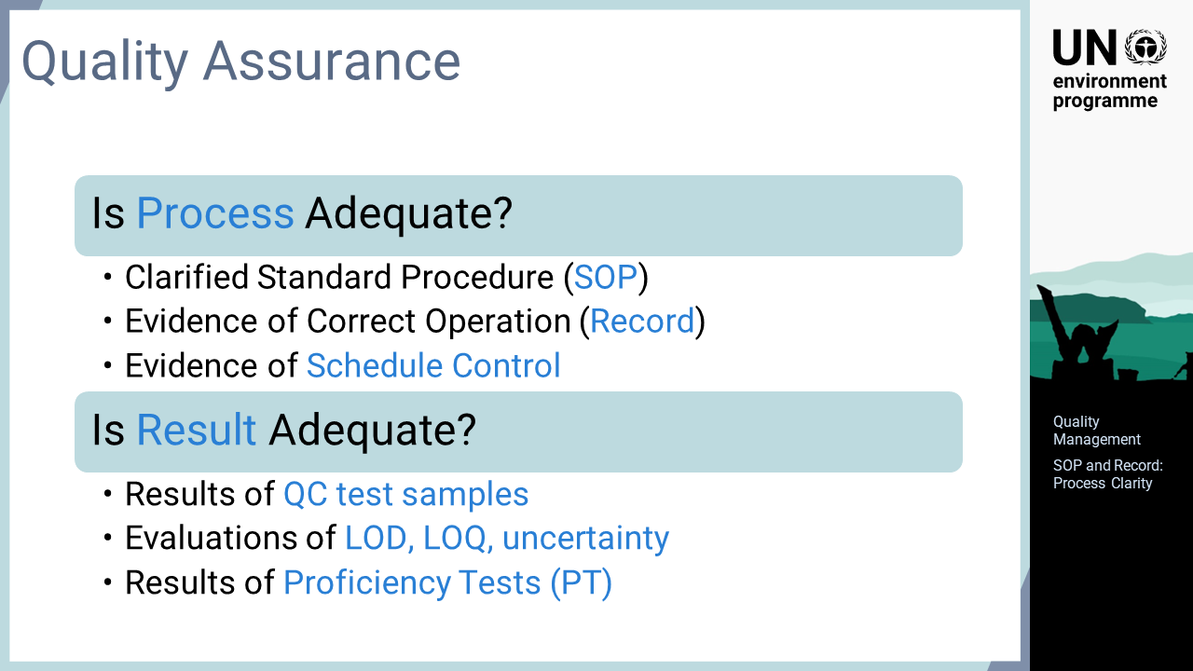
Notes:
‘11’ This slide explains how the quality of analytical data can be ensured. The quality of analytical data should be ensured from two aspects: the adequacy of the process employed and the result obtained. The adequacy of the process is ensured by a set of documents, including a clearly refined SOP, evidence of correct operation that records that the operation was performed correctly according to the SOP, and evidence of schedule control that ensures that the activities in the analysis were appropriately done. The adequacy of the result is also ensured by a combination of several types of information, including the results of QC test samples such as operation blanks, duplicate analysis, standards reference materials, evaluations of the experimentally obtained limit of detection, limit of quantification, and uncertainty, and the results of proficiency tests conducted between laboratories.

Slide 13
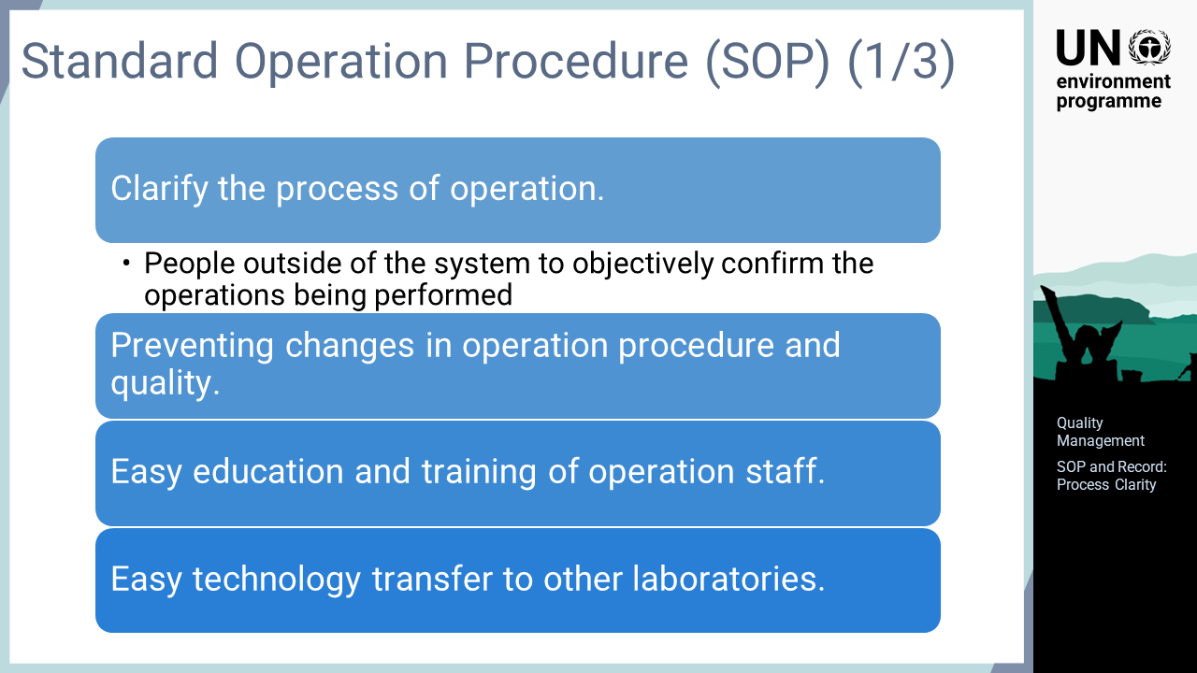
Notes:
‘12’ This slide explains the roles and effects of an SOP, which is an important document for determining the analytical process. The key role of the SOP in quality management is to clarify the process of operation to avoid different operations being performed on different occasions or by different operators. The documented SOP enables people outside of the system to objectively confirm the operations being performed. The SOP in written form is an effective means of preventing changes that may affect the results during the analytical operation, which tends to drift gradually over time or with the replacement of operators. Other benefits of having an SOP include the easy education and training of operation staff, and easy technology transfer to other laboratories.

Slide 14
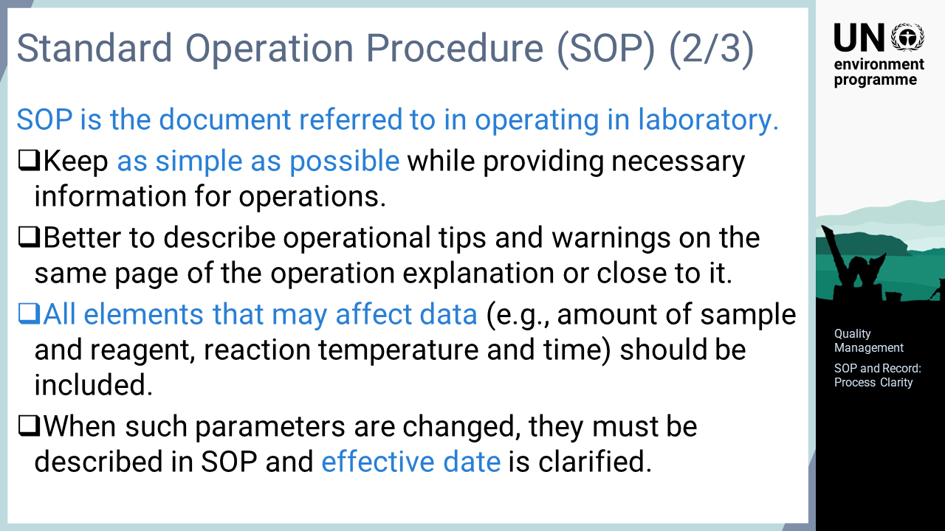
Notes:
‘13’ The key considerations for preparing an SOP are explained in this slide. Firstly, different from manuals, SOPs are developed from the viewpoint of facilitating the actual operations in a laboratory. The descriptions of the operations should be simple enough to be understood easily when performing the operations. Additionally, the operational tips and warnings should be put on the same page or close to it for easy reference instead of summarised on a separate page. On the other hand, while keeping the descriptions as simple as possible, the SOP should include all factors that affect the analytical data, such as the amount of sample to be used, the amounts of reagents, and the reaction temperature and duration. Without clear instructions on these elements, the quality of data may vary on different operation dates or with different operators; therefore, these elements should be addressed in the SOP. If some of the operation parameters in an SOP have been changed due to improvements of the analysis method, such changes should be reflected in the SOP and the effective date should be indicated.

Slide 15
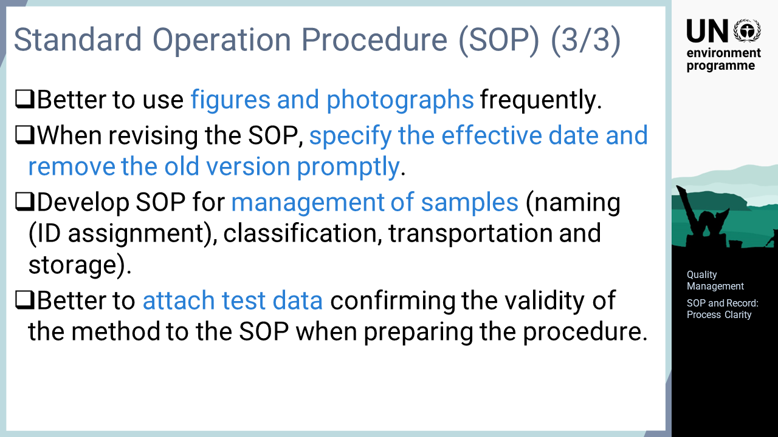
Notes:
‘14’ This slide shows a few more tips for developing an SOP. To make it simple and easy to understand, it is recommended that figures and photos are used effectively. When the contents of the SOP are revised, the effective date will be very important when later checking the data. Thus, whenever the SOP is revised, the effective date should be indicated, and the old version should be removed promptly to prevent misuse. SOPs for sample management, such as sample naming, ID assignment, classification, transportation, and storage, should be developed in addition to the analytical operations to clarify the process of sample management. This is very important as failures due to improper sample management frequently occur. Sometimes, preparatory tests may have been carried out to determine some parameters, such as the amounts of reagents used in the SOP. Attaching these test data to the SOP will be very useful when verifying analysis results or improving the operations.

Slide 16
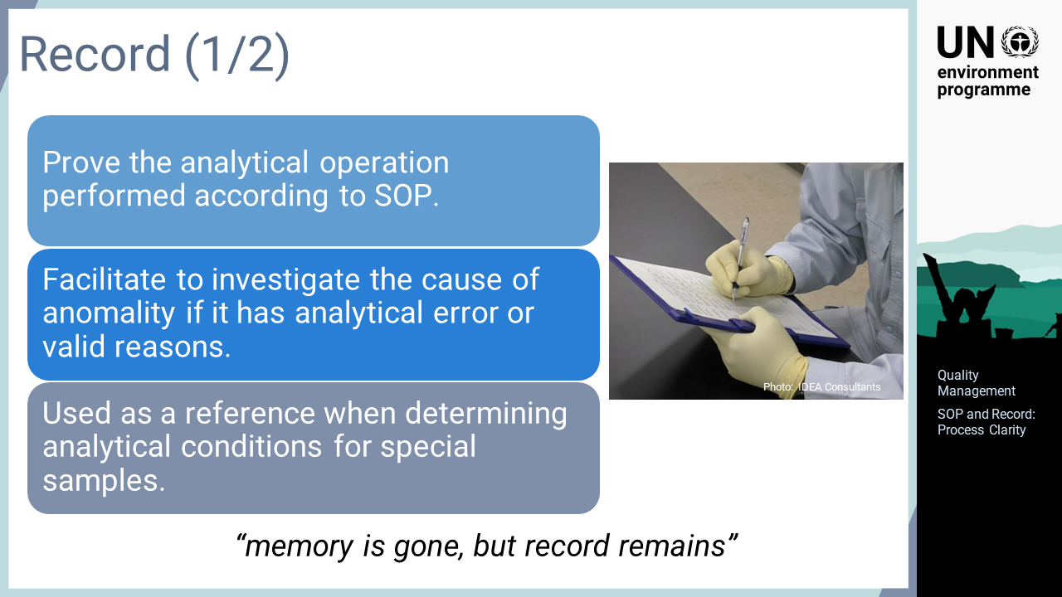
Notes:
‘15’ The record is another important factor for ensuring the analysis process. An SOP is developed to clarify the operation of the analysis, but the actual analysis must be performed accordingly. A record is essential evidence to prove that the analytical operations were performed according to the SOP. Detailed records are not only very useful for proof of operation but also for proper data collection. Analytical data may sometimes exhibit anomalies with values outside the normal data range or different trends from past data series. In such cases, the detailed record from the time of analysis will help to determine whether the cause of the anomaly was an analytical error or a valid reason due to the situation of the survey location or sample. In addition, the accumulation of past analysis records can provide a reference of similar examples when analysing a special sample or a reference for considering appropriate countermeasures based on the analysis situation of normal samples.

Slide 17
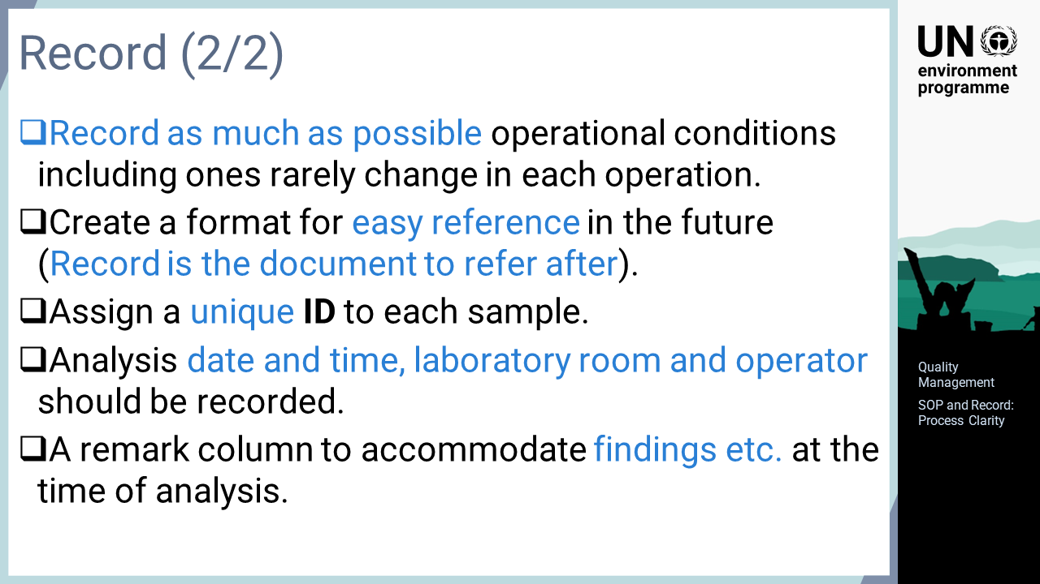
Notes:
‘16’ This slide explains the key considerations when deciding the contents of the record. In actual analytical operations, many items, such as the amount of reagent to be added and, the heating time., rarely change and do not seem to differ in each analytical operation. Although it may seem meaningless to record these items for each operation, it is actually useful to ensure correct operations; thus, such information should be recorded each time, to the extent possible. It is Important to note that the record is not the end product but is the information to be referred to at a later time. Therefore, a record form should be prepared for easier reference in the future. It is also important to assign a unique ID to each analytical samples and enter it in the record to identify the samples referred to in the record. The date and time of analysis, the operator, and the laboratory room, if there are more than one, are some easily forgotten but important information for quality management. The record form should be prepared to accommodate this information. During the analytical operations, some abnormal situations may occur. A remark column in the record form can accommodate such observations, which will benefit future analysis.

Slide 18
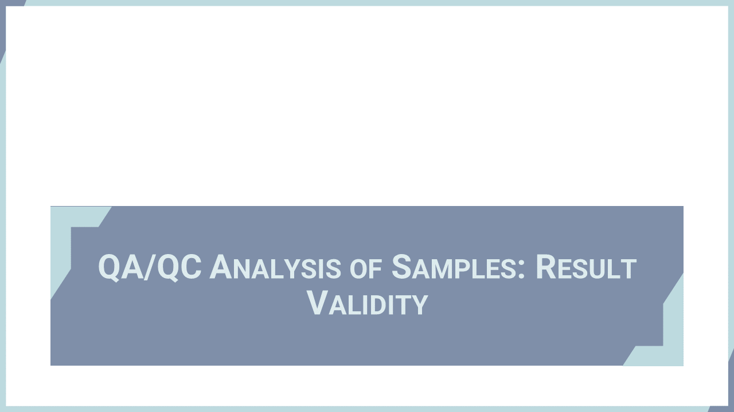
Notes:
‘17’ In this section, the use of operation blanks, duplicate analysis, and standard samples for evaluating the validity of analytical data are explained.

Slide 19
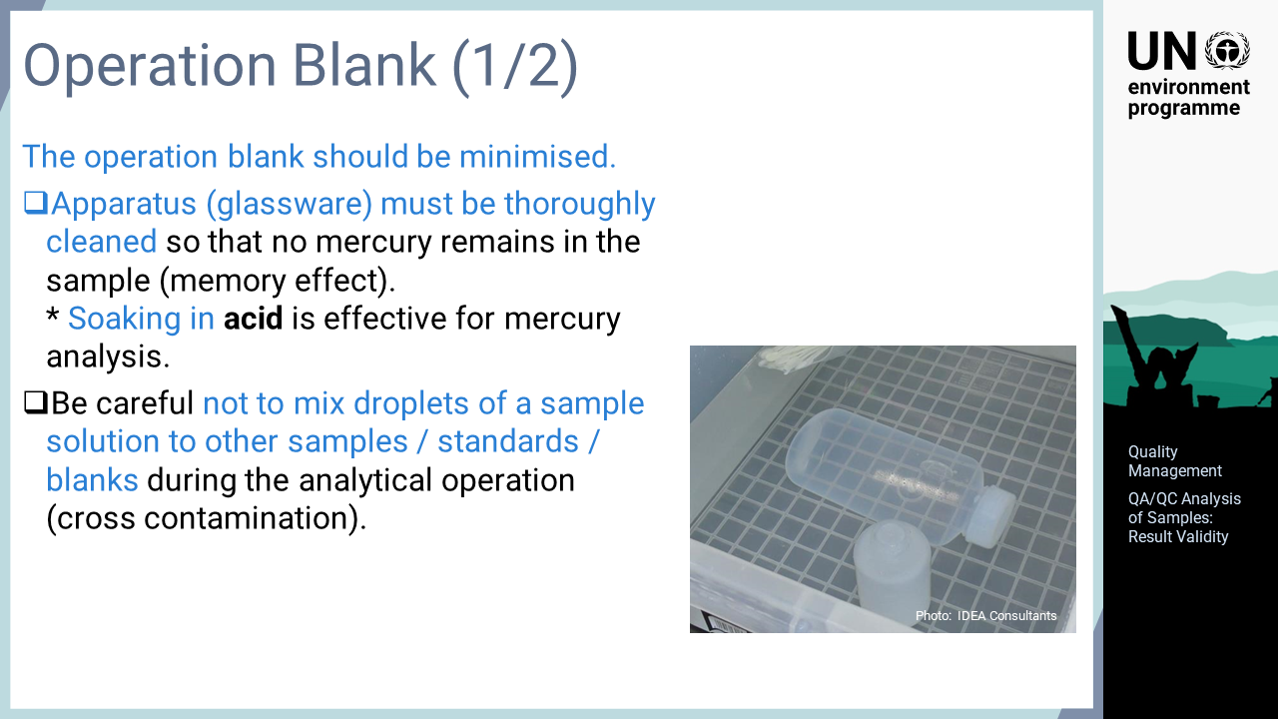
Notes:
‘18’ The operation blank has great impact on the accuracy of analysis and the detection limit, so its level must be minimised. Mostly, the operation blank level in chemical analysis comes from contamination of the air in the laboratory, elution from materials or residues of previous samples on the glassware, accidental spillage of the target substances from other samples or standard solutions during operation, or contamination of the initial reagents. For mercury analysis, the air in the laboratory usually does not affect the blank, except in the case of ultra-trace analysis of samples such as ocean water. Therefore, other factors, such as contamination of the apparatus or reagents and contamination from other samples, need to be considered. The glassware must be thoroughly cleaned after use so that no mercury from the sample remains. Soaking in acid, even in dilute solutions, is an effective means of cleaning. Additionally, droplets of a sample solution are often inadvertently dropped into other samples, blanks, or standard solutions. The analytical operation should be carefully performed to avoid the mixing of such droplets, known as cross-contamination.

Slide 20
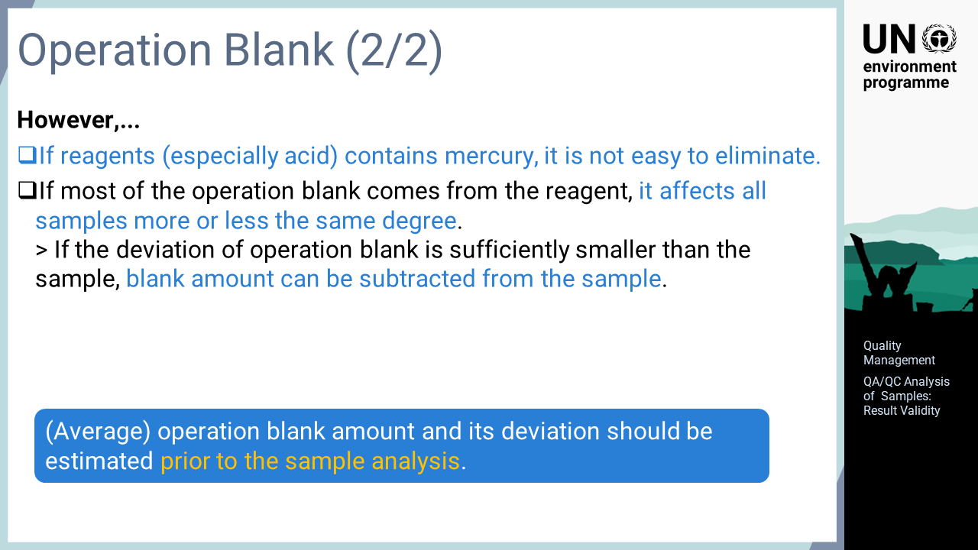
Notes:
‘19’ Cross-contamination from the sample container or apparatus used for analysis can be avoided by thorough careful cleaning. On the other hand, the effect of trace mercury in reagents is not easy to eliminate. The best and simplest solution is to switch the reagent for mercury-free one. If this is not possible, the analysis must be undertaken with a certain blank level. It is assumed that the amounts of reagents used for an analysis are usually the same for all samples and standard solutions; thus, all the samples and standard solutions might be affected by the reagent to more or less the same degree. If the deviation of the operation blank is estimated in advance and proven to be sufficiently smaller than the actual sample concentration, the effect of the blank can be eliminated by subtracting the value from the analysed concentrations of the samples and standard solutions. The deviation of the operation blank is also related to the detection limit, which affects the accuracy of analysis and the detection limit to a great extent. It may not be possible to obtain data that meets the purpose of the survey if the blank value is larger than expected. It is particularly important to estimate the level and deviation of the operation blank prior to the actual analysis to ensure that the analytical operation meets the purpose of the survey.

Slide 21
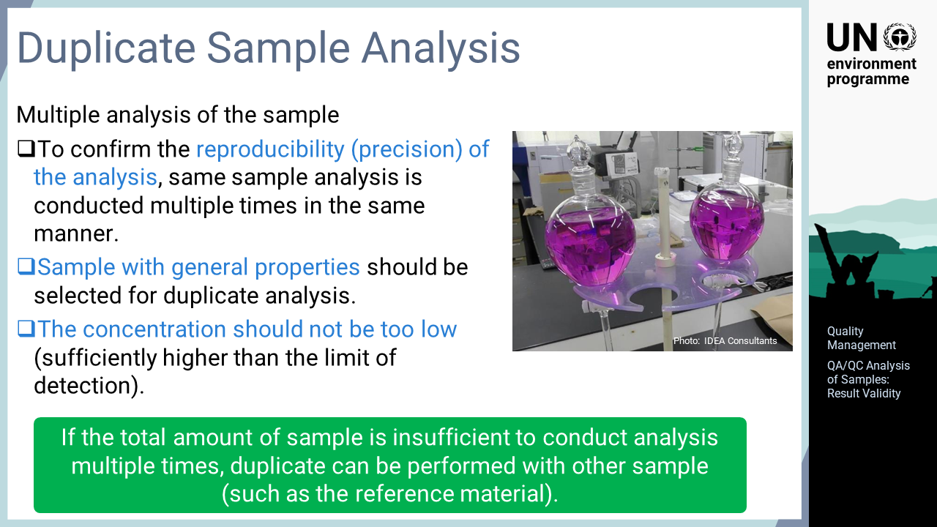
Notes:
‘20’ Duplicate analysis involves multiple analyses of the same samples. It is performed to check the reproducibility of the analysis. The same samples are analysed more than twice with the same procedure and the differences are compared. To understand the general situation in the analysis, the sample to be duplicated for analysis should be selected from among the samples with typical properties. Additionally, a sample with a concentration that is sufficiently higher than the detection limit should be selected to verify the differences among the analytical results. In some cases, the amount of sample is not sufficient for multiple analyses. Duplicate analysis may also be performed with another sample with similar properties prepared for that purpose and analysed together with the analytical samples.

Slide 22
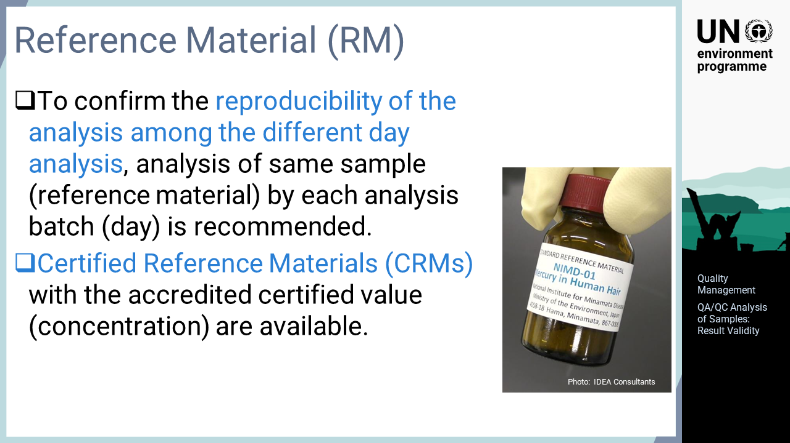
Notes:
‘21’ The reproducibility of the analysis within the same day can be assessed using the duplicate analysis information, but the most effective way to confirm the reproducibility of the analysis between different days is to analyse the same samples on every day of analysis. For this reason, it is recommended that the same sample is analysed and the results are compared for each processing batch for analysis, usually daily. Certified reference materials, CRMs, which have been evaluated jointly by many analytical institutions and given a certified value, are commercially available for use in the laboratory as a standard material. CRMs can be used to assess the reproducibility of the analysis. Since the certified value is traceable to the national or international standard, CRM analysis is a very useful method for understanding the level of bias in the analytical data of the laboratory. CRMs are expensive materials for use in daily analysis, but it is recommended that such as analysis is performed on a regular basis, if possible.

Slide 23
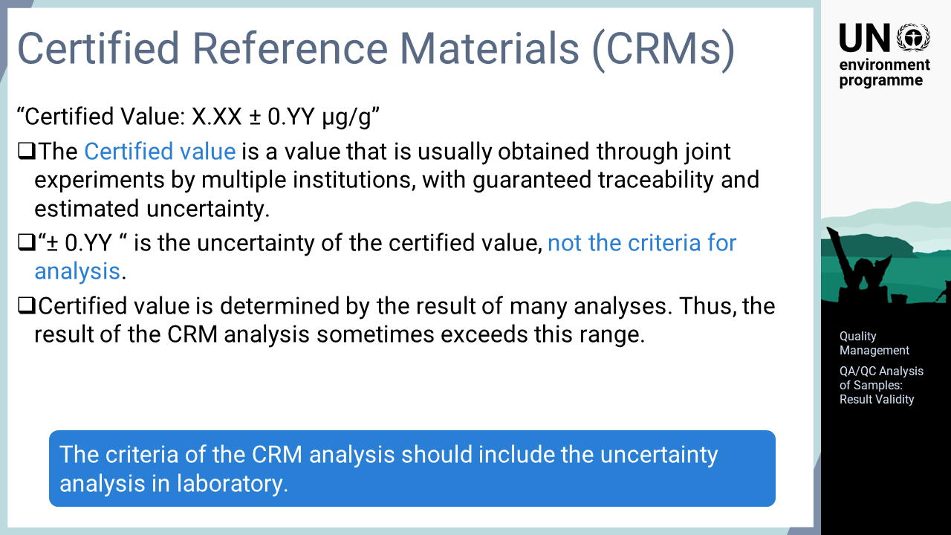
Notes:
‘22’ As the name implies, CRMs are standard materials with certified values. The certified value is usually obtained through joint experiments by multiple analytical institutions, so that the traceability of the analysis is guaranteed and the uncertainty is estimated. The number after the plus-minus sign in the certified value is sometimes misunderstood. The numerical value described as zero-point yy is the uncertainty of the given certified value, that is, the degree of accuracy of the certified value. It should be noted that this number is not the value obtained by the actual analysis of the CRM. Instead, the uncertainty of CRM is estimated from multiple analysis data, and not all analysis results fall within this range. Therefore, using this range to control the CRM analysis may disqualify laboratory results that were actually completed properly. It should be noted that the criteria of the CRM analysis should consider both the uncertainty of the certified value and the uncertainty of the analysis conducted in the laboratory.

Slide 24
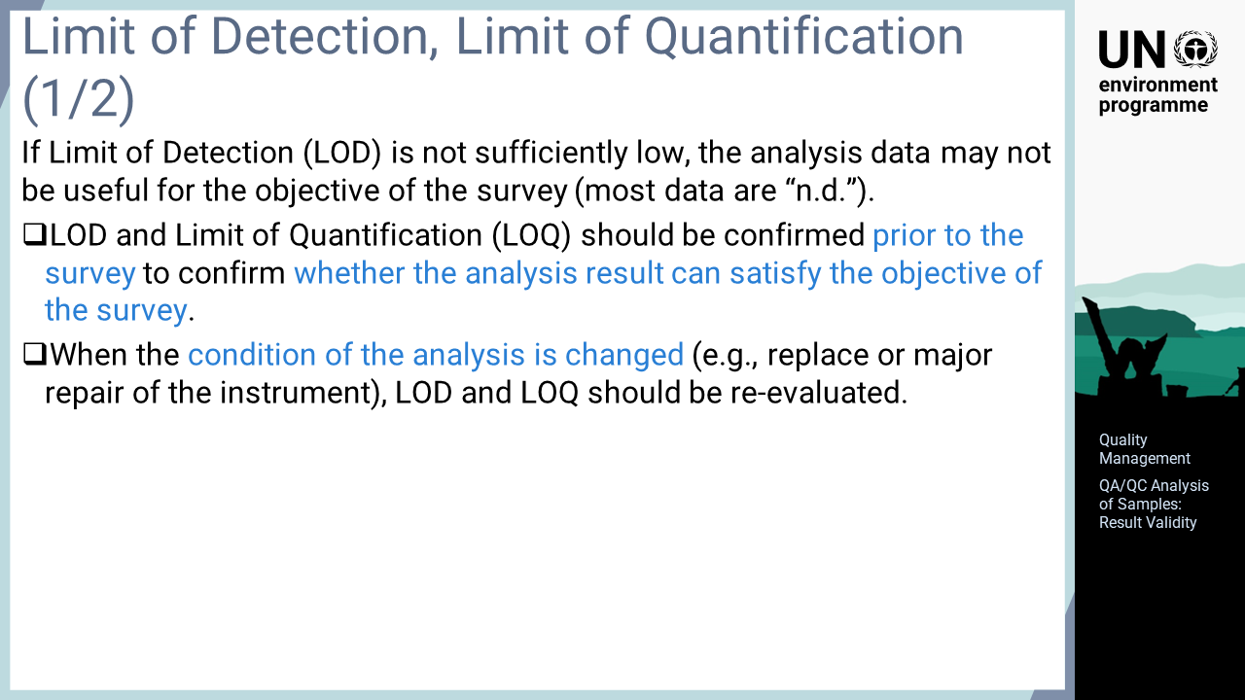
Notes:
‘23’ The use of limit of detection, LOD, and limit of quantification, LOQ for QA/QC is explained here. If the LOD of the analysis exceeds the concentrations of most of the samples, the survey may not fulfil its purpose as these samples will be classified as “not detected”. To ensure that sufficient analytical data is obtained to fulfil the purpose of the survey, the lowest value that is detectable in the laboratory should be estimated prior to the analysis. The LOD and LOQ may change when the analysis situation is changed due to the replacement or repair of analytical instruments, or other reasons. In such cases, the values should be re-evaluated.

Slide 25
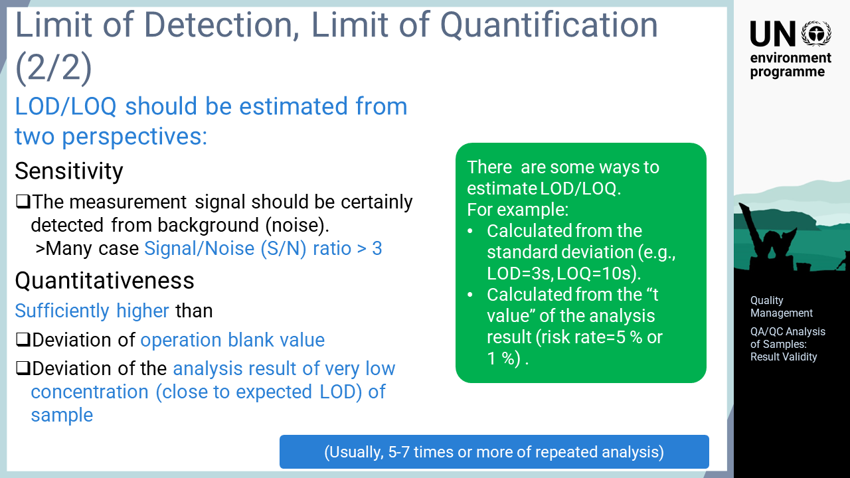
Notes:
‘24’ The LOD and LOQ of the analysis need to be estimated from two perspectives. One is the limit at which the measurement signal of the sample can be certainly detected, which is a judgment based on the sensitivity of the instrument. The other is the reliability of the data obtained in the analysis, which is a judgment based on the quantification of the results. For the sensitivity of the instrument, the fluctuation of the baseline without a sample signal is considered noise; thus, the signal of mercury must be sufficiently larger than the noise to detect the mercury in the sample. In many cases, the signal is considered detectable when it is at least three times larger than the noise. The results are considered quantifiable when the variation in the analytical results for a sample is sufficiently smaller than the analytical value of the sample. This is determined by repeated analysis of the operation blank or the sample with the lowest possible concentration, ideally close to the expected LOD. The analytical value that are sufficiently larger than these deviations are estimated as the LOD and LOQ. Several methods have been proposed in various manuals and surveys to calculate the LOD and LOQ from repeated analyses. One example proposes that the LOD is estimated as three times the standard deviation and the LOQ as 10 times the standard deviation for repeated analyses. Another method calculates these values from the t value of the analysis results.

Slide 26
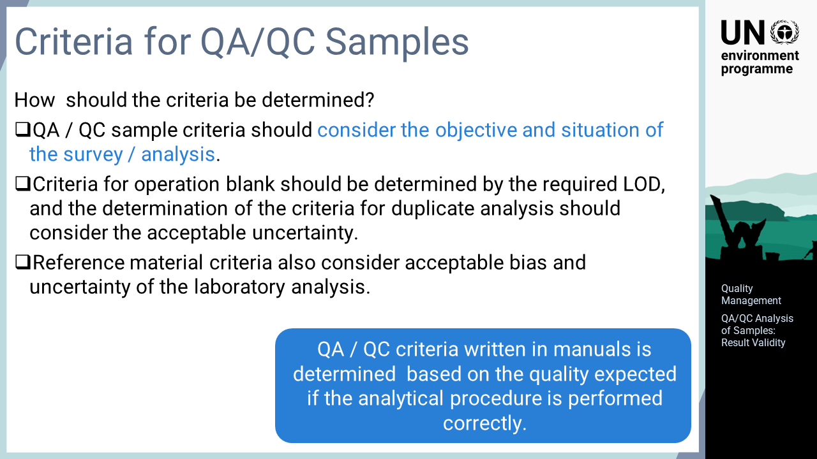
Notes:
‘25’ A frequently asked question is, "How should the criteria be determined?". It is not possible to determine absolute criteria for QA/QC sample data without considering the objective or circumstances of the survey or analysis. The acceptable quality of data differs depending on the objective of the survey or analysis. The QA/QC sample criteria must consider the objective of the analysis normally performed in the laboratory. For example, the criteria for the operation blank should be determined with the required LOD, and the criteria for duplicate analysis must consider the acceptable uncertainty. The reference material criteria should also take into account the acceptable bias and the uncertainty of the laboratory analysis. The QA/QC criteria described in manuals are determined based on the quality expected when the analysis operation is performed properly.

Slide 27
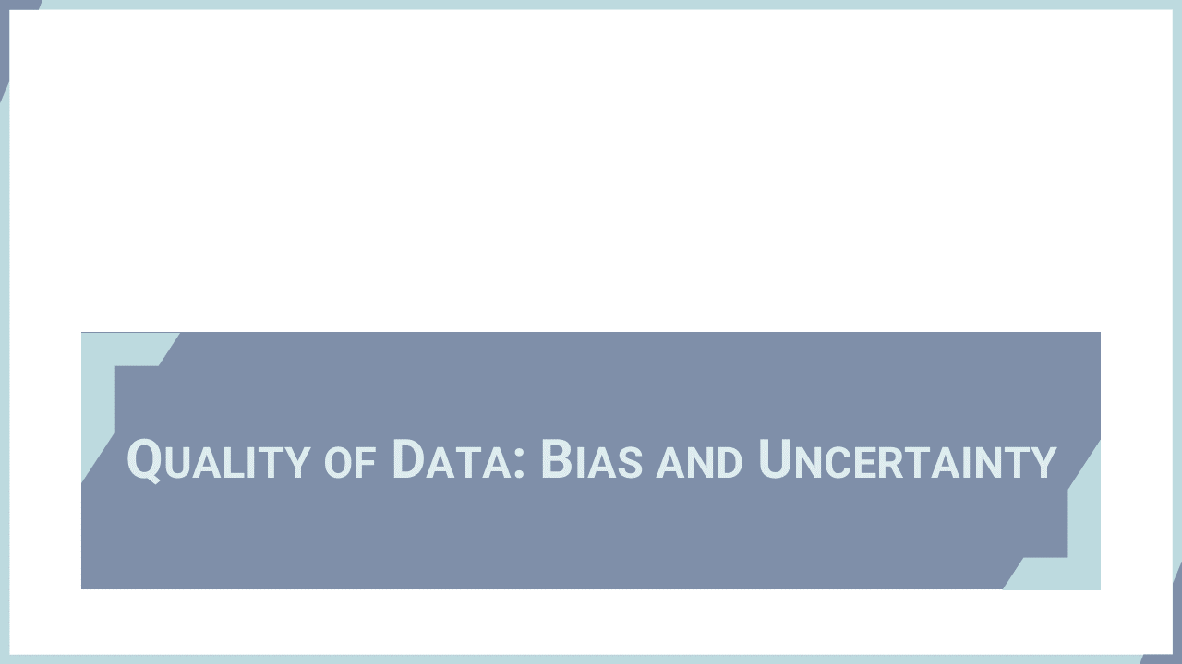
Notes:
‘26’ The most important factors for data quality are their errors, biases and uncertainties. This section outlines two of these factors: bias and uncertainty.

Slide 28
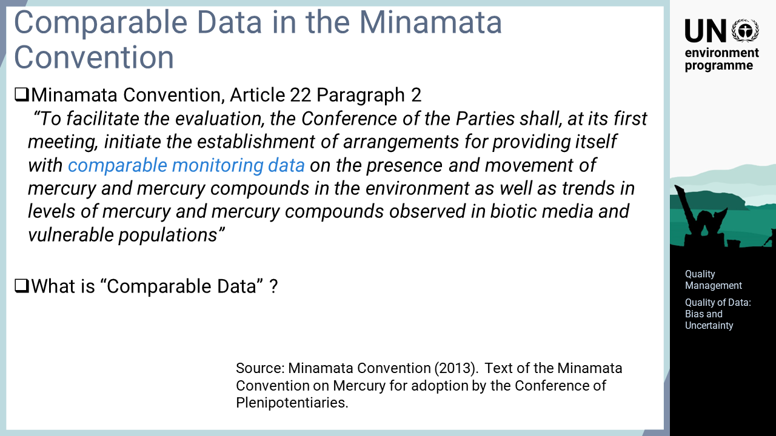
Notes:
‘27’ Firstly, the text of Article 22 of the Minamata Convention on Mercury is shown here. The article mentions the establishment of arrangements for providing itself with comparable monitoring data on the presence and movement of mercury and mercury compounds in the environment as well as trends in levels of mercury and mercury compounds observed in biotic media and vulnerable populations. It refers to comparable data, but what does comparable data mean?

Slide 29
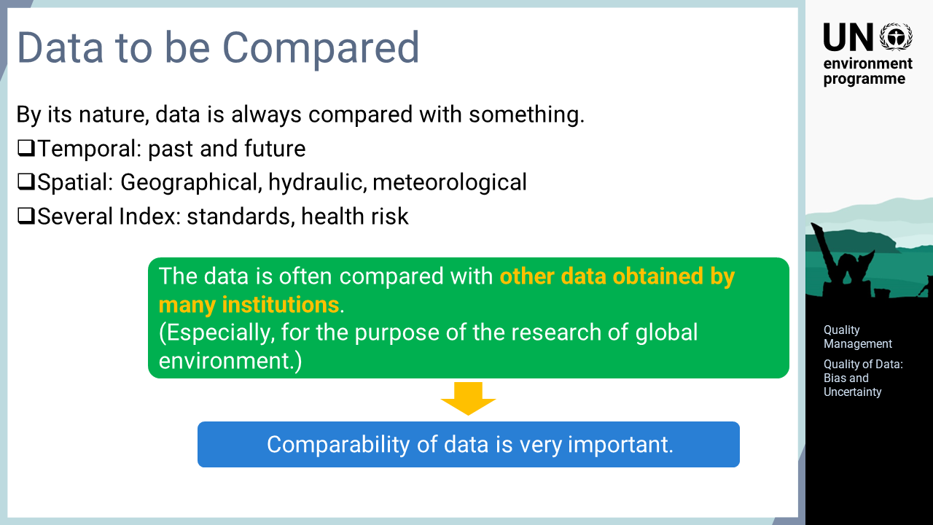
Notes:
‘28’ By its nature, data is always compared with something. For example, it can be compared in chronological order with past or future data, compared with points that are spatially, geographically, hydraulically, or meteorologically relevant, or compared with administrative standards or health risks. In this sense, the data is retrieved for comparison. In many cases, the data is compared with data obtained by many other institutions. This is especially significant when the purpose of the data acquisition includes global environmental studies, such as the effectiveness evaluation of the Minamata Convention. Therefore, data comparability is a very important concept.

Slide 30
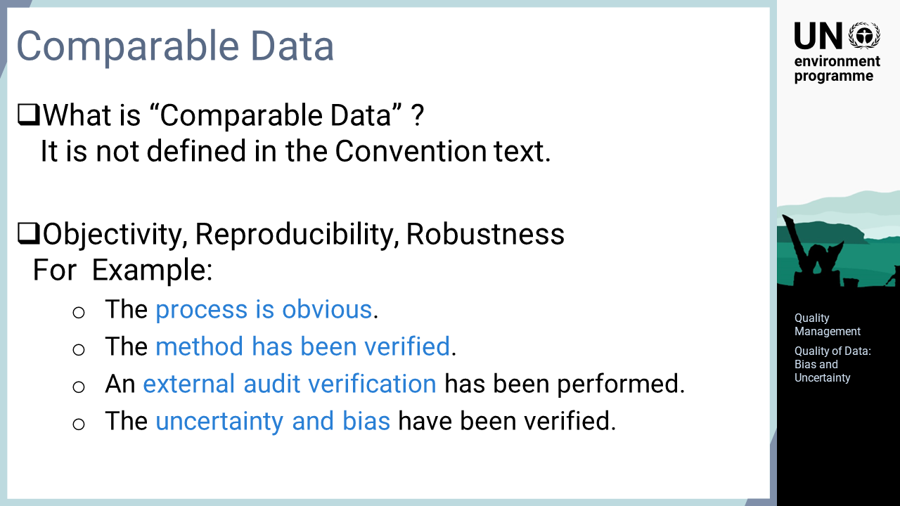
Notes:
‘29’ The importance of data comparability was emphasized but not defined in the Minamata Convention. The important factors for data comparability are objectivity, reproducibility, and robustness. The following items are relevant for ensuring the comparability of data: the procedure is obvious, the method has been verified, an external audit verification has been performed, and the uncertainty and bias have been verified.

Slide 31
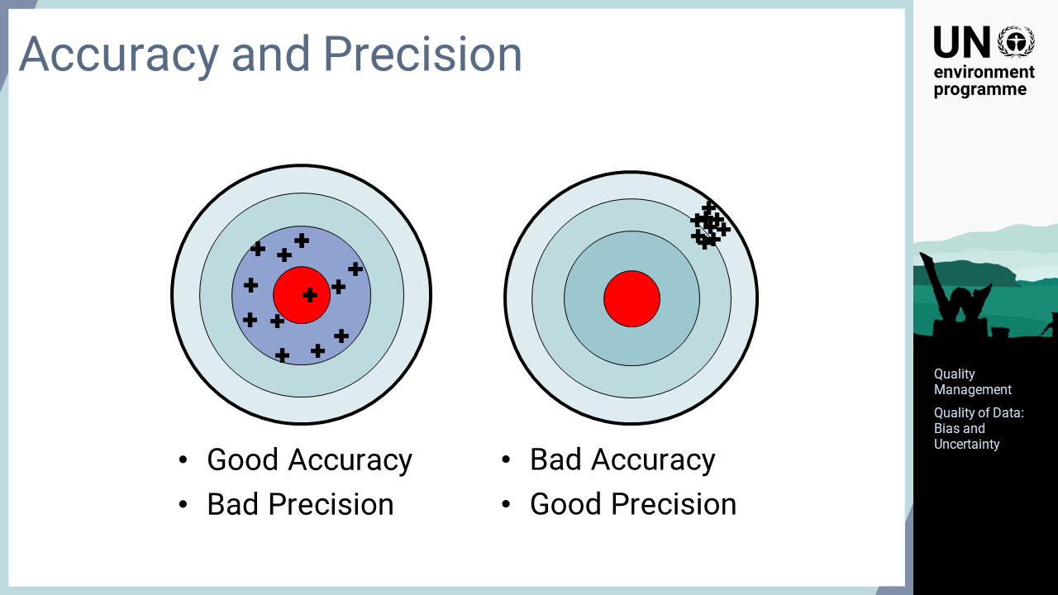
Notes:
‘30’ This slide illustrates data bias and uncertainty schematically. The centre of the circular target in this figure indicates the true value, and the + marks indicate the obtained analysis data. The target on the left has a small bias but a large uncertainty, that is, good accuracy but bad precision. The + marks are scattered around the centre of the target. On the other hand, the target on the right has a large bias but a small uncertainty, that is, good precision but bad accuracy. The + marks are concentrated in a small area away from the centre of the target. As efforts should be made to improve both accuracy and precision in the analysis, properly evaluating the bias and uncertainty of the obtained data is a very important factor for understanding and comparing the data.

Slide 32
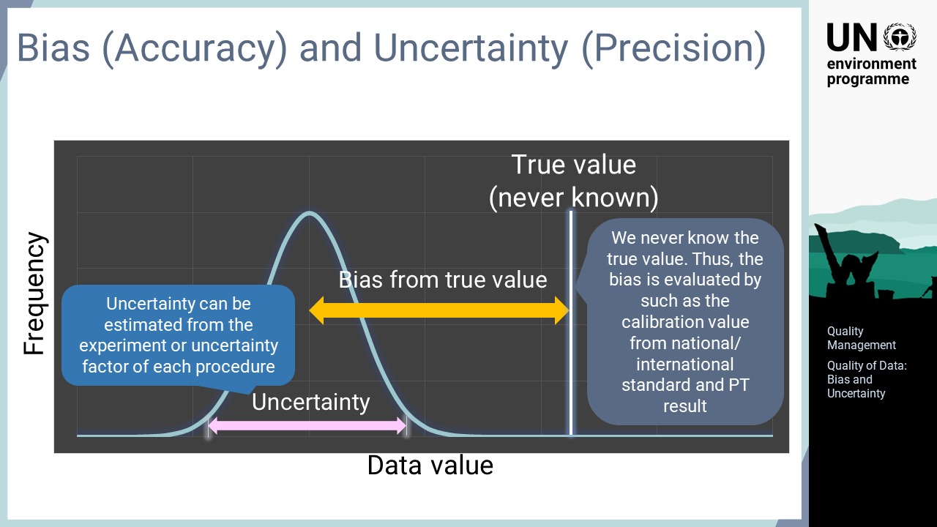
Notes:
‘31’ The accuracy and precision can also be described statistically. The blue line in the figure indicates the relationship between the data value and frequency. Bias is the difference between the analysed average value and the true value, that is, the accuracy. As the true value cannot be obtained analytically, an accurate bias value cannot be determined for the analytical data. If the analytical data is obtained using a traceable system calibrated with national or international standards, the bias of the data can be evaluated against these standards, and the data can be precisely compared with other data evaluated in the same manner. Uncertainty is the degree of data variability when a sample is analysed, that is, the precision. The uncertainty of an analysis can be estimated experimentally and analytically. The comparison of analysed data with other data becomes possible through the evaluation of the bias and uncertainty of the analysis.

Slide 33
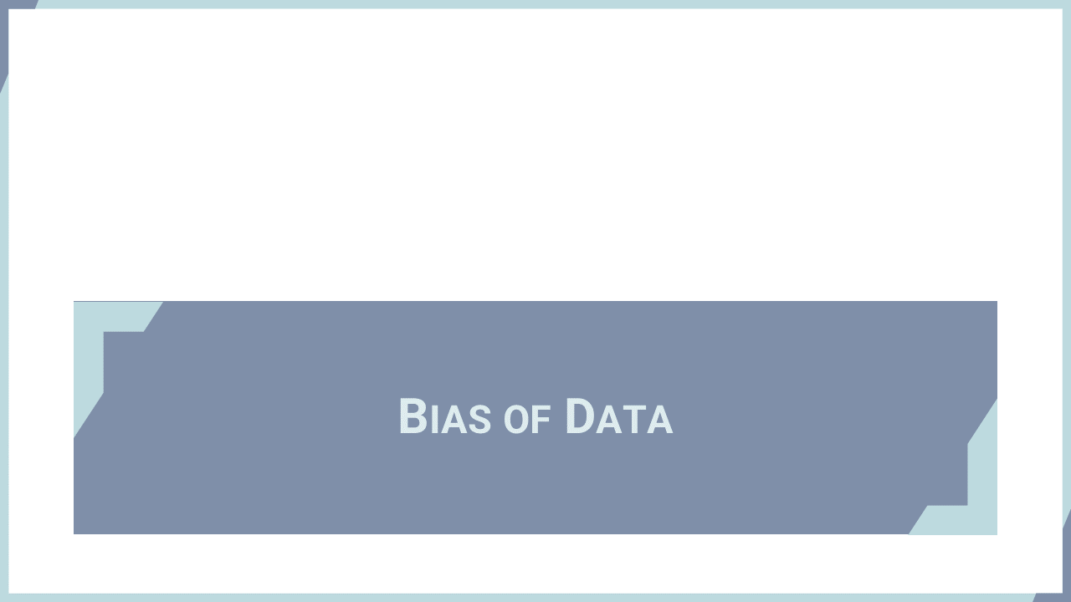
Notes:
‘32’ This section describes traceability as a means of assessing data bias against standards.

Slide 34
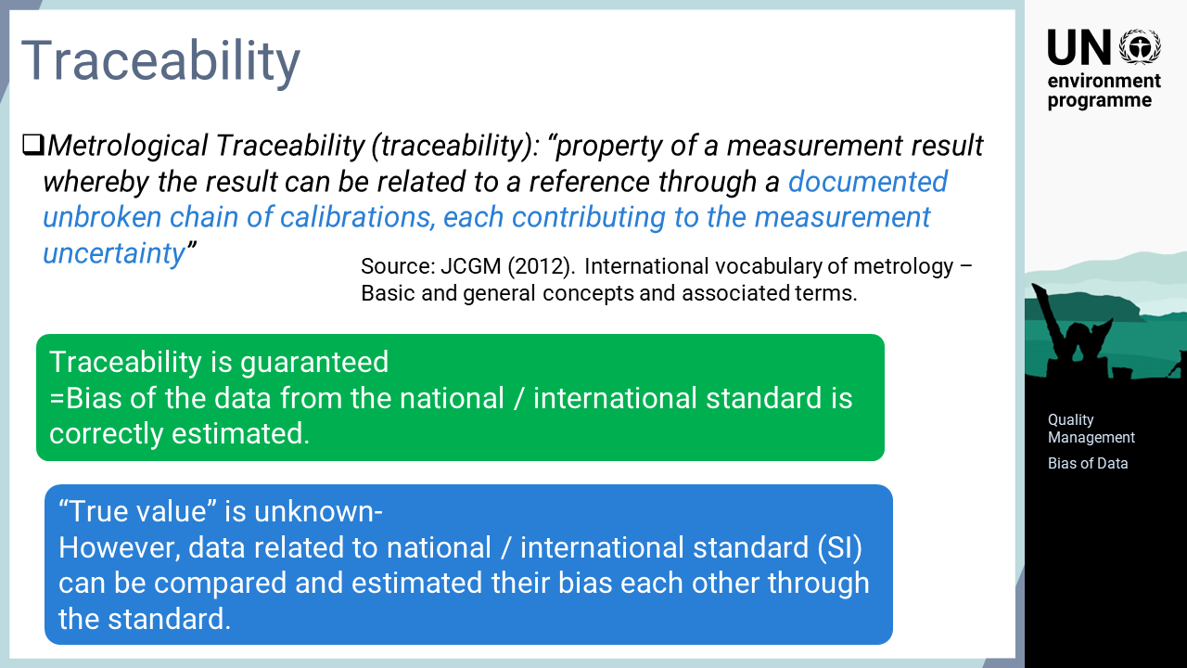
Notes:
‘33’ The term traceability is defined as the "property of a measurement result whereby the result can be related to a reference through a documented unbroken chain of calibrations, each contributing to the measurement uncertainty". Therefore, the fact that traceability is guaranteed means that the bias of data from the national or international standards is accurately estimated. For data secured by traceability in alignment with a standard, the bias against each other can be evaluated through the standard, even if the true value of the analysis cannot be known.

Slide 35
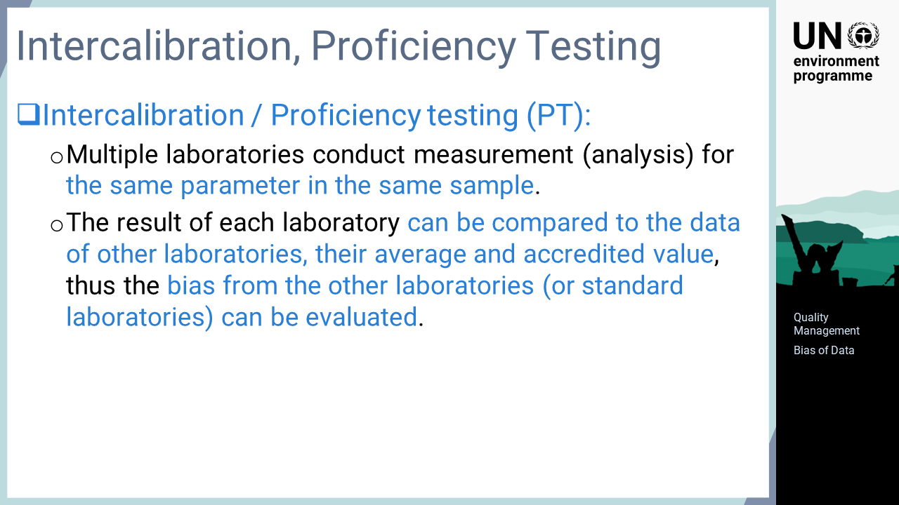
Notes:
‘34’ A comparative test between laboratories or a proficiency test is also effective for evaluating the bias between laboratories. This test simply organizes multiple laboratories to analyse the same parameter in the same sample and compares the results. Participating laboratories can see the differences from other laboratories or standard laboratories, from which they can obtain information about data bias between their own and other laboratories.

Slide 36

Notes:
‘35’ Another important factor, uncertainty, is explained in this section.

Slide 37
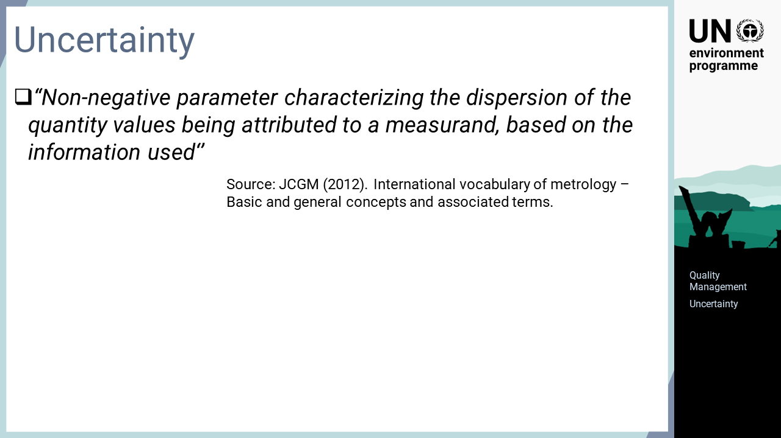
Notes:
‘36’ The term uncertainty is defined as "non-negative parameters characterizing the dispersion of the quantity values being attributed to a measurand based on the information used". Uncertainty is a value obtained by testing and calculation, which is referred to as "based on the information used".

Slide 38
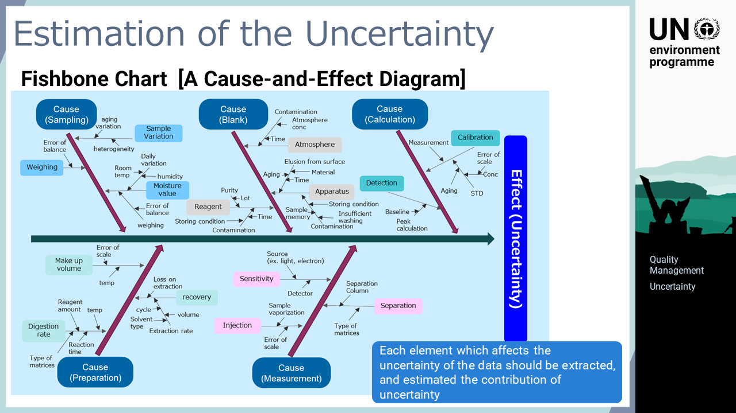
Notes:
‘37’ The process for estimating the uncertainty is explained here. Firstly, the analytical operations are examined to extract possible factors affecting the data uncertainty for evaluation. A schematic figure called a cause-and-effect diagram or fishbone chart is used for quality management. In this case, the diagram contains possible uncertainty factors involved in total mercury analysis with acid digestion. The fishbone chart relates elements that are possible factors that may affect the uncertainty and puts them in their respective places. This chart helps in developing logical discussions. It cannot directly estimate the uncertainty but serves as an effective tool to identify relevant points for quality management including the uncertainty, and to discuss improvement measures.

Slide 39
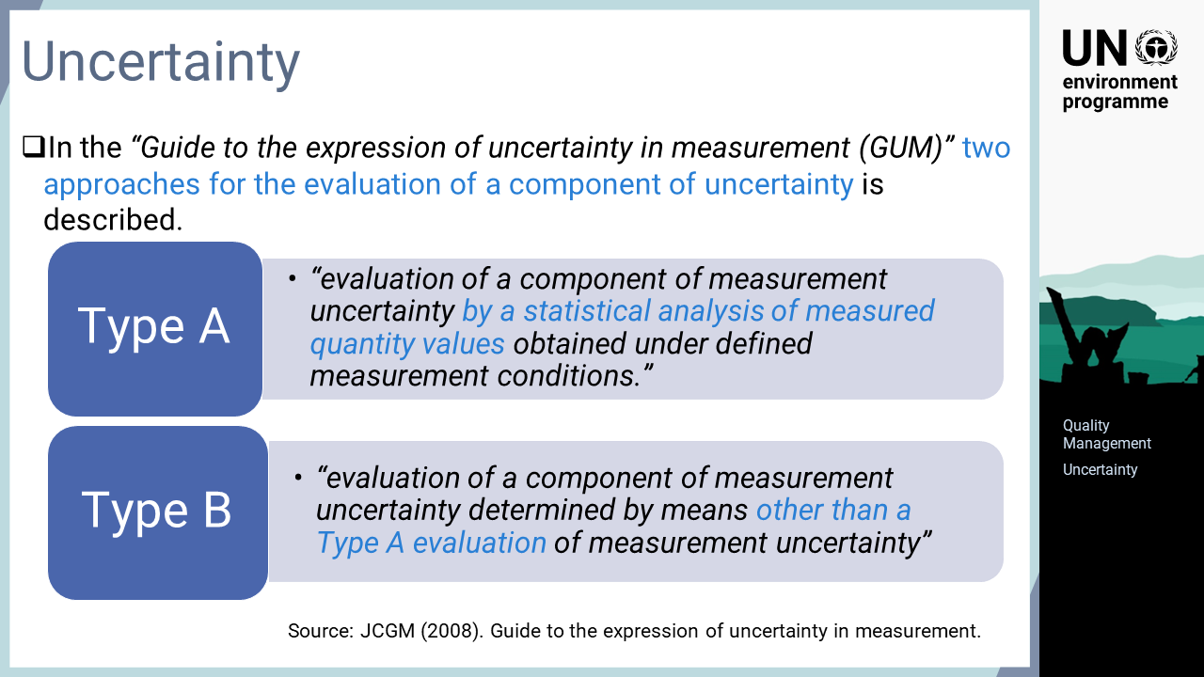
Notes:
‘38’ Once the factors affecting the uncertainty of analysis are identified, the contribution of each factor to the uncertainty is estimated. In the “Guide to the expression of uncertainty in measurement”, GUM in short, two approaches for the evaluation of uncertainty are described. Type A is a method deriving uncertainty from actual measured values statistically, and type B is a method deriving uncertainty by other means than type A.

Slide 40
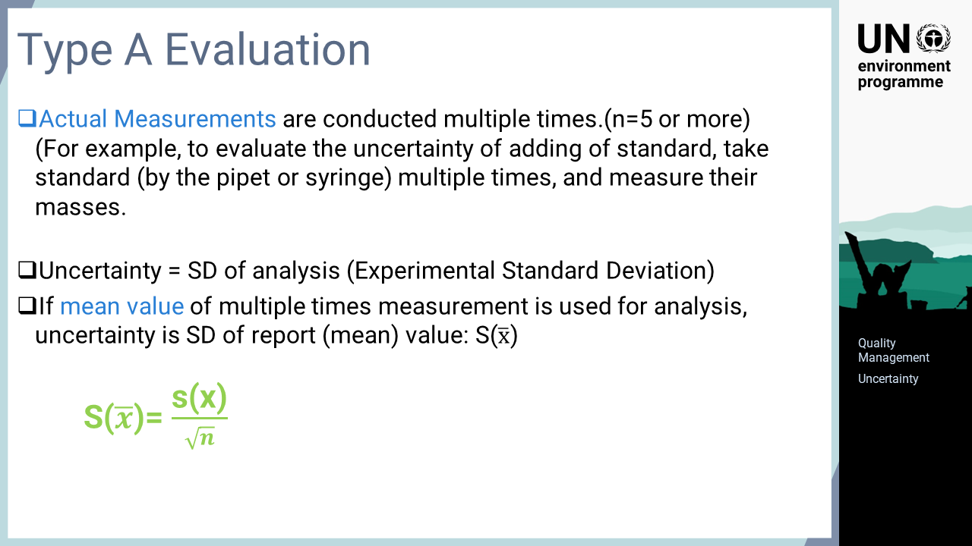
Notes:
‘39’ The uncertainty assessment using the Type A approach is described here. The idea of Type A is rather simple. The standard deviation is calculated from actual measurements conducted multiple times. For example, the uncertainty in the amount of standard solution added is evaluated by actually collecting the standard solution multiple times with a pipette or syringe and measuring the mass to calculate the standard deviation. The uncertainty of operation by Type A is the standard deviation obtained from the measurements. It is not commonly practised in analytical operations but if the average value of multiple operations is used, the uncertainty is the standard deviation divided by the square root of the number of measurements.

Slide 41
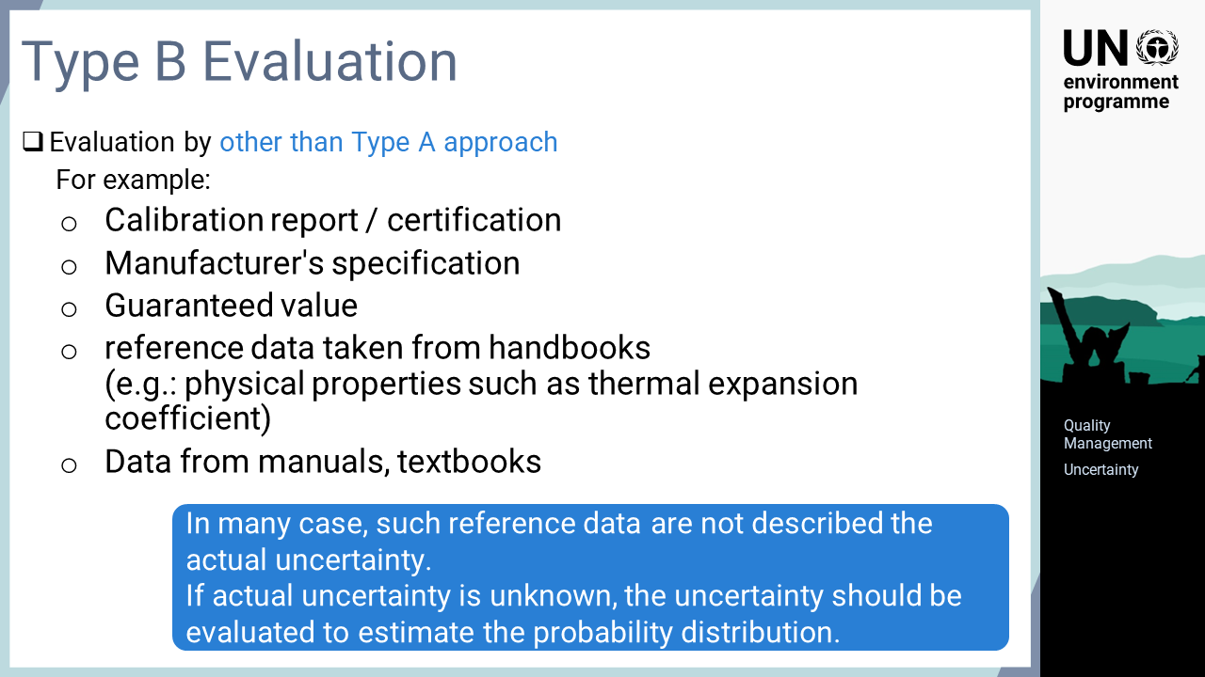
Notes:
‘40’ Type B applies to all information obtained by methods other than Type A. For example, a calibration report for an analytical instrument, the manufacturer’s specifications, the guaranteed value of the product, reference data taken from handbooks, or data from manuals and textbooks. Some of these data sources, such as calibration reports, describe the uncertainty itself, but in many cases, the uncertainty is not directly reported. In such cases, the uncertainty needs to be evaluated, for example, by assuming a probability distribution for the data.

Slide 42
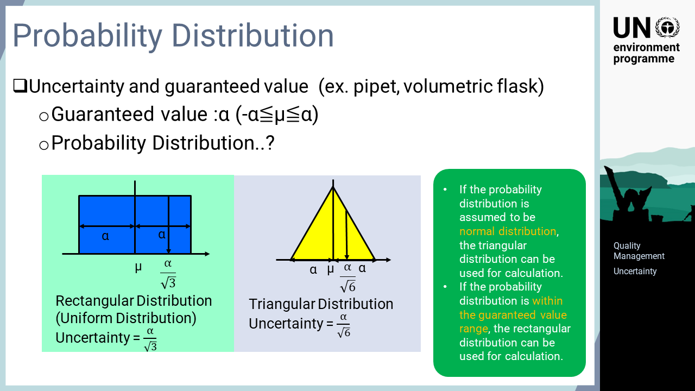
Notes:
‘41’ The uncertainty evaluated from the guaranteed value is used as an example of the Type B approach. When assessing the volume uncertainty of a pipette or volumetric flask, which have guaranteed volume values, uncertainty cannot be calculated because it is unclear how the actual values are distributed. In this case, the uncertainty can be estimated by assuming a probability distribution. If the data is assumed to be distributed to the normal distribution, the approximate uncertainty can be obtained from a triangular distribution, as shown on the right side of the slide. If the data is assumed to be distributed uniformly within the guaranteed value range, the uncertainty can be calculated by assuming a rectangular distribution.

Slide 43
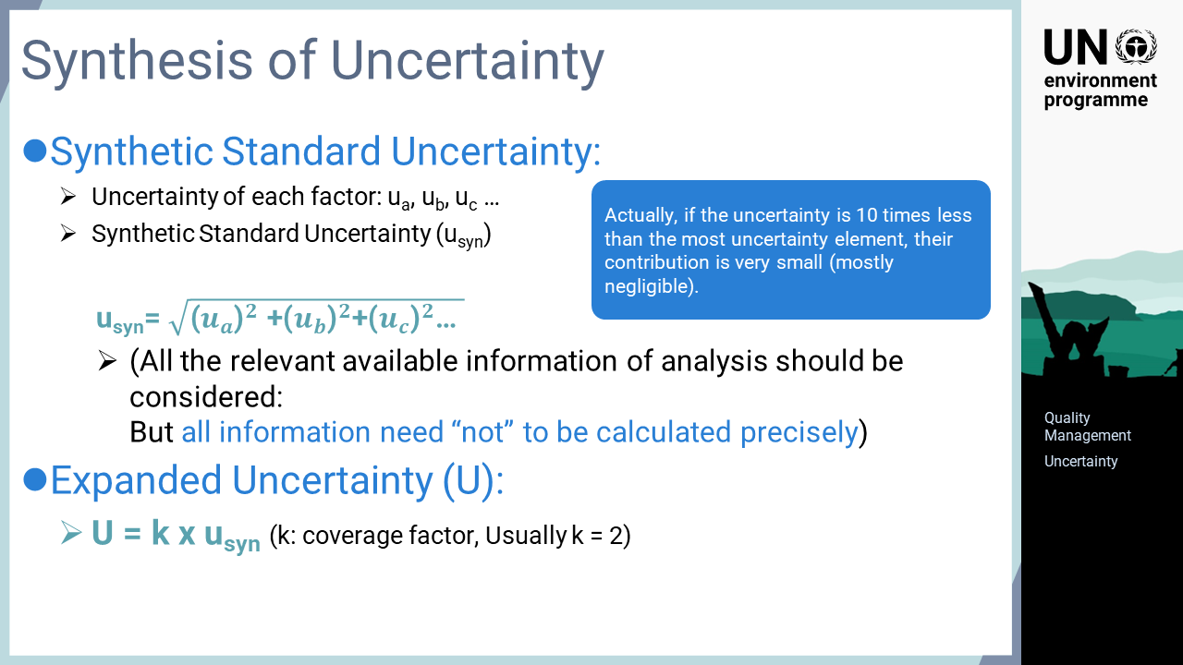
Notes:
‘42’ Once the uncertainty of each element contributing to the uncertainty of the analysis is estimated, they are combined to obtain an overall uncertainty. As shown in the formula, the squared values of individual uncertainty elements are used due to the propagation law of uncertainty and then summed to estimate the overall uncertainty. There are many elements affecting uncertainty in analytical operations as was shown in the fishbone chart. The magnitude of each element needs to be considered, but it is not necessary to estimate and calculate the values for all of them. As shown in the formula, the individual uncertainty elements are squared, thus there is little contribution from the individual uncertainty elements that are less than one tenth of the maximum value. For this reason, the elements that are sufficiently smaller than the maximum value do not need to be included in the calculation. The uncertainty is calculated this way, but in many cases, the extended uncertainty is obtained by multiplying the uncertainty by a factor to increase the range of probabilities that the uncertainty covers. As shown at the bottom of the slide, the expanded uncertainty is calculated by multiplying the uncertainty by a coverage factor, to which a value of two is usually assigned. The uncertainty is based on the standard deviation, so double the standard deviation covers approximately 95% of the probability distribution.

Slide 44
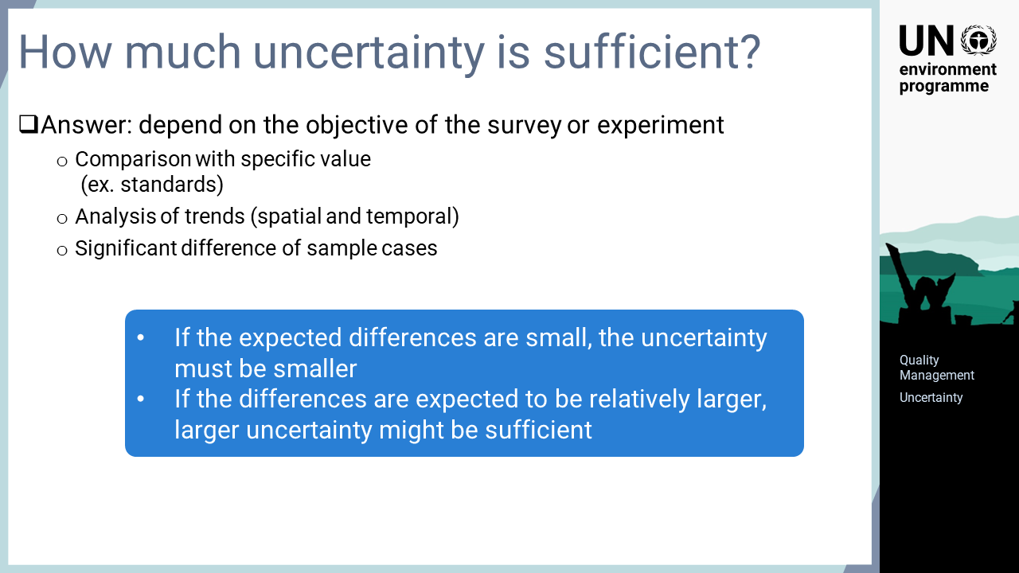
Notes:
‘43’ A frequently asked question is, “How much uncertainty is sufficient?” This depends on the objective of the survey or experiment. Analyses are performed with various objectives, such as verifying the compliance of standard values, monitoring spatial or temporal trends, or evaluating the significance of differences between target groups. When evaluating the groups with small difference, uncertainty of the analysis must be reduced. On the other hand, a relatively higher uncertainty of analysis might be sufficient if there are larger differences between the subjects to be evaluated.

Slide 45
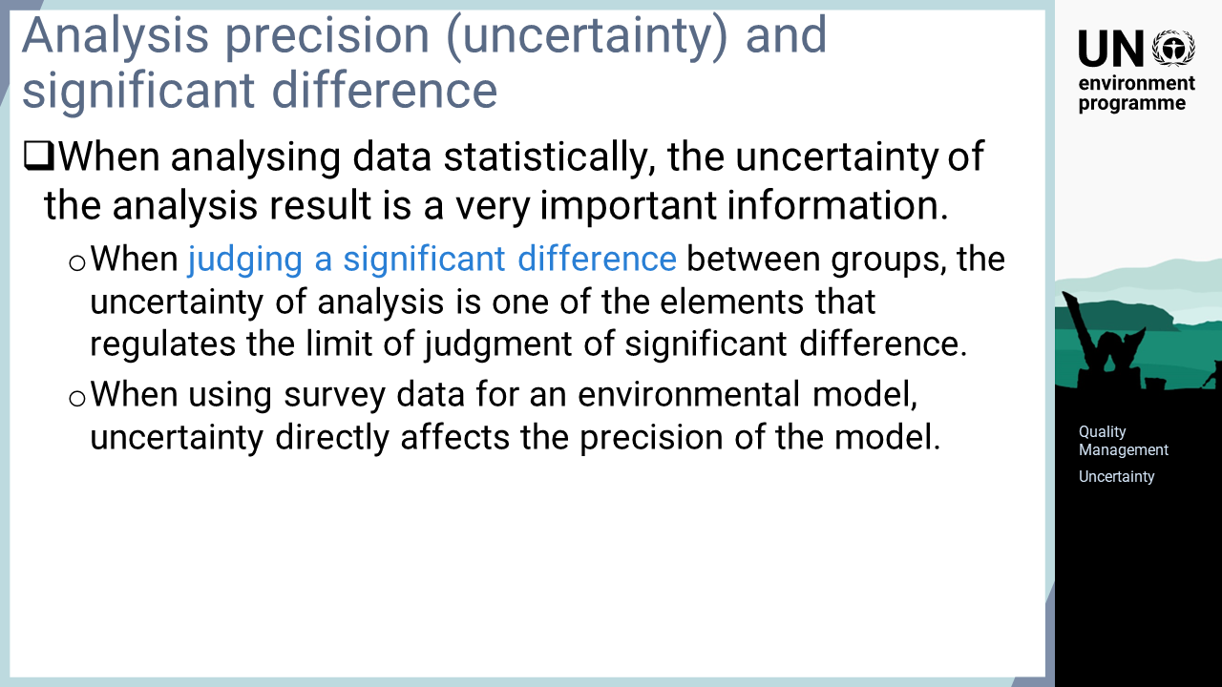
Notes:
‘44’ High-quality data has greater value and one of the factors affecting quality is uncertainty. When judging the difference between target populations as being statistically significant, an analysis operation with higher uncertainty may not be able to conclude that there is a difference, even though the subjects might have verifiable differences. Additionally, when analytical data is used for parameters such as in environmental models, the uncertainty of analysis directly affects the precision of the model.

Slide 46
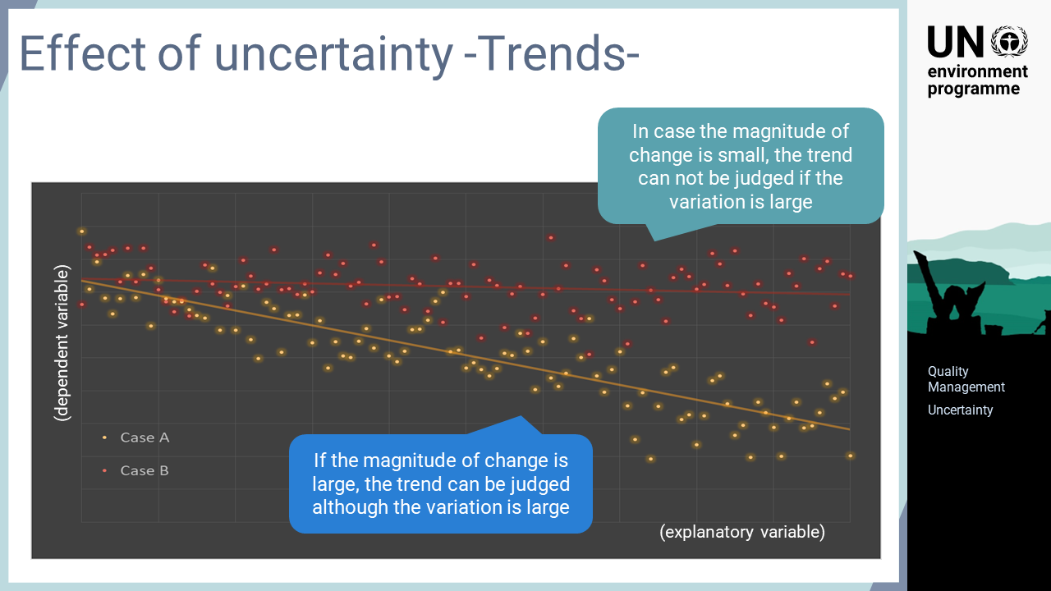
Notes:
‘45’ This slide provides an example of data uncertainty affecting the judgment of data reading. Both the red and yellow plots are dispersed with the same variability around the lines. Although both gradually decrease to the right, the trend in the red plot is obscured due to the uncertainty of the data. The trend in the yellow plot is obvious despite the data uncertainty because the decreasing trend is large enough.

Slide 47
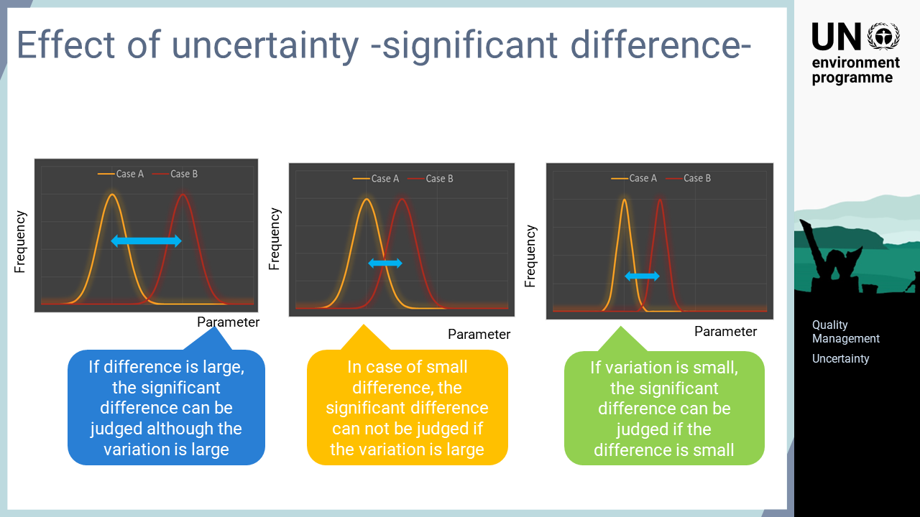
Notes:
‘46’ This slide provides an image of the significant differences between different case scenarios. As shown in the figure on the left, a significant difference can be determined if the difference between the targets is sufficiently large, even though the variation of the cases is large. If the difference between the cases becomes smaller while the variation remains large, as is shown in the centre, it may not be possible to conclude that the difference has significance. On the contrary, even if the difference between the targets is small, it may be judged that the difference is significant if the variation becomes sufficiently smaller. In real cases, the uncertainty of analysis does not always affect significant differences, as target populations also have internal variation. Nevertheless, uncertainty must be managed appropriately as it may affect the interpretation of the data.

