Slide 1




Contribution to Session III: Uncovering the Climate and SDG Synergies
Expert group meeting on optimizing SDGs implementation in the framework of integration and policy coherence organised jointly by
Ayman Cherkaoui, a.cherkaoui@fm6e.org
July 13th 2019, New York City

Slide 2
Agenda: Following the Guiding Questions
How best can we advance joint efforts for both the SDGs and climate action at the global, regional and country levels and help to scale up levels of ambition?
What would be specific examples to illustrate the potential of synergistic and interlinked approaches towards realizing the objectives of the 2030 Agenda and the Paris Agreement, including through analyses of national development plans, nationally determined contributions, national adaptation plans and national risk reduction strategies, among others?
What are the gaps, challenges and recommendation for strengthening synergies, increasing ambition, advancing implementation actions, maximizing co-benefits and stimulating multi-stakeholder partnerships?
Contributing elements of answer to the question of our friend from South African yesterday regarding the mainstreaming of SDGs to people on the ground

Slide 3

How best can we advance joint efforts for both the SDGs and climate action at the global, regional and country levels and help to scale up levels of ambition?
Mohammed VI Prize for the Climate and Sustainable Development
Marrakech Action Proclamation for Our Climate and Sustainable Development
Marrakech Partnership for Global Climate Action
Action for Climate Empowerment
Impact focused initiatives (3 Commissions, AAA, SSS, Blue Belt Initiative, etc.)
Synergies between Agenda 2063 and the 2030 Agenda
Our task now is to (…) together, [move] forward purposefully to reduce greenhouse gas emissions and to foster adaptation efforts, thereby benefiting and supporting the 2030 Agenda for Sustainable Development and its Sustainable Development Goals.

Slide 4
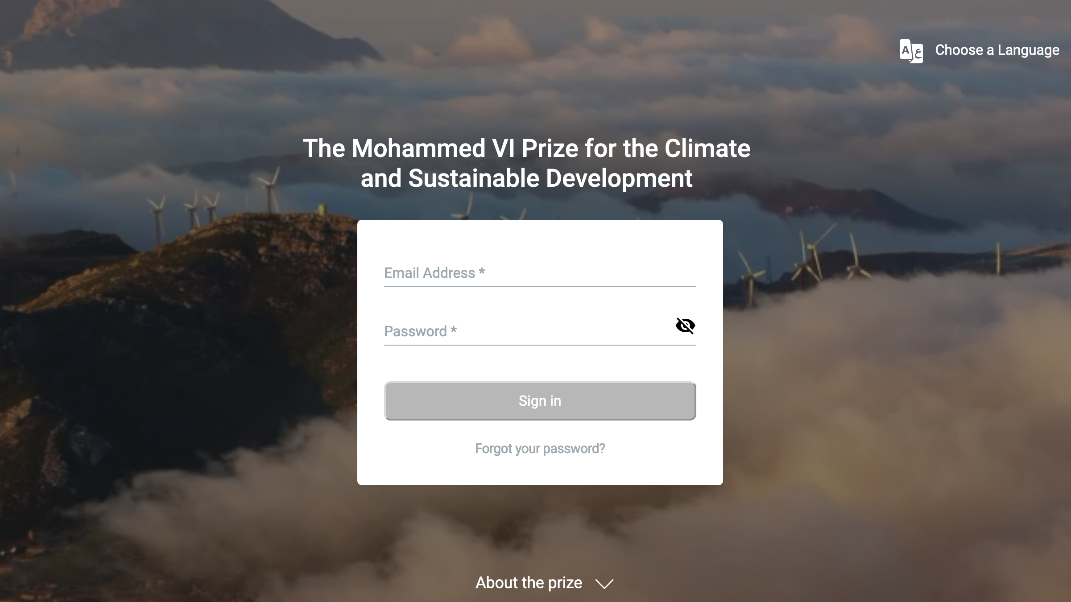

Slide 5
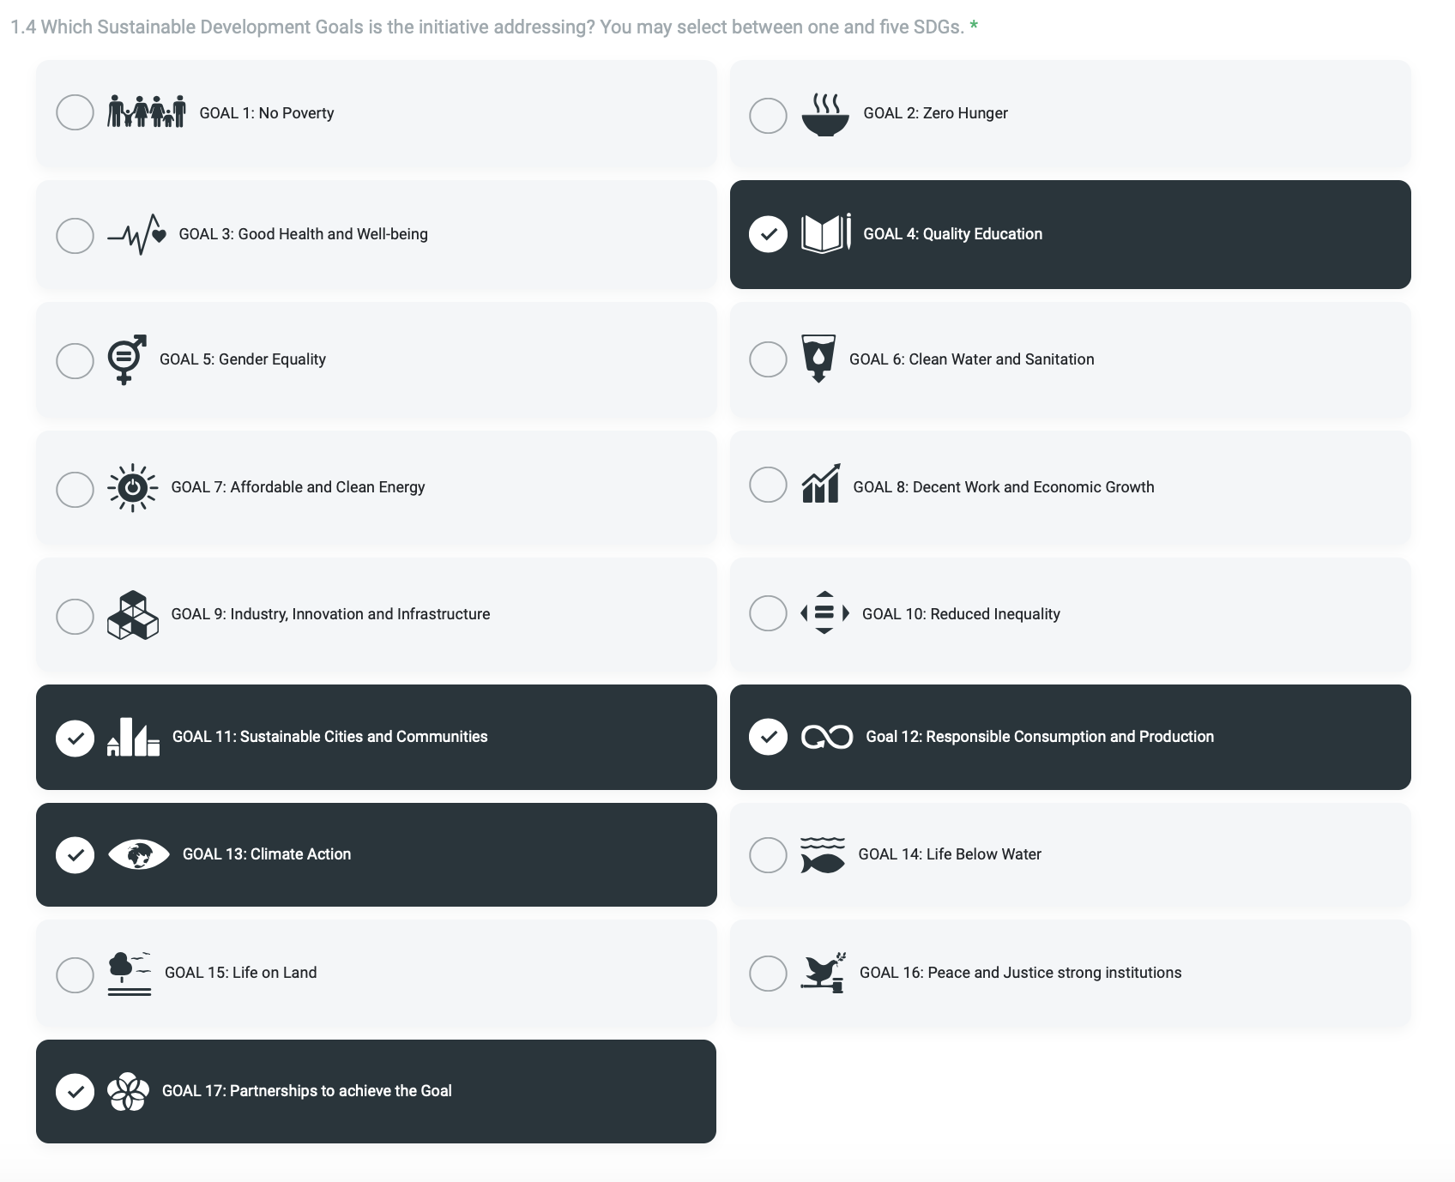
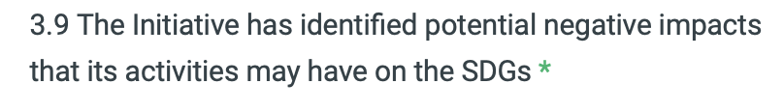
The Prize aims to support the implementation of the 2030 Agenda for Sustainable Development, the United Nations Framework Convention on Climate Change and its related instruments such as the Paris Agreement as well as the Marrakech Action Proclamation for Our Climate and Sustainable Development.

Slide 6
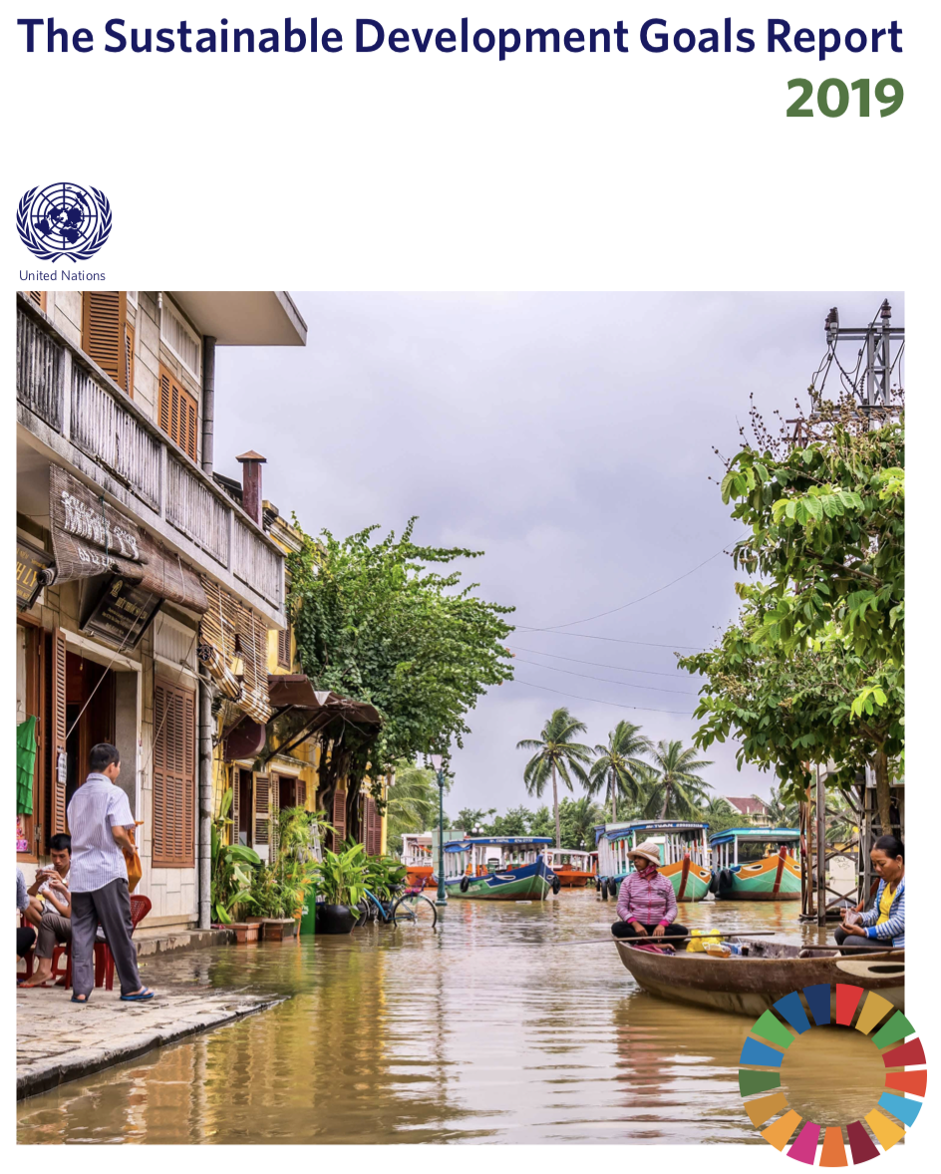
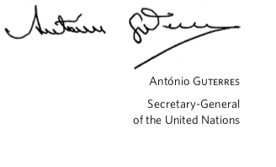
What would be specific examples to illustrate the potential of synergistic and interlinked approaches towards realizing the objectives of the 2030 Agenda and the Paris Agreement, including through analyses of national development plans, nationally determined contributions, national adaptation plans and national risk reduction strategies, among others?
Excerpt from Foreword:
“It is abundantly clear that a much deeper, faster and more ambitious response is needed to unleash the social and economic transformation needed to achieve our 2030 goals. From our advances, we know
what works. This report therefore highlights areas that can drive progress across all 17 SDGs: financing; resilience; sustainable and inclusive economies; more effective institutions; local action; better use of data; and harnessing science, technology and innovation with a greater focus on digital transformation. In everything we do, we must diligently ensure that policy choices leave no one behind, and that national efforts are supported by effective international cooperation, grounded in a commitment to diplomacy and crisis prevention."
A few words on the NDC, NAP, National Strategy for Sustainable Development of Morocco,

Slide 7
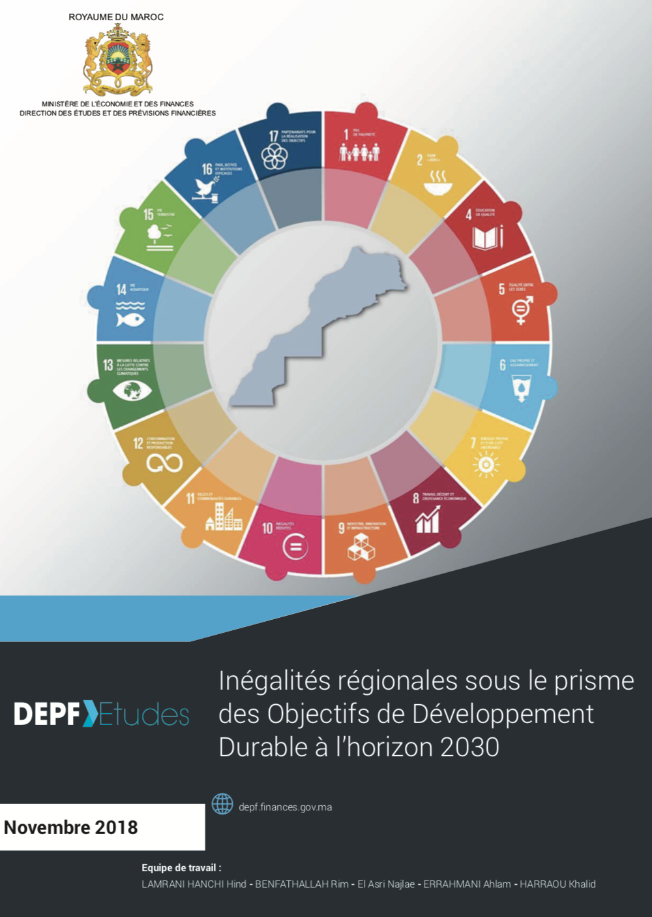
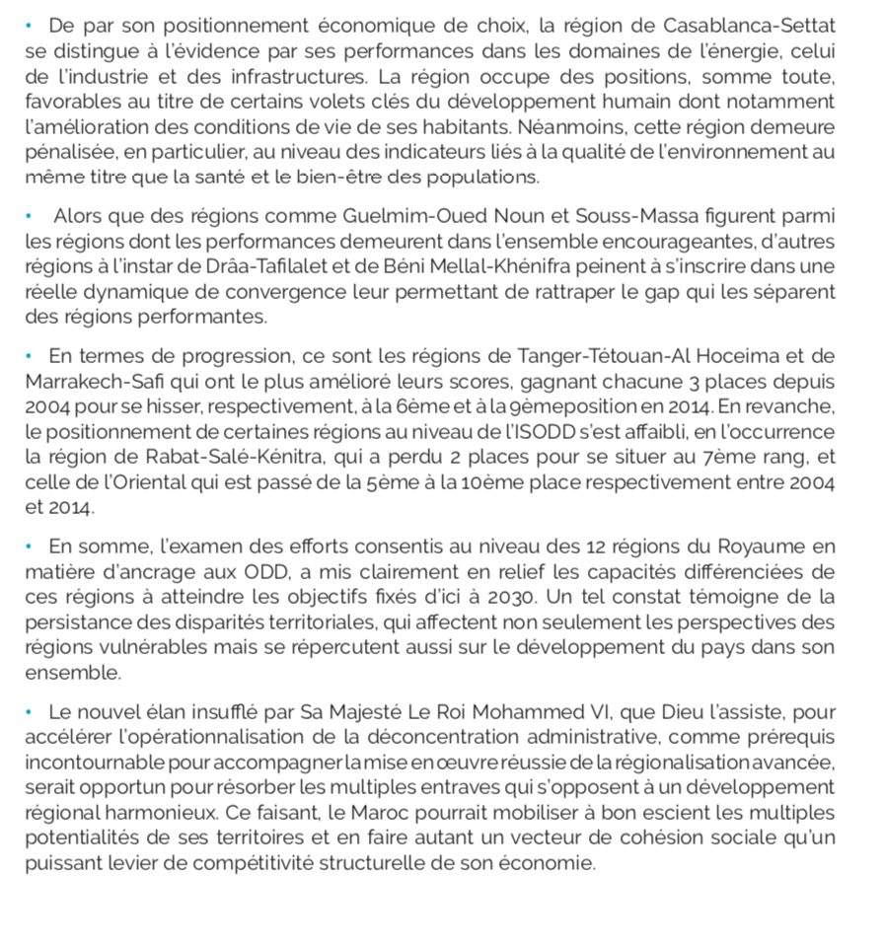
What would be specific examples to illustrate the potential of synergistic and interlinked approaches towards realizing the objectives of the 2030 Agenda and the Paris Agreement, including through analyses of national development plans, nationally determined contributions, national adaptation plans and national risk reduction strategies, among others?
NDC
NAP
National Strategy for Sustainable Development

Slide 8
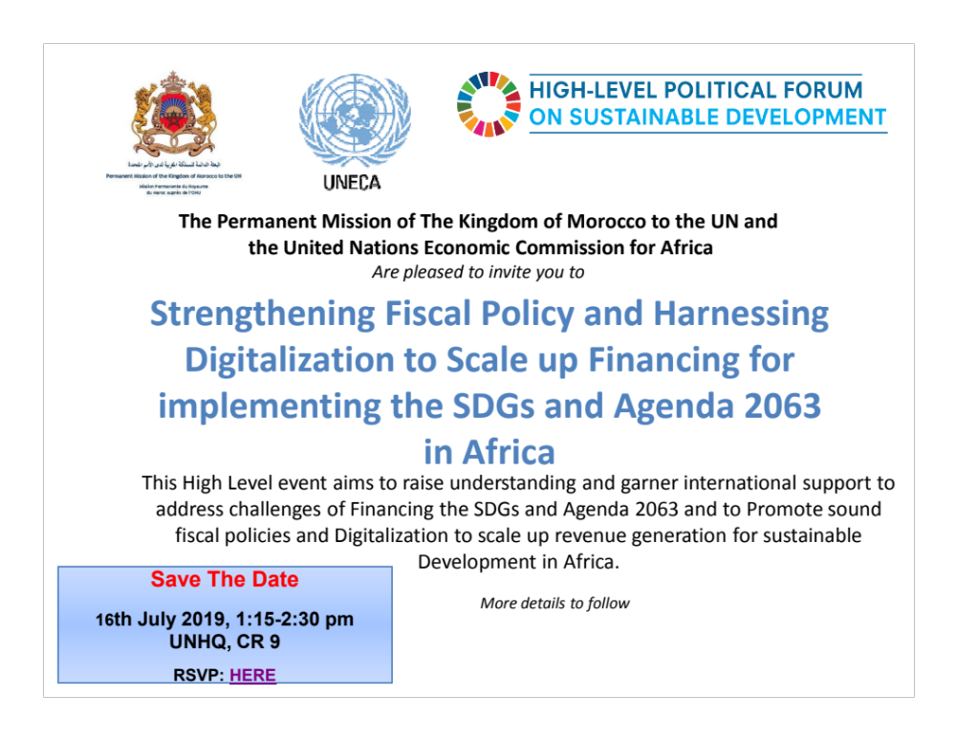
What would be specific examples to illustrate the potential of synergistic and interlinked approaches towards realizing the objectives of the 2030 Agenda and the Paris Agreement, including through analyses of national development plans, nationally determined contributions, national adaptation plans and national risk reduction strategies, among others?

Slide 9
What are the gaps, challenges and recommendation for strengthening synergies, increasing ambition, advancing implementation actions, maximizing co-benefits and stimulating multi-stakeholder partnerships??
Intellectual Rigor is the renewable source of trust
Synergies and Tradeoffs
Focus on outputs and outcomes
Go beyond strategic ownership into operational duties
Public/Private Partnerships
Don’t start from scratch
Education for Sustainable Development
Work closely with Local authorities and civil society
“Big results require big ambition” Heraclites, 6th Century BC

Slide 10
Reacting to yesterday’s comment:
How to mainstream the SDGs to reach on onboard people on the ground ?

Slide 11
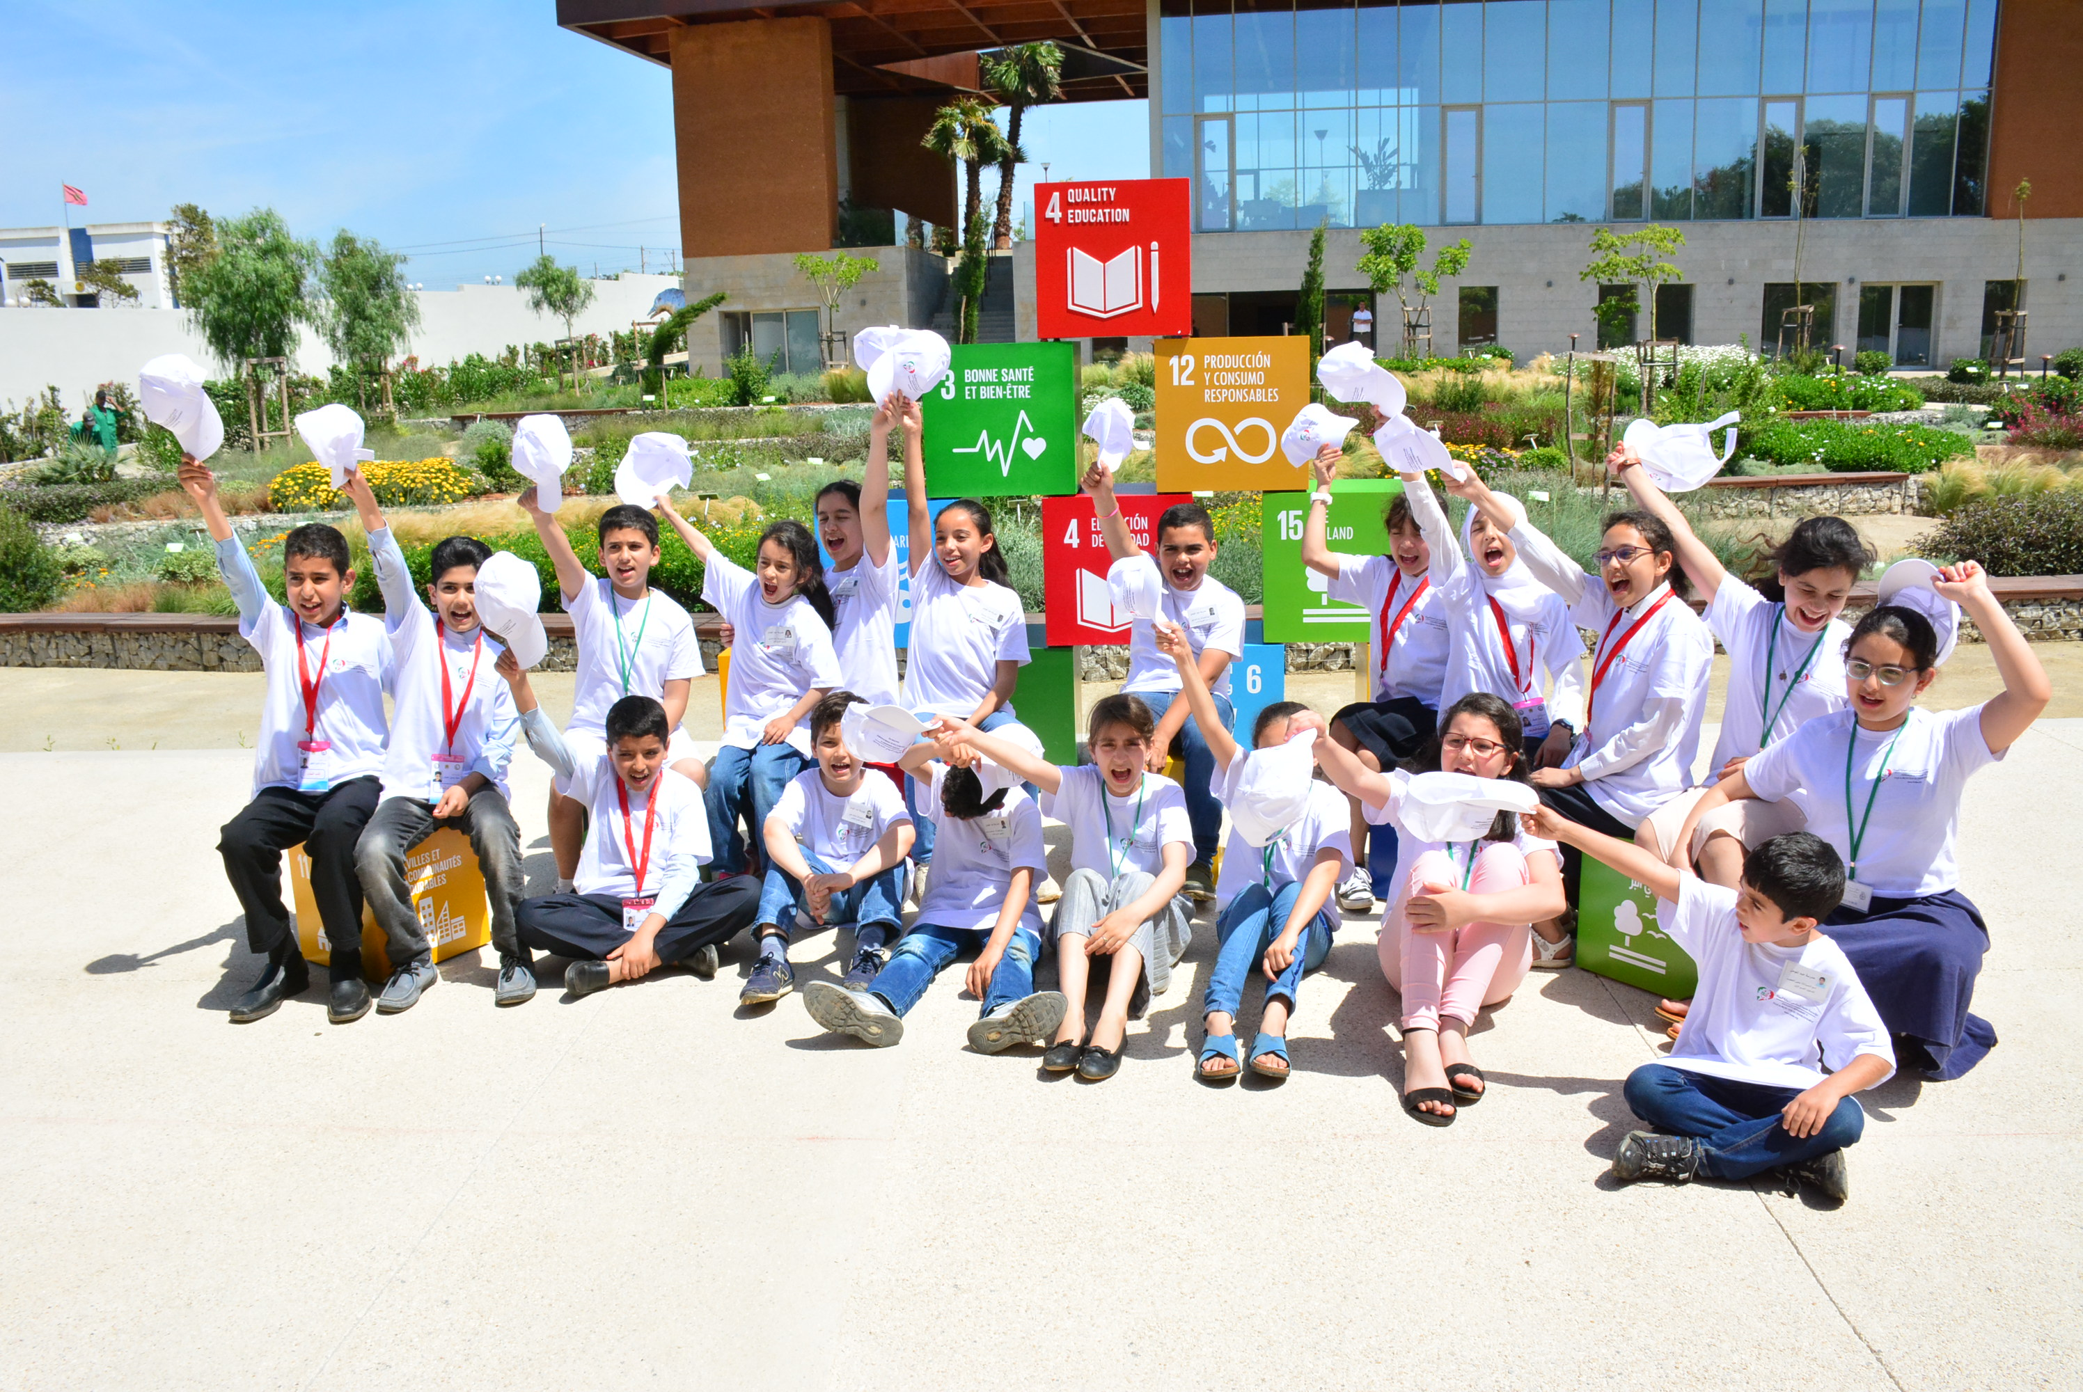
Education for Sustainable Development

Slide 12
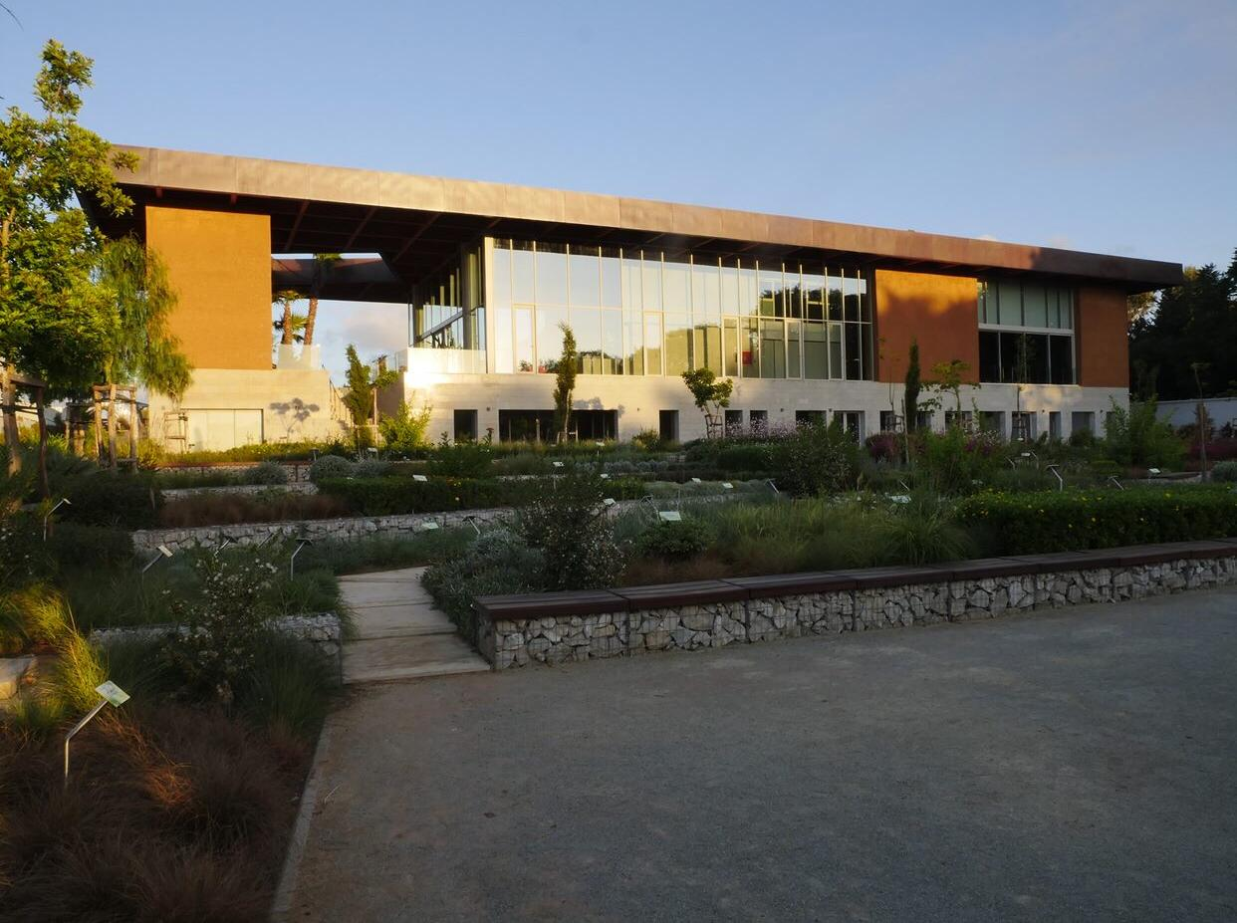
The Hassan II International Center for Environmental Training

Slide 13
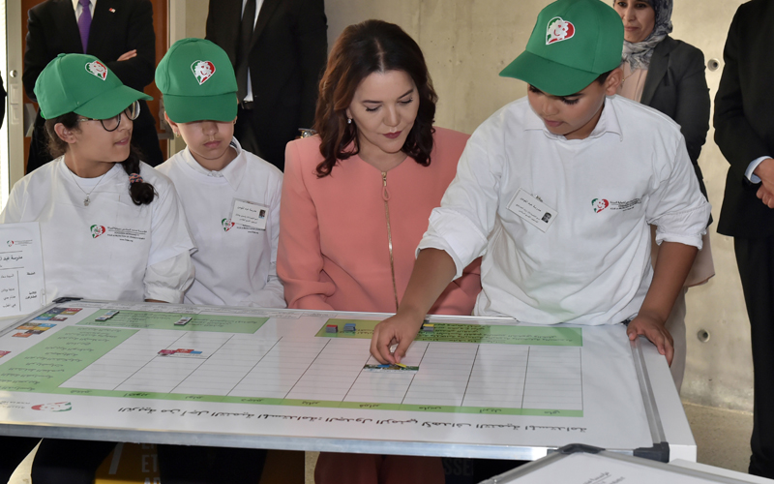
Inaugurated by Her Royal Highness Princess Lalla Hasnaa on June 18th 2019

Slide 14
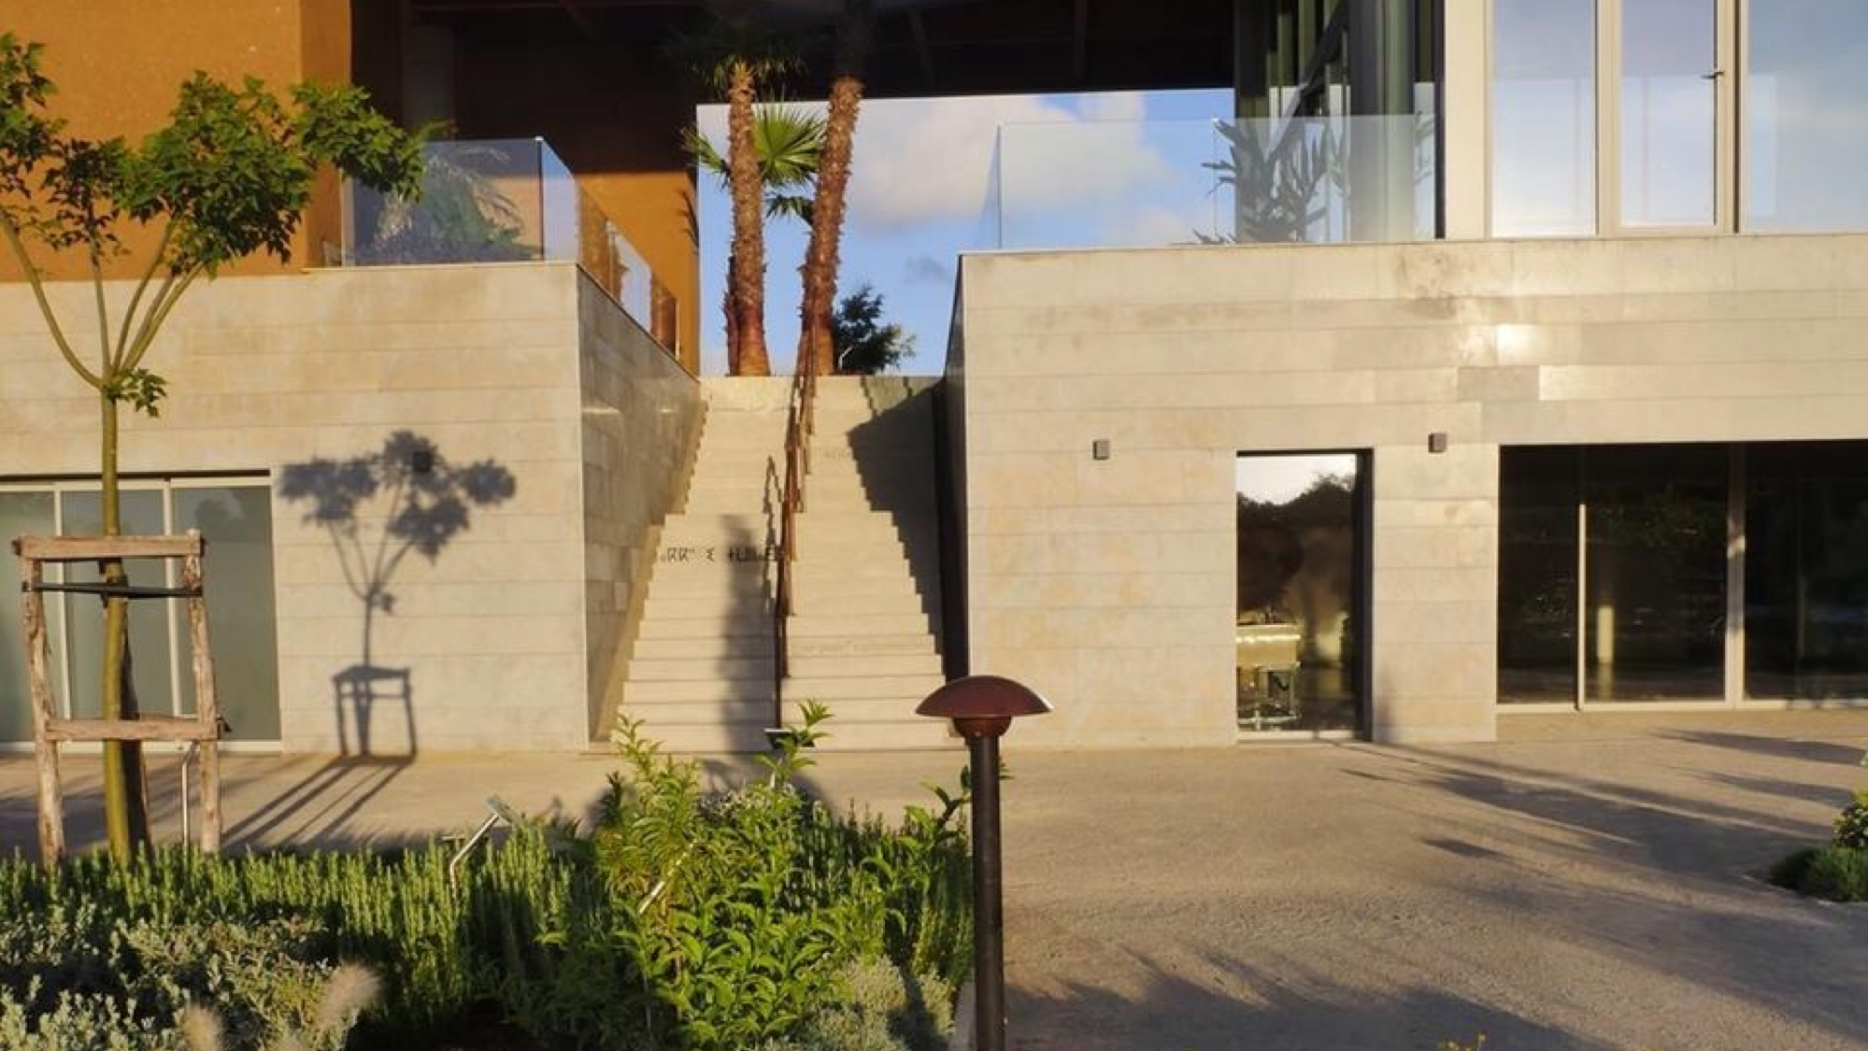
Working with Nature

Slide 15
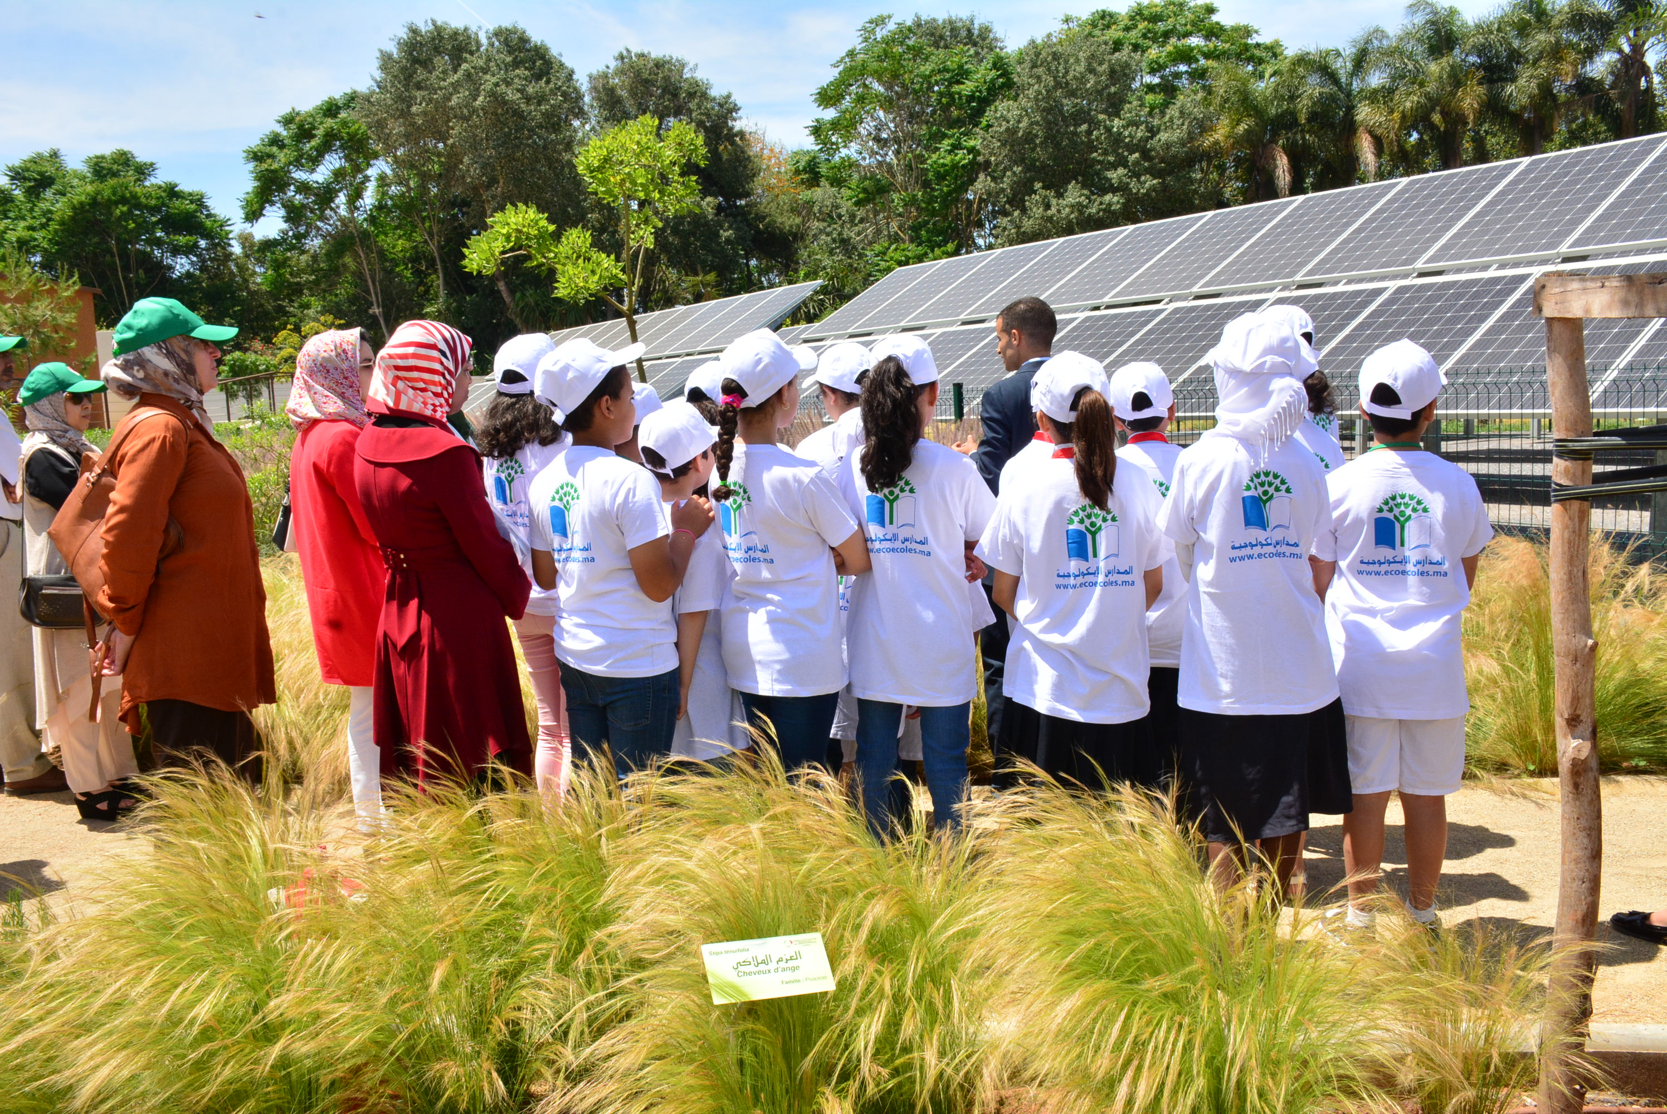
Reconnecting with Nature and Showcasing Sustainable Energy

Slide 16
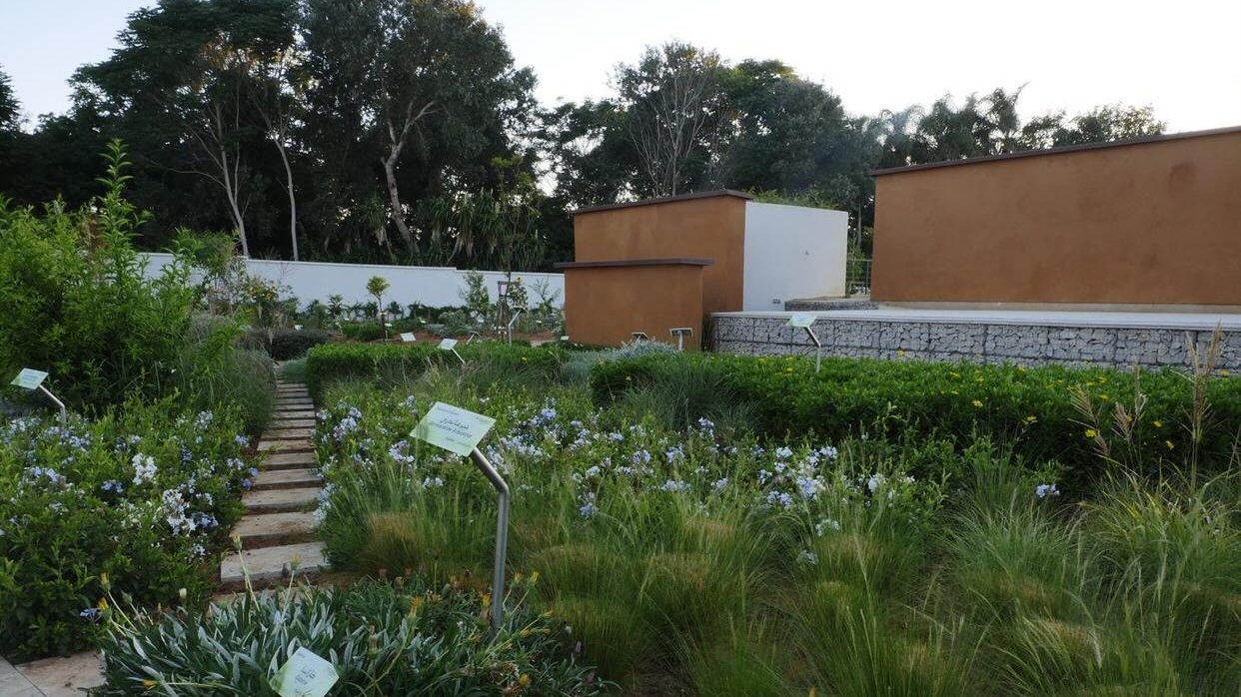
Pedagogical tracks

Slide 17
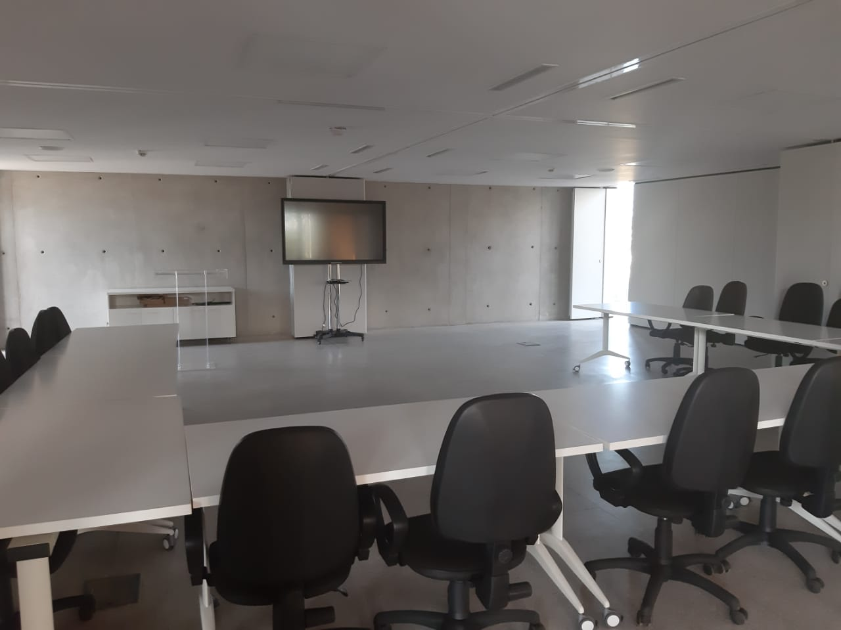
E Learning Facilities

Slide 18
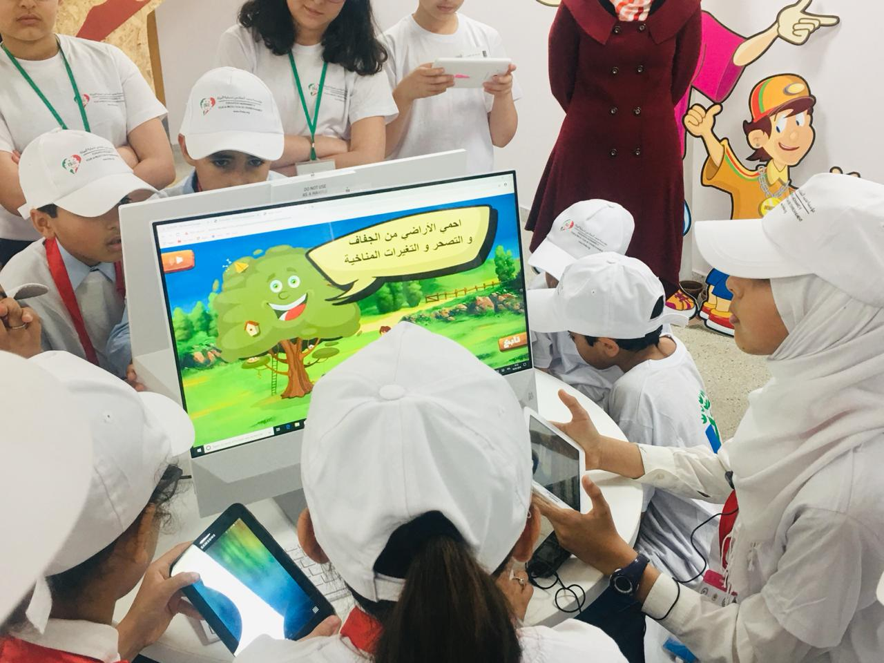
Leveraging the Digital for Education for Sustainable Development

Slide 19
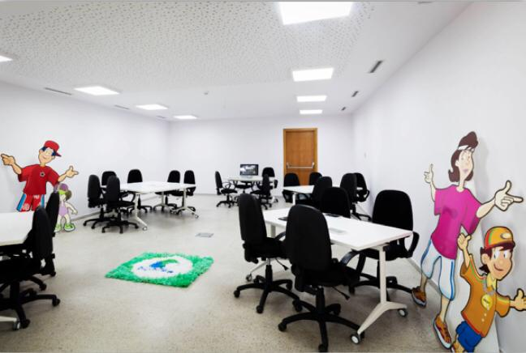
Classrooms emphasizing collaborative learning

Slide 20
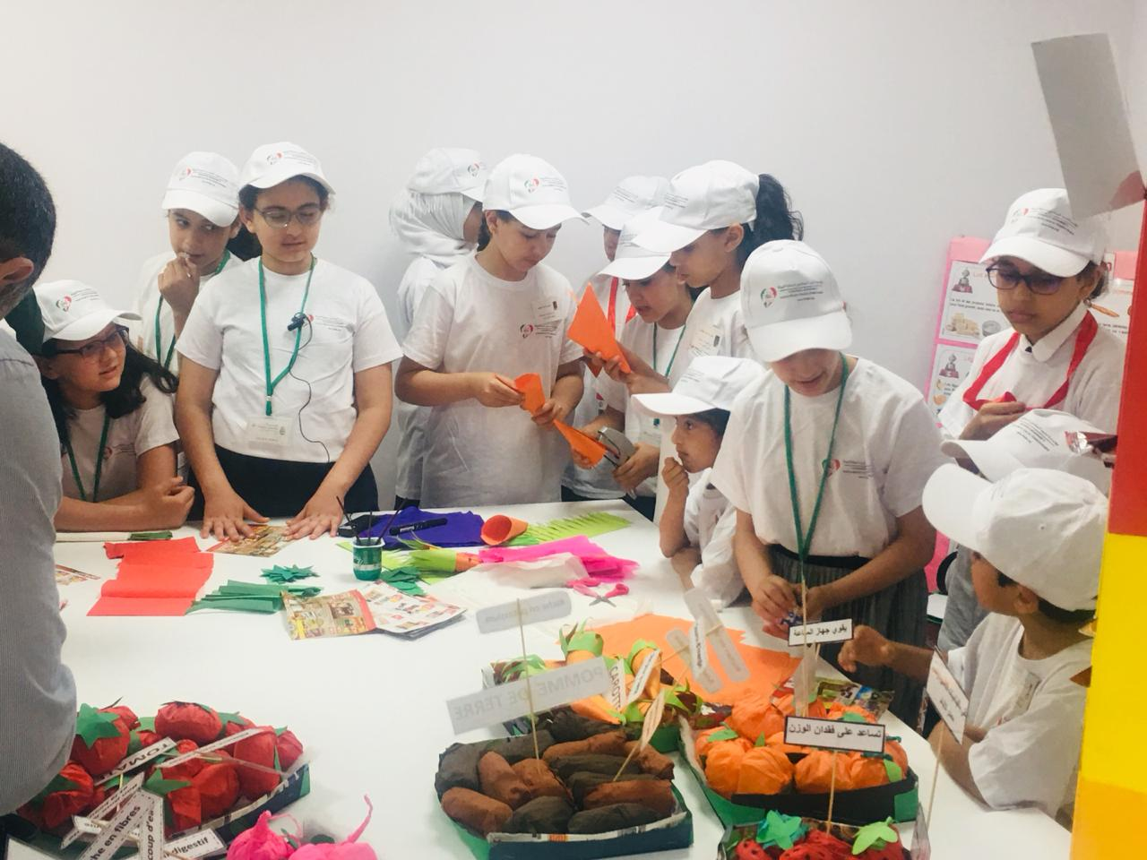
Peer to Peer Learning

Slide 21
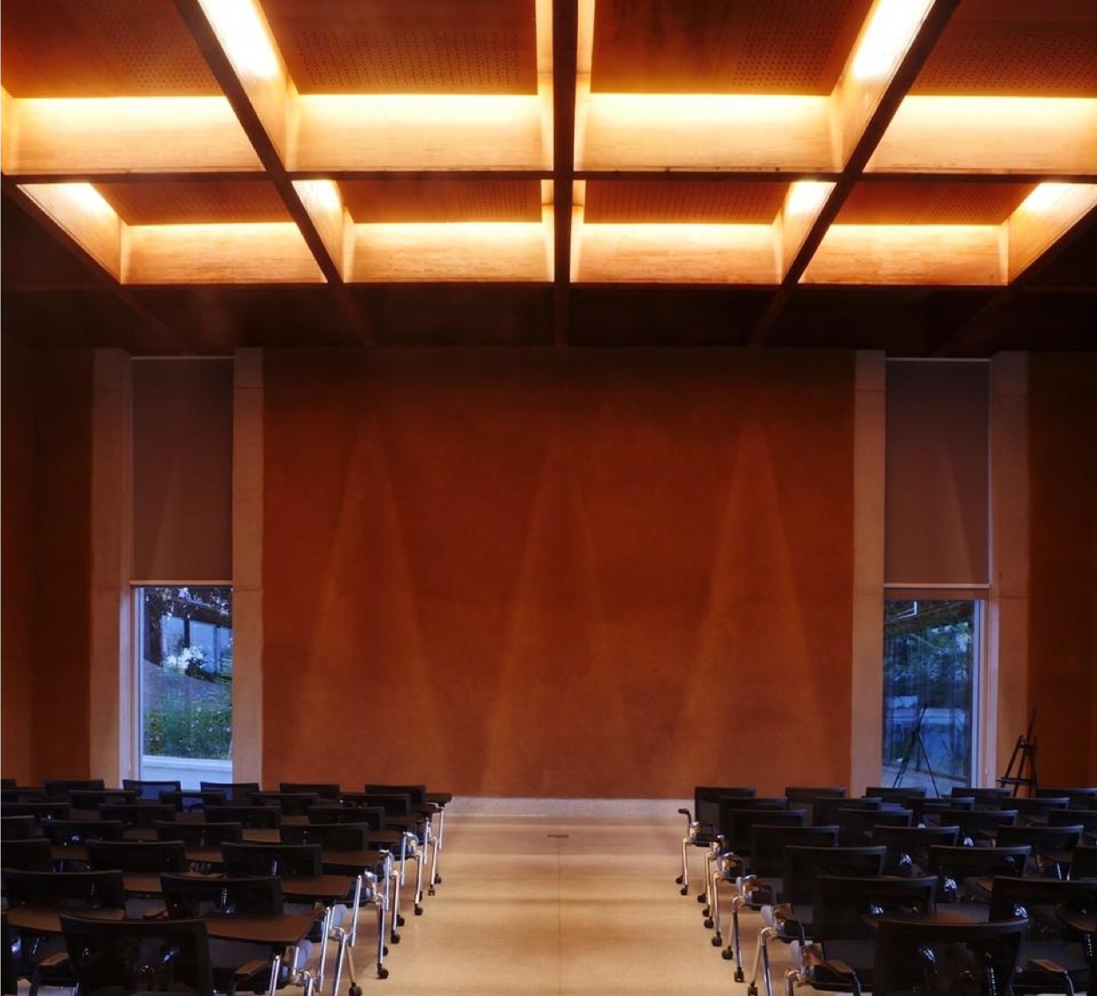
Conference Center leveraging ancestral knowledge: Plenary Hall

Slide 22
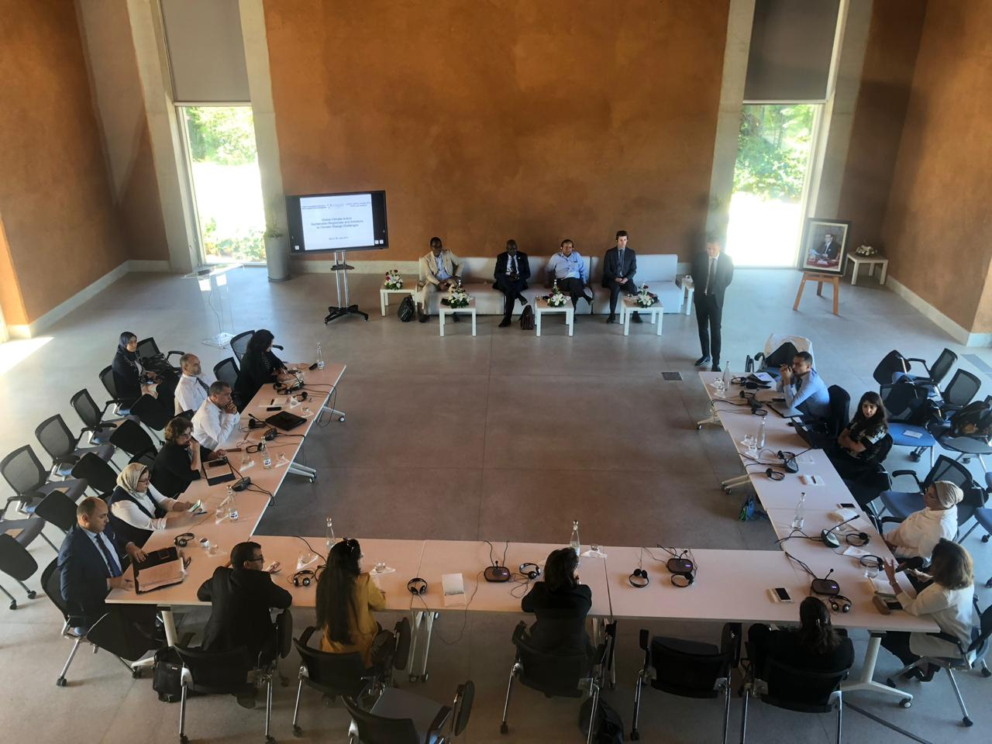
Expert Roundtables

Slide 23
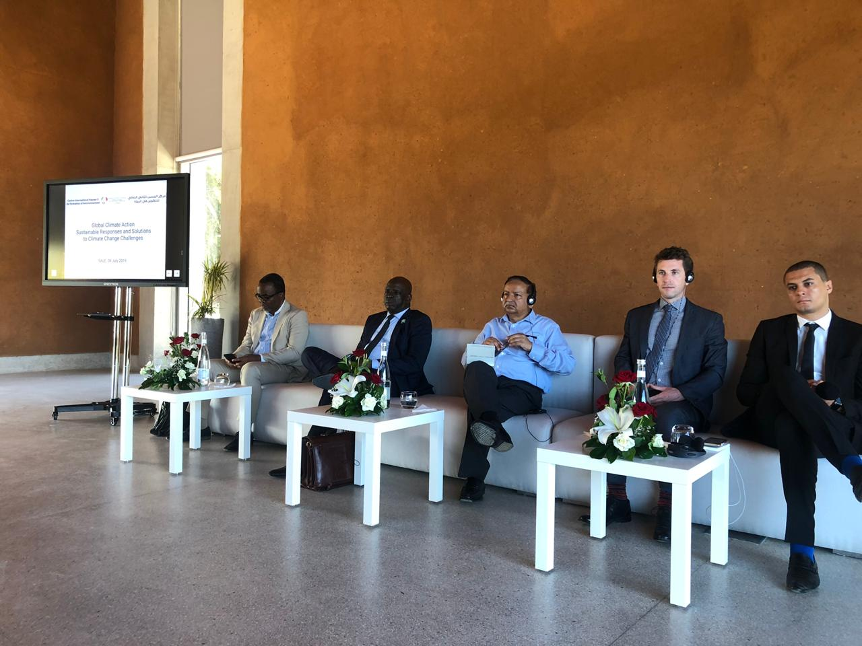
Global Climate Action Roundtable hosted July 9th 2019

Slide 24
Key Conclusions
Education for Sustainable Development is critical (lifelong learning)
Focus on impact (rigorous evidence based decision making)
We are not operating in a vacuum
Foster, not hinder: seek consensus through inclusion: Leaving no one behind at all levels.
Bringing down silos takes more than drawing lines between SDGs, it’s about drawing lines between people. Interconnected People is central to Interlinked Agenda

Slide 25
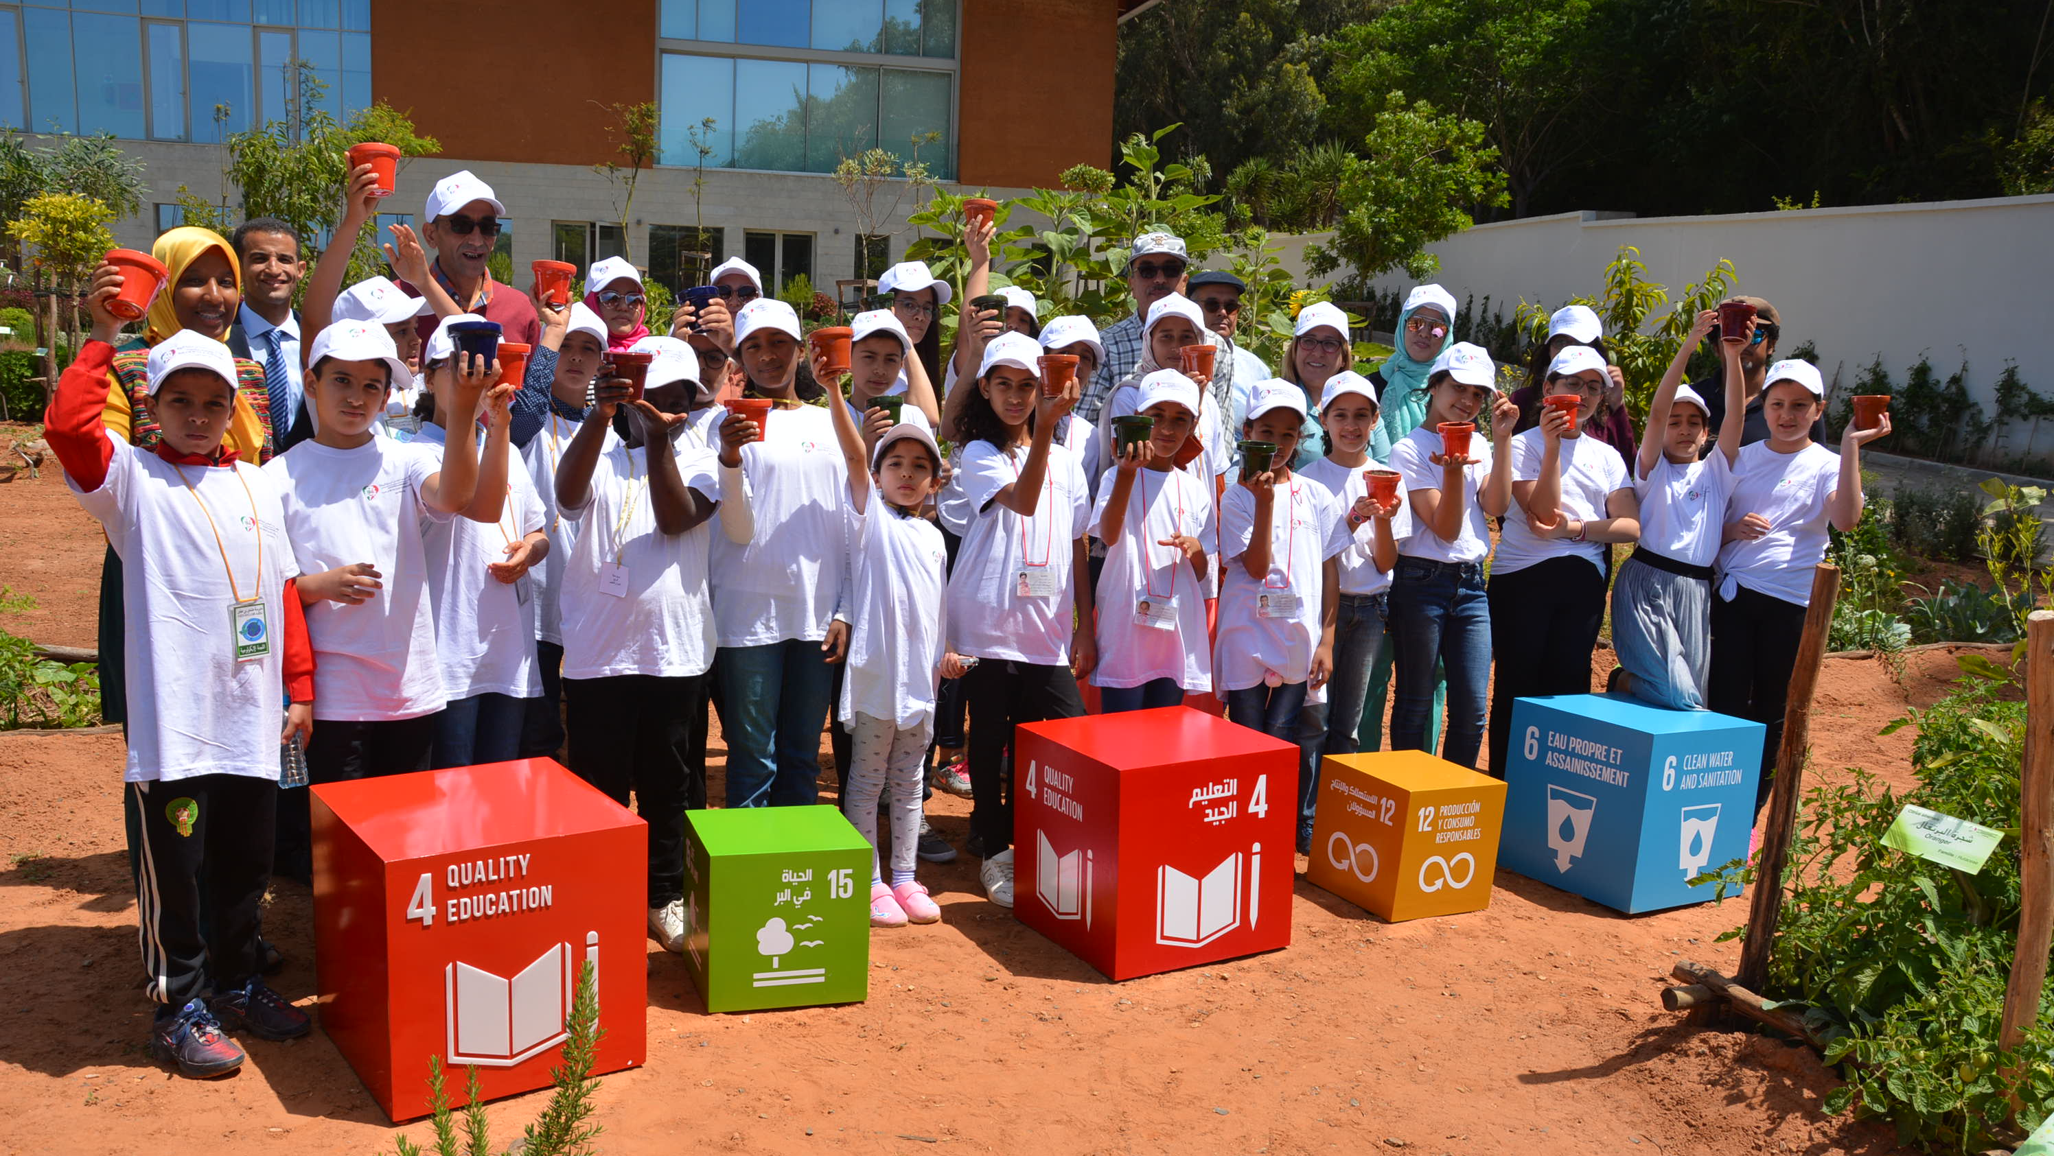
Celebrating the SDGs
Thank you for your attention
Looking forward to your comments and questions
Ayman Cherkaoui, Coordinator, a.cherkaoui@fm6e.org

