Slide 1
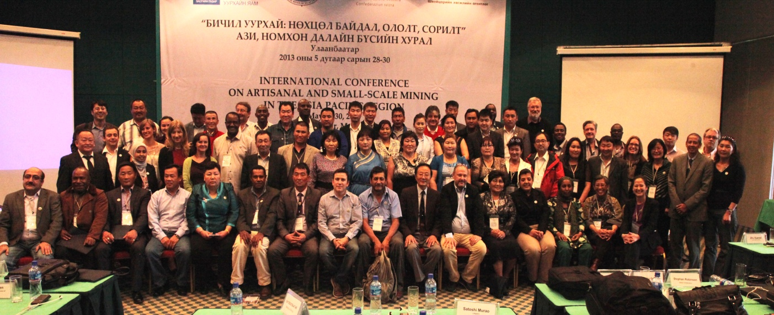
Report on ASM in Asia Pacific Region Conference, 2013 – Mongolia
Patience Singo, SAM Project Manager
Swiss Cooperation Office Mongolia

Slide 2
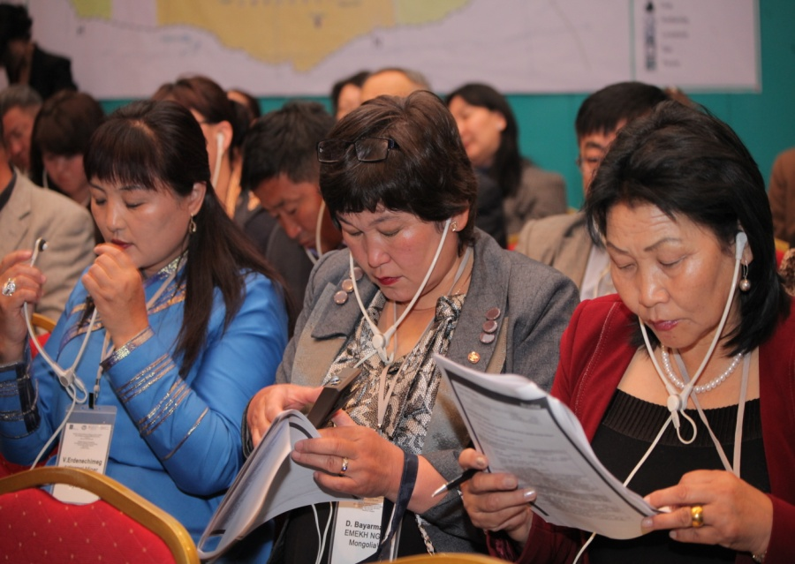
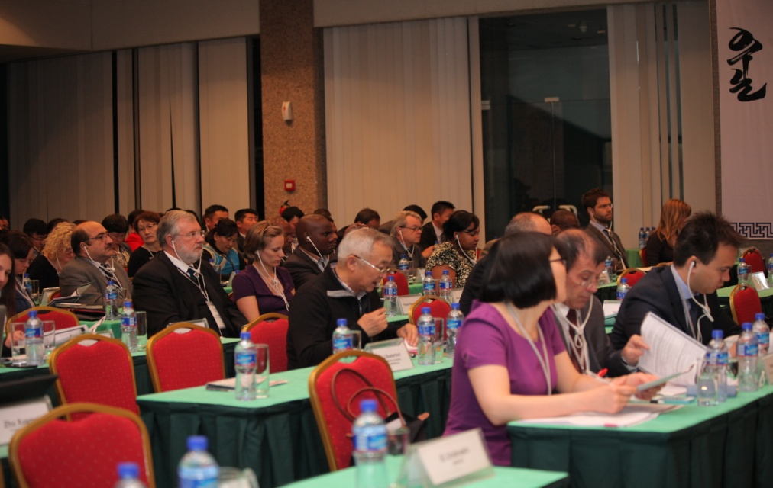
Introduction
Hosted by the Mongolian Ministry of Mining and SAM Project
  May 2013,
  Field trip to Hg –free plant.
40 international participants from the region, Latin America and Africa
  Government, miners, ASM experts, civil society and researchers.
  Supported by UNEP, UNIDO, AIST Japan & World Vision Mongolia.
80 local participants.
Due to overwhelming interest, Africa and Latin American countries participated.

Slide 3
Asia Pacific ASM Conference
Why the Regional Conference?
To share experiences (good and bad) on ASM.
To transfer knowledge to Mongolia.
To find solutions on ASM challenges, lessons learned, what to do and what to avoid!
  Not re-inventing the wheel
  Making best use of limited resources
  Common priorities.
Networking and regional cooperation.
How to leverage on already accumulated experiences and knowledge.

Slide 4
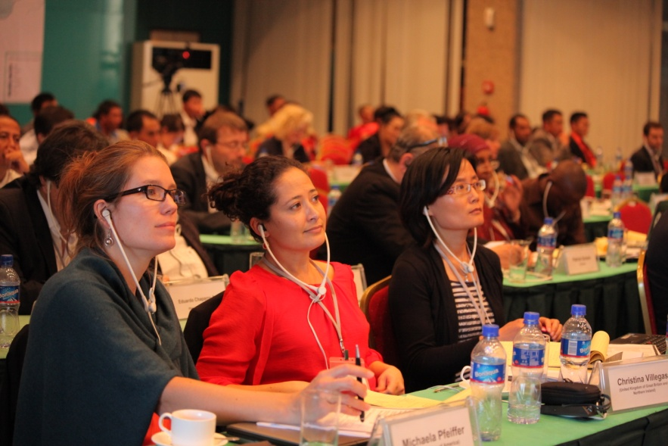
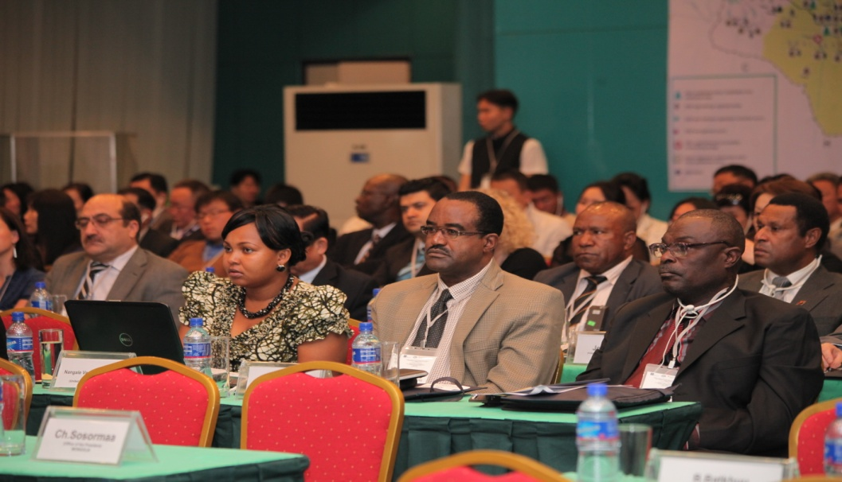
Outcomes on Regional Cooperation
Three break-out groups to explore priorities and modalities for regional cooperation.
Governments
Miners
Civil society and researchers

Slide 5
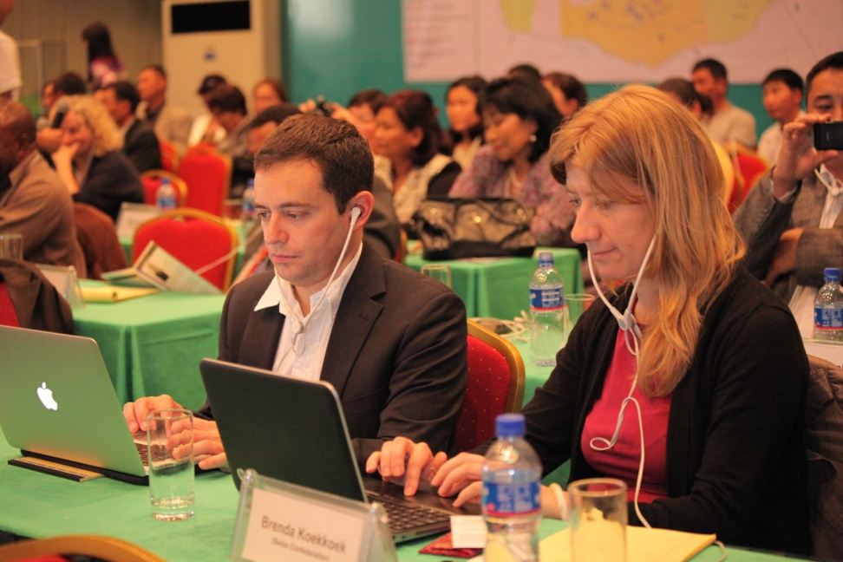
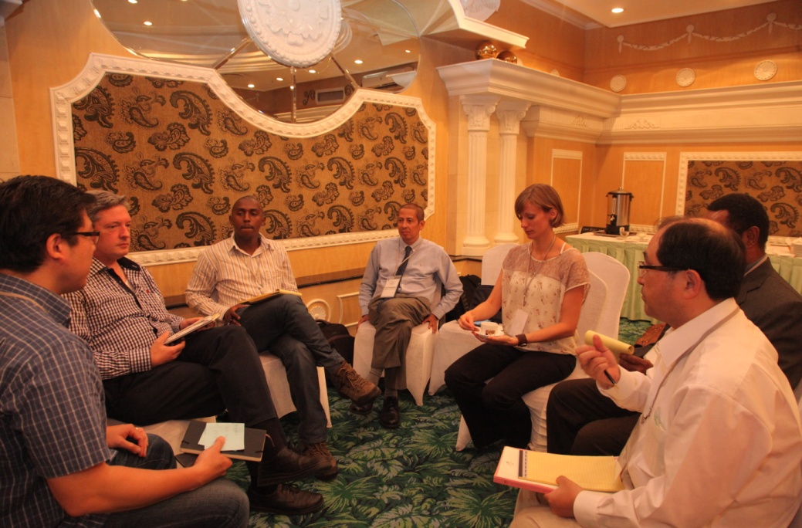
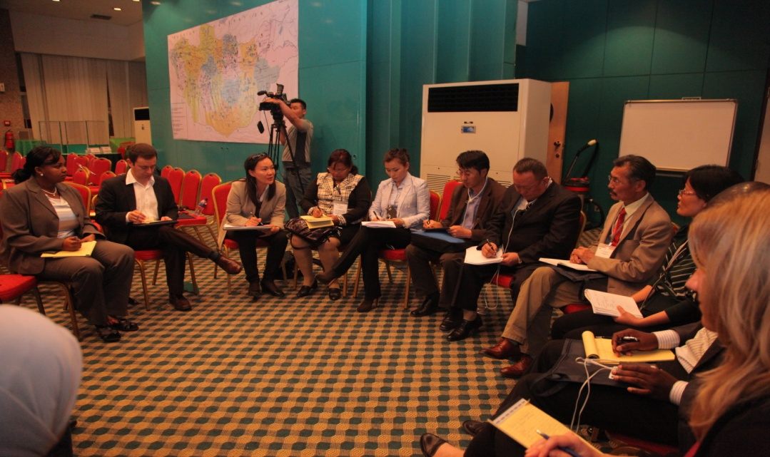
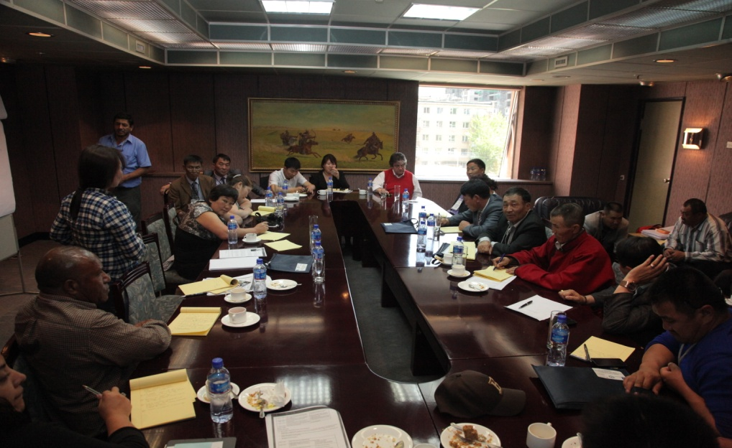
Outcomes

Slide 6
Outcomes -Governments
Strong consensus on regional cooperation.
Key recommendations:
  To be led by Government as policy makers
  Both Ministries of Mining and Environment to participate as they are key in the ASGM sector.
  Experts to provide guidance/knowledge during networking events or platforms.
  To use already existing regional networks to leverage on funds and achieve greater efficiency.
  The networking should cover different aspects of ASGM.

Slide 7
Outcome-Governments
  Key Recommendations:
  Network to have country focal points
  Countries to share cost of participation
  To take advantage of existing projects to organize regional network conferences to:
      Co-finance events
      Share good examples and tangible results from ASM project implementation.

Slide 8
Outcomes-Miner’s Organizations
Miners were unanimous on the significance and role of regional networking :
  To share experiences, opinions and policy inputs for governments.
  To improve visibility of ASM organizations at country and regional levels.
  Strengthening their roles.

Slide 9
Outcomes-ASM Organizations
Key Recommendations
  Important for regional ASM networks to tap into existing regional resources and networks i.e (Americas, Asia etc)
  Conduct inter-country visits and study tours.
  ASM National Federations to be in place in every country.
  To have thematic groups on environment, safety, and technology improvement.
  To create website for information sharing and quick set up of regional networks.

Slide 10
Civil Society & Researchers
Consensus on a regional central forum for networking
  Forum objectives to determine its form.
    If information sharing-Internet based
    If experience sharing and training- face to face meetings.
  Structure and processes of the forum are important to create trust for donor funding.

Slide 11
Civil Society and Researchers
Why central forum?
  Quick sharing of information
  Technology transfer and support amongst members
Key issues!
  Forum agenda and members expectations
  Funding;
  Leadership, coordination, fundraising and communication.

Slide 12
Other existing platforms
AGC has developed a platform for health collaboration in ASM.
http://artisanalmininghealth.org/
Resource websites
ASM in Mongolia www.bichiluurhai.mn
Alliance for Responsible Mining
  http://communitymining.org/

Slide 13
The challenge for regional platforms
Key questions to answer. Regional break-out groups.
What form of regional cooperation/platform is best for your region?
What are the common areas for collaboration?
How do we get the regional platforms functional and sustainable?
How will the platforms be funded?
How will they be coordinated?
I hope we can advance this topic to a higher level during this FORUM.

Slide 14
Thank you
Gracias
Merci

