Slide 1


Notes:
‘0’ This lecture explains the legally-binding provisions of the Minamata Convention on Mercury particularly the measures that the Parties are to implement for sound mercury management.

Slide 2
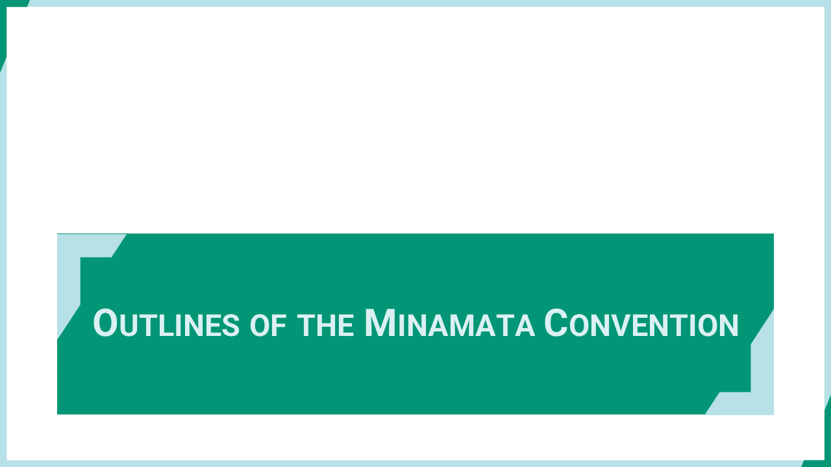
Notes:
‘1’ This section explains the background and scope of the Minamata Convention on Mercury.

Slide 3
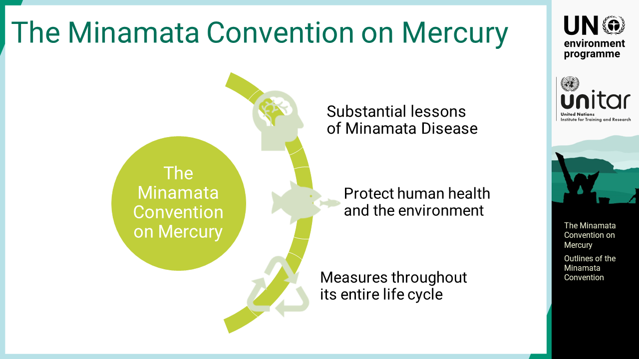
Notes:
‘2’ The Minamata Convention on Mercury is a multilateral legally-binding environmental agreement aiming to protect the human health and the environment from anthropogenic emissions and releases of mercury and mercury compounds. The Convention, in its preamble, recognizes the substantial lessons of Minamata Disease and the need to ensure proper management of mercury and the prevention of such events in the future. The text was adopted in October 2013, and is composed of a preambular text, 35 articles, and 5 annexes. The Convention entered into force on 16th August 2017, on the 90th day after the deposition of the 50th instrument of ratifications, acceptance, approval, or accession.

Slide 4
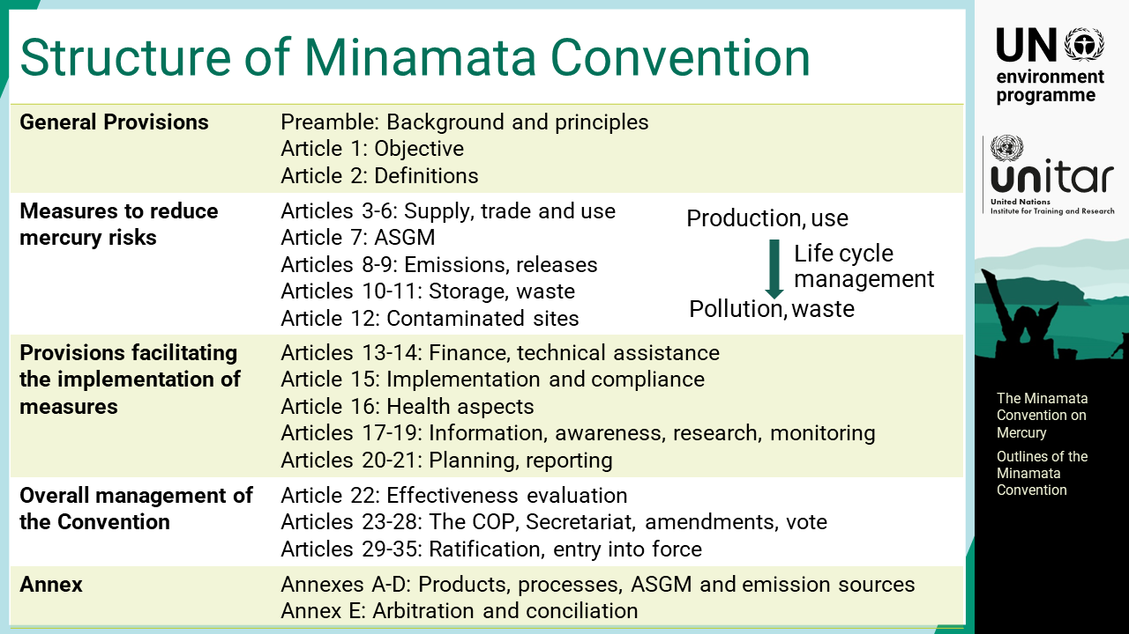
Notes:
‘3’ In its preamble, the Convention recognises the substantial lessons of Minamata disease, in particular the serious health effects resulting from the mercury pollution, and makes aware of the health concerns to women, children, and future generations. The Convention sets out a range of measures throughout the entire life cycle of mercury to meet its objective. Articles 3 to 12 relate to the operational provisions describing the Parties’ obligations to reduce emissions and releases, with controls throughout their life cycle, which include measures to control the supply and trade of mercury, mercury-added products, manufacturing processes in which mercury or mercury compounds are used, as well as artisanal and small-scale gold mining, ASGM. The text also includes the articles on emissions and releases of mercury, environmentally sound interim storage, mercury waste, and contaminated sites. Articles 13 to 21 facilitate the implementation of these measures including provisions related to support for the Parties, information, awareness raising, and reporting. Articles 22 to 35 cover the overall management of the Convention. Annexes A and B list the mercury-added products and manufacturing processes to be controlled by the Convention. Annex C sets the items to be included in the national action plans for ASGM. Annex D lists the point source categories for emission control.

Slide 5
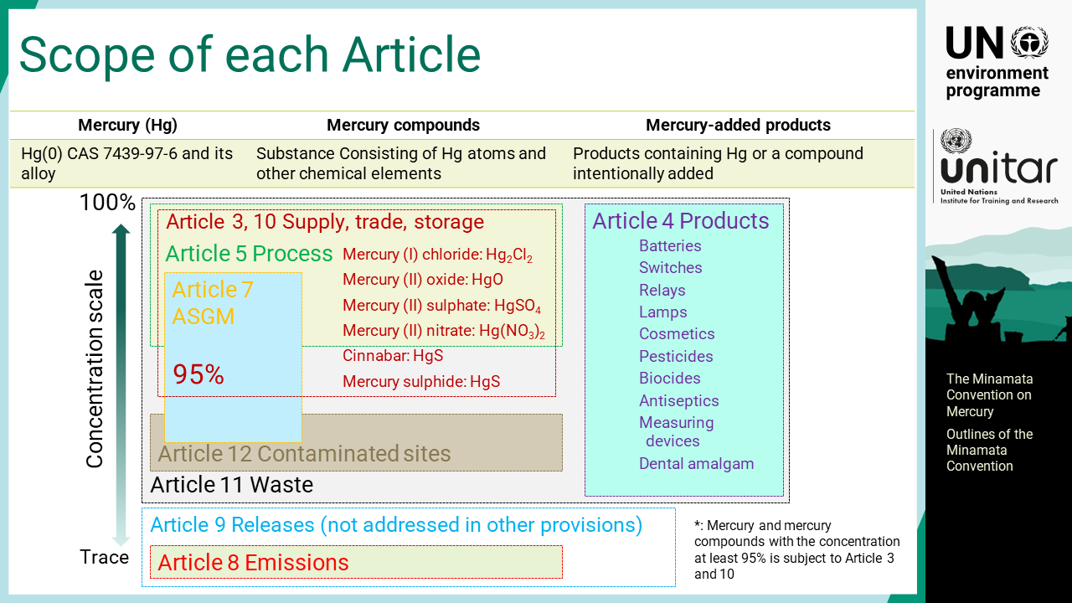
Notes:
‘4’ This Convention covers all forms of mercury, as element, and mercury compounds. Specific mercury compounds are subject to control in Article 3, supply and trade, and Article 10, interim storage. Article 4 specifies mercury-added products to be phased out or phased down by the Parties.

Slide 6

Notes:
‘5’ This section explains the measures stipulated in the Convention on mercury supply, trade, and use.

Slide 7
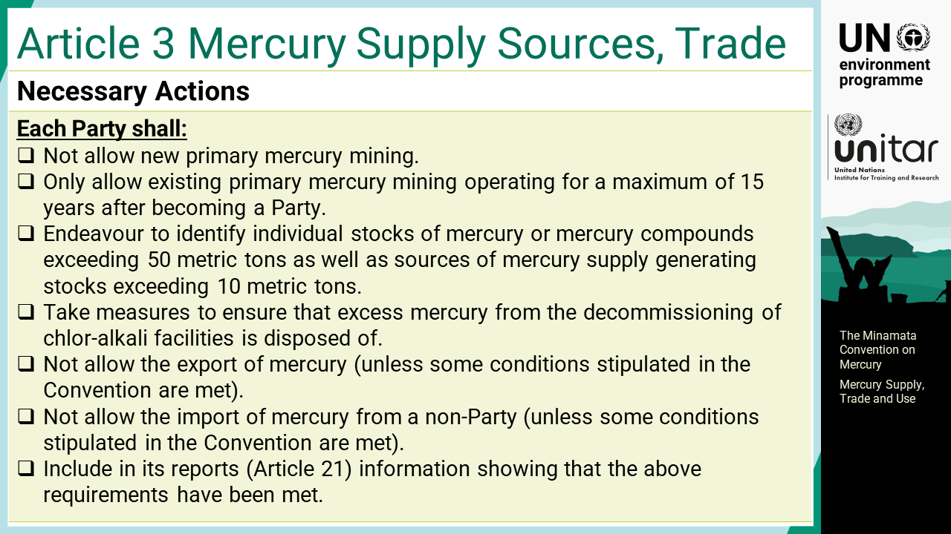
Notes:
‘6’ Article 3 Mercury supply sources and trade: Each Party shall not allow new primary mercury mining and shall only allow existing primary mercury mining operating for a maximum of 15 years after becoming a Party. Each Party shall also endeavour to identify individual stocks of mercury or mercury compounds exceeding 50 metric tons as well as sources of mercury supply generating stocks exceeding 10 metric tons. Each Party shall not allow the export and import of mercury unless some conditions stipulated in the Convention are met.

Slide 8
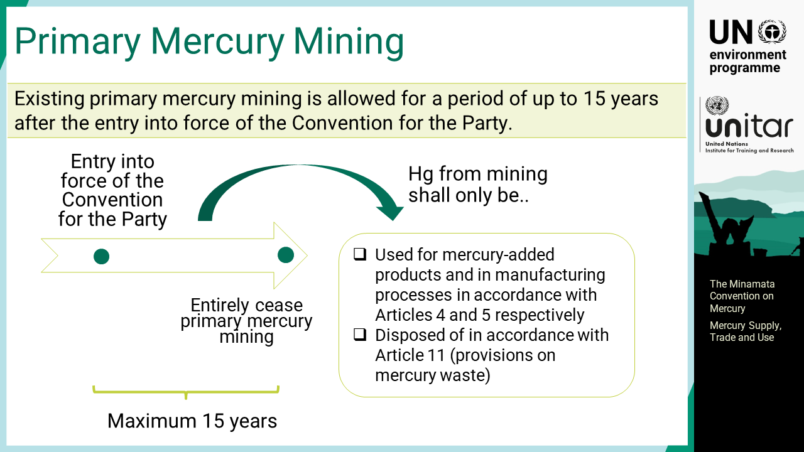
Notes:
‘7’ Existing primary mercury mining is allowed for a period of up to 15 years after the entry into force of the Convention for the Party. Mercury from such mining shall only be used for mercury-added products and in manufacturing processes in accordance with Article 4 and 5, respectively. Or it shall be disposed of in accordance with Article 11.

Slide 9
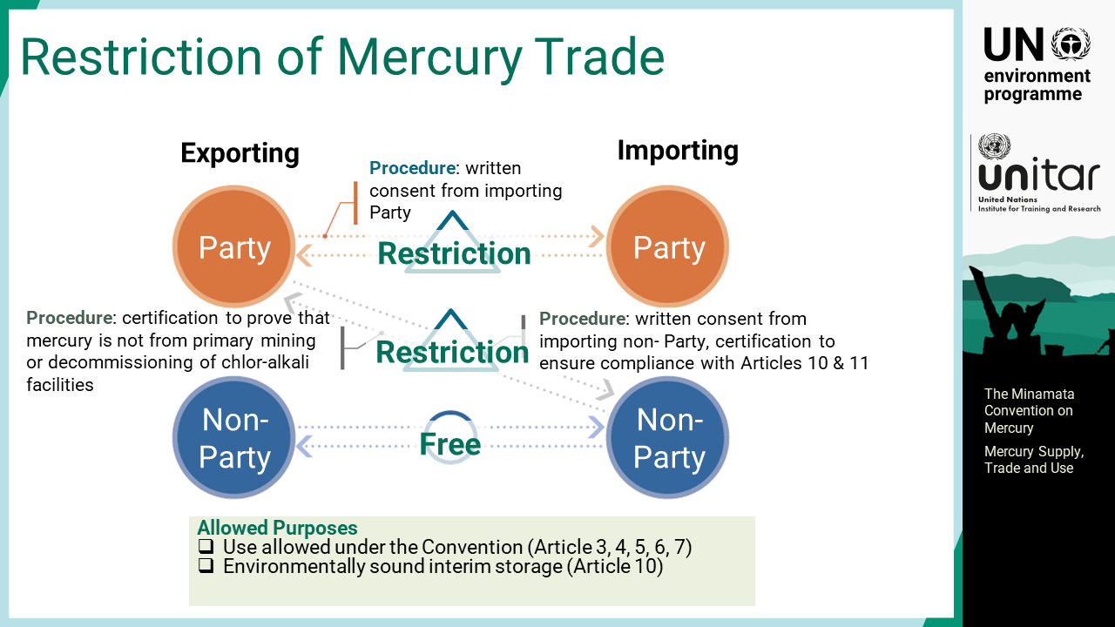
Notes:
‘8’ Mercury trade between Parties or a Party and a non-Party requires a written consent from the importing country and shall be allowed only for the use allowed under the Convention or for environmentally sound interim storage. Exporting Party shall ensure that importing non-Party is compliant with Articles 10 and 11 of the Convention. Likewise, importing Parties shall obtain certification from exporting non-Party which ensures that the mercury is from allowed sources, noting that there are restrictions on the use of mercury from primary mining or decommissioning of chlor-alkali facilities.

Slide 10
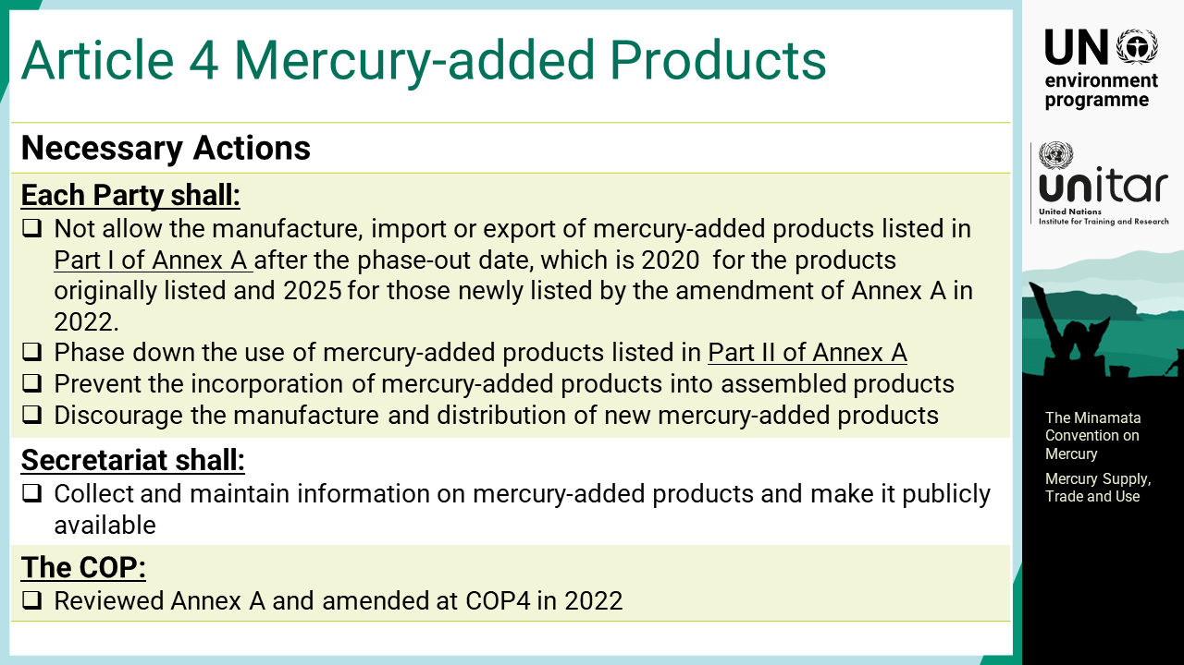
Notes:
‘9’ Article 4 Mercury-added products: Each Party shall not allow the manufacture, import or export of mercury-added products listed in Part I of Annex A after the phase-out date, which is 2020 for the products originally listed and 2025 for those newly listed by the amendment of Annex A in 2022. Each Party also shall take measures to phase down the use of mercury-added products listed in Part II of Annex A, which is dental amalgam. Each Party shall take measures to prevent the incorporation of mercury-added products into assembled products and discourage the manufacture and distribution of new mercury-added products. The Secretariat shall collect and maintain information on mercury-added products and make it publicly available. The Conference of the Parties, COP, shall review Annex A and may consider amendments. The first amendment was adopted by the COP at its fourth meeting in 2022.

Slide 11
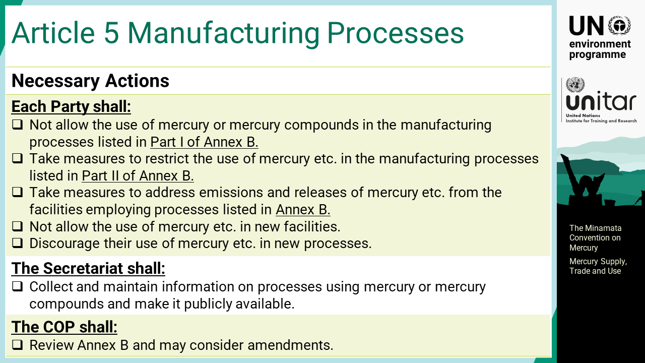
Notes:
‘10’ Article 5 Manufacturing processes in which mercury or mercury compounds are used: Each Party shall not allow the use of mercury or mercury compounds in the manufacturing processes listed in Part I of Annex B, and shall take measures to restrict the use of mercury or mercury compounds in the manufacturing processes listed in Part II of Annex B. Each Party shall also take measures to address emissions and releases of mercury or mercury compounds from these facilities. Each Party shall not allow the use of mercury or mercury compounds in new facilities and discourage their use of mercury or mercury compounds in new processes. The Secretariat shall collect and maintain information on processes using mercury or mercury compounds and make it publicly available. The COP shall review Annex B and may consider amendments.

Slide 12
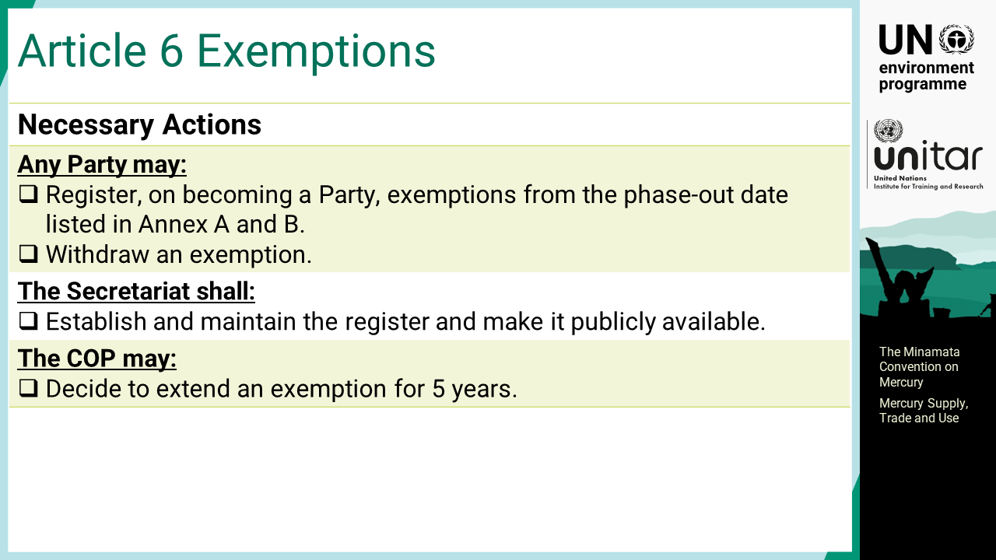
Notes:
‘11’ Article 6 Exemption available to a Party upon request: Any Party, may register, on becoming a Party, exemptions from the phase-out date listed in Annex A and B for five years or less or withdraw the registered exemption. The Secretariat shall establish and maintain the register and make it publicly available. The COP may decide to extend an exemption for five years.

Slide 13
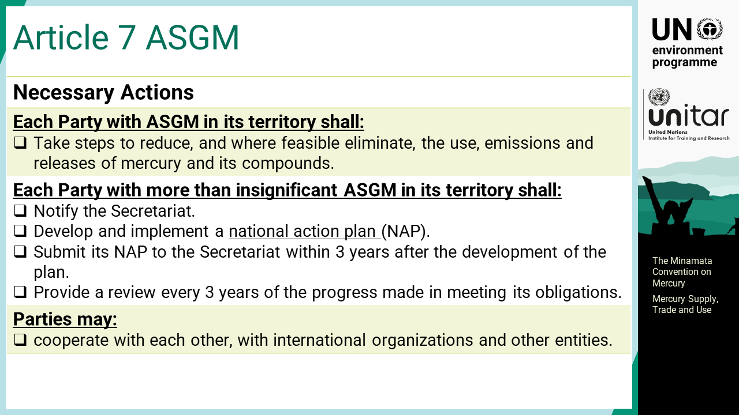
Notes:
‘12’ Article 7 Artisanal and small-scale gold mining: Each Party with ASGM in its territory shall take steps to reduce, and where feasible eliminate, the use, emissions and releases of mercury and its compounds. Each Party with more than insignificant ASGM in its territory shall notify the Secretariat and develop and implement a national action plan, which shall be submitted to the Secretariat within three years after the development of the plan. Thereafter, a review of the progress made shall be conducted every three years.

Slide 14

Notes:
‘13’ This section explains the environmentally sound management of mercury particularly control measures to reduce mercury risks stipulated in the Convention.

Slide 15
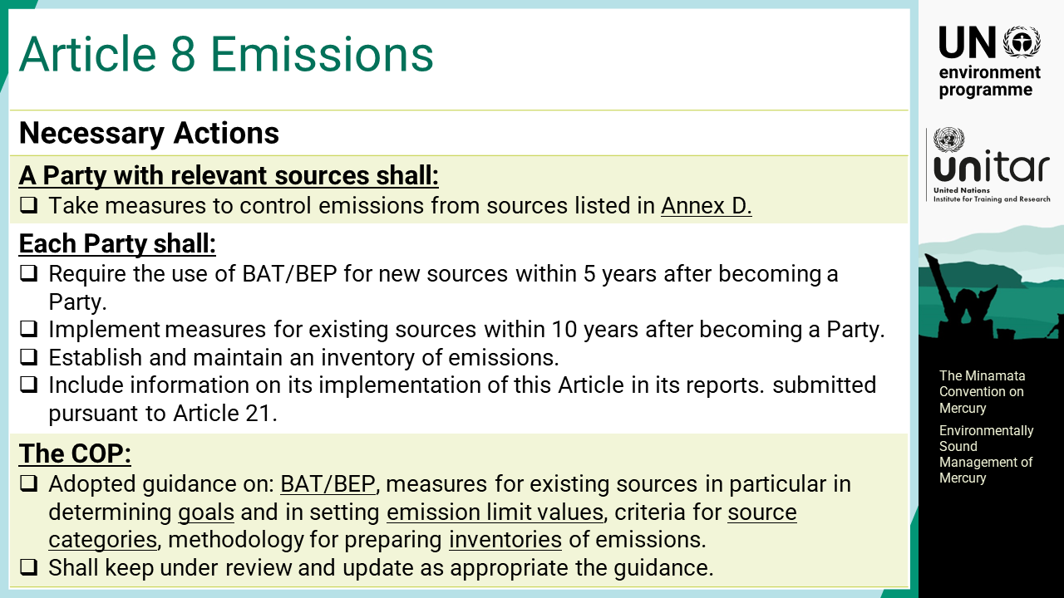
Notes:
‘14’ Article 8 Emissions: A Party with relevant sources shall take measures to control emissions from sources listed in Annex D. Each Party shall require the use of best available techniques, BAT, and best environmental practices, BEP, to control emissions for new sources within five years after becoming a Party, and implement one or more measures for existing sources within 10 years after becoming a Party. Each Party shall also establish and maintain an inventory of emissions. The COP adopted the guidance on BAT/BEP, including goals and emission limit values for existing sources, the guidance on criteria to identify source categories, and methodology for preparing the inventory. The BAT/BEP guidance was adopted by the COP at its first meeting in 2017.

Slide 16
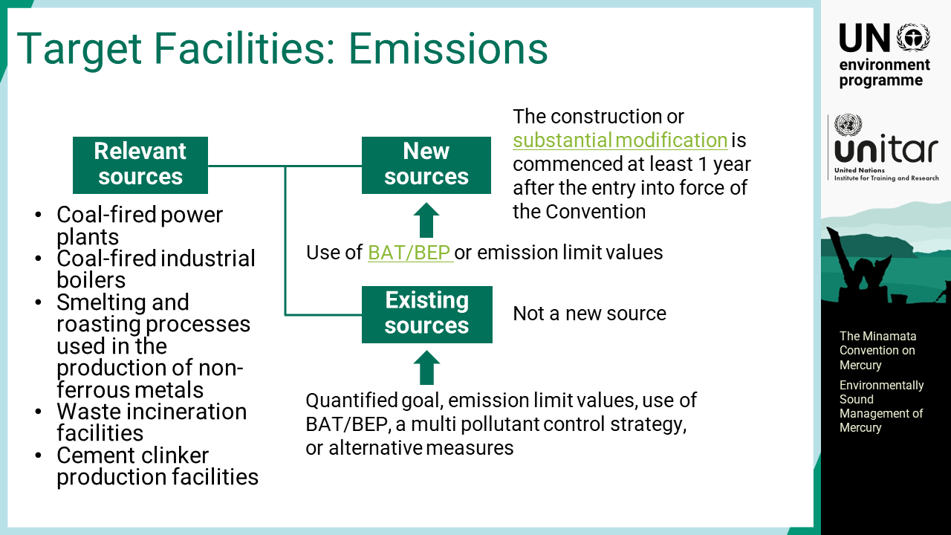
Notes:
‘15’ The relevant sources subject to this Article are listed in Annex D. Different control measures are required for new sources and existing sources.

Slide 17
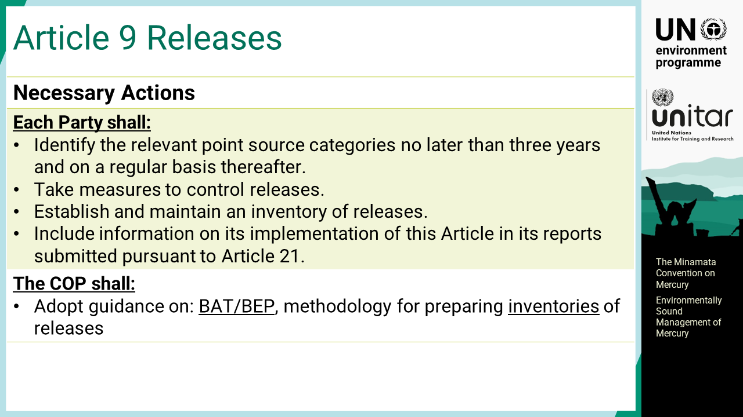
Notes:
‘16’ Article 9 Releases: Each Party shall identify the relevant point source categories, which are not addressed in the other provision of the Convention, no later than three years and on a regular basis thereafter. Each Party shall take measures to control releases, and establish and maintain an inventory of releases. The COP shall adopt guidance on BAT/BEP and methodology for preparing inventories.

Slide 18
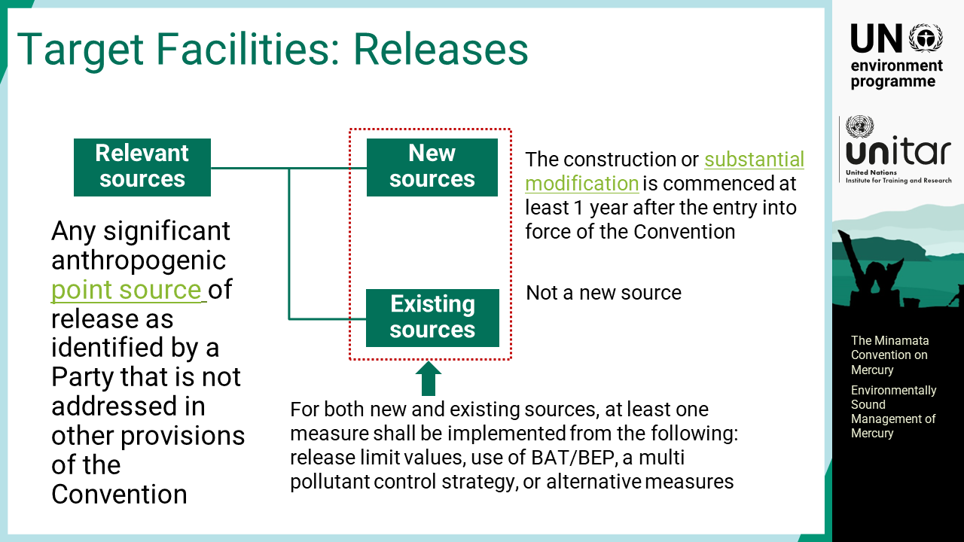
Notes:
‘17’ For both new and existing sources that are not covered by the other provisions of the Convention such as release limit values, use of BAT/BEP, a multi pollutant control strategy, or alternative measures, at least one measure listed in the Convention shall be implemented.

Slide 19
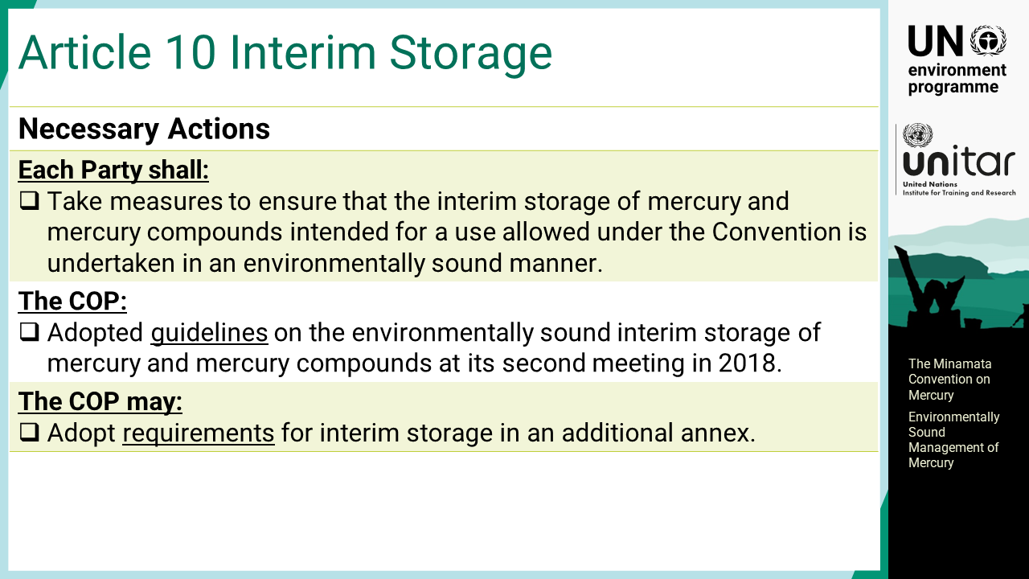
Notes:
‘18’ Article 10 Environmentally sound interim storage of mercury, other than waste mercury: Each Party shall take measures to ensure that the interim storage of mercury and mercury compounds intended for a use allowed under the Convention is undertaken in an environmentally sound manner. The COP adopted guidance on the environmentally sound interim storage of mercury and mercury compounds at its second meeting in 2018.

Slide 20
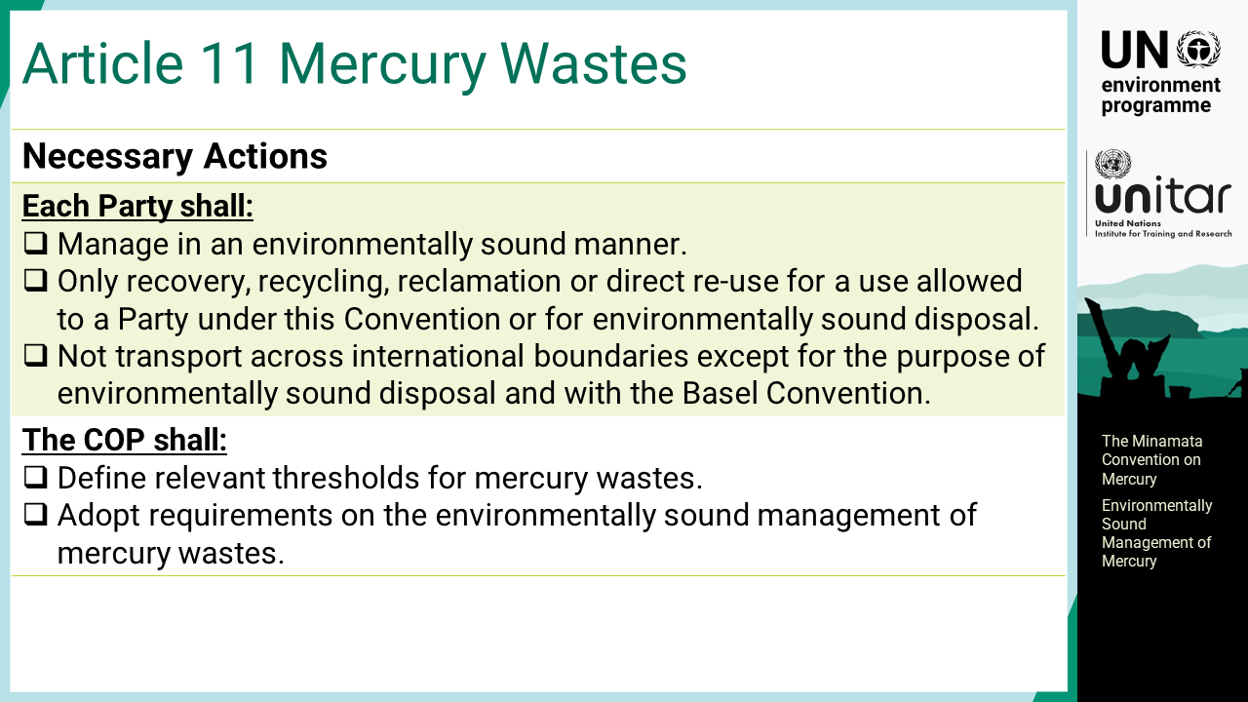
Notes:
‘19’ Article 11 Mercury wastes: Mercury wastes means substances or objects consisting of, containing or contaminated with mercury or mercury compounds in a quantity above the relevant thresholds defined by the COP. Each Party shall take measures to manage mercury waste in an environmentally sound manner. Each Party shall also ensure that the recovery, recycling, reclamation or direct re-use of mercury waste is for an allowed purpose or for environmentally sound disposal only. For the Party to the Basel Convention, mercury waste shall not be transported across international boundaries except for the purpose of environmentally sound disposal. The COP shall define relevant thresholds for mercury wastes.

Slide 21
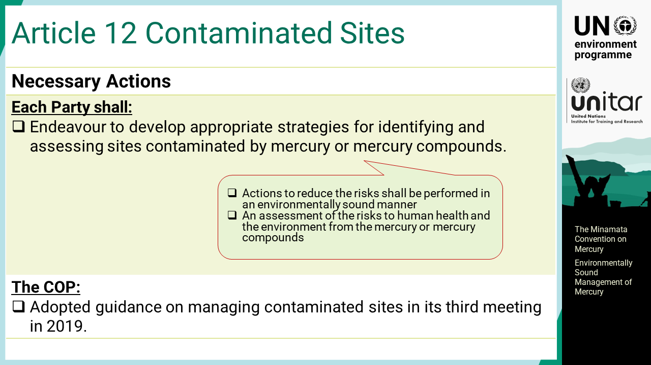
Notes:
‘20’ Article 12 Contaminated sites: Each Party shall endeavour to develop appropriate strategies for identifying and assessing sites contaminated by mercury or mercury compounds. Actions to reduce the risks shall be performed in an environmentally sound manner. The COP adopted guidance on managing contaminated sites in its third meeting in 2019.

Slide 22

Notes:
‘21’ This section explains the provisions of the Conventions that facilitate the Parties implementing the measures to fulfil the objective of the Convention.

Slide 23
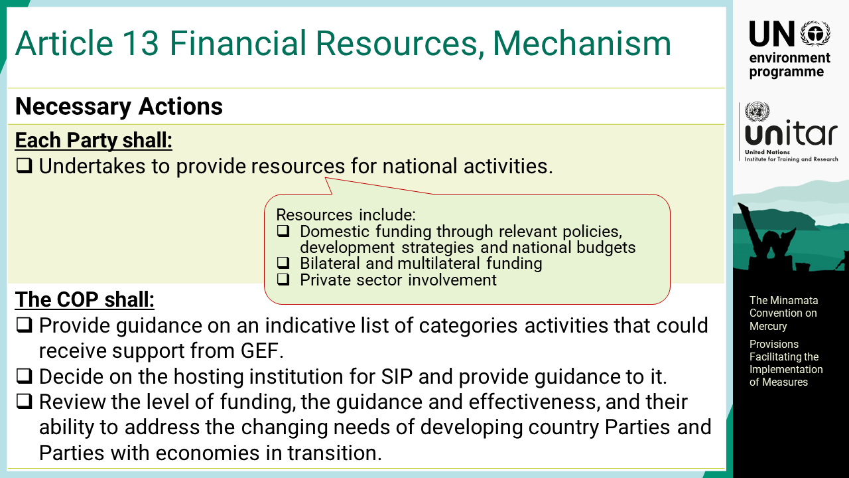
Notes:
‘22’ Article 13 Financial resources and mechanism: Each Party undertakes to provide resources such as domestic funding, bilateral and multilateral funding as well as private sector involvement for national activities. The mechanism shall include the Global Environment Facility, GEF, and the specific international programme, SIP.

Slide 24
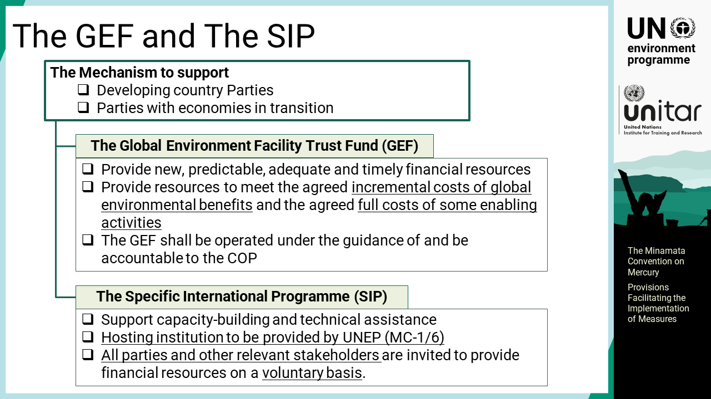
Notes:
‘23’ The GEF provides predictable, adequate and timely financial resources to meet the agreed incremental costs of global environmental benefits. The GEF shall be operated under the guidance of and be accountable to the COP. The SIP supports capacity-building and technical assistance. All parties and other relevant stakeholders are invited to provide financial resources on a voluntary basis.

Slide 25
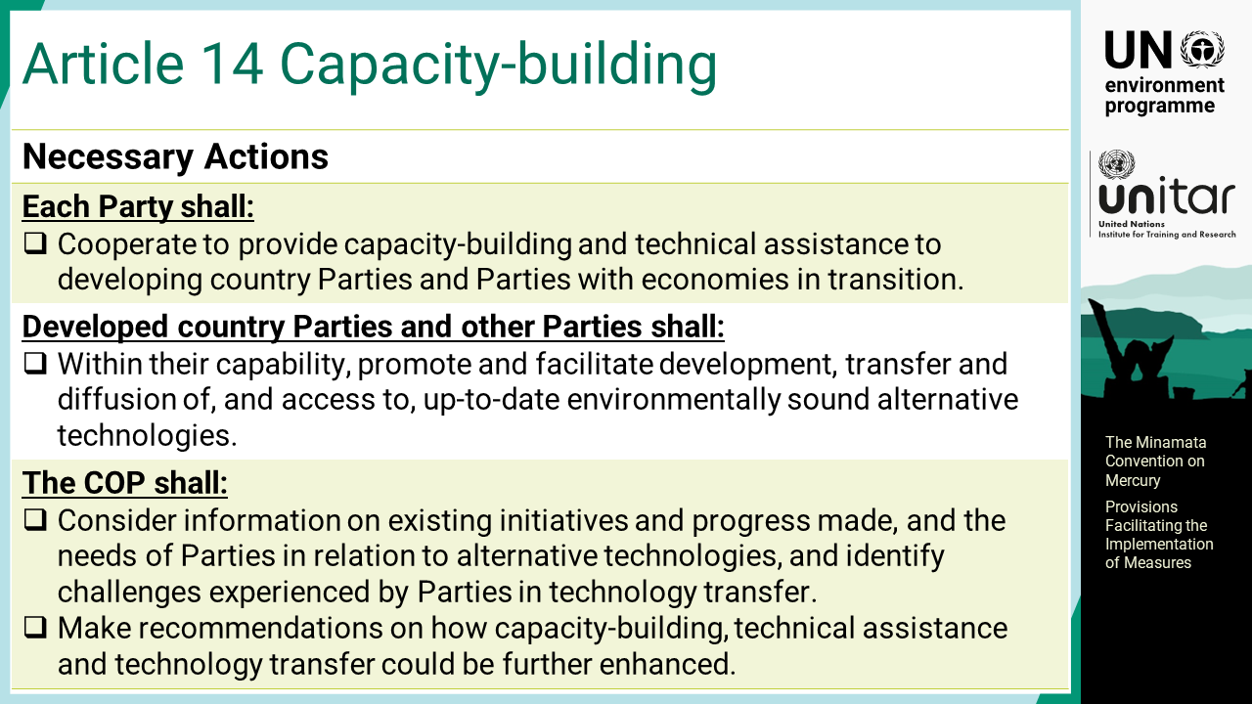
Notes:
‘24’ Article 14 Capacity-building, technical assistance and technology transfer: Parties shall cooperate to provide capacity-building and technical assistance to developing country Parties and Parties with economies in transition. Developed country Parties and other Parties shall, within their capability, promote and facilitate development, transfer and diffusion of, and access to, up-to-date environmentally sound alternative technologies. The COP shall consider information on existing initiatives and progress made, and the needs of Parties in relation to alternative technologies, and identify challenges experienced by Parties in technology transfer. The COP also shall make recommendations on how capacity-building, technical assistance and technology transfer could be further enhanced.

Slide 26
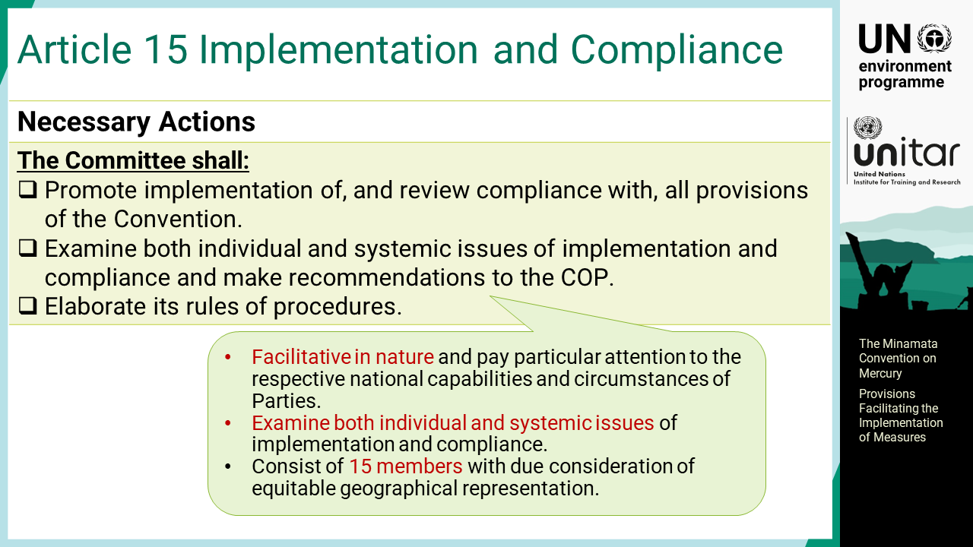
Notes:
‘25’ Article 15 Implementation and compliance committee: A Committee is established as a subsidiary body of the COP. The Committee shall promote implementation of, and review compliance with, all provisions of the Convention. It shall examine both individual and systemic issues of implementation and compliance and make recommendations to the COP.

Slide 27
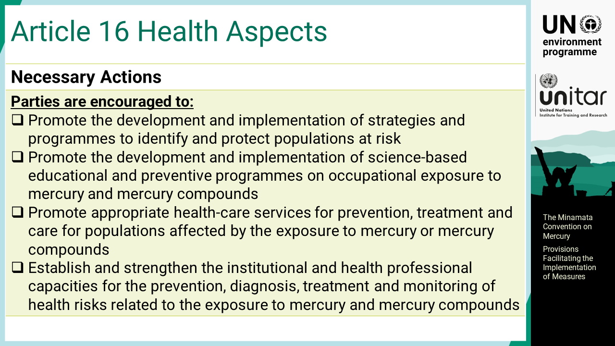
Notes:
‘26’ Article 16 Health aspects: Parties are encouraged to promote the development and implementation of strategies and programmes to identify and protect populations at risk. They are also encouraged to promote the development and implementation of science-based educational and preventive programmes on occupational exposure to mercury and mercury compounds, and to promote appropriate health-care services for prevention, treatment and care for populations affected by the exposure to mercury or mercury compounds. Furthermore, they are encouraged to establish and strengthen the institutional and health professional capacities for the prevention, diagnosis, treatment, and monitoring of health risks related to the exposure to mercury and mercury compounds.

Slide 28
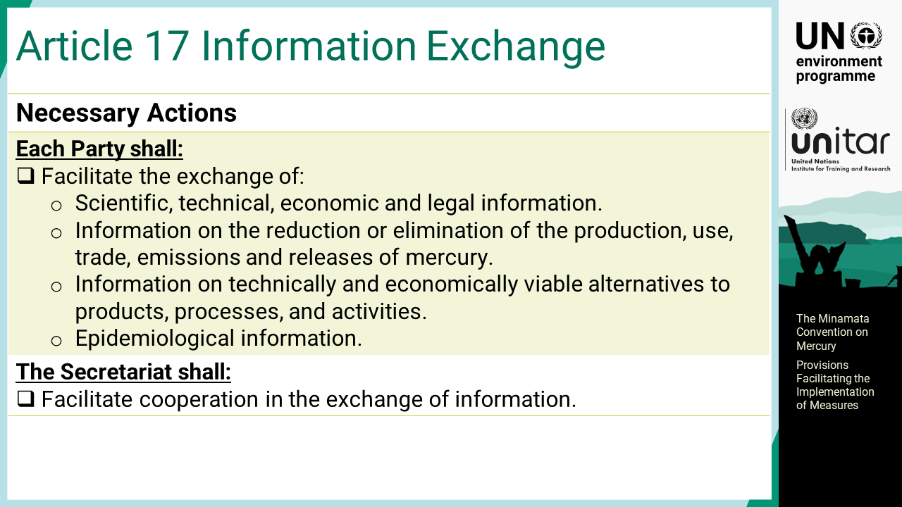
Notes:
‘27’ Article 17 Information exchange: Each Party shall facilitate the exchange of scientific, technical, economic, and legal information. Additionally, it shall facilitate the exchange of information such as on the reduction or elimination of the production, use, trade, emissions, and releases of mercury, on technically and economically viable alternatives to products, processes, and activities, and epidemiological information. The Secretariat shall facilitate cooperation in the exchange of information.

Slide 29
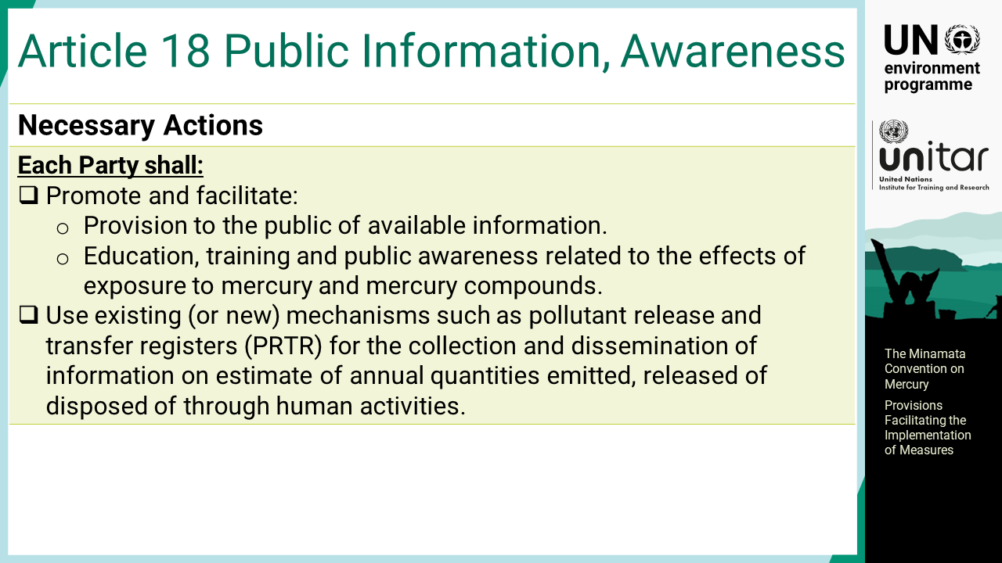
Notes:
‘28’ Article 18 Public information, awareness, and education: Each Party shall promote and facilitate the provision to the public of available information, and education, training and public awareness related to the effects of exposure to mercury and mercury compounds.

Slide 30
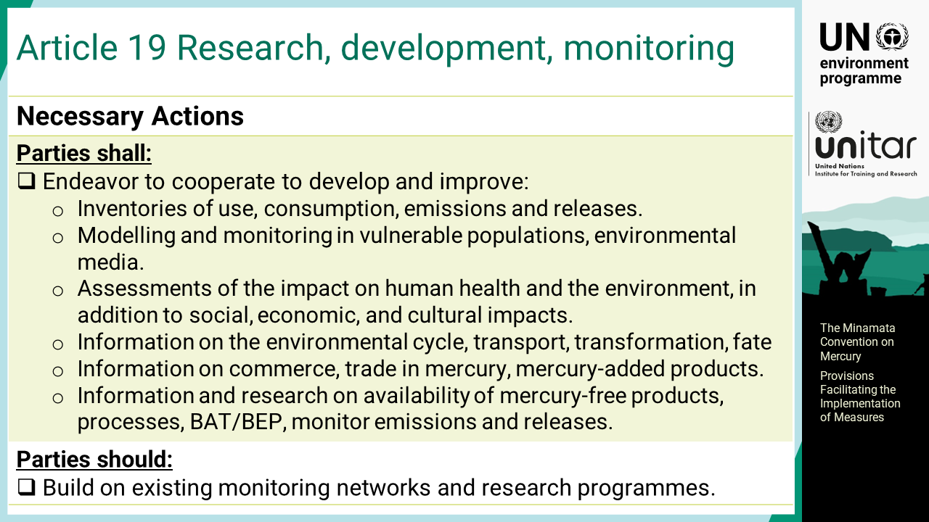
Notes:
‘29’ Article 19 Research, development and monitoring: Parties shall endeavour to cooperate to develop and improve inventories of use, consumption, and anthropogenic emissions and releases of mercury. The cooperation also includes modelling and monitoring of mercury in vulnerable populations and in environmental media, assessments of the impact of mercury on human health and the environment, in addition to social, economic, and cultural impacts, information on the environmental cycle, transport, transformation and fate of mercury, information on commerce and trade in mercury and mercury-added products, and information and research on the technical and economic availability of mercury-free products and processes and on BAT/BEP to reduce and monitor emissions and releases of mercury. Additionally, Parties should build on existing monitoring networks and research programmes.

Slide 31
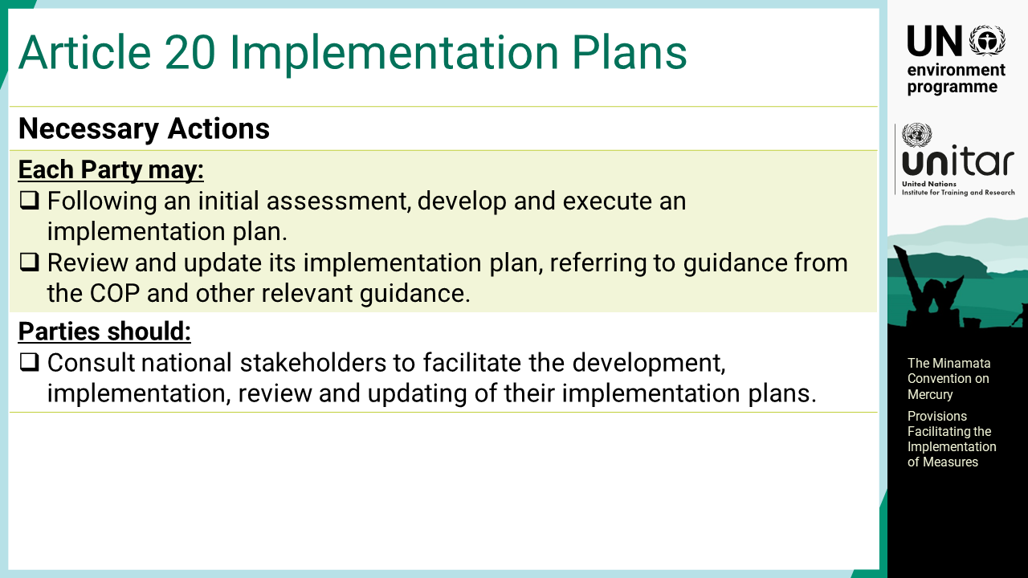
Notes:
‘30’ Article 20 Implementation plans: Each Party may, following an initial assessment, develop and execute an implementation plan. It may review and update its implementation plan, referring to guidance from the COP and other relevant guidance. Parties should consult national stakeholders to facilitate the development, implementation, review and updating of their implementation plans.

Slide 32
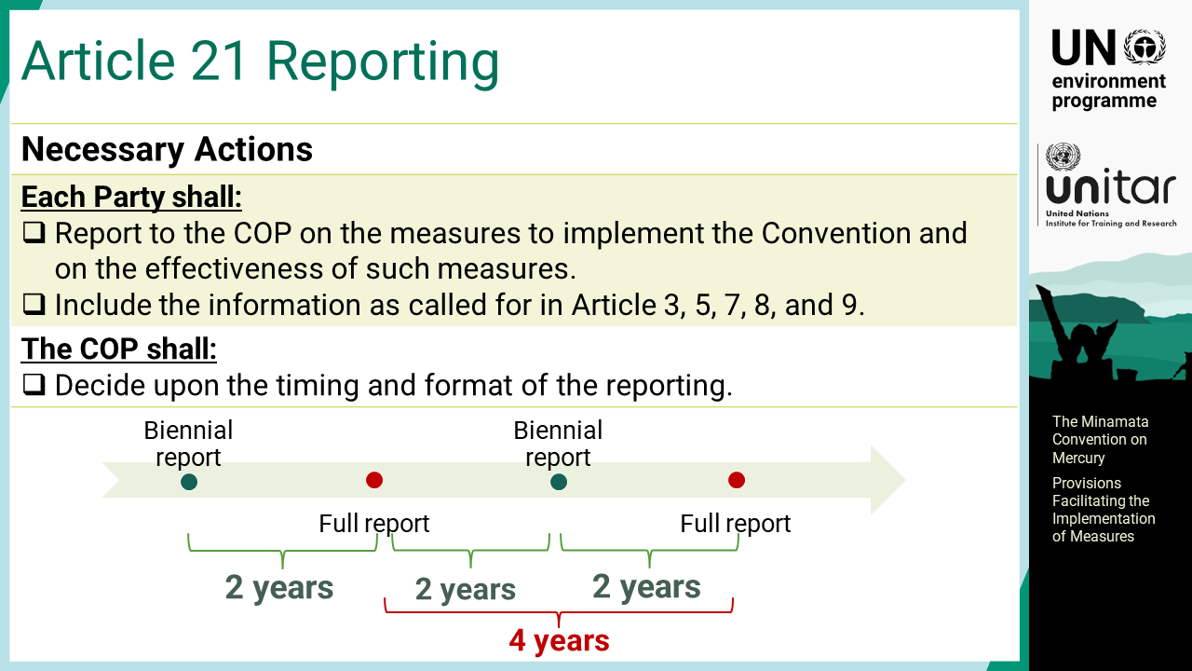
Notes:
‘31’ Article 21 Reporting: Each Party shall report to the COP on the measures to implement the Convention and on the effectiveness of such measures, which include the information as called for in Article 3, 5, 7, 8, and 9. The COP agreed on the timing of the reporting at its first meeting for full reports every four years and biennial reports every two years.

Slide 33
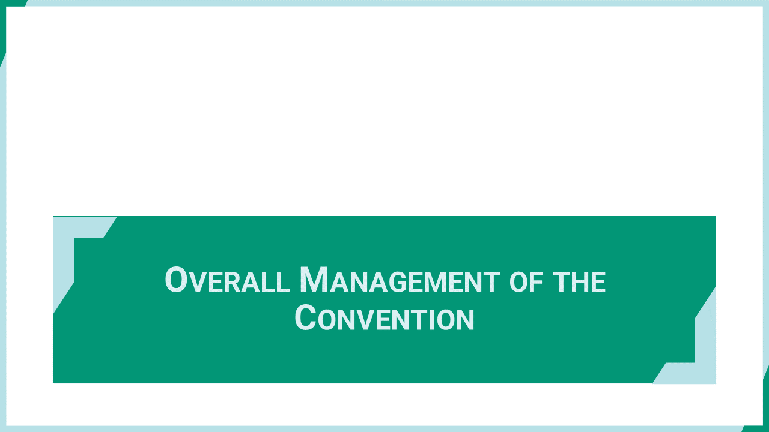
Notes:
‘32’ This section explains the provisions of the Conventions that provide overall management of the Convention particularly evaluating the effectiveness of measures to achieve the objective of the Convention.

Slide 34
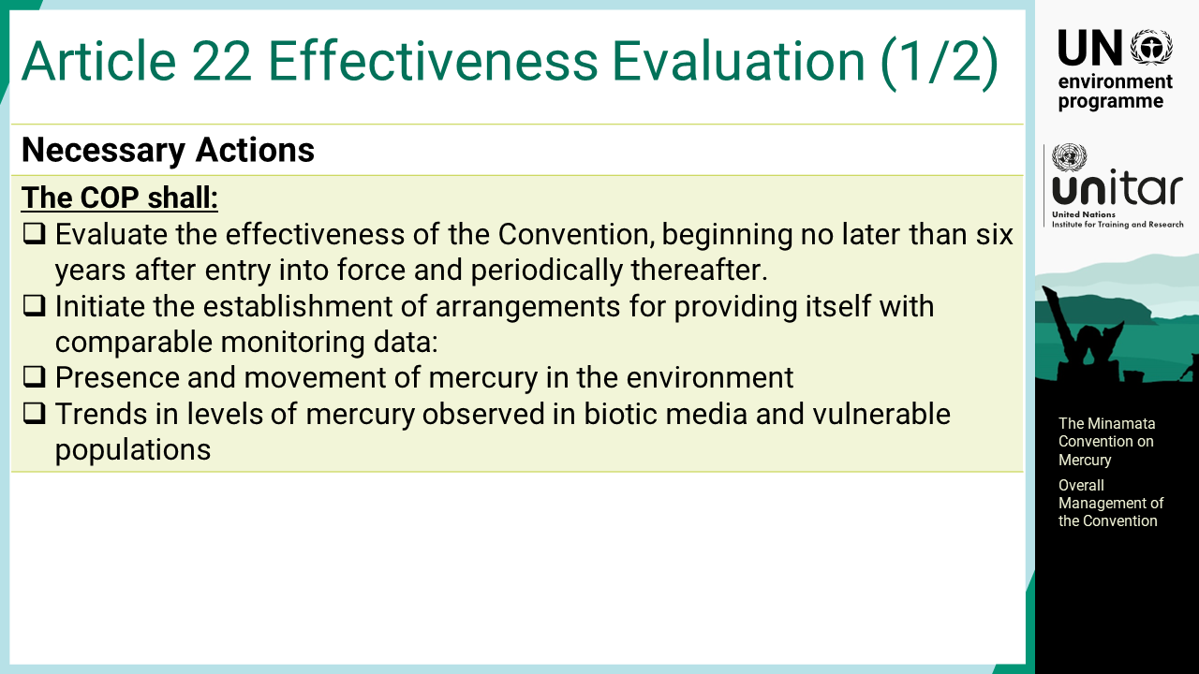
Notes:
‘33’ Article 22 Effectiveness evaluation: The COP shall evaluate the effectiveness of the Convention, beginning no later than six years after entry into force and periodically thereafter. To facilitate the evaluation, the COP shall initiate the establishment of arrangements for providing itself with comparable monitoring data on the presence and movement of mercury in the environment, and trends in levels of mercury observed in biotic media and vulnerable populations.

Slide 35
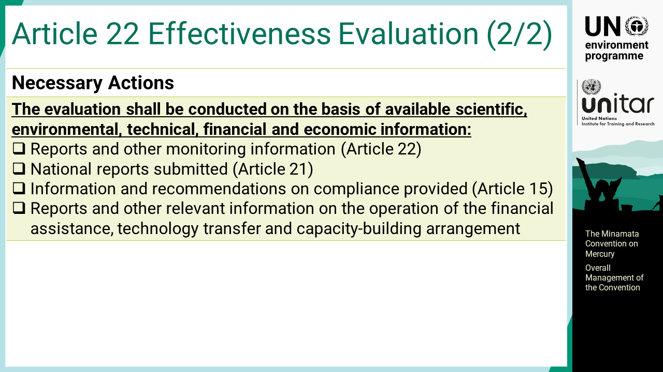
Notes:
‘34’ The evaluation shall be conducted on the basis of available scientific, environmental, technical, financial and economic information including reports and other monitoring information, national reports submitted, information and recommendations on compliance provided, and reports and other relevant information on the operation of the financial assistance, technology transfer and capacity-building arrangement.

Slide 36
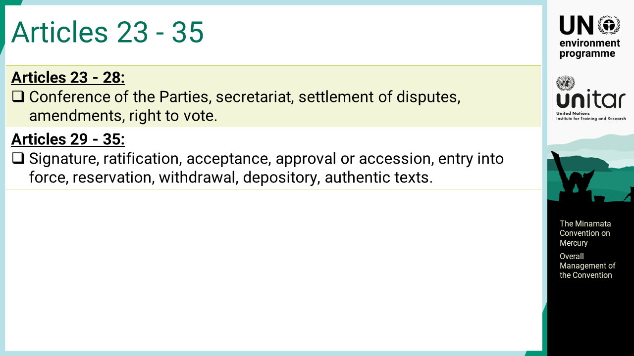
Notes:
‘35’ Articles 23 to 28 cover various rules and processes for operationalising the Convention by establishing the Conference of the Parties, secretariat, or by stipulating rules for settlement of disputes, amendments, voting, etc. Article 29 to 35 cover the provisions on the formality of the Convention, including signature, ratification, entry into force, reservation, withdrawal, depositary, and authentic texts.

