Slide 1



Progress of the POPs GMP 2 in Indonesia
8 August 2018, Ulaan bataar, Mongolia

Slide 2
Progress Activities on POPs GMP 2
Preparation meeting (4 Mei and 31 Mei 2017)
Small Scale Funding Agreement (SSFA) under the GMP2 Asia was prepared on July 2017
Ministry of Environment and Forestry (MOEF) conducted several meeting with Ministry of Health (MOH) and Laboratories to discuss about the implementation of the 6th round of the human milk survey
  Meeting on 15 September 2017 (with MOH)
  Meeting on 20 September 2017 (with 8 public and private laboratories )
  Meeting on 5 October 2017 (with MOH)
  Meeting on 9 October 2017 (with MOH)
SSFA under the GMP2 Asia was signed on Dec 2017 (UN) - Jan 2018 (MOEF) without human milk survey

Slide 3
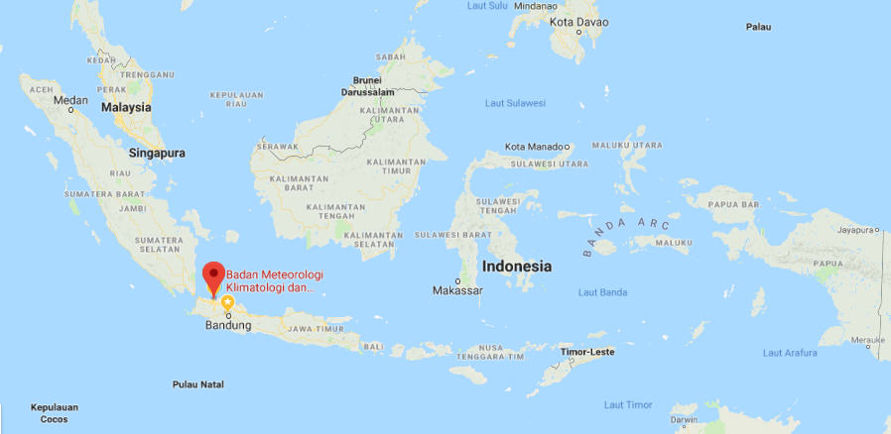
Progress Activities on POPs GMP 2
Location of air sampling monitoring
Urban Area at Indonesian Agency for Meteorology, Climatology and Geophysics (IAMCG), Kemayoran, Jakarta
Coordinate:
6°9'21" S
106°50’32” E

Slide 4
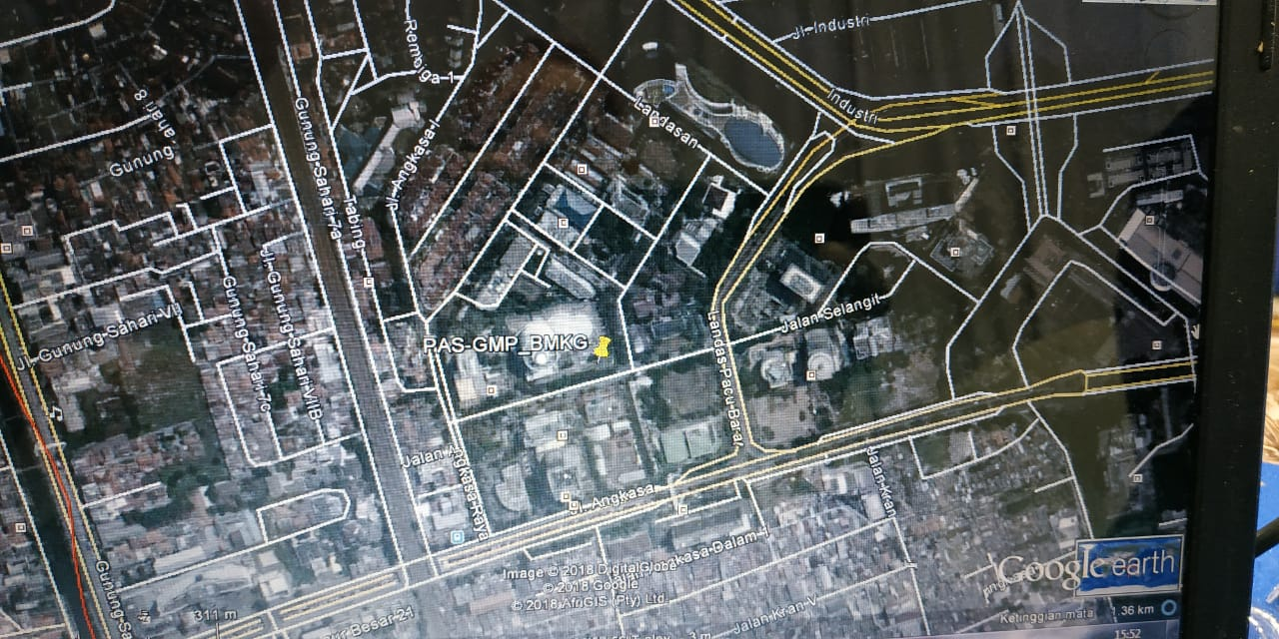
Progress Activities on POPs GMP 2
Location of air sampling monitoring
Urban Area at Indonesian Agency for Meteorology, Climatology and Geophysics (IAMCG), Kemayoran, Jakarta
Coordinate:
6°9'21" S
106°50’32” E

Slide 5
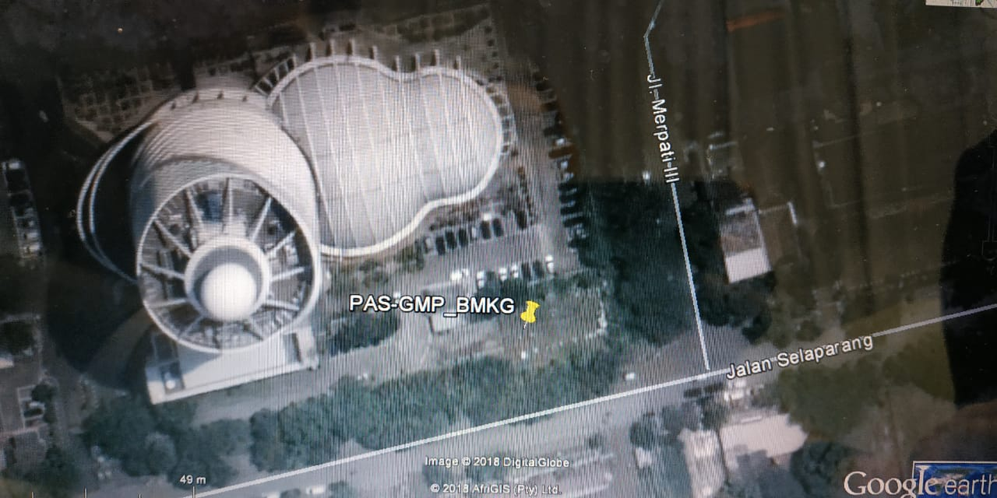
Progress Activities on POPs GMP 2
Location of air sampling monitoring
Urban Area at Indonesian Agency for Meteorology, Climatology and Geophysics (IAMCG), Kemayoran, Jakarta
Coordinate:
6°9'21" S
106°50’32” E

Slide 6
Progress Activities on POPs GMP 2
Air sampling monitoring (PUF sample installation and collection)
First monitoring on 30 November 2017 – 2 March 2018
Second monitoring on 3 April 2018 – 2 July 2018
PUF sample result analysis
PUF no 1,2,3,4,9 and 10 sent to Prof. Dr. Jacob de Boer c/o. Ms. Rianne van Dijk, Vrije Universiteit Amsterdam, The Netherlands
PUF no 5 and 11 sent to Prof. Dr. Heidelore Fiedler, MTM Research Centre, Örebro University, School of Science and Technology, Sweden

Slide 7
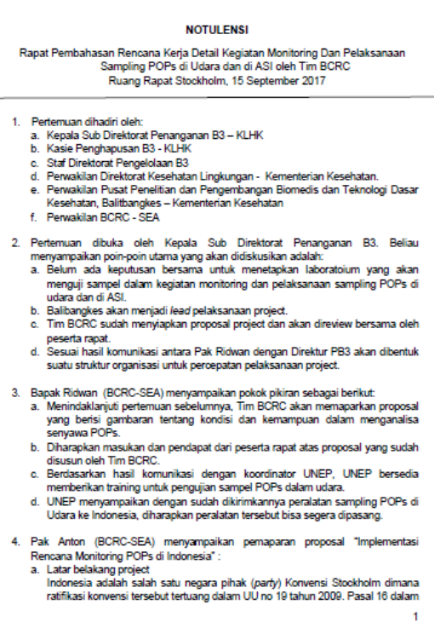

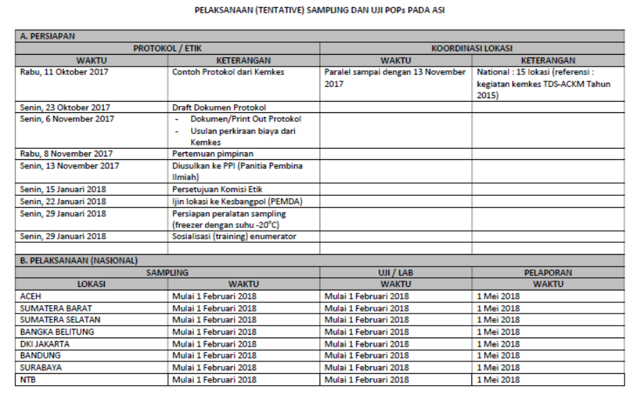
Documents Prepared on POPs GMP 2
Documents prepared
Report of PUF installation and collection
Time schedule and plan activities for human milk survey, air sampling and sediment sampling
Minutes of meetings

Slide 8
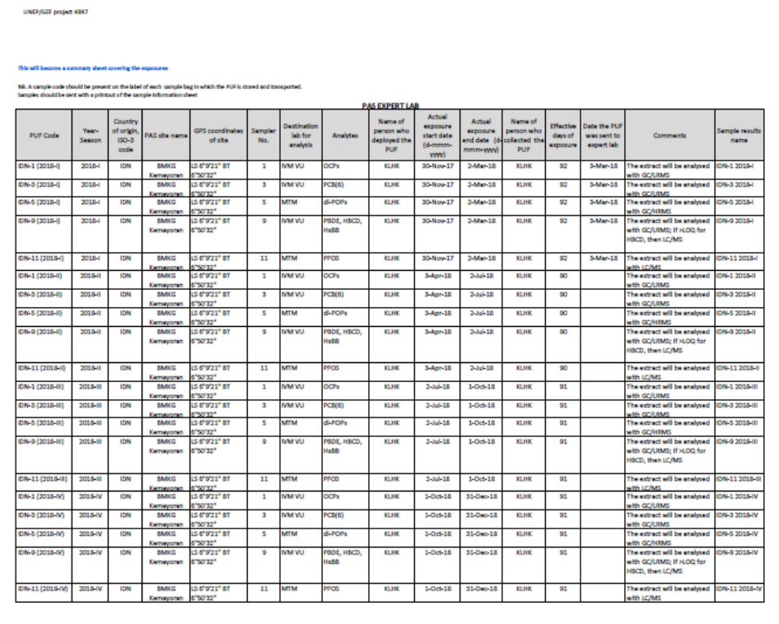
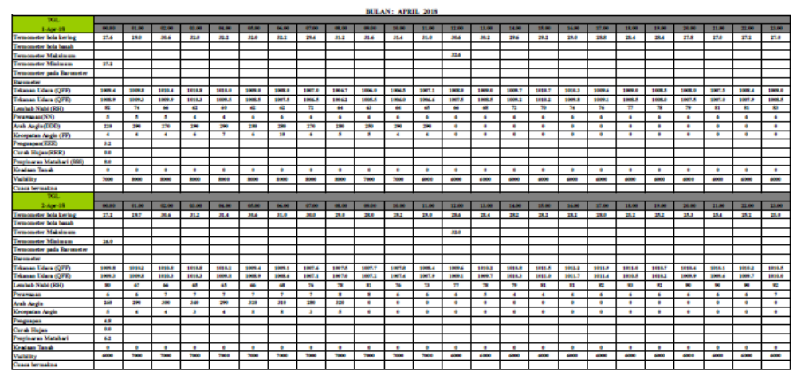
Documents Prepared on POPs GMP 2
Documents prepared
Summary sheet 0f exposures
Meteorological data on the site sampling location

Slide 9
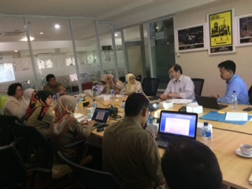
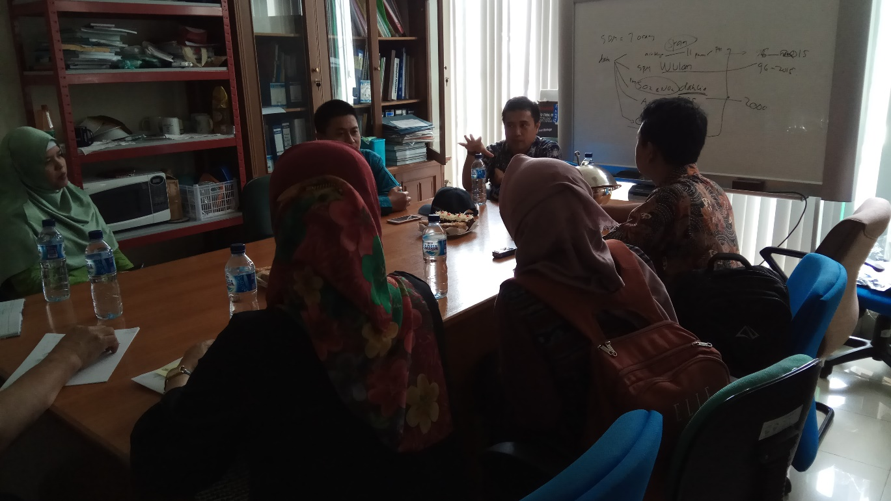
Pictures of Activities on POPs GMP 2
Meeting with Indonesian Agency for Meteorology, Climatology and Geophysics (IAMCG)
Meeting with Ministry of Health

Slide 10
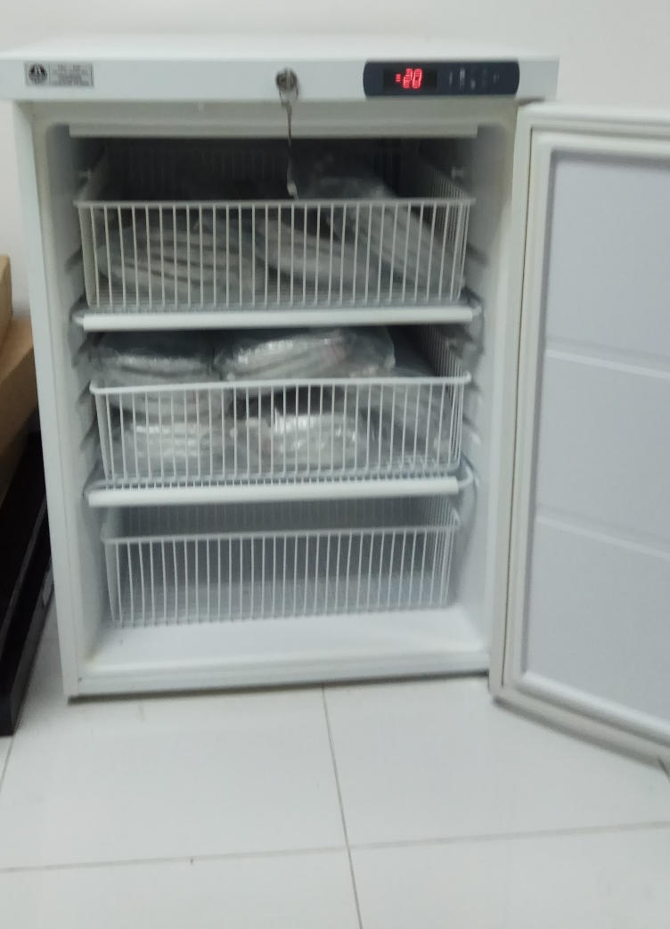
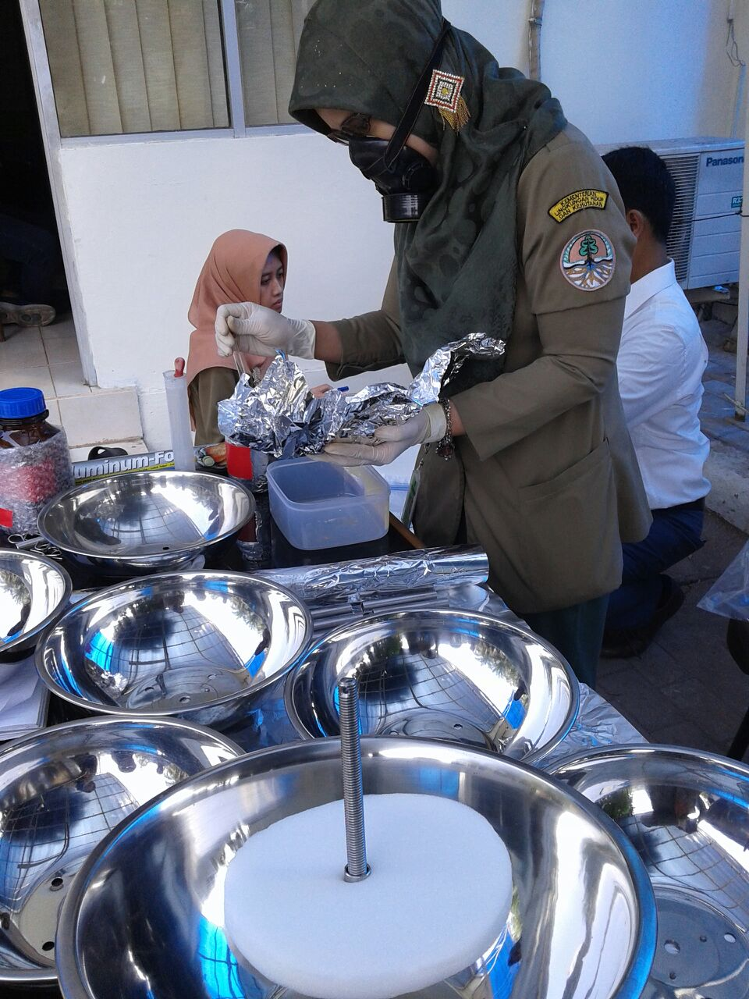
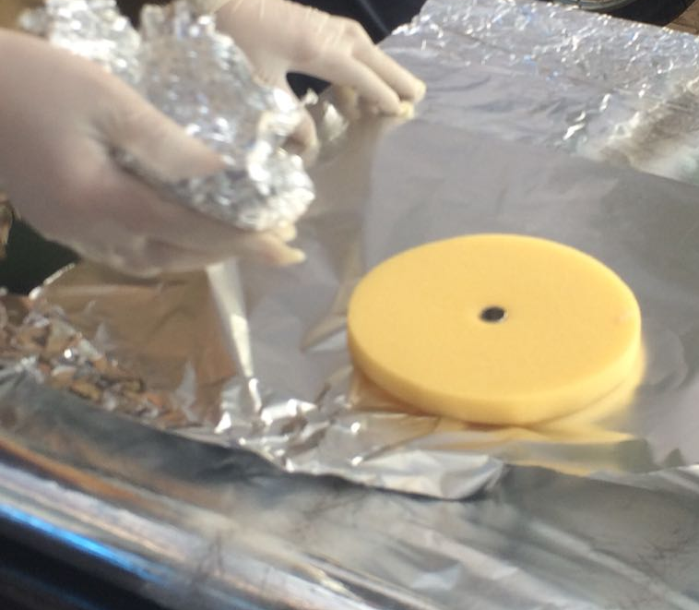
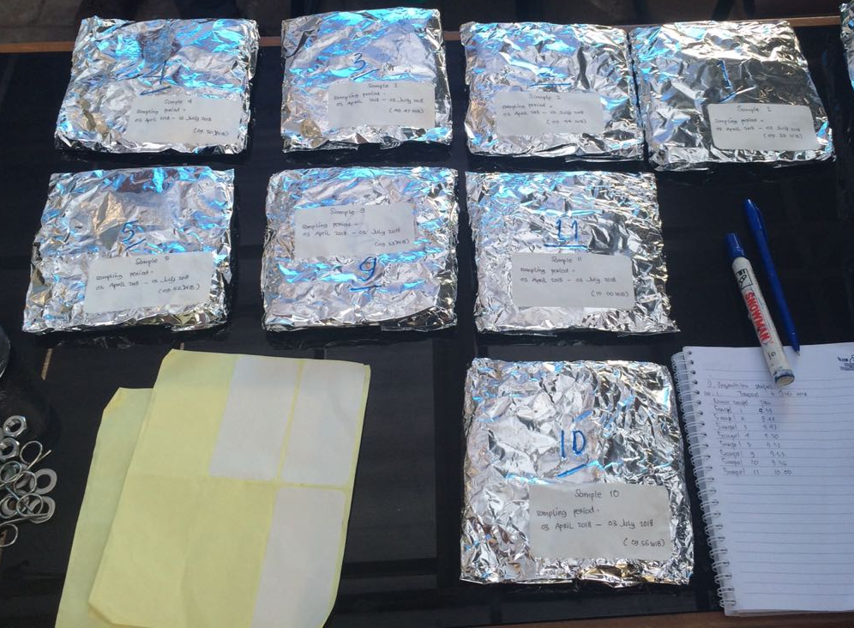
Pictures of Activities on POPs GMP 2
PUF are kept inside refrigerator at Research and Development Center for Environmental Quality and Laboratory, Serpong
Preparation and installation of the PUF sample and the PUF sample collection at IAMCG

Slide 11
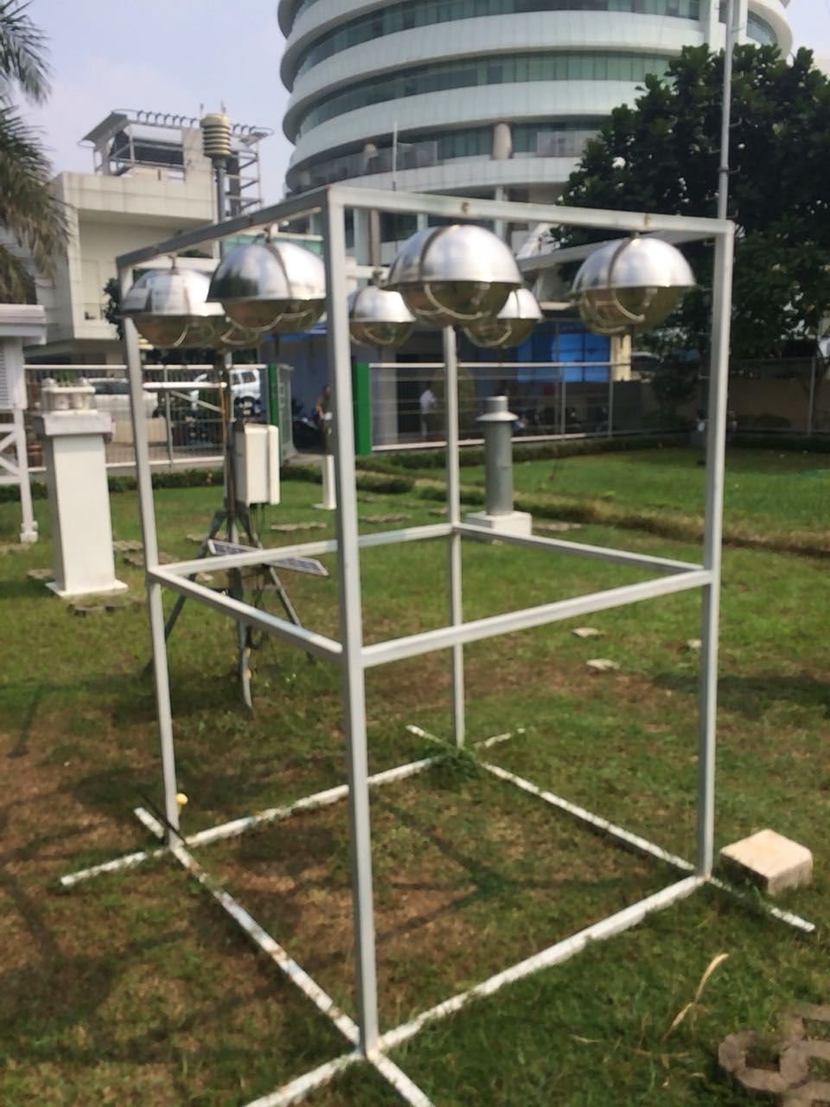
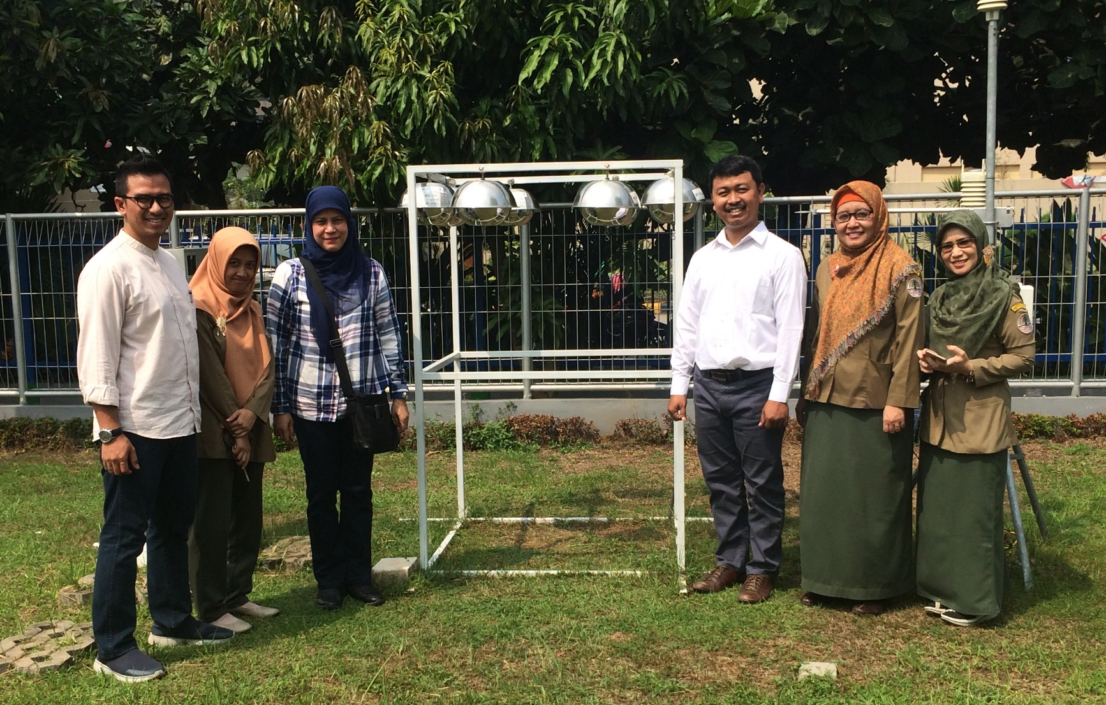
Pictures of Activities on POPs GMP 2
Set of air sampling collection

Slide 12
Plan on National Matrices
Matrices: fish, water, soil and sediment
Step:
  Consult with international expert (August 2018)
  Discuss and plan in national level (Q IV 2018)
  Conduct sampling (Q I-II 2019)
  Analysis
    National laboratory (Q II-III 2019)
    International laboratory (Q II-III 2019)

Slide 13
Concerns
Difficulty with national authority (Ministry of Health) for the human breast milk sample analysis abroad
Large area and high population to collect representative sample for human breast milk (if the project run)
Current capability 13 POPs monitoring at Research and Development Center for Environmental Quality and Laboratory, Serpong, need to increase capacity building (equipment and human resources) to analyze new POPs
Number of sample (national matrices interest soil and sediment) can be sent to be analyzed

Slide 14
Concerns
Samples needed for human breast milk survey
Province | Population |  | Number of sample
 | 2010 | 2015
Sumatera Island | 50,630,931 | 55,272,900 | 55
Jawa Island | 136,610,590 | 145,143,600 | 145
Bali dan Nusa Tenggara Islands | 13,074,796 | 14,108,500 | 14
Kalimantan Island | 13,787,831 | 15,343,000 | 15
Sulawesi Island | 17,371,782 | 18,724,000 | 19
Maluku Islands | 2,571,593 | 2,848,800 | 3
Papua Island | 3,593,803 | 4,020,900 | 4
INDONESIA | 237,641,326 | 255,461,700 | 255

Slide 15
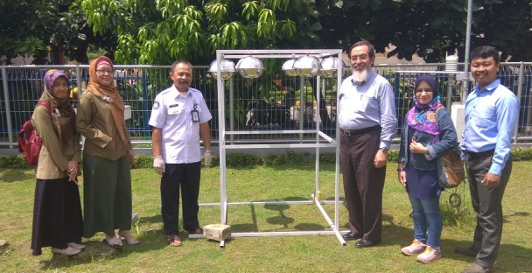
Thank you

