Slide 1
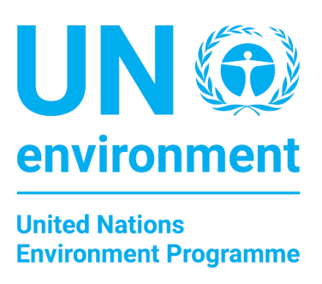

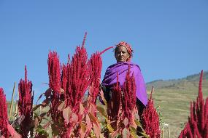

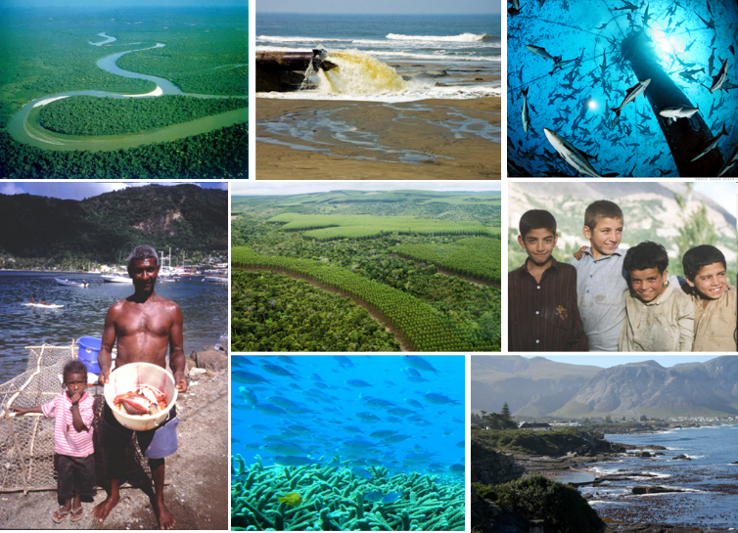
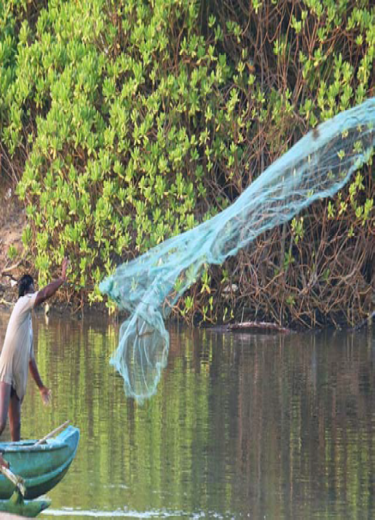
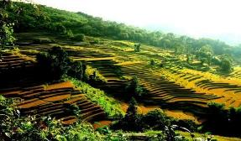
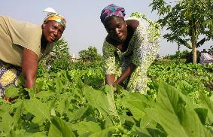
Healthy and Productive
Ecosystems
Programme Performance Report
January- June 2018
Programme of Work 2020-2021

Slide 2

Overview of presentation
Medium Term Strategy 2018-2021
2030 vision aligned to SDGs
Overall strategic direction
Programme of work
2018-2019
First biennial plan -
6 Month Performance
Programme of work
2020-2021
Second biennial plan - revisions design
Notes:
MT Strategy 2018-2021 approved by member states by the second Environment Assembly

Slide 3
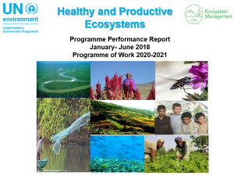
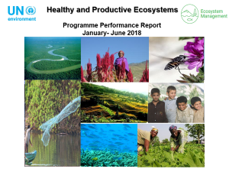
Objectives and Expected accomplishments
Overall objective:
Marine, freshwater and terrestrial ecosystems are increasingly managed through an integrated approach that enables them to maintain and restore biodiversity, long-term ecosystems functioning and the supply of ecosystem goods and services.
a) The health and productivity of marine, freshwater and terrestrial ecosystems are institutionalized in education, monitoring and cross-sector and transboundary collaboration frameworks at the national and international levels
2 Expected Accomplishments
(b) Increase in the number of countries and transboundary collaboration frameworks that demonstrate enhanced knowledge of the value and role of ecosystem services
Notes:
The objective of UN Environment Programme of work of Healthy and productive Ecosystems is to support countries to manage
Marine, freshwater and terrestrial ecosystems through an integrated approach that enables them to maintain and restore biodiversity, the long-term functioning of ecosystems, and the supply of ecosystem services and goods.
And the two Excepted Accomplishments are:
a) The health and productivity of marine, freshwater and terrestrial ecosystems are institutionalized in education, monitoring and cross-sector and transboundary collaboration frameworks at the national and international levels
(b) Increase in the number of countries and transboundary collaboration frameworks that demonstrate enhanced knowledge of the value and role of ecosystem services

Slide 4
Key Changes Since 2015-2017
EA (a)
Increase in the number of countries and transboundary collaboration frameworks that have made progress to monitor and maintain the health and productivity of marine and terrestrial ecosystems;
Increase in the number of countries and transboundary collaboration frameworks that demonstrate enhanced knowledge of the value and role of ecosystem services;
Increase in the number of countries and groups of countries that improve their cross-sector and transboundary collaboration frameworks for marine and terrestrial ecosystem management;
Increase in the number of education institutions that integrate the ecosystem approach in education frameworks
EA(b)
Increase in number of public sector institutions that test and consider the incorporation of the health and productivity of marine and terrestrial ecosystems in economic decision making;
Increase in the number of private sector entities that test and consider inclusion in their business models mechanisms to reduce their ecosystem-related risks and/or negative impacts on marine and terrestrial ecosystems.
Notes:
All six indicators for 2018-2019 are new and direct comparison with the indicators in 2016-2017 Programme of Work cannot be made nor can the 2016-2017 targets be used as baselines.
A key difference between the 2014-2017 Mid-Term Strategy and the MTS 2018-2021 is the alignment with the 2030 Agenda for Sustainable Development (SDGs). At the time of writting the 2018-2021 MTS, we were able to align with goals and targets for the 2030 Agenda but it did not had any specific indicators (proposed to be incorporated in 2020-2021 Programme of Work).

Slide 5
Portfolio Overview
Countries manage marine and terrestrial ecosystems through an integrated approach to maintain and restore their long-term functioning and the supply of ecosystem goods and services
PoW Indicators
Monitor and maintain the health and productivity of ecosystems
Enhanced knowledge of the value and role of ecosystem services
Improvement in collaboration frameworks for ecosystem management
Incorporation of ecosystems in economic decision-making
Private sector reduces ecosystem-related risks and/or impacts
SDG Targets
Integration of ecosystem approach in education frameworks
EA.(a) - Institutionalization of ecosystems in education, monitoring and cross-sector and transboundary collaboration frameworks
EA.(b) - inclusion of ecosystems in economic decision-making
A1 – Landscapes, wildlife and people
A2 – Economics and ecosystems
B1 –Poverty-Environment Action
(hosted by Environmental Governance)
B2- UN Environment Finance Initiative (hosted by Resource Efficiency)
A3 – Integrated marine ecosystem management
A4 – Integrated Land & Water Management
A5 – Education for sustainability (hosted by Healthy and Productive Ecosystems)
A6 – Ecosystems communication and outreach
Notes:
B1 and B2 are hosted in other sub programmes but as these are critical for the delivery of the SP3 indicators and SP3 intends to allocate resources to these projects
Seed funding from core resources to leverage additional donor support

Slide 6
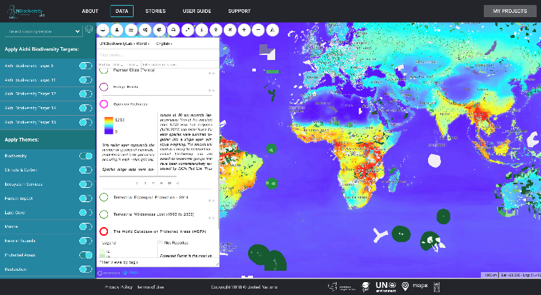
EA.(a) - Institutionalization of ecosystems in education, monitoring and cross-sector and transboundary collaboration frameworks
Monitor and maintain the health and productivity of ecosystems
The UN Biodiversity Lab (http://unbiodiversitylab.org), a new spatial data platform on biodiversity
Notes:
All six indicators for 2018-2019 are new and direct comparison with the indicators in 2016-2017 Programme of Work cannot be made nor can the 2016-2017 targets be used as baselines
The UN Biodiversity Lab is an online spatial data platform developed by UN Environment in collaboration with UNDP, UNEP GRID Geneva and UNEP-WCMC with funding from the Global Environment Facility. The UN Biodiversity Lab allows policymakers and other stakeholders to access global data layers, upload and manipulate their own datasets in a secure platform, and query multiple datasets for information and data related to spatial elements of the Aichi Biodiversity Targets (ABTs) and nature-based Sustainable Development Goals (SDGs). Using more than 80 layers from multiple providers currently data available on UN Biodiversity Lab, policymakers can deliver on their commitments to the Convention on Biological Diversity through better conservation planning and reporting. This first iteration of the Lab supports policymakers to produce data-driven Sixth National Reports to the CBD. The UN Biodiversity Lab can be accessed at https://unbiodiversitylab.org/.

Slide 7
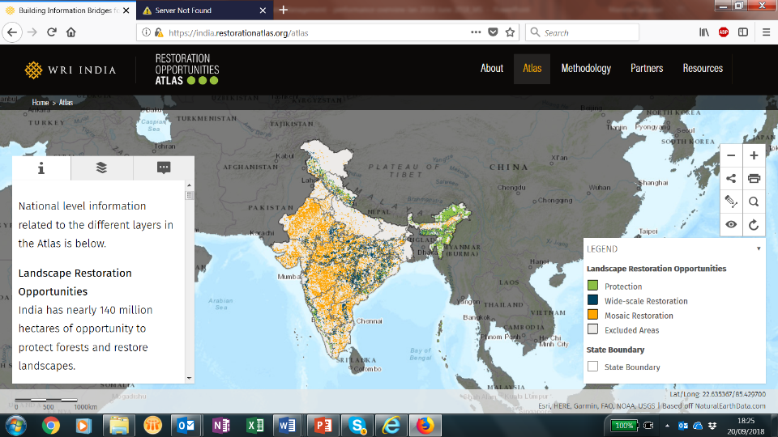
Restoration Monitoring
Monitor and maintain the health and productivity of ecosystems

Slide 8

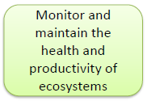
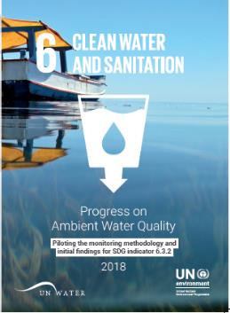
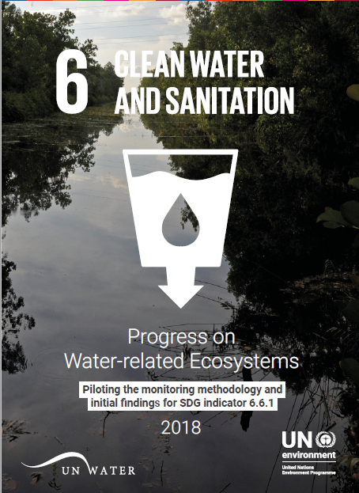
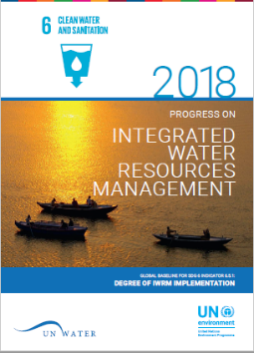
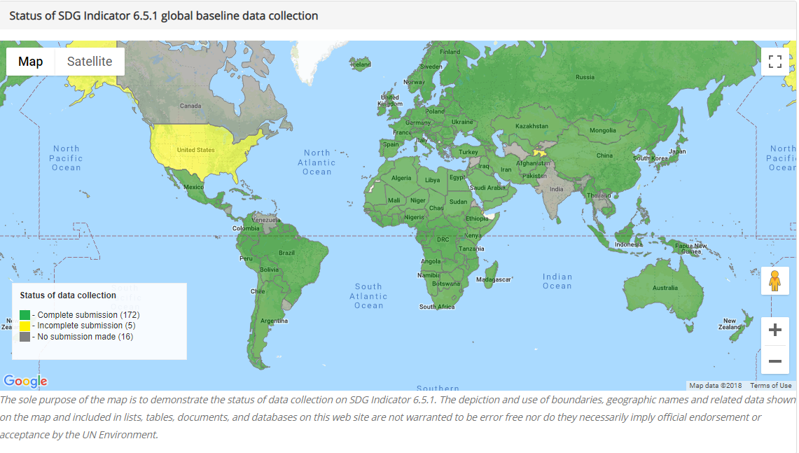
Implement Integrated Monitoring Initiative for water resources management
  Build country capacity to monitor and report SDG 6 water data and take action
IWRM 172 countries data sets
Notes:
UN Environment is the custodian agency for three of the SDG-6 (water) indicators on i) ambient water quality (indicator 6.3.2), ii) integrated water resources management (indicator 6.5.1) and iii) water related ecosystems (indicator 6.6.1). During 2017 UN Environment collected data on these three indicators from Member States and this data was then analyzed and presented during 2018. Three publications were produced (as can be seen in the slide) that detail the progress made for these three indicators.
Data received:
Indicator 6.3.2 (ambient water quality) from 52 countries
Indicator 6.5.1 (IWRM) from 172 countries
Indicator 6.6.1 (water related ecosystems) from 40 countries + data from earth observations for 188 countries

Slide 9

The Economics of Ecosystems and Biodiversity (TEEB) for Agriculture and Food (TEEBAgriFood)
Enhanced knowledge of the value and role of ecosystem services
The TEEB for Agriculture and Food Scientific and Economic Foundations report was launched in Delhi on 4 June 2018:
a) a comprehensive evaluation framework for food systems that helps decision-makers to compare different policies and the market to value food more accurately;
b) Focus on the three main blocks of the food value chain – food production, distribution and consumption.
Notes:
The Economics of Ecosystems and Biodiversity (TEEB) for Agriculture and Food (TEEBAgriFood)
TEEBAgriFood, an initiative of ‘The Economics of Ecosystems and Biodiversity’ (TEEB) by UN Environment. TEEBAgriFood has developed a comprehensive evaluation framework for food systems that helps decision-makers to compare different policies and the market to value food more accurately
It provides a new evaluation framework to capture malign and benign impacts of food production, distribution and consumption to make it sustainable, equitable and healthy
On the occasion of World Food Day, the World Future Council announced the 2018 Future Policy Award winners. The Future Policy Award is the only award which honours policies on an international level. UN Environment (TEEBAgrifood) was among this year’s winners, as recipient of the Vision Award.
received the Innovation award of the 2018 Future Policy Award co-organised by the World Future Council, FAO and IFOAM-Organics International.
On developing the Evaluation Framework
Culmination of work by >100 authors from >30 countries in the launch of the TEEBAgriFood Scientific and Economic Foundations report at part of the World Environment Day events, Delhi, June 2018.
Development of a comprehensive, inclusive Evaluation Framework that includes produced, natural, human and social capital stocks and flows that arise from these stocks
On TEEBAgriFood country work highlights:
In Thailand, the focus is on organics production – a comparison of ecosystem services under non-organic versus organic production, including a focus on the water quality impacts on biodiversity, fisheries productivity, and drinking water treatment costs
In Kenya, the options are two upper Basin areas (Tana Basin and Ewaso Njiro Basin), the Mau catchment area/ Mara River Basin and the drainage basin from Mt Suswa to Lake Magadi.
In Tanzania, study on the Southern Highlands and the optimization of agricultural production in light of planned changes in water availability in the region
In Colombia, focus on the Putumayo Department. This is a particularly diverse department since it includes Amazon lowlands, highland forests, Colombian plateau and several important water basins; it has a high percentage of indigenous population and indigenous reserves (80% of the territory) and the specific sector in which to focus will need to be consulted with the indigenous governance structures in the coming months

Slide 10
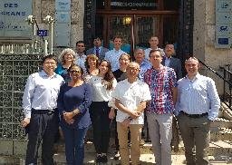
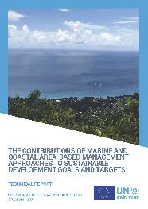
Marine and Coastal Ecosystem
Services
Improvement in collaboration frameworks for ecosystem management
2. Progress of reviewing global and regional governance and policy frameworks on coral reefs;
3. Regional Ocean Governance including
Marine Protected Areas – strengthening the
Regional Seas Programme and enhancing
collaboration with regional stakeholders,
e.g. Fisheries bodies, Large Marine Ecosystems;
4. Technical report, “The contributions of marine and coastal area-based management approaches to sustainable development goals and targets”;
5. Promote sustainable usage of marine resources Sustainable Blue Economy approach
6. Ocean strategy being developed – consultation across UN Environment, Member States and UN Agencies
Network of scientists and experts on seagrass beds launched with a task to
make a global assessment of functions and values of seagrass ecosystem services;
Notes:
1. 2018 is the International Year of the Reef. UN Environment is working with partners to step up global communication on coral reefs. A global campaign will be developed, for implementation over the coming years, and aiming to leverage improved protection for and investment in coral reefs.
‘Blue Economy’ is a relatively recent term framing the intent to deliver sustainable benefits from ocean, coastal and marine economic activity.
UN Environment launched a network of scientists and experts on seagrass beds where the fist task has been identified to make a global assessment of functions and values of seagrass ecosystem services.
2. In response to UN Environment Assembly Resolution 2/12, UN Environment, through a advisory group, initiated a process of reviewing global and regional governance and policy frameworks on coral reefs.
3. Within a joint project with the European Commission, UN Environment published a technical report, “THE CONTRIBUTIONS OF MARINE AND COASTAL AREA-BASED MANAGEMENT APPROACHES TO SUSTAINABLE DEVELOPMENT GOALS AND TARGETS” (https://www.unep-wcmc.org/news/area-based-management-approaches-contribute-to-sdg-delivery). This is also contribution to the ongoing discussion on Other Effective Area-based Conservation Measures at the Convention on Biological Diversity.

Slide 11
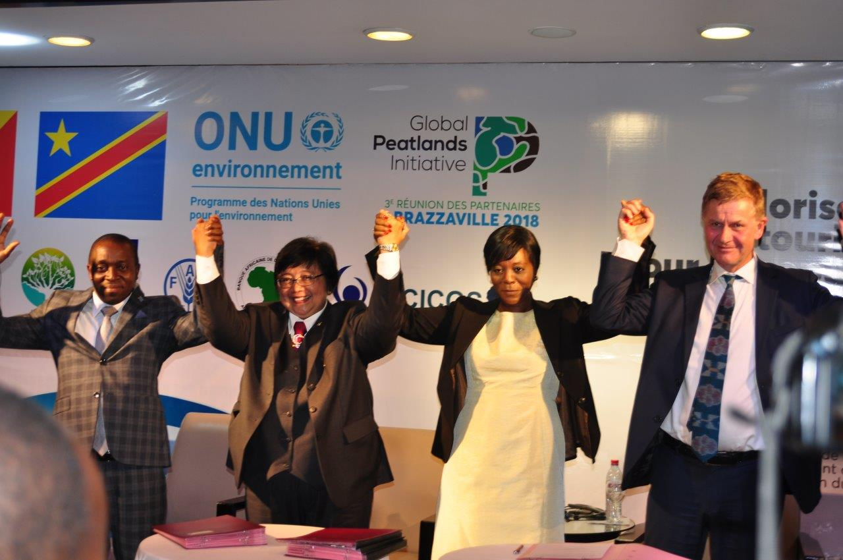

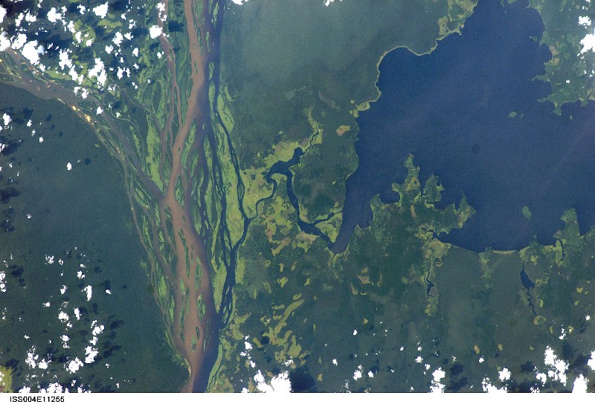
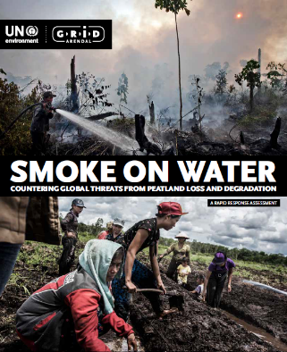
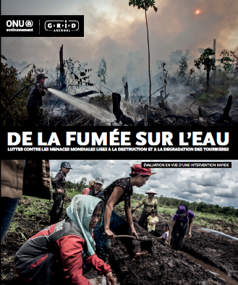
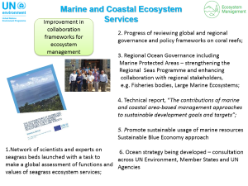
Terrestrial Ecosystems Management
Improvement in collaboration frameworks for ecosystem management
Brazzaville Declaration signed by Democratic Republic of the Congo, Republic of the Congo and Indonesia to Protect world’s largest tropical peatland http://www.globalpeatlands.org/
Notes:
The Global Peatlands Initiative is a new global initiative led by UN Environment to save peatlands as the world's largest terrestrial organic carbon stock.
Peatlands are found in over 180 countries and occur in both the tropics and in temperate zones – and while they cover only three percent of the global land surface area, they are estimated to store over 500 billion tonnes of carbon– equal to the carbon that is contained in all terrestrial biomass and twice as much as in all the world’s forest biomass.
However, being poorly understood, peatlands across the globe are under threat from drainage and burning for agricultural, forestry, infrastructure and other related development uses. The Global Peatland Initiative partners are trying to counter and avoid these threats and save peatlands globally - as the world’s largest terrestrial organic carbon stock.
Peatlands Matter for the climate. Peatlands matter for people. Peatlands Mater for the planet.
And you must have heard that recently that Peatlands Matter for the Congos - home to the world’s largest tropical Peatland– the Cuvette Centrale.
Recently at the 3rd Meeting of the partners of the Global Peatlands Initiative, Ministers of the Republic of the Congo, the Democratic Republic of the Congo and Indonesia signed the Brazzaville Declaration – an historic agreement to protect the world’s largest tropical peatland which contains 30 gigatons of carbon – equivalent to the amount of carbon the United States economy emits over 15-20 years.
Photo credits:
Signing of the Brazzaville Declaration on Peatlands – Hans Joosten
A view of the Cuvette Centrale Peatlands from the International Space Station - courtesy of NASA and kindly shared by Roberta Bondar, the first Canadian Woman Astronaut.

Slide 12
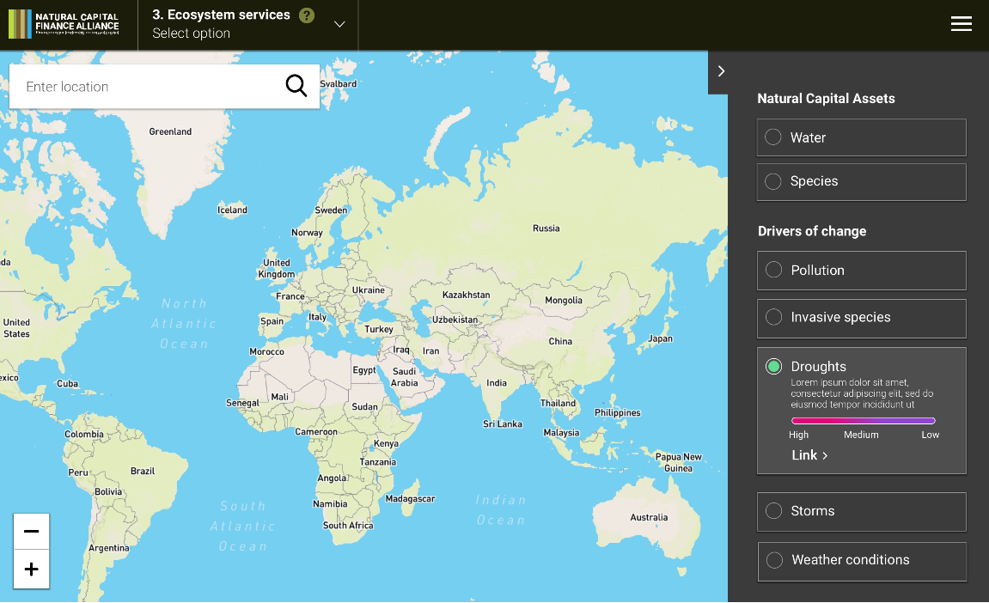





EA.(b) - Inclusion of ecosystems in economic decision-making
Incorporation of ecosystems in economic decision-making
Private sector reduces ecosystem-related risks and/or impacts
Natural Capital Risk Explorer: Online tool linking nature to economy will be launched November 26;
- Enables financial institutions to link drivers
of change in nature to ecosystem service
provision by economic sector thereby
supporting risk analysis;
Framework for corporate credit analysis using the online tool will be launched in January 2019;
Land use finance programme: Private sector engagement as to enhance public-private partnership
&Green Fund
Norway, IDH, GEF/UN Environment
Notes:
Completed natural capital risk knowledgebase connecting nature to economy. Database links divers of environmental change to environmental assets and services connected to economic subsectors. At each link a materiality assessment and description is provided;
Progressed development of online tool to access natural capital risk knowledgebase to enable analysis and support private sector decision making;
Progressed development of application of natural capital risk framework to commercial bank portfolios and clients. Piloting framework in five banks in Colombia, South Africa and Peru;
Progressed development of business cases for deforestation-free commodities in various countries.
Removing regulatory, economic & financial barriers that help unlock and (re)direct public and private capital to sustainable land use together with corporate partners & member states-Commercial & development banks; Robobank, BNP Paribas

Slide 13
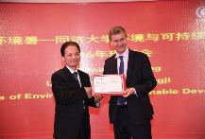


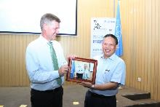
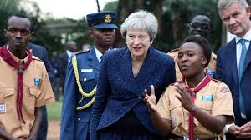
Education for Sustainability
Ecosystem approach integrated in education frameworks
A new 2 year strategy for education agreed;
New youth partnership with Scout and Guide movements to deliver a Plastic Challenge Programme in Africa announced;
10 Universities agree to join the Global University Partnership for Education and Sustainability;
5 new courses on environmental issues shared with partners.
Notes:
Plans for 2020 – 2021
New programme focussing on “youth leadership” in place.
Current programme with 820 global Universities scaled up and deepened with a focus on “green collar jobs”.
Partners with mass-reach (eg scouts, gaming sector, faith) supporting environmental messaging to their community.
One UN approach with partnerships with UNU, UNESCO, UNITAR and UNICEF extended, together with UN Youth Envoy.

Slide 14

Funding 2018-2019
Notes:
The Ecosystems Sub-programme receives the smallest percentage of core resources and is to 93% dependant on extra-budgetary resources. This presents some problems in programme planning. We have a good pipeline of projects but major concerns on the Global Environment Facility (many IA, high competition, 30% rule). This element of high dependency on extra-budgetary funds also guides the allocation of UN Environment Programme core resources. We, for example use core resources to foster partnerships that can deliver wider results and we invest staff time and core activity funds in shaping the extra-budgetary income and building up new work streams for example landscape finance.
As in previous years we see a higher than budgeted availability of resources for Trust Funds, Ear-marked contributions and GEF as these are multi year income

Slide 15
Challenges and Opportunities
Expected increase in finance from Global Environment Facility 7
Engagement with high level fora: CBD COP 14 and UNCCD COP 14
Alignment with post-2020 global biodiversity framework
Notes:
Main financial projections are presented under the budget presentation but we anticipate to continue our dependency on extra-budgetary resources with a shift from Global Environment Facility.

Slide 16


Questions & Discussion
Programme Lead Director
Ms. Monika McDavette
Ecosystems Division
UN Environment Programme Nairobi
Office Tel: +254 – 2076 24782
monika.macdevette@un.org
Programme Coordinator
Mr. Marieta Sakalian
Ecosystems Division
UN Environment Programme Nairobi
Office Tel: +254 – 2076 24294
Marieta.Sakalian@un.org

Slide 17


Healthy and Productive
Ecosystems
Programme Performance Report
January- June 2018
Programme of Work 2020-2021

Slide 18
Programme of Work
2020-2021
Medium Term Strategy 2018-2021
Programme of work
2018-2019
Programme of work
2020-2021

Slide 19





Theory of Change
Healthy ecosystems provide a secure supply of ecosystem goods and services
for human well-being
SDGs provide an opportunity to update educational frameworks
Increasing transparency around externalities
Integrated ecosystem management
Private and public economic decision-making support healthy and productive ecosystems
Countries are willing to invest in integrated approaches
Integrated delivery of SDGs
Knowledge drives behaviour
The health and productivity of marine, freshwater and terrestrial ecosystems are institutionalized in education, monitoring and cross-sectoral and transboundary collaboration frameworks at national and international level
Policymakers in the public and the private sector test the inclusion of the health and productivity of ecosystems in economic decision-making
Increasing considerations of sustainability in investment decisions
Increasing focus on resource availability
Guidance and technical support on effective conservation monitoring and implementation
Guidance and technical support to establish cross-sectoral institutional frameworks and agreements for ecosystem management
Technical assistance and partnerships to include the ecosystem approach in higher education
Support to countries and private sector entities which pilot the inclusion of healthy and productive ecosystems in economic decision-making
Technical assistance to conduct valuation, accounting and monitoring of ecosystem goods and services
Guidance and technical support to third party entities to conduct and deliver valuation and accounting of ecosystem services
Guidance and technical support to natural resource sustainability evaluations
Sectoral advocacy and support for integrated ecosystem management
Promotion of innovative tools and technologies for system thinking in relation to ecosystems
Development and dissemination of tools and methodologies to incorporate healthy and productive ecosystems in economic decision-making
Support to global efforts to standardize valuation, accounting and monitoring approaches for ecosystem goods and services
Development and dissemination of tools and methodologies for integrated ecosystem management
Support to partnerships advancing the inclusion of healthy and productive ecosystems in sectoral decision-making
Awareness-raising of the role of economic decision-making in achieving healthy and productive ecosystems
Key
Development outcome
Immediate outcome
Drivers
= Linkages
2030 Impact
Outputs
Assumption
Note: Key deliverables in the theory of change are related to either a single output or a group of outputs
Notes:
At the time of writting the 2018-2021 MTS, we were able to align with goals and targets for the 2030 Agenda but it did not had any specific indicators (proposed to be incorporated in 2020-2021 Programme of Work).
The objective of UN Environment Programme of work of Healthy and productive Ecosystems is to support countries to manage
Marine, freshwater and terrestrial ecosystems through an integrated approach that enables them to maintain and restore the long-term functioning of biodiversity ecosystems, and the supply of ecosystem services and goods.
And the two Excepted Accomplishments are:
a) The health and productivity of marine, freshwater and terrestrial ecosystems are institutionalized in education, monitoring and cross-sector and transboundary collaboration frameworks at the national and international levels
(b) Increase in the number of countries and transboundary collaboration frameworks that demonstrate enhanced knowledge of the value and role of ecosystem services
The sub-programme will drive change both over the short term and the long term. In the short term, the sub-programme will strengthen partnerships and support countries to better monitor and account for biodiversity and the health and productivity of ecosystems, thus guiding better public and private decision-making. The sub-programme will continue to work with sectoral partners to put in place cross‑sector ecosystem management frameworks. It will also support agreements and use science-based and traditional knowledge products
In order to foster long-term change and move considerations for healthy and productive ecosystems from the periphery to the center of the economy, the sub-programme will work with development banks and the finance sector, among other partners, to raise awareness of how the ecosystem approach can be firmly included in public and private economic decision-making.

Slide 20
2020-2021 Programme of Work
Clear alignment to Sustainable Development Goal Indicators at both impact and expected accomplishment level - Impact & process level
Rationalization of some indicators under expected accomplishment b;
Some changes in “Unit of measure” and “data source;
Baseline defined and targets updated;
Alignment with UNEA resolutions;
Focus areas: Terrestrial, Marine, Arctic and Antarctic ecosystems
Strategy updated to make it the development of the post-2020 global biodiversity framework and preparations for its subsequent implementation
Notes:
Inclusion of SDG indicators. We are not accountable and we report as data is available but not planning a paralel data collection excercise.
Maintains 7 indicators with few and small changes to wording of Unit of measures and data sources and analysis plans.
The Ecosystems programme of work is designed to support the delivery Agenda 2030 and the Sustainable Development Goals (SDGs) and is in alignment with the MEAs – more specifically the CBD and its protocols and the UNCCD:
- Climate resilience: SDG 1.5, 2.4, 13
- Low emissions: SDG 7.2, 7.3, 9, 13
- REDD+: SDG 6.6, 13.2, 15

Slide 21
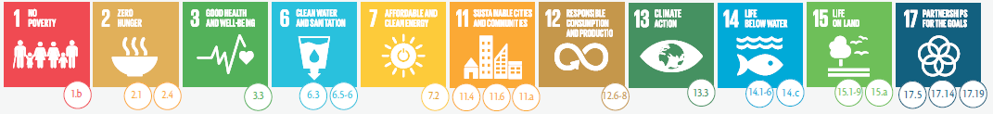









Alignment with SDGs
Countries manage marine and terrestrial ecosystems through an integrated approach to maintain and restore their long-term functioning and the supply of ecosystem goods and services
12. 7. Implementing sustainable public procurement policies
EA.(a) - Institutionalization of ecosystems in education, monitoring and cross-sector and transboundary collaboration frameworks
EA.(b) - Private and public economic decision-making support healthy and productive ecosystems
Notes:
The SP3 will support the achievement of the Agenda 2030 through

Slide 22

UN Environment Assembly Resolutions
UNEA 1/3 - Illegal trade in wildlife
UNEA 1/9 - Global Environment Monitoring System/Water Programme (GEMS/Water)
UNEA 2/3 - Investing in human capacity for sustainable development through environmental education and training
UNEA 2/4 - Role, functions and modalities for UN Environment Programme implementation of the SAMOA Pathway as a means of facilitating achievement of the Sustainable Development Goals
UNEA 2/10 – Oceans and Seas
UNEA 2/12 - Sustainable coral reefs management
UNEA 2/13 Sustainable management of natural capital for sustainable development and poverty eradication
UNEA 2/14 - Illegal trade in wildlife and wildlife products
UNEA 2/24 - Combating desertification, land degradation and drought and promoting sustainable pastoralism and rangelands

Slide 23
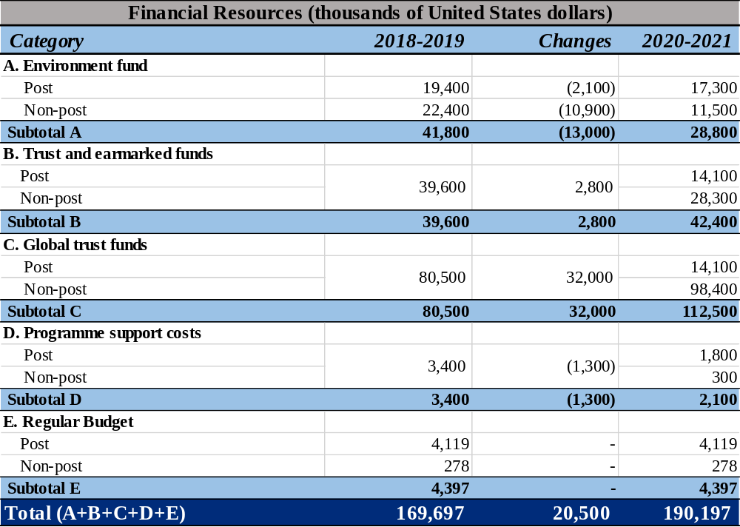
HEALTHY & PRODUCTIVES ECOSYSTEM

Slide 24
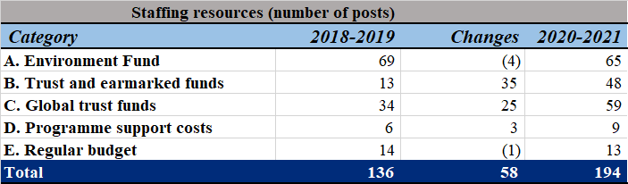
HEALTHY & PRODUCTIVES ECOSYSTEM: STAFFING

Slide 25
Questions & Discussion
Programme Lead Director
Ms. Monika McDavette
Ecosystems Division
UN Environment Programme Nairobi
Office Tel: +254 – 2076 24782
monika.macdevette@un.org
Programme Coordinator
Mr. Marieta Sakalian
Ecosystems Division
UN Environment Programme Nairobi
Office Tel: +254 – 2076 24294
Marieta.Sakalian@un.org

