Slide 1

Environment Live Data and Services to GEO Assessment
Training Session and Orientation Session GEO Frascati Meeting, 20th – 24th February 2017
Science Division
16th of February 2017

Slide 2
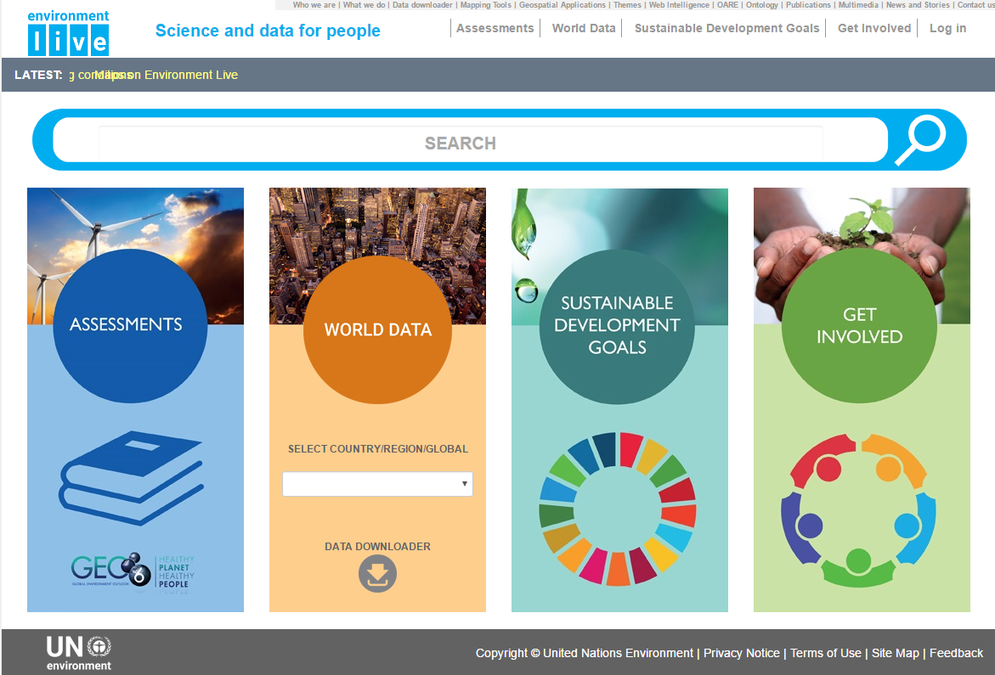
Environment Live Data and Services to GEO Assessment
20th – 24th February 2017

Slide 3
Environment Live and GEO Assessment
Environment Live: Access to Science Data, Information and Indicators
Environment Live: Assessments Workspace
Communities of Practice: Storing and Managing Working Chapters
Service Support: Permanent Technical Support from Headquarters

Slide 4
Environment Live and GEO Assessment
Environment Live: Access to Science Data, Information and Indicators
Environment Live: Assessments Workspace
Communities of Practice: Storing and Managing Working Chapters
Service Support: Permanent Technical Support from Headquarters

Slide 5
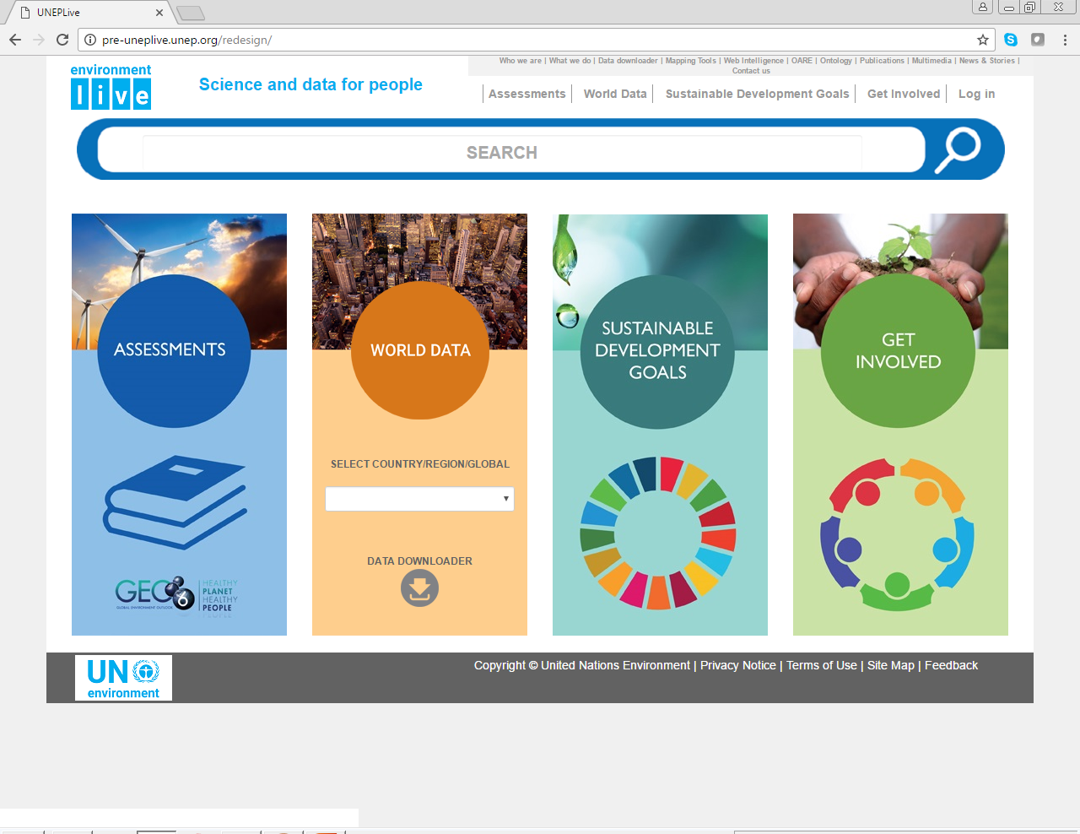
Renewed Environment Live

Slide 6
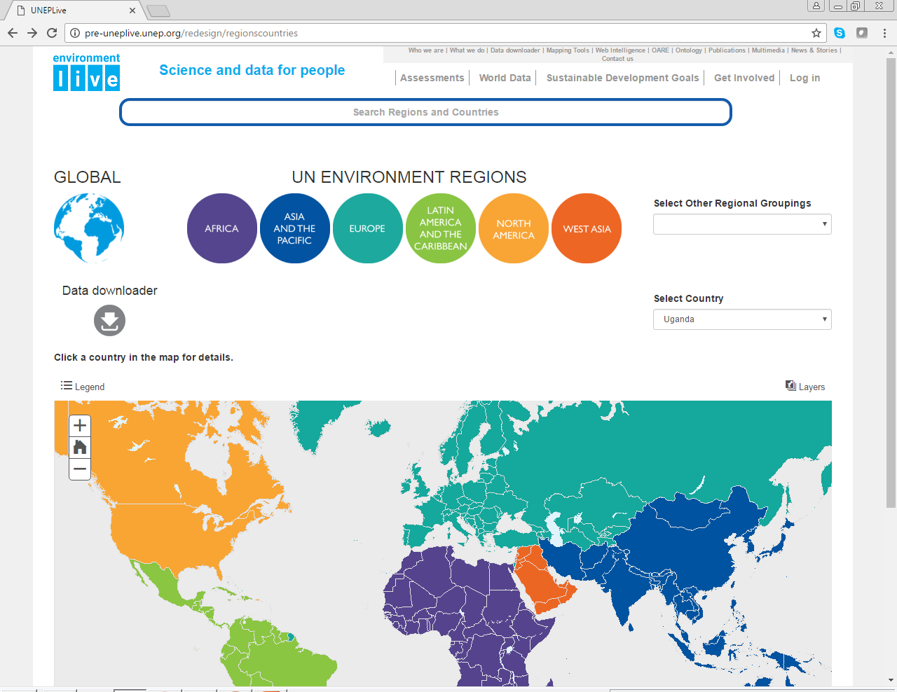
World Data – Regions and Countries

Slide 7
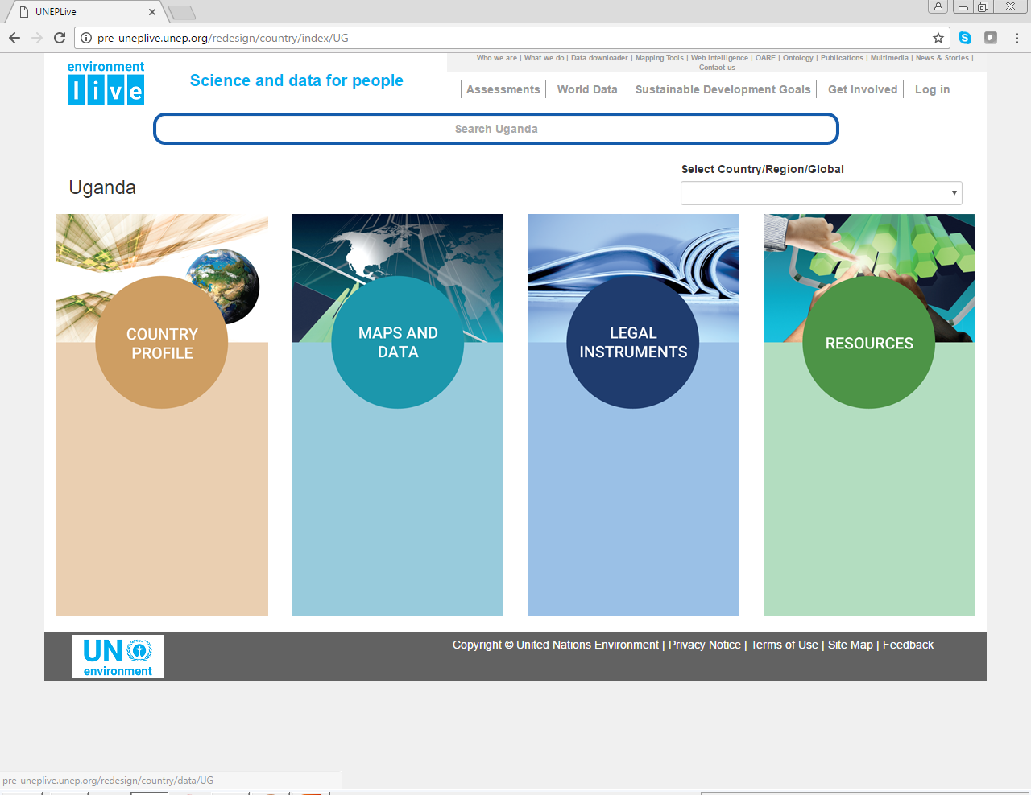
Country Maps and Data Uganda

Slide 8
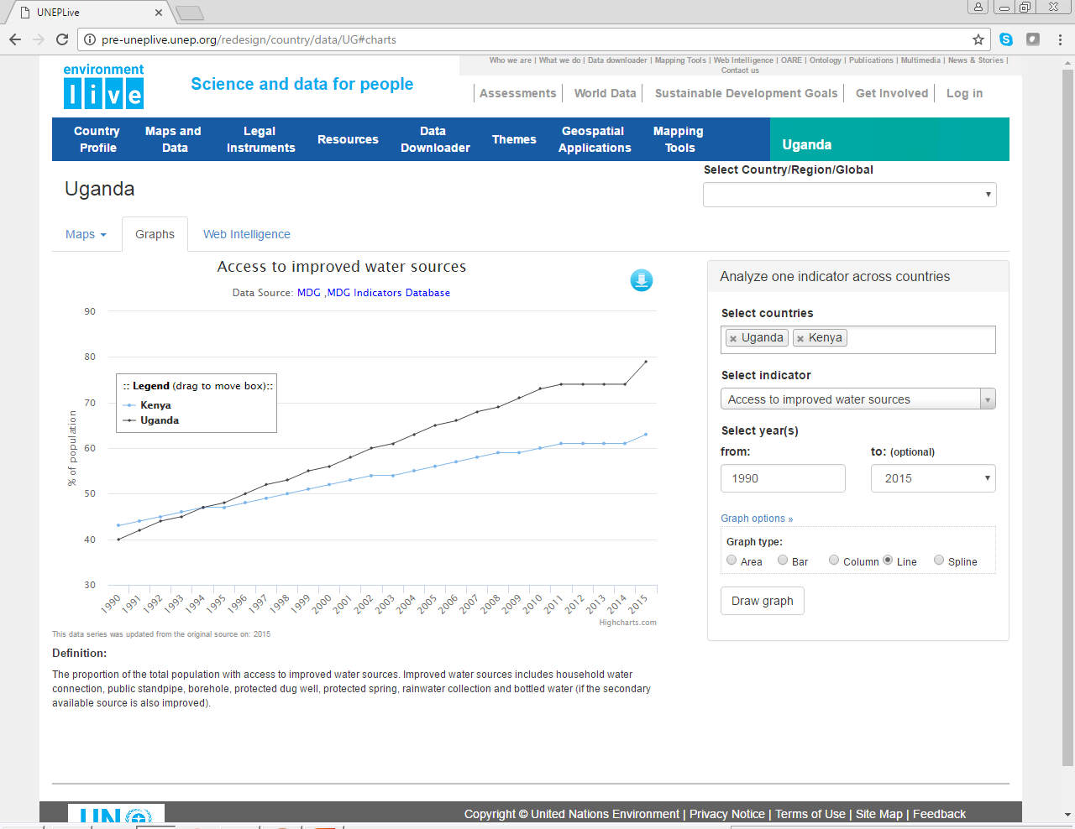
Access to Water Sources – Uganda - Kenya

Slide 9
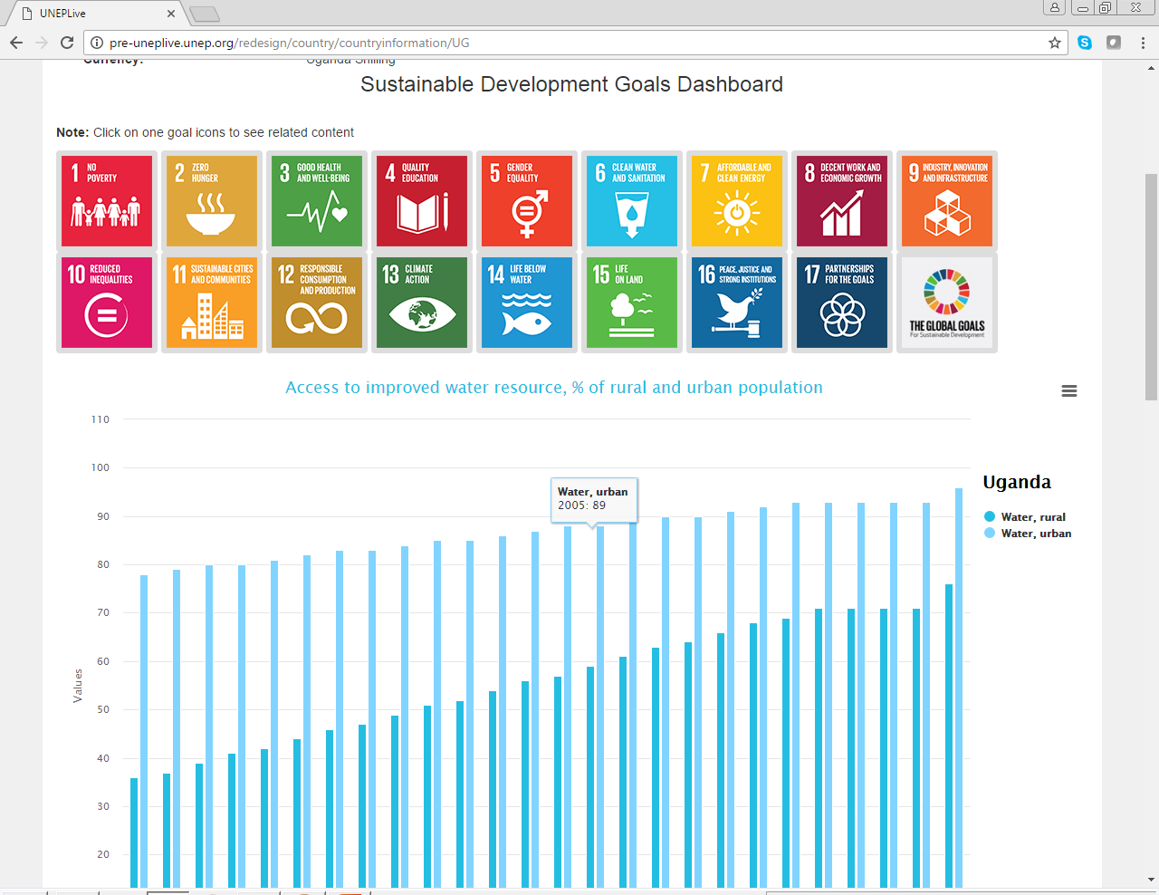
Sustainable Development data – 6 - Water

Slide 10
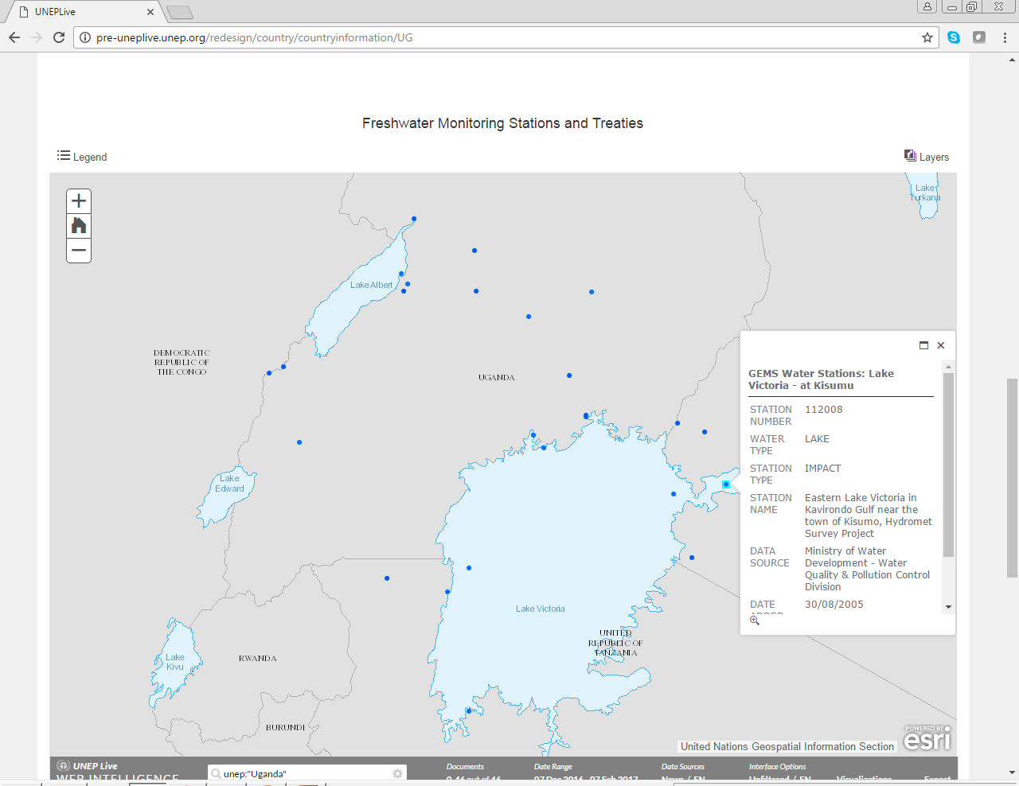
Maps – Monitoring Stations - Uganda

Slide 11
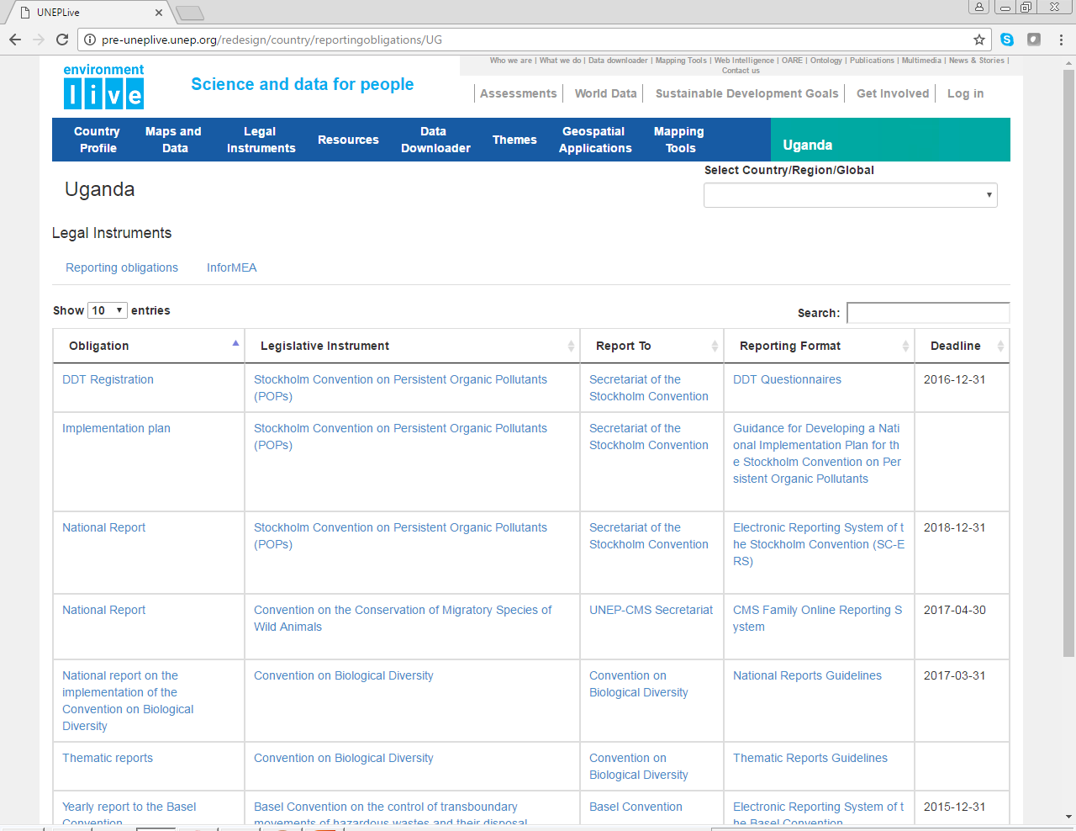
Legal Instruments – Reporting Obligations

Slide 12
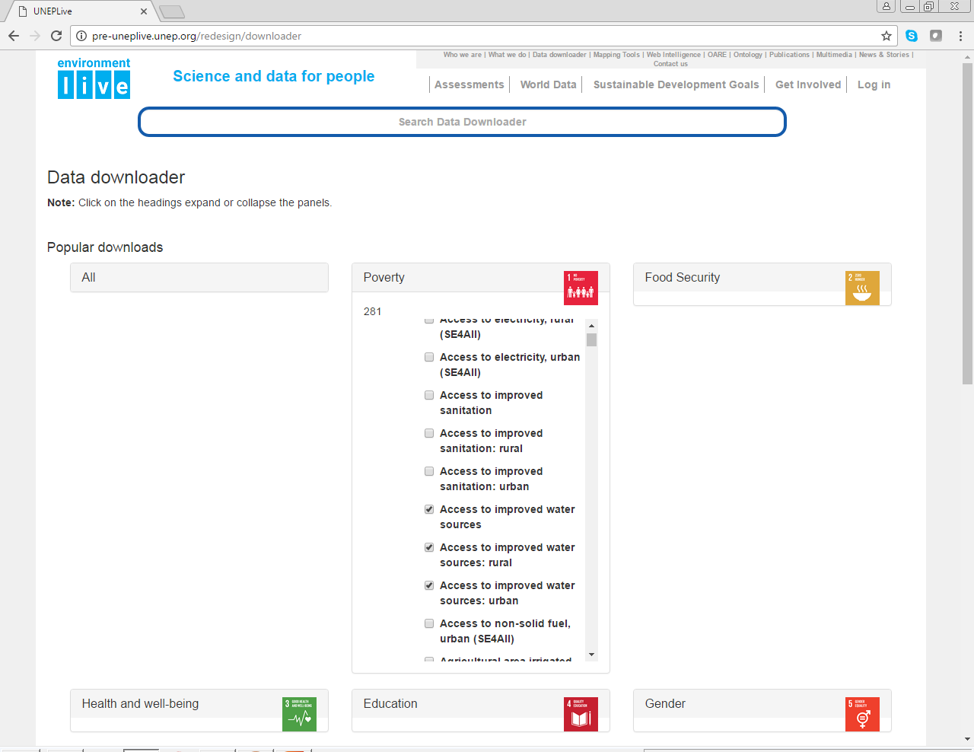
Data Indicators Downloader – Access Water

Slide 13
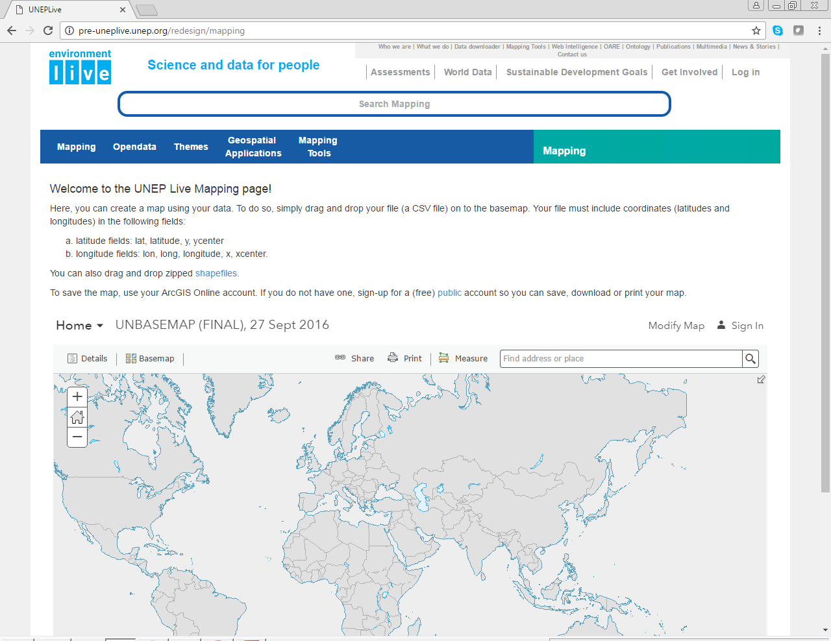
Mapping Tools - Indicators

Slide 14
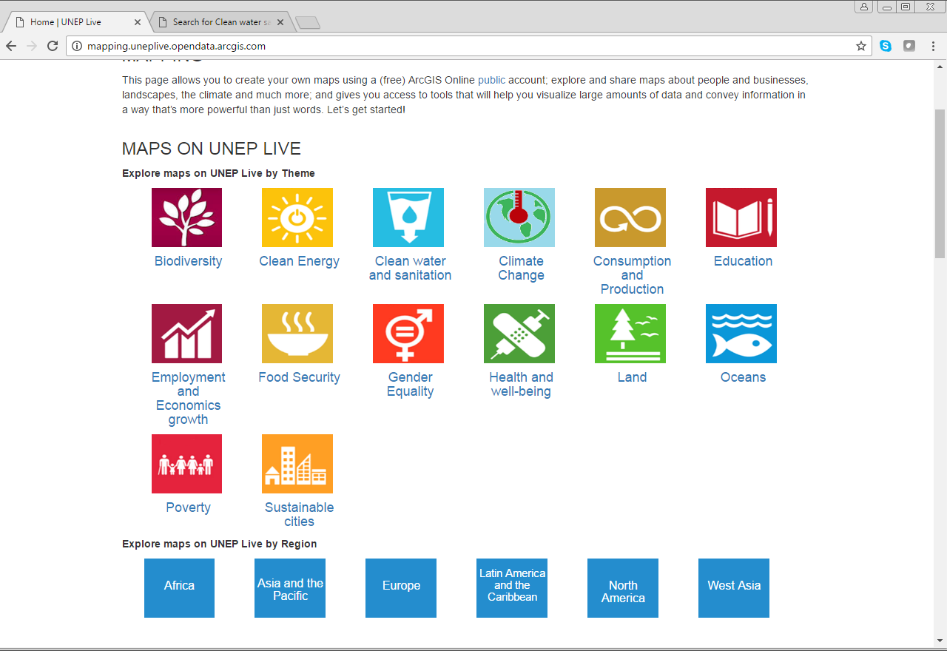
Open data – Maps Clean Water

Slide 15
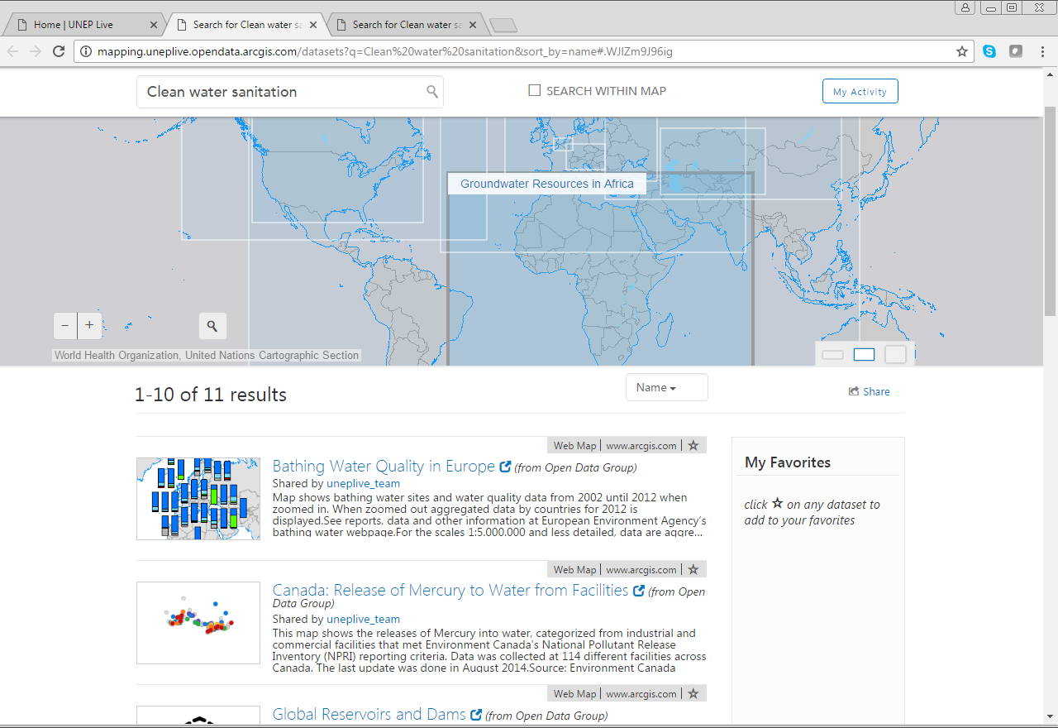
Ground Water Resources in Africa

Slide 16
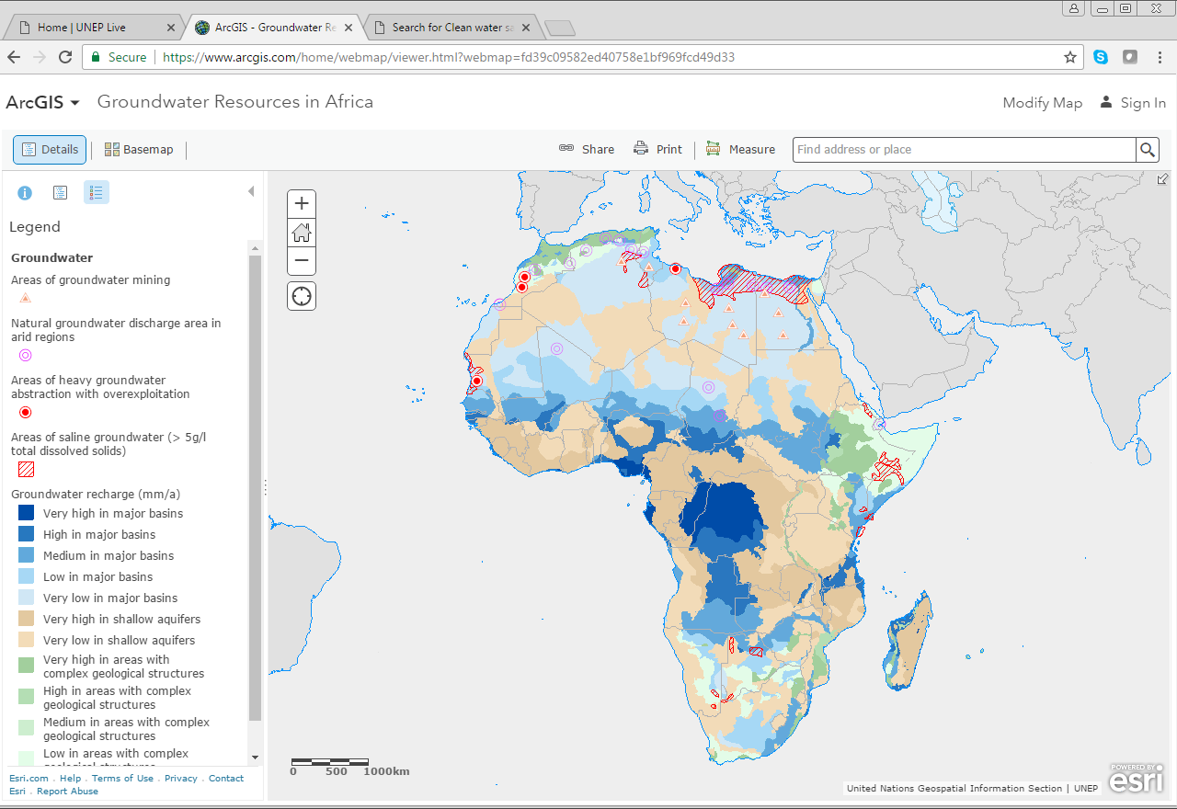
Map Water Resources in Africa – for Assessments

Slide 17
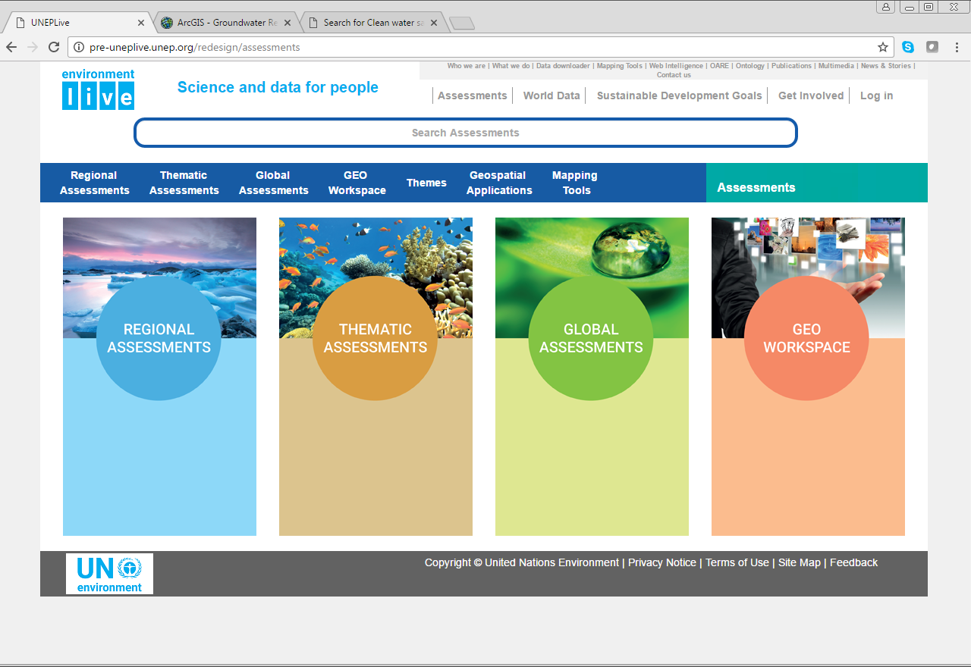
Science and data on Assessments

Slide 18
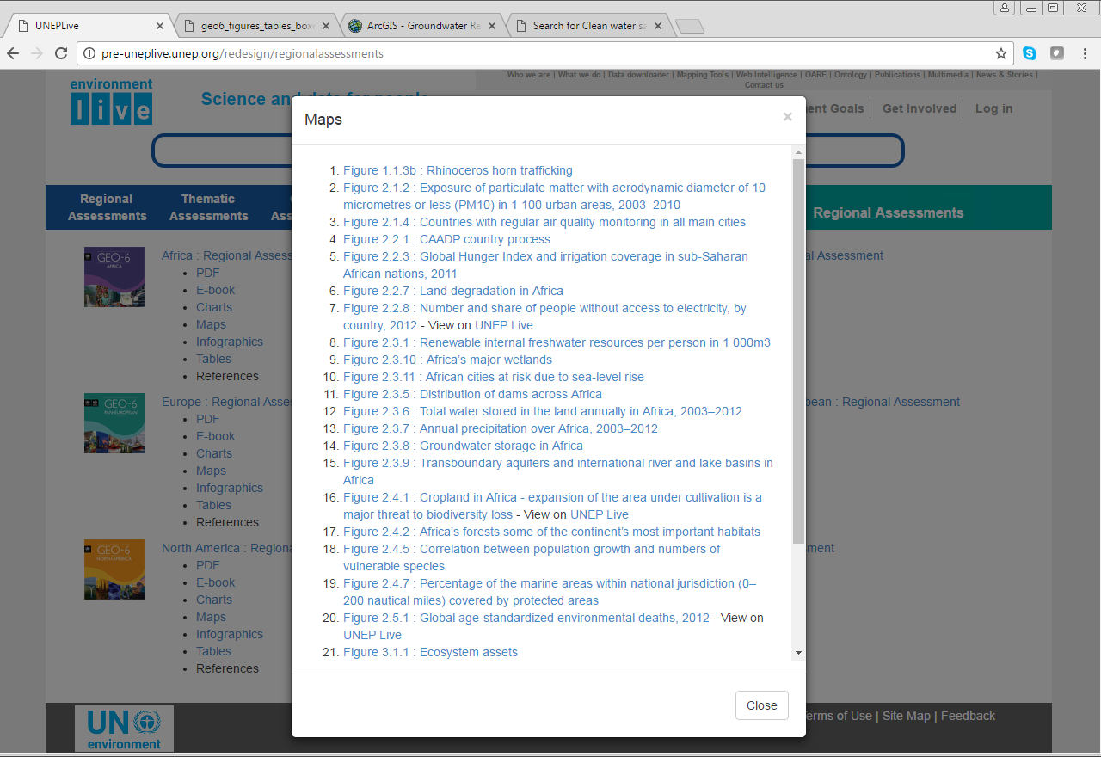
Maps on Regional Assessments Africa – Ground Water

Slide 19
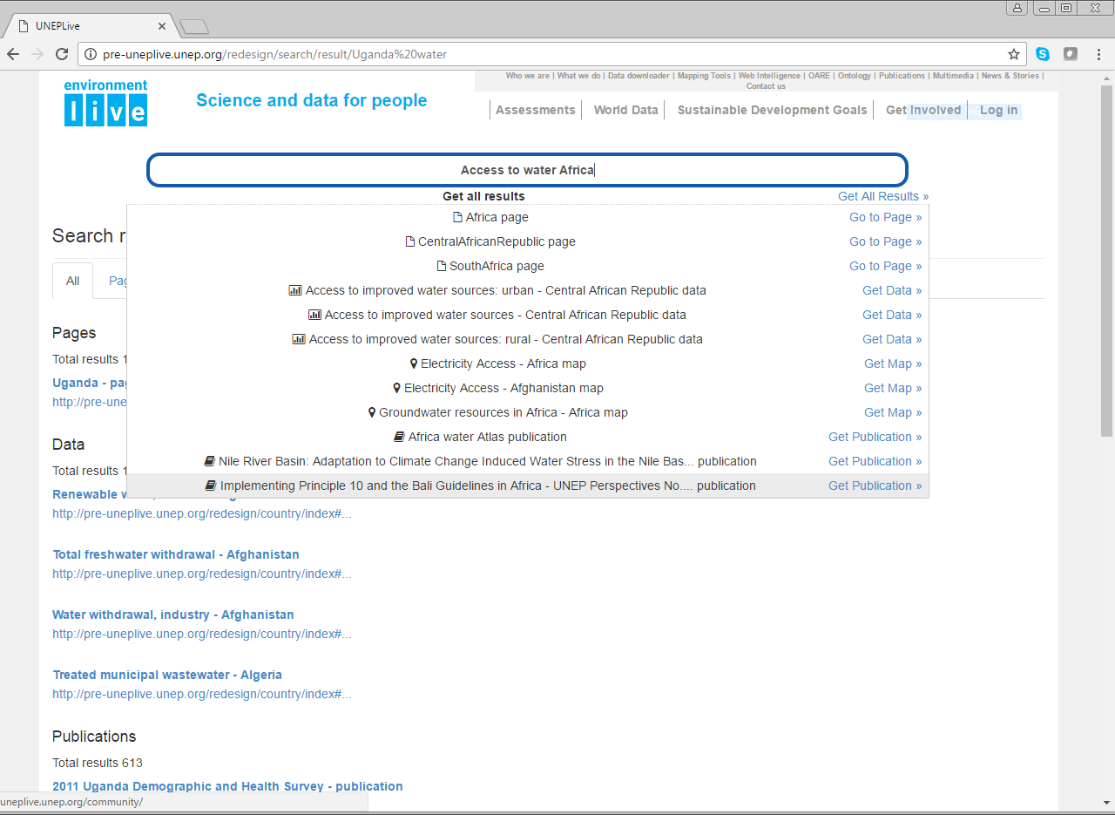
Powerful Search Data – Access to water Africa

Slide 20
Environment Live Global database
BACKGROUND
The UNEP Live Global database is an SQL based database which underlies all data available for download UNEP Live
Aims to provide a database which can be used for environmental assessment, including:
  GEO
  UN Environment SDG reporting
SCOPE
Currently includes more than 900 indicators from more 30 source organizations (UN Environment is only one source of data for the database)
Can be downloaded in bulk through the data downloader
Aggregations are automatically calculated using the methodology referenced in the metadata
Data is placed into SDG themes to improve the discoverability of the data

Slide 21
Environment Live Global database
CRITERIA
Data is either from a UN agencies or other international data sources which meets certain reputational criteria
Only includes indicators which have been updated in the last 5 years
Only includes data with a time series of at least 3 time points
Only includes sources for which metadata and methods are fully publically available
TWO-WAY COMMUNICATION
In addition to using the current data in the GEO, we aim to use the GEO process to improve the scope of the database
We look forward to collaboration with you in terms of how we can include additional indicators and sources that are relevant for environmental assessment.

Slide 22
Environment Live and GEO Assessment
Environment Live: Access to Science Data, Information and Indicators
Environment Live: Assessments Workspace
Communities of Practice: Storing and Managing Working Chapters
Service Support: Permanent Technical Support from Headquarters

Slide 23
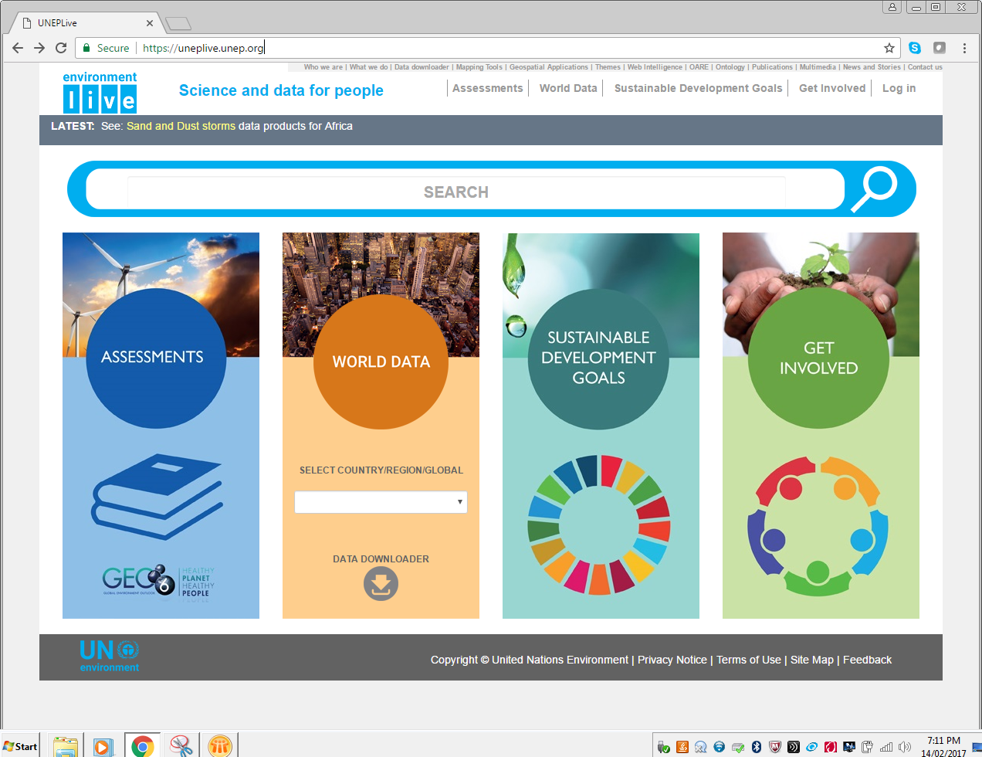
Assessments Landing Page – From Homepage

Slide 24
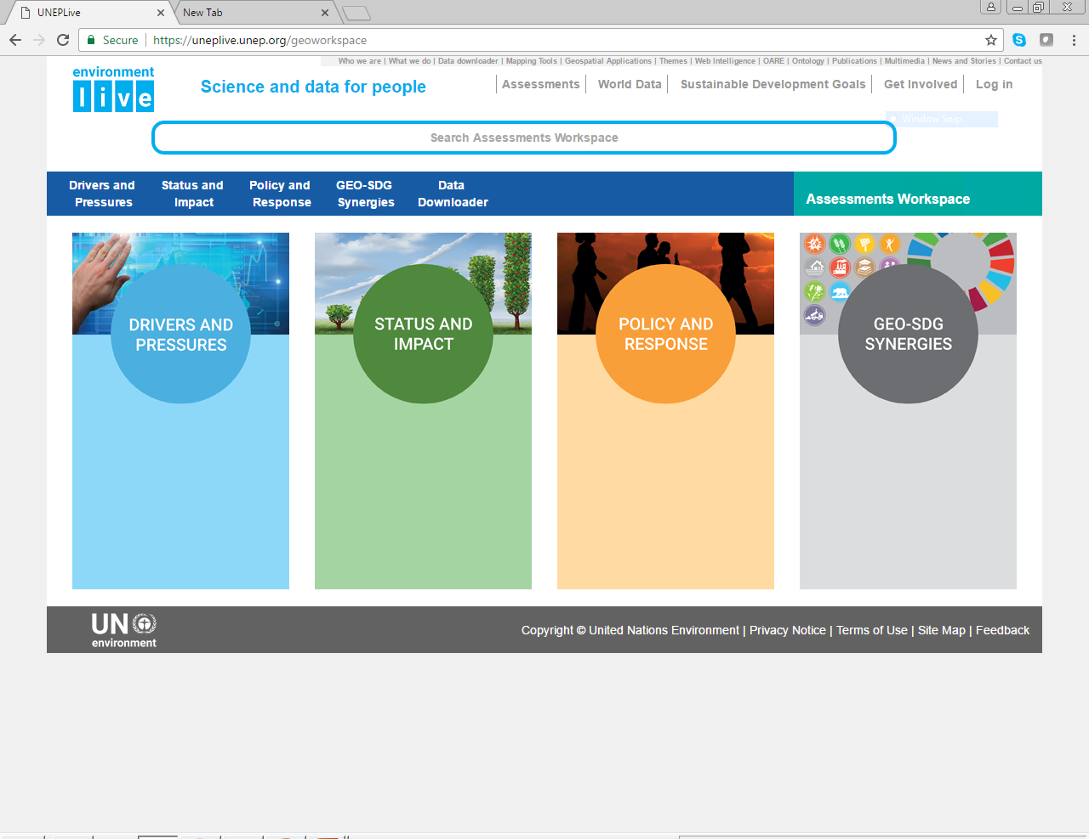
Assessments Workspace – A Place for Geo Authors

Slide 25
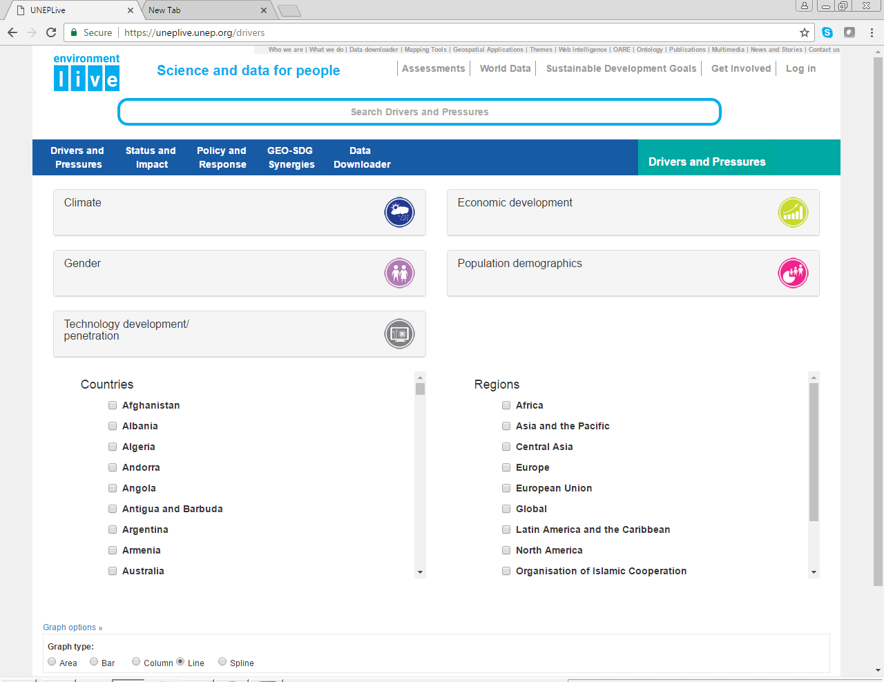
  Drivers and Pressures – Download Indicators

Slide 26
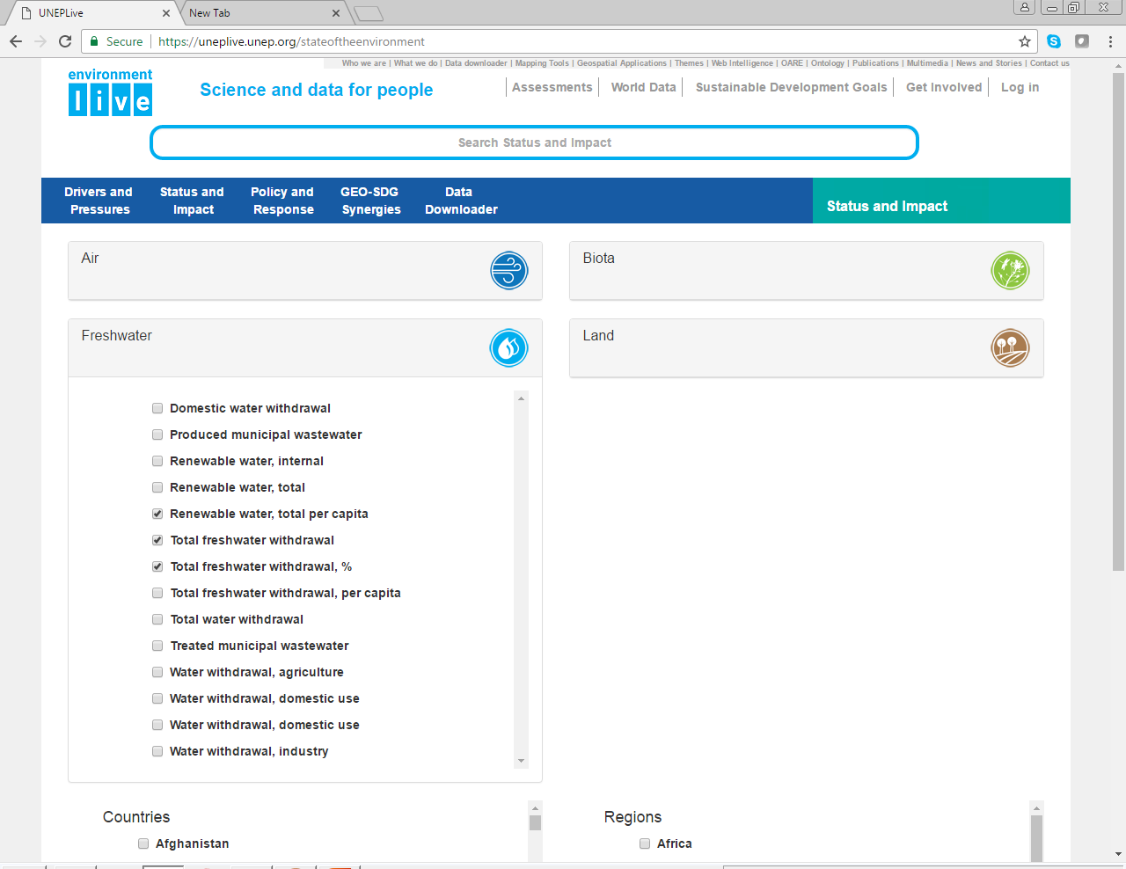
  Status and Impact – Download Indicators

Slide 27
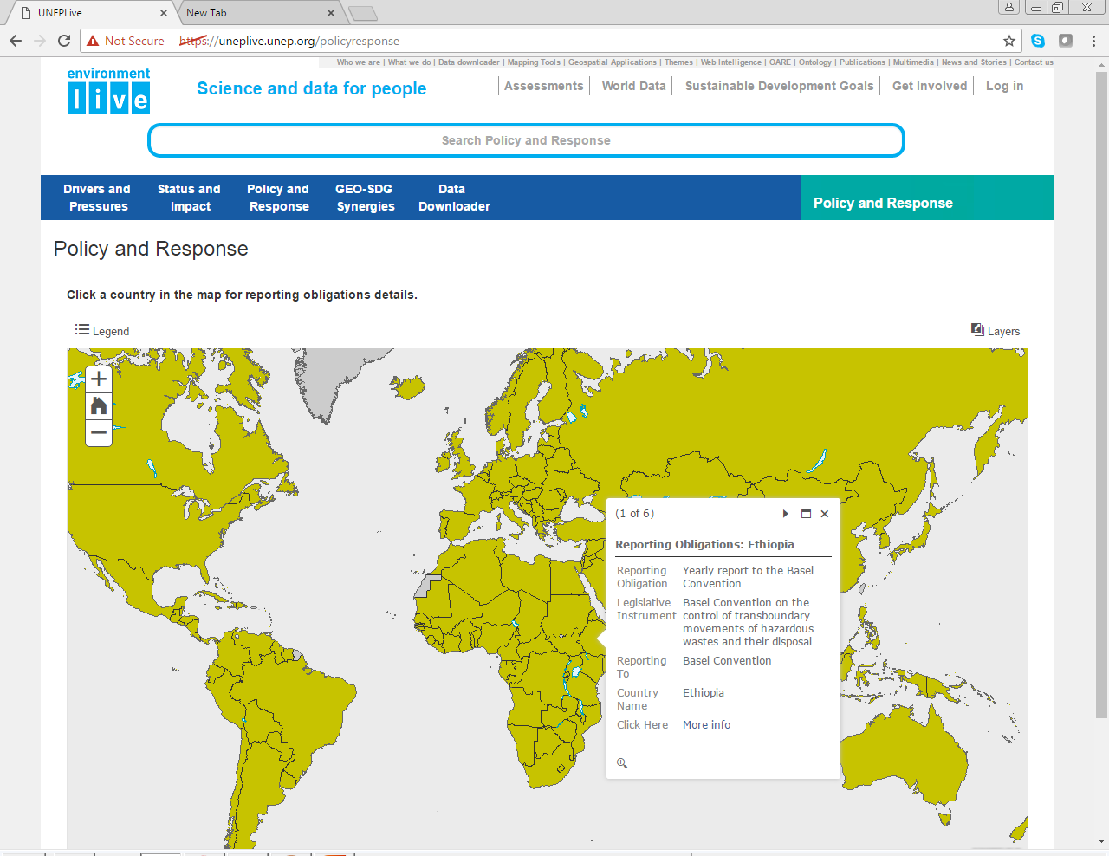
  Policy and Responses – Reporting Obligations

Slide 28
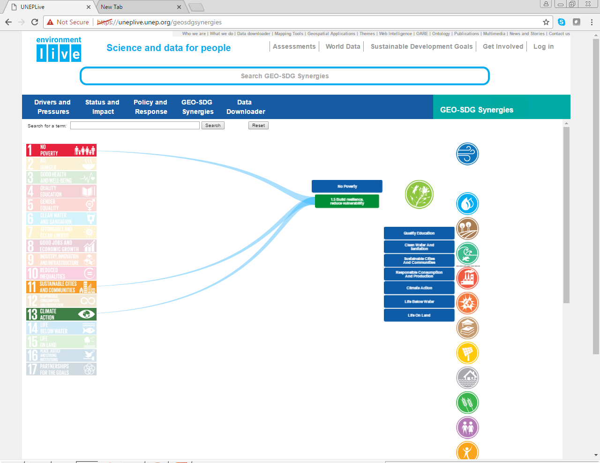
  GEO – SDG Synergies – Indicators

Slide 29
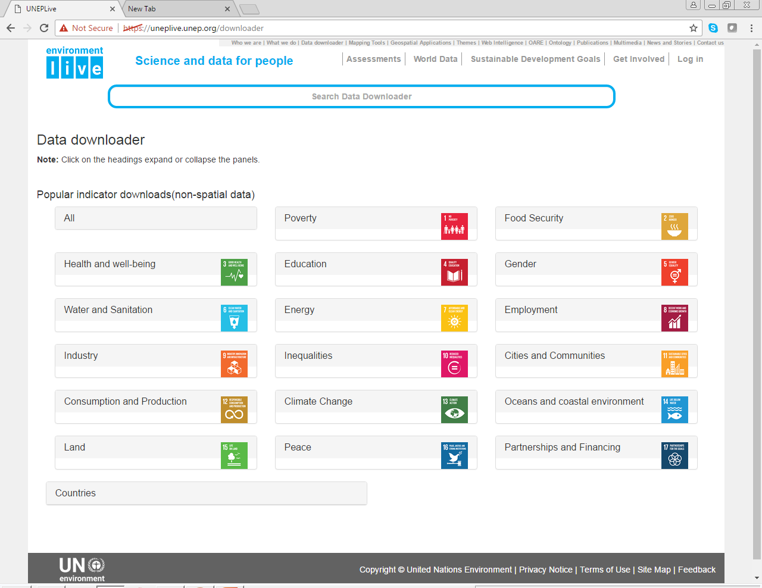
  GEO – SDG Synergies – Indicators

Slide 30
Environment Live and GEO Assessment
Environment Live: Access to Science Data, Information and Indicators
Environment Live: Assessments Workspace
Communities of Practice: Storing and Managing Working Chapters
Service Support: Permanent Technical Support from Headquarters

Slide 31
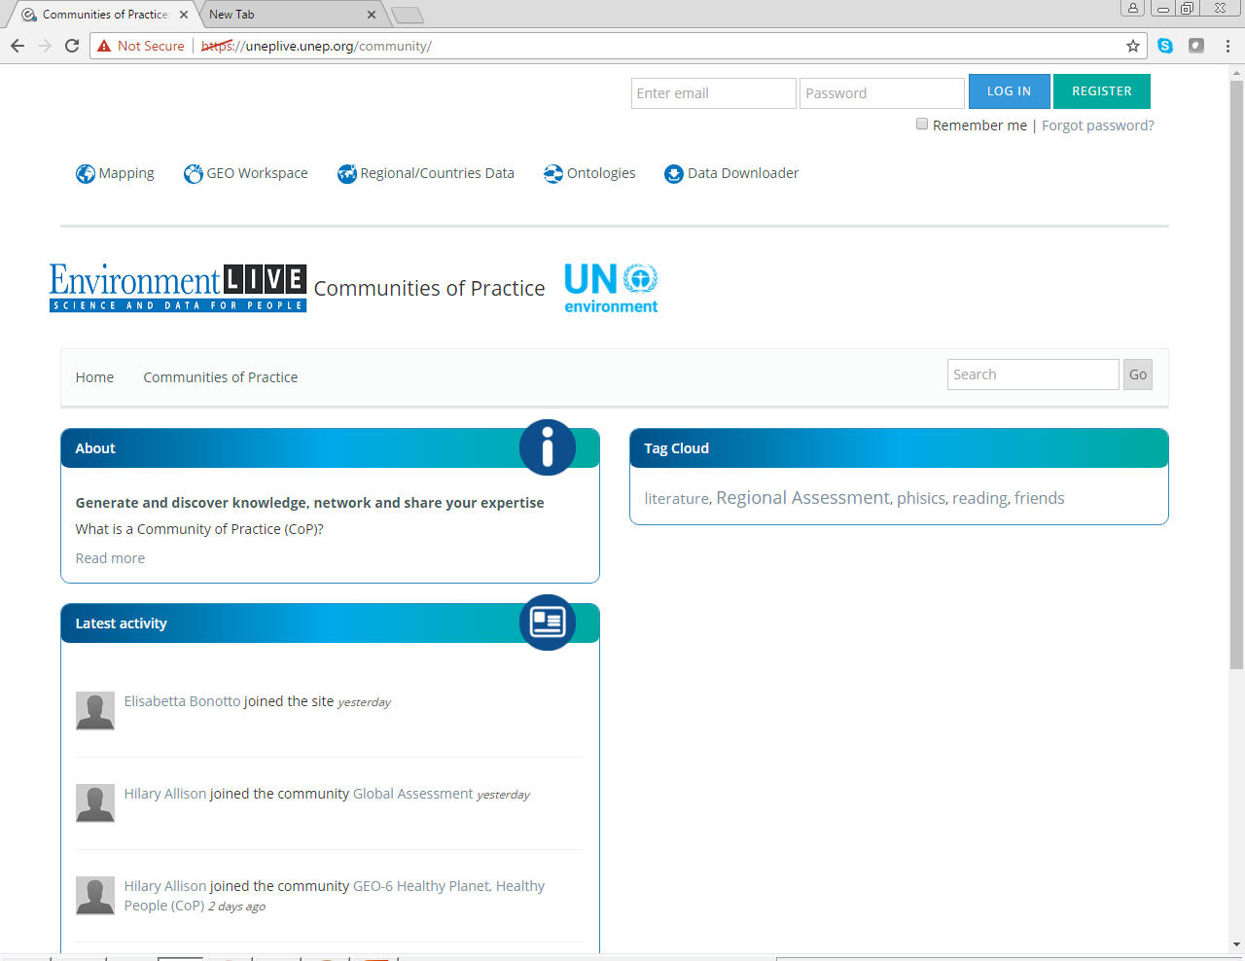
  Communities of Practice – Storing Documents and Collaboration

Slide 32
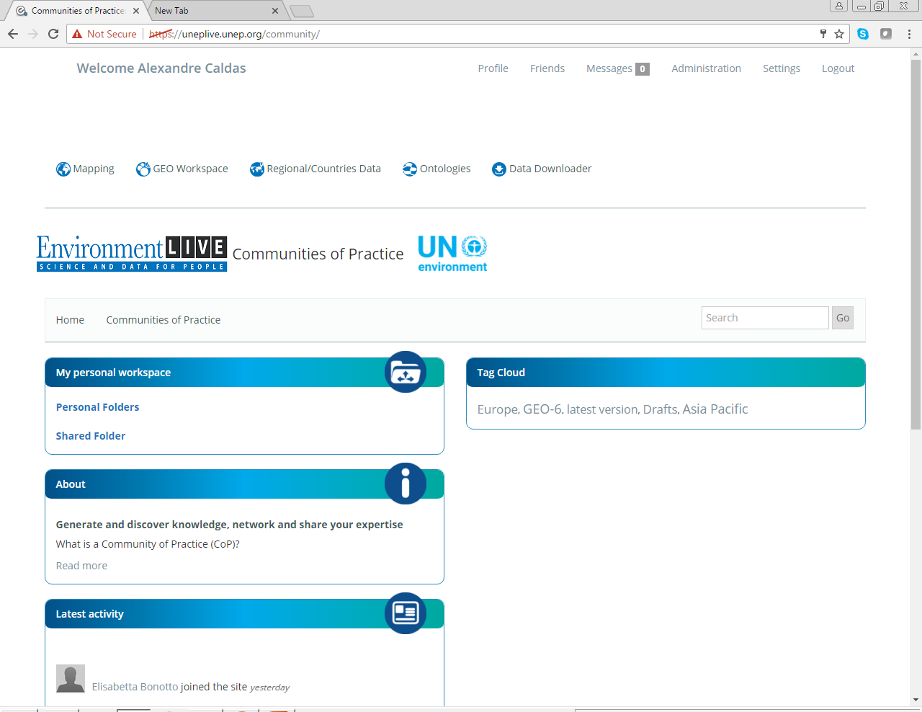
  Log in – Access to Personal Workspace

Slide 33
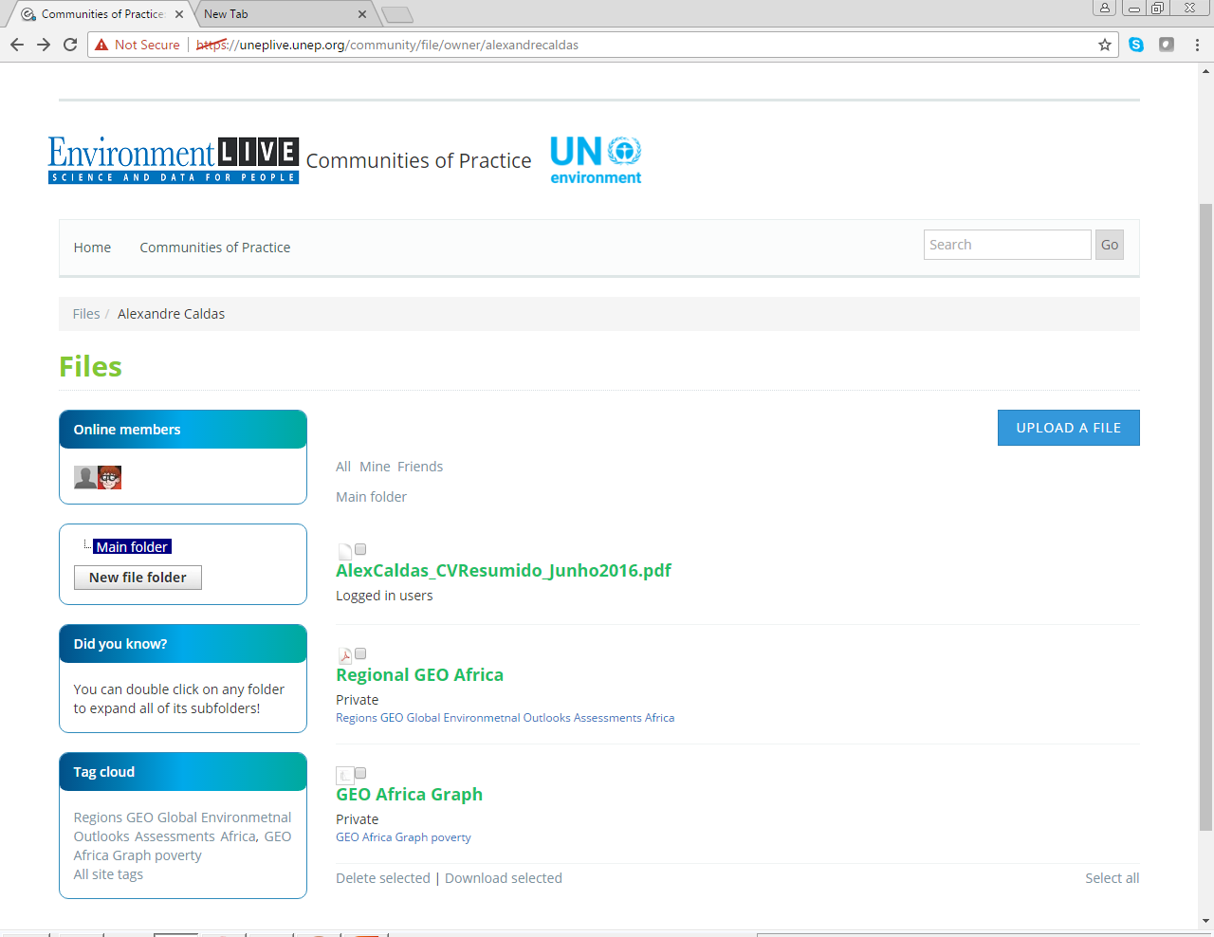
  Personal Folders for Working Chapters

Slide 34
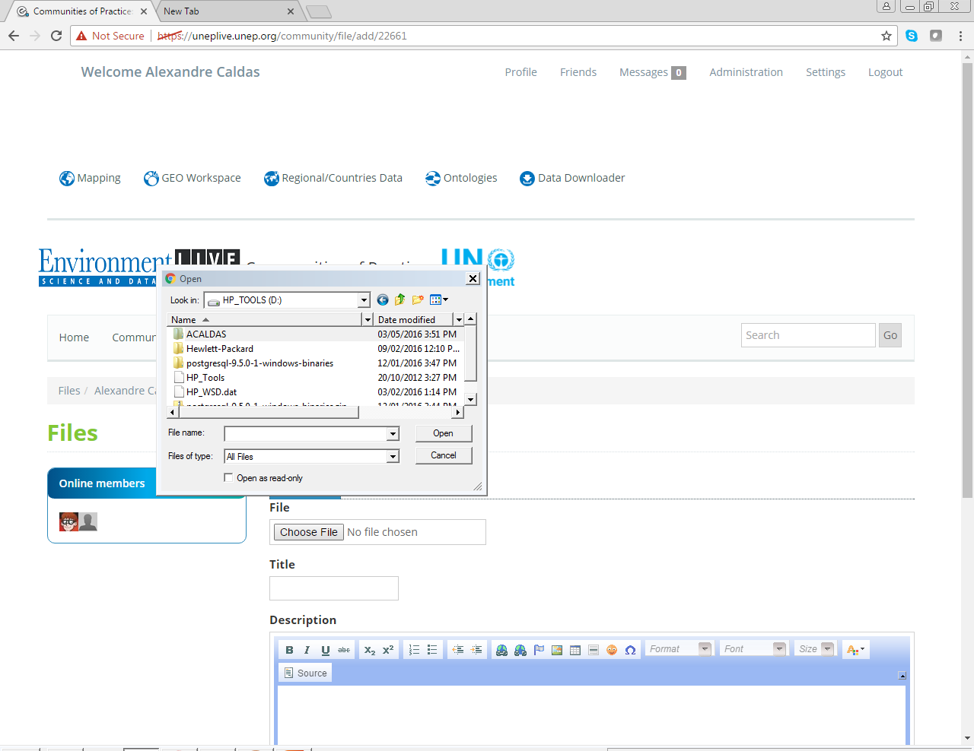
  Personal Folders for Working Chapters – Upload Files

Slide 35
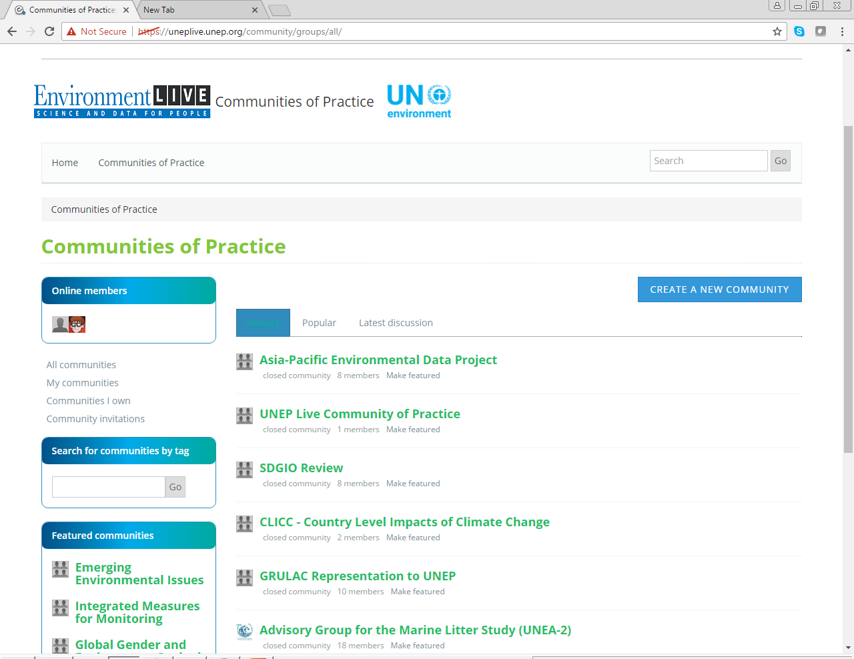
  Shared Folders for Working Chapters

Slide 36
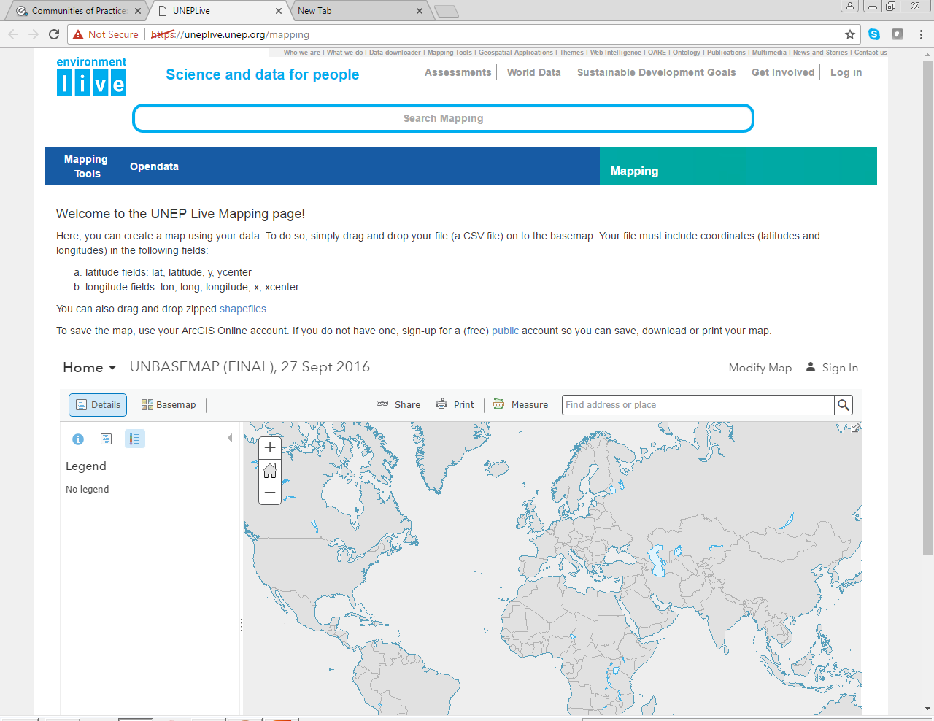
  Menu CoP – Access to Mapping Tools

Slide 37
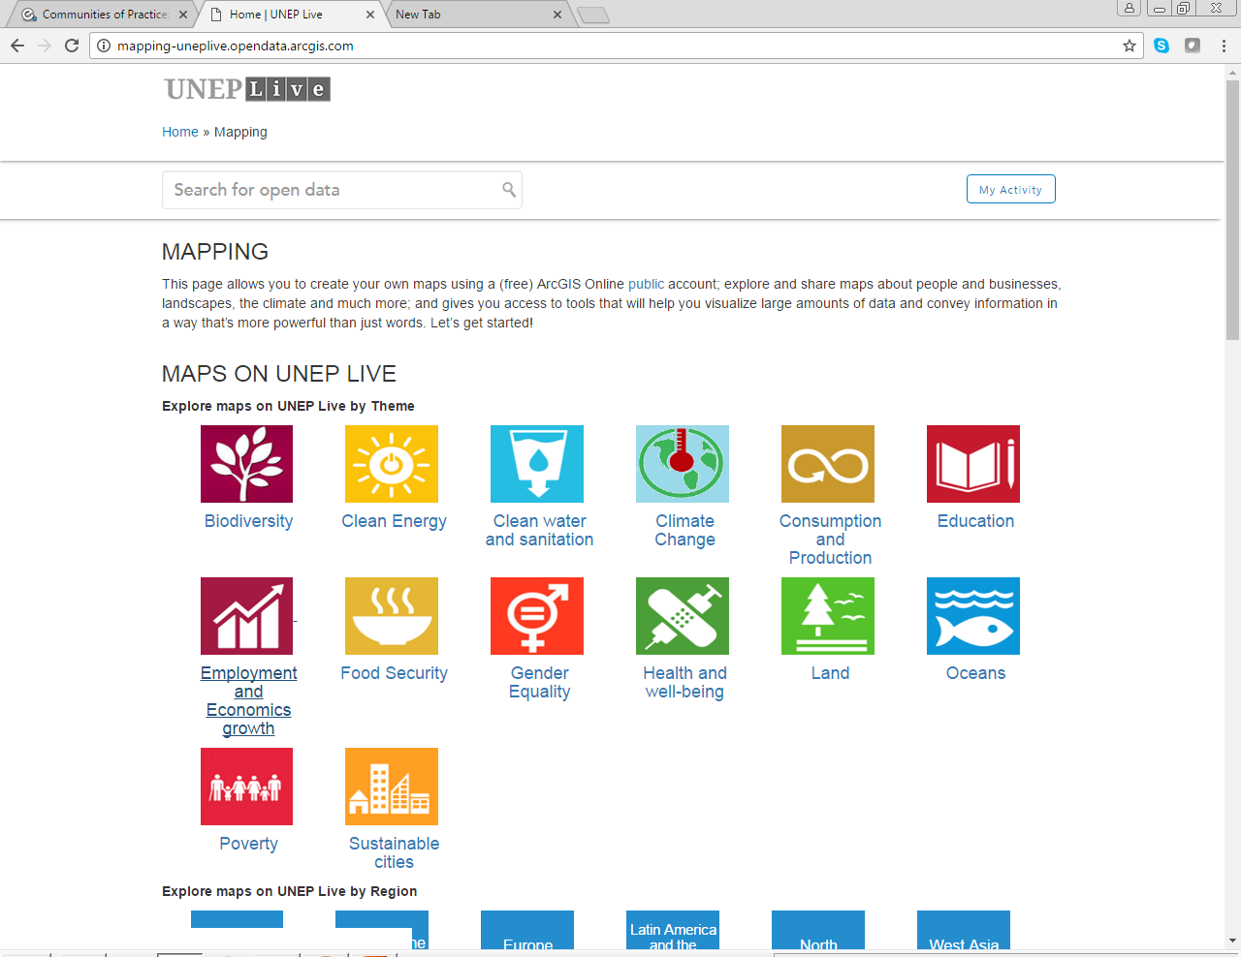
  Menu CoP – Access to Mapping Tools

Slide 38
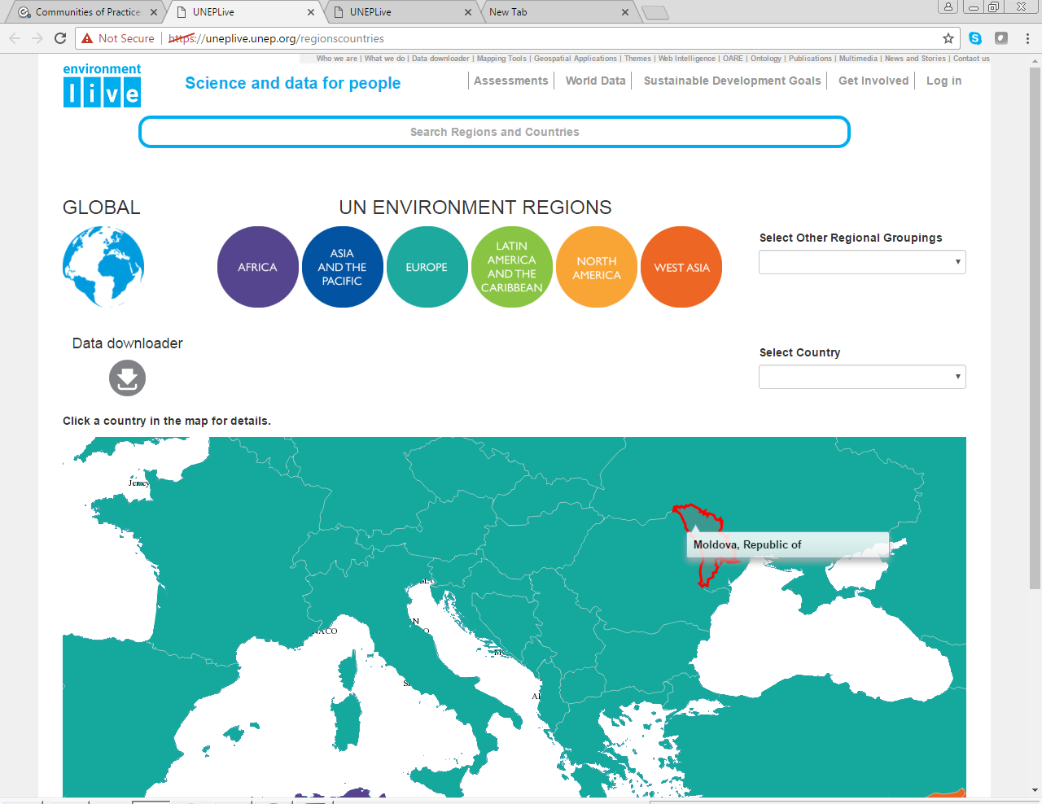
  Menu CoP – Access to Regions and Countries data

Slide 39
Environment Live and GEO Assessment
Environment Live: Access to Science Data, Information and Indicators
Environment Live: Assessments Workspace
Communities of Practice: Storing and Managing Working Chapters
Service Support: Permanent Technical Support from Headquarters

Slide 40
Service Support to GEO Users
Standard Operating Procedure for Service Desk Support – Environment Live
Overview
This Standard Operating Procedure will enter into effect at the GEO-6 authors meeting at the European Space Research Institute (ESRIN), Frascati, Italy. 20th-24th February 2017. It will be reviewed periodically (once every six months or as the need arises).
This Standard Operating Procedure document is intended to define the following:
Core technology services:
  Support procedures;
  When and how to contact the service desk;
  Response time guidelines;
  Typology of services that will be provided;
  Two forms (Environment Live Service Desk and Indicator Request).

Slide 41
Service Support to GEO Users
Core technology services
The GEO process and GEO authors benefit from the availability of tools and services providing management and the working documents, community of practice, and open platform for access to science, data, and indicators. Environment Live is a platform for open access to data and knowledge. It makes accessible more than 900 comparable indicators that underpin the core sets of indicators for global assessments, MEAs and SDG’s, near-real time data, thousands of maps, multiple databases, publications, data and visualizations that track progress toward the implementation of the 2030 Agenda.
All working documents supporting the GEO process and doc associated program of work should be stored in the Community of Practice. Quality of service and support is only provided to this platform. Data, information and indicators used in the GEO chapters should be stored and managed on the Community of Practice and made accessible through the Environment Live. Community of Practice is a portal that allows UN Environment stakeholders from the around the world to share data, knowledge and ideas on specific topics to generate knowledge.

Slide 42
Service Support to GEO Users
Service desk contact procedures and response time guidelines
All Environment Live service desk clients have the option to place service requests via Email (uneplive@unep.org), Telephone (+254 20 76-22-32-96), or Goto Meeting chats
Requests submitted via email to will be responded to within (2) hours if received between Monday and Friday from 8:00 am to 8:00 pm, Nairobi time. (GMT+3)
Responses to email received after 8:00 pm Monday - Friday will be made by 10:00 am the next business day. In exceptional circumstances, some requests may be processed after 8:00 pm.
When you call the Environment Live service desk, you will reach one of Environment Live team members who may ask you a few questions in order to provide the best service possible.
We will need to know the following information:
  Who made the request;
  Type of issue;
  Brief description of the issue in question;
  Type of data element that aligns with the issue;
  Depending on the type of issue, we may ask additional questions;

Slide 43
Service Support to GEO Users
Quality of Service
All service requests will be logged and assigned a ticket number. Because most issues will be addressed after a thorough search on Environment Live or Google, subsequent follow ups will make reference to the ticket numbers. All logged service requests are assigned levels of priority based on the following aspects
  Critical – To be resolved within (2) hours;
  High – To be resolved within (4) hours;
  Medium - To be resolved within (6) hours;
  To be resolved within COB.
All cases will be closed after the request has been completed.
The Environment Live Service Desk will randomly contact requesters to survey their satisfaction with the Service Desk and support received.

Slide 44
Service Support to GEO Users
Typology of services and descriptions:
The Environment Live service desk team will make every attempt to perform any steps that are necessary in order to resolve one of the following:
  Identification of potential data providers or databases;
  Provide a list of data providers and/or databases. Send report with links.
  Referral to SDG unit
  Identify specific data provider;
  Provide a specific data provider or data flow. Send file or link.
  Referral to SDG unit/ Environment Live unit
  Identify specific data set;
  Provide a specific dataset or data point. Send file or link..
  Referral to SDG unit/ Environment Live unit
  Check references ;
  Check the references of a cited publication. Send report.
  Referral to Library unit
  Recreation of data elements;
  Recreate a data element. Referral to Environment Live unit. The following types of recreations where data and other resources are available (Charts, Maps, Infographic, Table, Publication)

Slide 45
Service Support to GEO Users
Typology of services and descriptions:
The Environment Live service desk team will make every attempt to perform any steps that are necessary in order to resolve one of the following:
  Support to Community of Practice;
  Folder and file management
  Conference services using GoToMeeting software;
  Support services for video conference and recording over the entire period of the meeting according to
  logistics and needs for the meeting.
  Other support services.
  (to be indicated)

Slide 46
Service Support to GEO Users
Environment Live service desk contacts:
  Email: uneplive@unep.org
  Phone number: +254 20 76-22-32-96
  Cell phone number: +254 7-95-10-76-74
  Focal point in Nairobi, Kenya: Erick Litswa, Erick.Litswa@unep.org
  Focal point in Frascati, Italy: Simone Targettiferri, Simone.Targettiferri@unep.org

Slide 47
Renewed Environment Live

