Slide 1


Notes:
‘0’ This lecture explains the basic scientific knowledge such as physical and chemical properties, usage, and environmental behaviour of mercury, which will help in understanding mercury issues.

Slide 2
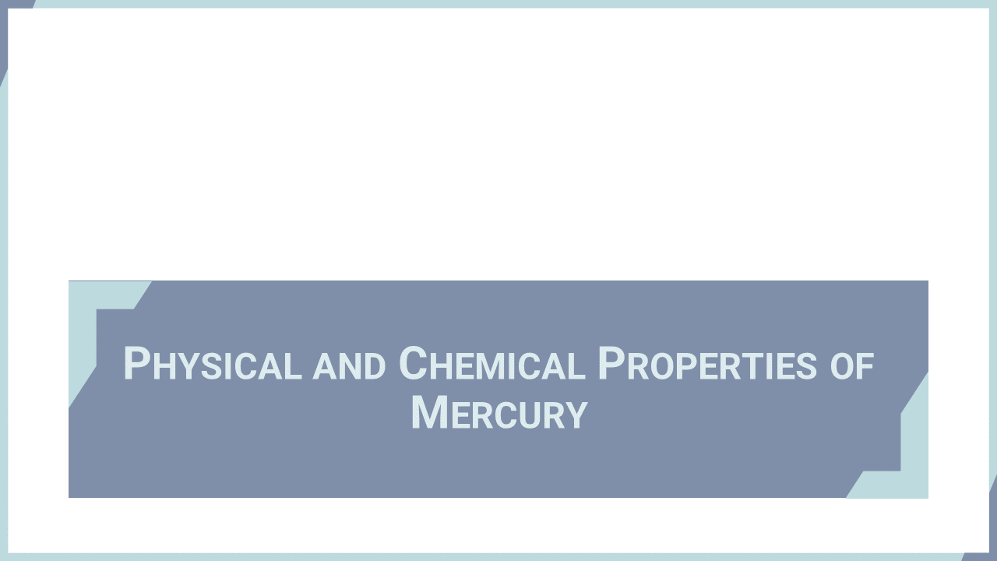
Notes:
‘1’ This section explains the physical and chemical properties of mercury.

Slide 3
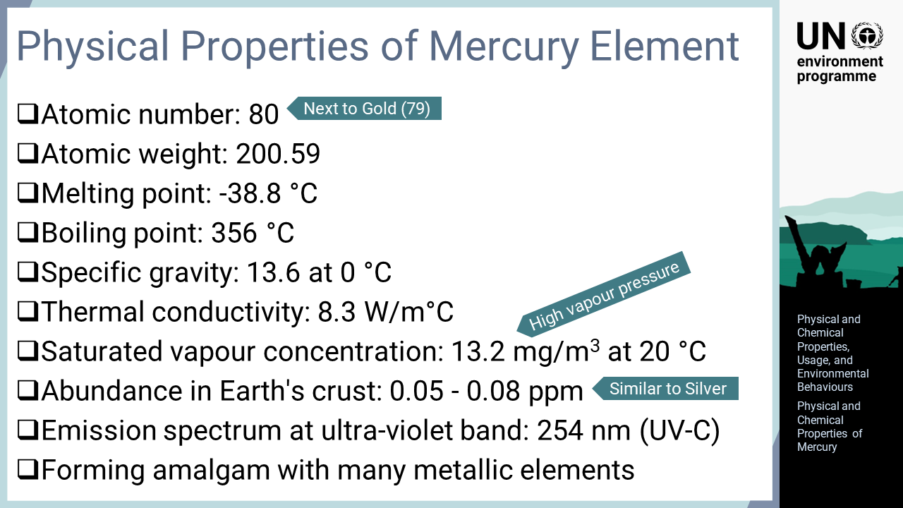
Notes:
‘2’ Mercury is a chemical element that exists in various forms. With an atomic number of 80, which is next to gold, mercury is the only metal element that exists in liquid form at normal temperatures. In addition, mercury has a low boiling point among metallic elements, and it is volatile with a high vapour pressure. The abundance of mercury in Earth’s crust is similar to that of silver, but mercury has a much lower market price than precious metals.

Slide 4
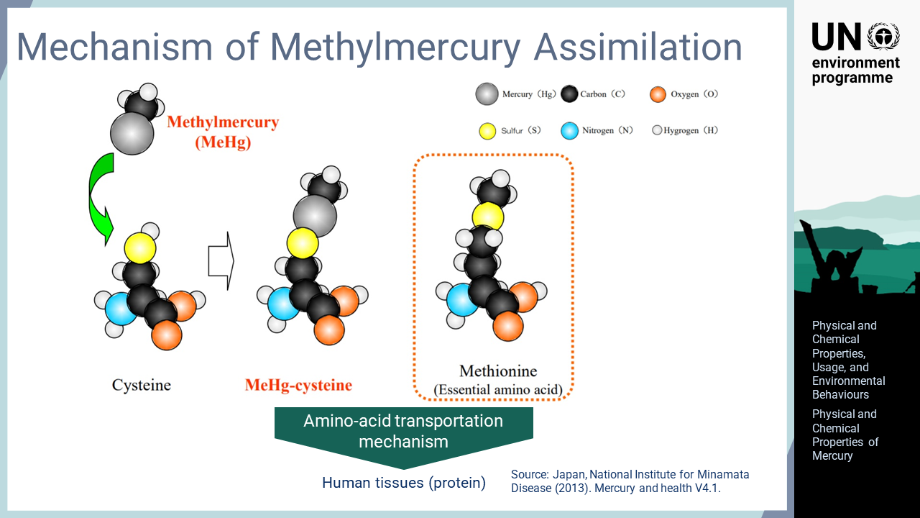
Notes:
‘3’ Methylmercury is a mercury compound of great concern due to its high toxicity. Methylmercury binds to cysteine, a kind of amino acid, to form a complex with a molecular structure similar to methionine, an essential amino acid. Due to this similarity, the complex is actively absorbed via an amino acid transporter. Then, it is incorporated into body tissues made of protein, including the brain and fetus.

Slide 5
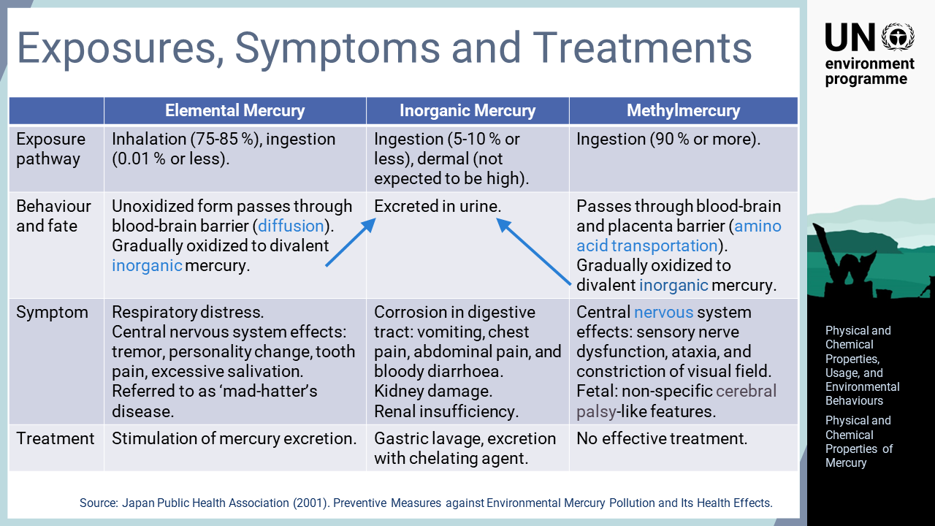
Notes:
‘4’ Most mercury and mercury compounds have certain toxicities, but their biological behaviours and toxicity levels differ. The absorption rates of inhaled elementary mercury and ingested methylmercury are very high, while the absorption rate of inorganic mercury is rather low. Ingested elemental mercury is usually directly excreted without absorption. Absorbed mercury is gradually oxidized and excreted in urine as inorganic mercury. Elemental mercury passes through the blood-brain barrier and causes mercury poisoning of the central nervous system. Accidental high-level exposure to mercury vapour in the workplace can be fatal, but acute symptoms are usually reversible. The symptoms of chronic low-level exposure to elemental mercury were known as mad hatter’s disease. Methylmercury is transported actively to form body tissues made of protein. The adverse effects depend on the body parts into which methylmercury is incorporated. Ingested inorganic mercury causes inflammation of the digestive tract and kidney damages if the amount is very high. Acute mercury exposure is usually treated by stimulating excretion. For chronic exposure, stopping the exposure is the most important measure.

Slide 6
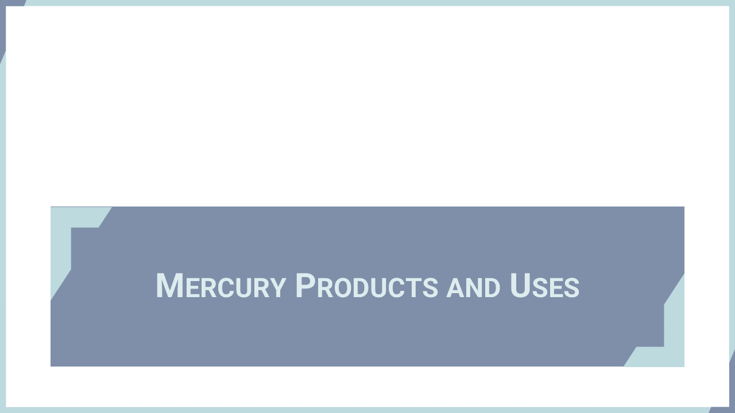
Notes:
‘5’ This section provides an overview of various applications where mercury is found in products or processes.

Slide 7
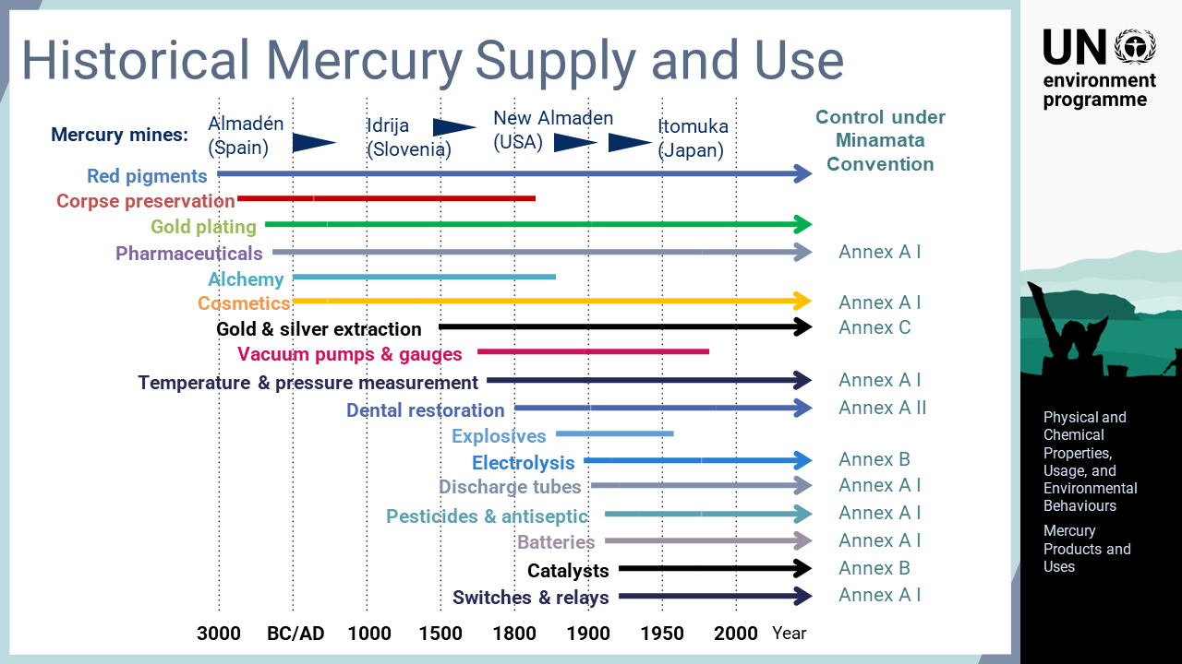
Notes:
‘6’ Mercury is one of a few elements known since ancient times. It has been used for various purposes for many thousands of years. Red pigments and the preservation of corpses are among the oldest applications. The demand for mercury has increased as new uses have been invented over time. The supply side, that is, mercury mining, has also been well developed to support the demand for mercury. Today, some mercury-added products and processes have been replaced by non-mercury alternatives, but many are still widely used globally. The Minamata Convention controls the products and processes stipulated in the Annexes, but even after phase out, mercury waste will continue to be generated for a long time. Thus, proper management of mercury waste is very important.

Slide 8
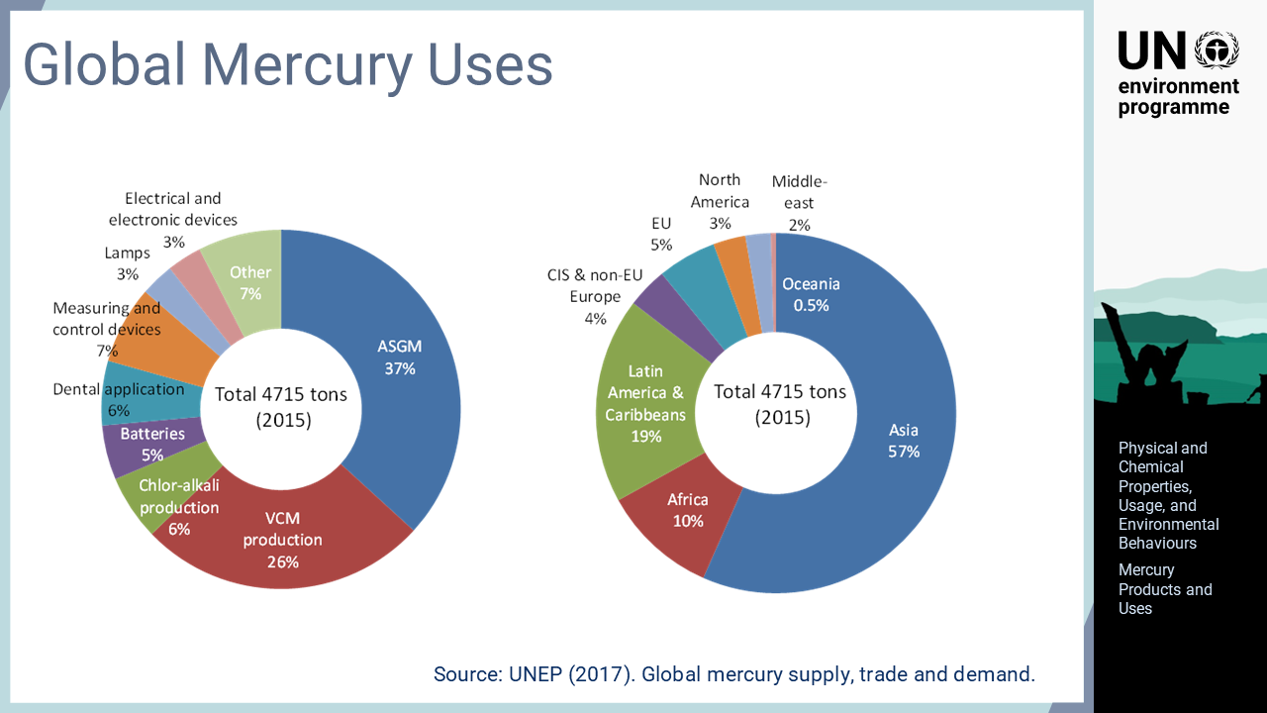
Notes:
‘7’ Global mercury use is estimated to be approximately 4700 tons per year as of 2015. Artisanal and small-scale gold mining is the largest mercury consumer, and Asia, Africa, Latin America and the Caribbean are the regions consuming a large amount of mercury.

Slide 9
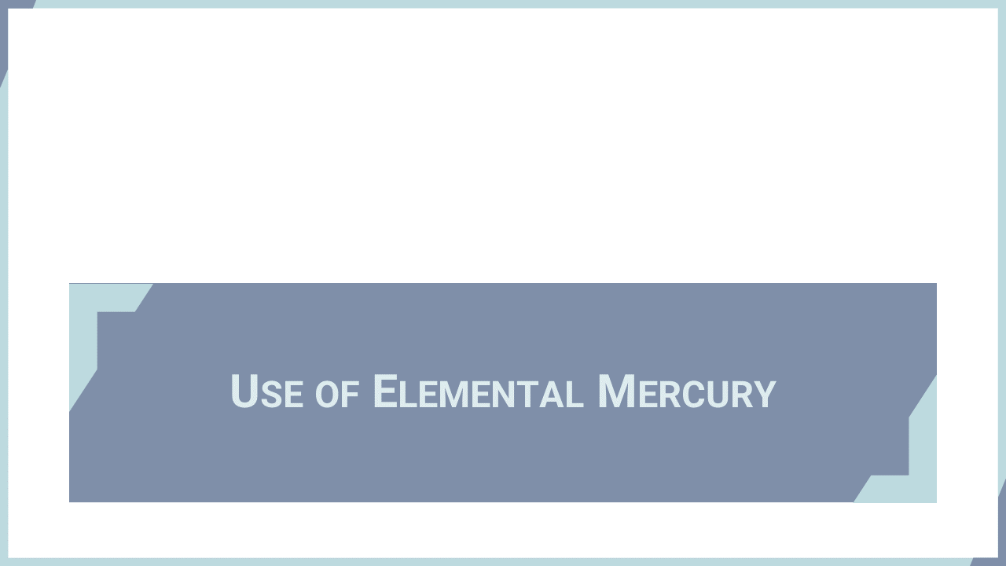
Notes:
‘8’ This section explains the applications of elemental mercury in products.

Slide 10
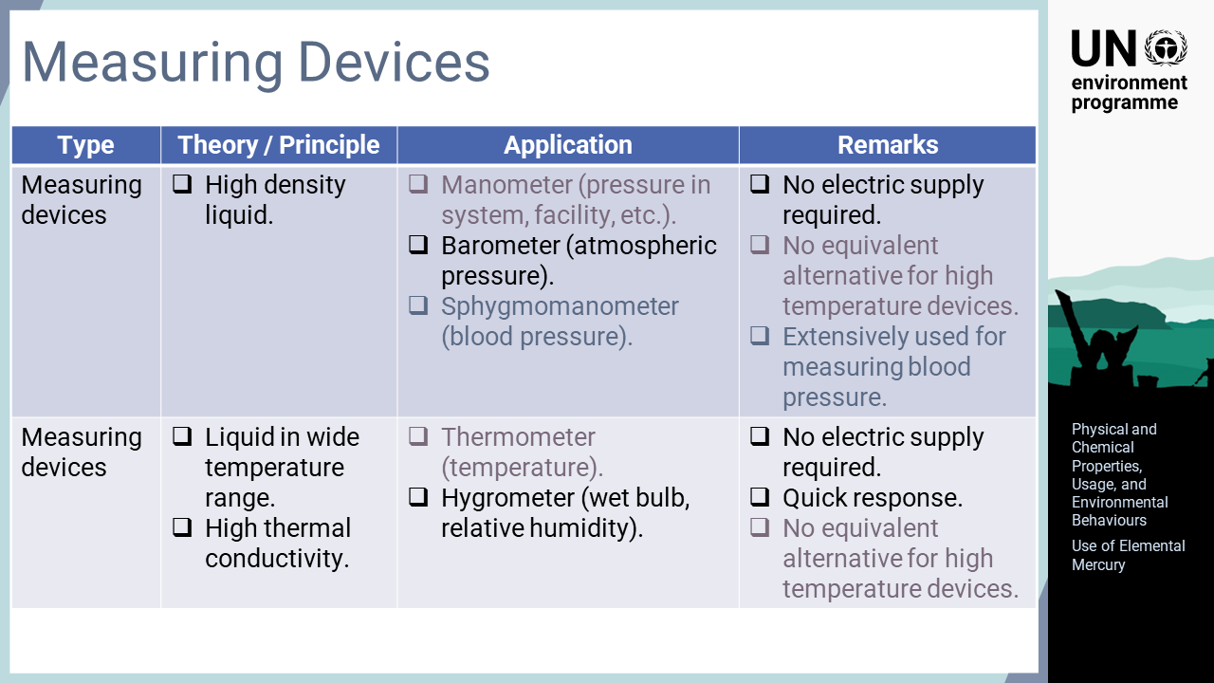
Notes:
‘9’ Elemental mercury is used for measuring purposes. As a high-density liquid, it is suitable for measuring pressure. Devices such as manometers, barometers, and sphygmomanometers enable precise pressure measurements without using electricity. For official purposes, mmHg or inHg can still be used as non-SI units of measurement. Mercury is also useful for measuring temperature because it exists in liquid form in a wide temperature range. As a metallic element, mercury has a high thermal conductivity, which provides a quick response. These mercury-added measuring devices are subject to phase out under the Minamata Convention.

Slide 11
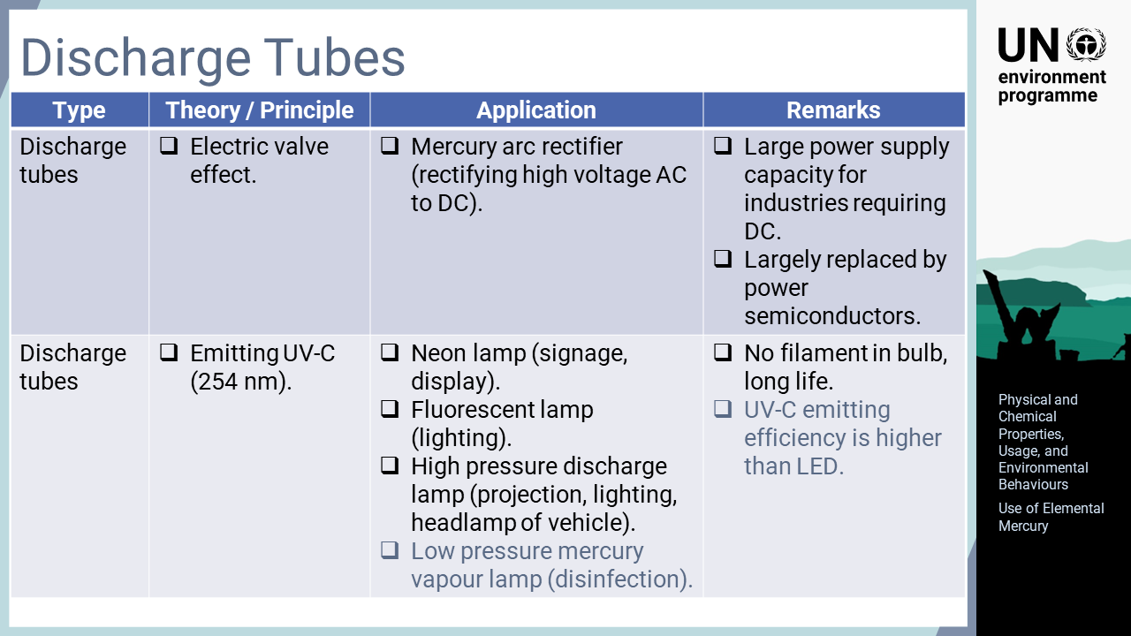
Notes:
‘10’ A discharge tube is an electronic device that contains gas or vapour at low pressure, and through which conduction takes place when a high voltage is applied. The mercury arc rectifier was an important device for converting high voltage alternating current, AC, to direct current, DC. As modern electricity supply networks were developed with AC, rectification was required if the industry required DC. Today, this function is mostly performed by power semiconductors. Several gaseous elements, including mercury vapour, emit various wavelengths of light. Mercury discharges ultraviolet ray, UV-C, which is invisible to humans. As UV-C damages DNA, mercury vapour lamps are used for microbial disinfection. Fluorescent lamps convert UV-C to visible light for lighting applications. The light emitted from discharge tubes is also used for various lighting applications, such as indoor and outdoor lighting, signage, and the headlamps of vehicles.

Slide 12
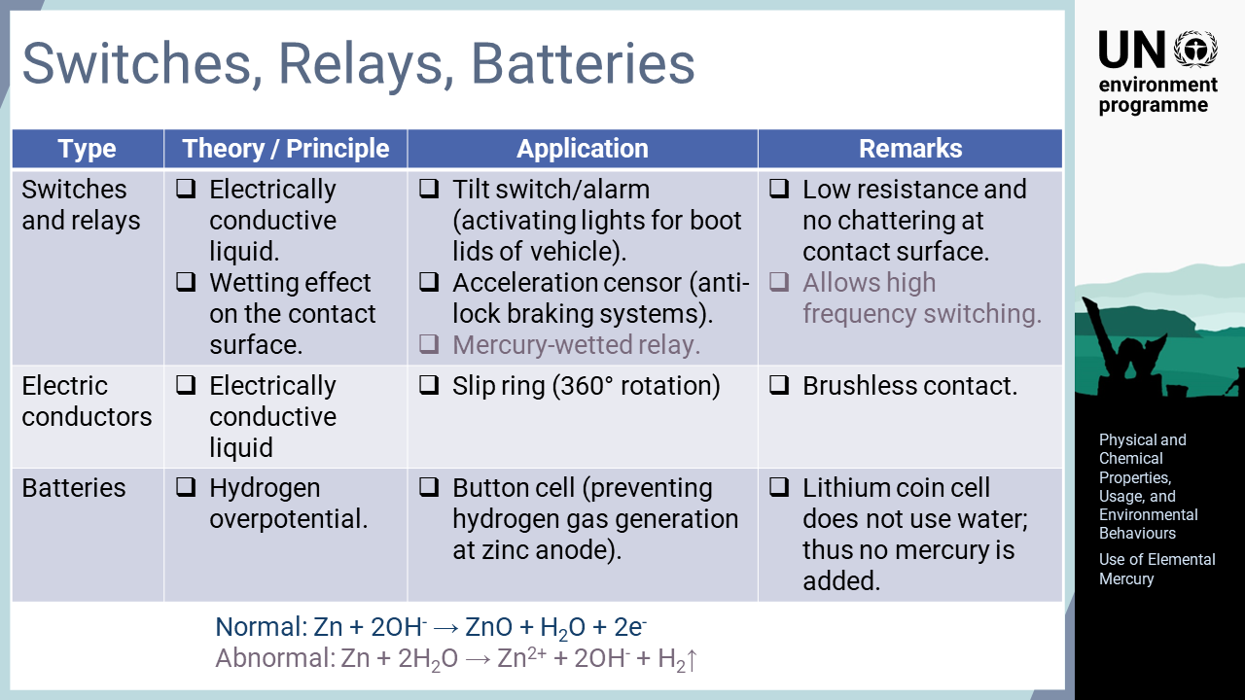
Notes:
‘11’ As mercury is electrically conductive, it is used for various electric controls. The mercury switch has several advantages for closing and opening electrical circuits. As the contact surface is concealed, no oxidation occurs, and the surface remains clean with a low resistance due to the wetting nature of mercury. Application includes tilt switches to activate lights on the boot lids of vehicles, rollover warning devices for vending machines, anti-lock braking systems that detects acceleration force, high-speed switches as mercury relay does not cause chattering, and mercury slip rings that transmit signals or power to devices over 360° of rotation. Mercury is added to batteries for safety purposes to prevent hydrogen gas generation. Abnormal reactions at the zinc anode causes cell rupture or leakage, but mercury inhibits such abnormal reactions. Although most dry cells have stopped using mercury, a few types of button cells still use mercury for this purpose. Lithium coin cells do not use water as the electrolyte, so no mercury is added.

Slide 13
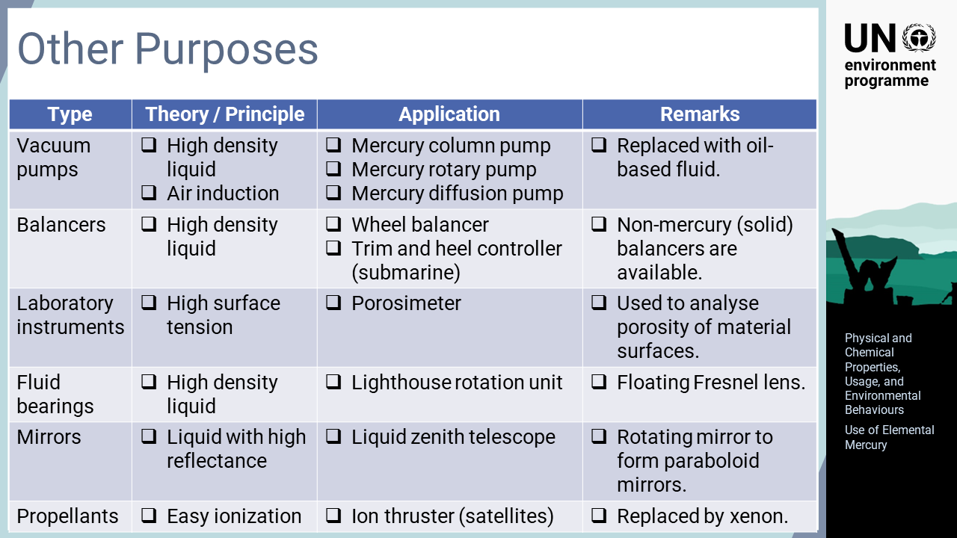
Notes:
‘12’ Elemental mercury is also used for many other purposes. Some are being phased out as non-mercury alternatives are becoming increasingly available. It is important to be aware that not all uses of mercury are subject to the Minamata Convention, so legitimate uses of mercury will remain.

Slide 14

Notes:
‘13’ This section explains the applications of amalgam in products or processes.

Slide 15
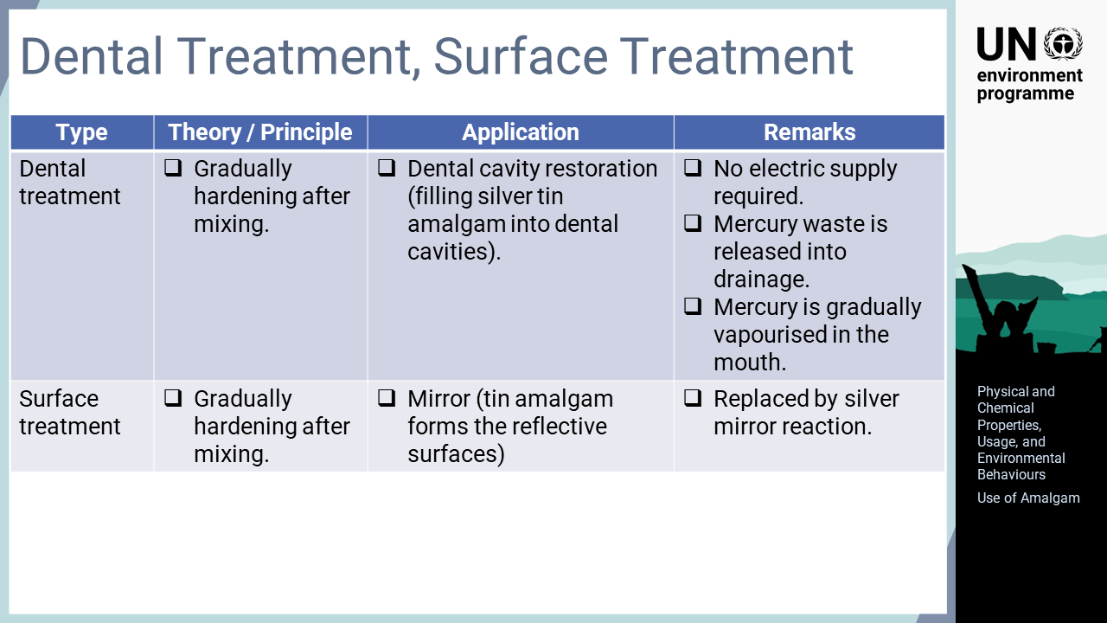
Notes:
‘14’ Mercury can form various alloys with other metals, which are called amalgam. Amalgam has been an important material for many industries as final products or in production processes. Dental amalgam is a mixture of silver and tin powder, which is gradually hardened to fill dental cavities. Tin amalgam was used for the reflective surfaces of mirrors.

Slide 16
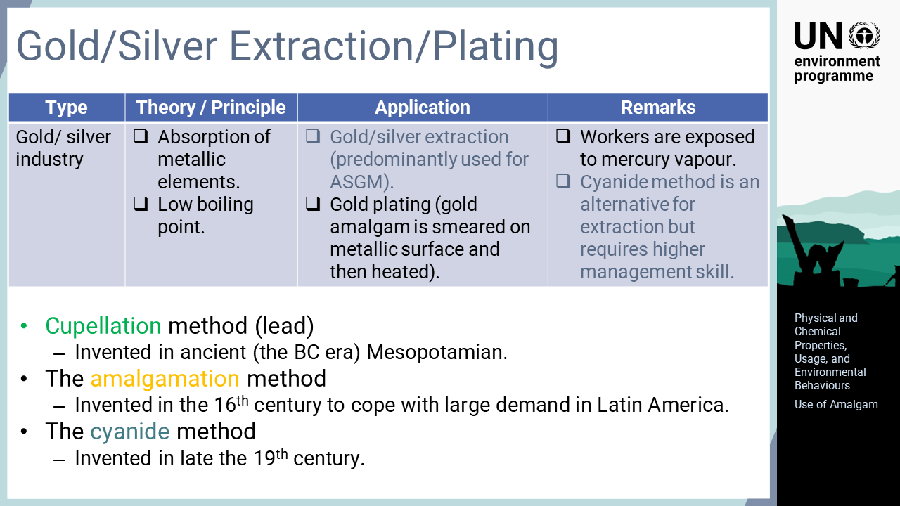
Notes:
‘15’ Gold and silver extraction and refining have been practised for many thousands of years. The oldest method called cupellation used lead and was invented in the BC era. There was a risk for lead poisoning with this method. The amalgamation method was then invented in the 16th century, when silver mining in Latin America was at its peak. Due to the melting and boiling points of mercury being lower than those of lead, the consumption of heat sources, such as firewood, was reduced, which preserved forests in the region. The amalgamation method for ASGM accounts for the largest usage of mercury today and disproportionally affects marginalised and less privileged groups. The cyanide method was invented in the 19th century during the Gold Rush era. This method is currently predominantly used for large-scale gold mining operations, but its application to ASGM is being explored.

Slide 17
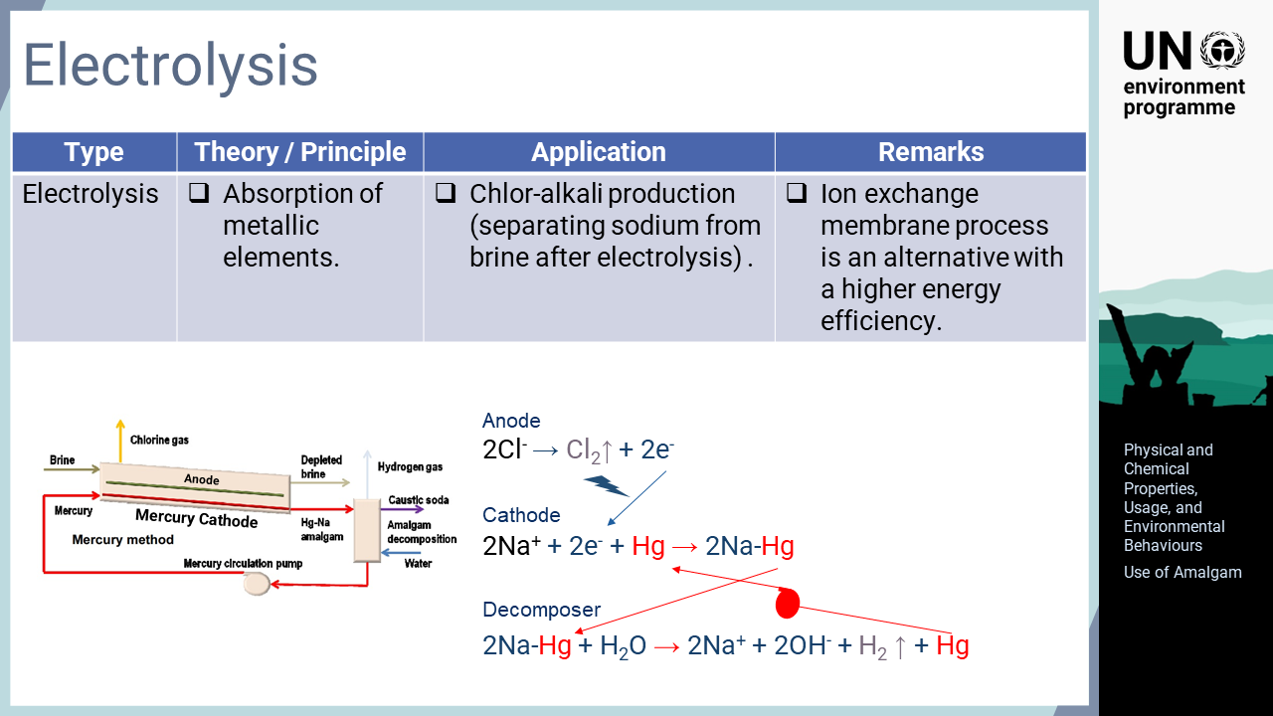
Notes:
‘16’ NaCl, which is the chemical form of edible salt, can generate chlorine gas and caustic soda by electrolysis. Caustic soda is used for manufacturing products such as soap and glass, and chlorine gas is used for producing disinfection and bleaching agents as well as PVC. Mercury is used as the electrode for the mercury-cell process, which was invented in the early 20th century and is still used in some countries. Chlorine ions are oxidized at the anode and become chlorine gas. On the cathode side, where mercury is used, sodium ions are reduced to metallic sodium, which forms an amalgam with mercury. The sodium amalgam is then sent to an amalgam decomposer, where caustic soda is formed. The key to this electrolysis process is blocking sodium backflow to the anode side. The diaphragm process physically blocks this backflow with the fibrinous structure of asbestos. This system is still used, but the risk of asbestos is a concern. The membrane process has a similar configuration to the diaphragm process, but an ion exchange membrane allows the selective permeation of sodium ions to the cathode side, which is more energy efficient and avoids toxic substances.

Slide 18
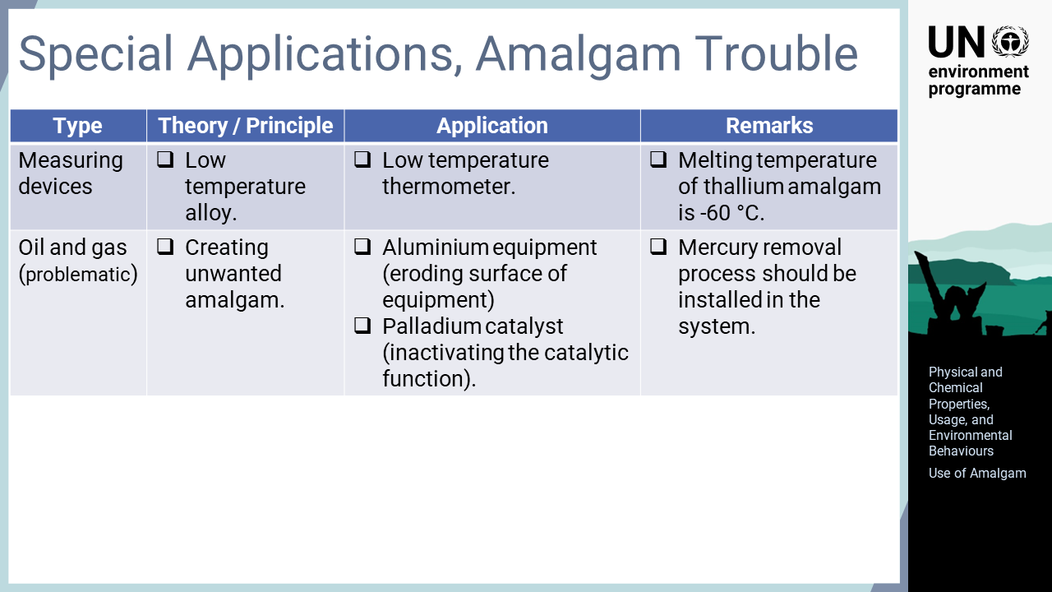
Notes:
‘17’ Special applications of amalgam includes low-temperature thermometers with thallium amalgam, which is a melting temperature of approximately minus 60 °C. However, mercury is problematic in the oil and gas sector. Mercury erodes aluminium equipment, such as heat exchangers, and inactivates palladium-based catalysts.

Slide 19
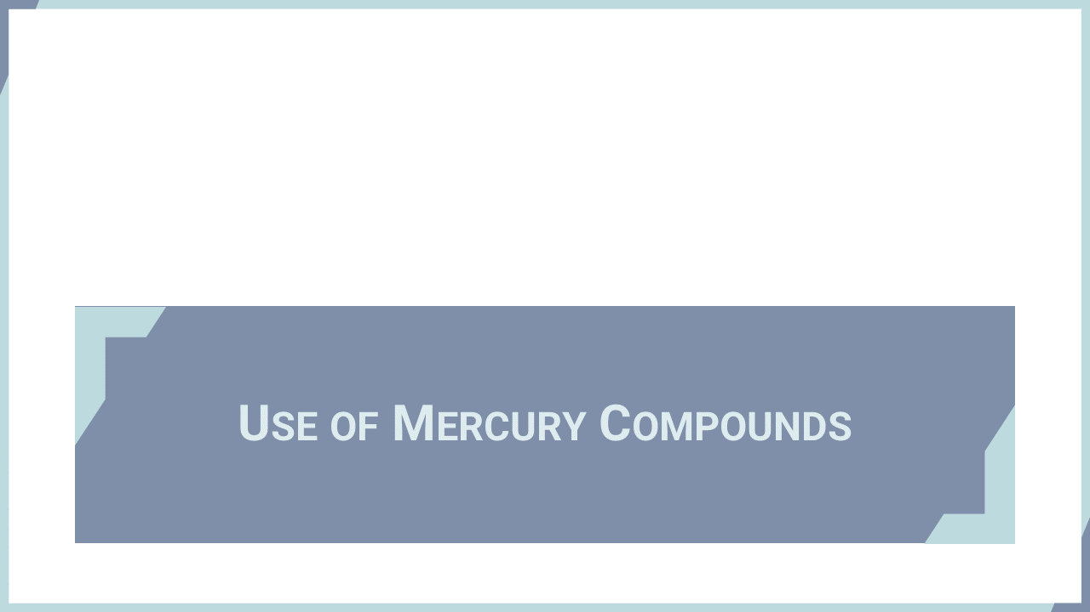
Notes:
‘18’ This section explains the applications of mercury compounds in products or processes.

Slide 20
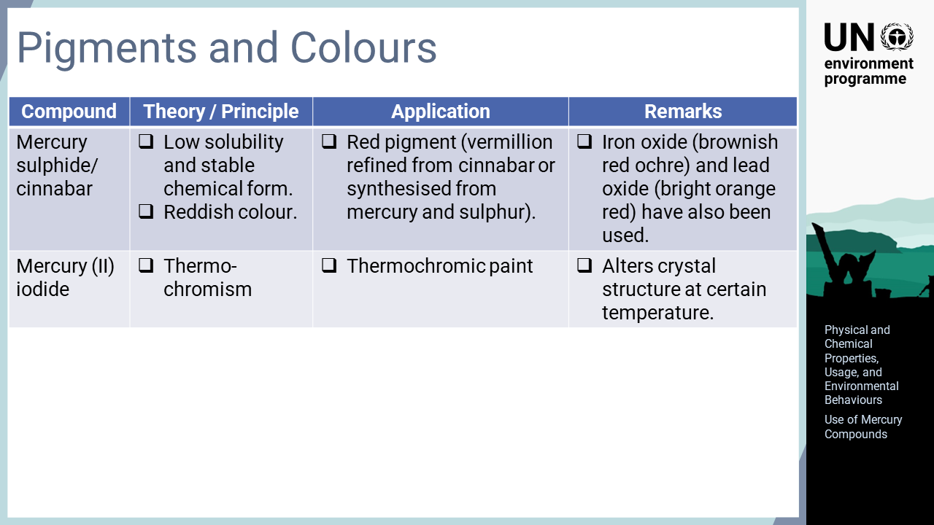
Notes:
‘19’ Mercury sulphide is naturally found as cinnabar, which exists as blood red crystals or dark red stones. Red is one of the oldest colours that humans have intentionally used since the pre-historic era. Three major red pigments have been used. Iron oxide provides brownish red and is easily available from red clay soil. By contract, mercury sulphide needs laborious refinement from ore, so it was an expensive pigment. It can also be synthesized from mercury and sulphur. Due to its preciousness, mercury sulphide was used for more important occasions, such as ceremonial and religious purposes. Lead oxide is also a synthesized pigment with a bright orange colour.

Slide 21
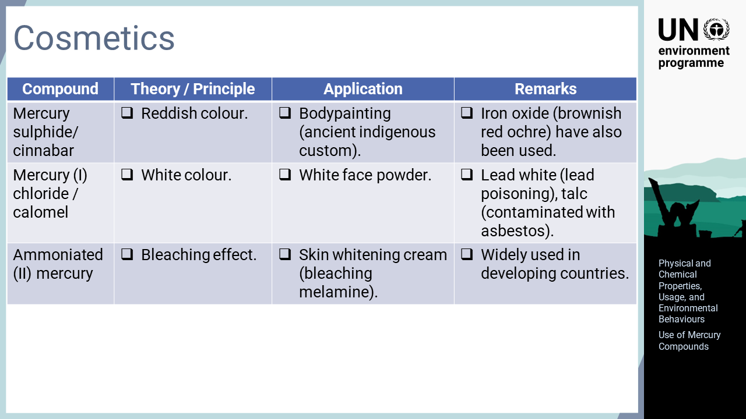
Notes:
‘20’ Cosmetics also use colour, which are predominantly consumed by women. Red, white, and black are the three base colours for cosmetics. Red pigments, such as cinnabar, were used for bodypainting in some indigenous societies. More broadly, white face powder has been used for makeup. Calomel, mercury (I) chloride, is a white powder used for such purposes. Other chemicals, including lead white and talc, have also been used. Lead poisoning by face powder was problematic in the past few centuries. Currently, concerns have been raised about talc, which contains asbestos as an impurity. Mercury use for skin-whitening cream is another concern, as it is still widely used globally. The preference to lighter coloured skin is still prevalent in many countries where the skin care industry keeps feeding illegal products into market.

Slide 22
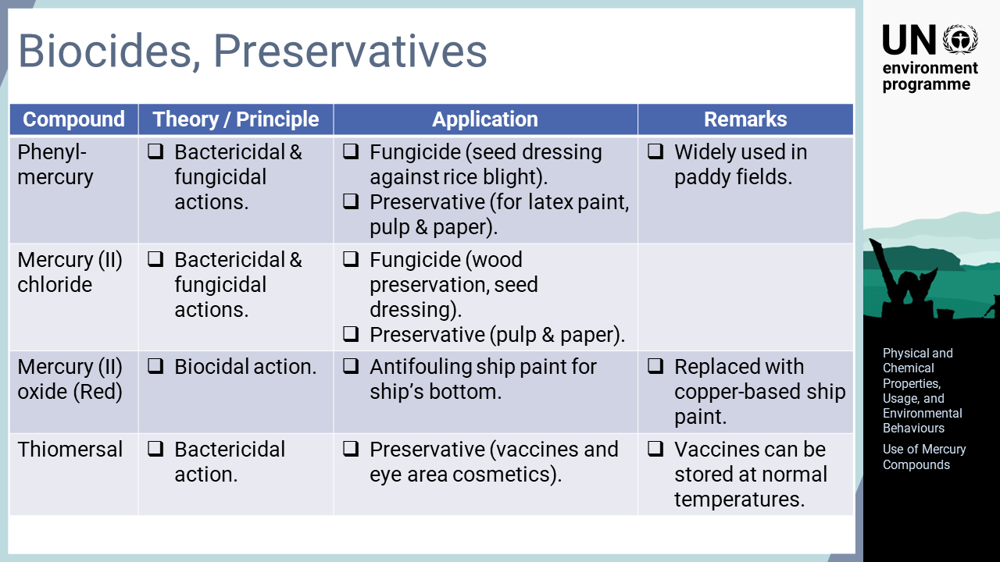
Notes:
‘21’ The biocidal action of mercury is used for fungicides and preservatives. Organic mercury compounds such as phenylmercury have been used for seed dressing, as fungicides for crops such as rice and wheat. Among inorganic mercury compounds, mercury chloride has been used for wood preservation and red mercury oxide has been used for anti-fouling ship paint. In some products that are directly applied to humans, mercury compounds are still used as preserving agents. For example, thiomersal preserves vaccines at normal temperatures, which is important when providing vaccines to remote areas where no cold chain is available.

Slide 23
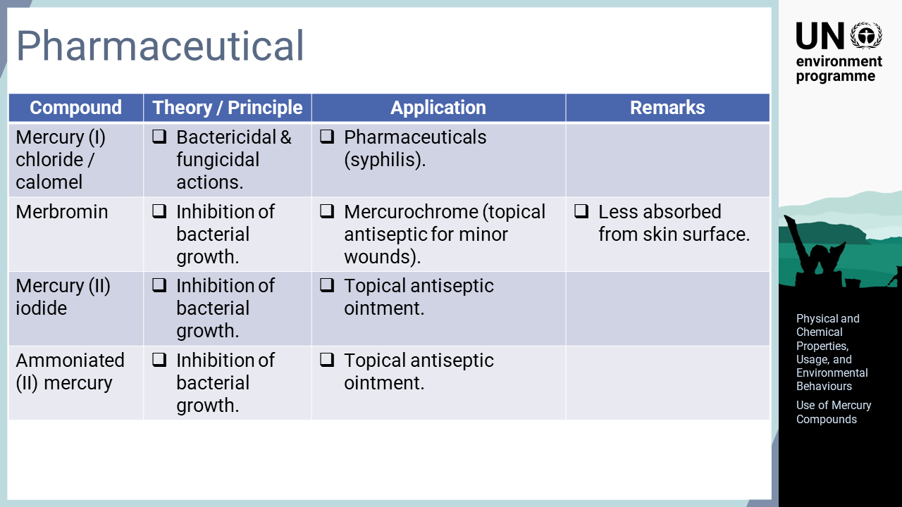
Notes:
‘22’ Mercury has been used in pharmaceuticals since ancient times. Traditional Chinese and Ayurveda medicines still include mercury products. One of the most significant historical uses of mercury for pharmaceutical purposes is the treatment of syphilis patients. Syphilis emerged in the late 15th century and rapidly spread over the globe. Many types of mercury compounds were used for medical treatment from the 16th century until being replaced by penicillin in the 1940s. Mercurochrome is a water solution of the organic mercury compound merbromin, which was invented in the early 20th century and has been widely used for treating minor wounds. Its less painful nature and cheap price allowed various applications in both clinical and household settings. Mercury inhibits the growth of microorganisms. This characteristic has been used for many preservation and antiseptic purposes.

Slide 24
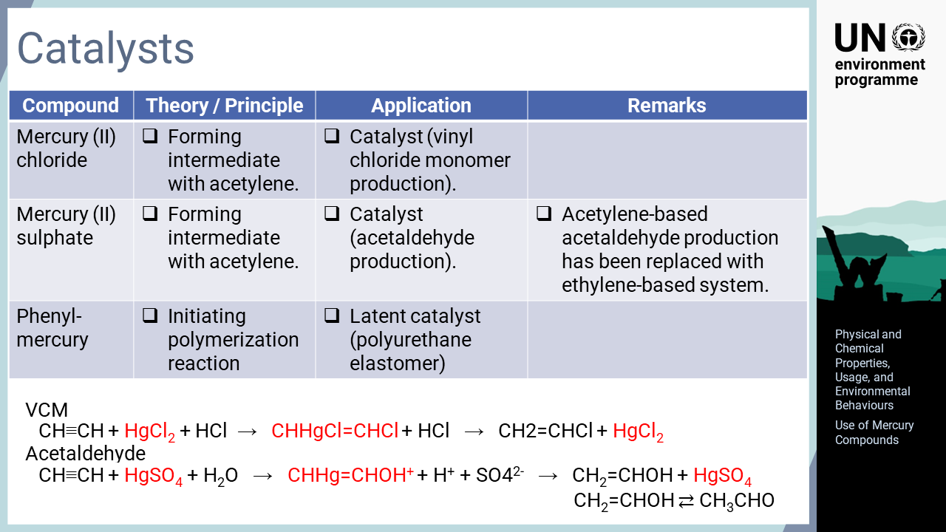
Notes:
‘23’ A catalyst is a substance that facilitate or accelerates a chemical reaction, but its form remains unchanged. The elements in the zinc group, which includes mercury, have been used as catalysts for organic synthesis, particularly for the production of vinyl polymers by accelerating addition reactions from acetylene. The catalysts form intermediate compounds to promote addition reactions. Minamata disease was caused by the mercury catalyst used for acetaldehyde production, which was methylated in the factory and then released into the environment. To avoid the use of mercury, ethylene can be used for the feedstock instead of acetylene. Another type of catalyst is the initiator for polymerising polyurethane elastomer, which triggers the process in moulded products or coatings. Although mercury acts as a catalyst for this process, it remains in the final product.

Slide 25
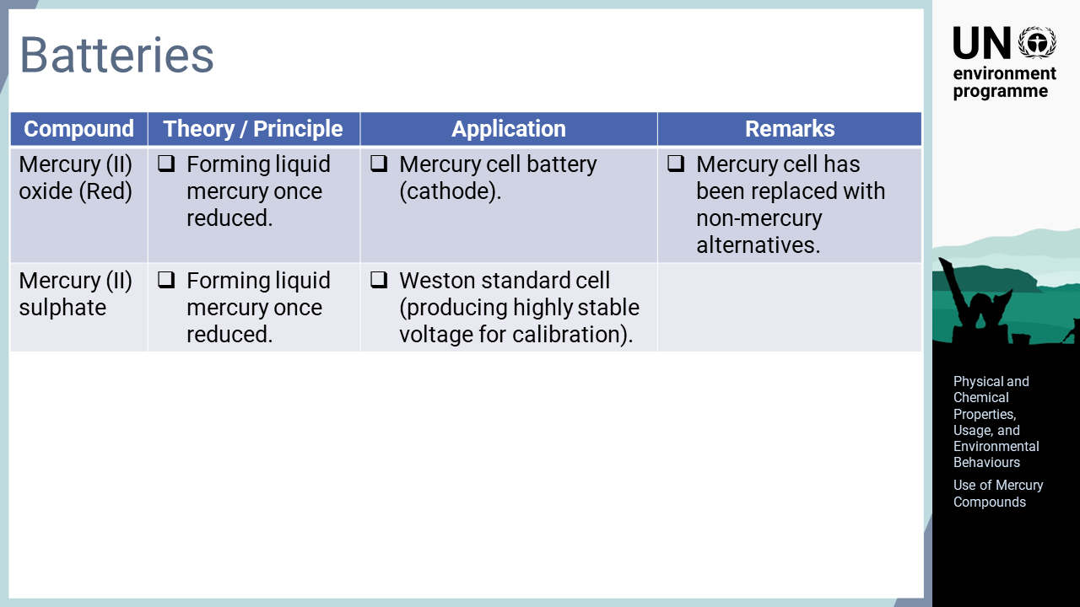
Notes:
‘24’ Batteries, especially chemical batteries, utilize the oxidation and reduction of chemical compounds to store electricity. The mercury cell is a type of battery that has a mercury oxide cathode. Once electricity is consumed, mercury oxide is reduced to metallic mercury, which flows out of the cathode. This product is subject to phase out under the Convention. However, mercury use for research, calibration, and reference is exempt from the Convention, so standard cells such as the Weston cell are not subject to phase out.

Slide 26
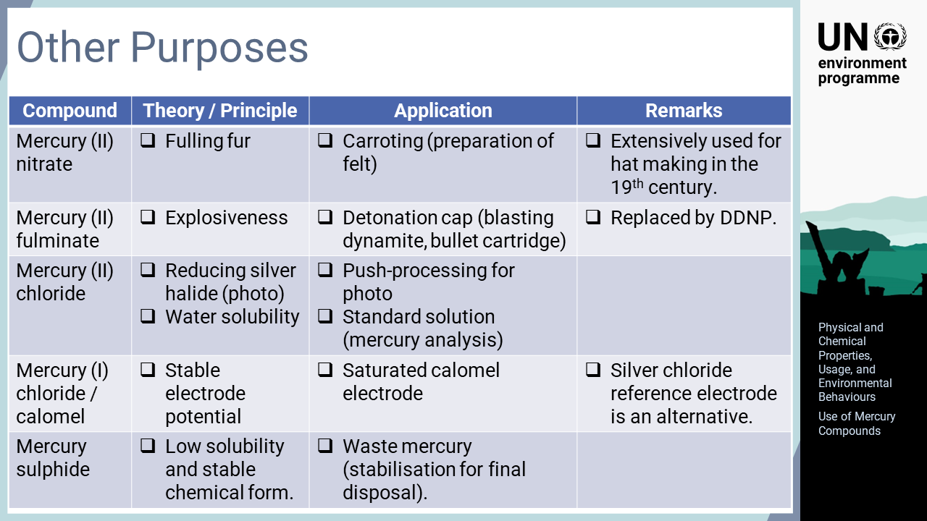
Notes:
‘25’ Various mercury compounds are used for many other purposes. One of historical uses is mercury (II) nitrate for hat making. A process called ‘carroting’ was extensively used for the preparation of felt. Mercury (II) fulminate was also an important mercury compound used extensively during wars as a material for the detonation caps of explosives. A new use has been examined for mercury (II) sulphide for the final disposal of mercury waste because stabilisation is required in some countries to dispose of mercury.

Slide 27
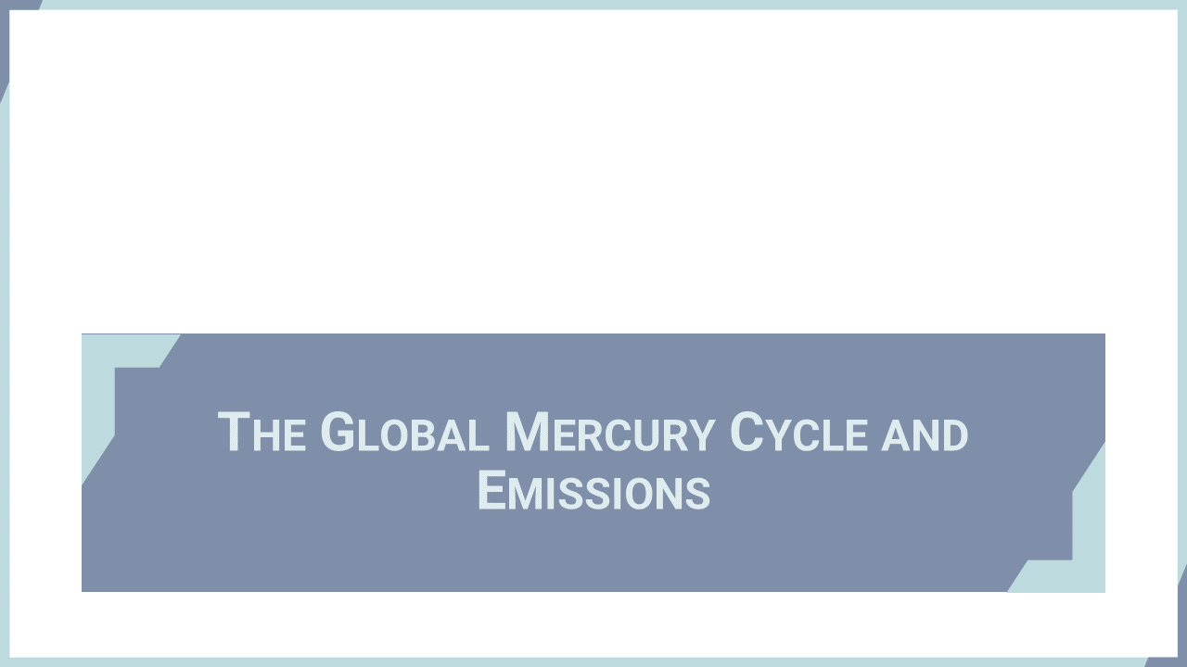
Notes:
‘26’ This section explains the global mercury cycle and emissions.

Slide 28
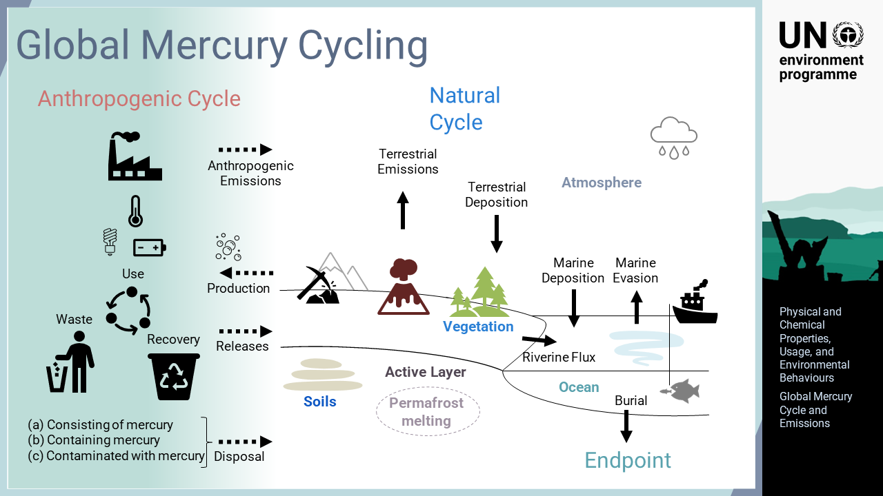
Notes:
‘27’ As a chemical element, mercury has existed on Earth since its creation. Mercury is released from natural sources by processes such as volcanic activity and permafrost melting. Once released, mercury poses risks to human health and the environment. In recent years, more mercury has been released through human activities, such as the combustion of fuels, mining activities, and the consumption of mercury-added products. Mercury emitted to the atmosphere remains for a long time and will be transported long distances. Atmospheric mercury is gradually oxidized and deposited in the ocean or on land. Inorganic mercury in water bodies can be methylated by microbial activity and bioaccumulated in biota at higher trophic levels. Eventually, fishing brings mercury back to human society through consumption.

Slide 29
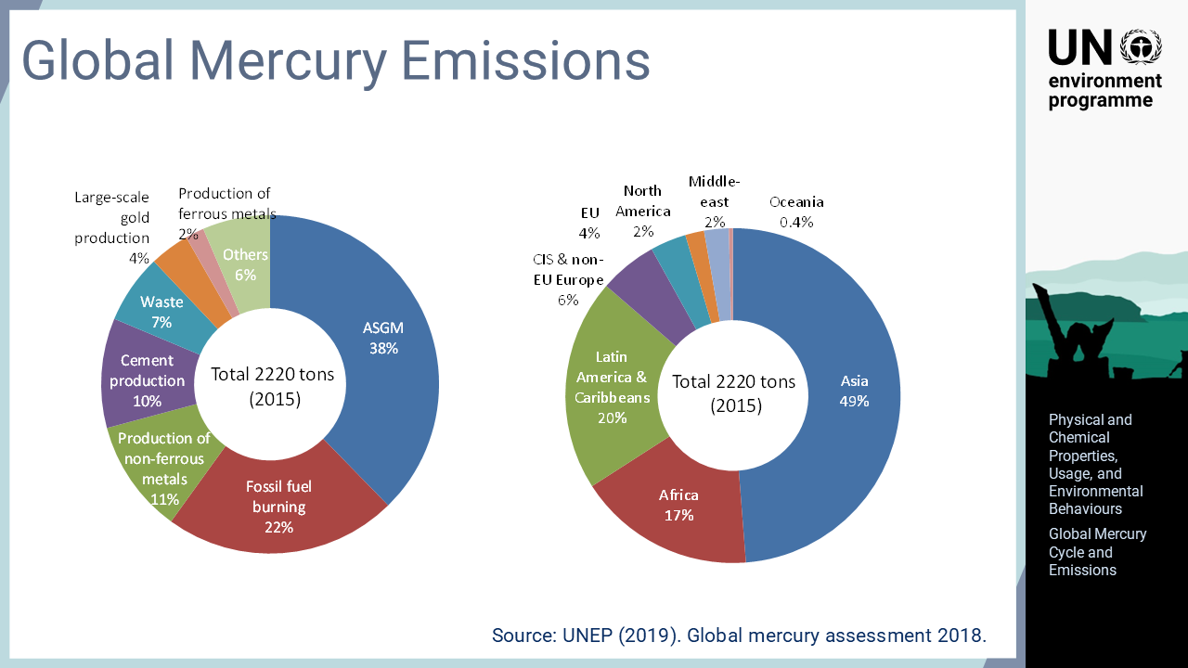
Notes:
‘28’ Similar to mercury usage, the largest mercury emission source is ASGM, which disproportionally affects marginalised and less privileged groups, such as children and women of child-bearing age. Asia, Africa, and Latin America and the Caribbeans are the regions emitting large amounts of mercury. The burning of fossil fuel and the production of cement and non-ferrous metals all remove mercury from the soil and emit it into the atmosphere. More importantly, such mercury by-product might increase with the economic development of developing countries.

