Slide 1
The global monitoring plan for persistent organic pollutants: outcomes of 10 years of POPs monitoring under the Stockholm Convention
Katarina Magulova
Secretariat of the Basel, Rotterdam and Stockholm Conventions

Slide 2
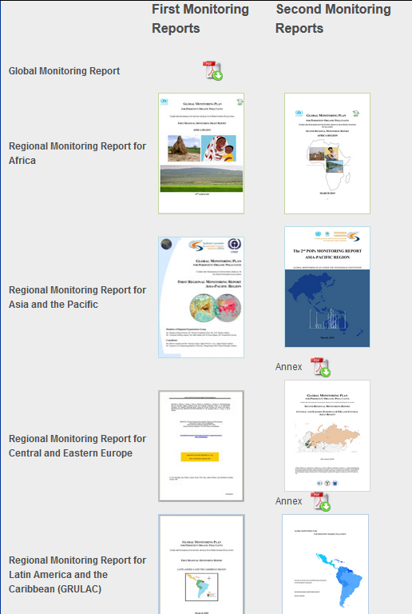
Regional and global monitoring reports
Second Global POPs Monitoring report will be presented in May 2017 at the 8th meeting of the Conference of the Parties to the Stockholm Convention
Global synthesis of 11 years of POPs monitoring data collection under the GMP since the entry into force of the Convention
Key input to effectiveness evaluation

Slide 3
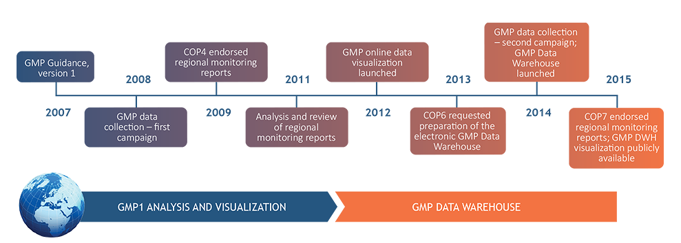
GMP Data warehouse
http://www.pops-gmp.org/

Slide 4
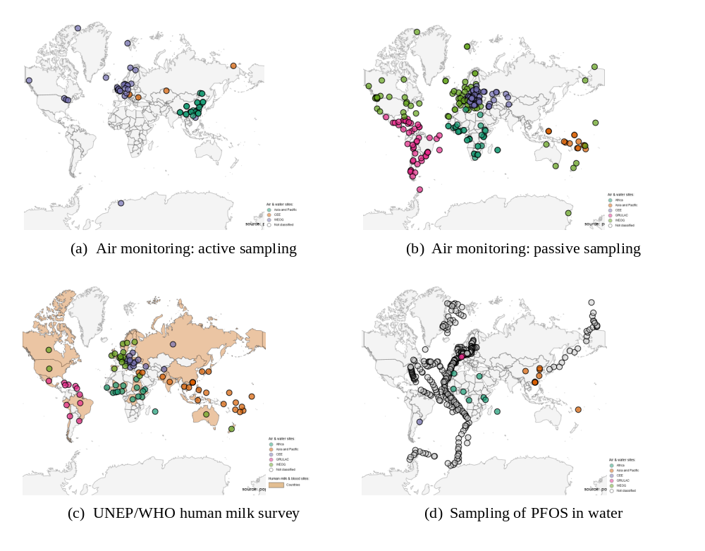
Data Availability

Slide 5
4. Results: changes in POPs concentrations over time

Slide 6
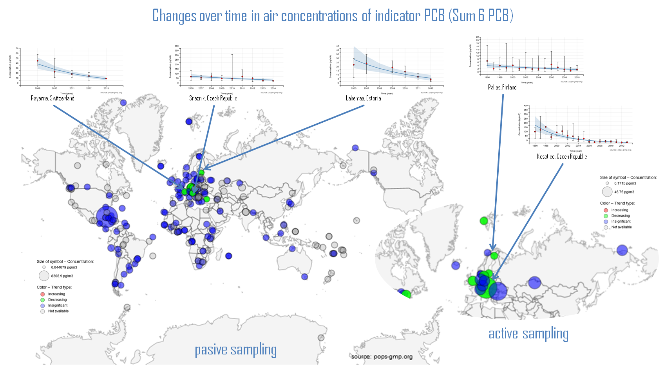
Changes over time in air concentrations of indicator PCB (Sum 6 PCB)

Slide 7
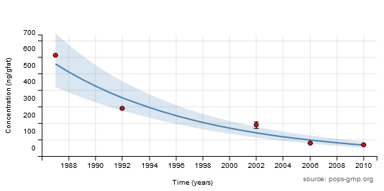
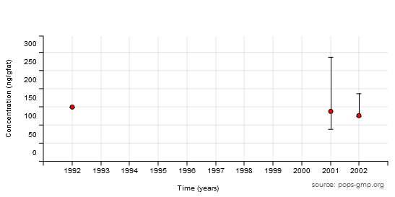
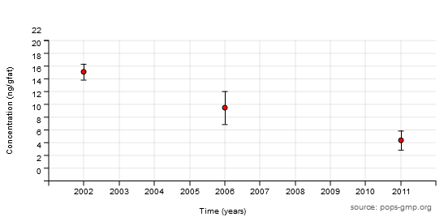
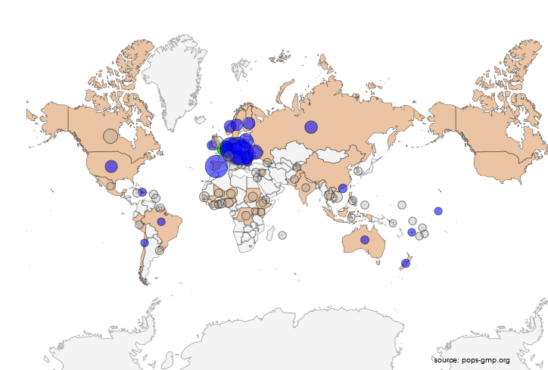
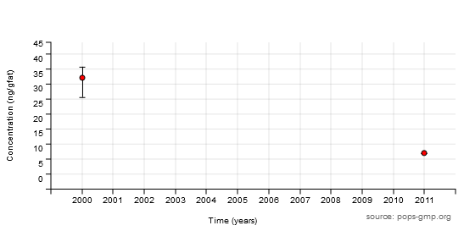
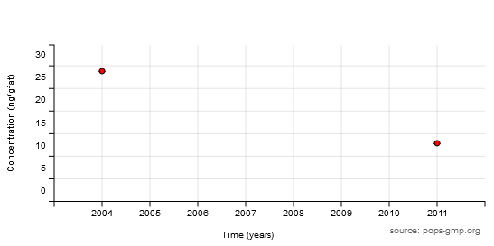
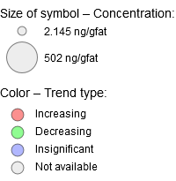
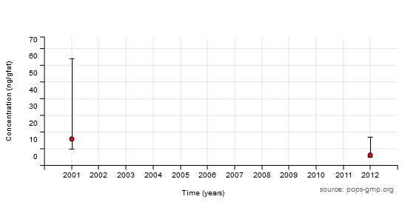
Changes over time in concentrations of indicator PCB in human milk (Sum 6 PCB)
Belgium
Russian Fed.
Fiji
New Zealand
Haiti
Brazil

Slide 8
Concentrations OF indicator PCB IN HUMAN MILK (Sum 6 PCB)

Slide 9
Concentrations OF pcdd/pcdf IN HUMAN MILK (Sum 17 PCdd/pcdf)

Slide 10
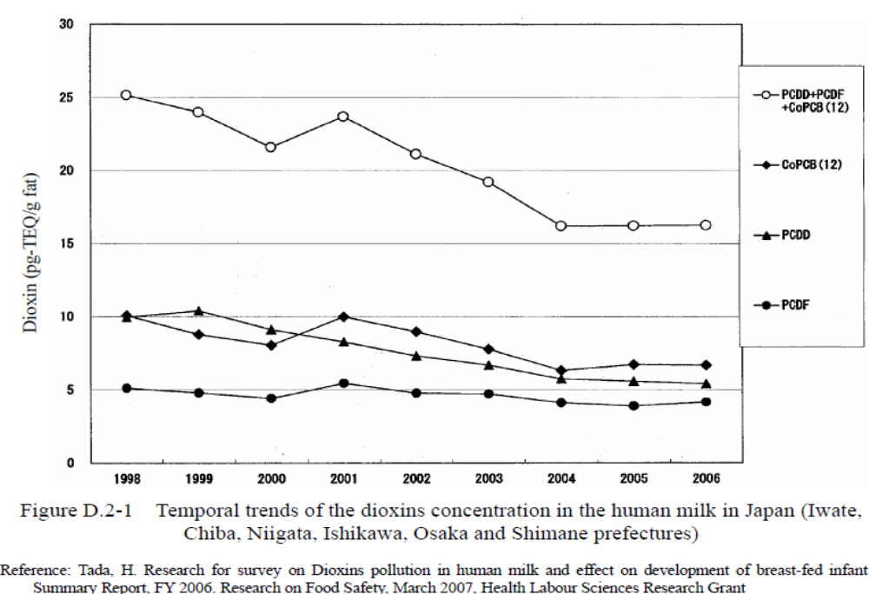
Trends – Dioxins (Japan)

Slide 11
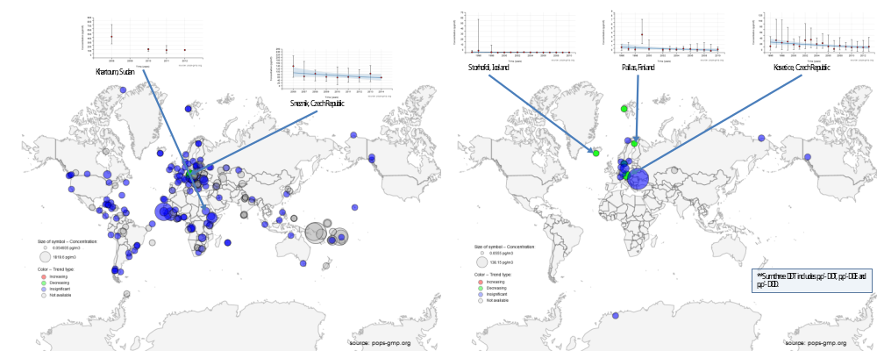
Changes over time in air concentrations of DDT (Sum 3 DDT)

Slide 12
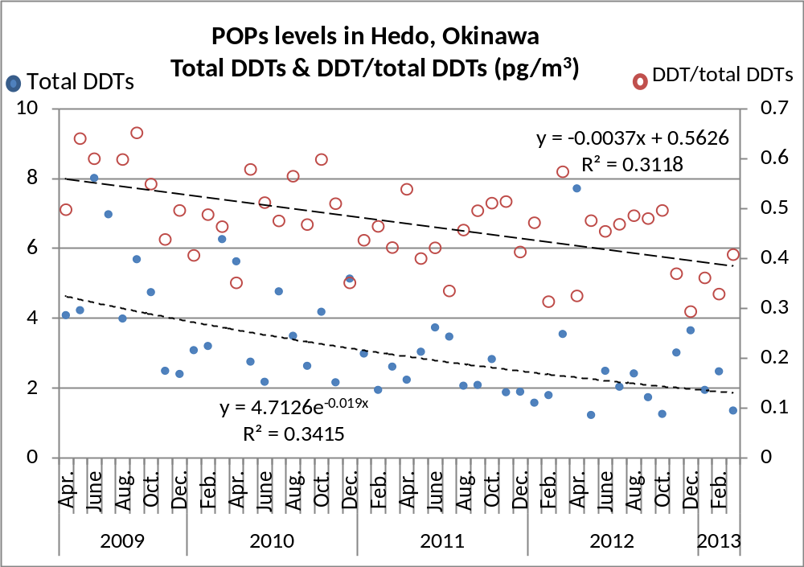


Trends – DDT in air, Japan

Slide 13
Concentrations OF ddt IN HUMAN MILK (Sum 6 ddts)

Slide 14
5. Acknowledgements

Slide 15
The worldwide implementation of the Global Monitoring Plan was made possible thanks to the generous contributions to the Stockholm Convention Voluntary Trust Fund from the Governments of Japan, Norway, Sweden, and through the European Commission’s Thematic Programme for Environment and Sustainable Management of Natural Resources, including Energy (ENRTP). Further, the contribution of the projects to support POPs monitoring activities in regions, funded through the Global Environmet Facility (GEF) and the Strategic Approach to International Chemicals Management (SAICM), is greatly acknowledged. Monitoring activities, and data collection and analysis are implemented in the five UN regions in cooperation with strategic partners and through involvement of Regional Organization Groups and Global Coordination Group.

Slide 16
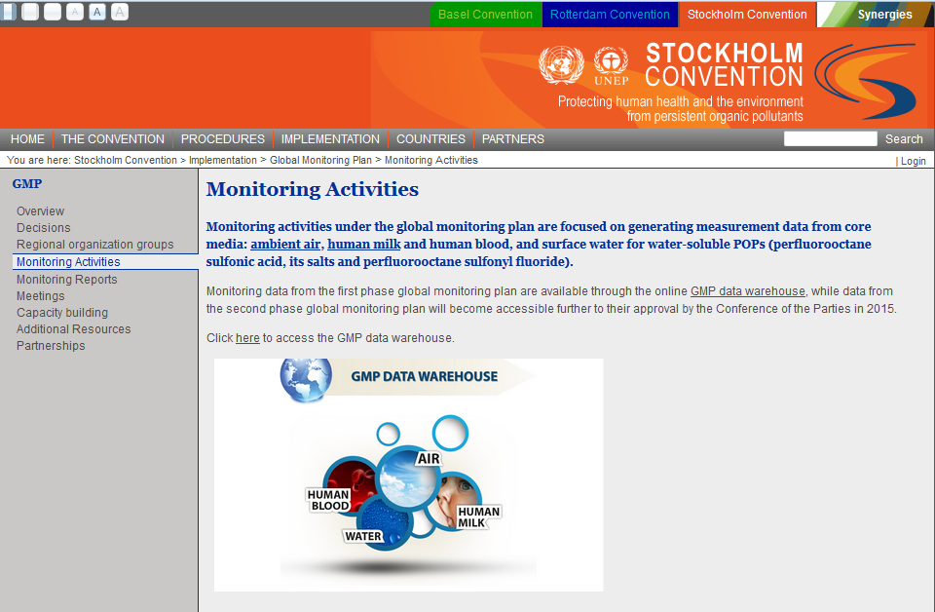
More information at:
chm.pops.int

Slide 17
Thank you for your attention

