Slide 1
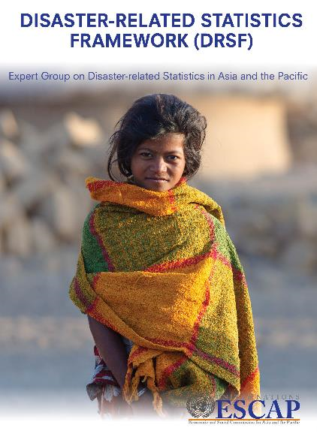
DRSF Basic Range of Disaster-related Statistics
https://stat-confluence.escap.un.org/display/TWG/DRSF%3A+Disaster-related+Statistics+Framework

Slide 2
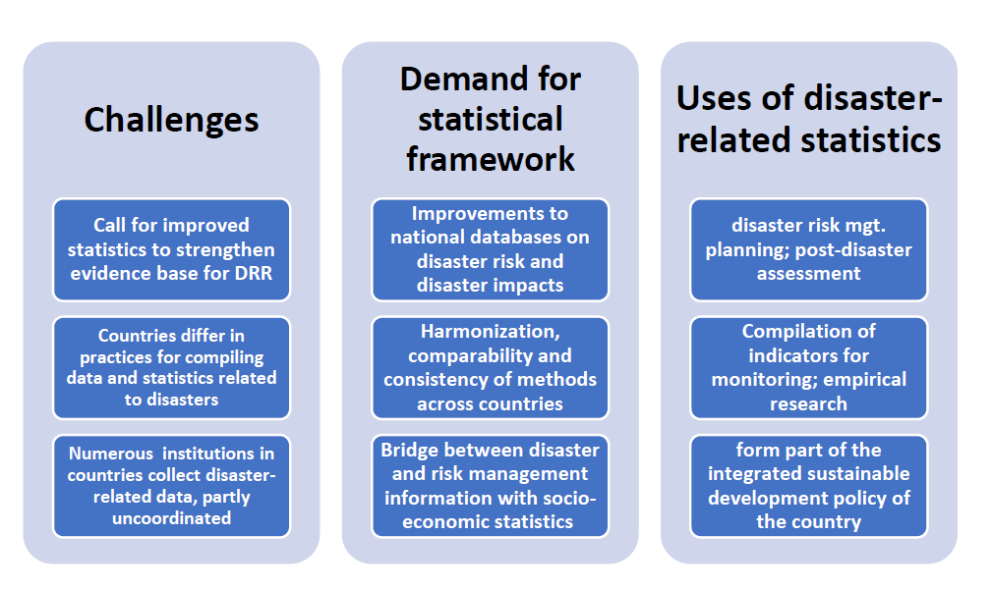

Slide 3
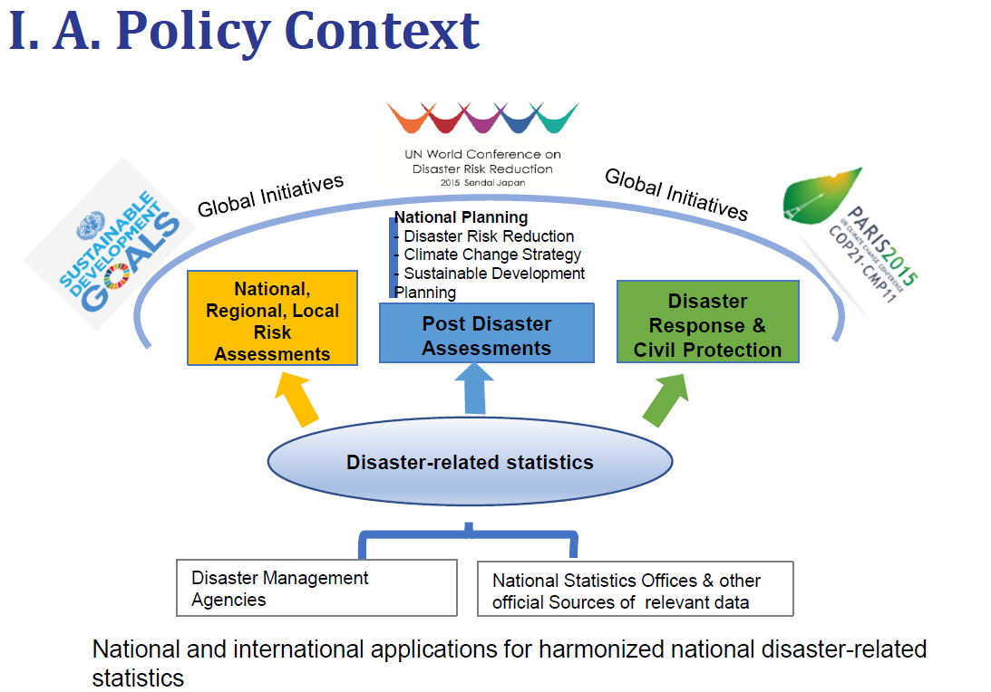

Slide 4
Components of the Basic Range of
Disaster-related Statistics
Emergency
Before hazards resulting in sudden disasters and slow processes resulting in disasters
During and after a disaster
Direct impacts to environment
and cultural heritage
(loss of critical ecosystems, water resources, cultural heritage zones or objects…)
Indirect impacts
(decline in economic value added as a consequence of direct economic loss and/or human and environment impacts)
Exposure
Direct human impacts
(deaths or missing, injured or ill, displaced or evacuated, damages to dwellings, loss of jobs…)
Vulnerability
3 core elements of
disaster-risk measurement
Direct material impacts and economic loss
(on fixed assets/valuables, critical goods and services, critical infrastructures…)
Coping capacity
Disaster Risk Reduction Activity

Slide 5
Basic range of disaster related statistics
Objectives: to help national statistical systems to assess data gaps; adopt priorities for statistical development for disaster risk management and identify opportunities to produce new statistics
Was developed based on pilot studies and extensive discussions by the Expert Group
Most of the statistics in the basic range are compatible with GIS, i.e., variables are associated with a standardized system of geo-referenced coding
Link to the complete DRSF statistical tables:
https://stat-confluence.escap.un.org/display/TWG/DRSF:+Disaster-related+Statistics+Framework?preview=/16155350/27852893/DRSF%20Tables_2021_Final.pdf

Slide 6
The basic range of disaster related statistics is organized according to generic tables or categories of tables:
  A: Summary tables of disaster occurrences
  B: Selected background statistics and exposure to hazards
  C: Summary tables of human impacts;
  D: Summary tables of direct material impacts in physical terms
  E: Summary tables of direct material impacts in monetary terms
  F: Summary of material impacts to Agriculture
  G: Summary table of direct environmental impacts and
  DRRE: Disaster risk reduction expenditure accounts

Slide 7
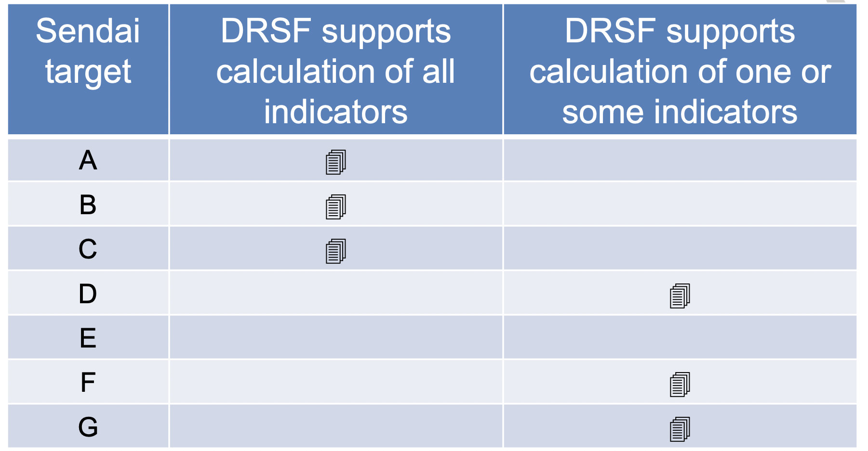
DRSF Tables for Sendai Indicators

Slide 8
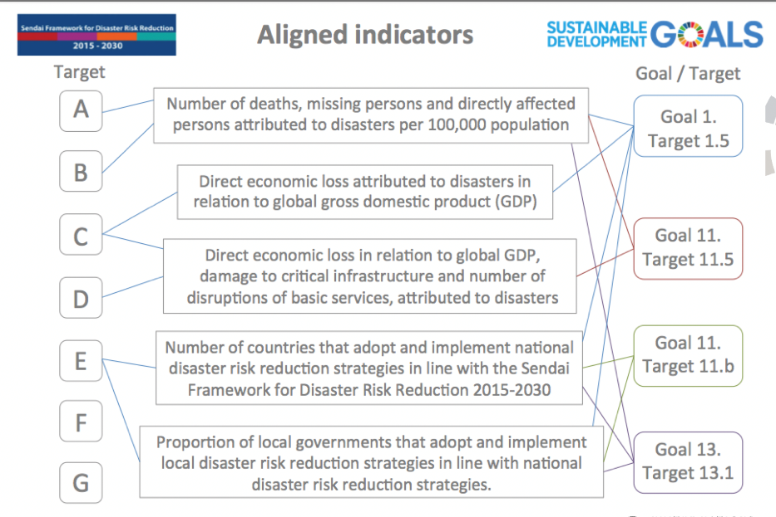
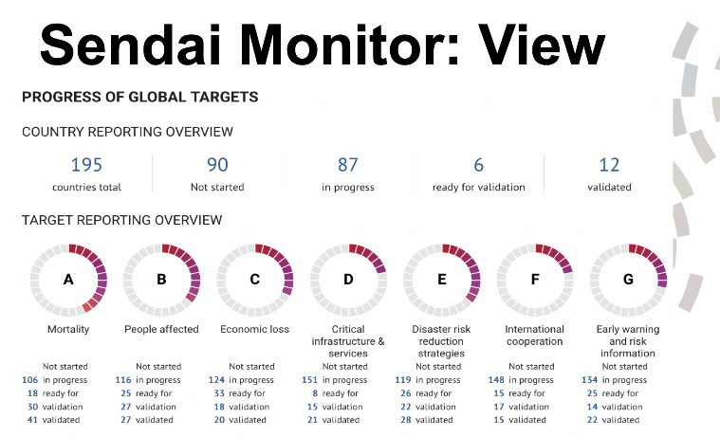
Linking the Sendai Targets to the SDGs

Slide 9
Basic range of disaster-related statistics: before a disaster
Before a Disaster | Concept | Data/Statistics | Indicators
Risk Assessment | process to determine the nature, extent, and locations of risk, by analysing exposure and conditions of vulnerability to hazards and present coping capacities against all types of disaster impacts. | Population density by location Characteristics of dwellings Information on assets of households, such as type of dwelling | Disaster risk indices Multi-hazard risk indices
Exposure to Hazards | state of being in which a person or a group of people remain in an imminent risk of danger due to hazards | Hazard map Map of the population, critical infrastructure Population density Land cover/Use HH income | Hazard Exposure by geographic regions Population Exposure by social groups Exposure of Land and Infrastructure by Hazard Type
Vulnerability | conditions determined by physical, social, economic and environmental factors or processes which increase the susceptibility of an individual, a community, assets or systems to the impacts of hazards. | statistics on basic social & demographic characteristics of populations, especially in high risk areas. | prevalence of sexual and physical violence and harassment in situations of instability women’s participation in post recovery process

Slide 10
Basic range of disaster-related statistics: before a disaster (con’t)
Before a disaster | Concept | Data/Statistics | Indicators
Coping Capacity | resilience of households, businesses, communities, social-ecological systems, and whole countries against external shocks in the form of a disaster | Disaster preparedness of HH; trainings attended Early warning systems Investments in DRR | Share of HH with emergency plans Population covered by early warning systems Share of HH with improved access to water
Disaster risk reduction activity (before a disaster) | Activities aimed at preventing new and reducing existing disaster risk and managing residual risk, all of which contributes to strengthening resilience | Expenses on land use planning; early warning systems; emergency management by institutional sector Production expenses on disaster preparedness; emergency supply by institutional sector | Activity expenditure and investment in disaster risk prevention and mitigation Current production expenditure on disaster management

Slide 11
Basic range of disaster-related statistics: during and after a disaster(con’t)
During and after a Disaster | Concept | Data/Statistics | Indicators
Disaster Occurrence | number of occurrences according to the hazards, scale and geographical classifications; provide background statistics for rapid assessment and decision-making by the disaster response authorities and allotting resources where needed | Annual, multi-year statistics on hazard type, date, time, geographical location, magnitude | context variables for statistics in other tables trend analyses, for measuring relative intensity of impacts over time.

Slide 12
Basic range of disaster-related statistics: during and after a disaster
During & after a Disaster | Concept | Data/Statistics | Indicators
Direct impacts: (economic loss) - to environment and cultural heritage | Physical damage happening during or shortly following a disaster directly triggered by a hazard. damage to land and other natural resources, ecosystems | Area of agricultural plantation destroyed Area of urban and dev’t area destroyed Area of cultural heritage sites destroyed | Effect of disasters on GDP Damage to ecosystems by land cover type Damage to natural water resources Damage to the atmosphere
- human impacts | Loss of lives; personal injury and illness; displacement of people due to disasters | hazard type by geographic region No. of deaths, injured, displaced, loss of jobs No. of persons evacuated; received aid | human impacts by hazards types and geographic regions affected human, population by demographic &social categories
- material impacts | Damages to buildings and structures; machinery | Dwellings, buildings and structures destroyed damage to critical infrastructure (roads, bridges, dams | direct material and agricultural impacts by hazards types and geographical region Disruption of basic services by hazard type and geographical region

Slide 13
Basic range of disaster-related statistics: during and after a disaster(con’t)
During and after a Disaster | Concept | Data/Statistics | Indicators
Indirect impacts (indirect economic loss) | Consequences of a disaster to the economy or other social conditions for which causality is not directly observed | time series statistics on: hazards; population and housing; economic activities from business surveys | Loss of livelihood Disruption of basic services as a consequence of disasters
Disaster risk reduction activity | aimed at preventing new and reducing existing disaster risk and managing residual risk, all of which contributes to strengthening resilience | Expenditures on relocation, rehabilitation and construction by institutional sector Government expenditure for disaster risk reduction Public transfers to private | Production expenditure on disaster recovery’ Research & dev’t, education expenditure Disaster-reduction transfers paid

Slide 14
Title of Basic Range of Disaster-related Statistics Tables
A Summary Table of Disaster Occurrences A1 Summary table of disaster occurrences, by hazard types, scale, and geographic region
B Selected Background Statistics and Exposure to Hazards B1a Population background statistics and hazard exposure by geographic regions B1b Population exposure by social groups B2 Exposure of land and infrastructure by hazard type B3 Coping capacity background statistics
C Summary Tables of Human Impacts C1 Summary table of human impacts by hazard types C2 Summary table of human impacts by geographic region C3 Summary table of human impacts by demographic and social categories
D Summary Tables of Direct Material Impacts in Physical Terms D1a Summary table of direct material impacts by hazard types D1b Summary table of direct material impacts by hazard types and geographic region D1c Summary of agricultural impacts by hazard types and geographical regions D2a Disruption of basic services from a disaster by hazard type D2b Disruption of basic services from a geographic region

Slide 15
Title of Basic Range of Disaster-related Statistics Tables
E Summary Table of Direct Material Impacts in Monetary terms E1a Summary table of direct material impacts by hazard types E1b Summary table of direct material impacts by hazard types and geographic regions
F Agriculture F1 Summary of material impacts to agriculture by hazard types
G Summary Tables of Direct Environmental Impacts G1 Summary table of direct environmental impacts by hazard types G2 Summary table of direct environmental impacts by hazard types and geographic regions
DDRE Disaster Risk Reduction Expenditure Account DDRE_Activ. Production expenditure account (current plus investment) by characteristic activities DRRE_Trans. Transfers expenditure account and DRR National Expenditure.

Slide 16
Summary of Statistics Tables
Before a disaster: Tables B, E
B: Selected baseline statistics
and exposure to hazards
E: DRRE: Disaster risk
reduction expenditure
accounts
B tables are for assessing hazard exposure statistics, which are compiled prior to disaster occurrences, and updated over time according to the relevant categories (hazard types and geographic zonings); the DRRE provides the background statistics on coping capacity and resilience.

Slide 17
Summary of Statistics Tables
A: Summary tables of disaster
occurrences
During a disaster: Tables A, C, D, E
C: Summary tables of human impacts
D:Summary tables of direct material
impacts in physical terms
E: DRRE: Disaster risk reduction
expenditure accounts

Slide 18
Summary of Statistics Tables
C: Human impacts
D: Direct material impacts in physical terms
After a disaster: Tables C,D,E,F,G
E: Direct material impacts in monetary terms
F: Material impacts to agriculture
G: Direct environmental impacts
E: DRRE: Disaster risk reduction expenditure
accounts

Slide 19
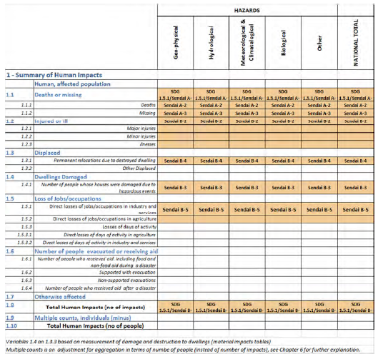
Example of C table
Table C1: Summary table of human impacts by hazards types
Some data and statistics relate to both human and material categories. For example, the same data sources that are used for accounting for damaged or destroyed dwellings (Sendai Framework Target C for economic loss) should also be applicable for estimating the number of people whose houses were damaged (Sendai Framework Target B for affected population).

Slide 20
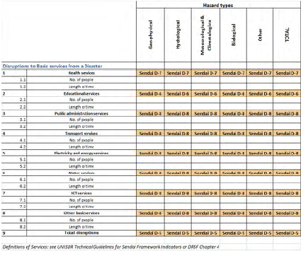
Example of D table
Table D2a: Disruption of basic services from a disaster by hazard type
Disruptions to the functioning of a community or a society is one of the defining elements of disasters. The table is an extension of the direct material impacts tables, especially impacts to critical infrastructure. The recorded disruptions are caused by the material impact, and have a direct consequence on the affected people.

Slide 21
Thank you
WWW.UNESCAP.ORG
UNESCAP
UNESCAP
UNESCAP
UNITEDNATIONSESCAP
UNITEDNATIONSESCAP
Notes:
Add a slide on international recognition
“what happened since ESCAP endorsed the framework”
UNSC
IAEG
TWG

