Slide 1

WORLD
ENVIRONMENT
DAY 2017
A presentation to the Sub-Committee Meeting of the
Committee of Permanent Representatives to the
United Nations Environment Programme
THU 27 APR 17

Slide 2

World Environment Day
World’s biggest day to celebrate the environment
UN Environment-inspired; universally “open source”
Digital + events
Symbol + substance; fun + further
2

Slide 3

Connecting People to Nature
3

Slide 4

2017 Global Host Country
4

Slide 5

2017 Global Host Country
4000+ activities
150+ regional
events
Greenlit icons
Advocacy moments
HQ •
Oceans Summit •
Partnerships •
5

Slide 6




Toolkits to Inspire and Guide Activities
Governments & cities
Schools
Businesses & organisations
Citizens
Universities
6

Slide 7
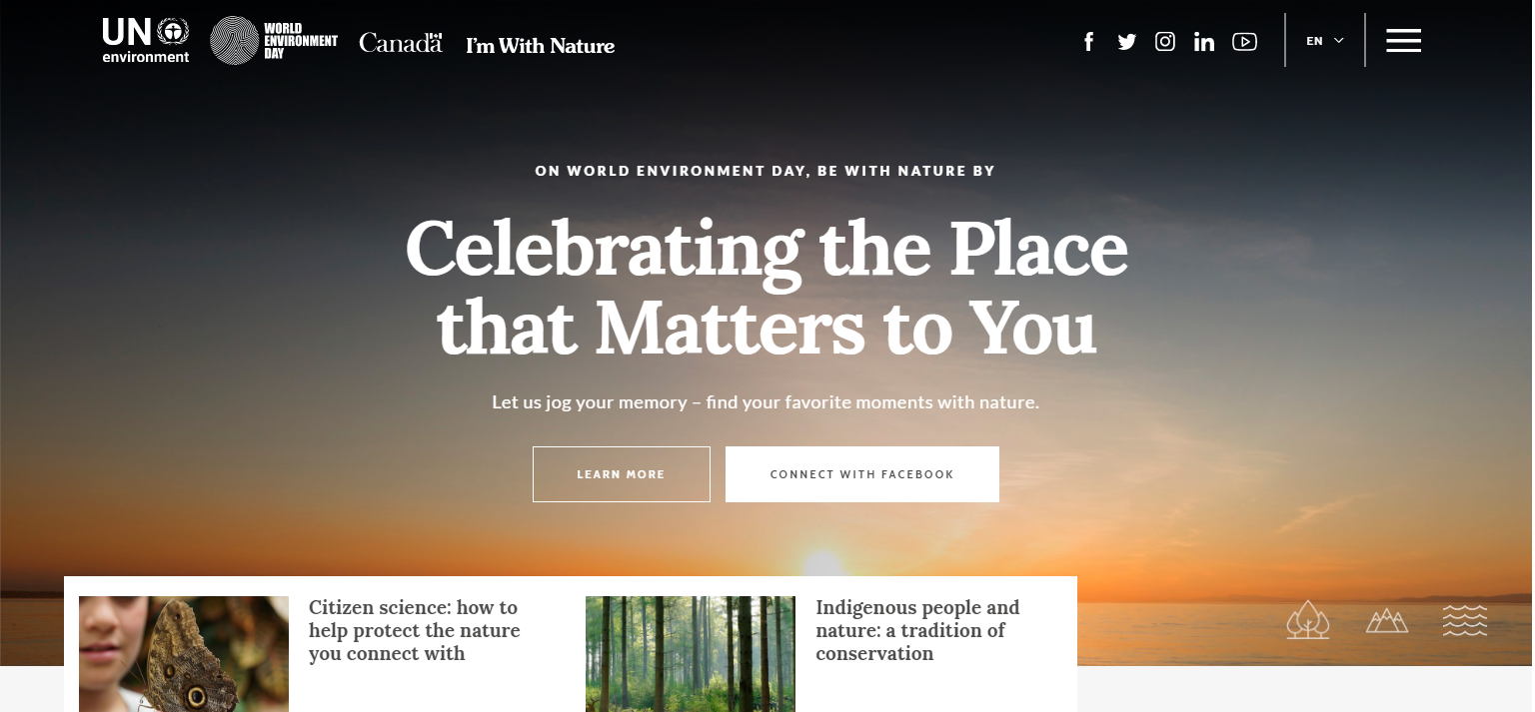
worldenvironmentday.global
Inform | Inspire | Involve
Call to action / engagement
#WithNature
Event registration
7

Slide 8
A Call to Action on Conservation Areas
Review the latest data available on protected areas
Evaluate how far the world is from meeting its commitments on area-based conservation measures (Aichi Target 11)
Make recommendations on ways to bridge the gap
A call to raise the ambition and commitments for area-based conservation for 2020 and beyond
8

Slide 9
Member States
Make a new announcement
A protected area? A related policy? A new resource or programme? Join a 24-hour arc of announcements
Call on citizens to get out into nature
Free access to parks; special programmes
Invite Education, schools; inspire others to participate
A special action-learning moment; a great moment to engage on integration, and the Environment Assembly
Engage leadership; host a special event
A great visibility moment; a great day for out-of-the-box, out-of-the-office events
9

Slide 10
Thank you
worldenvironmentday.global
#WorldEnvironmentDay
#WithNature
For more information:
Sam.Barratt@unep.org
Valeria.Torner@unep.org
Naysán Sahba
Communication Division
communication.director@unep.org
www.unep.org

