Slide 1

Operational Efficiency and Effectiveness
9th Annual Subcommittee Meeting
Sonja Leighton-Kone, Director, Corporate Services Division

Slide 2
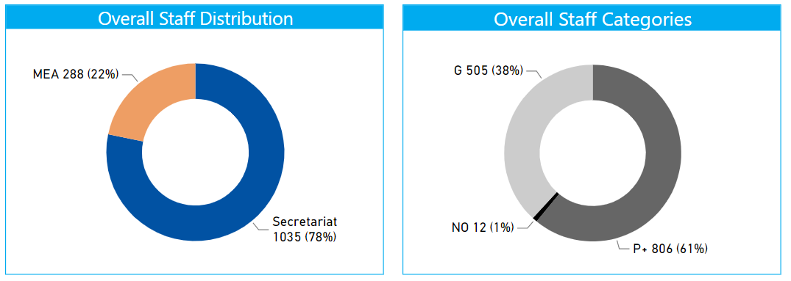

Human Resources Overview
General Staffing
  Staff Distribution and Categories
  As of 30 September 2022, UNEP employed 1323 staff members comprising 1035 (78%) in the Secretariat and 288 (22%) in the MEAs.
  Of the 1323 staff members, 806 (61%) were in the professional and higher categories, 12 (1%) in the National Professional Officer (NPO) category and 505 (38%) in the General Service category.

Slide 3
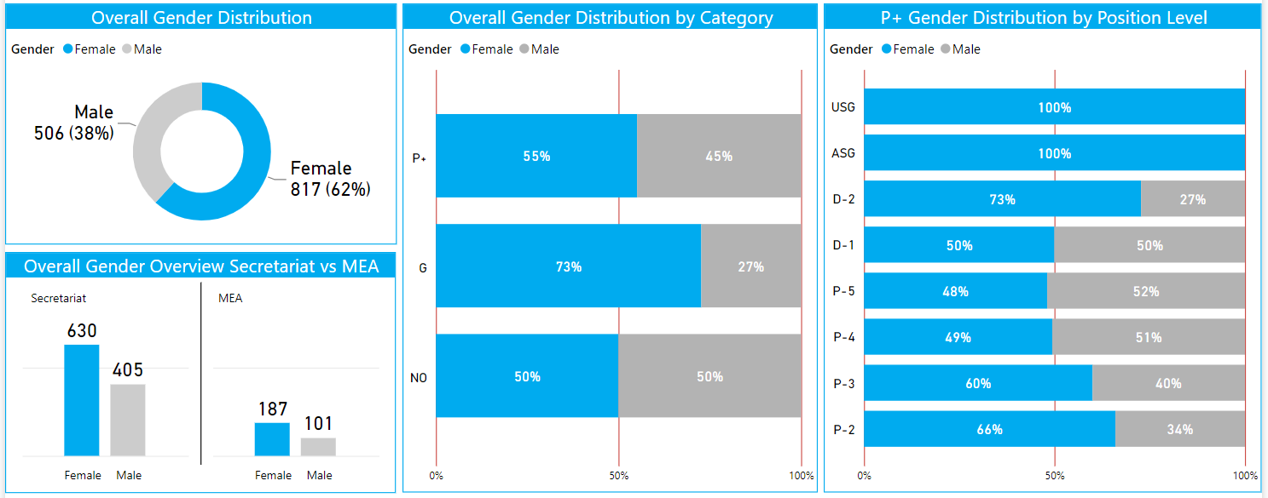
Human Resources Overview
General Staffing
  Staff Distribution and Categories
Out of the total staff portfolio of 1323 in September, 62% (817) are female and 38% (506) are male. The UNEP Secretariat employed 1035 staff. 61% were female and 39% male.

Slide 4
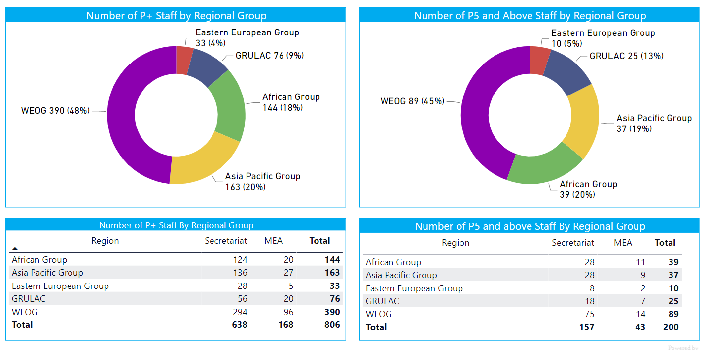
Human Resources Overview
Regional Representation – P and Above Staff

Slide 5
Human Resources
Outreach and Young Talent in accordance to the 4-Point Plan
Key Achievements:
The internal Human Resources Dashboard for senior management and hiring managers
Outreach products (presentations, distribution materials) specifically on How to Apply to UNEP for outreach events and career fairs
Working with/through UNEP networks:
Internal UNEP sections and units who are recruiting
UN-system wide: UN agencies/entities, inter-agency working groups
Academic institutions with graduate programmes, research institutions and alumni networks in targeted regions and/or with large diaspora from targeted regions
Developing the Young/Future Talent Pipeline for specific number of recruitments to be targeted at focus regions.
Engagement
 | Engagement (Active) | Passive (Engagement)
Q1 2022 | 1200 | 1100
Q2 2022 | 3675 | 3945
Q3 2022 | 135 | 432
Total engagement | 5010 | 4487

Slide 6
Conduct and Discipline Policy and Approach Priorities
Misconduct Risk Register- Priority areas identified
Types of misconduct
Sexual harassment
Abuse of authority and harassment
Sexual Exploitation and Abuse
Unauthorized outside activities
Other types of misconduct including fraud and corruption
Reporting
Reporting misconduct
Preliminary assessments- Timeline to complete reviews of reports of possible unsatisfactory conduct and implementation of recommendations from preliminary assessments
Cooperation with the Office of Internal Oversight Services (OIOS)
Actions taken
Managerial, administrative and disciplinary measures

Slide 7
Implementation of Misconduct Risk Register
Capacity awareness/sensitization for UNEP Personnel
Trainings- Leadership role in addressing sexual harassment
Regular update of internal UNEP C&D page to sensitize UNEP Personnel
Q and A Memo on Outside occupation and activities
UNEP response on SH and SEA visible and whistleblower/retaliation on UNEP main website
5 United to Respect Dialogues Workshops
Mandatory training on “Preventing Fraud and Corruption at the United Nations”
UNEP is raising awareness about fraud and corruption: UNEP’s Corporate Academy includes two courses on fraud and corruption: “Anti-Fraud Policy Fundamentals” (CSD 104) and “Navigating the Anti-Fraud and Anti-Corruption Policy” (CSD 105).
Sexual Harassment​
Actively follow up on complaints for sexual harassment with the OIOS
Administrative/Managerial action taken- Reprimand letter, Administrative leave without pay, termination of staff member appointment.
Broadcast to staff member on sexual exploitation and whistleblowing
Sexual harassment action plan for UNEP
UNEP Conduct and Discipline policy and approach
Sexual Exploitation and abuse (SEA)
Policy: Statement on the protection from SEA for Implementing partners
Policy: Statement on protection of SEA for UNEP Personnel
Active participation in UN SEA Working group
Active participation in the UNON- PSEA Task force- participated in the development the PSEA Brochure for UNON
Reporting on C&D
Annual fraud and corruption report
Annual conduct and discipline report
Report to the CPR on action on Sexual Harassment (SH) and Prevention of Sexual Exploitation and Abuse (PSEA)

Slide 8
Audit and Investigation Recommendations
External:
In 2021 and 2022, the following audits were undertaken:
The Board of Auditors (BOA) from China conducted the Internal Control and Management Audit (Interim) on UNEP Headquarter including Regional Office for North America (NAO) and The Secretariat of the Convention on Biological Diversity (SCBD) and the end of year Financial Audit (Final) for FY2021.
The following internal audits have been closed as implemented since the beginning of 2021:
2015 Audit of the United Nations Environment Programme Caribbean Environment Programme
2015 Environmental Governance Subprogramme
2016 Resource Efficiency Sub-Programme
2018 Audit of Official Travel at UNEP
2018 UNEP Afghanistan Project Office
2019 Audit of the Recruitment Process at the UNEP
2021 Audit on the Multilateral Fund (MLF)
2021 Evaluation of the Prevention, Response and Victim Support Efforts Against Sexual Exploitation and Abuse by the United Secretariat Staff and Related Personal.
Internal:
In 2021 and 2022, the following audits were undertaken:
2021 Audit of Accounts Receivable and Accounts Payable at UNON, UNEP and UN-Habitat:
Received 5 important recommendations.
2021 Audit of response to COVID 19 at UNON, UNEP and UN-Habitat:
Received 2 important recommendations.
2021 Audit on the Multilateral Fund (MLF): Received 6 important recommendations All 6 implemented.
2021 Audit on the Regional Office for Africa (ROA): Received 6 important recommendations.
2021 Audit on the UNEP Secretariat of the Convention on International Trade in Endangered Species (CITES): Received 9 important recommendations.
2021 Evaluation of the Prevention, Response and Victim Support Efforts Against Sexual Exploitation and Abuse by the United Secretariat Staff and Related Personal. All 2 implemented.
Audit of ICT Governance, operations and security at UNEP
Not yet published.
2022 Audit of the Ecosystems Division at United Nations Environment Programme Not yet published.
Ongoing implementation from internal audits: (26 total open recommendation)
2018 Audit of the Convention for the Protection and Development of the Marine and Coastal Environment of the West and Central African Region (Abidjan Convention) (2)
2019 Audit of Secretariat of the Convention on Biological Diversity (SCBD) (3)
2019 Audit of Management of Partnerships at UNEP (6)
2019 Audit of Grants Management at UNON, UNEP and UN-HABITAT (2)
2021 Audit of Regional Office for Africa (ROA) (3)
2021 Audit of Secretariat of the Convention on International Trade in Endangered Species (CITES) (7)
2021 Audit of Accounts Receivable and Accounts Payable at UNON, UNEP and UN-Habitat (1)
2021 Audit of response to COVID 19 at UNON, UNEP and UN-Habitat (2)

Slide 9

Management Decisions based on Risk Information
Key Achievements:
Risk Committee established
Risk Treatment and Response Plan Monitoring and Assurance Meetings proceeded
Enterprise Risk Management (ERM) and Environmental Management System (EMS) Integration
Additional ERM Module 3 & 4 to Corporate Academy
Assigning of Risk Focal Points for MEA’s, Divisions, Offices Away from Headquarters (staff+10)
Bottom-up Approach initiated along with Top-down Approach
Risks:
High risk categories (Implementing Partners and Procurement) require further corporate-wide leadership, discussion, strategy, and development due to their divisional transcendence and complexity
Lessons Learned:
Successful implementation of ERM requires establishment of essential internal organizational structures and resources with clear roles and responsibilities in line with the ERM policy and “three lines of defence” model.
A two-year cycle for the Top-Down/ Bottom-up approaches has been established to accommodate full deployment of the ERM framework across the Organization including its Divisions, MEA’s, and Offices Away From Headquarters (Staff 10+)

Slide 10

Environmental Sustainability Management
Key Achievements:
Assigning of Environmental Sustainability Focal Points for Offices Away from Headquarters
Compilation of UNEP Environmental Inventory and boundary extension
Environmental Risk registers approach initiated for Headquarters and Offices Away in line with Enterprise Risk Management (ERM)
Launch of the new Greening the Blue Tutorial to be mandatory for all UNEP personnel and five new EMS Modules to Corporate Academy
Update travel Guidelines to reduce environmental footprint from air travels
Commencement of work with UN Secretariat and Umoja/BI Team for Carbon Tool and its application to UNEP air travel Greenhouse Gases (GHG) emissions
Risks:
Available resources across Office Away from Headquarters for environmental data collection and the challenges associated with environmental sustainability management and implementation at shared facilities
EMS Policy and Manual need more updates, including risks identified during the establishment of Environmental Risk register
Updates to the UN secretariat software come with their own set of risks as the solution is not tailored for UNEP and its specificies
Lessons Learned:
Successful deployment of EMS across Offices Away from Headquarters requires:
Appointment of resources with clear roles and responsibilities and a knowledge sharing platform to improve capabilities and share best practices
Drawn up a systematic approach to facilitate consistent deployment of the EMS across the Offices Away From Headquarters

Slide 11
Thank you
Sonja Leighton-Kone Director, Corporate Services Division Sonja.leighton-kone@un.org
United Nations Avenue, Gigiri PO Box 30552 – 00100 GPO Nairobi, Kenya | www.unep.org

