Slide 1

System of Environmental-Economic Accounting
Session 3: Data collection, compilation of indicators and quality control National Workshop on Climate Change and Disaster-related Statistics
Ekaterina Poleshchuk

Slide 2

The System of Environmental-Economic Accounting (SEEA)
https://seea.un.org/
The System of Environmental-Economic Accounting (SEEA) is a framework that integrates economic and environmental data to provide a more comprehensive and multipurpose view of the interrelationships between the economy and the environment. It contains the internationally agreed standard concepts, definitions, classifications, accounting rules and tables for producing internationally comparable statistics and accounts. The SEEA framework follows a similar accounting structure as the System of National Accounts (SNA).
2

Slide 3
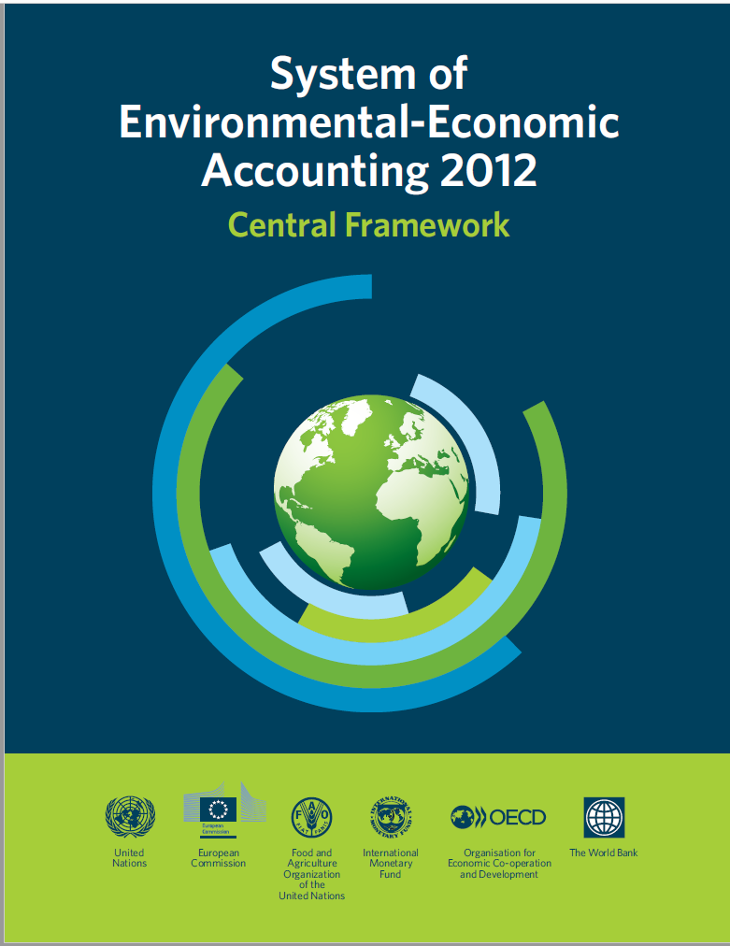
SEEA Central Framework (1/2)
https://seea.un.org/content/seea-central-framework
System of Environmental-Economic Accounting – Central Framework (SEEA CF) adopted in 2012 provides tools for describing stocks and changes in stocks of environmental assets (water, land, energy, timber, etc.), as well as supporting environmental activities
3
Assets accounts
Flow accounts
Environmental activity accounts

Slide 4
SEEA Central Framework (2/2)
https://seea.un.org/content/seea-central-framework
4
Flow Accounts
Describe the flows of materials and energy that come:
- from the environment to the economy,
- are used in the economy, and
- pass as residuals from the economy to the environment.
Asset Accounts
Measure the quantity and value of environmental assets and record changes in those assets over time.
Can be presented as material flows accounts, water accounts and energy accounts.
Consider the following environmental assets: mineral and energy resources, land, soil resources, timber resources, aquatic resources, other biological resources, and water resources.
Environmental Activity
Encompass those economic activities whose primary purpose is to reduce or eliminate pressures on the environment or to make more efficient use of natural resources.
Cover environmental protection expenditure, environmental goods and services, environmental taxes and subsidies, permits and licenses to use environmental assets.

Slide 5
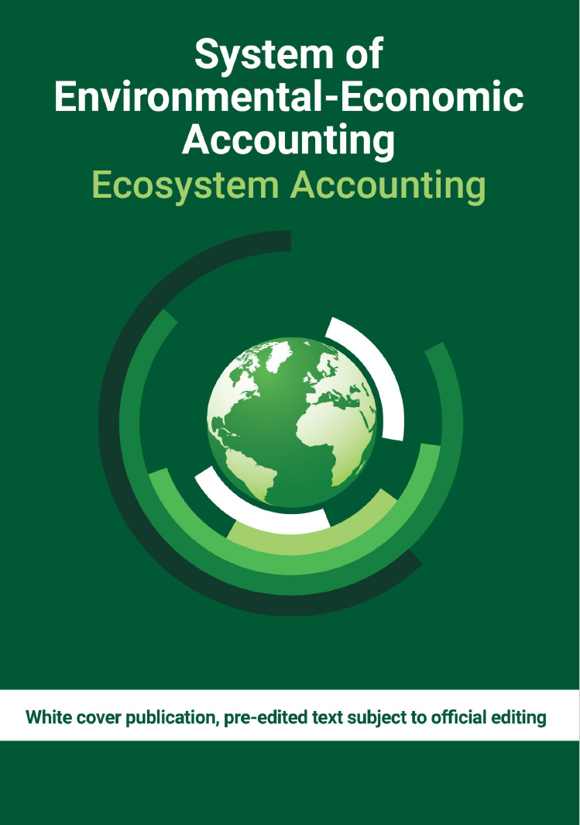
SEEA Ecosystem Accounting (1/2)
https://seea.un.org/ecosystem-accounting
System of Environmental-Economic Accounting – Ecosystem Accounting (SEEA EA) adopted in 2021 takes a spatial approach to accounting which identifies the location and size of ecosystem assets, the ecosystem services provided, and the location of beneficiaries
5
Ecosystem extent accounts
Ecosystem condition accounts
Ecosystem services accounts

Slide 6
SEEA Ecosystem Accounting (2/2)
https://seea.un.org/ecosystem-accounting
6
Ecosystem Accounts
Take a spatial approach to accounting which identifies the location and size of ecosystem assets and the ecosystem services provided.
- Ecosystem extent accounts record the total area of each ecosystem (terrestrial, freshwater and marine ecosystems).
- Ecosystem condition accounts measure the quality of an ecosystem measured in terms of its abiotic and biotic characteristics and how they have changed.
With focus on Climate Change
As described in Chapter 13 of the SEEA EA:
- Ecosystem extent accounts can be linked to emissions from land use, land use change and forestry (LULUCF).
- Condition accounts provide information on carbon storage in ecosystems, such as soil organic carbon and dry matter productivity.
- Ecosystem services accounts can also provide information on global climate regulation ecosystem services.
- Ecosystem services: providing, regulating, cultural.

Slide 7
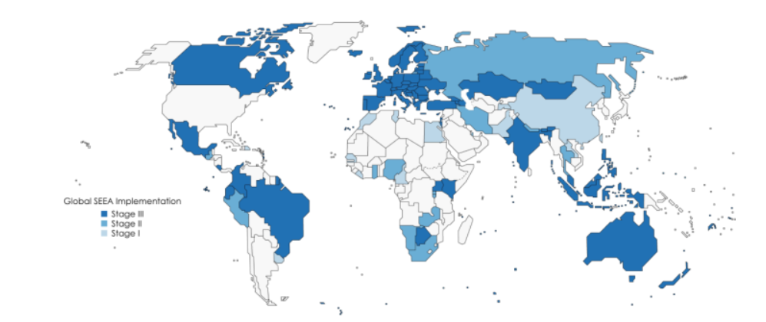
Global Assessment of Environmental-Economic Accounting
https://seea.un.org/content/global-assessment-environmental-economic-accounting
The Global Assessment of Environmental-Economic Accounting and Supporting Statistics is a survey, provided by UN Statistics Division Aim: to assess the progress of implementation of the SEEA in countries Results are available online: Country-by-country detailed results Report on the global assessment of SEEA
7

Slide 8
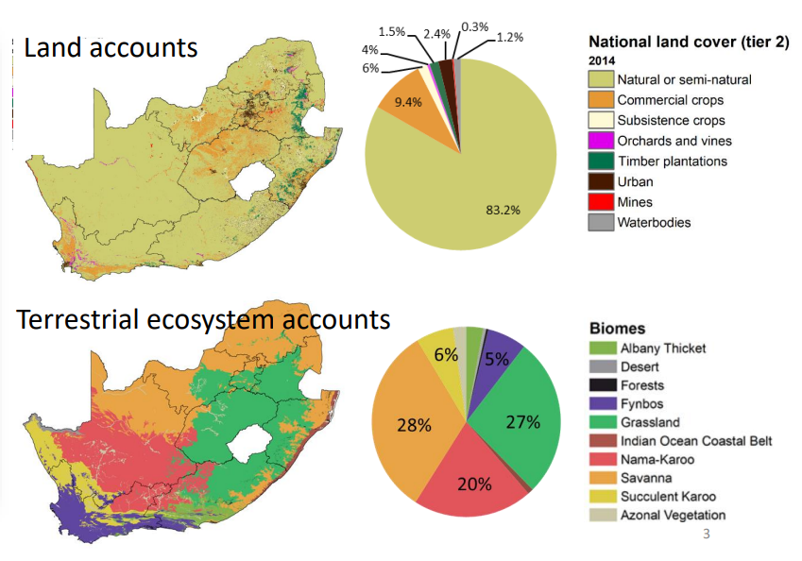
SEEA in different formats (1/2)
8

Slide 9
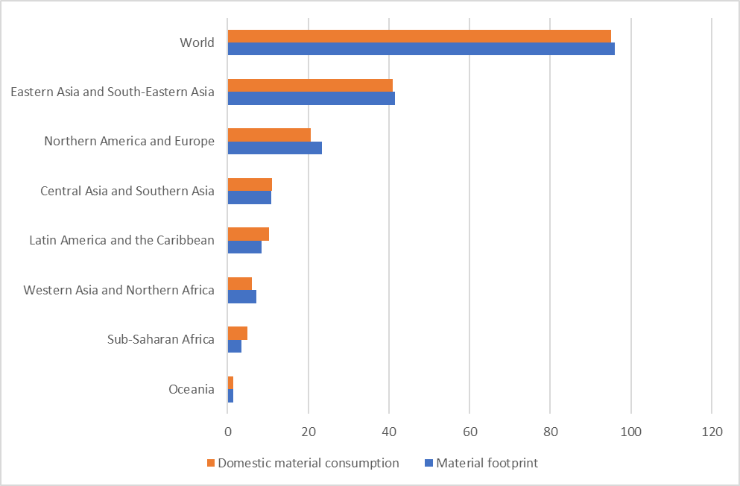
SEEA in different formats (2/2)
9
Indicators of economic pressure on the environment, 2019 (billion tons)

Slide 10
SEEA development at the national level
10
Preliminary Analysis:
  of legislative, institutional and methodological bases
  of international experience
Investigation :
  of data available in national institutions responsible for data collection
  of data available in international databases
Implementation:
  of environmental-economic accounts
Publication
Timeline: 2-3 years
4. Publication
3. Implementation
2. Investigation
1. Preliminary Analysis

Slide 11
Thank you
Ekaterina Poleshchuk Statistician, SDG and Environment Statistics Unit Early Warning and Assessment Division ekaterina.poleshchuk@un.org
United Nations Avenue, Gigiri PO Box 30552 – 00100 GPO Nairobi, Kenya | www.unep.org

