Slide 1
Compilation and dissemination of Environment Statistics

Slide 2
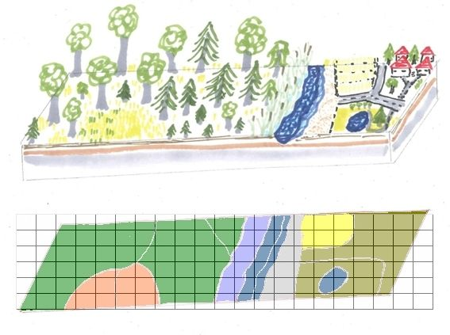
What do you need to compile statistics? Example Land cover
1. GIS platform
3. Expertise (EO, vegetation)
2. Maps
4. Ground truthing and statistics
Assess inputs,
Confusion matrix, Kappa
5. Classification(s) and units
International ones
Re-classify
Harmonize inputs
6. Compilation template
At least 2 time periods
Changes in additions and reductions
Aggregate and allocate statistics
Review available data sources

Slide 3
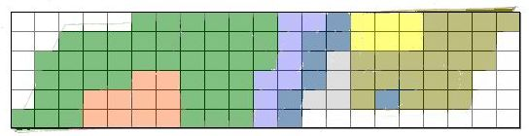
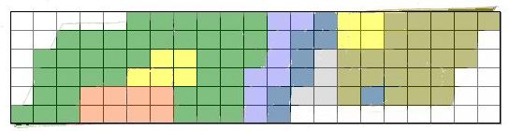
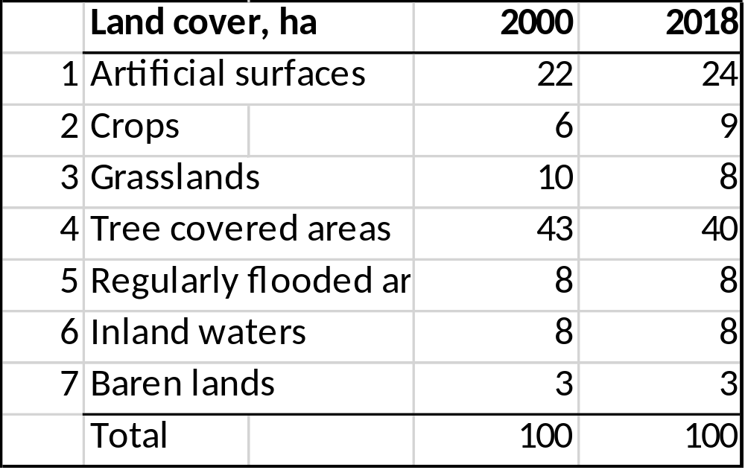
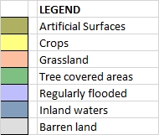
Land cover timeseries – basic statistics
Land cover 2000
Land cover 2018

Slide 4
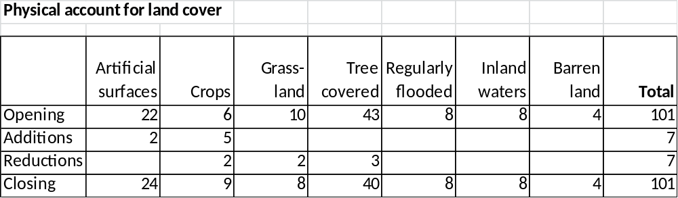
Land cover timeseries – calculate stocks and flows
Land cover 2000
Land cover 2018
Artificial surfaces +2
Crops -2
Grassland -2
Crops +2
Tree covered -3
Crops +3

Slide 5
Typical content of a compendium
Preamble
Acknowledgements
List of tables
List of figures
Abbreviations
Introduction
Methodology
Component 1: Environmental Conditions and Quality
Component 2: Environmental Resources and Their Use
Component 3: Residuals
Component 4: Extreme events and disasters
Component 5: Human settlements and environmental health
Component 6: Environmental protection, management and engagement
References

Slide 6
Process to develop an Environment Statistics Compendium
Following an assessment, identification of who (which institution) collects data; at what periodicity; via which data collection instrument (survey/ monitoring station/ administrative data) etc. can be made
Data may be centrally collected and compiled into a compendium by the NSO in collaboration with key stakeholders
A National Committee on Environment or similar committee can provide forum for conversation between NSO and ministries/agencies

Slide 7
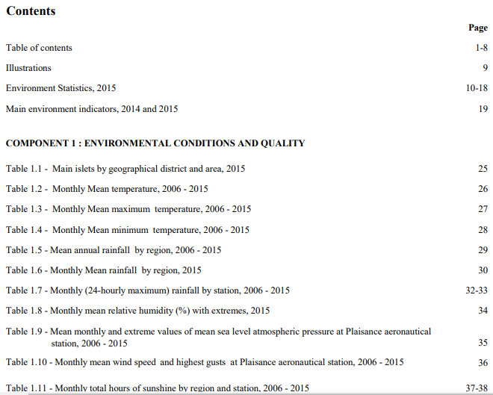
Demonstration of the Mauritian example…

Slide 8
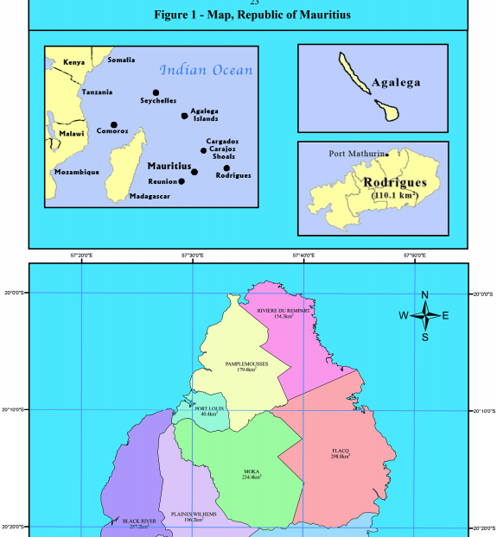
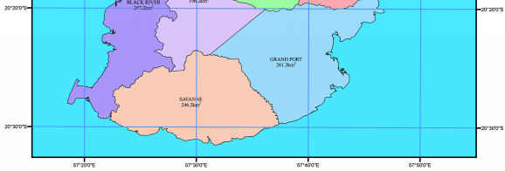
Demonstration of the Mauritian example… use of maps

Slide 9
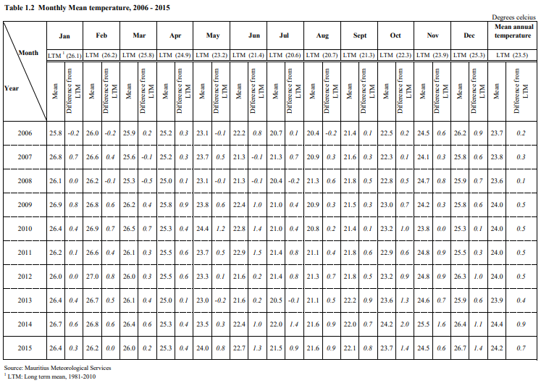
Demonstration of the Mauritian example: descriptive text to complement data…

Slide 10
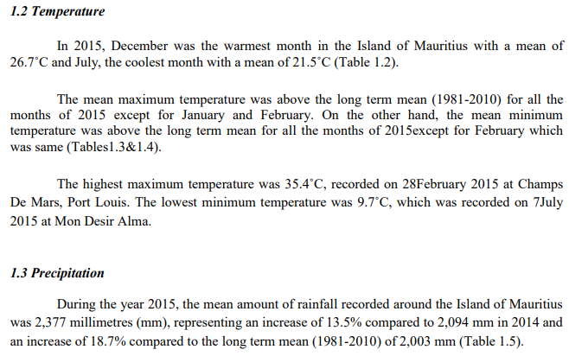
Demonstration of the Mauritian example: descriptive text to complement data…

Slide 11
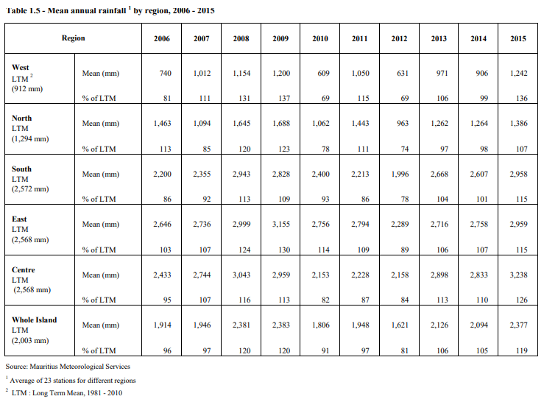
Demonstration of the Mauritian example: descriptive text to complement data…

Slide 12
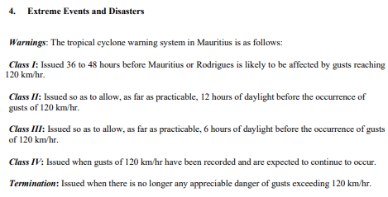
Demonstration of the Mauritian example: some (country-owned) definitions of terms used…

Slide 13
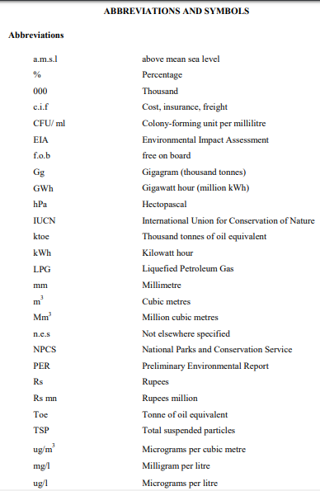
Demonstration of the Mauritian example: abbreviations used throughout…

Slide 14
The value of an Environment Statistics Compendium
Data and information can be shared with the public to inform perception and debate
Data are more readily accessible to researchers, policy analysts, key decision makers
The country is in ownership of its own data
A compendium is a natural follow-up to an assessment (e.g. if a country applies the Environment Statistics Self-Assessment Tool (ESSAT))
Compendium serves as a tool of coordination among the Statistical Office and ministries/agencies
Behind the scenes of a glossy compendium, there is invariably a database or several databases on several environmental themes which can be developed in the long-term
Compendium can improve quality of data

Slide 15
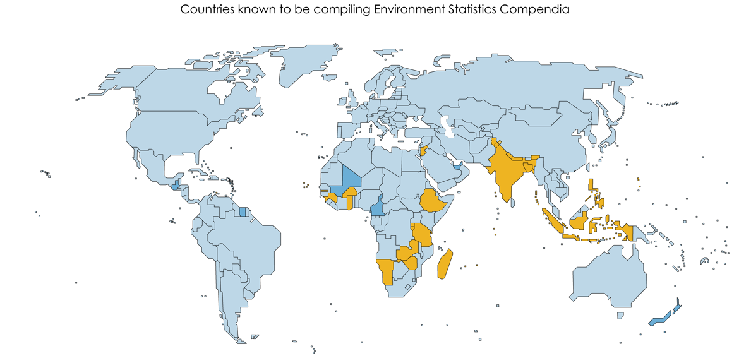
Examples of countries publishing Environment statistics compendia
FDES-coherent compendium Environment statistics compendium
https://unstats.un.org/unsd/envstats/fdescompendia.cshtml
Notes:
Following the adoption at the 47th UNSC of the FDES, countries were advised to … Peru to mention. Please share links with us, there are certainly more similar

Slide 16
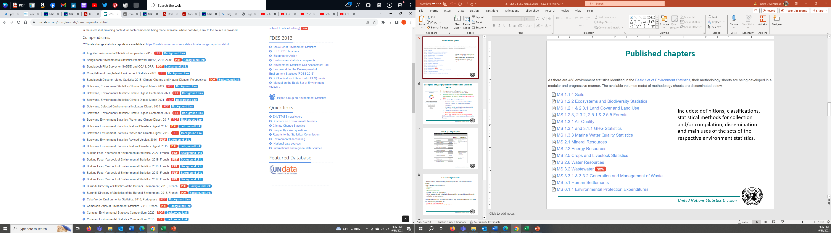
UNSD’s commitment to provide continuous support
Offers on its website countries compendia via their source links
Notes:
IF you like to add your publication to this list please send us an email at

Slide 17
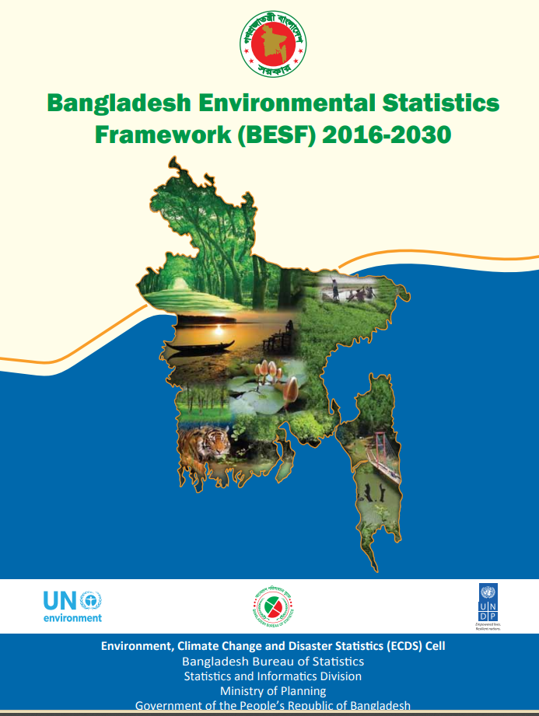
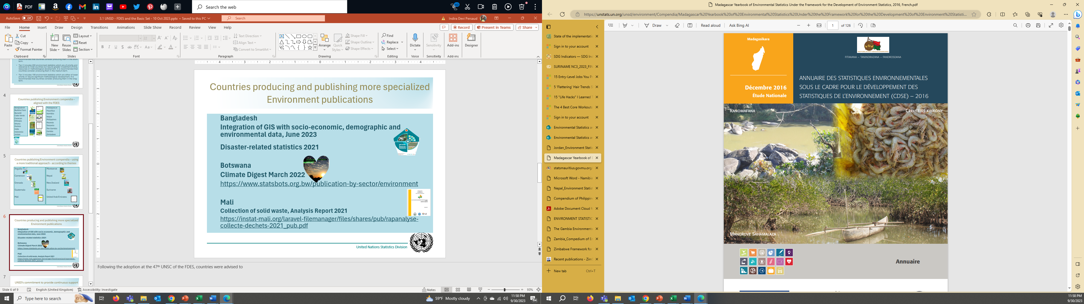
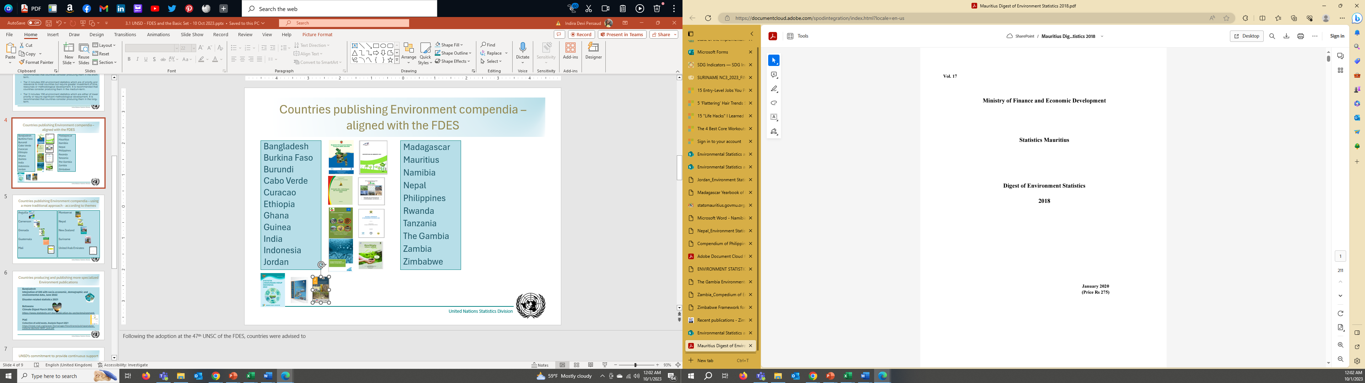
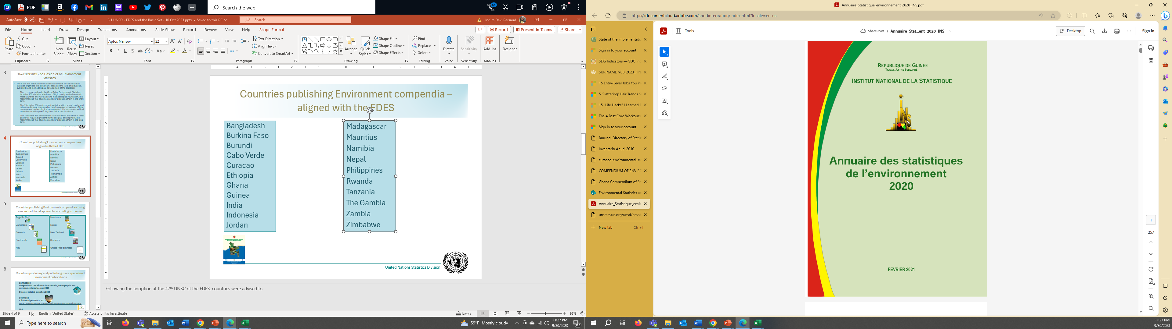
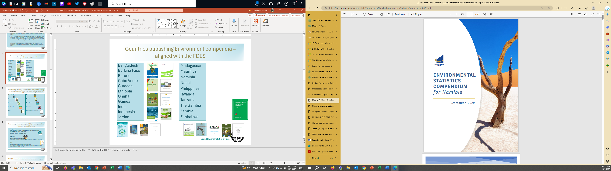
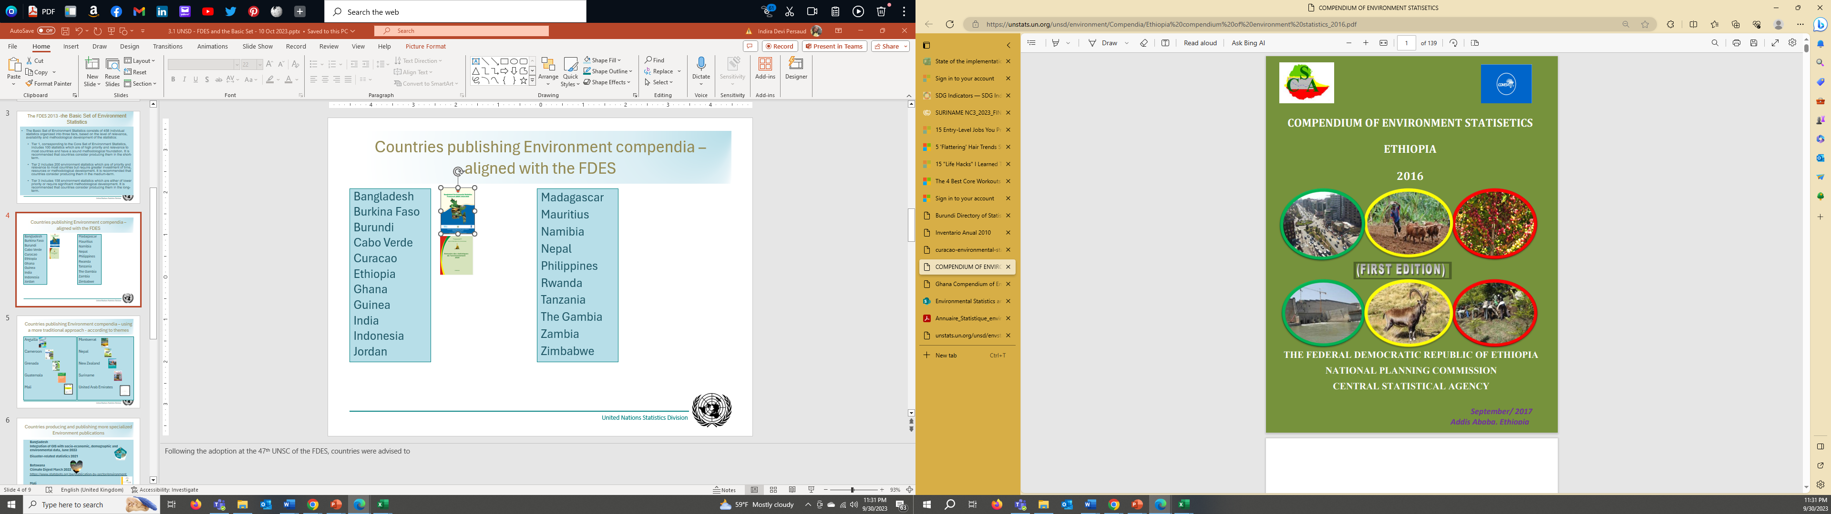
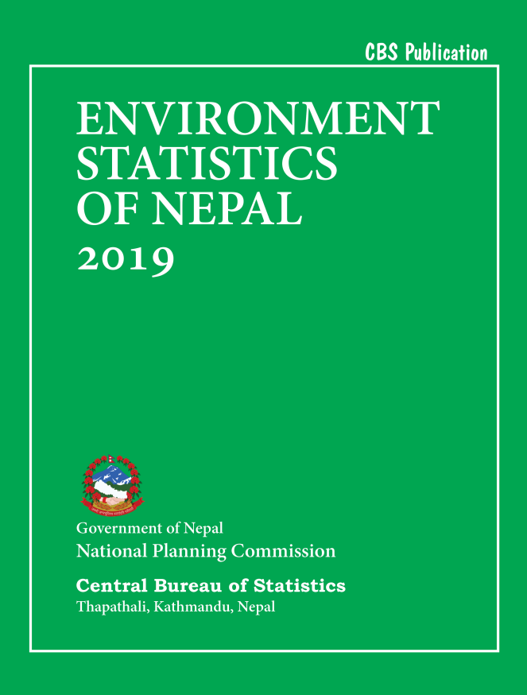
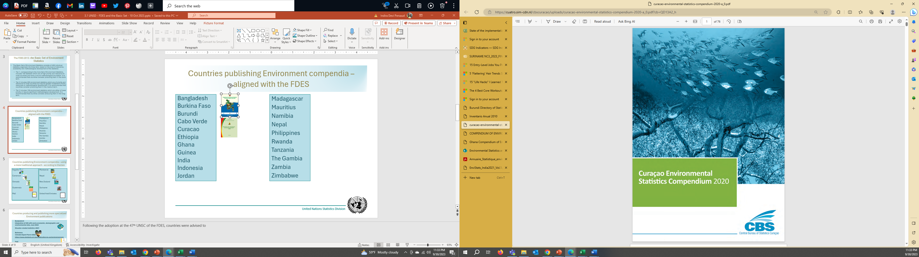
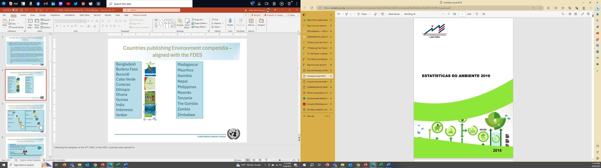
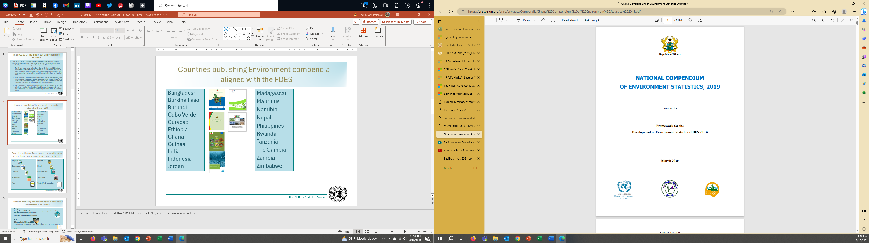
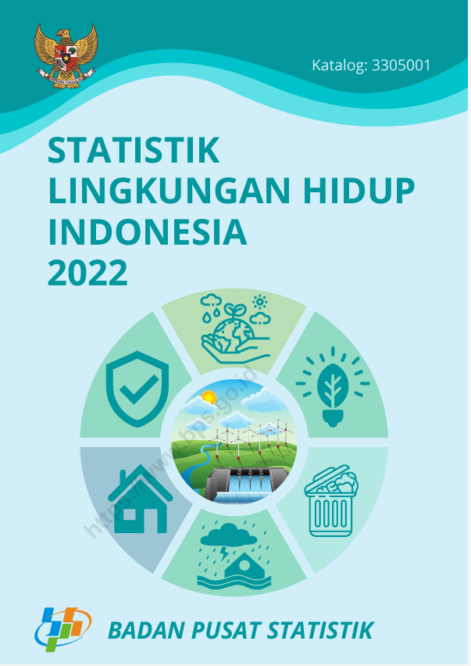
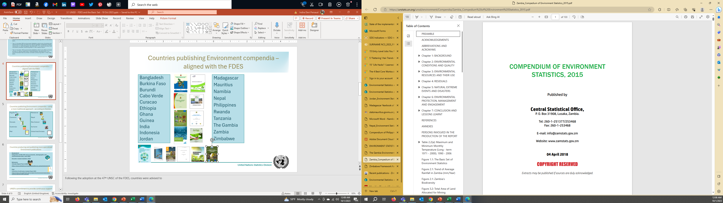
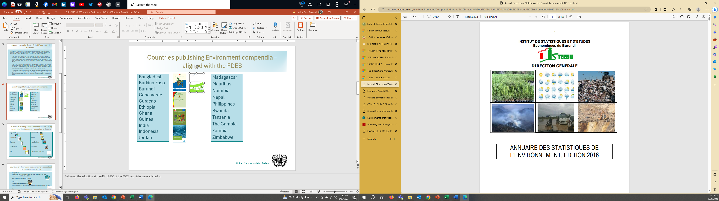
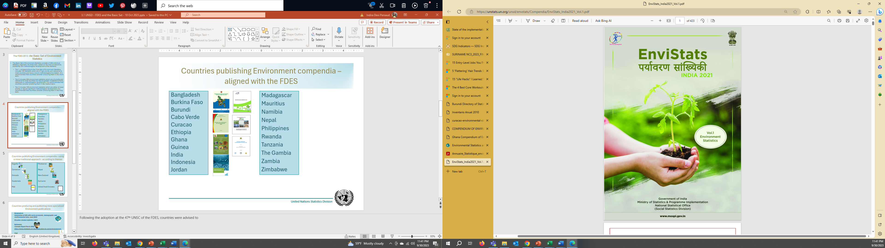
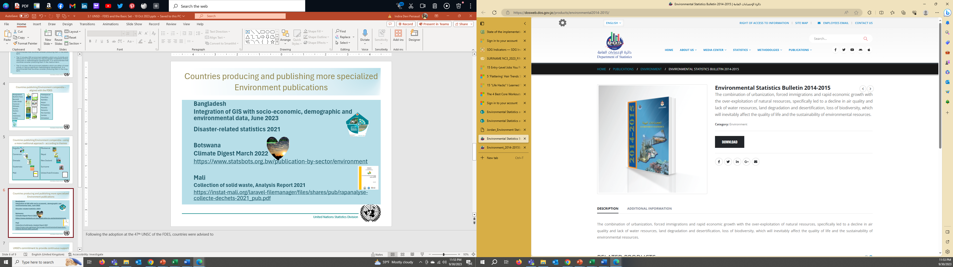
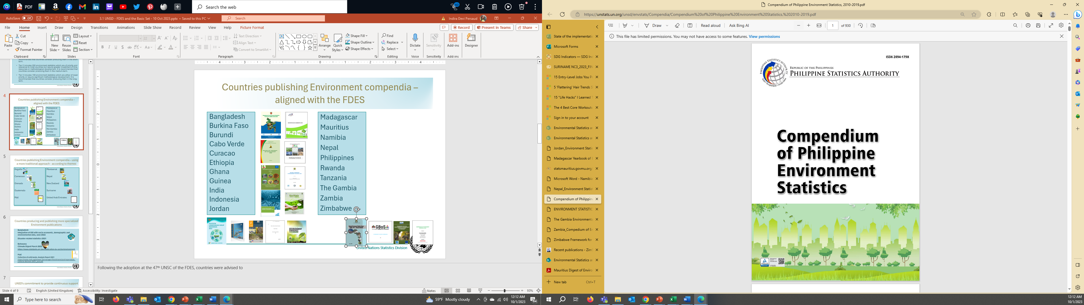
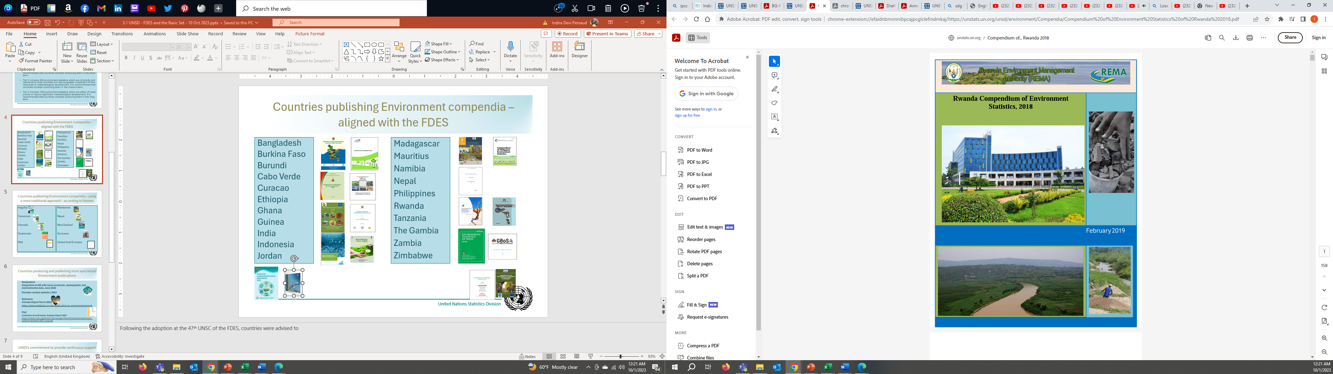
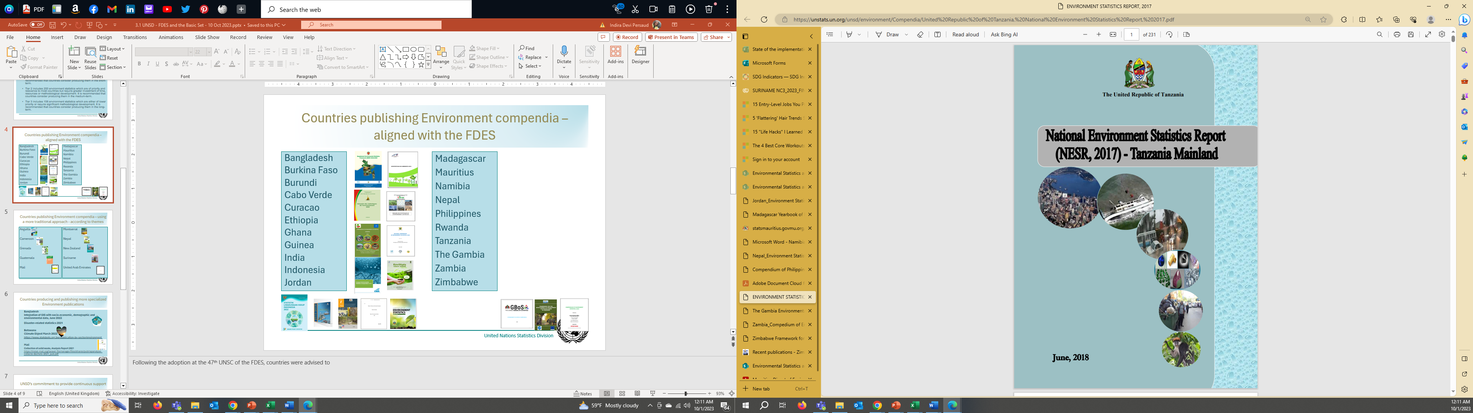
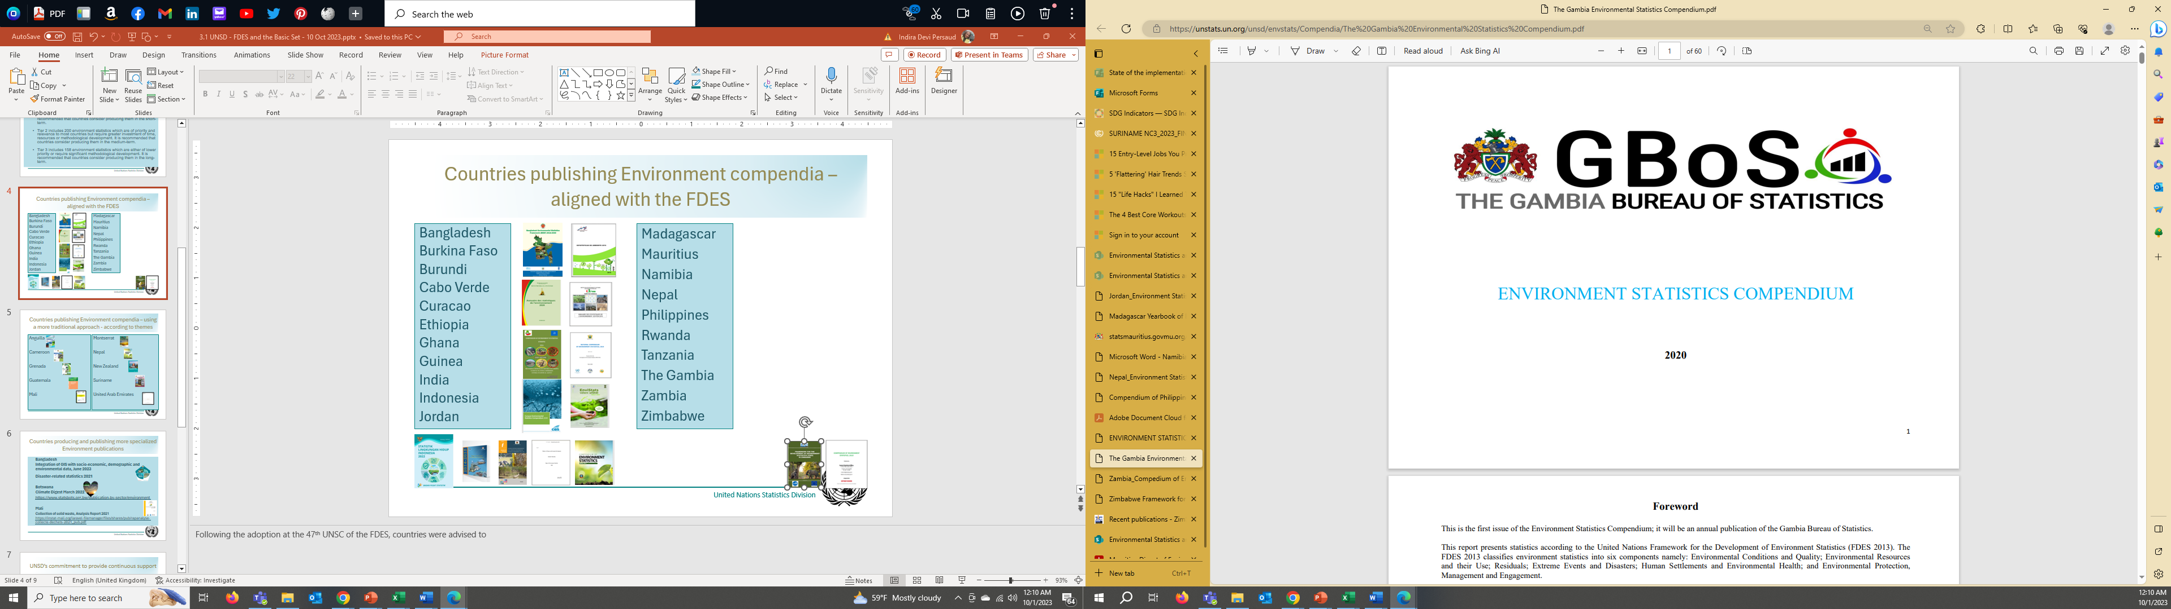
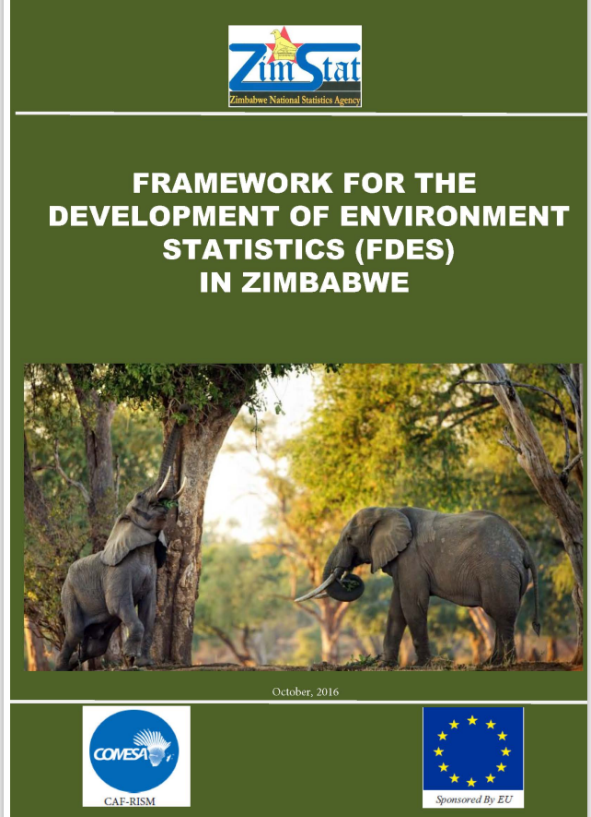
Countries publishing Environment compendia – aligned with the FDES
Examples of countries publishing Environment compendia – aligned with the FDES
Bangladesh
Burkina Faso
Burundi
Cabo Verde
Curacao
Ethiopia
Ghana
Guinea
India
Indonesia
Jordan
Madagascar
Mauritius
Namibia
Nepal
Philippines
Rwanda
Tanzania
The Gambia
Zambia
Zimbabwe
Notes:
Compendia following the structure of the FDES, with the 6 components have been published after 2013, with most recent from 2023 (India), 2022 (Indonesia, also Peru even it’s not on our list). These are the most comprehensive

Slide 18
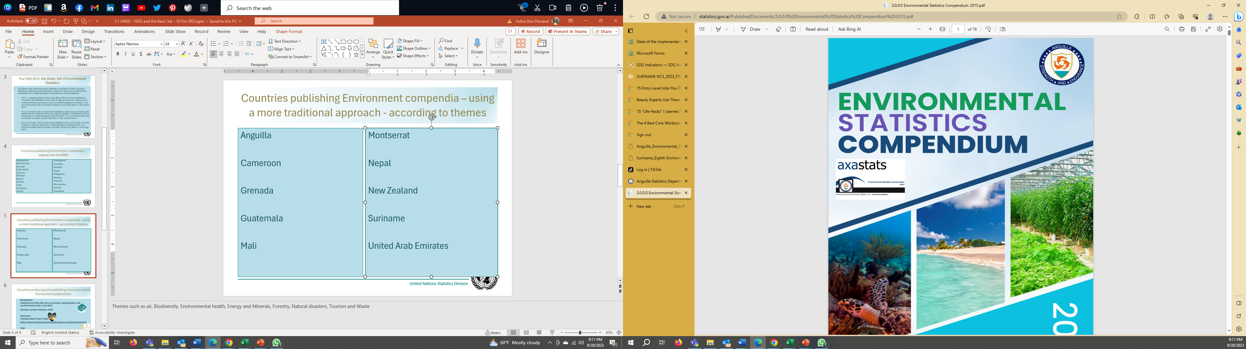
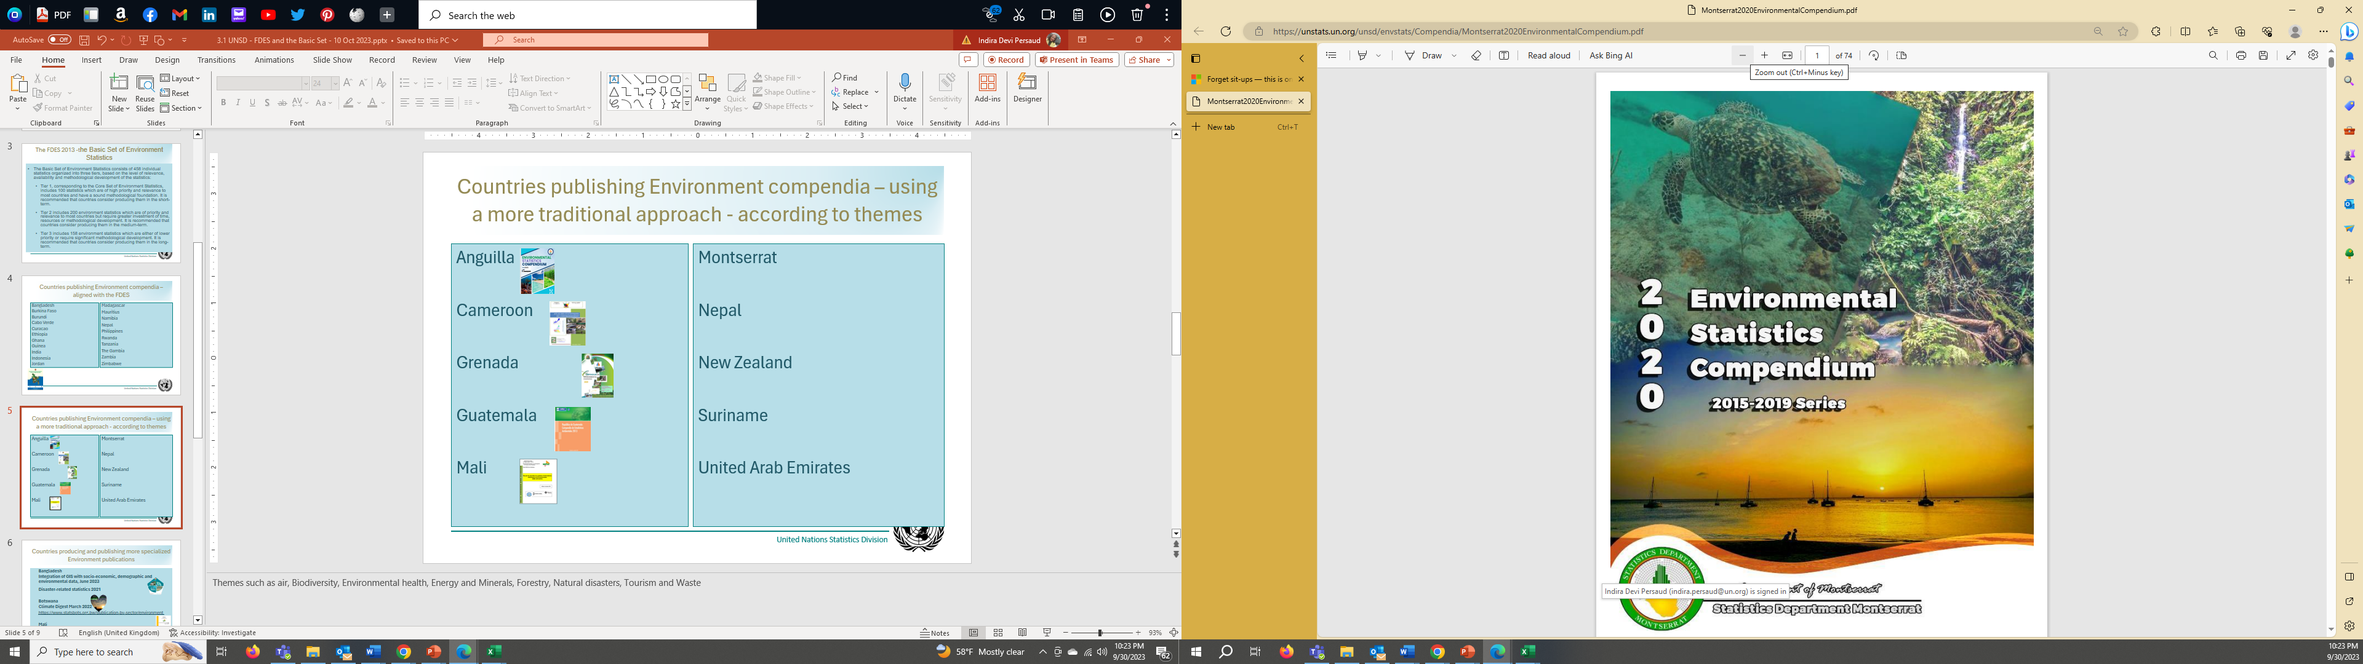
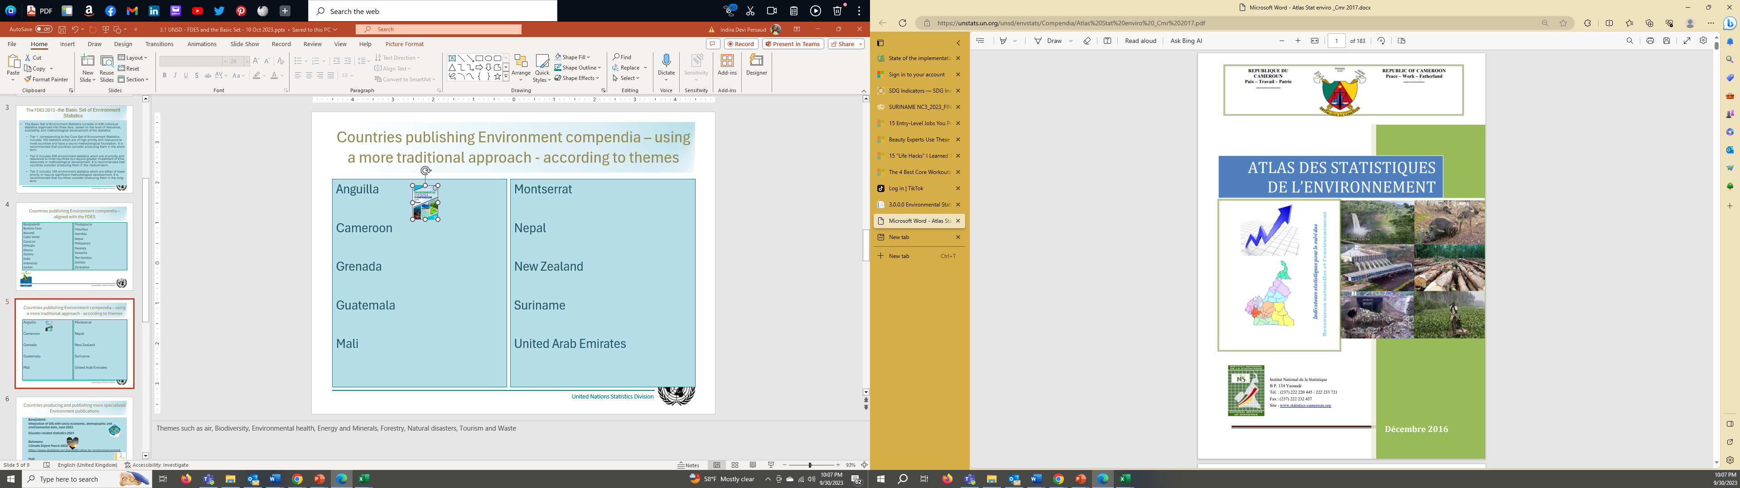
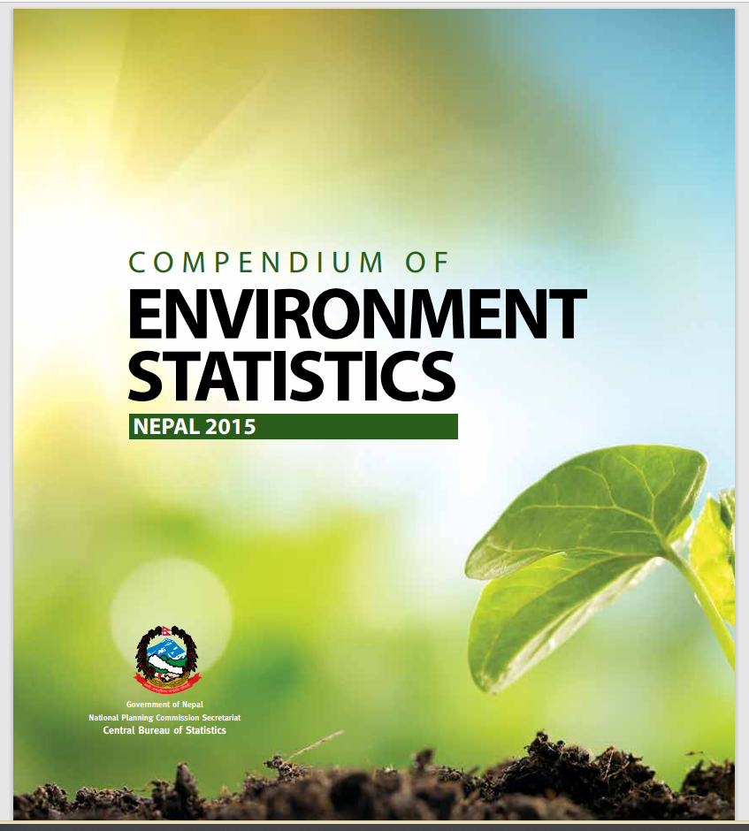
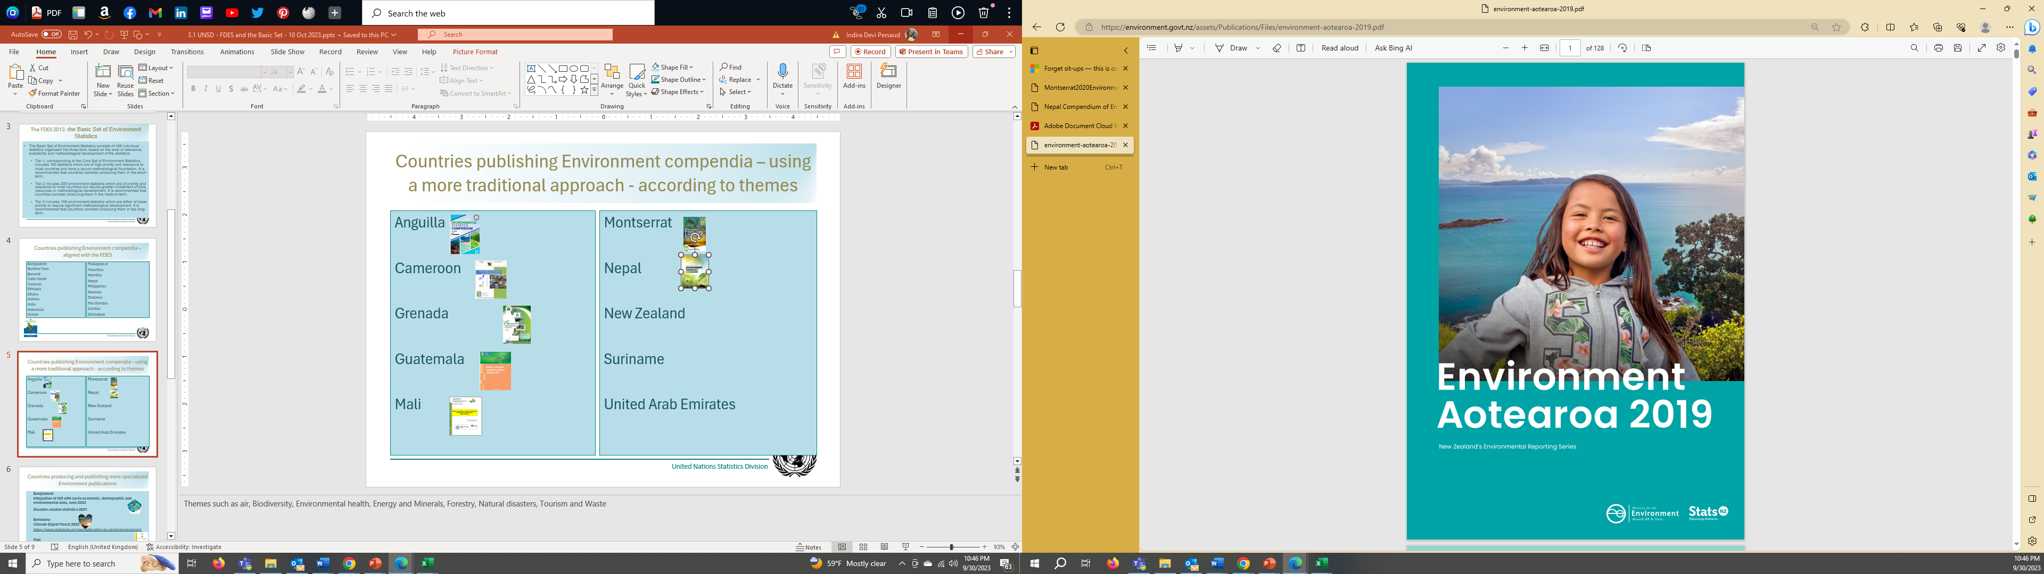
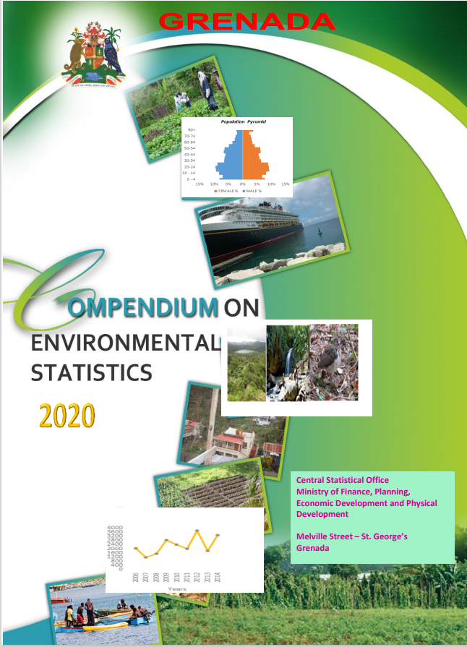
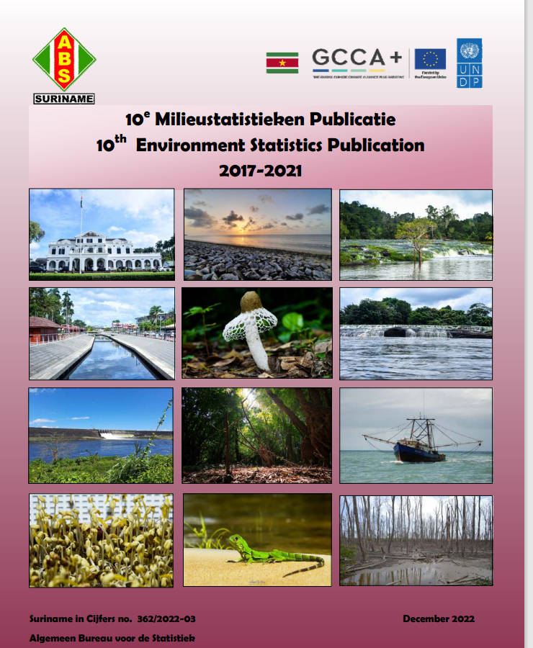
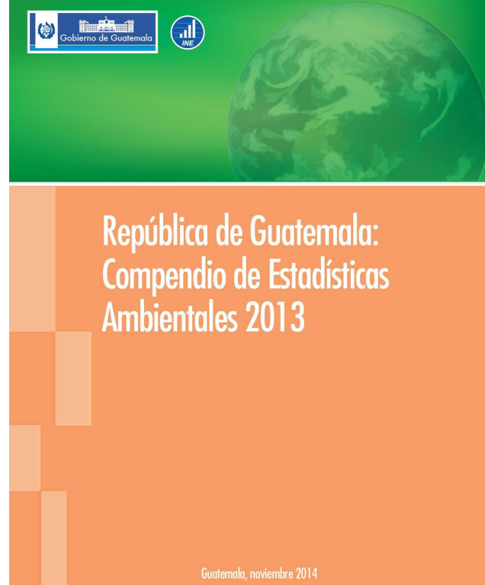
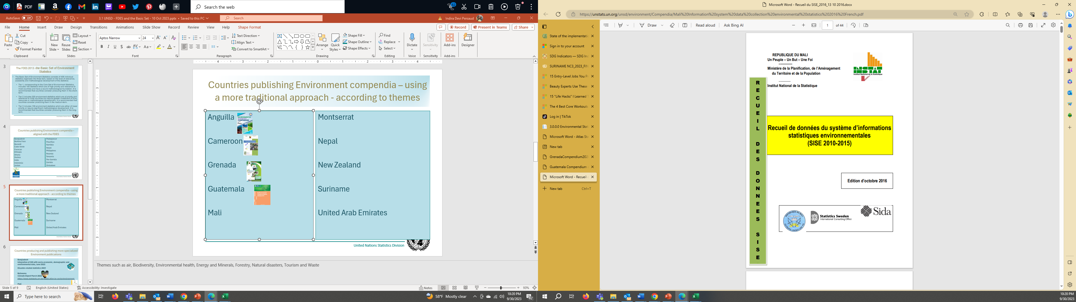
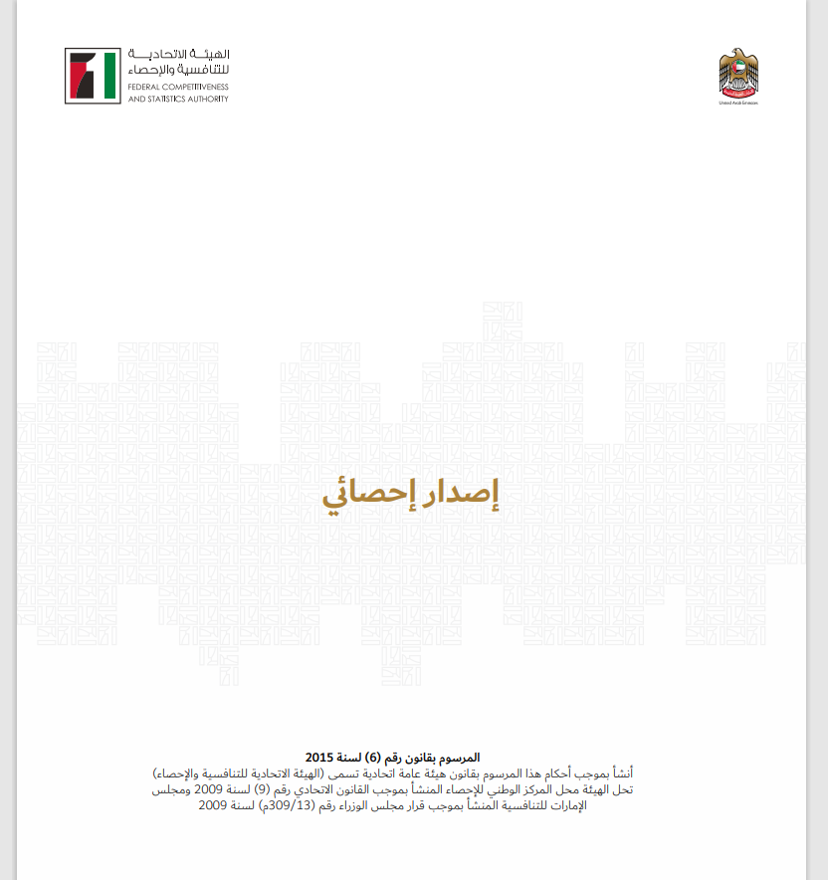
Countries publishing Environment compendia using a more traditional approach - according to themes such as Air and Biodiversity
Anguilla
Cameroon
Grenada
Guatemala
Mali
Montserrat
Nepal
New Zealand
Suriname
United Arab Emirates
Notes:
Thematic compendia have also been published by many countries, Themes such as air, Biodiversity, Environmental health, Energy and Minerals, Forestry, Natural disasters, Tourism and Waste. We have seen example of countries publishing compendia by theme and switching to the comprehensive overview.

Slide 19
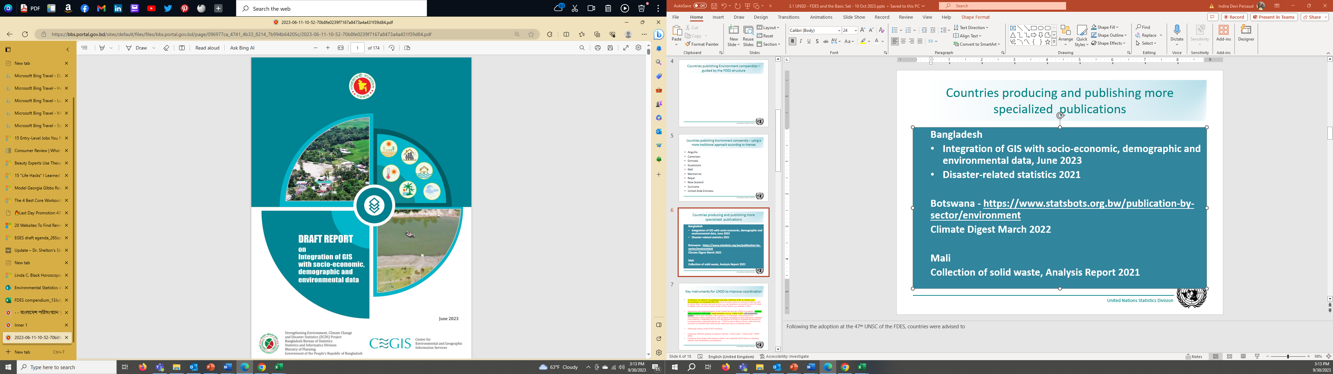
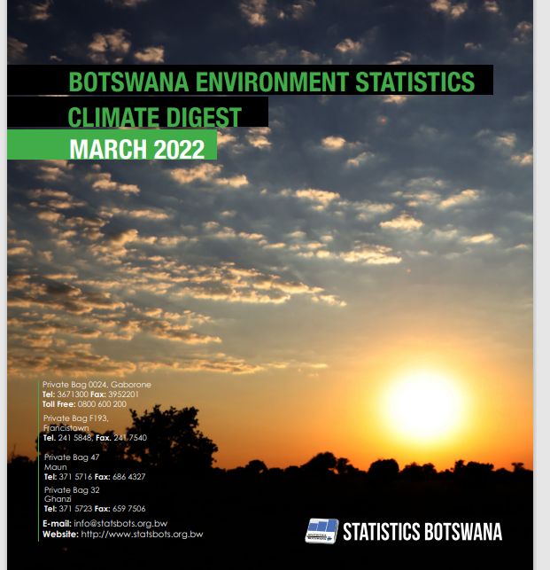
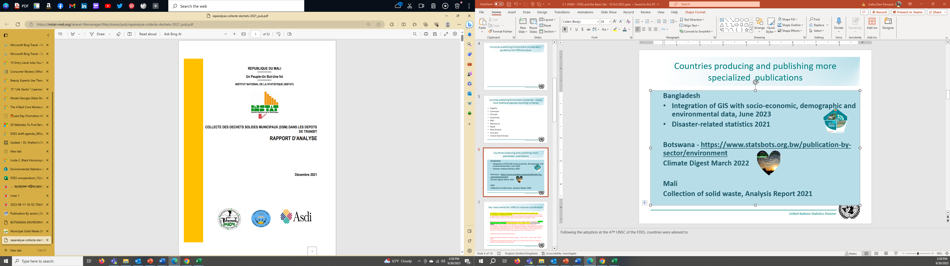
Countries producing and publishing more specialized Environment publications
  Bangladesh
  Integration of GIS with socio-economic, demographic and environmental data, June 2023
  Disaster-related statistics 2021
  Botswana
  Climate Digest March 2022
  https://www.statsbots.org.bw/publication-by-sector/environment
  Mali
  Collection of solid waste, Analysis Report 2021
  https://instat-mali.org/laravel-filemanager/files/shares/pub/rapanalyse-collecte-dechets-2021_pub.pdf
Notes:
Still more specialized statistical publication have also been procuded, for example Bangladesh on disaster-related statistics; Botswana on climate and Mali on solid waste

Slide 20
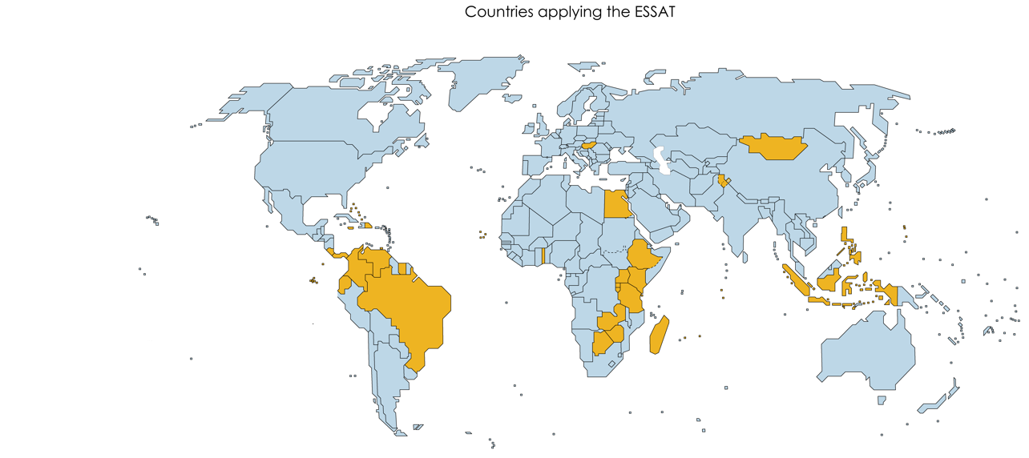
Examples of countries applying the ESSAT
Notes:
Following the adoption at the 47th UNSC of the FDES, countries were advised to

Slide 21


Thank you for your attention!
For more information please contact the Environment Statistics Section
at the UN Statistics Division:
E-mail: envstats@un.org
website: http://unstats.un.org/unsd/ENVIRONMENT/

