Slide 1


Soil Protection and Soil Pollution Legislation in Montenegro Biljana Kilibarda, MSc, UNCCD NFP, Institute of Hydrometeorology and Seismology, Montenegro UNEP South-East Europe Platform to beat Pollution (SEEPP), Western Balkans Regional Soil Pollution Conference
Vienna, 26 - 27.03.2026

Slide 2
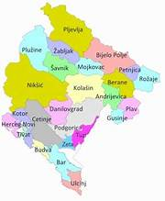
Country profile
Montenegro is part of Southeastern Europe and the Western Balkans.
Total surface area - 13,812 km². Total population (2023): 633,158, Average 45.1 inhabitants per square kilometer
Administrative divisions: 25 municipalities
The GDP per capita in 2024 - EUR 12,259 , in 2023- EUR 11,336
Tourism (25% of GDP), energy, construction, agriculture (7.6% of GDP, 25% of total number of employees), communications, finance and real estate
The unemployment rate- 11.56%, inequalities in income and regional development
Diverse climatic zones ranging from Mediterranean climate along the coast to continental climate inland.
Forests: 6,225 km² or 45%
Agricultural land: 5,145 km², i.e., 37%
Settlements, roads, waters, rocky areas, and other categories: 2,442 km² or 18% of the territory

Slide 3

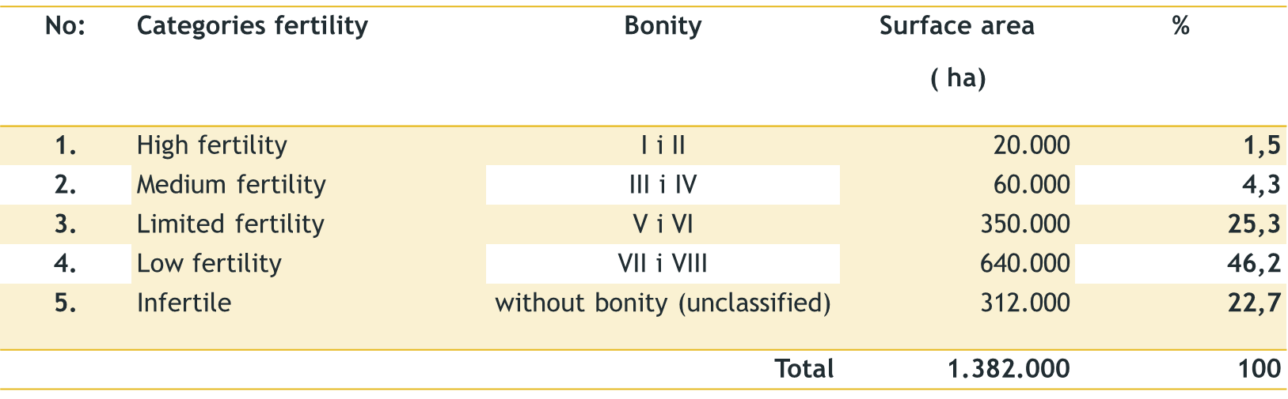



Soil in Montenegro
Most of the soil represented in Montenegro has a shallow soil profile and low contents of nutrients.
Of the total area, not considering the infertile lands (rocks, wetlands, lakes, rivers, roads and urban settlements) the soil of Montenegro (Fustic and Djuretic, 2000) is classified in five categories of effective fertility.

Slide 4
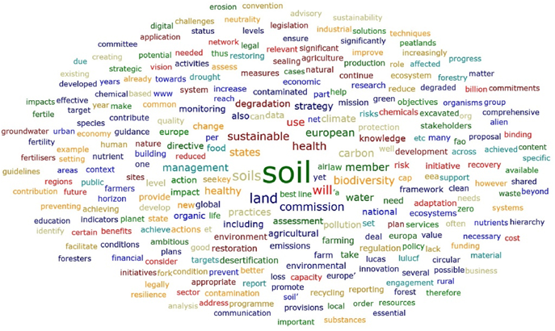


Main sources of soil pollution
Historical industrial and mining activities
Waste disposal sites and landfills
Agricultural inputs (pesticides and fertilizers)
Urban development and infrastructure
Localized contamination around former industrial zones
Legacy pollution from older industrial activities is still a challenge.

Slide 5



Legal framework related to soil protection and contaminated sites
Environmental laws
Law on Environment (Official Gazette of Montenegro, No. 052/16, 073/19, 084/24)
Law on Environmental Damage Liability (Official Gazette of Montenegro, No. 27/2014)
Sectoral laws relevant for soil protection
Law on Agricultural Land (Official Gazette of Montenegro, No. 52/16),
Law on Waste Management (Official Gazette of Montenegro, No. 34/2024)
Law on Chemicals (Official Gazette of Montenegro, No. 051/17)
Law on Plant Protection Products (Official Gazette of Montenegro, No. 51/2008, 40/2011, 18/2014)
Spatial Planning and Construction Law (Official Gazette of Montenegro, No. 19/2025)
The Law on Protection from Ionizing Radiation and Radiation Safety (Official Gazette of Montenegro, Nos. 056/09, 058/09, 040/11, 055/16)
By-laws and technical regulations
Rulebook on permitted concentrations of hazardous substances in soil (Official Gazette of Montenegro, No. 18/97)
The Regulation on the Detailed Content and Method of Maintaining the Register of Environmental Polluters (Official Gazette of Montenegro, No. 48/08)
Regulation on the types of fertilizers, the conditions for ammonium nitrate fertilizers of high nitrogen concentration, method of labeling and packaging of fertilizers

Slide 6
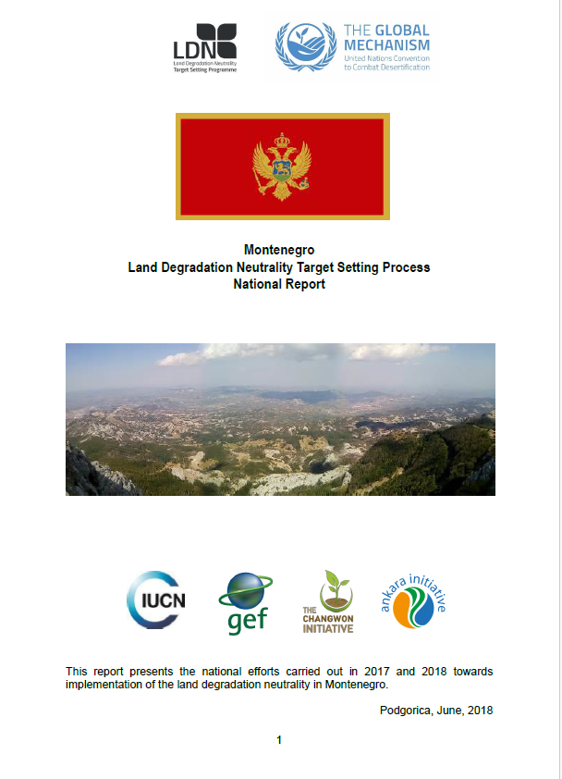
Strategic & policy framework
National Action Plan to Combat Desertification (2015)
National Strategy for Sustainable Development (to 2030)
Strategic Master Plan for Solid Waste Management
Commitments under:
  UNCCD (Land Degradation Neutrality)
  EU Soil Strategy (alignment in progress)
These guide long-term soil protection policies but are not legally binding instruments.

Slide 7

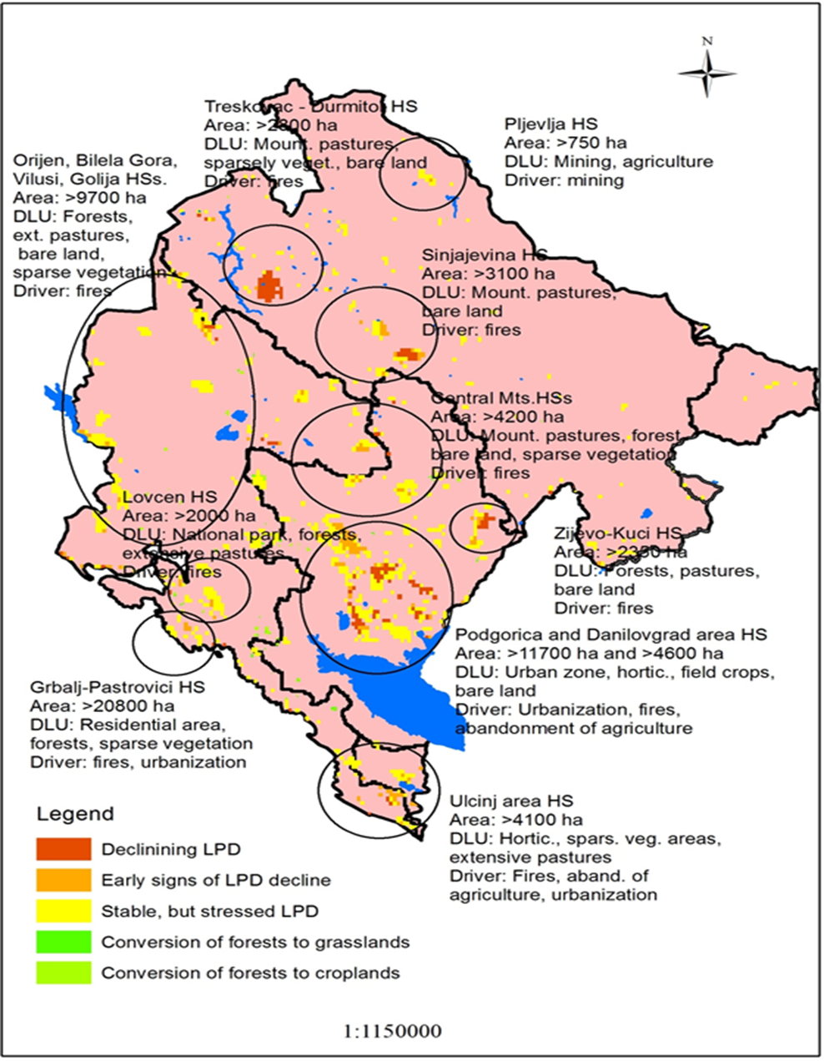
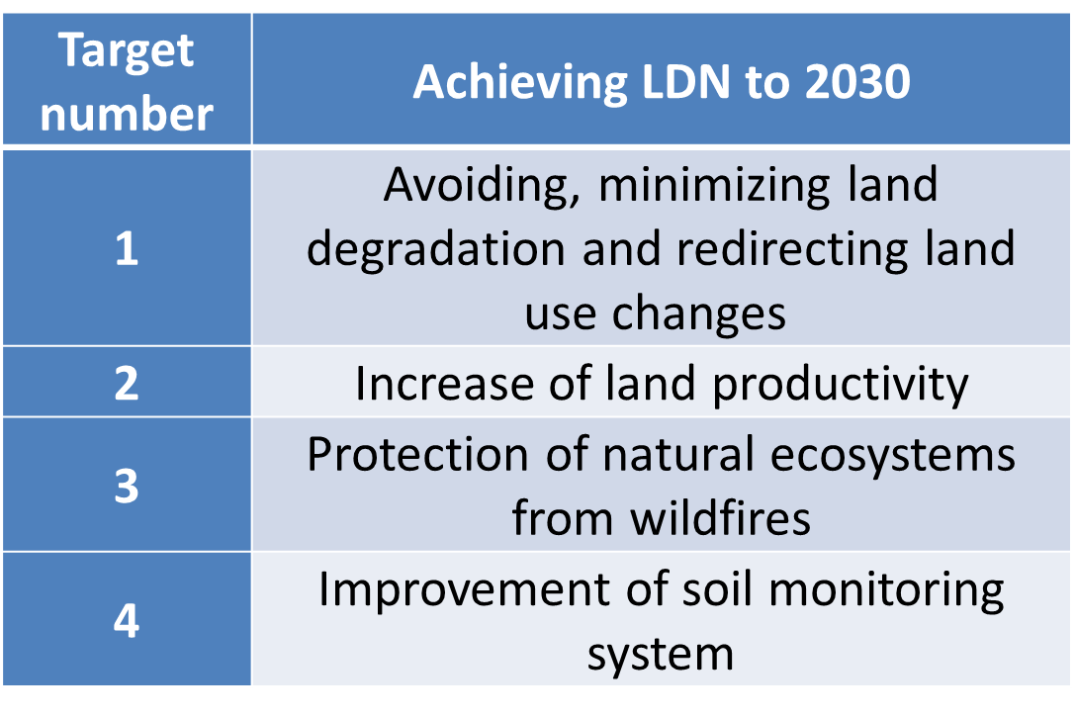

Cooperation with UNCCD

Slide 8
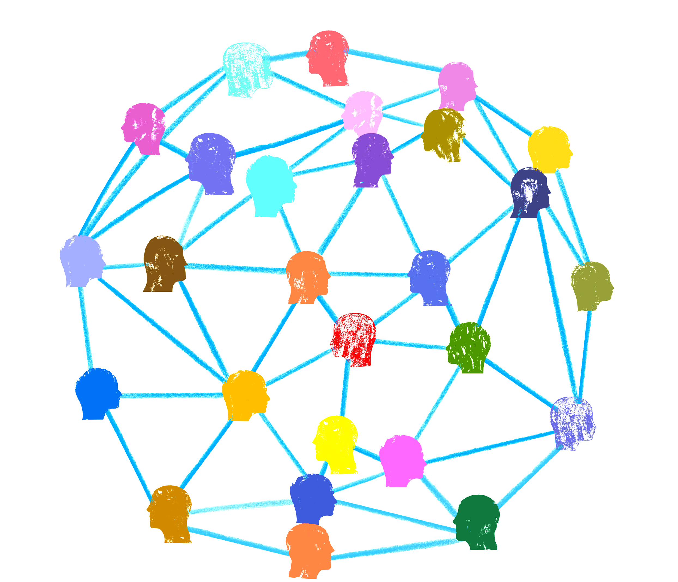
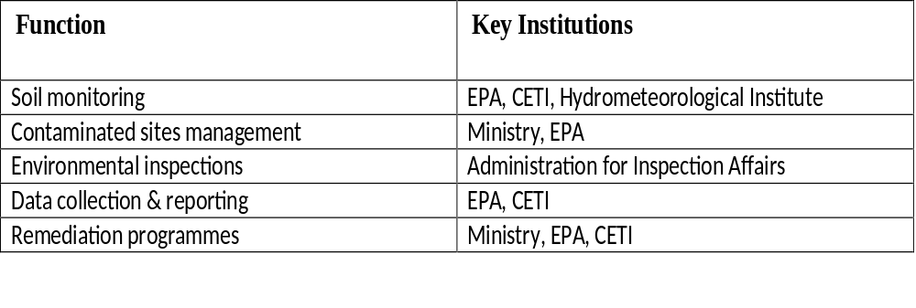
Institutional set-up
Ministry responsible for ecology and sustainable development
Ministry of Agriculture, Forestry and Water Management
Environmental Protection Agency
Centre for Eco toxicological Research
Institute of Hydrometeorology and Seismology of Montenegro
University of Montenegro – Biotechnical Faculty, specifically the Center for Land Reclamation
Administration for Food Safety, Veterinary and Phytosanitary Affairs
Local municipalities
Environmental inspection services

Slide 9

Soil monitoring
Law on Environment (“Official Gazette of Montenegro”, Nos. 052/16, 73/19, 84/24),
Law on Agricultural Land (“Official Gazette of the Republic of Montenegro”, Nos. 015/92, 059/92, 027/94, “Official Gazette of Montenegro”, No. 073/10, 032/11),
Rulebook on Permissible Concentrations of Harmful and Hazardous Substances in Soil and Methods for Their Testing (“Official Gazette of the Republic of Montenegro”, No. 018/97)
Annual information on state of the environment
Program of monitoring of environment:
hazardous and harmful substance content (Cd, Pb, Hg, As, Cr, Ni, F, Cu, Mo, B, Zn, Co)
toxic and carcinogenic organic substances, i.e. persistent organic pollutants (POPs)

Slide 10

Management of contaminated sites
IDENTIFICATION OF POTENTIALLY CONTAMINATED SITES
INVENTORY OF CONTAMINATED SITES
RISK ASSESSMENT OF DIFFUSE AND LOCAL SOIL POLLUTION

Slide 11
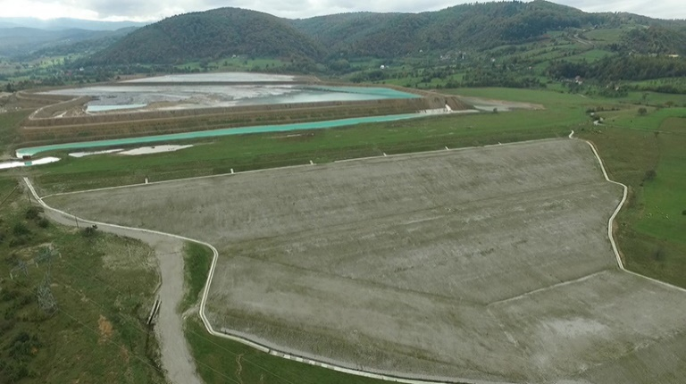

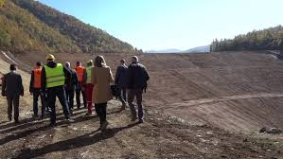

Major Remediation Programmes and Projects
Industrial Waste Management and Clean-Up Project (Government of Montenegro + World Bank)
Priority contaminated sites:
Gradac mine tailings- Removal and safe disposal of contaminated soil and industrial waste from local landfills and former industrial plants.
Maljevac ash landfill (Pljevlja)-Focus on cleaning soil near the thermal power plant and industrial facilities
Bijela shipyard-Soil remediation and removal of industrial waste resulting from years of operation of port and industrial facilities.
KAP aluminium plant (Podgorica – red mud basins)
Status:
Several sites (Gradac, Maljevac, Bijela) successfully remediated
Ongoing work at KAP and other industrial areas.

Slide 12
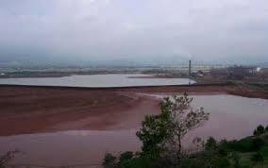
Major Remediation Programmes and Projects
Aluminium Plant Podgorica) Remediation
Key problems:
PCB contamination
Red mud basins (≈8 million tons of waste)
Heavy metals and hydrocarbons in soil
Actions:
Removal and disposal of PCB-contaminated soil and equipment
Risk-based soil remediation approaches
Planned remediation of red mud basins
Current status:
Partial remediation completed
Large-scale clean-up still ongoing/planned

Slide 13
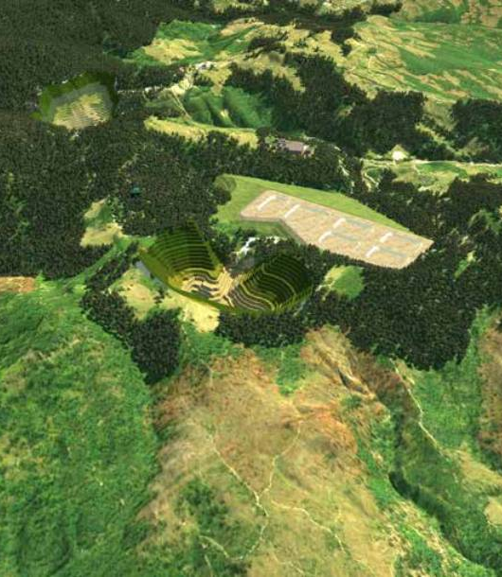
Major Remediation Programmes and Projects
Historic remediation of lead–zinc tailings in Mojkovac, 2011
New project „The Development of Remediation Options for the Mercury-Contaminated Site – Brskovo Mine“, Mojkovac
soil and water contamination analysis,
mercury risk assessment,
sustainable remediation solutions

Slide 14

Main challenges and gaps
No dedicated soil protection law
  Regulations dispersed across multiple legal frameworks
Limited soil monitoring infrastructure
  Difficult to consistently track soil quality
Lack of comprehensive data on contaminated sites
  No national inventory
  No clear classification criteria
Weak institutional capacity
  Gaps in monitoring, data collection, and project development
  Need for stronger technical expertise
Insufficient coordination between sectors
  Environmental, agricultural, and spatial planning authorities
Limited financial resources
  High costs of remediation and restoration projects
Weak enforcement of existing environmental laws

Slide 15

Priority needs and opportunities
Strengthen capacity of the Environmental Protection Agency of Montenegro and other institutions
Increase investment in modern remediation technologies and infrastructure
Develop a comprehensive and regularly updated inventory of contaminated sites
Include detailed data on pollutants and site conditions
Conduct thorough risk assessments for all identified sites
Establish the Registry of polluters
Integrate soil protection into formal education systems
Establish continuous monitoring programmes
Regularly evaluate remediation effectiveness and adjust strategies
Update policies and practices based on latest scientific and technological developments

Slide 16
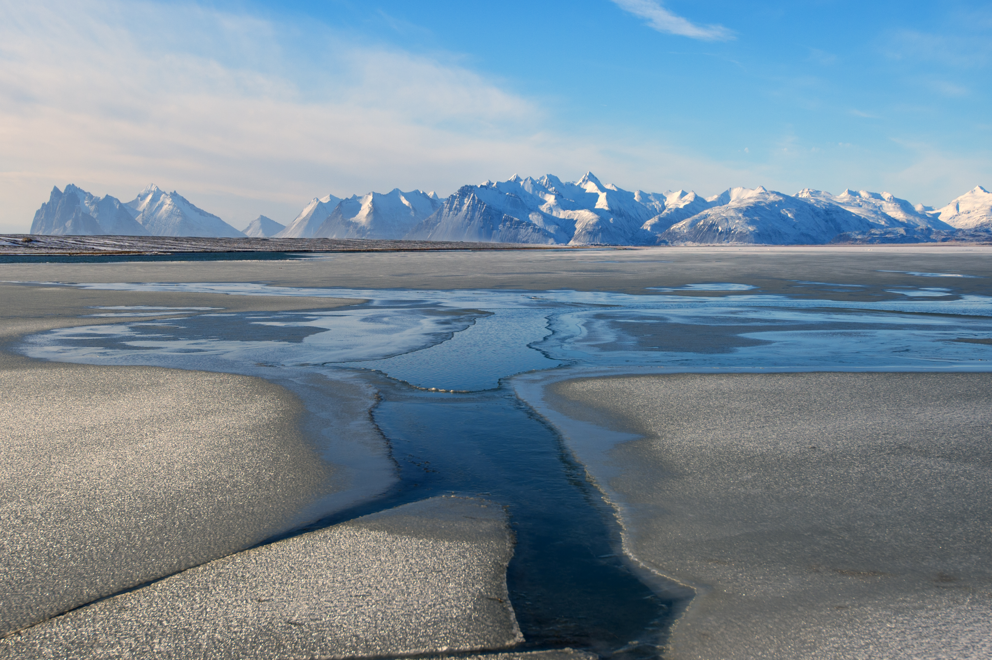
Thank you
For further information, please, refer to biljana.kilibarda@meteo.co.me
www.unep.org

