Slide 1


Overview Resources & Management
Programme Performance Report
January – June 2020
Sonja Leighton-Kone
Director, Corporate Services Division
sonja.leighton-kone@un.org
Notes:
Thank you, Chair
I am pleased to present an overview of the financial part of the Programme Performance Report for January to June 2020 in other words, Programme Performance Report for the first 6 months of 2020

Slide 2
Budget, Income, Available Resources and Expenditure
(Annual Funds) January - June 2020
CORE FUNDS –
our essential capacity
science-policy
innovation & advocacy for solutions
convening stakeholders
capacity building
leadership, direction & oversight
Notes:
This slide as well as the next one, provide an overview of the approved PoW budget, actual income, available resources, as well as expenditures for the five funding streams of UNEP’s Programme of Work
On this slide we are presenting the annually-based funds.
Regular budget and the Environment Fund provide the core funding for the organisation - our essential capacity to
Provide science policy interface
Convene our stakeholders for global decision making
Innovate and advocate for solutions to environmental challenges
Build capacity of our member states and other partners.
The core funds also provide for the leadership, stewardship and direction as well as robust oversight for the organisation.
You will note that the regular budget including income, available resources and expenditures are almost symmetric due to the assessed nature of this funding stream. The income amounted to 8% of total income at mid-year mark. It is expected that the share will reduce to 5% of UNEP’s annual income.
At mid-point of the year, the Environment Fund has received 57% of the approved budget which performance is ahead of previous years. It amounts to 19% of the overall income. The available resources are slightly higher to enable better planning for the year and may be adjusted further as and when additional income becomes available.
The Programme support cost has a one-to-one relation with earmarked funds. The available resources are higher than the budget due to the increased resources under earmarked funds as we will show in the next slide.

Slide 3
Budget, Income, Available Resources and Expenditure
(Multi-year Funds) January - June 2020
Notes:
Because earmarked contributions are multi-year based we are showing the data separately from the annual funds. To further clarify:
the budget reflects the planned financial needs for the year 2020.
expenditures comprise actual funds spent during the year; including commitments pertaining to future years
Both income and available resources contain multi-year elements, including unspent balances from prior years and funds meant for future years’ spending.
I would also like to highlight that the main purpose of the earmarked funds is to replicate and upscale the core work of the organisation.
The Earmarked Contributions received by mid-year amounted to 68% of the yearly budget and 73% of the total income.

Slide 4
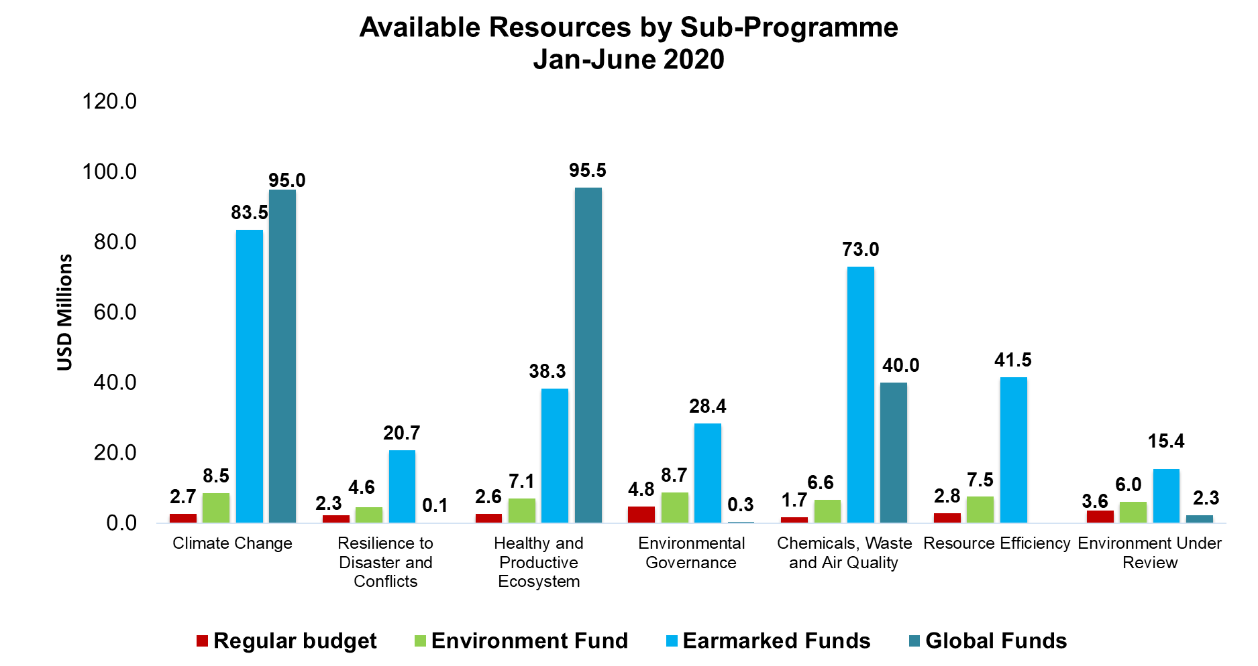
Available Resources by Sub-Programme
January - June 2020
Notes:
This slide shows the breakdown of the available funds across the Sub-programmes by source of funds.

Slide 5
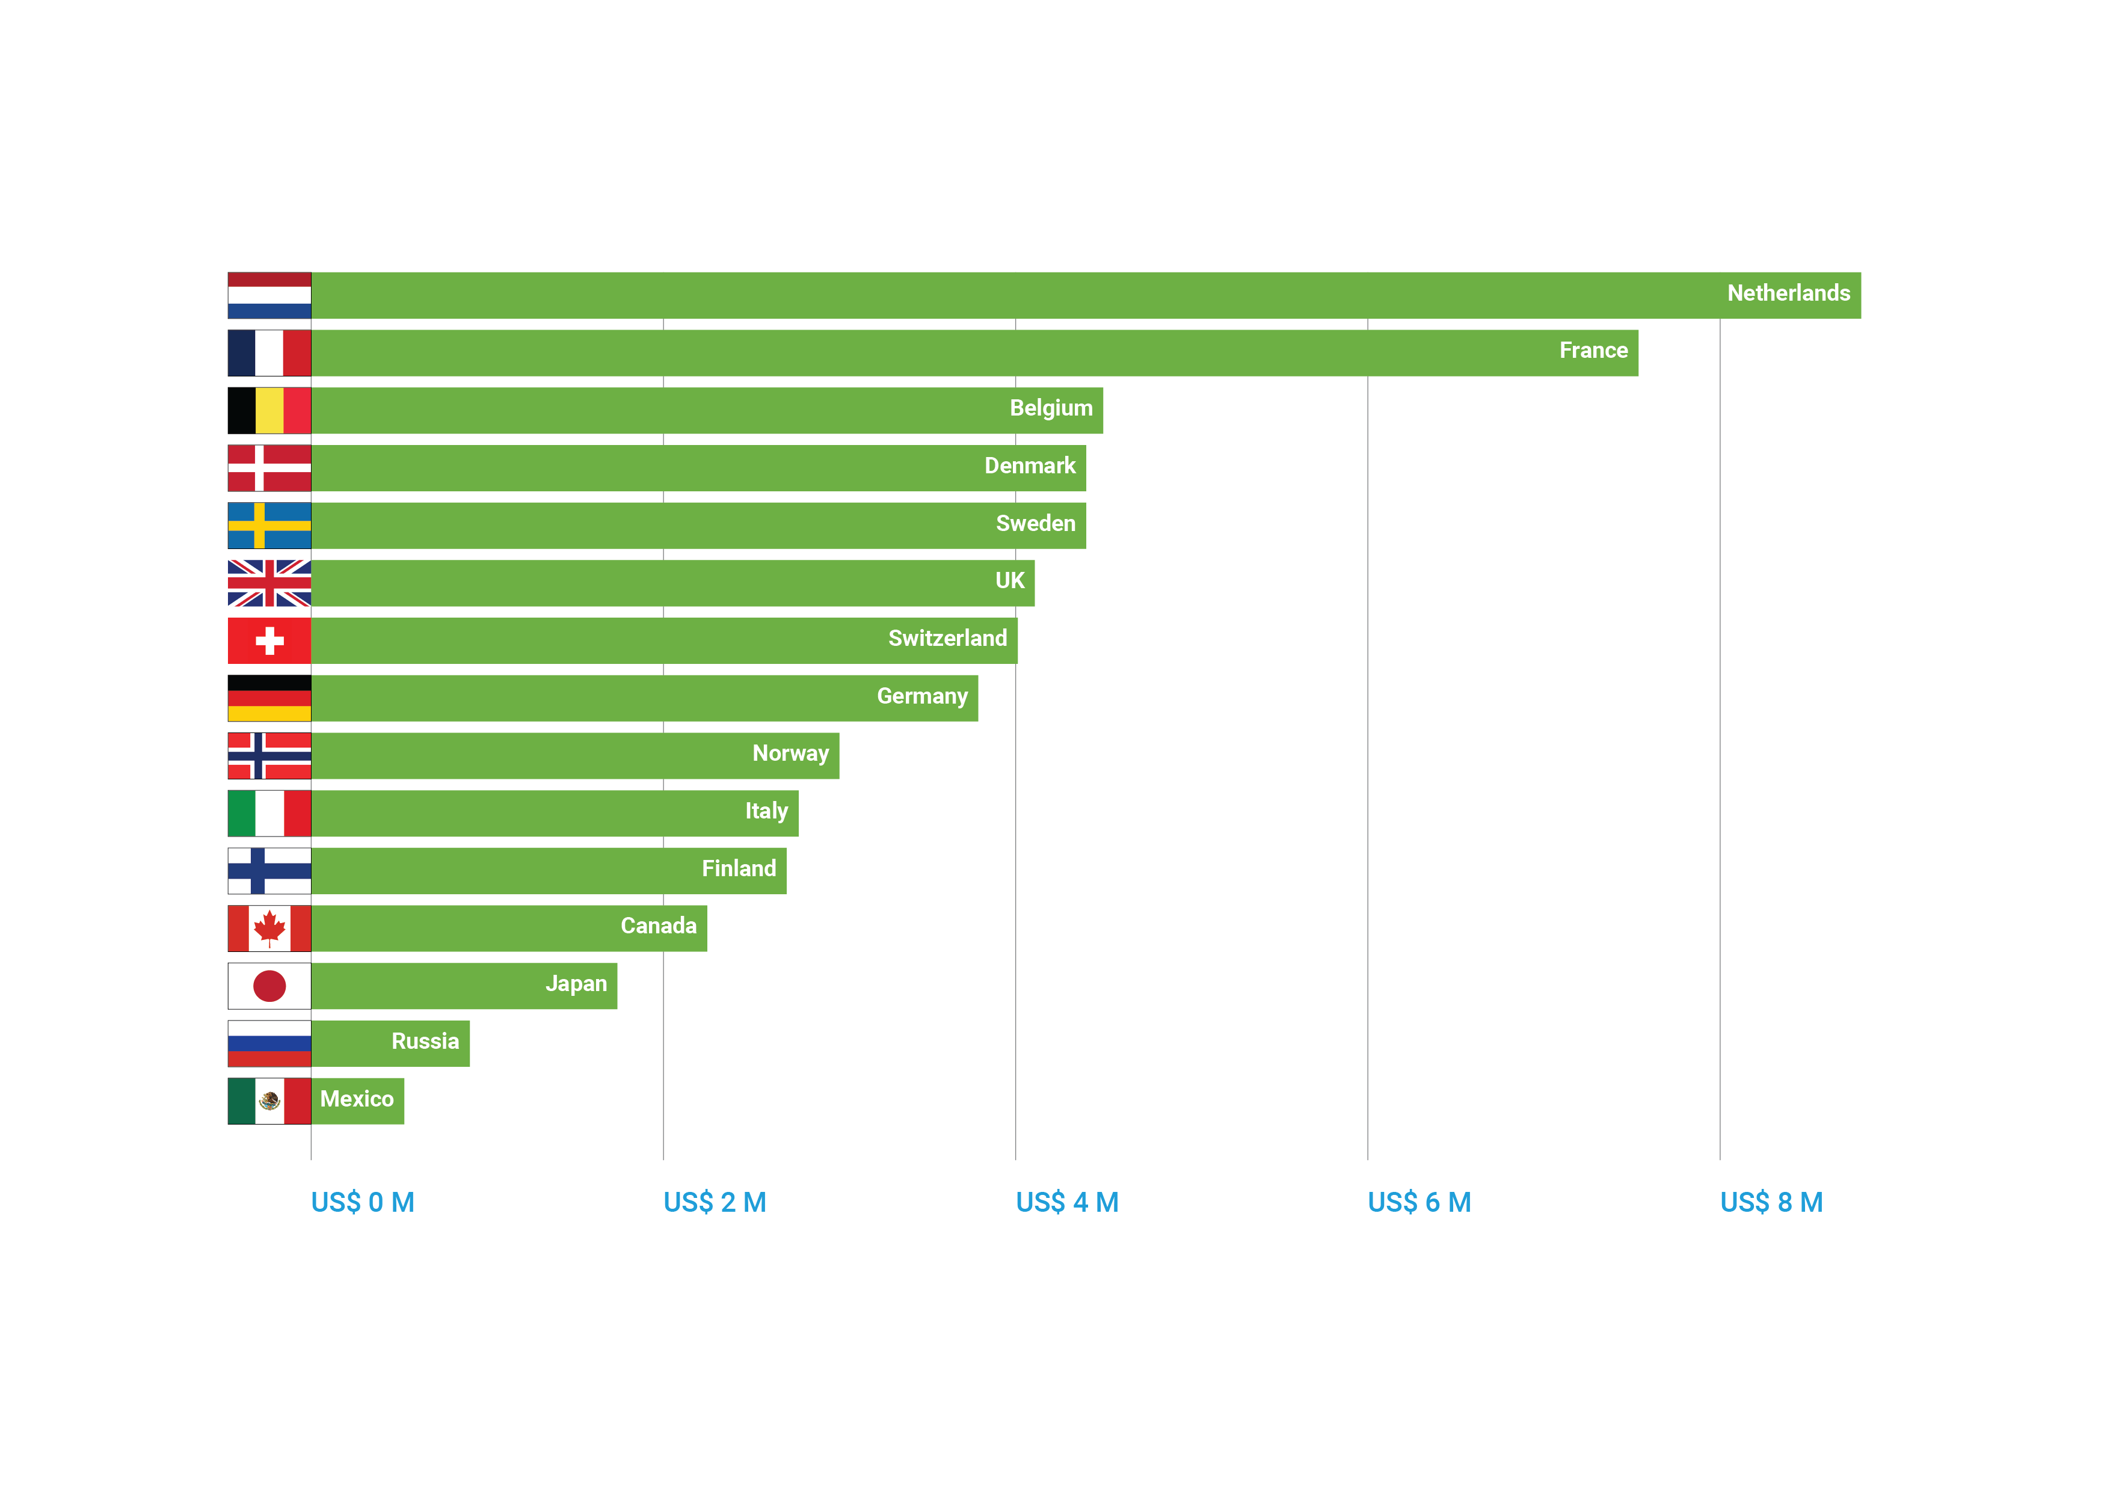
Top contributors to the Environment Fund
January - June 2020
Notes:
Now, let me thank those partners that have been supporting UNEP in the first six months of this year.
First, when it comes to the Environment Fund, you can see the top 15 contributors in this slide. I thank the Netherlands, France, Belgium, Denmark, Sweden, the United Kingdom, Switzerland, Germany, Norway, Italy, Finland, Canada, Japan, the Russian Federation and Mexico for their generous support.

Slide 6
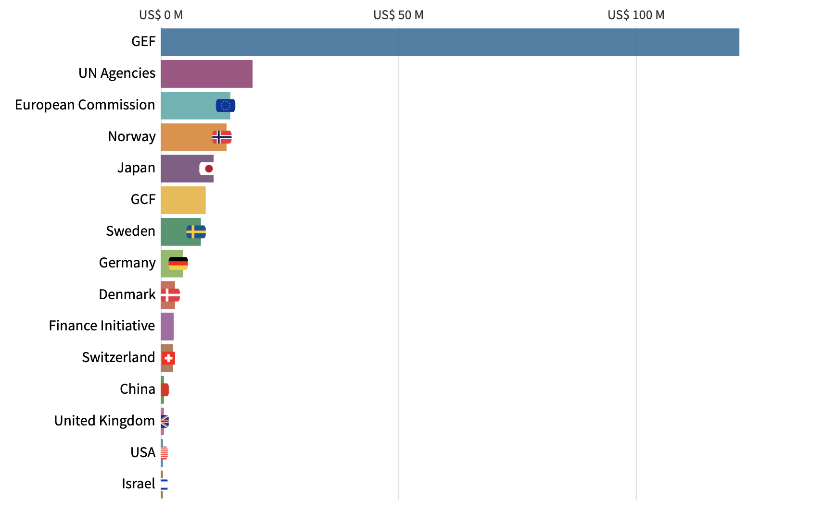
Top contributors earmarked funds
January - June 2020
Notes:
When it comes to contributors of earmarked funds, the Global Environment Facility continues to be top contributor of funds and we are grateful for these significant resources provided. UN Agencies, the European Commission, the Green Climate Fund, and the Finance Initiative also provided substantial amounts to our programmes.
Ten of the top-15 earmarked contributors during the first half of 2020 are Member States: Norway, Japan, Sweden, Germany, Denmark, Switzerland, China, United Kingdom, the United States, and Israel .
Thank you to these Member States for their generous contributions.

Slide 7
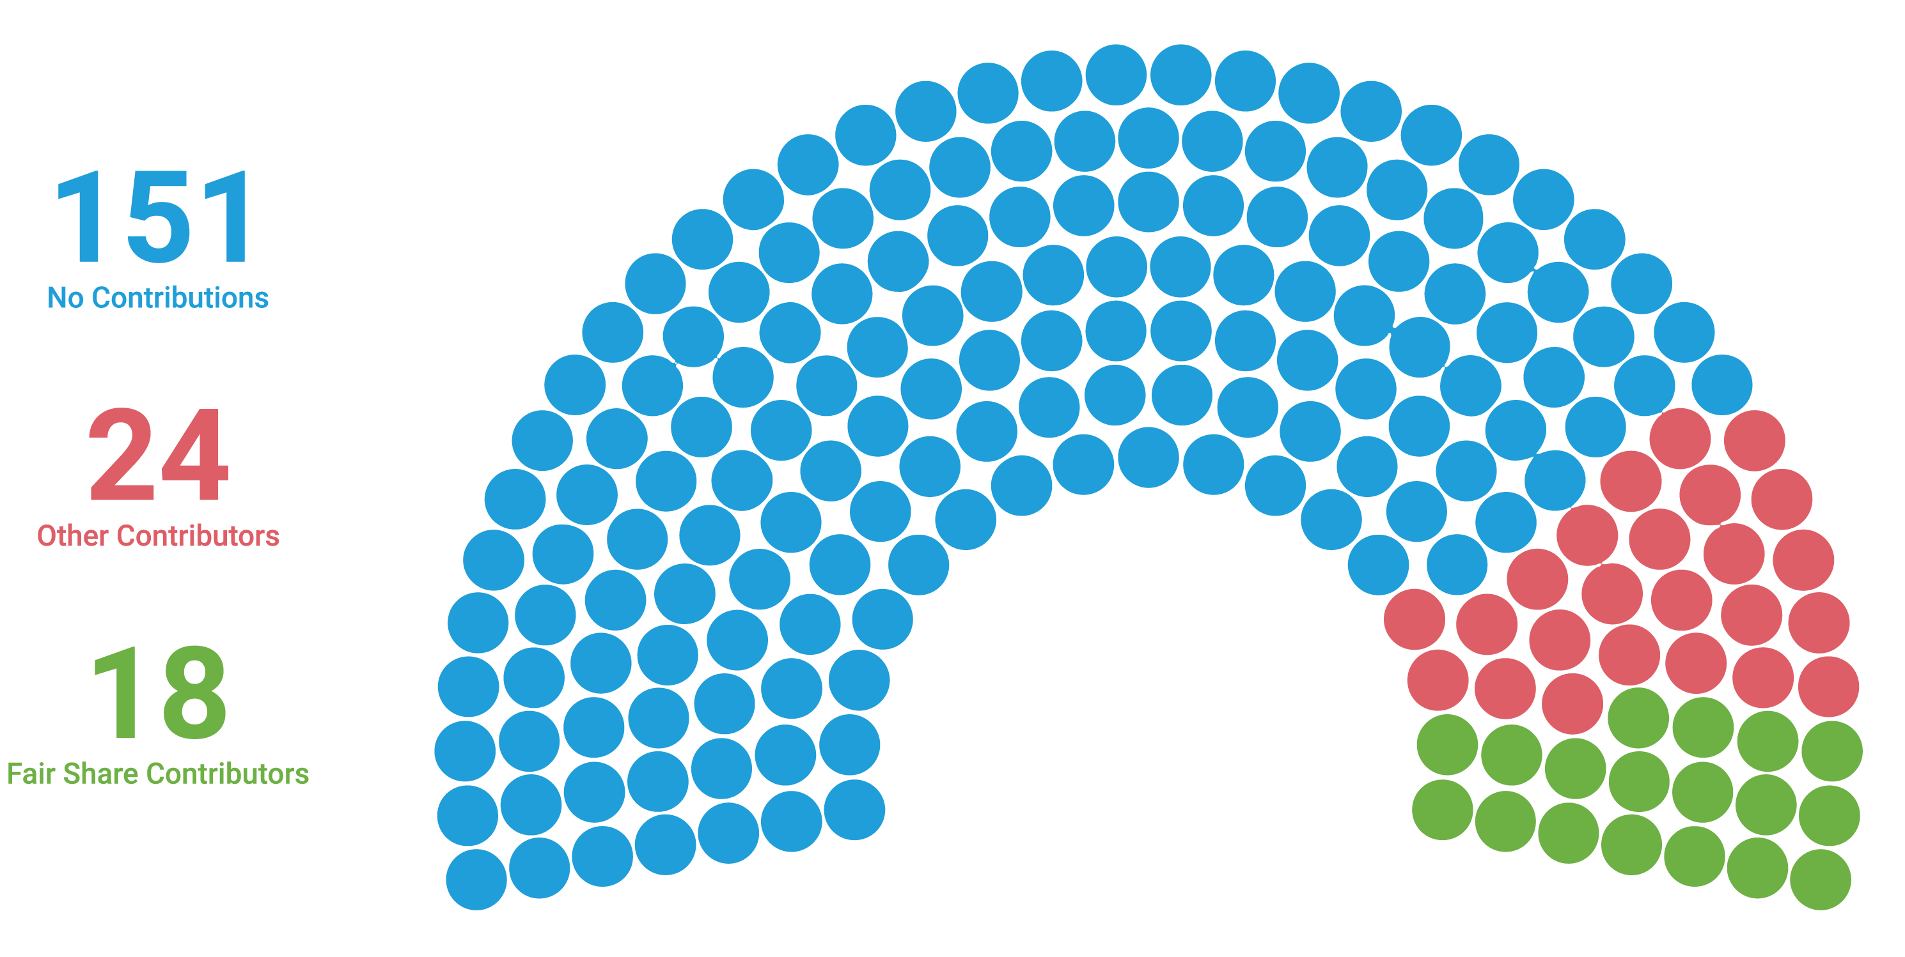
Every Member State Counts
- so does contributing the Fair Share
Notes:
Last year we identified three funding challenges for UNEP: 1. the balance between core and earmarked funding, 2. the narrow funding base and 3. strong preference for tight earmarking rather than soft earmarking at programme level.
To address the issue of core funding and funding base, we introduced the Fair Share concept that simplifies the rather technical term Voluntary Indicative Scale of Contributions, or VISC. We believe it better reflects the purpose of the scale which is to encourage each member state to provide core funds at the level commensurate with their economic and social situation. We have also conducted a survey on UNEP’s funding to better understand which factors prevent or encourage member states to provide financial support to the organisation and how funding UNEP an be made easier and more attractive. The results will be shared with you separately
And as you can see in this graph on UN assembly of 193 member states that we still have a way to go: during the first half of 2020, 18 Members paid their Fair Share and 24 contributed but less than their Fair Share, while 151 Member States didn’t contribute at all. Our goal is of course to have a Green Parliament, and we hope that the Fair Share concept will be helpful in our journey.

Slide 8
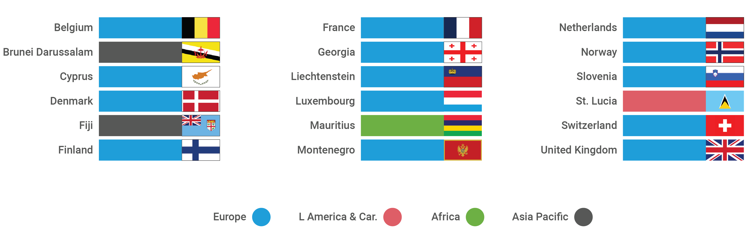
Big thanks to these 18 Fair Share Contributors!
Notes:
In more detail, here are the 18 Member States that contributed their Fair Share during the first half of 2020. I will not read all the names but will give you a moment to have a look at this slide.
The Fair Share is fair because it considers each country individually and distributes the responsibility collectively. Therefore each and every country, no matter how big or small, can pay their Fair Share.
A sincere thank you to these 18 Member States who are leading by example.

Slide 9

It’s me again…
thanking you for your support in the first half of 2020…
…and counting on your continued support in 2020, and beyond!
Investing in UNEP means investing in the health of the planet and its people.
Notes:
With that, let me and our Fair Share Macaw thank you for your support in the first half of 2020.
I hope that we can count on your continued support in 2020, the year that has brought about the urgent need to build back better, faster and more concretely. As we know, the health of the planet and the health of humanity are closely interlinked.
Thank you.

Slide 10

HR OVERVIEW - GENERAL STAFFING
STAFF DISTRIBUTION AND CATEGORIES
As of 30 June 2020, UNEP employed 1246 staff members comprising 916 (74%) in the Secretariat and 330 (26%) in the MEAs and Conventions. Of the 1246 staff members,742 (59.5%) were in the professional and higher categories, 6 (0.5%) in the National Professional Officer (NPO) category and 498 (40%) in the General Service category.

Slide 11
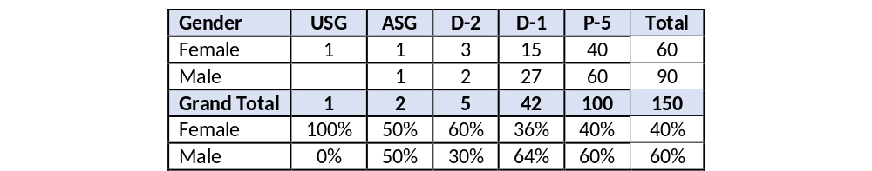
GENDER DISTRIBUTION
Out of the total staff portfolio of 1246 in June, 61% (764) are female and 39% (482) are male. The UNEP Secretariat employed 916 staff, of which 61% were female and 39% male staff. As at June 2020, at the D2 level and above UNEP surpassed the gender parity target and is working to meet targets at the P5 and D1 levels. The overall female to male representation at the professional and higher categories is 53% female and 47% male, which is above the UN target of 50%. The NPO level registered parity at 50 % for both genders, while the General Service category had 74% female and 26% male.

Slide 12
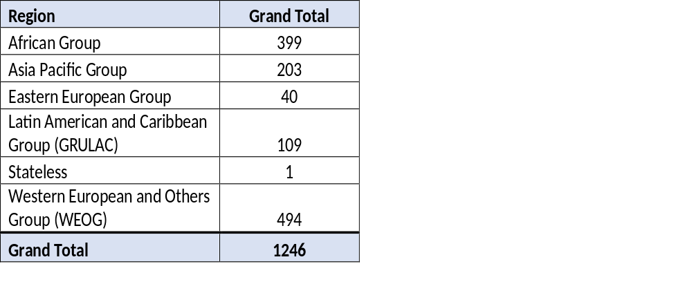
REGIONAL REPRESENTATION
SECRETARIAT AND MEAs
Western European and Other Groups (WEOG) has a staff representation of 40% followed by Africa group with 32%. The Eastern European group has the smallest representation of 3% (40). Efforts will continue to be made to recruit more staff from regions with lower representation.

Slide 13
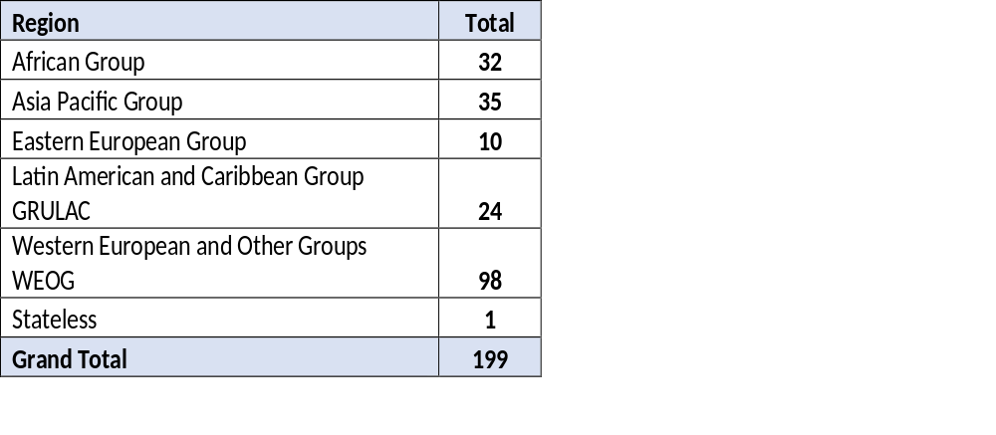
REGIONAL REPRESENTATION P5 AND ABOVE

Slide 14
KEY HUMAN RESOURCES, ACHIVEMENTS, RISKS AND ISSUES
Achievements: Implementation of a revised Human Resources organizational structure in line with the transformation of Corporate Services Division. Clearly delineating roles and responsibilities to enhance our delivery and oversight of HR processes. This has resulted in increased efficiencies in service delivery to clients. Initiatives have including streamlining workflows, establishment of an electronic platform in Wecollaborate for all HR related service requests, drafting of 6 Recruitment SOP’s in line with Delegation of authority ; regular meetings to strengthening our working partnership with UNON, HRMS on key service delivery areas in relation to established KPI’s ( recruitment, performance management and administration entitlements). Established an HR focal point network comprising of 65 HR focal points located in Divisions, MEAs and Regional offices across 40 duty stations. Completed HR Focal Point Survey to assess baseline skills and knowledge, hold regular HR focal point meetings to provide guidance and updates, and build capacities on HR related matters and real-time information which has proved an effective mechanism to disseminate complex and critical HR information in relation to COVID-19. In collaboration with UNON TMC, and SPnB three briefings/trainings have been held on Recruitment of Consultants and contractors(CICs), Time Management and sick leave, and Contract Extensions. HRS also participates in several working groups and task forces around HR reform and continues to make contributions to the special working group on the CEB task Force on Sexual Exploitation and Abuse(SEA), serves in the capacity of one of UNEP’s Conduct and Discipline Focal Points, participates in the HR, High-Level Committee (HCLM) working groups on recruitment, outreach and future of work; and , the HR Task Force on Training and Learning, and Multi-Lingualism. Risks: In line with the Secretary-General’s system-wide Gender Parity Strategy and UNEP’s Gender Parity Implementation Plan, progress has been made to increase gender parity, however there is still work to do. Currently UNEP’s female to male ratio is 61:39. HRS continues to work with Hiring Managers and the Executive Office to oversight and improve on overall gender parity targets at the senior Level of P5 and above. Issues: The COVID – 19 pandemic has posed several challenges around HR related issues, and duty of care. COVID-19 may also pose challenges on staff recruitment, given travel limitations, telecommuting, nature of functions and country specific situations. A further freeze on all Regular Budget related recruitment has also impacted on UNEP’s ability to fill key positions. The freeze is anticipated to last until December 2020.

Slide 15
MANAGEMENT OVERVIEW
Achievements: Implementation of a revised Human Resources organizational structure in line with the transformation of Corporate Services Division. Clearly delineating roles and responsibilities to enhance our delivery and oversight of HR processes. This has resulted in increased efficiencies in service delivery to clients. Initiatives have including streamlining workflows, establishment of an electronic platform in Wecollaborate for all HR related service requests, drafting of 6 Recruitment SOP’s in line with Delegation of authority ; regular meetings to strengthening our working partnership with UNON, HRMS on key service delivery areas in relation to established KPI’s ( recruitment, performance management and administration entitlements). Established an HR focal point network comprising of 65 HR focal points located in Divisions, MEAs and Regional offices across 40 duty stations. Completed HR Focal Point Survey to assess baseline skills and knowledge, hold regular HR focal point meetings to provide guidance and updates, and build capacities on HR related matters and real-time information which has proved an effective mechanism to disseminate complex and critical HR information in relation to COVID-19. In collaboration with UNON TMC, and SPnB three briefings/trainings have been held on Recruitment of Consultants and contractors(CICs), Time Management and sick leave, and Contract Extensions. HRS also participates in several working groups and task forces around HR reform and continues to make contributions to the special working group on the CEB task Force on Sexual Exploitation and Abuse(SEA), serves in the capacity of one of UNEP’s Conduct and Discipline Focal Points, participates in the HR, High-Level Committee (HCLM) working groups on recruitment, outreach and future of work; and , the HR Task Force on Training and Learning, and Multi-Lingualism. Risks: In line with the Secretary-General’s system-wide Gender Parity Strategy and UNEP’s Gender Parity Implementation Plan, progress has been made to increase gender parity, however there is still work to do. Currently UNEP’s female to male ratio is 61:39. HRS continues to work with Hiring Managers and the Executive Office to oversight and improve on overall gender parity targets at the senior Level of P5 and above. Issues: The COVID – 19 pandemic has posed several challenges around HR related issues, and duty of care. COVID-19 may also pose challenges on staff recruitment, given travel limitations, telecommuting, nature of functions and country specific situations. A further freeze on all Regular Budget related recruitment has also impacted on UNEP’s ability to fill key positions. The freeze is anticipated to last until December 2020.

Slide 16
Audit updates
Recently finalized and ongoing OIOS audits Management of Partnerships at UNEP Management of Data Classification and Data Privacy at UNON, UNEP and UN-Habitat Grants Management at UNON, UNEP and UN-Habitat Implementation of recommendations of completed OIOS audits Recruitment Process at UNEP UNEP Secretariat of the Convention on Biological Diversity UNEP Afghanistan Project Office Official travel at UNEP Board of Auditors Starting the 26th of October, the Board of Auditors team from China will (remotely) conduct the Interim Audit (2020 Interim Audit) of UNEP Headquarters, the UNEP Secretariat of the Basel, Rotterdam and Stockholm Conventions in Geneva, the Asia and the Pacific Office in Bangkok, as well as the Addis Ababa Liaison Office.
  UNEP’s Abidjan Convention Secretariat
  UNEP’s Asia and the Pacific Office
  Resource Efficiency Sub-Programme
  Environmental Governance subprogramme
  Caribbean Environment Programme

Slide 17
Key Milestones Update
FMO Mapping: The aim of the exercise is to ensure uniformity in the application of corporate standards; provide clarity of roles and responsibilities and strengthen accountability and transparency in financial governance across UNEP. Key updates:
this is First Global Assessment of Staffing and Capacity within the Administrative and Financial work forces;
Phase 1 has been completed;
Phase 2 of the exercise will focus on establishing standards.
2. Corporate Academy: the Academy was launched last year in person – it is now being moved to a virtual platform to make it universally available and reduce costs.
- preparations are underway to go online and launch the Academy in November on a new digital platform where the FMO Community of Practice will meet to learn, exchange ideas, network, update themselves on new knowledge, collaborate and create working relationships expected to infuse operational excellence in service delivery across UNEP.
3. Benchmarking Best Practices and Policies Study: terms of reference have been finalized , three UN Agencies have been identified for the study and is now at the stage of procurement process to engage the services of a consulting firm to carry out the study.

Slide 18

Thank you
www.unep.org

