Slide 1
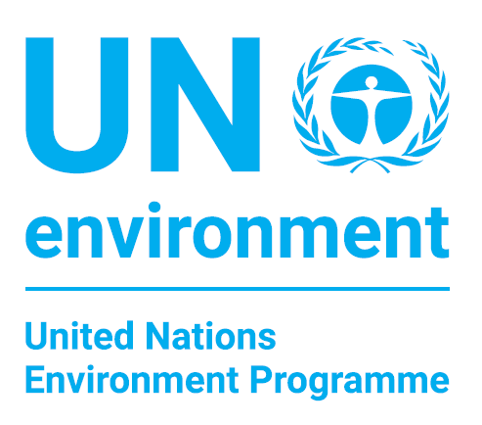

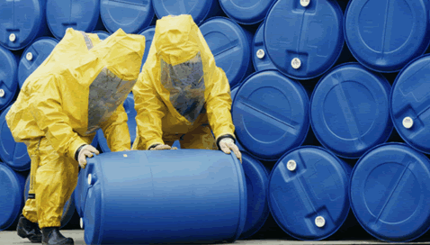


Presentation to the
Committee of Permanent Representatives
to UN Environment
Nairobi, 24 January 2017
Briefing on the implementation of the Subprogramme
Chemicals and Waste and UNEA-2 Resolution 2/7
Notes:
1

Slide 2
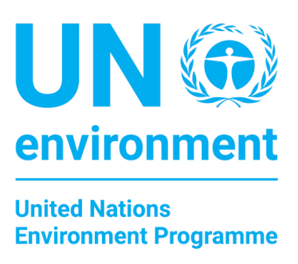

Overview of Presentation
Global Trends & 2030 Sustainable Development Agenda
Selected Subprogramme Activities, 2016-2017
Challenges and Opportunities

Slide 3
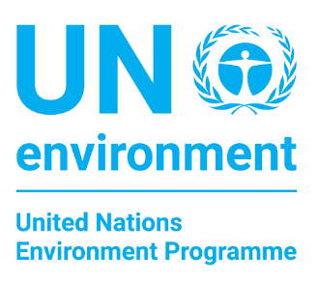




Key trends…….
The world economy and the global market for chemicals is likely to quadruple by 2050!
Growth is fuelled by a rising middle class, urbanization, and mobility in transports increasing amounts of chemicals and waste generation
We are witnessing fundamental structural changes in the chemical industry!
While the production and consumption of chemicals and waste have moved, regulatory systems have not moved with equal speed

Slide 4

UNEA-2 (2016):
Request for Policy Analysis and Options for Action to Address Chemicals and Waste Management in the 2030 Sustainable Development Agenda
Notes:
Mandate from the United Nations Environment Assembly
To be completed by 2018
Will provide an updated and comprehensive global overview of issues and challenges related to the sound management of chemicals
Will support stakeholders in assessing progress towards the 2020 goal for the sound management of chemicals and discussions beyond 2020
Consultative meeting was held in April 2016 in Geneva to review scope and process of the exercise and on updating the first edition of the Global Chemicals Outlook
The first meeting of the Steering Committee was held in Geneva on 15 and 16 December 2016.
The Secretariat is updating the Global Waste Management Outlook continually with targeted regional and thematic outlook reports
The first such a report was the “Waste Management Outlook for Mountain Regions” which was released on December 12.
The report can be downloaded from this site: http://www.grida.no/publications/default/6826.aspx

Slide 5







Chemicals and Waste and the SDGs
Unpacking the 69 Targets
Targets which directly mention chemicals and waste and its impacts (Core targets, 12.4, 3.9)
Targets with key development objectives that require sound management of chemicals and waste for effective implementation (development targets, e.g. safe food, affordable and safe housing)
Targets that are important enablers for sound management of chemicals and waste (enabling targets, e.g. access to information)

Slide 6






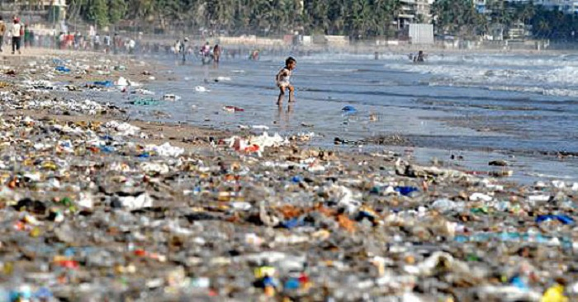
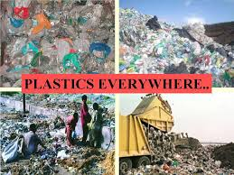
SDG 2: Zero Hunger
2.1 Safe, nutritious and sufficient food
Addressing Trade-offs

Slide 7
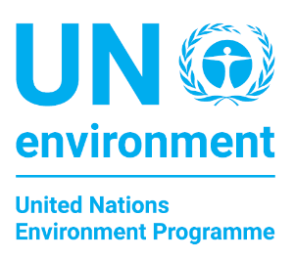

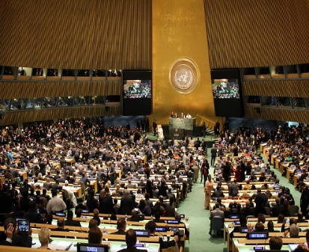
Sustainable Development Goals and
Chemicals and Waste
Activities 2016-2018
Geneva International Experts Consultation, April 2016
Communication/outreach with the Inter-Organization Programme for the Sound Management of Chemicals, 2017
Project on indicators and statistics in three pilot countries, 2017-19
Overview for policymakers on policies and actions (end of 2017, request by UNEA2)
Report to explore role of Sustainable Chemistry to implement 2030 Development Agenda (1st Quarter 2018, request by UNEA2)
Develop options to reach relevant SDGs and targets up to and beyond 2020 through the Global Chemicals Outlook II (end of 2018, request by UNEA 2)
Notes:
UN Environment organized an International Workshop in Geneva on 11-13 April 2016 to advance analysis and action for strengthening synergies between national implementation of the Sustainable Development Goals and international chemicals and waste agreements
The purpose was to integrate the agenda effectively into national implementation of the Goals and development planning
Within the UN Development Account, UN Environment is developing a project focusing on indictors and statistics to build capacity to minimize chemicals and waste risks across sectors through data collection, reporting and use for decision-making

Slide 8
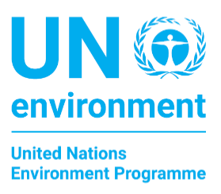
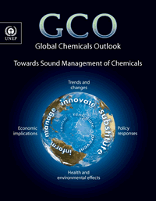
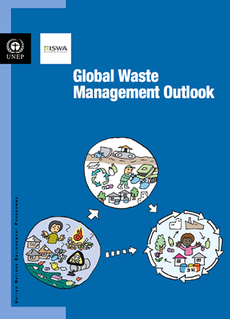
Second Editions of Global
Chemicals and Waste Outlooks
Global Chemicals Outlook II – 2018
Assessing progress towards the 2020 goal
Address issues with emerging evidence of risk to human health and the environment
Develop options for action to implement 2030 Agenda
Steering Committee, 15-16 Dec 2016, Geneva
Global Waste Management Outlook II- 2019
Outlook updated with regional and thematic reports
Waste Management Outlook for Mountains published in Dec. 2016
Regional outlooks for Asia, Central Asia, Africa, Latin America and the Caribbean, and Small Island Developing States planned for publication in 2017 and early 2018
Global Mercury Waste Assessment in preparation
Notes:
Mandate from the United Nations Environment Assembly
To be completed by 2018
Will provide an updated and comprehensive global overview of issues and challenges related to the sound management of chemicals
Will support stakeholders in assessing progress towards the 2020 goal for the sound management of chemicals and discussions beyond 2020
Consultative meeting was held in April 2016 in Geneva to review scope and process of the exercise and on updating the first edition of the Global Chemicals Outlook
The first meeting of the Steering Committee was held in Geneva on 15 and 16 December 2016.
The Secretariat is updating the Global Waste Management Outlook continually with targeted regional and thematic outlook reports
The first such a report was the “Waste Management Outlook for Mountain Regions” which was released on December 12.
The report can be downloaded from this site: http://www.grida.no/publications/default/6826.aspx

Slide 9

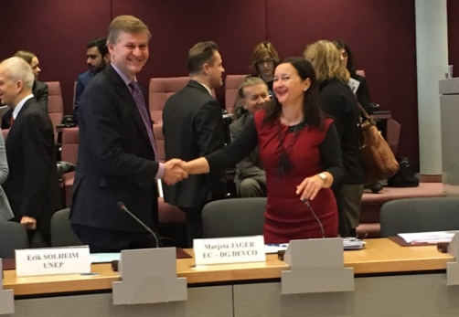
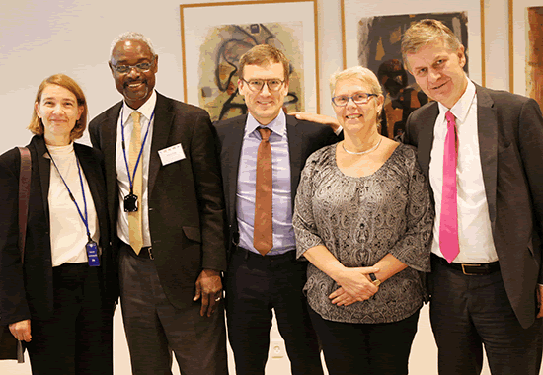
Special Programme on Institutional Strengthening for Chemicals and Waste Management
Board approved seven projects amounting US$ 1.75 million in 2016
Regional balance and needs of least developed countries, small island developing states
Projects in Benin, Tanzania, Iraq, Kyrgyz Republic, Ukraine, Argentina and Dominican Republic
Second round of applications in February 2017
Next Board meeting in October 2017
Trust Fund and Secretariat received US$ 17 million
Notes:
The Executive Board of the Special Programme approved in October 2016 seven projects during the pilot round amounting to US$ 1.75 million
The Board took into consideration: regional balance and the special needs of least developed countries and small island developing states
Selected projects are in Benin, Tanzania, Iraq, Kyrgyz Republic, Ukraine, Argentina and Dominican Republic
The Board agreed that the second round of applications would take place in February 2017
The third Board meeting is scheduled for October 2017
Pledges and contributions to the Trust Fund and the Secretariat amount to a total of US$ 17 million.

Slide 10

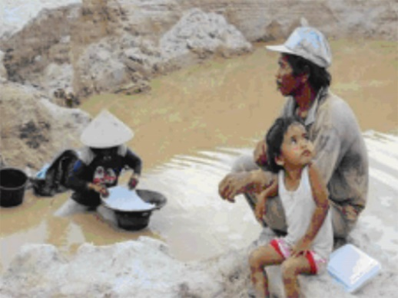

Minamata Convention on Mercury
Minamata Convention/Interim Secretariat
35 ratifications have been deposited (December 2016)
15 more are required for the convention to enter into force
Series regional meetings scheduled in first half 2017
First Meeting of Conference of the Parties: Sept. 2017
Implementation of the Convention
More than 85 Minamata Initial Assessment projects approved by the Global Environment Facility
Global Mercury Partnership assisting countries, stakeholders
USD 45 million GEF project on Global Opportunity for Long-term Development in Artisanal and Small Scale Gold Mining (GEF:GOLD)
New Global Mercury Assessment to be published in 2018
Notes:
The seventh session of the Intergovernmental Negotiating Committee for the Minamata Convention was held in Jordan in March 2016
Significant progress was made towards the preparation for entry into force of the Convention
35 ratifications have been deposited (as of 22 December 2016), while 15 more are required to enter into force
The First Meeting of the Conference of the Parties is scheduled for the week of 25 September 2017
The interim secretariat continues to provide support to countries towards ratification and early implementation
More than 85 Minamata Initial Assessment projects have been approved by the Global Environment Facility
This includes a 45 million USD project on a Global Opportunity for Long-term Development in the Artisanal and Small Scale Gold Mining Sector (GEF GOLD)
The Global Environment Facility launched in December 2016 a 15.2 million USD project to address mercury emissions from artisanal and small-scale gold mining
The Global Mercury Partnership assists countries and stakeholders in the action to reduce the risk of mercury
This partnership works also in other areas such as coal combustion, mercury-containing products, waste management, etc.
A new Global Mercury Assessment with updated mercury emission data will be published in 2018. An expert meeting was held in Copenhagen in November 2016

Slide 11
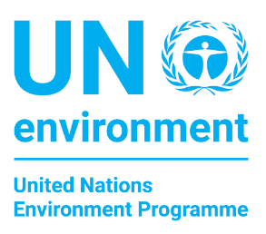




Addressing Lead Pollution
Cooperation with the World Health Organization in the Lead Paint Alliance to phase out lead in paint by 2020
International Lead Poisioing Prevention Week of Action, 23-36 Oct 2016 #BanLeadPaint
New regulations and standards have recently been or are being developed in Cameroon, India, and Kenya
Second United Nations Environment Assembly requested UN Environment to assist countries in establishing national and regional strategies to promote environmentally sound recycling of used lead acid batteries
African regional meeting on used lead acid batteries Burkina Faso, December 2016
Notes:
UN Environment is cooperating with the World Health Organization to lead the Global Alliance to Eliminate Lead Paint to phase out the use of lead in paint by 2020
New regulations and standards have recently been or are being developed in Cameroon, India, and Kenya
The second United Nations Environment Assembly requested UN Environment to assist countries in establishing national and regional strategies to promote environmentally sound recycling of used lead acid batteries
An African regional meeting on used lead acid batteries took place in Burkina Faso in December 2016

Slide 12

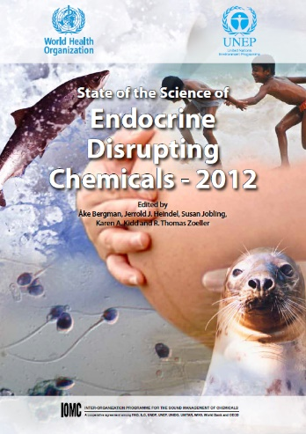

Other selected areas
Endocrine Disrupting Chemicals
Developing series of reports on existing scientific knowledge and initiatives
Meeting of Advisory Group, Nov 2016
Reports to be available in first semester of 2017
Chemicals in Products Programme
Knowledge-sharing on action taken by government and stakeholders
Steering Committee meeting, Feb. 2017
Support by the Global Environment Facility
Expanded concept to include Sustainable Chemistry
Notes:
Endocrine disrupting chemicals
UN Environment is working on reports that focus on existing scientific knowledge and initiatives to address endocrine disruptor chemicals
A meeting of the UN Environment Advisory Group took place in November 2016
The reports will be available first semester of 2017
Chemicals in Products
UN Environment is leading the Chemicals in Products Programme while engaging different sectors and executing projects with financial support of the Global Environment Facility
A meeting of the Steering Committee for the Programme will take place in February 2017

Slide 13
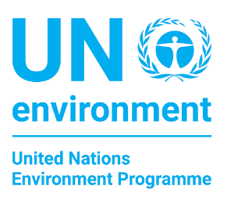

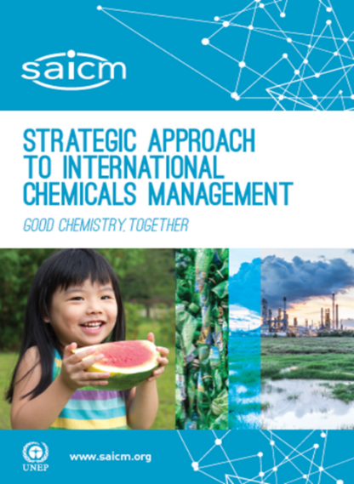
Strategic Approach to International
Chemicals Management (SAICM)
Looking Beyond 2020……
First meeting of the intersessional process on the Strategic Approach to International Chemicals Management beyond 2020 in Brasilia, Brazil from 7 to 9 February 2017
Objective is to prepare recommendations on the sound management of chemicals and waste beyond 2020 for adoption in 2020 at the Fifth Session of the International Conference on Chemicals Management (ICCM5)
Notes:
The first meeting of the intersessional process on the Strategic Approach to International Chemicals Management beyond 2020 is taking place in Brasilia, Brazil from 7 to 9 February 2017
The objective of the process is to prepare recommendations on the Strategic Approach and the sound management of chemicals and waste beyond 2020 for adoption in 2020 at the fifth session of the International Conference on Chemicals Management (ICCM5)

Slide 14


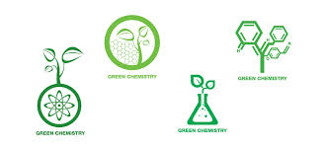
Sustainable Chemistry:
Exploring Opportunities
Mandate from UNEA2 (best practices & analysis)
Advances a chemistry that achieves all three dimensions of sustainable development
Potential driver to detoxify chemicals products and production processes (through alternatives)
Positive story with transformative vision compatible with the 2030 Sustainable Development Agenda
Helps expand traditional chemicals management with new concepts (incentives, innovation, business models)
Requires basic chemical safety infrastructure and capacities and addressing unfinished business !

Slide 15

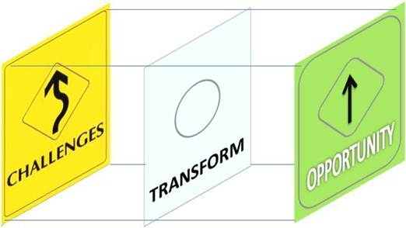
Opportunities and Challenges
Creating linkages and synergies
Sustainable Consumption and Production
Inclusive green economy
Life cycle thinking
Circular economy
Scaling up partnerships
Chemical industry
Downstream industry
Consumer organizations
Implementing the integrated approach to financing
Political commitment and support

Slide 16
Thank you very much for your attention!

