Slide 1

Early Warning and Data Analytics Strategy, Policy and Action for People, Places and Planet Executive Brief February 2024
Alexandre Caldas Director of the United Nations and Chair of the ECOSOC UN Geospatial Network Chief Early Warning and Data Analytics Branch, Early Warning and Assessment Division (EWAD) United Nations Environment Programme (UNEP)

Slide 2

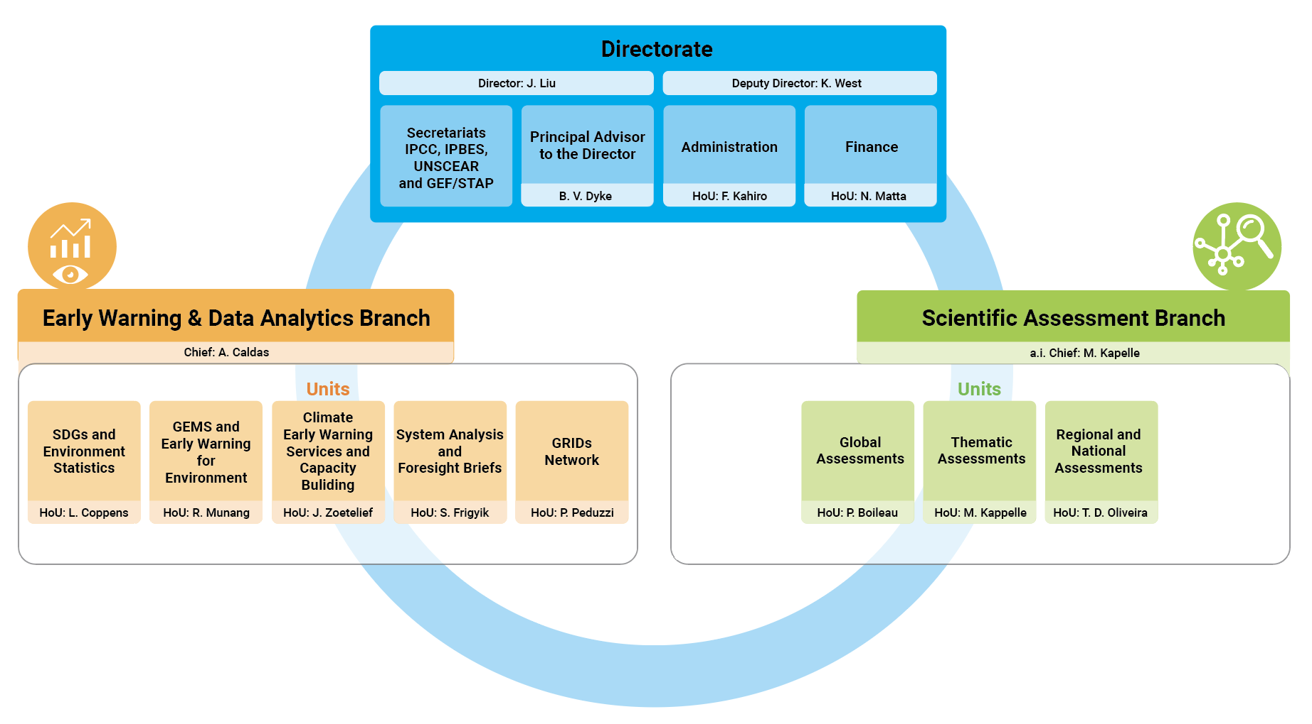
EWAD – An Agile Structure for the Future

Slide 3
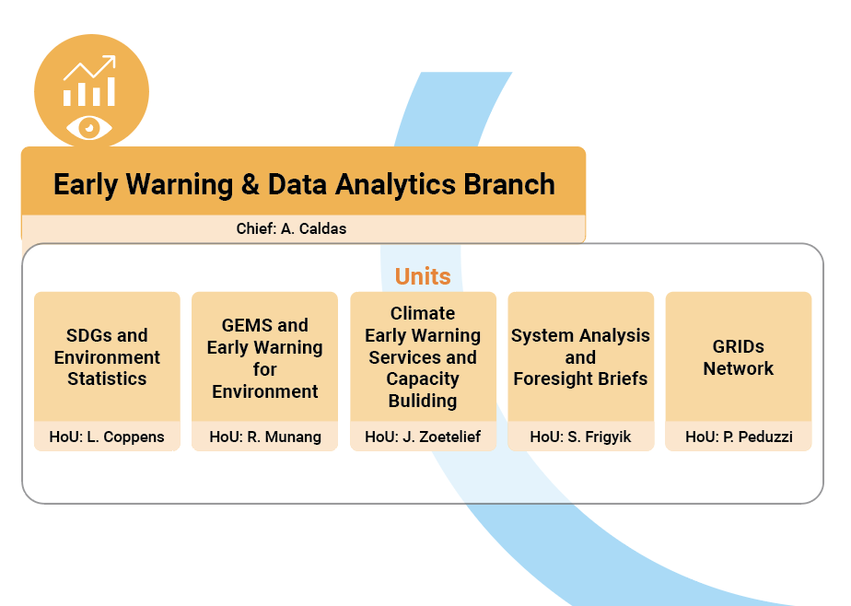
EWAD – An Agile Structure for the Future

Slide 4
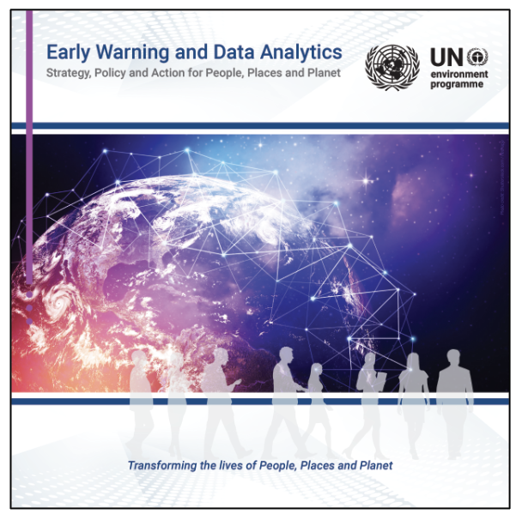
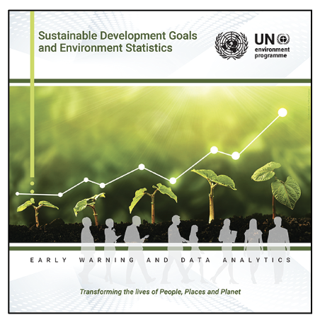
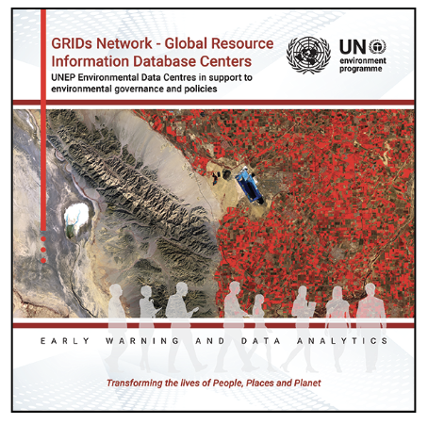
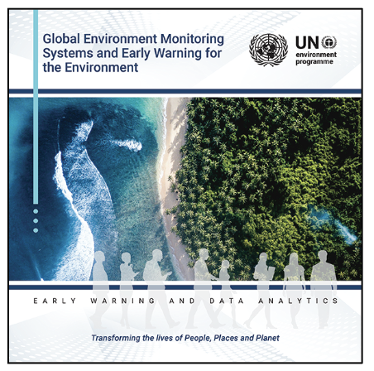
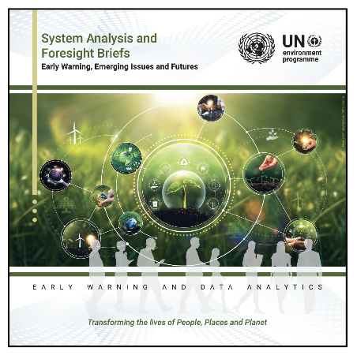
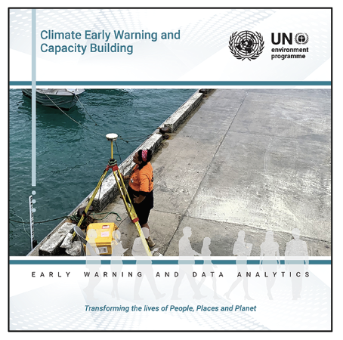
Early Warning and Data Analytics Services
https://wedocs.unep.org/20.500.11822/44794
https://wedocs.unep.org/20.500.11822/44792
https://wedocs.unep.org/20.500.11822/44791
https://wedocs.unep.org/20.500.11822/44790
https://wedocs.unep.org/20.500.11822/44793
https://wedocs.unep.org/20.500.11822/44789

Slide 5
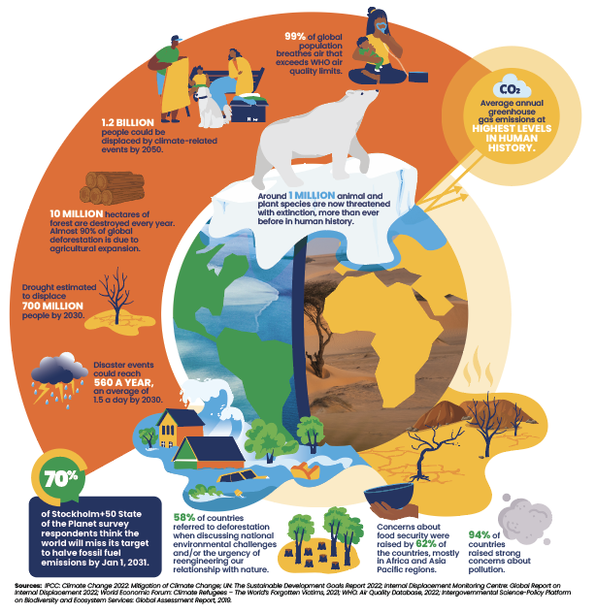
Early Warning for Environment
A complex, uncertain and unstable Future for People, Places and Planet

Slide 6
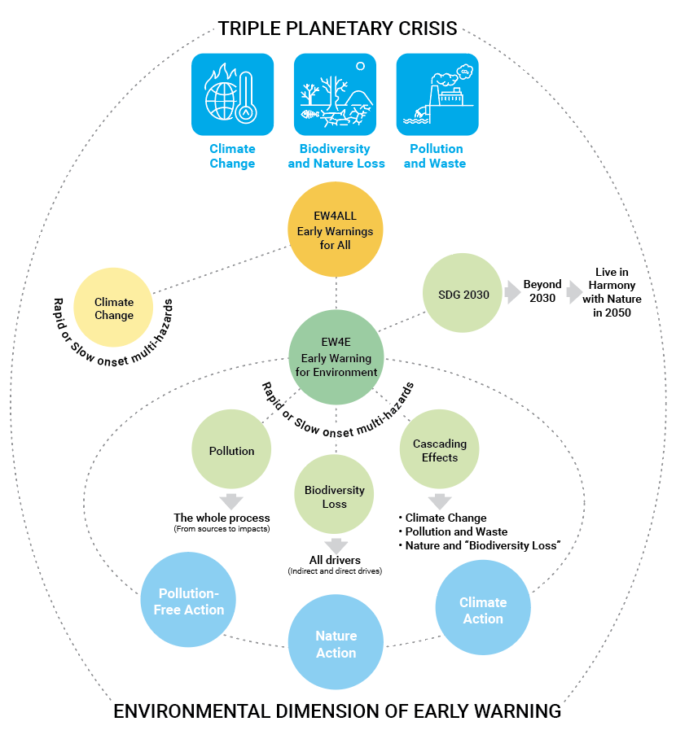
Early Warning & Data Analytics for People, Places and Planet
Early warning systems (EWS) are an adaptive measure for climate change, using integrated monitoring, forecasting and communication systems to help communities prepare for and manage hazardous climate-related events. A successful EWS saves lives and jobs, land and infrastructure and supports long-term sustainability and disaster risk reduction. Early warning systems assist public officials and administrators in their planning, saving money in the long run and protecting economies and natural assets. The UN, working in diverse partnerships, has introduced a number of innovative EWS initiatives in vulnerable areas around the world.
Early Warning for Environment
Identifying, monitoring and analysing both rapid onset multi-hazards (with a predominant focus on climate-related risks) and slow onset but continuous hazards and their interlinkages, or issuing warnings of future events that come early enough for one to prepare, respond and Build Back Better. Leaving No One Behind.
Saving the Lives of billions of People and preventing social and economic losses, protecting the property and natural assets of the most vulnerable communities in the world.

Slide 7
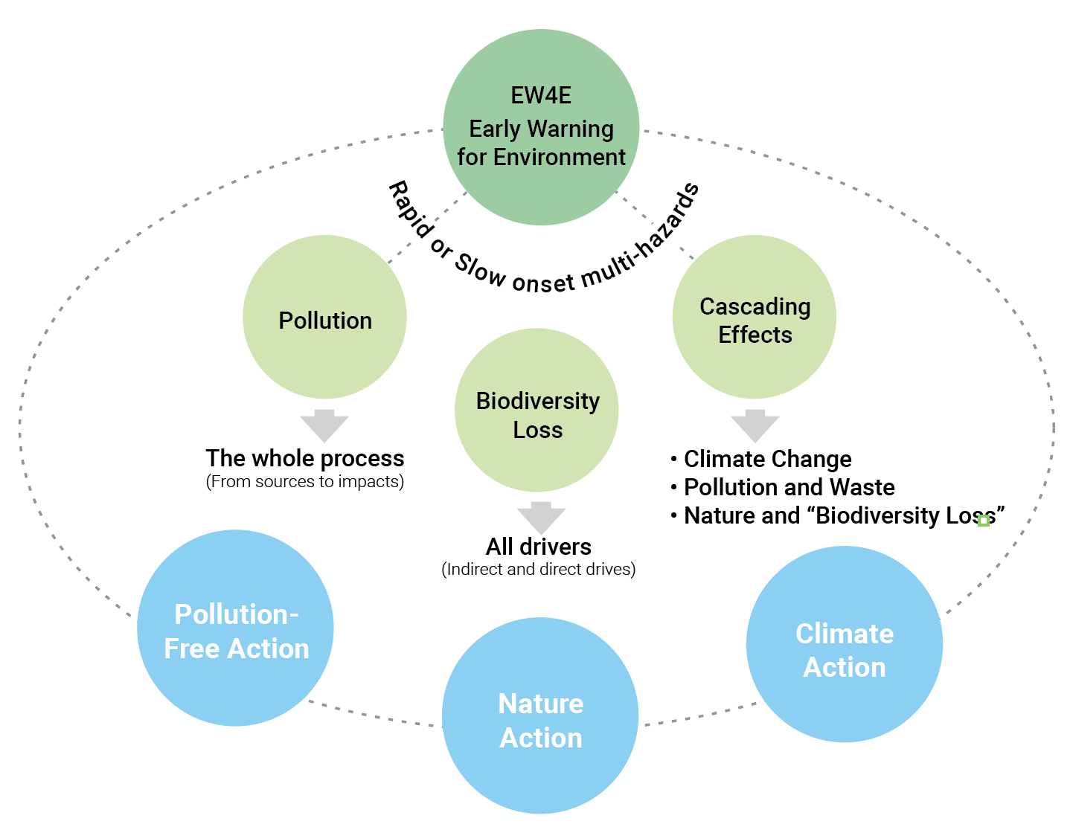
Early Warning & Data Analytics for People, Places and Planet
Early warning systems (EWS) are an adaptive measure for climate change, using integrated monitoring, forecasting and communication systems to help communities prepare for and manage hazardous climate-related events. A successful EWS saves lives and jobs, land and infrastructure and supports long-term sustainability and disaster risk reduction. Early warning systems assist public officials and administrators in their planning, saving money in the long run and protecting economies and natural assets. The UN, working in diverse partnerships, has introduced a number of innovative EWS initiatives in vulnerable areas around the world.
Early Warning for Environment
Identifying, monitoring and analysing both rapid onset multi-hazards (with a predominant focus on climate-related risks) and slow onset but continuous hazards and their interlinkages, or issuing warnings of future events that come early enough for one to prepare, respond and Build Back Better. Leaving No One Behind.
Saving the Lives of billions of People and preventing socio economic losses, protecting the property of the most vulnerable communities in the world.

Slide 8
Early Warning for Environment: towards a definition
Early warning systems (EWS) are an adaptive measure for climate change, using integrated monitoring, forecasting and communication systems to help communities prepare for and manage hazardous climate-related events. A successful EWS saves lives and jobs, land and infrastructure and supports long-term sustainability and disaster risk reduction. Early warning systems assist public officials and administrators in their planning, saving money in the long run and protecting economies and natural assets. The UN, working in diverse partnerships, has introduced a number of innovative EWS initiatives in vulnerable areas around the world.
Early Warning for Environment
Identifying, monitoring and analysing both rapid onset multi-hazards and slow onset but continuous hazards and their interlinkages, or issuing warnings of future environmental events that come early enough for one to prepare, respond and Build Back Better. Leaving No One Behind.
Build a multi-stakeholder approach and on the rich mandates of the Partner Agencies from the UN system and beyond to impact in countries, saving lives and property, particularly with the developing nations and the most vulnerable communities.

Slide 9
Early Warning for Environment
Strategic Positioning
We all know the importance of early warnings for climate change and related disasters. Early warnings can enhance resilience and adaptive capacity and reduce future loss and damage. Early warnings can save lives, livelihoods and nature’s services. They protect assets that are worth far more than the costs of the systems themselves. They work.
Through our Climate Information and Early Warning Systems (CIEWS) portfolio, UNEP helps countries across the world to increase access to high-quality weather and climate data, forecasting, and multi-hazard early warning systems that underpin evidence-based policy and early action.
UNEP is proud to be part of the UN’s Early Warnings for All initiative (EW4All), including as a founding partner and implementer of the Systematic Observations Financing Facility – a partnership between WMO, UNDP and UNEP.
But while extreme weather and climate change-induced disasters are often the most dramatic and obvious events, they are not the only ones we need to predict, prepare for and head off where possible. Alongside climate change, nature and biodiversity loss, and pollution and waste complete the triple planetary crisis.

Slide 10
Early Warning for Environment
Strategic Positioning
UNEP is already looking further into the future to predict signals of change. But we must do more. This is why you are now tasked with building a strategy for a new dimension to EW4All – Early Warning for Environment.
Nature loss and pollution are often more slow-onset and less visible than climate change, but no less damaging to lives and livelihoods. Air pollution and land degradation are perfect examples. Millions of people die around the world each year from air pollution, while billions of people are affected by land degradation. We also must consider issues like pollinator loss, zoonotic spillover, the erosion of natural barriers to floods and landslides, and more.
This dimension will require a systematic approach to tracking the sources of pollution and waste and the drivers of nature and biodiversity loss. It will require the cooperation of all relevant agencies and Multilateral Environmental Agreements (MEAs) – including the Kunming-Montreal Global Biodiversity Framework, the new Global Framework on Chemicals and the upcoming deal on plastic pollution.
Each agency and MEA must be a contributor and beneficiary and support the UN Common Approaches to biodiversity and pollution – with a view to boosting the achievement of the Sustainable Development Goals.

Slide 11
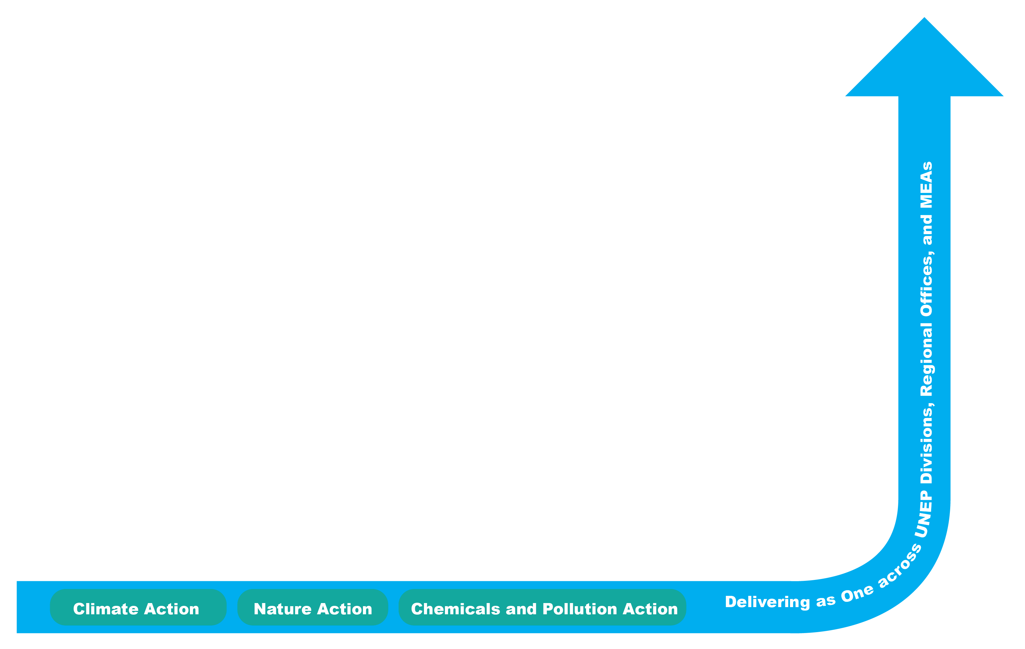



UNEP’s Strategic Goal and Priorities Early Warning and Data Analytics
Strengthen the environmental dimension of Early Warning towards acceleration of the achievement of Agenda 2030 and the Sustainable Development Goals (SDGs)
Increase the Impact in Countries
  30 focus countries in EW4All
  25+ countries with CIEWS investments
  60 CCA Countries
  One Planet EW Global, Regional and National Platform
  Accelerate the achievement of the SDGs
  Geospatial and Statistics integration and Leadership at UN level
  Capacity Development on SDGs and Early Warning for Environment
  Synergies on the Nexus (Development, Peace and Humanitarian)
  Provision of Disaggregated Data Analytics to countries
Ensure UNEP Leadership in Early Warning for Environment
  UNEP leadership on the environmental dimension of EW4ALL
  Leadership on Geospatial Early Warning
  Leadership on Statistics for Early Warning and SDGs

Slide 12
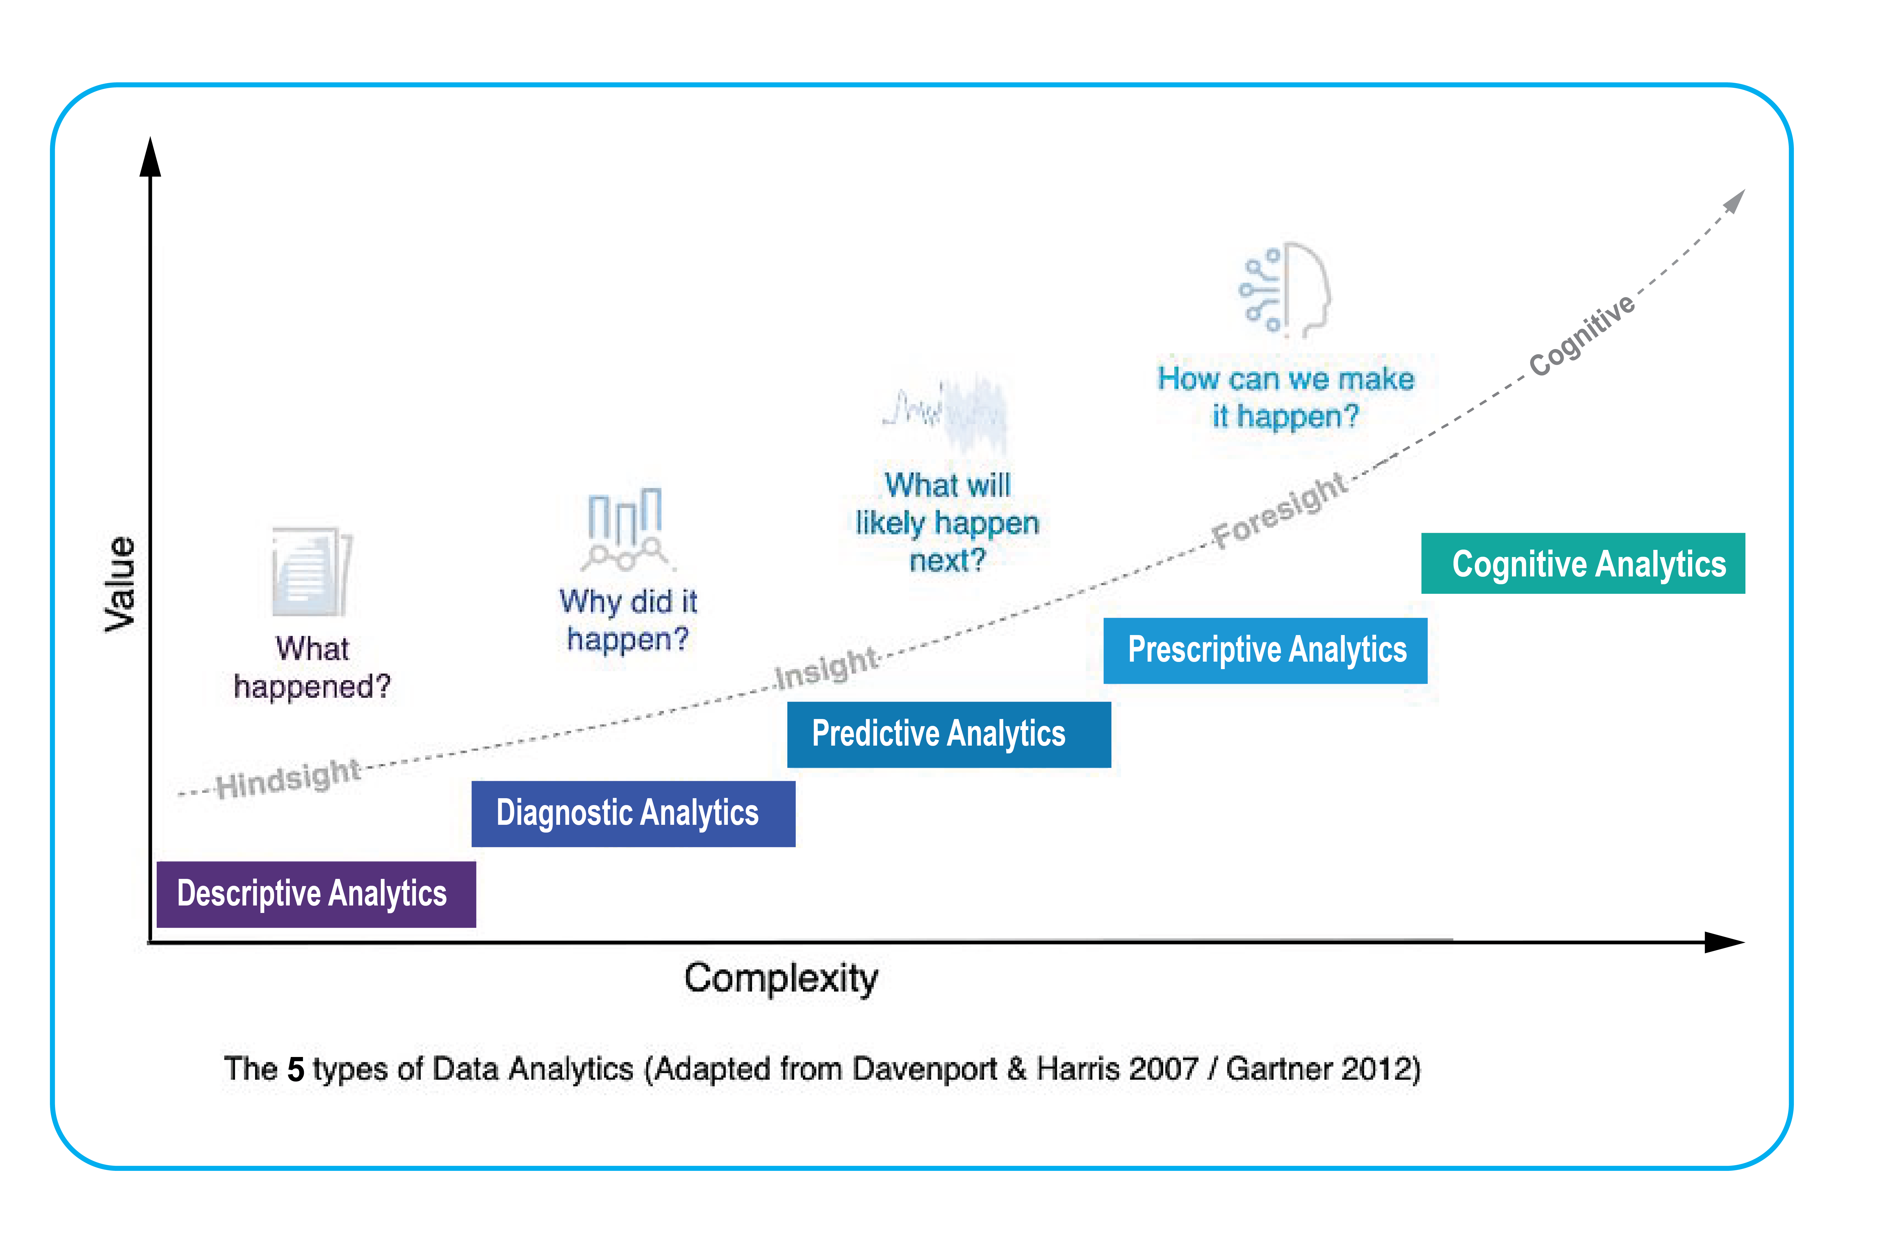
UNEP’s Data Analytics Service Portfolio
Data Analytics is used for the discovery, interpretation, and communication of meaningful patterns in data towards effective decision making.
01
Early Warning and
Data Analytics
Data Analytics is rated as highly relevant by 82% of the countries for the UN Sustainable Development Cooperation Framework.
02
Data Analytics: is the systematic computational analysis of data or statistics. Five main types are descriptive, diagnostic, prescriptive, predictive and Cognitive, including artificial intelligence.
Geospatial, Statistics and Data Analytics: are fundamental Accelerators for the Achievement of Global Agendas as Agenda 2030 and the Sustainable Development Goals.

Slide 13
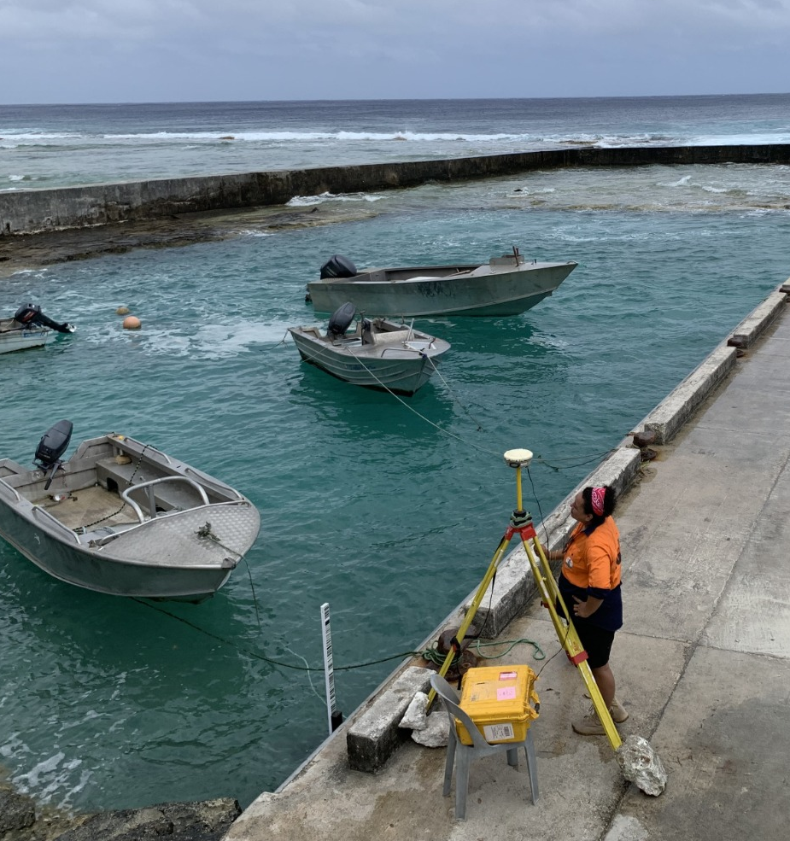
UNEP’s Climate Information and Early Warning Systems (CIEWS) Portfolio
Establishing, upscaling and strengthening end-to-end Climate Information Services and Multi-Hazard Early Warning Systems (MHEWS) to enhance resilience and adaptive capacity – helping to save lives, livelihoods and ecosystems in the face of climate-related hazards.
Core components of UNEP’s CIEWS initiatives:
Strengthening institutional frameworks for climate information and MHEWS
Enhancing capacity for monitoring, analysis and forecasting of climate and its impacts
Improving dissemination and communication of risk information and early warnings
Enhancing climate risk management capabilities
Early Warning and
Data Analytics
UNEP is also a co-founder and implementing entity of the Systematic Observations Financing Facility (SOFF) which supports the most vulnerable countries to close critical weather and climate data gaps that underpin better weather forecasts, early warning systems, and climate information services.

Slide 14
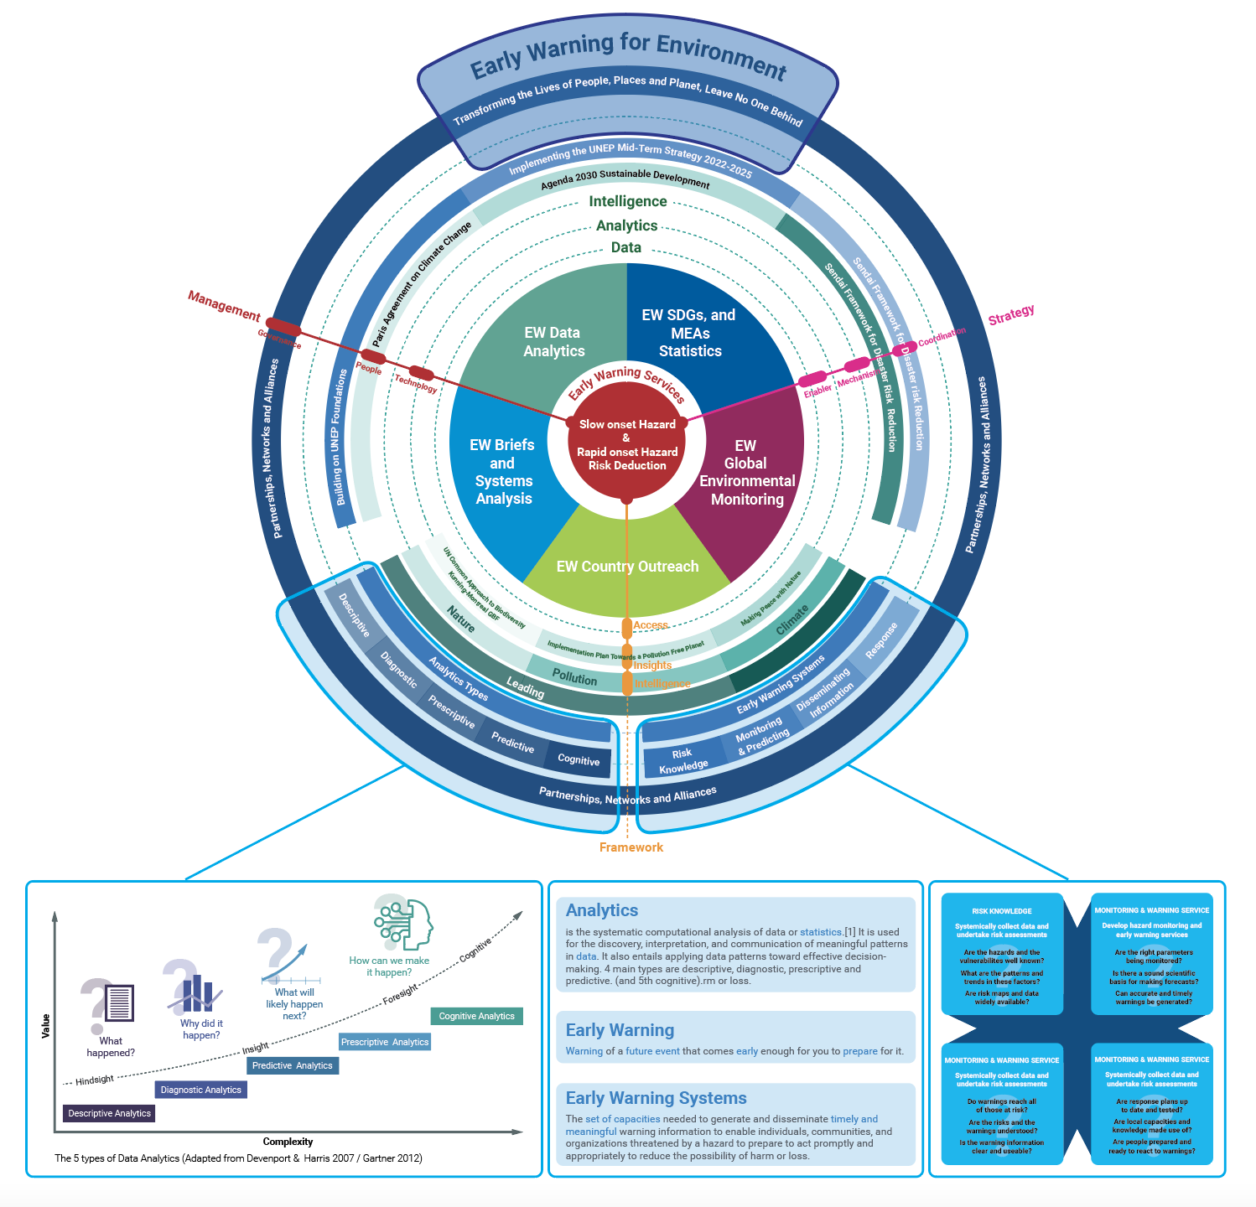
An Integrated Framework of Services
Identifying, monitoring and analysing both rapid onset multi-hazards and slow-onset but continuous hazards and their interlinkages or issuing warnings of future events that come early enough for one to prepare, respond and Build Back Better. Leaving No One Behind.

Slide 15
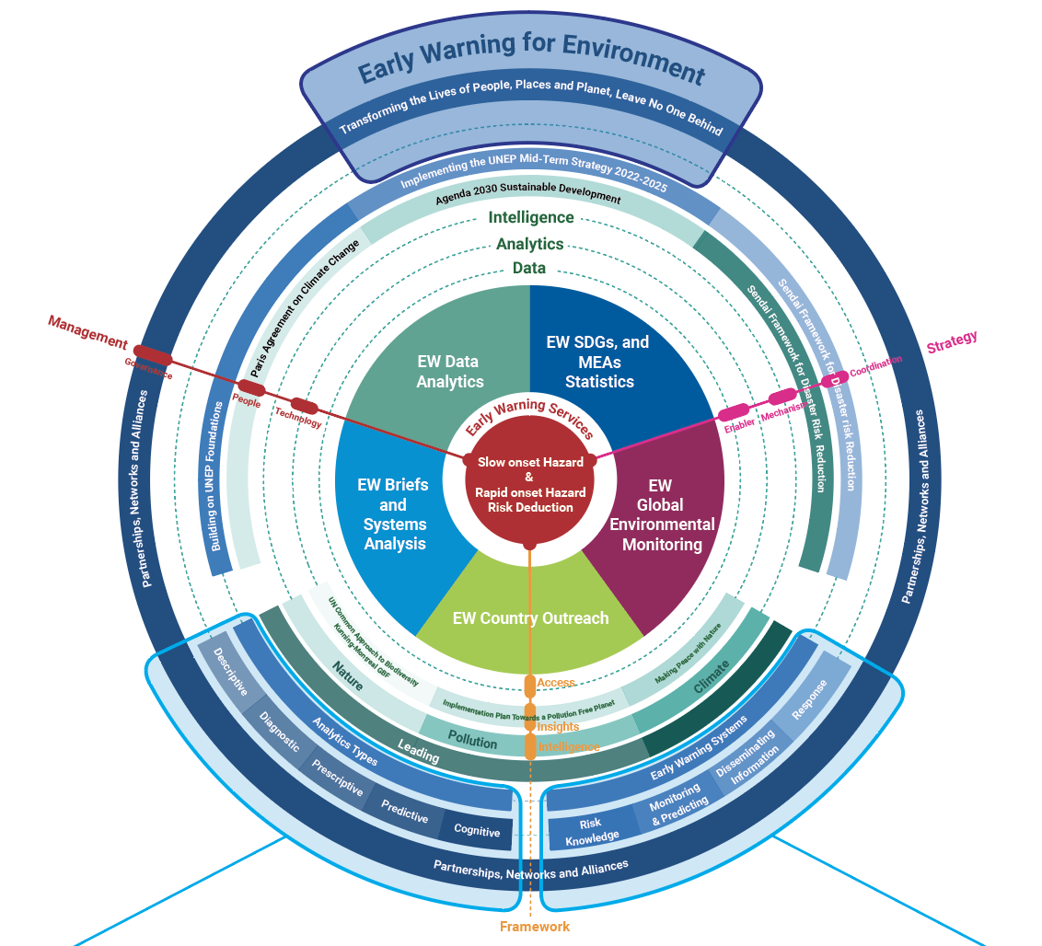
An Integrated Framework of Services
Identifying, monitoring and analysing both rapid onset multi-hazards and slow-onset but continuous hazards and their interlinkages or issuing warnings of future events that come early enough for one to prepare, respond and Build Back Better. Leaving No One Behind.
02
Scientific Assessment Branch

Slide 16
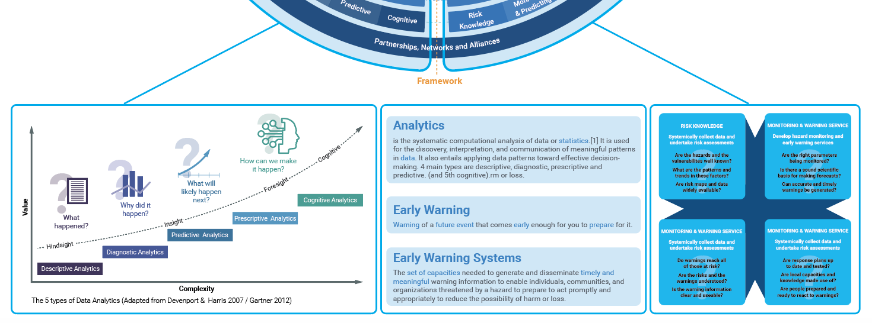
An Integrated Framework of Services
02
Scientific Assessment Branch

Slide 17
Why Early Warning for Environment?
1. There is a need for strengthened environmental governance at all levels. The planetary crises of climate change, pollution, nature and biodiversity loss can only be tackled successfully if they become a top policy Priority and Action supported by legislation, inclusive decision-making, monitoring, and enforcement.
2. Humanity has been facing multiple interlinked (SYSTEMIC) environmental, social, economic and health challenges – Including the TRIPLE PLANETARY CRISIS: the climate change crisis, pollution, biodiversity loss and the extinction of species, deforestation, land degradation, increased incidents of environmental disasters, widening gaps between rich and poor, backlash to women’s rights, lack of decent jobs and new emerging zoonotic diseases. The complexity and difficulties of addressing these challenges are compounded by the urgent need for action and the current fragility of the global economy.

Slide 18
Triple Planetary Crisis
Climate Change, Biodiversity Loss and Pollution
“Lead us out of this mess”, SG urged delegates at the Swedish summit convened by the UN General Assembly, in a call for action against a “triple planetary crisis” that’s been caused by the climate emergency – “that is killing and displacing ever more people each year” – biodiversity loss – which threatens “more than three billion people” – and pollution and waste, “that is costing some nine million lives a year”.
All Nations should do more to protect the basic human right to a clean, healthy environment for everyone, UN SG Mr. Guterres insisted, focusing in particular on “poor communities, women and girls, indigenous peoples and the generations to come”. – By UN SG

Slide 19
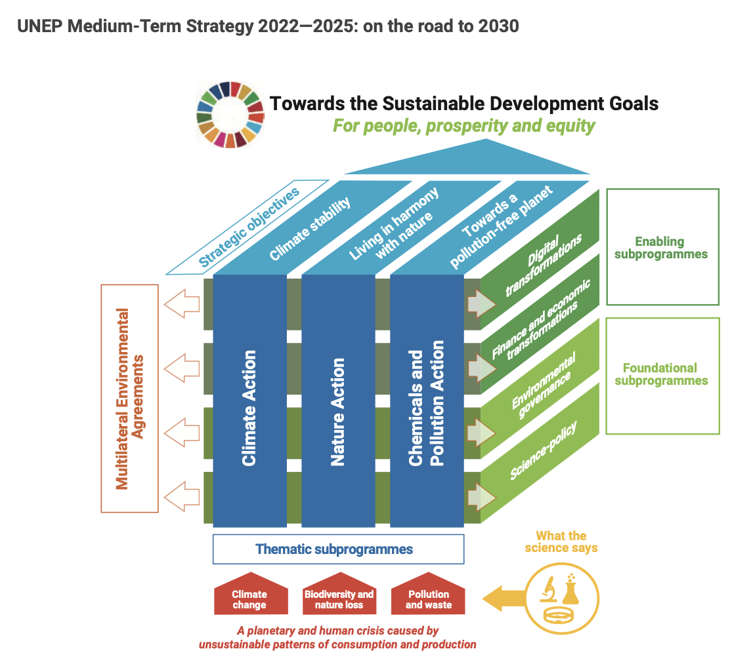
Aligned with UNEP – Mid Term Strategy and Agenda 2030
UNEP Medium-Term Strategy 2022-2025: on the road to 2030

Slide 20
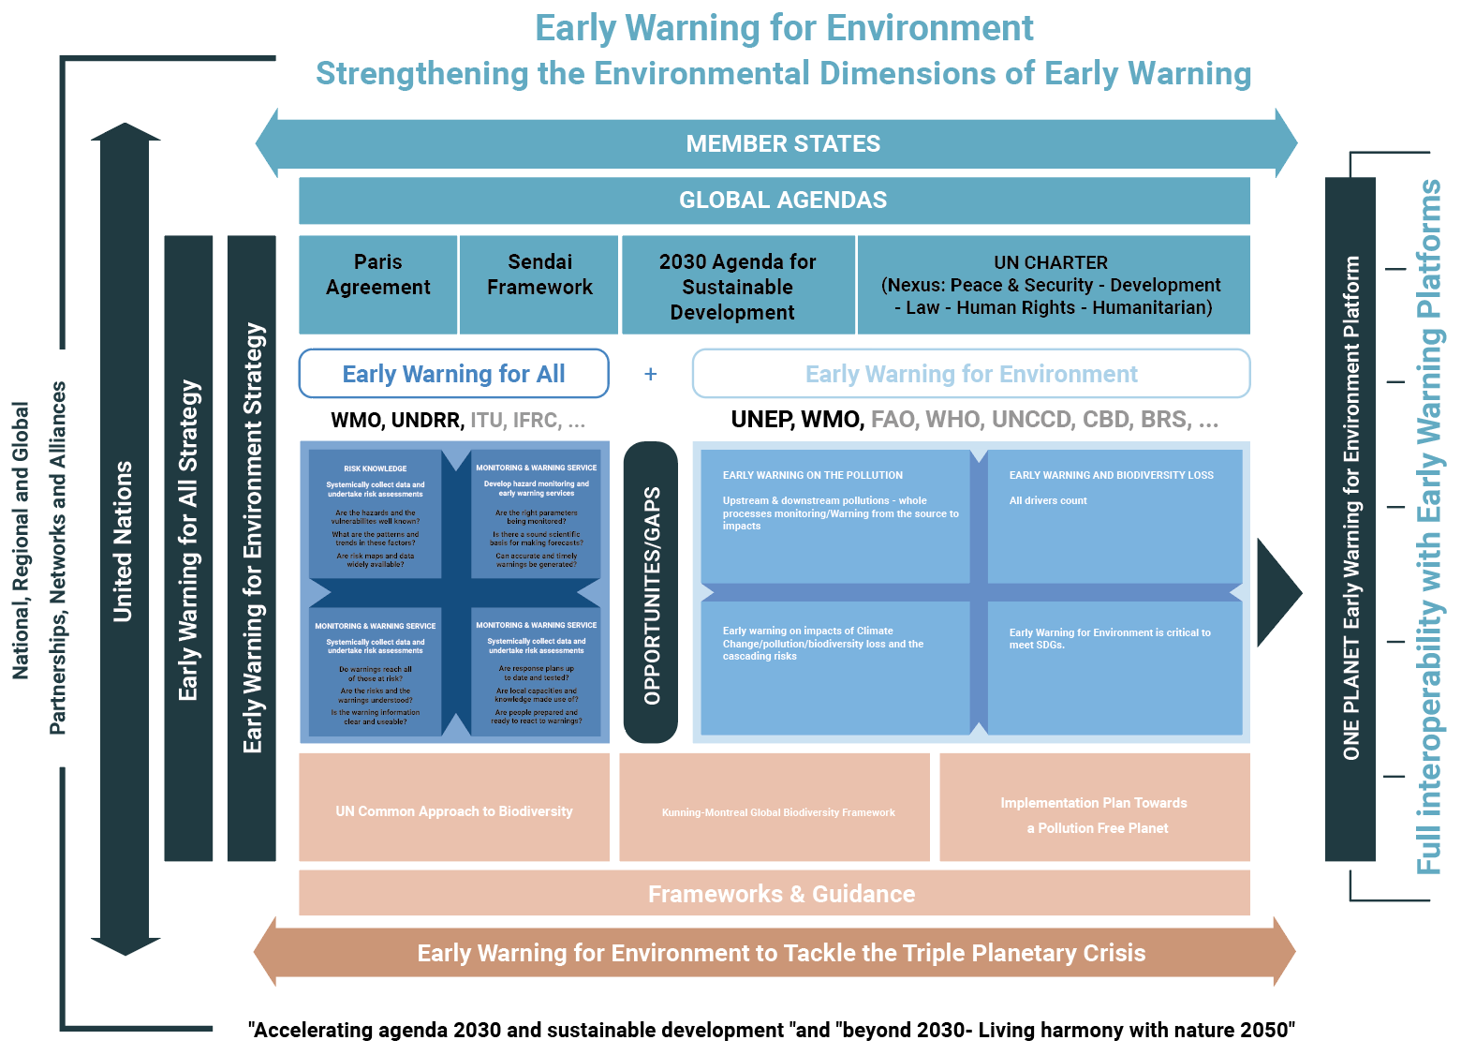
One UN Common Approach for Early Warning for Environment
Synergies between Early Warning for All and EWE
The availability of timely, quality and disaggregated data is critical for accelerating the achievement of Agenda 2030 and the Sustainable Development Goals (SDGs). Data is fundamental for Early Warning services, particularly at the local, sub-national and national levels.

Slide 21
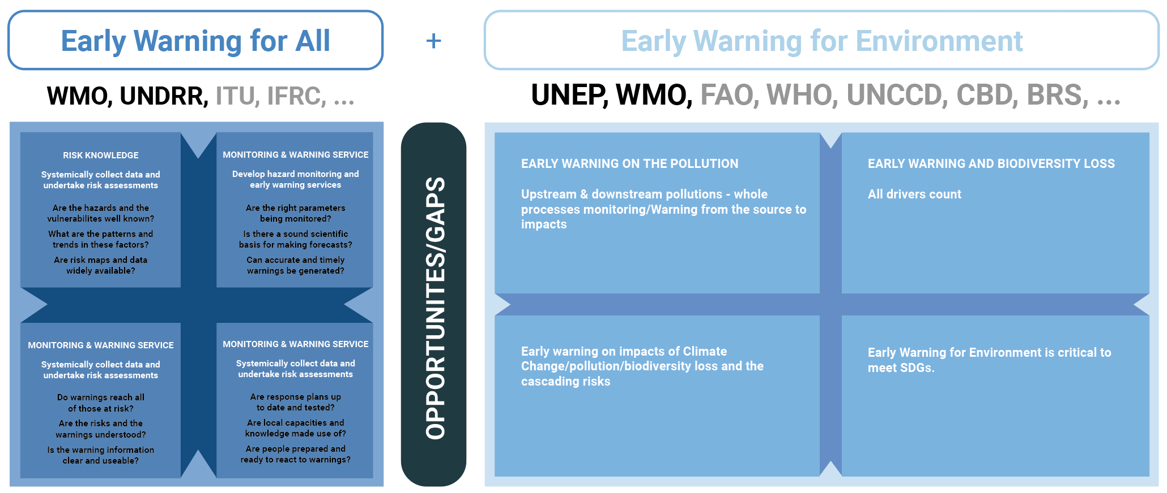
One UN Common Approach for Early Warning for Environment
Synergies between Early Warning for All and EWE

Slide 22
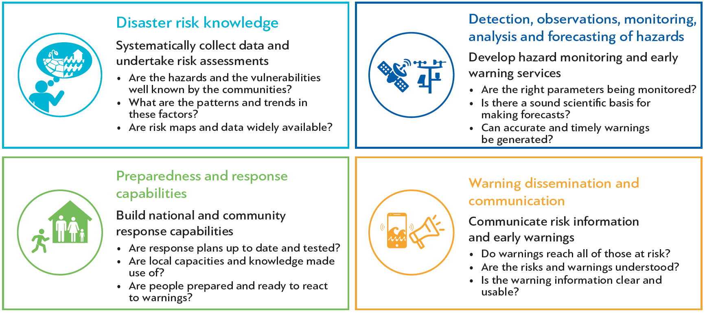
Synergies between Early Warnings for All and EWE
Early Warning for Environment Facilitated by UNEP
Co-creating with 14 UN Agencies and 3 MEAs
Early Warnings for All is co-led by WMO and UNDRR and supported by
pillar leads ITU and IFRC. UNEP is one of implementing partners.

Slide 23




Outcomes of the Scoping Workshop (6-7 July 2023)
July 2023
November 2023
February 2024
All participants from 4 plus 3 organizations (UNEP, WMO, …) (FAO, WHO, CBD, UNCCD, BRS) seem to support the need for an Early Warning for Environment initiative (4 Agencies and 3 MEAs).
Early Warning for Environment is to be Anchored in the Early Warning for All is an important initiative (EW4ALL Environment).
The scope of Early Warning for Environment is clear: focus on Pollution and Biodiversity, Ecosystems degradation and Nature Solutions in interlinkage with Climate Services.
The Early Warning for Environment contributes directly to the Agenda 2030 and SDGs (Cross-Cutting Effects).

Slide 24
Past & Future Events
July 2023
November 2023
26 February 2023 – 1 March 2024
Scoping Workshop
Location: Nairobi
Strategy Planning Workshop
Location: Geneva
Plenary & Roundtable UNEA 6
Location: Nairobi, UNEA 6

Slide 25




Outcomes of the Scoping Workshop (6-7 July 2023)
July 2023
November 2023
February 2024
The availability of timely, quality and disaggregated data is critical for accelerating the achievement of Agenda 2030 and the Sustainable Development Goals (SDGs). Data is fundamental for the Early Warning for Environment services, particular at the local, sub-national and national levels.
Building on existing platforms and monitoring and observation systems.
Capacity development and technology capacity development are critical for the Early Warning for Environment function, even more relevant at the national, sub-national and local levels.
The identification of a typology of Hazards is fundamental for the ‘Early Warning for Environment’ initiative.

Slide 26
Where is the Early Warning for Environment now?
July 2023
November 2023
February 2024
Group of 14 Agencies + 3 MEAs with One UN Common Approach to EWE
14 UN Agencies: UNEP, WMO, UNDRR, ITU, IFRC, FAO, WHO, UNDP, UNDA, OICT, OCHA, and IOM
3 MEAs: CBD, BRS AND UNCCD
Across UNEP, including Ecosystems Division, Industry and Economy Division, Policy and Programming Division, the Chief Digital Office and Chief Scientist Office, and All 6 UNEP Regional Offices

Slide 27
Mission, Goals and Principles for EWE
Mission:
Protect all developing countries with EWE services on pollution and waste, nature and biodiversity loss, and together with EW4All on climate change, to minimize risks of disasters from the triple planetary crisis beyond 2030 and live in harmony with nature in 2050.
Goals:
By 2030, at least half of developing countries before 2030 will be provided EWE services (EW4All by 2027)
By 2035, all developing countries will be provided EWE services
Principles:
Demand-driven, country ownership and sustainable operations

Slide 28
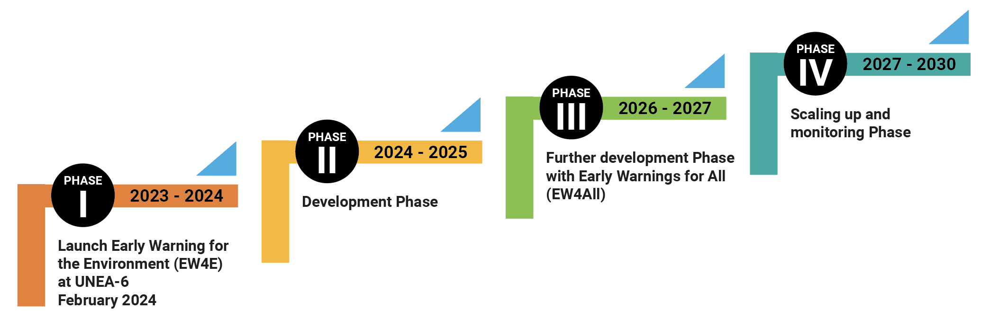
UNEP’s Early Warning Roadmap
Early Warning for Environment (EWE) will be developed in four phases within the Roadmap and Strategy

Slide 29
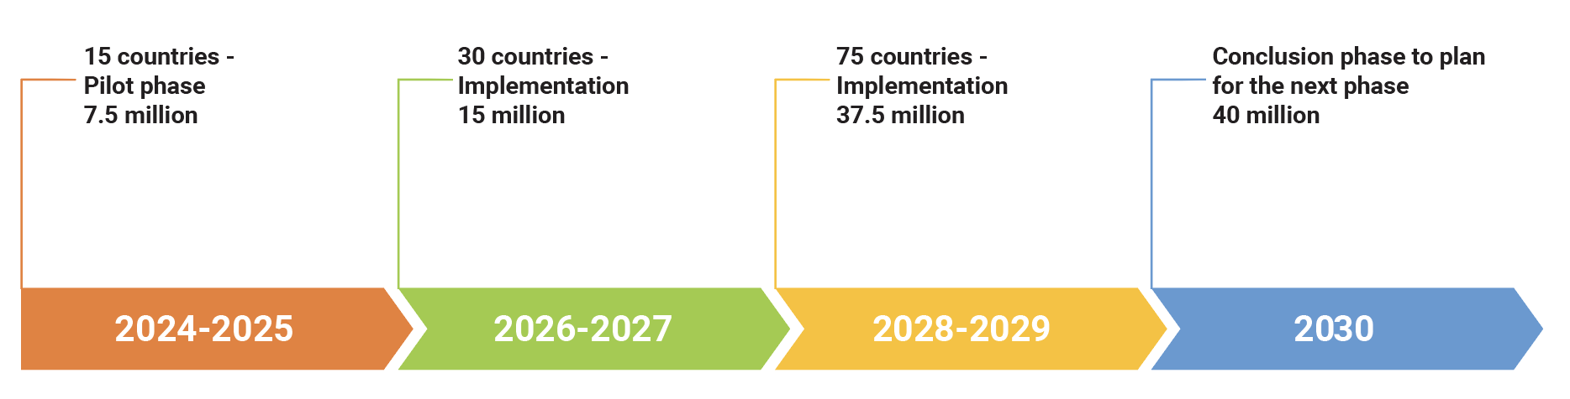
Implementation: a phased approach and milestones (2024-2030-2035)
e.g., EW on Air Pollution – Phase I 2024-2030

Slide 30
Agreed Strategic Pathway
A ONE UN Common Approach for Early Warning for Environment (EWE) to tackle the triple planetary crisis of climate change, biodiversity loss and pollution, within the umbrella of Early Warnings for All Initiative.
To build solutions at scale contributing to accelerate Agenda 2030 and the Sustainable Development Goals (SDGs). Focus on impacting in countries, implementing the environmental dimension of early warning throughout the risk management cycle (prevention, preparedness, response and recovery), with a particular focus on developing countries and the most vulnerable communities (such as SIDS, but groups as the elderly and youth), saving millions of lives and property, people, places and the Planet.
Adopt a multi-stakeholder approach with a user driven strategy and build on existing Partnerships across the UN system and beyond including the private sector and citizens and civil society.

Slide 31
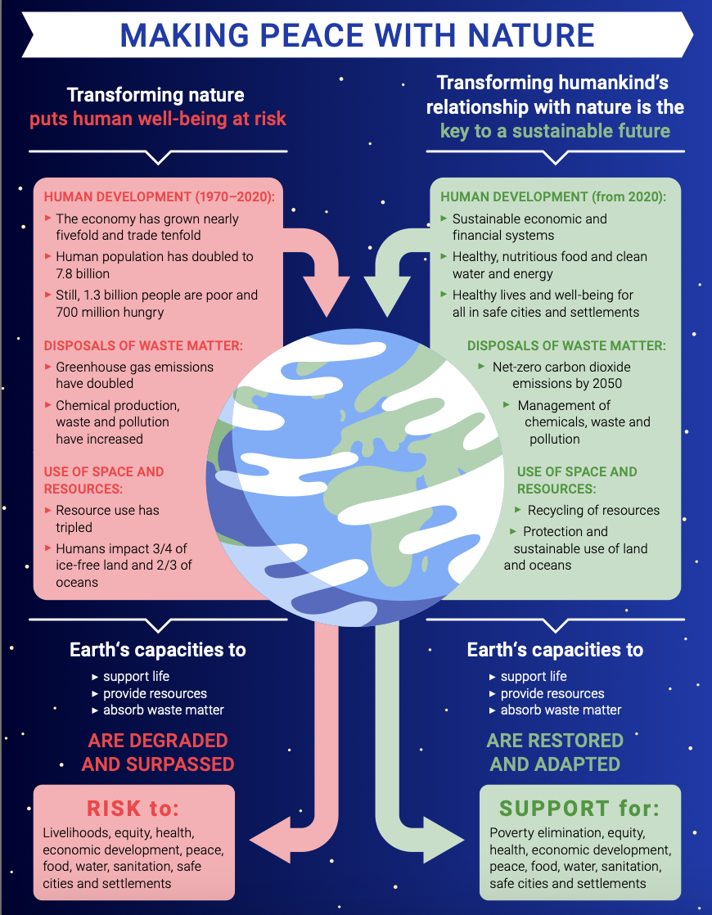
UNEP’s Early Warning Strategy
01
Early Warning and
Data Analytics
Accelerating Agenda 2030 and Sustainable Development and transforming the lives of People, Places and Planet
02
Scientific Assessment Branch

Slide 32
QUESTIONS & ANSWERS
Alexandre Caldas
Director of the United Nations and Chair of the ECOSOC UN Geospatial Network
Chief Early Warning and Data Analytics Branch, Early Warning and Assessment Division (EWAD)
United Nations Environment Programme
Early Warning and Assessment Division (EWAD)
Tel: +254 795 107 674
Email: alexandre.caldas@un.org
…and beyond

