Slide 1


UNEP Survey on Contaminated Sites - Priorities and Challenges in Western Balkan Countries
Vienna, 26 - 27.03.2026

Slide 2



Survey Overview
A comprehensive assessment of contaminated site management across Western Balkan countries, revealing critical gaps and opportunities for regional cooperation.
High Coverage Achieved
Complete Regional Response
Comprehensive Insights
Extensive participation from all relevant stakeholders and regulatory bodies
All countries involved has submitted detailed responses and data
26 questions for a regional assessment covering legal, technical, and operational dimensions

Slide 3

Legal Aspects – Overview
Current Status
Western Balkan countries face significant challenges in aligning national legislation with international standards for soil monitoring and contaminated site management.
Most countries have partial or no alignment with the European Soil Monitoring Directive, creating regulatory uncertainty.

Slide 4

Legal Challenges
Regulatory Misalignment
Significant differences in technical thresholds (SSTLs), risk assessment methodologies and remediation technology standards across countries
Harmonization Needed
Critical need for consistent regulatory frameworks to enable cross-border cooperation and knowledge transfer
End of Waste regulation for excavated soil
Ambiguity in classifying excavated soils as waste or reusable material creates operational challenges for site remediation projects.
Current regulations lack clear definitions and standardized testing protocols, leading to inconsistent decision-making.

Slide 5

Technical Aspects – Risk Assessment
1
Unclear Methodologies
Risk assessment procedures often lack specificity or vary significantly between jurisdictions
2
Software Limitations
Available tools have limited applicability to local conditions and data availability

Slide 6
Characterization Challenges
Standardization Costs
Lab Access
High expense of implementing standardized sampling and analysis protocols
Limited availability of accredited laboratories for specialized testing

Slide 7
Landfills and Abandoned Sites
Landfill Issues
Abandoned Sites
Inadequate leachate management systems
Insufficient post-closure monitoring programs
Limited long-term funding commitments
Unknown contamination conditions
High remediation costs (waste management)
No systematic prioritization framework

Slide 8


Project Impact
Regional Extension
Technical Coordination
Expanding the scope would enhance cross-border knowledge sharing and best practice exchange
Stronger coordination across Western Balkan countries would accelerate knowledge sharing and capacity building

Slide 9

Future Orientations
Immediate Priorities
On-site and on-the-job training programs
Technical assistance for legislative development
Enhanced risk analysis modeling capabilities
Emerging Focus Areas
Emerging contaminants monitoring
Nature-based remediation solutions

Slide 10
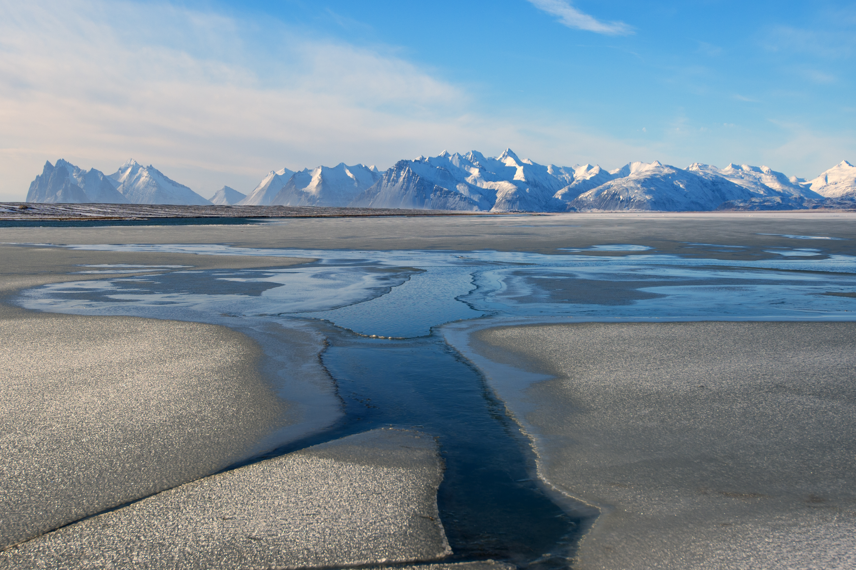
Thank you!
www.unep.org

