Slide 1


Notes:
‘0’ This lecture explains the legally-binding provisions of the Minamata Convention on Mercury particularly the Articles that are relevant to mercury monitoring in multiple media.

Slide 2
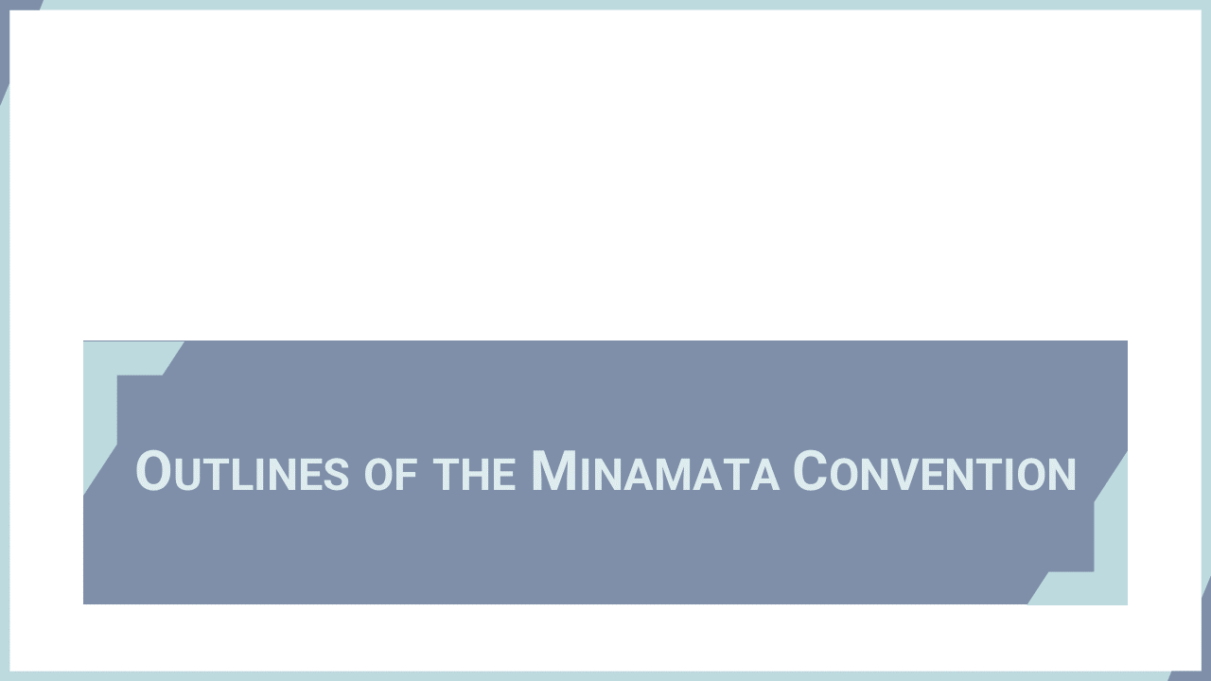
Notes:
‘1’ This section explains the backgrounds and scope of the Minamata Convention on Mercury.

Slide 3
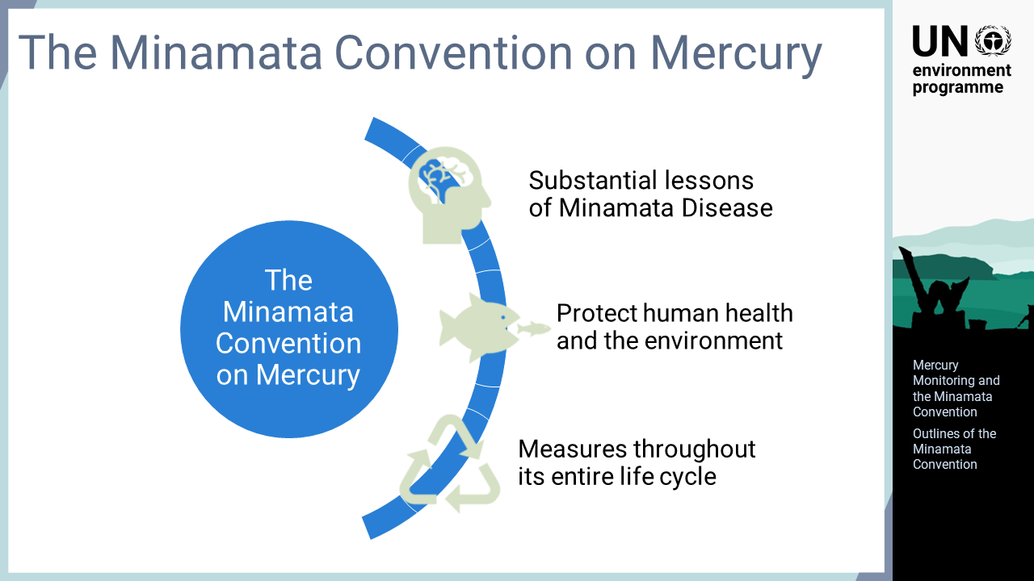
Notes:
‘2’ The Minamata Convention on Mercury is a multilateral legally-binding environmental agreement aiming to protect the human health and the environment from anthropogenic emissions and releases of mercury and mercury compounds. The text was adopted in October 2013 and is composed of a preambular text, 35 articles, and 5 annexes. The Convention entered into force on 16 August 2017, on the 90th day after the deposition of the 50th instrument of ratifications, acceptance, approval, or accession.

Slide 4
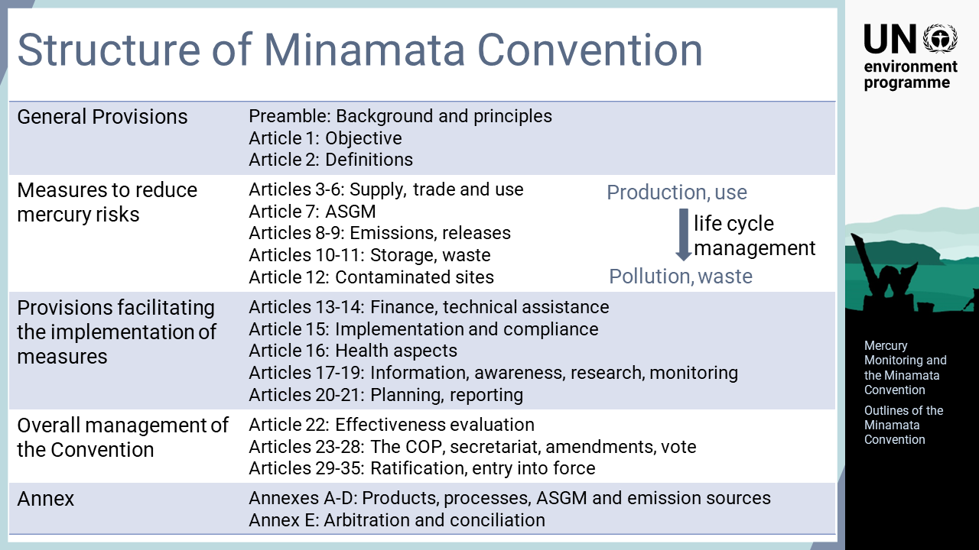
Notes:
‘3’ In its preamble, the Convention recognises the substantial lessons of Minamata disease, in particular the serious health effects resulting from the mercury pollution, and makes aware of the health concerns to women, children, and future generations. The Convention sets out a range of measures throughout the entire life cycle of mercury to meet its objective. Articles 3 to 12 relate to the operational provisions describing the Parties’ obligations to reduce emissions and releases, with controls throughout their life cycle, which include measures to control the supply and trade of mercury, mercury-added products, manufacturing processes in which mercury or mercury compounds are used, as well as artisanal and small-scale gold mining, ASGM. The text also includes the articles on emissions and releases of mercury, environmentally sound interim storage, mercury waste, and contaminated sites. Articles 13 to 21 facilitate the implementation of these measures including provisions related to support for the Parties, information, awareness raising, and reporting. Articles 22 to 35 cover the overall management of the Convention. Annexes A and B list the mercury-added products and manufacturing processes to be controlled by the Convention. Annex C sets the items to be included in the national action plans for ASGM. Annex D lists the point source categories for emission control.

Slide 5
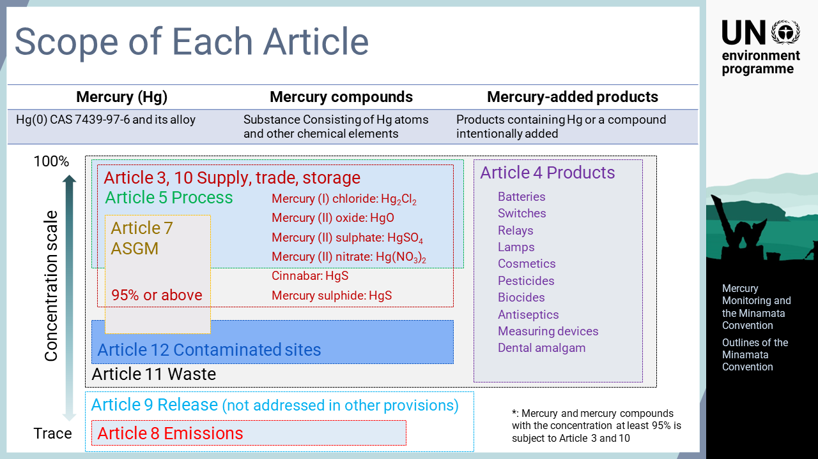
Notes:
‘4’ The Convention covers all forms of mercury as element and mercury compounds. Specific mercury compounds are subject to control in Article 3, supply and trade, and Article 10, interim storage. Article 4 specifies mercury-added products to be phased out or phased down by the Parties.

Slide 6
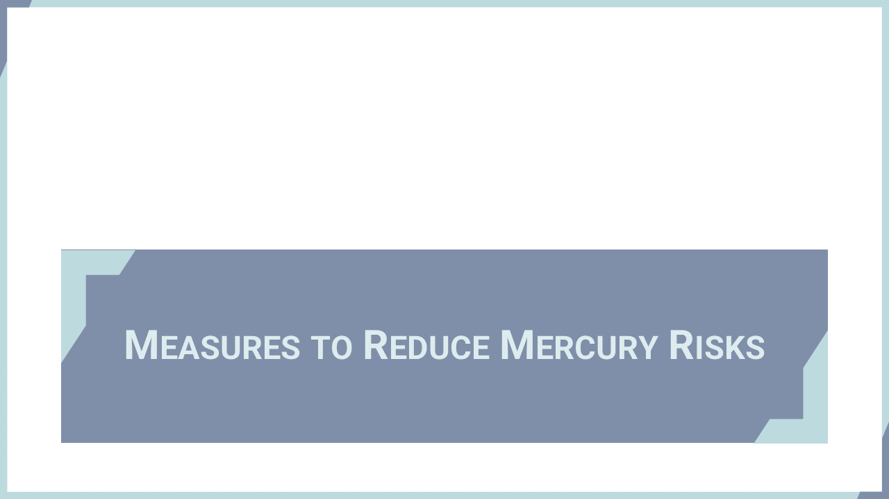
Notes:
‘5’ This section explains the measures stipulated in the Convention to reduce mercury risks to human health and the environment.

Slide 7
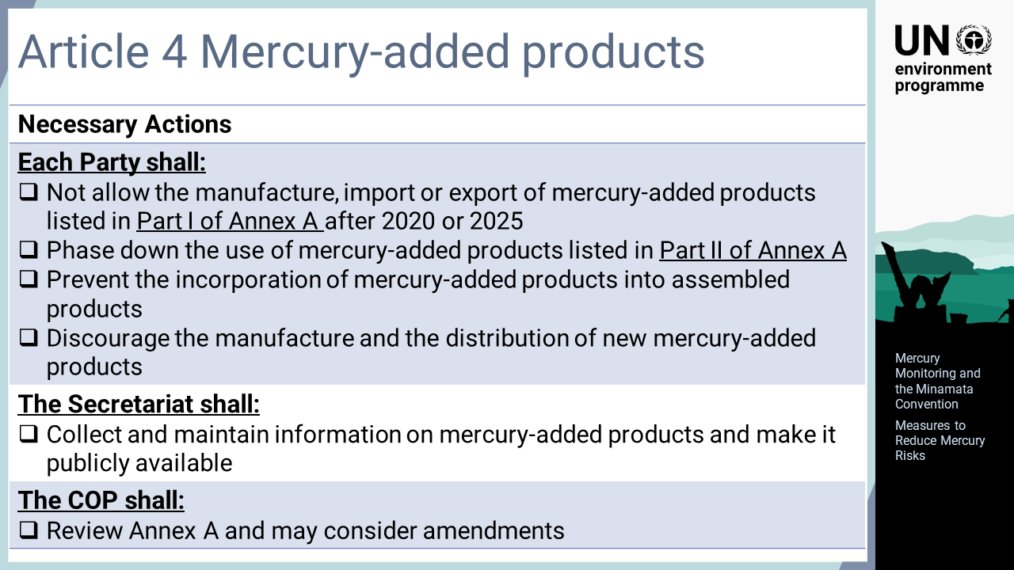
Notes:
‘6’ Article 4 Mercury-added products: Each Party shall not allow the manufacture, import or export of mercury-added products listed in Part I of Annex A after the phase-out date, which is 2020 for the products originally listed. Each Party also shall take measures to phase down the use of mercury-added products listed in Part II of Annex A, which is dental amalgam. Each Party shall take measures to prevent the incorporation of mercury-added products into assembled products and discourage the manufacture and distribution of new mercury-added products. The Secretariat shall collect and maintain information on mercury-added products and make it publicly available. The Conference of the Parties, COP, shall review Annex A and may consider amendments. The first amendment was adopted by the COP at its fourth meeting in 2022, which sets the phase-out for those newly listed in 2025.

Slide 8
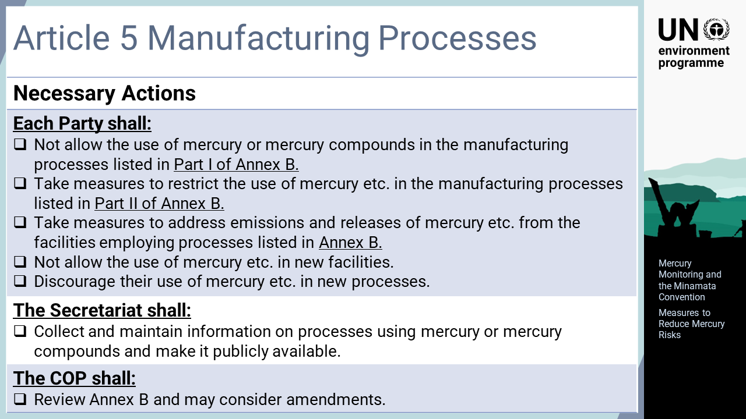
Notes:
‘7’ Article 5 Manufacturing processes in which mercury or mercury compounds are used: Each Party shall not allow the use of mercury or mercury compounds in the manufacturing processes listed in Part I of Annex B, and shall take measures to restrict the use of mercury or mercury compounds in the process listed in Part II of Annex B. Each Party shall also take measures to address emissions and releases of mercury or mercury compounds from these facilities. Each Party shall not allow the use of mercury or mercury compounds in new facilities and shall discourage their use of mercury or mercury compounds in new processes. The Secretariat shall collect and maintain information on processes using mercury or mercury compounds and make it publicly available. The COP shall review Annex B and may consider amendments.

Slide 9
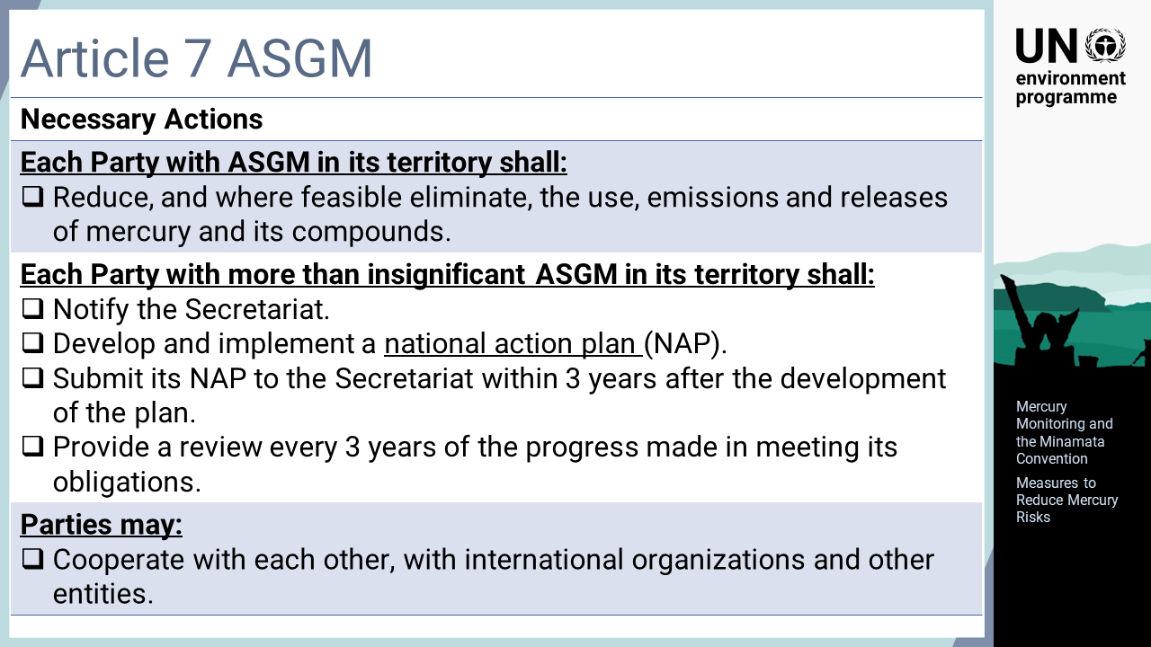
Notes:
‘8’ Article 7 Artisanal and small-scale gold mining: Each Party with ASGM in its territory shall take steps to reduce, and where feasible eliminate, the use, emissions and releases of mercury and its compounds. Each Party with more than insignificant ASGM in its territory shall notify the Secretariat and develop and implement a national action plan, which shall be submitted to the Secretariat within three years after the development of the plan. Thereafter, a review of the progress made shall be conducted every 3 years.

Slide 10
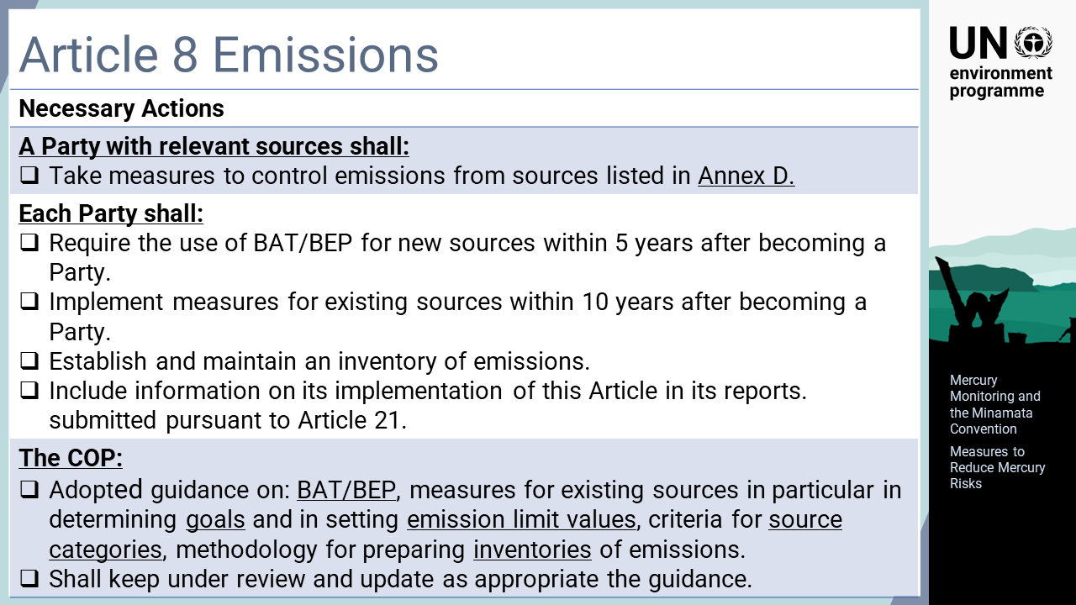
Notes:
‘9’ Article 8 Emissions: A Party with relevant sources shall take measures to control emissions from sources listed in Annex D. Each Party shall require the use of best available techniques, BAT, and best environmental practices, BEP, to control emissions for new sources within five years after becoming a Party and implement one or more measures for existing sources within 10 years after becoming a Party. Each Party shall also establish and maintain an inventory of emissions. The COP adopted the guidance on BAT/BEP, including goals and emission limit values for existing sources, the guidance on criteria to identify source categories, and methodology for preparing inventory. The BAT/BEP guidance was adopted by the COP at its first meeting in 2017.

Slide 11
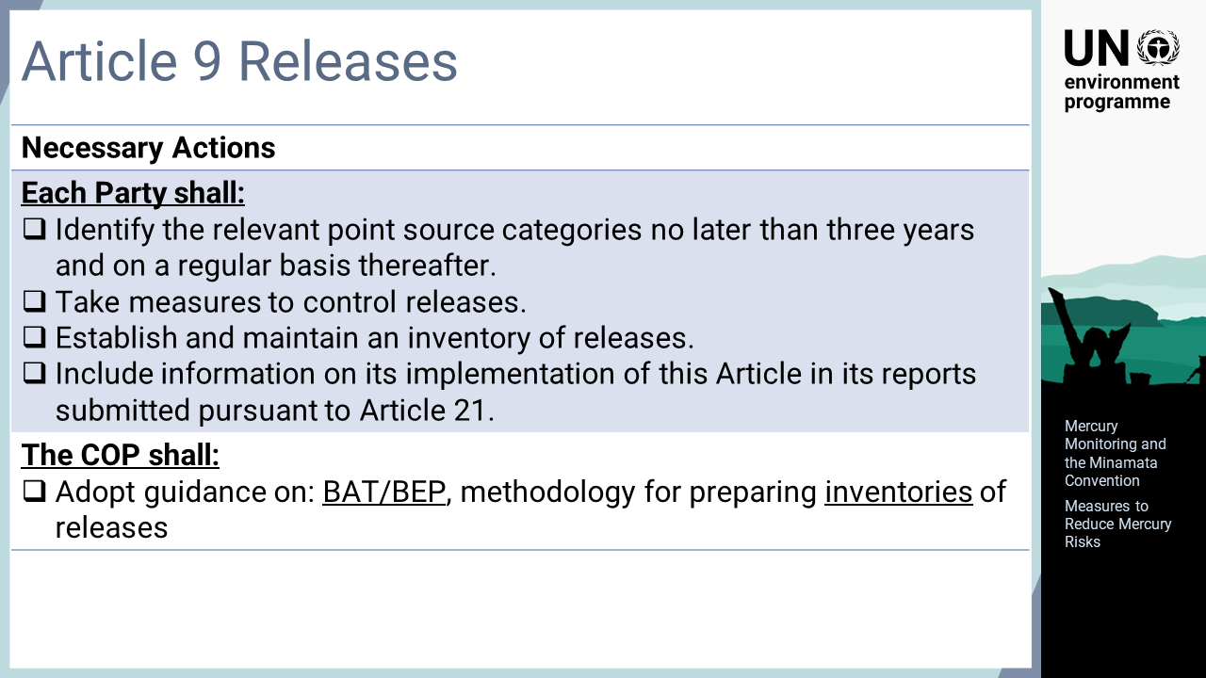
Notes:
‘10’ Article 9 Releases: Each Party shall identify the relevant point source categories, which are not addressed in the other provision of the Convention, no later than three years and on a regular basis thereafter. Each Party shall take measures to control releases, and establish and maintain an inventory of releases. The COP shall adopt guidance on BAT/BEP and methodology for preparing inventories.

Slide 12
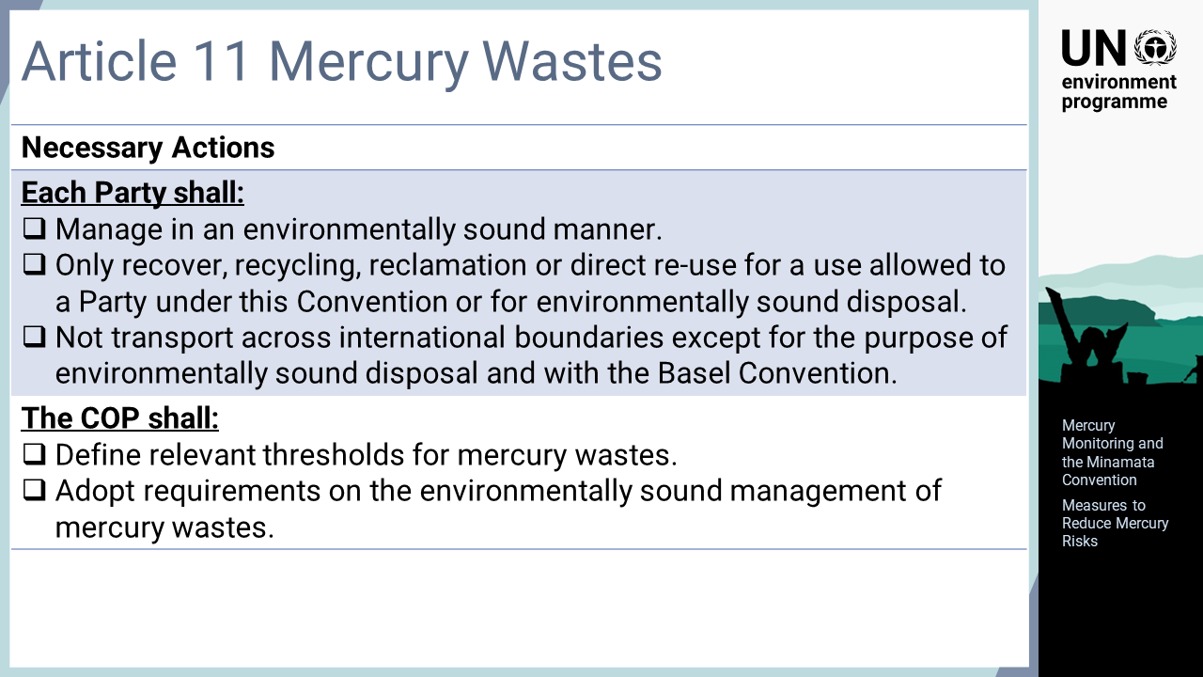
Notes:
‘11’ Article 11 Mercury wastes: Mercury wastes means substances or object consisting of, containing or contaminated with mercury or mercury compounds in a quantity above the relevant thresholds defined by the COP. Each Party shall take measures to manage mercury waste in an environmentally sound manner. Each Party shall also ensure that the recovery, recycling, reclamation or direct re-use of mercury waste is for an allowed purpose or for environmentally sound disposal only. For the Party to the Basel Convention, mercury waste shall not be transported across international boundaries except for the purpose of environmentally sound disposal. The COP shall define relevant thresholds for mercury wastes.

Slide 13
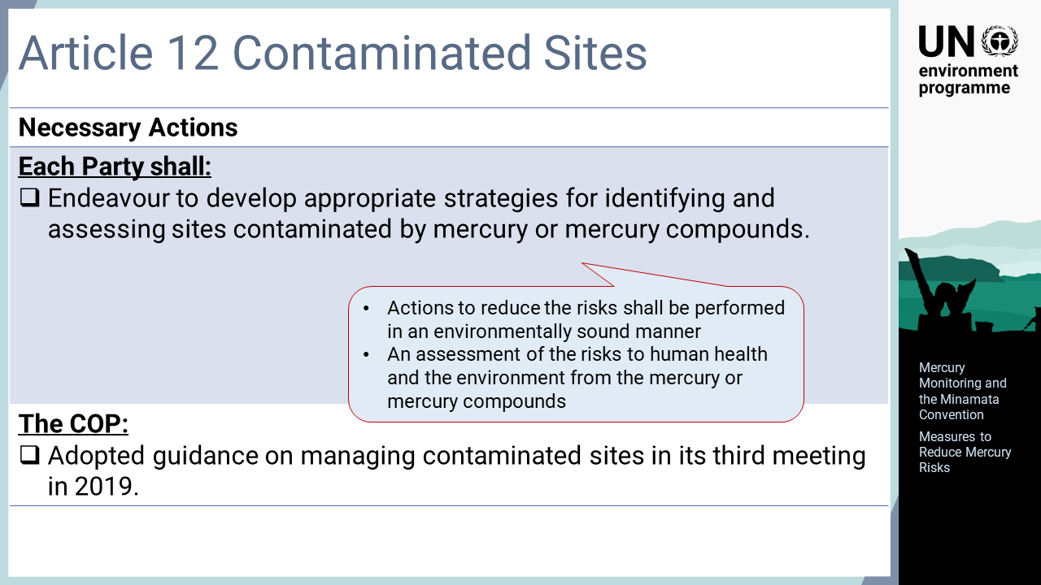
Notes:
‘12’ Article 12 Contaminated sites: Each Party shall endeavour to develop appropriate strategies for identifying and assessing sites contaminated by mercury or mercury compounds. Actions to reduce the risks shall be performed in an environmentally sound manner. The COP adopted guidance on managing contaminated sites in its third meeting in 2019.

Slide 14
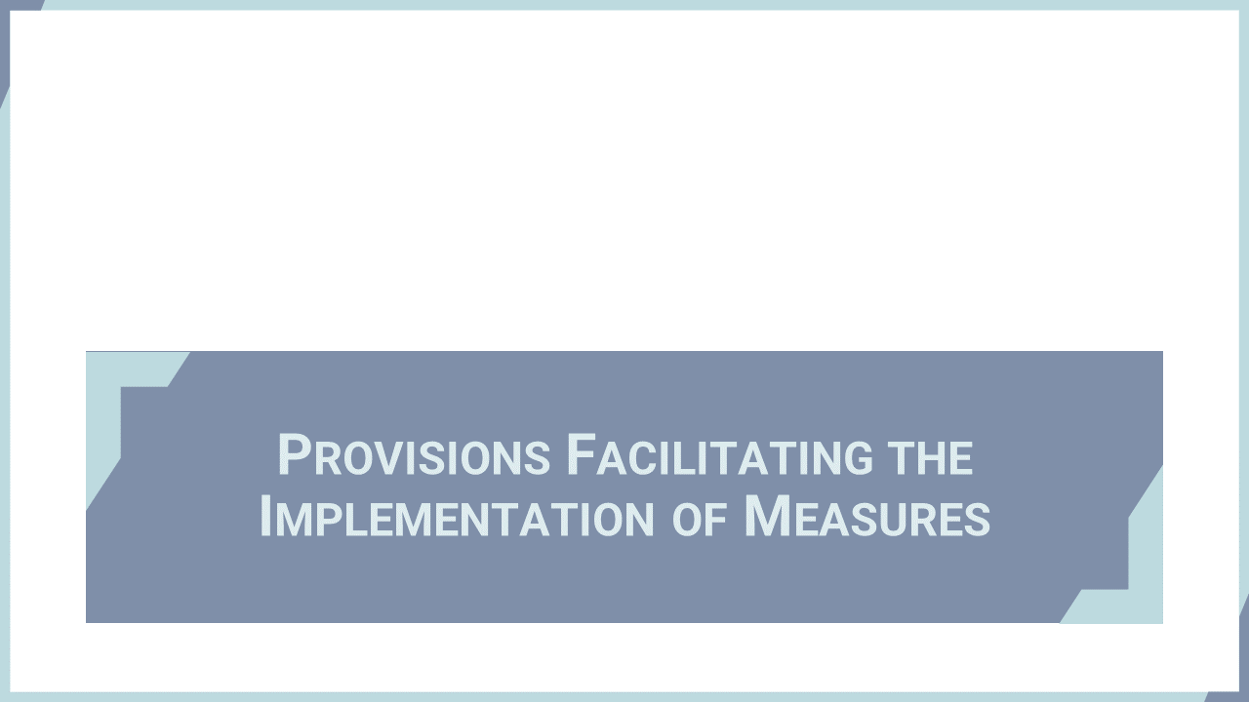
Notes:
‘13’ This section explains the provisions of the Conventions that facilitate the Parties implementing the measures to fulfil the objective of the Convention.

Slide 15
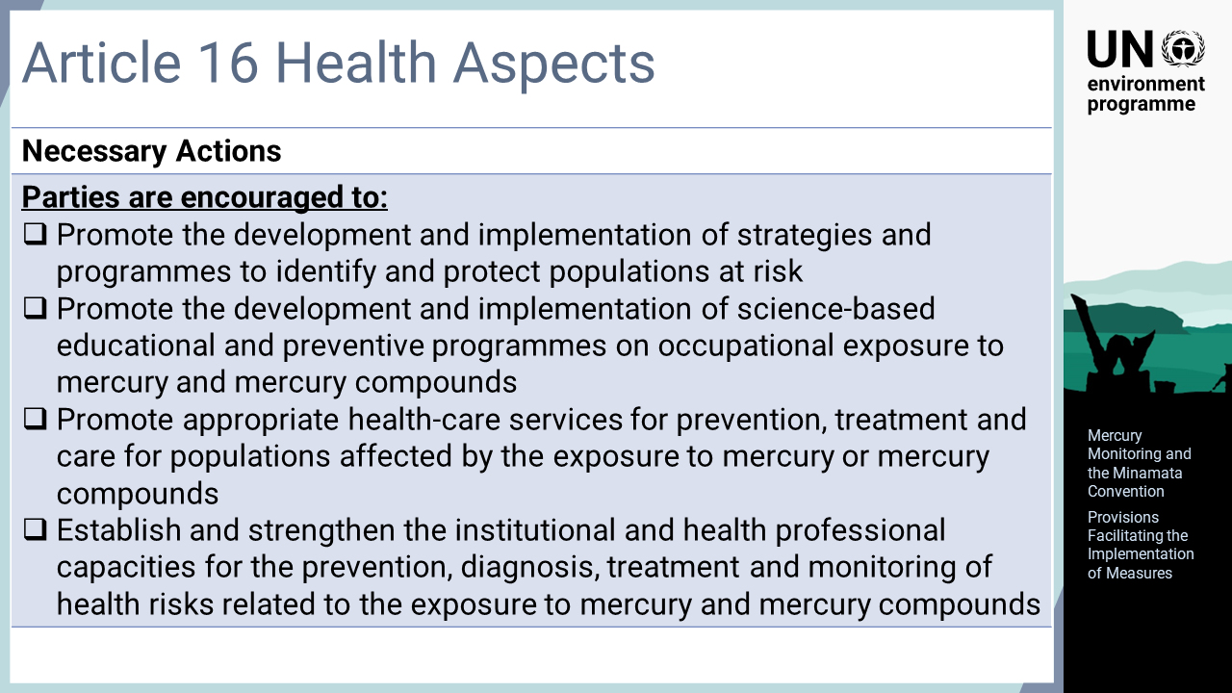
Notes:
‘14’ Article 16 Health aspects: Parties are encouraged to promote the development and implementation of strategies and programmes to identify and protect populations at risk. They are also encouraged to promote the development and implementation of science-based educational and preventive programmes on occupational exposure to mercury and mercury compounds, and to promote appropriate health-care services for prevention, treatment, and care for populations affected by the exposure to mercury or mercury compounds. Furthermore, they are encouraged to establish and strengthen the institutional and health professional capacities for the prevention, diagnosis, treatment, and monitoring of health risks related to the exposure to mercury and mercury compounds.

Slide 16
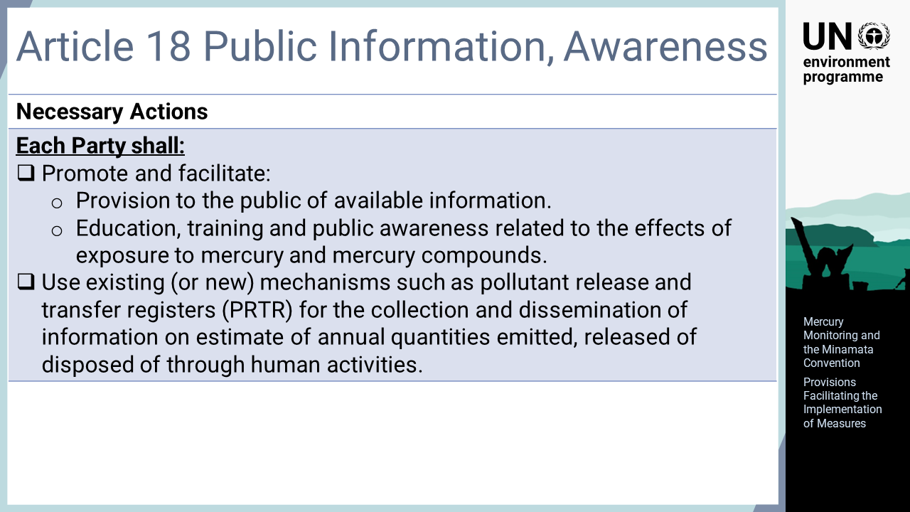
Notes:
‘15’ Article 18 Public information, awareness, and education: Each Party shall promote and facilitate the provision to the public of available information, and education, training and public awareness related to the effects of exposure to mercury and mercury compounds.

Slide 17
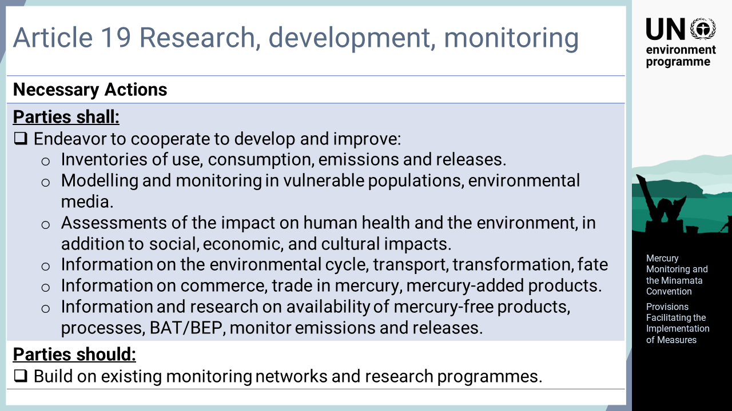
Notes:
‘16’ Article 19 Research, development and monitoring: Parties shall endeavour to cooperate to develop and improve inventories of use, consumption, and anthropogenic emissions and releases of mercury. The cooperation also includes modelling and monitoring of mercury in vulnerable populations and in environmental media, assessments of the impact of mercury on human health and the environment, in addition to social, economic, and cultural impacts, information on the environmental cycle, transport, transformation and fate of mercury, information on commerce and trade in mercury and mercury-added products, and information and research on the technical and economic availability of mercury-free products and processes and on BAT/BEP to reduce and monitor emissions and releases of mercury. Additionally, Parties should build on existing monitoring networks and research programmes.

Slide 18
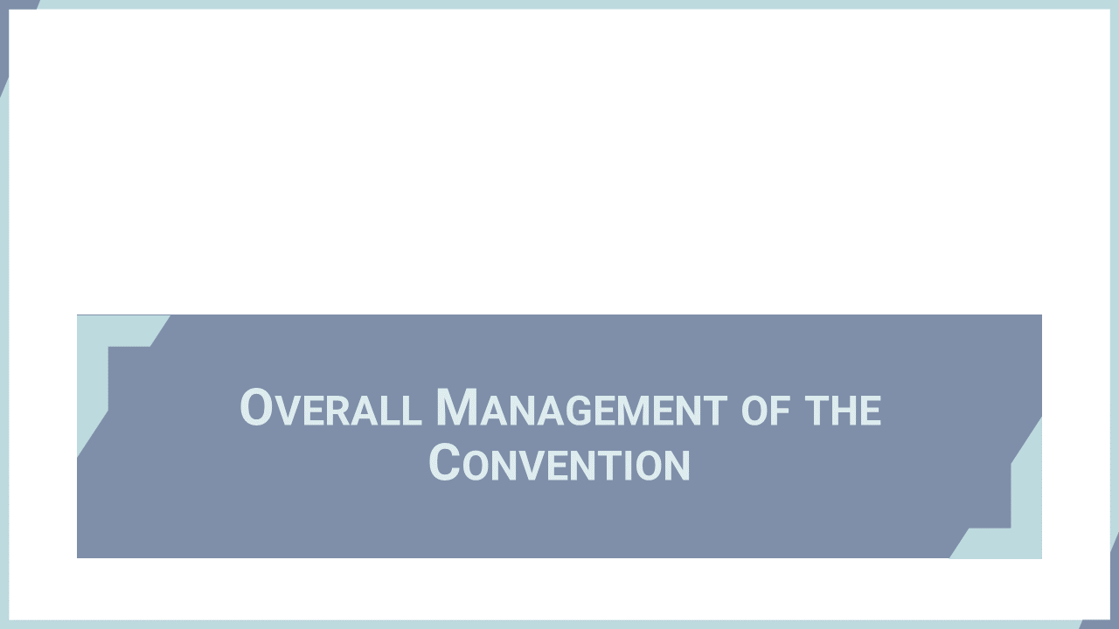
Notes:
‘17’ This section explains the provisions of the Conventions that provide overall management of the Convention particularly evaluating the effectiveness of measures to achieve the objective of the Convention.

Slide 19
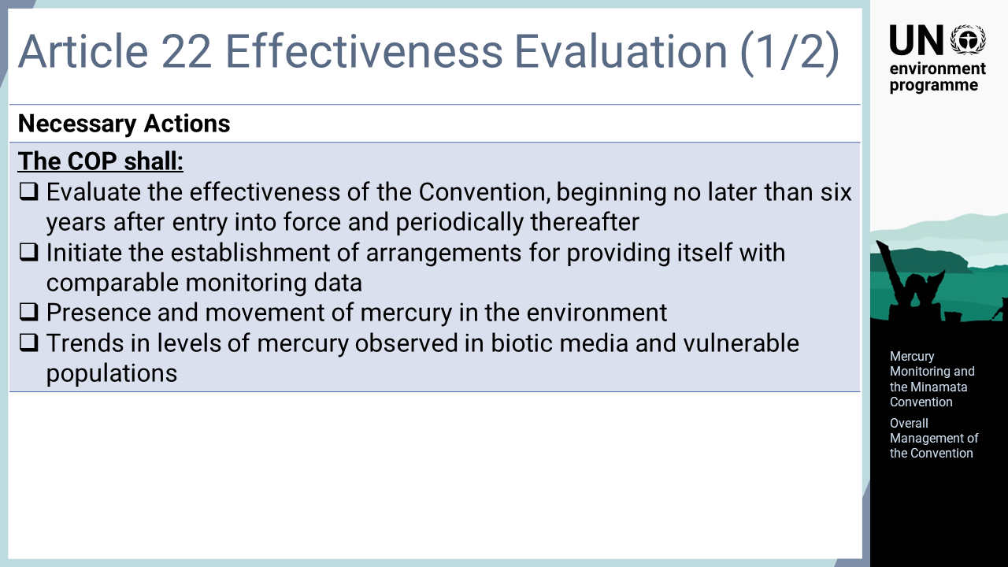
Notes:
‘18’ Article 22 Effectiveness evaluation: The COP shall evaluate the effectiveness of the Convention, beginning no later than six years after entry into force and periodically thereafter. To facilitate the evaluation, the COP shall initiate the establishment of arrangements for providing itself with comparable monitoring data on the presence and movement of mercury in the environment, and trends in levels of mercury observed in biotic media and vulnerable populations.

Slide 20
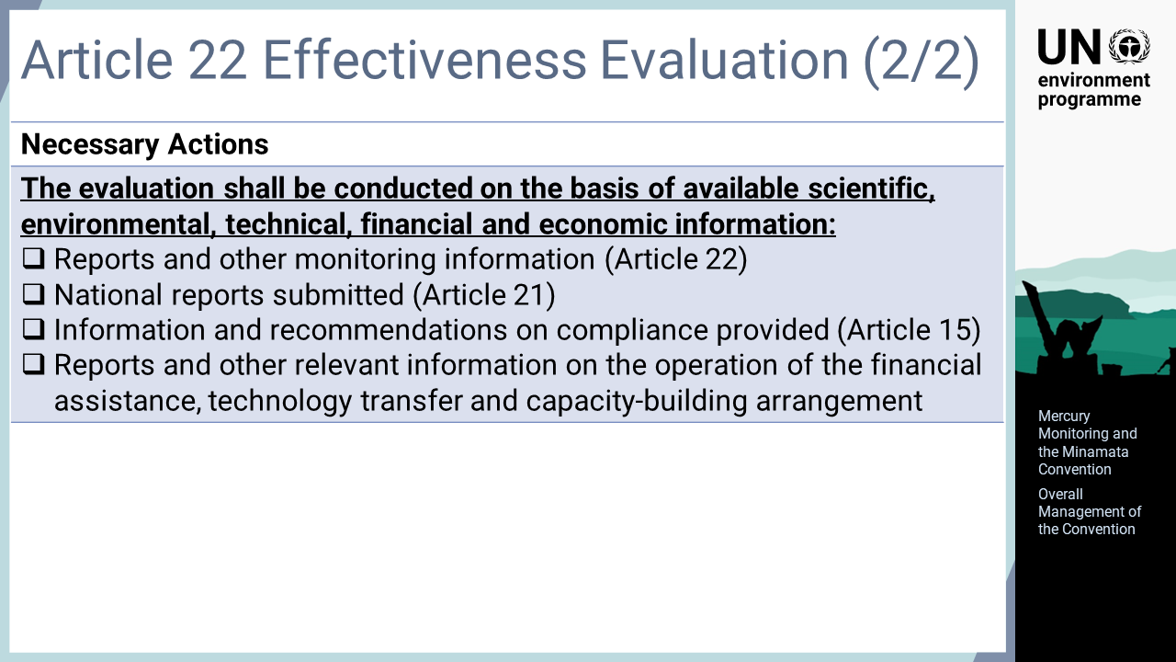
Notes:
‘19’ The evaluation shall be conducted on the basis of available scientific, environmental, technical, financial and economic information including reports and other monitoring information, national reports submitted, information and recommendations on compliance provided, and reports and other relevant information on the operation of the financial assistance, technology transfer and capacity-building arrangements.

Slide 21
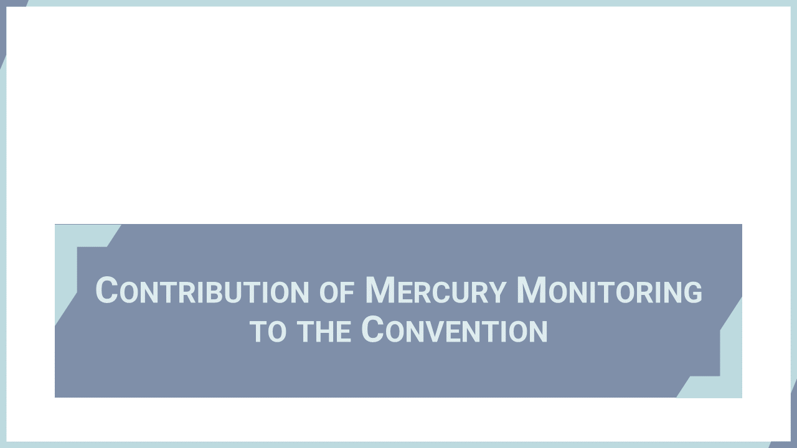
Notes:
‘20’ This section describes the value of mercury monitoring for the effective implementation of the Minamata Convention.

Slide 22
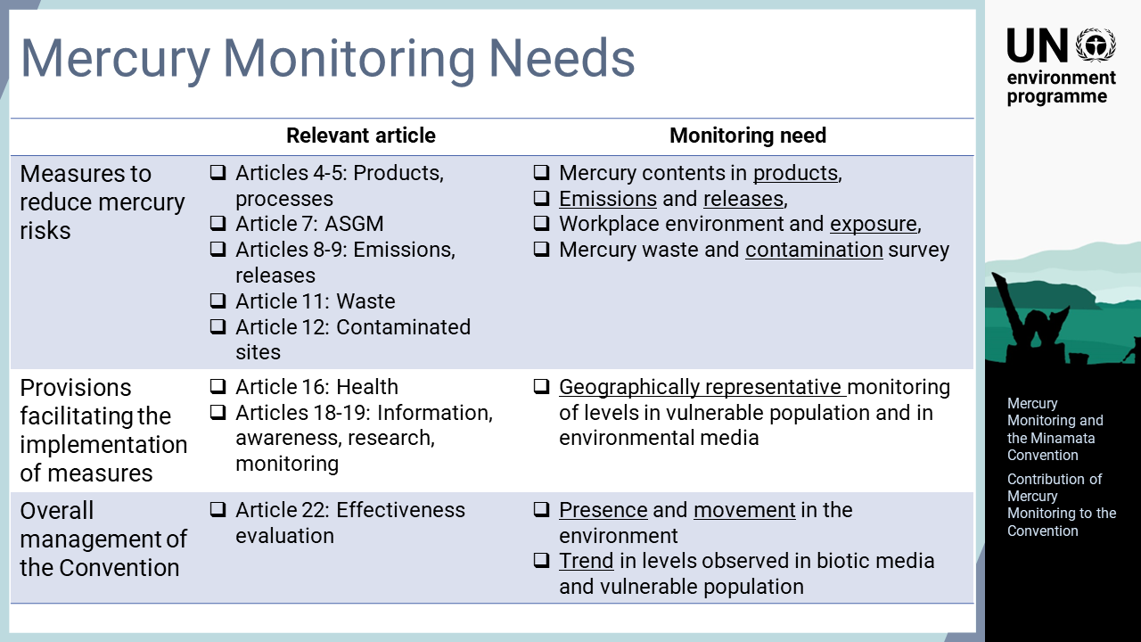
Notes:
‘21’ The Minamata Convention explicitly and implicitly refers to the monitoring required for its effective implementation. Mercury monitoring facilitates the implementation of some measures. The levels of mercury in environmental media or in products indicate the mercury risks to be reduced. Geographical and temporal profiles of mercury levels are key data for evaluating the overall effectiveness of the Convention.

Slide 23
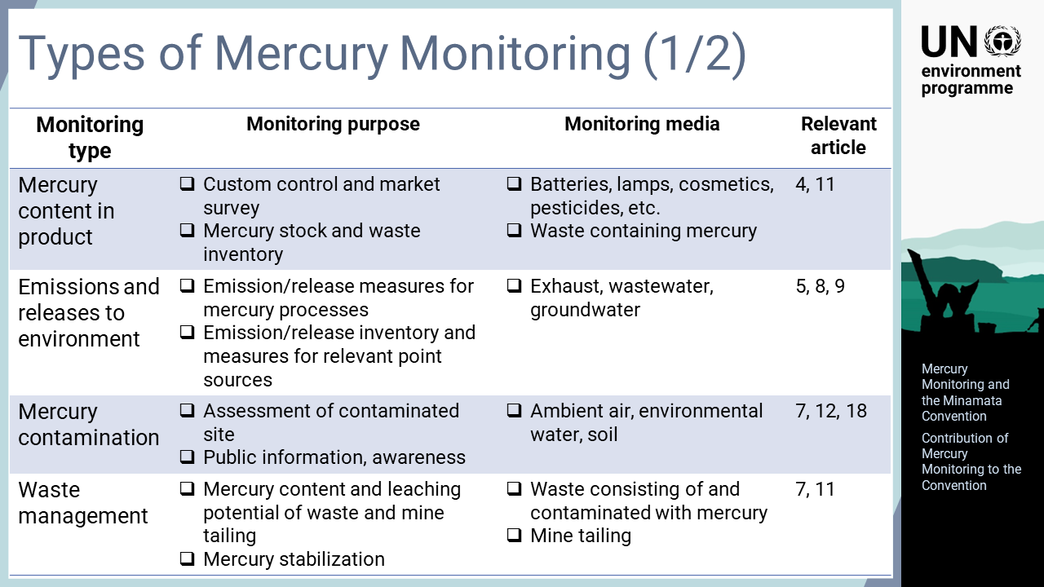
Notes:
‘22’ The mercury contents of products such as batteries, lamps, cosmetics, and pesticides can be used for import and export control as well as domestic market surveys. Skin whitening cosmetics are still widely used by many women in the societies where lighter coloured skin is preferred. The same information can also be used to estimate mercury stock in society and to forecast mercury waste generation. Emissions and releases can be monitored to assess the environmental impacts of mercury source facilities. Contamination surveys of environmental media can provide important data for public information and awareness. Mercury monitoring is also essential for the sound management of mercury waste.

Slide 24
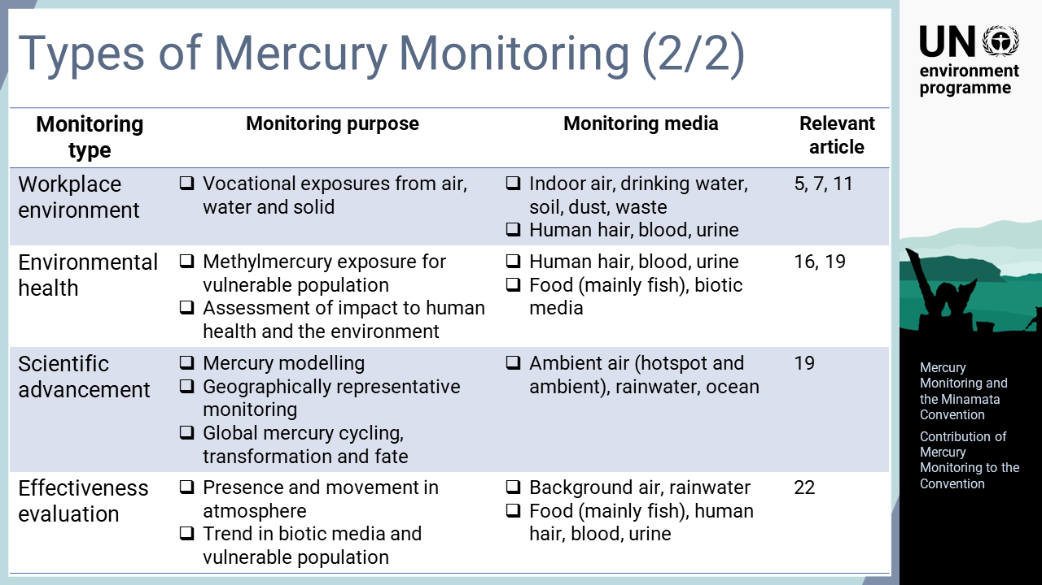
Notes:
‘23’ The human health concerns of mercury are twofold, namely health and safety in the workplace and environmental health for vulnerable population such as pregnant women. As methylmercury, inorganic mercury, and elemental mercury exhibit different toxicities in humans, mercury speciation is important for proper risk assessments. From a scientific perspective, mercury monitoring is essential for research activities that provide improved knowledge about the fate and transport of mercury as well as mathematical models for forecasting future trends. Additionally, the presence and movement of mercury in the atmosphere as well as trends in biotic media and vulnerable populations, such as children and women of child-bearing age, are useful for evaluating the effectiveness of the Convention.

